Slide 1
Wander Join
Hongxu Xu
Chunhao Liao

Slide 2
Problem and Motivation
Join is a central but expensive operation
Complex joins dominate analytics (TPC-H: 17/22 queries are joins; the hardest touches 8 tables)
On GB–TB scale, even top DBMSs can take minutes to hours for exact results.
Notes:
Modern decision support workloads lean heavily on multi-table joins—think TPC-H, where most queries are join-heavy and one involves eight tables.
At real data sizes, exact execution can take minutes or longer, which is unacceptable for exploratory analysis where analysts iterate rapidly and need feedback in seconds.
This latency gap motivates approximate, online techniques that can surface early, quality-bounded estimates while computation continues.

Slide 3
Online Aggregation: Idea & Join Challenge
Idea:
Approximate answers with confidence intervals;
Refine continuously;
Stop when acceptable.
Join challenge:
samples across tables are not i.i.d.
sample(R) ⨝ sample(S) ≠ sample(R ⨝ S)
Notes:
Online aggregation treats querying as live estimation: return an approximate answer with a confidence interval and tighten it as more samples arrive.
Joins are harder
samples across tables aren’t independent and identically distributed.
whether a sampled tuple “qualifies” depends on matching tuples in other tables, so samples become dependent and have unequal inclusion probabilities
(e.g., keys with many matches are overrepresented).

Slide 4
Ripple Join: Recap & Limitations
Round-robin sampling from each table; join all sampled tuples incrementally.
Weakness 1:
Low joinability. A tiny fraction of random tuples actually join.
Weakness 2:
Assumes tables are in random storage order for easy uniform sampling.
SOTA Approach
Notes:
Ripple Join alternates samples across tables and joins to produce running estimates.
Problem is efficiency:
in many real schemas, most randomly picked tuples don’t match, so we waste samples and get high variance，especially for natural multi-table joins.
It also implicitly relies on tables being randomly ordered which typical storage layouts don’t guarantee—making the approach costly or impractical at scale.
state of the art approach in both internal and external memory

Slide 5
Problem Formulation & Objective
Query class: SELECT … FROM … WHERE … GROUP BY … with selection predicates, equality/θ-joins, and optional GROUP BY.
Goal: Online aggregation—emit running estimates + confidence intervals (CIs) during execution.
Stop rule: User halts by error tolerance (CI width) or time budget.
Requirements: Unbiased estimators, valid per-group CIs, works for multi-table joins.
Notes:
We formalize online aggregation for general analytical queries that include selections, multi-table joins (equality or θ), and optional grouping.
During execution, the system continuously outputs an estimate and a confidence interval—per group when grouping is present.
Users control when to stop: either when the CI is tight enough or a time limit is reached.
The objective is to keep estimates unbiased and CIs statistically sound while operating over complex join structures.

Slide 6
Wander Join
Model the join as a graph: tuples (nodes), joinable pairs (edges)
Start from one table with a random tuple; then walk to neighbors that actually join.
Focus only on joinable regions, not blind sampling.
Produces unbiased estimates with CIs
Notes:
Wander Join treats a multi-table join as a graph.
We pick one tuple to start and then perform a random walk, moving only to tuples in other tables that truly match—its “neighbors.”
This concentrates effort where results exist, boosting the chance each sample contributes and reducing variance compared to blind sampling.
The approach yields unbiased estimators with confidence intervals and naturally extends to selections and group-by.

Slide 7
Wander Join: 3-Table Example
Query: R1(A,B) ⋈ R2(B,C) ⋈ R3(C,D); aggregate SUM(D)
Random walk: pick t1 in R1 uniformly -> pick a neighbor t2 in R2 that joins t1 -> pick a neighbor t3 in R3 that joins t2.
A path γ = (t1, t2, t3) is one sampled join result.
Notes:
We model the join as a graph. Starting from a random tuple in R1, we “walk” only to tuples that actually match in R2 and then R3.
Each complete path corresponds to one join output row.
Indexes let us enumerate neighbors quickly, so we focus effort on joinable regions instead of blind sampling.

Slide 8
Path Probability & Unbiased Estimation
Path probability: p(γ) = 1/|R1| × 1/d2(t1) × 1/d3(t2)
Horvitz–Thompson contribution: v(γ)/p(γ), an unbiased estimator of ∑_{γ} v(γ)
v(γ) is the contribution to the final result (e.g., COUNT uses v(γ)=1; SUM uses the D-value on the path).
Notes:
d2(t1) = #neighbors of t1 in R2; d3(t2) = #neighbors of t2 in R3.
If the value of the D attribute on one path is very large, then obviously this would tilt the balance, leading to an overestimate. Ideally, each path should be sampled with equal probability so as to ensure unbiasedness.
However, it is well known that random walks in general do not yield a uniform distribution
Horvitz-Thompson estimator can be used to re_x0002_move the bias easily. For Count, Different paths aren’t equally likely, so we weight each path by 1/p(γ).
This yields an unbiased estimator for SUM/COUNT and lets us compute confidence intervals.
Stuck walks are treated as zero contribution; they slow convergence but don’t introduce bias.

Slide 9
Example
R1(A,B): a1(B=10), a2(B=20)
R2(B,C): b1(10,x), b2(10,y), b3(20,z)
R3(C,D): c1(x,D=5), c2(y,D=7) (note: C=z has no match in R3)

Slide 10
Example
The true 3-table natural join has two complete paths:
(a1, b1, c1) (10→x)
(a1, b2, c2) (10→y)
Path (a2, b3, ?) has no neighbor in R3 → “stuck”.

Slide 11
Example
1. Pick start in R1 uniformly: P(a1)=P(a2)=1/2.
2. From R2 neighbors of the start, pick uniformly:
a1 has neighbors {b1, b2} → each 1/2
a2 has neighbor {b3} → 1
3. From R3 neighbors of the chosen R2 tuple, pick uniformly:
b1 has {c1} → 1; b2 has {c2} → 1
b3 has no neighbor → stuck

Slide 12
Example
p(a1,b1,c1) = (1/2) × (1/2) × 1 = 1/4
p(a1,b2,c2) = (1/2) × (1/2) × 1 = 1/4
p(stuck: a2,b3,∅) = (1/2) × 1 × 1 = 1/2

Slide 13
Example (Goal: COUNT)
True answer: 2 (the two complete paths above).
Contribution of a valid path: 1/(1/4) = 4
Contribution of a stuck path: 0
Expectation of one walk (unbiasedness):
E[estimate] = 4·(1/4) + 4·(1/4) + 0·(1/2) = 1 + 1 + 0 = 2 = true count.
Repeating independent walks and averaging converges to 2; more samples → lower variance → narrower confidence intervals.

Slide 14
Example (Goal: SUM)
D on paths: c1.D=5, c2.D=7 → true value 5+7=12
Path contribution v(γ)/p(γ), here v(γ) = D on the path:
(a1,b1,c1): 5 / (1/4) = 20
(a1,b2,c2): 7 / (1/4) = 28
stuck: 0
Expectation: 20·(1/4) + 28·(1/4) + 0·(1/2) = 5 + 7 + 0 = 12 → unbiased.

Slide 15
Path Probability & Unbiased Estimation
Path probability: p(γ) = 1/|R1| × 1/d2(t1) × 1/d3(t2)
Horvitz–Thompson contribution: v(γ)/p(γ) (e.g., COUNT uses v(γ)=1; SUM uses the D-value on the path).
Average over many independent walks → unbiased estimate; CIs from sample variance shrink with more paths.
If the walk gets stuck (no neighbor), return 0 for that path—keeps the estimator unbiased.
Notes:
d2(t1) = #neighbors of t1 in R2; d3(t2) = #neighbors of t2 in R3.
If the value of the D attribute on one path is very large, then obviously this would tilt the balance, leading to an overestimate. Ideally, each path should be sampled with equal probability so as to ensure unbiasedness.
However, it is well known that random walks in general do not yield a uniform distribution
Horvitz-Thompson estimator [20] can be used to re_x0002_move the bias easily. For Count, Different paths aren’t equally likely, so we weight each path by 1/p(γ).
This yields an unbiased estimator for SUM/COUNT and lets us compute confidence intervals.
Stuck walks are treated as zero contribution; they slow convergence but don’t introduce bias.

Slide 16
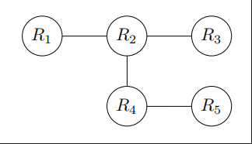
Acyclic Joins: Query Graph & Walk Order
Walk order: an order R1, …, Ri where each table (for i >= 2) is adjacent in the graph to some earlier table in the order.
R1, R2, R3, R4, R5 is valid;
R1, R3, R4, R5, R2 is invalid
(R3/R4 not adjacent to R1).
Notes:
View the query as a graph to extend Wander Join from a 3-table chain to any acyclic join.
A walk order ensures every new table connects to what we’ve already walked. Different orders affect yield and variance;

Slide 17
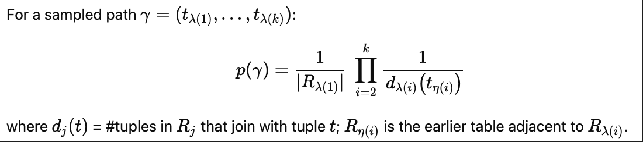
Random Walks & Path Probability (Acyclic)
Perform random walks following the walk order; a walk may include jumps back to the table that connects the next one.
Notes:
Start uniformly in R_{lambda(1)}; each next step picks uniformly among neighbors in the next table that connect to the already-walked part
—sometimes we jump back to the earlier table that provides the edge.
Multiplying inverse neighbor counts yields p(gamma). Weighting by 1/p(gamma) removes sampling bias, keeping estimates unbiased and enabling confidence intervals.

Slide 18
Wander Join for Cyclic Queries
After sampling a path on the tree, re-check non-tree edges (cycle-closing joins).
If any non-tree join fails, treat the path as a failed walk → contribution = 0.
Too many failed walks slow convergence.
Notes:
For cyclic queries, we don’t walk on the full graph. We first pick a spanning tree and run the random walk exactly as in the acyclic case.
Each sampled path is then validated against the missing edges that close the cycles—for example, check whether t3t_3t3​ also joins with t5t_5t5​ on edge (R3,R5)(R_3, R_5)(R3​,R5​).
If the check fails, we record a zero contribution.
This preserves unbiasedness because failed paths are legitimate outcomes in the sampling space; the tradeoff is potential slowdowns if many paths fail.

Slide 19
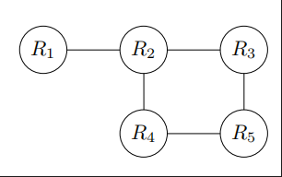
Example: Cyclic Queries
Assumed we have a path γ = (t1, t2, t3, t4, t5) on an acylic graph
γ should satisfy the non-spanning tree edge (R3, R5),
i.e., t3 should join with t5
Otherwise, the join fail
Notes:
After we have sampled a path γ = (t1, t2, t3, t4, t5) on Figure 3(b) (assuming the walk order R1, R2, R3, R4, R5),
then we need to verify that γ should satisfy the non-spanning tree edge (R3, R5), i.e., t3 should join with t5. If they do not join, we consider γ as a failed random walk and return an estimator with value 0

Slide 20
Comparison with Ripple Join
Ripple Join → uniform but dependent samples;
Wander Join → independent but non-uniform samples.
Sampling efficiency (chain join, k tables):
Ripple: expected join samples after n per table ≈ n^k · (d/N)^{k−1}.
Example: N=10⁶, k=3, d=1: need n=10,000 per table just to see the first join.
Wander Join:
success rate depends on “has-a-match” fraction;
if ≥ 1/2 per table, get ≥ n/2^{k−1} samples
Notes:
Scales with N:
Wander Join’s efficiency does not depend on N; Ripple Join degrades with N and k.

Slide 21

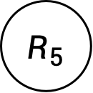



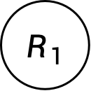
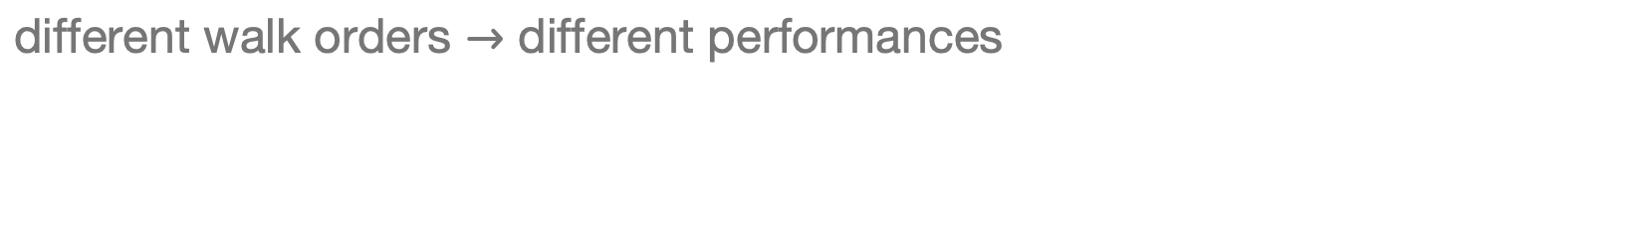
Walk Plan Optimizer
$$R_{1}$$
$$R_{2}$$
$$R_{3}$$
$$R_{4}$$
$$R_{5}$$
different walk orders $→$ different performances

Slide 22
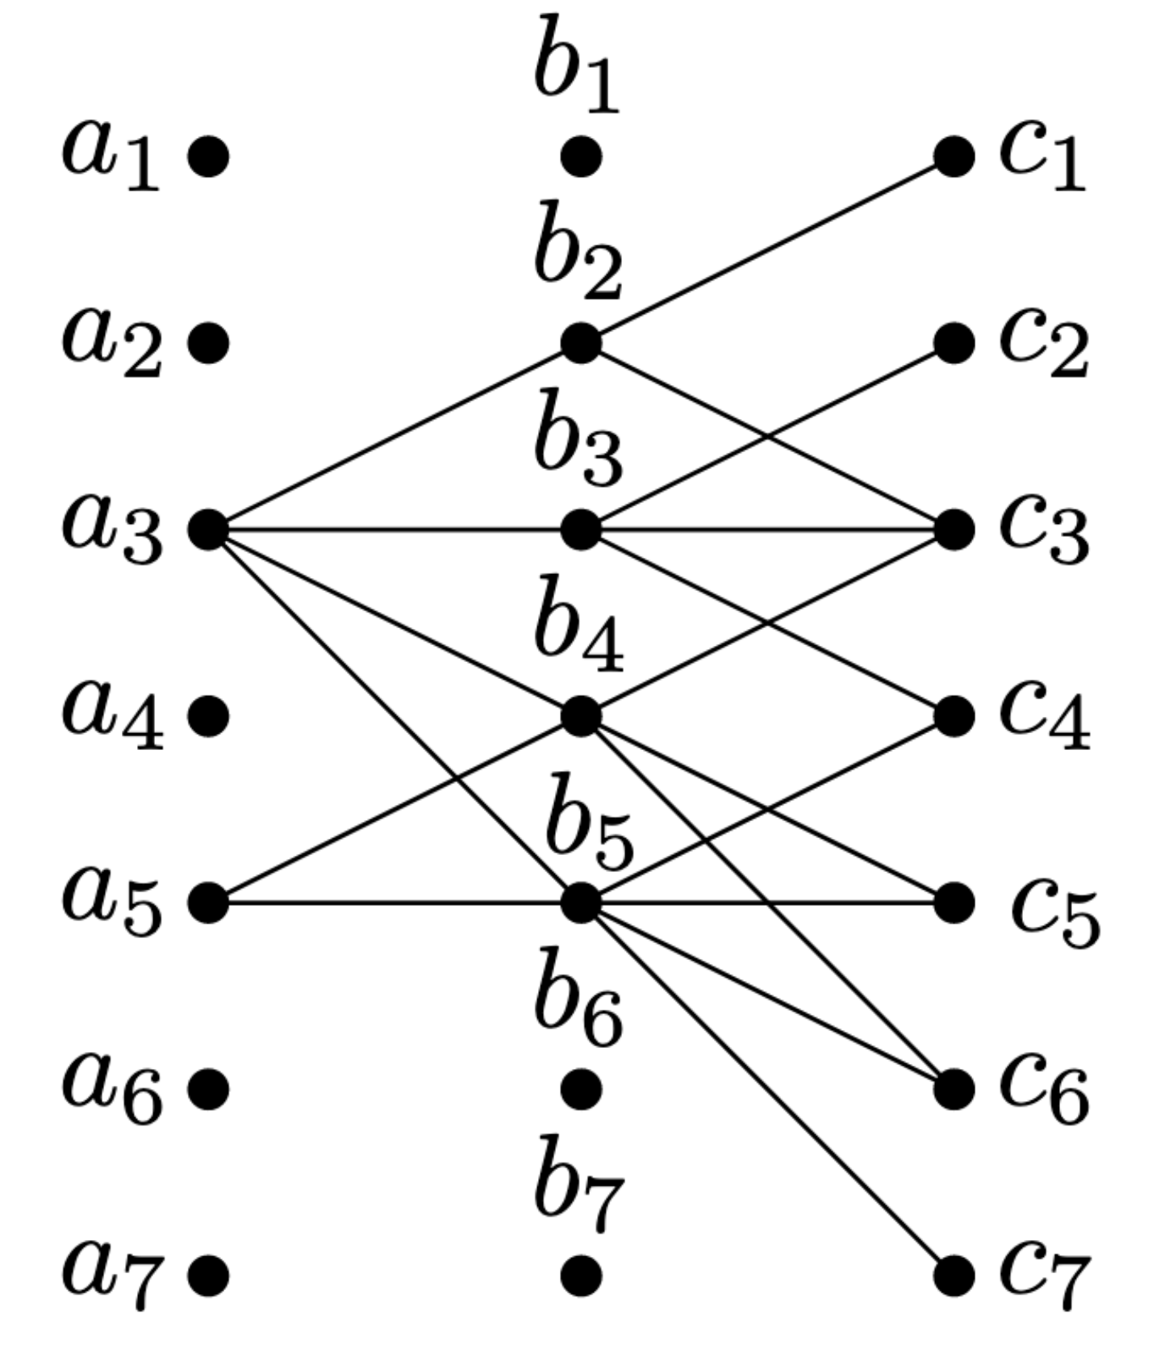
$$R_{1}$$
$$R_{2}$$
$$R_{3}$$
different walk orders
different performances

Slide 23

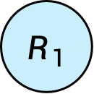
$$R_{1}$$
$$R_{2}$$
$$R_{3}$$
different walk orders
different performances
Success Rate
$$\frac{2}{7}$$

Slide 24

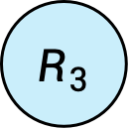
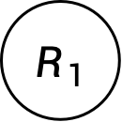
$$R_{1}$$
$$R_{2}$$
$$R_{3}$$
different walk orders
different performances
Success Rate
$$\frac{7}{7}$$

Slide 25





Walk Plan Generation
Generate Directed Graph from Join Query Graph Based on Index Availability
$$R_{1}(a, b)$$
$$R_{2}(b,c,e)$$
$$R_{3}(c,d)$$
$$R_{1}$$
$$R_{2}$$
$$R_{3}$$
$$R_{4}$$
$$R_{5}$$
$$R_{4}(e,f)$$
$$R_{5}(f,g)$$

Slide 26







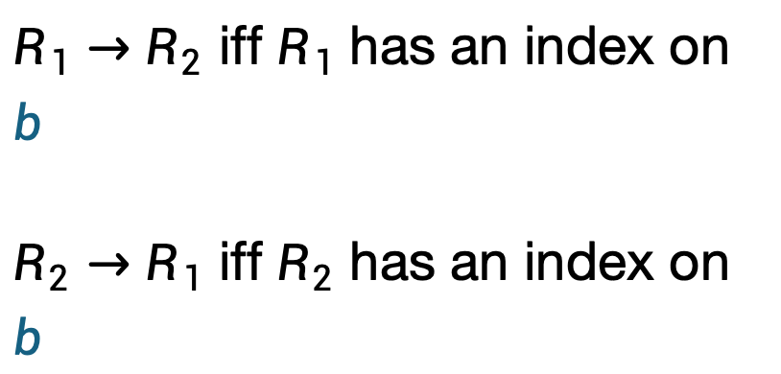

Walk Plan Generation
Generate Directed Graph from Join Query Graph Based on Index Availability
$$R_{1}(a, b)$$
$$R_{2}(b,c,e)$$
$$R_{3}(c,d)$$
$$R_{1}$$
$$R_{2}$$
$$R_{3}$$
$R_{1}→R_{2}$ iff $R_{1}$ has an index on $b$
$R_{2}→R_{1}$ iff $R_{2}$ has an index on $b$
$$R_{4}$$
$$R_{5}$$
$$R_{4}(e,f)$$
$$R_{5}(f,g)$$

Slide 27
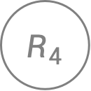

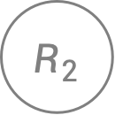
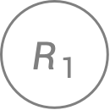

Walk Plan Generation
Generate Directed Graph from Join Query Graph Based on Index Availability
$$R_{1}$$
$$R_{2}$$
$$R_{3}$$
$$R_{1}$$
$$R_{2}$$
$$R_{3}$$
$$R_{4}$$
$$R_{5}$$
$$R_{4}$$
$$R_{5}$$

Slide 28
Walk Plan Generation
Enumerate All Plans
$$R_{1}$$
$$R_{2}$$
$$R_{3}$$
DFS to find all plans
$$R_{4}$$
$$R_{5}$$

Slide 29

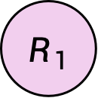
Walk Plan Generation
Enumerate All Plans
$$R_{1}$$
$$R_{2}$$
$$R_{3}$$
$$R_{1}$$
$$R_{4}$$
$$R_{5}$$

Slide 30

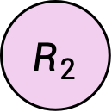
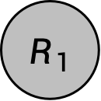
Walk Plan Generation
Enumerate All Plans
$$R_{1}$$
$$R_{2}$$
$$R_{3}$$
$$R_{1}→R_{2}$$
$$R_{4}$$
$$R_{5}$$

Slide 31

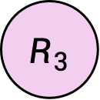
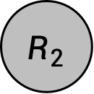
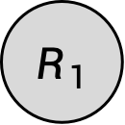
Walk Plan Generation
Enumerate All Plans
$$R_{1}$$
$$R_{2}$$
$$R_{3}$$
$$R_{1}→R_{2}→R_{3}$$
$$R_{4}$$
$$R_{5}$$

Slide 32
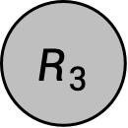
Walk Plan Generation
Enumerate All Plans
We can walk from any walked node
$$R_{1}$$
$$R_{2}$$
$$R_{3}$$
$$R_{1}→R_{2}→R_{3}$$
$$R_{4}$$
$$R_{5}$$

Slide 33


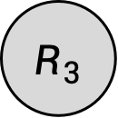
Walk Plan Generation
Enumerate All Plans
$$R_{1}$$
$$R_{2}$$
$$R_{3}$$
$$R_{1}→R_{2}→R_{3}→R_{4}$$
$$R_{4}$$
$$R_{5}$$

Slide 34



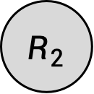
Walk Plan Generation
Enumerate All Plans
$$R_{1}$$
$$R_{2}$$
$$R_{3}$$
$$R_{1}→R_{2}→R_{3}→R_{4}→R_{5}$$
$$R_{4}$$
$$R_{5}$$

Slide 35
Walk Plan Generation
Enumerate All Plans
$$R_{1}$$
$$R_{2}$$
$$R_{3}$$
2nd example starts now…
$$R_{4}$$
$$R_{5}$$

Slide 36

Walk Plan Generation
Enumerate All Plans
$$R_{1}$$
$$R_{2}$$
$$R_{3}$$
$$R_{2}$$
$$R_{4}$$
$$R_{5}$$

Slide 37

Walk Plan Generation
Enumerate All Plans
$$R_{1}$$
$$R_{2}$$
$$R_{3}$$
$$R_{2}→R_{1}$$
$$R_{4}$$
$$R_{5}$$

Slide 38
Walk Plan Generation
Enumerate All Plans
We can walk from any walked node
$$R_{1}$$
$$R_{2}$$
$$R_{3}$$
$$R_{2}→R_{1}$$
$$R_{4}$$
$$R_{5}$$

Slide 39

Walk Plan Generation
Enumerate All Plans
$$R_{1}$$
$$R_{2}$$
$$R_{3}$$
$$R_{2}→R_{1}→R_{3}$$
$$R_{4}$$
$$R_{5}$$

Slide 40
Walk Plan Generation
Enumerate All Plans
We can walk from any walked node
$$R_{1}$$
$$R_{2}$$
$$R_{3}$$
$$R_{2}→R_{1}→R_{3}$$
$$R_{4}$$
$$R_{5}$$

Slide 41

Walk Plan Generation
Enumerate All Plans
$$R_{1}$$
$$R_{2}$$
$$R_{3}$$
$$R_{2}→R_{1}→R_{3}→R_{4}$$
$$R_{4}$$
$$R_{5}$$

Slide 42

Walk Plan Generation
Enumerate All Plans
$$R_{1}$$
$$R_{2}$$
$$R_{3}$$
$$R_{2}→R_{1}→R_{3}→R_{4}→R_{5}$$
$$R_{4}$$
$$R_{5}$$

Slide 43

Walk Plan Generation
Enumerate All Plans
$$R_{1}→R_{2}→R_{3}→R_{4}→R_{5}$$
$$R_{1}$$
$$R_{2}$$
$$R_{3}$$
$$R_{2}→R_{1}→R_{3}→R_{4}→R_{5}$$
$$R_{4}$$
$$R_{5}$$
$$…$$

Slide 44
Walk Plan Generation
Generate Non-Tree Edges For Cyclic Queries
$$R_{1}$$
$$R_{2}$$
$$R_{3}$$
$R_{1}, R_{2}, R_{3},R_{4}.$Non-Tree Edges: $\left(R_{2},R_{4}\right)$
$$R_{4}$$

Slide 45
Walk Plan Generation
Generate Non-Tree Edges For Cyclic Queries
$$R_{1}$$
$$R_{2}$$
$$R_{3}$$
$R_{1}, R_{2}, R_{3},R_{4}.$Non-Tree Edges: $\left(R_{2},R_{4}\right)$
$R_{1}, R_{2}, R_{4},R_{3}.$Non-Tree Edges: $\left(R_{2},R_{3}\right)$
$$R_{4}$$

Slide 46
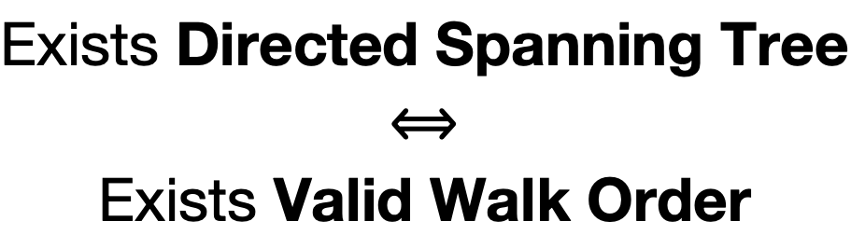
Walk Plan Generation
When There Is No Valid Order
$$R_{1}$$
$$R_{2}$$
$$R_{3}$$
Exists Directed Spanning Tree
$$⟺$$
Exists Valid Walk Order
$$R_{4}$$
$$R_{5}$$

Slide 47
Walk Plan Generation
When There Is No Valid Order
Directed Spanning Tree Decomposition
Wander Join
within each component
$$R_{1}$$
$$R_{2}$$
$$R_{3}$$
$$R_{4}$$
$$R_{5}$$

Slide 48
Walk Plan Generation
When There Is No Valid Order
Directed Spanning Tree Decomposition
Wander Join
within each component
$$R_{1}$$
$$R_{2}$$
$$R_{3}$$
$$R_{4}$$
$$R_{5}$$

Slide 49

Walk Plan Generation
When There Is No Valid Order
Directed Spanning Tree Decomposition
Wander Join
within each component
$$R_{1}$$
$$R_{2}$$
$$R_{3}$$
$$R_{4}$$
$$R_{5}$$

Slide 50


Walk Plan Generation
When There Is No Valid Order
Directed Spanning Tree Decomposition
Wander Join
within each component
$$R_{1}$$
$$R_{2}$$
$$R_{3}$$
$$R_{4}$$
$$R_{5}$$

Slide 51
Walk Plan Generation
When There Is No Valid Order
Directed Spanning Tree Decomposition
We sampled 2 paths
Now check if they join
$$R_{1}$$
$$R_{2}$$
$$R_{3}$$
Ripple Join
on the component level
$$R_{4}$$
$$R_{5}$$

Slide 52
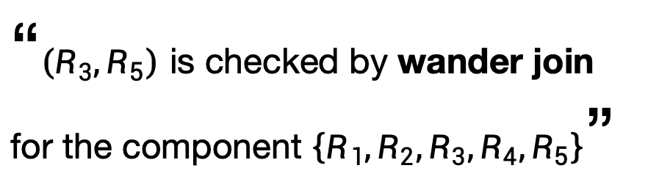
Walk Plan Generation
When There Is No Valid Order
Directed Spanning Tree Decomposition
???
$$R_{1}$$
$$R_{2}$$
$$R_{3}$$
“$\left(R_{3},R_{5}\right)$ is checked by wander join
for the component $\left\{R_{1},R_{2},R_{3},R_{4},R_{5}\right\}$”
???
$$R_{4}$$
$$R_{5}$$

Slide 53

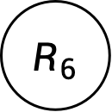
Walk Plan Generation
Directed Spanning Tree Decomposition
Objective: Minimizing the number of components
NP-Hard
$$R_{1}$$
$$R_{2}$$
$$R_{3}$$
$$R_{4}$$
$$R_{5}$$
$$R_{6}$$
$$R_{7}$$

Slide 54
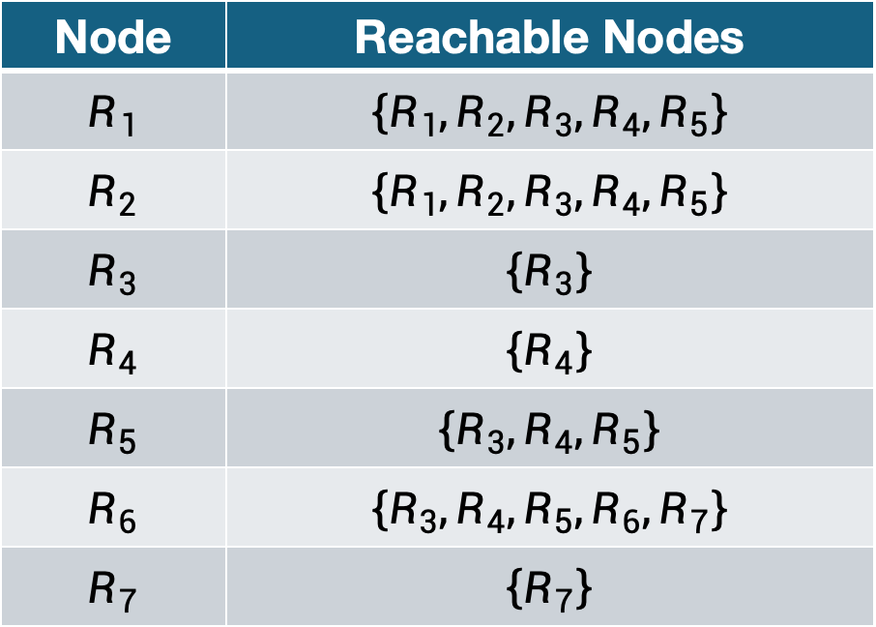
Walk Plan Generation
Directed Spanning Tree Decomposition
Step 1: Find Reachability and Remove Completely-Contained Ones
Node | Reachable Nodes
$$R_{1}$$ | $$\left\{R_{1},R_{2},R_{3},R_{4},R_{5}\right\}$$
$$R_{2}$$ | $$\left\{R_{1},R_{2},R_{3},R_{4},R_{5}\right\}$$
$$R_{3}$$ | $$\left\{R_{3}\right\}$$
$$R_{4}$$ | $$\left\{R_{4}\right\}$$
$$R_{5}$$ | $$\left\{R_{3},R_{4},R_{5}\right\}$$
$$R_{6}$$ | $$\left\{R_{3},R_{4},R_{5},R_{6},R_{7}\right\}$$
$$R_{7}$$ | $$\left\{R_{7}\right\}$$
$$R_{1}$$
$$R_{2}$$
$$R_{3}$$
$$R_{4}$$
$$R_{5}$$
$$R_{6}$$
$$R_{7}$$

Slide 55
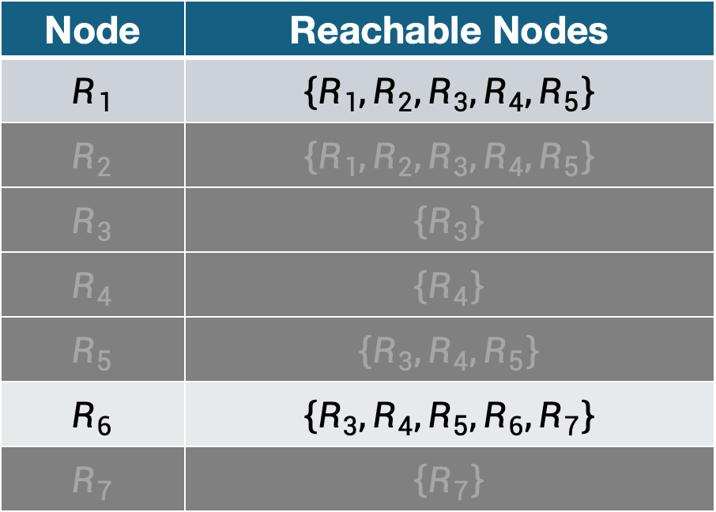
Walk Plan Generation
Directed Spanning Tree Decomposition
Step 1: Find Reachability and Remove Completely-Contained Ones
Node | Reachable Nodes
$$R_{1}$$ | $$\left\{R_{1},R_{2},R_{3},R_{4},R_{5}\right\}$$
$$R_{2}$$ | $$\left\{R_{1},R_{2},R_{3},R_{4},R_{5}\right\}$$
$$R_{3}$$ | $$\left\{R_{3}\right\}$$
$$R_{4}$$ | $$\left\{R_{4}\right\}$$
$$R_{5}$$ | $$\left\{R_{3},R_{4},R_{5}\right\}$$
$$R_{6}$$ | $$\left\{R_{3},R_{4},R_{5},R_{6},R_{7}\right\}$$
$$R_{7}$$ | $$\left\{R_{7}\right\}$$
$$R_{1}$$
$$R_{2}$$
$$R_{3}$$
$$R_{4}$$
$$R_{5}$$
$$R_{6}$$
$$R_{7}$$

Slide 56
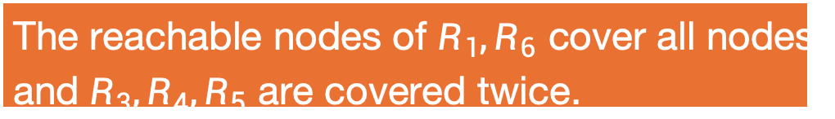
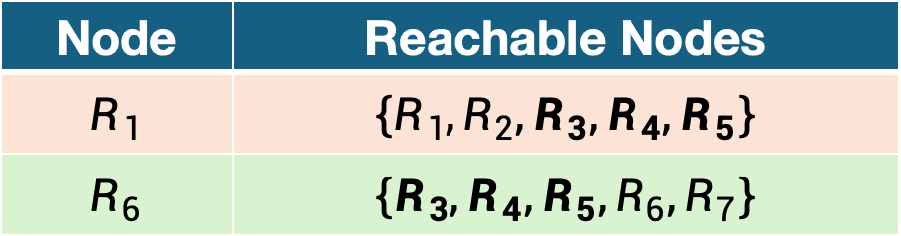
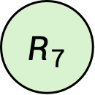
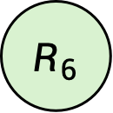
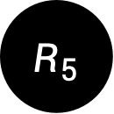
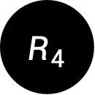
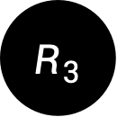
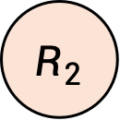
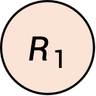
Walk Plan Generation
Directed Spanning Tree Decomposition
Step 2: Find the Smallest Cover
Node | Reachable Nodes
$$R_{1}$$ | $$\left\{R_{1},R_{2},R_{3},R_{4},R_{5}\right\}$$
$$R_{6}$$ | $$\left\{R_{3},R_{4},R_{5},R_{6},R_{7}\right\}$$
$$R_{1}$$
$$R_{2}$$
$$R_{3}$$
$$R_{4}$$
$$R_{5}$$
The reachable nodes of $R_{1},R_{6}$ cover all nodes,
and $R_{3},R_{4},R_{5}$ are covered twice.
$$R_{6}$$
$$R_{7}$$

Slide 57




Walk Plan Generation
Directed Spanning Tree Decomposition
Step 3: Convert into Decomposition
$$R_{1}$$
$$R_{2}$$
$$R_{3}$$
Induce subgraph containing the nodes that are covered for multiple times
$$R_{4}$$
$$R_{5}$$
$$R_{6}$$
$$R_{7}$$

Slide 58
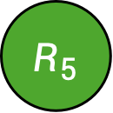
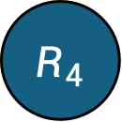
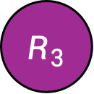
Walk Plan Generation
Directed Spanning Tree Decomposition
Step 3: Convert into Decomposition
$$R_{1}$$
$$R_{2}$$
$$R_{3}$$
Find the strongly-connected components,
and contract each into a “super vertex”
$$R_{4}$$
$$R_{5}$$
In this case, nothing can be contracted
$$R_{6}$$
$$R_{7}$$

Slide 59
Walk Plan Generation
Directed Spanning Tree Decomposition
Step 3: Convert into Decomposition
$$R_{1}$$
$$R_{2}$$
$$R_{3}$$
Assign them to one of the covers
in topological order
$$R_{4}$$
$$R_{5}$$
$$R_{6}$$
$$R_{7}$$

Slide 60
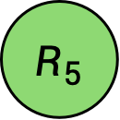
Walk Plan Generation
Directed Spanning Tree Decomposition
Step 3: Convert into Decomposition
$$R_{1}$$
$$R_{2}$$
$$R_{3}$$
Assign them to one of the covers
in topological order
$$R_{4}$$
$$R_{5}$$
$$R_{6}$$
$$R_{7}$$

Slide 61


Walk Plan Generation
Directed Spanning Tree Decomposition
Step 3: Convert into Decomposition
$$R_{1}$$
$$R_{2}$$
$$R_{3}$$
Same assignment as the predecessors
$$R_{4}$$
$$R_{5}$$
$$R_{6}$$
$$R_{7}$$

Slide 62



Walk Plan Generation
Directed Spanning Tree Decomposition
Step 3: Convert into Decomposition
$$R_{1}$$
$$R_{2}$$
$$R_{3}$$
Decomposed.
$$R_{4}$$
$$R_{5}$$
$$R_{6}$$
$$R_{7}$$

Slide 63
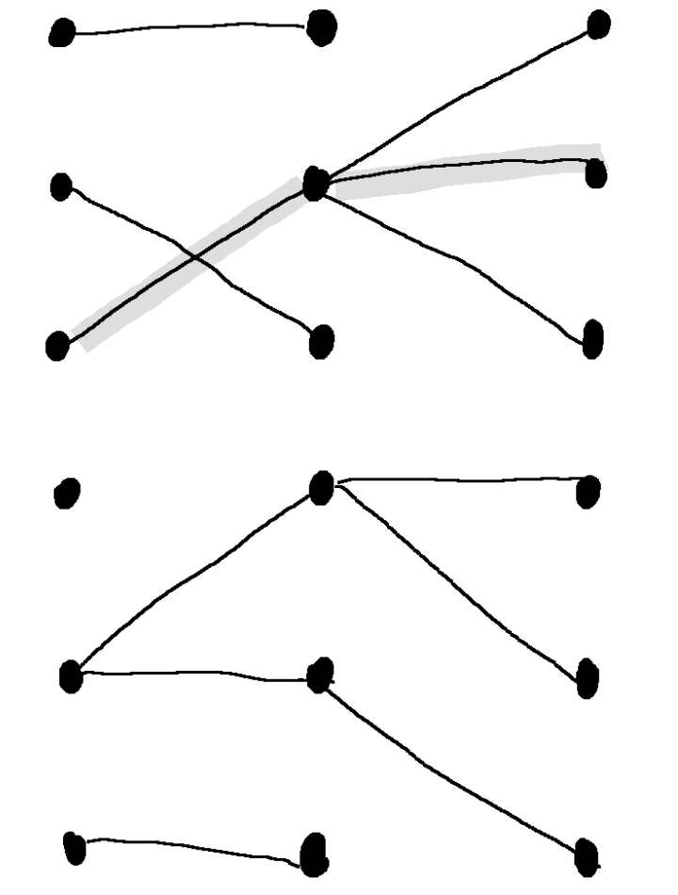
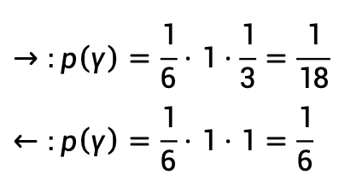
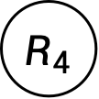
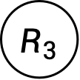
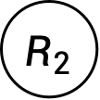
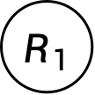


Walk Plan Optimization
affects how fast the variance of the estimator shrinks
Factors
Non-Tree Edges
Non-Uniformity
$$R_{1}$$
$$R_{2}$$
$$R_{3}$$
$$\frac{2}{7}$$
$$\frac{7}{7}$$
$$R_{4}$$
Selection Predicate
Degrees
SELECT … WHERE a < 10
$$→:p\left(γ\right)=\frac{1}{6}⋅1⋅\frac{1}{3}=\frac{1}{18} \\ ←:p\left(γ\right)=\frac{1}{6}⋅1⋅1=\frac{1}{6}$$

Slide 64
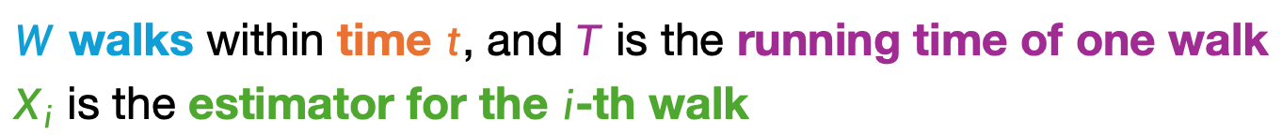
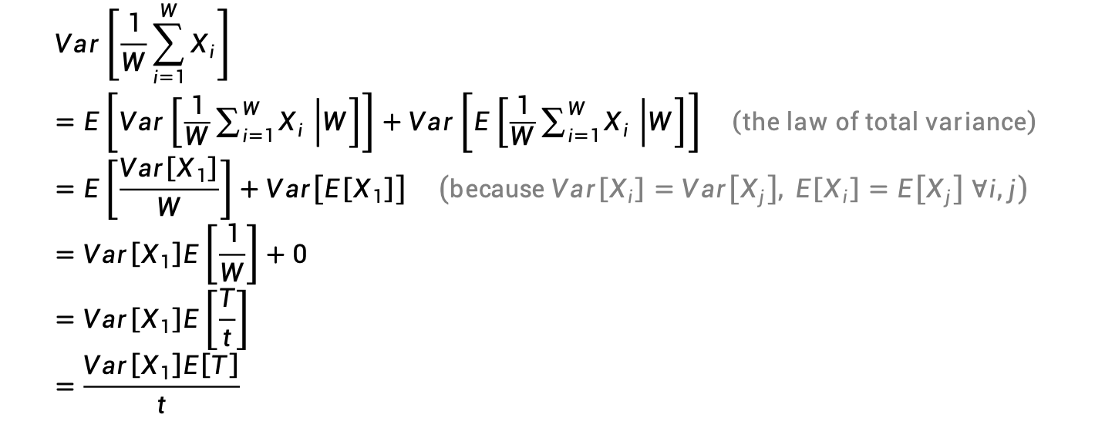
Walk Plan Optimization
Decisive Factor: the variance of the final estimator after a given time
$W$ walks within time $t$, and $T$ is the running time of one walk
$X_{i}$ is the estimator for the $i$-th walk
$$Var\left[\frac{1}{W}\sum_{i=1}^{W}{X_{i}}\right] \\ =E\left[Var\left[\frac{1}{W}\sum_{i=1}^{W}{X_{i}} | W\right]\right]+Var\left[E\left[\frac{1}{W}\sum_{i=1}^{W}{X_{i}} | W\right]\right] \left(the law of total variance\right) \\ =E\left[\frac{Var\left[X_{1}\right]}{W}\right]+Var\left[E\left[X_{1}\right]\right] \left(because Var\left[X_{i}\right]=Var\left[X_{j}\right], E\left[X_{i}\right]=E\left[X_{j}\right] ∀i,j\right) \\ =Var\left[X_{1}\right]E\left[\frac{1}{W}\right]+0 \\ =Var\left[X_{1}\right]E\left[\frac{T}{t}\right] \\ =\frac{Var\left[X_{1}\right]E\left[T\right]}{t}$$

Slide 65
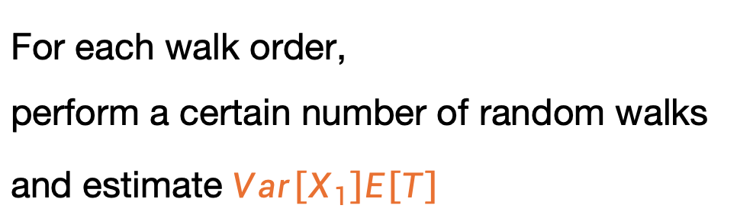
Walk Plan Optimization
Objective: Minimizing $Var\left[X_{1}\right]E\left[T\right]$
For each walk order,
perform a certain number of random walks
and estimate $Var\left[X_{1}\right]E\left[T\right]$
However, the best plan is not needed.

Slide 66

Walk Plan Optimization
Strategy
Conduct “trial” random walks following each plan in a round-robin fashion
Stop until at least one plan has $≥τ$ successful walks
Pick the plan with the minimum $Var\left[X_{1}\right]E\left[T\right]$ that has $≥\frac{τ}{2}$ successful walks
  $τ=100$ in their implementation
Trial walks can be included in the result

Slide 67


Experiments
standalone implementation and system implementation

Slide 68


Evaluation on Standalone Implementation
RRJ: Random Order Ripple Join
IRJ: Index-Assisted Ripple Join
WJ(B): Wander Join with Optimal Plan
WJ(M): Wander Join with Median Plan
WJ(O): Wander Join with Optimized Plan
RJ: Ripple Join
WJ: Wander Join
CI: Confidence Interval
Notes:
In Figure 8 we plot how the confidence interval (CI) shrinks over time, with the confidence level set at 95%, as well as the estimates returned by the algorithms. They are shown as a percentage error compared with the true answer
wander join (WJ) converges much faster than ripple join (RJ)
In Figure 9 we report the time spent by each algorithm to reach ±1% confidence interval with 95% confidence level
Wander join is in general faster than ripple join by two orders of magnitude to reach the same confidence interval.
The running time of ripple join increases with N , the data size, though mildly. The running time of wander join is not affected by N.

Slide 69

Evaluation on System Implementation
When Memory is Sufficient (32GB)
Notes:
the size of datasets is up to 20GB.
the data size has a mild impact on the performance of wander join. By our analysis and the internal memory experimental results, the total number of random walk steps should be independent of the data size.
However, because we use B-tree indexes, whose access cost grows logarithmically as data gets larger, so the cost per random walk step might grow slightly.
In addition, on larger data sets, the CPU cache may not be as effective as on smaller data sets.
These system reasons might have explained the small performance drop of wander join on larger data sets.
From the increasing trend shown in the figure, it can be observed that the relationship between the algorithm’s running time and the data size is sublinear.
Nevertheless, PostgreSQL with wander join reaching 1% CI has outperformed the PostgreSQL with full join by more than one order of magnitude when data size grows.

Slide 70

Evaluation on System Implementation
When Memory is Limited (4GB)
Notes:
Turbo DBO is fundamentally based on the Ripple Join algorithm.
data sets of sizes starting from 10GB and increasing to 40GB.
a small memory has a significant impact on the performance of wander join.
The reason is obviously due to the random-access nature of the random walks, which now has a high cost due to excessive page swapping.
Nevertheless, this is a “one-time” cost, the total cost remains almost flat afterward

Slide 71
Related Work
Online Aggregation
Algorithm | Uniformity | Independency | Sampling Efficiency
Ripple Join | Uniform | Not Independent | Lower
Wander Join | Non-Uniform | Independent | Higher
Query Sampling
for Uniform and Independent Samples
Random Sampling over Joins Revisited
Reservoir Sampling over Joins

Slide 72



Future Directions
Parallel Wander Join
to mitigate memory limit
Integration with Query Optimizer
because it can estimate COUNT quickly
Stratified Sampling
for GROUP-BY with unbalanced groups

Slide 73
Standalone Implementation
rows: std::vector<row_t>
// sorted by PK
indices: std::unordered_map<join_key_t, size_t>
// hash map
A (Primary Key) | B (Join Key)
0 | C
1 | B
2 | E
3 | A
B (Join Key) | Index
A | 3
B | 1
C | 0
E | 2
https://github.com/InitialDLab/wj-inmem/tree/master

