Slide 1
Random Sampling over Joins Revisited
Chunhao Liao, David Cheriton School of Computer Science

Slide 2
Problem and Motivation
Join is a fundamental but expensive operator, especially on large data, multiple relations.
Many applications do not require the full join results
Random sample of the join results often suffices for many applications (SUM, AVG, medians and quantiles etc.)
Trade-off between efficiency and accuracy
Notes:
How to Reduce the cost of join?
We can use a subset of the result to estimate the total result.

Slide 3
Challenges for Random Sampling over Join
sampling operation cannot be pushed down through a join operator
sample(R ⨝ S) ≠ sample(R) ⨝ sample(S)
Related work: Ripple Join and Wander Join
Notes:
Joined pair of tuples in sample(R) ⨝ sample(S) is uniformly chosen from the full join results, but there is strong correlation among the pairs.
Example:
R(A) = 1 1 2
S(A) = 1 2
R ⋈ S ON R.A = S.A (1,1), (1,1), (2,2)
P(1,1) = 2/3 P(2,2) = 1/3
1 1 ✅ (1,1)
1 2 ❌ no result
2 1 ❌ no result
2 2 ✅ (2,2)
P(1,1) = 1/2
P(2,2) = 1/2

Slide 4
Ripple Join
Idea: Don’t have to wait until the entire join is fully computed
Repeatedly and randomly pick small portions of data from each table, perform partial joins
Nearly uniform
Not independent
Strong correlation among different join resuts
Notes:
Idea of ripple join: We don’t have to wait until the entire join is fully computed. Instead, we can repeatedly and randomly pick small portions of data from each table, perform partial joins, and continuously estimate aggregates such as the average. Useful for online aggregation. users can watch the results converge in real time on the screen and decide whether to continue the computation.
Nearly uniform; Ripple join randomly selects data from both sides of R and S evenly. Each join pair has roughly equal chance to appear because tuples from both tables are randomly sampled.
Not independent: For some result they will occur in batches. Multiple join results share the same sampled tuples (e.g., one R row joins with many S rows), causing strong correlation.
Uniform: Every result has the same probability of being selected.
Example: If there are 100 join results, each has a probability of 1/100 of being chosen.
Independent：Selecting one sample does not affect the chance of selecting another.
Example: Picking result A does not change the probability of picking result B.

Slide 5
Wander Join
Idea: Don’t have to wait until the entire join is fully computed
Each random walk picks one tuple from a table, follows the join condition to another table, and produces one join result.
Independent
Not uniform
Notes:
Not Uniform: Some join results are more likely to be sampled since frequent join keys are visited more often during random walks
Independent: Each random walk generates one sample independently from previous walks, so samples do not affect each other.

Slide 6
Motivation: Integrating Joins and Machine Learning
Recent trend: Unified systems combine relational processing and ML to avoid data transfer and improve performance. Learning over joins is proposed.
Join sampling provides a general solution, saving cost with minor accuracy lost
Independent & Uniform solution is required
Notes:
In the past, the typical machine learning workflow involved using SQL in a database to query and join multiple tables, exporting the results as a CSV file, and then importing the data into Python, TensorFlow, for model training.
This process was inefficient because large datasets made import and export slow, data had to be frequently transferred between the database and the ML system, and the join operations and model training could not be optimized together.
Recently, systems like Apache Spark have unified these two stages:
Spark can perform SQL queries, joins, and aggregations, and directly run machine learning algorithms (such as MLlib) on the results.
This integration removes the need for data export and enables the system to learn over join. (Directly train the machine learning model on the join results, instead of materializing (fully computing) the entire join table before training)
Prior works on learning over joins rely on factorized computation, limited to models like linear regression.
Join sampling offers a more general solution — it reduces join and training costs while maintaining small, bounded accuracy loss.
However, it requires uniform and independent samples, so ripple join and wander join are not suitable.

Slide 7
Previous work: Sampling two-relation joins
Goal: Obtain uniform and independent samples from join results
Method1: (Olken et al.)
reject some samples with certain probabilities in sample(R) ⋈ sample(S)
Method2: (Chaudhuri et al.)
Sample from R non-uniformly, using statistics of S
Limitation:
Only applicable to two-way joins
Notes:
Method 1:
Start from sample(R) ⋈ sample(S) Then reject some samples with certain probabilities
Ensures the remaining samples approximate a uniform distribution
R1 ⋈ R2 where R1.B = R2.B
Only accepts an item with dB (v, R2)/MB (R2) in relation R2 for A-B-C
Method 2
However if MB (R2) is really big, and dB (v, R2) is relatively small, then most of the items will be rejected. The algorithm is not efficient.
Chaudhuri propose first we need to look at the frequency of a B value in S first and then select the item from R.
R (a,x) (b,y) (c,z)
S (x, 100 times) (y,3 times) (z,1 time) then select (a1,x) with a high probablity first because x shows up more times in S
Sample from R non-uniformly, using statistics of S as guidance
Reduces rejection overhead and improves sampling efficiency

Slide 8
Olken’s Join-Sampling Algorithm
Step 1: Sample t₁ ∈ R₁ uniformly.
Step 2: From matches in R₂ with the same B = v, sample t₂ uniformly.
Step 3: Accept (t₁ ⋈ t₂) with prob. d_B(v, R₂) / M_B(R₂); otherwise reject.
efficiency depends on skew (high rejection if M_B ≫ typical d_B).
d_B(v, R₂)：number of tuples in R₂ with join key B = v
M_B(R₂)：maximum such count for any value of B in R₂
Notes:
Method 1:
Start from sample(R) ⋈ sample(S) Then reject some samples with certain probabilities
Ensures the remaining samples approximate a uniform distribution
R1 ⋈ R2 where R1.B = R2.B
Only accepts an item with dB (v, R2)/MB (R2) in relation R2 for A-B-C

Slide 9
Chaudhuri’s Algorithm
Olken’s method has high rejection when M_B(R₂) ≫ typical frequencies.
If frequency info d_B(v, R₂) is known:
Sample t₁ ∈ R₁ with probability ∝ d_B(v, R₂).
Then pick matching t₂ ∈ R₂ uniformly → no rejection.
If full stats are unavailable → use a hybrid approach:
high-frequency values → Chaudhuri’s method
low-frequency values → Olken’s method
Notes:
Method 2
However if MB (R2) is really big, and dB (v, R2) is relatively small, then most of the items will be rejected. The algorithm is not efficient.
Chaudhuri propose first we need to look at the frequency of a B value in S first and then select the item from R.
R (a,x) (b,y) (c,z)
S (x, 100 times) (y,3 times) (z,1 time) then select (a1,x) with a high probablity first because x shows up more times in S
Sample from R non-uniformly, using statistics of S as guidance
Reduces rejection overhead and improves sampling efficiency
For high-frequency values—where statistics are available—they use Chaudhuri’s method for efficient, rejection-free sampling.
For low-frequency values—where exact counts are unknown—they fall back to Olken’s method, which may involve rejection but still guarantees correctness

Slide 10
Previous work: Sampling Multi-way Foreign-key Joins
Works only for acyclic foreign-key joins (tree-like joins) with a single source relation
Each join result maps one-to-one to the source table → sampling reduces to sampling that table.
But real joins are often cyclic or without a single source — the key challenge addressed in this paper.

Slide 11
Contribution in this work
A general and efficient framework for join sampling
1. Guarantees uniform and independent samples compatible with any join size upper bound method.
2. Supports multi-way joins, acyclic or cyclic, with or without selection predicates
3. Existing algorithms (Chaudhuri’s & Olken’s) are special cases of our framework.

Slide 12
Main Idea: General Join Sampling Framework
Each tuple t is assigned a weight w(t) representing how many join results can be extended from t.
Since w(t) is difficult to compute, an upper bound W(t) is used instead.
w(t) = |t ⨝ Ri+1 ⨝ Ri+2 ⨝ · · · ⨝ Rn |.
Sampling decisions are guided by W(t), with rejection probability used to correct overestimation.
Repeated executions yield uniform and independent join samples.
Notes:
The main idea behind this framework is to treat the join process as a weighted random walk.
Each tuple has a weight, w(t), which indicates how many complete join results can be extended from it.
Because calculating w(t) exactly is too expensive, the algorithm uses an upper bound, W(t), to guide sampling.
If W(t) overestimates the true weight, the algorithm compensates by rejecting that path with a certain probability.
By repeating this process multiple times, we can generate uniform and independent samples from the full join result—without ever computing the full join.

Slide 13
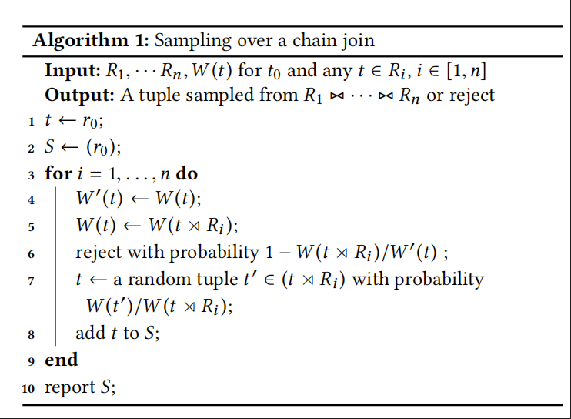
Algorithm 1 — Sampling over a Chain Join
Starts from a virtual root r₀ and walks through the join chain R₁ → Rn
At each step, updates the upper-bound W(t) and possibly rejects the path with probability 1 −
W(t ⋉Rᵢ)/W′(t).
If not rejected, randomly selects a joining tuple t′ ∝ W(t′).
Ensures every complete join path has equal probability 1/W(r₀).
t ⋊Ri+1 represents the set of all tuples in
Ri+1 that join with t
Notes:
Algorithm 1 can be understood as a random walk that samples one join result at a time.
We assume that there is a virtual root r0, which connects to every tuples in R1
we start from a virtual root tuple and move through each relation in the chain.
At every step, the algorithm keeps track of an upper bound W(t) on how many join results can extend from the current tuple.
If that bound is too loose, the path is rejected with a probability proportional to the over-estimation.
Otherwise, it chooses a child tuple from the next relation based on its weight.
By repeating this process, the algorithm guarantees that every complete join path is selected with the same probability, producing uniform and independent samples.

Slide 14
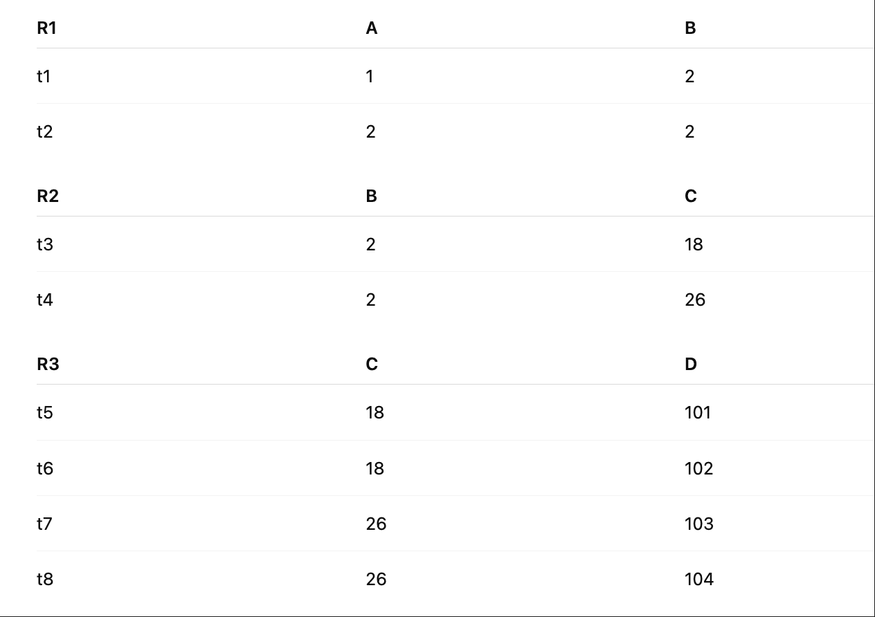
Algorithm 1 Example
Initialization:
Start with r₀ and set S = {r₀}.
Assume we know or estimate the
following weights:
W(t1)=4, W(t2)=4, W(t3)=2, W(t4)=2,
W(t5)=W(t6)=W(t7)=W(t8)=1

Slide 15
Algorithm 1 Example
Step 1: r₀ → R₁
Randomly select a tuple, say t₁ ∈ R₁.
W′(r₀) = W(r₀).
Update W(r₀) ← W(r₀ ⋉ R₁).
Reject with some probability (more possible paths → more likely to keep).
Suppose it’s not rejected.

Slide 16
Algorithm 1 Example
Step 2: R₁ → R₂
Current tuple t = t₁.
W′(t₁)=4.
Compute W(t₁ ⋉ R₂)=2 joins with t₃,t₄ → W(t₁ ⋉ R₂)=2.
Rejection probability = 1 − 2/4 = 0.5 → 50% chance to reject (to avoid bias).
If not rejected, randomly choose between {t₃, t₄} with probability ∝ W(t′).
Suppose we pick t₃.

Slide 17
Algorithm 1 Example
Step 3: R₂ → R₃
Current t = t₃. W′(t₃)=2.
W(t₃ ⋉ R₃): C=18 joins with t₅,t₆ → W(t₃ ⋉ R₃)=2.
Rejection probability = 1 − 2/2 = 0 → not rejected.
Randomly choose one from {t₅, t₆}, say t₅.
✅ Final path: (t₁, t₃, t₅)
S = (r₀, t₁, t₃, t₅) — this is the sampled join result.

Slide 18

Why uniform and independent？
Each partial path (r₀, t₁, …, tᵢ) is sampled with probability W(tᵢ)/W(r₀).
For i = n, W(tn)=1 ⇒ every complete join result has probability 1/W(r₀).
Therefore, all join results are equally likely and mutually independent.、
Sampling efficiency = |J| / W(r₀); loose bounds lead to higher rejection rates.
Notes:
To show that Algorithm 1 is uniform and independent, the paper proves Theorem 3.1 using induction over the join steps.
At each step, the probability of extending a partial path (r₀, t₁, …, tᵢ) is proportional to W(tᵢ)/W(r₀).
When we reach the final relation, W(tn) equals 1, which means every complete join result appears with the same probability 1 over W(r₀).
Because each accepted sample has this identical probability, and each run of the algorithm starts independently from r₀, the generated samples are both uniform and independent.

Slide 19
Remark of Algorithm 1
W(t) values don’t need to be precomputed — they can be estimated on the fly.
The algorithm always produces uniform and independent samples, regardless of how W(t) is derived.
When n = 2, Algorithm 1 generalizes previous works:
Olken (1993): uses a loose upper bound, low efficiency.
Chaudhuri et al. (1999): uses exact frequencies, 100 % efficiency.
Notes:
This section highlights the flexibility and generality of Algorithm 1.
First, the algorithm doesn’t require all W(t) values to be known in advance.
It can compute or estimate an upper bound on the fly, only when that tuple is actually visited during sampling.
Second, no matter how W(t) is chosen—whether it’s tight or loose—the algorithm always produces uniform and independent samples.
Each run starts fresh from the root, so the history of previous samples never affects the next one.
Finally, both Olken’s and Chaudhuri’s classic join-sampling methods are just special cases when the join involves only two relations
Algorithm 1 unifies these ideas and extends them to general multi-way joins.

Slide 20
Framework Instantiations
Different versions of Algorithm 1 only differ in how W(t) (join-size upper bounds) are computed.
There is a trade-off between setup cost and sampling efficiency.
Tighter bounds: higher initialization cost but faster sampling.
Looser bounds: easy to compute but higher rejection rates, low efficiency
Olken (1993) and Chaudhuri et al. (1999) represent the two extremes of this trade-off.
Notes:
Section 4 explains how different instantiations of Algorithm 1 are created by changing only one component — how we compute the upper bounds W(t).
These bounds determine both the cost and efficiency of sampling.
If the bounds are very tight, we need to spend more time computing statistics before sampling, but the sampling process itself becomes highly efficient, with almost no rejections.
On the other hand, loose bounds are quick to compute, but they cause many rejections and reduce efficiency.
Olken’s algorithm represents the low-cost, low-efficiency extreme, 、
while Chaudhuri’s algorithm achieves perfect efficiency but with heavy setup overhead.

Slide 21

Other Join Size Upper Bounds (AGM Bound)
AGM bound: a theoretical worst-case upper bound on join size derived from database theory.
It estimates the maximum possible output size based only on relation sizes, without using key frequencies.
Notes:
The sampling framework can use any join-size upper bound as W(t).
There are several different way to get the upper bound W(t)
Here we show AGM bound as en example.
One well-known theoretical result is the AGM bound, which provides the tightest possible upper limit on a join’s output size based only on relation sizes.
For chain joins, AGM is simple and can initialize W(t). On a general query, it requires solving a linear program. In the case of chain joins, the AGM bound is simple
Compared with Olken’s bound, AGM performs better when we don’t have detailed frequency information, while Olken’s can be tighter if maximum frequencies are small.

Slide 22
Acyclic join queries
Represent the query as a join tree — R₁ is the root; other relations are its children
For each tuple t ∈ Rᵢ:
w(t) = | t ⋈ (⋈_{Rⱼ : Rᵢ < Rⱼ} Rⱼ) | → number of join results reachable from t across all its subtrees.
If Rᵢ has multiple children (e.g., R₂, R₃), define w(t, R₂), w(t, R₃) for each branch.
Then w(t) = w(t, R₂) × w(t, R₃)

Slide 23
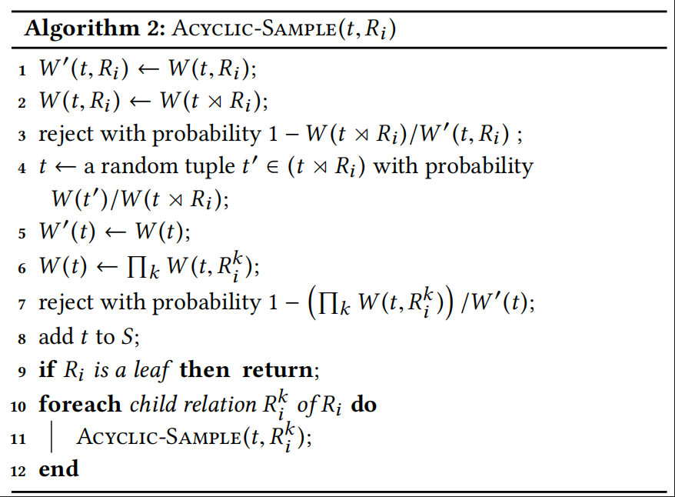
Algorithm 2: Sampling over Acyclic Joins
Notes:
In Algorithm 1, the process follows a single linear chain. Now, because the join graph becomes a tree, each node may have multiple child branches,
so the algorithm must perform recursive sampling across branches.
Thus, Algorithm 2 (Acyclic-Sample) becomes a recursive sampling algorithm:
For each node, randomly select a child branch first; Decide whether to reject;
Then recursively continue sampling within each child subtree.
If Rᵢ is a leaf node → W(t) = 1；If a relation has multiple child branches, the algorithm expands sampling in all subtrees simultaneously;
Algorithm 2 returns each join result in J with probability 1/W (r0), where W (r0) is the value before the algorithm runs

Slide 24
Cyclic queries
Idea: break the cycles by removing some relations.
Remaining acyclic part → skeleton query H_s
Removed relations → residual query H_r
Define Mᵣ = maximum # of tuples in Hᵣ that can join with any result from H_s.
Then sample H_s using Algorithm 2 and extend to H_r with controlled rejection.

Slide 25
Algorithm 3: Cyclic-Sample
Sample a tuple t from H_s (using Algorithm 2).
Accept with prob. |t ⋈ Hᵣ| / Mᵣ.
If accepted, return a uniform sample from t ⋈ Hᵣ.

Slide 26
Algorithm 3: Cyclic-Sample Example
Query: R₁(A,B) ⋈ R₂(B,C) ⋈ R₃(A,C)
Example data: H_s = R₁ ⋈ R₂; H_r= R₃
R₁(A,B) R₂(B,C) R₃(A,C)
(1,2) (2,3) (1,3)
(2,4) (4,5) (2,5)
Step 1️ Sample (t₁,t₂) from H_s = R₁⋈R₂ → (1,2,3) or (2,4,5).
Step 2️ Check if (A,C) pair exists in R₃.
Step 3️ If exists → accept and output (t₁,t₂,t₃); otherwise reject.

Slide 27
Algorithm 3: Cyclic-Sample Example
Query: R₁(A,B) ⋈ R₂(B,C) ⋈ R₃(A,C)
Example data: H_s = R₁ ⋈ R₂; H_r= R₃
R₁(A,B) R₂(B,C) R₃(A,C)
(1,2) (2,3) (1,3)
(2,4) (4,5) (2,5)
Step 4:️ Mᵣ = 1 (since each (A,C) pair is unique in R₃).
Acceptance probability = |t⋈Hᵣ| / Mᵣ = 1 → no rejection.
Each triangle is sampled with: P = 1 / Mᵣ×|Hs|
Notes:
Mᵣ = maximum # of tuples in Hᵣ that can join with any result from H_s.

Slide 28
Experiments Overview
Goal: Evaluate sampling methods for uniform & independent join samples
Methods compared: FJ, EO, EW, OE, RS
Datasets: TPC-H benchmark & Twitter social graph
Queries: chain, cyclic, and foreign-key joins
Notes:
In this section, the authors evaluate how well different sampling methods produce uniform and independent samples from joins.
They compare five methods — Full Join, Extended Olken, Exact Weight （Chaudhuri’s), Online Exploration (wander join) , and Reverse Sampling (multi-way foreign-key join）.
Experiments are run on two datasets: the TPC-H benchmark, which simulates business data, and a large Twitter social graph.
These datasets include different join patterns, such as chain joins, cyclic joins, and foreign-key joins, to test scalability and generality of the framework.

Slide 29
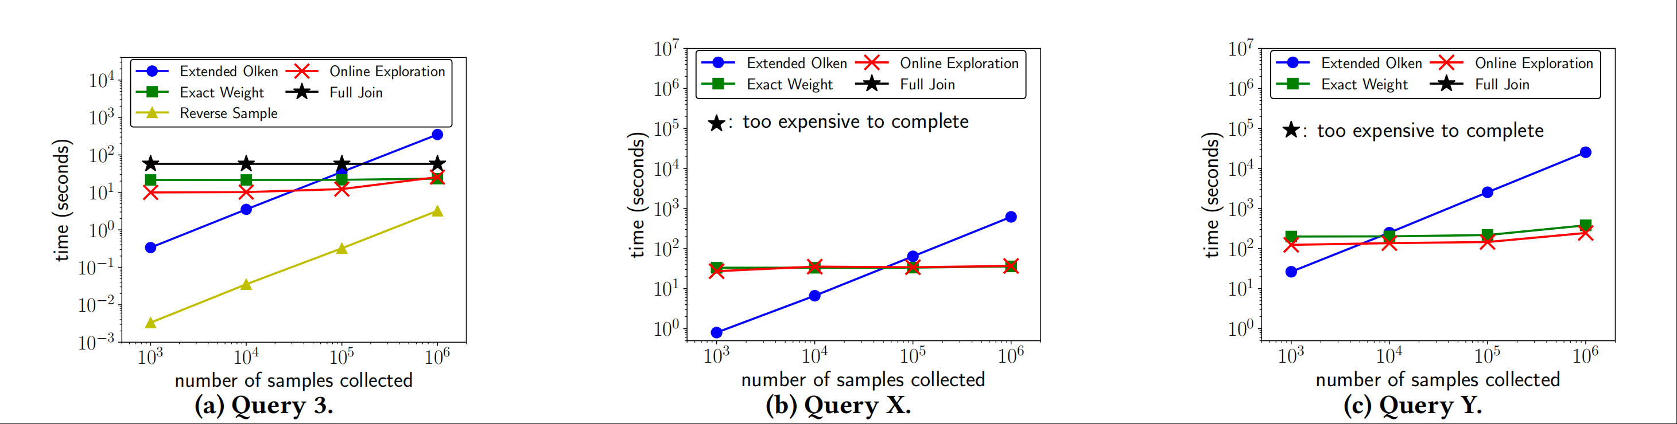
TPC-H Experiments
Query 3 (Q3) — Simple multi-way foreign-key chain join.
Query X (QX) — General multi-way chain join
Query Y (QY) — Multi-way cyclic join
Notes:
Figure 3 compares five sampling methods on the TPC-H dataset (scale 10).
In Q3 (simple foreign-key chain), EW and OE perform best, while FJ becomes costly and EO suffers from high rejection.
In QX (longer chain), the join size grows rapidly—EW and OE again outperform all others, and FJ cannot complete large samples.
In QY (cyclic join), OE stays efficient, but EO slows down.

Slide 30
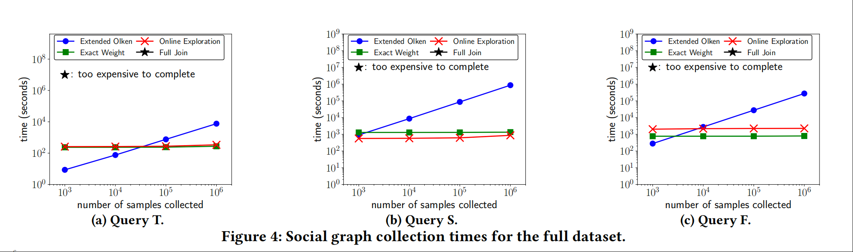
Social graph experiments
Query T — Triangle Join
Query S — Square Join
Query F — Snowflake Join
Notes:
Figure 4 shows the sampling performance of the five methods on the full Twitter social graph dataset.
Each subfigure corresponds to one query pattern: QT (triangle join), QS (square join), and QF (snowflake join).
For all three queries, Exact Weight (EW) and Online Exploration (OE) clearly outperform the others, producing up to a million uniform samples much faster.
Extended Olken (EO) is consistently several orders of magnitude slower because of its high rejection rate, while Full Join (FJ) is too expensive to complete except on the smallest workloads.
Overall, the results confirm that EW and OE scale efficiently on complex graph-structured joins, even when the dataset contains billions of records.

Slide 31
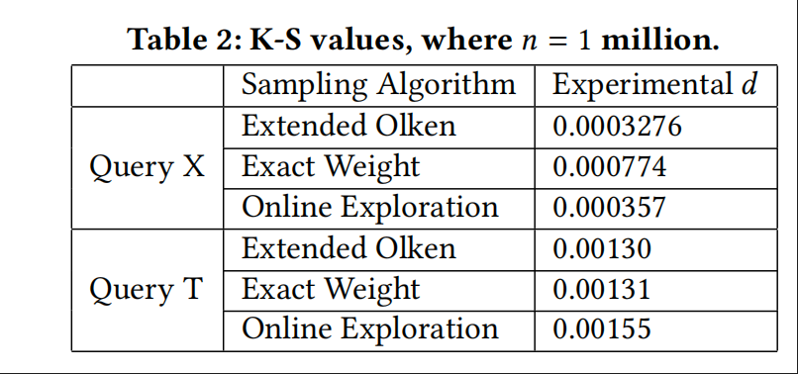
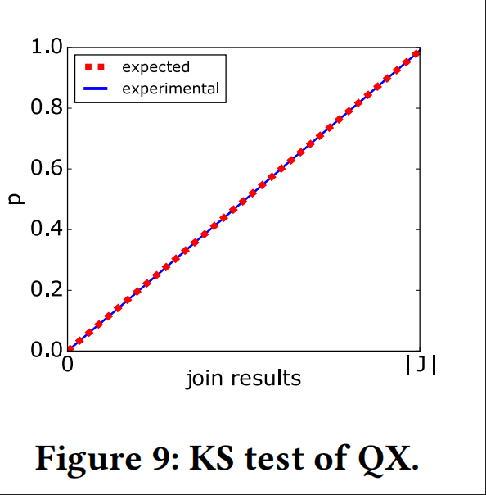
Verifying Uniform Sampling with the KS Test
Method: Kolmogorov–Smirnov (KS) test
Uniformity accepted if d < 0.00163 (α = 0.01).
Notes:
Section 6.4 evaluates whether the samples produced by each algorithm are truly uniform using the Kolmogorov–Smirnov test.
For both acyclic and cyclic queries, the authors collected one million samples and compared their cumulative distributions with the expected uniform line.
The KS statistic d measures the maximum deviation between these two distributions.
As shown in Table 2 and Figure 9, all methods have d values smaller than 0.00163, meaning we can accept the hypothesis of uniformity at the 1% significance level.
This confirms that our sampling framework consistently generates uniform and independent join samples.

Slide 32
Conclusion
The framework supports random sampling over arbitrary join queries efficiently.
Comparison of Algorithms:
EO (Extended Olken): Fastest to start, but lowest efficiency due to high rejection rate.
EW (Exact Weight): Most accurate (0 rejection), but slowest to initialize.
OE (Online Exploration): Hybrid; balances speed and efficiency.

