Slide 1
Conjunctive Queries with Negation and Aggregation: A Linear Time Characterization
Desen Sun,
Computer Science

Slide 2
Introduce of Conjunctive Queries with Negation
Defination:
  Conjunctive Queries (CQ) with NOT predicate, e.g., R1 ⋈ R2 ⋈ ¬ R3
  Notion: CQ¬
Practical Application:
  E-commerce Recommendation Engines: Show me the laptops with Intel processor and 16GB DDR5 memory, but exclude all PCs which has AMD GPU or one-star reviews
  Social Network Services: Suggest new friends to a user who share the same friends, but they are not friends and they are not in each other’s blacklist

Slide 3
Why does this research matter?
A Simple Example in E-commerce Recommendation Engines:
  CQ¬ = R1(PC, brand, mem) ∧ ¬ R2 (gpu) ∧ ¬ R3(review)
Complexity Analysis:
  Get items from R1
  Flip bits corresponding to R2
  Flip bits corresponding to R3
  Flip bits corresponding to R2 ∧ R3
  …
  Q = S – A –B + (A ∩ B)

Slide 4
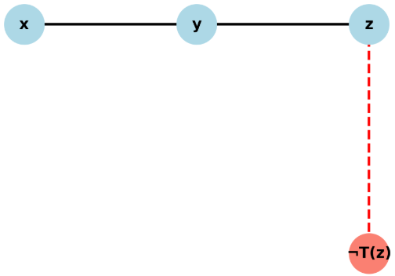
Signed Hypergraphs
Notion: H = ([n], E⁺, E⁻)
  Q(x, z) = R(x, y) ∧ S(y, z) ∧ ¬ T(z)
R
S

Slide 5
Acyclicity
𝛼-acyclic: there exists a tree that all nodes containing certain vertexes can form a connected part
𝛽-acyclic: for every subgraph which contains all vertexes, it is still 𝛼-acyclic
𝛽-leaf: there exists a chain that showing the containing relation of some specific vertex
  Example: Q=R(a,b,c) ∧ S(a,b) ∧ T(a);
    {a} ⊆ {a, b} ⊆ {a, b, c}
S
T
a
b
c
R

Slide 6
Findings
Every 𝛽-acyclic graph has a 𝛽-leaf
If we remove 𝛽-leaf, the remaining part is still acyclic
a
b
c
T
S
R

Slide 7
Signed Acyclicity
Defination:
  All positive edges form an 𝛼-acyclic graph
  All positive edges and one arbitrary negative edge also form an 𝛼-acyclic graph
R
S

Slide 8
Signed Leaf
Defination:
  𝛼-property: all edges which contain x are subsets of one hyperedge in the hypergraph
  𝛽–property: such hypergraph and all negative edges with x except those which are the subsets of that hyperedge can form an inclusion order
  Example: Q = R(a, b, c) ∧ S(b, d) ∧ T(c, e) ∧ ¬ U(b) ∧ ¬ V(c)
R
a
b
c
U
V
S
T
d
e

Slide 9
Findings
Every signed-acyclic graph has a signed-leaf
If we remove signed-leaf, the remaining part is still acyclic
R
a
b
c
U
V
S
T
d
e

Slide 10
Signed Elimination Sequence
An order σ = (v1, v2, …, vn)
Vi is the signed-leaf of Hi
Hi means the hypergraph which have eliminated (n-i) vertexes
Every signed hypergraph has signed elimination sequence
R
a
b
c
U
V
S
T
d
e

Slide 11
Example
Q(x1, x2, x3, x4) ← A(x1, x2, x3) ∧ U(x3, x4) ∧ ¬ V(x4) ∧ ¬ R(x2, x3, x4) ∧ ¬ S(x1, x2, x3, x4)
x1
x2
A
S
R
x4
x3
V
U

Slide 12
Example
Q’(x1, x2, x3) ← A(x1, x2, x3) ∧ U(x3) ∧ ¬ R(x2, x3) ∧ ¬ S(x1, x2, x3)
x1
x2
A
S
R
x3
U

Slide 13
Efficiency of Enumeration
Defination:
  The database performs a preprocessing phase
  Get the query results batch by batch without storing the full result
Advantage:
  Less memory consumption
  Return first result faster

Slide 14
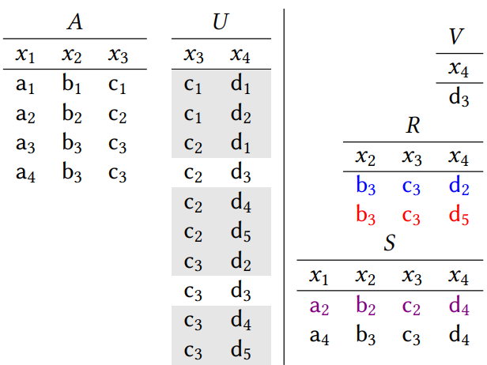
Example Query
Q(x1, x2, x3, x4) ← A(x1, x2, x3) ∧ U(x3, x4) ∧ ¬ V(x4) ∧ ¬ R(x2, x3, x4) ∧ ¬ S(x1, x2, x3, x4)

Slide 15
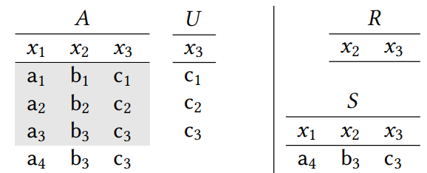
Eliminate x4
Q’(x1, x2, x3) ← A(x1, x2, x3) ∧ U(x3) ∧ ¬ R(x2, x3) ∧ ¬ S(x1, x2, x3)

Slide 16
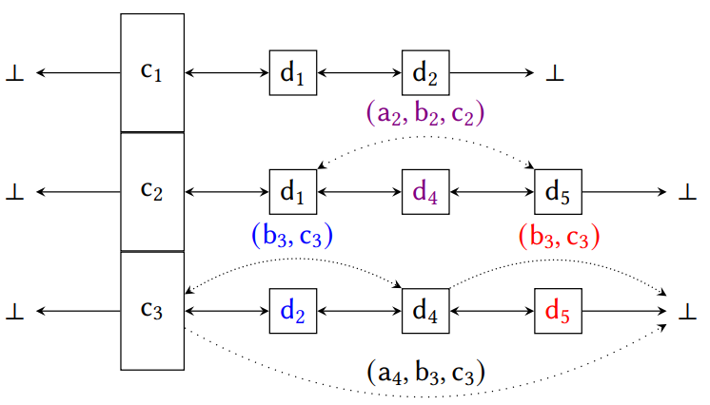
Build Doubly Linked List
Q’(x1, x2, x3) ← A(x1, x2, x3) ∧ U(x3) ∧ ¬ R(x2, x3) ∧ ¬ S(x1, x2, x3)

Slide 17
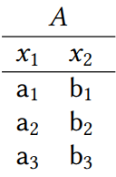

Continue Eliminate More Vertexes
Q’’(x1, x2) ← A(x1, x2) ∧ ¬ R(x2) ∧ ¬ S(x1, x2)
Q’’’(x1) ← A(x1) ∧ ¬ S(x1)

Slide 18
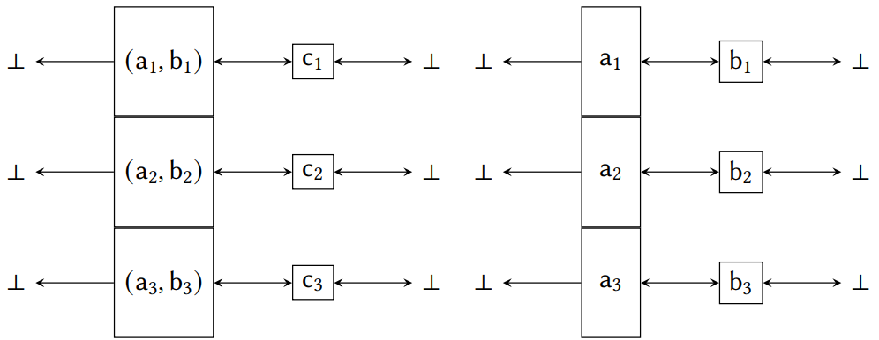
Corresponding Lists
Q’’(x1, x2) ← A(x1, x2) ∧ ¬ R(x2) ∧ ¬ S(x1, x2)
Q’’’(x1) ← A(x1) ∧ ¬ S(x1)

Slide 19
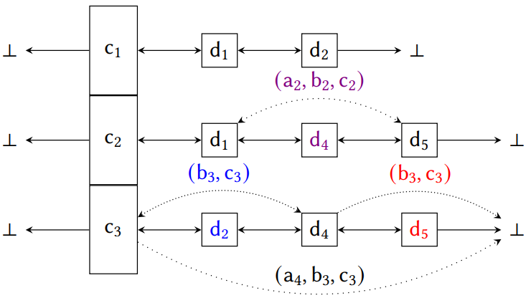
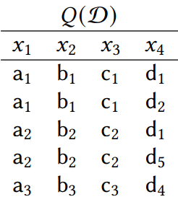
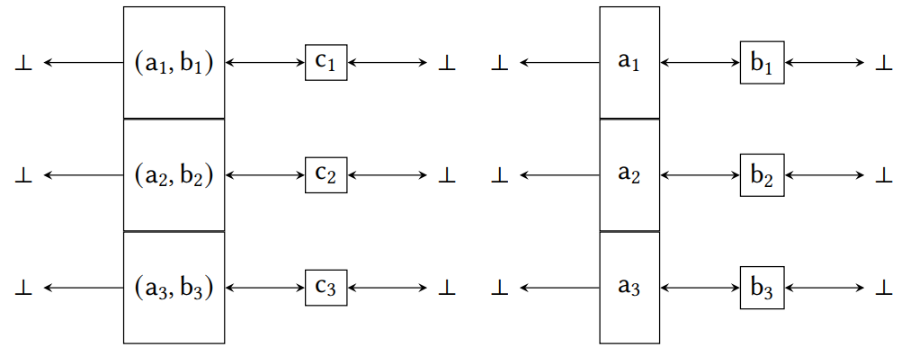
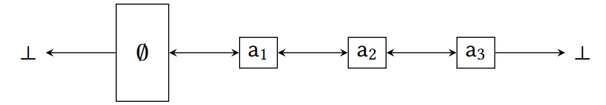
Final Results

Slide 20
Summary
Propose an enumeration way to process conjunctive queries with negation
Use an consistent example to show the procedure of enumeration
Narrowed scope
Can enumeration method keep balance between preprocess and delay stages?
Photo credit: @bruce.digital

Slide 21
Q & A

Slide 22
Thank you!

