Slide 1
Computing the Difference of Conjunctive Queries Efficiently
Desen Sun

Slide 2

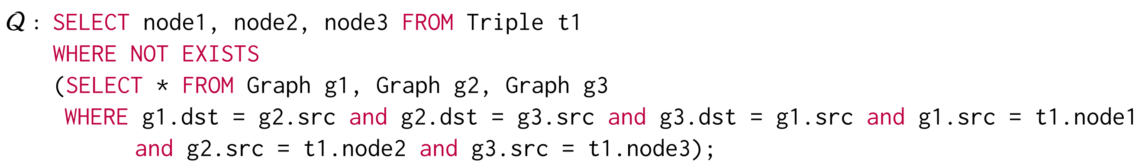
What is Difference of Conjunctive Queries?
SQL instruction: NOT IN, NOT EXISTS, EXCEPT, MINUS, DIFFERENCE, LEFT-OUTER JOIN
Notion:
Example:

Slide 3
Conjunctive Queries
A Conjunctive Queries is:
R1, R2, …, Rn are relations, e1, e2, …, en are corresponding attributes
Y is the output attributes
Q = (y, V, E), V is the set of all attributes, E is the multisets of all relations’ attributes

Slide 4
Difference Conjunctive Queries
Given two CQs Q1 and Q2, the DCQ Q1 – Q2 is defined as:
y1 = y2

Slide 5
What if Q1 and Q2 share the same schema?
Q1 = 𝑅1 (𝑥1, 𝑥2) ⋈ 𝑅2 (𝑥2, 𝑥3)
Q2 = R1’(x1,x2) ⋈ R2’(x2, x3)
Q1 – Q2 = (R1 – R1’) ⋈ R2 + R1 ⋈ (R2 – R2’)
Total complexity is O(N + OUT)

Slide 6



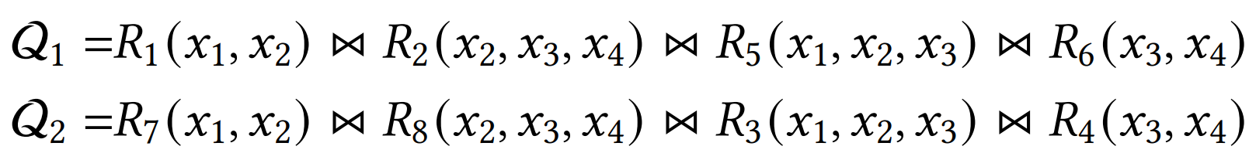
What if Q1 and Q2 have different schema?
If the outputs of Both Q1 and Q2 are the whole attributes set:
Convert Q1 and Q2 to the same schema
The same as previous solution

Slide 7
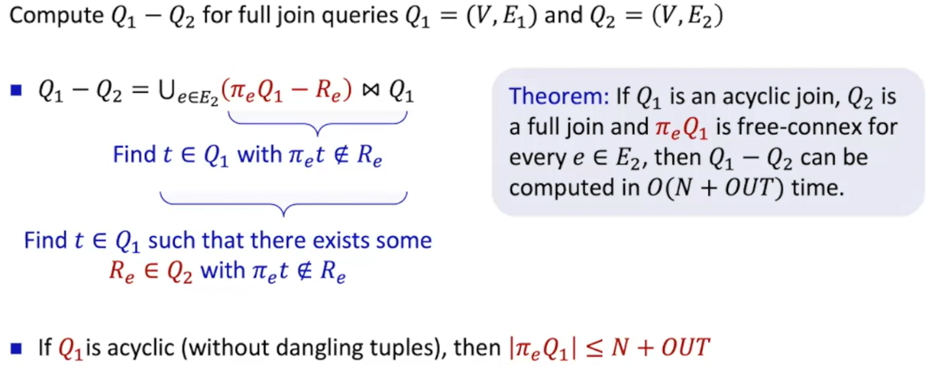
What if Q1 and Q2 have different schema?

Slide 8
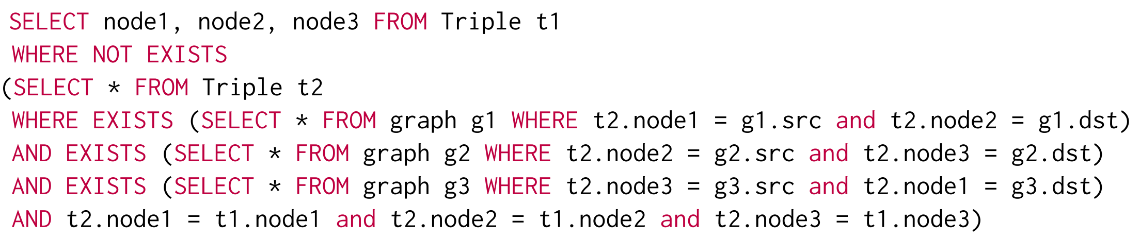
Example Rewrite

Slide 9
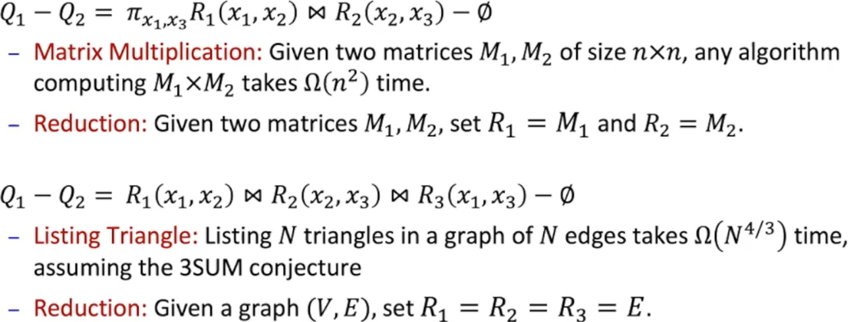
Case 1: Q1 is non-free-connex

Slide 10
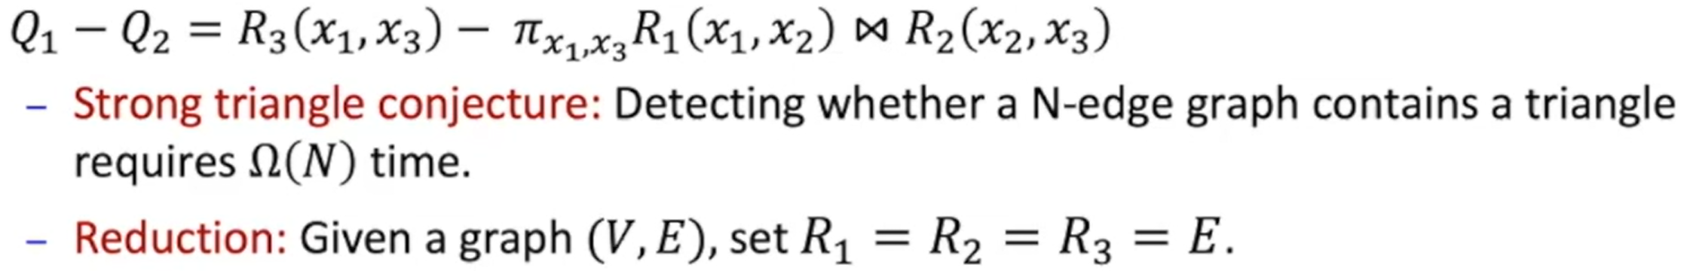
Case 2: Q1 is free-connex but Q2 is non-linear-reducible
Notes:
Lemma 4.3 proof

Slide 11
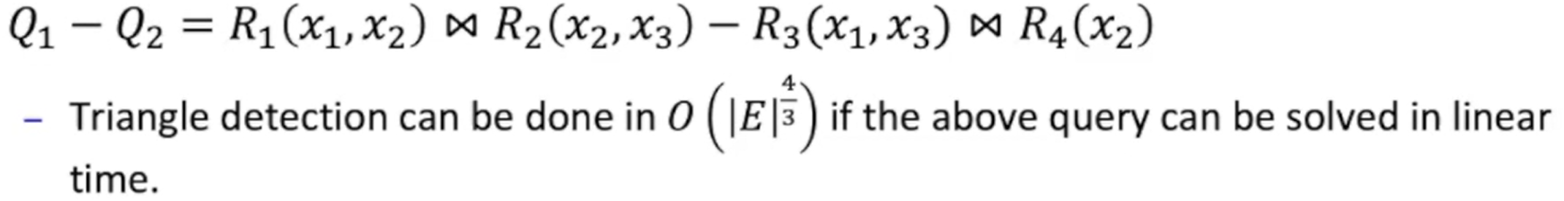
Case 3: Q1 is free-connex, Q2 is linear-reducible, but some attributes make Q1 non-free-connex
Notes:
Lemma 4.3 proof

Slide 12
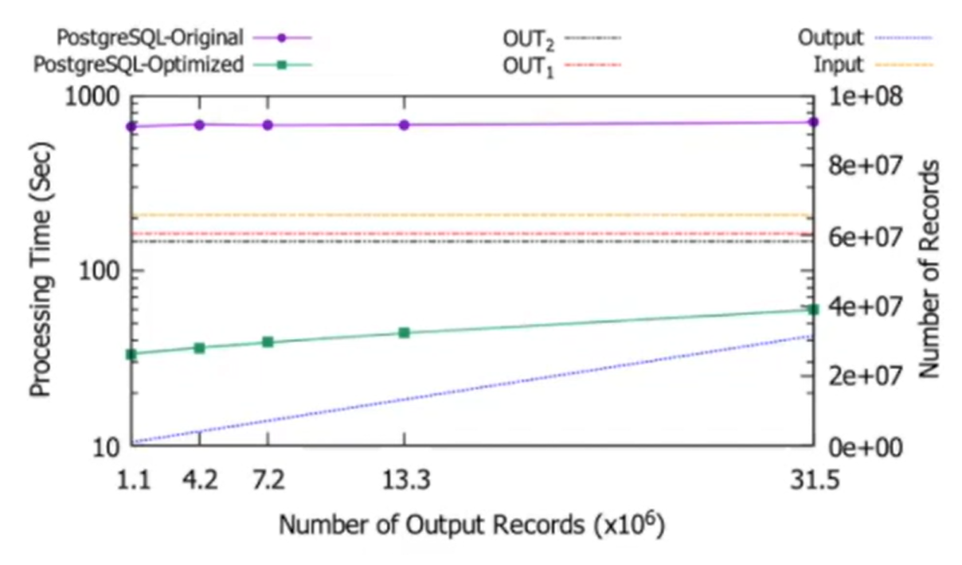
Evaluation
Sensitivity Study: Output1’s impact
Notes:
Lemma 4.3 proof

Slide 13
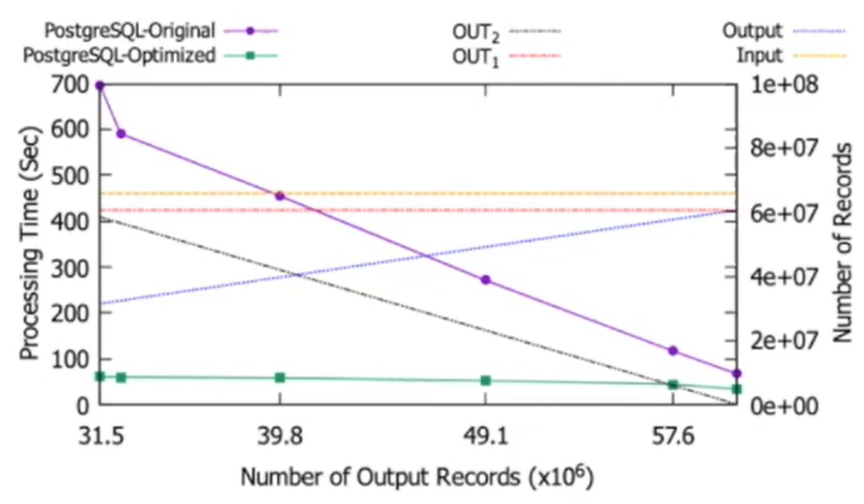
Evaluation
Sensitivity Study: Output2’s impact
Notes:
Lemma 4.3 proof

Slide 14
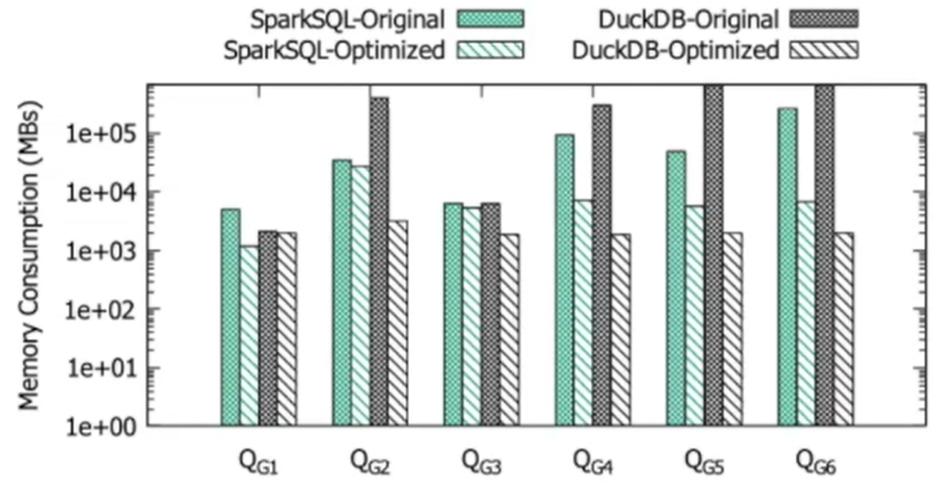
Evaluation
Storage cost
Notes:
Lemma 4.3 proof

Slide 15
Summary
Analysis of DCQ algorithm, and propose heuristic implementation for complicate scenarios
Real implementation to prove the effectiveness
Lack of analysis or description about how this algorithm works on multiple threads
Notes:
Lemma 4.3 proof

