Slide 1
Lecture 8: Language Model Pretraining
Presenters: Zhengyuan Dong, Yifan Jiang

Slide 2
Content
About pre-training
Why we need pre-training
Does pre-training indeed help?
Introduce pre-trained models
Motivation for developing different models
Detailed Methods in ELMo, BERT, …

Slide 3
Why Pre-training
Standard Learning
Transfer Learning
outputs
outputs
outputs
outputs
outputs
Task1
Model
Task2
Model
Pretrained
Model
inputs
inputs
inputs
inputs
inputs

Slide 4
Why Pre-training
Computer Vision
Language Modeling
Goal: Developing the ability to extract
transferable and informative features
from images
Models:
- VGG
- ResNet
- Inception
- MobileNet
Goal: A good language model should produce
good general-purpose and transferable
representations from text
Models:
- ELMo
- BERT
- ALBERT
- RoBERTa
- ELECTRA
- ERNIE
- UniLM
Examples
Examples
Linguistic knowledge:
● The bicycles, even though old, were in good shape because ____ …
● The bicycle, even though old, was in good shape because ____ …
World knowledge:
● The University of Waterloo was founded in _____
● Ontario had a huge population boom as a launching point for expeditions to _____
Visualizing and Understanding
Convolutional Network, 2014

Slide 5
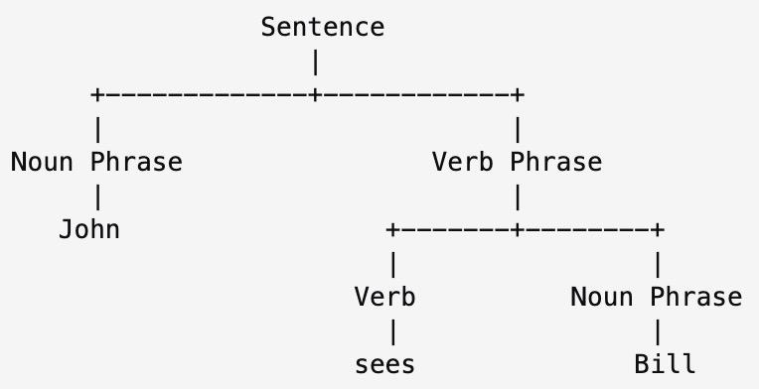
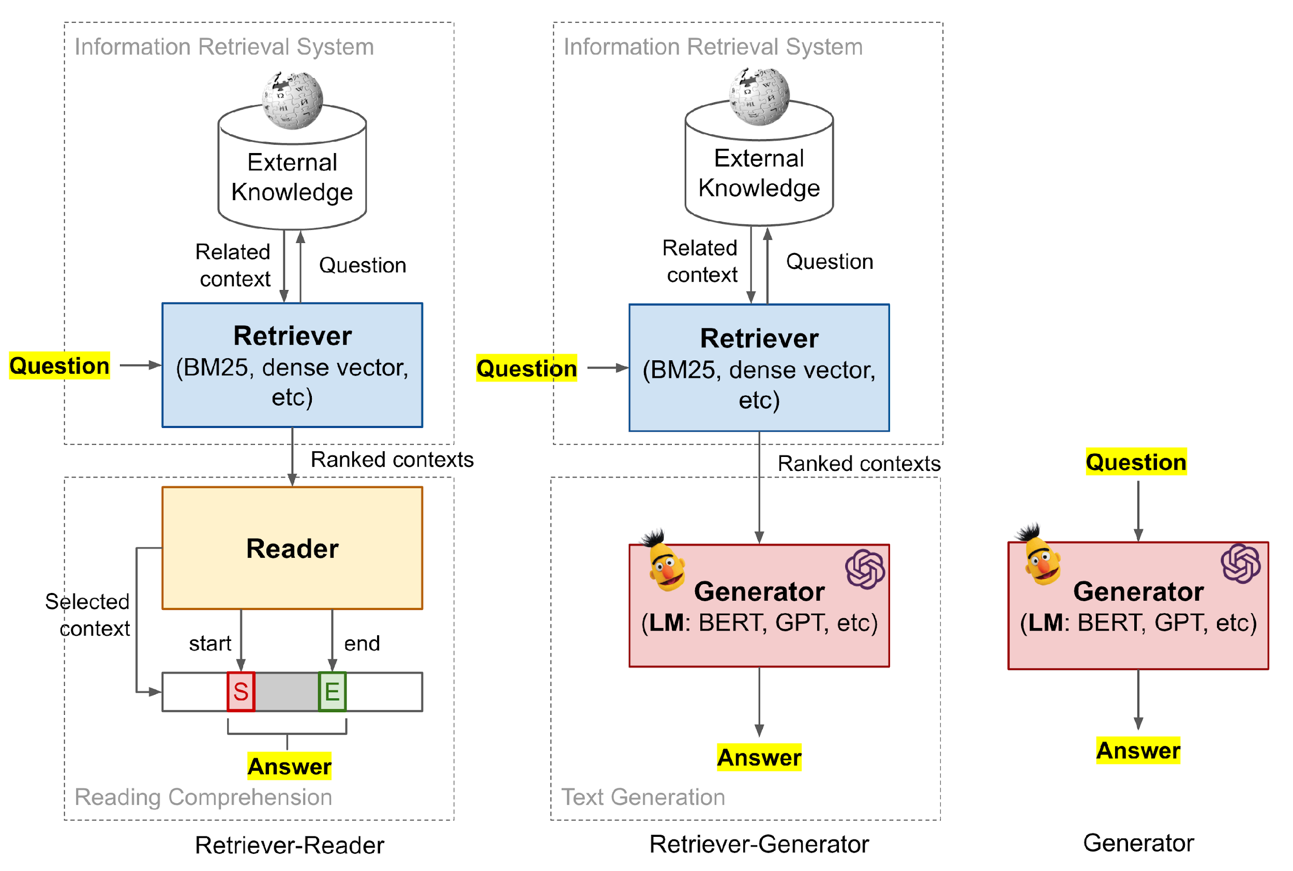
Where to transform from
Constituency Parsing
Question Answering
Machine Translation
Problem
They all need expensive annotation
Can we train an unsupervised model?

Slide 6
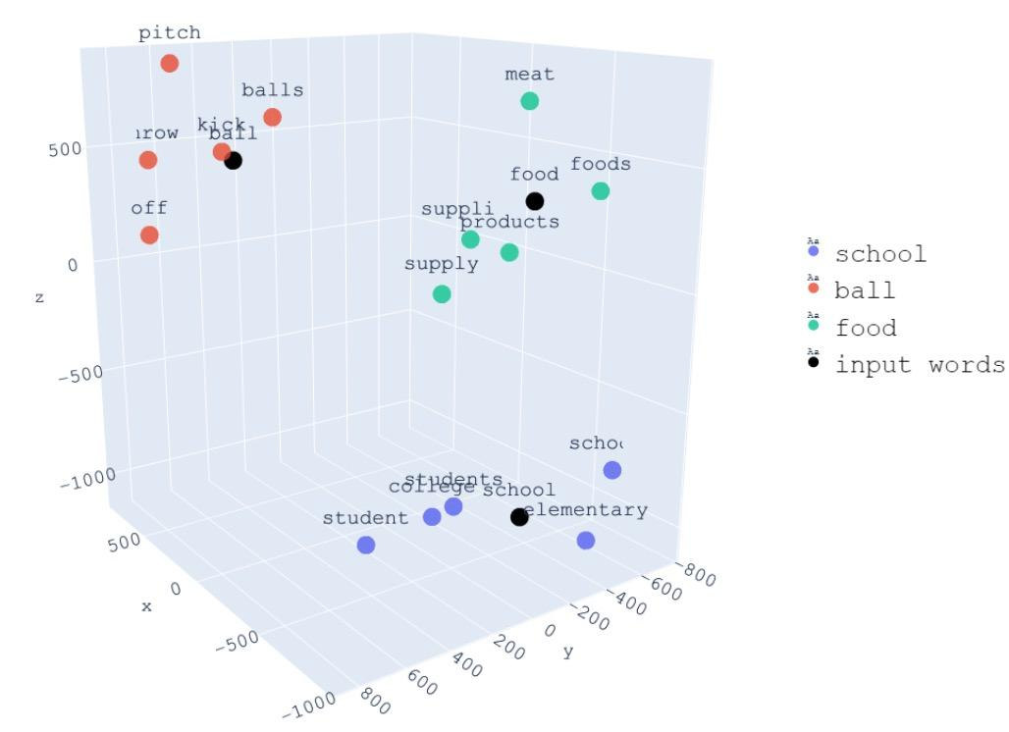
Next word prediction
Next word prediction
Word Embedding
W1
W2
W3
end
softmax
softmax
softmax
softmax
Next word prediction is inherently an unsupervised task
Model
Model
Model
…
Model
Represent semantic distance through spatial distance
embedding
embedding
embedding
embedding
<bos>
W1
W2
other

Slide 7
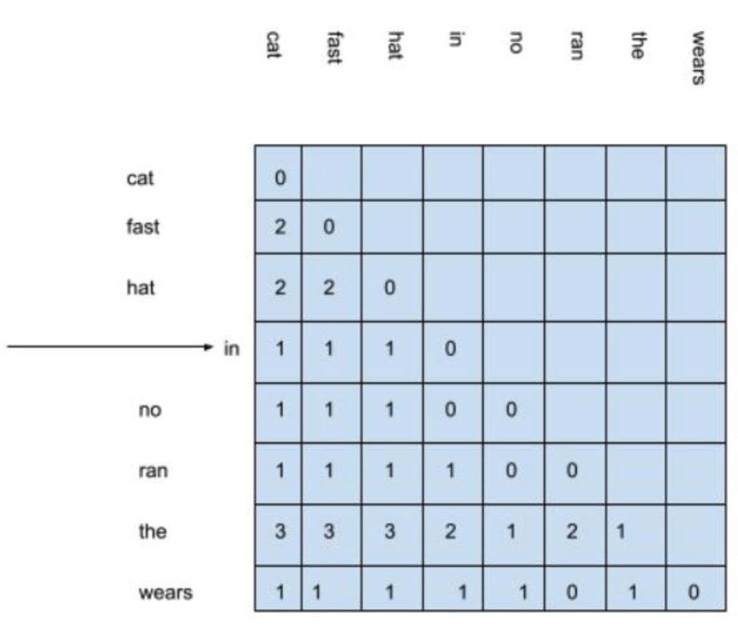
Next word prediction
Word Embedding – Word2Vec
Input
Skip-gram
Projection
Output
CBOW
Word Embedding – Glove
Input
Co-occurrence matrix
Output: embedding
The fast cat wears no hat
The cat in the hat ran fast

Slide 8
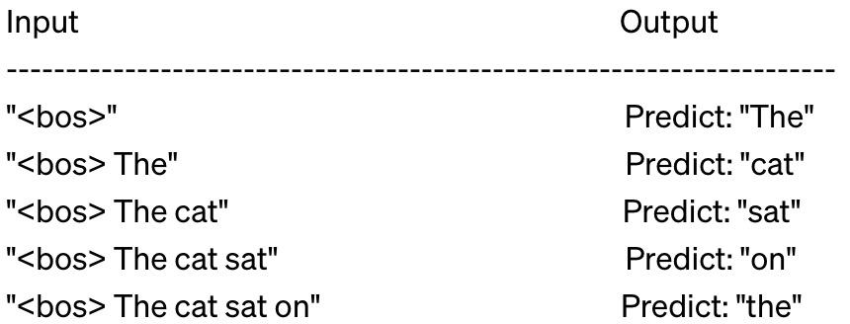
Next word prediction
Usage-like a lookup table
Problem-Polysemy
embedding dimension
I saw a beautiful python at the zoo.
Can you help me debug this Python script?
I use the pandas library for data manipulation in Python.
The pandas in the zoo are a favorite attraction among children.
apple
bee
cat
…
number of words
Solution-contextualized word embedding

Slide 9
ELMo
Motivation
Why not incorporating right content into input?
Attention
Data Leakage
Sequence structure
Bidirectional Language Model
hidden states
LSTM
softmax
W1
W2
W3
W4
W5
W6
W7
concatenate
LSTM
hidden states

Slide 10
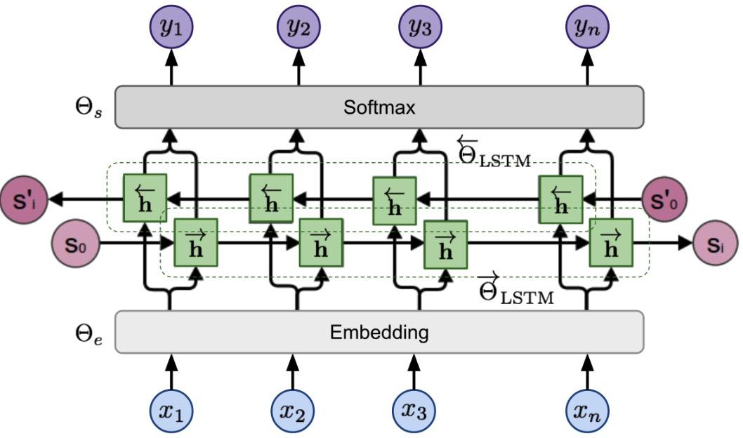
ELMo
Architecture
embedding layer
softmax layer
Input
Loss
Forward
Backward

Slide 11
ELMo
Representations
semantic features. Top layer
syntactic features. First layer
On downstream tasks
Representations
linear coefficient, learnable parameters
Hidden states of embedding layer
scaling factor, learnable parameters

Slide 12
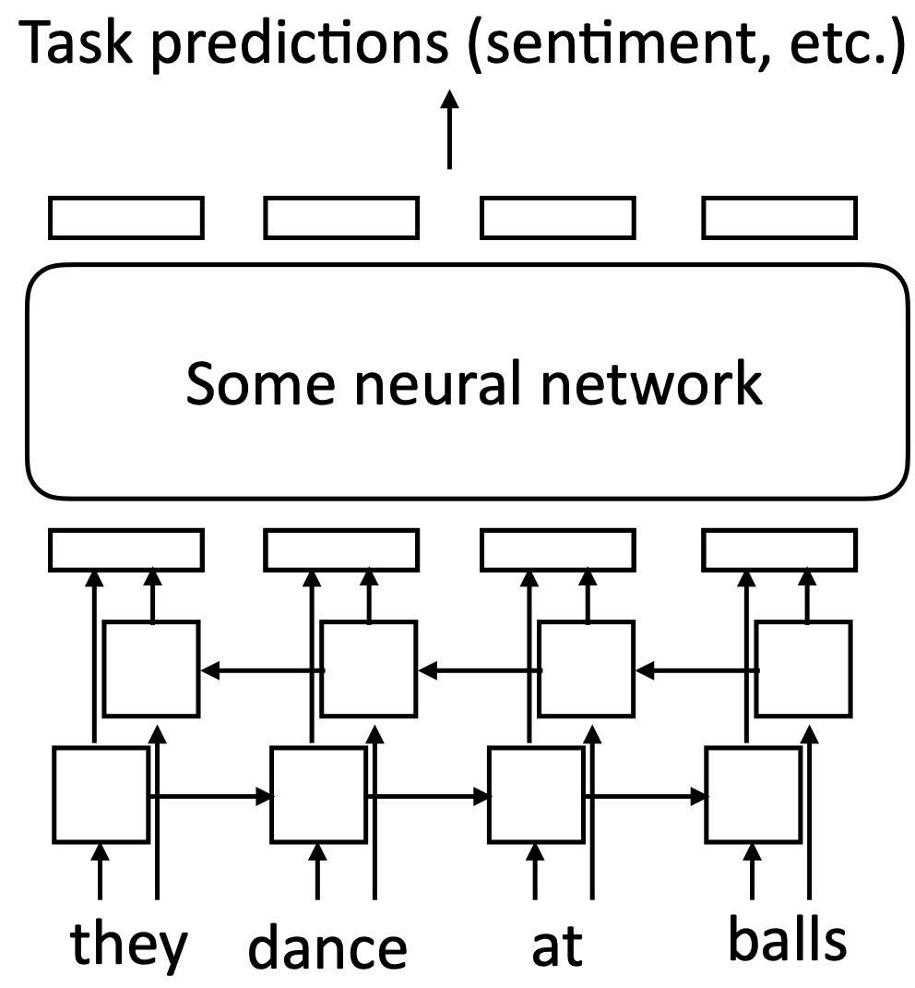
ELMo
How to apply
Take embeddings from ELMo
ELMO
Frozen ELMo’s weights, updates new neural network
Finetune both ELMo and new neural network

Slide 13
ELMo
Performance-Frozen ELMo
Conclusion: ELMo improves a lot on 6 NLP benchmarks

Slide 14
ELMo
Performance-how about polysemy issue
 | Source | Nearest Neighbors
GloVe | play | playing, game, games, played, players, plays, player, Play, football, multiplayer
biLM | Chico Ruiz made a spectacular play on Alusik’s grounder… | Kieffer, the only junior in the group, was commended for his ability to hit in the clutch, as well as his all-round excellent play.
 | Olivia De Havilland signed to do a Broadway play for Garson… | …they were actors who had been handed fat roles in a successful play, and had talent enough to fill the roles competently, with nice understatement.

Slide 15
ELMo
Bottleneck/Drawback
ELMO utilizes LSTM instead of Transformer
weaker feature extraction capability
weaker integrated feature fusion than BERT

Slide 16
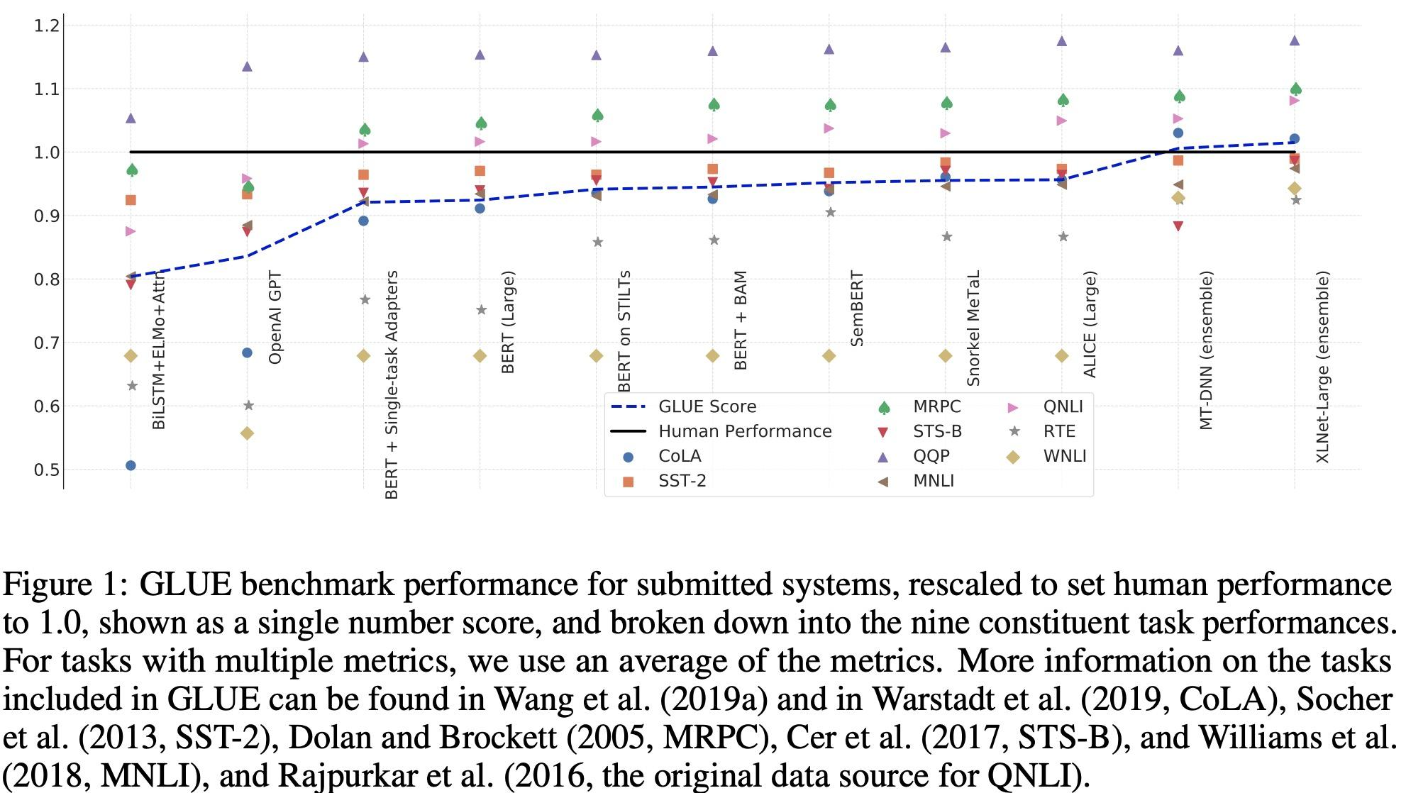
Why still pursuing pre-training models
SuperGLUE: A Stickier Benchmark for General-Purpose Language Understanding Systems
Conclusion: ELMo model is far from reaching the level of human understanding of language tasks

Slide 17
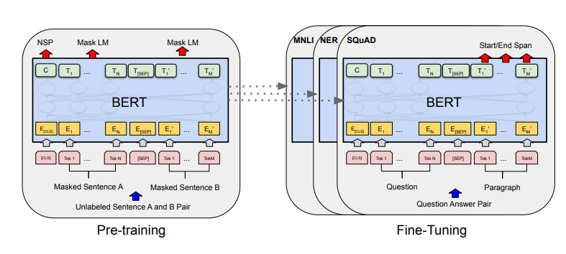
BERT
BERT, short for Bidirectional Encoder Representations from Transformers

Slide 18
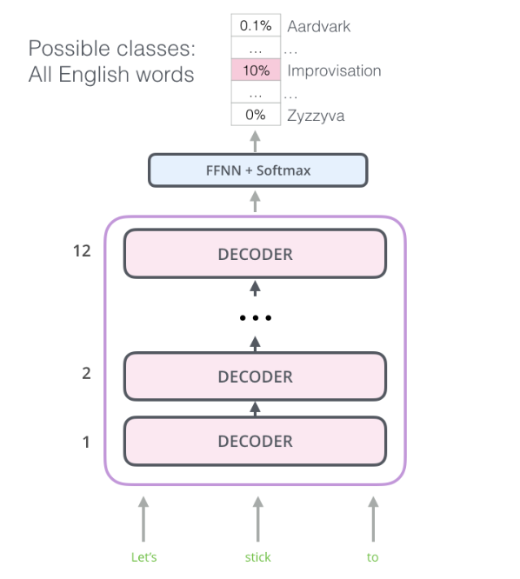
Transformer Decoder as LM
OpenAI GPT, short for Generative Pre-training Transformer
Decoder-only architecture
Encoder part of the original Transformer is discarded
Each token is predicted conditioned on its previous tokens

Slide 19
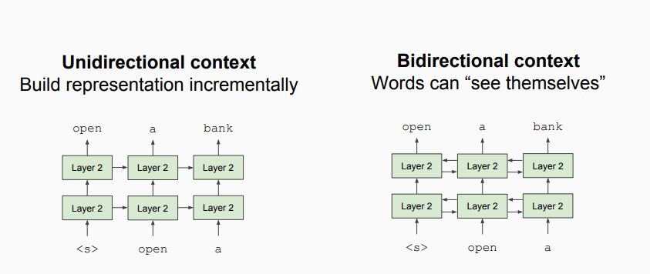
Unidirectional vs. Bidirectional Models
Problem: Language models are unidirectional, but language understanding is bidirectional.
“I went to the bank to deposit money.”
The meaning of “bank” depends on “to deposit money”

Slide 20
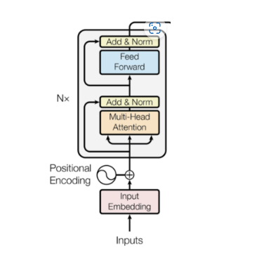
Model Architecture
ELMo uses a bidirectional LSTM, but each direction is trained independently
How to learn a “deeply bidirectional” language model?
Multi-layer bidirectional Transformer encoder

Slide 21
Input Representation
WordPiece token embeddings: subword tokenization
30,000 token vocabulary
[CLS], [SEP]: special tokens
Segment embeddings: is this input from sentence A or sentence B?
Position embeddings: learned rather than hard-coded

Slide 22
BERT Base vs. BERT Large
BERT Base:
12 Transformer blocks
768 hidden units
12 attention heads
Total parameters: 110M
BERT Large
24 Transformer blocks
1024 hidden units
24 attention heads
Total parameters: 340M

Slide 23
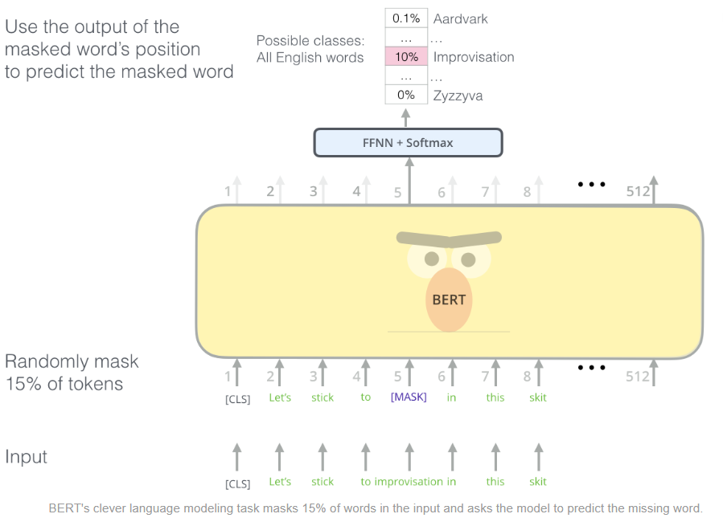
Pretraining: Masked Language Modeling
How to prevent cheating?
Masked Language Modeling
Masked out 15% of the input text, and predicted the masked words
Mismatch between pretraining and fine-tuning
80% of the time, replace with [MASK]
10% of the time, replace with random word
10% of the time, keep same

Slide 24
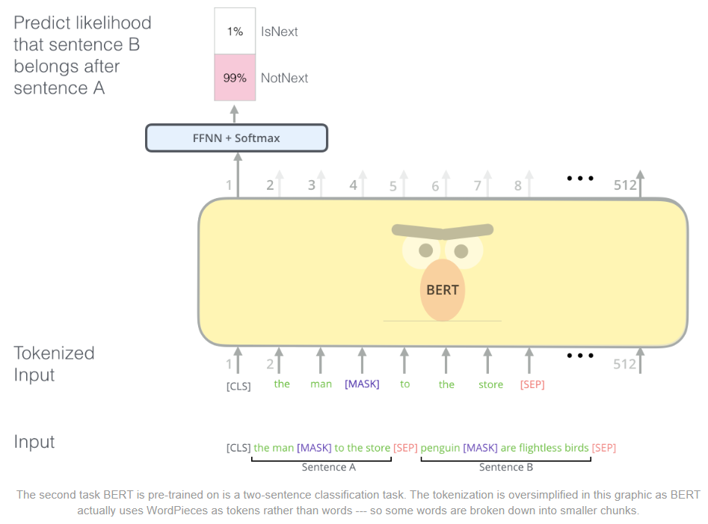
Pretraining: Next Sentence Prediction
Given two sentences A and B, did B follow A in the training corpus, or not?
Help the model to learn relationships between sentences
Beneficial to downstream tasks including QA and NLI

Slide 25
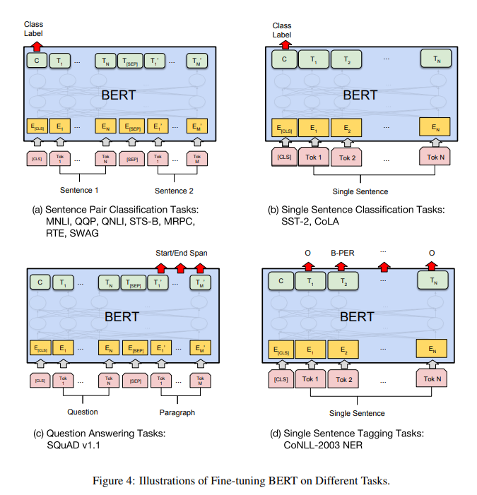
Fine-tuning
Plug in the task-specific inputs and outputs and fine-tune all parameters end to end
Token-level tasks (e.g., sequence tagging, question answering) use token representations in the output layer
Classification tasks (e.g., entailment, sentiment analysis) use the [CLS] representation in the output layer

Slide 26
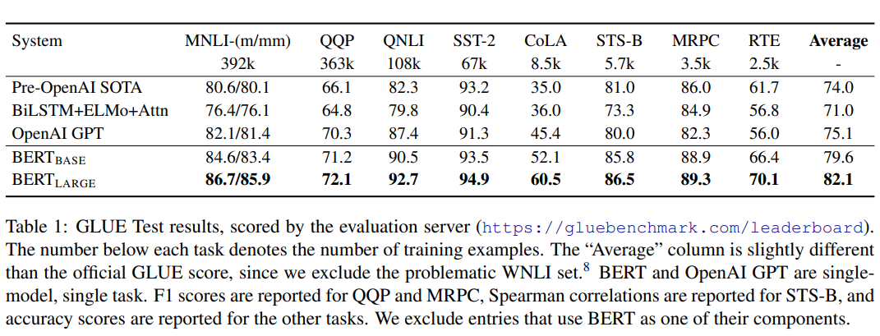
Results

Slide 27
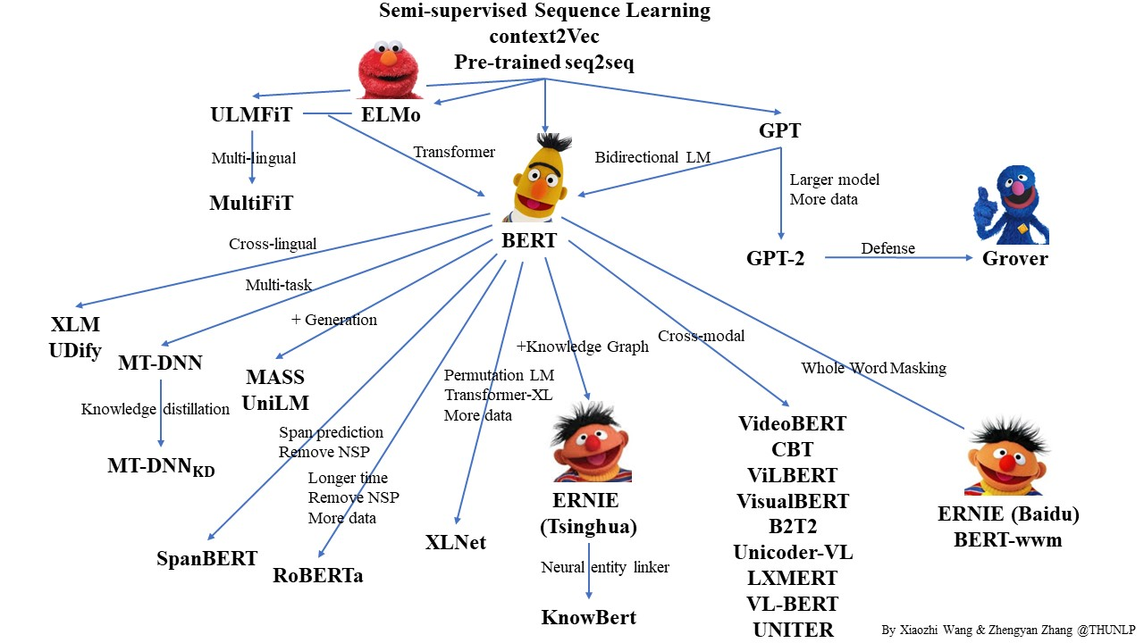
BERT Variants
The original BERT, with its size and data requirements, has certain limitations
To address these limitations, several variants of BERT have been developed
RoBERTa
ALBERT
ERNIE
ELECTRA
……

Slide 28
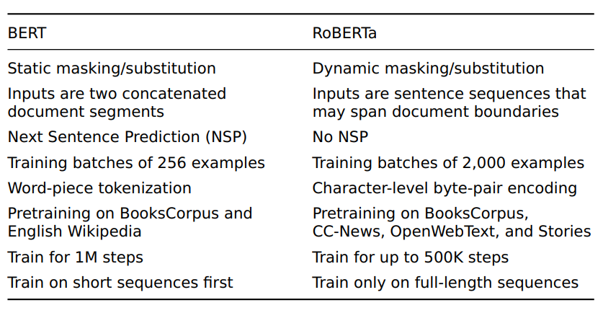
RoBERTa
RoBERTA, short for Robustly optimized BERT approach
One of the most popular variants of BERT
Main contributions:
Introduce alternative design choices for BERT
Add a new pre-training dataset CommonCrawl News

Slide 29
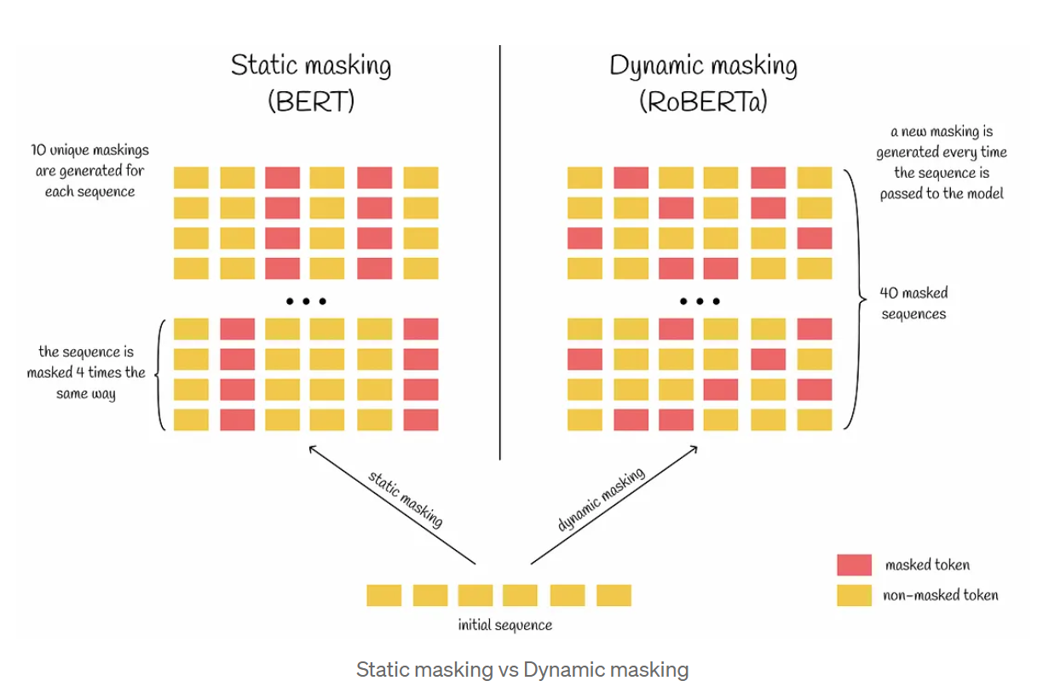
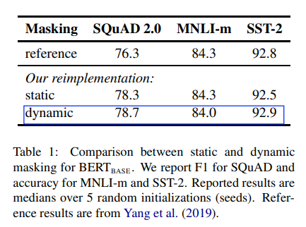
Static vs. Dynamic Masking

Slide 30
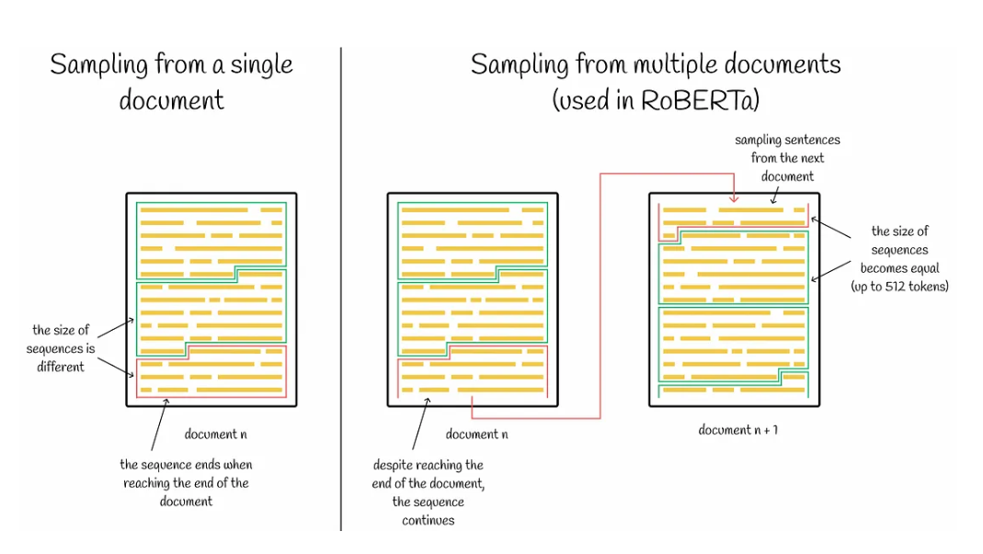
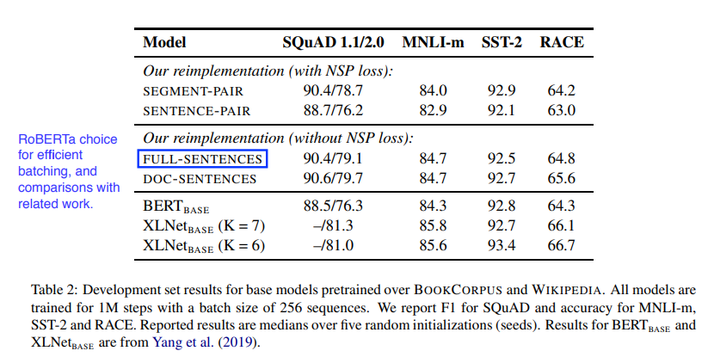
Model Input Format and NSP
Remove the NSP task
Use longer sequences
Segment-Pair+NSP: Original BERT
Sentence-Pair+NSP: Paired natural sentences from one or multiple documents.
FULL-SENTENCES: Contiguous sentences from one or more documents, up to 512 tokens.
RoBERTa choice
DOC-SENTENCES: Similar to FULL-SENTENCES, but doesn't cross document boundaries.

Slide 31
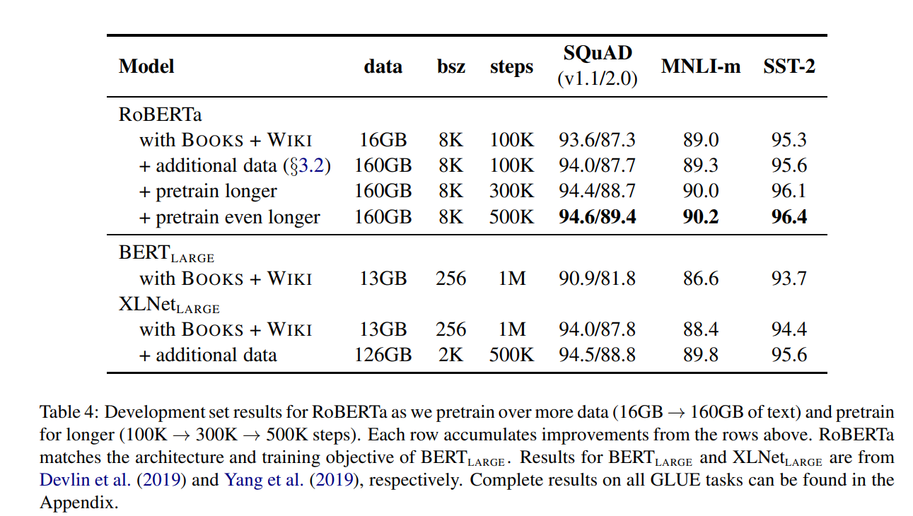
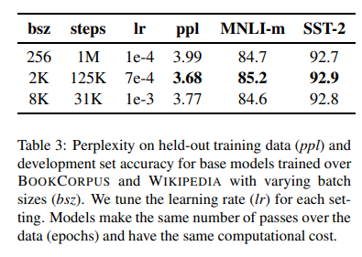
Larger Batches, More data, Longer training

Slide 32
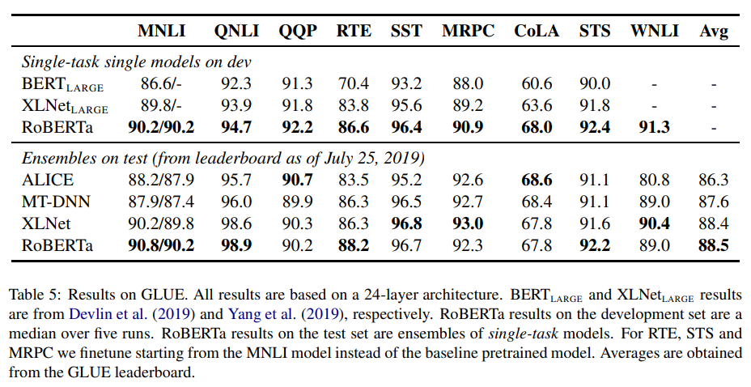
Results

Slide 33
ALBERT
ALBERT, short for A Lite BERT, is a light-weighted version of BERT model
Motivation
Scaling up BERT results in better performance; however, there are several challenges:
Memory limitation
Longer training time
“An ALBERT configuration similar to BERT-large has 18x fewer parameters and can be trained about 1.7x faster”

Slide 34
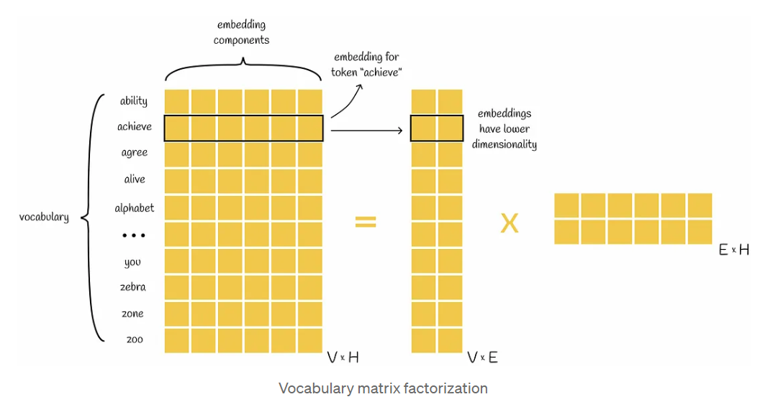
Factorized Embedding Parametrization
In BERT, the token embedding size E matches the hidden layer size H
A suboptimal choice
The power of BERT comes from hidden-layer embeddings, so naturally H >> E
Increase H would increase the size of the embedding matrix: V x H, which could be very large
V = 30k, H = 768 => 23M
Decompose the embedding
O(V x E + E x H) vs. O(V x H)

Slide 35
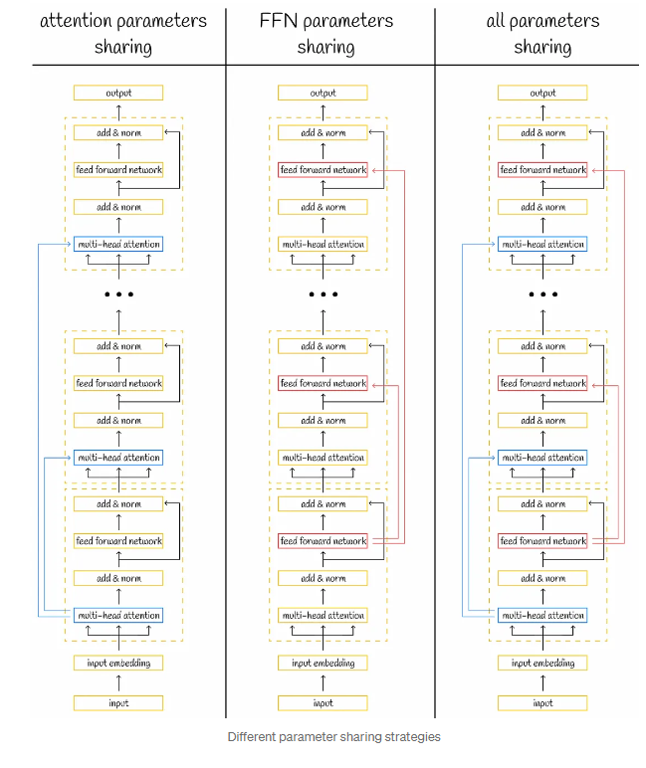
Cross-layer Parameter Sharing
Parameter sharing can greatly reduce parameters without compromising the performance significantly
Several ways of parameter sharing across layers
only share FFN parameters
only share attention parameters
share all the parameters (default)

Slide 36
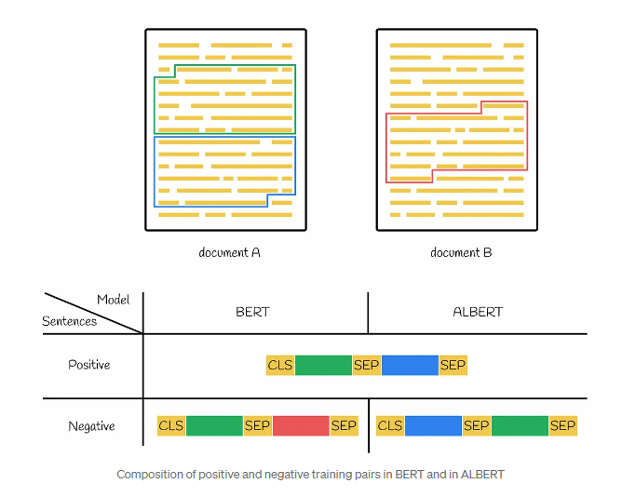
Sentence Order Prediction
Multiple studies have shown NSP is ineffective and decided to remove it
Replace NSP with Sentence Order prediction (SOP) problem
Predict whether two sentences are in the correct order or not
Model inter-sentence coherence

Slide 37
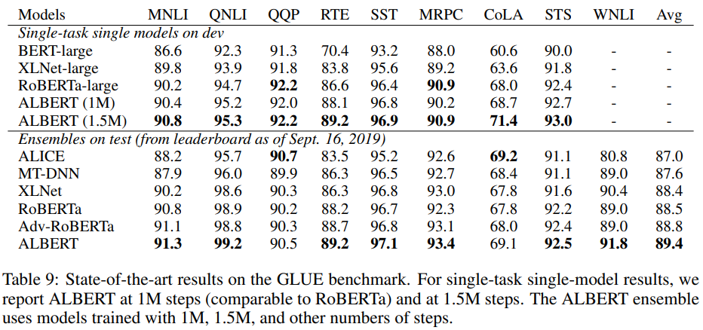
Results

Slide 38
ERNIE-baidu
Problems
- Is random masking good enough?
- What about new word `APPLE VISION PRO`
Whole word masking

Slide 39
ERNIE-baidu
Which level
Basic level masking, randomly mask
Phrase level masking, mask a portion of phrases in a sentence
Entity level masking, mask named entities
Questions
How did they recognize the entity and phrases
Are these two levels independent?
Will they merge the phrase into one embedding?
Architecture
The same as GPT, BERT, XLM.

Slide 40
ERNIE-baidu
Dialogue Task
Reference Relationship
Semantic Consistency

Slide 41
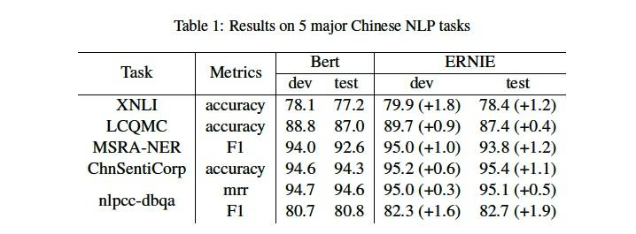
ERNIE-baidu
Performance
XNLI : Cross-lingual Natural Language Inference
LQAMC: Large-scale Chinese Question Matching Corpus
MSRA-NER: Named Entity Recognition
ChnSentiCrop: Sentiment Analysis
nlpcc-dbqa: Question-Answering

Slide 42
ELECTRA
Motivation
Those pretrained models requires too much computation resources
How to avoid that?
Replaced Token Detection
- Change seq prediction to original/replaced signal prediction
Reasonable?
- Grammatical, semantic, and fluency aspects
- handle errors

Slide 43
ELECTRA
Problem - generate data
No annotation required
Reasonable sentence
Replace word should be distinguishable
Problems
Did it improve comparing to a single small bert?
Will they finetune Generator?
How to use on downstream tasks?

Slide 44
ELECTRA
Architecture
Mask
Design
Loss

Slide 45
ELECTRA
Difference with GAN
Conclusion: Similar architecture, but quite different

Slide 46
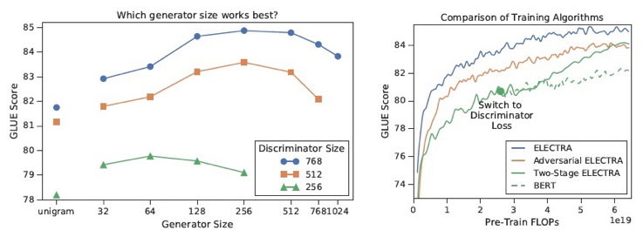
ELECTRA
Tricks for improving performance
Weight sharing :
G has better embedding representation
Smaller Generators:
Smallest BERT possess most fundamental capabilities
Training Algorithms:
Adversarial: RTD loss + Policy Gradient
Two-stage training: Fine-tuning G, then freeze G initialize D and finetune D

Slide 47
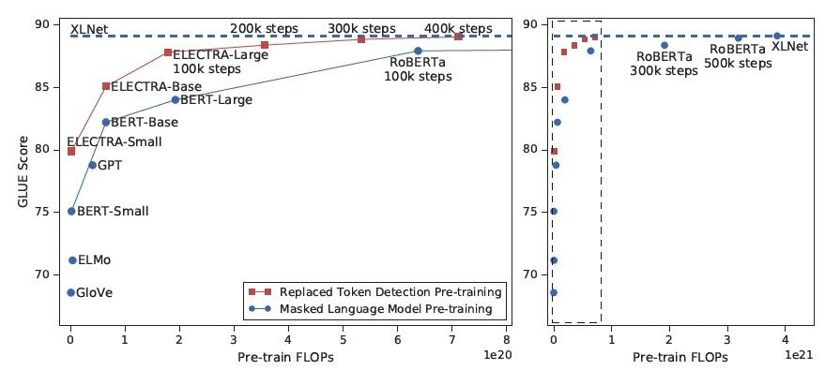
ELECTRA
Performance
Conclusion: ELECTRA outperforms BERT under same FLOPs

Slide 48
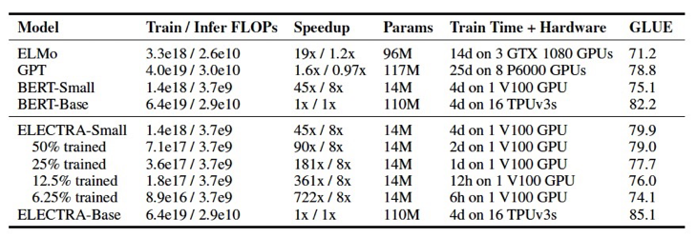
ELECTRA
Performance
Smaller ELECTRA on single GPU
Conclusion: under same level of # parameters, ELECTRA outperform BERT

Slide 49
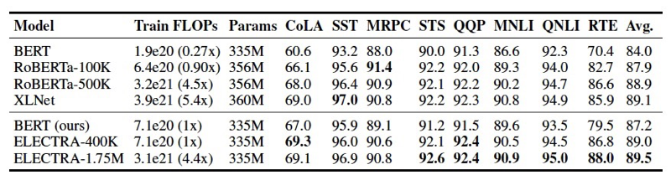
ELECTRA
Performance
Larger ELECTRA
Conclusion: under same level of FLOPs, ELECTRA outperform RoBERTa

Slide 50
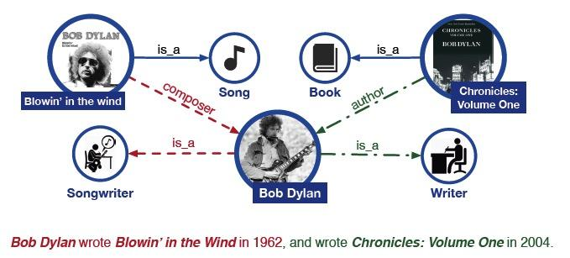
ERNIE-Tsinghua
Motivation
Can we incorporate structured entity information?
Problem
How to incorporate structured entity information? Input, Output?

Slide 51
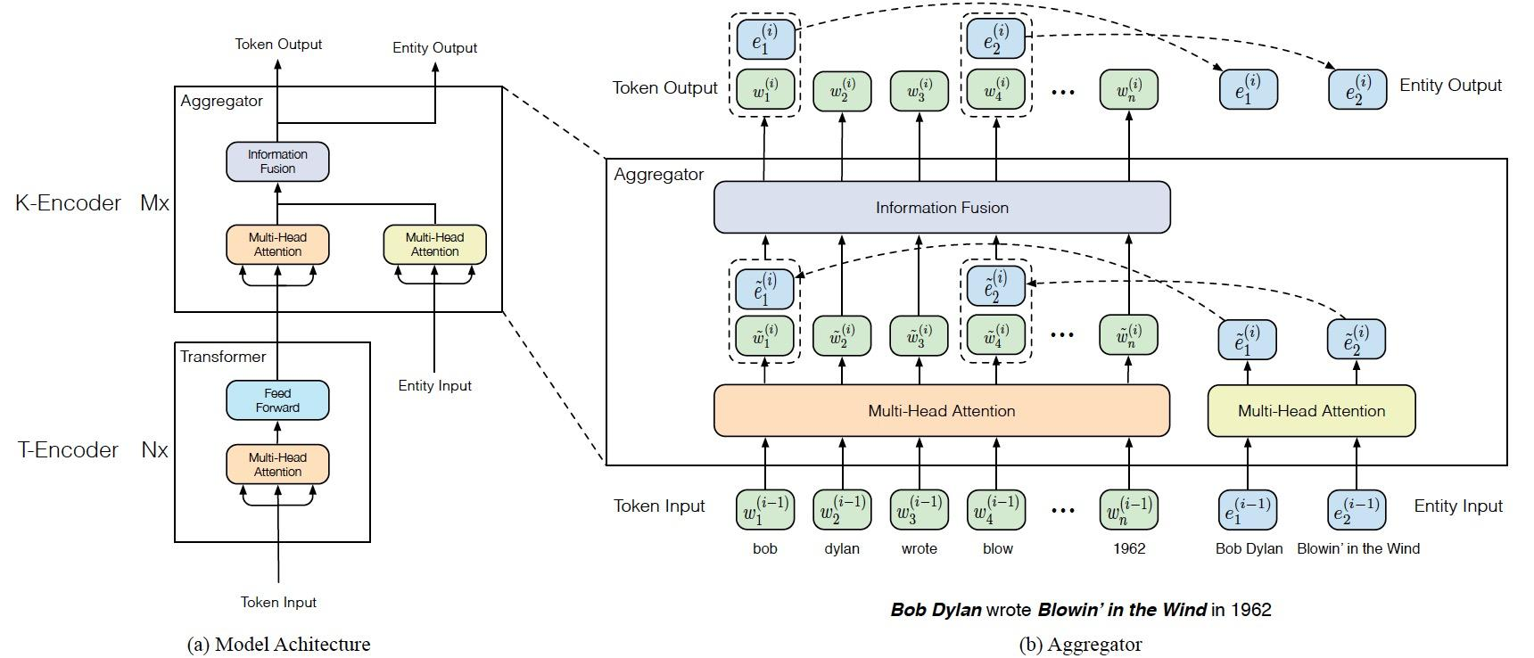
ERNIE-Tsinghua
Architecture

Slide 52
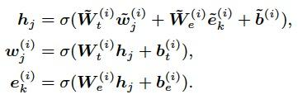
ERNIE-Tsinghua
Architecture
With entity
Without entity
Loss

Slide 53
ERNIE-Tsinghua
Downstream tasks
CLS: overall sentence embedding
ENT: Named Entity Recognition tasks
HD: Head, representing the main entity or subject in a relationship
TL: Tail, indicating the secondary entity or object in a relationship.

Slide 54
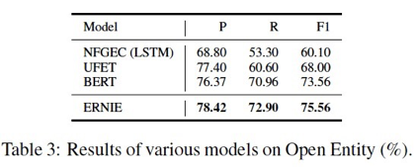
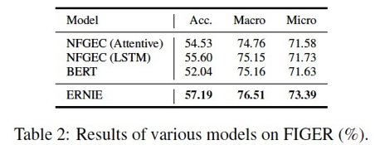
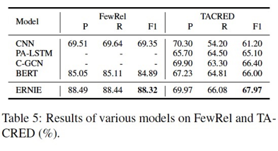
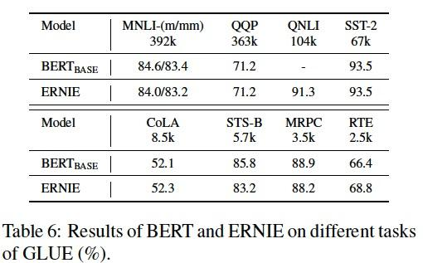
ERNIE-Tsinghua
Performance

Slide 55
Unified language model
Problem
On generation task, BERT is not applicable
Training
BERT
W1
W2
W3
W4
W5
W6
Inference
BERT
W1
W2
W3
Cause
The input is different

Slide 56
Unified language model
Problem
How to absorb seq2seq task into BERT
Elements
Tasks
Input
Output
Existing LM
Bert
GPT
BART
MASS
Insight
Core of LM is MASK

Slide 57
Unified language model
Architecture-UniLM

Slide 58
Unified language model
Problem - about training details
How to organize these tasks to train a unified LM?
How to add mask?
How to apply to downstream tasks?
Solution
Same MASK frequency as BERT
In one batch, organize tasks as
1/3 data for training Bi-LM task, update parameters
1/3 for seq2seq task, update parameters
1/6 for left-to-right task, update parameters
1/6 for right-to-left task, update parameters
NLU: same as BERT, NLG: mask [SEG] in second sentence to learn when to stop
Other details
Initialize from BERT- large
80% randomly masked one token, 20% randomly masked bigram/trigram

Slide 59
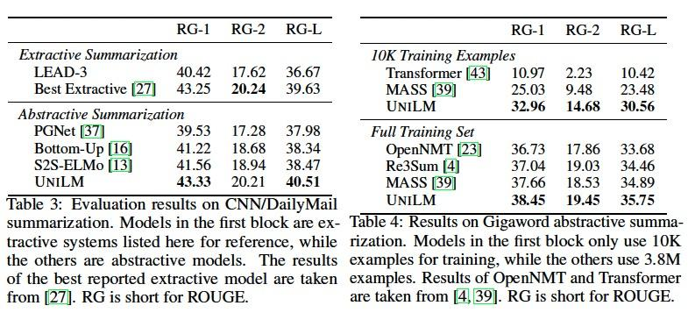
Unified language model
Performance
Care about improvement on each kind of task

Slide 60
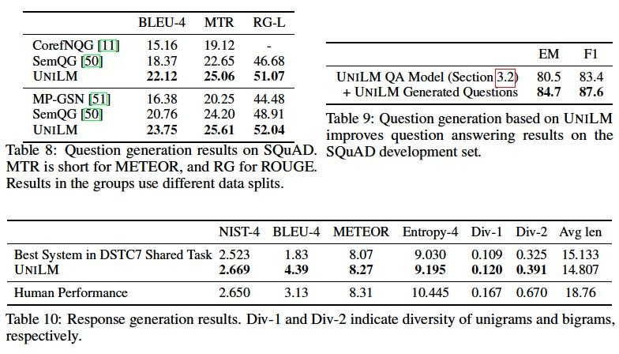
Unified language model
Performance

Slide 61
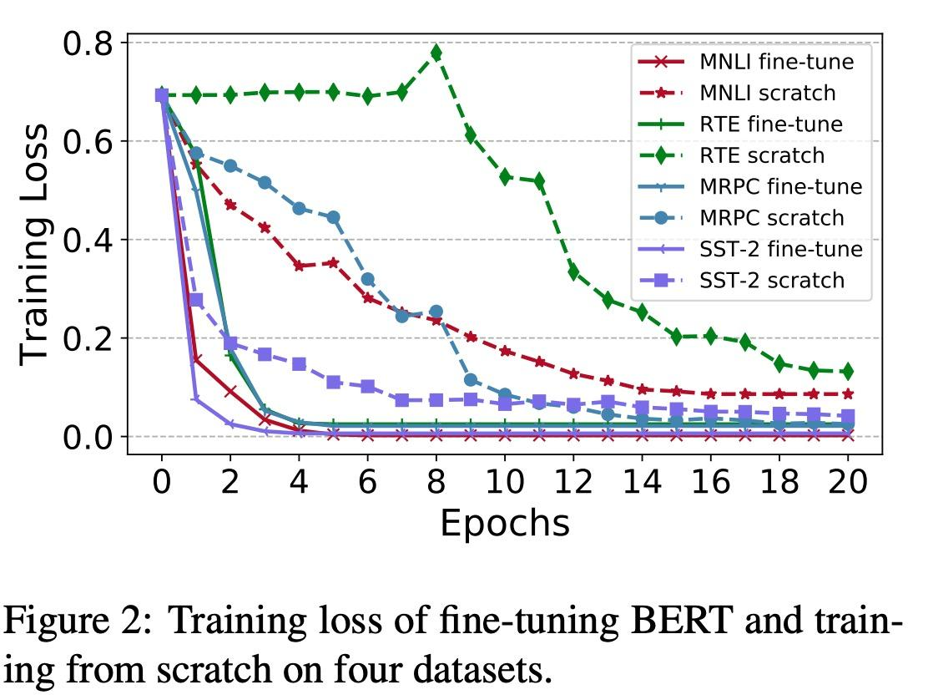
How Pre-training helps
Visualizing and Understanding
the Effectiveness of BERT
Conclusion: Faster gradient descending at first

Slide 62
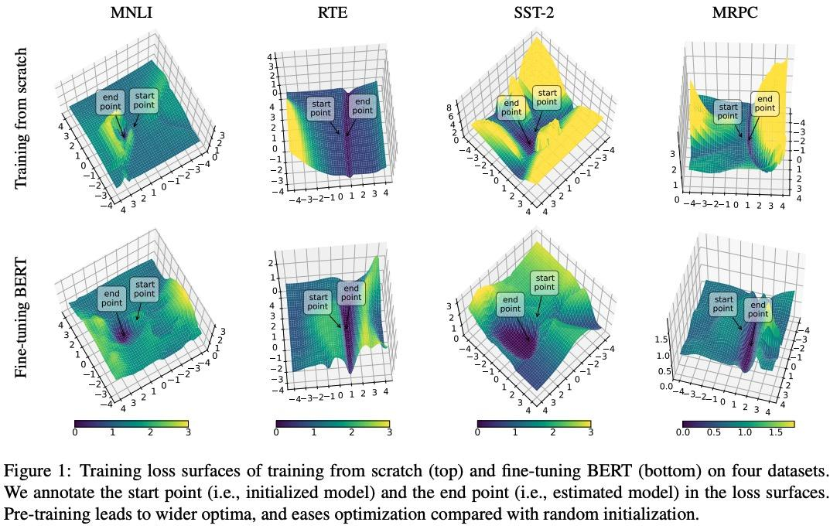
How Pre-training helps
Generalization
Visualizing and Understanding
the Effectiveness of BERT
Conclusion: Better generalization capability

Slide 63
Conclusion
A Comprehensive Survey on Pretrained Foundation Models: A History from BERT to ChatGPT
Conclusion: The development of pre-trained language models is inseparable from the support of other modalities or related fields.

Slide 64
Conclusion
Year | Conference | Model | Architecture | Embedding | Training Method | Key Innovations
2018 | NAACL-HLT | ELMo | LSTM | Contextual LM | Language model pre-training | Context-dependent word embeddings using bidirectional LSTM
2018 | NAACL-HLT | BERT | Transformer Encoder | Contextual MLM | Masked Language Model (MLM) | Bidirectional context learning using MLM and NSP
2018 | OpenAI | GPT | Transformer Decoder | Autoregressive LM | Language model pre-training | Pretrain-Finetune framework with unidirectional Transformer
2019 | ICLR | ALBERT | Transformer Encoder | Contextual MLM | Masked Language Model (MLM) | Embedding factorization, cross-layer parameter sharing to reduce model size
2019 | ICLR | ELECTRA | Transformer Encoder | Contextual MLM | Replacement token detection | Efficiency and accuracy improvement by using a generator and discriminator
2019 | ACL | ERNIE(THU) | Transformer Encoder | Contextual MLM | Masked Language Model (MLM) | Integrating external knowledge into MLM
2019 | NeurIPS | UniLM | LSTM + Transformer | Contextual LM + MLM | Language model pre-training | Unifies language understanding and generation capabilities in a single model
2019 | arXiv | RoBERTa | Transformer Encoder | Contextual MLM | Masked Language Model (MLM) | Optimizes BERT's pre-training process for better performance
A Comprehensive Survey on Pretrained Foundation Models: A History from BERT to ChatGPT
Rapid Evolution: Pretrained models have evolved quickly from simple embeddings to complex systems like BERT and GPT, showcasing major advancements in language understanding

Slide 65
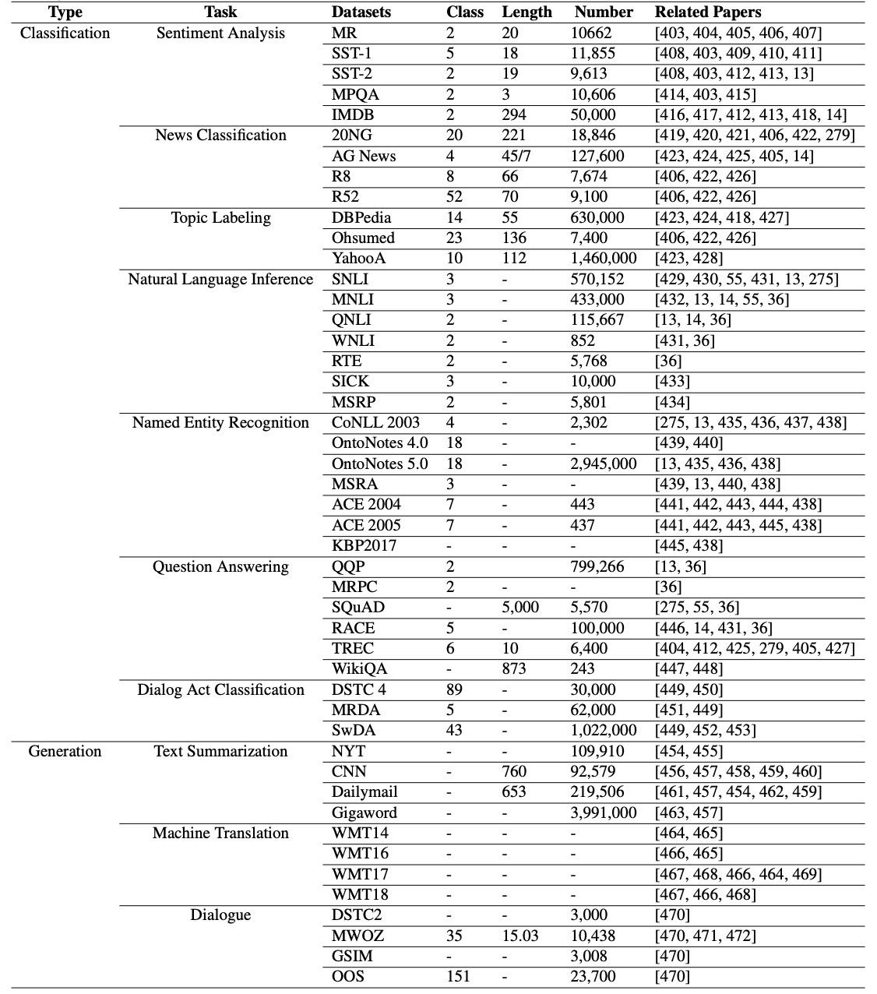
Conclusion
A Comprehensive Survey on Pretrained Foundation Models: A History from BERT to ChatGPT
Conclusion: Numerous benchmark datasets with unified standards support the effective validation and comparison of these models.

Slide 66
Conclusion
Takeaway
Contextual Understanding: Models like ELMo introduced deep contextualized representations, significantly enhancing word meaning comprehension in varied contexts.
Bidirectional Training: BERT's bidirectional MLM approach revolutionized model training, enabling a deeper grasp of language syntax and semantics.
Scalability and Efficiency: Advances by GPT-2, GPT-3, and ELECTRA demonstrate that larger, efficiently trained models can achieve remarkable language understanding and generation capabilities.
Specialization and Innovation: Innovations in models like ALBERT, RoBERTa, and UniLM highlight the trend towards specialized optimizations for efficiency and task unification.
Knowledge Integration: Models like ERNIE emphasize integrating external knowledge, improving the understanding of complex concepts beyond textual data.
Towards General AI: The evolution towards models like GPT-3 suggests a move towards General AI in NLP, capable of understanding and reasoning across a wide range of tasks with minimal tuning.

