Slide 1
Lecture 7: Parameter-efficient Transformer
Presenters: Ansh Sharma and Manveer Singh Tamber

Slide 2
Outline (First half)
Paper 1: Parameter-efficient Transfer Learning for NLP
What is transfer learning?
Feature-based vs Fine-tuning
Adapter tuning
Architecture
Experiments and results
Paper 2: LoRA: Low-Rank Adaptation of Large Language Models
Fine-tuning LLMs and Parameter-efficient approach
Adapter modules and prefix tuning
Intrinsic Dimension and Intrinsic Rank
LoRA
Experiments and results

Slide 3
Outline (First half)
Paper 3: It’s Not Just Size That Matters: Small Language Models Are Also Few-Shot Learners
Zero-Shot Learning vs Few-Shot Learning
PET (Pattern-Exploiting Training)
iPET (Iterative variant of PET)
PET with Multiple Masks
Experiments and results
Paper 4: Making Pre-trained Language Models Better Few-shot Learners
LM-BFF (better few-shot fine-tuning of language models)
Prompt-based Fine-tuning
Automatic Prompt Generation
Fine-tuning with Demonstrations
Experiments and results

Slide 4
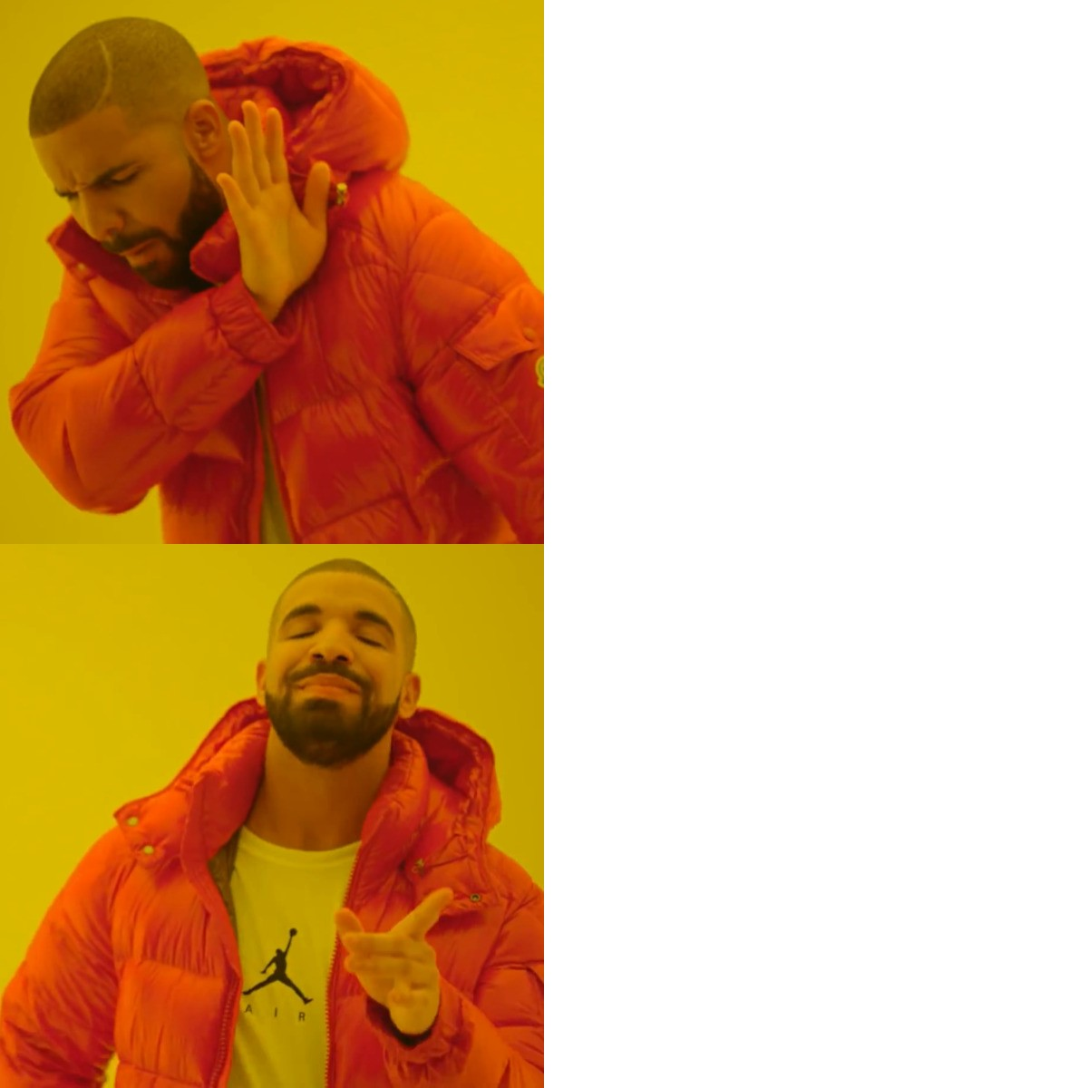
Paper 1: Parameter-efficient Transfer Learning for NLP
Prerequisites
What is transfer learning?
A machine learning method where a model developed for one task is reused as the starting point for a model on a different but related task.
Efficiency
Do not reinvent
the wheel!
Benefits
Performance
Use the wheel
to make a car
Versatility

Slide 5
Feature-based vs Fine-tuning
For example- Learning French from English
Pre-Trained Model
Eg.- multilingual BERT
Pre-Trained Model
Eg.- BERT
Feature Extraction
Model extracts features capturing the linguistic essence of input sentences
Fine-Tuning on Parallel Corpus
Fine-tune the model on a dataset with English sentences and their French translations
Usage of Features
These features are then used in an application to assist in specializing in French
Application
This model can then be used in an application to assist English speakers in learning French
Feature-based
Fine-tuning

Slide 6
Concepts
Feature-Based
$ϕ$: Original function
$w$: Original parameters
$x$: Input
$χ:New f$unction
$v$: New parameters
$$φ_{w}(x)$$
$$χ_{v}$$
Overall Function: $χ_{v}(φ_{w}\left(x\right))$
Fine-Tuning
$$φ_{w}(x)$$
$$φ_{(w tuned for v)}(x)$$
Adapter Tuning
Frozen during training
$ψ$: $New f$unction
$$φ_{w}(x)$$
Note-
1. $ψ_{w, v_{0}}(x)≈$ $φ_{w}(x)$
2. $|v|≪ |w|$
3. Only 3% new parameters in
comparison to Fine-Tuning
$φ_{w}(x)$ becomes $ψ_{w, v}(x)$

Slide 7
Layer Norm
+
Adapter Layer
Transformer
Layer
+
Adapter
Feed-forward
up-project
2x Feed-forward layer
Nonlinearity
Layer Norm
+
Adapter
Feed-forward
down-project
Feed-forward layer
Multi-headed attention
Transformer layer architecture with adapter
Adapter module architecture

Slide 8
Layer Norm
Multi-Headed Attention: Primary
sub-layer in the transformer to process input data.
Feed-Forward Layer: Data is processed here using the attention mechanism.
'+' (Skip Connection): The output of the adapter/feed-forward layer is added to the original input of the layer (or sub-layer). This process helps the network to preserve information from earlier stages.
Layer Normalization: The combined output is normalized (for stabilizing the learning process).
Transformer
Layer
+
Adapter
2x Feed-forward layer
Layer Norm
+
+
Adapter
Feed-forward layer
Multi-headed attention

Slide 9
“A bottleneck architecture”
Adapter Layer
+
The total number of parameters added per layer, including biases, is 2md + d + m. Here, m << d.
Only 0.5 − 8% of the parameters of the original model are used.
Using skip connection, if the parameters of the projection layers are initialized to near-zero, the module is initialized to an approximate identity function.
Feed-forward
up-project
Nonlinearity
Feed-forward
down-project

Slide 10
Experiments
The goal is to build a compact and extensible system that performs well on multiple similar downstream tasks (new data is unknown at start), but without training an entire new model for every new task.

Slide 11
26 diverse text classification tasks using BERT!
The GLUE (General Language Understanding Evaluation) benchmark is a resource set for training, evaluating, and analyzing natural language understanding systems. It has diagnostic dataset, nine language understanding tasks, a leaderboard and dashboard.
GLUE is model-agnostic, suitable for any system handling sentence or sentence pairs. It's designed to encourage models that use transfer learning or parameter sharing, aiming to advance robust natural language understanding systems.

Slide 12
SQuAD (Stanford Question Answering Dataset)
The Stanford Question Answering Dataset (SQuAD) is a set of question-answer pairs from Wikipedia articles. Answers are sequences of text from the articles, and the dataset is created through crowdsourcing, offering diversity.
SQuAD 1.1 has 107,785 pairs across 536 articles. The latest version, SQuAD2.0 (or SQuAD-Open), combines SQuAD1.1's questions with over 50,000 unanswerable ones, crafted adversarially to resemble answerable queries.

Slide 13
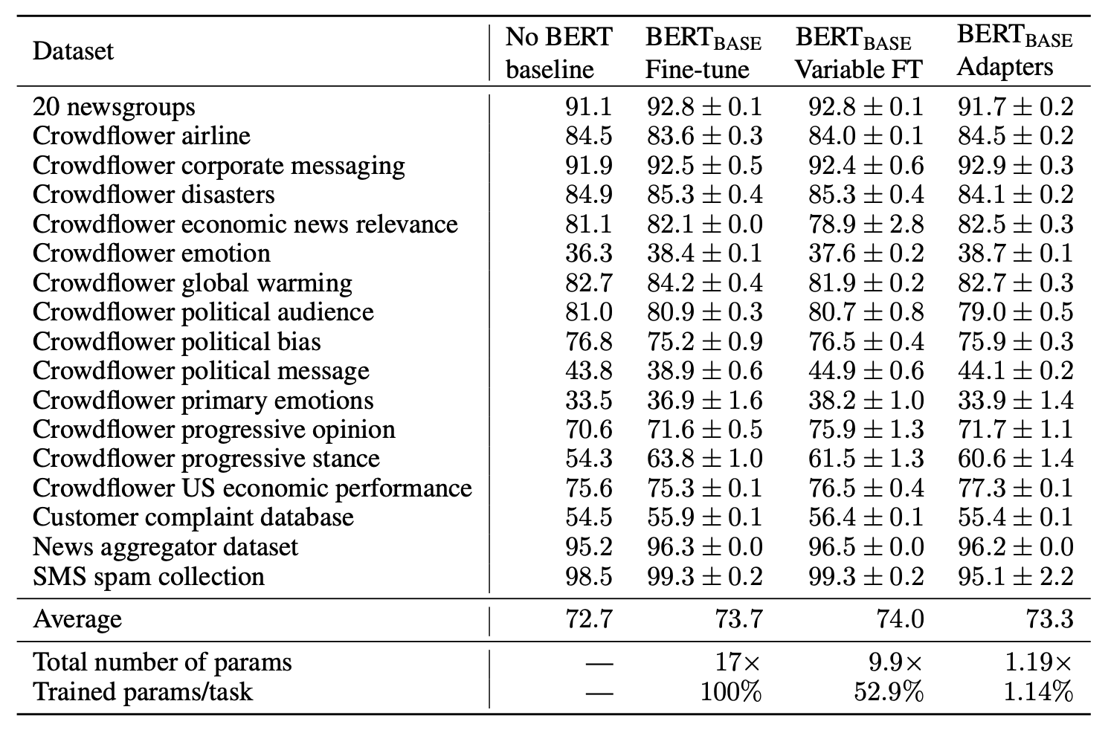
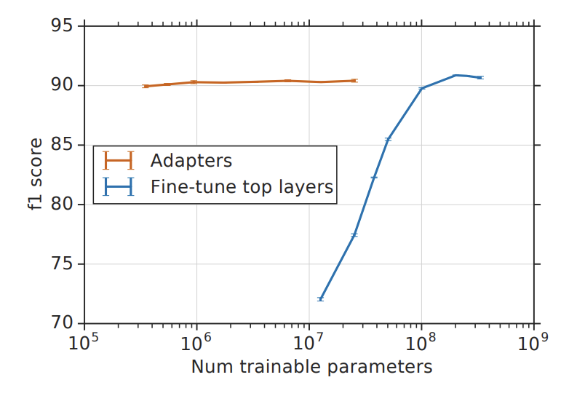
Results
GLUE benchmark results
(Fine-tuning)
Overall batch size
Adapter size
AutoML benchmark results
SQuAD test results (validation accuracy)
Similar accuracy! Less parameters!

Slide 14
Paper 2: LoRA: Low-Rank Adaptation of Large Language Models
$${}_{Φ}^{max} \sum_{(x,y)∈z}{ }\sum_{t=1}^{|y|}{log⁡(P_{Φ}\left(y_{t} | x,y_{<t}\right))}$$
Prerequisites
(to predict the next word)
Original weights: $Φ_{0}$
Fine-tuning LLMs
New weights: $Φ_{0}+ △Φ$ (Here, dimensions of $|△Φ|$ = ${|Φ}_{0}|$)
Parameter-efficient approach
New weights: $Φ_{0}+ △Φ (Θ)$ (Here, dimensions of $|Θ|$ << ${|Φ}_{0}|$, eg- $|Θ|$ can be as small as 0.01% of ${|Φ}_{0}|$)
$${}_{Θ}^{max} \sum_{(x,y)∈z}{ }\sum_{t=1}^{|y|}{log⁡(P_{Φ_{0}+Φ \left(Θ\right)}\left(y_{t} | x,y_{<t}\right))}$$

Slide 15
Can we apply adapter modules to LLMs like GPT-3?
Yes, but with high inference latency as adapter layers have to be processed sequentially.
Additional depth because of adapters requires more synchronous GPU operations, unless we store the adapter parameters redundantly many times.
Can we apply prefix tuning and add a prompt before the input?
Yes, but prefix tuning is difficult to optimize and its performance varies in an inconsistent, non-linear manner with changes in trainable parameters.
Allocating a portion of a model's sequence length for adaptation (such as prompt tuning) limits the length available for processing specific tasks. We can combine LoRA with prefix tuning.

Slide 16
Let’s understand 2 key concepts: Intrinsic Dimension and Intrinsic Rank
The intrinsic dimension of a neural network refers to the minimum number of parameters or features needed to get a performance similar to the full model. It's like finding the simplest version of the model that still does the job well.
The intrinsic rank is the complexity or the degree of freedom in a particular component of a neural network, like a weight matrix in a layer. It indicates the minimum number of dimensions needed to represent the important information in that component.

Slide 17
Concepts
h
$$B=0$$
Frozen
during
training
Pretrained Weights
$$W ∈ ℝ^{d×d}$$
r
$$A= Ν(0,σ^{2})$$
d
x
Reparameterization done in the paper

Slide 18
Pre-trained weight matrix: $W_{0}∈ ℝ^{d×d}$
Update to the original matrix: $W_{0}+ △W=W_{0}+BA$
(Here, $B∈ ℝ^{d×r}$, $A∈ ℝ^{r×k}$) Note- rank r << min(d, k)
Forward pass- Before using LoRA: ${h= W}_{0}x$
After using LoRA: ${h=W}_{0}x+△Wx=W_{0}x+BAx$
For initialization,
$$B=0, A=random gausian initialization (0,σ^{2})$$
While training,
$$△Wx is scaled by a factor of \frac{α}{r}, where α is a constant in r.$$
(This scaling helps to reduce the need to retune hyperparameters when we vary r)

Slide 19
Experiments
RoBERTa, DeBERTa, GPT-2, and GPT-3 were used for comparison.
GLUE Benchmark (discussed earlier)
WikiSQL (Zhong et al., 2017)
Data: 56,355 training and 8,421 validation examples.
Structure: Context encoded as {table schema, query}; target as {SQL}.
SAMSum (Gliwa et al., 2019)
Data: 14,732 training and 819 test examples.
Structure: Context encoded as concatenated utterances; target as {summary}.

Slide 20
E2E NLG Challenge (Novikova et al., 2017)
Data: Approximately 42,000 training, 4,600 validation, and 4,600 test
examples in the restaurant domain.
Structure: Input as sequence of slot-value pairs; target as natural language
reference text.
DART (Nan et al., 2020)
Data: 82,000 examples.
Structure: Inputs as sequences of ENTITY — RELATION — ENTITY triples.
WebNLG (Gardent et al., 2017)
Data: 22,000 examples across 14 categories, with 9 seen during training.
Structure: Input as sequence of SUBJECT — PROPERTY — OBJECT triples.

Slide 21
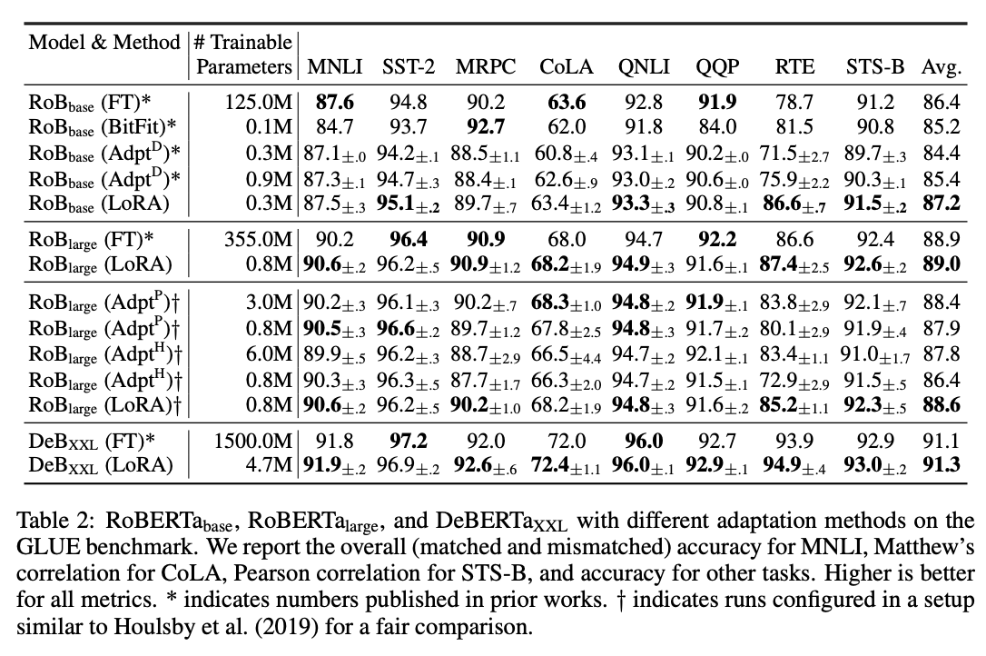
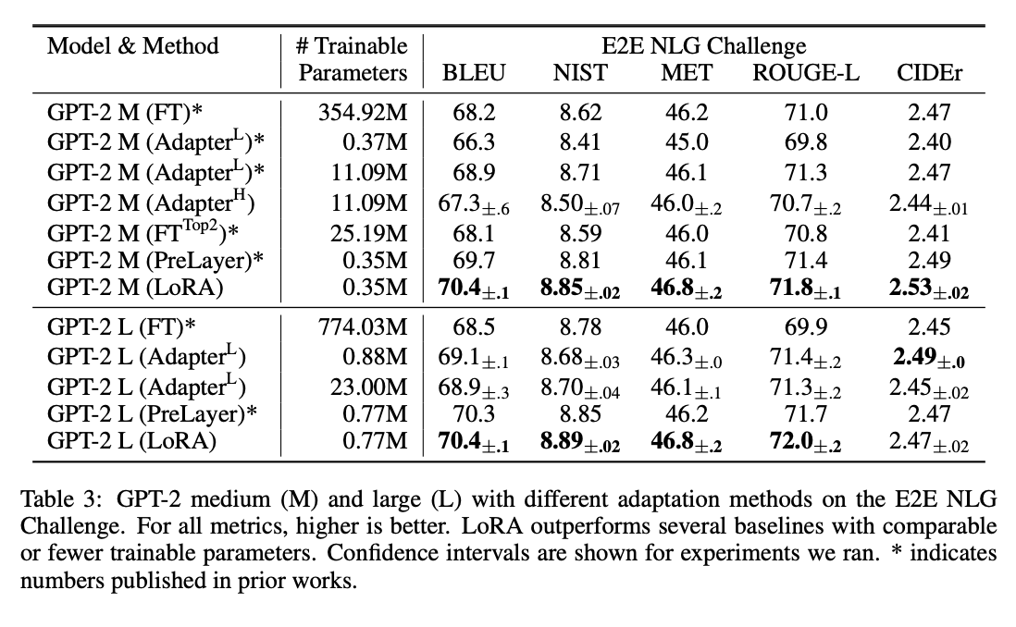
Results
Bias-only
or BitFit
Better accuracy! Less Trainable Parameters! Less Storage Requirements!

Slide 22
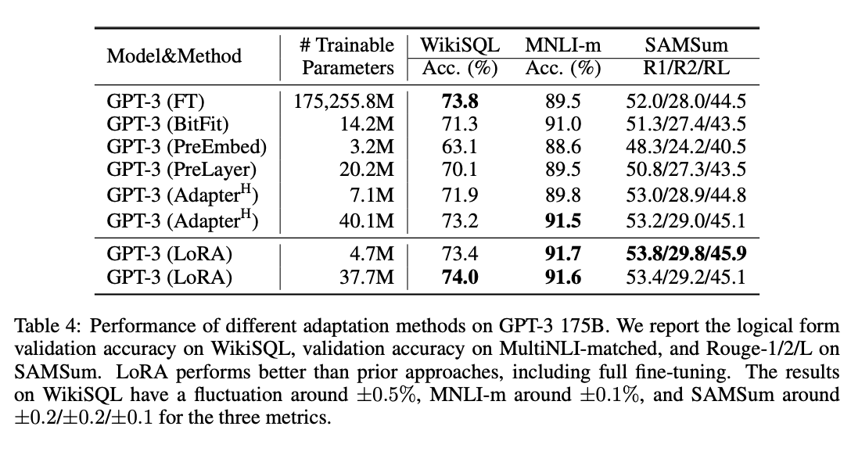
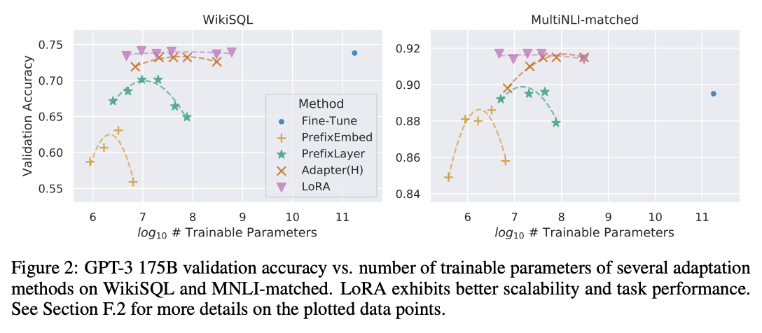

Slide 23
Paper 3: It’s Not Just Size That Matters: Small Language Models Are Also Few-Shot Learners
Prerequisites
Zero-Shot Learning: the model is trained on a range of tasks but is then applied to a completely new task for which it has seen no specific examples. The model relies on its general understanding and knowledge gained during training to infer and make predictions about the new task.
Eg- When a model trained on English tasks (like text classification, etc.) encounters a task of performing sentiment analysis on French data, its success hinges on the linguistic similarities between French and English, as well as the model's ability to adapt to different languages.

Slide 24
Few-Shot Learning: involves training a model on a small set of examples specific to the new task, assuming that the model has already been pre-trained on a large, diverse dataset, and then it is fine-tuned with just a few examples of the specific task.
Eg- (Same example as previous) but now you give the model 20 documents with labeled French text. Leveraging its foundational training in English, along with the nuances learned from the few French examples, the model attempts to perform sentiment analysis on French data.

Slide 25
PET (Pattern-Exploiting Training)
An input $x=(x_{1},x_{2})$ is converted to cloze question $P\left(x\right)$.
$q_{p}(y|x)$ is the probability of output $(y)$ which is derived from probability of $v(y)$ being plausible choice for the masked position.
$$q_{p}(y|x)$$
Oil prices rise
? __ ,
Oil prices fall back
.
$$x_{2}$$
$$x_{1}$$
$$P(x)$$
entailment
Yes
not_entailment
No
$$y$$
$$v(y)$$

Slide 26
${PVP}_{p}=(P,v)$ To map inputs $(x∈X)$ to
outputs $(y∈Y)$, each PET
contains a set of Pattern-
verbalizer pairs (PVPs)
$P:X→T^{∗}$ Maps inputs to cloze questions
containing a single mask
$v:Y→T$ Maps each output to a single
token representing its task-
specific meaning in the pattern
Note- $T$ is the vocabulary of the MLM
$T^{∗}$ is the set of all token
sequences
$$q_{p}(y|x)$$
Oil prices rise
? __ ,
Oil prices fall back
.
$$x_{2}$$
$$x_{1}$$
$$P(x)$$
entailment
Yes
not_entailment
No
$$y$$
$$v(y)$$

Slide 27
Raw position of $v(y)$at the
masked position in $P(x)$
$$q_{p}\left(y | x\right)= \frac{\exp{s_{p}\left(y \right| x)}}{\sum_{y′∈Y}{\exp{s_{p}\left(y′ \right| x)}}}=\frac{\exp{s_{M}^{1}\left(v(y) \right| P(x))}}{\sum_{y′∈Y}{\exp{s_{p}\left(y′ \right| x)}}}$$
$$q_{p}(y|x)$$
Identifying PVPs that perform well is challenging in the absence of a large development set. Therefore, PET enables a combination of multiple PVPs P = {p1, . . . , pn}.
Multiple MLMs are trained for each PVP and fine-tuned on training examples.
Oil prices rise
? __ ,
Oil prices fall back
.
$$x_{2}$$
$$x_{1}$$
$$P(x)$$
entailment
Yes
not_entailment
No
$$y$$
$$v(y)$$

Slide 28
An ensemble of these fine-tuned MLMs is then used to assign probabilities
(soft labels) to unlabeled examples $(x∈X)$. Each unlabeled input is given a probability distribution for each possible output.
Weighting term for each PVP, which is based on how accurate each PVP is on the training set.
$$q_{p}\left(y | x\right) ∝\exp{ \sum_{p∈P}{w_{p} . }}{s_{p}\left(y \right| x)}$$
P = {p1, . . . , pn}
The resulting dataset is used to train a regular sequence classifier by minimizing cross entropy between its output and $q_{p}$.

Slide 29
iPET (Iterative variant of PET)
Initial Training
Train an ensemble of MLMs using PET. This involves each model learning from a small set of examples
Creating New Training Sets Each model $M_{i}$ in the ensemble, uses a random subset of other trained models to label a set of unlabeled examples. The subset of models is chosen based on their confidence in their predictions
Retraining Models
Each model $M_{i}$ is then retrained on its newly created training set $T_{i}$
(With each iteration, the size of the training set
$T_{i}$​is increased by adding more examples)

Slide 30
PET with Multiple Masks
For every ${PVP}_{p}=(P,v)$
we define maximum number of tokens required to express the output as $l\left(x\right)= \max_{y∈Y_{x}}|v(y)|$
$v:Y→T$ PET with single mask
$v:Y→T^{∗}$ PET with multiple masks
A set of outputs are retrieved for a single input.
$P(x)$ becomes $P^{k}(x)$, where $k$ is $l\left(x\right).$
$$Z=$$
Awful pizza!
It was __ __ .
$$x$$
$$P^{2}(x)$$
$$q_{M}^{1}\left(terri | z\right)<q_{M}^{2}(\text{•}ble|z)$$
$$Z′=$$
Awful pizza!
It was __ •ble.
$$x$$
$$P^{2}(x)$$
$$q_{M}^{1}\left(terri | z′\right)$$

Slide 31
$__∈T$ __ is the mask token
$q_{M}^{k}(t|z)$ Probability that t ($t∈T$) will be
assigned at the kth position
$s_{M}^{k}\left(t | z\right)$ Logit (raw score) of the neural
network corresponding to the
above probability before
applying softmax
$$Z=$$
Awful pizza!
It was __ __ .
$$x$$
$$Z∈T^{∗}$$
$$P^{2}(x)$$
$$q_{M}^{1}\left(terri | z\right)<q_{M}^{2}(\text{•}ble|z)$$
$$Z′=$$
Awful pizza!
It was __ •ble.
$$x$$
$$P^{2}(x)$$
$$q_{M}^{1}\left(terri | z′\right)$$

Slide 32
For example-
Sentiment classification for restaurant reviews.
$Y=\{+1,−1\}$
An approximate probability is calculated for each $Y$ ie. +1 and -1
${\text{q}\text{̃}}_{p}\left(y′ | x\right)=\prod_{i=1}^{k}{q_{M}^{i}(t_{i}|P^{l\left(x\right)}(x))}$
${\text{q}\text{̃}}_{p}\left(+1,x\right)=q_{M}^{1}\left(great | z\right)$
${\text{q}\text{̃}}_{p}\left(−1,x\right)=q_{M}^{1}\left(terri | z\right){.q}_{M}^{2}\left(•ble | z\right)$, because $\left|v\left(y\right)\right|=\left|\left\{terri,•ble\right\}\right|=2$
Now, autoregressive predictions are made, and in each step the next token is chosen based on the MLM's confidence.
$q_{p}\left(−1 | x\right)=q_{M}^{2}\left(•ble | z\right).q_{M}^{1}\left(terri | z′\right)$

Slide 33
Experiments
PET is based on ALBERT.
SuperGLUE (Super General Language Understanding Evaluation) is an advanced benchmark designed to evaluate and measure the performance of the latest AI models in natural language understanding (NLU). Introduced as a successor to the original GLUE benchmark, SuperGLUE was developed to present more challenging tasks and push the limits of AI language models. SuperGLUE has tasks like BoolQ, CB, COPA, etc.

Slide 34
FewGLUE
The authors developed FewGLUE, a variation of the SuperGLUE benchmark, to evaluate language models like PET and GPT-3 under constrained conditions. They generated new training sets by selecting 32 random examples from each SuperGLUE task, using a consistent random seed for uniformity.
Additionally, they created unlabeled example sets (up to 20,000 per task) by stripping labels from the original training data. These adjustments aim to test models' performance in unsupervised or semi-supervised settings with limited or no labeled data.

Slide 35
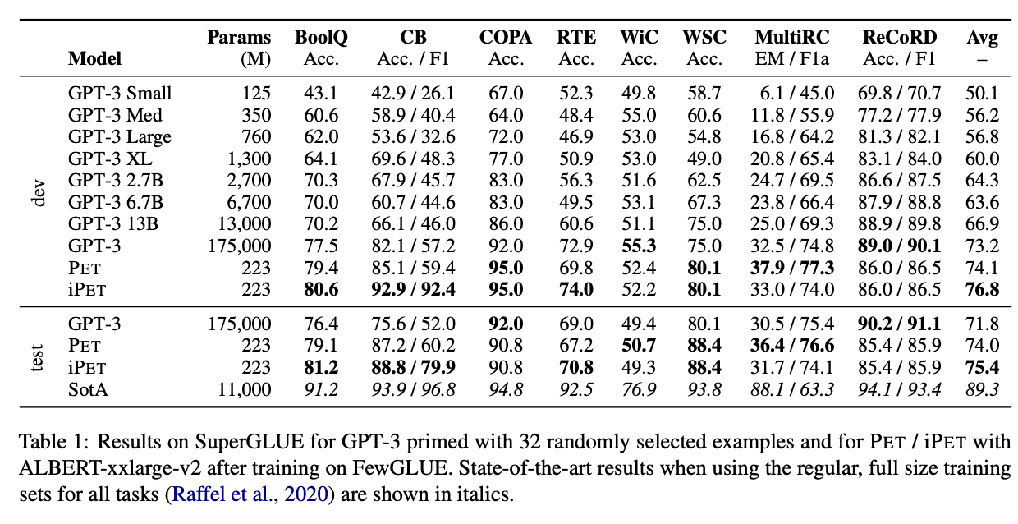
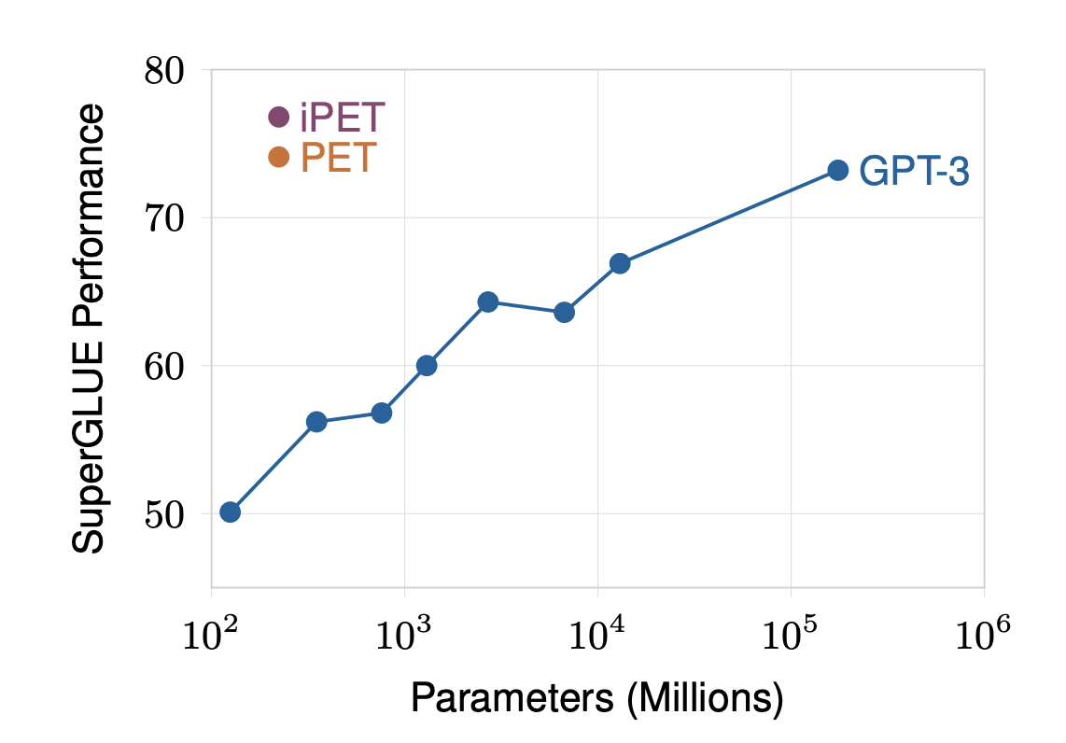
Results
Mostly better results, except a few!

Slide 36
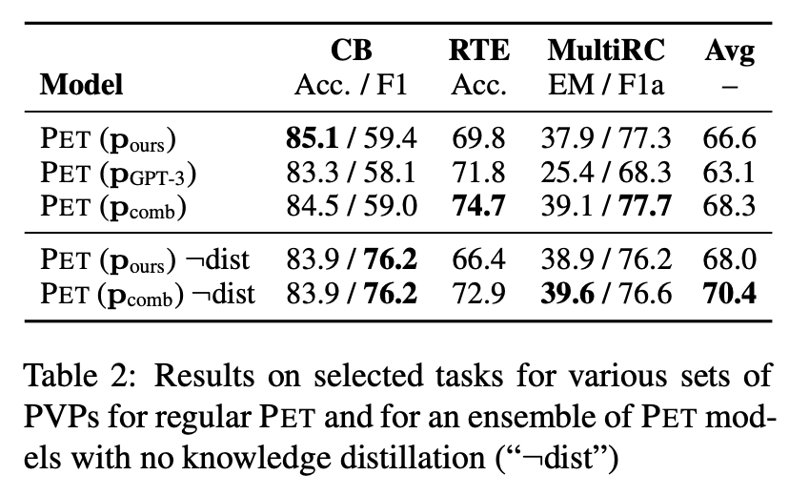
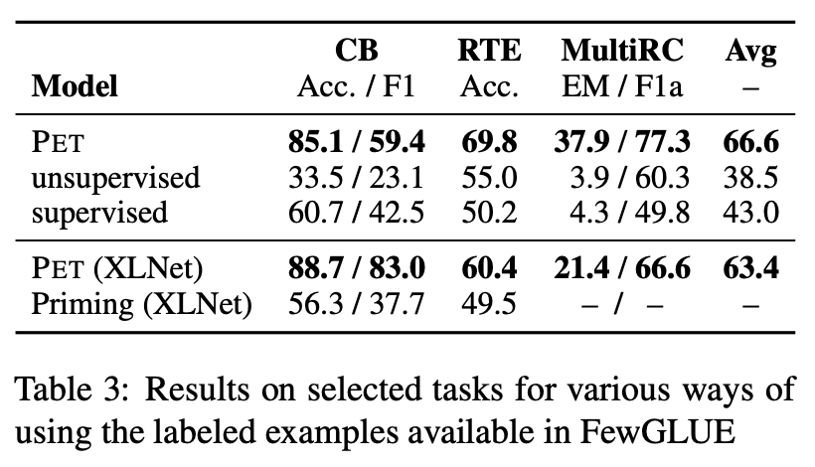
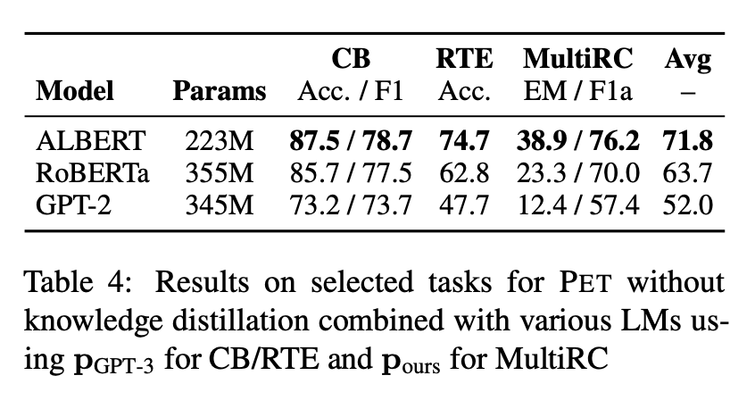
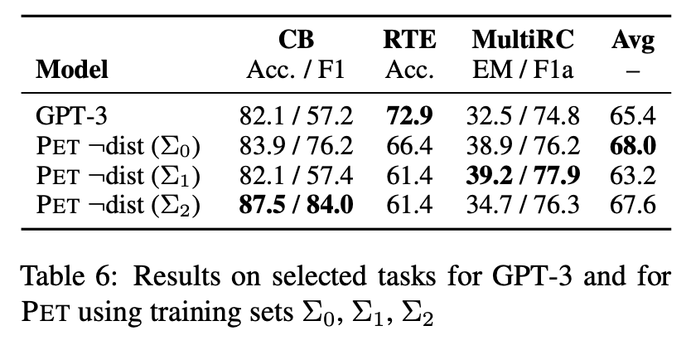
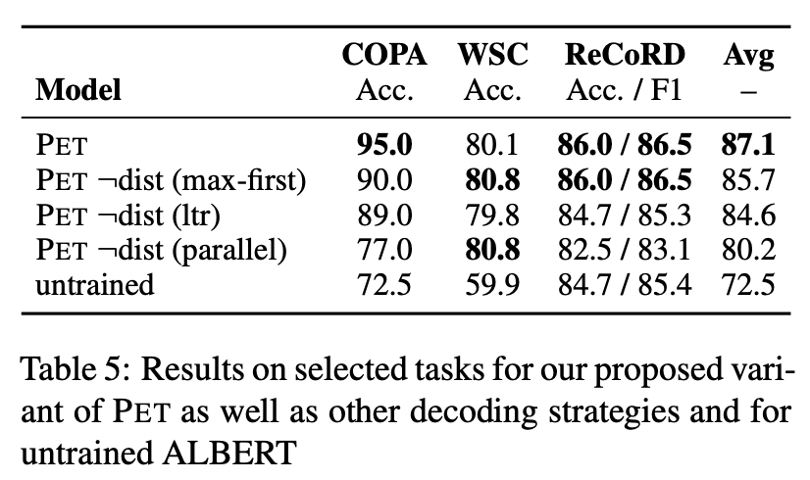

Slide 37
Paper 4: Making Pre-trained Language Models Better Few-shot Learners
Prerequisites
LM-BFF (better few-shot fine-tuning of language models)
- The task is transformed into a text prompt automatically, with demonstration sets formed by randomly selecting one example per class from the training data for each input. This gives the model a diverse set of examples, each representing a unique class, to illustrate the range of possible responses or categories for the task. The prompt is then enhanced by adding highly relevant examples from each class, providing contextual information to guide the model's response generation.
Fine-tuning with Demonstrations
Prompt-based Fine-tuning
Automatic Prompt Generation

Slide 38
1. Prompt-based Fine-tuning
In standard fine-tuning the MLM ($L$) converts $x_{in}$(input task) to $x^{\sim }$ (token sequence)
${x_{single}^{\sim }}_{ }=\left[CLS\right] x_{1}\left[SEP\right] or x_{pair}^{\sim }=\left[CLS\right] x_{1}\left[SEP\right]x_{2}\left[SEP\right]$
In prompt-based fine-tuning the MLM ($L$) automatically converts $x_{in}$ to textual prompts to be fed back to the model
$x_{prompt}=T\left(x_{in}\right)=\left[CLS\right] x_{1}$ $<prompt>\left[MASK\right].\left[SEP\right]$
Eg- We can formulate a binary sentiment classification task using a prompt with input $x_{1}$ (e.g., “No reason to watch
it .”) then $x_{prompt}=\left[CLS\right] x_{1}$ It was $\left[MASK\right].[SEP]$
Then $L$ decides whether it is more appropriate to fill in “great” (positive) or “terrible” (negative) for [MASK].

Slide 39
a. Classification tasks-
$M:Υ→v$ (maps task label space to individual vocabulary words of $L$)
$p\left(y | x_{in}\right)=p\left(\left[MASK\right]=M\left(y\right) | x_{prompt}\right)=\frac{\exp{(W_{M\left(y\right)}.h_{[MASK]})}}{\sum_{y′∈γ}{\exp{(W_{M\left(y′\right)}.h_{[MASK]})}}}$
b. Regression tasks-
$Υ$ is treated as bounded intervals which are opposing poles $[v_{l},v_{u}]$
(eg- [0,1], 0 = “terrible” and 1 = “great”)
$y=v_{l}.p\left(y_{l} | x_{in}\right)+v_{u}.p\left(y_{u} | x_{in}\right)$
$y∈γ$
$W_{M\left(y\right)}$ Pre-trained weights before softmax
$h_{[MASK]}$ Hidden vector of [MASK]

Slide 40
2. Automatic Prompt Generation
a. Automatic selection of label words
For each class $c∈Υ$we construct a set $v^{c}⊂v$ of the top k vocabulary words.
This is to make $D_{train}^{c}⊂D_{train}$.
I.e. $v^{c}={}_{v∈υ}^{Top−k}{\{ \sum_{x_{in}∈D_{train}^{c}}{\log{P_{L}\left(\left[MASK\right]=v \right| T(x_{in}))}}\}}$

Slide 41
b. Automatic generation of templates
We use a large pre-trained text-to-text Transformer T5 by inputting sentences from
$D_{train}$ to train and then it fills in missing spans in the input (eg- <X> and <Y>) and
constructs a template for the task.
This helps find an output template that maximizes
$\sum_{(x_{in},y)∈D_{train}}{\log{{}_{T5}^{P}{\left(T \right| T_{g}(x_{in},y))}}}$
These templates are tested on $D_{dev}$
and pick either the best or the top k
templates to use as an ensemble.
(Size of $D_{dev}$ is similar to size of $D_{train}$ )
A fun ride. <X> great <Y>
T5
Decode
A pleasure to watch. <X> great <Y>
…
<$S_{1}$> This is [MASK].
Training examples for label: positive
<$S_{1}$> A [MASK] one.
No reason to watch. <X> terrible <Y>
…
This Junk. <X> terrible <Y>
Generated templates
…
Fine-tuning and evaluate
Training examples for label: negative
Positive: great, negative: terrible
<$S_{1}$> A [MASK] one.
Label mapping$M(Υ)$
Best templates

Slide 42
3. Fine-tuning with Demonstrations
GPT-3's in-context learning adds up to 32 random training examples to the input but faces issues with input size limits and less effective, complex contexts, particularly for smaller models.
Sampling training examples as similar demonstrations-
To address this, we randomly sample one example $(x_{in}^{\left(c\right)},y^{c})∈D_{train}$ from each class, convert it into the template (with [MASK]) and concatenate with $x_{in}$ making the final result- $T(x_{in})⨁{}_{T}^{\sim }{(x_{in}^{\left(1\right)},y^{(1)})}$ $⨁$. . . .$⨁$ $⨁{}_{T}^{\sim }{(x_{in}^{|Υ|},y^{|Υ|})}$
MLM head
great (label: positive)
terrible (label: negative) ✔
Label mapping $M(Υ)$
[CLS] No reason to watch. It was [MASK]. [SEP] A fun ride. It was great. [SEP] The drama discloses nothing. It was terrible. [SEP]
|-------------------Input-------------------|
|----------Template----------|
|-----Demonstration for label: Positive-----|
|----------------------------Demonstration for label: Negative----------------------------|

Slide 43
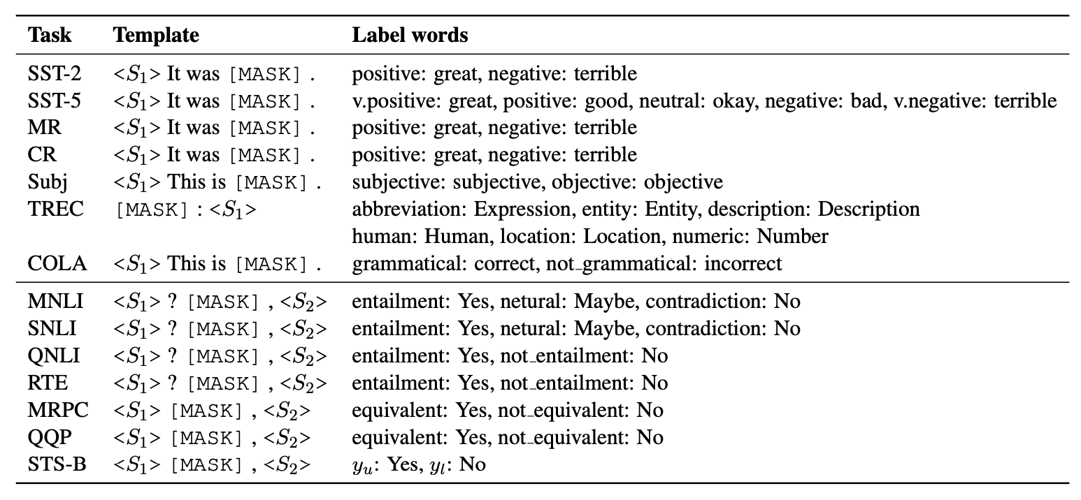
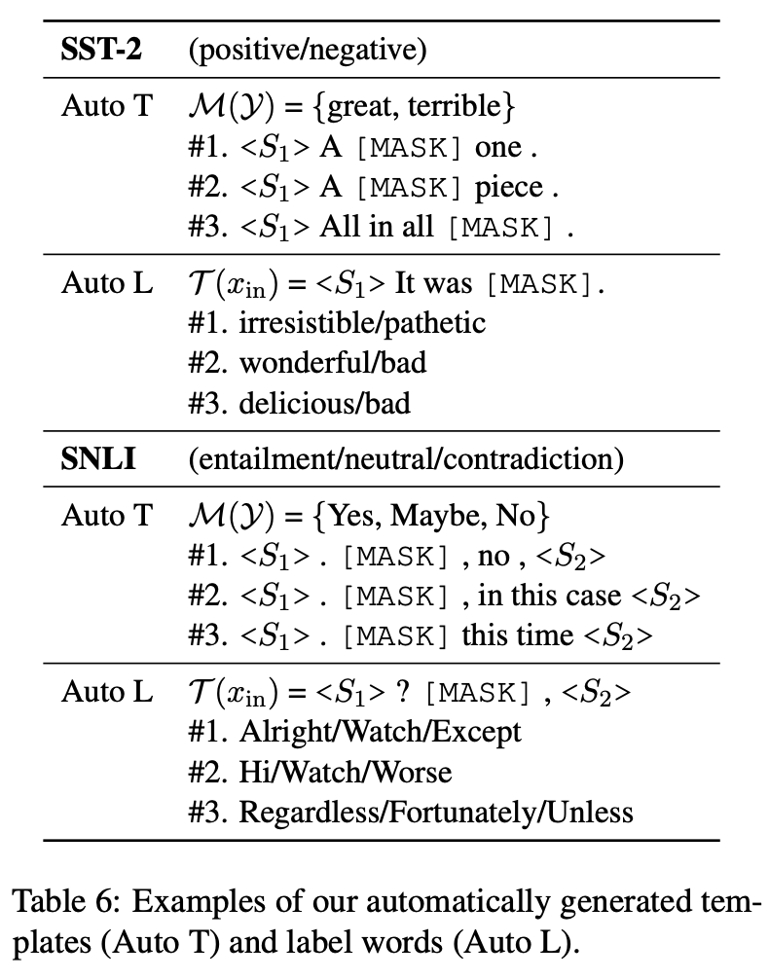
Experiments and Evaluation
Evaluation takes place across 8 single-sentence and 7 sentence-pair English tasks, including 8 tasks from the GLUE benchmark, Stanford Natural Language Inference (SNLI), and 6 other popular sentence classification tasks. The average performance is measured across 5 different randomly sampled $D_{train}$ and $D_{dev}$ splits. RoBERTa-large was used for this.

Slide 44
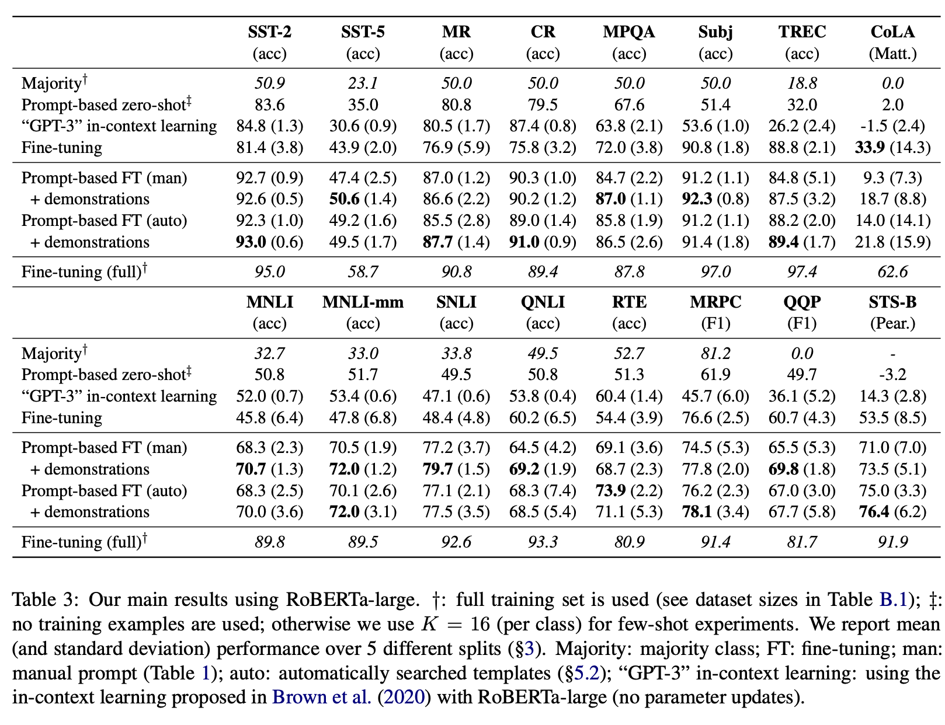
Results
Great results!

Slide 45
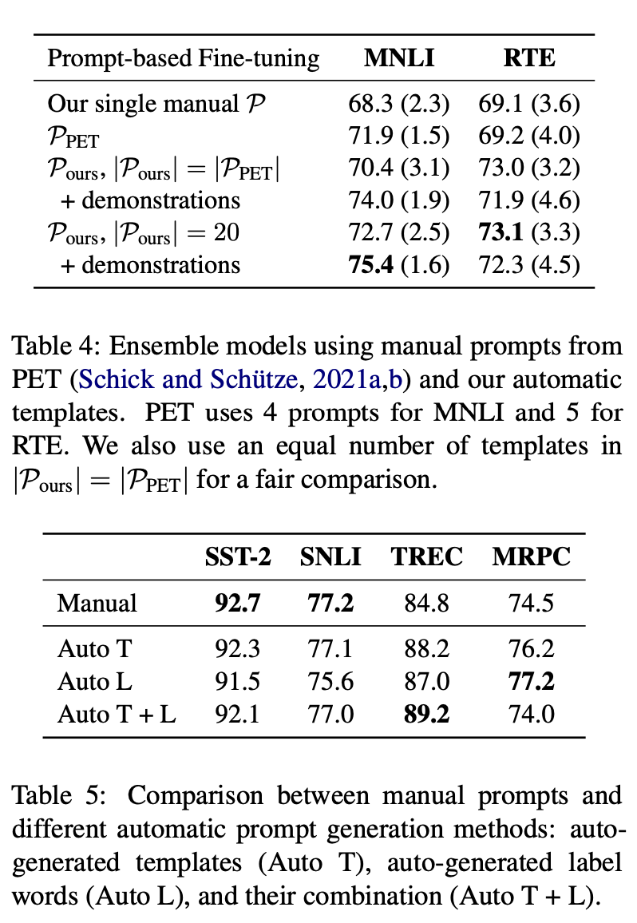
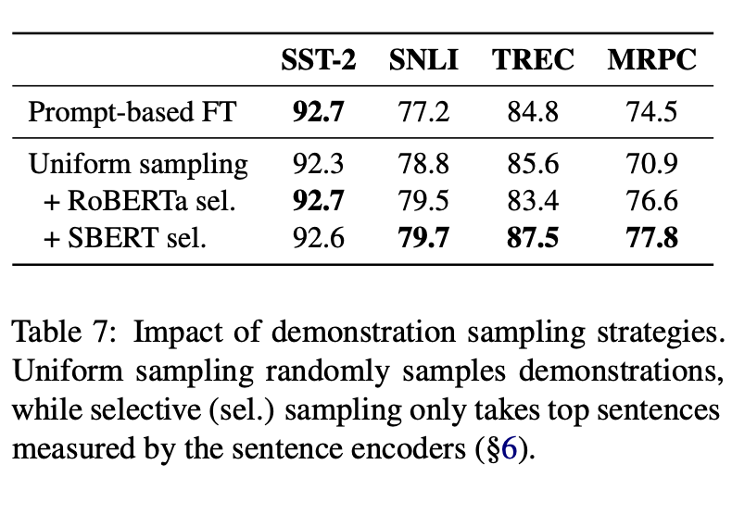
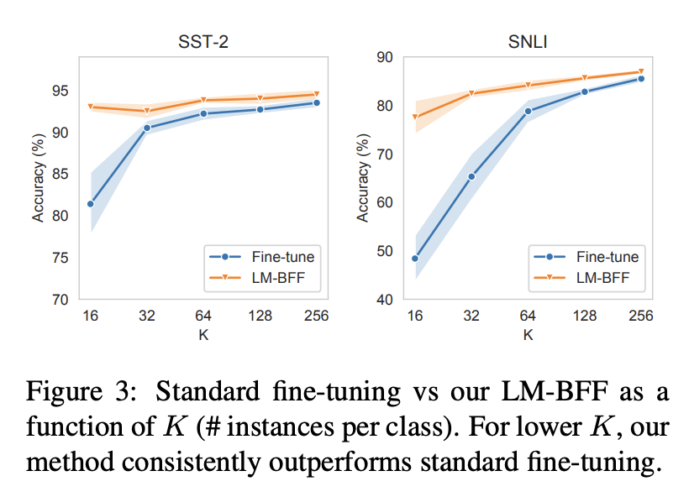
(Uniform sampling to selective sampling comparison with SBERT)

Slide 46
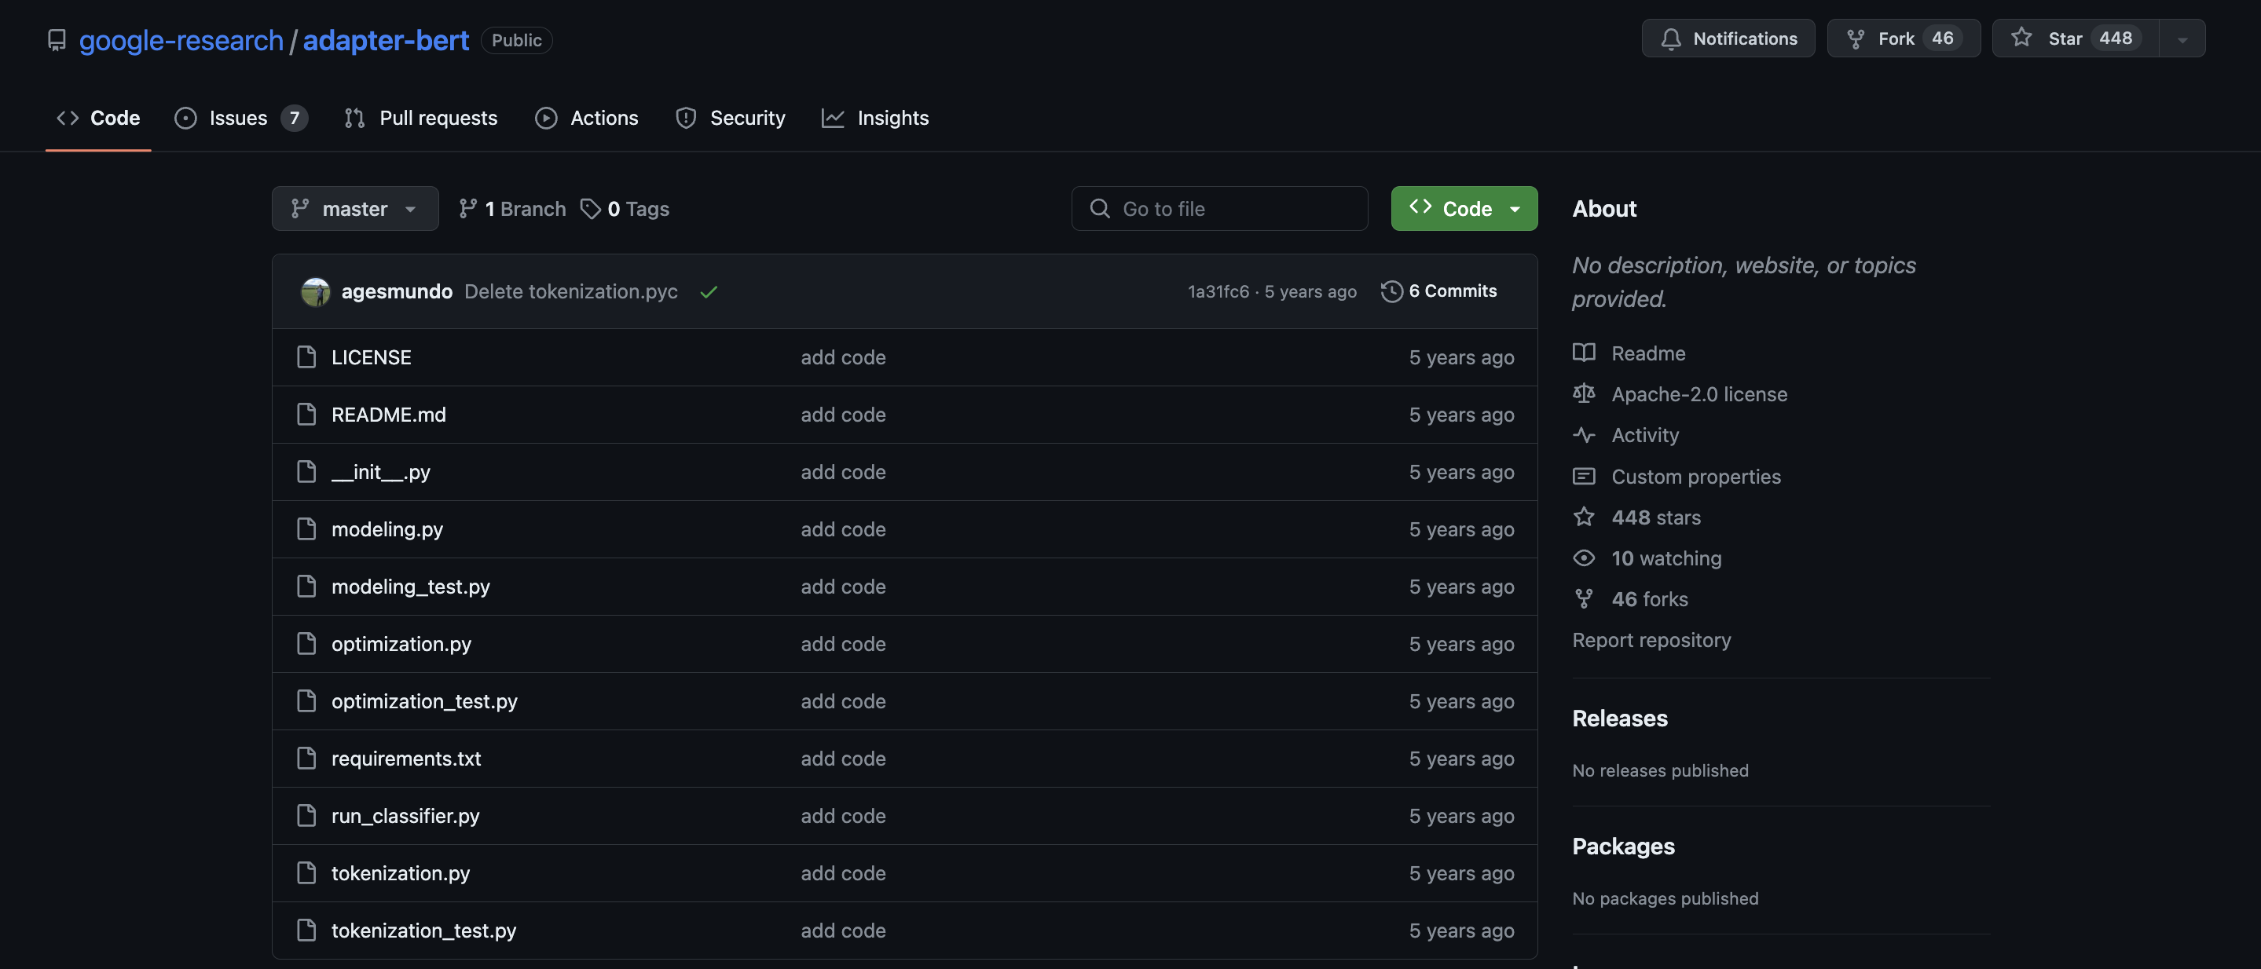
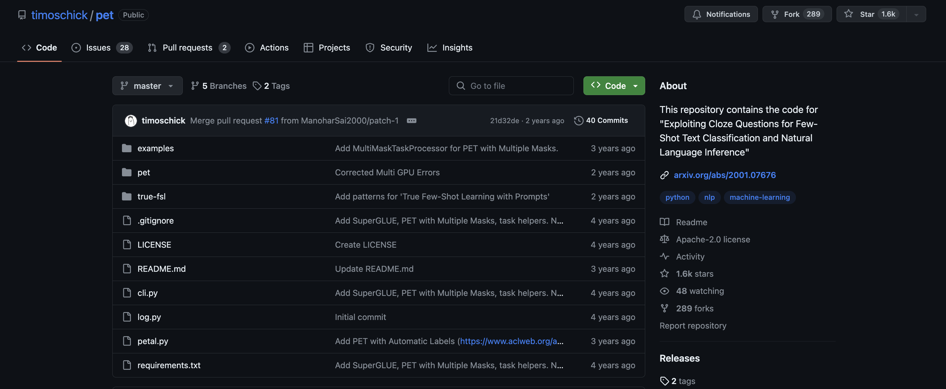
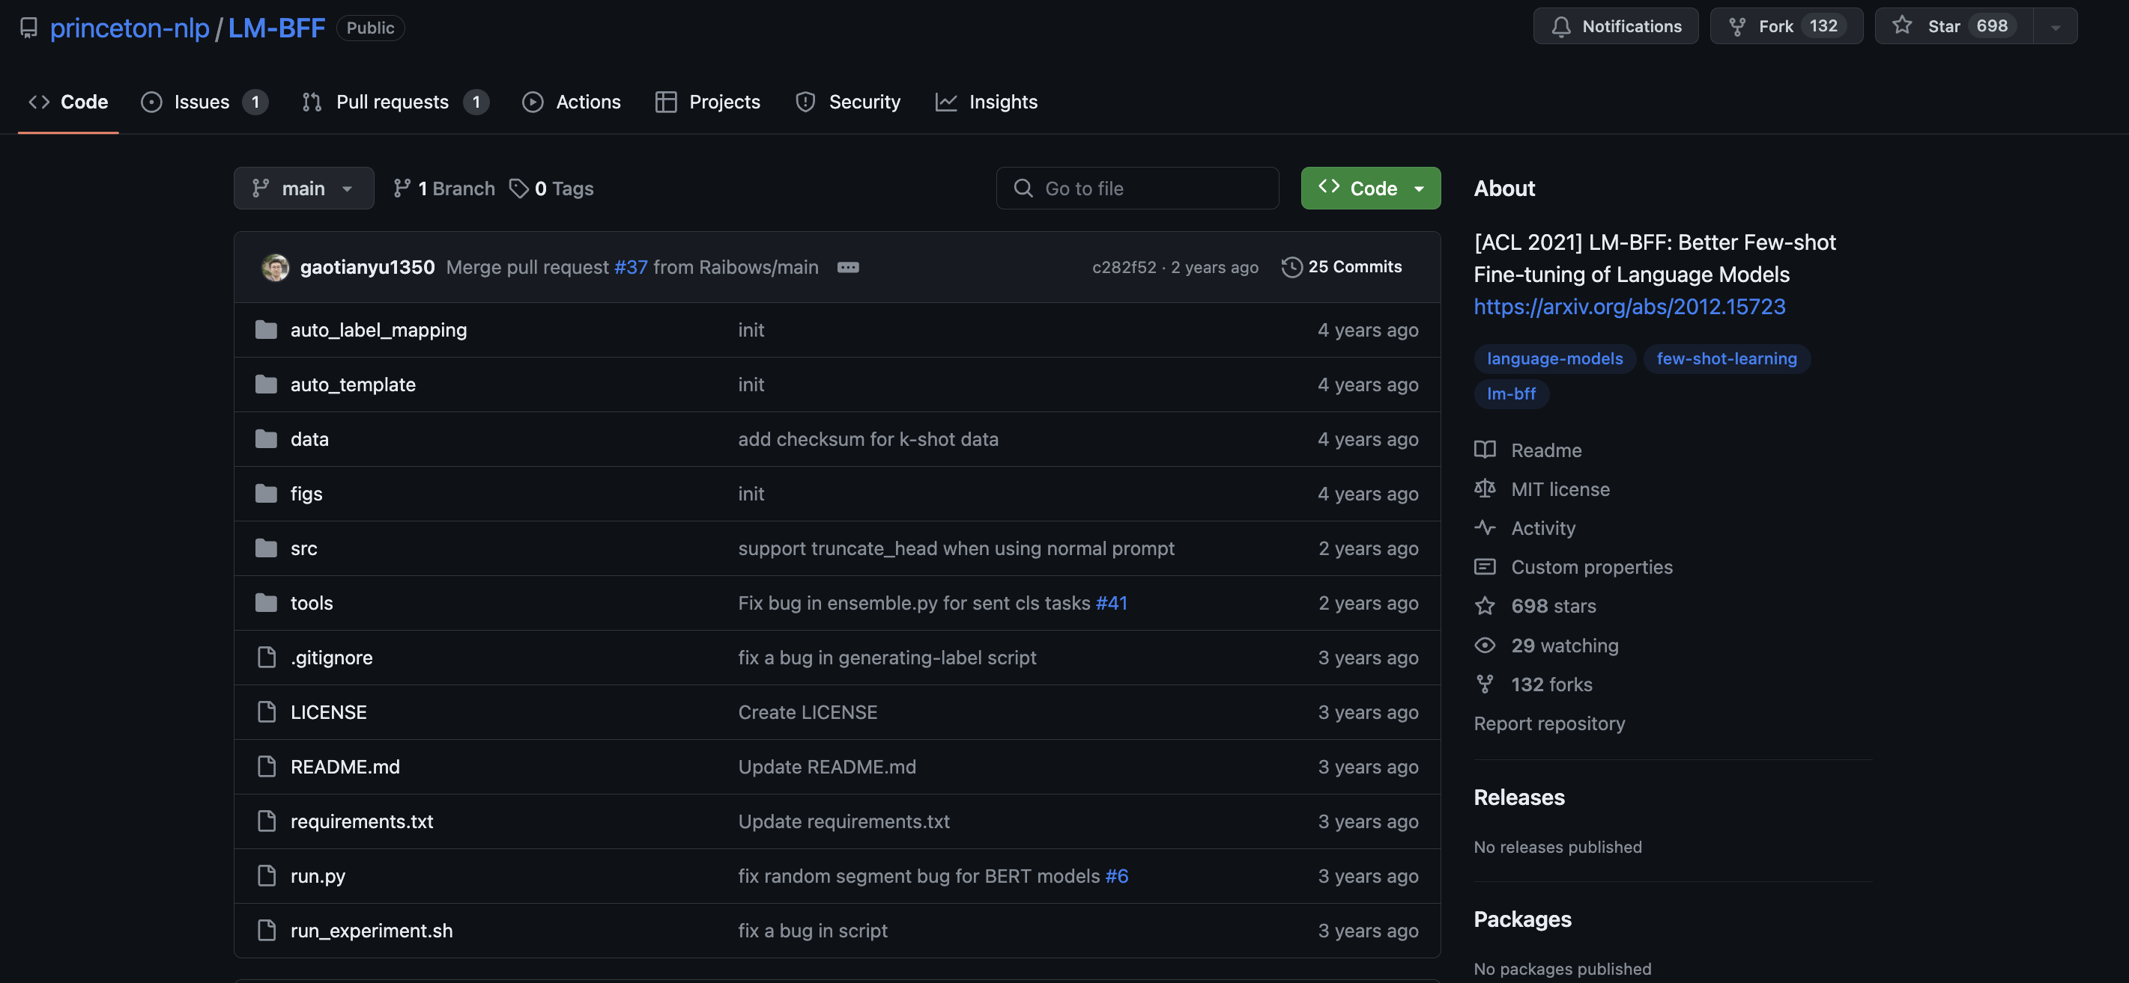
CODE (GitHub)
https://github.com/google-research/adapter-bert
https://github.com/microsoft/LoRA
https://github.com/timoschick/pet
https://github.com/princeton-nlp/LM-BFF

Slide 47
What I will Cover (Second Half)
Additional PEFT Methods:
Prefix Tuning
Prompt Tuning
(IA)^3
Understanding PEFT More Broadly:
Unified View of PEFT
PEFT vs Full Model Fine-Tuning Comparisons

Slide 48
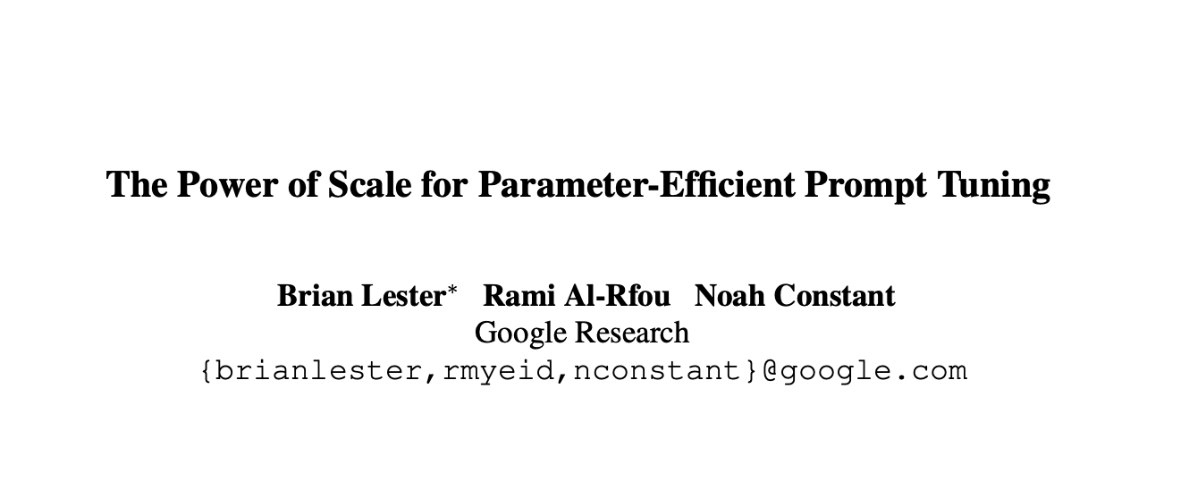
18 Apr 2021

Slide 49
Background: Prefix-Tuning
Prefix Tuning: Learn a small, fixed set of additional parameters (the “prefixes”).
To do prefix-tuning, we prepend some number of tunable prefix vectors ($l$) to the keys and values of the multi-head attention at every layer.
$$h_{1} h_{2} h_{3} h_{4} h_{5} h_{6} h_{7} h_{8}$$
Prefix
$x$ (Source Text)
Activations:
Where do polar bears live?

Slide 50
Background: Prefix-Tuning and Attention
Given a query vector $x∈ℝ^{d}$ and a sequence of m vectors $C∈ℝ^{m×d}$ over which we would like to perform attention
Multi-Head Attention:
$$head_{i}=Attn(xW_{q}^{\left(i\right)},CW_{k}^{\left(i\right)}, CW_{v}^{(i)})$$
Multi-Head Attention (with prefixes):
$$head_{i}=Attn(xW_{q}^{\left(i\right)},concat(P_{k}^{\left(i\right)},CW_{k}^{\left(i\right)}),concat(P_{v}^{\left(i\right)},CW_{v}^{\left(i\right)}))$$
Two sets of $l$prefix vectors $P_{k}, P_{v}∈{ ℝ}^{l×d_{h}}$ are concatenated with the original keys $K$ and values $V$, at every attention head and every layer.
We now learn just $P_{k}, P_{v}$ instead of all the model parameters

Slide 51
Prompt-Tuning: A Descendant of Prefix Tuning
Prefix Tuning: Prefix activations prepended to the keys and values in each layer and attention head.
Prompt Tuning: Prefix k tokens to the input text. Learn the token embeddings.
This is an input text
$$P_{1}$$ | $$P_{2}$$ | $$P_{3}$$
[CLS] | This | is | a | input | . | [SEP]
101 | 2023 | 2003 | 1037 | 7953 | 1012 | 102
0.689 0.797 0.068 -0.165 . . . | -0.423 -0.526 -0.607 -0.035 . . . | -0.946 0.426 0.452 -0.523 . . .
0.522 0.258 -0.045 0.592 . . . | -0.731 0.188 -0.398 -0.782 . . . | -0.598 -0.253 0.070 0.376 . . . | -0.689 -0.441 0.388 0.907 . . . | -0.045 -0.963 0.446 -0.618 . . . | 0.408 -0.357 0.115 0.073 . . . | -0.153 0.094 -0.186 0.503 . . .
UWaterloo CS886 L7: Parameter-efficient Transformer

Slide 52
Prompt-Tuning: Evaluation
Model: T5-lm-adapt models of all sizes (Small, Base, Large, XL, XXL)
Evaluation Dataset: The SuperGLUE benchmark, a collection of eight challenging English language understanding tasks.

Slide 53
Prompt-Tuning: How to Initialize the Prompt?
Random Drawn from Model Vocabulary. Restricted to 5000 most “common” tokens
Embeddings that Enumerate Output Classes (ex. News Classification)
Random
$$P_{1}$$ | $$P_{2}$$ | $$P_{3}$$
$$P_{1}$$ | $$P_{2}$$ | $$P_{3}$$
$$P_{1}$$ | $$P_{2}$$ | $$P_{3}$$
0.689 0.797 0.068 -0.165 . . . | -0.423 -0.526 -0.607 -0.035 . . . | -0.946 0.426 0.452 -0.523 . . .
Dog | Sky | Purple
-0.926 0.850 0.099 0.751 . . . | 0.386 0.755 0.032 0.646 . . . | 0.543 0.492 0.006 0.559 . . .
World | Sports | Business
0.354 -0.889 -0.031 0.147 . . . | -0.679 0.731 0.297 -0.810 . . . | -0.457 0.720 0.900 -0.669 . . .
Prompts are represented as a parameter $P_{e}∈ℝ^{p×e}$ where $e$ is the dimension of the embedding space and $p$is the length of the prompt

Slide 54
Prompt-Tuning: How to Initialize the Prompt?
The authors say:
Class Label initialization performs best.
“At smaller model sizes, there are large gaps between the different initializations, but once the model is scaled to XXL size, those differences disappear.”
Does the chart suggest the same?

Slide 55
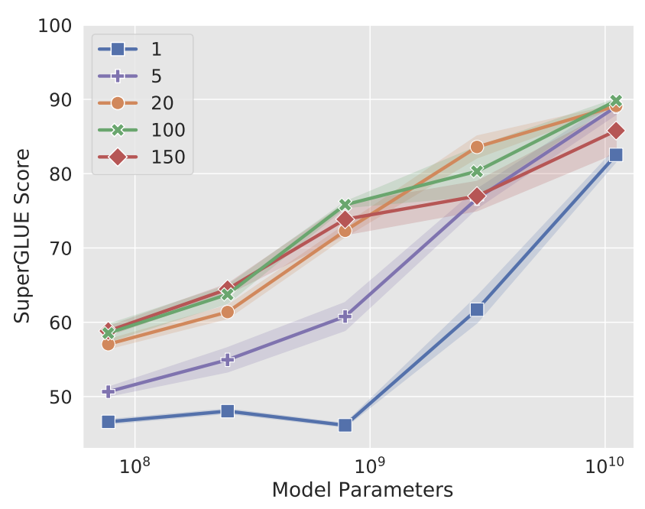
Prompt-Tuning: How Long should Prompts be?
Across all models, increasing beyond 20 tokens only yields marginal gains.
The XXL model still gives strong results with a single-token prompt, suggesting that for larger models, prompts do not need to be as large.
A single token embedding has dimension 1024 in the case of the T5-XXL

Slide 56
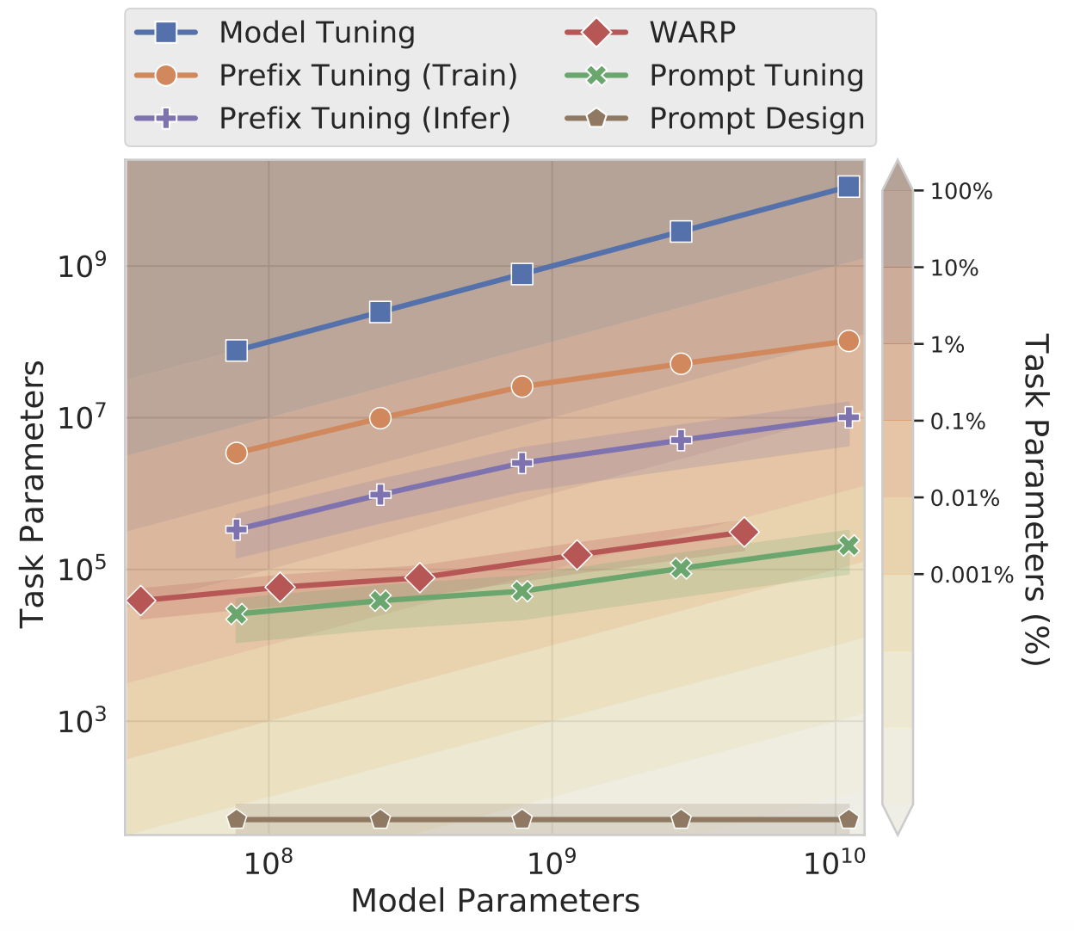
Prompt-Tuning: Comparisons
Interestingly the paper does not make effectiveness comparisons with other PEFT methods. Only comparisons to full model tuning are made for effectiveness.
On one hand, making these comparisons would have required them to reproduce these other methods
On the other hand, their work on a PEFT method is incomplete without effectiveness comparisons to other PEFT methods
They do compare parameter usage with other methods
They argue that Prompt tuning is the most parameter efficient method

Slide 57
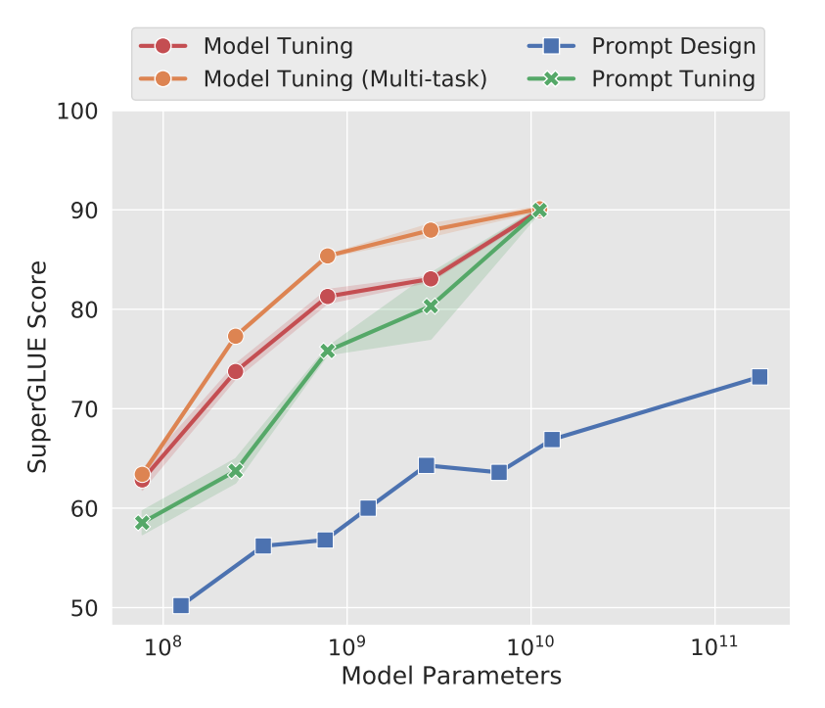
Prompt-Tuning: Comparison to Full Model Tuning
Prompt tuning becomes more competitive with scale
Prompt tuning matches even the stronger multi-task model tuning baseline
Multi-task: A single model is tuned on all tasks jointly
Prompt design measures GPT-3 few-shot performance

Slide 58
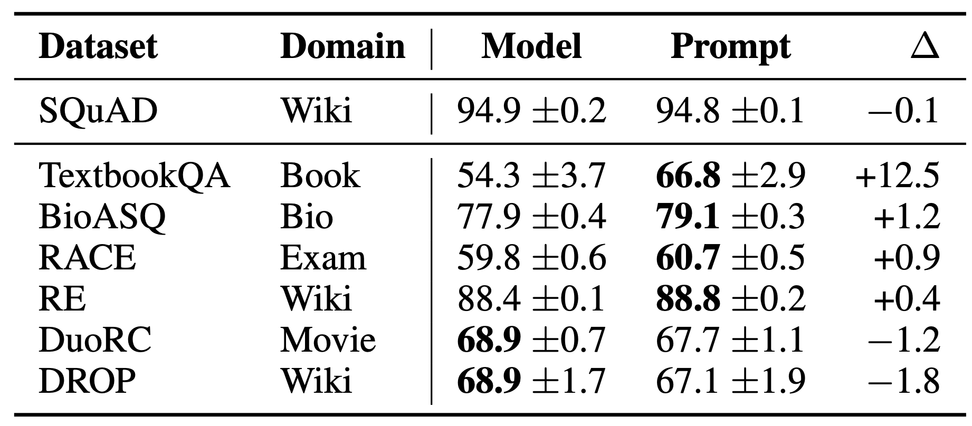
Prompt-Tuning: Resilience to Domain Shift
Domain Shift: Change in data characteristics across contexts.
By freezing the core language model parameters, prompt tuning prevents the model from modifying its general understanding of language.
This reduces the model’s ability to overfit to a dataset
Prompt tuning may improve robustness to domain shifts
Model is trained on SQuAD and evaluated out-of-distribution

Slide 59
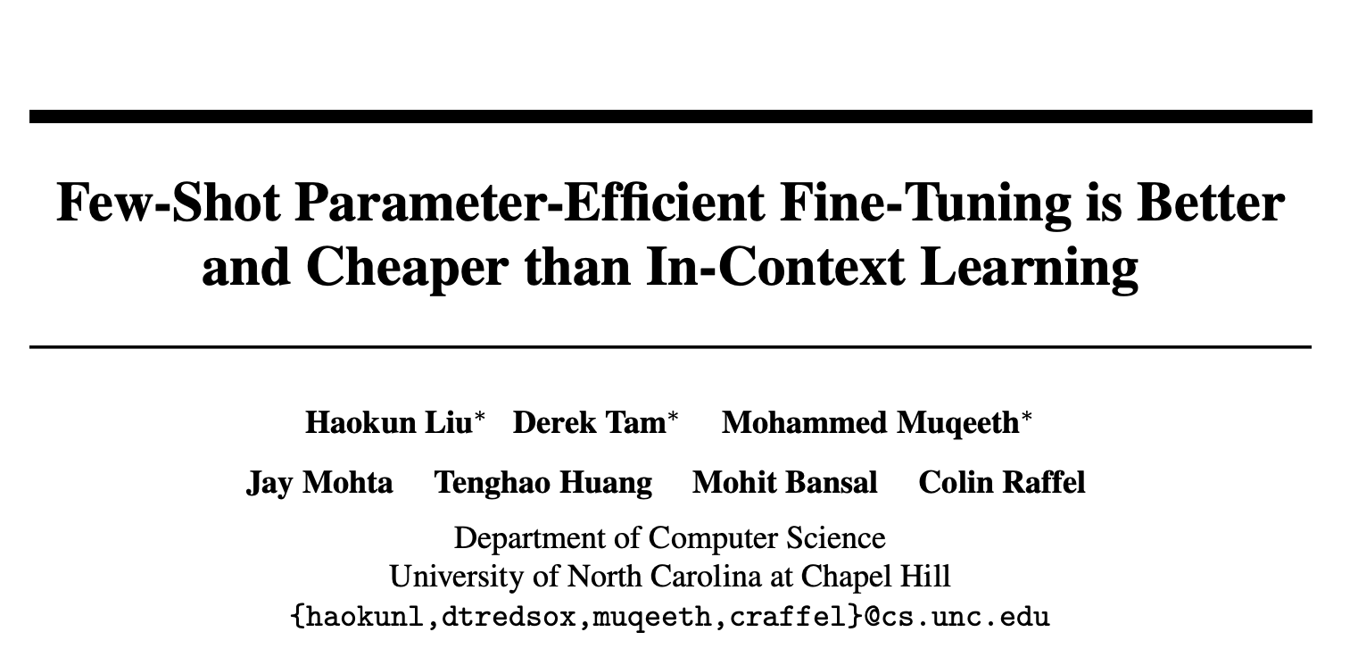
11 May 2022

Slide 60
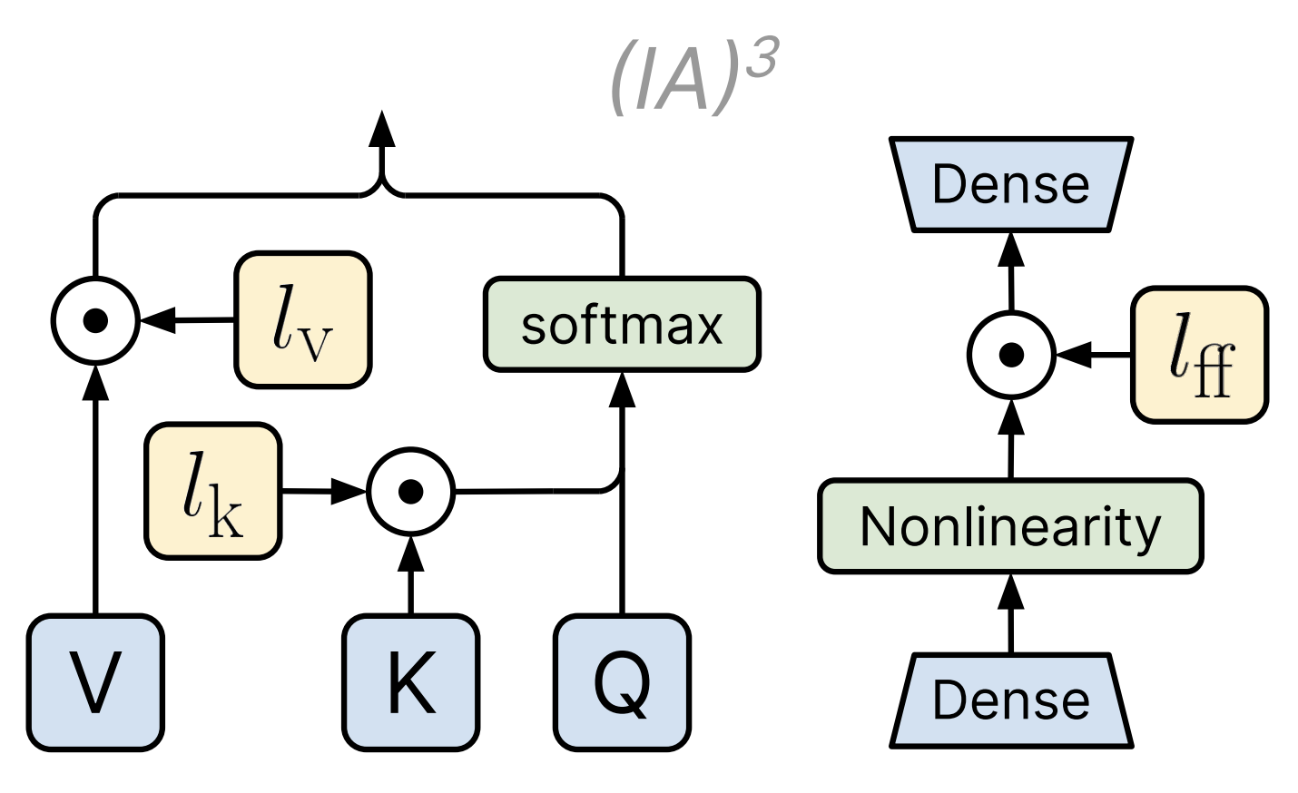
A new PEFT method: ${\left(IA\right)}^{3}$
${\left(IA\right)}^{3}$: “Infused Adapter by Inhibiting and Amplifying Inner Activations”
Learn vectors $l_{k}, l_{v},l_{ff}$ which rescale (via element-wise multiplication), the keys and values in attention and the inner activations in feed-forward networks (FFN).

Slide 61
Few-Shot Parameter-Efficient Fine-Tuning is Better and Cheaper than In-Context Learning
This paper introduces ${\left(IA\right)}^{3}$
Argues that PEFT is better than ICL in few-shot settings
Few-Shot Learning: Learning from only a few examples
In-Context Learning: Inducing a model to perform a downstream task by inputting prompted examples
Example: A 4-shot input or context would be ”Please unscramble the letters into a word, and write that word: asinoc = casino, yfrogg = froggy, plesim = simple, iggestb = biggest, astedro =”

Slide 62
What’s Wrong with In-Context Learning?
Advantage: ICL enables single models to perform many tasks without fine-tuning
Disadvantage: Making predictions is expensive because the model needs to process all in-context examples every time a prediction is made
Instead of ICL, PEFT is a promising alternative

Slide 63
Parameter-Efficient Fine-Tuning vs In-Context Learning: Evaluation
Evaluation is done using the T0 Model
The T0 model is created by fine-tuning the T5 on a mixture of datasets to enable zero-shot generalization
For each dataset tested, the number of few-shot examples used varies from 20 to 70, matching the same numbers as the evaluation from the paper: “Language models are few-shot learners”

Slide 64
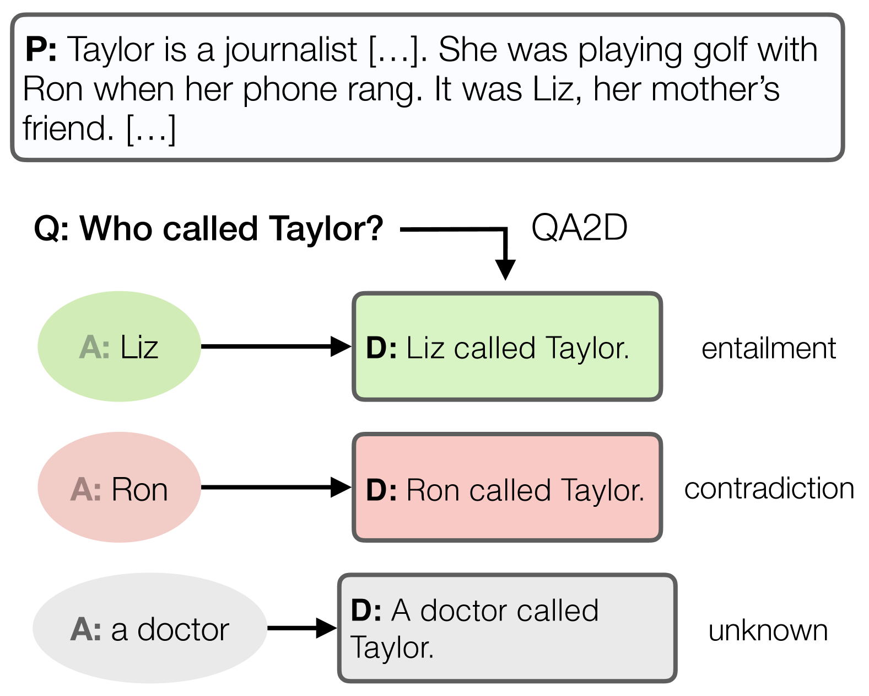
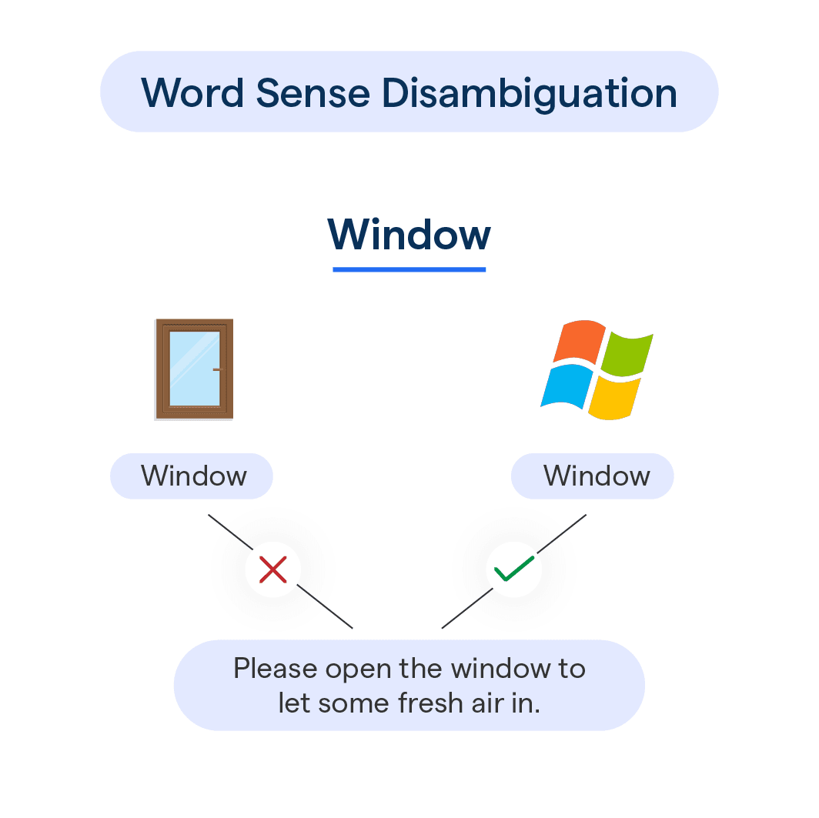
Parameter-Efficient Fine-Tuning vs In-Context Learning: Evaluation
Datasets used for testing are sentence completion (COPA, H-SWAG, and Story Cloze), natural language inference (ANLI, CB, and RTE), coreference resolution (WSC and Winogrande), and word sense disambiguation (WiC).
Natural Language Inference
Sentence Completion
Coreference Resolution
Word Sense Disambiguation

Slide 65
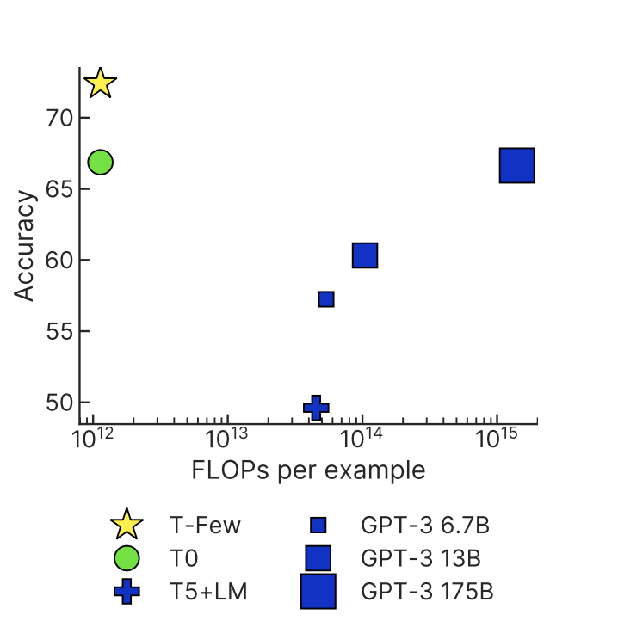
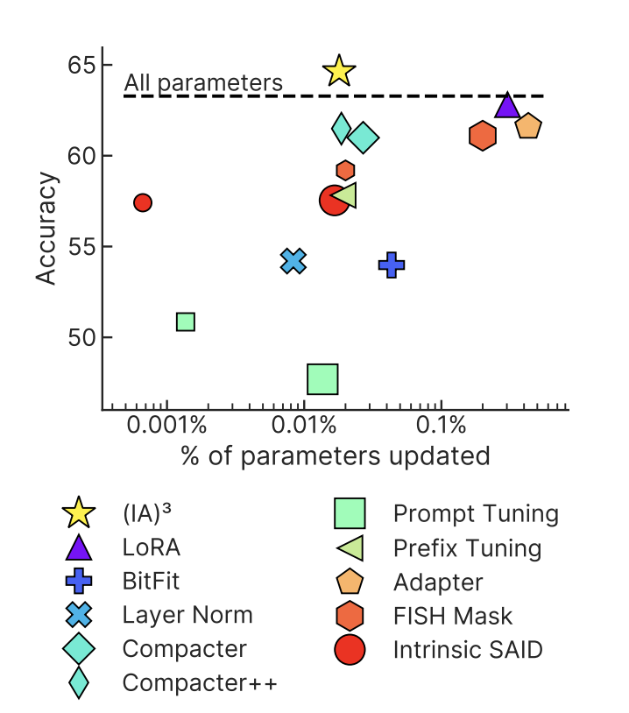
Parameter-Efficient Fine-Tuning vs In-Context Learning: Results
Compared to Other PEFT Methods with T0-3B
Compared to ICL
Baselines not Intuitive
T0: Evaluates the T0-11B model in zero-shot setting
T5+LM: Evaluates the T5-lm-adapt-11B model with ensemble ICL
GPT-3: Strong ICL baseline

Slide 66
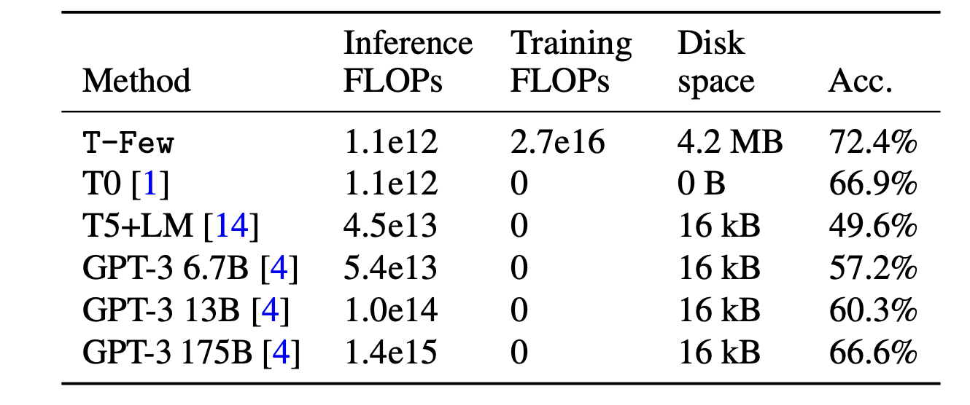
Parameter-Efficient Fine-Tuning vs In-Context Learning: Efficiency
The T-Few method shines in terms of Inference FLOPS
Inference FLOPs listed are FLOPS to make a prediction for a single example

Slide 67
Parameter-Efficient Fine-Tuning vs In-Context Learning: Criticisms
All experiments were on classification tasks only
Evaluation was only done using the T0 model
Evaluation of the ${\left(IA\right)}^{3}$ PEFT method is only done in the few-shot setting

Slide 68
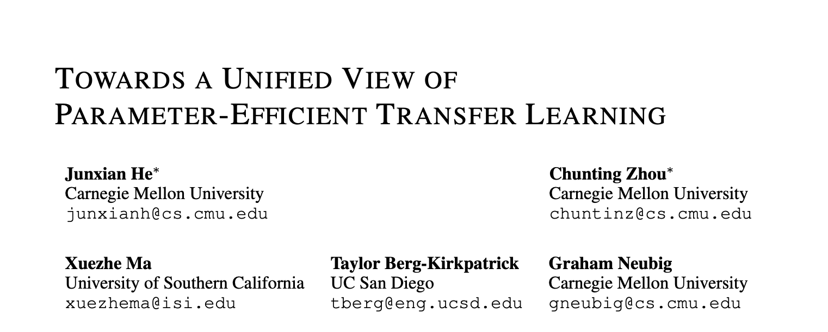
8 Oct 2021

Slide 69
A Unified View of Parameter-Efficient Transfer Learning
Can Adapters, LoRA, and Prefix Tuning be related to one another? In fact they can! And a unified understanding of these methods allows for creation of even better parameter-efficient fine-tuning methods.

Slide 70
Recall: Adapters
The adapter approach inserts small modules (adapters) between transformer layers
Down Projection: $W_{down}∈ℝ^{d×r}$
Up Projection: $W_{up}∈ℝ^{r×d}$
Nonlinear Activation Function: $f$
Functional Form:
$$h←h+f\left(hW_{down}\right)W_{up}$$
(Let’s Remember this for Later!)

Slide 71
Recall: Prefix Tuning, now in a New Form!
To do prefix-tuning, two sets of $l$prefix vectors $P_{k}, P_{v}∈{ ℝ}^{l×d_{h}}$ are concatenated with the original keys $K$ and values $V$ , at every attention head and every layer.
Given a query vector $x∈ℝ^{d_{h}}$ and a sequence of m vectors $C∈ℝ^{m×d}$ over which we would like to perform attention
Recall from earlier:
$$Attn(xW_{q},concat(P_{k},CW_{k}),concat(P_{v},CW_{v}))$$
Can re-write as:
$$\left(1−λ\left(x\right)\right)Attn\left(xW_{q},CW_{k},CW_{v}\right)+λ(x)Attn\left(xW_{q},P_{k},P_{v}\right)$$
Where $λ(x)$ is a scalar that that represents the sum of normalized attention weights on the prefixes (i and j index values in the vectors)
$λ\left(x\right)=\frac{\sum_{i}{{\exp\left(xW_{q}P_{k}^{T}\right)}_{i}}}{\sum_{i}{{\exp\left(xW_{q}P_{k}^{T}\right)}_{i}}+\sum_{j}{{\exp\left(xW_{q}W_{k}^{T}C^{T}\right)}_{j}}}$

Slide 72
Recall: Prefix Tuning, now in a New Form!
Whereas attention before was just: $Attn\left(xW_{q},CW_{k},CW_{v}\right)$
With prefix tuning we have: $\left(1−λ\left(x\right)\right)Attn\left(xW_{q},CW_{k},CW_{v}\right)+λ(x)Attn\left(xW_{q},P_{k},P_{v}\right)$
An alternative view of prefix tuning in the functional form we have been considering is: $h←\left(1−λ\left(x\right)\right)h+λ\left(x\right)Δh$
Where $Δh=Attn\left(xW_{q},P_{k},P_{v}\right)$ is the modification to the original head attention output $h=Attn\left(xW_{q},CW_{k},CW_{v}\right)$ through linear interpolation.

Slide 73
Relating Prefix Tuning and Adapters
Prefix Tuning
Original Head Attention Output: $h=Attn\left(xW_{q},CW_{k},CW_{v}\right)$
Modification: $Δh=Attn\left(xW_{q},P_{k},P_{v}\right)=softmax\left(xW_{q}P_{k}^{T}\right)P_{v}$ Functional Form: $h←\left(1−λ\left(x\right)\right)h+λ\left(x\right)Δh$
Adapters
Down Projection: $W_{down}∈ℝ^{d×r}$
Up Projection: $W_{up}∈ℝ^{r×d}$
Nonlinear Activation Function: $f$
$$\text{Functional} \text{Form}\text{: }h←h+f\left(hW_{down}\right)W_{up}$$
If we define $W_{1}=W_{q}P_{k}^{T}, W_{2}=P_{v}, f=softmax$, then we can rewrite the functional form of prefix tuning to
$$h←\left(1−λ\left(x\right)\right)h+λ\left(x\right)f\left({xW}_{1}\right)W_{2}$$
This is very similar to adapters, except that prefix tuning is doing weighted addition

Slide 74
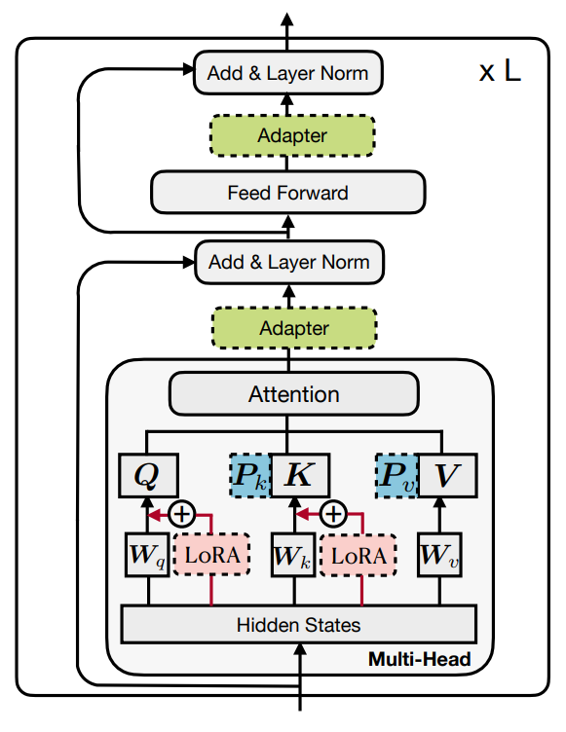
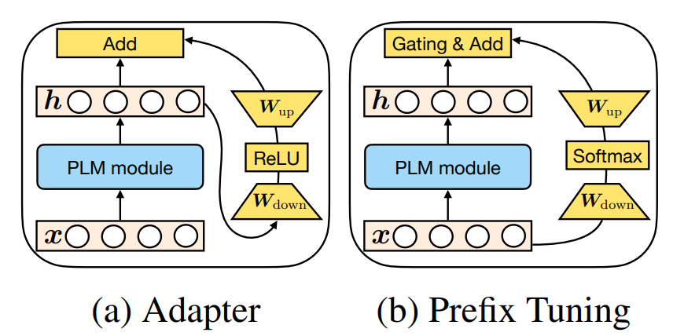
Relating Prefix Tuning and Adapters
Prefix Tuning
Functional Form: $h←\left(1−λ\left(x\right)\right)h+λ\left(x\right)f\left({xW}_{1}\right)W_{2}$
Adapters
$$\text{Functional} \text{Form}\text{: }h←h+f\left(hW_{down}\right)W_{up}$$
Some key differences:
Prefix tuning uses x to compute $Δh$, while adapters use h to compute $Δh$. (Parallel vs Sequential Computation)
Adapters are more flexible with respect to where they are inserted, adapters modify attention or FFN outputs,
while prefix tuning only modifies the attention output of each head.

Slide 75
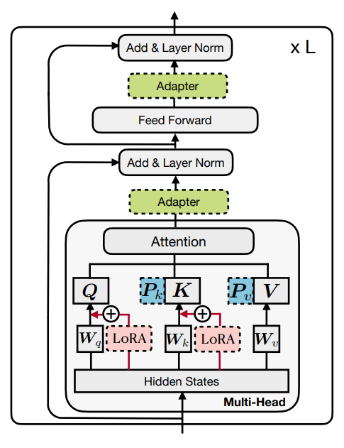
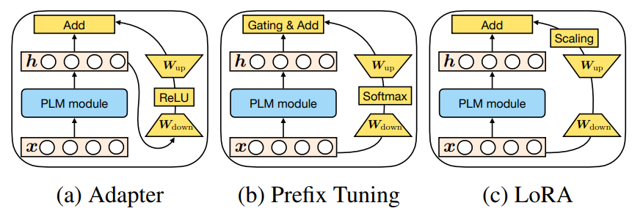
Summary of Differences: Prefix Tuning vs Adapters vs LoRA

Slide 76
How Can These Differences be Used to Formulate New PEFT methods?
We can test and compare:
Parallel vs sequential insertion
Modifying attention representations vs FFN representations
Scaling composition function vs unscaled

Slide 77
A Unified View of Parameter-Efficient Transfer Learning: Evaluation
Datasets:
XSum: News Article Summarization Dataset
English to Romanian Translation
MNLI: Natural Language Inference
SST2: Sentiment Classification
Models:
BART-large for XSum and English to Romanian Translation
RoBERTa-base for MNLI and SST2

Slide 78
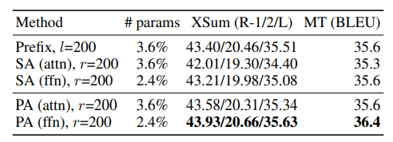
Sequential or Parallel?
Some Observations:
Prefix tuning which uses parallel insertion, outperforms attention sequential adapters
Further, a parallel adapter from this work is able to beat sequential adapters in all cases
$r$ is the bottleneck dimension, $l$is the length of the prefix

Slide 79
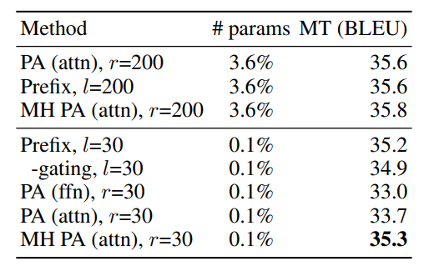
Modify Attention or FFN?
Some Observations:
Any method with FFN modification outperforms all the methods with attention modification in all cases.
However, modifying head attention shows the best results when the parameter budget is very small

Slide 80
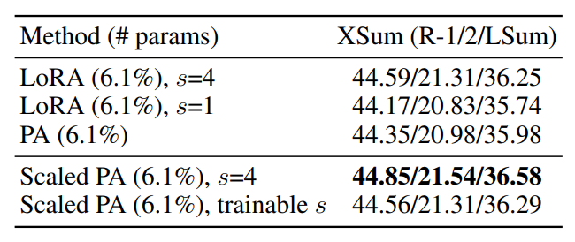
Scale Composition Function?
Some Observations:
The scaling composition function: $h←h+s⋅Δh$ is better than the vanilla additive one: $h←h+Δh ,$ just have to find the right s value
However, a learned scalar does not give much better results than manually tuning

Slide 81
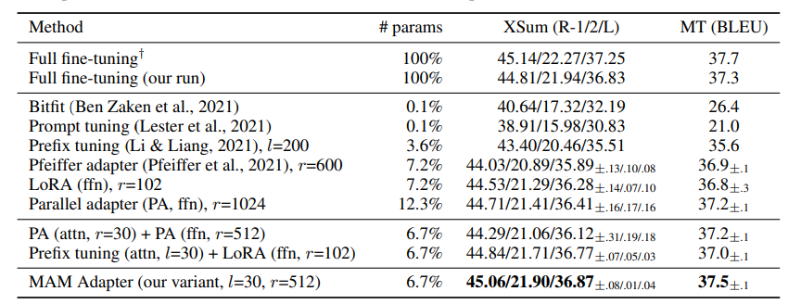
A Unified View: Combining the Best Design Elements
Scaled parallel adapter is the best variant to modify FFN;
FFN can better utilize modification at larger parameter counts;
Modifying head attentions with prefix tuning can achieve strong performance with only 0.1% parameters.
The paper presents a Mix-And-Match adapter (MAM Adapter) that combines all of these, attaining strong results

Slide 82
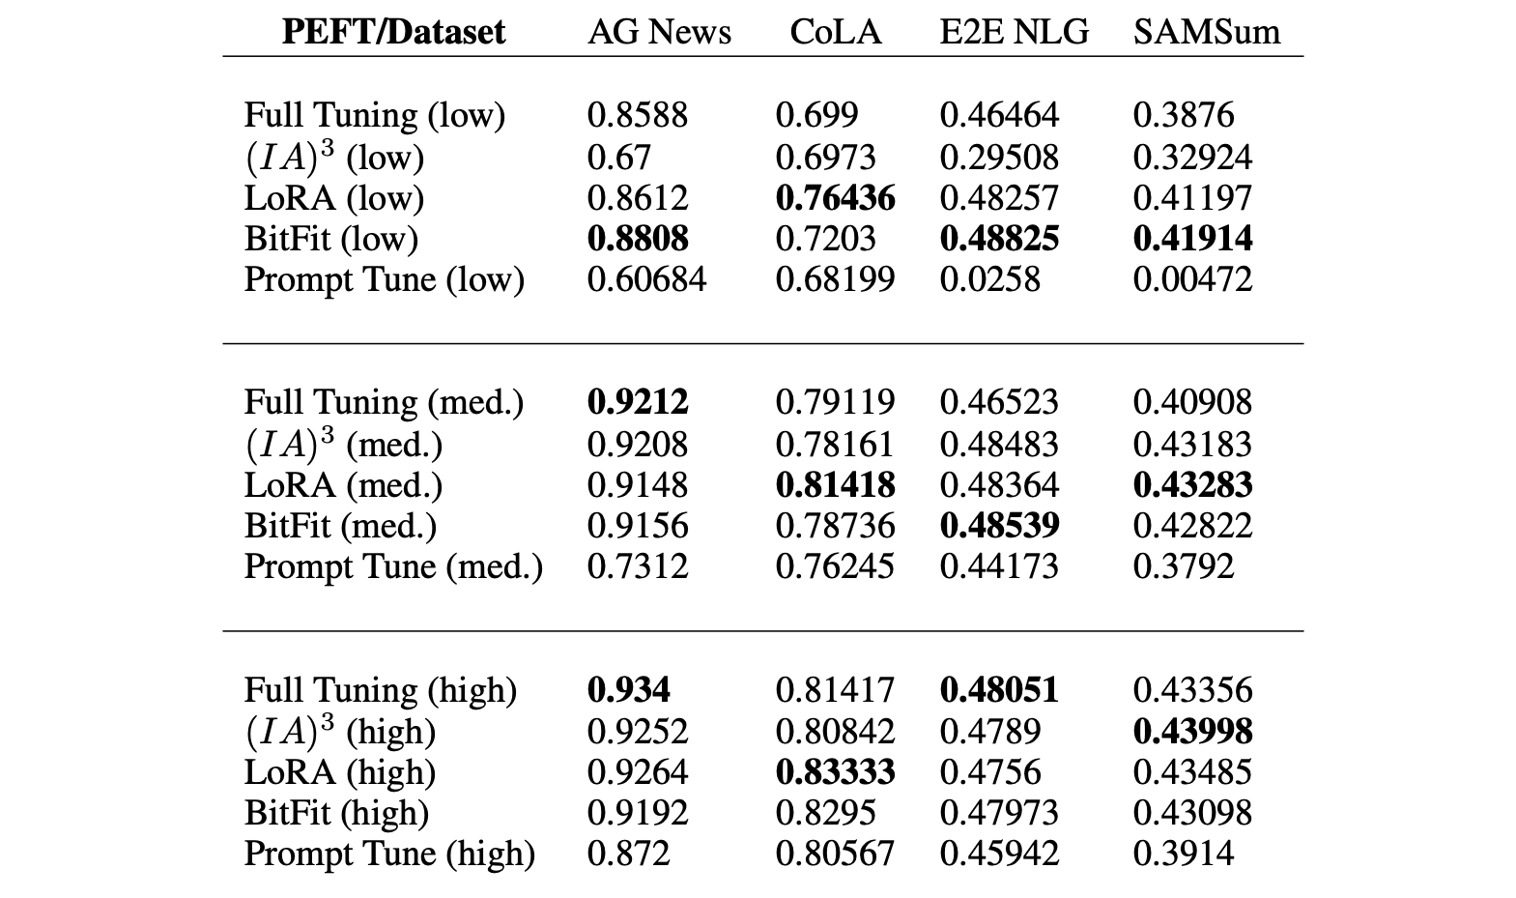
When to use PEFT?: Empirical Analysis of the Strengths and Weaknesses of PEFT Techniques for LLMs
PEFT methods perform the best in low/medium-resource scenarios
Full tuning does better in high-resource scenarios
PEFT methods slower (in time) to converge in low-resource scenarios than full tuning, but faster to converge in high-resource scenarios
Three data scales: low-resource (at most 100 data points), medium-resource (at most 1,000 data points), and high-resource (at most 10,000 data points)

Slide 83
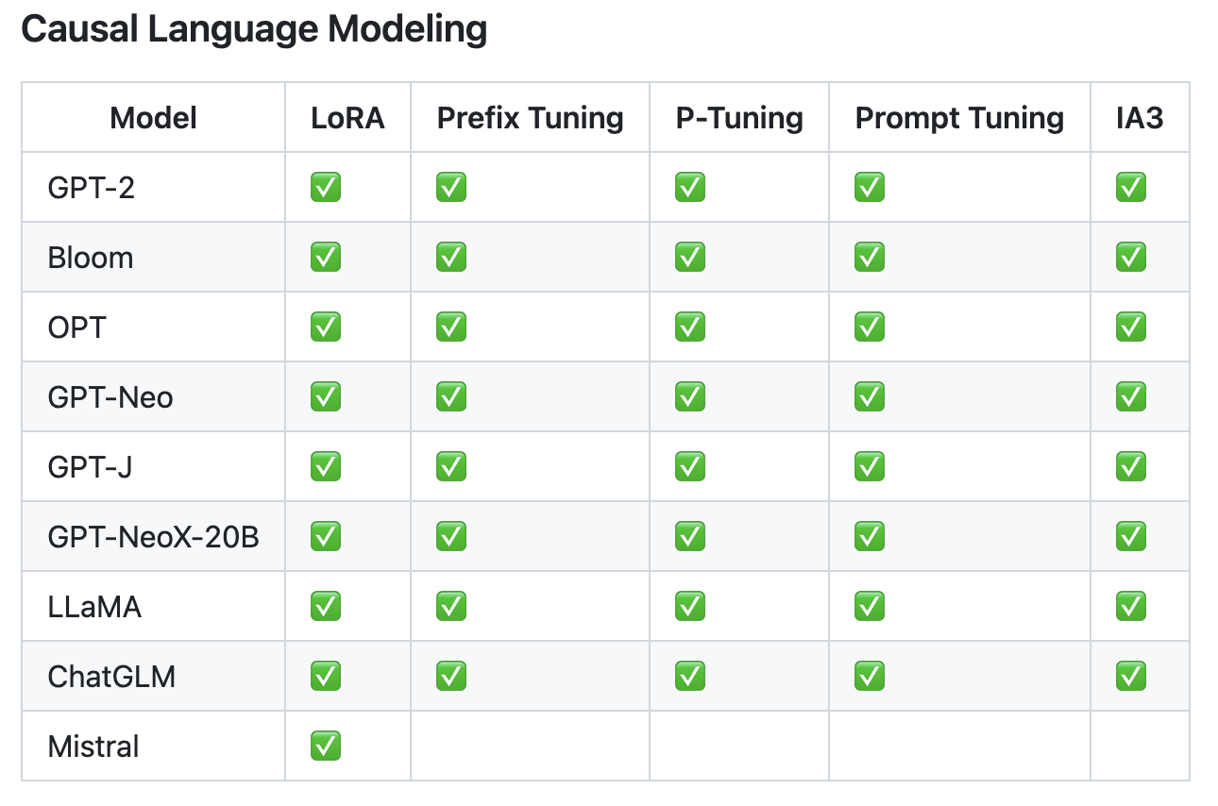
🤗 PEFT
HuggingFace PEFT supports many of the fine-tuning methods we discussed on modern models out-of-the-box
With some manual configuration, these methods can be used with most models

Slide 84
Thank you! Questions?

