Slide 1
Lecture 6: Efficient Transformer
Presenters: Albert Shi and Hossein Aboutalebi
Notes:
Hi everyone, my name is Albert, and I will be presenting the lecture on Efficient Transformer.

Slide 2
What we are covering…
Quick review of transformer – attention mechanism
Time and space complexity of traditional transformer
Proposed solutions
Sparse Transformers
Linformer
Linearized Attention
Longformer
Random Feature Attention (RFA)
…
Notes:
So, what are we covering today. I will give a real quick review of the attention mechanism in transformers, and then explain the time and space complexity of a traditional transformer and why that would be a problem, and finally present several solutions proposed over the past, including …,…, …. These are, of course not all of them, but due to time constraint these are all we will be able to cover. In the end, I will present a GitHub project comparing the performance of all efficient transformers.

Slide 3
Quick Review of Attention Mechanism
$$softmax\left(\frac{QK^{T}}{\sqrt{d_{k}}}\right)V$$
$N≔$sequence length
$h≔$ number of heads (8)
$d_{model}≔$embedding size (512)
$d_{k}≔\frac{d_{model}}{h}$ (64)
$$\dim\left(X\right)=N×d_{model}$$
$$\dim\left(W_{i}^{Q}\right)=\dim\left(W_{i}^{K}\right)=\dim\left(W_{i}^{V}\right)=d_{model}×d_{k}$$
Credit: https://jalammar.github.io/illustrated-transformer/
Notes:
First, let’s go through the attention mechanism quickly. On the left, we define a bunch of values: big N as sequence length, …, …, …. The input sequence is imbedded into X, with dimension Ndmodel. Then, the input is put through 8 separate heads, each containing weight matrices which X will multiply, with dimensions dmodel times dk, to obtain query Q, key K, and value V. Then, attention is calculated by taking softmax of Q times k transposed divided by sqrt of dk timed by V. Finally, The results from each head are concatenated and multiplied by a final weight matrix to obtain the output.

Slide 4
Computational and Space Complexity
The attention function: $Attention\left(Q, K, V\right)= softmax\left(\frac{QK^{T}}{\sqrt{d_{k}}}\right)V$
$\dim\left(QK^{T}\right)=N^{2}→O\left(N^{2}d_{k}\right)$ time complexity to calculate $QK$.
Attention matrix $\dim\left(softmax\left(\frac{QK^{T}}{\sqrt{d_{k}}}\right)\right)=N×N$
Storing the attention matrix for each head $→O\left(N^{2}h\right)$.
If $N≫d_{k}, h$, the time and space complexity is $O\left(N^{2}\right)$.
Scalability, resource consumption, adoption, etc.
Notes:
Let’s then look at where the complexity come from. Recall the attention function …, where dim of q = dimk = Ndk. Calculation of QKt would thus cost O(N^2dk). As for the space complexity, storing the attention matrix which is this (draw) part, cost O(N2) space complexity as well, for each head. Therefore, if we have very long sequences, much longer and dk and h, the time and space cost would be quadratic to sequence length, which would be very terrible if the sequence is very long. This would have a bad impact on the scalability of the transformer, and greatly increase its resource consumption. This would also affect its adoption to all sorts of situation, such as image completion and audio recognition and so.

Slide 5
Solutions
Sparse Transformers (April 2019) by Child et al.
$O\left(N\sqrt[p]{N}\right)$ time and space cost.
Linformer (June 2020) by Wang et al.
Linearized Attention (August 2020) by Katharopoulos et al.
Longformer (December 2020) by Beltagy et al.
Random Feature Attention (RFA) (March 2021) by Peng et al.
$O\left(N\right)$ time and space cost.
Some even constant space cost.
Notes:
So, to counter that situation, many has come up with solutions. Here we list a bunch of them and their improved cost. First, the sparse transformer approach proposed by Child et al in April of 2019. It achieved a O of (n times p root of N) time and space cost, where p is a hyperparameter independent of N. In their work, they gave examples when p = 2, but they claimed that higher dimensions were also feasible.
Next, we have the Linformer …., the linear attention approach by …, the longformer,,,., and the RFA …., which all achieved O(N) time and space cost, in various ways.

Slide 6
Sparse Transformers (Apr 2019)
Generating Long Sequences with Sparse Transformers Rewon Child, Scott Gray, Alec Radford, and Ilya Sutskever
Notes:
Let’s talk about them one by one. First, the sparse transformers.

Slide 7
Sparse Transformers: Motivation
Notes:
The motivation behind sparse transformer can be explained by the following images. These are the learned attention patterns from a 128-layer network on the CIFAR-10 image set trained with full attention. The white areas highlights the attention weights for a head while generating a given pixel, while black indicates masked pixels in an autoregressive task. It’s interesting to note that layers are able to learn a variety of specialized sparse patterns. For example, in image set a), which are from the initial layers, we notice that the white areas surround the target pixel, resembling convolution. In image set b), which is from layer 19 to 20, we notice a row and column attention. In further layers (point to c), we notice data dependent access patterns, for example, the white areas here surrounds the bird. And in the final set from layer 64 to 128, whites only appear in few specific locations, as we can see here. So, maybe we don’t need a full attention? Maybe sparse attention is enough.

Slide 8
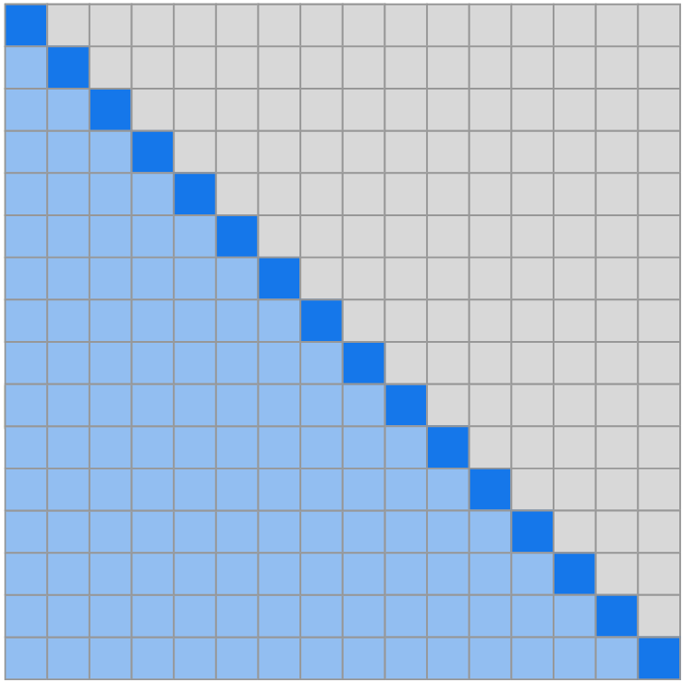
Sparse Transformers: Motivation
Let $S=\left\{S_{1}, …, S_{n}\right\}$, $S_{i}≔$input vectors that $i$th output vector attends.
$Attend\left(X, S\right)={\left(a\left(x_{i}, S_{i}\right)\right)}_{i∈\left\{1, …, n\right\}}$
$a\left(x_{i}, S_{i}\right)=softmax\left(\frac{\left(W_{q}x_{i}\right)K_{S_{i}}^{T}}{\sqrt{d}}\right)V_{S_{i}}$
$K_{S_{i}}={\left(W_{k}x_{j}\right)}_{j∈S_{i}}, V_{S_{i}}={\left(W_{v}x_{j}\right)}_{j∈S_{i}}$
$p$ separate attention heads, Efficient $A_{i}^{\left(m\right)}⊂\left\{j :j≤i\right\}$, $\left|A_{i}^{\left(m\right)}\right|∝\sqrt[p]{n}$
$$S_{i}=\left\{j :j≤i\right\}$$
Notes:
Here, we explain the motivation in a more mathematical way. Recall the attention function, the softmax function. What you are seeing here is just a token-by-token form of the function, with the output token only being able to attend to the tokens before it. Notice that this is basically the decoder part of a transformer. All the inputs after the location of the target output are masked.
So, in a full attention mechanism, Si = {j : j<i}, meaning that the output token attends to all of the previous input vectors. However, from what we have seen before, this might not be necessary. Thus, the idea is to separate the attention into p attention heads and find efficient subset of {1, …, i} such that the size of A is proportional to p root of n.

Slide 9
Sparse Transformers: $p=2$
$$S_{i}=\left\{j :j≤i\right\}$$
$$t=\max\left(0, i−l\right)$$
$$t=l−c$$
$$A_{i}^{\left(1\right)}=\left\{t, t+1, …, i\right\} \\ A_{i}^{\left(2\right)}=\left\{j :\left(i−j\right) mod l=0\right\}$$
$$A_{i}^{\left(1\right)}=\left\{j :\left(\left\lfloor j/l\right\rfloor =\left\lfloor i/l\right\rfloor \right)\right\} \\ A_{i}^{\left(2\right)}=\left\{j :j mod l∈\left\{t, t+1, …, l\right\}\right\}$$
Notes:
Here, the authors proposed two solutions when p = 2. To the left is the full attention. In the middle, they choose a hyperparameter l, in this case 4. an output token would attend to the 3 tokens before them (draw), and also the 4th, 8th, and so on ‘s token before it. The reason for this (circle Ai2) is to maintain full connectivity, since this token (circle one) is not connected to the previous tokens but through that one (circle another one) it would be able to do so, and so on. This is named the strided sparse transformer due to its shape.
To the right, they propose another solution called fixed sparse transformer. In this example, the fifth, ninth and thirteenth token would attend to their previous three tokens, the 4th, 8th and 12th tokens attending to their previous 2, and so on. These are indicated by be the dark blue areas. Now, to maintain full connectivity, the set of four tokens (draw) should attend to the last token in the previous sets (circle). These are indicated by the light blue areas.
These are just two examples when p = 2. Higher dimensions are also possible. The calculation needed then is reduced to O(Nsqrt(n)) in this case.

Slide 10
Sparse Transformers: Space Complexity
Gradient Checkpoint & recomputation
Only greyed blocks are stored
Attention and feed-forward recomputed
Notes:
But how about the space complexity? Well, instead of remembering every attention matrices, they perform recalculation for attention and feed-forward network, and instead only saving the results of the calculation. Only the grey blocks indicated here are stored, i.e., only the outputs of size N times d_model are stored.

Slide 11
Sparse Transformers: Experiments
Notes:
Now, let’s look at its performance against the state-of-the-art models at that time. They were trained on the CIFAR-10 image set, Enwik8 text dataset, ImageNet 64x64 image set, and a 5 second 12 khz Classical music. Bits per byte here means the number of bits required to generate a byte, or a pixel. The lower this number is, the better the performance. We can see that the sparse transformers here outperformed other models in every single test. The speed is also increased as indicated to the right. At the bottom right, we can see that even with long context, the performance is still good.

Slide 12
Linformer (June 2020)
Linformer: Self-Attention with Linear Complexity Sinong Wang, Belinda Z. Li, Madian Khabsa, Han Fang, and Hao Ma
Notes:
Next, we talk about linformer.

Slide 13
Linformer: Idea
Recall $Attention\left(Q_{i}, K_{i}, V_{i}\right)= softmax\left(\frac{Q_{i}K_{i}^{T}}{\sqrt{d_{k}}}\right)V_{i}$ where $\dim\left(K_{i}\right)=\dim\left(V_{i}\right)=N×d_{k}$
Project $K_{i}$ and $V_{i}$ with $E_{i}, F_{i}∈ℝ^{k×n}$ into ${\tilde{K}}_{i}=E_{i}K_{i}, {\tilde{V}}_{i}=F_{i}V_{i}∈ℝ^{k×d_{k}}$ such that $k≪N$.
Now softmax only requires $O\left(Nk\right)$ computational cost.
The attention matrix is of dimension $N×k$, thus storage takes $O\left(N×k×h\right)$ which is linear to $N$ when $k, h≪N$.
Notes:
The idea behind linformer is as follows. If you remember the attention function, the idea behind linformer is basically to project Key and Value into lower dimentional matrices k times dk with k much smaller than N. This way, the computational cost would be reduced to O(Nk), and since the dim of the attention matrix would become N times k, the space complexity is reduced to O(Nkh). Now, the question becomes whether such projections exist.

Slide 14
Linformer: Theorem
Let $k=\frac{9\log\left(d_{k}\right)}{ε^{2}−ε^{3}}, E_{i}=δR, F=e^{−δ}R$, where $R∈ℝ^{n×k}$ with i.i.d. entries from $N\left(0,\frac{1}{k}\right), δ=\frac{1}{2^{N}}$, this theorem still holds, i.e., $softmax\left(\frac{Q_{i}{\left(E_{i}K_{i}\right)}^{T}}{\sqrt{d_{k}}}\right)F_{i}V_{i}\sim softmax\left(\frac{Q_{i}{K_{i}}^{T}}{\sqrt{d_{k}}}\right)V_{i}$
Notes:
Here, the authors proposed a theorem to show that they do. The theorem basically showed that for a certain value of k, such E and F exists. But here, K is dependent on n. but they noted that the Rank of QiKi transposed divided by sqrt dk is at most dk since dim(Qi)=dim(Ki)=ndk. This theorem combined with that fact gives the following: let k … which is independent of n, …, …, …, normal distribution with mean of 0 and variance of 1/k, delta = ½^N, then…,…. The proof of this theorem combines a bunch of inequality lemmas and so, and due to time constraint I will not delve into too much details, but just know that we can find concrete k, delta, Ei and Fi.

Slide 15
Linformer: Experiments
The performance aligns with that of the standard transformer.
Different sharing:
Headwise: same $E_{i}=E$ and $F_{i}=F$ for all $i.$
Key-value: $E_{i}=F_{i}=E$.
Layerwise: single $E$ for all.
For different $n$ and $k$: the performance merges eventually.
Notes:
Now we looked at some experiments they performed to evaluate its performance. Valid ppl here means the validation perplexity, and the lower that is, the less uncertain the model is when predicting, the better the performance. First, they compare the performance with fixed sequence length but varying k. We can see that the validation perplexity of the linformer merged very close to that of a standard transformer, and even not very much, the larger k is, the better the performance. Next, they compared three different ways to initialize E and F. First is headwise, where they used the same E and F for each head but varying between layers. Second is keyvalue-wise, where they used the same E for both key and values for every head, varying between layers. Third is layerwise, where they use a single E for all projections. The performances of these three ways of sharing did not vary much, but layerwise sharing was just a bit more unstable. Finally, for fised k and varying N, we can see that the longer N is, the slower the perplexity decreases, but eventually they merged to similar values.

Slide 16
Linformer: Experiments
Notes:
Now, let’s look at its performances compared to other models. They used a RoBERTa-based model as the base model, trained on the same corpus as BERT. They are tested on 4 different benchmark NL understanding tasks, with varying N and for each N, varying k and sharing strategy. We can see that (point)

Slide 17
Linformer: Experiments
Notes:
Now comes the time and memory efficiency improvements. Left is time save, and right is memory save. The baseline is the basic transformer. We observe a great improvement over the the basic transformer, both in time and space. The longer the sequence is, the more obvious the improvement is.

Slide 18
Linearized Attention (Aug 2020)
Transformers are RNNs: Fast Autoregressive Transformers with Linear Attention Angelos Katharopoulos, Apoorv Vyas, Nikolaos Pappas, and François Fleuret
Notes:
Next, we talk about Linearized Attention by ….

Slide 19
Linearized Attention
Recall the definition of the $softmax$ function: $softmax{\left(x\right)}_{i}=\frac{e^{x_{i}}}{\sum_{j=1}^{n}{e^{x_{i}}}} for i=1, …, n, x=\left(x_{1},…, x_{n}\right).$
Thus, let $M_{i}$ denote the $i$th row of matrix $M$, and let $Y$ be the output of the attention mechanism, then $Y_{i}=softmax\left(\frac{Q_{i}K}{\sqrt{d_{k}}}\right)V=\frac{\exp\left(\frac{Q_{i}K}{\sqrt{d_{k}}}\right)V}{\sum_{j=1}^{n}{\exp\left(\frac{Q_{i}K_{j}}{\sqrt{d_{k}}}\right)}}=\frac{\sum_{j=1}^{N}{sim\left(Q_{i}, K_{j}\right)V_{j}}}{\sum_{j=1}^{N}{sim\left(Q_{i}, K_{j}\right)}}$ where $sim\left(q, k\right)=\exp\left(\frac{q⋅k}{\sqrt{d_{k}}}\right)$.
Notes:
Here, we quickly recall the definition of the softmax function. Given a sequence x = x1 all the way to xn, the ith position of softmax of x is equal to e to the power of xi divided by the sum of exponents of all xi. So, if I let i denote the ith row of a matrix, and Y denote the output of the attention mechanism, then the ith row of Y can be calculated by the following. Yi equals to softmax of Qi times K divided by sqrt dk then times V. Plugging the softmax function in gives the next part. Finally, notice that the top part is (draw), thus we come to the final form of the function, where sim(q,k) = exponents of (q dot k divided by sqrt of dk).

Slide 20
Linearized Attention
The only constraint on $sim\left(⋅\right)$ is non-negativity.
Any $k\left(x, y\right) :ℝ^{2×d_{model}}→ℝ_{+}$ works.
Let $φ\left(x\right)$ be the feature representation of such a kernel. Then $Y_{i}=\frac{\sum_{j=1}^{N}{φ{\left(Q_{i}\right)}^{T}φ\left(K_{j}\right)V_{j}}}{\sum_{j=1}^{N}{φ{\left(Q_{i}\right)}^{T}φ\left(K_{j}\right)}}=\frac{φ{\left(Q_{i}\right)}^{T}\sum_{j=1}^{N}{φ\left(K_{j}\right)V_{j}^{T}}}{φ{\left(Q_{i}\right)}^{T}\sum_{j=1}^{N}{φ\left(K_{j}\right)}}$
$\sum_{j=1}^{N}{φ\left(K_{j}\right)V_{j}^{T}}$ and $\sum_{j=1}^{N}{φ\left(K_{j}\right)}$ can be computed once and reused
$O\left(N\right)$ time and space complexity
$φ\left(x\right)=elu\left(x\right)+1, elu\left(x\right)=\left\{\begin{matrix}x & x≥0 \\ α\left(e^{x}−1\right) & x<0\end{matrix}\right.$
Notes:
Now, by the definition of an attention function, the only constraint on the aforementioned sim() function is that it has to be non-negative. Here, we do not need to specify the kernel. We only need to specify its feature map, or feature representation. A feature representation phi of a kernel k is the function such that k of x and y is equal to phi x times phi y. Plugging that into the previous equation we have gives the following. We can take out phi of Qi transposed from the top and the bottom. Notice that these sums can be computed once and reused. The cost for computing the sums depend on N linearly, and computing this (circle) and this (circle) cost O(N), since the top sum produce a constant, and the bottom is a dot product. Yi has dmodel rows in total, so in the end, the model’s computational cost is linear to O(N). The computational cost could also be reduced to O(N) since we do not need to save the full attention matrix anymore; each of these (point) requires O(N) to save.
Their choice of phi(x) was the exponential linear unit activation function to avoid setting the gradient to 0 when x is negative.

Slide 21
Linearized Attention: Causal Masking
Causal Masking: masking the attention computation such that the $i$th position can only be influenced by a position $j$ if and only if $j≤i$.
$$Y_{i}=\frac{φ{\left(Q_{i}\right)}^{T}\sum_{j=1}^{i}{φ\left(K_{j}\right)V_{j}^{T}}}{φ{\left(Q_{i}\right)}^{T}\sum_{j=1}^{i}{φ\left(K_{j}\right)}}=\frac{φ{\left(Q_{i}\right)}^{T}S_{i}}{φ{\left(Q_{i}\right)}^{T}Z_{i}}$$
where $S_{i}=\sum_{j=1}^{i}{φ\left(K_{j}\right)V_{j}^{T}},Z_{i}=\sum_{j=1}^{i}{φ\left(K_{j}\right)}$.
Notice that $S_{i}, Z_{i}$ can be computed from $S_{i−1},Z_{i−1}$ in constant time.
How about space complexity?
Notes:
Causal masking is the technique used in autoregressive feature generation, which we mentioned before. We basically mask the tokens after the target token, making only the tokens before visible to it. In this case, our equation becomes the following. We simply replace N by i. We replace the top sum by Si and the bottom sum by Zi. Notice that Si can be computed from Si-1 by adding phi Ki times Vi transposed, and Zi can be computed from Zi-1 by adding phi of Ki. Since computation of the sums are linear to N and adding those are constant to N, we still have a linear time complexity.

Slide 22
Linearized Attention: Causal Masking
Given numerator $\overline{Y_{i}}=φ{\left(Q_{i}\right)}^{T}\sum_{j=1}^{i}{φ\left(K_{j}\right)V_{j}^{T}}$and the gradient of loss fuction $∇_{\overline{Y_{i}}}ℒ$, they derived the gradients of $Q, K, V$ $∇_{{φ(Q}_{i}) }ℒ=∇_{\overline{Y_{i}}}ℒ{\left(\sum_{j=1}^{i}{φ\left(K_{j}\right)V_{j}^{T}}\right)}^{T}$ $∇_{φ\left(K_{i}\right)}ℒ=\left(\sum_{j=1}^{N}{φ\left(Q_{j}\right)V_{j}^{T}{\left(∇_{\overline{Y_{j}}}ℒ\right)}^{T}}\right)V_{i}$ $∇_{V_{i}}ℒ={\left(\sum_{j=1}^{N}{φ\left(Q_{j}\right){\left(∇_{\overline{Y_{j}}}ℒ\right)}^{T}}\right)}^{T}φ\left(K_{i}\right)$
Notes:
During back propagation, the gradients w r t q, k, v needs to be computed from the full attention matrix, giving a space complexity of O(N^2). Here, the authors derive the gradients so that the time cost is linear and space cost is constant. Given the numerator from the equation before and the gradient of the loss function nebla sub y bar of L, the authors were able to derive the gradients w r t phi q phi k and v as follows. We can see that these calculations all require linear to N time, and storing them require constant space. The total time and computational cost are thus all linear overall. We omitted the discussion regarding the derivation of these gradients due to time and space constraints.

Slide 23
Linearized Attention: RNN
Transformers are RNNs.
$s$ and $z$ are the hidden states.
$x_{i}$ is the $i$th input.
$y_{i}$ is the $i$th output.
Notes:
From what we gathered above, they formalized the transformers as an RNN. This, and I quote, is a first step towards better understanding the relationship between transformers and popular recurrent networks (Hochreiter & Schmidhuber, 1997) and the processes used for storing and retrieving information. The authors did not mention why RNN means linear time and space complexity; their goal for formulating transformers in the way of an RNN is just to emphasize the idea that transformers and RNNs can be closely related to each other.

Slide 24
Linearized Attention: Experiments
Notes:
So, let’s look at some experimentation results. I will just quickly run through them. The black line represent the authors model, the blue lines are from the Reformer model, and the red line is the standard transformer. We can see that the linaer attention model outperforms the rest both in terms of time and space requirements as the sequence length grows.

Slide 25
Linearized Attention: Experiments
Notes:
Next, we look at the convergence of cross entropy loss. We can see that, as the steps grows, the linear attention model’s loss converged to that of the standard transformer, while the Reformer did not.

Slide 26
Linearized Attention: Experiments
Notes:
Comparing image generation, we can see that linear attention model significantly outperforms the other models in term of speed. Although the performance is not the beest, i.e., the bits/dim is not the lowest, they are still close to the baseline.

Slide 27
Linearized Attention: Experiments
Notes:
These are just some illustrations of the image generation results, you may pause to observe some of them.

Slide 28
Linearized Attention: Experiments
Notes:
Finally, on speech recognition task, the linear attention model still outperforms the rest in terms of time spent per epoch. It also has lower error rate than two of the baseline models, although not outperforming the standard transformer.

Slide 29
Longformer (Dec 2020)
Longformer: The Long-Document Transformer Iz Beltagy, Matthew E. Peters, and Arman Cohan
Notes:
Next, I will talk about Longformer, …….

Slide 30
Longformer: Idea
Local context is important.
Sparsify the full self-attention matrix
“attention pattern” specify pairs of input locations attending to one another.
If the window is fixed (i.e. independent of $N$), the computational and space cost is $O\left(N\right)$.
Notes:
The idea here is similar to that of sparse transformer, therefore we will not delev into too much details here. Basically, they define a fixed window size independent of N, so that the total computational and space cost would be linear to N.

Slide 31
Longformer
Sliding Window: give fixed window size $w$, each token attends to $\frac{1}{2}w$ tokens on each side.
Dilated Sliding Window: with gaps of size dilation $d$.
Global Attention: Specific tokens that receive global attention.
They can all achieve $O\left(N\right)$ time and space complexity.
Notes:
Here we show their approaches. They proposed three form of sliding window attention, first one simply called the sliding window attention. Given a fix window size w, each token attend to 1/2 w tokens on each size. The second one is called dilated sliding window, which is sliding window with gaps of size dilation (d).
Global attention, on the other hand, specify certain tokens that both attend to all other tokens and receive attention from all other tokens. For example, for classification, global attention is used for the [CLS] token. While specifying global attention is task specific, it is an easy way to add inductive bias to the model’s attention, and it is much simpler than existing task specific approaches that use complex architecture to combine information across smaller input chunks.
For the global plus sliding window approach, two sets of Q, k and V are used for each, but they are initialized to be the same.
As the number of such global tokens are small relative to N, the total computational and space cost is still O(N).

Slide 32
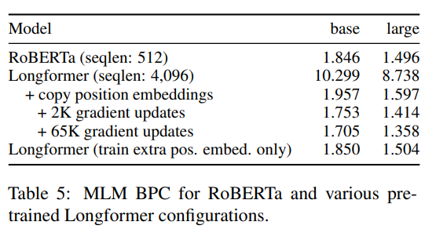
Longformer: Bits-per-Character
Notes:
Now lets come to some experiments. BPC is the equivalent concept to BPP in terms of text-based task. We can see that longformer has the best small model BPC on text8 and enwik8 dataset, and close to best BPC for large models on enwik8.
To the right, it shows the comparison within the model for different mode of sliding window and dilation. We can see that …
To the bottom right, they tested several longformer configurations.

Slide 33
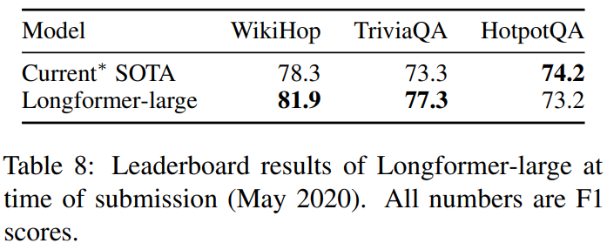
Longformer: Experiments
Notes:
Here we show some other accuracy results for Q&A, coreferencing, and classification, compared to RoBERTa and current leaderboard.

Slide 34
Longformer: Experiments
Notes:
Here are just some more results, you can pause and read them if you want to, but I will move on due to limited time.

Slide 35
Random Feature Attention (RFA) (Mar 2021)
Random Feature Attention Hao Peng, Nikolaos Pappas, Dani Yogatama, Roy Schwartz, Noah A. Smith, and Lingpeng Kong
Notes:
Lastly, we come to RFA.

Slide 36
RFA: Preliminary
$w_{i}$ independently sampled from $𝒩\left(0, σ^{2}I_{d}\right)$: for $w_{i}=\left\{w_{1}, …, w_{d}\right\}$, each $w_{i}$ are independently sampled from $𝒩\left(0, σ^{2}\right)$, i.e., normal distribution with 0 mean and $σ^{2}$ variance.
$𝔼_{w_{i}}\left[φ\left(x\right)⋅φ\left(y\right)\right]$: expected value of $φ\left(x\right)⋅φ\left(y\right)$ given $w_{i}$.
Notes:
The idea here is inspired by linearized attention. First, we introduce the preliminary theorem used. Let wi be independently sampled vectors from N(0, sigma^2I_d), in other words, let each entry in wi be sampled from N(0, sigma^2), and Let phi be a nonlinear transformation from R small d to R 2big D, where phi of vector x is equal to sqrt of 1 over big D times the transpose of sin(w_1 dot x) all the way to sin(w_d dot x) and cos of w1 dot x all the way to cos of w sub d dot x. Then, the expected values of phi(x) times phi(y) given wi is the exponent of the length of x-y squared divided by 2 sigma squared negated. Notice that big D is a hyperparameter independent of sequence length.
So how does this help us?

Slide 37
RFA
$$\exp\left(\frac{Q_{i}^{T}K_{j}}{\sqrt{d_{k}}}\right)=\exp\left(\frac{{\left\|Q_{i}\right\|}^{2}}{2\sqrt{d_{k}}}+\frac{{\left\|K_{j}\right\|}^{2}}{2\sqrt{d_{k}}}\right)\exp\left(−\frac{{\left\|Q_{i}−K_{j}\right\|}^{2}}{2\sqrt{d_{k}}}\right)≈\exp\left(\frac{{\left\|Q_{i}\right\|}^{2}}{2\sqrt{d_{k}}}+\frac{{\left\|K_{j}\right\|}^{2}}{2\sqrt{d_{k}}}\right)φ\left(Q_{i}\right)φ\left(K_{j}\right)$$ where $σ^{2}=\sqrt{d_{k}}.$ $$Y_{i}≈\frac{\sum_{j=1}^{N}{φ{\left(Q_{i}\right)}^{T}φ\left(K_{j}\right)V_{j}^{T}}}{\sum_{j=1}^{N}{φ\left(Q_{i}\right)⋅φ\left(K_{j}\right)}}=\frac{φ{\left(Q_{i}\right)}^{T}\sum_{j}{φ\left(K_{j}\right)⊗V_{j}}}{φ\left(Q_{i}\right)⋅\sum_{j}{φ\left(K_{j}\right)}}$$ This is defined as $RFA\left(Q_{i},K, V\right)$.
Notes:
Well, now we can perform the following operation: exponents of Qi transpose time K_j divided by sqrt d_k equals this formula, which should be trivial. Notice the second exponents. Now we can use the theorem before to replace it with its kernel representation to obtain its final form.
Now, we can see why this work is inspired by linearized attention. Recall the attention function from Linear attention. We just replace the sim() function with what we have here, and define what we obtain as RFA of (Qi, K, V). O times here denote the outer product. Which produce the matrix whose entries are all products of an element in the first vector with an element in the second vector, correspondingly. (draw maybe)

Slide 38
RFA: Complexity
$φ\left(q_{t}\right)$:
Time: $O\left(2Dd_{k}\right)$
Space: $O\left(2D\right)$
$\sum_{i}{φ\left(k_{i}\right)⊗v_{i}}$:
Time: $O\left(2NDd_{k}\right)$
Space: $O\left(2Dd_{k}\right)$
$$RFA\left(q_{t}, \left\{k_{i}\right\}, \left\{v_{i}\right\}\right)=\frac{φ{\left(q_{t}\right)}^{T}\sum_{i}{φ\left(k_{i}\right)⊗v_{i}}}{φ\left(q_{t}\right)⋅\sum_{j}{φ\left(k_{j}\right)}}$$
Operations with $φ\left(q_{t}\right)$:
Time: $O\left(2Dd_{k}\right)$
$\sum_{i}{φ\left(k_{i}\right)}$:
Time: $O\left(2Dd_{k}\right)$
Space: $O\left(2D\right)$
Notes:
Here we discuss the time and space complexity. In the gaussian case, Phi (qt) takes time 2Ddk and space 2D, this cross product takes time 2NDd_k and space 2Ddk, the summation alone takes time O(2NDk) and space O(2D), and the operations with phi qt, the dot products, take time 2Dk. Thus, time is linear to N, and memory is constant, but highly dependent on D. Further expeirments shows that when D>2d, the benefit is marginal.

Slide 39
RFA: RNN
Causal attention → RNN.
At time step $t$, $RFA\left(q_{t}, {\left\{k_{i}\right\}}_{i≤t}, {\left\{v_{i}\right\}}_{i≤t}\right)=\frac{φ{\left(q_{t}\right)}^{T}S_{t}}{φ\left(q_{t}\right)⋅z_{t}},$ where $S_{t}=S_{t−1}+φ\left(k_{t}\right)⊗v_{t}, z_{t}=z_{t−1}+φ\left(k_{t}\right).$
$S_{t}$ and $z_{t}$ are the hidden states.
Stateful: the last hidden states passed to the next mini-batch during both training and evaluation.
Notes:
Now, like the linearized attention, this again gives us an RNN in case of causal attention. I need to remind everyone here that this does not explain why the time and space cost is linear. This just strengthen the relationship between a transformer and an RNN.
Also, due to its RNN-like property, RFA can be made “stateful”: that is, we can pass the last hidden states St and zt to the next mini-batch. We will see later that this improves the performance quite a bit.

Slide 40
RFA: Gated
Transformers rely heavily on positional encodings.
The previous RNN variance offers ways to learn with recency bias, augmented with a learned gating mechanism: $g_{t}=sigmoid\left(w_{g}⋅x_{t}+b_{g}\right),$ $S_{t}=g_{t}S_{t−1}+\left(1−g_{t}\right)φ\left(k_{t}\right)⊗v_{t},$ $z_{t}=g_{t}z_{t−1}+\left(1−g_{t}\right)φ\left(k_{t}\right).$
$w_{g}$ and $b_{g}$ are learned parameters. $0<g_{t}<1$.
With this, history is exponentially decayed, favoring more recent context.
Notes:
Another benefits that RNN-like form gives us is the ability to learn recency bias, with a gating mechanism. Here wg and bg are learned parameters, and the hidden states are multiplied by the learned scalar gates gt that falls between 0 and 1 so that history is exponentially decayed, favoring more recent context.

Slide 41
RFA: Alternative Kernel
Previously: Gaussian Kernel.
A family of shift-invariant kernels works. $φ_{arccos}\left(x\right)=\sqrt{\frac{1}{D}}{\left[ReLU\left(w_{1}⋅ x\right), …, ReLU\left(w_{D}⋅x\right)\right]}^{T}$ $ReLU\left(x\right)=\max\left(0, x\right)$
Achieved similar results.
Supplements to alternatives to softmax.
Notes:
Here we introduce an alternative kernel to the Gaussian one we used before. They chose from a family of shift-invariant kernel the rectified linear unit activation function. Here, relu of x equals the max of 0 and x.

Slide 42
RFA: Experiments
Notes:
Now lets look at some experimentation results. The baseline used here is the linearized attention, compared with the variances proposed in this one. We can see that in term of perplexity, the gated variance performed much better than the baseline and the ungated ones, and the stateful variance performed even better.

Slide 43
RFA: Experiments
Notes:
When it comes to machine translation, where the baseline is the standard transformer. We can see here that the speed of RFA is nearly as good as the linearized attention model, while the performance is near the baseline and better than the linearized attention.

Slide 44
RFA: Experiments
Notes:
Here is a comparison with other models on different text databases. We can see that it has an outstanding accuracy among the tested models. It did not lead in terms of speed and memory consumption, but it still reached quite up there.

Slide 45
RFA: Experiments
Notes:
Finally, we look that the comparison to the softmax function in terms of decoding speed and memory consumption. Notice that the x scale is log 2 based. As sequence length grows, the speed of softmax clearly shows a quadratic decay, while the speed of RFA in both variances did not vary much. In terms of memory consumption, softmax grows quadratically, while RFA remained almost constant.

Slide 46
Comparing Efficient Transformers
Notes:
As a final note, I present a github page comparing all the efficient transformers. Shout out to professor Wenhu Chen for this.

Slide 47
Comparison
https://github.com/google-research/long-range-arena
Notes:
This website lists all the efficient transformers as of 8th of November 2020, and their performance comparisons, as shown in this chart. You can go to this link for more information.

Slide 48
Thank you :-)
Notes:
And that’s it, thank you for your time.

Slide 49
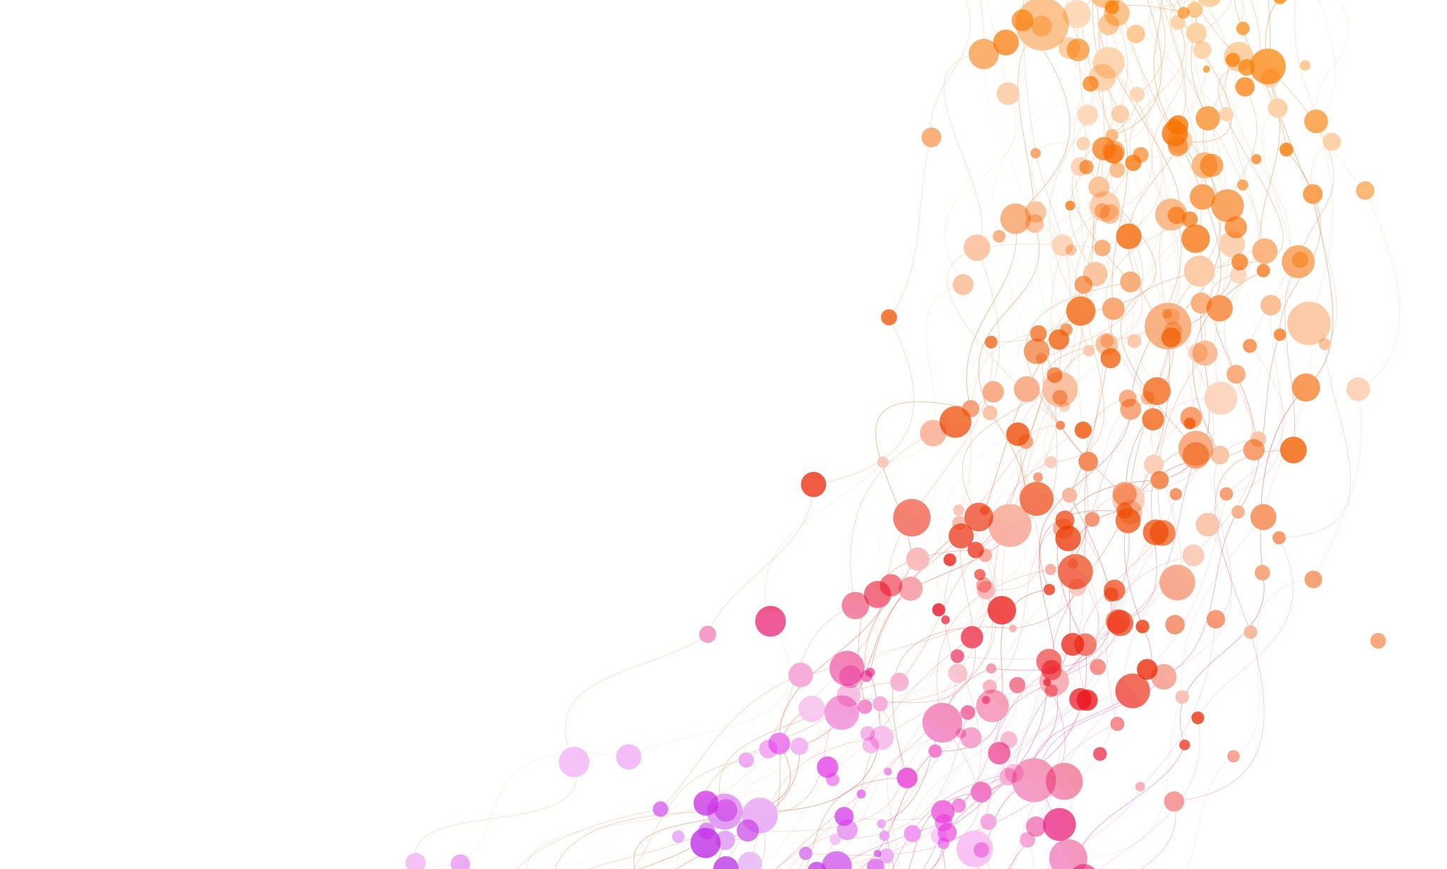
State Space Models, introduction of Mamba

Slide 50
Introduction
Foundation models (FMs), or large models pretrained on massive data then adapted for downstream tasks
Modern FMs are predominantly based on a single type of sequence model: the Transformer and its core attention layer
Problem with Transformers: an inability to model anything outside of a finite window, and quadratic scaling with respect to the window length.
Structured state space sequence models (S4) intend to address these issues

Slide 51
Structured State Space for Sequence Modeling (S4)
Many subquadratic-time architectures such as linear attention, gated convolution and recurrent models, and structured state space models (SSMs) have been developed to address Transformers’ computational inefficiency on long sequences
SSM models can be interpreted as a combination of recurrent neural networks (RNNs) and convolutional neural networks (CNN)

Slide 52
Structured State Space for Sequence Modeling (S4)
a new approach to very long-range sequence modeling tasks for vision, language, and audio
Have a capacity to capture dependencies over tens of thousands of steps.

Slide 53
State Space Models
Goal: efficient modeling of long sequences
Solution: build a new neural network layer based on State Space Models.
RNN can be used but they are sequentially computed.
Transformers are not sequential like RNN but they come with heavy computation cost with longer sequence
Can we do something better? Maybe with “state space model”
But what is state space model?

Slide 54
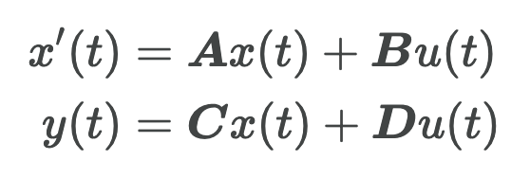
What is state space model?
It maps a 1-Dimensional input signal $u(t)$ to an $N$-Dimensional latent state x$(t)$
Then it projects the result to a 1-Dimensional output signal $y(t)$
Note: The input and output can be multi-dimensional, for simplicity we assume here it is 1-dimensional
SSM is used as a black-box representation in a deep sequence model, where $A, B, C, D$ are parameters learned by gradient descent.
Note: We discard the term D for simplicity in next follow-up equations

Slide 55
What is state space model?
$u$ is the input function
$x$ is the latent function
$y$ is the output function
SSM first introduced in control models in 1960s
$x$ usually has higher dimension than $u$ and $y$
$u, y, x$are functions of time

Slide 56
Properties of SSM
Source: https://srush.github.io/annotated-s4/
It is a sequence-to-sequence map
You can use SSM for:
1- Continuous models
2- Recurrent models
3- Convolutional models

Slide 57
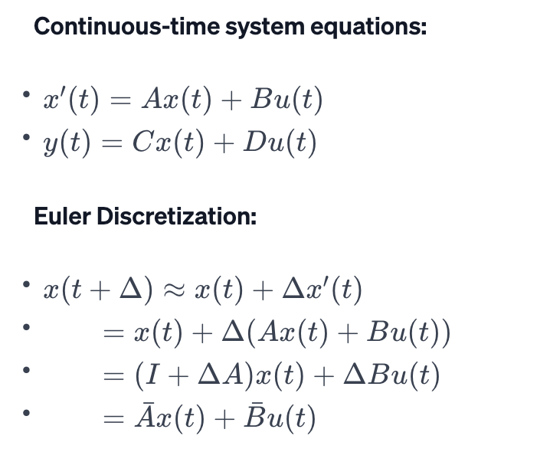
Discrete-time SSM: The Recurrent Representation
What to do if instead of having continuous function $u(t)$ , we have discrete inputs sequence like:
$u_{0}, u_{1}, …,$
SSM must be discretized by a step size $Δ$
$Δ$ represents the resolution of the input.
$u_{i}$can be viewed as a sample from function $u(t)$
To discretize the continuous-time SSM, we can use the bilinear method
It converts $A$ to approximation of $\overline{A}$

Slide 58
Discrete-time SSM: The Recurrent Representation
How to change the transformation equation for $u\left(t\right)→y(t)$ given discrete input sequence?
Instead of working with $u\left(t\right)→y(t)$, we work with $u_{k}→y_{k}$ to indicate time-steps
Now the equation is recurrence on $x_{k}$
We can use RNN model to compute state of SSM
$x_{k}$ is basically the hidden state carried out in RNN
RNN are more efficient at inference time due to constant state size independent of sequence length (faster at testing)
But they cannot get parallelized like transformers (problem during training)
Next state
Previous state
Input

Slide 59
Discrete-time SSM: A Mechanics Example
Consider a mass attached to a wall by spring with forward position $y\left(t\right)$
Varying force $u\left(t\right)$ is applied to the mass
Parameters of the system:
mass: $m$
Spring constant: $k$
Friction constant: $b$
We can relate everything with the following Differential Equation:
$${my}^{′′}\left(t\right)=u\left(t\right)−by^{′}\left(t\right)−ky\left(t\right)$$

Slide 60
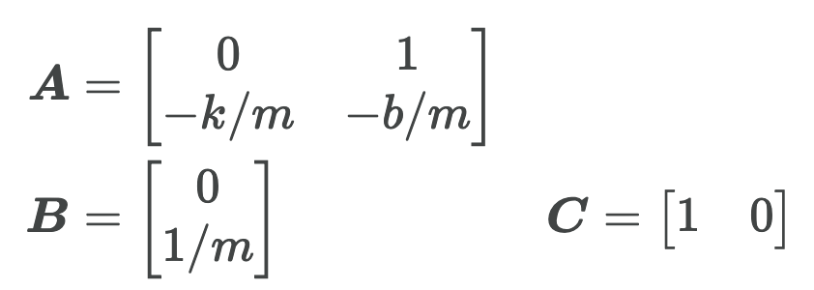
Discrete-time SSM: A Mechanics Example
We can rewrite this equation with $A, B, C$ of SSM:
$C$ shows the first dimension of hidden state is the position
Because it becomes $y\left(t\right)$
The second dimension is velocity as it is impacted by $u\left(t\right)$ through $B$
$A$ relates these terms

Slide 61
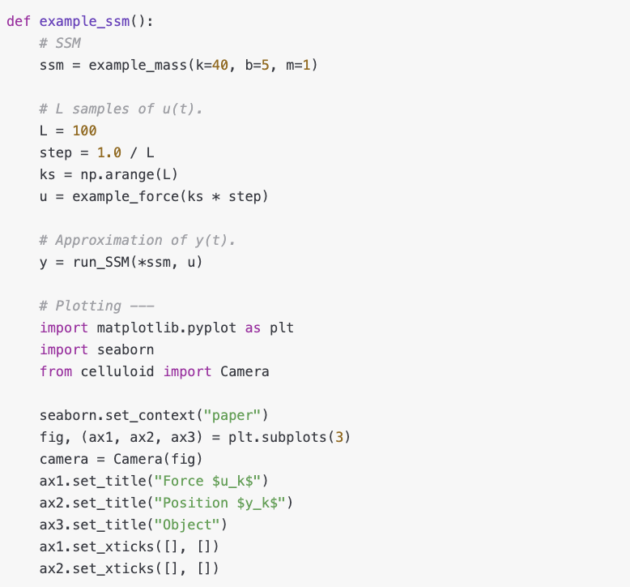
Discrete-time SSM: A Mechanics Example
$C$ shows the first dimension of hidden state is the position
Because it becomes $y\left(t\right)$
The second dimension is velocity as it is impacted by $u\left(t\right)$ through $B$
$A$ relates these terms
The following code put everything together to simulate SSM modeling of the problem

Slide 62
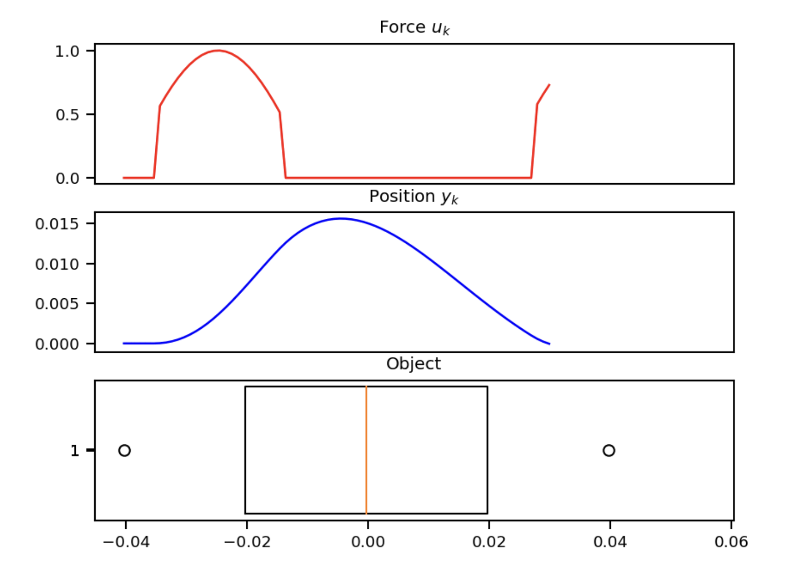
Discrete-time SSM: A Mechanics Example
Position is predicted by SSM matches with object position
The force is asserted to the object to change the position over time
This example is just 1 SSM, with 2 hidden states over 100 steps
We can stack many SSM blocks in our network

Slide 63
Training SSMs: The Convolutional Representation
we can turn the “RNN” representation into a “CNN” by unrolling it
Why want CNN representation? Training RNN is sequential
Recurrent SSM can be written as a discrete convolution
Let’s see the equations by unrolling them

Slide 64
Training SSMs: The Convolutional Representation
We can vectorize this as follows and get the closed formula:
$\overline{K}$ is called the SSM convolution kernel or filter
$\overline{K}$ is a giant filter applied to input u
Now output can be computed without computing the internal state u(t) -> making it parallel

Slide 65
Training SSMs: The Convolutional Representation
Is the problem solved? No!
$\overline{K}$ (the SSM convolution kernel) is just too big!
Solution? Use Fast Fourier Transform (FFT) using convolution theorem
How?
The discrete convolution theorem allows us to efficiently calculate the output of convolution by first multiplying FFTs of the input sequences
Next applying an inverse FFT
So, instead of sweeping the whole input sequence with a large filter which takes O$(NM),$where N is the sequence length and M is the filter length
For FFT it is O($(N+M)log⁡(N+M))$

Slide 66
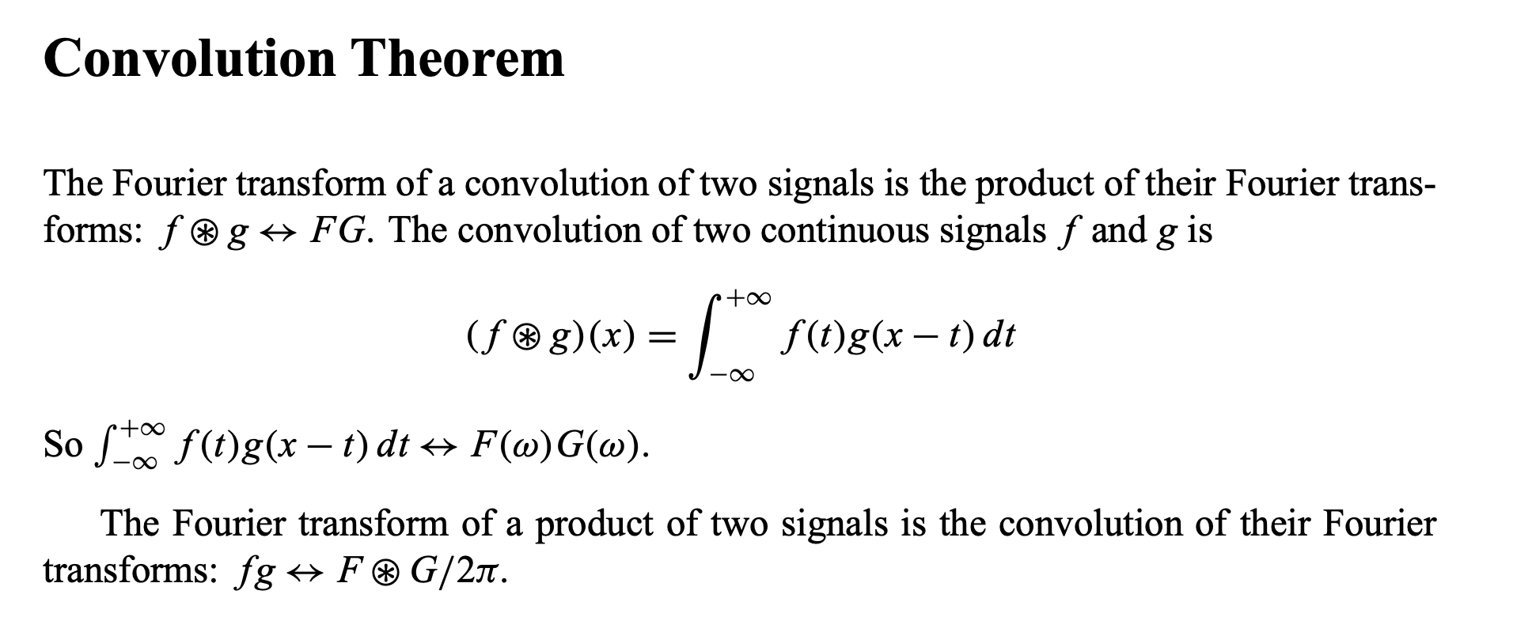
The Convolution Theorem

Slide 67
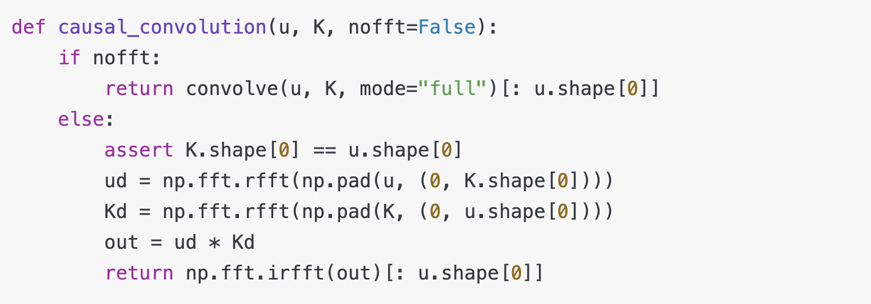
Training SSMs: FFT Transform code
nofft: a boolean flag to choose between direct convolution (True) and FFT-based convolution
np.fft.rfft: This function computes the one-dimensional n-point discrete Fourier Transform (DFT) of a real-valued array by means of an efficient algorithm called the Fast Fourier Transform (FFT)
np.fft.irfft: is the inverse FFT function to convert it back to the time domain

Slide 68
S4 & HiPPO Matrix: Addressing Long range dependency
It has been shown that basic SSM performs very poorly in practice
Why? vanishing/exploding gradients problem
They suffer from gradients scaling exponentially in the sequence length
For long-term dependency, we need something better
Use HiPPO Matrix in SSM to get S4
S4 is a special SSM

Slide 69
What is S4
SSM + HiPPO + Structured Matrices = S4
HiPPO: Use special formulas for A, B Matrices in SSM
Matrix A is basically can be seen as the matrix that captures the previous state. It also decides how the information is copied.

Slide 70
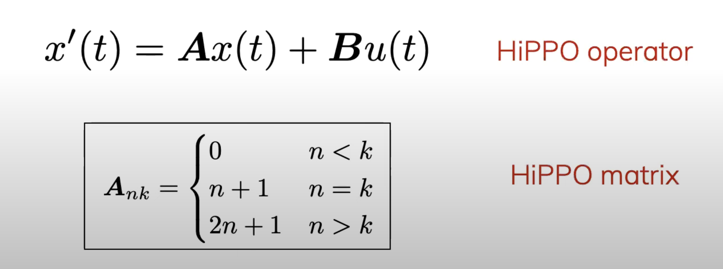
HiPPO Matrix:
HiPPO specifies a class of certain matrices $A∈R^{n×n}$
Motivation: The matrix allow the state $x(t)$ to memorize the history of the input $u\left(t\right)$
It is shown that simply modifying an SSM from a random matrix $A$ to HiPPO improved its performance on the sequential MNIST classification benchmark from 60% to 98%
HiPPO matrix aims to compress the past history into a state (x) that has enough information to approximately reconstruct the history

Slide 71
Example of HiPPO: Reconstruction of function
u(t) is our input function
We pass it through HiPPO to get the higher dimension latent state x(t)
x(t) is a vector of dimension size 64
We use linear projection to get red line for reconstruction function y(t)
After 10000 steps it can perfectly reconstruct the most recent part of the function
As we go backward in time, the accuracy of reconstruction drops as our state size 64 << 10000 steps
Green line is the weight matrix for reconstruction, saying that recent history matters more than older one
It can be used for online function reconstruction
credit: https://srush.github.io/annotated-s4/

Slide 72
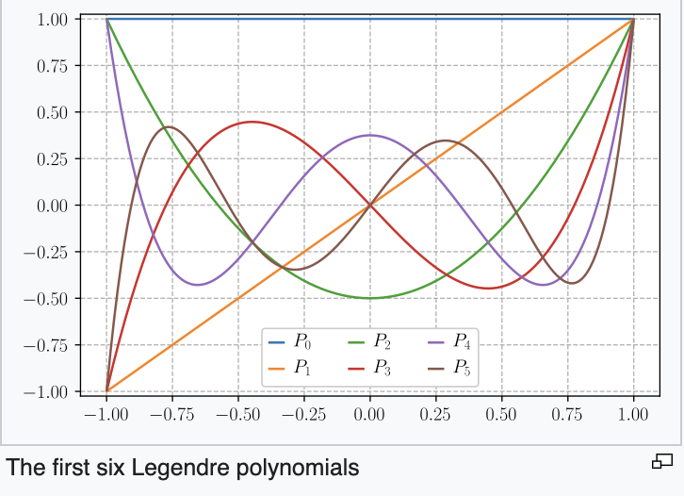
How HiPPO Matrix keep track of history?
It produces a hidden state that memorizes its history
keeps track of the coefficients of a Legendre polynomial
These coefficients let it approximate all of the previous history
Legendre polynomial are a system of complete and orthogonal polynomials

Slide 73
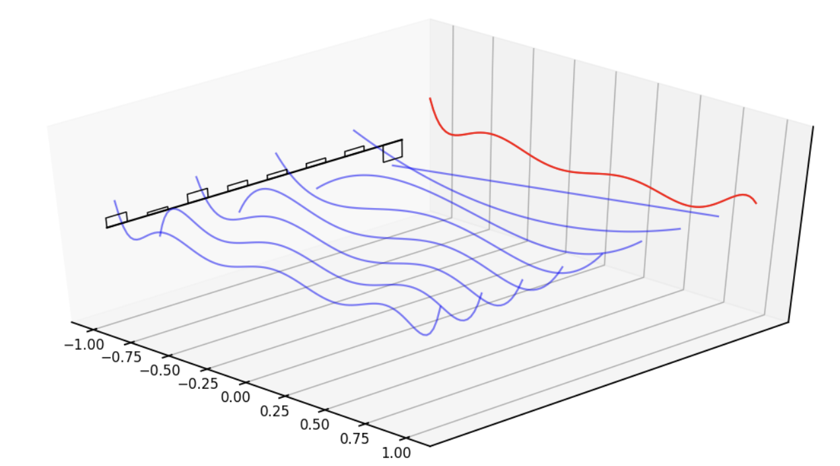
How HiPPO Matrix keep track of history? Example
Red line represents that curve we are approximating
Black bars represent the values of our hidden state
Each is a coefficient for one element of the Legendre series shown as blue functions
HiPPO matrix updates these coefficients each step

Slide 74
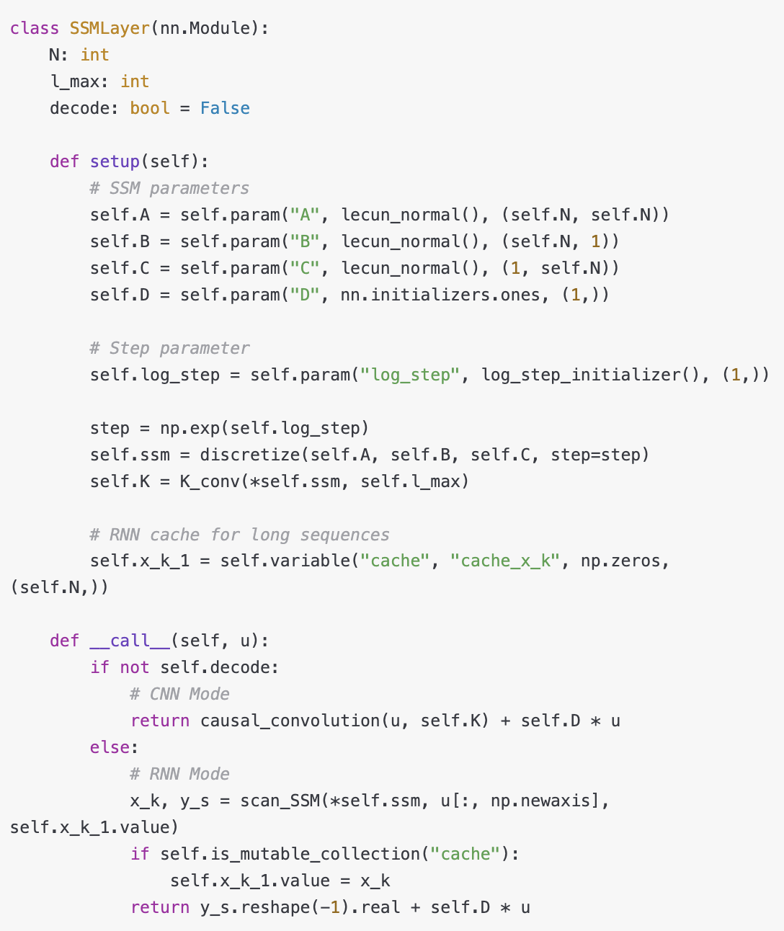
SSM Neural Network
We now have all of the ingredients needed to build a basic SSM neural network layer
We assume that we are going to be learning the parameters:
$B$
$C$
step size Δ
scalar $D$
The HiPPO matrix is used for the transition $A$
The code on the right shows torch implementation of SSM Layer

Slide 75
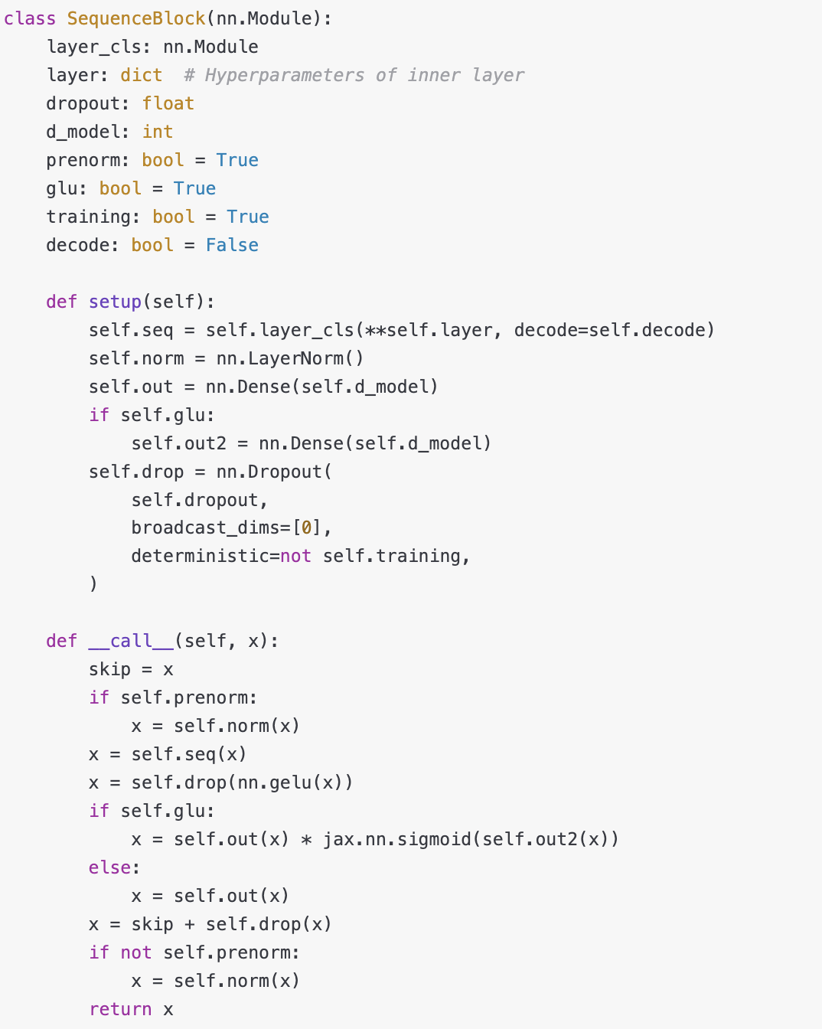
SSM Neural Network
The SSM Layer can be put into standard NN layer
Here the dropout and layer norm is added

Slide 76
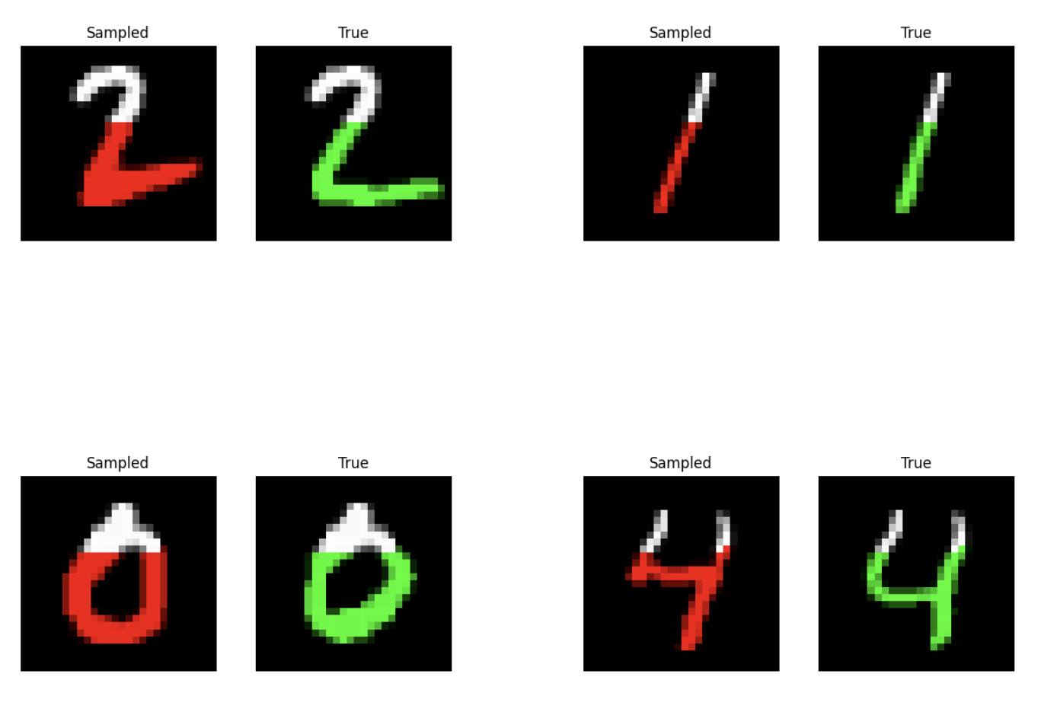
Experiment: Generating MNIST digits
Task: Given the initial the first few pixels, generate the rest of MNIST digit
It should predict the entire sequences of pixels
How it works? we feed in a sequence of pixels into the model and it predict the next one
Like language modeling
S4 is on the left and ground truth is on the right.
White pixels shows the initial state

Slide 77
SSM weaknesses
They have not performed as well as attention on important modalities such as language.
key weakness: inability to perform content-based reasoning
Mamba tries to address these weaknesses

Slide 78
Mamba

Slide 79
Mamba
Mamba has several improvements in comparison with previous methods:
Introduces discrete modalities, allowing the model to selectively propagate or forget information along the sequence length
Introduces hardware-aware parallel algorithm in recurrent mode
these selective features are integrated into a simplified end-to-end neural network architecture without attention or even MLP blocks

Slide 80
Benefits of Mamba
It has faster inference (5× higher throughput than Transformers)
It has linear scaling in sequence length
These features allows Mamba to be used on larger sequence length up to millions
It achieves state-of-the-art performance across several modalities such as language, audio, and genomics
It proposes new class of SSM to cover the weaknesses of preceding models

Slide 81
Improvement
Selection Mechanism
the ability to efficiently select data in an input-dependent manner
focus on or ignore particular inputs
Introduces a simple selection mechanism by parameterizing the SSM parameters based on the input
This allows the model to filter out irrelevant information and remember relevant information indefinitely

Slide 82
Improvement
Architecture
Simplify prior designs
MLP block of Transformers is compressed into a single block
leads to a simple and homogenous architecture design
Includes selective state spaces

Slide 83
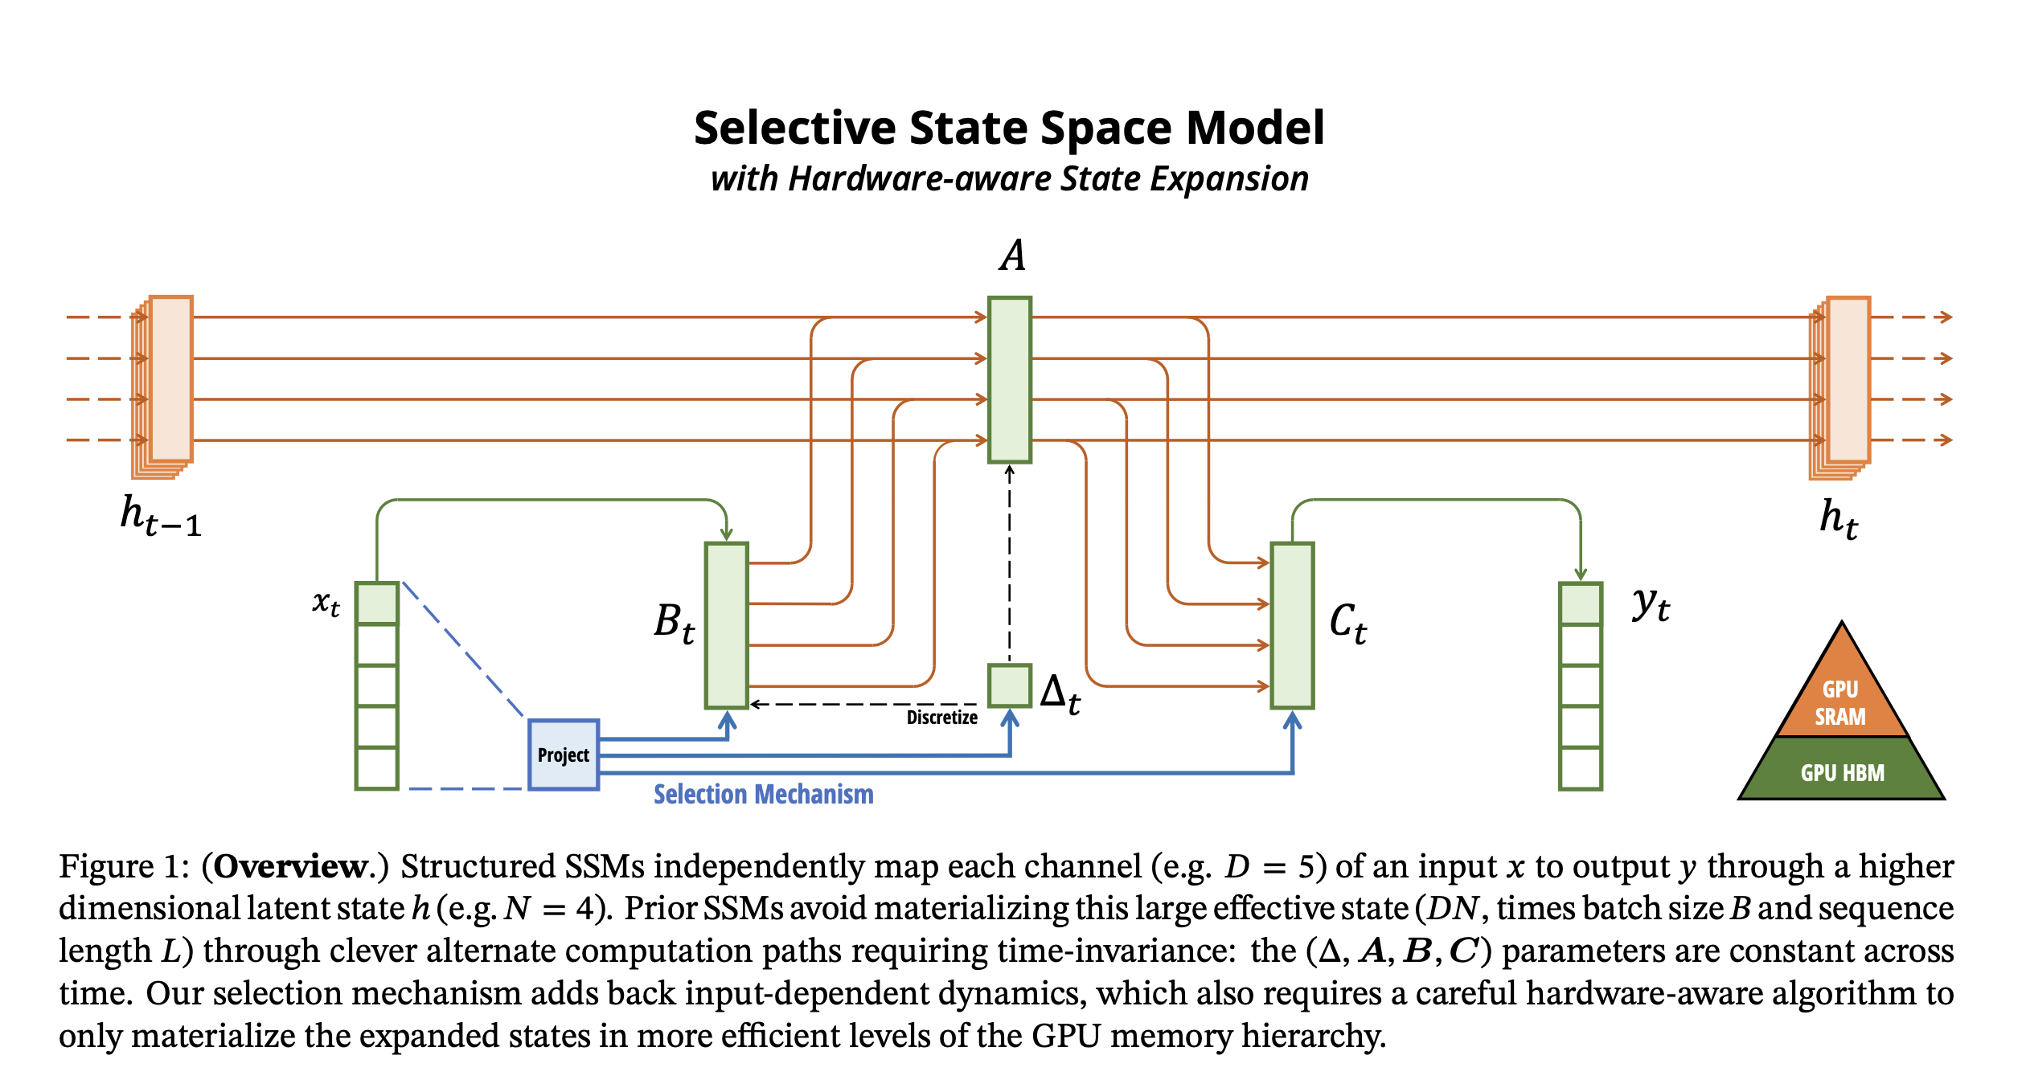
Selective State Space block
It is fully recurrent models with key properties
High quality: selectivity brings strong performance on dense modalities such as language
Long context: the quality and efficiency together yield performance improvements on real data up to sequence length 1M
As it can be seen, $Δ, B, C$ is not fixed but dependent on input $x_{t}$
Credit: Gu, A., & Dao, T. (2023). Mamba: Linear-time sequence modeling with selective state spaces. arXiv preprint arXiv:2312.00752

Slide 84
Selective State Space (Motivation)
Fundamental problem of sequence modeling is compressing context into a smaller state.
Attention is both effective and inefficient
Autoregressive inference requires explicitly storing the entire context
On the other hand, recurrent models are efficient because they have a finite state
Recurrent models effectiveness is limited by how well this state has compressed the context
Efficient models must have a small state
Effective models must have a state that contains all necessary information from the context.
Mamba achieves this balance by using selection

Slide 85
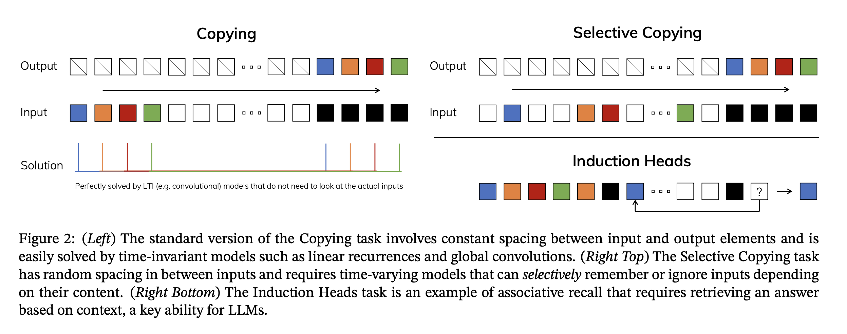
Selective State Space Example (Motivation)
Consider two simple tasks:
Copying: The model should produce the same output as input but time shifted. This can be done with S4
Selective copying: The model should only output colored tokens and not the white ones. Example: Removing bad words from tweet. Here S4 fails, mamba wins
Incorporating a selection mechanism into models provides more efficient solution
It keeps ignoring irrelevant inputs
White tokens in selective copying is irrelevant
S4 fails because it cannot do content-aware reasoning
Credit: Gu, A., & Dao, T. (2023). Mamba: Linear-time sequence modeling with selective state spaces. arXiv preprint arXiv:2312.00752

Slide 86
Selective State Space Example (Motivation)
Consider another simple task:
Induction Head: The model require to recall information from previous input to build the next output. For example: remembering after each black token, blue token comes. S4 fails, Mamba wins
The main reason why S4 fails is because all its matrices A, B, C, D are constant over time and does not change.
So, S4 it loses its content awareness over time.
Credit: Gu, A., & Dao, T. (2023). Mamba: Linear-time sequence modeling with selective state spaces. arXiv preprint arXiv:2312.00752

Slide 87
Main Difference between Mamba and S4
The main difference is simply making several parameters functions of the input
$Δ, B, C$
Algorithm S6 (Mamba) is time-varying
Algorithm S4 is time-invariant
Mamba relaxes the idea of time transition between input sequences are independent

Slide 88
Selective State Space (Algorithm)
(Batch size, sequence length, token dimension)
Dimension of hidden state is N, A captures history
These are functions of x, L refers to each token in the sequence
Step size for discretization (learned)
The main difference is simply making several parameters functions of the input
$Δ, B, C$
Algorithm S6 (Mamba) is time-varying
Algorithm S4 is time-invariant
Mamba relaxes the idea of time transition between input sequences are independent

Slide 89
Punchline
Mamba moves S4 a little bit closer to LSTM models by introducing time-dependant transition from time step to time step in processing input sequence.
It still preserve the quality of S4 in processing input sequence in one pass like transformers

Slide 90
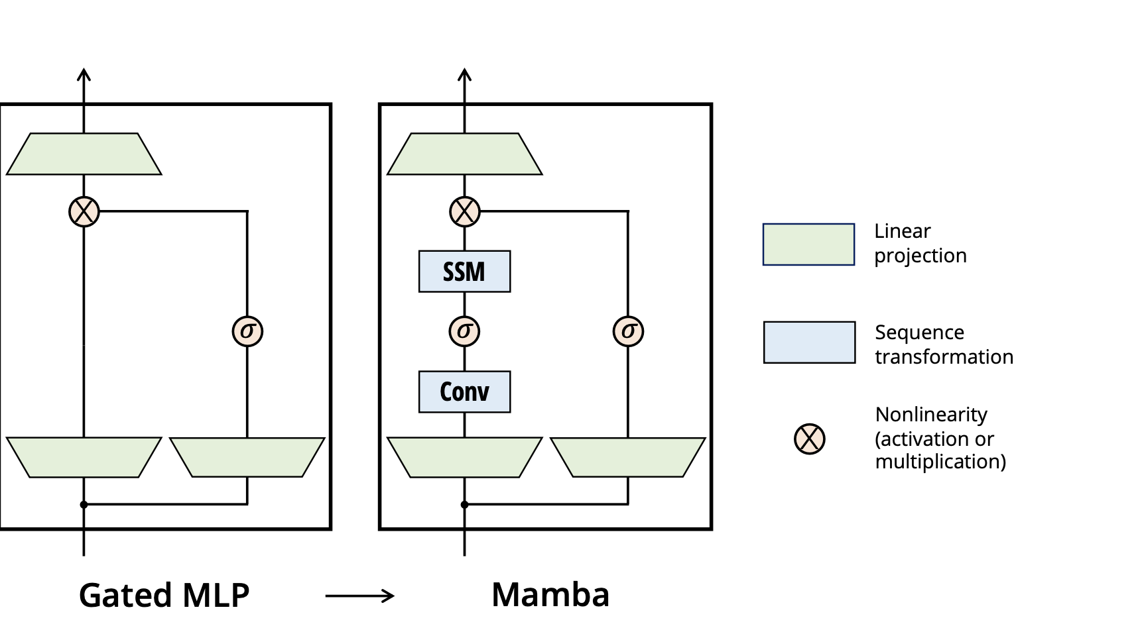
Mamba Architecture: A Simplified SSM Architecture
Right figure shows Mamba Architecture
Mamba simplify this architecture by combining MLP and linear attention components into one block
It also has gating mechanism to keep or modify passed info through the network
SSM block here is the previous selective state architecture shown in slide 17:

Slide 91
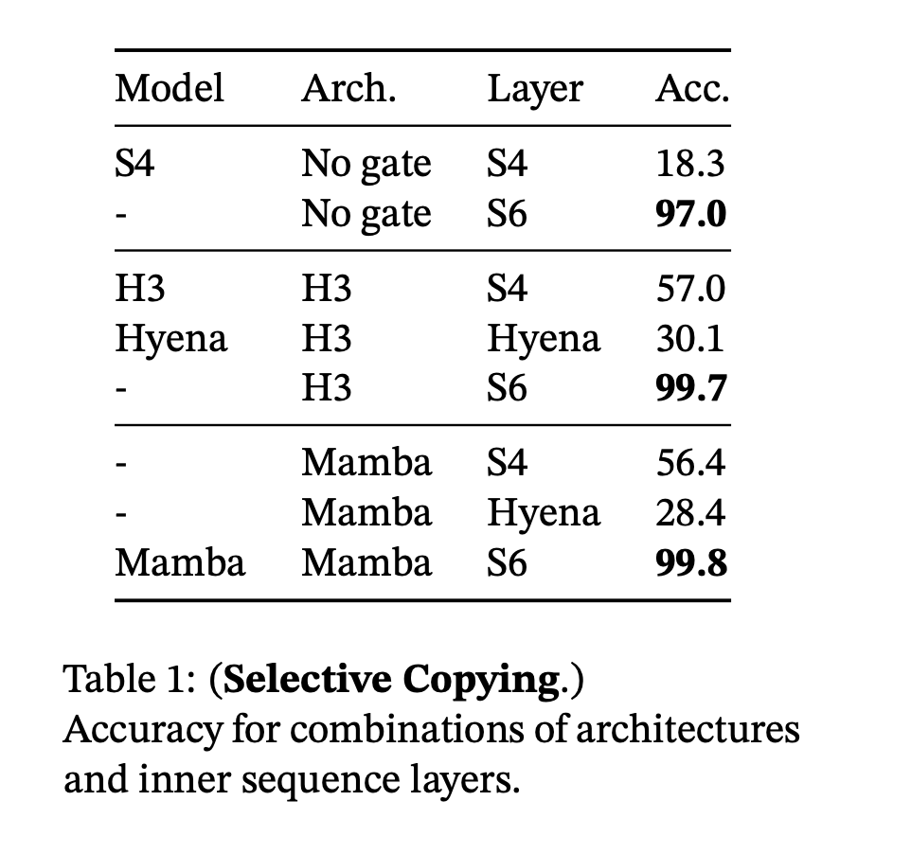
Empirical Evaluation
Selective Copying task: synthetic tasks for sequence modeling, designed to test the memorization abilities of recurrent models

Slide 92
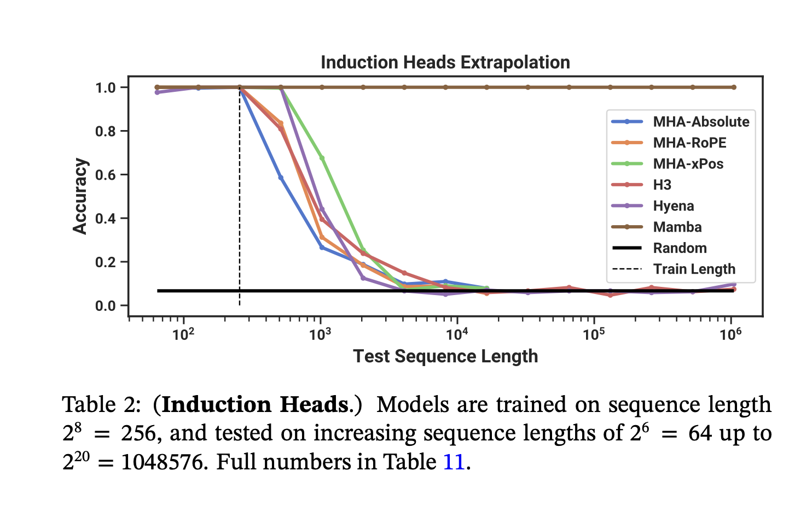
Empirical Evaluation
Induction Heads: requires models to perform associative recall and copy
For example, if the model has seen a bigram such as “Harry Potter”, then the next time “Harry” appears in the same sequence, the model should be able to predict “Potter” by copying from history.
This experiment shows the strength of Mamba for longer sequence length

Slide 93
Down Stream Evaluation (DNA Modeling)

Slide 94
Summary
Introduction to State Space Models
Weakness of Transformers
RNN Representation
CNN Representation
HiPPO Matrix
S4 models
Mamba
Benefits of Mamba
Selective State Space block
Comparison with S4
Connection with LSTM

