Slide 1
Lecture 2: NLP & CV
Presenters: Amir David and Susan Esho

Slide 2
Outline
Background in NLP
Sequence to Sequence Learning
Thumbs up? Sentiment Classification Using Machine Learning Tech
Teaching Machine to read and comprehend
A Neutral Attention Model for Sequence Learning
Class discussion

Slide 3
Background in NLP
  Involves computers being able to understand text and spoken words just like humans can.
  Developed to address various challenges related to the interaction between computers and human language, such as:
    Machine translation
    Sentiment Analysis
    Text generation
    Text classification
    Named Entity Recognition (NER)
    Question Answering
    Speech Recognition

Slide 4

NLP TASK
Machine Translation
Translate text from one language to another.

Slide 5
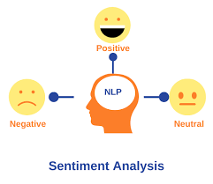
NLP TASK
Sentiment Analysis
Determine the sentiment expressed in a piece of text (positive, negative, neutral).

Slide 6
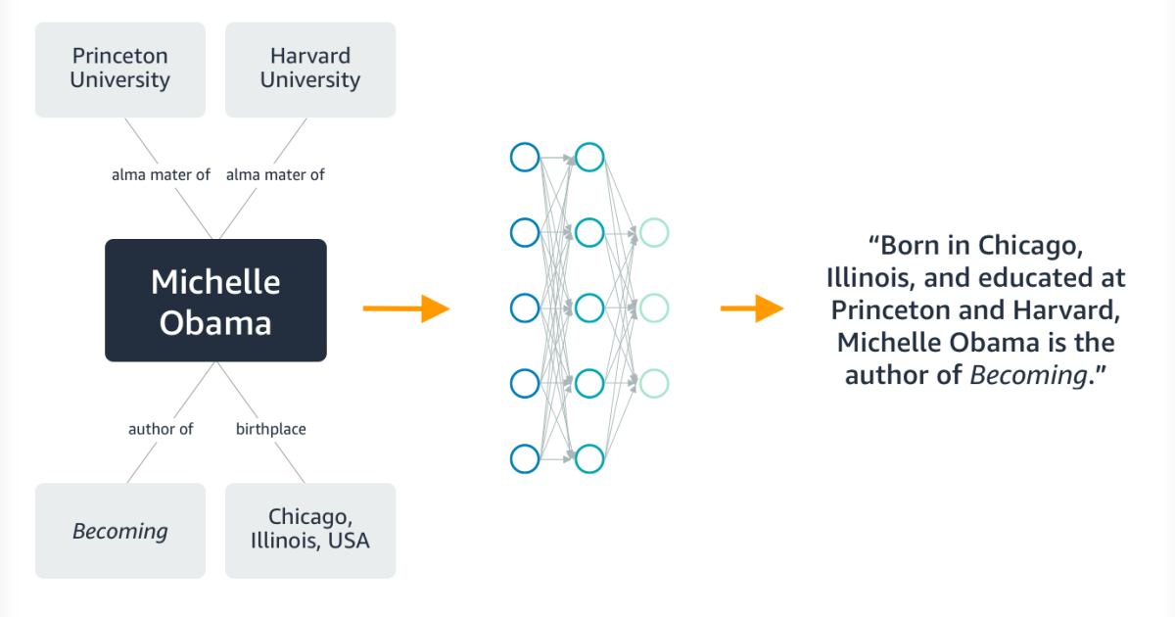
NLP TASK
Text Generation
Generating human like text based on given input.
Examples include chatbot responses, content creation, summarization.

Slide 7
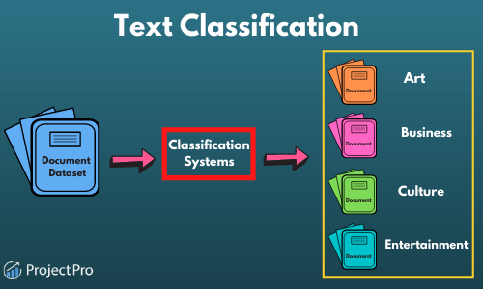
NLP TASK
Text Classification
Assigning predefined categories or labels to a given piece of text.
Essential for organizing, sorting, and making sense of large volumes of textual information.

Slide 8
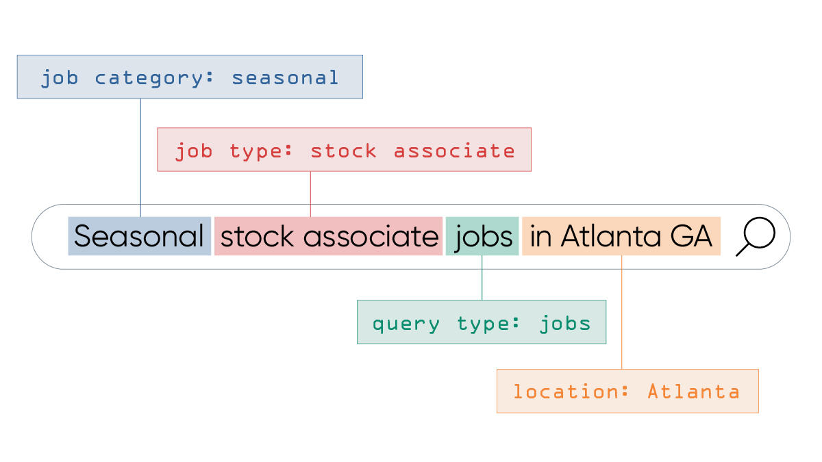
NLP TASK
Named Entity Recognition (NER)
Identify and classify entities (such as names of people, organizations, locations) in text.
Some common entity categories include PER (person), LOC (location), ORG (Organization).

Slide 9
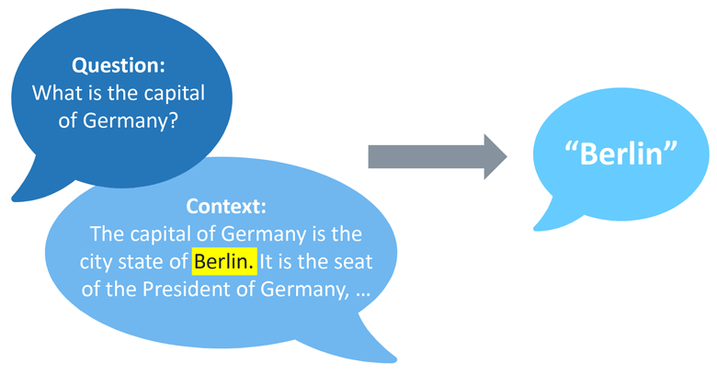
NLP TASK
Question Answering
Aims to develop systems that can answer questions posed in human language.

Slide 10
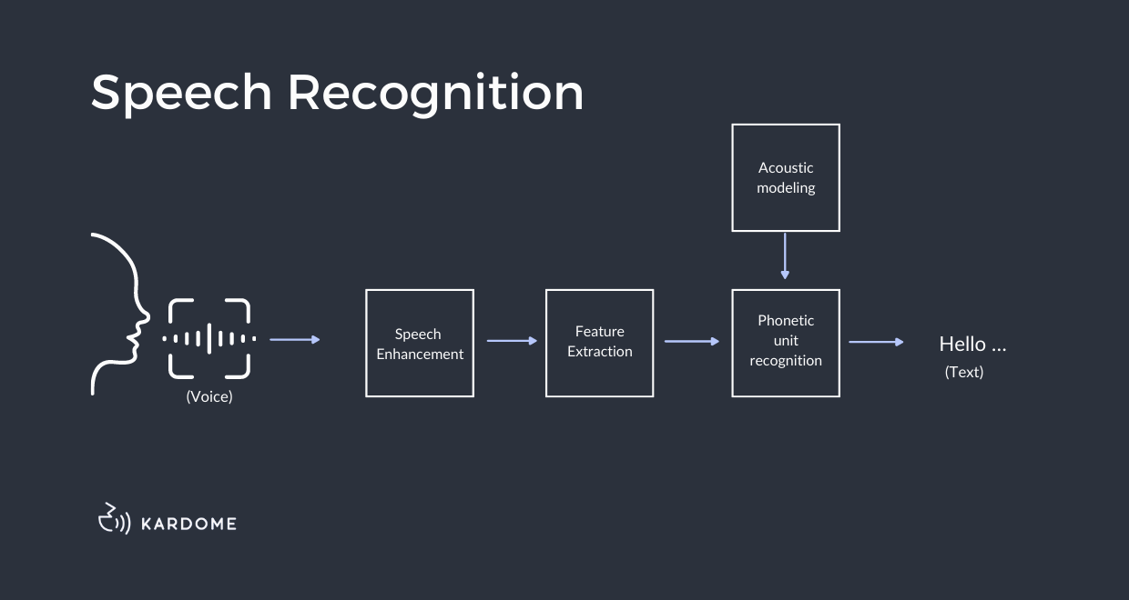
NLP TASK
Speech Recognition
The conversion of voice data into text data.
Speech-to-text.

Slide 11
Why NLP Matters?
Bridging the gap between human communication and machine understanding.
It finds applications in various fields, including:
Customer Support: Automated chatbots…
Healthcare: Analyzing medical records..
Finance: Analyzing financial reports….
Social Media Monitoring: Analyzing and summarizing user sentiments..

Slide 12
Sequence to Sequence Learning with Neural Networks
(Ilya Sutskeve, Oriol Vinyals and QuocV.Le)

Slide 13
Motivation
What are DNN’s?
They attempt to model the way the human brain works
They excel when large labeled datasets are available however
Struggle with sequential data.
Limitation:
DNNs have limitations in handling sequences, which is common in tasks like translation.
Solution:
A new approach using a type of RNN called Long Short-Term Memory (LSTM)

Slide 14
Recurrent Neural Network(RNN)
What?
They are neural networks that are good at modeling sequence data
Feature
Works great with sequences of data.
Works well when the length between input and output sequences are known.
Challenge with RNN’S:
Has short memory.
Cannot deal with sequences of different lengths.

Slide 15
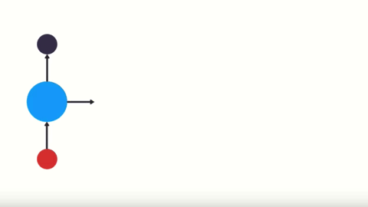
Recurrent Neural Network(RNN)

Slide 16
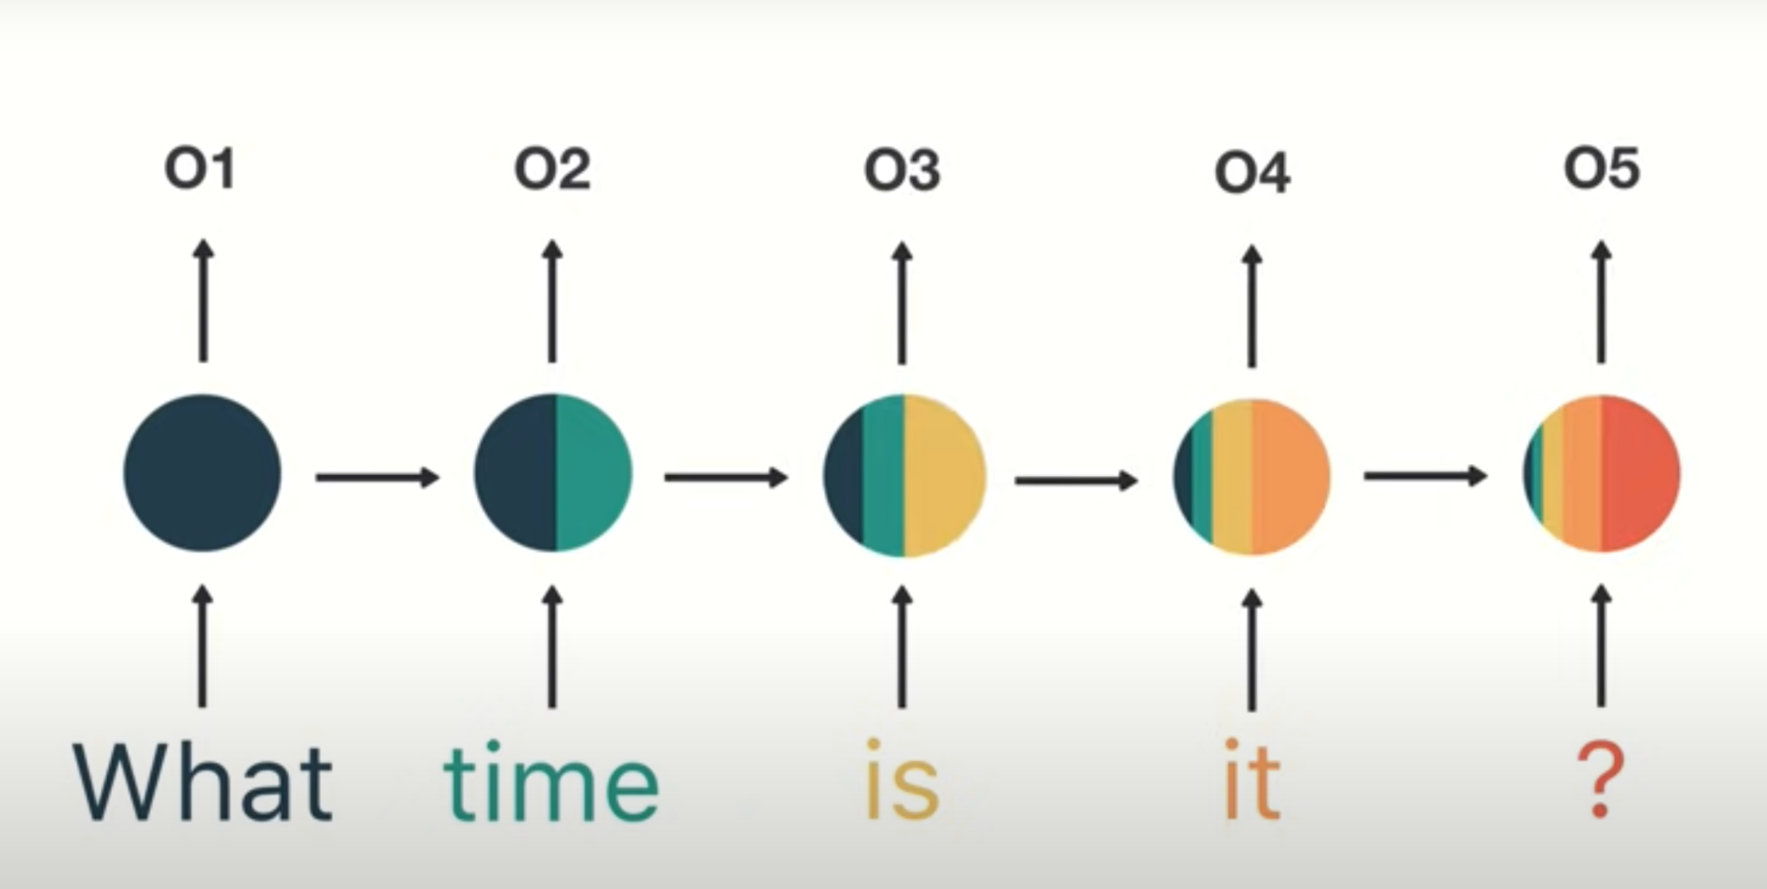
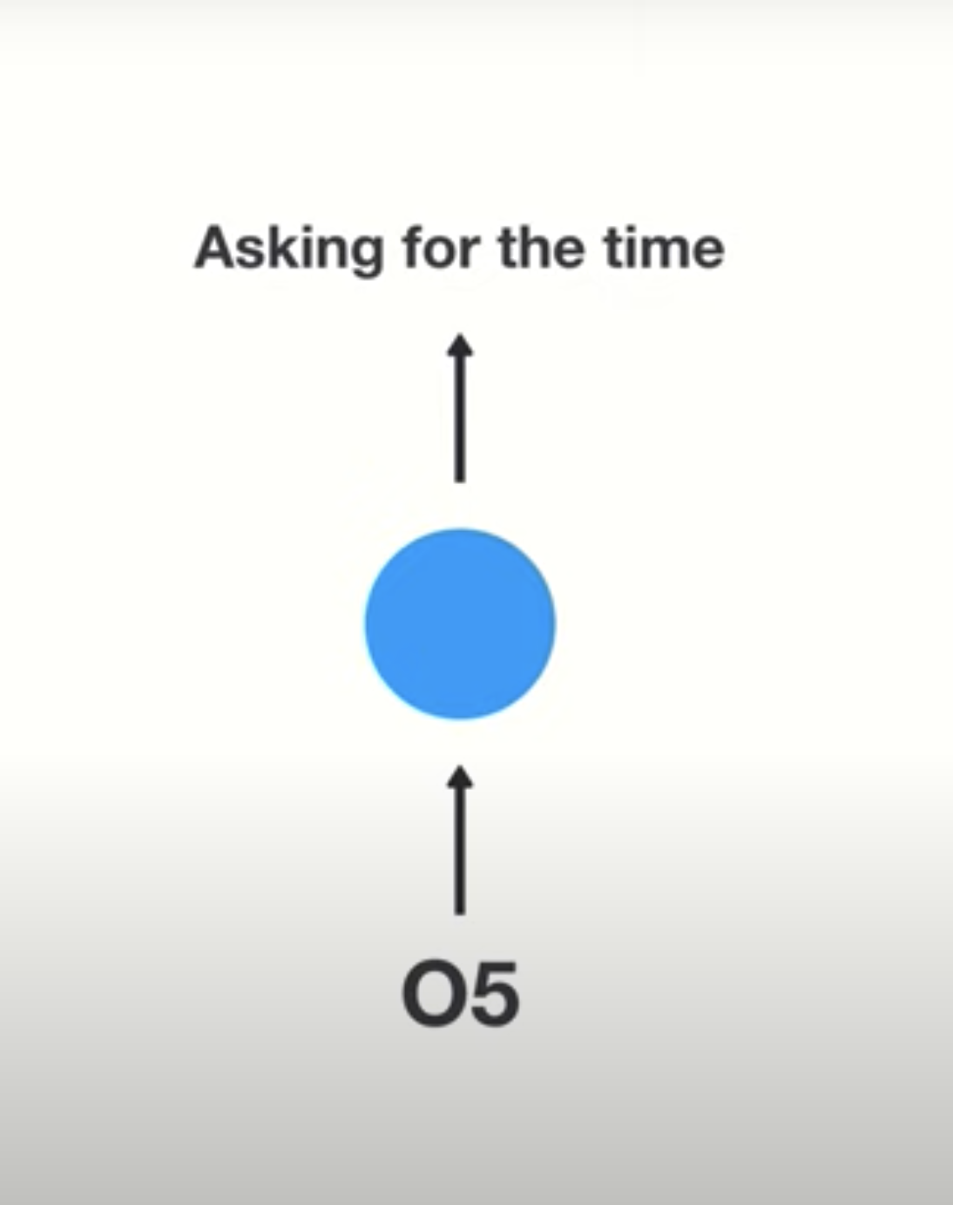
HOW RNN WORKS?
Task: Intent Classification
Example: “What time is it?”
Expected Output: “Asking for the time?”

Slide 17
Long Short Term Memory(LSTM)
What?
An RNN that deals with vanishing gradient problem in traditional RNN.
They can learn longer sequences.
Suitable for tasks where the input and output lengths vary.
Goal:
To estimate the probability of generating an output sequence given an input sequence.

Slide 18
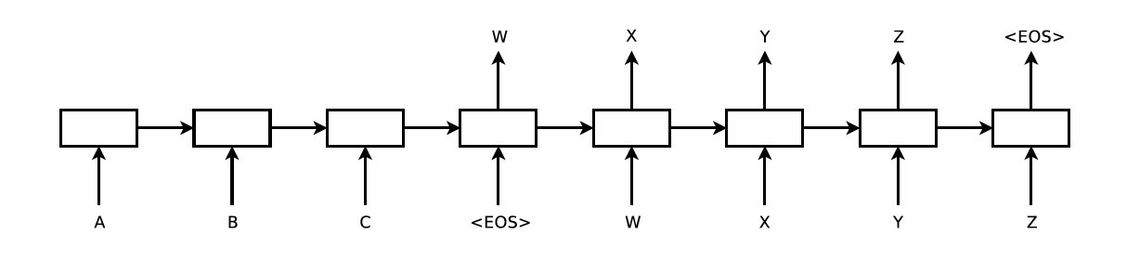
Sequence-to-Sequence Model
INPUT LSTM
OUTPUT LSTM
Takes an input like “ABC”
Generates an output like ”WXYZ”

Slide 19
Input and Output LSTM
The two LSTMs used are called Encoder LSTM and Decoder LSTM
Encoder reads the input sequence and create a fixed-size vector representation.
Decoder generate the output sequence from that vector.
Why?
To improve the model's performance across different language pairs.

Slide 20
Data Transformation
Rather than map a sequence like "a, b, c" to the desired output, it was trained to reverse the word and map "c, b, a" to the desired output.
Why?
Made it easier for the model to understand and communicate between input and output.
Strong communication link between input and output.
Preserve the most important part of input sequence especially with long sentences.

Slide 21
Translation Task
WMT’14 English to French MT task
Tested their approach on English-to-French translation
Achieved a high BLEU(evaluation metric) score
Outperforming baseline Statistical Machine Translation Model(SMT) model.

Slide 22
LSTM PERFORMANCE
Word Order
Reversed order of words in source sentences
Significantly improved LSTM performance.
Performed great when there was long sentences.
Result
Achieved a BLEU score of 34.81 on translation
When compared it surpassed traditional methods.

Slide 23
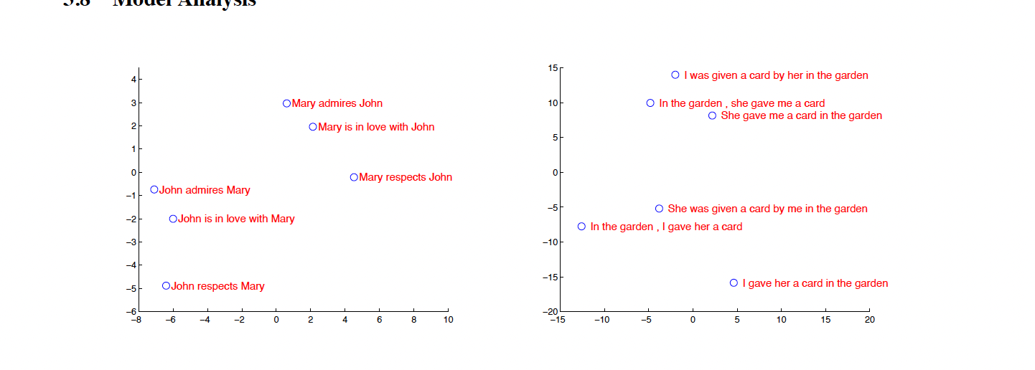
Model Analysis
Representations are sensitive to the order of words.

Slide 24
Model Analysis
Representations are sensitive to the meaning of sentences. Irrespective of an active voice with a passive voice.

Slide 25
Training Details
Architecture
Used deep LSTMs with 4 layers,
Each layer had 1000 cells.
1000-dimensional word embeddings.
Input vocabulary of 160,000
Output vocabulary of 80,000.
Trained models for a total of 7.5 epochs
Batch size of 128 sequences.
The resulting model size had 384 million parameters

Slide 26
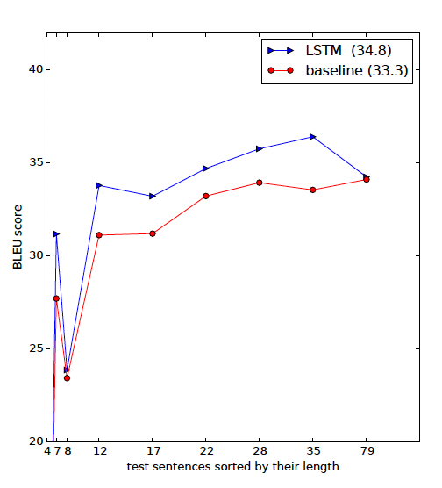
Model Performance
BLEU is an evaluation metric for translation task.

Slide 27
Thumbs up? Sentiment Classification using Machine Learning Techniques
(Shifting from topic-based to sentiment classification)

Slide 28
Motivation
Perceived Difficulty of Sentiment Detection:
Experts in machine learning predicted that automatic methods might not perform well.
Distinguishing positive from negative reviews seems easier for humans when compared to the standard problem of categorizing text by topics.

Slide 29
Sentiment Classification
Objective:
Focused on classifying documents, based on the overall sentiment(positive or negative) rather than categorizing them by topic.
Machine Learning Methods Used:
Naive Bayes
Maximum entropy classification, and
Support vector machines

Slide 30
Naive Bayes(NB):
How it works:
Assumes words don't really depend on each other. If it sees certain words a lot in positive or negative writing, it guesses the feeling.
Example:
If it often sees "good", it guesses a piece is positive when it spots "good.”
Features:
Despite its simplicity, often performs well.

Slide 31
Maximum Entropy(MaxEnt)
How it works:
Tries to find a balance between not assuming too much and still making sense of the data.
Example:
Instead of assuming certain words always mean positive or negative, it learns to be flexible.
Features:
Doesn't assume much and might be good when words don't follow simple rules.

Slide 32
Support Vector Machines (SVMs):
How it works:
Looks for a way to draw a plane(line) between positive and negative writing. Tries to make this line as clear as possible, like a big gap between positive and negative.
Example:
If you imagine positive and negative writings as dots, it tries to find the best line to separate them.
Features:
Known for effective text categorization.
Focus on drawing a clear line between positive and negative.

Slide 33
Movie-Review Domain
Why?
Convenient because there are large online collections of movie reviews.
Reviewers provide a machine-readable rating (like stars), eliminating the need for manual labeling of data.
Dataset
20 reviews per author
752 Negatives
1301 Positives

Slide 34
Internet Movie Database(IMDb)
Data Source:
Archive from IMDB movie reviews newsgroup.
Selected reviews with clear author ratings expressed in stars or numerical values.
Sentiment Categories:
Positive,
Negative or
Neutral.
However, authors distinguished between positive and negative sentiments only.

Slide 35
Experiment
Testing Human Intuition:
Two graduate students independently picked words they believed represented positive and negative sentiments in movie reviews.
Choices were converted into simple rules that counted the occurrences of these words in a document.

Slide 36
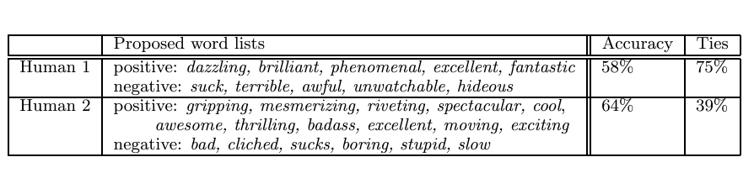
Human-Generated Lists Accuracy
Data Collection:
700 positive and
700 negative reviews.
Ties here means sentiments were rated equally likely.

Slide 37
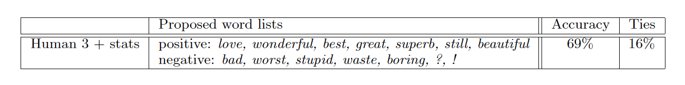
Comparison with smaller words
The ? tends to occur in sentences like “What was the director thinking?"
Appears in sentences like “Still, though, it was worth seeing"

Slide 38
Experiment Result
Unlikely choices like "?" or "still" in the small word list proved valuable for sentiment classification.
These words, not initially obvious, contributed significantly to the accuracy of sentiment analysis.
Their inclusion demonstrated that seemingly unconventional words could play a crucial role in capturing sentiment nuances.

Slide 39
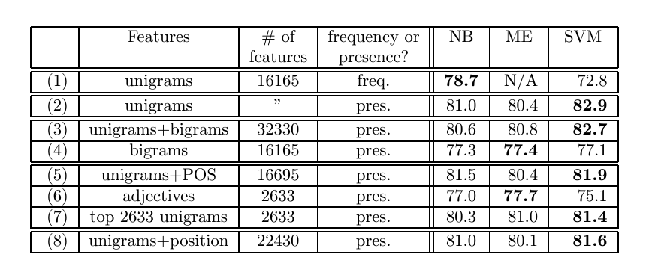
Results
Outperformed random guessing (50%).
Did better than human-selected unigram baselines (58% and 64%).
Feature Frequency vs. Presence:
Compared frequency of words versus presence
Presence of word check worked better.

Slide 40
Result Overview
Bigrams (Two-word Phrases):
Adding bigrams (pairs of words) didn't significantly improve accuracy.
Unigrams (single words) were more effective.
Parts of Speech (POS) Tags:
Adding information about the part of speech of each word didn't show a consistent improvement.
Adjectives alone didn't perform as well as expected.
Position of Words in the Text:
Considered if the position of a word in a text (beginning, middle, or end) matters.
Results didn't differ much from using unigrams alone.

Slide 41
Conclusion
Unigrams (single words) were often more informative than bigrams, Parts of speech, or word positions in determining sentiment in movie reviews.
Machine learning models performed well, hence great for sentiment analysis despite its challenges.

Slide 42
Teaching Machines to Read and Comprehend
(Improve machine reading comprehension)

Slide 43
Motivation
Challenge
Teaching machines to read like humans is a tough task.
How?
Ensure machines are asked questions about what they read in document.
Why?
Lack of big datasets for training and the difficulty in creating flexible models that adapt well to various document structures.
Previous researchers approach
Created artificial stories and questions to generate training data.
Challenge
Doesn't always work well when applied to real-world situations.
Falls short in capturing the complexity, richness, and noise of real language.

Slide 44
Proposed Solution
Solution
Built a real training dataset.
How?
Converted sentences and documents into context, query, and answer sets.
Data Collection:
Collected two million real news stories and associated questions.
Source:
CNN and Daily Mail websites.

Slide 45
Baseline Models
Majority Baseline: Pick the most common entity in the document.
Exclusive Majority: Pick the most common entity in the document but not in the query.

Slide 46
Deep Learning Models
Used Deep Learning models with Attention Mechanisms
How?
Models pay attention to specific parts of a document when answering a question.
Comparison: Neural Models vs. Traditional Methods:
Neural models performed better
Does not need specific information about how the document or question is structured.

Slide 47
Traditional NLP Approaches:
Rely on symbolic matching or rule-based systems.
Two symbolic matching models were used:
Frame-Semantic Parsing.
Word Distance Benchmark.

Slide 48
Frame-Semantic Parsing
Seeks to understand the meaning of sentences Identifies actions and and the entities involved.
Provides information about "who did what to whom."
Limitation
Difficulty in handling non-standard relations.
Difficulty handling queries that requires information scattered across multiple sentences.

Slide 49
Word Distance Benchmark
Measures how close words in a question are to words in a document.
Perfect for when questions and document content share a lot of similar words.
It's like finding the right pair of shoes in a closet – if they're close, it's a good match.
Limitation
Struggles when dealing with complicated language structures.

Slide 50
Neural Network Models
Emulates how the human brain processes information.
Learn patterns and relationships within vast amounts of text data, enabling them to understand and respond to questions about the content.
Three key models stand out:
Deep LSTM Reader
Attentive Reader
Impatient Reader

Slide 51
Deep LSTM Reader
Uses Long Short-Term Memory (LSTM) networks to understand and process information.
Reads through the document once and then answers questions based on what it learned during that pass.

Slide 52
Attentive Reader
What?
Also uses LSTMs but adds an attention mechanism.
How?
Focuses more on certain parts of the document that are important for answering a specific question.
Pays more attention to crucial sentences.

Slide 53
Impatient Reader
Pays attention to crucial sentences.
Further ability to re-read parts of the document as it processes each question.
Hint: It's like a reader who keeps flipping back to previous pages to get a better understanding.

Slide 54
Conclusion
Neural models with attention mechanisms(Attentive and Impatient Readers) perform the best.
Traditional NLP approaches face challenges in coverage and scalability.
Hard to manage when size of the dataset and complexity of the language increase.
Can’t handle diverse and evolving language patterns.
Attention mechanisms play a crucial role in improving machine reading and question answering tasks.

Slide 55
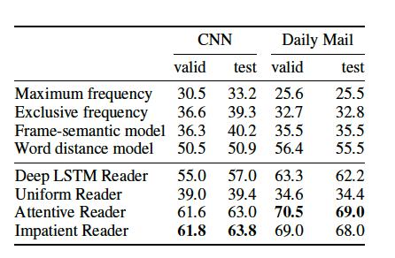
Results
Accuracy of all the models and benchmarks
on the CNN and Daily Mail datasets.

Slide 56
A Neural Attention Model for Abstractive Sentence Summarization
(a new method for creating summaries of sentences)

Slide 57
Background on Summarization:
Summarization is a challenge in understanding natural language.
Most successful systems for summarization use the following approaches:
Extractive: selects the most important sentences from original text and to form a condensed version..
Abstractive: creates a new summary that might have information not exactly in the original text.
Goal: Ability to make short summaries for each sentence.

Slide 58
Proposed Solution
Attention-Based Summarization (ABS):
Aims to generate abstractive summaries at the sentence level.
The method is data-driven, scalable, and outperforms existing systems in experiments.
It draws inspiration from the success of neural machine translation.
Pays close attention to each sentence, kind of like a highlighter, to create a good summary.

Slide 59
Proposed Model
Authors made use of combination a neural language model with a contextual input encoder.
The encoder uses a soft alignment over the input text to inform the summary generation.
The encoder is trained on the sentence summarization task.
The following encoders were used:
Bag-of-Words Encoder
Attention-Based Encoder
Convolutional Encoder

Slide 60
Bag-of-Words Encoder
Takes all the words in a sentence, mixes them up, and tries to figure out the next word without caring about the order of words or how they relate to each other.
The basic model simply uses the bag-of-words of the input sentence.

Slide 61
Convolutional Encoder:
Looks at groups of words at a time, not just one word by itself. It's like having a spotlight on chunks of words to see how they work together.
Why Authors Used it?
To address some of the modelling issues with bag-of-words such as;
  Treating each word independently
  Not considering the order or relationships between words in a sentence.

Slide 62
Attention-Based Encoder:
This encoder pays more attention to specific parts of the input sentence.
Focuses on important words when predicting the next one.
Why Authors Used it?
To address the limitation of Convolutional Encoder inability to capture variations or nuances in different parts of the sentence.

Slide 63
Training Data and Corpus:
The system is trained on a corpus of article pairs from Gigaword
Gigaword consists of around 4 million articles.
The model can be trained for headline generation directly on document-summary pairs.

Slide 64
Conclusion
The effectiveness of the ABS approach is tested against multiple baselines, including abstractive and extractive methods.
The experiments include the following
  Traditional syntax-based systems,
  Constrained systems,
  Information retrieval style approaches
  Statistical phrase-based machine translation.
Results indicate that the ABS approach outperforms a machine translation system trained on the same dataset and shows a significant improvement over the highest-scoring system in the DUC- 2004 competition.

Slide 65

Discussions

Slide 66

Computer Vision Section

Slide 67
Outline
Background on Computer Vision
Microsoft COCO Dataset
Computer Vision Architectures
Computer Vision Development
Class discussion

Slide 68
Background – Computer Vision Tasks

Slide 69
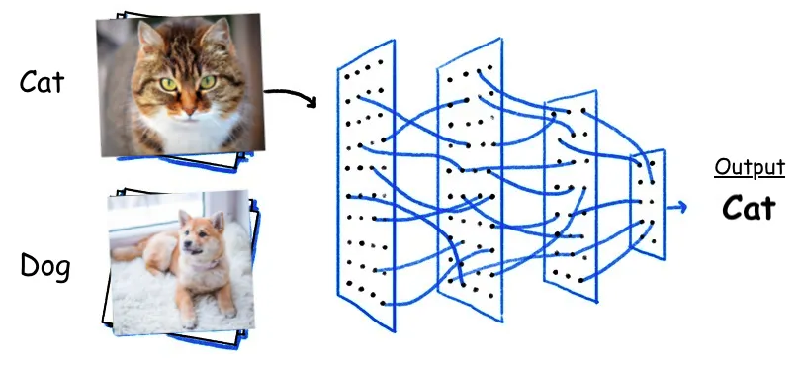
Background
Computer vision tasks - Classification
Source: https://towardsdatascience.com/10-papers-you-should-read-to-understand-image-classification-in-the-deep-learning-era-4b9d792f45a7
Notes:
Starting with the simplest task, in classification the machine learning model classifies or identifies the contents of an image

Slide 70
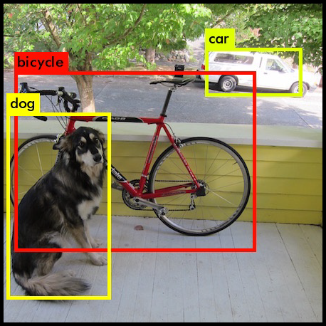
Background
Computer vision tasks - Detection
Source: https://machinethink.net/blog/object-detection-with-yolo/

Slide 71
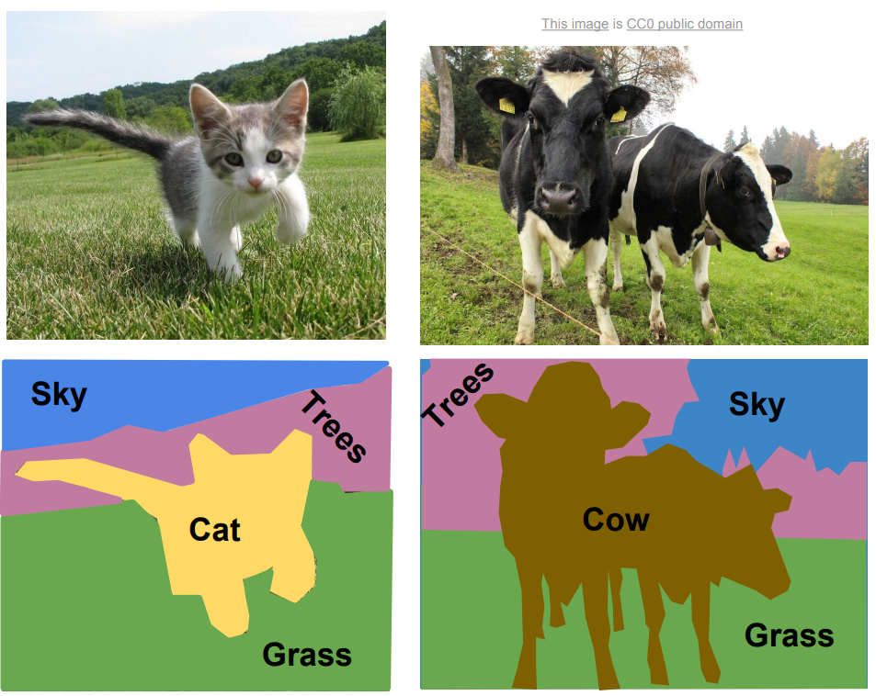
Background
Computer vision tasks - Segmentation
Source: CS231n Stanford 2017 lecture 11. http://cs231n.stanford.edu/slides/2017/cs231n_2017_lecture11.pdf

Slide 72
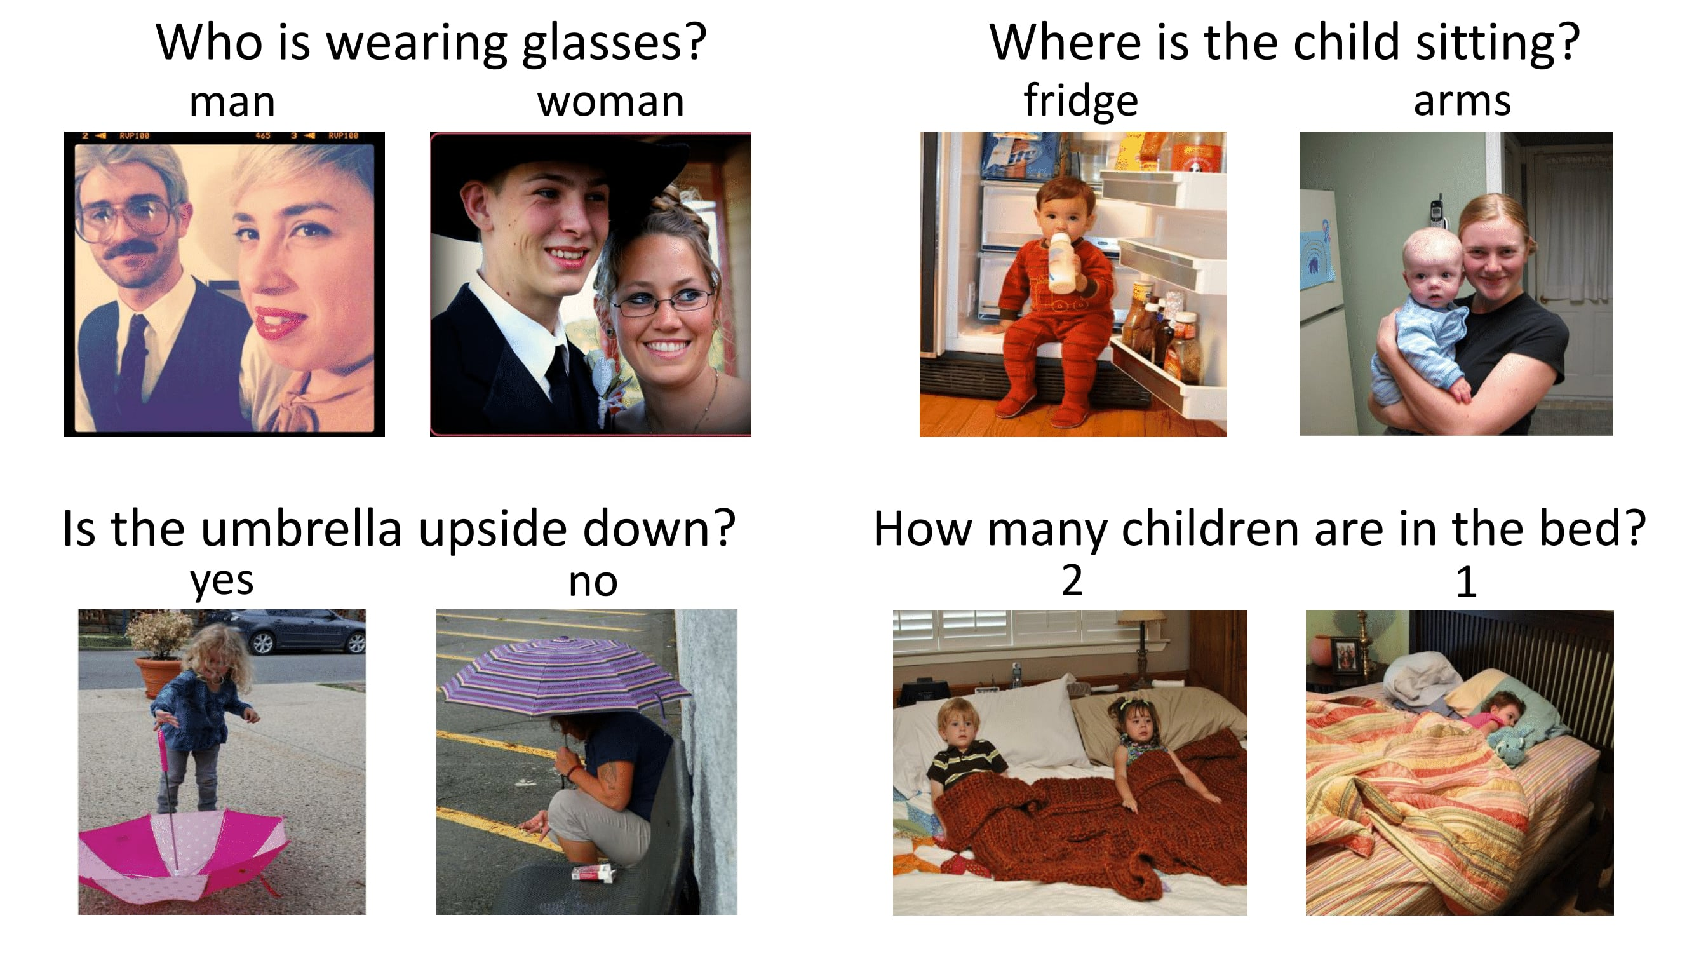
Background
Computer vision tasks – Visual Question Answering (VQA)
Source: https://visualqa.org

Slide 73
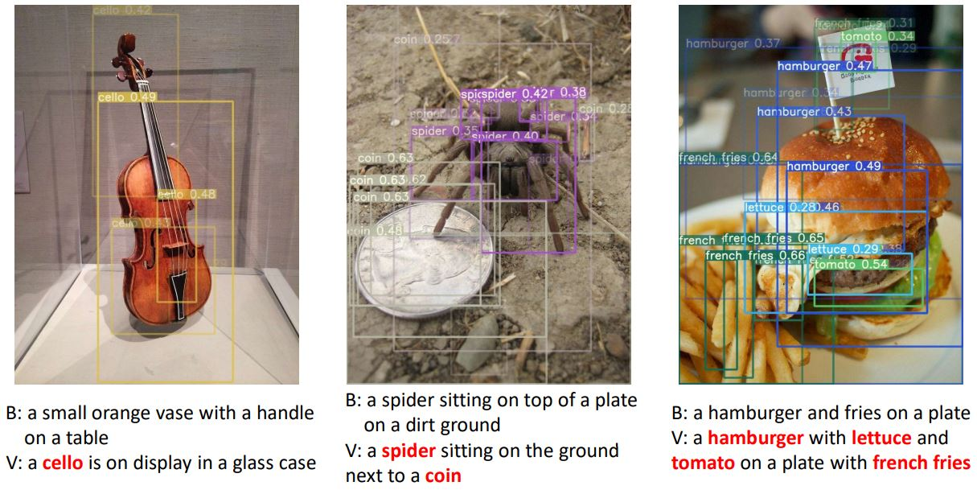
Background
Computer vision tasks – Captioning
Source: https://www.dpreview.com/news/9384724203/microsoft-s-latest-computer-vision-technology-beats-humans-at-captioning-images
Notes:
Let’s take a look at some real world application of computer vision

Slide 74
Background – Computer Vision Applications

Slide 75
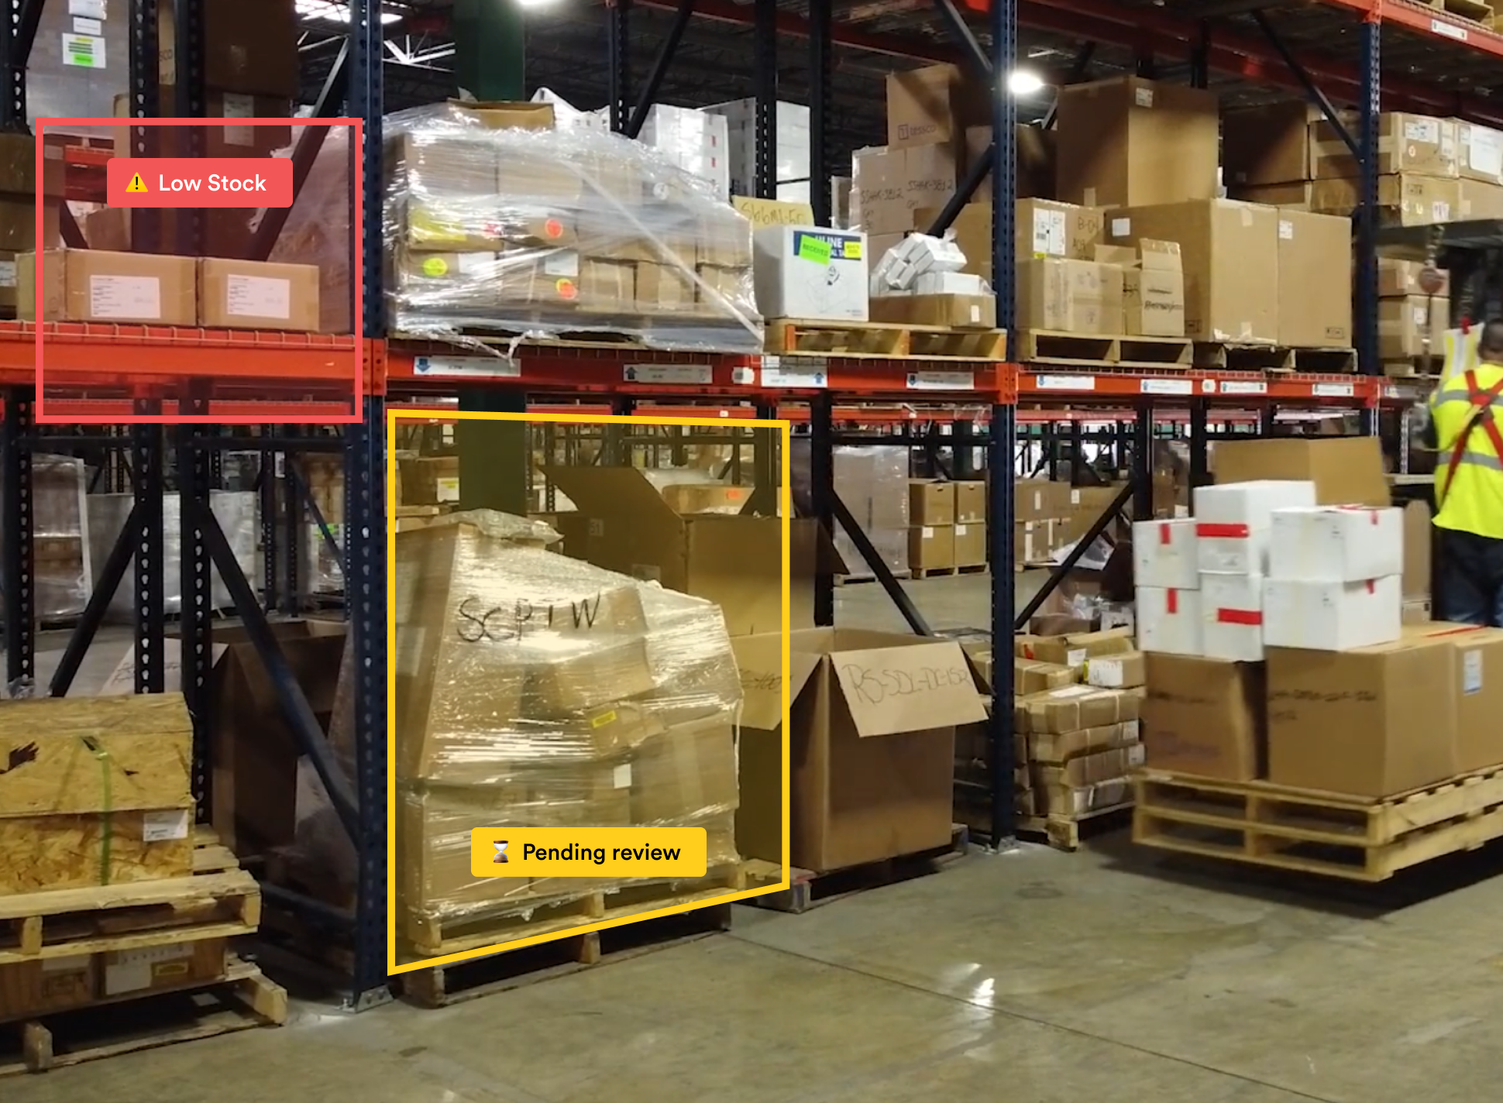
Background
Computer vision tasks – Applications
Source: https://www.pento.ai/blog/computer-vision-manufacturing
Notes:
Detection of stock levels in factories

Slide 76
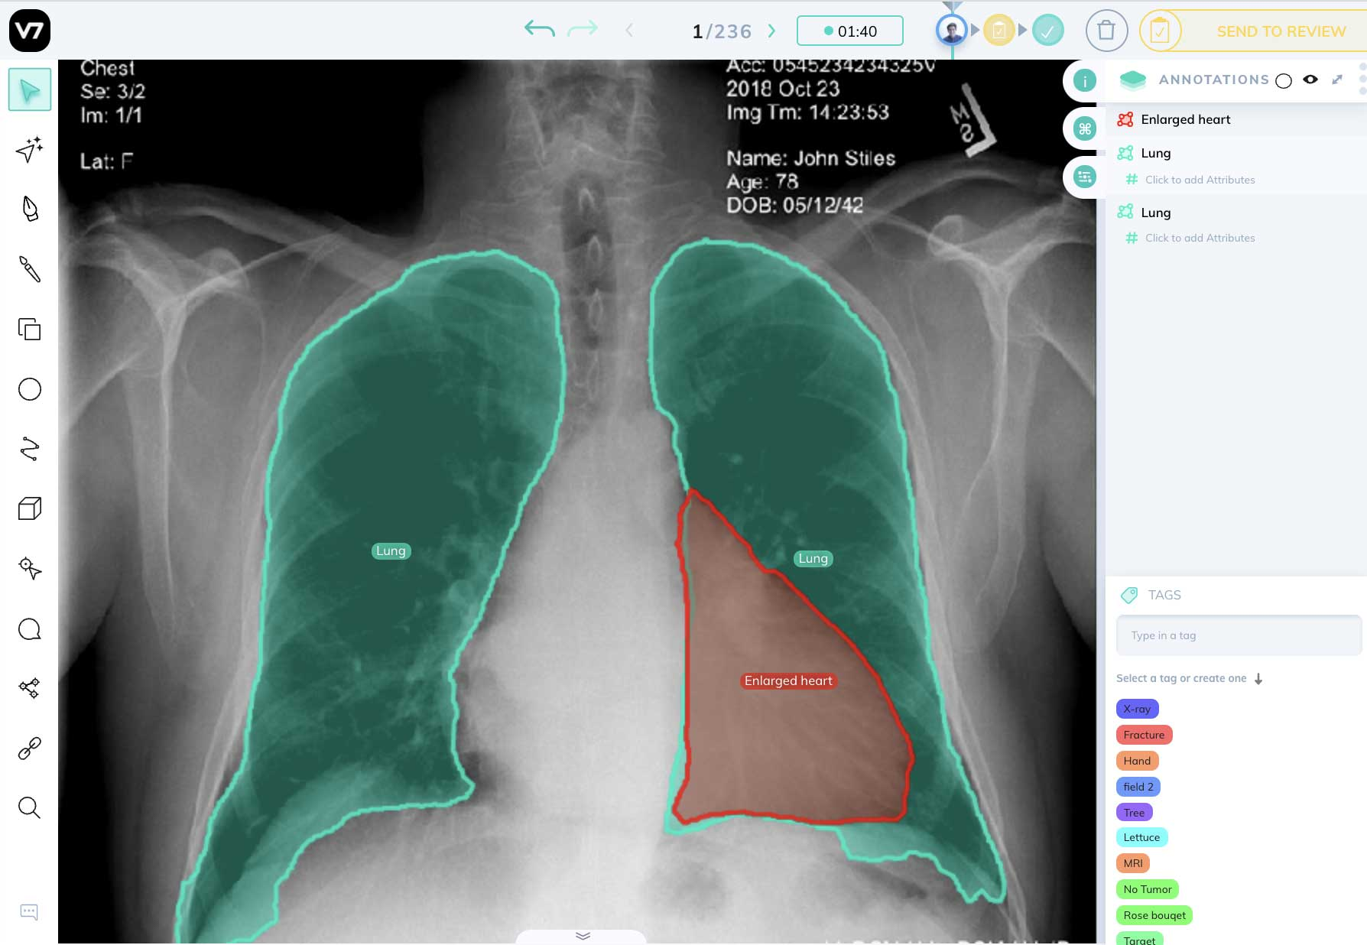
Background
Computer vision tasks – Applications
Source: https://www.v7labs.com/blog/what-is-computer-vision
Notes:
Segmentation in medical imaging

Slide 77
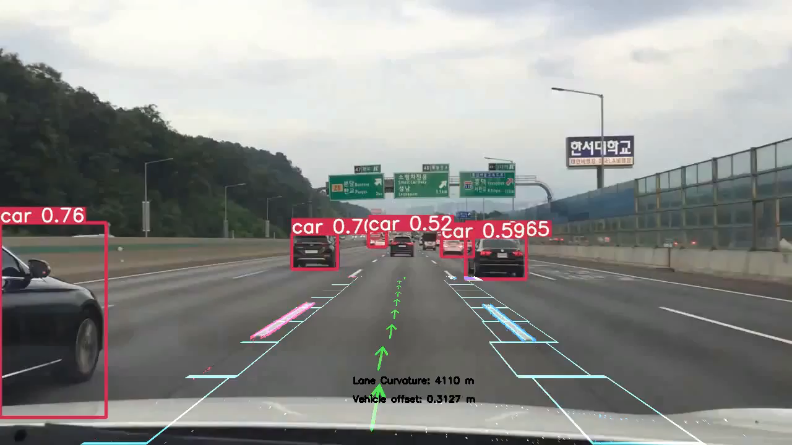
Background
Computer vision tasks – Applications
Source: https://www.youtube.com/watch?v=chzq2E75M84
Notes:
Live demo of object detection in a self-driving car

Slide 78
Background – Computer Vision Preliminaries

Slide 79
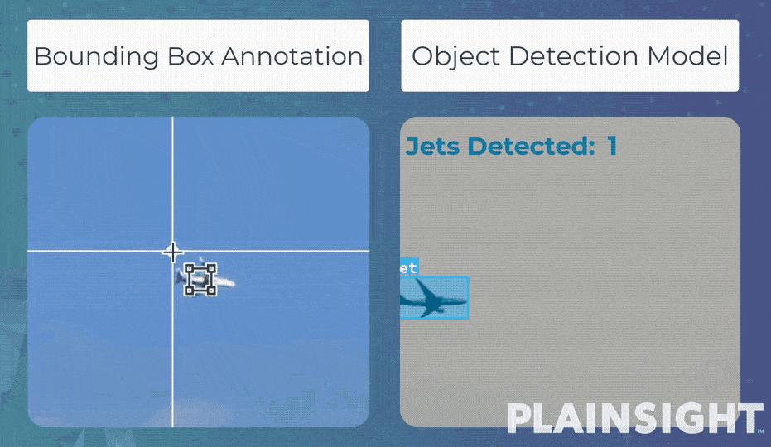
Background
Computer vision – annotation
Source: https://plainsight.ai/blog/what-is-data-annotation/
Notes:
When we annotate datasets in computer vision, we define the ground truth of the image.
In this example, on the left, we see a object detection annotation, where a bounding box is put around a plane.
On the right, we see the models prediction of the bounding box, i.e. the object detection.

Slide 80
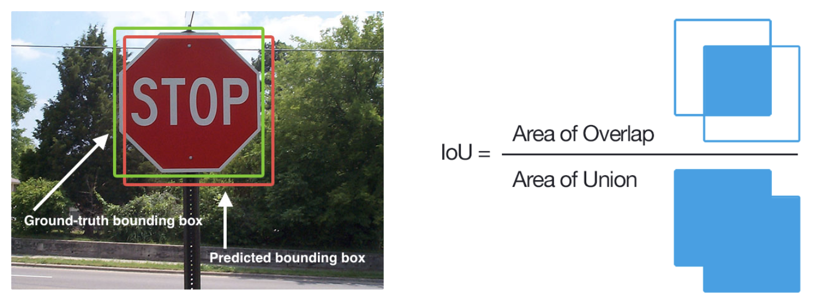
Background
Computer vision – IoU
Source: https://www.v7labs.com/blog/mean-average-precision
Notes:
IoU or intersection over union is a common way to evaluate an object detector’s performance.
It is calculated as the ratio of the area of overlap over the area of union, of the ground truth bounding box and the detector’s predicted bounding box.
Typically an IoU>0.5 is considered as a good prediction.

Slide 81
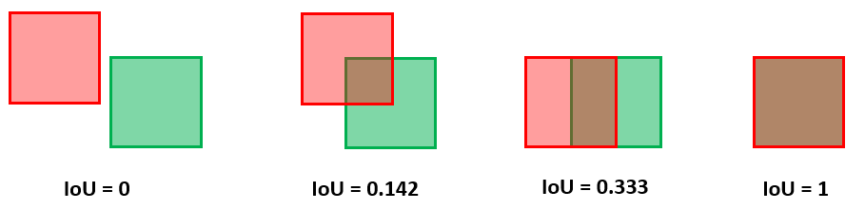
Background
Computer vision – IoU
Source: https://www.baeldung.com/cs/object-detection-intersection-vs-union
Notes:
Some examples of IoU values are visualized here

Slide 82
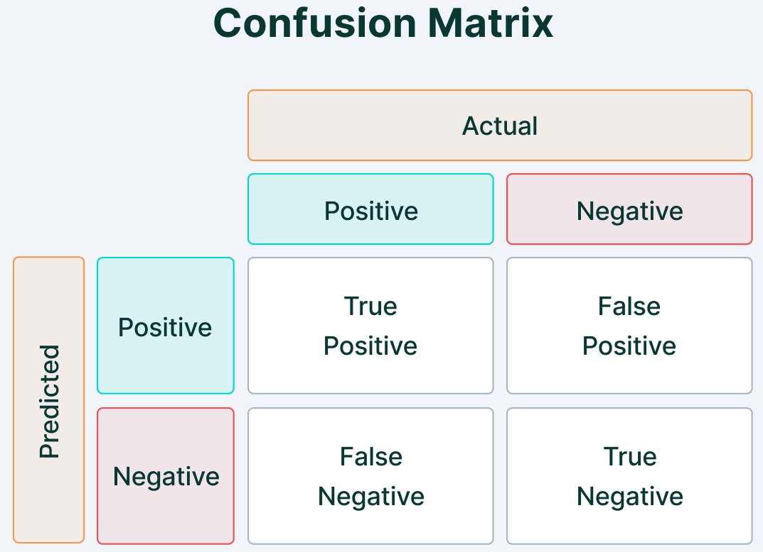
Background
Computer vision – Confusion Matrix
Source: https://www.v7labs.com/blog/mean-average-precision
Notes:
A common concept in computer vision is the confusion matrix, which is a way for us to represent and calculate the performance of the model.
It shows the percentage of false positives and false negatives, as well true positives and true negatives.

Slide 83
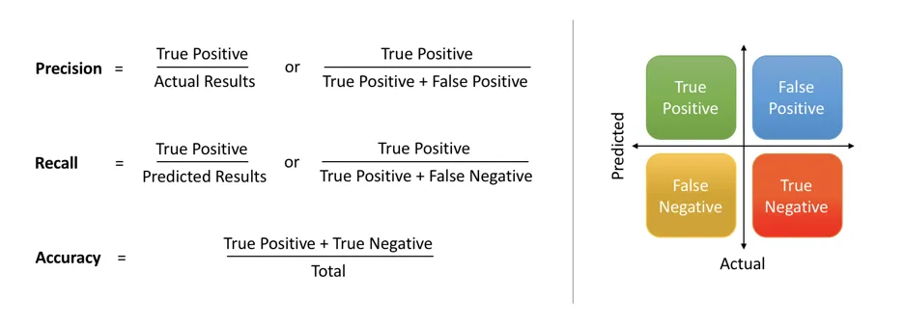
Background
Computer vision – Precision, Recall, and Accuracy
Source: https://medium.com/@shrutisaxena0617/precision-vs-recall-386cf9f89488
Notes:
Using the values from the confusion matrix we can calculate things like Precision, Recall, and Accuracy.
The Precision is a measure that tells us how often the model predicts correctly. The ratio of true positive over all predictions.
The Recall is a measure that tells us if the model predicted when it should have. The ratio of

Slide 84
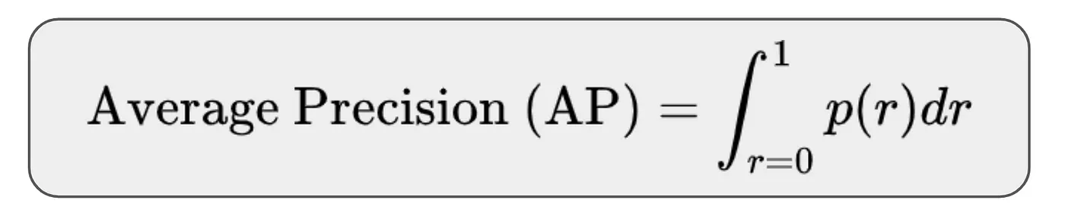
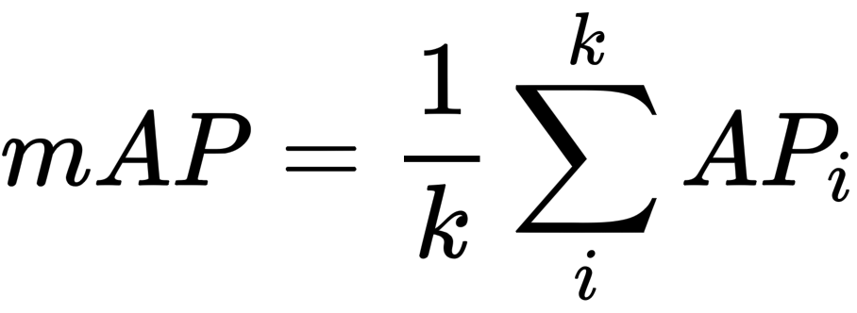
Background
Computer vision – AP and mAP
Source: https://towardsdatascience.com/what-is-average-precision-in-object-detection-localization-algorithms-and-how-to-calculate-it-3f330efe697b
Notes:
If we were to plot the precision against the recall of the model, and calculate the area under that graph, we would find the average precision of the model for that class.
Now the Mean Average Precision or mAP, measures the overall performance of the object detection model across all classes. Which is calculated by taking the mean of average precisions across all classes.

Slide 85
Datasets – Microsoft COCO

Slide 86
Datasets
Microsoft COCO – common objects in context
Stats:
  91 common object categories
  82 of which have > 5000 labeled instances
  Total of 2.5M labeled instances
  328K images
Notes:
Microsoft COCO is one of the most popular object detection and instance segmentation datasets out there.

Slide 87
Datasets
Microsoft COCO – common objects in context
Large scale dataset that addresses
  Detecting non-iconic views of objects
  Contextual reasoning between objects
  Precise 2D localization of objects
Notes:
Detecting non-iconic views: means that the objects aren’t in a neatly composed photo, but rather partially occluded or in the background… Like an actual everyday scene.
Contextual reasoning: means that find the identity of an object based on the context rather than just identifying objects in isolation.
Precise 2D localization: means that they localize and label (either by a bounding box or segmentation) every individual object in the image.

Slide 88
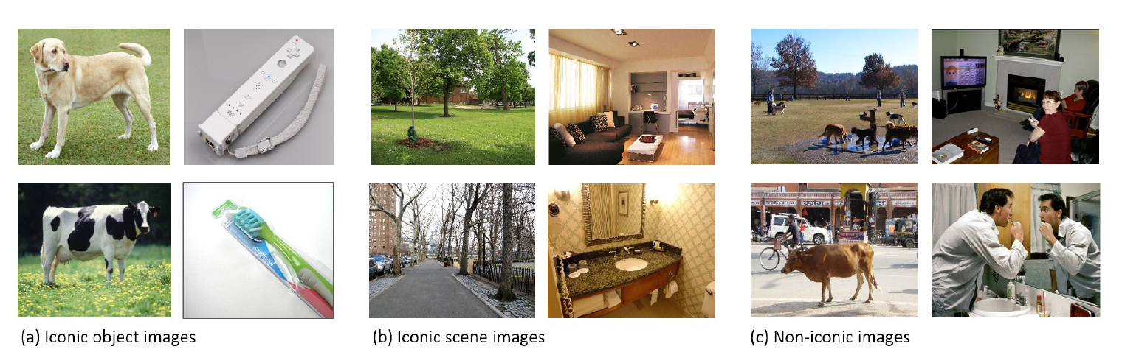
Datasets
Microsoft COCO – common objects in context
Notes:
As you can see here, iconic object images typically a single large object centered in the image.
Iconic scene images are shot from canonical viewpoint and lack people. Unlike the non-iconic images.
According to the authors, it has been shown that datasets containing more non-iconic images are better at generalizing.

Slide 89
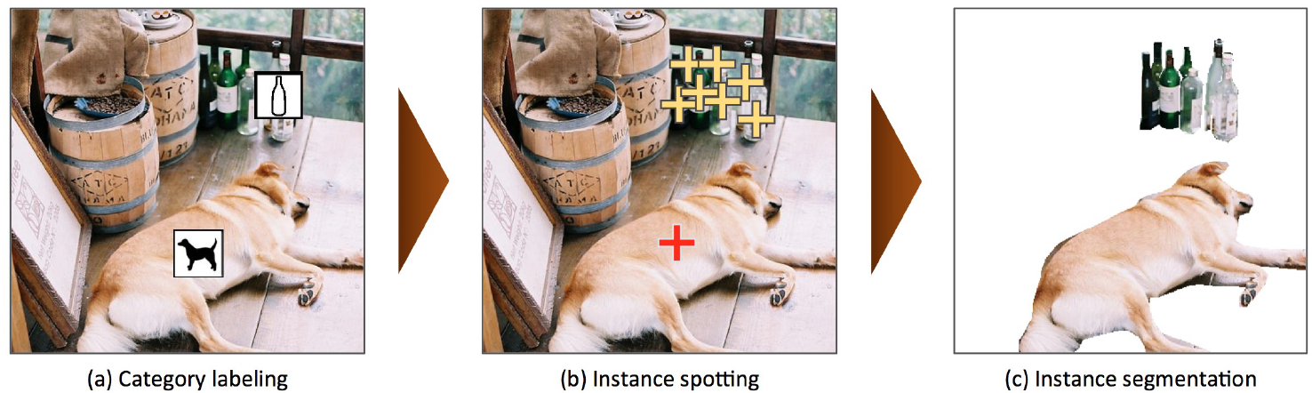
Datasets
Microsoft COCO – common objects in context
Data collection and annotation:
  Non-iconic image collection using Flickr
  Crowdsource annotations using Amazon Mechanical Turk
    Category labeling
    Instance spotting
    Instance segmentation
Notes:
For data collection, they used the website Flickr and searched for multiple objects (e.g. “dog”+”car”) rather than individual objects (“dog”).
For the annotation they needed to devise an efficient method as the dataset contains more than 2.5M images.
The authors used Amazon’s crowdsource annotation platform.
First, for category labeling they divided the 91 categories into 11 super categories. Then asked 8 workers to label each image category.
Then, for the instance spotting, they asked the workers to place a cross on top of each instance.
Lastly, for instance segmentation, they trained the workers then asked them to segment the instances from the previous stage using a custom interface.

Slide 90
Datasets
Microsoft COCO – common objects in context
Comparison with other datasets:
  ImageNet – large # of categories, but many are fine grained
  Pascal VOC – focuses on labeling scenes and their objects
  CIFAR – small number of categories
  SUN – only a few categories with large number of instances

Slide 91
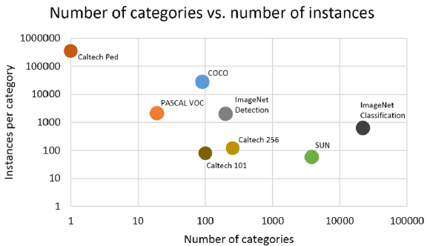
Datasets
Microsoft COCO – common objects in context
Notes:
As can be seen in this graph from the paper, the MS COCO dataset strikes a balance between the number of categories and the number of instances per category

Slide 92
Architectures - RCNN

Slide 93
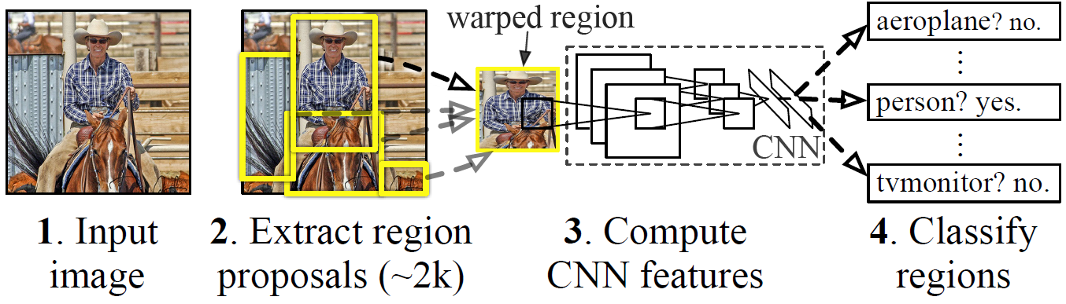
Architectures
RCNN – Regions with CNN features
Object detection architecture:
  Generate region proposals
  Extract a feature vector from each region
  Classify using SVM
Notes:
The object detection system consists of the following three modules:
First, generate category-independent region proposals using the Selective Search algorithm.
Then, they warp each proposal and a large convolutional neural network extracts a feature vector from each region.
Next, a set of class-specific SVM score the extracted features.
Finally, they apply a greedy non-maximum suppression on each class to reject regions with low Intersection-over-union (IoU).

Slide 94
Architectures
RCNN – Regions with CNN features
  How efficient is RCNN?
    CNN parameters are shared across all categories
    Feature vectors are low dimensional (e.g. 360K vs 4K)
  The only class-specific computations are dot products between features and SVM weights, and non-maximum suppression.
  Dot products are batched into a single matrix-matrix product
  This means RCNN can scale to thousands of classes
  Even for 100K classes, the matrix multiplication takes seconds
  Linear predictions storage of 1.5GB vs 134GB (in UVA detection system)
Notes:
In RCNN, two properties make detection efficient.
First, all CNN parameters are shared across all categories. This means that the time spent computing region proposals and features is amortized over all classes.
Second, the feature vectors computed by the CNN are low-dimensional when compared to other approaches

Slide 95
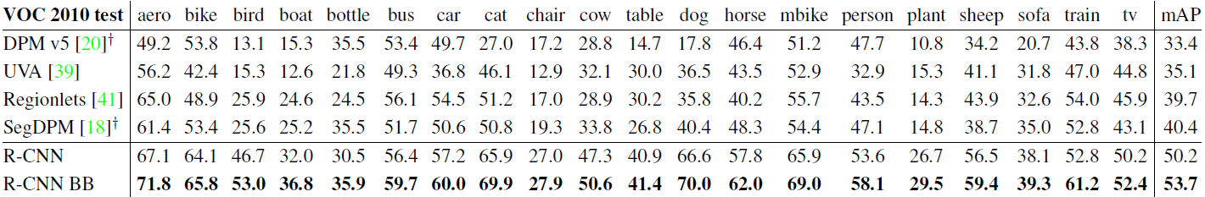
Architectures
RCNN – Regions with CNN features
  Training:
    Supervised pre-training
    Domain specific fine tuning
    Negative regions below IoU threshold
Detection results comparison on VOC 2010 test dataset.
Notes:
For the training:
The authors pre-trained the CNN on a large auxiliary dataset
To adapt the CNN to the new task of detection and the new domain of warped proposals they continued stochastic gradient descent training of the CNN parameters using only warped region
proposals.
3. Regions below the IoU threshold are considered negative, and the ground truth region as positive
Here, this is a table from the paper that compares the performance of RCNN to other models that the authors say are comparable based on the architecture. As you can see RCNN BB (bounding box regression) achieves better performance across all classes in the Pascal VOC 2010 test dataset.

Slide 96
Architectures - FCN

Slide 97
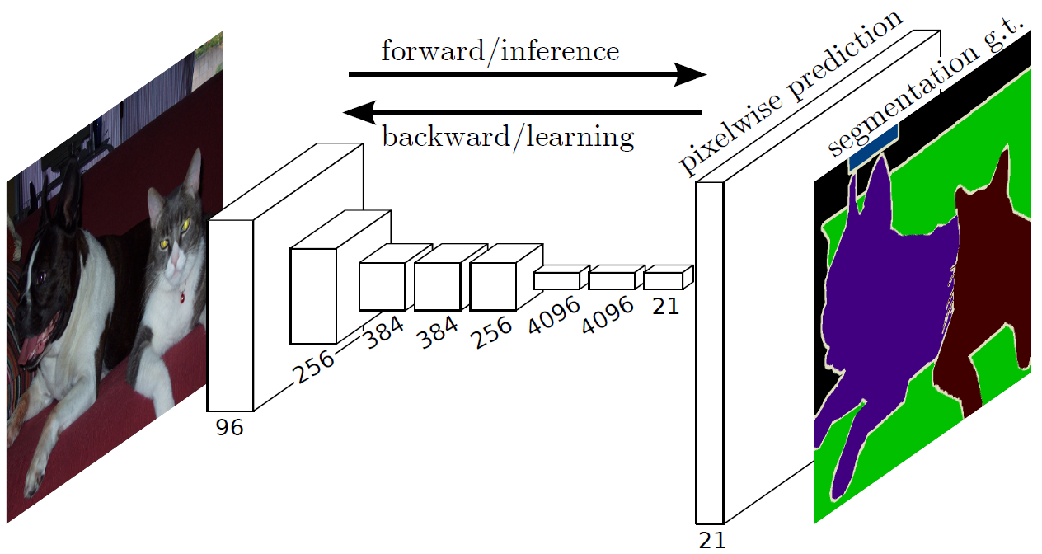
Architectures
FCN – Fully Convolutional Networks for Semantic Segmentation
Notes:
In this paper, the authors show that convolutional networks by themselves, trained end-to-end, pixels-to-pixels, exceed the state-of-the-art in semantic segmentation.
FCN naturally operates on an input of any size, and produces an output of corresponding spatial dimensions.
In order to achieve this, the authors needed to manipulate a CNN to adapt it for the task.

Slide 98
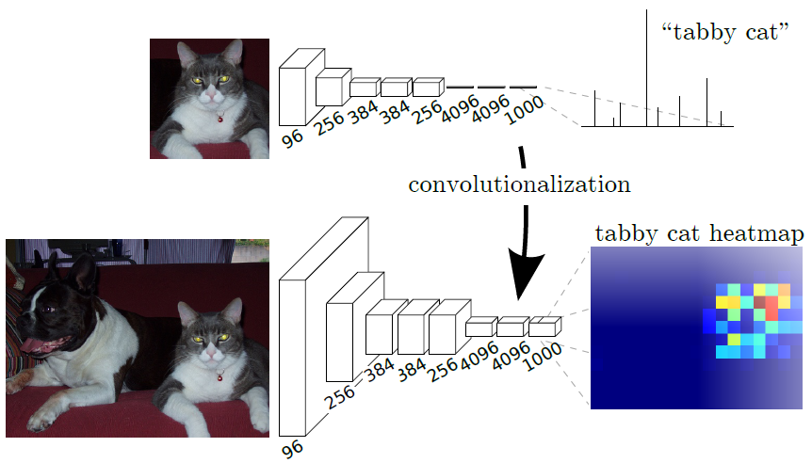
Architectures
FCN – Fully Convolutional Networks for Semantic Segmentation
Notes:
For example, what you can see here is that the authors transformed the fully connected layers of a classification neural network into convolutional layers
to enable the classification network to output a heatmap. By avoiding the use of dense layers, it means that the network has less parameters (making it faster to train).
It also means that the FCN can work for variable image sizes given all connections are local.
The problem with doing that transformation is that the output dimensions are reduced by subsampling.

Slide 99
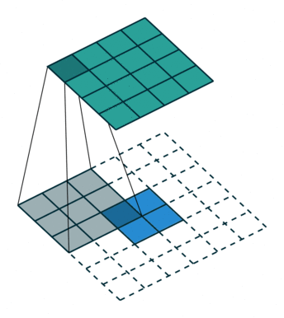
Architectures
FCN – Fully Convolutional Networks for Semantic Segmentation
Source: https://towardsdatascience.com/review-fcn-semantic-segmentation-eb8c9b50d2d1
Notes:
So in order to solve reduced output dimensions problem, the authors opted to using upsampling by means of deconvolution.

Slide 100
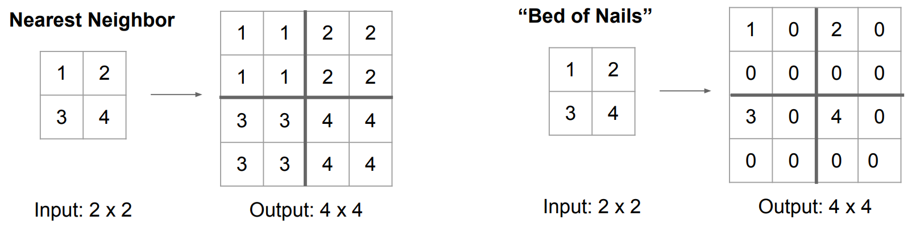
Architectures
FCN – Fully Convolutional Networks for Semantic Segmentation
Source: CS231n Stanford 2017 lecture 11. http://cs231n.stanford.edu/slides/2017/cs231n_2017_lecture11.pdf
Notes:
There are various ways to upsample, by un-pooling. With the nearest neighbor method we fill all the neighbors missing values with the same value. Another method is to populate the missing values with 0s.

Slide 101
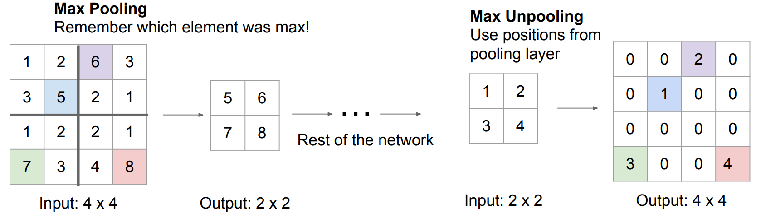
Architectures
FCN – Fully Convolutional Networks for Semantic Segmentation
Source: CS231n Stanford 2017 lecture 11. http://cs231n.stanford.edu/slides/2017/cs231n_2017_lecture11.pdf
Notes:
An even better way is by using Max Unpooling. Basically we take note of the max element position when we do the pooling, and then during the unpooling we place value back in the original location of the max value.
The challenge with this upsampling method is that while deep features can be obtained when going deeper, spatial location information is also lost when going deeper. That means output from shallower layers have more location information. If we combine both, we can enhance the result.

Slide 102
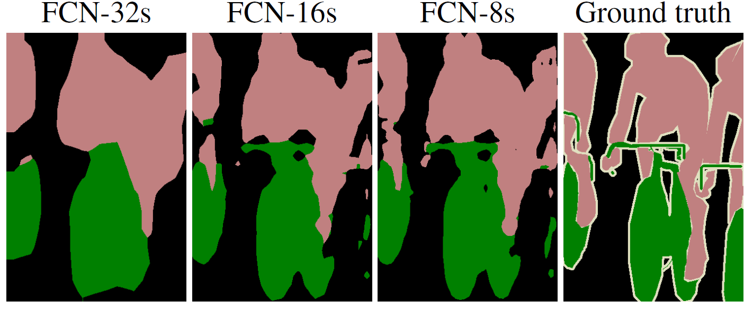
Architectures
FCN – Fully Convolutional Networks for Semantic Segmentation
Notes:
The challenge with this upsampling method is that while deep features can be obtained when going deeper, spatial location information is also lost when going deeper. That means output from shallower layers have more location information.
If we combine both, we can enhance the result.

Slide 103
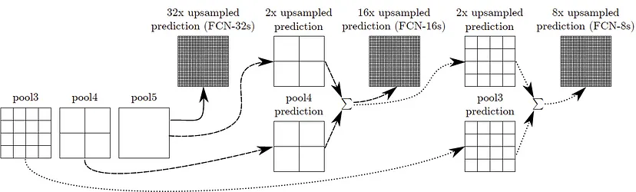
Architectures
FCN – Fully Convolutional Networks for Semantic Segmentation
Notes:
In order to combine outputs from shallow layers with the output from deep layers, the authors fuse the output (by element-wise addition).

Slide 104
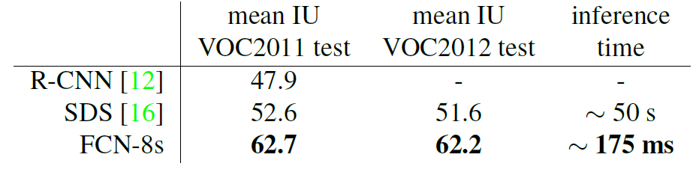
Architectures
FCN – Fully Convolutional Networks for Semantic Segmentation
Notes:
The results show that the fully convolutional network, gives a 20% relative improvement over the state-of-the-art on the PASCAL VOC 2011 and 2012 test sets, and reduces inference time.

Slide 105
Architectures - YOLO

Slide 106
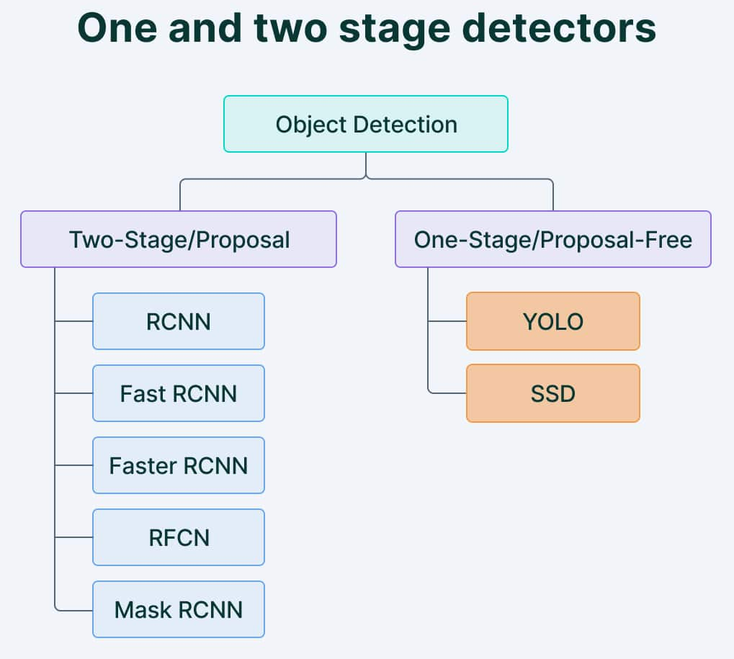
Architectures
YOLO – You Only Look Once
Source: https://www.v7labs.com/blog/yolo-object-detection
Notes:
Two-shot object detection uses two passes of the input image to make predictions about the presence and location of objects. The first pass is used to generate a set of proposals or potential object locations, and the second pass is used to refine these proposals and make final predictions. This approach is more accurate than single-shot object detection but is also more computationally expensive.
Single-shot object detection uses a single pass of the input image to make predictions about the presence and location of objects in the image. It processes an entire image in a single pass, making them computationally efficient.

Slide 107
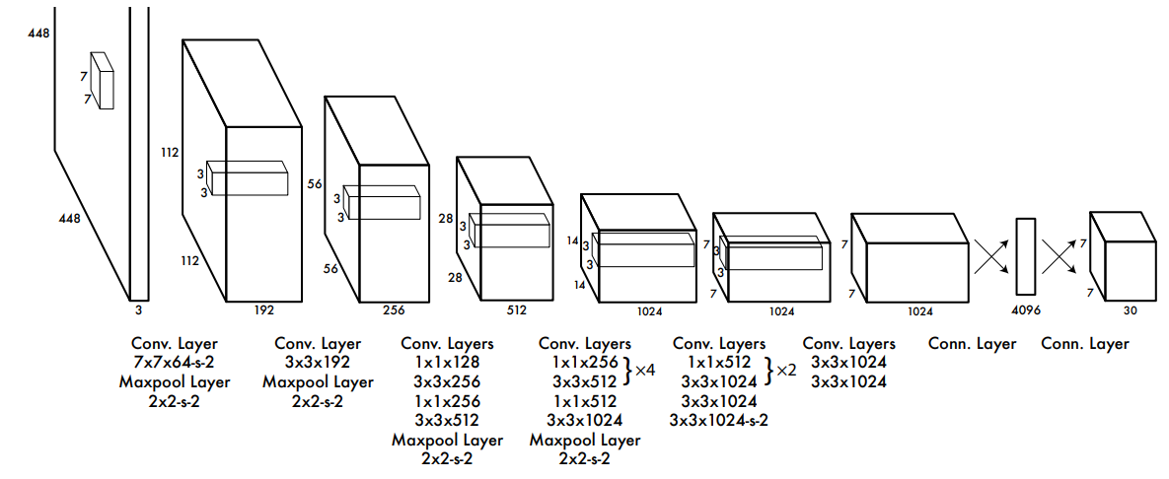
Architectures
YOLO – You Only Look Once
Notes:
While algorithms like RCNN work by detecting possible regions of interest using the Region Proposal Network and then performing recognition on those regions separately, YOLO performs all of its predictions with the help of a single fully connected layer.

Slide 108
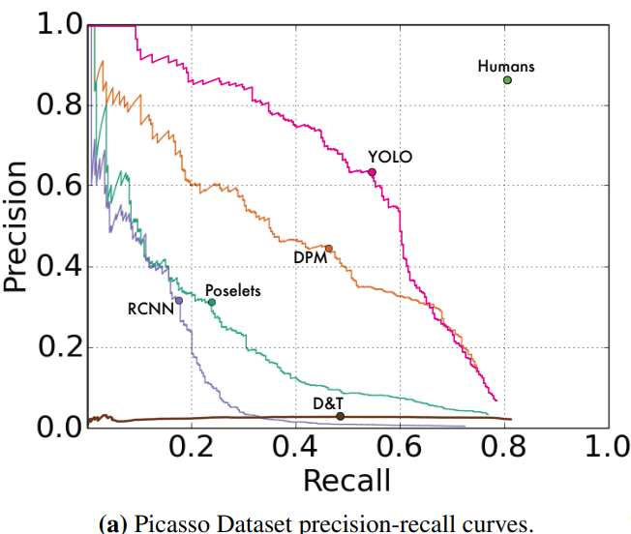
Architectures
YOLO – You Only Look Once
Notes:
What YOLO gives us, is better performance, faster training and detection speeds when compared with the two shot object detection methods.

Slide 109
Computer Vision Development

Slide 110
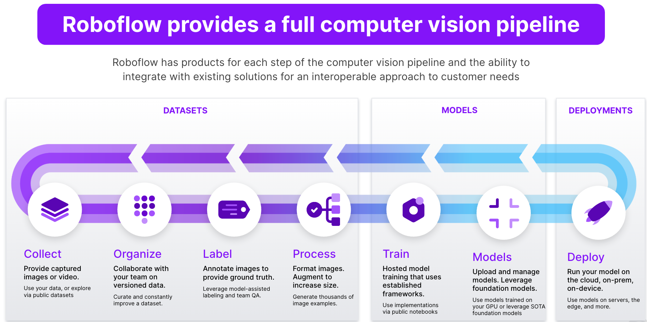
Computer vision Development
Source: https://roboflow.com/
Notes:
An online tool that allows you to manage your computer vision project. Personally I used the free version of it for object detection dataset annotation, and conversion between annotation formats. But by now, it can also do all sorts of other things, but not all are free. They have pre-trained models, dataset universe, automated annotation assist etc.

Slide 111
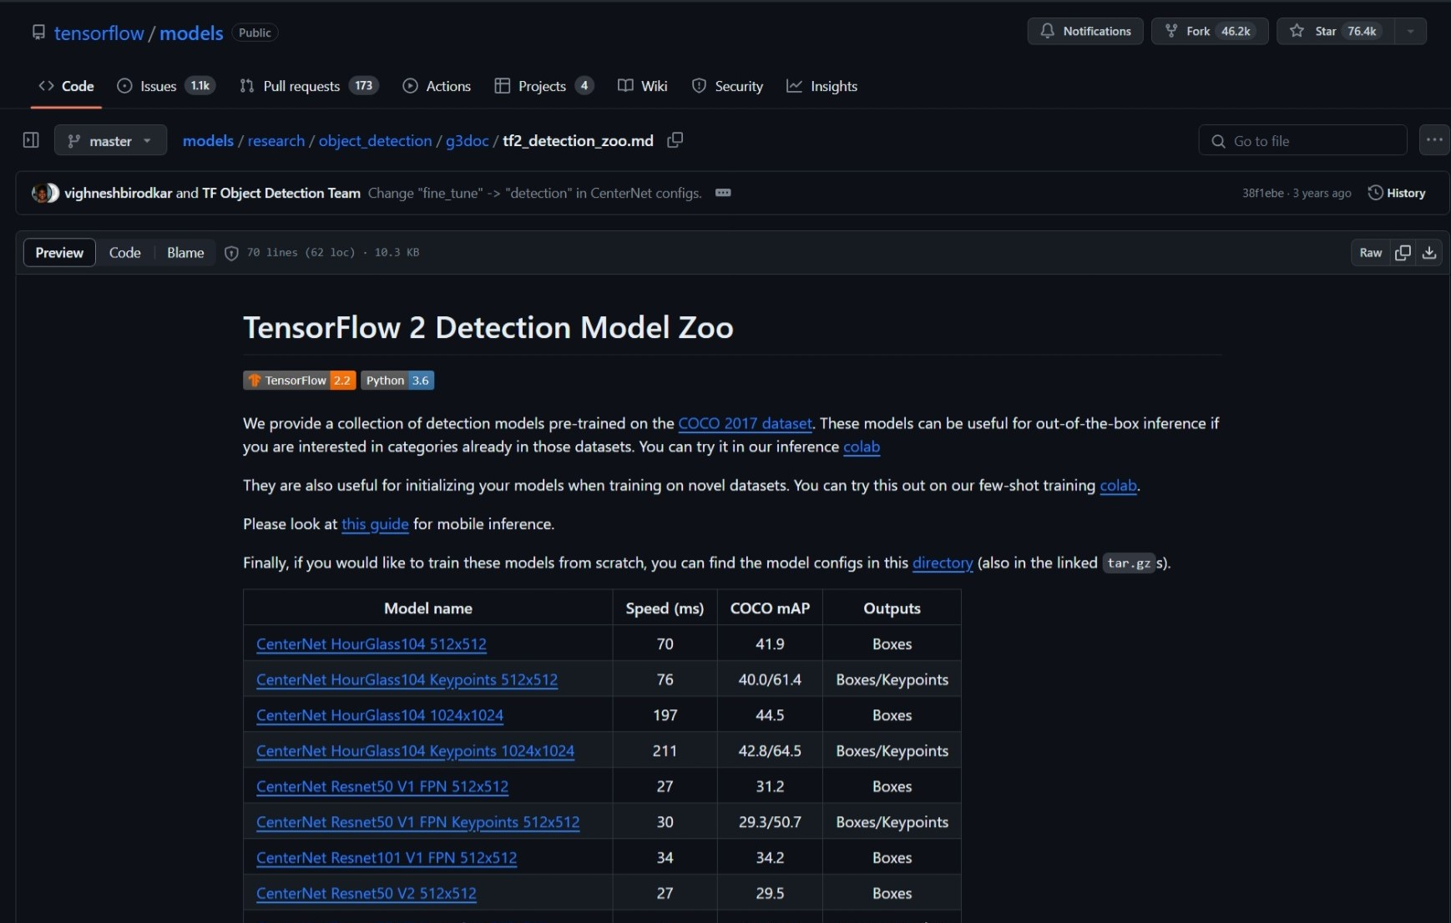
Computer vision Development
Source: https://github.com/tensorflow/models/blob/master/research/object_detection/g3doc/tf2_detection_zoo.md
Notes:
Most major computer vision development platforms like TensorFlow, PyTorch, OpenMMLab, ONNX have something called a model zoo, which is a collection of pre-trained models that we can download and use in our projects, for example to finetune for our own specific tasks.

Slide 112
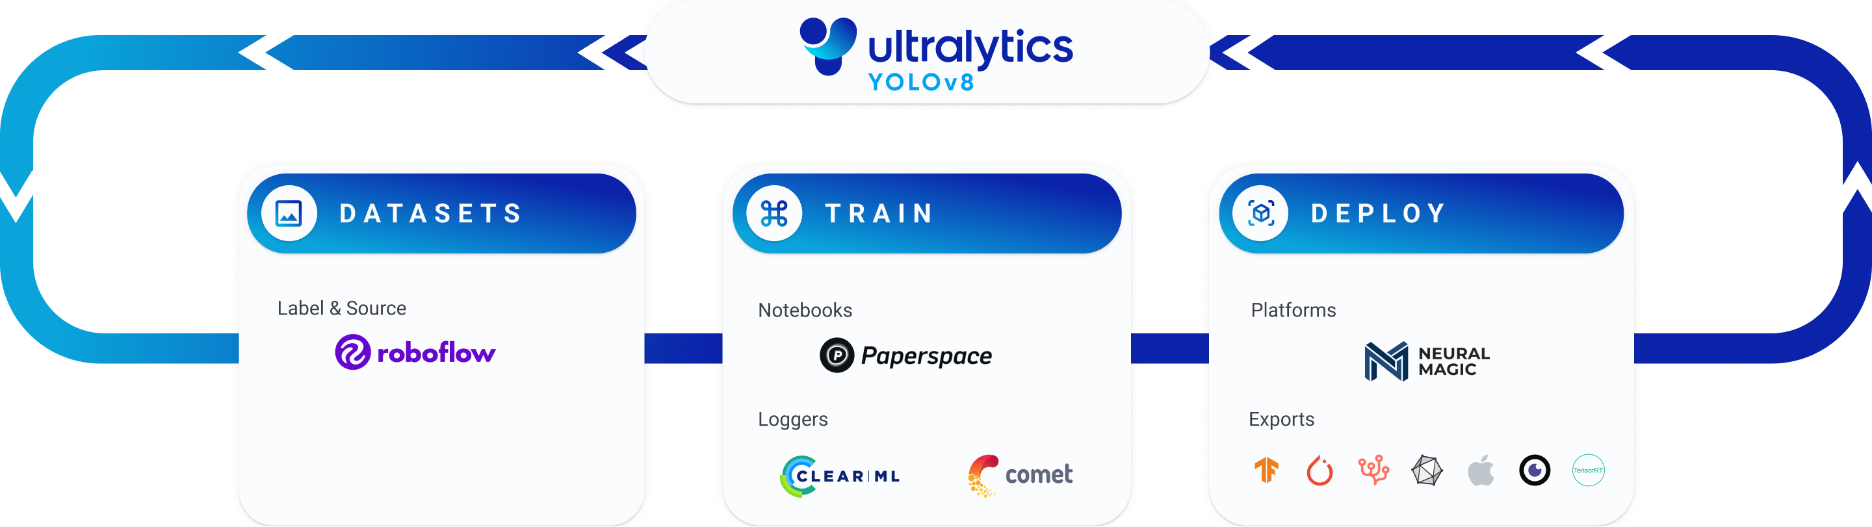
Computer vision Development
Ultralytics
Source: https://www.ultralytics.com/
Notes:
Open source object detection platform that makes it super easy to train your own object detection models.

Slide 113
Discussion
Questions?
Anything to add?
Feedback?
Notes:
I wanted to leave a few minutes at the end of the presentation to open the floor for anyone…
Does anyone have any question, wants clarification, has anything to add, or would like to provide feedback?

Slide 114
Thank you!

Slide 115
Bibliography
https://towardsdatascience.com/10-papers-you-should-read-to-understand-image-classification-in-the-deep-learning-era-4b9d792f45a7
https://www.superannotate.com/blog/guide-to-semantic-segmentation
https://machinethink.net/blog/object-detection-with-yolo/
https://visualqa.org
https://www.dpreview.com/news/9384724203/microsoft-s-latest-computer-vision-technology-beats-humans-at-captioning-images
https://plainsight.ai/blog/what-is-data-annotation/
https://www.v7labs.com/blog/mean-average-precision
https://www.baeldung.com/cs/object-detection-intersection-vs-union
https://medium.com/@shrutisaxena0617/precision-vs-recall-386cf9f89488
https://towardsdatascience.com/what-is-average-precision-in-object-detection-localization-algorithms-and-how-to-calculate-it-3f330efe697b
T.-Y. Lin et al., “Microsoft COCO: Common Objects in Context.” arXiv, Feb. 20, 2015. [Online]. Available: http://arxiv.org/abs/1405.0312

Slide 116
Bibliography
R. Girshick, J. Donahue, T. Darrell, and J. Malik, “Rich feature hierarchies for accurate object detection and semantic segmentation.” arXiv, Oct. 22, 2014. [Online]. Available: http://arxiv.org/abs/1311.2524
https://towardsdatascience.com/review-fcn-semantic-segmentation-eb8c9b50d2d1
CS231n Stanford 2017 lecture 11
J. Long, E. Shelhamer, and T. Darrell, “Fully Convolutional Networks for Semantic Segmentation.” arXiv, Mar. 08, 2015. [Online]. Available: http://arxiv.org/abs/1411.4038
J. Redmon, S. Divvala, R. Girshick, and A. Farhadi, “You Only Look Once: Unified, Real-Time Object Detection.” arXiv, May 09, 2016. [Online]. Available: http://arxiv.org/abs/1506.02640
https://www.v7labs.com/blog/yolo-object-detection
https://roboflow.com/
https://github.com/tensorflow/models/blob/master/research/object_detection/g3doc/tf2_detection_zoo.md
https://www.ultralytics.com/

