Slide 1
Lecture 22: Retrieval Augmentation
Presenters: Sheng-Chieh Lin, Joel Rorseth, Minghan Li

Slide 2
Outline
Pre-training language models with the help of Retrieval
REALM
RETRO
Jointly fine-tuning a retriever and language model for downstream task
RAG for Knowledge-Intensive NLP Tasks
REPLUG
More comprehensive Interaction between language model and retriever
Self-RAG

Slide 3
What is RAG
Memorize World Knowledge in Model Parameters VS Store World Knowledge in an External Database
Language Model Pre-training
Language Model Pre-training
World Knowledge (Corpus)
Retriever
World Knowledge (Corpus)

Slide 4
Why RAG
Explainability
LLM's output comes from retrieved knowledge rather than its internal memory
Privacy
Use proprietary data as external knowledge rather than training data
Decompose memorization and other capability in pre-training
LLM can focus on the tasks other than memorization
Small LLM + Retriever leads to better performance than solely Large LLM

Slide 5
Different Types of RAG
How to fuse retrieved knowledge with input text (e.g., Question)
Insert retrieved knowledge by text concatenation (e.g., REALM)
Insert retrieved knowledge by cross attention (e.g., RETRO, FID)
Insert retrieved knowledge by interpolate language model output probability (e.g., KNNLM)
Interpolate with output
Language Model Pre-training
Cross Attention
Retriever
Retrieved knowledge
Text concatenate
Who is the president of the USA?

Slide 6
Different Types of RAG
How to fuse retrieved knowledge with input text (e.g., Question)
Insert retrieved knowledge by text concatenation (e.g., REALM)
Insert retrieved knowledge by cross attention (e.g., Retro, FID)
Insert retrieved knowledge by interpolate language model output probability (e.g., KNNLM)
Interpolate with output
Language Model Pre-training
Cross Attention
Retriever
Retrieved knowledge
Text concatenate
Who is the president of the USA?

Slide 7
Outline
Pre-training language models with the help of Retrieval
REALM
RETRO
Jointly fine-tuning a retriever and language model for downstream task
RAG for Knowledge-Intensive NLP Tasks
REPLUG
More comprehensive Interaction between language model and retriever
Self-RAG

Slide 8
REALM: Illustration of RAG Pre-Training
Language Model Pre-training
Language Model Pre-training
the at the top of the [MASK] pyramid
the at the top of the [MASK] pyramid
The pyramidion on top allows for less material higher up the pyramid
Retriever
the at the top of the [MASK] pyramid

Slide 9
REALM: Application to Downstream Tasks
Pre-training task: Input: Concatenate retrieved passages and masked text --> Output: masked token prediction
Fine-tuning task: Input: Concatenate retrieved passages and query --> Output: Answer span in the retrieved passages

Slide 10
REALM: Challenges of RAG Pre-Training
How to Update Retriever in MLM Pre-Training
Synchronized Problem when Updating Retriever
How to Create Training Data in RAG MLM Pre-Training

Slide 11
REALM: How to Update Retriever?
Language Model Pre-training
Language Model Pre-training
the at the top of the [MASK] pyramid
the at the top of the [MASK] pyramid
The pyramidion on top allows for less material higher up the pyramid
Retriever
the at the top of the [MASK] pyramid

Slide 12
REALM: How to Update Retriever?
P(y|x,z1)
P(y|x,z2)
Language Model Pre-training
Language Model Pre-training
the at the top of the [MASK] pyramid
the at the top of the [MASK] pyramid
P(z1|x)
P(z2|x)
The pyramidion on top allows for less material higher up the pyramid
Passage...
Retriever
Retriever
the at the top of the [MASK] pyramid
the at the top of the [MASK] pyramid

Slide 13
REALM: How to Update Retriever?
P(y|x,z1)
P(y|x,z2)
Language Model Pre-training
Language Model Pre-training
the at the top of the [MASK] pyramid
the at the top of the [MASK] pyramid
P(z1|x)
P(z2|x)
If P(y|x,z1) > P(y|x,z2), Retriever will be updated to increase P(z1|x) more than P(z2|x)
The pyramidion on top allows for less material higher up the pyramid
Passage...
Retriever
Retriever
the at the top of the [MASK] pyramid
the at the top of the [MASK] pyramid

Slide 14
REALM: Solution to Synchronized Issue
P(y|x,z1)
P(y|x,z1)
Language Model Pre-training
Updated Language Model Pre-training
Update
the at the top of the [MASK] pyramid
the at the top of the [MASK] pyramid
P(z1|x)
P(z1|x)
The pyramidion on top allows for less material higher up the pyramid
The pyramidion on top allows for less material higher up the pyramid
Retriever
Updated Retriever
Index
Update
Index
the at the top of the [MASK] pyramid
the at the top of the [MASK] pyramid

Slide 15
REALM: Asynchronized Index Update
Assuming it requires two update times for a Retriever to encode index
Retriever
Update
Updated Retriever 1
Index Encoding
Index1
Index
Index
Update
Index Update
Updated Retriever 2
Update
Updated Retriever 3
Index Encoding
Index3
Index
Index1
Update
Index Update
Updated Retriever 4
Update
Updated Retriever 5
Index Encoding
Index5
Index
Index3

Slide 16
REALM: Data for RAG MLM Pre-Training
Salient Span Masking: Name Entity (e.g., United Kingdom) or Dates (e.g., July 9)
Null Documents: Replacing Retrieved Documents with Null so that Model can only rely on its knowledge to predict [MASK]
Prohibiting Trivial Retrieval: If the masked sentence comes from the retrieved document; the task becomes too trivial. Thus, the document is removed from the top-K documents.

Slide 17
REALM: Effectiveness Comparison
Retrieval + language modeling jointly pre-training improves RAG performance on downstream in-domain tasks (NQ), out-of-domain tasks (WQ, CT)

Slide 18
Other Recent RAG Pre-Training Works
Atlas: Few-shot Learning with Retrieval Augmented Language Models
Encoder-Decoder Structure
Start with a better unsupervised pre-trained retriever (i.e., Contriever)
Discuss how to update retriever using the signal from language model
Discuss more alternatives to unsynchronized index update
In-Context Pre-Training: Language Model Beyond Document Boundaries
Decoder-only structure
Aggregate relevant documents to create context input for next word prediction

Slide 19
Outline
Pre-training language models with the help of Retrieval
REALM
RETRO
Jointly fine-tuning a retriever and language model for downstream task
RAG for Knowledge-Intensive NLP Tasks
REPLUG
More comprehensive Interaction between language model and retriever
Self-RAG

Slide 20
Different Types of RAG
How to Combine Retrieved Knowledge with Input Text (e.g., Question)
Insert retrieved knowledge by text concatenation (e.g., REALM)
Insert retrieved knowledge by cross attention (e.g., Retro, FID)
Insert retrieved knowledge by interpolate language model output probability (e.g., KNNLM)
Interpolate with output
Language Model Pre-training
Cross Attention
Retriever
Retrieved knowledge
Text concatenate
Who is the president of the USA?

Slide 21
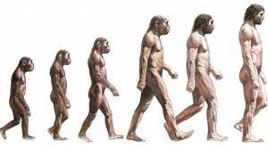
Why Retro: Scaling Index VS Model Size?
GPT3
GPT2
GPT1
Index
Index
Index
Language Model Pre-training
Language Model Pre-training
Language Model Pre-training

Slide 22
Why Retro: Other Advantages
Frozen Retriever Parameters: No Synchronized Index Issue
Chunked Cross-Attention to incorporate retrieved contexts: Linear Time Complexity vs Retrieved Context Length

Slide 23
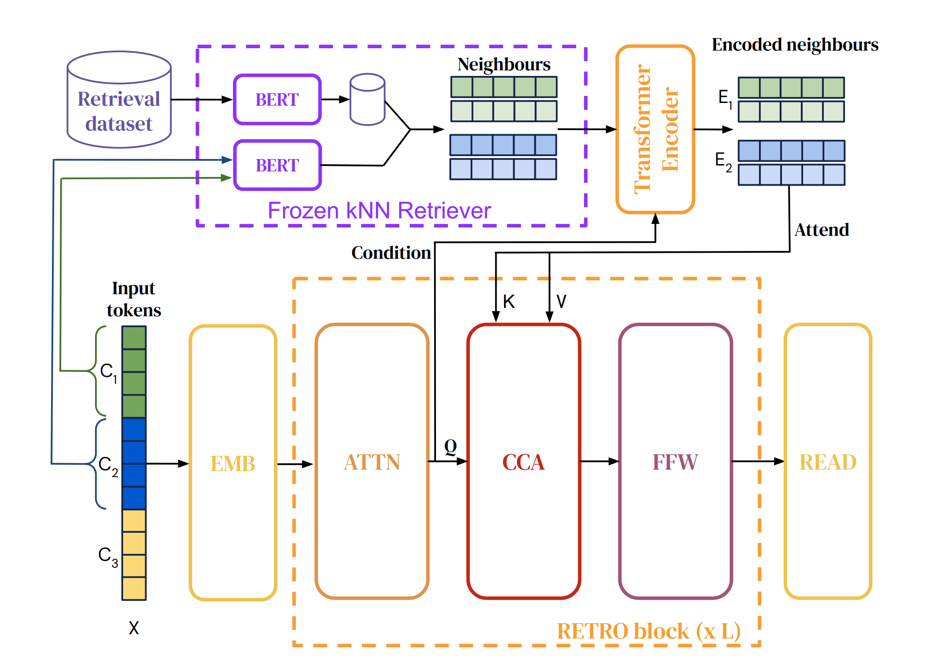
Retro Architecture
Chunked Retrieval
Retrieved Chunk Encoding
Fuse Input and Retrieved Context

Slide 24
Chunked Retrieval
Chunked Retrieval:
Use frozen BERT retriever
Each chunk retrieves its K neighbors plus the neighbors' continuation
Chunked input: Who is the president of the USA
Retrieved chunk: Here is the list of president of the USA.
Retrieved chunk continuation: 2008—2016 Barack Obama, 2016—2020 Donald Trump, 2020—2024 Joe Biden.

Slide 25
Retrieved Chunk Encoding
Retrieved Chunk Encoding
Trainable Bi-directional Encoder
Encoding Retrieved Chunks condition on its query

Slide 26
Chunked Cross Attention
Fusing Input and Retrieved Context with Chunked Cross-Attention
Each input chunk only attends the context retrieved by its previous input chunk
Like causal mask
Linear time complexity with increasing context length
Long dependency between chunks can still propagate through self-attention

Slide 27
Retro Results: Language Modelling
The performance gain of Retro is comparable to multiplying the parameteric model size by ∼ 10×
The gain increases with the size of the retrieval database (middle) and the number of retrieved neighbours

Slide 28
Retro Results: Question Answering
The performance of Retro is competitive with previous approaches such as Realm, RAG and DPR, but underperforms the more recent FiD.

Slide 29
Outline
Pre-training language models with the help of Retrieval
REALM
RETRO
Jointly fine-tuning a retriever and language model for downstream task
RAG for Knowledge-Intensive NLP Tasks
REPLUG
More comprehensive Interaction between language model and retriever
Self-RAG

Slide 30
RAG for Knowledge-Intensive NLP Tasks
Full Paper Title: Retrieval-Augmented Generation for Knowledge-Intensive NLP Tasks
Authors: Lewis et al. (FAIR, NYU, University College London)
Publication: NeurIPS 2020
Link: https://arxiv.org/abs/2005.11401

Slide 31
Terminology
Term | Definition
Knowledge-intensive tasks | Tasks that require external knowledge to answer
Parametric memory | Pre-trained model knowledge (i.e., model weights)
Non-parametric memory | External knowledge (e.g., retrieval systems)
Hybrid memory | Parametric + non-parametric (e.g., REALM)

Slide 32
Motivation: Hybrid Approach for seq2seq
Parametric:
Difficult to update or expand
Cannot inspect or explain knowledge
May produce hallucinations
Non-parametric:
Easy to update or expand
We can inspect directly
Hybrid:
Only explored open-domain extractive QA
Not yet adapted for seq2seq models

Slide 33
Solution: RAG for seq2seq models
Goal: Adapt hybrid methodology for seq2seq models
How: A fine-tuning strategy named retrieval-augmented generation (RAG)
Architecture:
Pretrained seq2seq transformer: BART
Pretrained neural retriever: Dense Passage Retriever (DPR)
Dense vector index of Wikipedia
Assume: Models already have trained ability to access knowledge
Notes:
Assumption: models have the ability to access knowledge without additional training TODO: Add citations for BART and DPR

Slide 34
Introducing RAG
Idea: Combine retriever (nonparametric) and generator (parametric)
Retriever: $p_{η}\left(z|x\right)$
Gives (top-$k$ truncated) distribution over text passages $z$, given query $x$
Generator:$p_{θ}\left(y_{i}|x,z,y_{1:i−1}\right)$
Gives next token $y_{i}$ given previous tokens, query $x$, retrieved passage $z$

Slide 35
Two Types of RAG Models
RAG-Sequence Model
RAG-Token Model
Use one retrieved document to generate entire sequence
Use different document to generate each token in sequence
Notes:
TODO: Create an illustration to contrast?

Slide 36
Generators
$p_{RAG−Sequence}\left(y|x\right)≈\sum_{z∈top−k\left(p\left(∙|x\right)\right)}{p_{η}\left(z|x\right)\prod_{i}^{N}{p_{θ}\left(y_{i}|x,z,y_{1:i−1}\right)}}$
Marginalized over each top-$k$ document…
Generate probability for entire output sequence
$p_{RAG−Token}\left(y|x\right)≈\prod_{i}^{N}{\sum_{z∈top−k\left(p\left(∙|x\right)\right)}{p_{η}\left(z|x\right)p_{θ}\left(y_{i}|x,z,y_{1:i−1}\right)}}$
For each token…
Marginalized over each each top-$k$ document…
Generate distribution for next output token
Notes:
$$p_{RAG−Sequence}\left(y|x\right)≈\sum_{z∈top−k\left(p\left(∙|x\right)\right)}{p_{η}\left(z|x\right)p_{θ}\left(y|x,z\right)}$$

Slide 37
Implementation: Encoding
Retriever:
Uses DPR, which uses BERT to encode query and document
Similarity between query and document is computed using MIPS
Generator:
Uses BART-large (400M parameters)
Input query and retrieved document are simply concatenated
Notes:
$$p_{RAG−Sequence}\left(y|x\right)≈\sum_{z∈top−k\left(p\left(∙|x\right)\right)}{p_{η}\left(z|x\right)p_{θ}\left(y|x,z\right)}$$

Slide 38
Implementation: Decoding
Question: How do we approximate ${argmax}_{y}p\left(y|x\right)$?
RAG-Token: Plug $p_{θ}\left(y_{i}|x,z,y_{1:i−1}\right)$ into standard beam decoder
RAG-Sequence: Run beam search for each document $z$
$p\left(y|x\right)$doesn’t break into per-token likelihood
Therefore, it cannot be solved using a single beam search
Notes:
[TODO] Explain “Thorough Decoding” and “Fast Decoding”

Slide 39
Implementation: Fine-Tuning
Joint Fine-Tuning Update:
Update: Retriever query encoder and generator
Don’t Update: Retriever document encoder
Expensive since document index must be periodically updated
Authors find it isn’t necessary for strong performance
Aside: REALM does this during pre-training
Fine-Tuning Data: A collection of pairs $\left(x_{j},y_{j}\right)$
Objective: Minimize $\sum_{j}{−log⁡p\left(y_{j}|x_{j}\right)}$ using SGD (via Adam)

Slide 40
Putting Everything Together

Slide 41
Experiment: Non-Parametric Setup
Data:
Wikipedia dump from Dec 2018
21M Wikipedia chunks (size of 100-words)
Indexing:
Use document encoder (BERT) to compute embeddings
Embeddings put into MIPS index using FAISS
Hierarchical Navigable Small World used for fast retrieval
Retrieval:
Training: Retrieve $k ε \left\{5,10\right\}$ documents
Testing: Set $k$ using “dev data”

Slide 42
Experiment: The 4 Tasks
Open-Domain Question Answering
Abstractive Question Answering
Jeopardy Question Generation
Fact Verification

Slide 43
Task 1: Open-Domain QA
Task: Answering objective factual questions
Data:
Natural Questions (NQ)
TriviaQA (TQA)
WebQuestions (WQ)
CuratedTree (CT)
Setup: Fine-tune using $\left(x,y\right)$ = (question, answer) pairs
Baselines:
Open-Book Models: Has access to external knowledge
Closed-Book Models: No access to external knowledge
Metrics: Exact Match (EM) score
Notes:
TODO: Explain metric?

Slide 44
Task 1: RAG Has Strong QA Performance
Why?
Can generate answers when answer not in documents
Even if answer isn’t in documents, they can provide other useful info
In general: RAG combine benefits of open + closed book

Slide 45
Task 2: Abstractive QA
Task: Natural language generation (NLG)
Data: MSMARCO NLG task v2.1
A large dataset of questions
Each question has 10 gold search engine passages
Each question has full sentence answer annotated from passages
Setup: Fine-tune using $\left(x,y\right)$ = (question, answer) pairs
To force RAG to rely on parametric knowledge, ignore gold passages
Baselines: BART, SotA
Metrics: BLEU, Rouge-L
Notes:
TODO: Explain metrics?

Slide 46
Task 2: RAG Approaches SotA on NLG
Consider:
SotA has access to gold passages, required for some answers
Not all questions are answerable from Wikipedia alone
Nonetheless:
RAG outperforms BART
RAG approaches SotA

Slide 47
Task 3: Jeopardy Question Generation
Jeopardy question? A factual statement that prompts exact answer
“In 1986 Mexico scored as the first country to host this international sports competition twice” (Answer: “The World Cup”)
Task: Generate Jeopardy questions conditioned on answer entities
Setup: Fine-tune using $\left(x,y\right)$ = (answer, question) pairs
Data: SearchQA
Baselines: BART
Metrics: BLEU, Q-BLEU-1

Slide 48
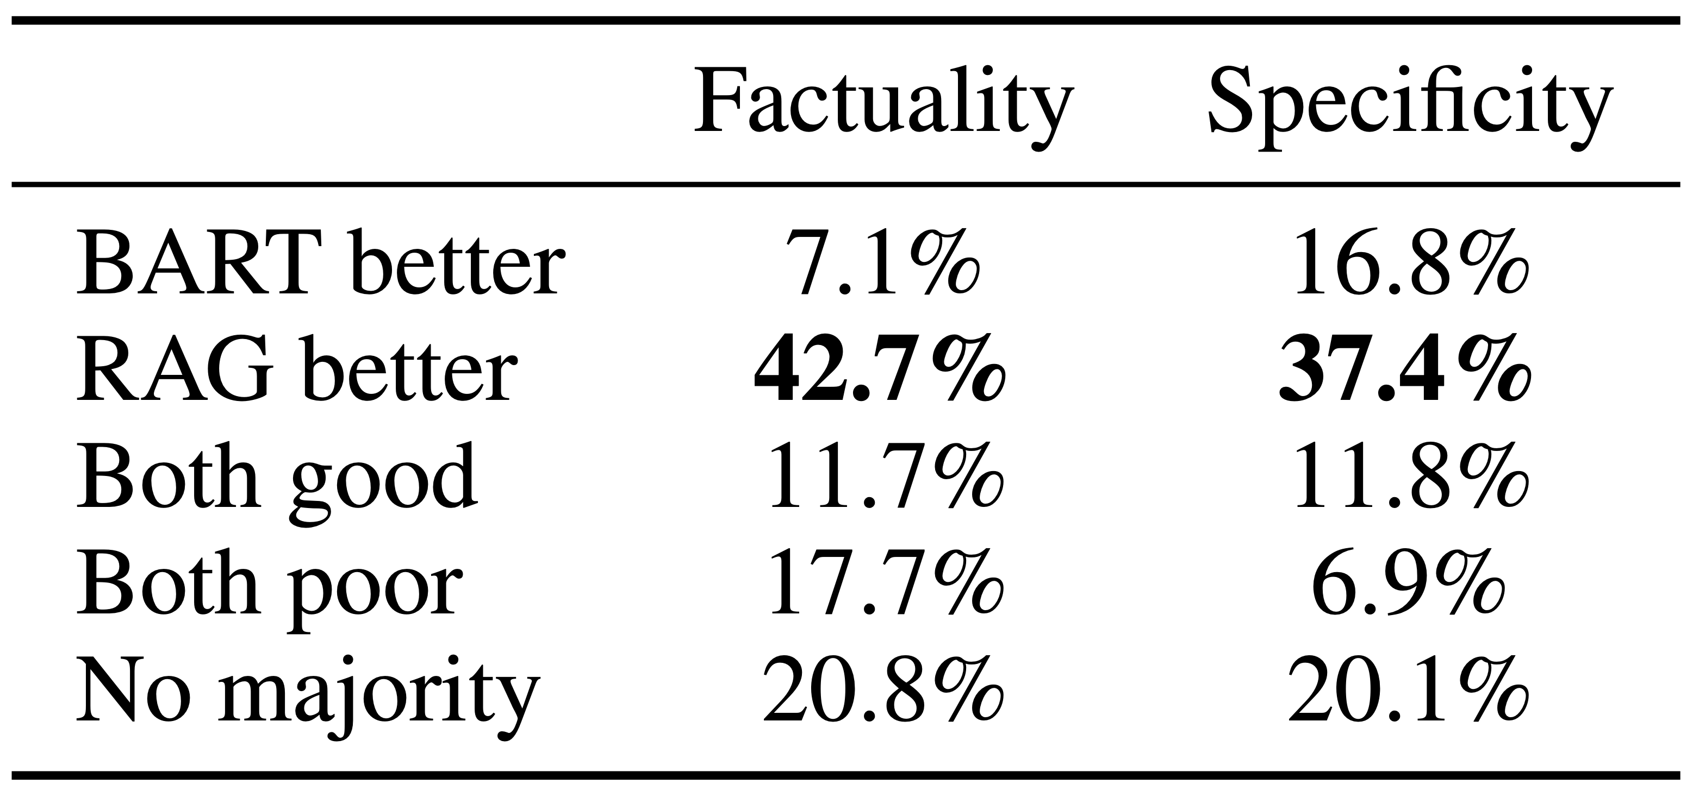
Task 3: RAG-Token Performs Best
RAG-Token > RAG-Seq > BART
RAG-Token can pull from multiple documents!
RAG generators help to complete document-initiated generations
Human evaluators prefer RAG
Generations are more factual
Generations are more specific

Slide 49
Task 4: Fact Verification
Task: Classify whether a claim is true, false, or unverifiable
3-Way Classification: Supports / Refutes / Not Enough Info
2-Way Classification: Supports / Refutes
Data: FEVER
A dataset of claims and evidence annotations for Wikipedia data
Setup: Fine-tune using $\left(x,y\right)$ = (claim, class) pairs
Each class mapped to unique output token
Similar to NLG, ignore evidence annotations
Baselines: BART, SotA
Metrics: Label accuracy

Slide 50
Task 4: RAG Scores Approach SotA
Consider:
SotA has access to gold evidence annotations
SotA use complex pipelines, trained with supervision
Nonetheless:
RAG scores are close to SotA
High overlap between RAG documents retrieved and gold evidence (not shown)

Slide 51
Outline
Pre-training language models with the help of Retrieval
REALM
RETRO
Jointly fine-tuning a retriever and language model for downstream task
RAG for Knowledge-Intensive NLP Tasks
REPLUG
More comprehensive Interaction between language model and retriever
Self-RAG

Slide 52
REPLUG
Title: REPLUG: Retrieval-Augmented Black Box Language Models
Authors: Shi et al. (University of Washington, Stanford, KAIST, Meta AI)
Publication: ArXiv 2023
Link: https://arxiv.org/abs/2301.12652

Slide 53
Motivation: RAG for Black-Box LMs
Issue: Fine-tuning LMs with retrieval requires white-box access (i.e., access to the LM parameters)
To train the model
To index the datastore
In Practice: Many LLMs are only accessible via API
Can’t access model parameters!
Can’t fine-tune!

Slide 54
Introducing REPLUG
Focus: Retrieval-augmentation in the black-box setting (no access to model parameters)
LM is a black box
Retriever is optionally tunable
How does it work?
Get documents from retriever
Prepend documents to LM input
Feed input to LM

Slide 55
Implementation: Retrieval
Given:
Corpus of $m$ documents $D=\left\{d_{1}…d_{m}\right\}$
Input context $x$
Output:
The $k$ documents in $D$ that are most relevant to $x$, denoted $D′⊂D$
How:
Precompute embedding for each document $d$ (construct FAISS index)
Encode input $x$ to obtain embedding
Find top-$k$ most similar documents to $x$ using cosine similarity function $s$

Slide 56
Hang On, Can We Fit $k$ Documents?
Context Window: The input text for a LM
Context Window Size: Number of tokens a LM can process as input
Problem: Context window may not fit $k$ documents
The context window size varies by LM
The size of each document could vary
The number of retrieved documents $k$could vary

Slide 57
Solution: Ensemble Inference Scheme
Idea: Do $k$ separate LM predictions!
Concatenate each $d∈D′$ with $x$
Ensemble the output probabilities from $k$ inference calls
Benefits:
Inference calls can be parallelized!
Minimal overhead compared to single inference over $k$ documents
Context window size need only fit $x$ and largest document
$p\left(y|x,D′\right)=\sum_{d∈D′}{p\left(y|d∘x\right)∙λ\left(d,x\right)}$
$∘$ denotes concatenation
$λ$measures similarity of $d$ and $x$
$y$ is the next token

Slide 58
REPLUG LSR (LM-Supervised Retrieval)
Idea: Train retriever to find documents that minimize LM perplexity
Retrieve $k$relevant documents $D^{′}⊂D$
Compute retrieval likelihood of each document
$P_{R}\left(d|x\right)=\frac{e^{s\left(d,x\right)/γ}}{\sum_{d′∈D′}{e^{s(d′,x)/γ}}}$
Compute LM likelihood of each document ($y$ = ground truth)
$Q_{LM}\left(d|x,y\right)=\frac{e^{P_{LM}\left(y|d,x\right)/β}}{\sum_{d′∈D′}{e^{P_{LM}(y|d′,x)/β}}}$
Minimize KL divergence between retriever and LM ($ℬ$ = contexts)
$ℒ=\frac{1}{\left|ℬ\right|}\sum_{x∈ℬ}{KL\left(P_{R}\left(d|x\right)∥Q_{LM}\left(d|x,y\right)\right)}$

Slide 59
Implementation: Training
REPLUG: No training, use off-the-shelf retriever (Contriever)
REPLUG LSR: Use retriever (Contriever) + LM (GPT-3 Curie)
Sample training queries from Pile dataset (256 tokens x 800K sequences)
Query split into:
Input context $x$ (128 tokens)
Ground truth continuation $y$ (128 tokens)
Sample external documents from Pile (128 tokens x 36M documents)
Training queries and documents are verified for non-overlapping
Notes:
[TODO] Add specific details about hyperparams / optimization?
Retrieve top-20 documents from FAISS index

Slide 60
Putting Everything Together

Slide 61
Experiments
Language Modeling
Massive Multi-task Language Understanding (MMLU)
Open-Domain QA

Slide 62
Task 1: Language Modeling
Data: The Pile
Setup:
REPLUG will use 128-token context window size
Retrieval corpus is 367M documents (each 128 tokens) sampled from The Pile
Retriever will retrieve top-10 documents
Baselines: Test how much REPLUG improves…
GPT-2 (Small, Medium, Large, XL)
GPT-3 (Davinci, Curie, Baddage, Ada)
Metrics: Bits per UTF-8 encoded byte (BPB)

Slide 63
Task 1: REPLUG Consistently Improves Language Modeling

Slide 64
Task 2: MMLU
Task / Data: Multiple choice QA from MMLU dataset
Exam questions from 57 tasks spanning 4 categories:
Humanities, STEM, social sciences, other
Setup:
Use Codex + REPLUG, evaluate in 5-shot setting
For each MMLU test query, retrieve and prepend 10 Wikipedia documents (Dec 2018 dump) and ensemble the output
Baselines:
LLMs that are SotA for MMLU: Codex, PaLM, Flan-PaLM
RAG LMs: Atlas
Metrics: Accuracy

Slide 65
Task 2: REPLUG Improves Codex

Slide 66
Task 3: Open-Domain QA
Task: Answering objective factual questions
Data:
Natural Questions (NQ)
TriviaQA
Setup:
Use Codex + REPLUG, evaluate in 16-shot setting
Wikipedia for retrieval, top-10 documents
Baselines:
LLMs: Chinchilla, PaLM (both 64 shots), Codex (16 shots)
RAG LMs: RETRO, R2-D2, Atlas

Slide 67
Task 3: REPLUG Beats Previous RAG LMs

Slide 68
Outline
Pre-training language models with the help of Retrieval
REALM
RETRO
Jointly fine-tuning a retriever and language model for downstream task
RAG for Knowledge-Intensive NLP Tasks
REPLUG
More comprehensive Interaction between language model and retriever
Self-RAG

Slide 69
Self-RAG: Learning to Retrieve, Generate,
and Critique through Self-Reflection

Slide 70
Problems of RAG Models
Robustness to Irrelevant Contexts
"The 2022 FIFA World Cup, also branded as Qatar 2022 was the 22nd FIFA World Cup, the world championship for national football teams organized by FIFA."
"Write an essay of your best summer vacation"
Ram, Ori, et al. "In-context retrieval-augmented language models." arXiv preprint arXiv:2302.00083 (2023).

Slide 71
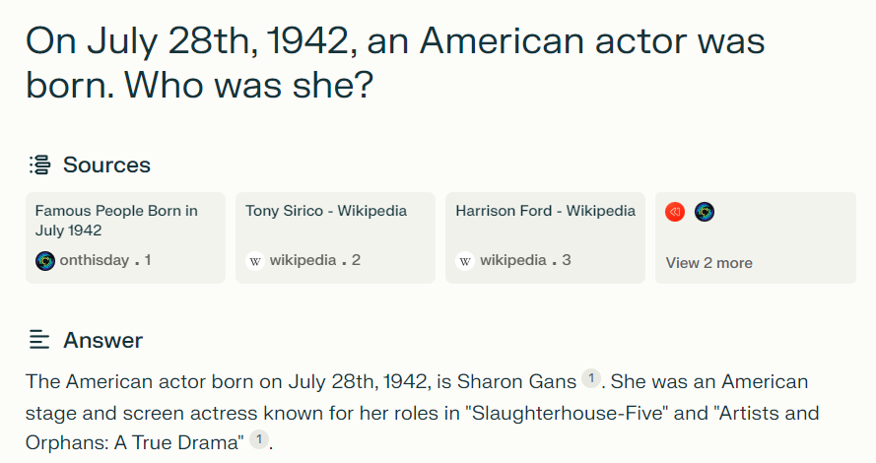
Problems of RAG Models​
Attribution
https://www.perplexity.ai/

Slide 72
Main Components in Self-RAG
Designed a special set of tokens called "reflection tokens", which enables the base LM to decide when to retrieve evidence and re-evaluate its own generation quality.

Slide 73
Main Components in Self-RAG
Generator and Critic
The generator generates next segment given the previous context.
The critic evaluates the retrived evidence, generated segments, and overall response
The generator and critic can be seen as different roles of the same model (this is where the "self" comes from in "Self-RAG"); each role is invoked by specific reflection tokens.

Slide 74
Self-RAG Inference

Slide 75
Self-RAG Inference Details
Adaptive retrieval with threshold
Only when the probabiliy of "Retrieve=YES" exceeds some threshold, the retrieval component will be triggered

Slide 76
Self-RAG Inference Details
Adaptive retrieval with threshold
Only when the probabiliy of "Retrieve=YES" exceeds some threshold, the retrieval component will be triggered
Tree-decoding with critique tokens
Evaluate multiple retrieved passages in parallel
Conduct a segment-level beam search to obtain the top segment continuations at each timestamp and return the best sequence.
Segment selection

Slide 77
Self-RAG Example

Slide 78
Self-RAG Data Collection
The authors create supervised data by prompting GPT-4 to generate reflection tokens and then distill their knowledge into an in-house generator/critic.
As different reflection token groups have their own definitions and input, they use different instruction prompts for them.
Manual assessment reveals that GPT-4 reflection token predictions show high agreement with human evaluations.

Slide 79
Self-RAG Training

Slide 80
Datasets and metrics
Closed-set tasks (metrics: accuracy)
PubHealth: fact verification dataset about public health
ARC Challenge: multiple-choice reasoning dataset created from scientific exams
Short-form QA (metrics: em)
PopQA and TriviaQA: Wikipedia-based open-domain QA datasets
Long-form QA
ALCE-ASQA (Metrics: MAUVE, citation precision and recall): Citation evaluation
FactScore (Metrics: FactScore): Biography evaluation

Slide 81
Baselines
Baselines without retrievals:
Llama2 (7B, 13B)
Alpaca(7B, 13B)
Llama2-chat (13B)
ChatGPT
CoVE (65B)
Baselines with retrievals
RAG (Llama2, Alpaca)
Ret-ChatGPT and Ret-Llama2-chat
Perplexity.ai
SAIL
Toolformer

Slide 82
Self-RAG Results

Slide 83
Self-RAG Analysis

Slide 84
Self-RAG Discussion
Connections to prior work on learning with critique.
Recent work incorporates additional critique (feedback) during training, e.g., RLHF via PPO. While PPO relies on separate reward models during training, we compute critique offline and directly insert them into the training corpus, where the generator LM is trained with a standard LM objective. This significantly reduces training costs compared to PPO.
While Self-RAG shows significant improvements in terms of performance, factuality, and citation accuracy, it can still generate outputs that are not fully supported by the citations.

Slide 85
Q&A
What types of tasks are not suitable for RAG?

Slide 86
Q&A
What types of tasks are not suitable for RAG?
Lack of expert knowledge (i.e., retrieval coverage)
Doesn't require factual supports (i.e., writing a fiction)

Slide 87
Q&A
What types of tasks are not suitable for RAG?
Lack of expert knowledge (i.e., retrieval coverage)
Doesn't require factual supports (i.e., writing a fiction)
What's the down-side of Self-RAG and RePLUG?

Slide 88
Q&A
What types of tasks are not suitable for RAG?
Lack of expert knowledge (i.e., retrieval coverage)
Doesn't require factual supports (i.e., writing a fiction)
What's the down-side of Self-RAG and RePLUG?
Latency: Processing multiple passages in parallel still bring up computational cost (depending on the GPU usage).

Slide 89
Q&A
What types of tasks are not suitable for RAG?
Lack of expert knowledge (i.e., retrieval coverage)
Doesn't require factual supports (i.e., writing a fiction)
What's the down-side of Self-RAG and RePLUG?
Latency: Processing multiple passages in parallel still bring up computational cost (depending on the GPU usage).
What are the pros and cons of different types of RAG?
Input text concatenation, cross-attention, output interpolation

Slide 90
Q&A
What types of tasks are not suitable for RAG?
Lack of expert knowledge (i.e., retrieval coverage)
Doesn't require factual supports (i.e., writing a fiction)
What's the down-side of Self-RAG and RePLUG?
Latency: Processing multiple passages in parallel still bring up computational cost (depending on the GPU usage).
What are the pros and cons of different types of RAG?
Input text concatenation, cross-attention, output interpolation
Do we need RAG with long-context large language models?
Lost in the Middle: How Language Models Use Long Contexts

