Slide 1
Lecture 21: LLM & Tool Augmentation
Presenters: Zhiying Yu & Mohammad Mahdi Abdollahpour
Notes:
In this presentation, we talk about how we can use external tools to augment LLMs.

Slide 2
LLMs Using External Tools
LLMs excels at several natural language processing tasks, but shows several limitations including:
Access up-to-date information
Hallucinating facts
Multi-step reasoning
Lack of mathematical skills for precise calculation
Unawareness of the progression of time
There are growing interest in overcoming LLM limitations with external tool use.
calendar, calculator, program interpreter, etc.
search engine, external database for retrieval.

Slide 3
LLMs Using External Tools
Notes:
LlamaIndex has a indexing mechanism that gives access to
Databases (structured), Documents (unstructured), APIs (semi-structured and programmatic data)

Slide 4
Coverage of Tool LLMs
Toolformer
ART
AgentBench
ToolLLM
ToolkenGPT
CogAgent

Slide 5
Toolformer: Language Models Can Teach Themselves to Use Tools
Timo Schick, Jane Dwivedi-Yu, Roberto Dessì, Roberta Raileanu, Maria Lomeli, Luke Zettlemoyer, Nicola Cancedda, and Thomas Scialom.

Slide 6
Issue with existing approach
Approach:
Using human annotation
Limited tool use for task specific setting
Issues:
High cost for large amount of human annotation
Restricted use of tools
Lack of generality, prompts needs to be tailored to specific task or specific tools.

Slide 7
Toolformer
Giving models the ability to use APIs that have access to external database.
Toolformer aims to allow the model to decide when and how to call which of the available tools.
The use of tools should be learned in a self-supervised manner without large amount of human annotations.
The approach should not hurt the model’s core language ability.
Notes:
…
But more importantly, Toolformer is a method of finetuning language models so that the model itself can decides whether to use, when and how to use an available tool.
This is beneficial not only because LLM has more tools to use, but because
Human intuition may not be always be correct. The tool that human find useful at a particular scenario may not be the tool the model find useful.

Slide 8
Toolformer Approach
We want to equip a language model M with the ability to use different tools from API calls.
An API call is represented as ,
is the name of the API and is the input to the API.
Inputs and outputs of API calls are represented as text sequence:
Notes:
Let’s say we want to equip a language model M with …
The idea is that with just a handful of human examples of how APIs can be used, we use in-context learning to let the LM generalize and annotate a large dataset with potential use
of API calls.
And then we determine which of these API calls actually help the model predict future tokens, then fine-tune the model on the API calls it find useful.

Slide 9
Augmenting Plain Text Dataset
Given a plain text dataset C, we augment the dataset to C* with API call as follows:
Use M to sample a large amount of potential API calls,
Execute the API calls and filter out the result that doesn’t help predict future tokens,
Merge API calls for different tools.

Slide 10
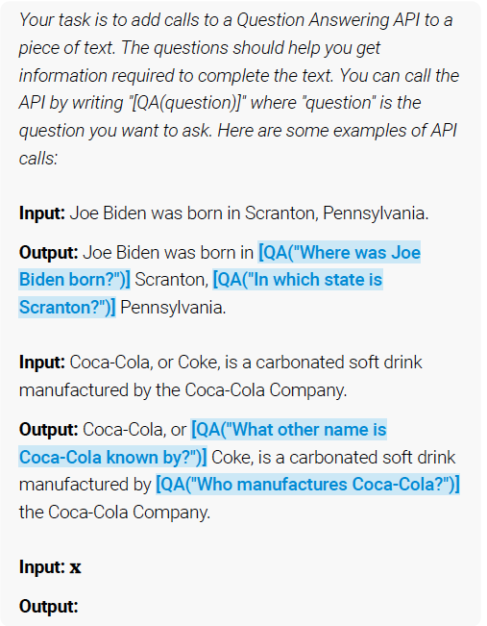
Sampling and Executing API calls
For each API, we write a prompt P(x) that encourages the LM to annotate an example x with API calls.
We sample up to k candidate positions for doing API calls by computing the probability that the next token is the special API token

Slide 11
Sampling and Executing API calls
Given a sampling threshold , we keep all positions
For each position , we sample up to API calls
Notes:
candidate positions to insert API calls

Slide 12
Filtering API Calls
Given a sequence of weights, we compute the weighted cross entropy loss for M:
For the weight function, the authors use
to make sure API calls happen close to where the API outputs
is actually helpful for generation.

Slide 13
Filtering API Calls
We calculate the weighted loss of having and not having the result of the API calls as prefix:
Given a filtering threshold , we only keep API call that reduce the loss by at least , i.e.
Notes:
epsilon is the empty string

Slide 14
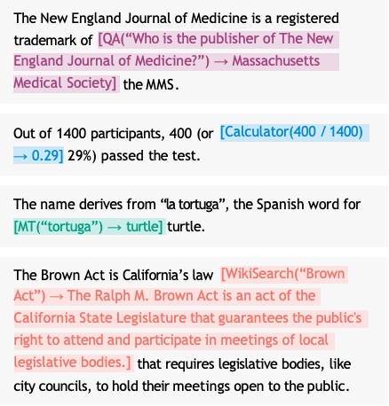
Toolformer Fine-tuning
After filtering, merge the remaining API calls and interleave them with the original inputs.
We use the augmented dataset C* to finetune M.
During inference, whenever M encounters the token, it pauses generation, execute the API call, generate the response, and continue decoding.

Slide 15
Tools Used for Experiment
Experiment with five tools: Question Answering API, Calculator, Wikipedia Search Engine, Machine Translation System, Calendar.
Notes:
The authors of this paper has done a few experiment to benchmark the effectiveness of this approach.
For that, they use explore the following tools in attempt to address the different shortcomings of language models.
Question Answering tool - Atlas, a RAG LM that can answer simple factual questions.
The second tool is a search engine, which given a search term, returns a short text snippets from Wikipedia,
Calculator - perform simple arithmetic operations.
Calendar - when queried, return the current date without input.
600M parameter language model NLLB, it can translate from any of the 200 languages to English
The examples in the table are all pretty straight forward.

Slide 16
Experimental Setup
Use a subset of CCNet as out language modeling dataset C and GPT-J as the language model M.
Define some heuristics for some APIs to get a subset of C for which API calls are more likely to be helpful.
We mainly compare the following models:
GPT-J: The original model without fine-tuning,
GPT-J + CC: GPT-J fine-tuned on C without any API calls,
Toolformer: GPT-J fine-tuned on C*,
Toolformer(disabled): GPT-J fine-tuned on C*, but API calls are disabled during decoding.
Notes:
If API calls are disabled during inference, this is done by manually setting the probability of <API> token to 0.

Slide 17
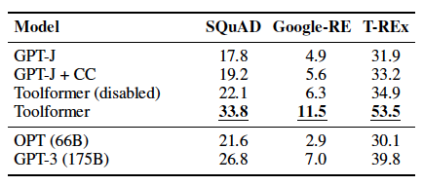
Subsets of LAMA Benchmark
For the dataset SQuAD, Google-RE, T-REx, the task is to complete a short statement with a missing fact.
Toolformer is prevented from using Wikipedia Search API
Toolformer outperform the baseline models.

Slide 18
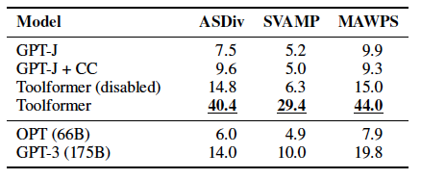
Math Datasets
Testing mathematical reasoning abilities on ASDiv, SVAMP and the MAWPS benchmark.
Zero-shot setup
Allowing models to make API calls more than doubles the performance.
Notes:
ASDivm, SVAMP, MAWPS are all math word problem repositories.
Zero shot setting because we are not necessarily using only calculators.

Slide 19
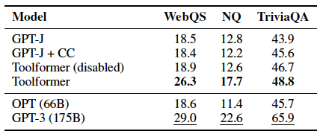
Question Answering Dataset
We look at Web Questions, Natural Questions, TriviaQA datasets.
Check whether the first 20 words predicted by a model contain the correct answer
QA API disabled for Toolformer

Slide 20
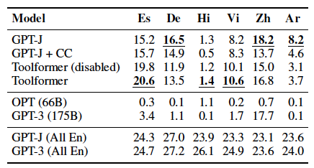
Multilingual QA Dataset
Evaluate Toolformer and all baseline models on MLQA, a multilingual QA benchmark.
Evaluate the percentage of times the model’s generation contains the correct answer
Using API calls improves Toolformer’s performance. But Toolformer doesn’t consistently outperform base GPT-J.

Slide 21
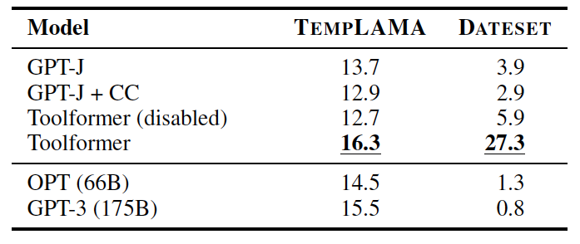
Temporal Datasets
Evaluate on TEMPLAMA and DATESET datasets.
Requires knowledge about current time
Notes:
TEMPLAMA and DATESET are datasets where the answer to the questions changes with time.
Specifically, TEMPLAMA contains questions that ask about facts such as “who is the head of government in new york city?”
While DATESET ask questions regarding date and durations, such as “what day of the week is it 10 days ago?”
Interestingly, improvements on TempLAMA is not attributed to the calendar tool, but more to Wiki-search + QA.
The significant improvement in DATESET is a result of the use of calendar tool.

Slide 22
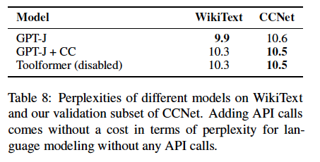
Language Modelling
We want to ensure the language modeling performance of Toolformer doesn’t degrade from its baseline model.
Approach: Evaluate the models on WikiText and a subset of CCNet not used for training.
Notes:
….
Comparisons are made for the perplexity of different models to ensure that the language modeling performance doesn’t degrade.

Slide 23
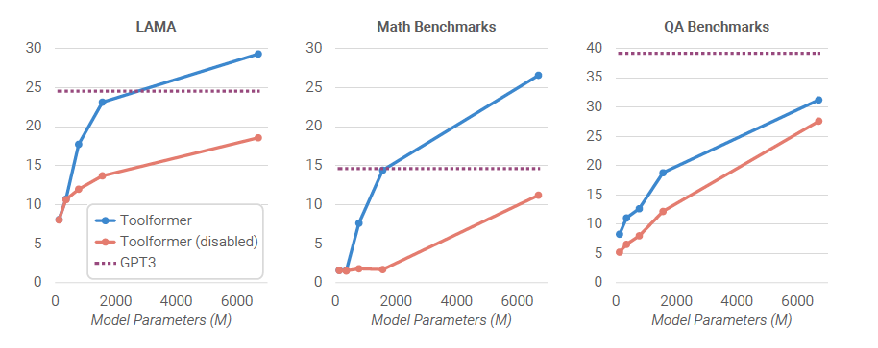
Scaling Laws
Using a similar experimental setup for 124M, 355M, 775M, 1.6B parameter models from the GPT-2 family.
The ability to leverage the provided tools only emerges at around 775 M parameters.

Slide 24
ART: Automatic multi-step reasoning and tool-use for large language models
Bhargavi Paranjape, Scott Lundberg, Sameer Singh, Hannaneh Hajishirzi, Luke Zettlemoyer, and Marco Tulio Ribeiro.

Slide 25
ART
In-context learning allows LLMs to quickly adapt to new tasks using natural language instructions and a few demonstration.
However, there are severe performance limitations around multi-step reasoning, math, and other complex tasks.
ART (Automatic Reasoning and Tool-use) is a framework that automatically generates decompositions of intermediate reasoning steps for instances of new tasks.
Automatically use appropriate tools at each intermediate step.
Notes:
For the motivation of ART, we have seen that …
While we have seen many prompting methods such as CoT and least-to-most prompting that can mitigate issues involving multi-step reasoning.
in this presentation, we try to incorporate the use of tools into the model.
ART is a framework that try to resolve this issue by trying to … while it automatically use …
How is ART different from Auto-CoT and Retrieve-CoT?
There are recent work propose to use LLMs to mimic a CoT for multisteps reasoning

Slide 26
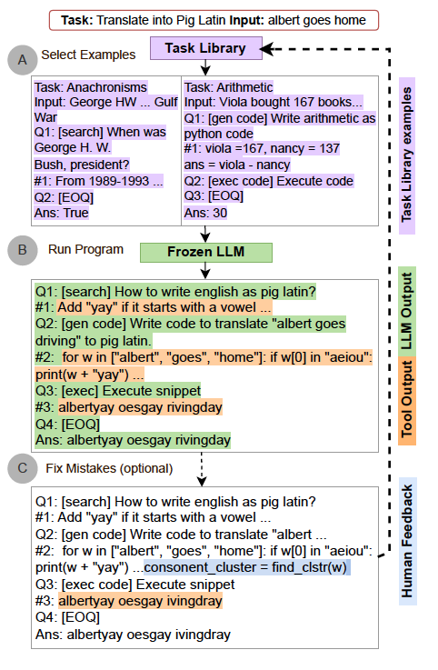
ART
ART provide the LLM with demonstrations of how to decompose several related tasks, and how to use any tools from a tool library.
Encourages the model to generalize, decompose new tasks, select and use tools.
Notes:
In the ART framework, we provide …
We will see later that the decomposition of the task and related tasks are given by followed by a structured query language such that we can use it to parse the intermediate steps.
Overall, ART is a framework that encourage...

Slide 27
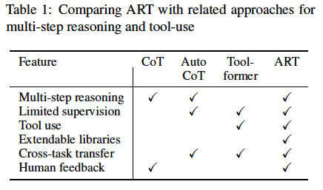
Prompting with reasoning steps
ART builds on CoT and AutoCoT. It enables cross-task demonstration. It improves accuracy of intermediate reasoning steps.
ART doesn’t require any additional training or tool-specific prompts. Users can replace the underlying LLM or add new tools.
Notes:
ART is a framework that builds on both CoT and AutoCoT.
Auto-CoT are like CoT, but automatically construct the demonstrations by sampling different questions and generating their reasoning chain.
ART has the added advantage that it doesn’t …
Here is a table that compares the features available in multiple framework…

Slide 28
Overview of ART framework
ART uses a frozen LLM to decompose instances of a new task into multiple steps without supervision.
Prompt Building: ART retrieves similar tasks from a task library and adds instances of those tasks as demonstrations in the prompt.
Decomposition: A demonstration in the task library is written in a custom parsing expression grammar(PeG) format. This grammar helps break down each task instance into a sequence of sub-steps. Some of these sub-steps contain symbols corresponding to tool use. We refer to these decompositions as program.
Notes:
Now, we take a look at an overview of this framework.
At its core, …
In the first stage, we try to do prompt building, where …
… here, the author also refer to decompositions as programs because sequential reasoning steps and symbolic calls to tools are resemblances to conventional programs with function calls.

Slide 29
Overview of ART framework
Generation: At generation time, the LLM writes it own program. ART pauses generation whenever it encounters a tool call in the generated text, calling the tool and integrate the tool’s output back to the program.
Optional Human Feedback: Humans can add new decomposition demonstrations to the task library. Humans can also add or edit tools in the tool library to improve performance on a particular task of interest.
Notes:
…
If the there is a mistake in the decomposition, it also allows the user to fix any mistake in reasoning by adding new tool or updating the task library. b

Slide 30
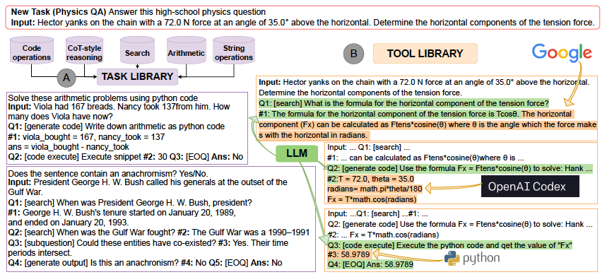
A run-through of ART on Physics QA task
Notes:
Here is an example of everything we talked about in the previous outline.
On the left hand side, we have some few-shot demonstrations from the task library, the LLM will learn from this library for potential cross-task generalization.
On the right is an example of a task from the physics question-answer dataset.
It ask a classical mechanic question,
To find the appropriate physical formula, a search engines used to find appropriate physics formula, the LLM uses code generation and execution to substitute the given value and compute the answer.

Slide 31
ART Task Library
The task library consists of programs for a small seed set of tasks from Big-Bench, a benchmark that measures the capabilities and limitations of language models. The problems span categories of traditional NLP, mathematics, commonsense reasoning, and QA.
We group the five most used skills in the benchmark by:
Arithmetic
Code: Generating/Executing Python code
Search and Question Decomposition
Free-form Reasoning: Explaining step-by-step reasoning
String Operation: Reformatting/Editing String, etc.
Select 2 - 4 tasks from each group and write programs for a few instances of each tasks, including calls to external tools.

Slide 32
Parsing Expression Grammar
PeG is a query language for representing decomposed reasoning steps and incorporating function calls to external tools.
Each program consists of a series of nodes:
One input node contains the task name, instruction describing the task, and the input for an instance of the task.
The input node is followed by a sequence of sub-step nodes, represented by the query-answer pair
The program ends with a dummy sub-task with the final answer
Notes:
…
The answer A_i contains either the generated output given the task, or the result of the use of external tools.

Slide 33
ART Task Retrieval
Given a new task, ART retrieves N tasks from the task library to construct a dynamic multi-task prompt.
Two strategies:
(Task-cluster based) Iterate over all five groups and select a few task programs from each group to compose the prompt. The task cluster with the highest performance on the labeled examples is chosen.
(LLM-similarity based) Craft a few-shot prompt with task pairs, each task includes a name, instructions, and a few input-output examples. For each pair , we provide a label of “Similar” or “Not similar”. At runtime, we pair the test-task with every task in the task library, and choose the task based on highest-ranked log probability ratio between “Similar” and “Not similar”.
Notes:
…
from there, the paper explored two strategies to “retrieve similar task”.
-For strategy 1, the task cluster with the highest performance on the labeled examples is chosen
-… For each pair , we provide a label of “similar”

Slide 34
ART Tool Library
The tool library are seeded with the following tools:
Search: Uses SerpAPI, which provide API for Google search:
Code Generation: Use Codex model with:
Code Execution: Run Python code in a virtual environment with arithmetic, symbolic, and scientific computing package installed:
Notes:
In the parsing expression grammar. If a task name matches a tool name, we incorporate the result of tool use in the partially completed program.
…

Slide 35
ART Human Feedback
Since ART doesn’t need additional fine-tuning, users can incorporate feedback into the framework by editing the task/tool library.
Notes:
Finally, …
The diagram below shows an example where the user corrects a specific program by including a step that adds the unit of measurement, and adds this program to the task library.
In part a), the user edits a program by adding two-substeps, in order to round the answer to the nearest integer and include the appropriate unit of measurement to the answer
In part b) the user implement the tool for lookup in the tool library.
The users here manually interfere with the decomposition of task, but the generations are still performed by the LLM
In this example, human feedback can be seen as a form of debugging, where users edit programs instead of creating programs.
Because human expert knowledge are used, these simple operations can very drastically improve the performance on target tasks.

Slide 36
Experimental Setup
In addition to the 15 tasks from the task library, we evaluate ART on 19 additional task from BigBench.
Further evaluate ART on the MMLU benchmark
Frozen LLM: InstructGPT (text-davinci-002)
Code Generation Tool: Codex
Use 2 demonstration programs from each task.
Report performance averaged over 5 runs.
Notes:
... To compare the approach of using tools with finetuning versus in-context learning …
MMLU - massive multitask language understanding

Slide 37
Experiment Baselines
Few-shot: Prompt LLM with input-output pairs, uses 3 - 5 examples based on the benchmark used.
Auto-CoT: Automatically generate multi-step reasoning in natural language. This baseline doesn’t include the use of tools.
ART-tool: ART with tool use turned off
GPT-3 Best: Best published GPT-3/Codex result with multi-step decomposition and tool use. (additional human supervision to decompose reasoning steps)

Slide 38
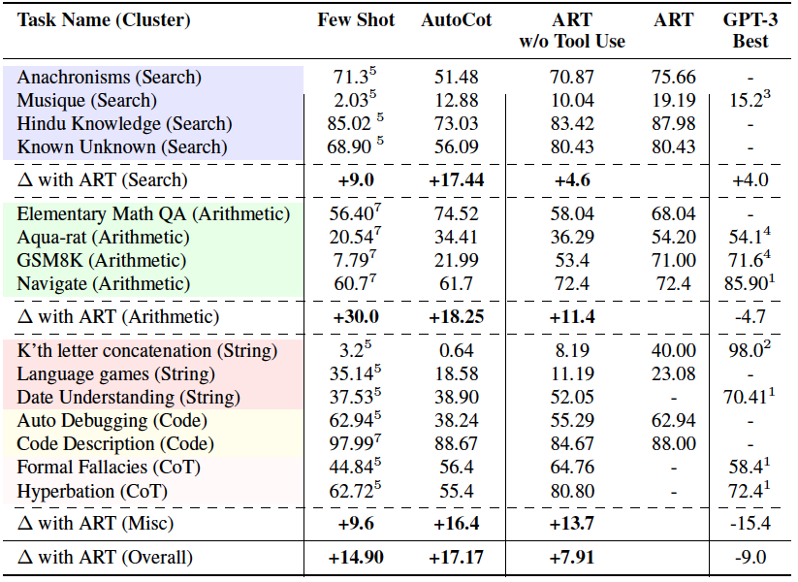
Result on task library

Slide 39
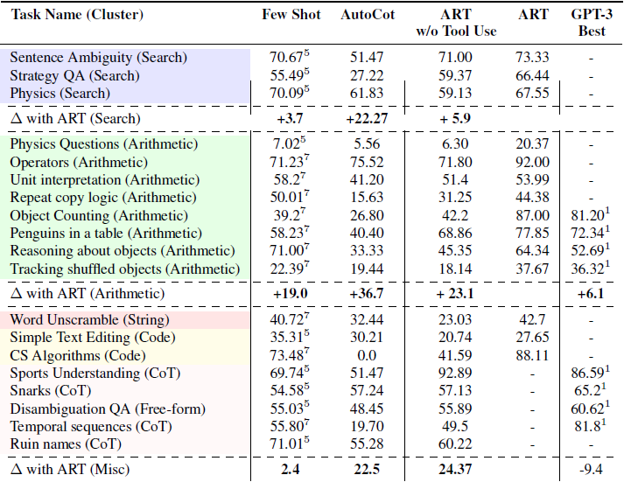
Results on BigBench tasks

Slide 40
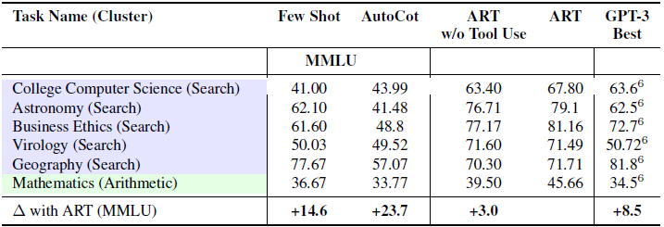
Results on MMLU tasks

Slide 41
Evaluating ART on other benchmarks
Compare ART to a random subset of tasks used to evaluate Toolformer.
Comparing ART with self-consistency (over 15 generations).
Notes:
The comparison is not exact since Toolformer uses a small GPT-J model while ART experiment uses a more performant frozen LLM.

Slide 42
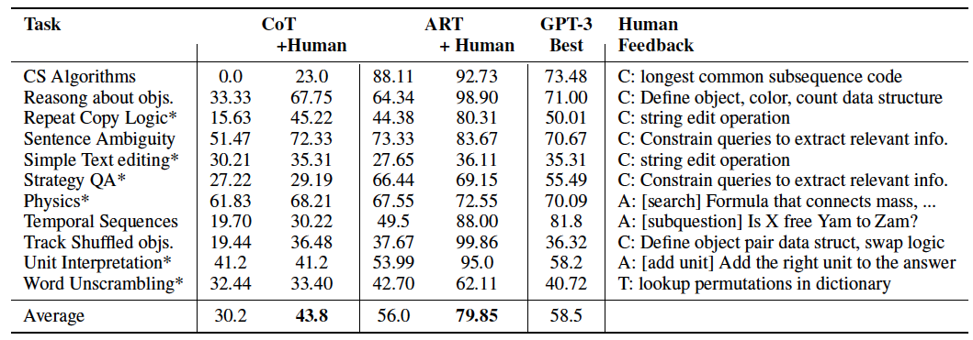
ART with free form CoT and feedback
For each task, one author edit 5 random instances of model-generated programs that resulted in error.
Notes:
Correct error by:
-Correct errors in substeps (denoted by “C:”)
-Add missing substeps (denoted by “A:”)
-Define a new tool or demonstration (denoted by “T:”)

Slide 43
AgentBench: Evaluating LLMs as Agents
Xiao Liu, Hao Yu, Hanchen Zhang, Yifan Xu, Xuanyu Lei, Hanyu Lai, Yu Gu, Hangliang Ding, Kaiwen Men, Kejuan Yang, Shudan Zhang, Xiang Deng, Aohan Zeng, Zhengxiao Du, Chenhui Zhang, Sheng Shen, Tianjun Zhang, Yu Su, Huan Sun, Minlie Huang, Yuxiao Dong, and Jie Tang.

Slide 44
LLM as Agent
LLMs can do more than natural language tasks. They are capable of decision making and executing instructions. Thus, there has been an urgent need to evaluate LLMs as agents in an interactive environment.
Most agent benchmarks now focus on single environment. There is a lack of systematics and standard benchmark to reflect LLMs as agents in practical use cases.

Slide 45
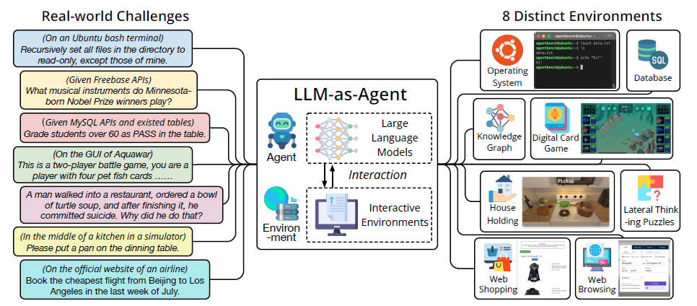
AgentBench
AgentBench is a comprehensive benchmark that evaluates LLMs as agents across 8 different environments.

Slide 46
AgentBench
AgentBench concentrates on the practical evaluation of LLMs via CoT prompting.
This paper also offered an integrated toolkit that enables customization of model assessments. This toolkit is openly accessible to the research community.
AgentBench environments are categorized by 3 types of grounding: Code, Game, and Web.

Slide 47
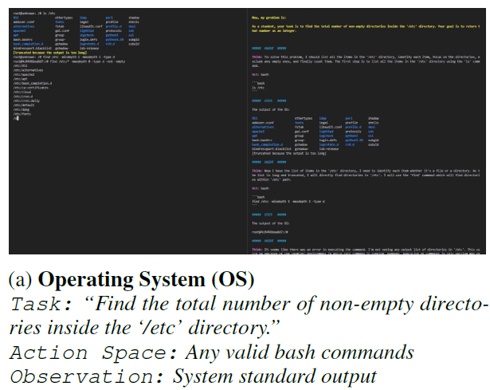
Code-Grounded Environment
Since LLMs can generate high quality code, we want to evaluate their ability to assist human interaction with computer interface.
1. Operating System (OS):
Allows LLM to access and manipulate OS in the terminal.

Slide 48
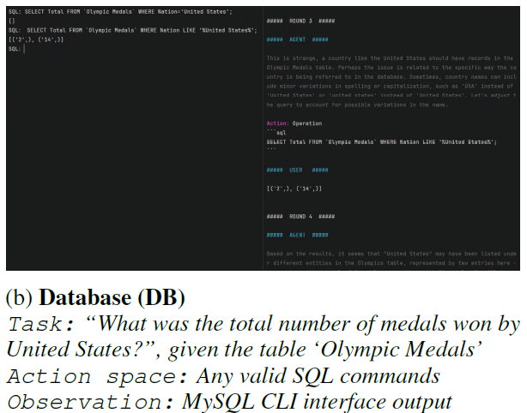
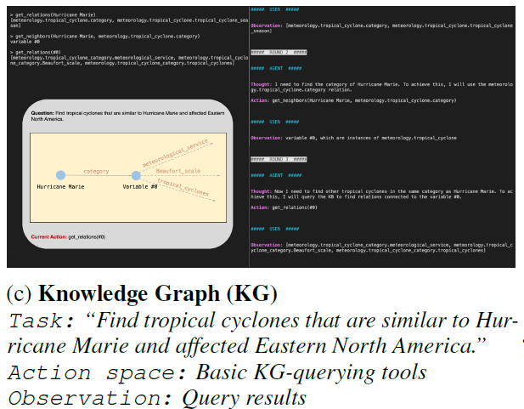
Code-Grounded Environment
2. Database
Operate and examine real database via SQL.
3. Knowledge Graph
Requires the agent to make decisions with incomplete information and manage uncertainties.

Slide 49
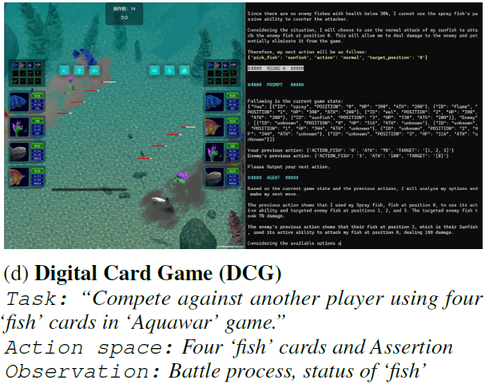
Game-Grounded Environment
Evaluate ability to design strategies for playing game, reason, and follow instructions.
4. Digital Card Game
Involves abundant text descriptions for cards.
Test a model’s understanding of game rules, operating logic, and ability to make strategic decisions.

Slide 50
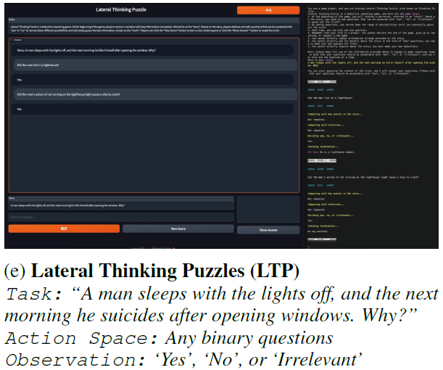
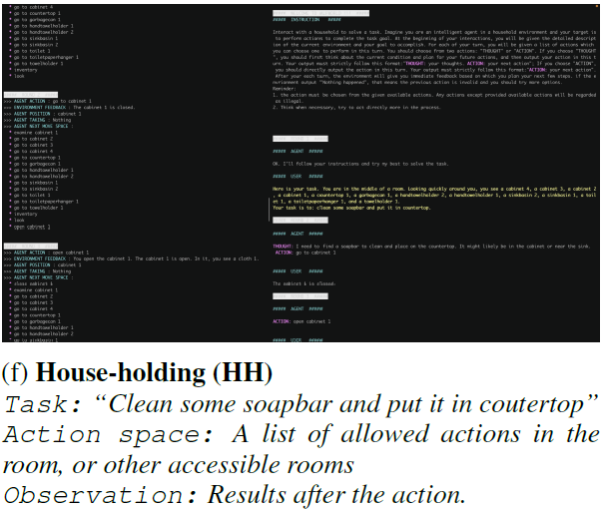
Game-Grounded Environment
5. Lateral Thinking Puzzle
Deduce facts from unconventional perspective and explore new ideas.
6. House-Holding
ALFWorld, navigating a household environment
Notes:
LTP involves a host giving an obscure description of a scene such as ..
In order to get a more complete story, the agent will ask questions with binary answers such as “Did he suicide out of guite?” or “Are the windows he opened in the room he sleeps in?”
The true plot of a puzzle is divided down to several bullet points and the performance of LLM is evaluated by the game progress.

Slide 51
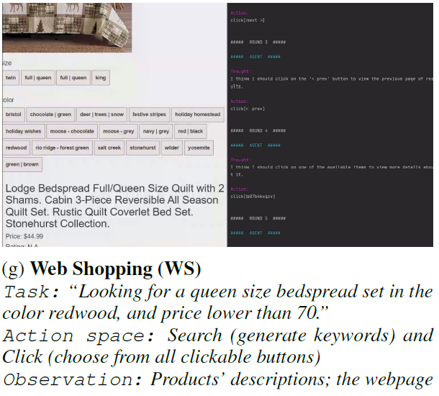
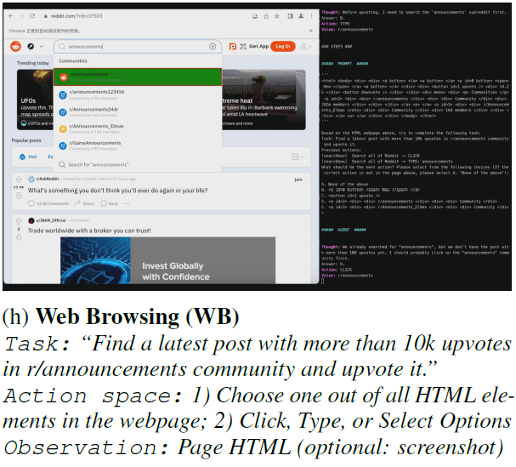
Web-Grounded Environment
Evaluate ability to travel through web pages.
7. Web Shopping 8. Web Browsing

Slide 52
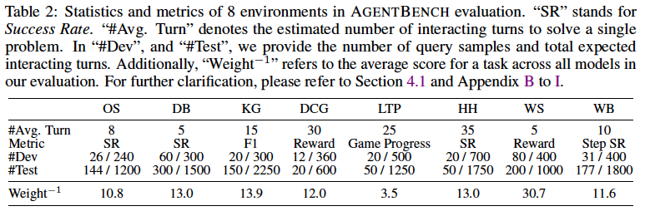
Dataset Statistics
27 API-based LLMs, both commercial and open-sourced models, are thoroughly evaluated with this benchmark. The interaction histories between LLM and environment are given as prompts.

Slide 53
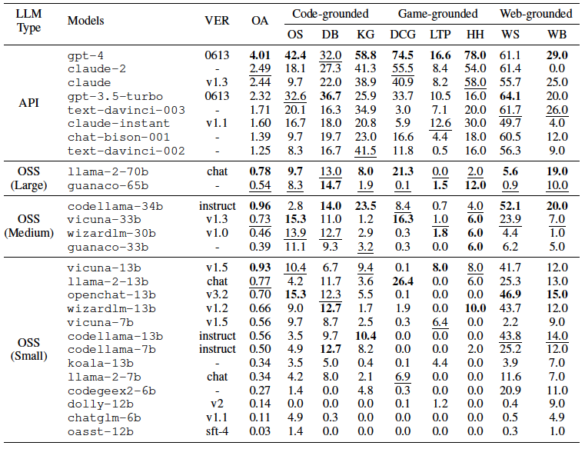
AgentBench: LLMs Evaluation
Notes:
Here is a table of scores achieved across all benchmarks and all LLMs.
# Score distribution for each task varies significantly as tasks differ in difficulty levels.
# The overall score are taken by resize each task’s average score to 1 across all the models, and then averaging the scores across all tasks for each model.
Dataset specific scores are presented in this table.
On some challenging benchmarks, top LLMs are capable of dealing with real-world interactions.
For example, gpt-4 has the best performance of 6/8 of the datasets in AgentBench.
claude-2 and claude, gpt-3.5 follows gpt-4
Other API-based LLMs has poorer performance but most of them can solve quite a few percent of problems.
Open-source LLM however commonly fail to solve problems in challenging tasks, such as KG search, Digital card game, and household.
This identify most OSS LLM incapable as agents in real-world environment.

Slide 54
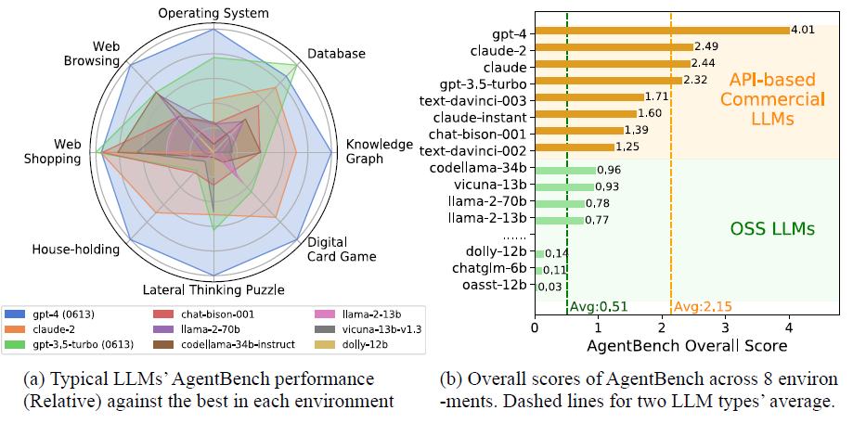
AgentBench: LLMs Evaluation

Slide 55
AgentBench
We also identify and categorize LLM agents’ finish reason on AgentBench tasks into five types:
Completed
Context Limit Exceeded (CLE)
Invalid Format (IF)
Invalid Action (IA)
Task Limit Exceeded (TLE)
Notes:
To further identify the reasons of failures, we categorize LLM agents’ finish reason into five types.
CLE - happens when the interaction history exceeds the LLM’s maximum context length
Invalid format - the agent doesn’t follow the format instruction
Invalid Action - agent follow the format instruction, but choose an invalid action.
TLE - happens when the agent does not solve the problem after reaching a maximum amount of interaction.
This happens when the generation gets in an infinite loop.

Slide 56
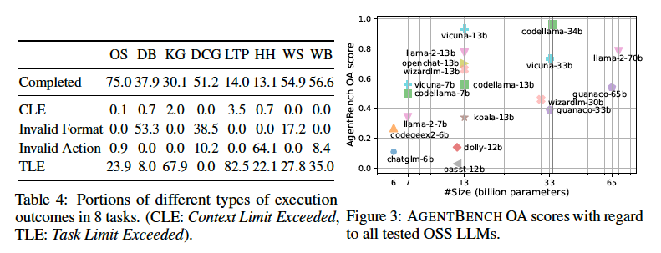
AgentBench: LLMs Evaluation
Most LLM agents fail to solve the challenge in given time or fall into repeated generation.
Weak reasoning and decision making abilities from most LLM agents.
Notes:
IF, IA are caused by LLM’s inability to follow instructions, and TLE indicates the LLM has weak multi-turn decision ability.

Slide 57
ToolLLM: Facilitating Large Language Models to Master 16000+ Real-world APIs
Yujia Qin, Shihao Liang, Yining Ye, Kunlun Zhu, Lan Yan, Yaxi Lu, Yankai Lin, Xin Cong, Xiangru Tang, Bill Qian, Sihan Zhao, Lauren Hong, Runchu Tian, Ruobing Xie, Jie Zhou, Mark Gerstein, Dahai Li, Zhiyuan Liu, Maosong Sun

Slide 58
ToolLLM
Goal: use multiple APIs to fulfill a textual request
Solution: ToolLLM (a general tool use framework)
Contributions:
ToolBench: instruction-tuning dataset for tool use
DFSDT: algorithm to enhance reasoning capabilities of LLMs
ToolEval: automatic tool use evaluator
ToolLLaMA: fine-tuned LLaMA to recommend appropriate APIs

Slide 59
Tool learning
LLMs with competencies in utilizing tools are closed-source
Limitations with previous instruction tuning data
Limited APIs: fake APIs or small scope
Constrained Scenario: single tool or manual specification of ideal API
Inferior planning and reasoning: failure on complex instructions or not executing the APIs
ToolBench to the rescue!
Notes:
prior work on instruction tuning has limitation:
(1) limited APIs: no real-world APIs or consider only a small scope of APIs
(2) constrained scenario: involve single tool + assume that users manually specify the ideal API set
(3) inferior planning: either CoT or ReACT which cannot handle complex instructions + some works do not even execute APIs

Slide 60
ToolBench
Dataset constructed using gpt-3.5-turbo-16k (ChatGPT)
In 3 phases:
API Collection: 16k REST APIs from RapidAPI in 49 categories
Instruction Generation: Generate instructions for single and multi-tool scenarios
Solution Path Annotation: Use DFSDT to find the correct sequence of APIs to accomplish the task

Slide 61
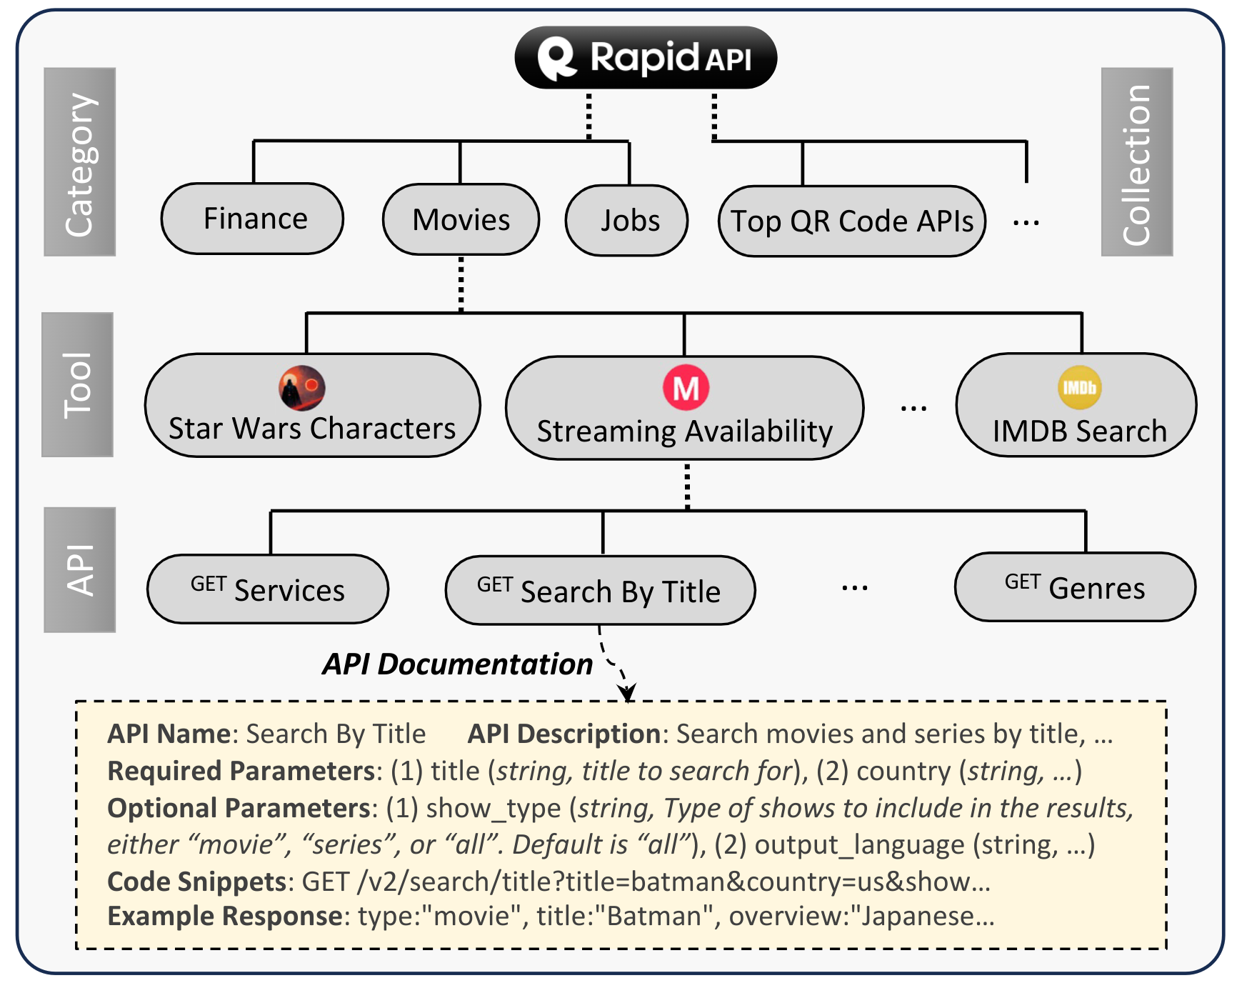
API Collection
Started with 53k APIs from 10k tools in 49 categories
Filtered functional APIs
Kept 16k APIs from 3.4k tools
Notes:
from
53, 190 APIs and 10,853 tools
to
16, 464 APIs and 3,451 tools

Slide 62
Instruction Generation - Overview
Core idea:
Select a subset of APIs
Prompt ChatGPT to generate possible instructions and relevant APIs
Prompt includes:
General description of the instruction generation task
Documentation for each of the selected APIs
Three in-context seed examples written by human experts

Slide 63
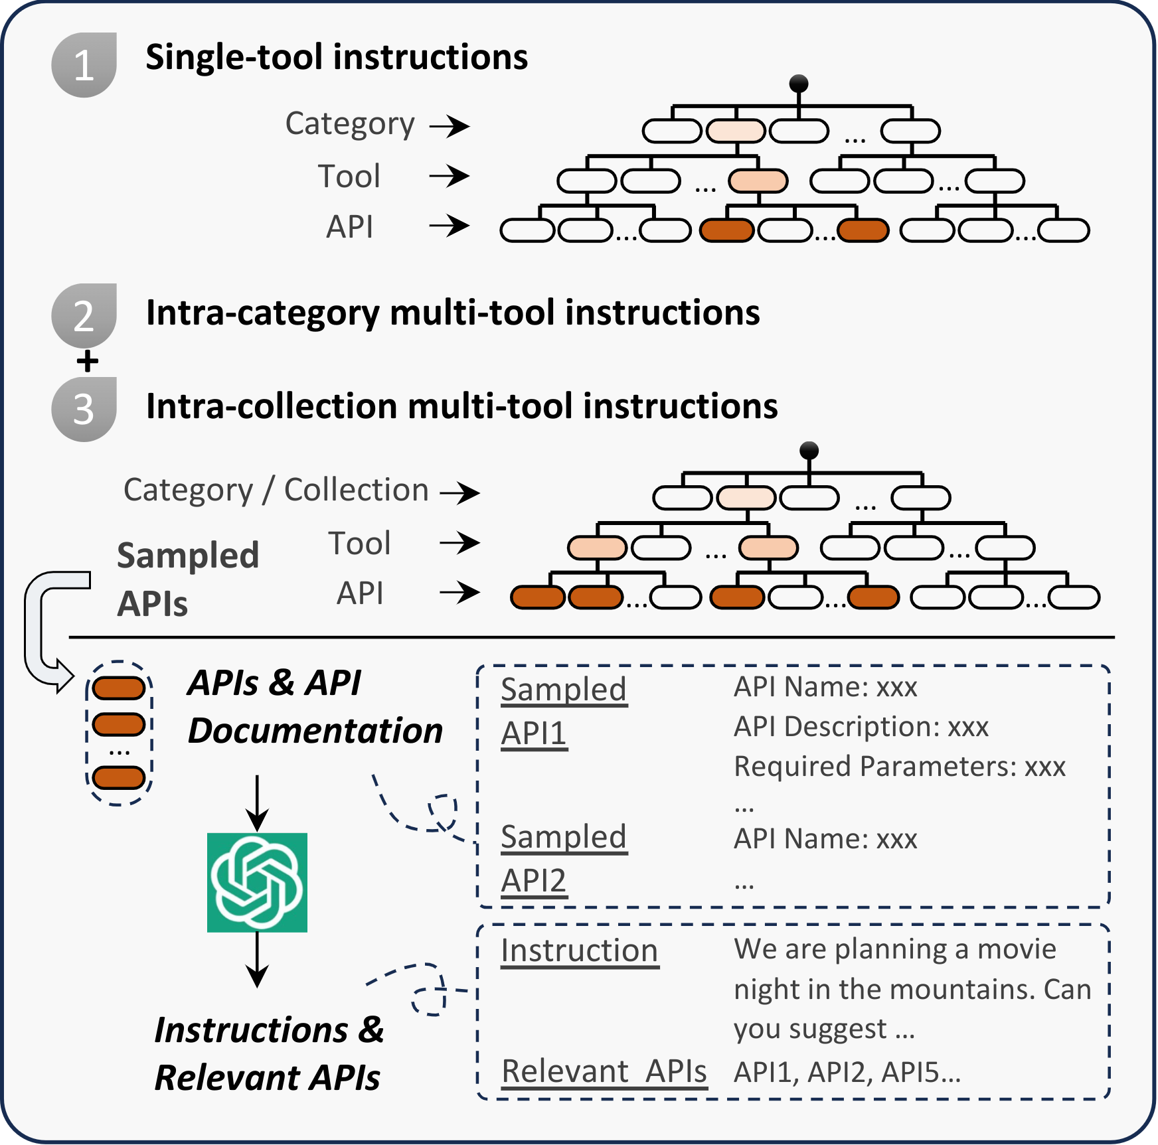
Instruction Generation - Diversity
Generating instructions for different scenarios:
single-tool: generate APIs for one tool
multi-tool:
randomly select 2-5 tools from same category/collection
sample up to 3 APIs from each tool
Filter out the hallucinated APIs
87k single-tool APIs
84k multi-tool same category APIs
25k multi-tool same collection APIs
Notes:
87413, 84815, and 25251 instances for I1, I2, and I3

Slide 64
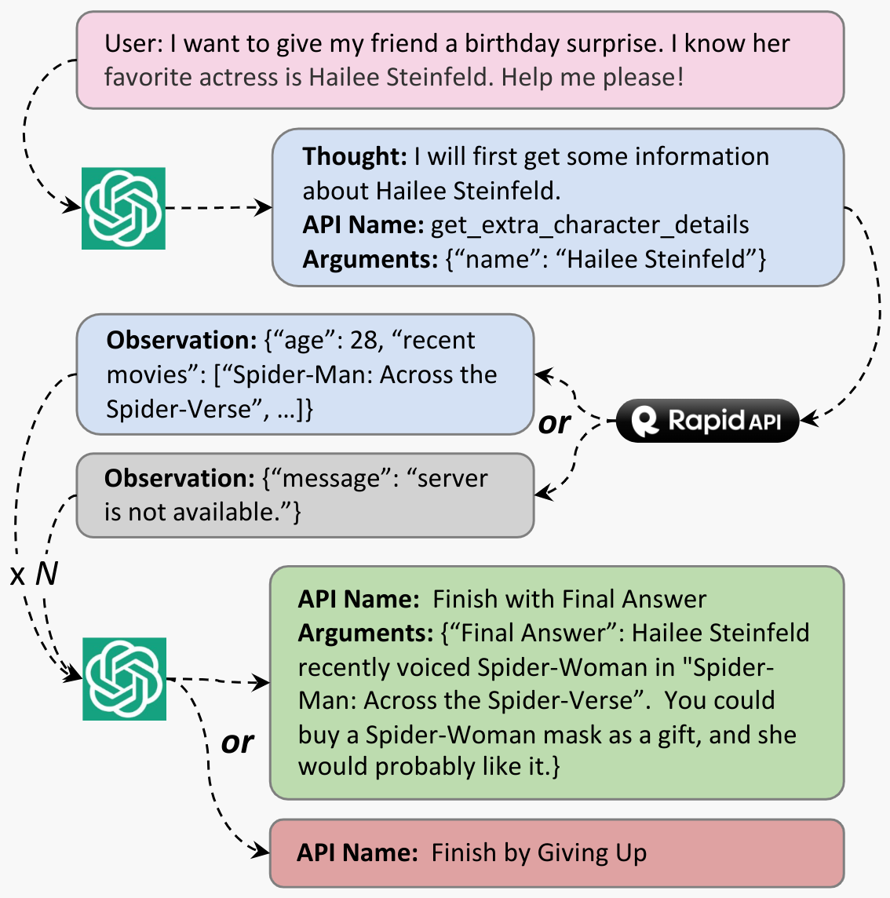
Solution Path Annotation
Prompt ChatGPT to find a valid action sequence for each instruction in a multi-round conversation
At each round model generates action and thought based on previous actions and real API responses

Slide 65
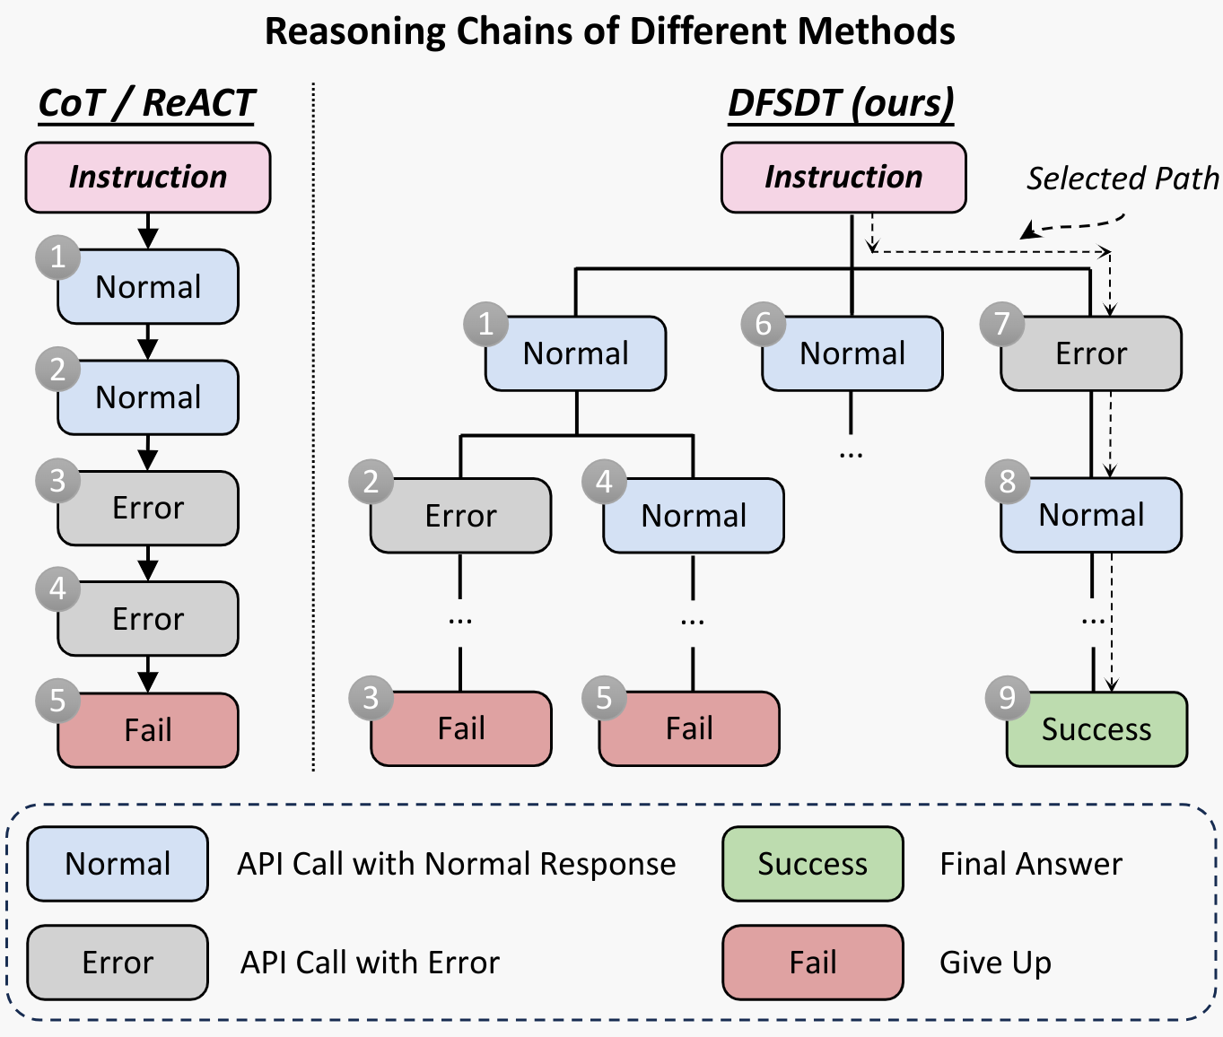
Solution Path Annotation
Function call feature of ChatGPT:
Each API as a function
Add special functions:
“Finish by Giving Up”
“Finish with Final Answer”
DFS-based Decision Tree:
Access different reasoning paths
At each step either:
proceed along a promising path
abandon an existing node expansion
Notes:
we prefer depth-first search (DFS) instead of breadth-first search (BFS) because the annotation can be finished as long as one valid path is found

Slide 66
ToolEval
Infeasible to annotate a fixed ground-truth solution path for each test instruction:
Temporal variability on RapidAPI
Infinite potential solution paths for an instruction
Evaluation metrics in ToolEval:
Pass Rate: Executability of instructions for an LLM within limited budgets
87.1% agreement with human eval
Win Rate: Comparison of the quality and usefulness of two solution paths
Ask ChatGPT’s preference
Pre-defined criteria through prompting
Average of multiple evaluations
80.3% agreement with human eval

Slide 67
Efficacy of API Retriever
The API retriever aims to retrieve relevant APIs to an instruction
Calculates embedding similarities between instructions and API doc
Embeddings come from a trained BERT-BASE model
Comparisons with BM25 and OpenAI’s ada-002
Notes:
Our API retriever v.s. two baselines for three types of instructions (I1, I2, I3). We report NDCG@1 and NDCG@5.
We train and evaluate our model on single-tool instructions (I1), intra-category multi-tool instructions (I2), and intra-collection multi-tool instructions (I3).

Slide 68
Superiority of DFSDT over ReACT
They compare DFSDT and ReACT using the pass rate metric
DFSDT consumes more OpenAI API calls ➤ “ReACT@N” baseline
Conduct multiple times of ReACT until the total costs reach the same level of DFSDT
Once a valid solution is found by ReACT@N, deem it a pass

Slide 69
ToolLLaMa
Fine-tuned LLaMa-2 7B using instruction-solution pairs
Increased input length from 4096 to 8192 using positional interpolation
Evaluation of generalizability in three levels:
Unseen instructions for the same tools
Unseen tools in the same category
Unseen tools in different category
Experiments in three scenarios:
Single-tool instructions (all three levels)
Intra-category multi-tool (levels 1 and 3)
Intra-collection multi-tool (only level 3)
Vicuna, Alpaca, ChatGPT, Text-Davinci-003, GPT-4 and Claude-2 as baselines.

Slide 70
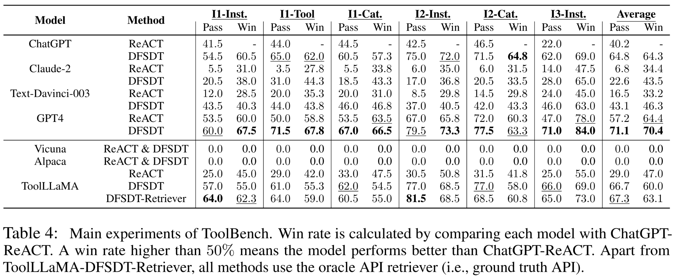
ToolLLaMa
Notes:
Vicuna and Alpaca’s instruction-following abilities do not cover the tool-use domain.
Proving the deficiency of current instruction tuning attempts.
DFSDT significantly outperforms ReACT in both pass rate and win rate.
ToolLLaMA+DFSDT demonstrates competitive generalization performance in all scenarios.
API retriever expands the search space of relevant APIs and finds more appropriate ones for the current instruction (even better than ground truth set!)

Slide 71
ToolLLaMa - Evaluation Results
Vicuna and Alpaca’s instruction-following abilities do not cover the tool-use domain.
Proving the deficiency of current instruction tuning attempts.
DFSDT significantly outperforms ReACT in both pass rate and win rate.
ToolLLaMA+DFSDT demonstrates competitive generalization performance in all scenarios.
API retriever expands the search space of relevant APIs and finds more appropriate ones for the current instruction (even better than ground truth set!)

Slide 72
ToolLLaMA - Generalization
Evaluated the out-of-distribution generalizability of ToolLLaMA.
Experiments on APIBench
Oracle (ground-truth) retriever vs. their API retriever
ToolLLaMA vs. Gorilla (ZS & RS)
Notes:
(RS / retrieval aware setting) means the retrieved APIs are sent to the model as part of the prompts; while the (ZS / zero shot) does not incorporate the APIs in the prompts when training the model.

Slide 73
ToolkenGPT: Augmenting Frozen Language Models with Massive Tools via Tool Embeddings
Shibo Hao , Tianyang Liu , Zhen Wang , Zhiting Hu

Slide 74
ToolkenGPT - Overview
Fine-tuning LLMs:
Computationally expensive
Lacks the adaptability to new tools
In-context learning:
Limitation of context length
Few-shot learning is not always effective

Slide 75
ToolkenGPT - Overview
Key idea: represent each tool as a new token (“toolken") to augment the vocabulary
During generation:
A toolken is predicted
The LLM temporarily switches into a special mode
LLM produces input arguments for the tool to execute
Inject the outputs back into the generation
Notes:
Consequently, ToolkenGPT combines the strengths of both fine-tuning and in-context learning paradigms while avoiding their limitations (Table 1): Compared to in-context learning that can only accommodate a small number of tools and few-shot demonstrations, ToolkenGPT allows massive tools (by simply inserting respective toolkens in the vocabulary) and can use extensive demonstration data for learning toolken embeddings; In contrast to LLM fine-tuning, the tool embeddings not only requires minimal training cost, but also provide a convenient means for plugging in arbitrary new tools on the fly by expanding the toolken vocabulary

Slide 76
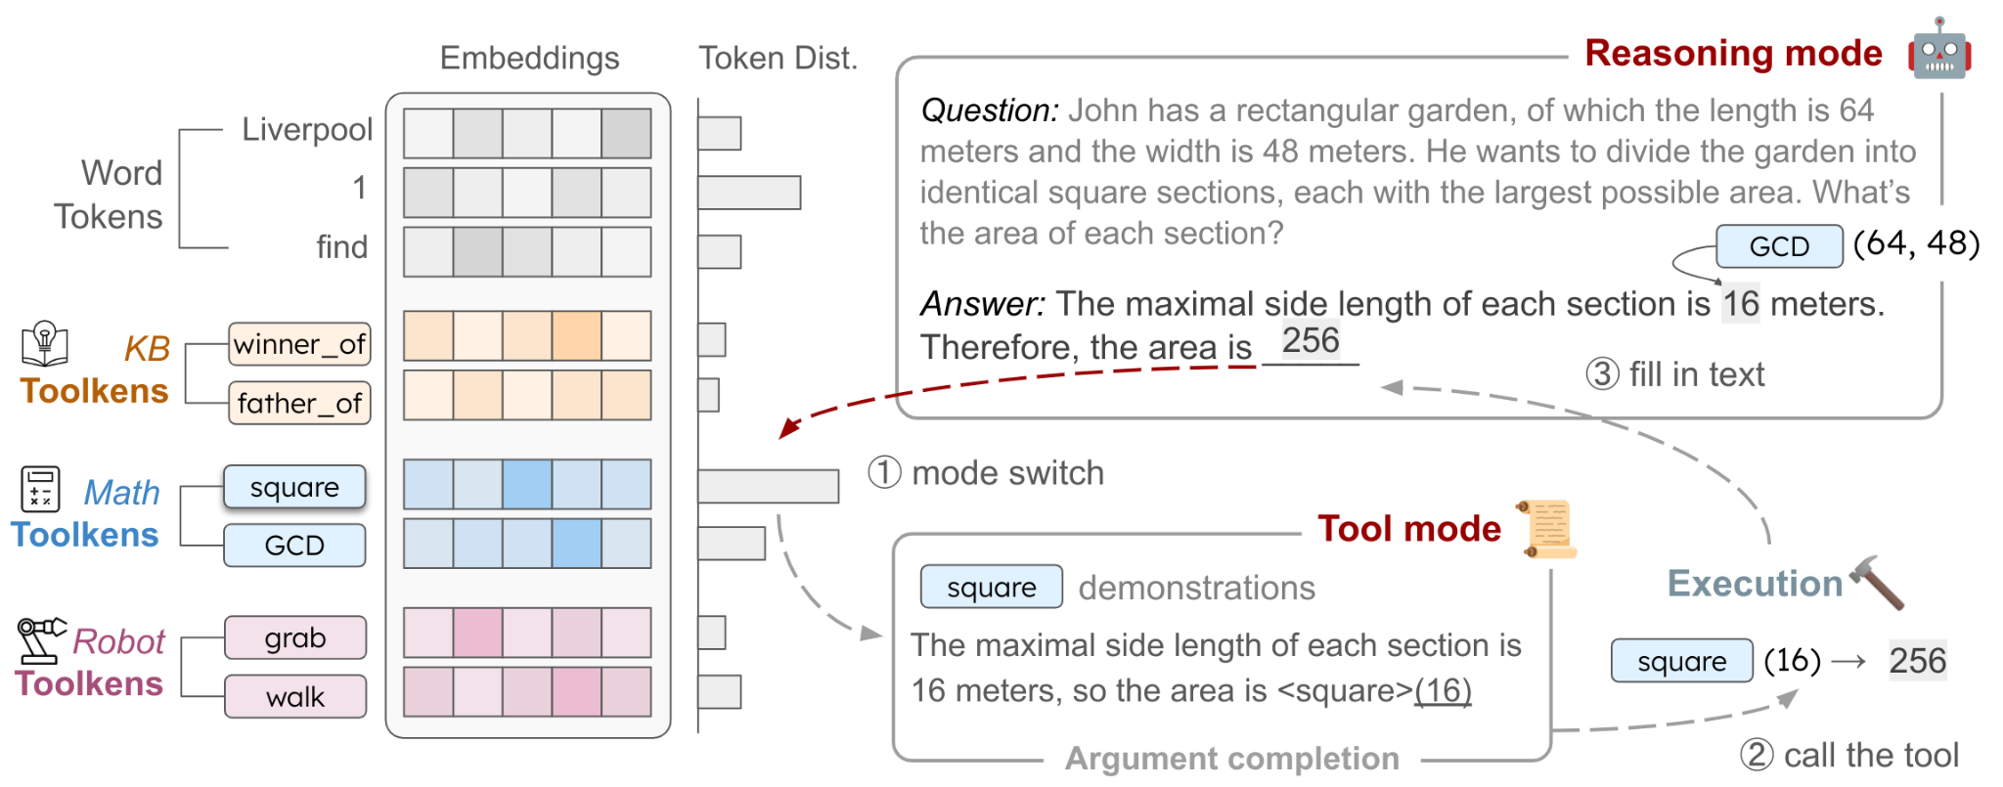
ToolkenGPT - Architecture
Toolken embeddings are appended to the language model head like regular word token
Once a toolken is predicted, the LLM switches to the “tool mode”
Then, the tool call is executed, and the result is sent back to the text to continue the reasoning mode

Slide 77
ToolkenGPT - Architecture
Common way of predicting the next token:
In ToolkenGPT they concatenate the embedding matrix of tools:

Slide 78
ToolkenGPT - Architecture
By default, the model is in “reasoning mode” trying to generate response to the user prompt
Once P outputs tool token (vs. word token) model goes into “tool mode”
The model in “tool mode” aims to generate the arguments for the tool
The prompt for “tool mode” includes:
In-context demo for the tool using special syntax [tool](arguments)
Currently predicted context

Slide 79
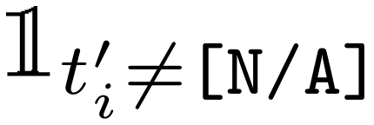
ToolkenGPT - Training
For training the toolken embeddings we can freeze the weights for the rest of the model
Training data:
Pairs of (s, s′)
s = (“the”, “area”, “is”, “2”, “5”, “6”, “square”, “feet”, ...)
s′ = (“the”, “area”, “is”, “[square]”, “[N/A]”, “[N/A]”, “square”, “feet”, ...)
[N/A] not considered in loss ( )
Objective:
Notes:
data from predefined datasets + other LLMs

Slide 80
Numerical Reasoning
Dataset:
GSM8K-XL (an enhanced version of GSM8K)
School-grade math word problems
Sequence of calculations using basic arithmetic
Added large numbers
FuncQA
synthetic dataset with more complex arithmetic tools
two subsets: 68 one-hop and 60 multi-hop questions
Comparison models:
0-shot ChatGPT
CoT LLaMA-33B
ReAct LLaMA-33B
Notes:
three experiments: arithmetic tools for numerical reasoning, database APIs for knowledge-basedquestion answering, and robot actions for embodied plan generation.
Datasets. To evaluate the tool-learning proficiency in numerical reasoning comprehensively, wecurate two new test datasets: (1) GSM8K-XL, an enhanced version of the existing GSM8K [ 10 ]dataset. GSM8K is a dataset of linguistically diverse grade school math word problems, involvingperforming a sequence of calculations using 4 basic arithmetic operations (+, −, ×, ÷) to reachthe final answer. In the original GSM8K dataset, the numbers for calculations are typically small,which might be less challenging for the recent powerful LLMs [ 10 , 6 ]. So in the test set, we magnifythe numbers to increase the computational difficulty for LLMs, which results in the GSM8K-XLdataset, featuring 568 test cases with much larger numbers. (2) FuncQA is a synthetic dataset wecreated to increase the complexity of math problems involving more arithmetic tools, which serves asa much more challenging benchmark to test the model’s tool-learning capabilities. Specifically, Thisdataset requires at least 13 operators (e.g., power, sqrt, lcm) to solve, and it is challenging for bothhumans and LLMs to solve without an external calculator. Furthermore, FuncQA is categorized intotwo subsets: 68 one-hop questions (FuncQAone) solvable with just one operation, and 60 multi-hopquestions (FuncQAmulti) requiring a few reasoning steps

Slide 81
Numerical Reasoning
Toolken embeddings are trained solely using one-hop synthetic data
Toolken embeddings still manage to enhance performance in multi-hop problem contexts and can be integrated effectively with CoT prompting
Notes:
Table 2: Results on the GSM8K-XL and FuncQA datasets. The numbers in parentheses indicate howmany available tools are available. For GSM8K-XL and FuncQAone dataset, accuracy is evaluatedbased on an exact match (float numbers rounded to two decimals). In FuncQAmulti, we allow a marginof error of 0.1% to account for potential errors at each step of multi-hop reasoning.

Slide 82
Knowledge-based Question Answering
Dataset:
KAMEL: knowledge about 243 relations from Wikipedia
Subsets of size 500 with different number of tools
Comparison:
ToolkenGPT (sup): Supervised learning using 200 examples per tool
ToolkenGPT (syn): Supervised learning using 40 synthesized data (ChatGPT)
Prompting: “Question: [...]\nThe answer is”
In-context learning (ICL, few shot): Description and tool demo in the prompt
In-context learning (desc, zero shot): Description of tools + 8 unavailable tool demo (call format)
Base model is LLaMA-13B
Notes:
(1) ToolkenGPT(sup): We sample 200 examples per relationfrom the training set of KAMEL and trainthe toolken embeddings via supervised learn-ing. This setting represents real-world scenarioswhere sufficient in-domain training data is avail-able. (2) ToolkenGPT (syn): In a more challeng-ing setting where we assume in-domain trainingdata is not available, we use the text descrip-tion of each relation to synthesize training datawith ChatGPT, e.g. “The Nobel Peace Prize in2020 was awarded to the United Nations WorldFood Programme for its efforts...”, where the un-derlying tool call is winner_of(NOBEL PEACEPRIZE IN 2020)→UNITED NATIONS WORLDFOOD PROGRAMME. On average, 40 examplesare used to train each toolken embedding

Slide 83
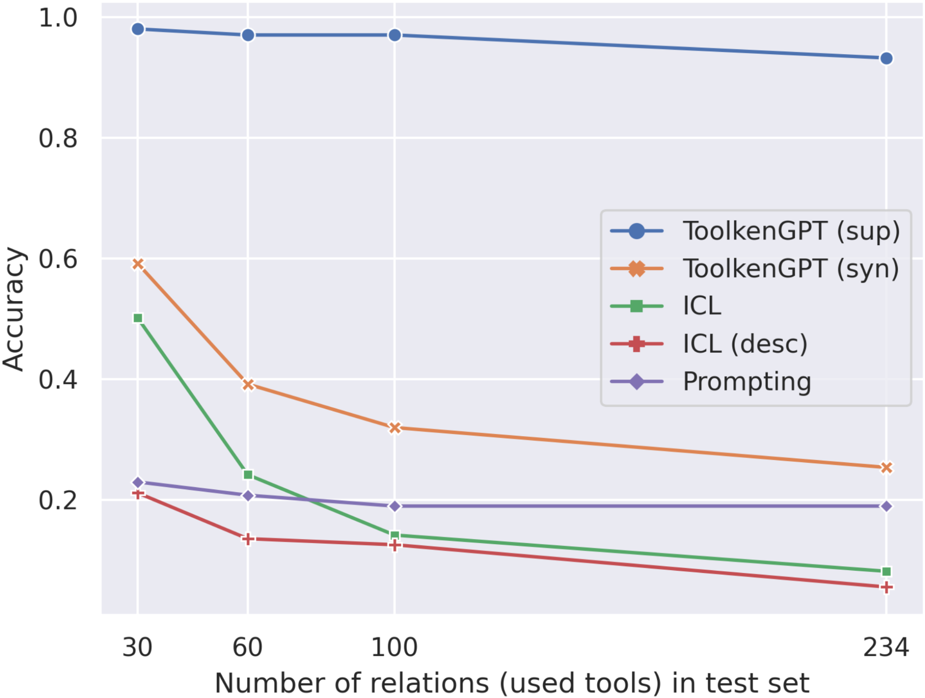
Knowledge-based Question Answering
LLMs still struggle to store accurate facts in their parameters and it’s necessary to augment them with a knowledge base
Toolken is an effective method on massive in-domain data
The context length limit leads to drastic performance drops for >30 tools
Notes:
Result analysis. We show the experiment results on 4 testsets involving different numbers of relations in Figure 2. Note that the number of involved relations is the number of tools we can use. For all testsets, the accuracy of Prompting is about 20%, which indicates LLMs still struggle to store accurate facts in their parameters and it’s necessary to augment them with a knowledge base. ToolkenGPT (sup) achieves the highest results with a large margin, showing that learning toolken embeddings is an effective method when there is massive in-domain training data. On the contrary, even though In-context learning also sees in-domain training data in the context, it still gets confused about which tools to call. Furthermore, the context length limit leads to drastic performance drops when there are more than 30 tools to use. The failure in the many-tools scene reveals the fundamental limitation of the in-context learning paradigm. ToolkenGPT (syn) also outperforms all other baselines in all subsets, without seeing any in-domain training data. The synthetic training data, often in very different expression styles from the dataset, still helps the LLM understand these relations.

Slide 84
Embodied Plan Generation
Dataset:
ActivityPrograms knowledge base on top of VirtualHome
Typical household activities
Task Input:
A high-level goal (e.g. "Read book")
A detailed instruction (e.g. "I would go lie down in my bed and open the book and start reading.",
A description of the environment,
the initial state of the agent
the object list of the environment (e.g. "I am in [’home_office’]. The objects I can manipulate are [’mail’, ’freezer’, ’television’, ..., ’novel’]".
The model is expected to output an executable plan
An ordered list of verb-object instructions (e.g. "[FIND] <novel>")
Notes:
Each task comes with an initial and final stategraph, enabling the verification of the generated plans with the simulator and the comparison of theresulting final state with ground truth. We split the dataset into a training set of 247 tasks and a testset of 50 tasks, with a total of 25 verbs and 32 objects used in the dataset.

Slide 85
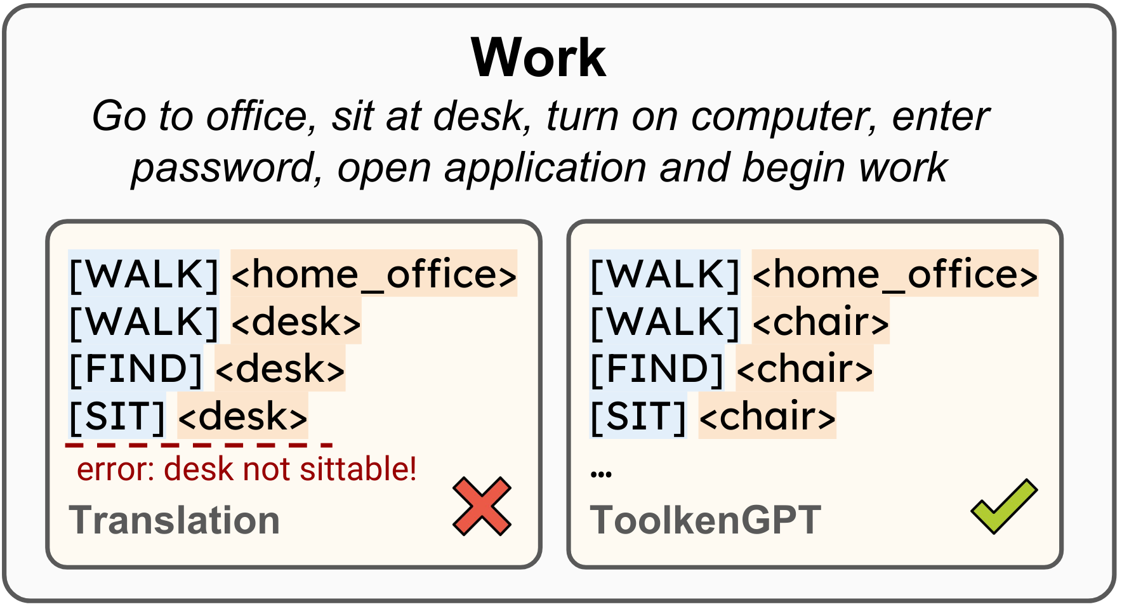
Embodied Plan Generation
Comparison:
In-context Learning: prompting the LLM.
the action list, 3 demonstration plans, and a new task with its goal, detailed description, and environment description.
+Translation: translate the LLM’s generation to admissible instructions
SentenceRoBERTa-large
translate the actions or objects to available ones with the highest cosine similarities
+Grounded Decoding: decoding-stage grounding method
Base model is LLaMA-13B
Notes:
Each task comes with an initial and final stategraph, enabling the verification of the generated plans with the simulator and the comparison of theresulting final state with ground truth. We split the dataset into a training set of 247 tasks and a testset of 50 tasks, with a total of 25 verbs and 32 objects used in the dataset.

Slide 86
Embodied Plan Generation
In-context Learning sometimes fails to ground its prediction to admissible instructions
Translation helps solve some shallow grounding problems, while
Grounded Decoding further improves executable and success rate by considering grounding earlier in the decoding stage
ToolkenGPT’s approach significantly improves LLMs performance
Notes:
Results on VirtualHome. Grounding means the proportion of scripts in which all the actionsand objects can be grounded to the environment. Executable means the proportion of scripts that canbe executed in VirtualHome without violating any rules. Success means the proportion of scripts thatleads to the correct final state. Success (R) is a relaxed variant meaning the proportion of scripts thathave reached the correct final state, but not necessarily ending with it.

Slide 87
ToolkenGPT - Computational Cost
Fine-tuning with LoRA performs slightly better but the training cost is significantly more
Base model: LLaMA-7B

Slide 88
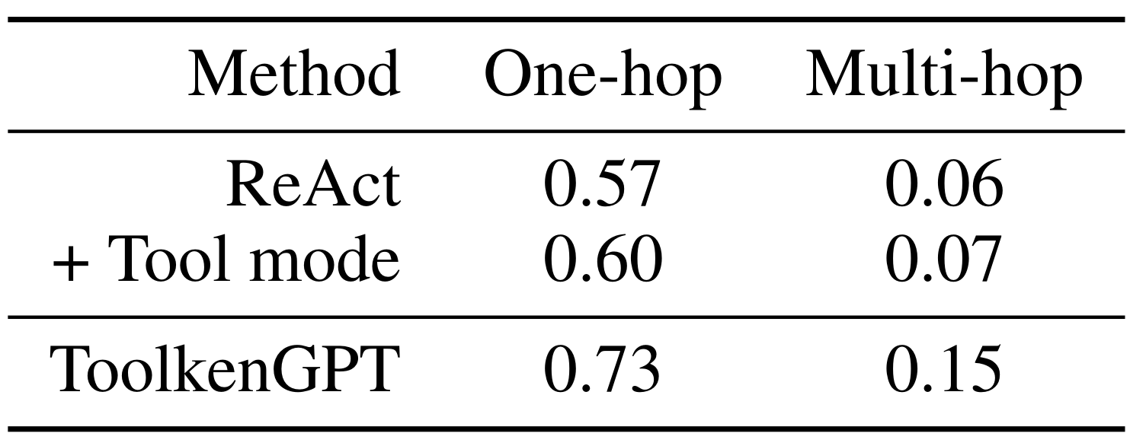
ToolkenGPT - Ablation Study
Adding a tool mode can improve the vanilla ReAct prompting method by enhancing the accuracy of argument completion
Notes:
In the tool mode, the LLM is prompted with demonstrations using only the selectedtool, which will provide more relevant knowledge than ReAct prompt for argument completion

Slide 89
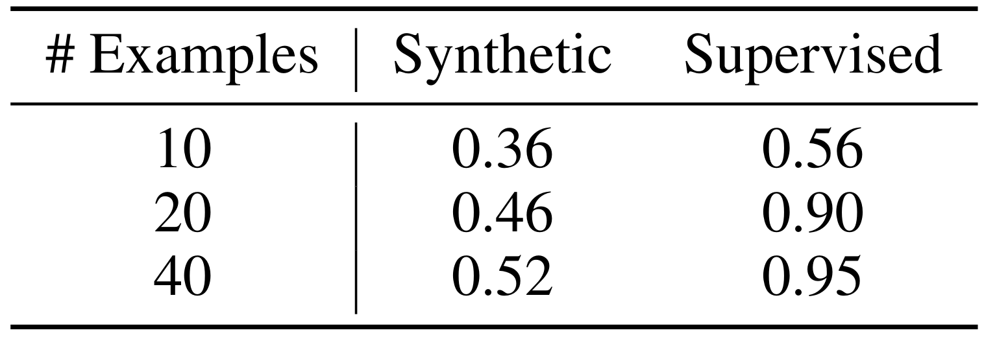
ToolkenGPT - Training Data
Sample 10/20/40 training examples from KAMEL
Test on 30 tools
The distribution gap between synthetic data and test set may prevent toolken embedding from performing well

Slide 90
CogAgent: A Visual Language Model for GUI Agents
Wenyi Hong, Weihan Wang, Qingsong Lv, Jiazheng Xu, Wenmeng Yu, Junhui Ji, Yan Wang, Zihan Wang, Yuxuan Zhang, Juanzi Li

Slide 91
CogAgent
CogAgent: visual language model
specializing in GUI understanding and planning
also have ability for general cross-modality tasks
Other contributions:
Large-scale annotated dataset about GUIs and OCR
Separate model to extract features from high-resolution (1120x1120)

Slide 92
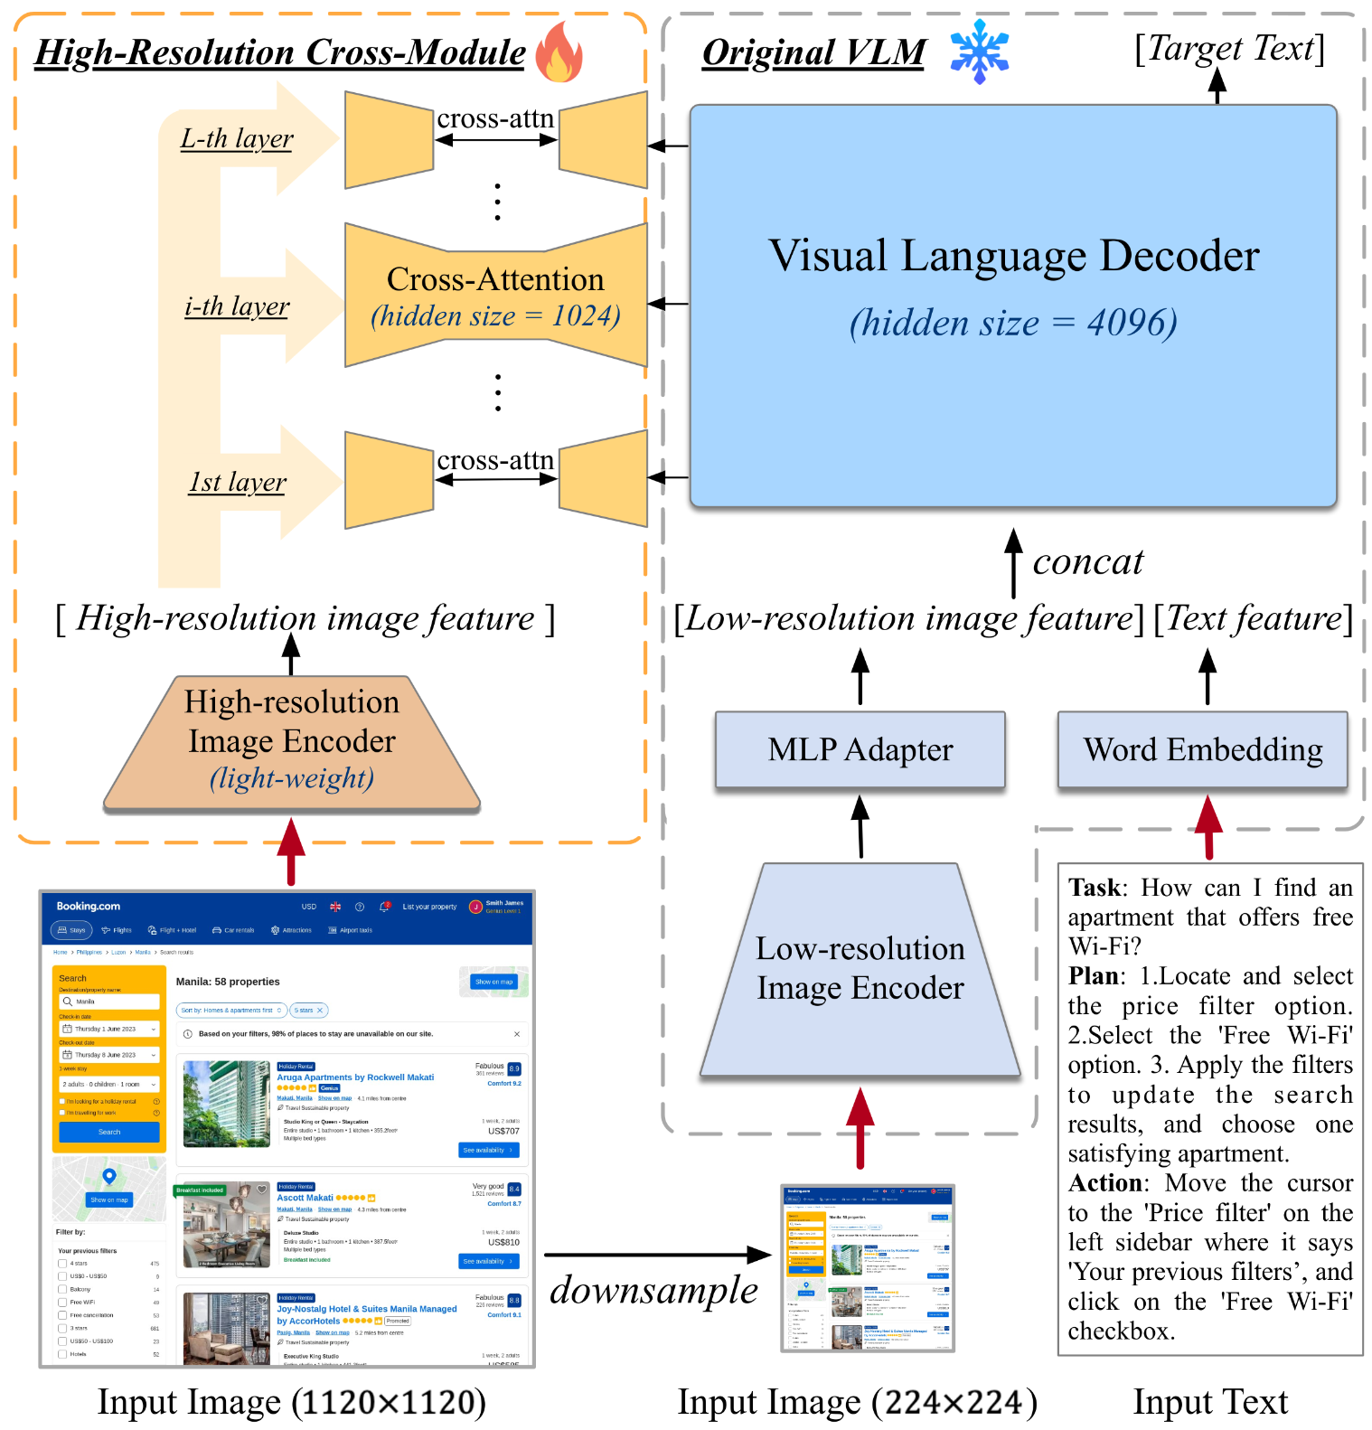
CogAgent - Architecture
Base VLM: CogVLM 17B
EVA2-CLIP-E as encoder for low-res images (224x224)
MLP maps the encoder output to feature space of VLM
High-resolution cross-module 0.3B
Extracts features from high-res image
Cross-attention with the VLM decoder

Slide 93
CogAgent - Pre-train
Text Recognition
Synthetic renderings with text from language pre-training dataset (80M)
Text of varying font, size, color, orientation, diverse image background from LAION-2B
Optical Character Recognition (OCR) of natural images (18M)
Natural images from COYO and LAION-2B with extracted text and bounding boxes
Academic documents (9M):
Image-text pairs from arXiv
Visual Grounding
Image-caption pairs from LAION-115M with bounding boxes of entities in caption
Notes:
they focus their pre-training efforts on three aspects:
the capability to recognize texts of various sizes, orientations, and fonts in high-resolution images,
the grounding ability of text and objects in the image,
and a specialized understanding capability for GUI imagery such as webpage

Slide 94
CogAgent - Pre-train
GUI Imagery
GUI Referring Expression Generation (REG)
Model is tasked with generating HTML code for DOM elements based on a specified area in a screenshot
GUI Referring Expression Comprehension (REC)
Model should create bounding boxes for given DOM element
Created a dataset of 400k web-pages
Pre-train CogAgent for 60k iterations
Further fine-tuned on a set of diverse tasks
Phone and computer screenshots annotated with screen elements, potential tasks, methods of operation
Mind2Web and AITW: Tasks on web and Android
Misc. VQA datasets

Slide 95
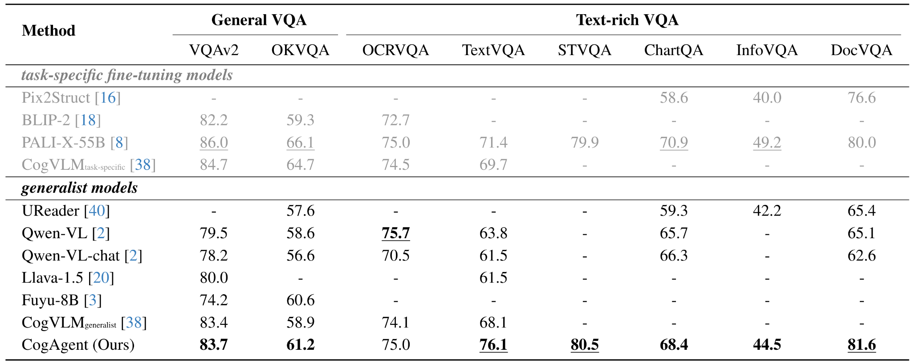
CogAgent - Experiments
First experiment on foundational visual understanding
Dataset:
General VQA: VQAv2 and OK-VQA
Text-rich VQA: TextVQA, OCR-VQA, ST-VQA, DocVQA, InfoVQA and ChartQA

Slide 96
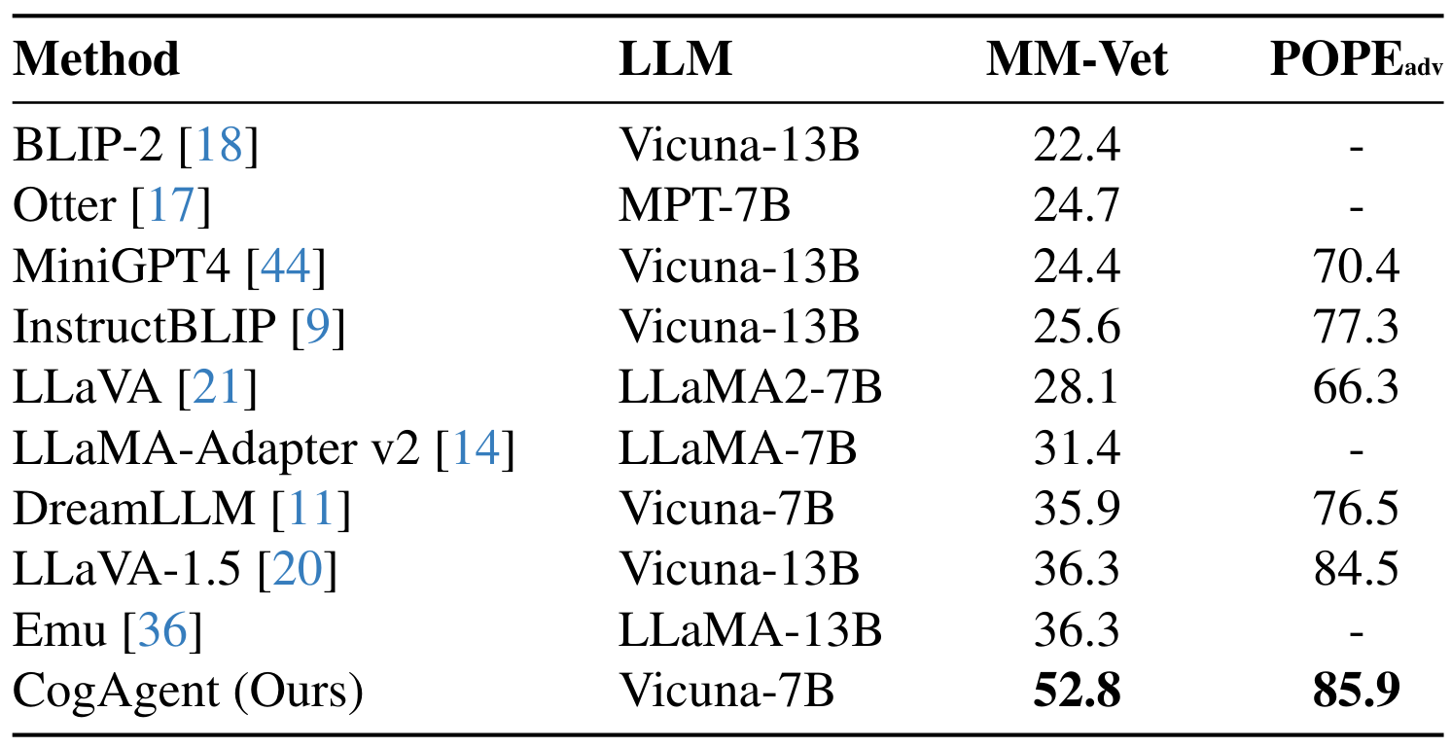
CogAgent - Experiments
They conducted zero-shot tests of their model on MM-Vet and POPE
Notes:
MM-Vet is designed with six core tasks to assess multi-modal models’ proficiency in handling intricate assignments, and POPE-adversarial models on their susceptibility to hallucinations

Slide 97
CogAgent - Experiments
Second experiment is GUI Agent: Computer Interface
Dataset:
Mind2Web: dataset for web agents that includes over 2,000 open-ended tasks collected from 137 real-world websites across 31 domains
Each entry in the dataset comprises a high-level task description, a sequence of actions, and webpage snapshots in a variety of formats
Given task description, current webpage snapshot and previous actions as inputs, agents are expected to predict the subsequent action

Slide 98
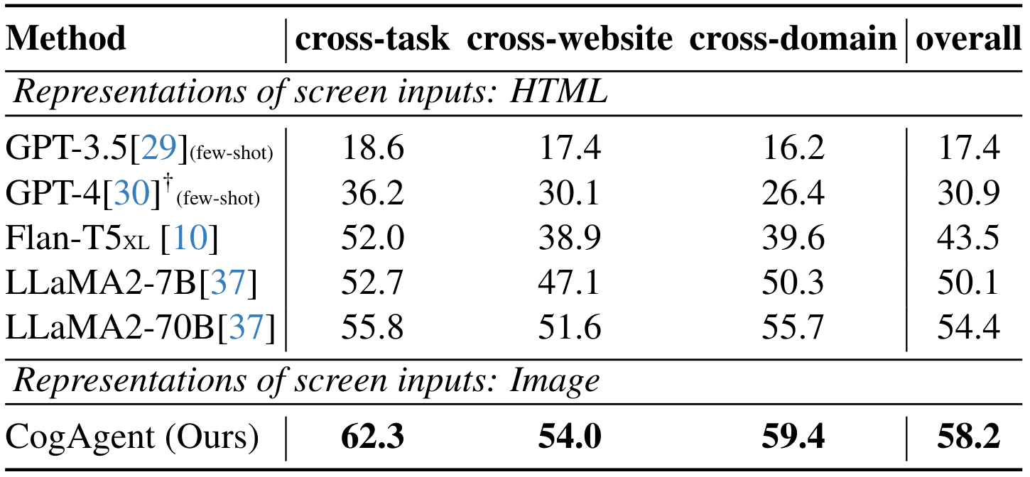
CogAgent - Experiments
Fine-tuned their model on the train set and evaluate on three out-of-domain subsets: cross-website, cross-domain, and cross-task

Slide 99
CogAgent - Experiments
Third experiment is on Smartphone Interfaces
Dataset:
Android in the Wild (AITW): a large-scale dataset for Android device agents.
715k operation episodes, covering 30k distinct task instructions, four Android versions, and eight device types featuring varying screen resolutions
Each episode in the dataset consists of a goal described in natural language, followed by a sequence of actions and corresponding screenshots
Task: predict the next action based on the given goal, historical actions, and the screenshot

Slide 100
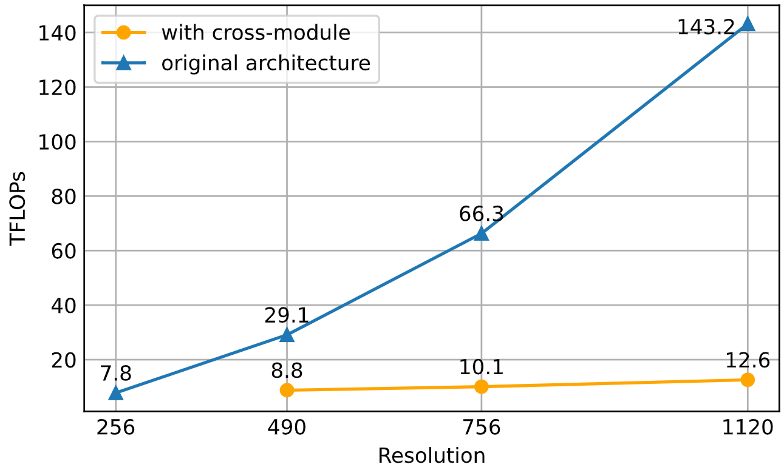
CogAgent - Ablation Study
Comparison of FLOPs during forward propagation
Using basic CogVLM leads to a significant increase in the number of FLOPs at higher resolutions
Notes:
feeding high res to CogVLM vs cross attention

Slide 101
CogAgent - Ablation Study
They empirically compared the model performance
Training time is evaluated on A800 with the batch size of 8.
Models are pre-trained with Caption+OCR data
Notes:
Ablation study on model architecture.
cross-modules enables us to perform better with lower cost

Slide 102
CogAgent - Ablation Study
They studied the effect of pre-training data
Image-caption data ➤ added OCR data ➤ added GUI grounding data
Notes:
ablation study on pre-training data
we sequentially add OCR data(denoted as Cap+OCR), as well as GUI and grounding data(denoted as All)
web and grounding data have a significant impacton the Mind2Web dataset, underscoring the importance of constructing domain-specific pre-train data in the training of GUI agents.

Slide 103
Summary
Toolformer: Finetune LLM with tool-use
ART: framework for problem decomposition
AgentBench: LLM-as-agent benchmark
ToolLLM: LLMs use multiple APIs with enhanced reasoning
ToolkenGPT: Augment LLMs with massive tools
CogAgent: High-res GUI understanding and planning

Slide 104
Discussion Phase
Questions?

