Slide 1
Lecture 20: Large Multimodal Models
Presenter: Muhammad Fetrat

Slide 2
Overview
Flamingo
Visual Instruction Tuning (LLaVA)
InstructBLIP
PaLI
PALI-3
Emu2
InternVL
Gemini

Slide 3
Flamingo
A GPT-3 Moment in Multimodal ( Vision-Language ) Tasks
The content of some of the slides for Flamingo have been taken from the following source:
https://www.youtube.com/watch?v=H82s6BrJduM

Slide 4
What is Flamingo?
Flamingo is a visual language model (VLM ) capable of multimodal tasks like captioning, visual dialogue, classification, and visual question answering (VQA)

Slide 5
Visual Dialogue

Slide 6
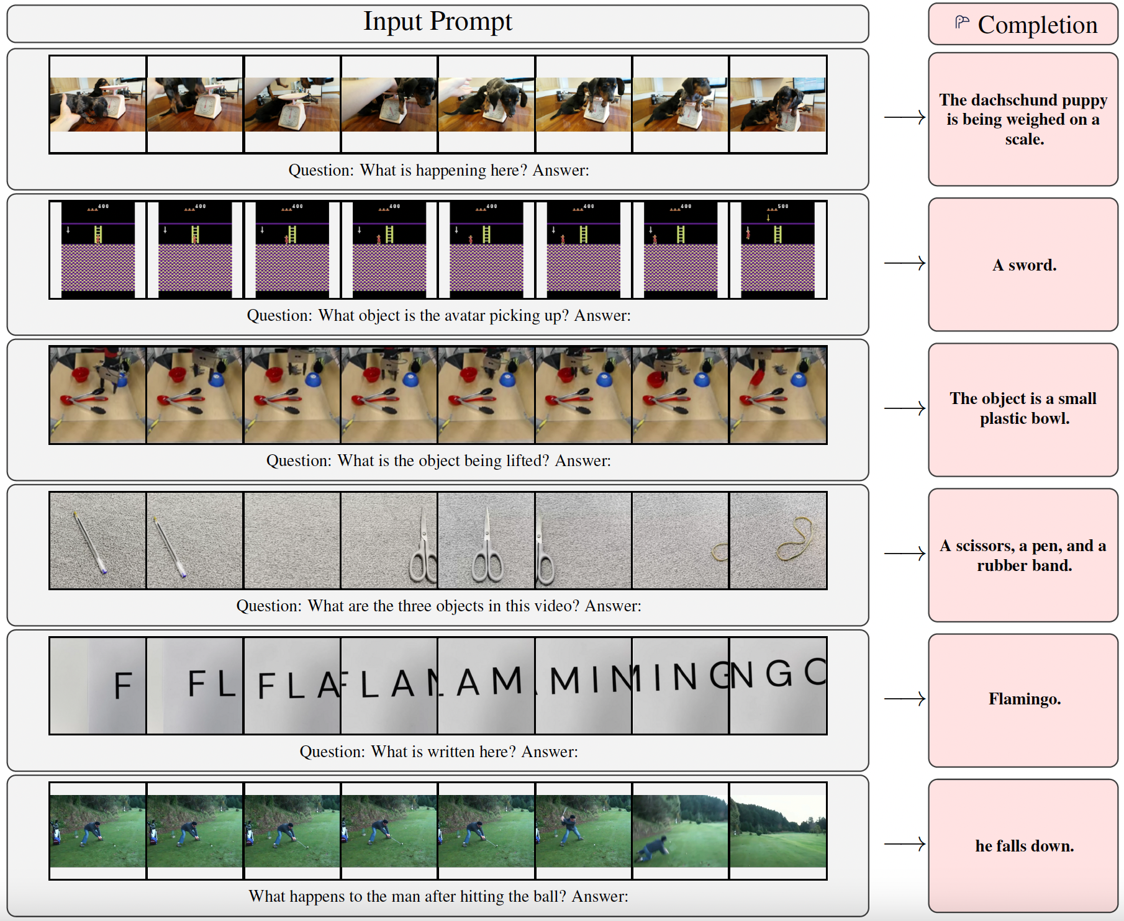
Video prompt

Slide 7
Motivation
The few-shot dream
Open-ended task abilities
Aspect of intelligence: ability to quickly learn tasks given short instructions
Model Learning environment to make better use of data
We like the multimodal systems (vision and language) that achieve this property
Dominant computer vision paradigm:
But current fine-tuning approaches require:
Thousands of training samples
Task specific hyperparameter tuning
Significant computational resources
Multimodal models like CLIP and ALIGN show good zero shot performance
But they are not flexible, they lack the ability to generate language
Inspiration from NLP: large language models like GPT-3 are flexible few-shot learners
Given a few examples of a task as a prompt + query input the language model generates a continuation to produce the predicted output
A key factor of their success is large-scale pretraining.
In principle: image/video understanding tasks (e.g. classification, captioning, question answering) are text prediction problems with visual input conditioning.
Large-scale pretraining
$$+$$
Task specific fine-tuning
Can we train a multimodal model that has good performance in “few-shot” regime ?
Can we learn a models capable of open-ended multimodal task via pretraining?

Slide 8
Challenges for multimodal generative modelling
Unifying strong unimodal models
Supporting images and videos
Heterogeneous training data
Training large language models is computationally expensive
We like to save resources by starting from a pretrained language model
But a text only model has no built-in ability to incorporate inputs from other modalities.
We like to enable this retaining the knowledge of the original language model.
Proposed approach: interleave cross-attention layers with language-only self-attention layers (frozen)
Goal: enable both video and image inputs
These are high-dimensional so flattening to 1D sequences (as used in text generation) is costly
This is exacerbated by quadratic cost of self-attention.
Secondary goal: would also like unified treatment of images and videos
Proposed approach: Perceiver-based architecture with a fixed number of visual tokens
Large models require vast training datasets.
Existing (image, text) datasets (e.g. used by CLIP and ALIGN) may not be general enough to reach GPT-3 style few-shot learning.
Large internet-based text-only datasets exist, but not for multimodal data.
One scalable approach: scrape web pages with interleaved image and text.
But such images and text are often only weakly related
Proposed approach: combine web scraping with existing paired (image-text) and (video, text) datasets

Slide 9
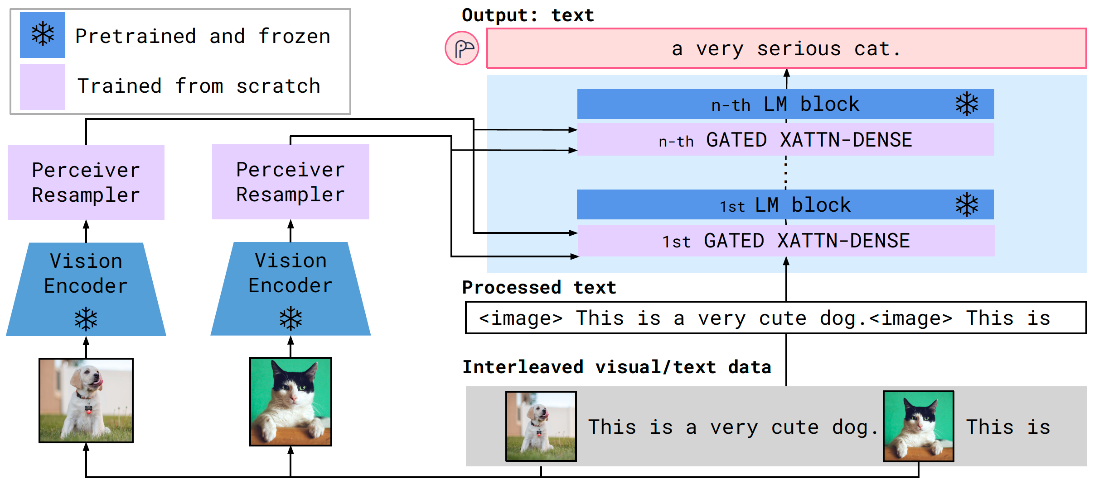
Flamingo Model
Approach
Architecture
Flamingo is a visual language model that accepts interleaved inputs:
This enables a broad range of tasks:
Goal 1: leverage pretrained models to save compute
Goal 2: bridge pretrained models harmoniously
Interleaved inputs
🦩
outputs
Text
Images
Video
Text
Open-ended tasks
Close-ended tasks
Visual question answering
captioning
classification
Vision: CLIP
Language: Chinchilla
Perceiver resampler
Cross-attention

Slide 10
Flamingo Model
Flamingo models can model the likelihood of text $y$ interleaved with a sequence of images/videos $x$:
$p\left(y | x\right)=\prod_{l=1}^{L}{p(y_{l}|y_{<l},x_{≤l})}$
Multimodal likelihood
$p≔$ flamingo model
$y_{l}≔l$-th language token in input text
$y_{<l}≔$ preceding text tokens
$x_{≤l}≔$ preceding image/videos

Slide 11
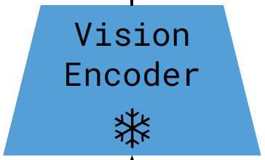
Vision encoder: pixels to features
Flamingo vision encoder
Vision encoder: F6 Normalizer-Free ResNet (NFNet) backbone
Pretrained as dual encoder using contrastive loss employed by CLIP
BERT is used for text encoder (discarded after pretraining)
Slight difference to CLIP: global average pooling is used to produce the vision embedding (rather than global attention pooling)
Outputs 2D spatial grid of features which is flattened to 1D
For videos: frames are sampled at 1FPS (features are concatenated)
Resolution
Embedding
288 x 288 pixels
1376
Vision encoder is frozen after pretraining

Slide 12
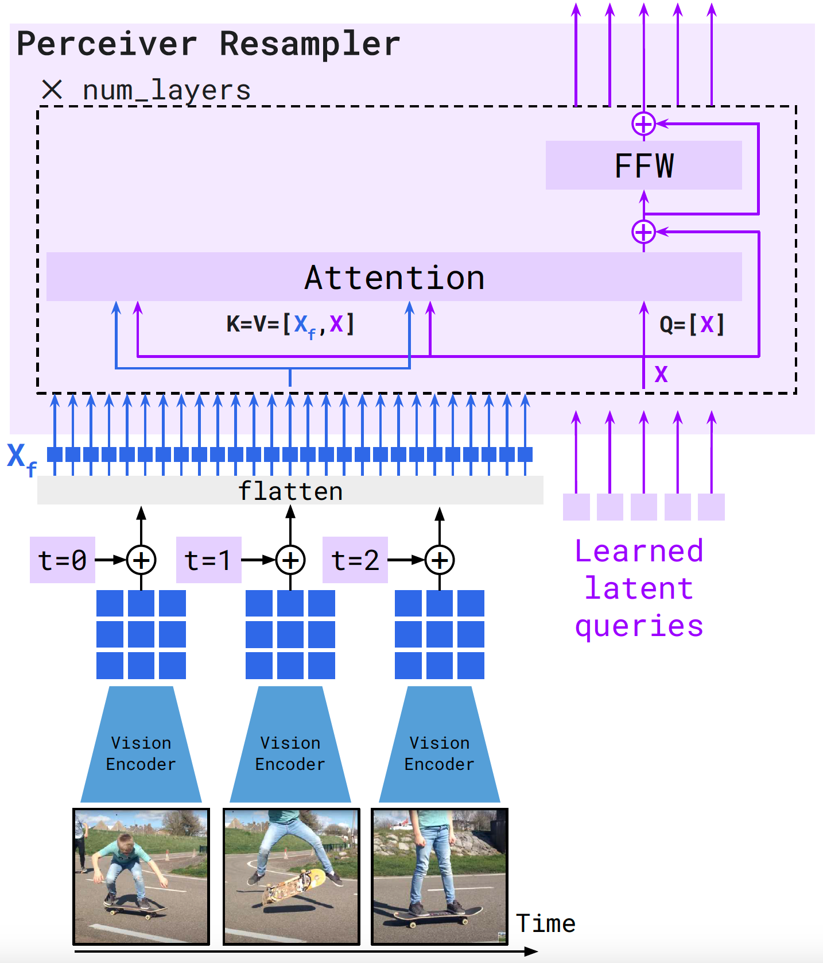
Perceiver resampler
Perceiver resampler module
From large, variable-size features to fixed # tokens
A variable number of input frames are processed (for videos)
The vision encoder thus produces a variable number of features
Perceiver outputs a fixed number of visual tokens (64) to limit complexity
Temporal encodings are added to visual inputs (spatial grid position encodings are not used, since they did not help)
The results are then flattened to form a 1D sequence
These are combined with a fixed set of learned latent queries (64)
Both are processed by attention and feed-forward layers.
Note: differently to DETR and Perceiver, keys and values for latent queries are concatenated to those from the visual embedding

Slide 13
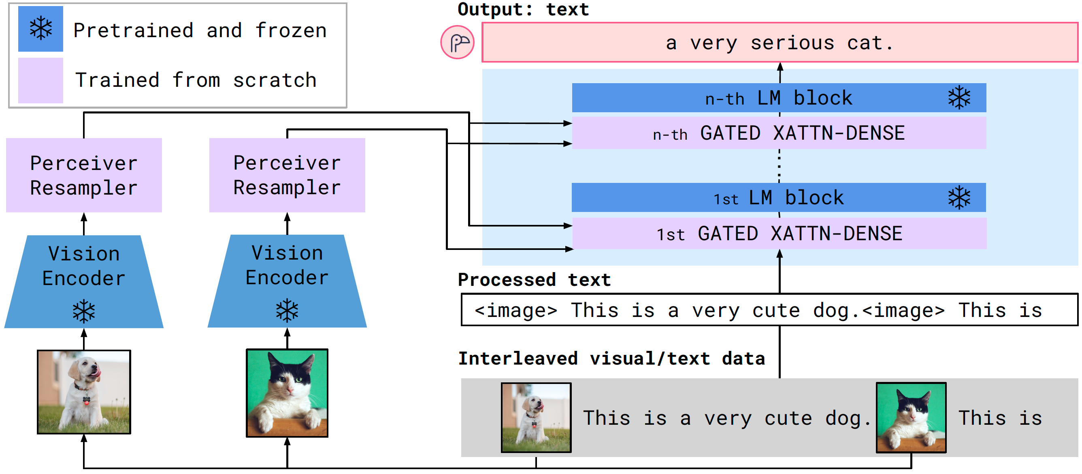
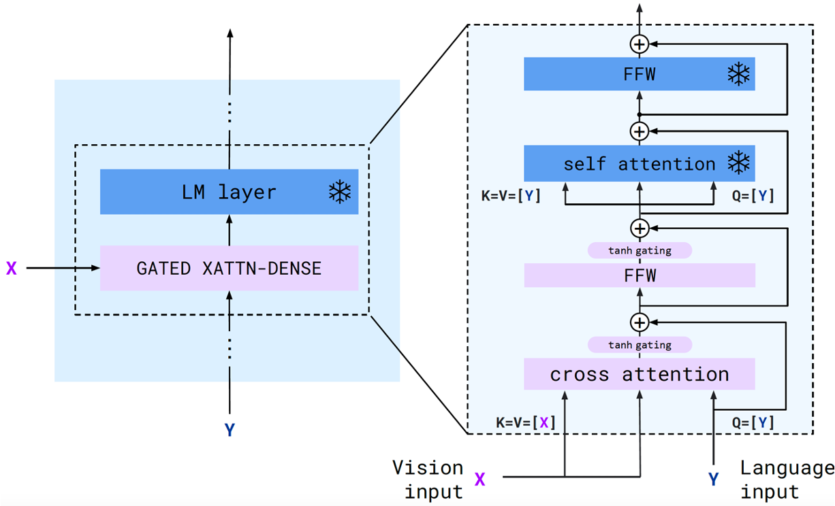
Conditioning the language model
Gated xattn-dense block structure
Interleaving gated cross-attention layers
Language models: frozen Chinchillas (trained on MassiveText)
Gated xattn dense blocks (trained from scratch) are inserted between layers
Layer norm is applied to all attention inputs and the feed-forward layers (GPT-2 style)
Use tanh gates to preserve original language model behavior at initialization
Each tanh($α$) gate controlled via a layer-specific learnable scaler $α$ (initialized to zero)

Slide 14
Flamingo- training data
Data sources
Flamingo is trained on:
Image-Text Pairs data
Video-Text Pairs data
Webpage data
Flamingo training objective
Models are trained with a weighted sum of datasets specific negative log likelihoods of text (conditioned on visual inputs):
$$\sum_{m=1}^{M}{λ_{m}}∙𝔼_{\left(x,y\right)\sim 𝒟_{m}}[−\sum_{l=1}^{L}{\log{p(y_{l}|y_{<l},x_{≤l})}]}$$
$𝒟_{m}$- $m$-th dataset
$λ_{m}$ - positive scalar weight for the $m$-th dataset
Similarly to the vision encoder pretraining:
Tuning these weights is important for good performance
The accumulation strategy is used

Slide 15
Evaluation Datasets
⚙️ 7 benchmarks used for design decisions
Image benchmarks
Video benchmarks
COCO (Captioning) ⚙️
Flickr30k (Captioning)
VQAv2 (Visual question answering)⚙️
OK-VQA (Visual question answering)⚙️
VizWiz (Visual question answering)
TextVQA (Visual question answering)
VATEX (Captioning) ⚙️
YouCook2 (Captioning)
MSVD-QA (Visual question answering)⚙️
MSRVTT-QA (Visual question answering)
NextQA (Visual question answering)
iVQA (Visual question answering)
Open-ended
VisDial (Visual dialogue)
HatefulMemes (Image + Text Classification)
ImageNet (Classification) ⚙️
START (Multiple-Choice visual question answering)
RareAct (Composite action retreival)
Kinetics700 (Classification)⚙️
Close-ended

Slide 16
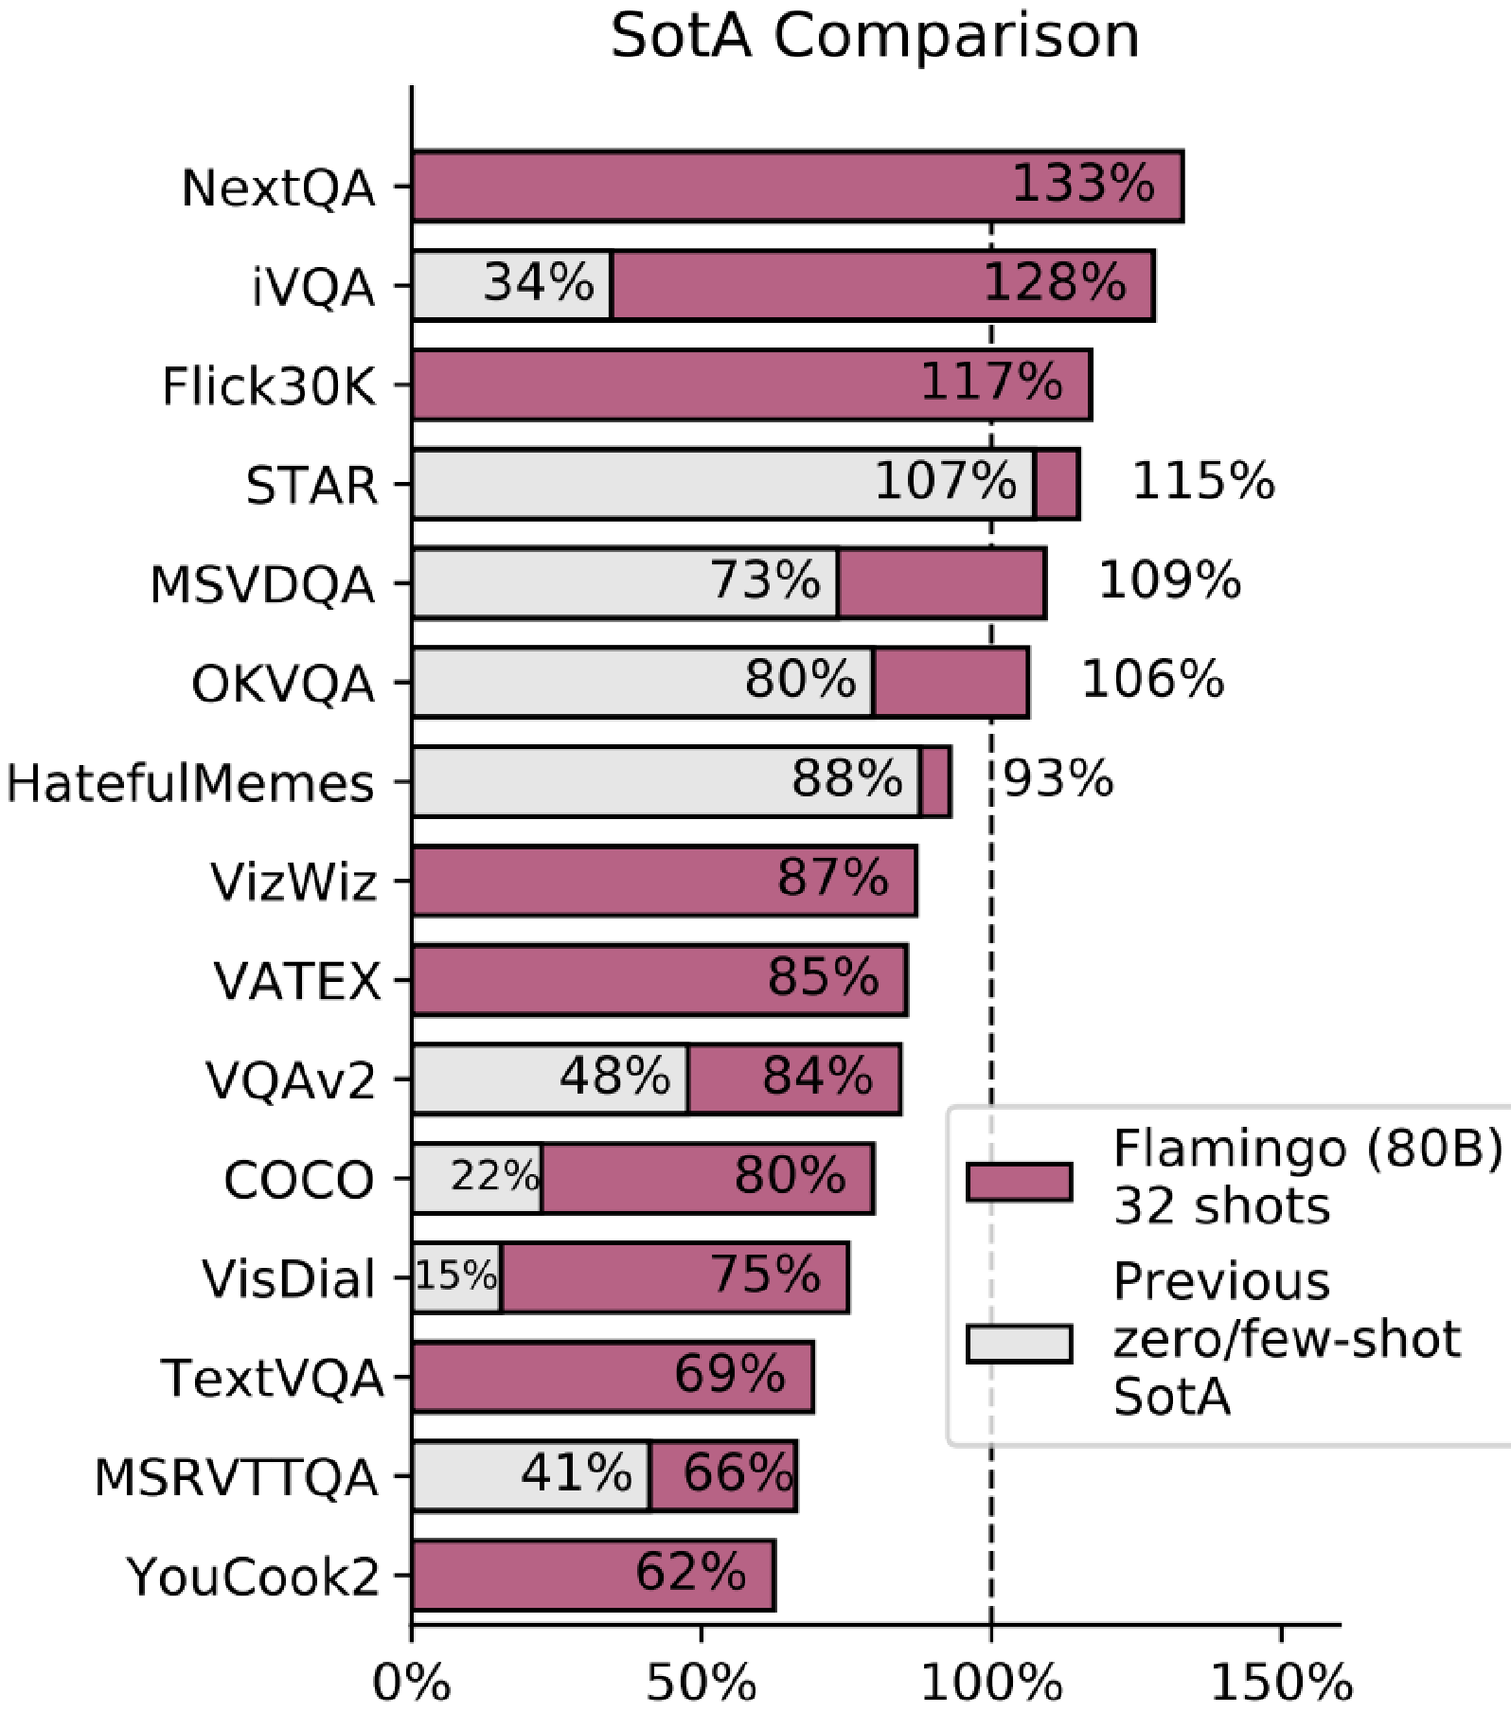
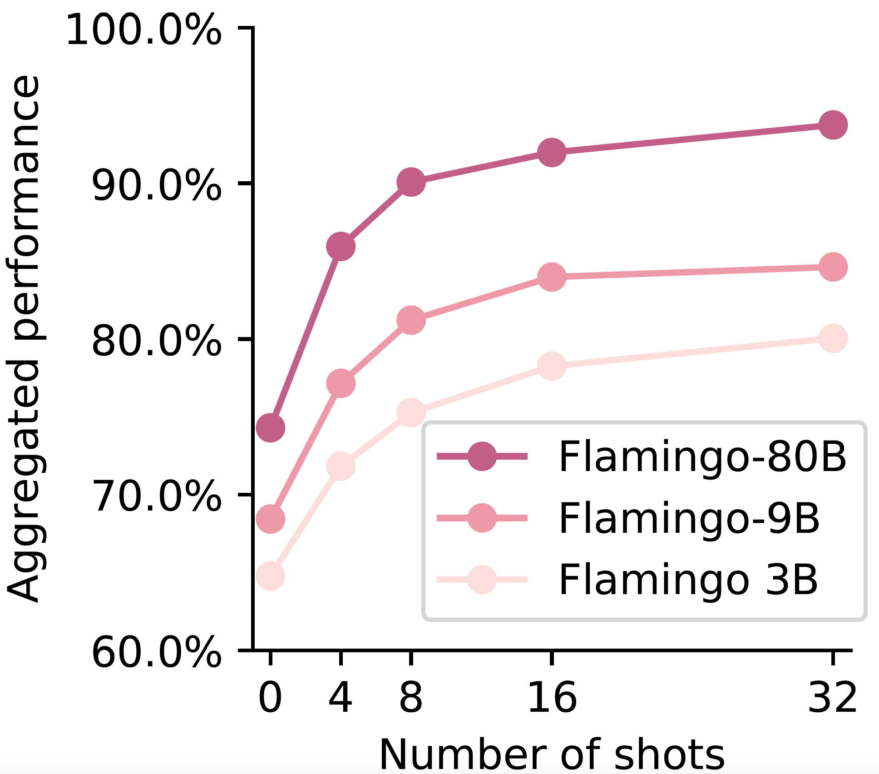
Main results
Few-shot results
Scaling model size/ number of shots

Slide 17
Overview
Flamingo
Visual Instruction Tuning (LLaVA)
InstructBLIP
PaLI
PALI-3
Emu2
InternVL
Gemini

Slide 18
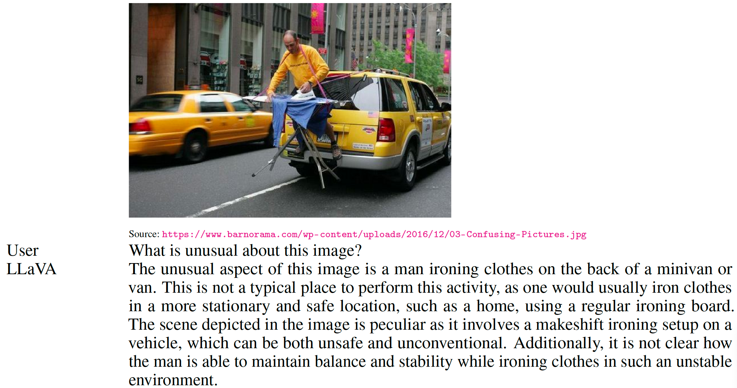
Visual Instruction Tuning
What can it do?
What is the paper about?
It introduces LLaVA: Large Language and Vision Assistant
LLaVA is an end-to-end trained LMM that connects a vision encoder and an LLM
It is instruction tuned on multimodal language-image instruction-following data.
Language-only GPT-4 is used to generate such data

Slide 19
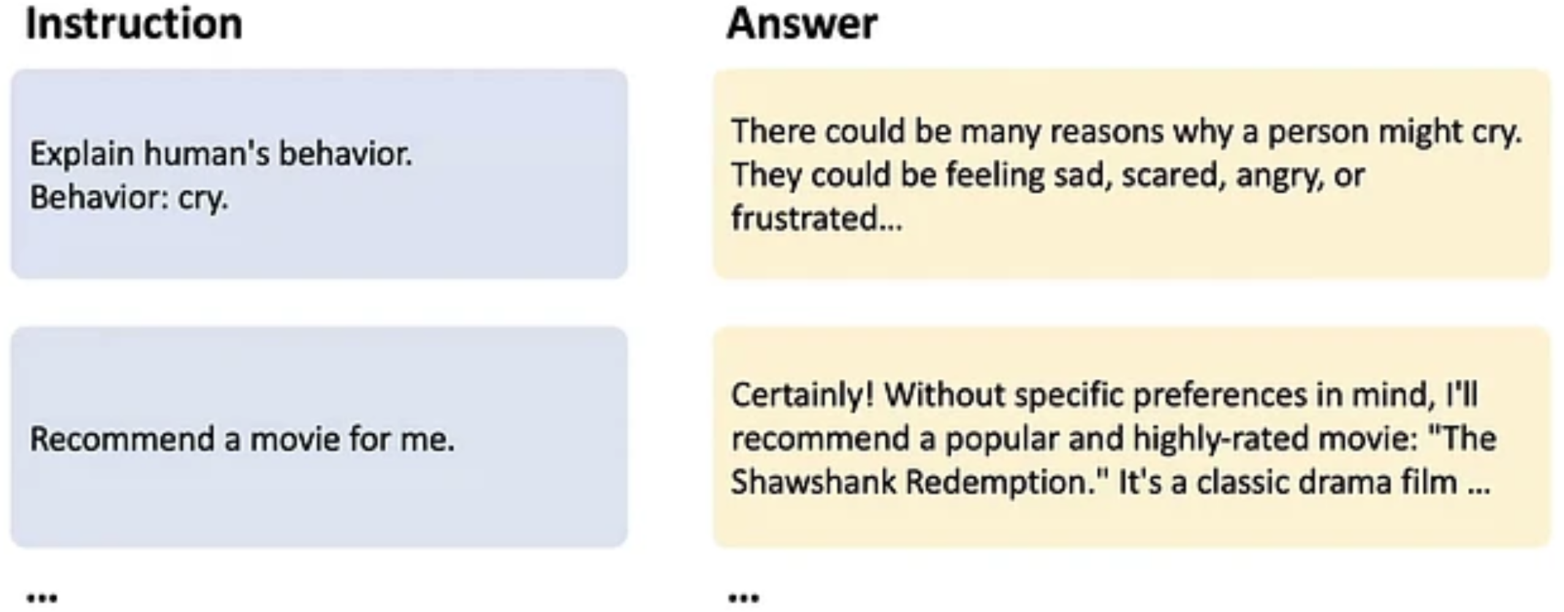
Background
An instruction tuned LLM
Inspired by:
Large Multimodal Models
Instruction Tuning for LLMs

Slide 20
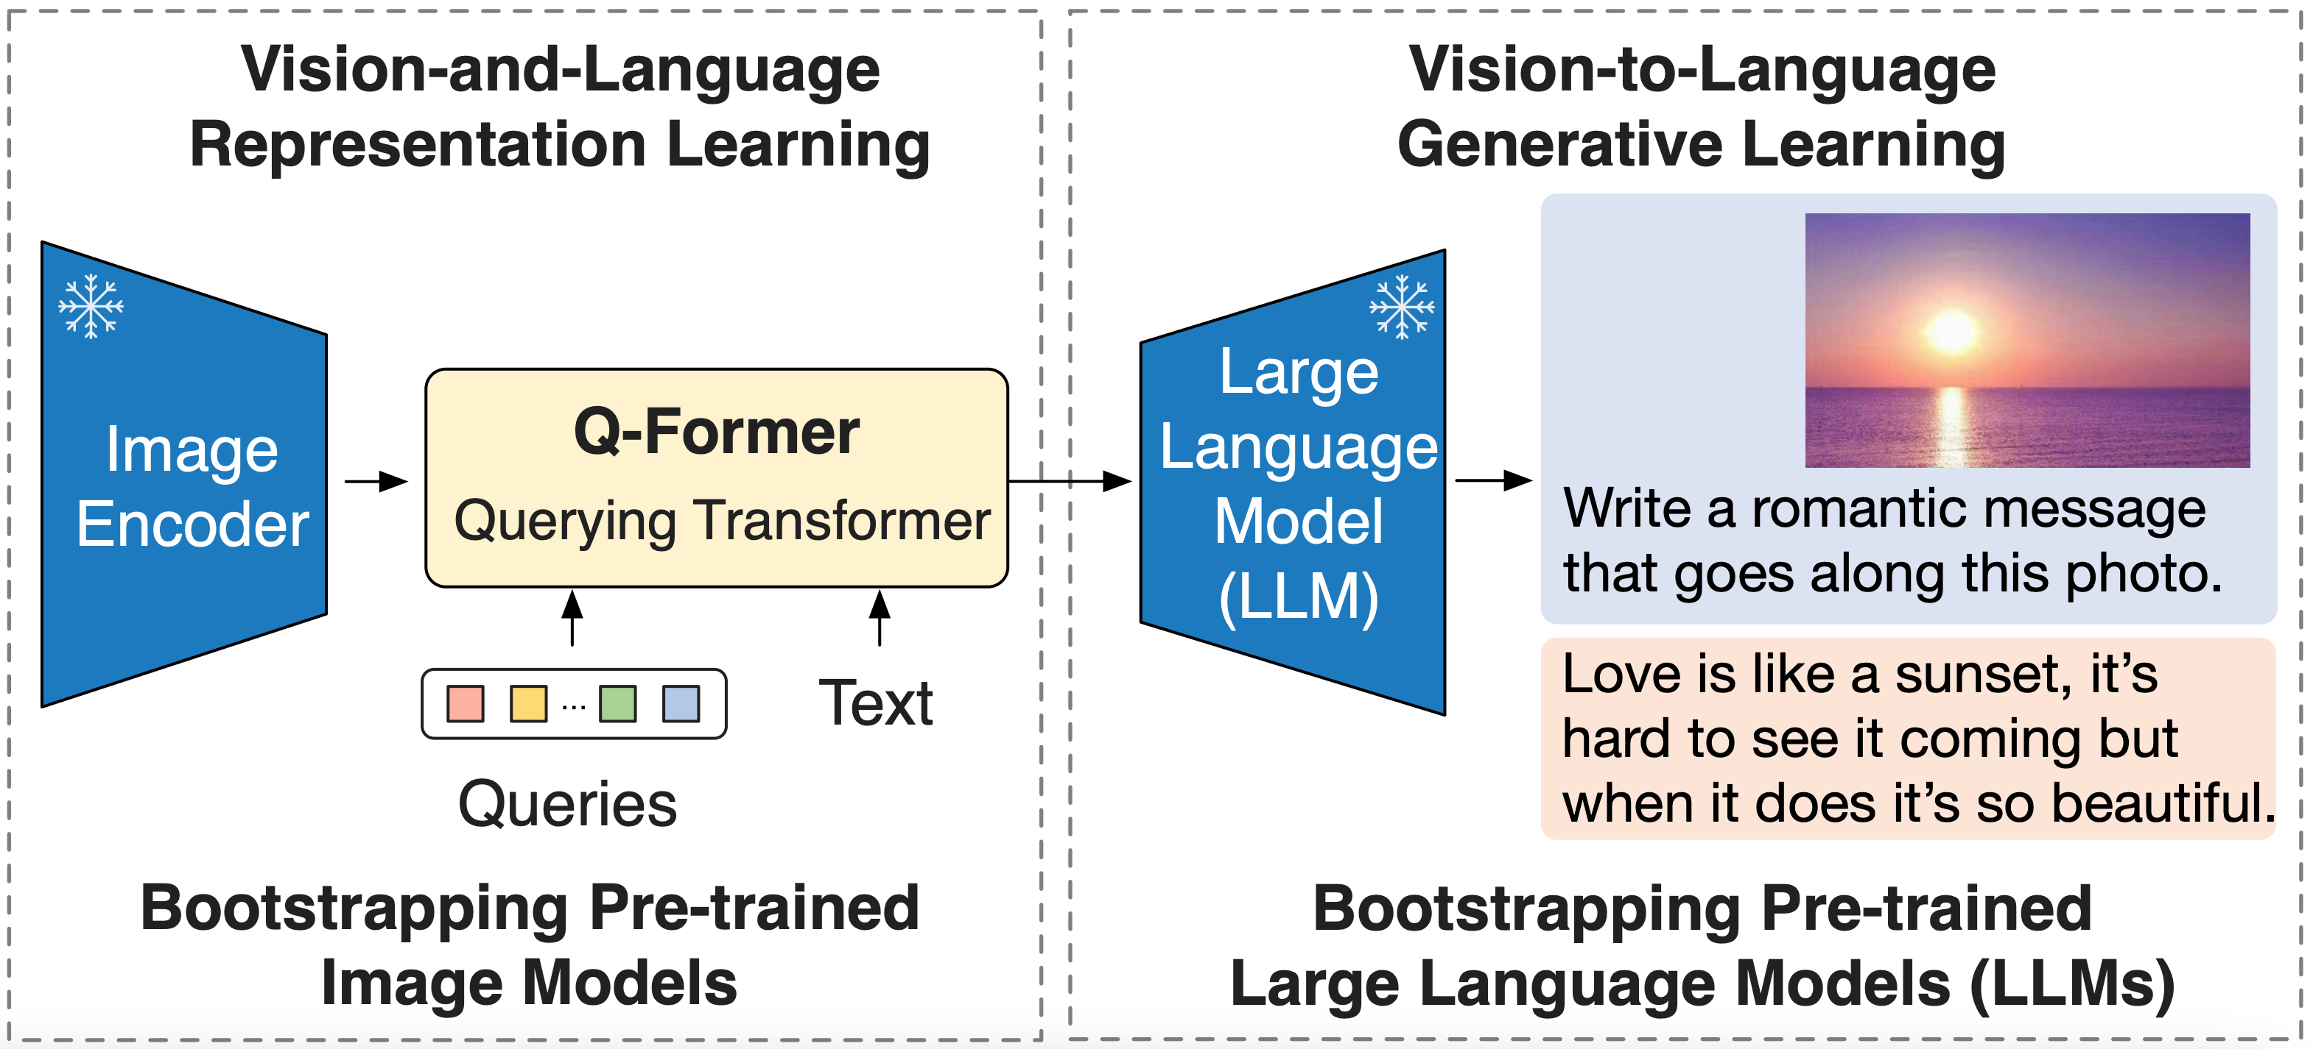
Prior work and their shortcomings
Pretrained image-to-text generative models
BLIP-2
Flamingo
Question:
Prior methods generally lack instruction following capabilities
Problem
How can we create such multimodal models that follow human’s intent?
Proposed approach: visual instruction tuning

Slide 21
Instruction Tuning in LLMs
How to collect the instruction tuning data?
Human-Human: high-quality, hand-written by humans – high cost
Human-Machine: strong LLM-based teacher like ChatGPT – affordable cost
Using ChatGPT
Instruction Tuned LLMs

Slide 22
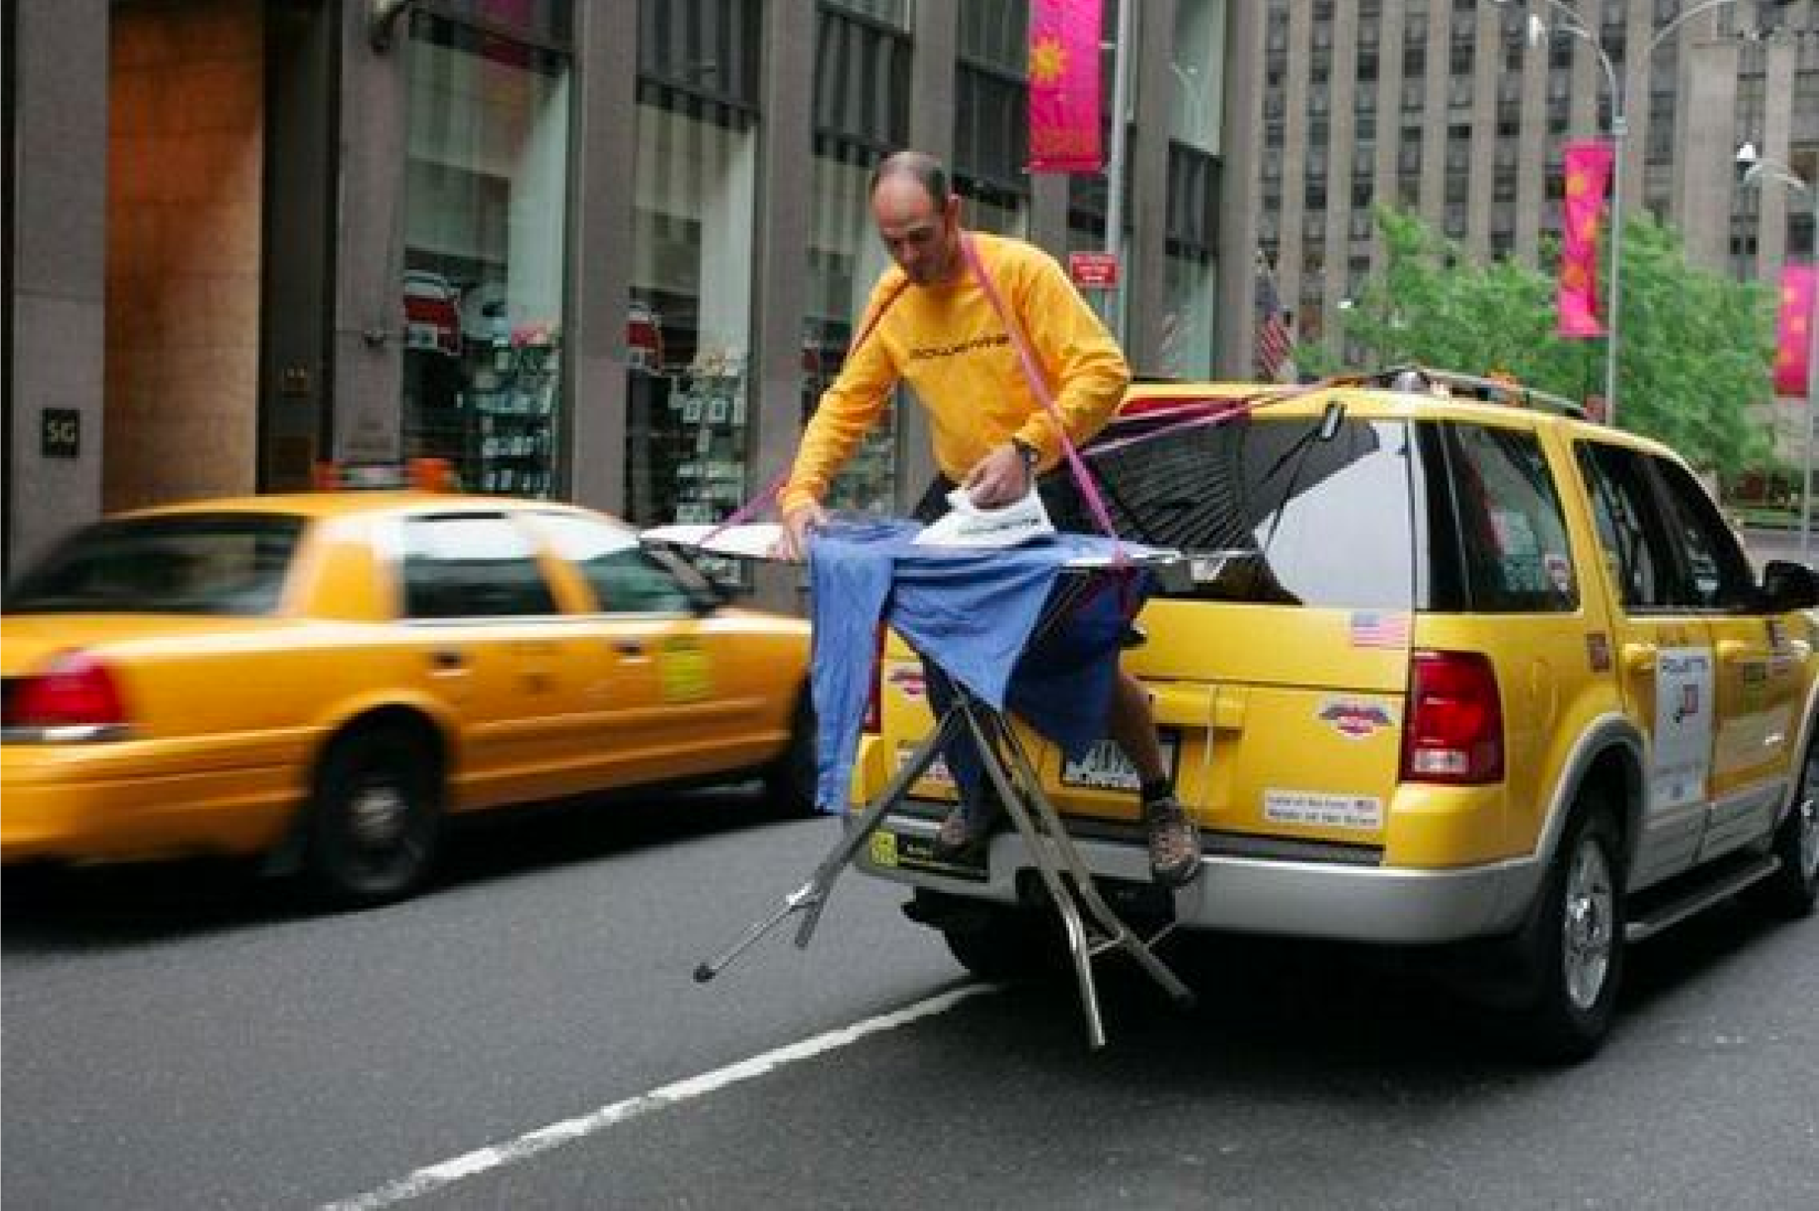
Visual Instruction Tuning
How to build instruction-following LMMs?
Output
The unusual aspect of this image is …
Instruction
What is unusual about this image?
Language Decoder
Image
Cross-modal Connector
Visual Encoder
So
But
what we need?
Strong pretrained vision and language models
Cross-modal Connector
Tuning the model for following multimodal instructions
All are text-only!
No powerful multi-modal teachers!

Slide 23
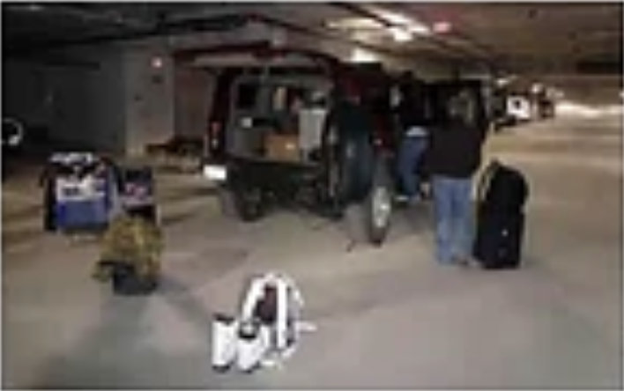
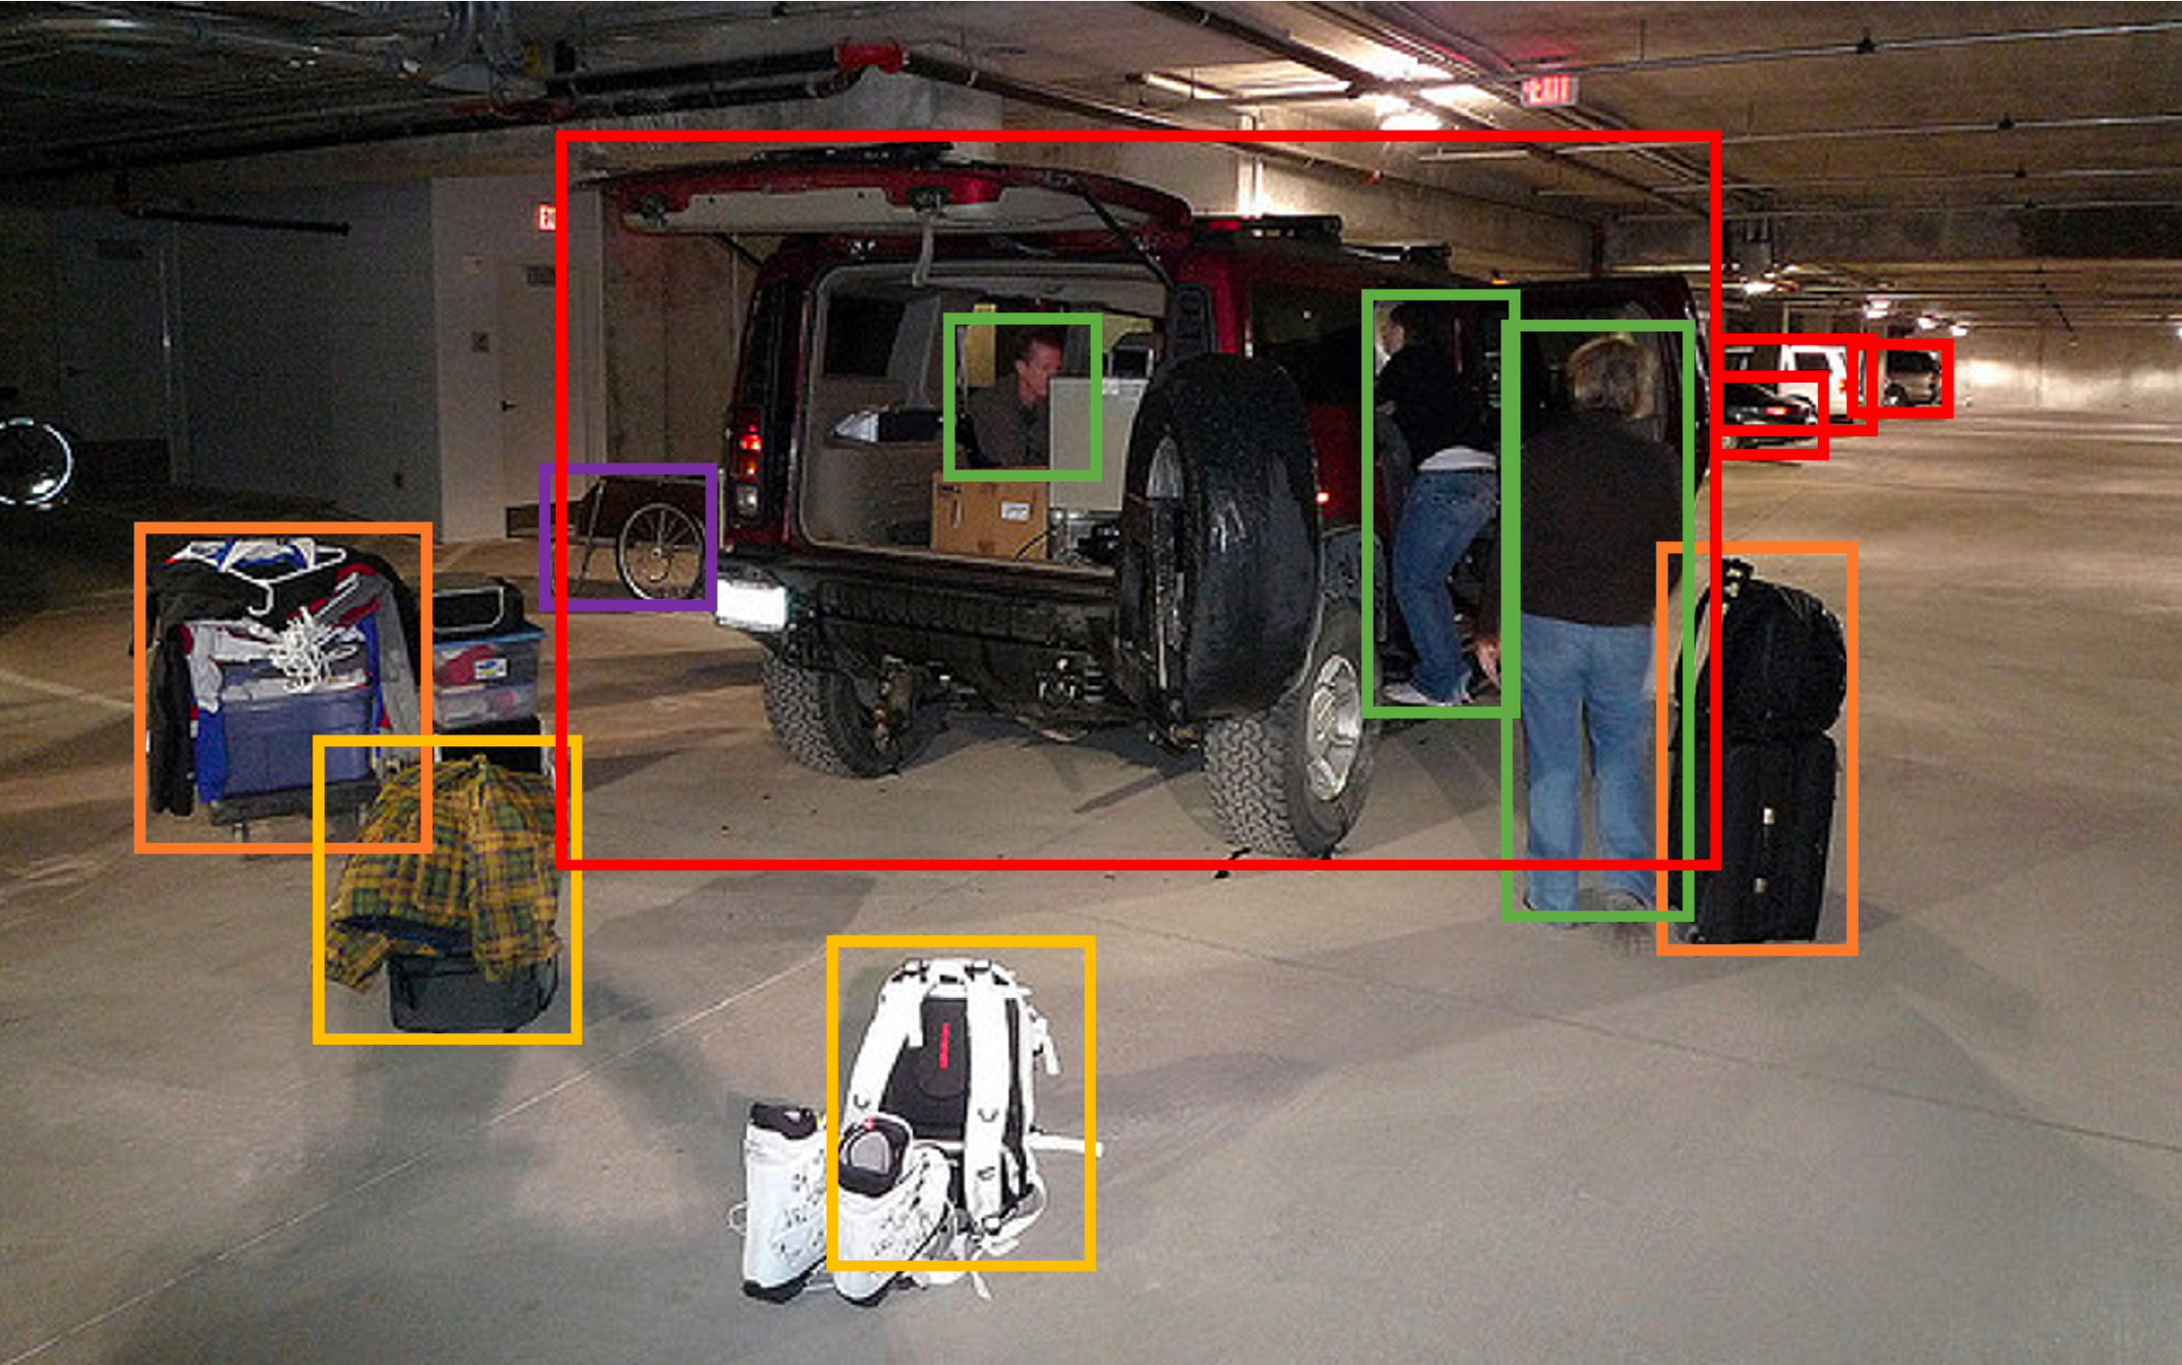
GPT-Assisted Visual Instruction Data Creation
Image
Instruction
Output
What are the challenges these people might be facing?
They may be having difficulty fitting all luggage into the back of the SUV.
There are many bags, suitcases already in the back, while more …
Context (caption)
A group of people standing outside of a black vehicle with various luggage.
Context (layout)
Person: [0.68, 0.24, 0.77, 0.69], person: [0.63, 0.22, 0.68, 0.51],
person: [0.44, 0.23, 0.48, 0.34], backpack: [0.38, 0.69, 0.48, 0.91],
…
Microsoft coco: Common objects in context

Slide 24
Produce new samples
Context
Instruction
Output
Context (caption)
A group of people standing outside of a black vehicle with various luggage.
What are the challenges these people might be facing?
They may be having difficulty fitting all luggage into the back of the SUV.
There are many bags, suitcases already in the back, while more …
Context (layout)
Person: [0.68, 0.24, 0.77, 0.69], person: [0.44, 0.23, 0.48, 0.34], backpack: [0.38, 0.69, 0.48, 0.91], …
In-context example(s) of visual-context/instruction/output triplets.
<new context (caption) 1>
<new context (layout) 1>
Please generate new Context-Instruction-Output triplets that meet following requirements: …
<new instruction 1>
<new output 1>

Slide 25
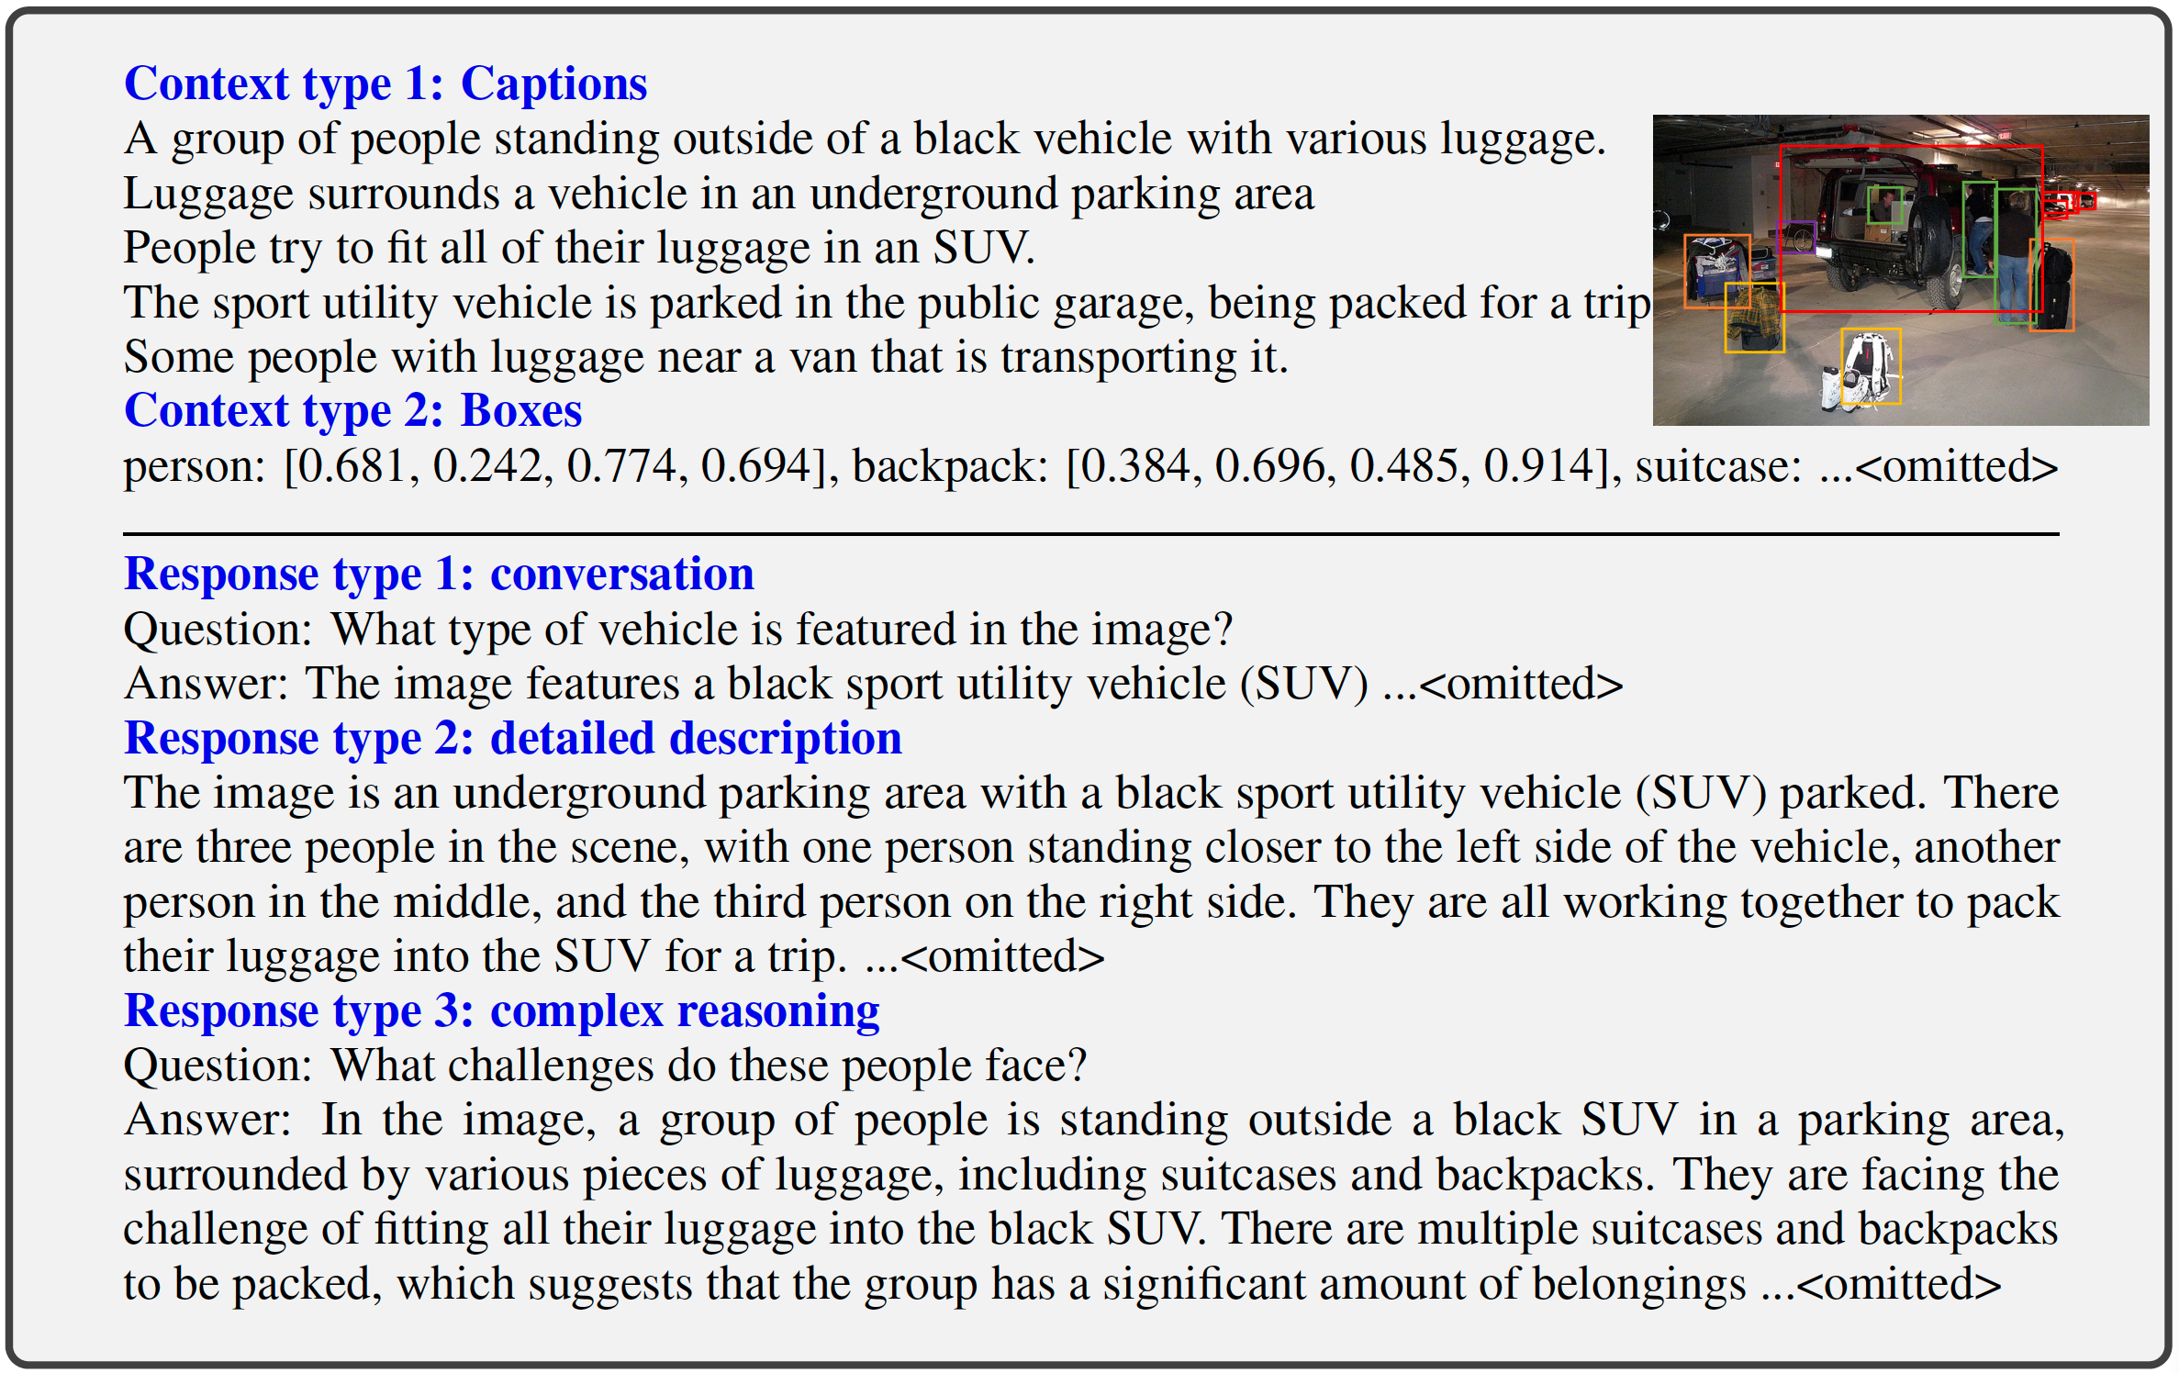
Creating the Dataset
LLaVA-Instruct-158K
Conversation: 58K
Detailed description: 23K
Complex reasoning: 77K

Slide 26
LLaVA model
The architecture
Components
Vision Encoder: CLIP-ViT-L/14
Projection: Linear layer
Language Model: Vicuna, LLaMA-2-Chat, MPT-Chat, etc.

Slide 27
Training
Stage 1: pre-training for feature alignment
Data
A filtered CC3M subset (595K)
❄️
🔥
❄️

Slide 28
Training
Stage 2: End-to-end visual instruction tuning
🔥
🔥
❄️
Two tasks
Visual Chat: LLaVA-Instruct-158K for open-ended user-oriented visual task.
Science QA: Multimodal reasoning dataset for the science domain

Slide 29
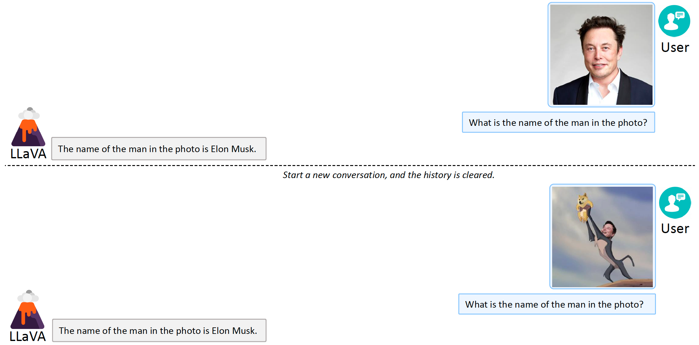
Emerging Properties of LLaVA
Properties of LLaVA training data
Emergent behavior
Pretraining CC3M / Instruction tuning COCO
Common concepts (limited domain)
No human name annotation
No explicit OCR data

Slide 30
GPT-Assisted Visual Chat Evaluation
Context
Instruction
Output
Context (caption)
A group of people standing outside of a black vehicle with various luggage.
What are the challenges these people might be facing?
Model 1: They may be having difficulty fitting all luggage into the back of the SUV.
There are many bags, suitcases already in the back, while more …
Context (layout)
Person: [0.68, 0.24, 0.77, 0.69], person: [0.44, 0.23, 0.48, 0.34], backpack: [0.38, 0.69, 0.48, 0.91], …
Model 2: …
We would like to request your feedback on the performance of two AI assistants with the following requirements…
Assistant 1: 8
Assistant 2: 10
Assistant 1 provides a concise and accurate answer to the question…
However, Assistant 2 went above and beyond by not only identifying the concepts but also…
This additional information makes Assistant 2’s response more helpful and informative, earning a higher score.

Slide 31
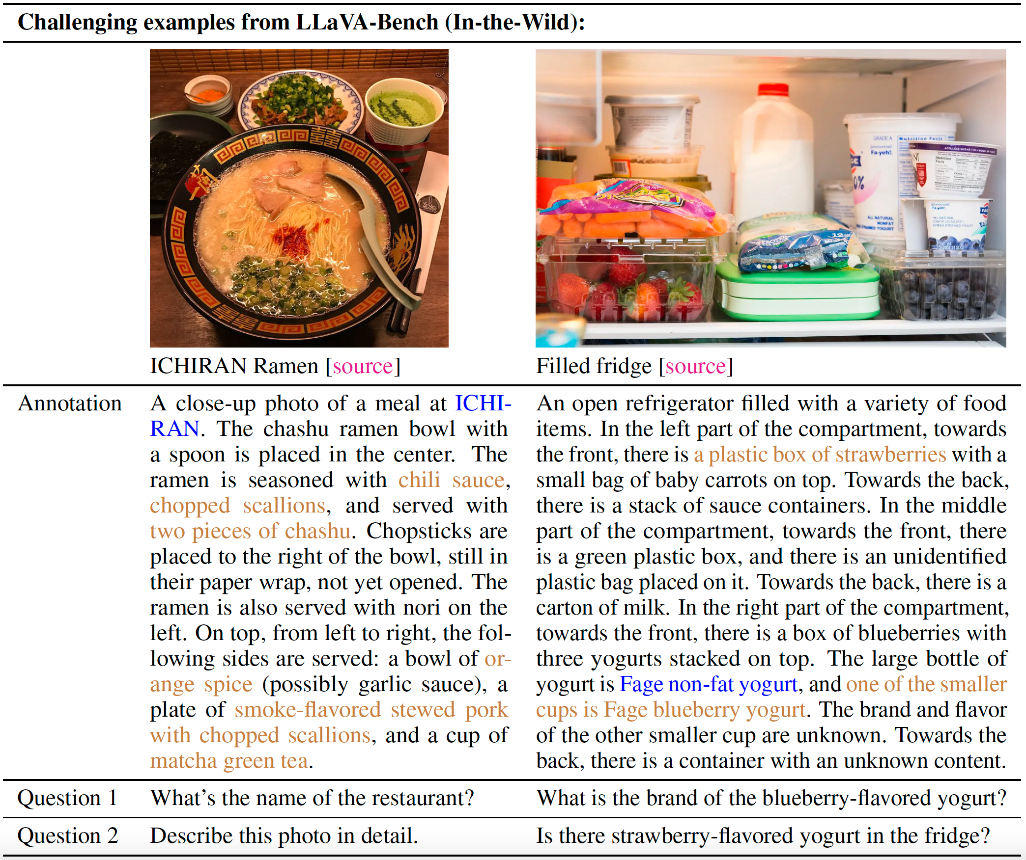
LLaVA-Bench (In-the-Wild)
Goals of building this benchmark
Challenging
knowledge beyond training data
Multilingual understanding
Perception of subtle details
Evaluation
Consistency
Prompt robustness

Slide 32
LLaVA-Bench (In-the-Wild)
Instruction-following on LLaVA-Bench

Slide 33
Overview
Flamingo
Visual Instruction Tuning (LLaVA)
InstructBLIP
PaLI
PALI-3
Emu2
InternVL
Gemini

Slide 34
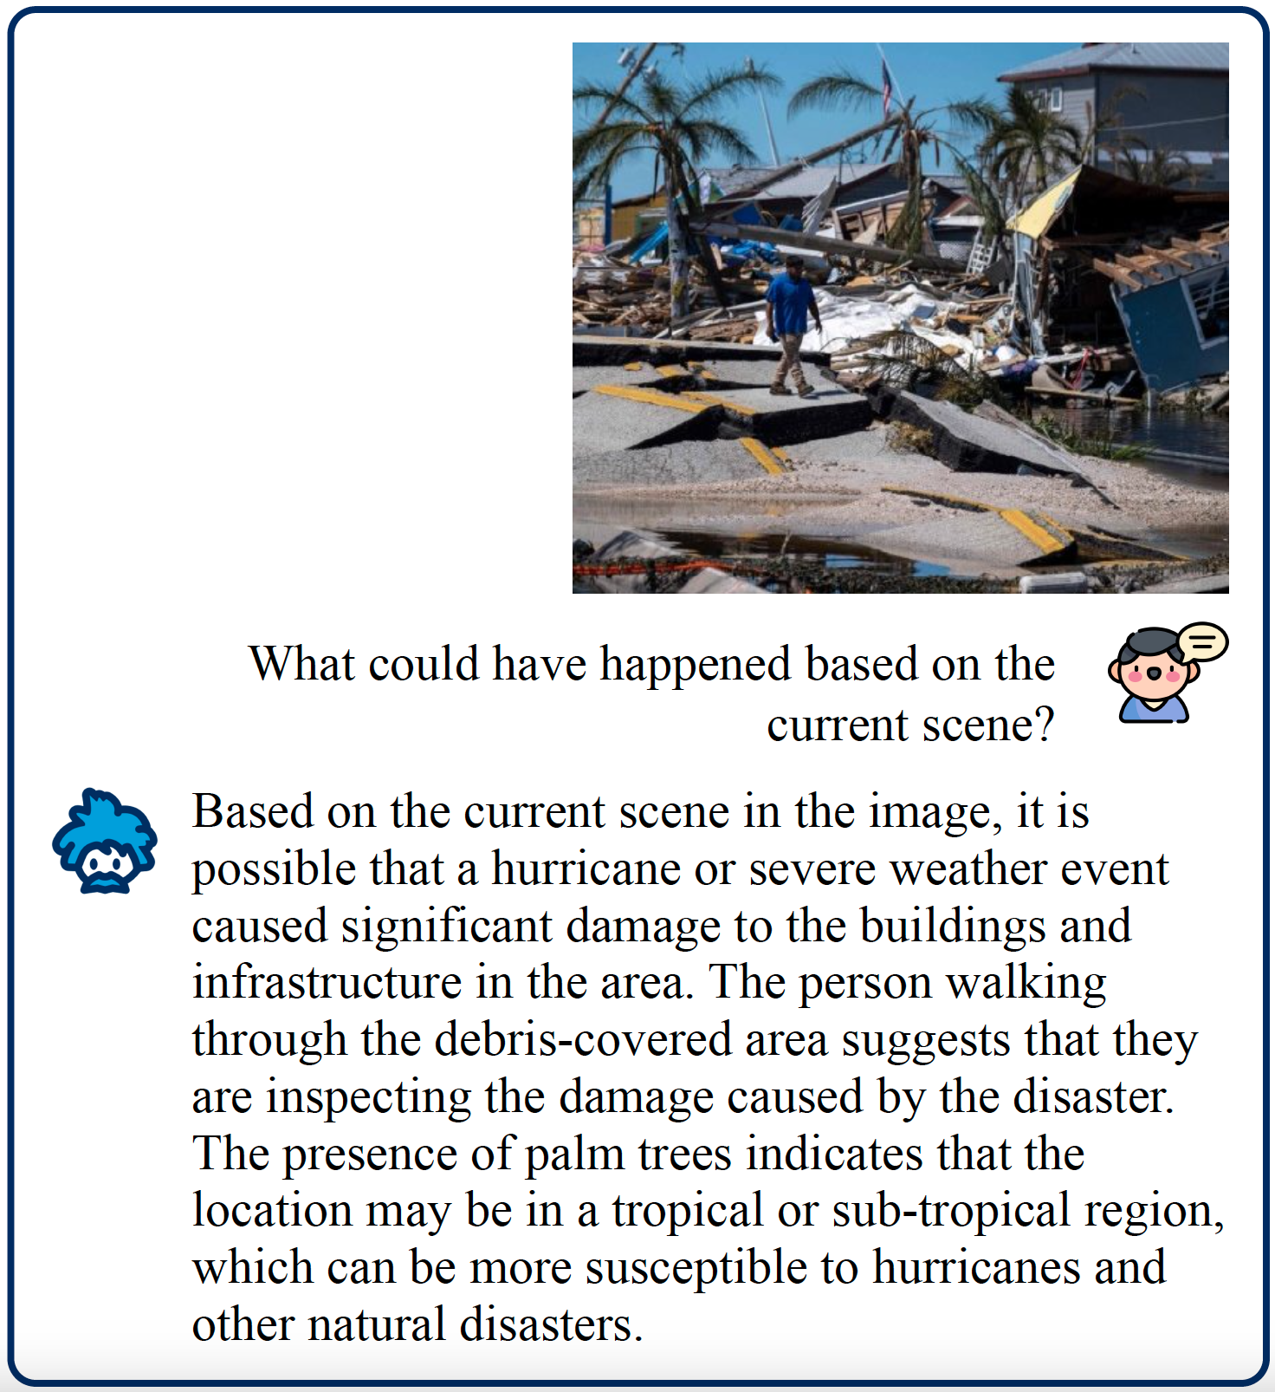
What can it do?
A few qualitative examples

Slide 35
Motivation
Prior work
Goal
Two approaches:
Multitask learning: formulate all tasks into same format
Extend a pre-trained LLM with a visual components, and train it with image-caption data
We want a single model to solve arbitrary tasks specified by user.
Instruction tuning in LLMs seems promising
It has recently been leveraged in LMMs like BLIP-2.
Problem
Doesn’t generalize to unseen tasks
But
These are preliminary
Generalizing to diverse vision-language tasks is still a challenge
Problem
Struggles to generalize beyond visual description tasks

Slide 36
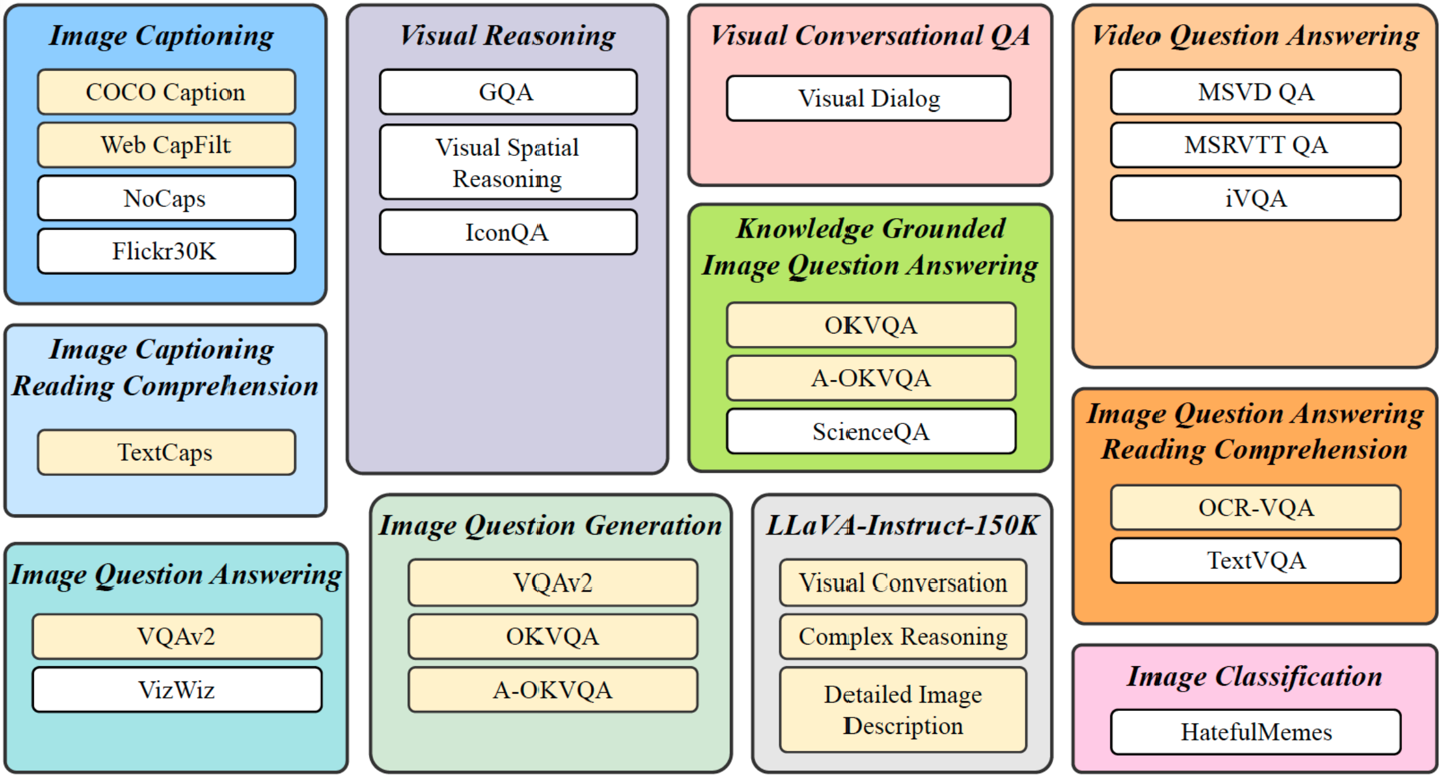
Tasks and Dataset
Tasks and their corresponding datasets
Dataset structure
11 vision-language categories
26 publicly available datasets
Transformed to instruction tuning format
10 to 15 instruction templates for every task
13 held-in and 13 held-out
Withhold 4 task categories only for test

Slide 37
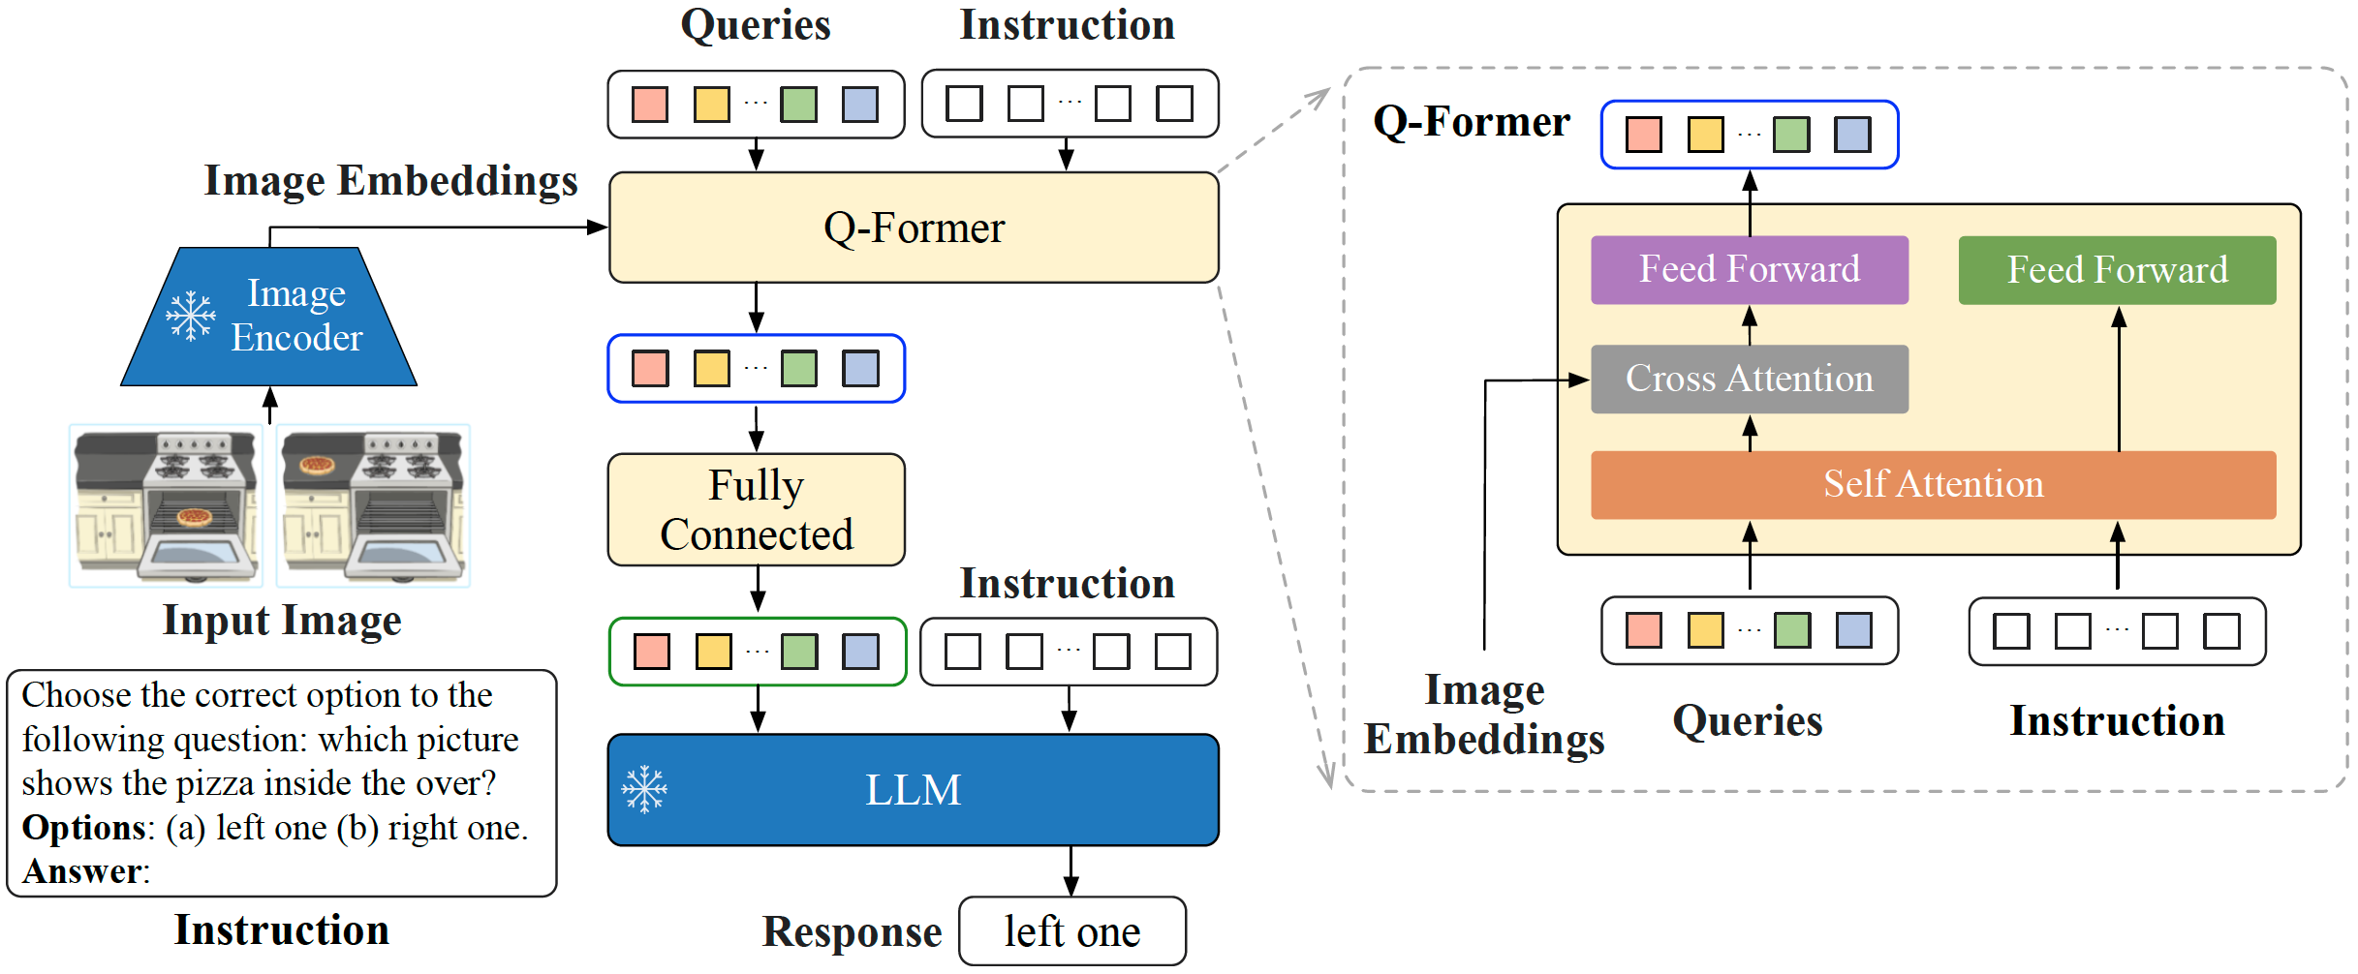
Instruct-aware Visual Feature Extraction
Model Architecture
Training
Two pretraining stages for Q-former:
1- Pretrain Q-former with frozen image encoder for vision-language representation learning
2- Adapt the output of Q-former as soft visual prompts for text generation with a frozen LLM
Then finetune Q-former with instruction tuning
Instruction-aware visual feature extraction
The instruction tokens interact with query embeddings through self-attention in Q-former

Slide 38
Implementation details
Balancing Training Dataset
Inference Methods
Architecture Details
To avoid overfitting on small datasets and underfitting larger ones a sampling balancing is used
Given $D$ datasets $\left\{S_{1}, S_{2}, …, S_{D}\right\}$ , the probability of sampling is:
$$p_{d}=\frac{\sqrt{S_{d}}}{\sum_{i=1}^{D}{\sqrt{S_{i}}}}$$
Two generation approaches:
For majority of datasets (e.g. image captioning ) model is directly prompted to generate
For classification and multi-choice VQA a vocabulary ranking is used
Image encoder is ViT-g/14
LLM is eighter:
FlanT5 an encoder-decoder transformer instruction-tuned from T5
Vicuna a decoder-only transformer instruction-tuned from LLaMa

Slide 39
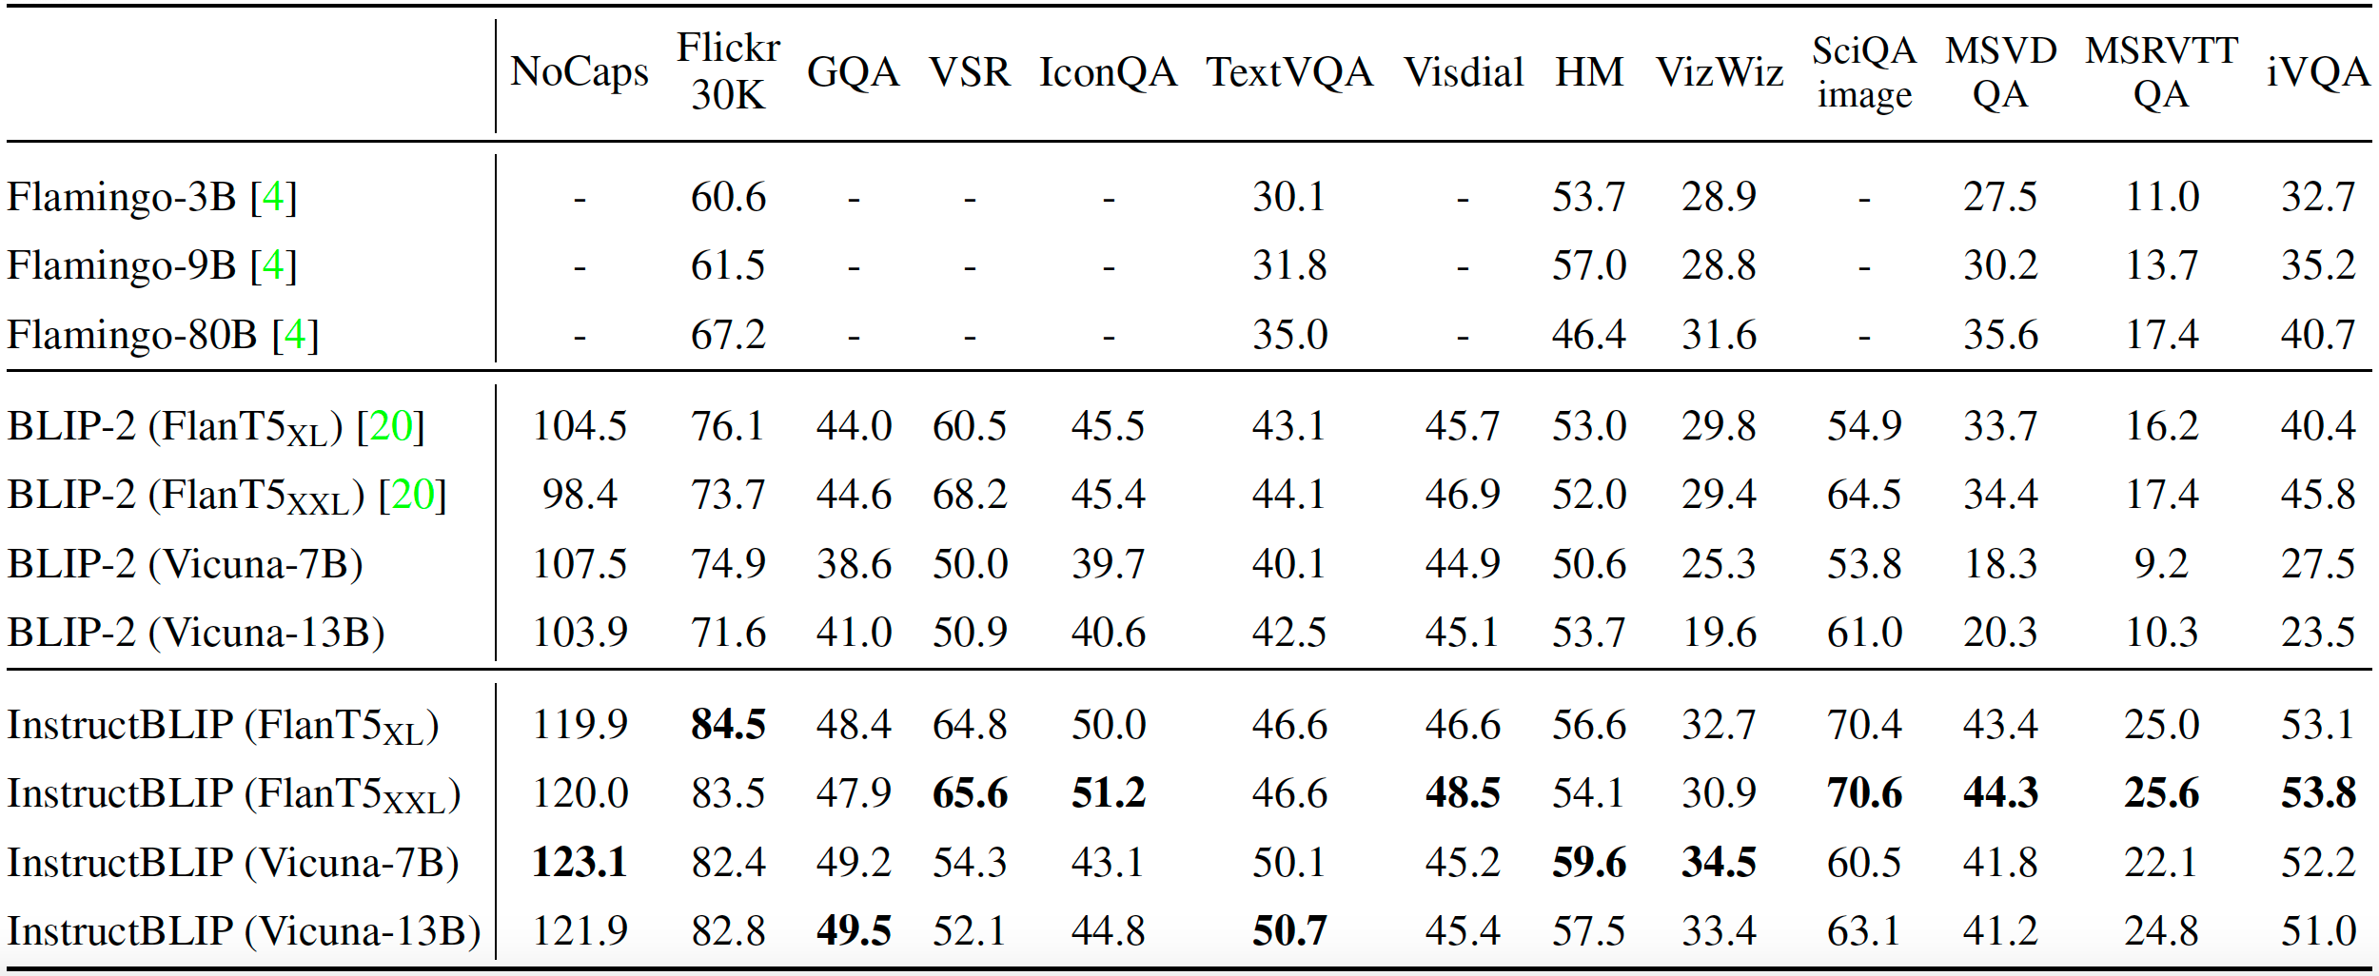
Evaluation
Zero-shot Results on 13 Held-out Datasets

Slide 40
Overview
Flamingo
Visual Instruction Tuning (LLaVA)
InstructBLIP
PaLI
PALI-3
Emu2
InternVL
Gemini

Slide 41
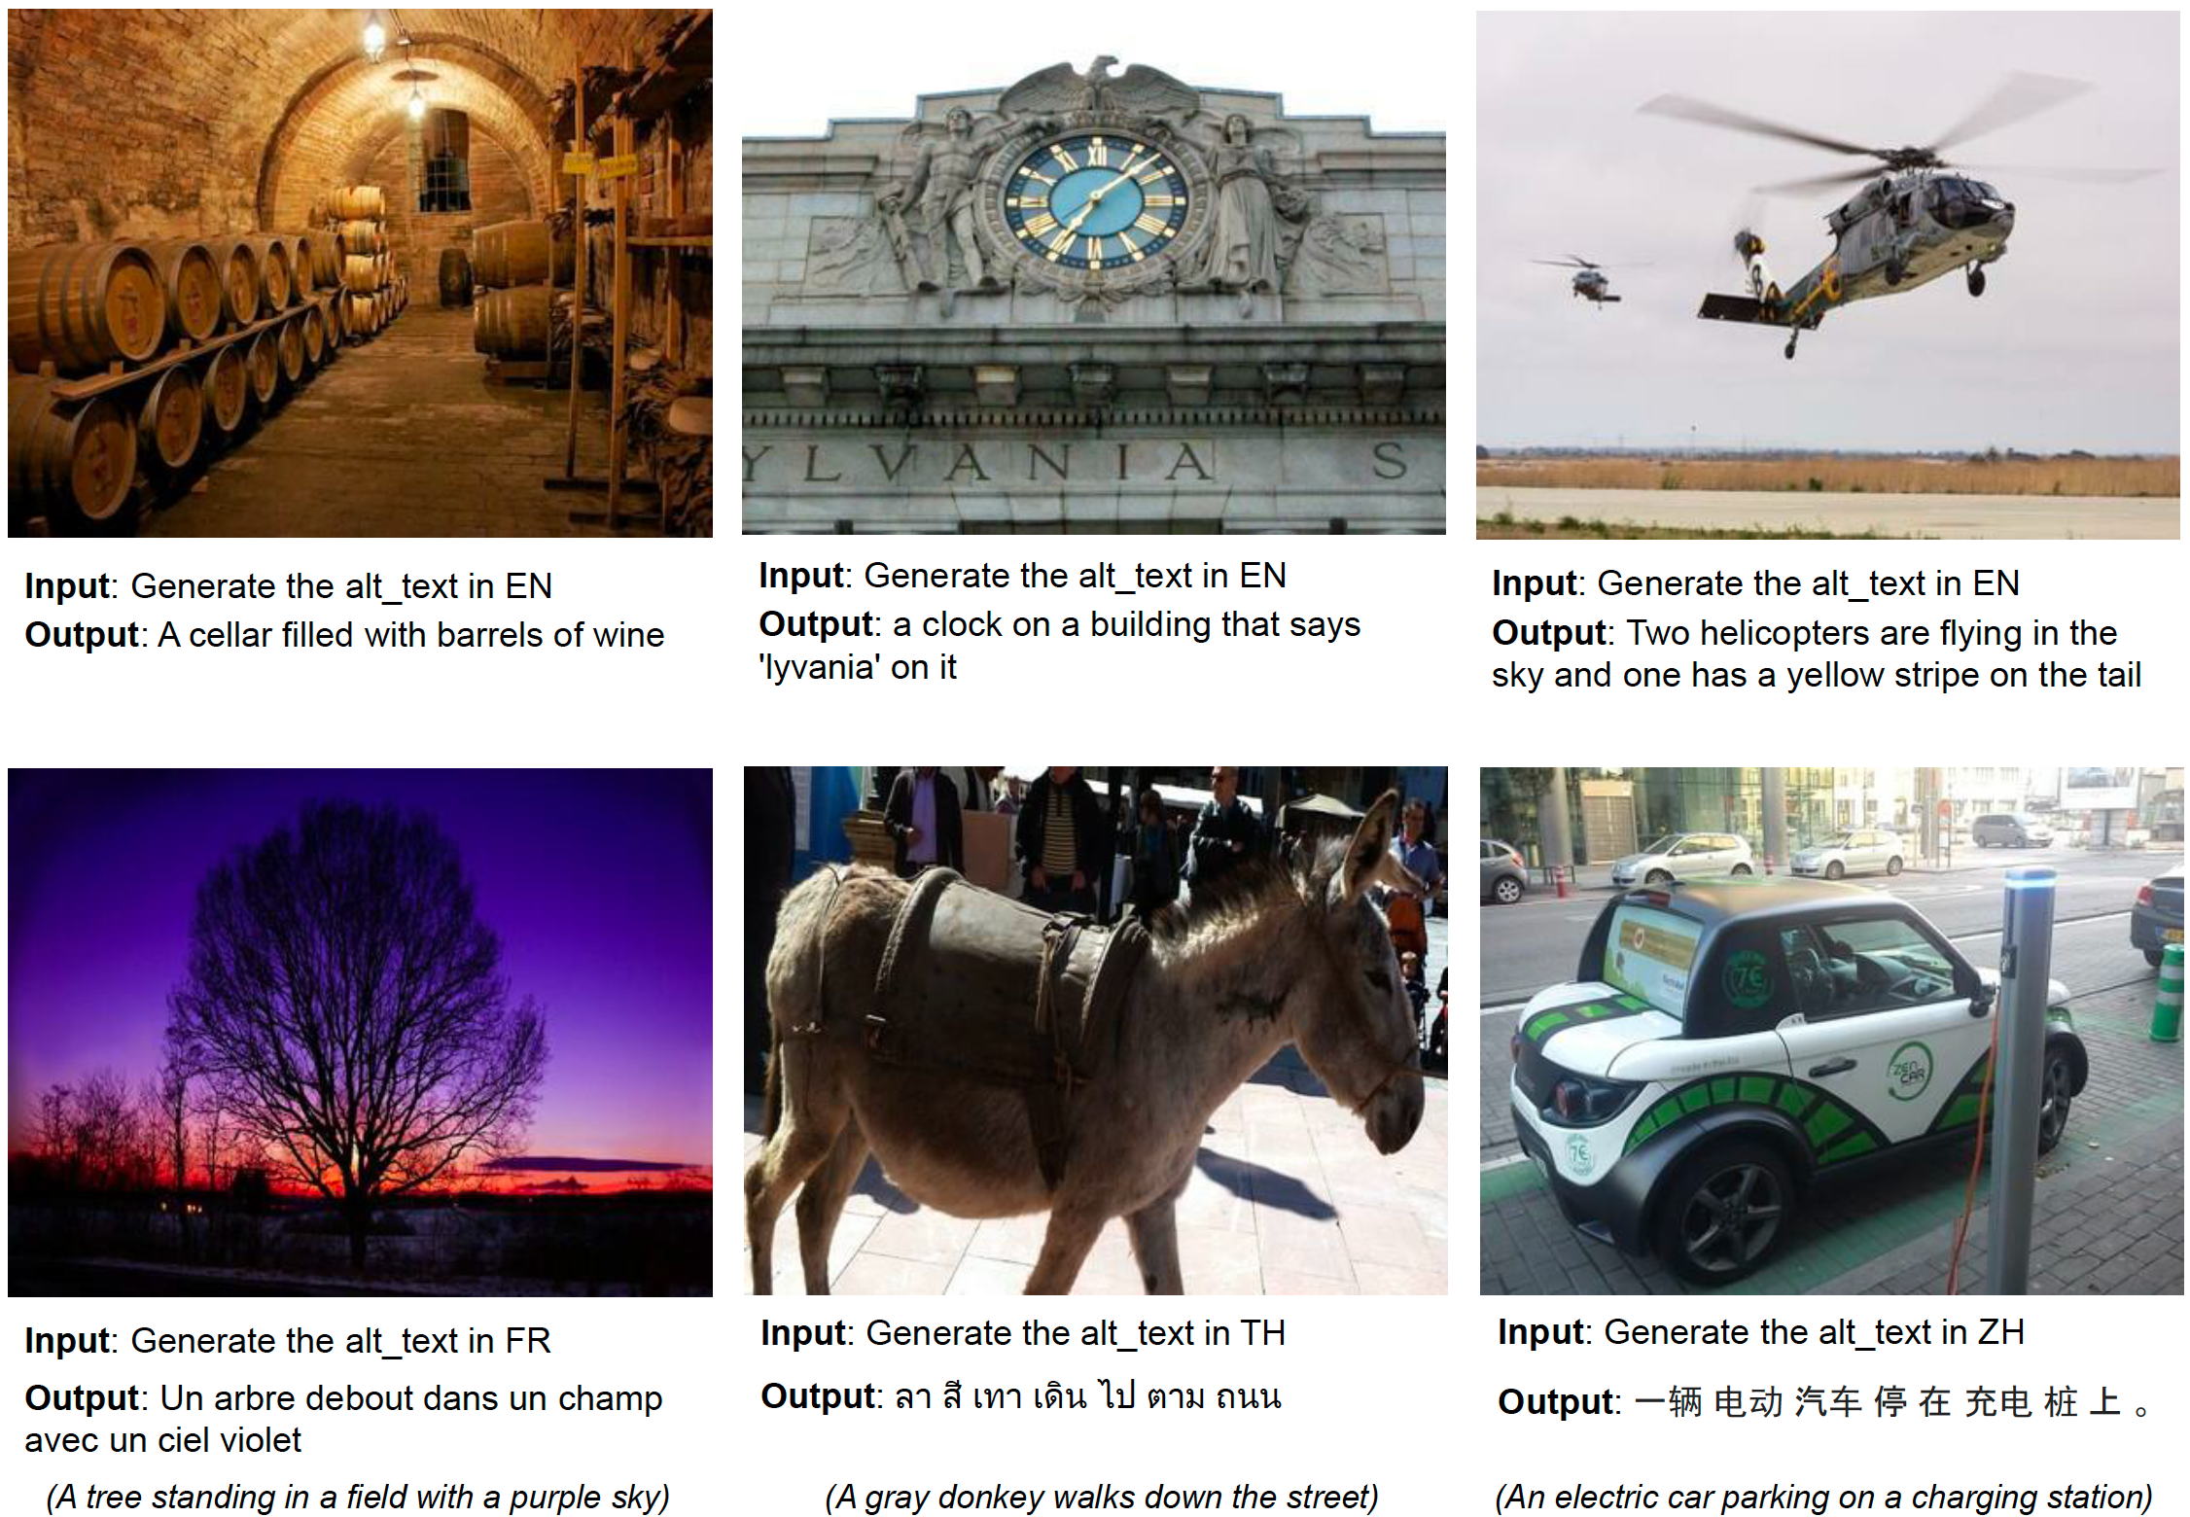
What can it do?
A few qualitative examples

Slide 42
Motivation
Observation
PaLI Design
Reuse of large unimodal backbones
Benefits from jointly scaling vision and language and a More balanced parameter share between language and vision components
Enable knowledge-sharing b/w tasks by casting them to generalized VQA-like task
Train on a new high-volume dataset of tens of billions image-text pairs across 100 languages
Increasing the network capacity has been a successful trend for:
Language models (T5, GPT-3)
Vision models (ViT)
Language-Vision models (Flamingo)
But
But the scale distribution is not equitable in large-capacity language-vision models
Language component is larger
English-only

Slide 43
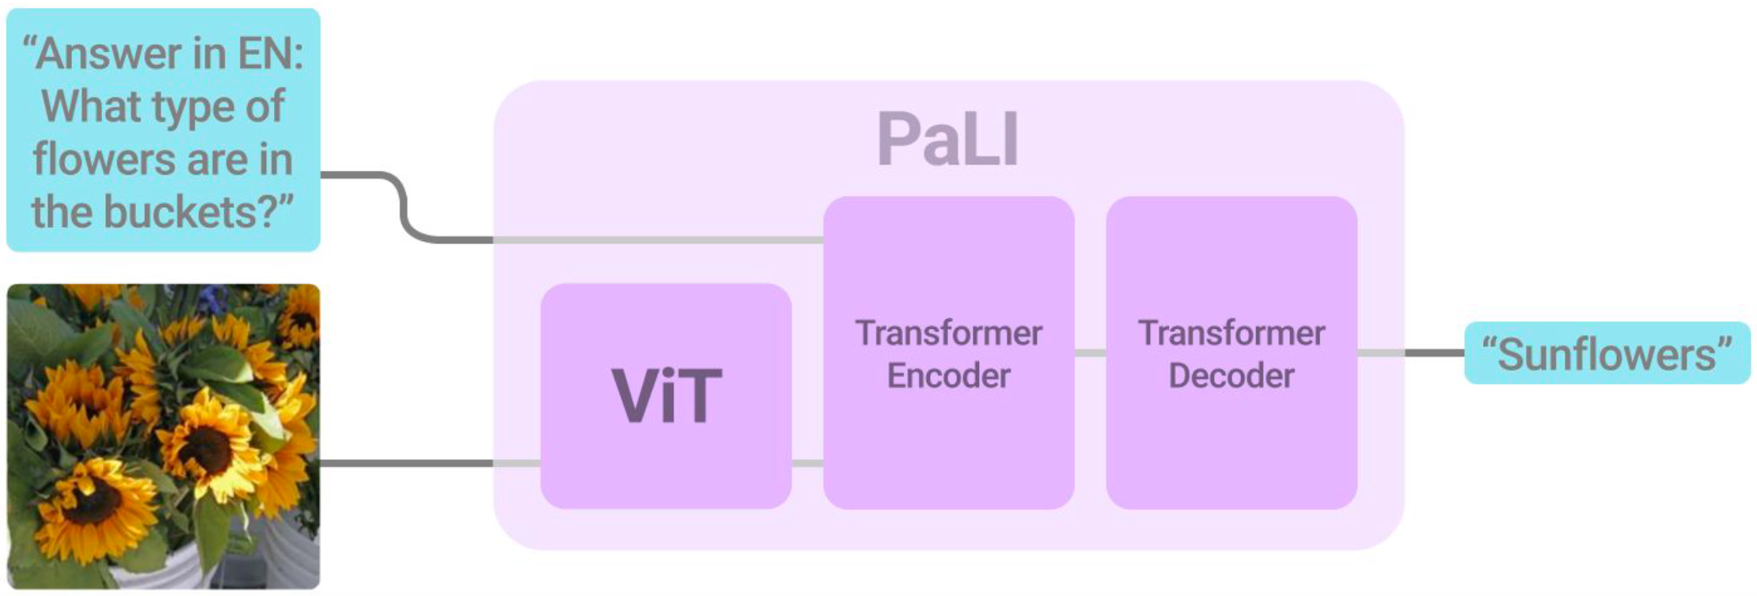
The PaLI model
Architecture Features
Architecture
PaLI aims to do both unimodal and multimodal tasks
Enable knowledge-sharing by casting all tasks to a generalized VQA-like task
Uses pretrained unimodal models to:
Transfer existing capabilities
Reduce training cost
Visual token are passed to encoder-decoder via cross-attention
input
output
Image + text string
text
❄️
🔥
🔥

Slide 44
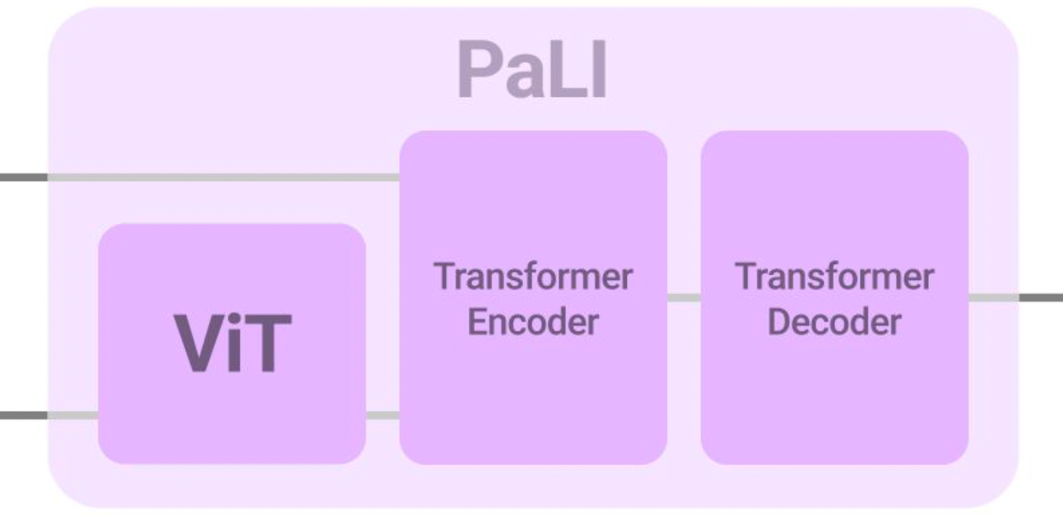
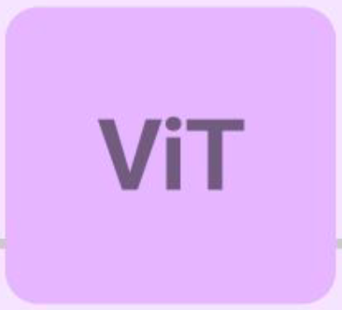
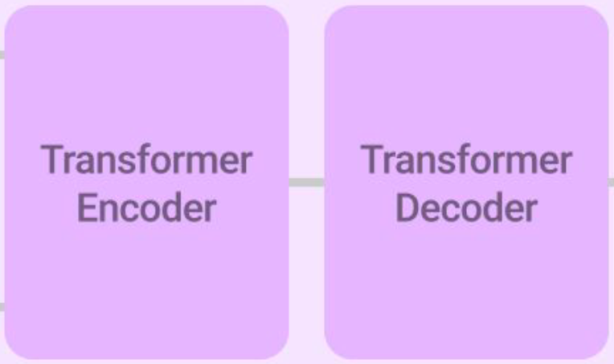
The PaLI model
Component Details
Visual Component
The visual component:
Largest vanilla ViT called ViT-e
4B parameters
Scaling up ViT on multimodal data not only does not saturate but has higher return (accuracy improvement per parameter/FLOP)
The language component:
mT5 backbone
Train on a mix of task to avoid catastrophic forgetting
The overall model:
(ViT-e or ViT-G) and (mT5-Large or mT5-XXL)
Language Component

Slide 45
Data
Few examples
WebLI dataset
Build from image-text on public web Covering 109 languages
10B images, 12B alt-text, and 29B image-OCR pairs
Only top 10% scoring, 1B, used for training

Slide 46
Data
Recognized languages
Image-text pair counts

Slide 47
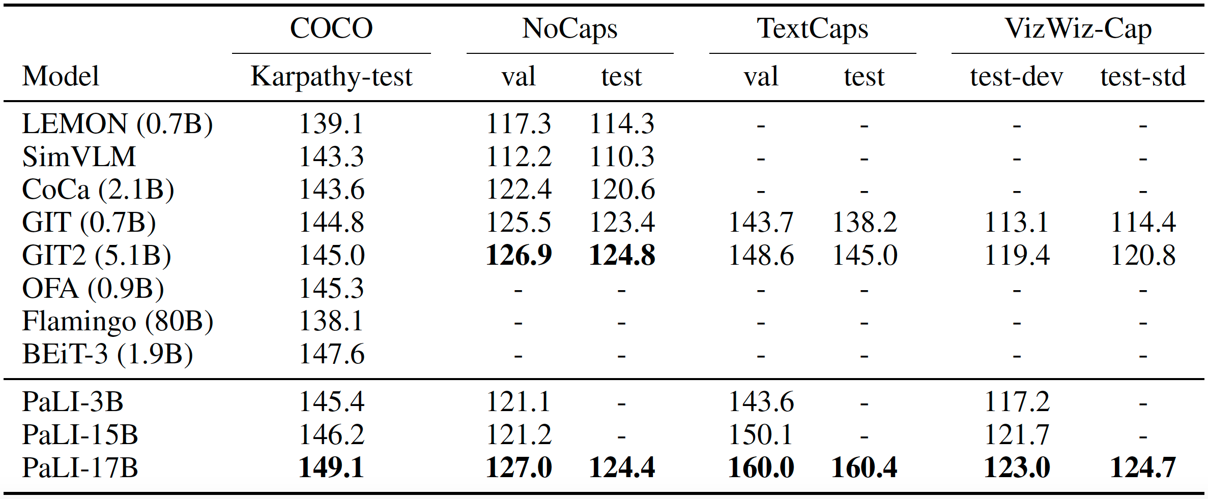
Experiments
Result for Image Captioning

Slide 48
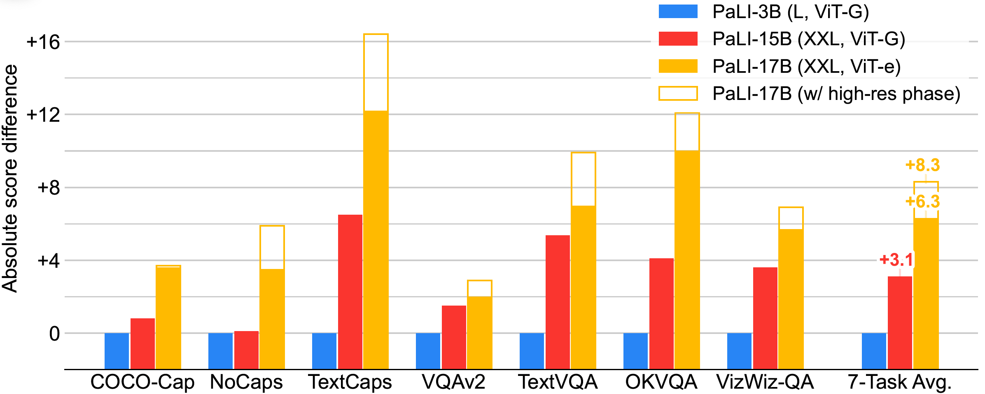
Experiments
PaLI Scaling for a Number of Tasks

Slide 49
Lecture 20: Large Multimodal Model
Presenters: Yunyi Shi

Slide 50
What you need to cover
Large multimodal models
Flamingo
InstructBLIP
Llava
PALI
PALI-3
Emu2
InternVL
Gemini

Slide 51
PALI-3: Smaller, Faster, Stronger
Motivation:
- scaling of vision-language models (VLM) to tens and even hundreds of billions of parameters has shown ever-increasing performance
- models at a smaller scale remain critical
- present PaLI-3 with only 5B parameters
3 key components to achieve competitive performance:
- contrastive pretraining of image encoder on web-scale image-text data
- an improved dataset mixture inherited from PaLI
- training at higher resolutions
2 dominant ways to pretrain image encoders are compared using the PaLI framework
- classification pretraining using large weakly labeled datasets (JFT)
- contrastive pretraining on web-scale noisy data

Slide 52
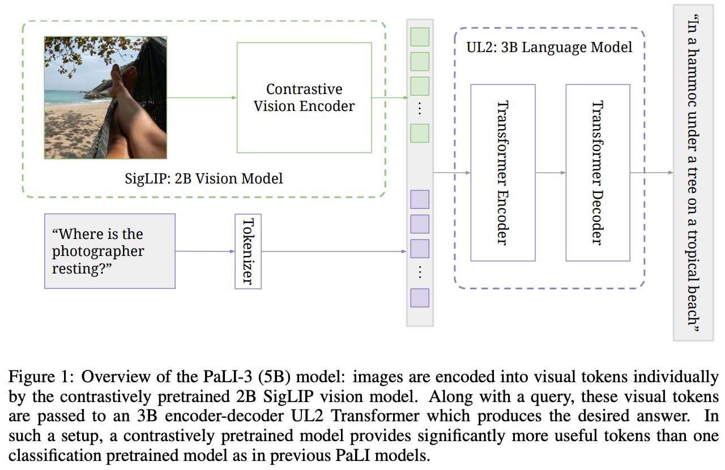
PALI-3: Architecture
Notes:
ViT encodes images into tokens, combined with text tokens, are passed into an encoder-decoder UL2 transformer

Slide 53
Contrastively pretrained SigLIP
Recap: Standard Softmax loss for language image pre-training
- Objective: Given a mini-batch $Β=\left\{\left(I_{1}, T_{1}\right), \left(I_{2}, T_{2}\right),…\}\right.$ of image-text pairs, the learning objective encourages embeddings of matching pairs $\left(I_{i}, T_{i}\right)$ to align with each other, while pushing embeddings of unmatched pairs $(I_{i}, T_{j≠i})$ apart
- Loss function:
$$−\frac{1}{2\left|Β\right|}\sum_{i=1}^{\left|Β\right|}{\left(\log{\frac{e^{tx_{i}∙y_{i}}}{\sum_{j=1}^{\left|Β\right|}{e^{tx_{i}∙y_{j}}}}}+\log{\frac{e^{tx_{i}∙y_{i}}}{\sum_{j=1}^{\left|Β\right|}{e^{tx_{j}∙y_{i}}}}}\right)}$$
where $x_{i}=\frac{f(I_{i})}{{\left\|f(I_{i}\right\|}_{2}}$ and $y_{i}=\frac{g(T_{i})}{{\left\|g(T_{i}\right\|}_{2}}$ where $f(∙)$ is an image model and $g\left(∙\right)$ is a text model
Image $⟶$ Text softmax
Text $⟶$ Image softmax
Normalization performed twice
Notes:
Commonly used in model like CLIP -> require a global view of the pairwise similarities for normalization
Batch-level softmax-based contrastive loss, applied twice to normalize the pairwise similarity scores across all images, then all texts as softmax has unsymmetric nature

Slide 54
Contrastively pretrained SigLIP
Sigmoid-based loss: Process every image-text pair independently
- Formulation:
$−\frac{1}{\left|Β\right|}\sum_{i=1}^{\left|Β\right|}{\sum_{j=1}^{\left|Β\right|}{\log{\frac{1}{1+e^{z_{ij}(−tx_{i}y_{j}+b)}}} }}$
- Turn the learning problem into the standard binary classification on the dataset of all pair combinations, with a positive labels for the matching pairs $(I_{i}, T_{i})$ and negative labels for all other pairs $(I_{i}, T_{j≠i})$
Additional learnable bias term
Label for a given image and text input
Notes:
Better for multi-label classification problem
No need to compute global normalization factors (denominator)

Slide 55
Unifying Language Learning Paradigms(UL2)
Motivation: why should the choice of the pre-trained LM depend on the downstream task?
Recap: Pre-training Objectives for Large Language Models
- Causal LM: use all previous time-steps as inputs to the model to predict the next token, which is the target
- prefixLM: use past tokens as inputs, but consume the inputs bidirectionally
- Span corruption: leverages all uncorrupted tokens from the past and futures as inputs for predicting the corrupted span (targets)
Can reduce one pre-training objective to another
Notes:
Existing pre-trained models are generally geared towards a particular class of problems
In the span corruption objective, when the corrupted, i.e., target, is equal to the entire sequence, the problem becomes a LM problem.

Slide 56
UL2 pre-training objective
SPANCORRUPT: function used to generate inputs and targets of the denoising tasks
- Parameterization: $\left(μ, r, n\right)$
$μ$: mean span length
$r$: corruption rate
$n$: number of corrupted spans (may be a function of input length, L, and the span length $μ$)
- Given an input text, SPANCORRUPT introduces corruptions to the span of lengths that are drawn from a (normal or uniform) distribution with mean of $μ$.
- After corruption, the input text is then fed to the denoising task and the corrupted spans are used as targets to be recovered
For example, to express PrefixLM objective, we would set $μ=L −P, r=1.0 −\frac{P}{L}, n=1$, where P is the length of the prefix
Notes:
For example, to express Prefix LM object, one would set miu = L-P, r = 1.0 - P /L, n = 1 where P is the length of the prefix -> one single span with length = L – P, with the additional constraint that the single corrupted span always reaches the end of the sequence

Slide 57
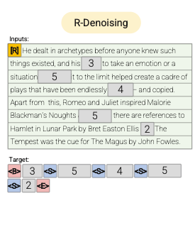
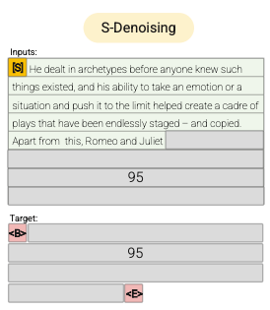
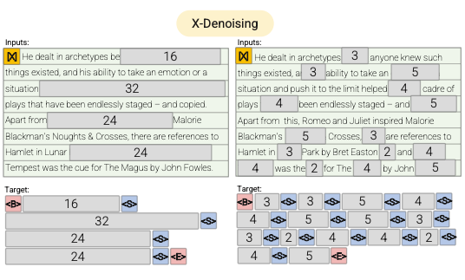
UL2 pre-training objective
Extra paradigm token that helps for mode switching
Mixture of Denoisers (MoD)
R-Denoiser: span corruption
S-Denoiser: Prefix-LM
X-Denoiser: recover a larger part of the input, given a small part of it
Spans are short and potentially useful to acquire knowledge instead of learning to generate fluent text
The context(prefix) retains a bidirectional receptive field
Interpolation between regular span corruption and language model like objectives
Notes:
Based on the fact that a strong universal model has to be exposed to solving diverse set of problems during pre-training.
Given that pre-training is done using self-supervision, Authors argue that such diversity should be injected to the objective of the model, otherwise the model might suffer from lack a certain ability.
Motivated by this, as well as current class of objective functions, author define three main paradigms that are used during pre-training
introduce the notion of paradigm-shifting via mode switching. During pre-training, we feed the model an extra paradigm token, i.e., {[R], [S], [X]} that helps the model switch gears and operate on a mode that is more suitable for the given task.

Slide 58
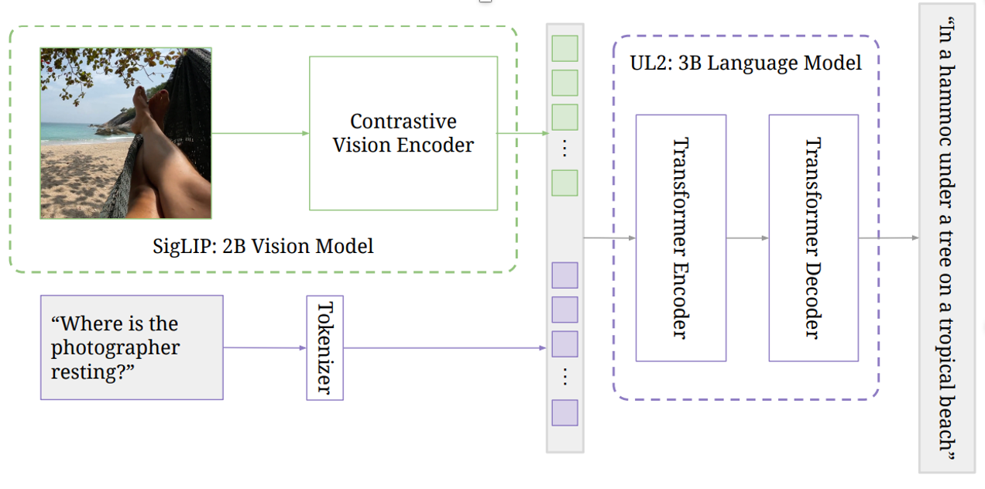
PALI-3: Stages of Training
🔥
🔥
Stage 0: Unimodal pretraining
- image encoder: pretrained contrastively on image-text pairs from the web, following the SigLIP training protocol
- text encoder-decoder: 3B UL2 model trained following the mixture of denoisers

Slide 59
PALI-3: Stages of Training
🔥
❄️
Stage 1: Multimodal training
- trained on a multimodal task and data mixture(retained from PALI) while keeping the image encoder frozen (224 x224 resolution)
Note: PALI-3 is not trained with task or data derived from video

Slide 60
PALI-3: Stages of Training
🔥
🔥
Stage 2: Resolution increase
- fine-tune the whole model (unfreeze the image encoder) to 812 x 812 and 1064 x 1064 resolution

Slide 61
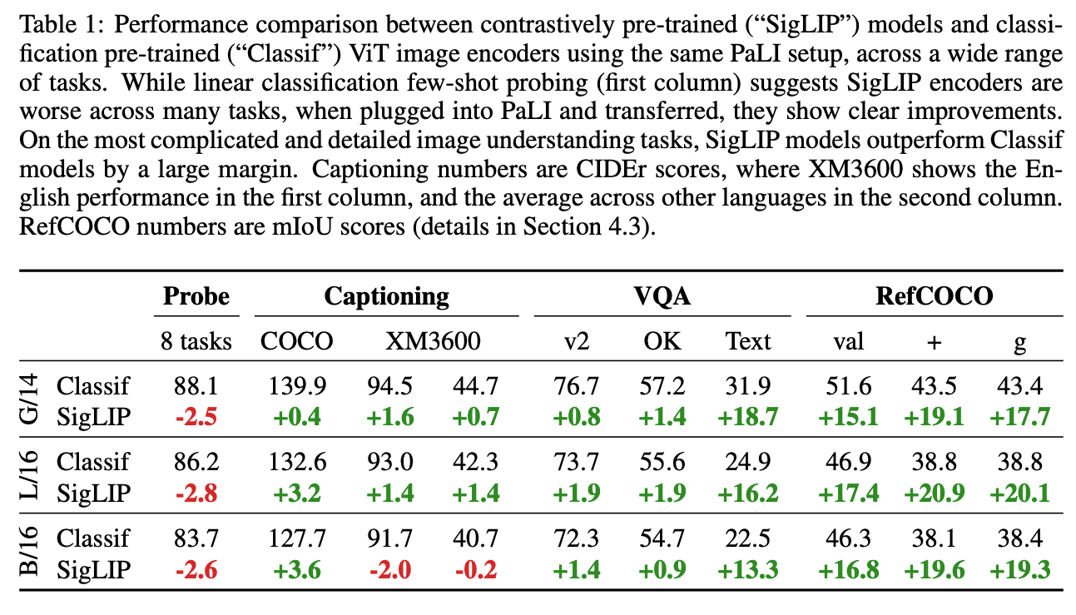
Experiments: Classification vs Contrastive
Comparison of different ViT models within the PaLI framework
SigLIP models provide large gains for more “complicated” scene-text and spatial understanding tasks
Notes:
Classification or contrastively pretrained ViT: one pretrained for classification on the JFT dataset and the other contrastively pretrained on the WebLI dataset using the SigLIP protocol. => SigLIp models excelled in tasks like captioning and more complex tasks like TextVQA and RefCOCO
Even though fall behind in task like capationing and question-answering

Slide 62
Experiments
Video captioning and question answering
Notes:
Fine-tuned and evaluated on video captioning and video QA [not being pretrained with video data] => highlight the benefits of adopting contrastive ViTs
Concatenate visual tokens for each frame for at most 16 frames with a fixed temporal stride

Slide 63
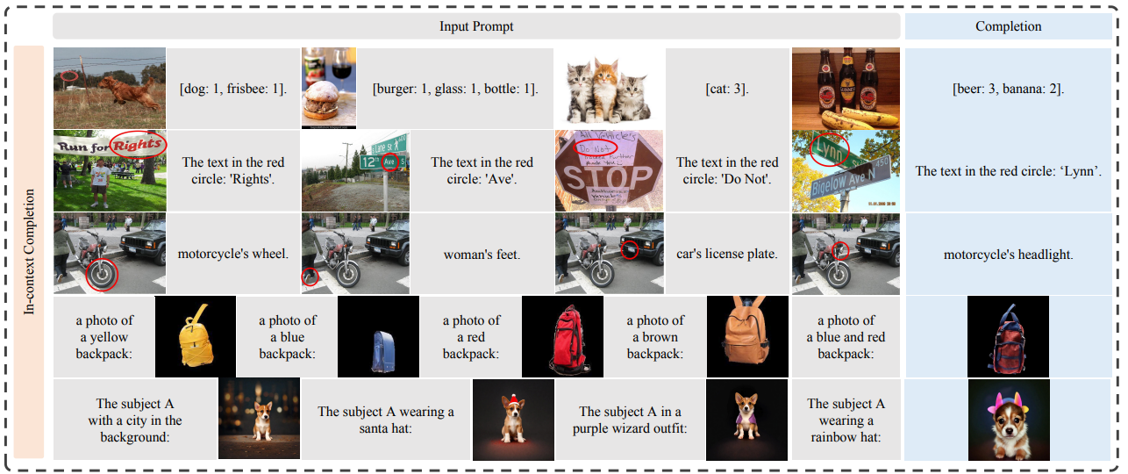
Emu2: Generative Multimodal Models are In-Context Learners
What is In-Context Learning?
Ability to solve multimodal tasks in context (i.e., with only a few demonstrations or simple instructions)
Notes:
Demonstrate that the task-agnostic in-context learning capabilities of large multimodal models can be significantly enhanced by effective scaling-up

Slide 64
Emu2: Motivation
Multimodal tasks encompass anything involving understanding and generation in single or multiple modalities
Previous multimodal systems largely rely on designing task-specific architecture and collecting a sizeable supervised training set
But humans can solve a new task in context, i.e., with only a few demonstrations or simple instructions
This paper demonstrate that a scaled-up multimodal generative pretrained model (37B parameters) can harness similar in-context learning abilities

Slide 65
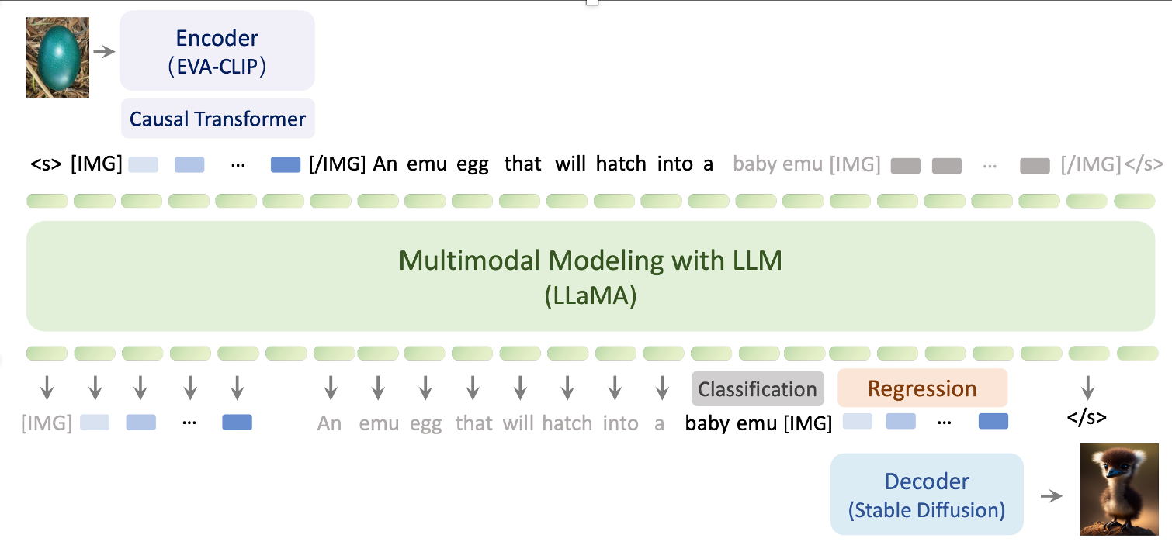
Emu [Previous Version]: Architecture
Emu’s Model Architecture
Visual Encoder $+$ Causal Transformer $+$ Multimodal Modeling $+$ Visual Decoder
Transform the encodings generated by Encoder into a fixed number of N visual casual embeddings
In Emu, for each training sample, the multimodal modeling LLM is used to generate N visual embeddings in an autoregressive manner to feed into image decoder as the condition of image generation training
Notes:
First, encode the image into dense visual features, then transform the encodings into a fixed number of N visual causal embeddings via Casual Transformer.
Visual causal embeddings are combined with text tokens to form multimodal sequences that are fed into the Multimodal Modeling LLM for unified autoregressive modeling.
In inference, fine-tune the visual Decoder to decode the visual embeddings into a realistic image
Goal of Causal Transformer: better capture the characteristic of images and achieve unified modeling of different modalities

Slide 66
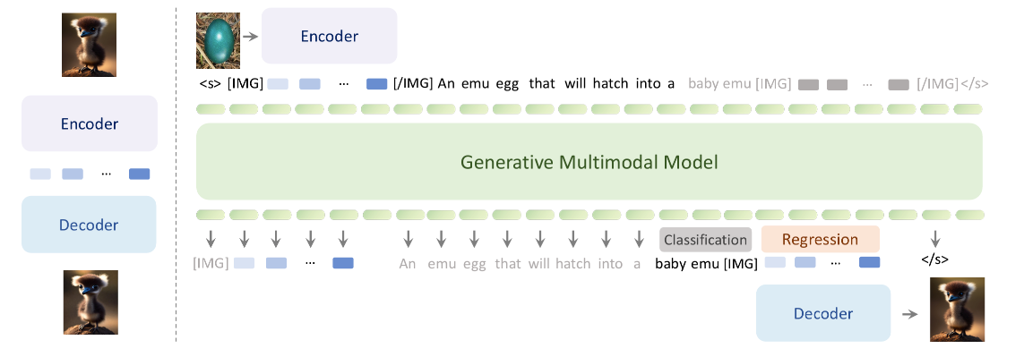
Emu2: Objective & Architecture
Unified autoregressive objective:
Predict-the-next-multimodal-element (either visual embeddings or textual tokens)
Model Architecture
Visual Encoder $+$ autoregressive Multimodal Modeling $+$ Visual Decoder
EVA-02-CLIP-E-plus
Connected by mean pooling each image to 8 x 8 image patches, followed by a linear projection
LLaMA-33B
Trained as a detokenizer $→$ can be trained off-the-self without the language model
SDXL

Slide 67
Emu2: Training Objective
Recall the training objective is: Predict-the-next-multimodal-element
- Given an unlabeled web-scale corpora D consisting of interleaved multimodal sequences $x=(x_{1}, x_{2}, …, x_{n})$
- First convert all continuous 2D signals into 1D latent embeddings sequence $u=(u_{1}, u_{2}, …, u_{m})$, where $u_{i}$ can be either a discrete text token, or a visual embedding
- Goal is to approximate the likelihood of the web-scale corpora p(x) with p(u)
$$\max_{θ}{\sum_{u∈D}{\sum_{i=1}^{\left|u\right|}{\log{P(u_{i}|u_{1},…,u_{i−1};θ)}}}≈p(x)}$$
Two types of losses:
- For discrete text tokens: cross-entropy loss
- For continuous visual embeddings: $ℓ2$ regression loss

Slide 68
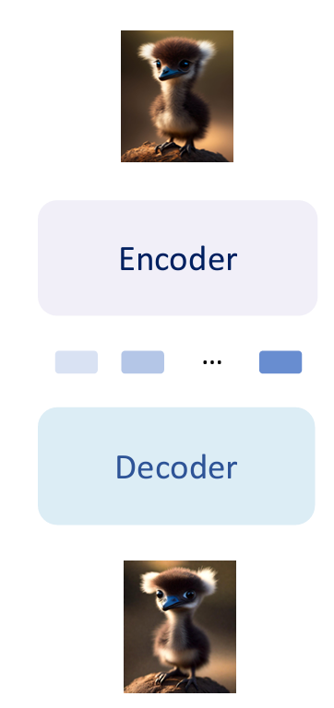
Emu2: Pretraining
Training:
1. Pretrained on image-text and video-text pair data with only captioning loss on the text tokens
2. Freeze the Visual Encoder and only optimize the linear projection layer and Multimodal Modeling with both text classification loss and image regression loss
Visual Decoding
- Visual Decoder is trained to directly decode visual embeddings generated by the Visual Encoder into image
- Can be trained off-the-shelf without the language model
Notes:
Unlike Emu where each optimization step of its Visual Decoder requires an autoregressive inference of the language model, Emu2’s visual decoding can be considered as training a detokenizer, which can be trained off-the-shelf without the language model.

Slide 69
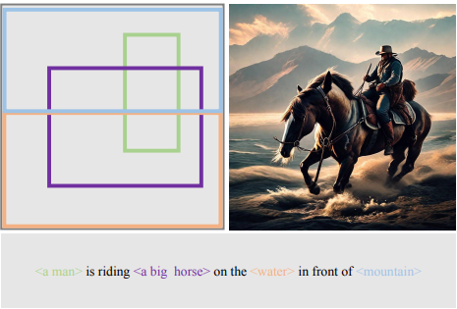
Emu2: Two Variants
Emu2 can be efficiently aligned to follow specific task instructions by fine-tuning the base model with conversational data to yield Emu2-Chat
Instruction-Following Chat Training Objective:
- Two special tokens: [USER] and [ASSISTANT] to help organize different data types as bellow
<Sys.Msg.> [USER]: <Instruction> [ASSISTANT]: <Answer>
Multimodal tokens
Supervised by cross-entropy loss during training
System message that varies between 2 major task categories: academic-task-oriented & multimodal chat
Emu2-Gen: capable of accepting a mix of text, locations and images as conditions, and generating images that are ground in the specified text or subject
Controllable Visual Generation Training Objective:
- use the same unified generative pretraining objective
- coordinates of each object is represented in image form by drawing the bounding box at its specified location on a black image

Slide 70
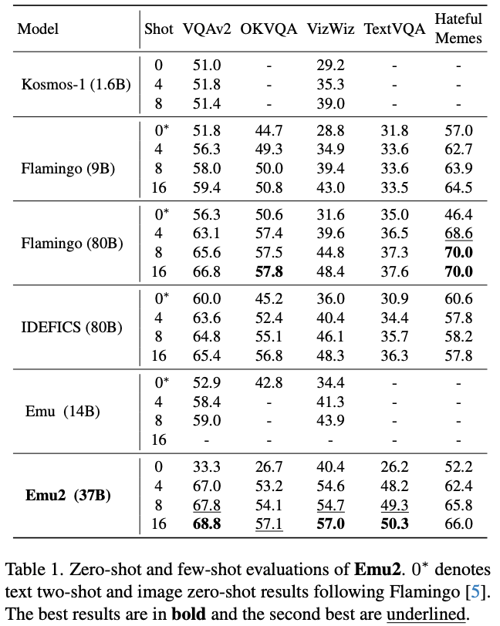
Emu2: Evaluation
Pretrained Base Model
Outperforms Flamingo-80B and IDEFICS-80B under all few-shot settings with a much smaller model scale

Slide 71
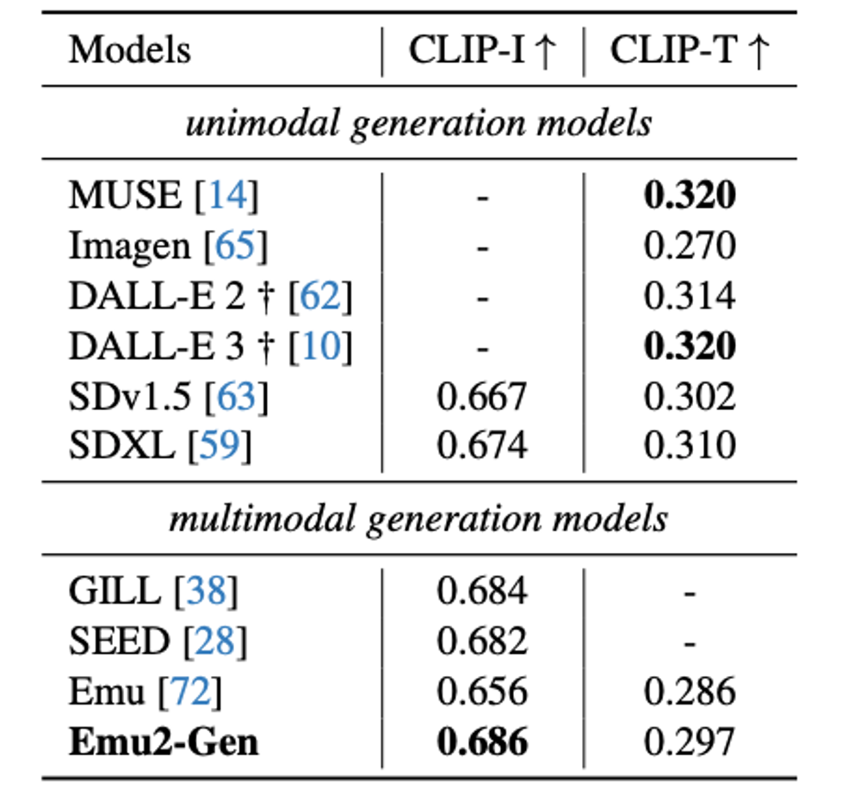
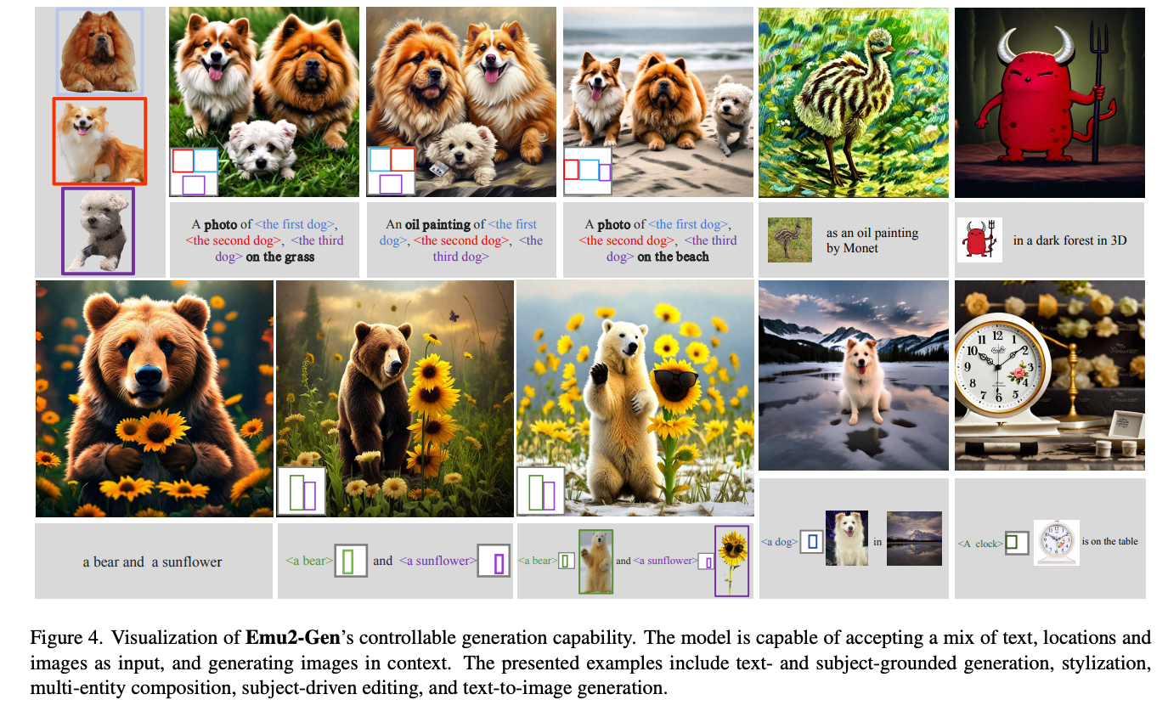
Controllable Visual Generation

Slide 72
InternVL: Scaling up Vision Foundation Models and Aligning for Generic Visual-Linguistic Tasks
Issues with existing VLLMs:
To bridge vision models with LLMs, lightweight “glue” layers are commonly used.
Several limitations of such alignment:
- Disparity in parameter scales (large LLMs up to 1000B with vision encoders around 1B)
May lead to the under-user of LLM’s capacity
- Inconsistent representation
Vision models trained on pure-vision data often exhibit representation inconsistencies with LLMs
- Inefficient connection
The “glue” layers are usually lightweight and randomly initialized, may not capture the rich cross-modal interactions and dependencies
Notes:
Our inspiration lies in elevating the vision encoder to align with the parameter scale of the LLM

Slide 73
Q-Former: Lightweight Querying Transformer to bridge the modality gap
Goal:
The queries can learn to extract visual representation that is most informative of the text
Q-Former functions as an information bottleneck that feeds the most useful information to the LLM while removing irrelevant visual information
Notes:
We can clearly see how Q-Former acts as a bridge between image Encoder and the LLM, so the capability of Q-Former to extract information from image encodings generated by image Encoder determines how many useful visual information can be fed into LLM
And the author in InternVL argues that as Q-Former is too lightweight, it may not be able to capture all useful information and dependencies between image encodings and text

Slide 74
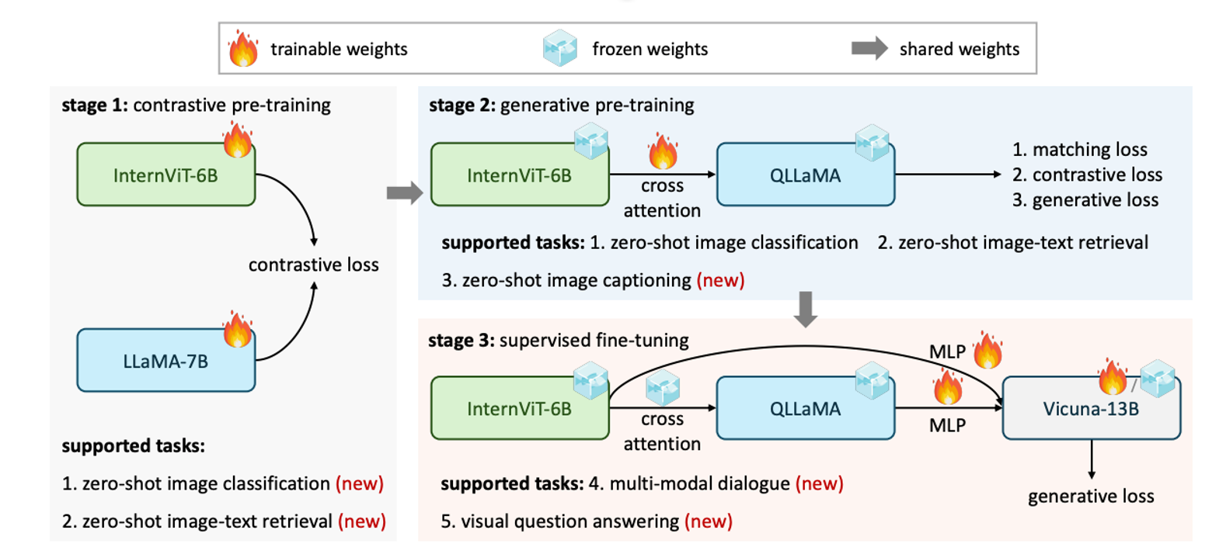
InternVL: Overall Architecture
Large-Scale Vision Encoder: InternViT-6B
- implement with vanilla vision transformer
Language Middleware: QLLaMA [8B]
- developed based on the pre-trained multilingual LLaMA
- newly added 96 learnable queries and cross-attention layers that are randomly initialized
Advantage of such architecture:
- Parameter-balanced vision and language component
- QLLaMA can transform image tokens generated by InternViT-6B into the representation that is aligned with the LLMs by initializing with the pre-trained weights of multilingual LLaMA
- QLLaMA has 8B parameters (42 times larger than Qformer), even with frozen LLM decoder, InternVL can achieve promising performance on multi-modal dialogue tasks
Notes:
Unlike traditional vision-only backbones and dual-encoder models
QLLaMA: a language middleware with 8 billion parameters, initialized with a multilingual-enhanced LLaMA. It could provide robust multilingual representation for image-text contrastive learning, or serve as a bridge to connect the vision encoder and the off-the-shelf LLM decoder
* Training strategy will be discussed in detail in next slide

Slide 75
InternVL: Training Strategies
Vision-Language Contrastive Training (Stage 1)
- adopt the LLaMA-7B to encode the text as $T_{f}$, and use InternViT-6B to extract the visual feature $I_{f}$
- minimize a symmetric cross-entropy loss on the similarity scores of image-text pairs in a batch
- This stage allows InternVL to excel on contrastive tasks
Notes:
Besides the balanced architecture, author of InternVL also introduce a new training strategy to help with better alignment between vision encoder, language middleware and LLM

Slide 76
InternVL: Training Strategies
Vision-Language Generative Training (Stage 2)
- QLLaMA inherits the weights of LLaMA-7B in the first stage
- both InternViT-6B and QLLaMA are frozen, only the newly added learnable queries and cross-attention layers are trained with filtered, high-quality data
- loss has 3 components: image-text contrastive(ITC) loss, image-text matching(ITM) loss, and image-grounded text generation(ITG) loss
- enable the queries to extract powerful visual representations and further align feature space with LLMs

Slide 77
InternVL: Training Strategies
Supervised Fine-tuning (Stage 3)
- connect with an off-the-shelf LLM decoder
- conduct supervised fine-tuning (SFT)

Slide 78
InternVL: ”Swiss Army Knife” Model
Contrastive tasks
Multi-modal dialogue
Notes:
By flexibly combining the vision encoder and the languge middleware, InternVL can support various vision-language tasks
For contrastive tasks, InternVL-C and InterVL-G, using the vision encoder or the combination of InternViT and QLLaMA to encode visual features
For generative tasks, QLLaMA inherently has promising image captioning abilities, the queries of QLLaMA reorganize the visual representations from InternViT-6B and play as the prefix texts for QLLaMA

Slide 79
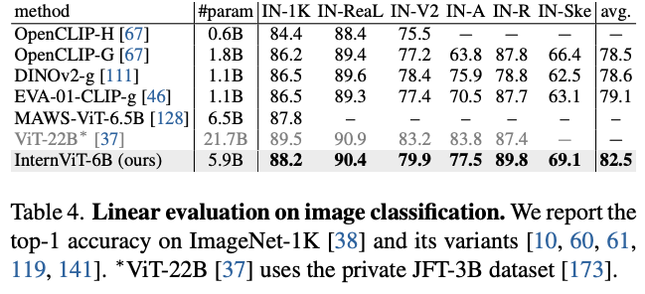
InternVL: Experiments
Validate the visual perception capabilities of InternViT-6B
Notes:
Goal: validate the visual perception capabilities of InternViT-6B

Slide 80
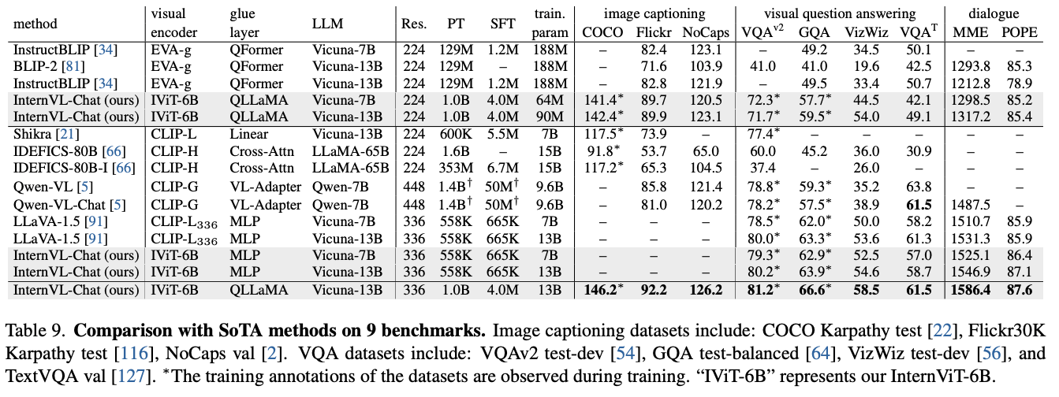
Evaluations on InternVL-Chat

Slide 81
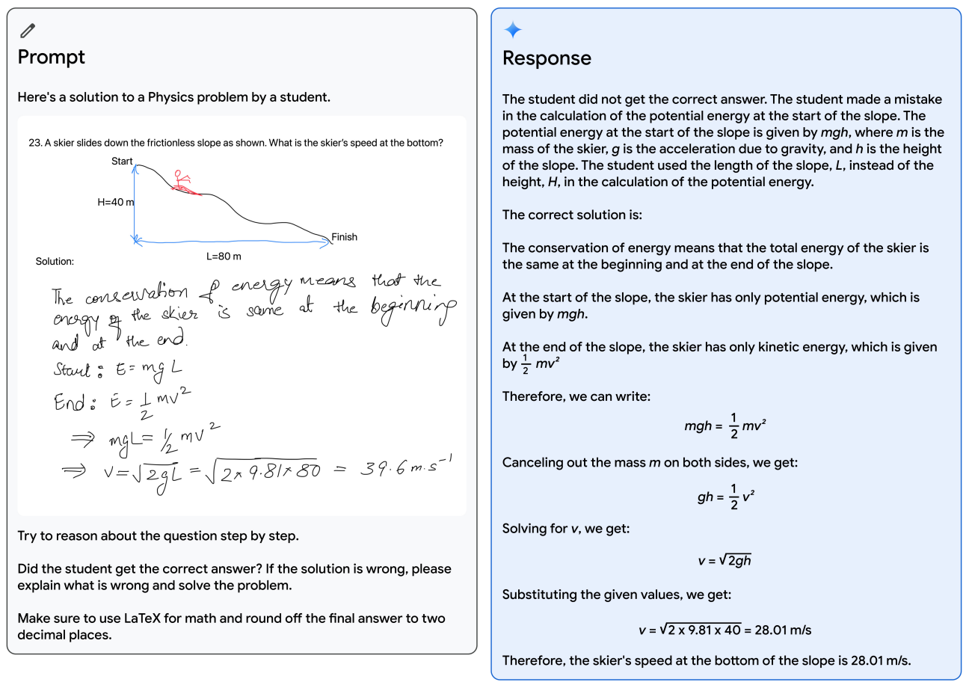
Gemini: A Family of Highly Capable Multimodal Models
3 sizes available:
- Ultra: for highly-complex tasks
- Pro: for enhanced performance and deployability at scale
- Nano: for on-device applications
Achieves new state-of-art results in 30 of 32 benchmarks
- 10/12 text and reasoning benchmarks
- 9/9 image understanding benchmarks
- 6/6 video understanding benchmarks
- 5/5 speech recognition and speech translation benchmarks
First model to achieve human-expert performance on MMLU
- MMLU is a benchmark that covers 57 tasks including elementary mathematics, US history, computer science, law and more, which requires the model to possess extensive world knowledge and problem-solving ability
Notes:
There are three models with different sizes that can be used in different scenarios in this family
Gemini Ultra is a really strong model which has noticeable performance on various benchmarks

Slide 82
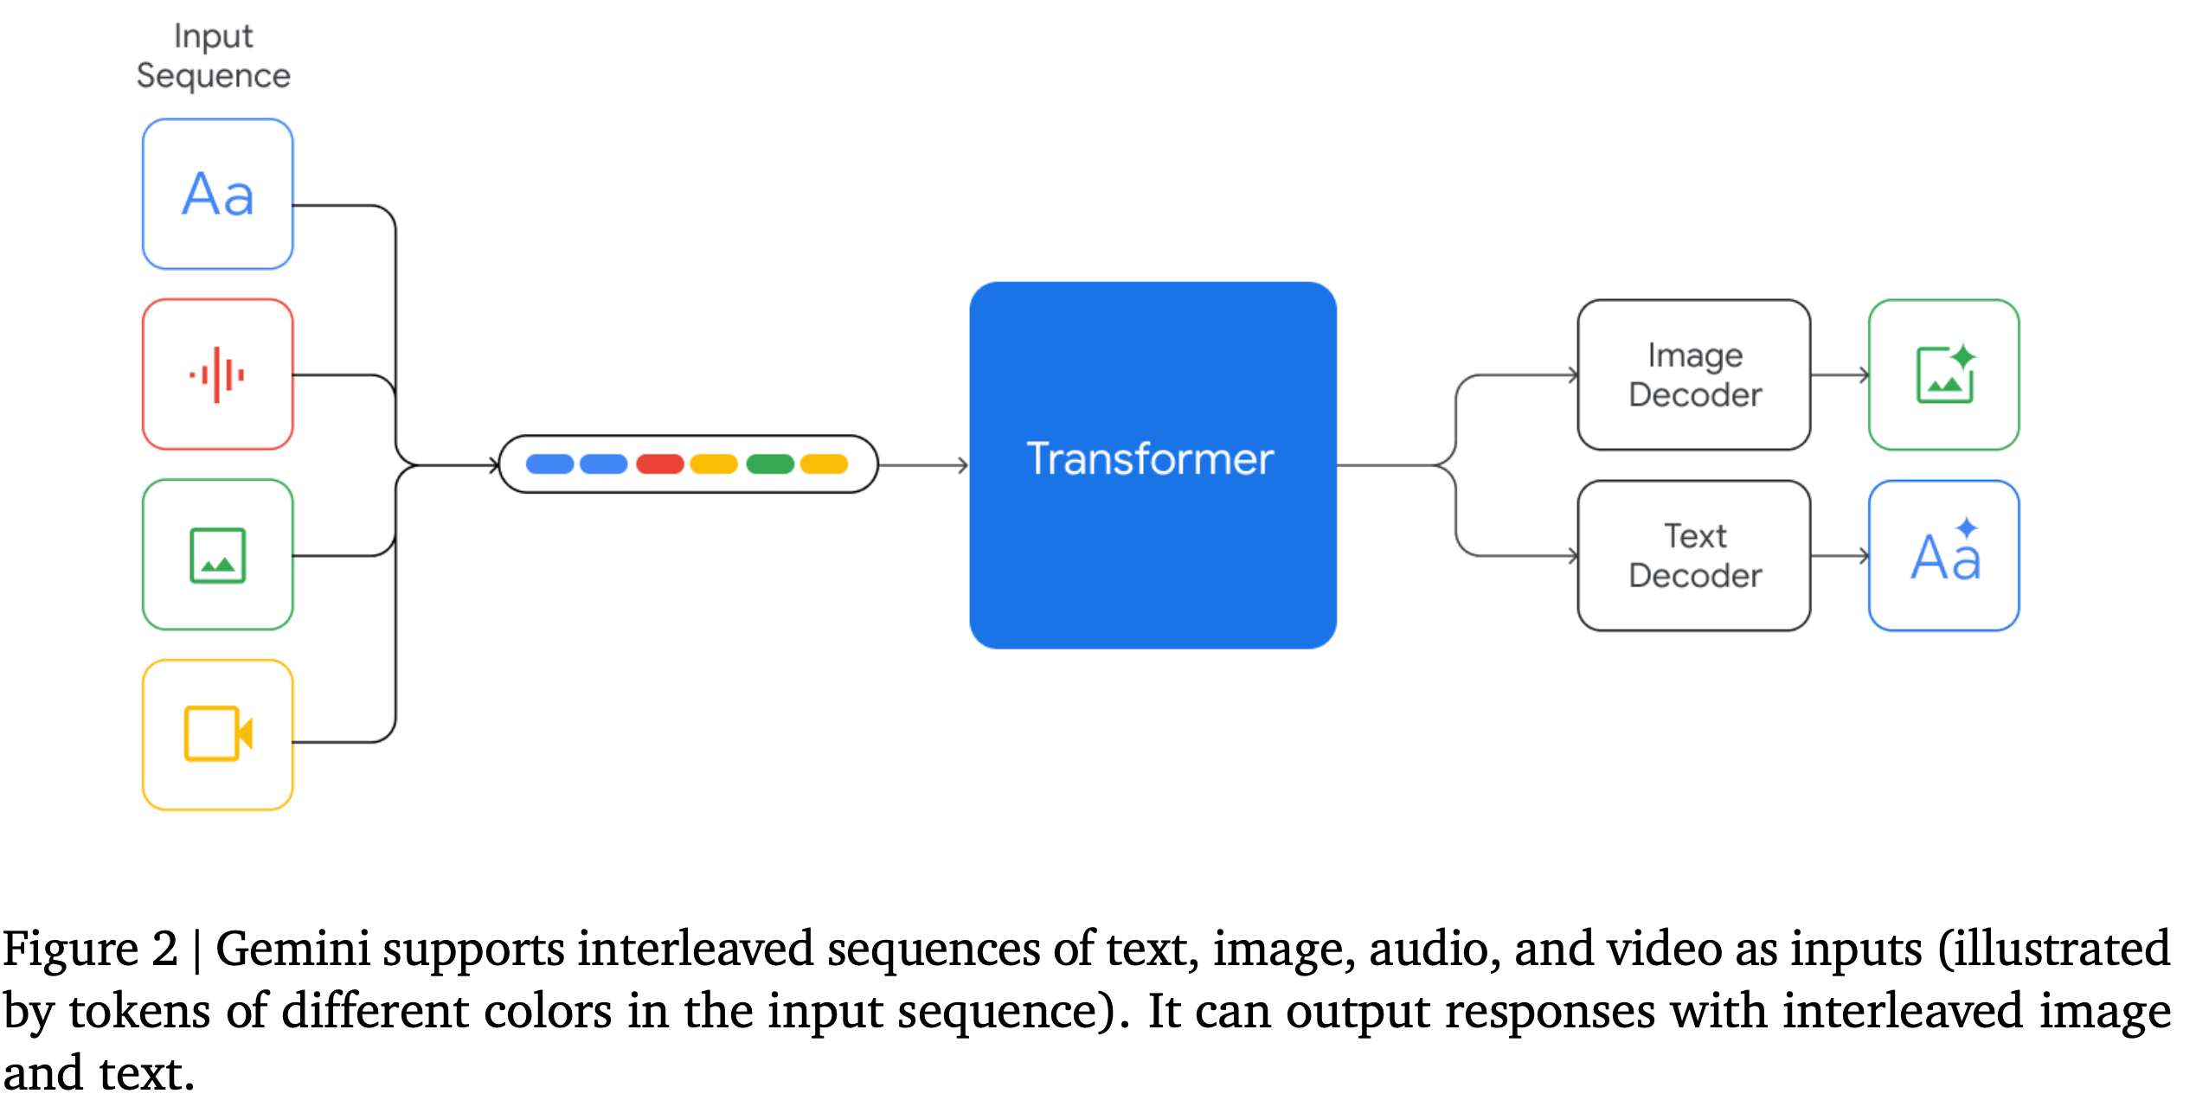
Gemini: Model Architecture
Build on top of Transformer decoders that are enhanced with improvements in architecture and model optimization
Trained to support 32k context length
Trained to accommodate textual input interleaved with a wide variety of audio and visual inputs
Visual encoding of Gemini models is inspired by Flamingo, Coca, and PaLI, with the important distinction that the models are multimodal from the beginning and can natively output images using discrete image tokens
Notes:
Until now, the standard approach to creating multimodal models involved training separate components for different modalities and then stitching them together to roughly mimic some of this functionality
Gemini is natively multimodal, pre-trained from the start on different modalities

Slide 83
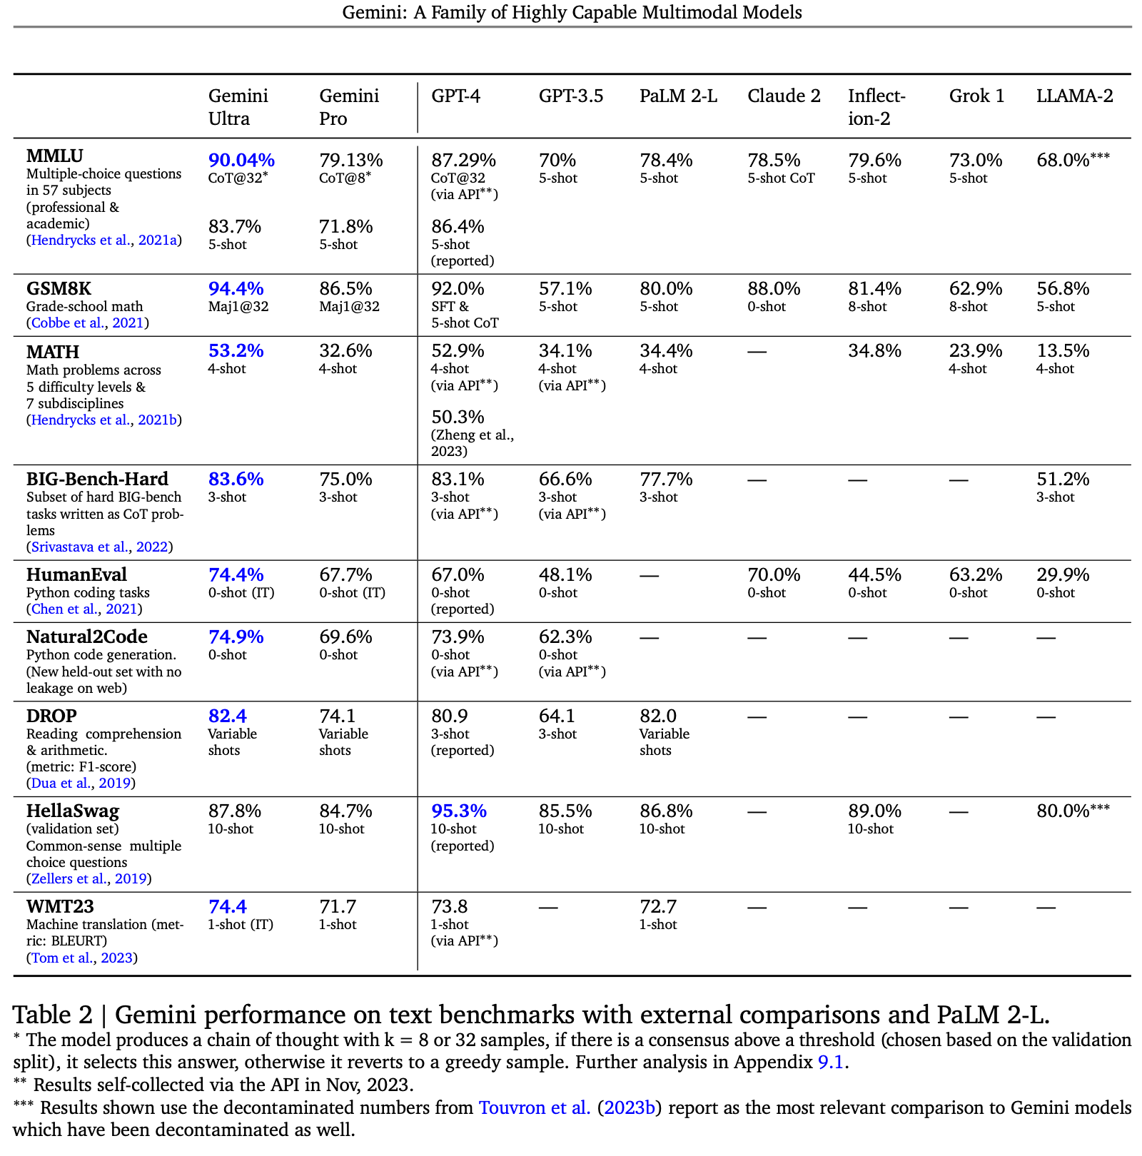
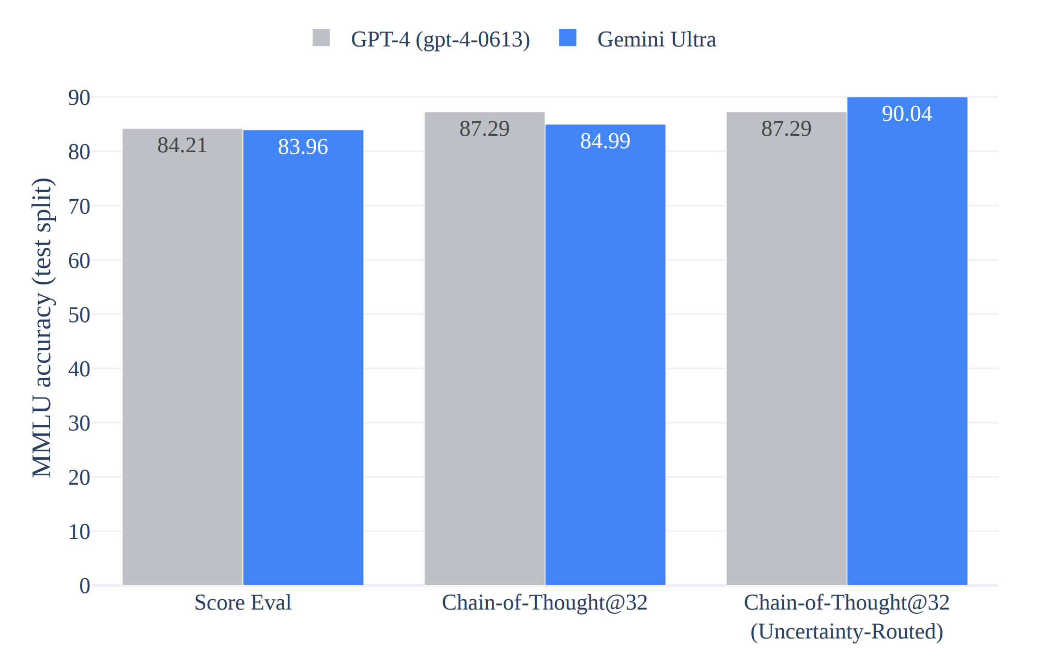
Gemini: Evaluation
1. Text
MMLU measures knowledge across a set of 57 subjects.
Human expert performance is gauged at 89.8%
Chain-of-thought with uncertainty routing on MMLU
- model produces k chain-of-thought samples
- selects the majority vote if the model is confident above a threshold
- otherwise defers to the greedy sample choice
Notes:
One astonishing performance of Gemini is that Gemini Ultra reaches 90.4%

Slide 84
Gemini: Evaluation
1.2. Multilinguality
Machine translation
Multilingual Math and summarization
Notes:
The multilingual capabilities of the Gemini models are evaluated using a diverse set of tasks requiring multilingual understanding, cross-lingual generalization and the generation of text in multiple language.
Beyond translation, Gemini is evaluated on math and summarization benchmarks across all languages

Slide 85
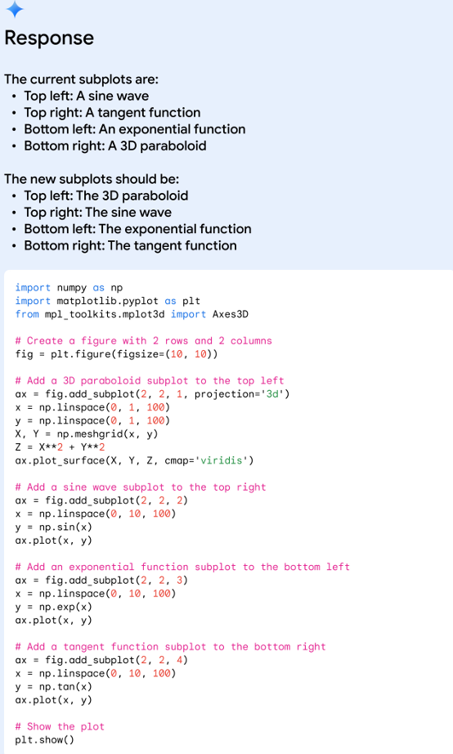
Gemini: Multimodal
Gemini models exhibit the unique ability to seamlessly combine their capabilities across modalities (e.g. extracting information and spatial layout out of a table, a char, or a figure) with the strong reasoning capabilities of a language model (e.g. its state-of-art performance in math and coding)
Notes:
Google writes that Gemini “can be your personal tutor — creating step-by-step instructions, sample quizzes or back-and-forth discussions tailored to your learning style.”
The above examples show Gemini's multimodal reasoning capabilities to generate matplotlib code for rearranging the subplots, which reveal several capabilities:
Recognition; Inverse graphics; Instruction-following; abstract reasoning

Slide 86
Gemini: Multimodal
-Video Understanding
- Image Understanding
OCR engine: designed to recognize and extract text from images or scanned documents
Notes:
Zero-shot image understanding
Few-shot video understanding

Slide 87
Gemini: Multimodal
- Image Generation:
Gemini is able to output images natively, without having to rely on an intermediate natural language description
- Audio Understanding
Notes:
Gemini Pro model significantly outperforms the USM and Whisper models across all ASR and AST tasks, both for English and multilingual test sets

Slide 88
Overall Comparison
Model | Contrib. | Zero/few shot or fine-tuned | size | VQAv2 | NoCap | GQA | TextVQA
Flamingo | The first LMM | Few shot | 80B | 56.3 | - | - | 36.0 few shot 57.1 fine-tuned
LLaVA | Visual instruction tuning | Few shot | 1.5-13B | 80.0 | - | 63.3* few-shot | 61.3* few-shot
InstructBLIP | Visual instruction tuning & instruction aware visual feature extraction |  | 13B | - | 121.9 few-shot | 49.5 f-show | 50.7 few-shot
PALI | Scaling up the Vision, multilingual | Fine-tuned | 55B | 86.1 | 126.3 zero-shot | 54.2 fine-tuned | 73.06 zero-shot
PALI-3 | Contrastively trained visual encoder | Fine-tuned | 5B | 85.2 | - | - | 79.51 fine
EMU2 | Strong in-context learning ability | Few shot | 37B | 84.9 | - | 65.1* few-shot | 66.6* few-shot
InternVL | Bridge the gap between vision encoder and LLM | Zero shot | 24B | 81.2 | 126.2 few-shot | 66.6* few-shot | -
Gemini | Natively multimodal | Zero shot | - | 77.8 | - | - | -

Slide 89
Limitations of current LMMs: Hallucination
What’s a Hallucination?
Model can generate text that is factually incorrect or nonsensical to the provided source content
Possible Hallucination causes:
- Data: flawed data sources and the inferior utilization of factual knowledge captured in the data
- Training: architecture flaw and misalignment
- Inference: inherent randomness of decoding strategies and imperfect decoding representation
Notes:
Data related hallucinations: misinformation and inherent biases within data sources; tend to capture spurious correlations and demonstrate difficulties in knowledge recalling
Training LLMs: inadequate unidirectional representation and attention glitches in architecture design; in the alignment phase, capability misalignment and belief misalignment
Decoding strategy: over-reliance on nearby content and the softmax bottleneck can limit the model’s ability to express diverse output probabilities

