Slide 1
Lecture 19: Multimodal Models Pre-training
Presenters: Eric Wang & Shengye Chen

Slide 2
Overview
Introduction & Background
Multimodal representations
Multimodal tasks
Visual Representation Improvement
Oscar
VinVL
Contrastive Language-Image Pre-training
CLIP
ALIGN
Generative Language-Image Pre-training
BLIP
CoCa
Training Scaling Up
SigLIP
Review & Summarizations

Slide 3
Introduction & Background

Slide 4
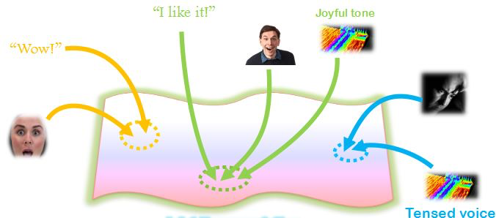
Multimodal Representations
Multimodality is the scientific study of heterogeneous (e.g., texts, images, audios) and interconnected data
Goal: to represent and summarize multimodal data in joint representations s.t.
complementary information is preserved
redundant parts of the modalities are filtered out
This presentation will only focus on Vision-Language Pre-training (VLP)
"Multimodal Machine Learning: A Survey and Taxonomy." https://arxiv.org/abs/1705.09406

Slide 5
Multimodal Tasks - Understanding
Image-text retrieval: predict whether the given image-text pair is aligned or not
Image-to-text (I2T) retrieval: given an image, retrieve the best-fitting sentence from a pre-existing database
Text-to-image (T2I) retrieval: vice versa
Datasets: COCO, Flickr30k
Natural Language Visual Reasoning (NLVR): given a pair of images and a text, determine whether the text statement is true about the images
Datasets: NLVR, NLVR2

Slide 6
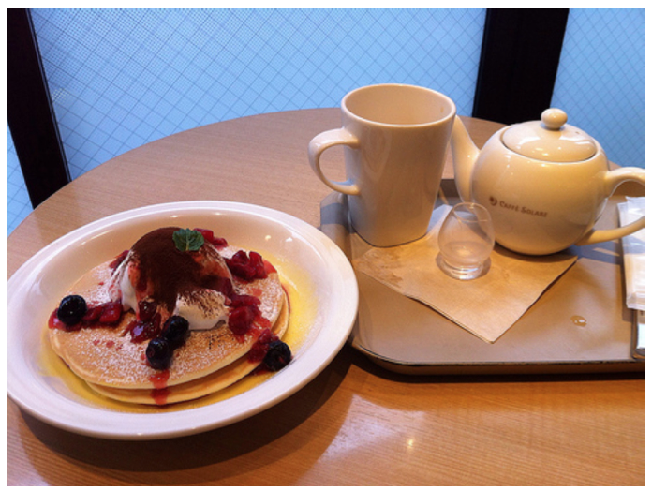
Multimodal Tasks - Understanding
Visual Question Answering (VQA): given an image and a question, select the correct answer from a multi-choice list
Datasets:
GQA: tests the reasoning capability of the model

Slide 7
Multimodal Tasks - Generation
Image captioning: generate a natural language description of the content of an image
Datasets:
COCO
NoCaps: describe novel objects which are not in the training corpus
Open-ended VQA

Slide 8
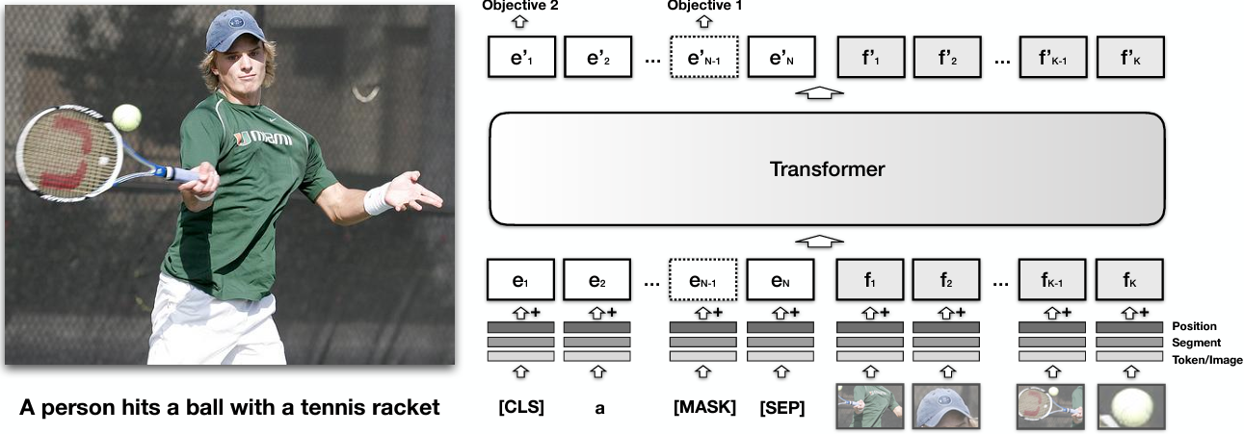
VLP Methods prior to 2020
Existing methods (e.g., VisualBERT) simply concatenate visual region features and word embeddings of the paired text as input to the model and use self-attention to implicitly align elements of the text and image regions
"VisualBERT: A Simple and Performant Baseline for Vision and Language." https://arxiv.org/abs/1908.03557

Slide 9
VLP Methods prior to 2020
Existing methods (e.g., VisualBERT) simply concatenate visual region features and word embeddings of the paired text as input to the model and use self-attention to implicitly align elements of the text and image regions
"VisualBERT: A Simple and Performant Baseline for Vision and Language." https://arxiv.org/abs/1908.03557

Slide 10
Visual Representation Improvement

Slide 11
OSCAR: Object-Semantics Aligned Pre-training for Vision-Language Tasks
“Semantic alignments between texts and images using object tags”
March 2020

Slide 12
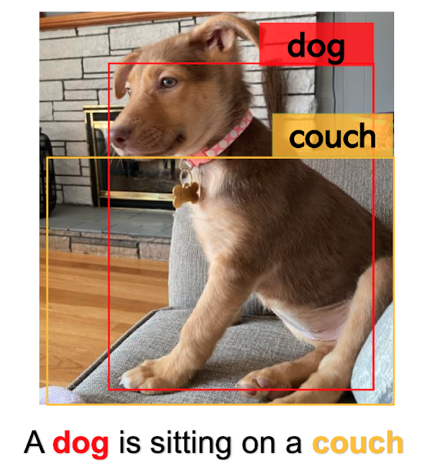
OSCAR - Background & Motivation
Challenges:
Ambiguity: Image region overlapping at different positions results in ambiguities for the extracted visual embeddings
Lack of explicit alignments: There is no explicitly labeled alignments between regions or objects in image-text pairs
Motivation:
Salient objects can be accurately detected by object detectors and are often mentioned in the paired text
They can be used as anchor points for learning semantic alignments between image region features and word embeddings

Slide 13
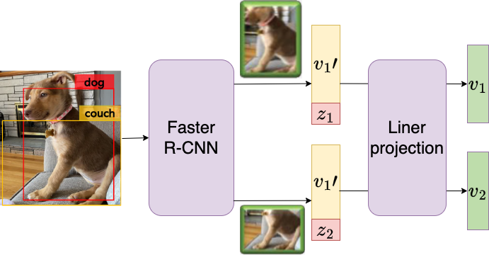
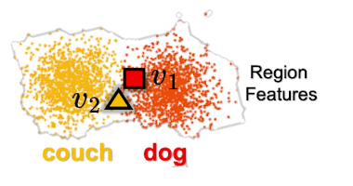
OSCAR - Extracting Anchor Points
To extract visual embeddings v
Faster R-CNN is used to extract the visual semantics of each region as (v’, z)
v’: region feature, a vector of dimension P (e.g., 2048)
z: region position, a vector of dimension R (e.g., 4)
Concatenate v’ and z to form a position-sensitive region feature vector
Using a trainable linear projection to transform [v’, z] into v, a vector of dimension H (e.g., 768)

Slide 14
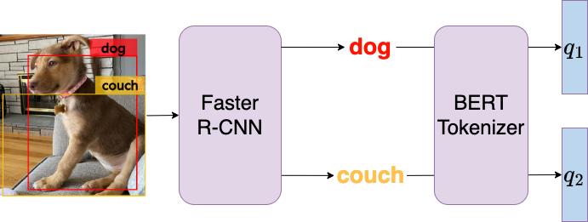
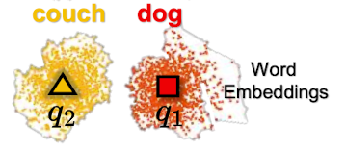
OSCAR - Extracting Word Embeddings
To extract tag embeddings q
Faster R-CNN is used to extract the tags
Embed tags into word tokens q (H-dimensional) using pre-trained BERT
To extract text embeddings w
Embed tags into word tokens w (H-dimensional) using pre-trained BERT

Slide 15
Looking at the same input from 2 perspectives
Now that we have embeddings for texts (w), tags (q) and image regions (v), all in dim H
Modality view:
Text modality: word tokens (w)
Image modality: image region features (v) & associated object tags (q)
Goal: to distinguish the representations between a text and an image
Dictionary view:
Linguistic semantic space: word tokens (w) & object tags (q)
Visual semantic space: image region features (v)
Goal: to distinguish the semantic spaces between text and image

Slide 16
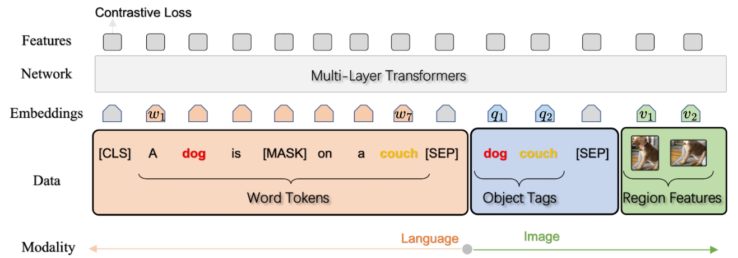
OSCAR - Loss for Modality View
w
h’ = [q, v]
Text modality representation w
Image modality representation
Pollute h’ s.t. it contains a set of images where the 50% tags are replaced with different tags
Train a binary classifier f to predict whether image-text modality pair (h’, w) contains the original image or polluted ones
Contrastive Loss
Goal: to adjust word embedding space where a text is similar to its paired image and dissimilar to the polluted images

Slide 17
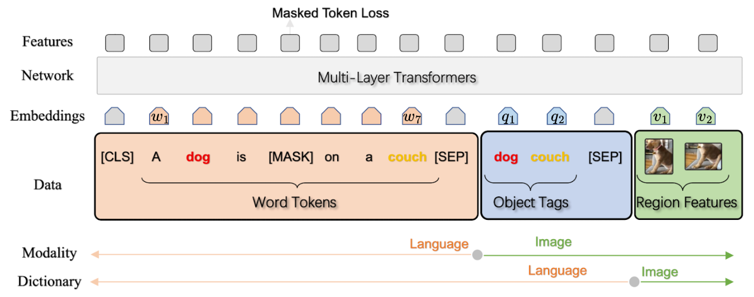
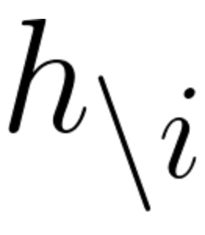
OSCAR - Loss for Dictionary View
h = [w, q]
v
Linguistic semantic space representation
Visual semantic space representation v
15% tokens in h is replaced with [MASK] token
Similar to masked language models, we want to predict masked text tokens (h_{i}) based on surrounding text tokens ( ) and all image features (v)
Masked Token Loss
Goal: to ground the learned word embeddings in the vision context

Slide 18
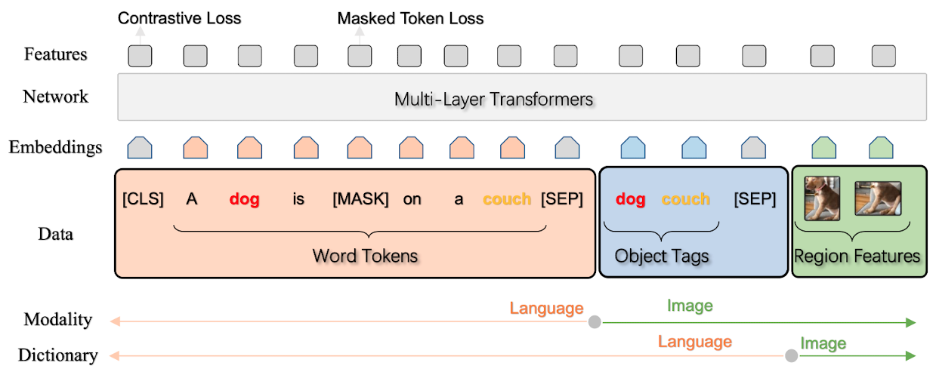
OSCAR - Pre-training
The total pre-training loss is
Trainable parameters
Linear projection matrix
BERT
Datasets:
6.5M image-text pairs consisting of 4M unique images
COCO, Conceptual Captions (CC), SBU captions, Flickr30k, GQA

Slide 19
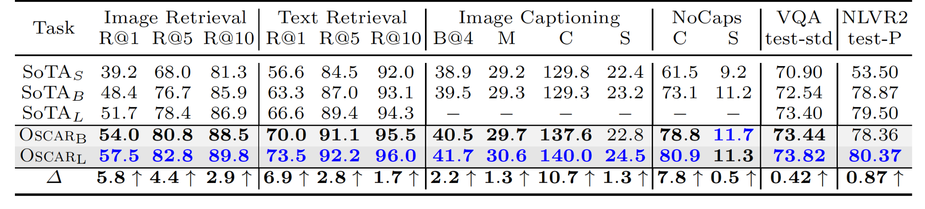
OSCAR - Quantitative Results
Note that the dataset size of
OSCAR: 6.5M image-text pairs
Counterpart: over 9M image-text pairs
With fewer image-text pairs than SoTA_{L}, OSCAR_{B} achieves higher score than its counterpart in 5 out of 6 tasks, highlighting OSCAR’s parameter efficiency, partially because the use of object tags as anchor points eases the learning of semantic alignments between images and texts

Slide 20
OSCAR - The Effect of Object Tags
Training using predicted tags takes less than half of the training time to achieve the final performance of the baseline (no tags), showing the efficiency of utilizing object tags for VLP
Training using ground truth tags further reduces the training time by over 50% to achieve the final performance of the predicted tags

Slide 21
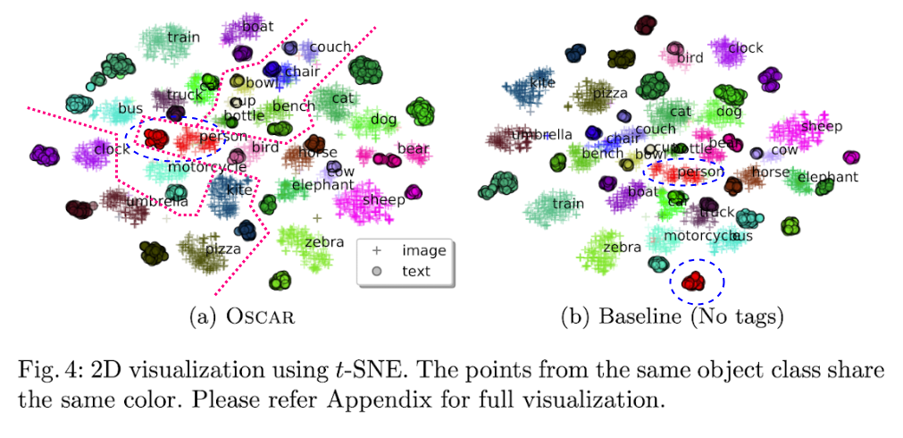
OSCAR - Qualitative Results
Intra-class: same object between two modalities is closer (e.g., person)
Inter-class: classes of related semantics are closer but still distinguishable, such as animal (zebra, elephant, sheep), transportation (train, car, truck), furniture (couch, chair, bowl).

Slide 22
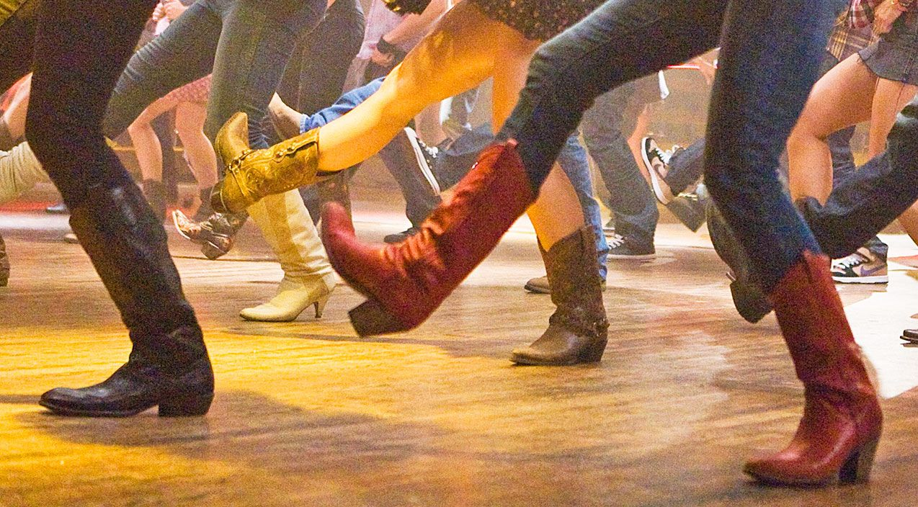
OSCAR - Limitations
Requires a powerful object detector to handle complex scenes
Does not work well when salient objects are missing in the text
A few good reasons to start with country line dance

Slide 23
VinVL: Revisiting Visual Representations in Vision-Language Models
"Extract better visual representation rather than just fuse multi-modal information"

Slide 24
VinVL: Background & Motivation
Success of visual language pre-training (VLP) in visual language (VL) tasks
VilBERT and OSCAR
object detection (OD) model + cross-modal fusion model
Vision-language fusion model
OD model improvement untouched
significance of visual features
OD
large-scale object-attribute detection model - ResNeXt-152 C4 (X152-C4)
Visual Genome (VG) dataset

Slide 25
VinVL: Improve Vision in Vision Language
Mainstream
Vision as a black box
larger training dataset: OpenImages and Objects 365
new insights in OD algorithms: feature pyramid network
Powerful GPUs for bigger models
Idea:
improve Vision for better visual representations
enrich the visual object and attribute categories
enlarge the model size
train on much larger OD dasetset

Slide 26
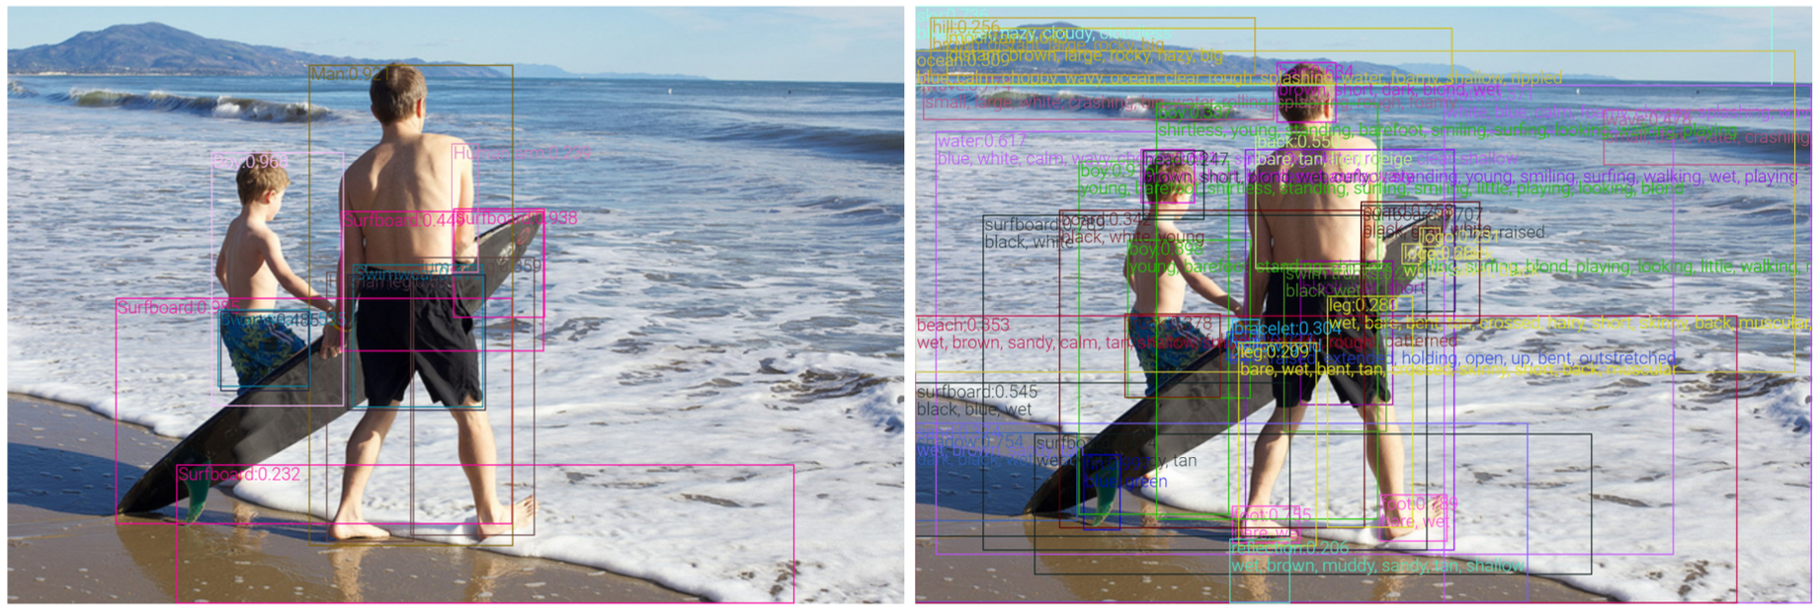
VinVL: Improve Vision in Vision Language
A new object detection model
more accurate object-attribute detection results and better visual features for VL applications
X152-FPN: "boy"
X152-C4: "young barefoot shirtless standing surfing smiling little playing looking blond boy"
More than 20 additional object concepts
Zhang, Pengchuan, et al. "Vinvl: Revisiting visual representations in vision-language models." Proceedings of the IEEE/CVF conference on computer vision and pattern recognition. 2021.

Slide 27
VinVL: Improve Vision in Vision Language
Pre-training
data
4 public complementary dataset - COCO, OpenImagesV5 (OI), Objects365V1, and Visual Genome (VG)
build a unified corpus with VG vocabulary - sampling, balancing and merging
model architecture: X152-C4
model pre-training
freezing: first conv layer, first res block and all batch-norm layers
data augmentation: horizontal flipping and multi-scale training
initialization from an ImageNet-5K checkpoint
2. Fine-tuning
fine-tune the new OD model on VG to inject attribute information

Slide 28
VinVL: Revisit VL Models
Deep learning-based VL models:
Vision: image understanding module
VL: cross-modal understanding module
Img: vision
q: semantic representation of the image - object tag
v: distributional representation of the image - visual representation
w: language - text (question in VQA)
y: output - text (answer to be predicted in VQA)
Convention
unify vision and language modeling VL with Transformer
pre-train the unified VL with large-scale text-image corpora

Slide 29
VinVL: OSCAR+ Pre-training
Pre-train an OSCAR+ to learn the joint image-text representations using image tags as anchors for image-text alignment.
Pre-training corpus
three types of existing vision and VL dataset
8.85 million (w-q-Img) triples
image captioning dataset
visual QA dataset
image tagging dataset
OSCAR+ pre-training loss:

Slide 30
VinVL: OSCAR+ Pre-training
OSCAR+ pre-training loss:
Masked Token Loss:
defined on the text modality (w and q)
define the discrete token sequence as
apply the Masked Token Loss (MTL)
randomly mask each input token with probability 15% and replace the masked one with a special token [MASK].
predict the masked tokens based on their surrounding tokens and image features

Slide 31
VinVL: OSCAR+ Pre-training
OSCAR+ pre-training loss:
Three-way Contrastive Loss:
optimize the objectives for VQA and text-image matching
training samples:
Negative examples for contrastive learning:
polluted “captions”: (w′, q, v) for text-image matching task
polluted “answers”: (w, q′, v) for VQA
apply a FC layer on top as a 3-way classifier f( · ) given encoding of [CLS]
triplet is matched (c = 0)
triplet contains a polluted w (c = 1)
triplet contains a polluted q (c = 2)

Slide 32
VinVL: OSCAR+ Pre-training
Pre-trained models
language tokens = [w, q]
region features = v
BERT base and BERT large
ensure that the features have the same input embedding size using a linear projection via matrix W
trainable parameters are θ = {θBERT, W}

Slide 33
VinVL: Adapt to VL Tasks
Generation tasks - Image Captioning
fine-tune
training sample converted to a triplet: a set of captions, a set of image region features and a set of object tags
seq2seq objective + uni-directional prediction with mask of 15% of the caption
inference
encode the image regions, object tags, and [CLS] as input
generate a caption by feeding in a [MASK]

Slide 34
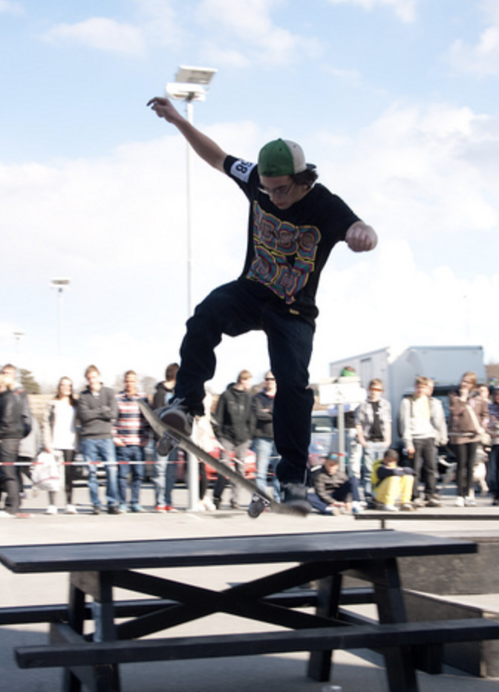
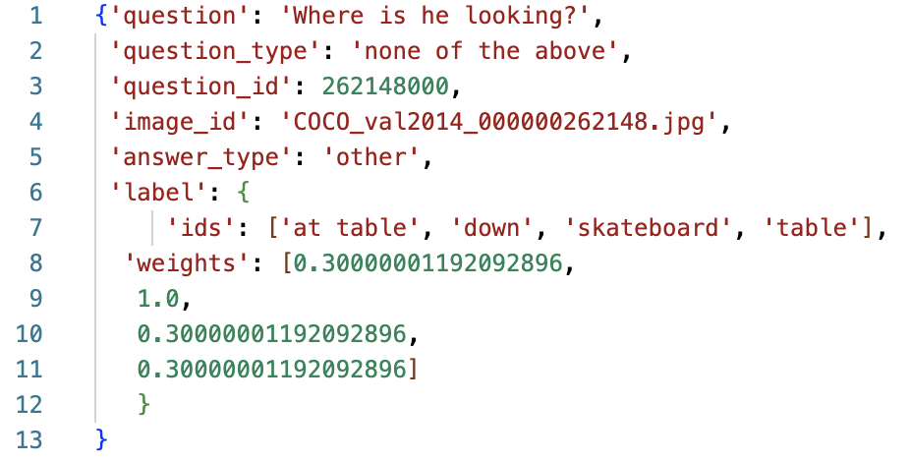
VinVL: Adapt to VL Tasks
Understanding tasks - VQA & GQA
construct the input by concatenating a given question, object tags and object region features
feed the [CLS] output from OSCAR+ to a task-specific linear classifier with a softmax layer

Slide 35
Contrastive Language-Image Pre-training

Slide 36
Learning Transferable Visual Models From Natural Language Supervision (CLIP)
"Introduce self-supervised signals widely used in NLP into Vision"

Slide 37
CLIP: Background & Motivation
Success of pre-trained models in NLP
GPT family
Zero-shot CV tasks
11.5% accuracy on ImageNet in 2017
Improved performance in narrower and more targeted weak supervision
SOTA CV systems
Fixed set of predetermined object categories
Low generality and usability
CLIP-like methods
VirTex, ICMLM, and ConVIRT: small scale training (< 1 million images)
Close the gap
Big data set: 400 million image-text pairs
Large model size: ViT-large

Slide 38
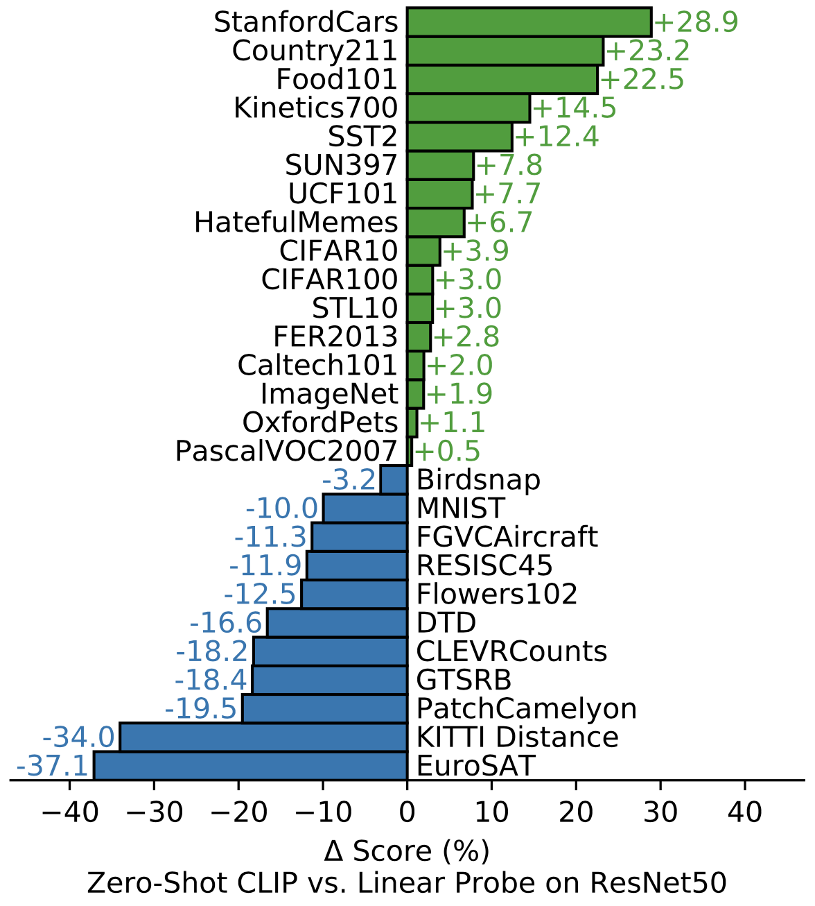
CLIP: Contribution
Contrastive language-image pre-training
Zero-shot beats task-specific supervised models
Linear-probe with good performance
Better generalization performance
combine representation natural language and image
Radford, Alec, et al. "Learning transferable visual models from natural language supervision." International conference on machine learning. PMLR, 2021.

Slide 39
CLIP: Method
Idea
use natural language supervision signals to train a better visual model
Why?
no need to label data anymore
images and text bound together to form a multi-modal feature
Method
create a sufficiently large dataset: Wikipedia-based Image Text (WIT) dataset - over 400 million image-text pairs
select an efficient pre-training method
choose and scale a model
train

Slide 40
CLIP: Efficient Pre-Training Method
Trial
predictive task: training from scratch and predicting the caption of the image with CNN for image & Transformer for text
Problem
difficult and slow to predict the exact words corresponding each image
Solution
contrastive learning
Why?
easy to only predict which text as a whole is paired with which image, instead of the exact words of the text

Slide 41
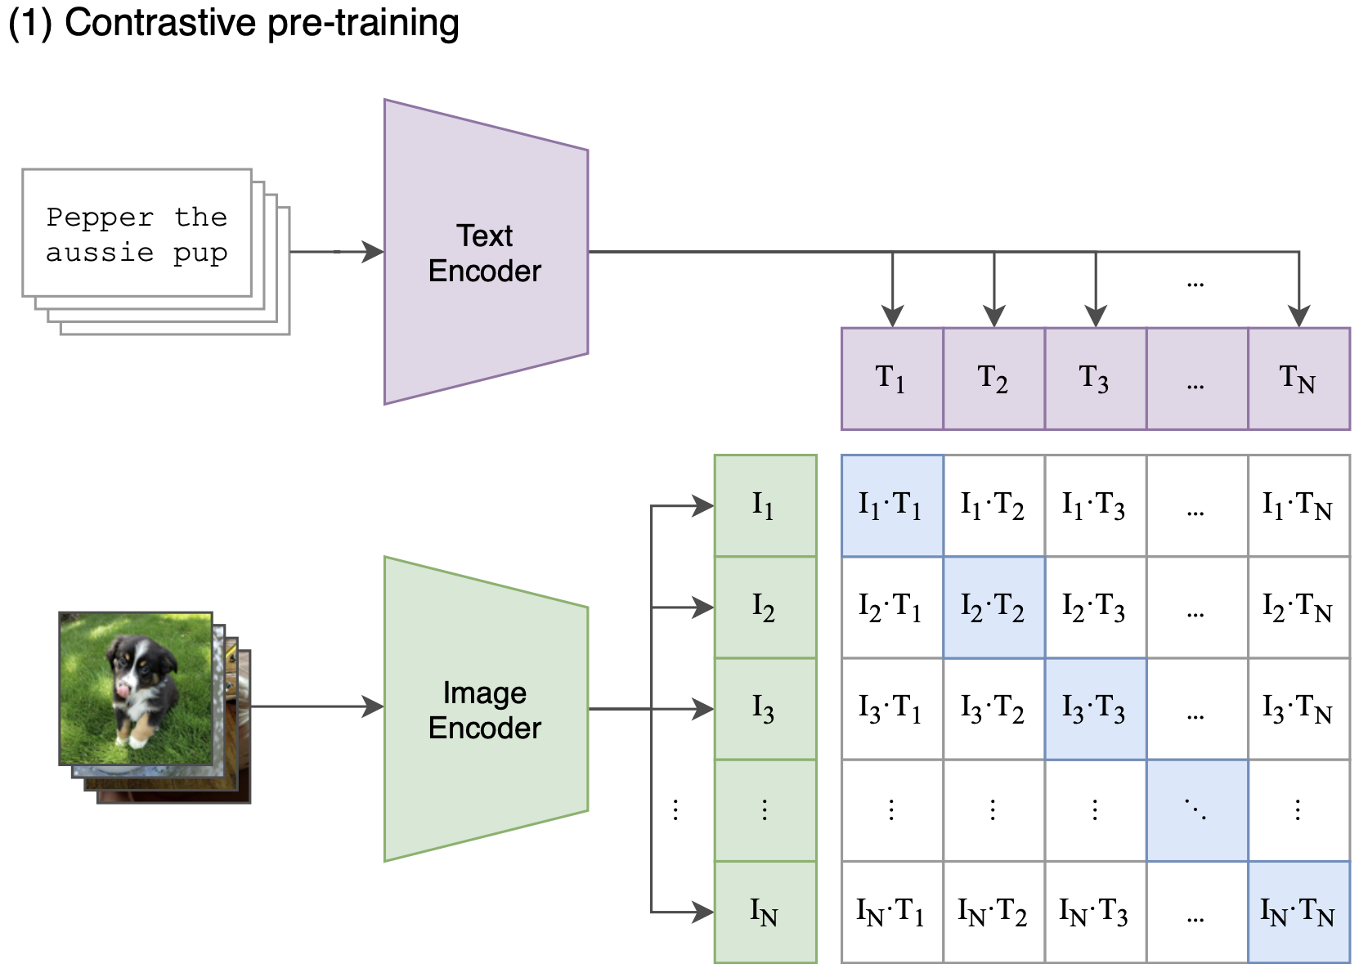
CLIP: Pre-training
Image encoder
ResNet / Vision Transformer
Text encoder
Transformer
Contrastive pre-training
contrastive learning on n × n features
positive samples: image-text pairs on the diagonal
negative samples: image-text pairs not on the diagonal
Radford, Alec, et al. "Learning transferable visual models from natural language supervision." International conference on machine learning. PMLR, 2021.

Slide 42
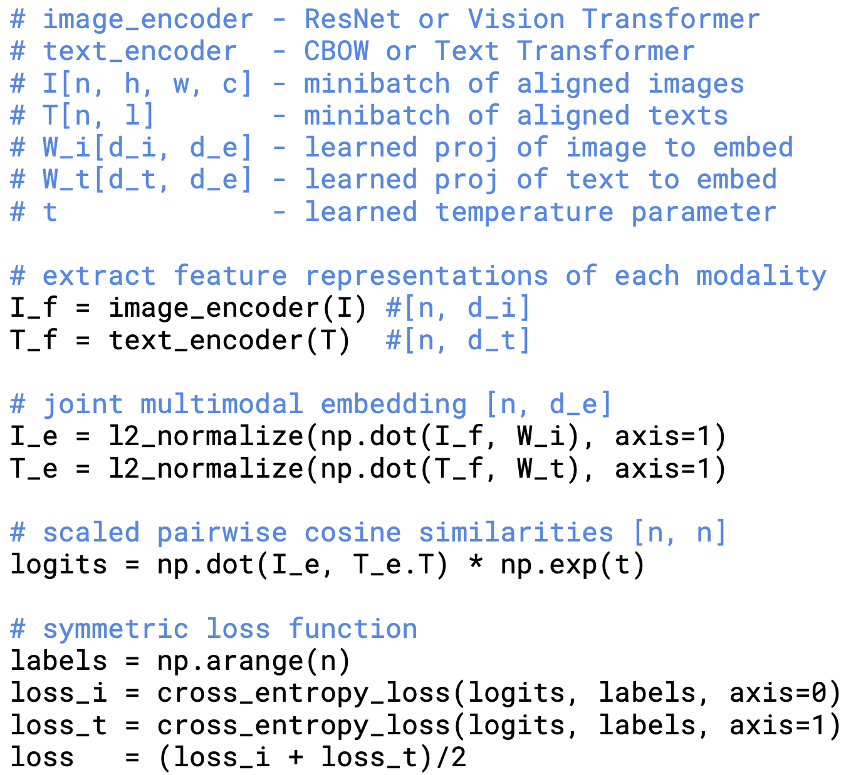
CLIP: Contrastive Training
1
2
3
4
5
Radford, Alec, et al. "Learning transferable visual models from natural language supervision." International conference on machine learning. PMLR, 2021.

Slide 43
CLIP: Contrastive Training
Radford, Alec, et al. "Learning transferable visual models from natural language supervision." International conference on machine learning. PMLR, 2021.

Slide 44
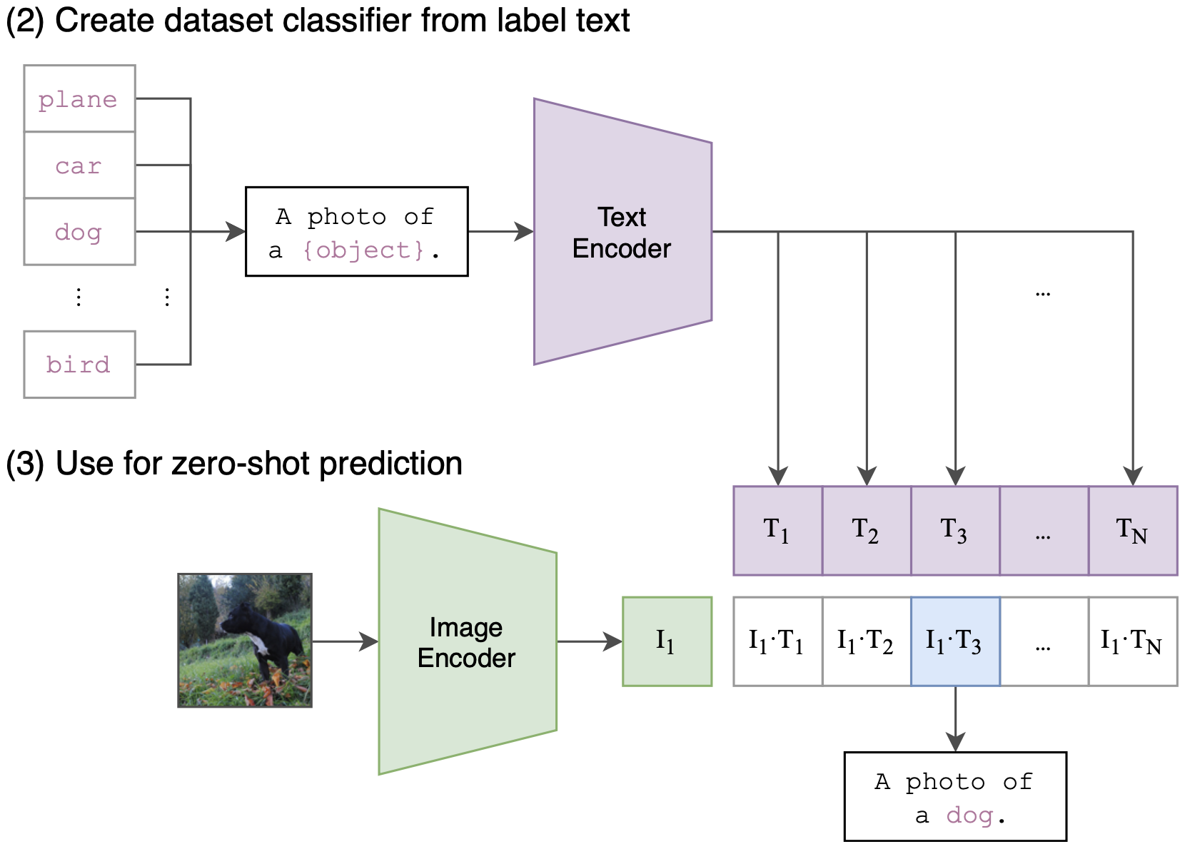
CLIP: Inference
Inference without classification header
cosine similarity
prompt template
“A photo of a {label}, a type of pet”
Radford, Alec, et al. "Learning transferable visual models from natural language supervision." International conference on machine learning. PMLR, 2021.

Slide 45
CLIP: Zero-Shot Classification Results
Across a 27 dataset eval suite, a zero-shot CLIP classifier outperforms a fully supervised linear classifier fitted on ResNet-50 features on 16 datasets, including ImageNet.
Radford, Alec, et al. "Learning transferable visual models from natural language supervision." International conference on machine learning. PMLR, 2021.

Slide 46
CLIP: Limitations
Computational efficiency
SOTA performance on general dataset requires 1000x computation
Weak zero-shot performance
fine-grained classification
abstract concepts: counting tasks
new tasks un-existed in pre-training dataset
Static classification
non-generative model: image description
Data efficiency
12.8 billion imagers in total requires 405 years with training one image / second
Unrealistic zero-shot
ImageNet

Slide 47
ALIGN: Scaling Up Visual and Vision-Language Representation Learning With Noisy Text Supervision
"Scale of the corpus makes up for noise and leads to SoTA representations"

Slide 48
ALIGN: Background & Motivation
Non-trivial data collection / cleaning in VL field
CLIP
Scaling of the corpus makes up for noise
noisy dataset of over one billion image alt-text pairs: Conceptual Captions dataset
An objective aligning the visual and language representations
dual-encoder
Image and text encoders learnt with contrastive loss
a shared latent embedding space
Aligned representations for cross-modality matching/retrieval tasks
Zero-shot image classification

Slide 49
ALIGN: Noisy Image-Text Dataset
Scale up visual and vision-language representation learning.
Trade quality for scale by relaxing most of the cleaning steps in the original work of Conceptual Captions dataset.
Only apply minimal frequency-based filtering: aspect ratio, short dimension, content relevancy, text length, …
Jia, Chao, et al. "Scaling up visual and vision-language representation learning with noisy text supervision." International conference on machine learning. PMLR, 2021.

Slide 50
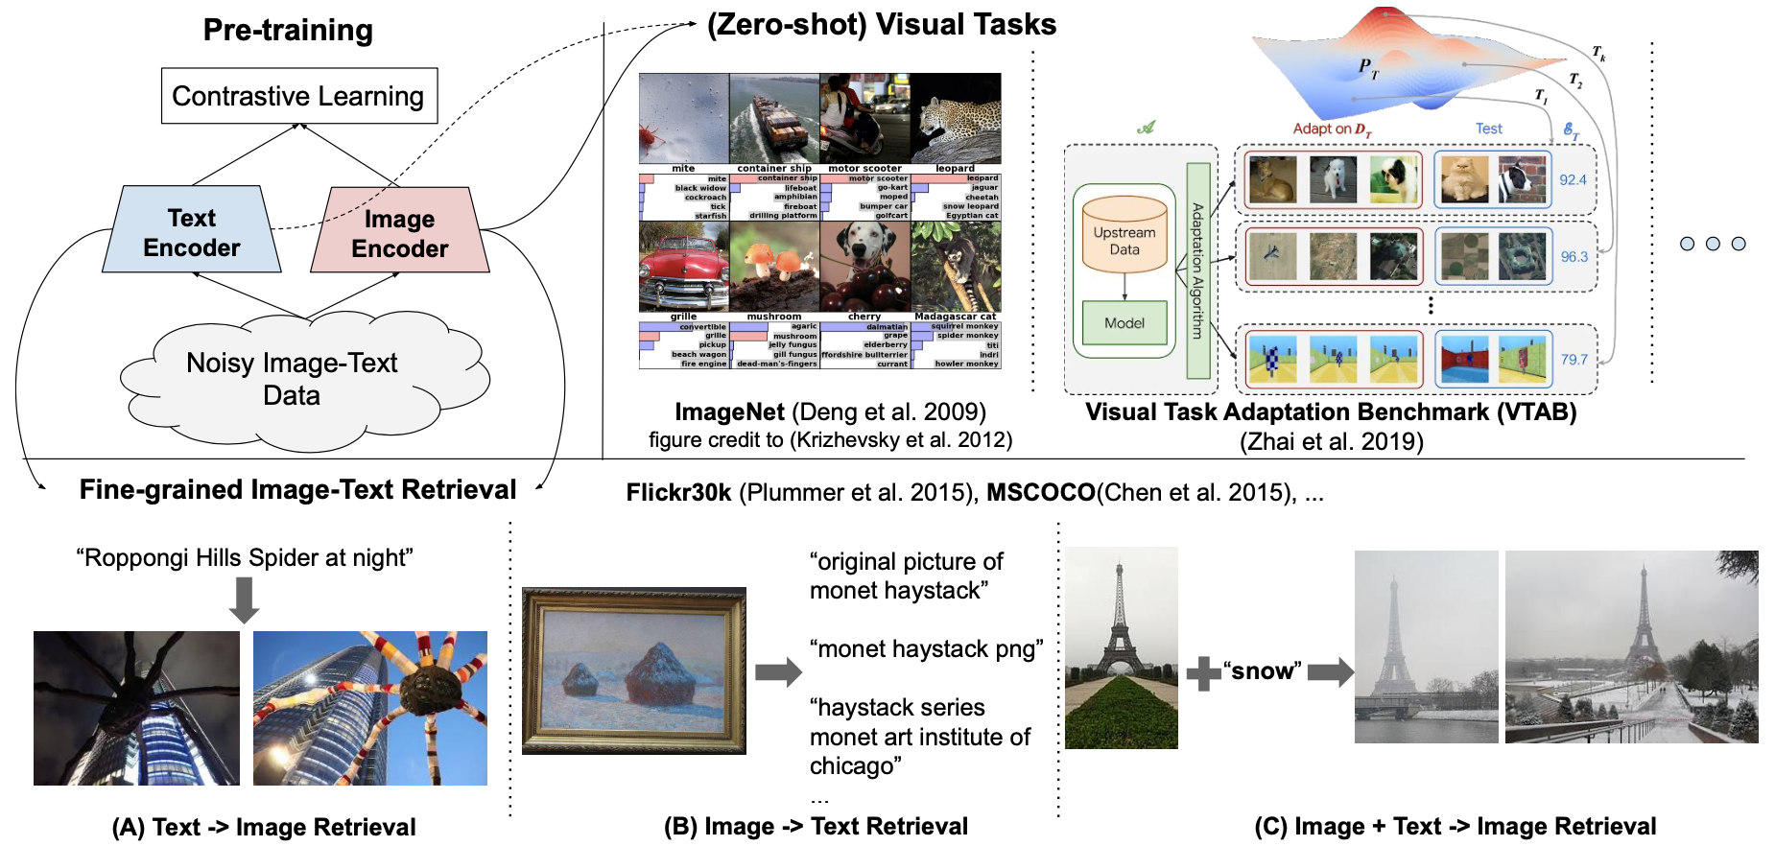
ALIGN: Method
Visual and language representations are jointly learned from noisy image alt-text data. The representations can be used for vision-only or vision-language task transfer. Without any fine-tuning, ALIGN powers zero-shot visual classification and cross-modal search including image-to-text search, text-to-image search and even search with joint image+text queries.
Jia, Chao, et al. "Scaling up visual and vision-language representation learning with noisy text supervision." International conference on machine learning. PMLR, 2021.

Slide 51
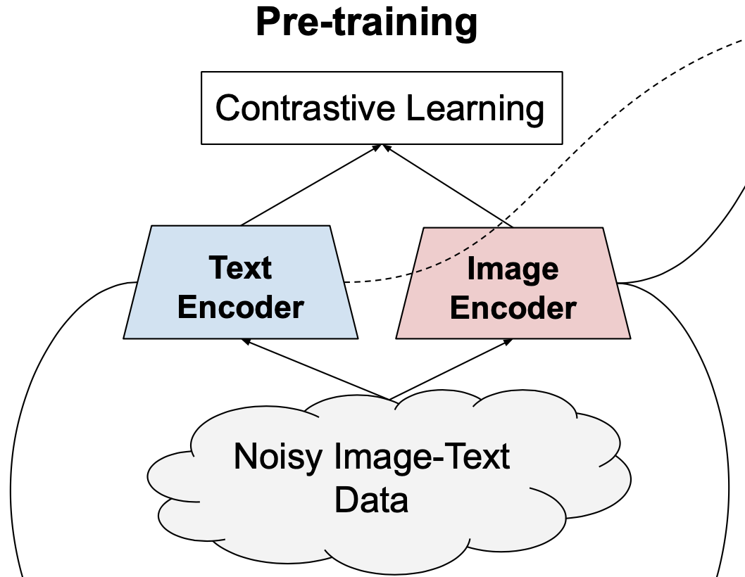
ALIGN: Pre-training on Noisy Data
Image encoder
EfficientNet
global pooling
without training the 1x1 conv layer in the classification head
Text encoder
BERT with [CLS] token embedding
A fully-connected layer on top
Cosine-similarity combination function on top
optimized via normalized softmax loss
Training
matched image-text pairs as positive and other as negative
Jia, Chao, et al. "Scaling up visual and vision-language representation learning with noisy text supervision." International conference on machine learning. PMLR, 2021.

Slide 52
ALIGN: Pre-training on Noisy Data
Minimize the sum of two losses:
Image-to-text classification:
Text-to-image classification:
Parameters
xi and yj: normalized embedding of image in the i-th pair and that of text in the j-th pair respectively
N: batch size
σ: learnable temperature to scale the logits

Slide 53
ALIGN: Transferring
Image-text matching & retrieval
w/wo fine-tuning
dataset: Flickr30K, MSCOCO and CxC
four intra- and inter-modal retrieval tasks
three semantic similarity tasks
Visual classification
ALIGN zero-shot transfer
dataset: same set (or a subset) of ImageNet classes
Image encoder transfer
dataset: ImageNet
fine-grained classification dataset: Flowers-102, Oxford-IIIT Pet, Stanford Cars and Food101
ImageNet
training the top classification layer only with frozen ALIGN image encoder
fully fine-tuned

Slide 54
ALIGN: Results
Image-text retrieval
Zero-shot Visual Classification
Jia, Chao, et al. "Scaling up visual and vision-language representation learning with noisy text supervision." International conference on machine learning. PMLR, 2021.

Slide 55
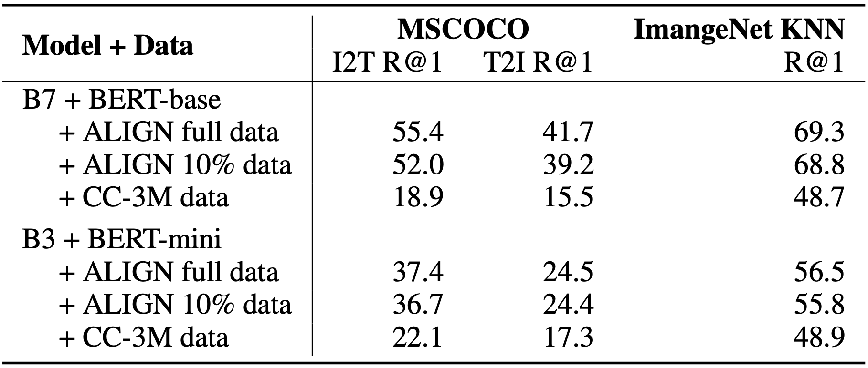
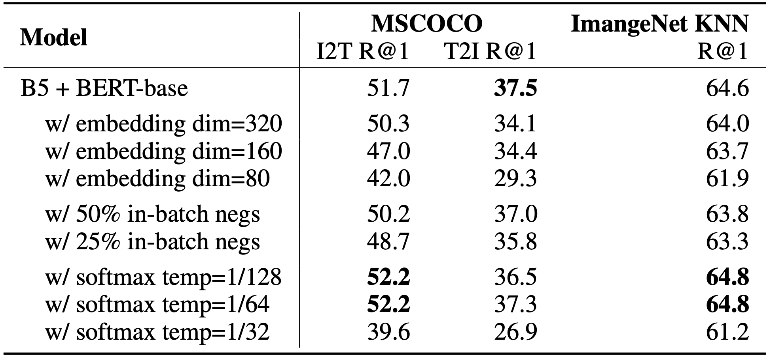
ALIGN: Ablation Study
A large scale training set is essential to allow scaling up of the models and to achieve better performance. A larger model is required to fully utilize the larger dataset.
Model quality improves nicely with larger backbones. As expected, scaling up image encoder capacity is more important for vision tasks. In image-text retrieval tasks the image and text encoder capacities are equally important.
Jia, Chao, et al. "Scaling up visual and vision-language representation learning with noisy text supervision." International conference on machine learning. PMLR, 2021.

Slide 56
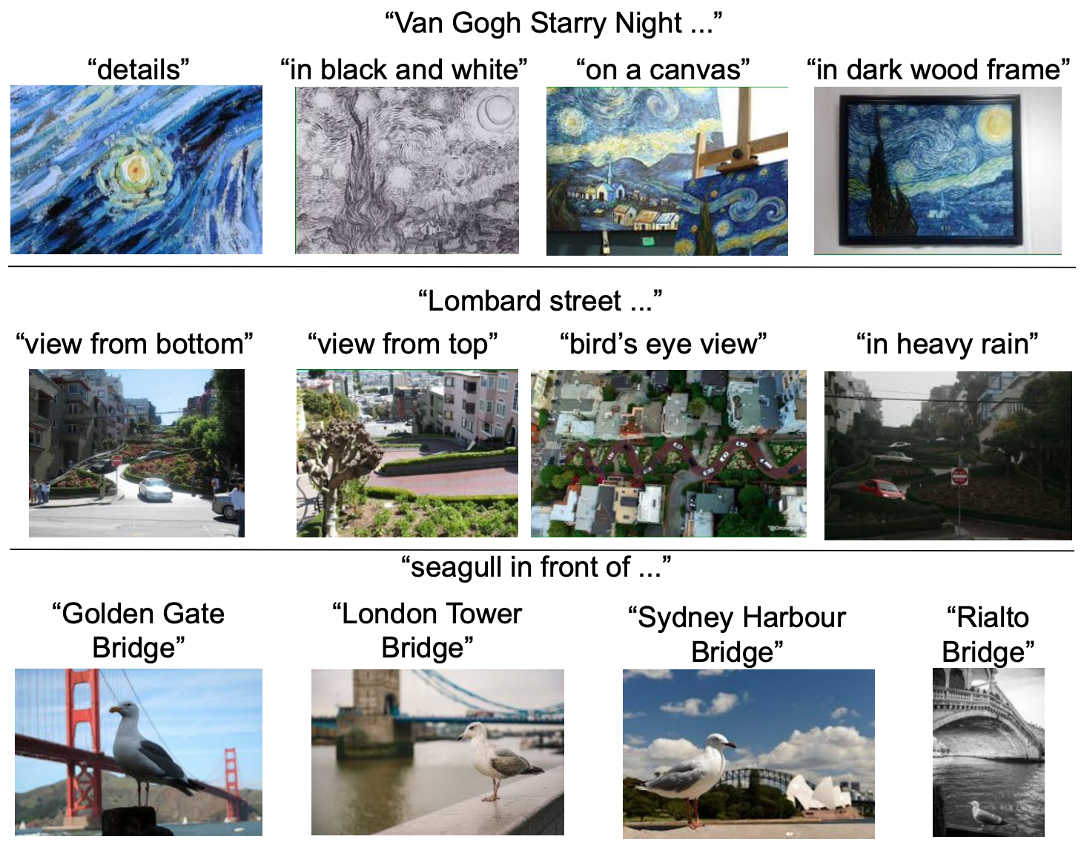
ALIGN: Analysis of Learned Embeddings
A simple image retrieval system to study the behaviors of embeddings trained by ALIGN.
ALIGN can align images and texts with similar semantics and generalize to novel complex concepts.
Jia, Chao, et al. "Scaling up visual and vision-language representation learning with noisy text supervision." International conference on machine learning. PMLR, 2021.

Slide 57
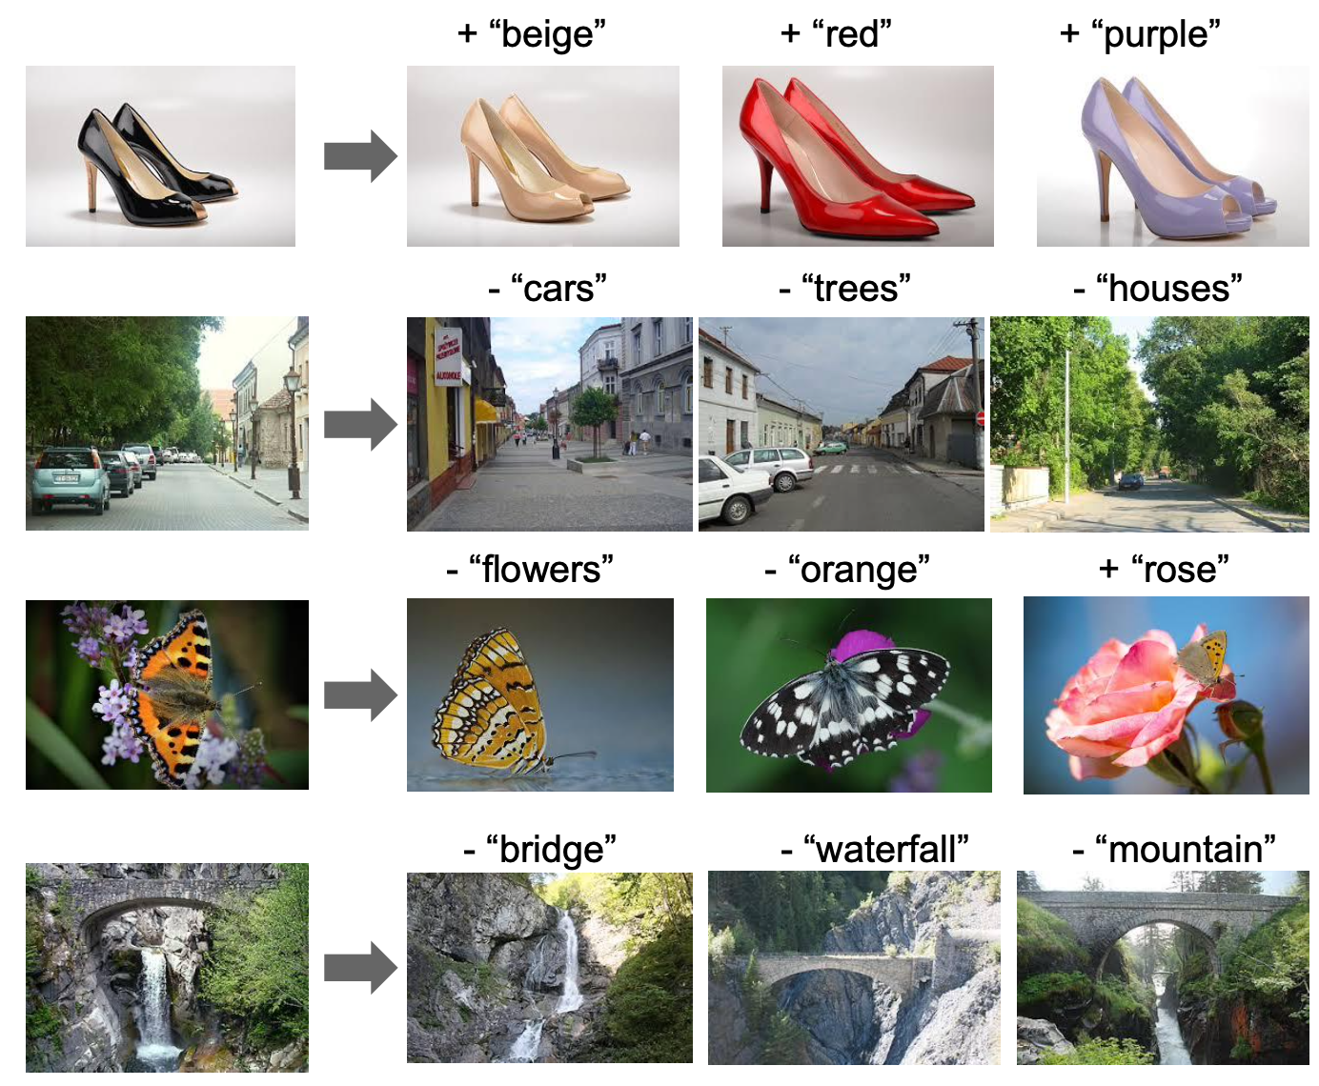
ALIGN: Analysis of Learned Embeddings
ALIGN shows that word2vec-like linear relationships between word vectors emerge as a result of training them to predict adjacent words in sentences and paragraphs.
Given a query image and a text string, add their ALIGN embeddings together and use it to retrieve relevant images.
Jia, Chao, et al. "Scaling up visual and vision-language representation learning with noisy text supervision." International conference on machine learning. PMLR, 2021.

Slide 58
Generative Language-Image Pre-training

Slide 59
BLIP: Bootstrapping Language-Image Pre-training for Unified Vision-Language Understanding and Generation
“Improving text quality by bootstrapping contrastive training”
January 2022

Slide 60
BLIP - Background & Motivation
To improve CLIP and ALIGN from 2 perspectives:
1. From model perspective: CLIP & ALIGN adopt encoder-based models
Encoder-based models are not easily transferred directly to text generation tasks, such as image captioning
Encoder-decoder models have not been successfully adopted for image-text retrieval tasks

Slide 61
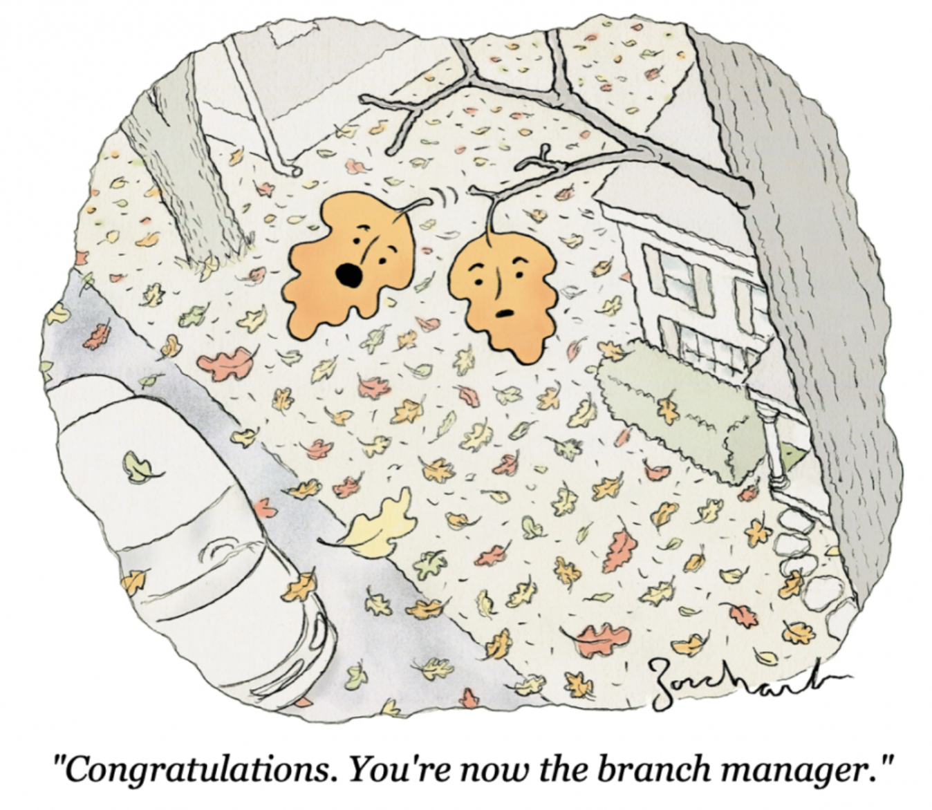
BLIP - Background & Motivation
2. From data perspective:
The number of high-quality human-annotated image-text pairs (e.g., COCO) is not enough for large multimodal model training
CLIP & ALIGN are pre-trained on noisy web text, which can only yield suboptimal results

Slide 62
BLIP - Improving Caption Quality
To solve the text quality issue, a natural approach is to build
A discriminator to distinguish between good and bad image-text pairs
A generator to synthesize better quality captions to replace noisy captions
A unimodal encoder to align vision and language representations (similar to ALIGN)
Discriminator
(filter)
Generator
(captioner)

Slide 63
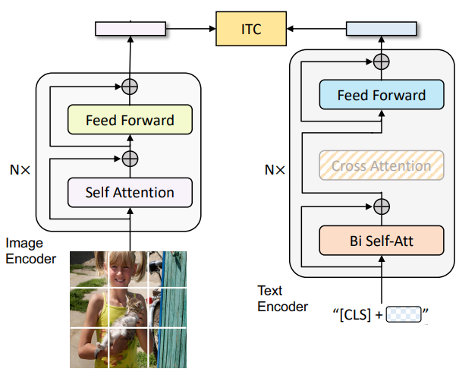
BLIP - Unimodal Encoder
A multimodal alignment task to encourage matched image-text pairs to have similar representations in contrast to the negative pairs
Image-Text Contrastive (ITC) Loss
x_{i} and y_{j} are normalized low-dimensional representations of [CLS] embeddings of text in the i-th pair and image in the j-th pair mapped by linear transformations
Sum of 2 InfoNCE (Noise Contrastive Estimation) losses for I2T and T2I

Slide 64
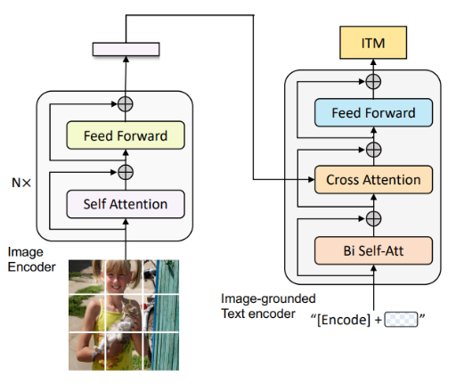
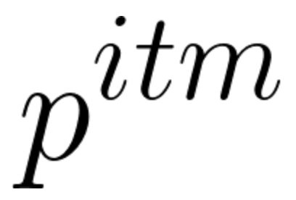
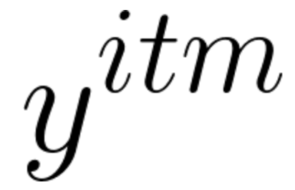
BLIP - Discriminator (Filter)
A binary classification task to predict whether an image-text pair is matched or nor, given multimodal features
Hard negative sampling strategy: negative pairs with higher contrastive similarity from ITC are more likely to be selected so that training is meaningful
Image-Text Matching (ITM) Loss
is the predicted two-class probability
is a 2-D one-hot vector representing the ground-truth
H is cross-entropy loss

Slide 65
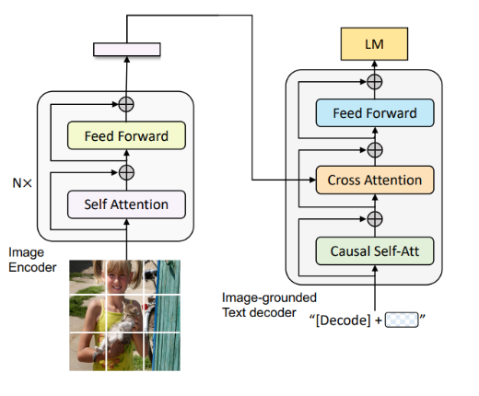
BLIP - Generator (Captioner)
A generative task to produce textual descriptions in an autoregressive manner given an image
Language Modeling (LM) Loss
y is the language tokens
x is the image embedding

Slide 66
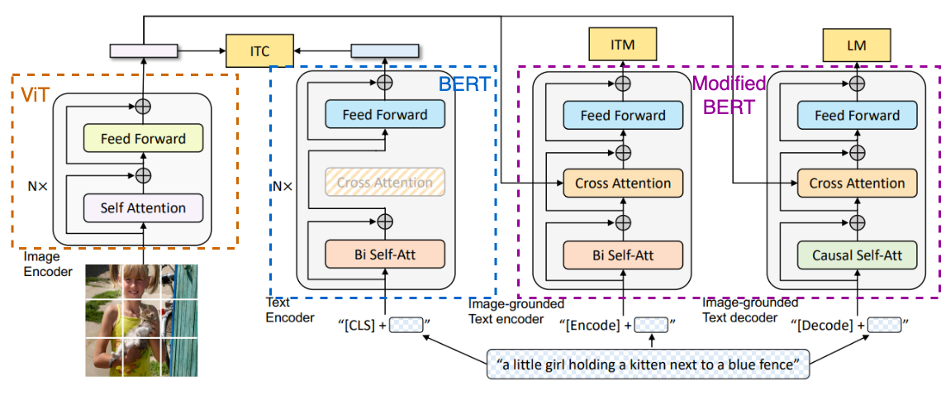
BLIP - Architecture
The same color of blocks indicates shared parameters

Slide 67
BLIP - Bootstrapping Dataset with CapFilt
1. Pre-train encoder & decoder with noisy web-scale dataset
2. Fine-tune filter and captioner using human annotated dataset (e.g., COCO)
3. Generate synthetic caption for web dataset.
Noisy text
Clean text

Slide 68
BLIP - Bootstrapping Dataset with CapFilt
4. Filter synthetic and web captions to get high quality image-text pairs
5. Use high quality image-text pairs (129M, larger and cleaner) to pre-train a new model
Continue training does not help. This observation agrees with the common practice in knowledge distillation, where the student model cannot be initialized from the teacher
Noisy text
Clean text

Slide 69
BLIP - Bootstrapping Dataset with CapFilt
These examples showcase the effectiveness of both captioner and filter
Captioner is able to generate reasonable descriptions given an image
Filter is able to accurately identify the more matched text

Slide 70
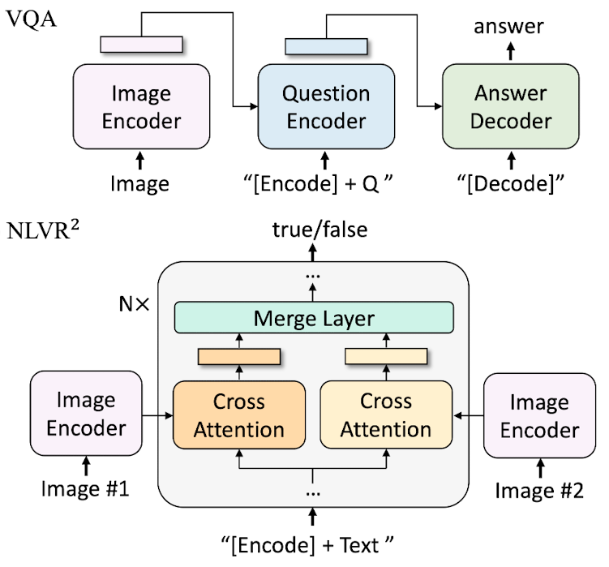
BLIP - Downstream Tasks

Slide 71
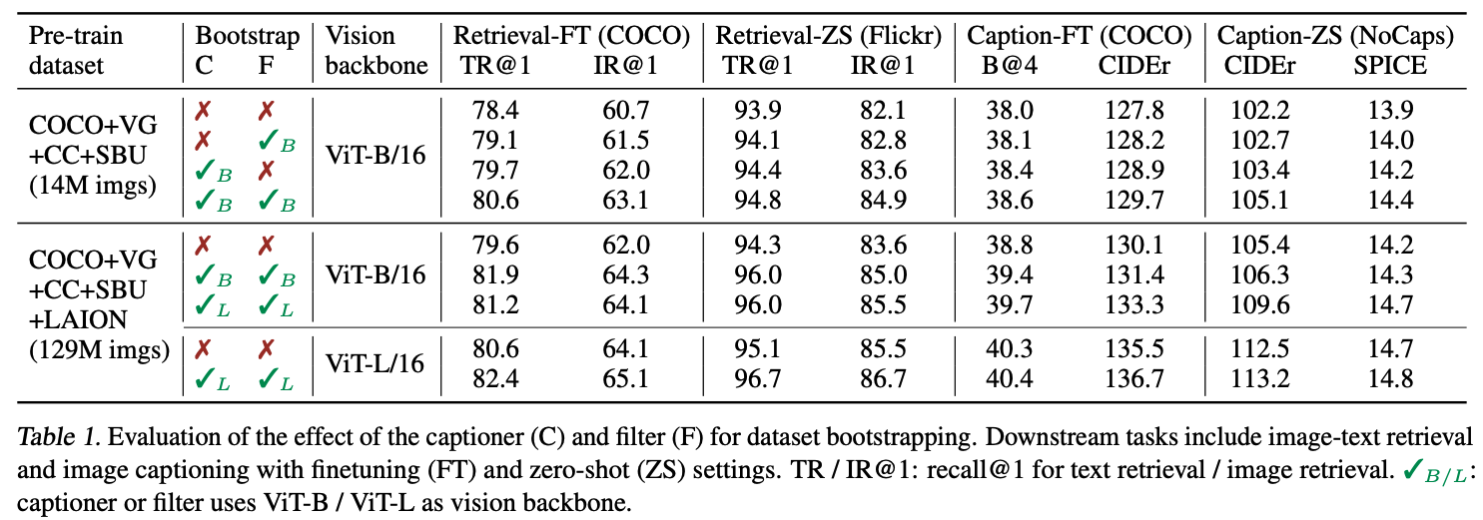
BLIP - Quantitative Results
Comparison between using captioner only and using filter only
Captioner generates more diverse captions, which contain more new information that the model could benefit from

Slide 72
BLIP - Quantitative Results
Comparison between using CapFilt base and using CapFilt large
Scaling up CapFilt from base to large only improves generative task performance
Improvements of retrieval tasks is achieved by scaling up the vision backbone

Slide 73
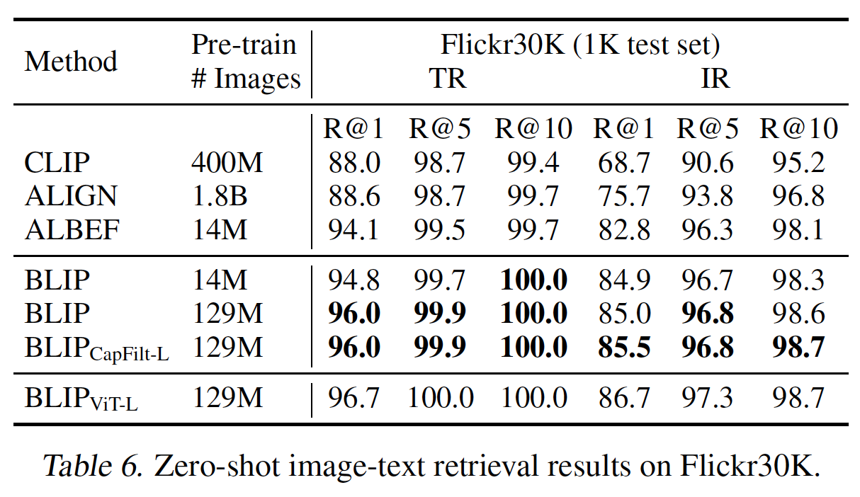
BLIP - Quantitative Results
The smallest BLIP outperforms ALIGN, despite using less than 1% of the data
The smallest BLIP also outperforms ALBEF, which adopts encoder-based design and uses the same 14M images as BLIP without bootstrapping text

Slide 74
CoCa: Contrastive Captioners are Image-Text Foundation Models
“Combining contrastive training + generative training”
May 2022

Slide 75
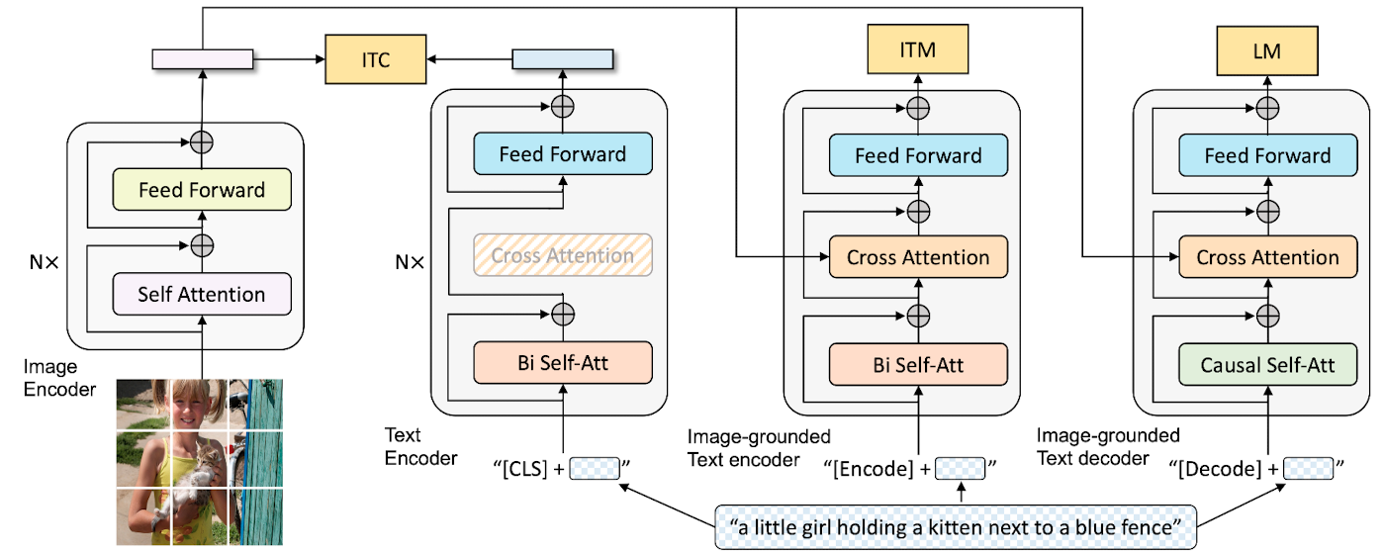
CoCa - Background & Motivation
Recall: for each image-text pair, BLIP pre-training requires 1 forward pass through visual transformer and 3 forward passes through text transformers
Need a minimalist design of BLIP to improve training efficiency

Slide 76
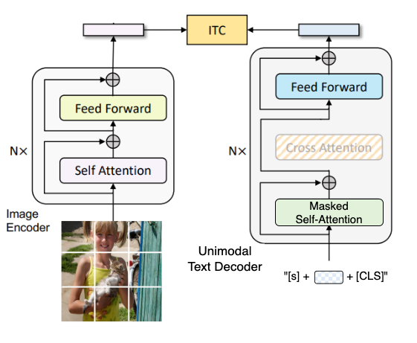
CoCa - Replacing Text Encoder with Decoder
Append a [CLS] token at the end of input sentence and use its corresponding output of decoder as the text embedding
BLIP
CoCa

Slide 77
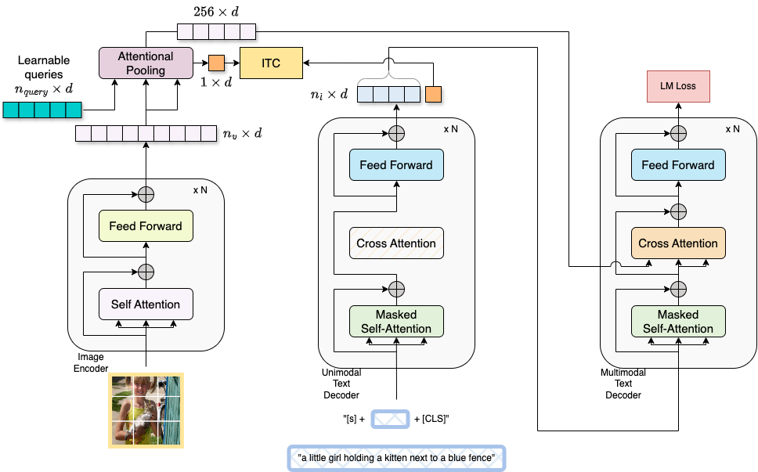
CoCa - Decoupled Decoder
Split the decoder into unimodal and multimodal components, by skipping the cross-attention mechanism in the unimodal decoder layers
Benefit: the text decoder can efficiently generate outputs for both contrasive and generative losses with a single forward pass, compared to two passes for in BLIP

Slide 78
CoCa - Attentional Poolers
Task-specific attentional pooling
A multi-head attention layer with n_{query} learnable queries, with image encoder output as both keys and values
n_{query} = 1 for ITC loss. Pooled image embedding as a global representation
n_{query} = 256 for LM loss. More visual tokens are beneficial for region-level features

Slide 79
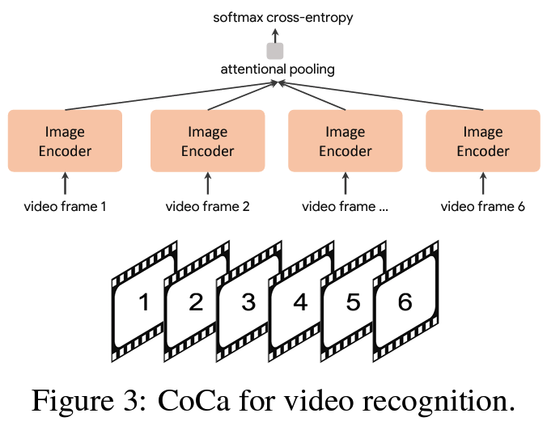
CoCa - Benefits of Attentional Poolers
Adaptor for downstream tasks
E.g., for video classification, a single query-token is learned to weight outputs of all tokens of spatial patches x temporal frames
Enhanced frozen-feature evaluation
Linear probing struggles to accurately measure learned representations
Learning a new pooler to aggregate features enables the model to obtain strong performance as a frozen encoder
It can also benefit to multi-task problems that share the same frozen image encoder but different task-specific heads

Slide 80
CoCa - Pre-Training Details
Loss Function
λ are loss weighting hyper-parameters
Empirically, a larger LM loss weight is better (λ_{LM}: λ_{ITC} = 2:1)
Explanation: the ITC loss can be interpreted as a special case of the generative approach applied on image, when the vocabulary is the set of all captions
Number of unimodal and multimodal decoder layers
N_{unimodal_decoder} = N_{multimodal_decoder}
Intuitively, fewer unimodal text layers leads to worse zero-shot classification due to lack of capacity for good unimodal text understanding
Fewer multimodal layers reduces the model’s power to reason over multimodal inputs such as VQA
Dataset (4.8B): ALIGN (1.8B) + JFT-3B (internal Google dataset)

Slide 81
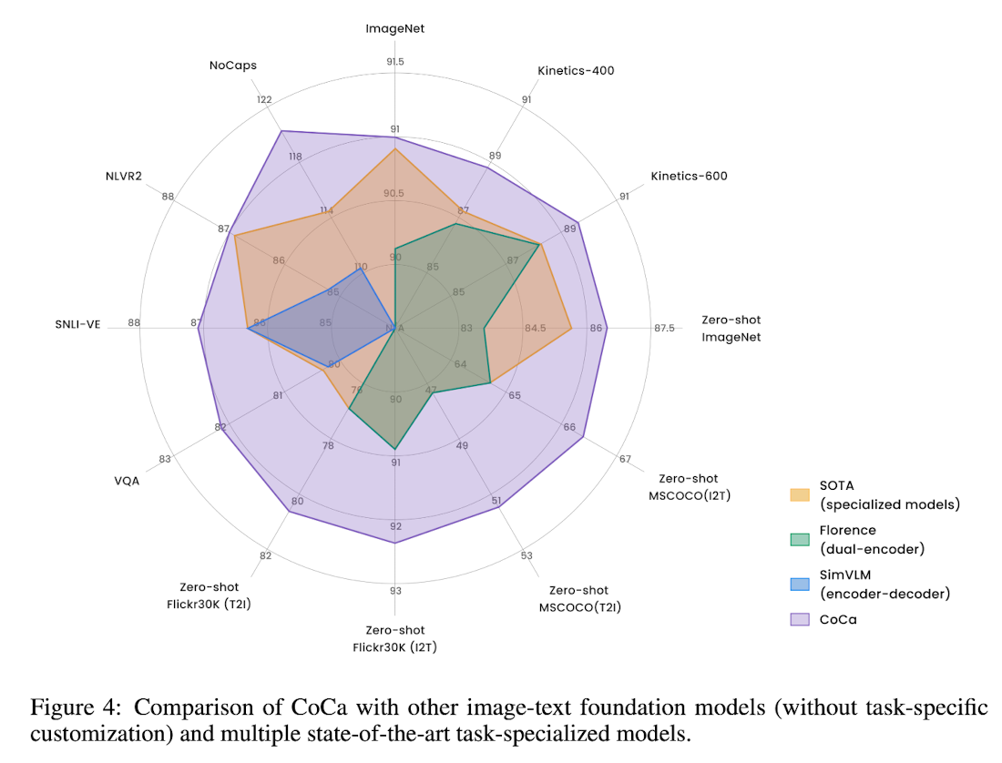
CoCa - Evaluations
CoCa outperforms foundation models and task-specialized models on 12 benchmarks including significant improvements in image-text retrieval, image captioning and VQA

Slide 82
Training Scaling Up

Slide 83
SigLIP: Sigmoid Loss for Language Image Pre-Training
"Scaling up training with sigmoid loss"

Slide 84
SigLIP: Background & Motivation
Contrastive pre-training
weak supervision
aligned representation space for images and texts
CLIP and ALIGN
contrastive objective
Batch-level softmax-based contrastive loss
pairwise similarity scores across all images, then all texts
numerically unstable
stabilization requiring additional pass over the full batch
Sigmoid loss
simplifying the distributed loss implementation
symmetric sigmoid loss requiring just a single pass
boosting efficiency
decoupling batch size from definition of task

Slide 85
SigLIP: Softmax-based Contrastive Loss
Given a mini-batch B = {(I1, T1), (I2, T2), . . . } of image-text pairs.
When using the softmax loss to formalize this objective, an image model f(·) and a text model g(·) are trained to minimize the following objective:
, , scalar t is parametrized as exp(t′) , and
is a global freely learnable parameter.
Due to the asymmetry of the softmax loss, the normalization is independently performed two times: across images and across texts.

Slide 86
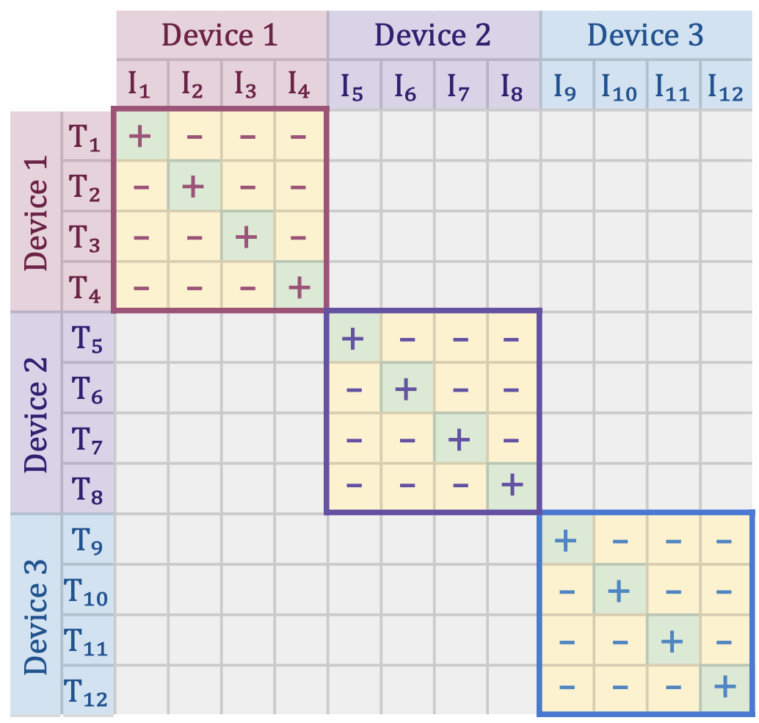
SigLIP: Softmax-based Contrastive Loss
Contrastive training typically utilizes data parallelism. Computing the loss when data is split across D devices necessitates gathering all embeddings with expensive all-gathers and the materialization of a memory-intensive |B| × |B| matrix of pairwise similarities.
Zhai, Xiaohua, et al. "Sigmoid loss for language image pre-training." arXiv preprint arXiv:2303.15343 (2023).

Slide 87
SigLIP: Sigmoid Loss
Sigmoid loss does not require computing global normalization factors. It processes every image-text pair independently, effectively turning the learning problem into the standard binary classification on the dataset of all pair combinations, with a positive labels for the matching pairs (Ii , Ti ) and negative labels for all other pairs (Ii, Tj̸=i) . The loss is defined as:
zij is the label for a given image and text input, which equals 1 if they are paired and −1 otherwise.
An additional learnable bias term b similar to the temperature t is introduced to overcome heavy imbalance coming from the many negatives dominating the loss.

Slide 88
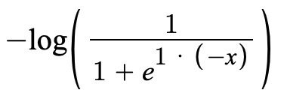
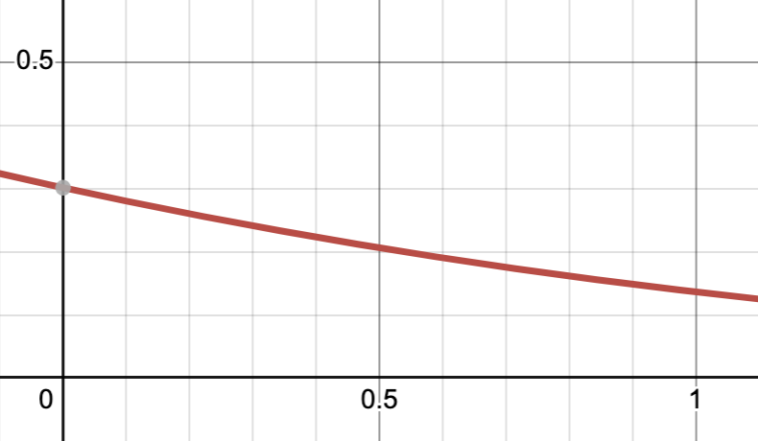
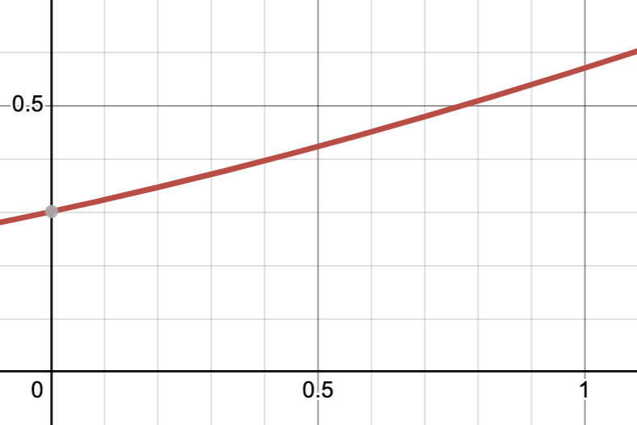
SigLIP: Sigmoid Loss
L =
pair: - =
unpair: - =

Slide 89
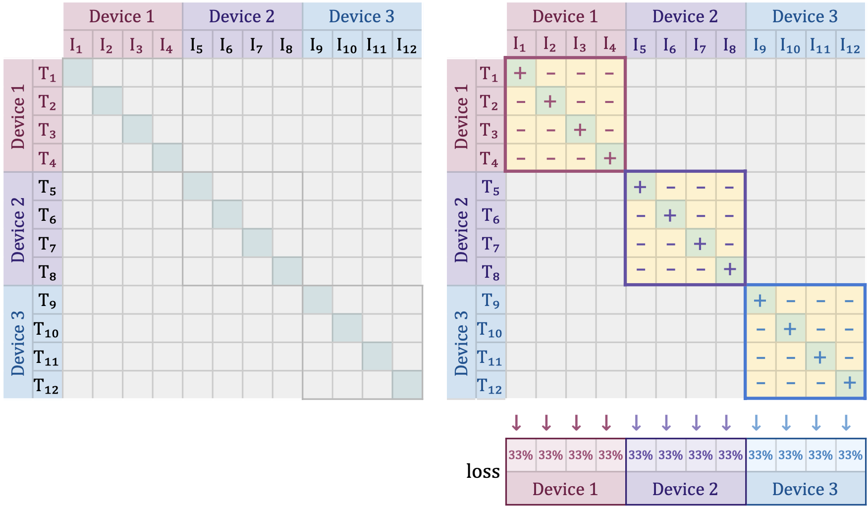
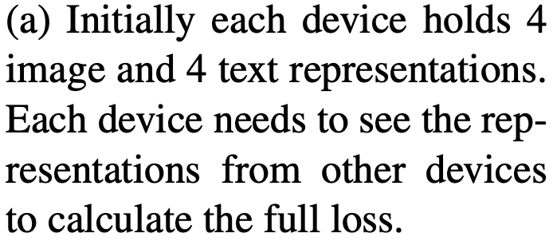
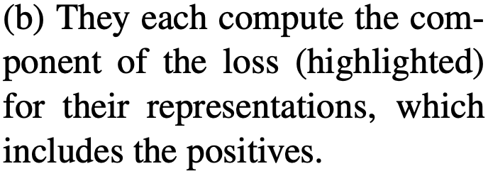
SigLIP: Efficient Loss Implementation
(a) (b)
Zhai, Xiaohua, et al. "Sigmoid loss for language image pre-training." arXiv preprint arXiv:2303.15343 (2023).

Slide 90
SigLIP: Efficient Loss Implementation
(c) (d)
Zhai, Xiaohua, et al. "Sigmoid loss for language image pre-training." arXiv preprint arXiv:2303.15343 (2023).

Slide 91
SigLIP: Batch Size
Apply sigmoid-based loss with CLIP and LiT:
SigLiT results: Sigmoid loss outperforms the softmax loss significantly with small batch sizes, and performs similarly at larger batch sizes.
SigLIP results: Both sigmoid loss and softmax loss saturate at a reasonable batch size, while the peak of the sigmoid loss comes earlier and slightly outperforms the peak of the softmax loss.
Zhai, Xiaohua, et al. "Sigmoid loss for language image pre-training." arXiv preprint arXiv:2303.15343 (2023).

Slide 92
SigLIP: Label Noise Robustness
Sigmoid-training increases robustness to data noise.
Titles show the type of corruption applied, and x-axes show the probability with which they are applied. With increasing corruption severity, M-scale models trained with sigmoid loss for 3.6 billion examples retain superiority over corresponding softmax baseline.
Models trained with sigmoid loss are increasingly robust to all kinds of added noise.
Zhai, Xiaohua, et al. "Sigmoid loss for language image pre-training." arXiv preprint arXiv:2303.15343 (2023).

Slide 93
Summarizations

Slide 94
Loss
Contrastive loss
ITC: sum of I2T and T2I InfoNCE loss to contrast paired text against others in the sampled batch (e.g., CLIP, BLIP)
Sigmoid loss: binary classification of all pair combinations (SigLip)
Binary classification to predict whether text-tag-image triplet contains the original tag or polluted tag (e.g., OSCAR)
Image-Text Matching (ITM) loss
Binary classification to predict whether an image-text pair is matched or unmatched (e.g., BLIP)
Language Modeling (LM) loss
A generative task to produce textual descriptions in an autoregressive manner given an image (e.g., BLIP)
Masked Language Modeling (MLM) loss
Predict masked text tokens based on surrounding text tokens and image features (e.g., OSCAR, VinVL)

Slide 95
Uni-Encoder Family
OSCAR
Feeding the sequence of texts, tags and image regions embeddings to BERT
Semantic alignments between texts and images using object tags
Image-Text Contrastive (ITC) loss, Masked Language Modeling (MLM) loss
VinVL
Improving OSCAR with a more powerful object detection model
3-way contrastive loss
Same MLM loss as OSCAR
Architecture | First published | Model Name | Image-text Pairs (M) | VQA (test-dev) | GQA (test-dev) | NLVR2 (dev) | I2T retrieval (COCO R@1) | T2I retrieval (COCO R@1) | Image Captioning (BLEU@4) | NoCaps (Valid CIDEr) | NoCaps (Valid SPICE)
Uni-encoder | 2020/03 | OSCAR | 7 | 73.82 | 61.58 | 80.37 | 73.5 (FT) | 57.5 (FT) | 41.7 | 80.9 | 11.3
 | 2021/01 | VinVL | 9 | 76.6 | 65.05 | 82.7 | 75.4 (FT) | 58.8 (FT) | 41 | 105.1 | 14.4

Slide 96
Dual-Encoder Family
CLIP
Introducing a learnable text encoder to encode free-form texts
Image-Text Contrastive (ITC) loss
ALIGN
Sacrificing quality to gain quantity – scaling up the corpus to 1.8B
Extends dataset to multilingual to train ALIGNmling
SigLIP
Changing softmax-based contrastive loss to sigmoid loss
Advantages: memory efficient, fast, and numerically stable implementation
Architecture | First published | Model Name | Image-text Pairs (M) | I2T retrieval (COCO R@1) | T2I retrieval (COCO R@1) | I2T retrieval (Flickr R@1) | T2I retrieval (Flickr R@1)
Dual-encoder | 2021/02 | CLIP | 400 | 58.4 (ZS) | 37.8 (ZS) | 88.0 (ZS) | 68.7 (ZS)
 | 2021/02 | ALIGN | 1800 | 58.6 (ZS) | 45.6 (ZS) | 88.6 (ZS) | 75.7 (ZS)
 | 2023/03 | SigLIP | 40000 | 70.6 (ZS) | 52.7 (ZS) | -- | --

Slide 97
Encoder-Decoder Family
BLIP
Adding natural language generation capabilities
ITC, LM, ITM loss
Quality also matters – improving text quality by bootstrapping text
CoCa
Minimalist design of BLIP, reducing the number of forward passes through transformer blocks
ITC, LM loss
Pre-trained with 4.8B images
Architecture | First published | Model Name | Image-text Pairs (M) | VQA (test-dev) | NLVR2 (dev) | I2T retrieval (Flickr R@1) | T2I retrieval (Flickr R@1) | Image Captioning (BLEU@4) | NoCaps (CIDEr)
Encoder-decoder | 2022/01 | BLIP | 129 | 78.3 | 82.2 | 96.7 (ZS) | 86.7 (ZS) | 40.4 | 113.2 (ZS)
 | 2022/05 | CoCa | 4800 | 82.3 | 86.1 | 92.5 (ZS) | 80.4 (ZS) | 40.9 | 122.4 (ZS)

