Slide 1
Lecture 18: Image Generation
Presenters: Max Ku, Julia Qi

Slide 2
Outline
Task Definition and Paradigm Method
Latent Diffusion Model / Stable Diffusion
Imagen
unCLIP / Dall-E 2
Parti
PixArt-Alpha
Stable Diffusion XL Turbo

Slide 3
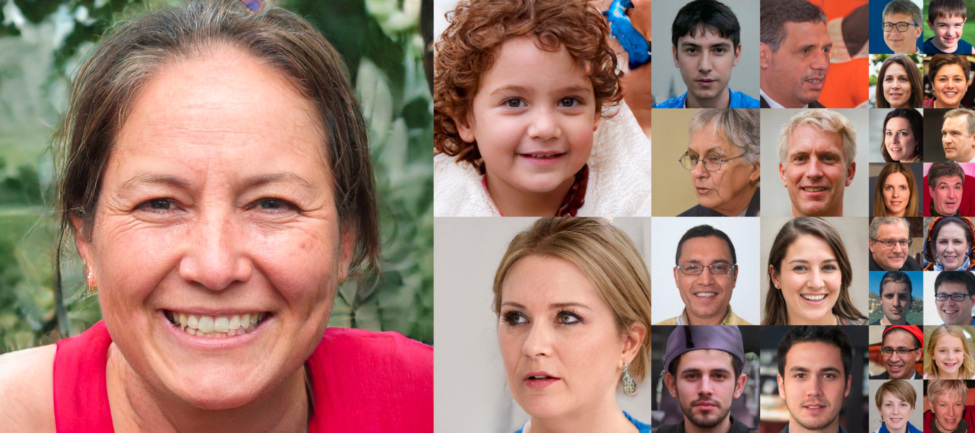
What was Image Generation
In context of year 2015:
Unconditional Image Generation, lack of controllability
https://thispersondoesnotexist.com/

Slide 4
What is Image Generation
In context of year 2024:
Often referred to Text-To-Image (T2I) Synthesis
“A tiger in a lab coat”
How is it done?

Slide 5
SOTA Image Generation Methods
“A tiger in a lab coat”
Text
Encoder
Text Prompt
Text Vector
Generation
Model
Input Latent
Latent
Decoder
Intermediate
Latent
Generated Image

Slide 6
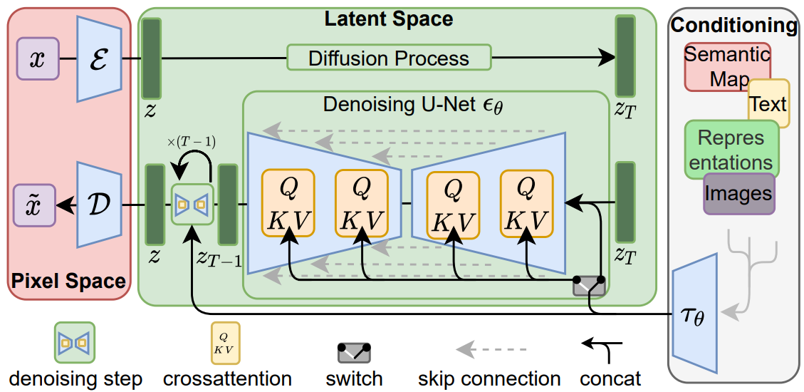
Latent DM (Stable Diffusion)
Denoise in the Latent space instead of Data space
Training Process
VAE
Encoder
512x512
VAE
Decoder
64x64
64x64
77x768
Domain-specific Encoder
High-Resolution Image Synthesis with Latent Diffusion Models
https://arxiv.org/abs/2112.10752

Slide 7
Latent DM (Stable Diffusion)
Downsampling Factor 8 on the latent is the best (512//8 = 64)
Pixel-based LDM-1 requires substantially larger train times
Too much perceptual compression as in LDM-32 limits the overall sample quality
High-Resolution Image Synthesis with Latent Diffusion Models
https://arxiv.org/abs/2112.10752

Slide 8
Latent DM (Stable Diffusion)
Only required a 64x64 random noise for generation
Generation Process
Generation Model
“A tiger in a lab coat”
Latent Space
Decoder
64x64
64x64
512x512
77x768
Domain-specific Encoder (BERT-Tokenizer)
High-Resolution Image Synthesis with Latent Diffusion Models
https://arxiv.org/abs/2112.10752

Slide 9
Latent DM (Stable Diffusion)
What's the Advantage?
Fast training
start from lower dimension
Simple denoising
The distribution of latent embeddings close to Normal distribution
Tailored Autoencoders
Application to any data type (e.g. graphs, text, 3d data etc.)
High-Resolution Image Synthesis with Latent Diffusion Models
https://arxiv.org/abs/2112.10752

Slide 10
Latent DM (Stable Diffusion)
The 3 Core components in Latent Diffusion Model
Variational AutoEncoder (VAE)
To Encode and Decode Latents
Domain-specific Encoder
Text Encoder (BERT-Tokenizer)
UNet
Integrated ResBlock (Residual Block)
Integrated BasicTransformerBlock (Transformer Block) + TimeEmbedding
High-Resolution Image Synthesis with Latent Diffusion Models
https://arxiv.org/abs/2112.10752

Slide 11
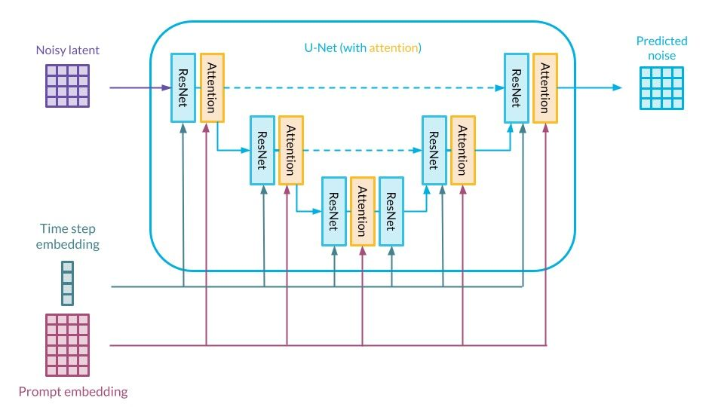
Latent DM (Stable Diffusion)
UNet in Stable Diffusion (Figure not in scale)
High-Resolution Image Synthesis with Latent Diffusion Models
https://arxiv.org/abs/2112.10752

Slide 12
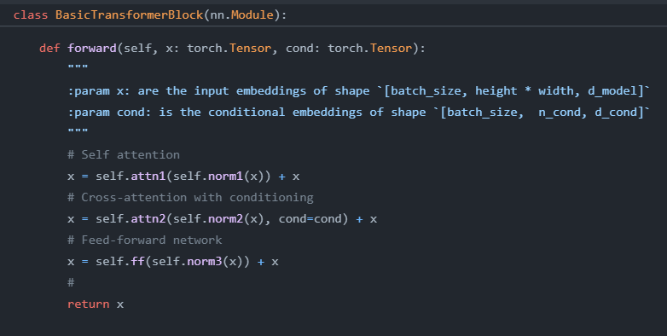
Latent DM (Stable Diffusion)
Cross Attention allows text control on image generation
BasicTransformerBlock in UNet
Self Attention
Cross Attention
FeedForward
High-Resolution Image Synthesis with Latent Diffusion Models
https://arxiv.org/abs/2112.10752

Slide 13
Stable Diffusion
LDM trained by Stability AI for Text-to-Image
256 A100 GPUs on AWS for a total of 150k GPU-hours
Spent $600k USD
Trained on dataset LAION-5B
5 billion CLIP-filtered image-text pairs
Uses CLIP Text Encoder instead of BERT-Tokenizer Encoder in LDM (Why?)
High-Resolution Image Synthesis with Latent Diffusion Models
https://arxiv.org/abs/2112.10752

Slide 14
Stable Diffusion 2 and XL We will talk about SDXL Turbo later
Stable Diffusion 2
Retrained SD from scratch
filtered LAION-5B
New Text Encoder
CLIP -> OpenCLIP
Output size 512x512
Stable Diffusion XL
Retrained Autoencoder on larger batch size
A 3.5x larger UNet than SD
Output size 1024x1024
SDXL: Improving Latent Diffusion Models for High-Resolution Image Synthesis
https://arxiv.org/abs/2307.01952

Slide 15
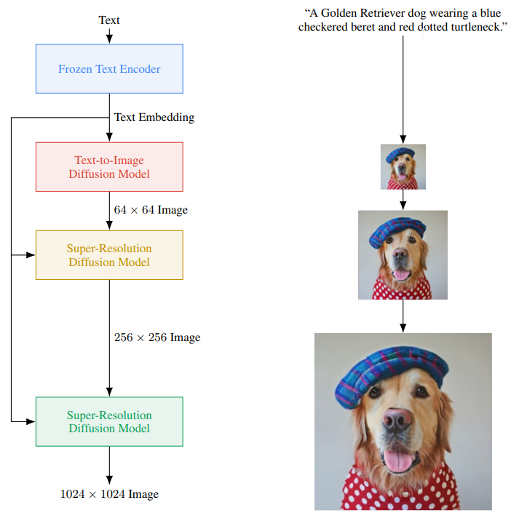
Imagen
Generation Process
Domain-specific Encoder
Keywords
Cascaded Model
Dynamic Thresholding
Generation Model
Decoder
Photorealistic Text-to-Image Diffusion Models with Deep Language Understanding
https://arxiv.org/abs/2205.11487

Slide 16
Imagen
What's the Highlight?
Simple
Does not involve latent space (Goodbye VAE)
Cascaded Model
High Fidelity and Photorealism
Dynamic Thresholding
Study on the Importance of Text Encoder
Larger Text Encoder -> Performance++++
DrawBench
A challenging set of prompts for evaluation
Photorealistic Text-to-Image Diffusion Models with Deep Language Understanding
https://arxiv.org/abs/2205.11487

Slide 17
Cascaded Diffusion Models (CDM)
Pipelines of DM that generate images of increasing resolution.
Noise conditioning augmentation, a data augmentation technique that find critical towards achieving high sample fidelity.
Cascaded Diffusion Models for High Fidelity Image Generation
https://arxiv.org/abs/2106.15282

Slide 18
Cascaded Model in Imagen
Noise conditioning augmentation weakens information from low-res models
Found that introduce text conditioning as extra information improve the performance
Photorealistic Text-to-Image Diffusion Models with Deep Language Understanding
https://arxiv.org/abs/2205.11487

Slide 19
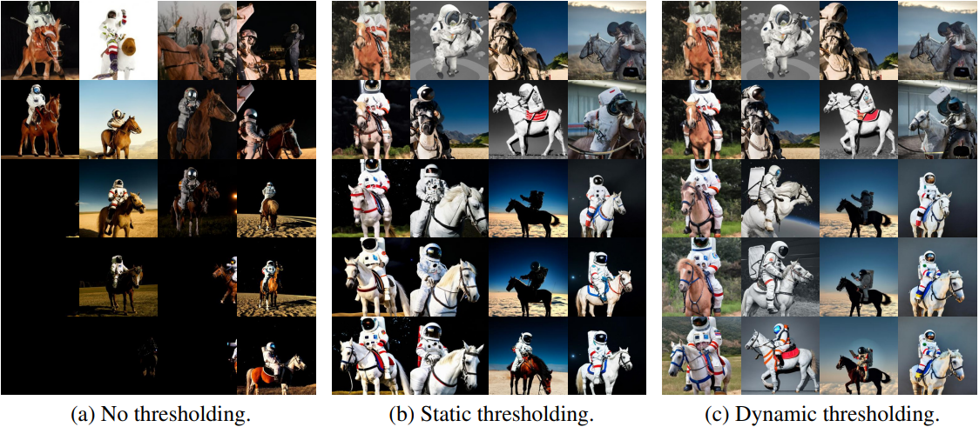
Dynamic Thresholding in Imagen
Adjusts the pixel values of samples at each sampling step to be within a dynamic range computed over the statistics of the current samples
Photorealistic Text-to-Image Diffusion Models with Deep Language Understanding
https://arxiv.org/abs/2205.11487

Slide 20
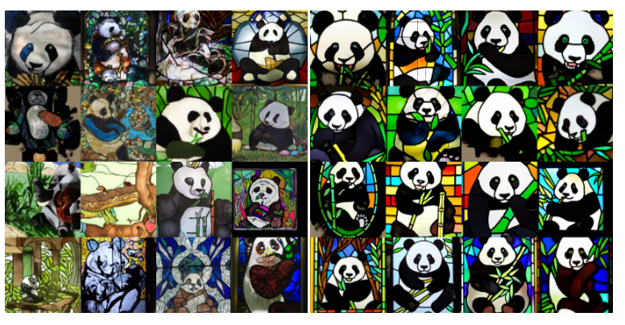
Revisit Classifier-Free Guidance
Instead of training an additional classifier, get an “implicit classifier” by jointly training a conditional and unconditional diffusion model
Barycentric combination of the conditional and the unconditional score function
Trade-off for sample quality and sample diversity
Only Conditional
Classifier-Free
Classifier-Free Diffusion Guidance
https://arxiv.org/abs/2207.12598
GLIDE: Towards Photorealistic Image Generation and Editing with Text-Guided Diffusion Models
https://arxiv.org/abs/2112.10741

Slide 21
Dynamic Thresholding in Imagen
At each sampling step the output is clipped into same bounds of training data
Static thresholding (Standard Practice)
Clipping to [-1, 1]
=> image look saturated
Dynamic thresholding
Threshold to [-s, s] and then divide by s
s is a certain percentile absolute pixel value in the output at each sampling step
=> preventing pixels from saturation and image look more realistic
Photorealistic Text-to-Image Diffusion Models with Deep Language Understanding
https://arxiv.org/abs/2205.11487

Slide 22
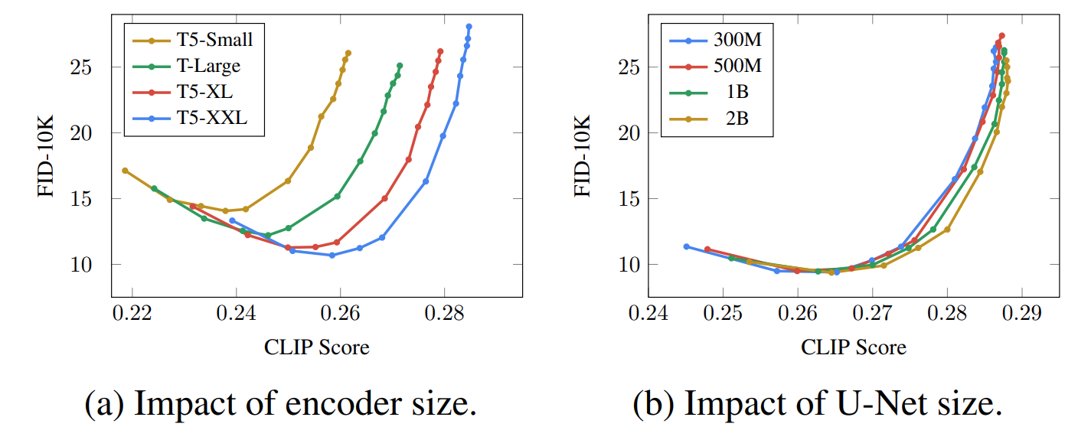
Powerful Text Encoders are necessary
Imagen used T5-XXL as Text Encoder
Photorealistic Text-to-Image Diffusion Models with Deep Language Understanding
https://arxiv.org/abs/2205.11487

Slide 23
Revisit FID
Fréchet inception distance (FID)
Measures image fidelity
Compute Fréchet distance between real and generated data points
Number ranged from 0 to inf
A lot of samples needed (>10K)
GANs Trained by a Two Time-Scale Update Rule Converge to a Local Nash Equilibrium
https://arxiv.org/abs/1706.08500
On Aliased Resizing and Surprising Subtleties in GAN Evaluation
https://arxiv.org/abs/2104.11222

Slide 24
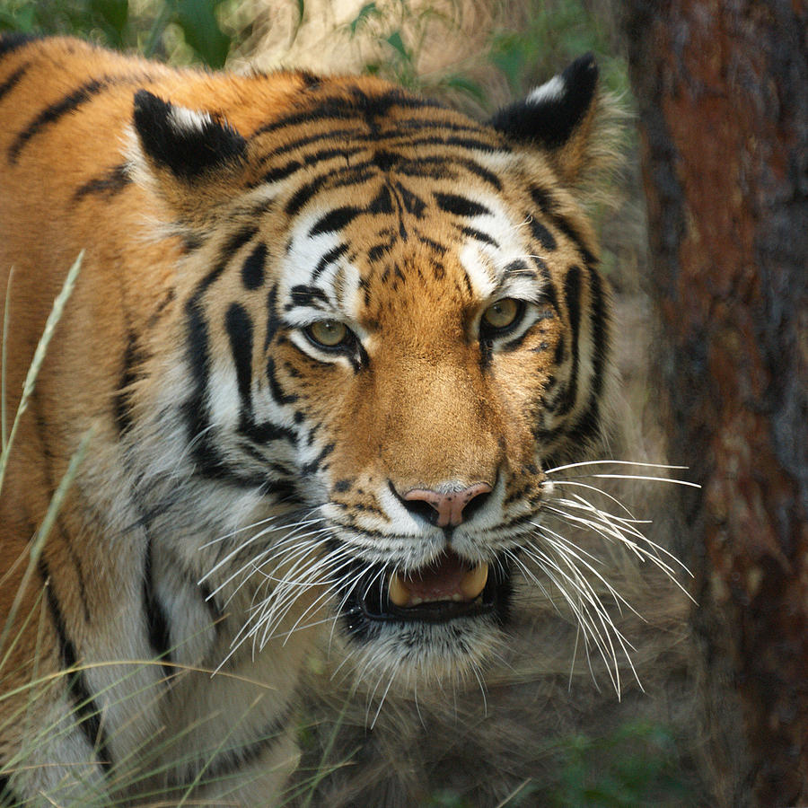
Revisit CLIP, CLIPScore
Contrastive Language-Image Pre-training (CLIP)
Trained with 400M image-text pairs
CLIPScore: Measures image-text alignment
Cosine similarity between text and image vector
Text Vector
“A tiger with mouth opened”
Text
Encoder
Close or Far?
CLIPScore: 0.45
Image
Encoder
Image Vector
Learning Transferable Visual Models From Natural Language Supervision
https://arxiv.org/abs/2103.00020
CLIPScore: A Reference-free Evaluation Metric for Image Captioning
https://arxiv.org/abs/2104.08718

Slide 25
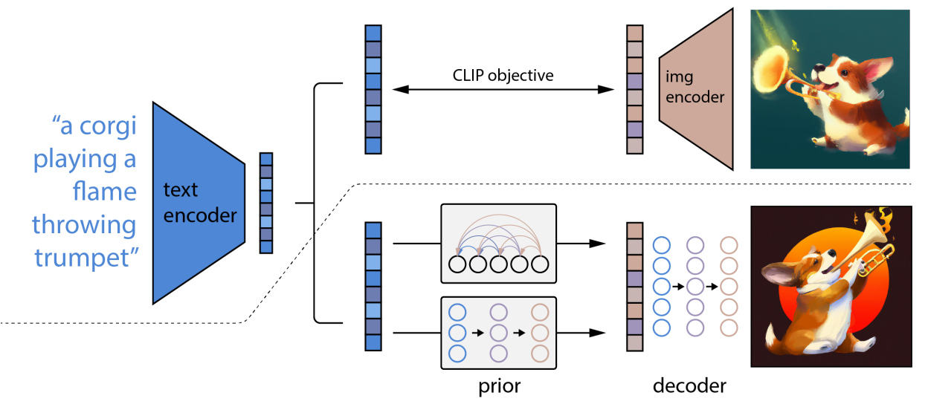
unCLIP (Dall-E 2)
Model
Hierarchical Text-Conditional Image Generation with CLIP Latents
https://arxiv.org/abs/2204.06125

Slide 26
unCLIP (Dall-E 2)
Text Vector
Image Vector
Learn a join representation space for text and images
Model
Hierarchical Text-Conditional Image Generation with CLIP Latents
https://arxiv.org/abs/2204.06125

Slide 27
unCLIP (Dall-E 2)
Frozen
Text Vector
Image Vector
Diffusion Model
Generation Model
(Transformer Decoder)
Decoder
(Cascaded Diffusion Model)
Encoder
produces CLIP image embeddings conditioned on the input caption
produce image conditioned on the CLIP image embedding and text
Hierarchical Text-Conditional Image Generation with CLIP Latents
https://arxiv.org/abs/2204.06125

Slide 28
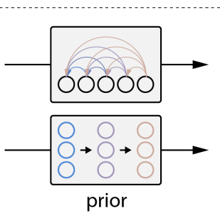
Which Model to use for Prior?
Prior model produces CLIP image embeddings conditioned on the input caption
Autoregressive
quantize image embedding to a sequence of discrete codes and predict them autoregressively
Diffusion Prior
model the continuous image embedding by diffusion models conditioned on caption
A decoder-only Transformer
Autoregressive
Diffusion
Hierarchical Text-Conditional Image Generation with CLIP Latents
https://arxiv.org/abs/2204.06125

Slide 29
Dall-E 2 Decoder
Decoder conditioned on CLIP image embedding and Text
CLIP Image embeddings capture high-level semantic meaning
Latents in the decoder model take care of the low-level details
Decoder is a Cascaded Diffusion Model
1 base model (64x64)
2 super-resolution models (64x64 -> 256x256,256x256->1024x1024)
Similar to Imagen!
Hierarchical Text-Conditional Image Generation with CLIP Latents
https://arxiv.org/abs/2204.06125

Slide 30
Parti (Pathways Autoregressive Text-to-Image Model)
Motivation
Research by Google in parallel with Imagen to explore two families of generative models - autoregressive and diffusion
Autoregressive models: taking previous prediction as input to generate a new prediction
Treating text-to-image generation as a sequence-to-sequence modeling problem: image tokens as target outputs
To demonstrate the capability of autoregressive models to generate high-fidelity, photorealistic images, and to support content-rich synthesis
Scaling Autoregressive Models for Content-Rich Text-to-Image Generation
https://arxiv.org/abs/2206.10789
Notes:
The next paper introduces Parti, which stands for Pathways Autoregressive Text-to-Image model, unlike previous models that are mentioned, Parti is not a diffusion model. Parti represents a research effort by Google done in parallel with Imagen to explore two families of generative models, which are autoregressive and diffusion models. The autoregressive approach by Parti hinges on the principle of using previous predictions as input to generate subsequent ones, which is a method synonymous with the likes of language translation in NLP. Specifically in Parti, it treats text-to-image generation as a sequence-to-sequence modeling problem, where image tokens are predicted in a series that corresponds to the sequence of descriptive text tokens. The motivation for this research is to demonstrative the ability of autoregressive models to generate high-fidelity, photorealistic images that reflect the content density and complexity proposed by the textual description.

Slide 31
Contributions
Demonstrated autoregressive models achieving SOTA performance
Demonstrated consistent improvements over 4 scales of the model (350M, 750M, 3B, and 20B)
Developed PartiPrompts (P2) benchmark
Identified limitations and provided a detailed breakdown with exemplars for observed error types
Scaling Autoregressive Models for Content-Rich Text-to-Image Generation
https://arxiv.org/abs/2206.10789
Notes:
Here are the main contributions of this paper. First, it highlights the model's state-of-the-art (SOTA) performance in autoregressive modeling for text-to-image generation, setting a new benchmark in the field. Second, it marks the consistency of improvements that Parti has demonstrated across 4 different scales of its architecture, from 350 million to 20 billion parameters, emphasizing the scalability of the system. Third, this research introduces the PartiPrompts (P2) benchmark, a development that provides a comprehensive framework for evaluating text-to-image models. Last, the paper also acknowledges the importance of transparency in research by identifying the limitations of the Parti model and detailing these alongside observed error types.

Slide 32
Parti: Image (De/)Tokenizer + Autoregressive Model
Revisit T2I structure
“A tiger in a lab coat”
Text
Encoder
Text Prompt
Text Tokens
Generation Model
Input Latent
Latent
Decoder
Intermediate
Latent
Generated Image
Notes:
Parti is presented as a two stage model which has an image tokenizer/detokenizer alongside an autoregressive model. To dissect its structure, let’s revisit the text-to-image structure.
A text-to-image model begins with a text prompt, which is passed to a text encoder that translates the input into a series of discrete text tokens. These tokens are then fed into the generation model, which interacts with an input latent space, then a model generates intermediate latents. Finally, a latent decoder interprets these intermediate representations, constructing the output as a detailed, photorealistic image that corresponds to the original text prompt.

Slide 33
Parti: Image (De/)Tokenizer + Autoregressive Model
A two-stage model
“A tiger in a lab coat”
Text
Encoder
Text Prompt
Text Tokens
Image
Tokenizer
Autoregressive
Model
(Decoder)
Input Image
Input Image Tokens
Image
Detokenizer
Output Image Tokens
Generated Image
Notes:
In the context of the training process in Parti, both images and text are converted to tokens. First, an image tokenizer breaks down an input image into corresponding image tokens, which are essentially the visual syllables of the picture. These tokens are then processed by an autoregressive model, particularly the decoder part of a Transformer network. The output is a series of new image tokens. Finally, an image detokenizer reassembles these tokens into a coherent generated image that visually represents the initial text prompt.

Slide 34
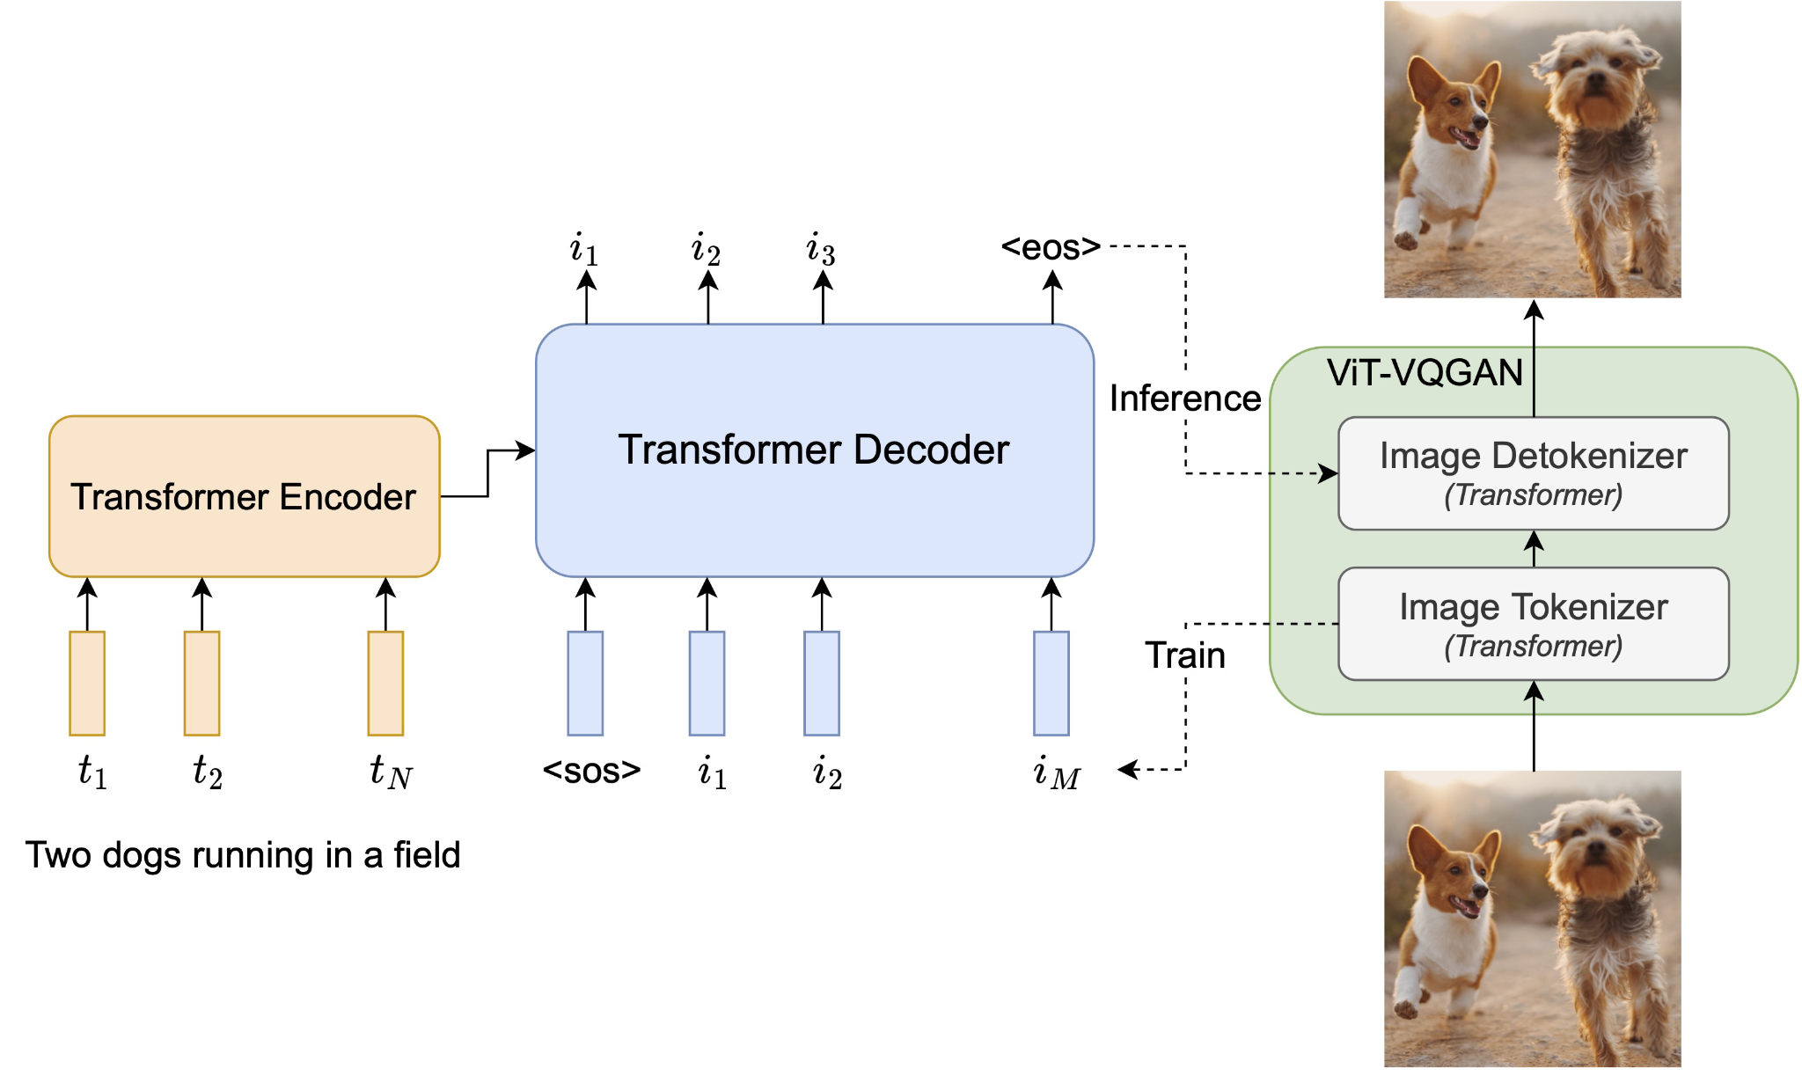
Parti: Image (De/)Tokenizer + Autoregressive Model
A two-stage model cont’d
Output (Generated)
Image
Text Tokens
Predicting Next Token
Input (Training)
Image
Scaling Autoregressive Models for Content-Rich Text-to-Image Generation
https://arxiv.org/abs/2206.10789
Notes:
Here is a schematic of the structure as presented in the paper. It follows a two stage structure, the image tokenizer and detokenizer stage in green and the autoregressive stage in orange and blue for predicting the next image token given text tokens and previous tokens. Each of these components is essentially a transformer, so Parti is effectively a Transformer based sequence to sequence model. Let’s first talk about the image tokenizer and detokenizer stage in green.

Slide 35
Stage I: Image (De/)Tokenizer
Methodology
Training a tokenizer that converts an image into a sequence of discrete visual tokens during training, and a detokenizer that reconstructs the image from tokens during inference
The problem: must linearize 2D images into 1D sequences of patch representations → long sequences! (256×256×3RGB Image → 196,608 rasterized values)
Previous work: learn quantized representations of image patches
Proposed solution: learn patch embeddings, learn a visual codebook, map embedding to nearest codebook entry (each codebook entry is a learned and indexable location in the latent space) → ViT-VQGAN
Scaling Autoregressive Models for Content-Rich Text-to-Image Generation
https://arxiv.org/abs/2206.10789
Notes:
This first stage involves training a tokenizer that converts an image into a sequence of discrete visual tokens during training, and training a detokenizer that reconstructs the image from tokens during inference.
However, there is a significant challenge, which is how to linearize 2D images into 1D sequences of patch representations. The problem lies in the complexity of images, where even a standard 256x256 pixel image with three color channels (RGB) results in 196 thousand rasterized values. Previous methods tackled this by learning quantized representations of image patches. However, the Parti model introduces a more refined solution. It utilizes a tokenizer to learn patch embeddings and then maps these embeddings to a visual codebook. Each entry in this codebook corresponds to an indexable location in the latent space, thereby reducing the complexity of the image data. This is achieved using the Vision Transformer (ViT) combined with Vector Quantized Generative Adversarial Networks (VQGAN), known as ViT-VQGAN. This approach not only streamlines the image data into a manageable sequence but also maintains the richness of the image's information. Let’s now talk about ViT-VQGAN in detail.

Slide 36
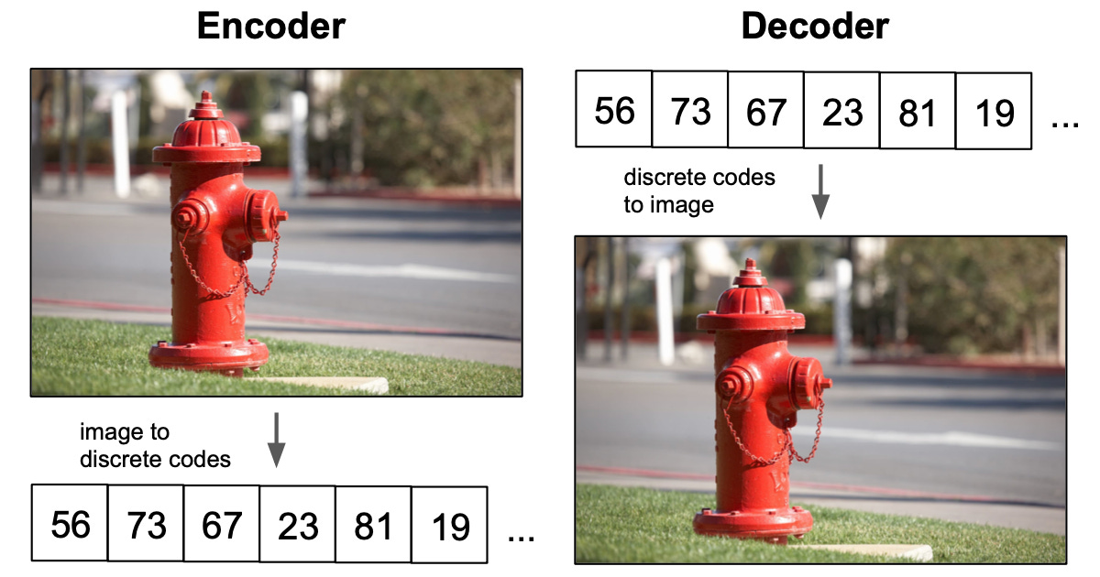
VQVAE → VQGAN → ViT-VQGAN
Methodology
VAE: learns a continuous latent representation
Vector Quantized-VAE: learns a discrete latent representation
Neural Discrete Representation Learning
https://arxiv.org/abs/1711.00937
Notes:
To understand ViT-VQGAN, let’s start with VQVAE.
A VAE typically learns a continuous latent representation, mapping input data into a continuous distribution. On the other hand, the VQ-VAE, which stands for Vector Quantized-Variational AutoEncoder, learns a discrete latent representation. This shift from continuous to discrete encoding is crucial because it can help address issues like the "posterior collapse" in VAEs, where the model ignores the latent variables because the decoder is too capable. Discrete codes, as shown in the encoder part of the slide, represent the input image as a series of integers (56, 73, 67, 23, 81, 19, ...), which correspond to specific vectors in a predefined embedding space. The decoder then translates these discrete codes back into a reconstructed image.

Slide 37
VQVAE → VQGAN → ViT-VQGAN
Methodology
Codebook
H
W
Codebook: list of K vectors with dimension D associated with index 1,2,...K
Latent embedding vector: e_{i}∈ R^{D}, i ∈ 1, 2, …, K
Neural Discrete Representation Learning
https://arxiv.org/abs/1711.00937
Notes:
This is a more detailed description of the VQ-VAE architecture, the encoder, represented by a CNN, transforms the input image into a set of latent variables, ze(x). These variables are then mapped to a discrete latent space using a codebook that consists of a list of K vectors, each with dimension D. This codebook acts as a lookup table where each embedding vector e_i is associated with an index from 1 to K.

Slide 38
VQVAE → VQGAN → ViT-VQGAN
Methodology
Codebook
H
W
Discrete latent variables z are calculated by a nearest neighbour look-up using the shared embedding space (codebook)
Posterior distribution q(z|x) probabilities defined as one hot:
Neural Discrete Representation Learning
https://arxiv.org/abs/1711.00937
Notes:
The mapping from the continuous latent space to the discrete codebook is performed by a nearest neighbor search in the shared embedding space, which is the codebook, and produces the discrete latent variables z.
The posterior distribution q(z|x) is defined as one hot where it is = 1 if the embedding vector is the nearest neighbour of ze (x) and 0 otherwise.

Slide 39
VQVAE → VQGAN → ViT-VQGAN
Methodology
Codebook
H
W
The input to the decoder is the corresponding embedding vector e_{k}:
Neural Discrete Representation Learning
https://arxiv.org/abs/1711.00937
Notes:
The input to the decoder zq(x) is then the corresponding embedding vector e_{k} where k is the index of the nearest neighbour embedding vector

Slide 40
VQVAE → VQGAN → ViT-VQGAN
Methodology
Codebook
H
W
Copy gradients ∇_{z}L from decoder input z_{q}(x) to encoder output z_{e}(x)
Train the network with loss:
Reconstruction loss
Codebook loss
Commitment loss
Neural Discrete Representation Learning
https://arxiv.org/abs/1711.00937
Notes:
The training involves copying gradients from the decoder input zq(x) to the encoder output ze(x), this allows for gradient flow despite the non-differentiability of the discrete latent space.
The loss function used to train the network consists of three parts:
1. Reconstruction Loss: which measures the difference between the original image and the reconstructed image
2. Codebook Loss: which pulls the codebook vectors e towards the encoder outputs ze(x), with sg denoting the stop gradient operation that prevents gradients from flowing into the encoder outputs.
3. Commitment Loss: which penalizes the encoder output ze(x) for deviating from the chosen codebook embeddings e, ensuring that the encoder commits to the codebook assignment.
Beta is a hyperparameter balancing term.
This loss function collectively ensures that the encoder representations are close to the codebook embeddings while still allowing for efficient reconstruction, and it maintains the integrity of the codebook by having embeddings that are representative of the encoder outputs.

Slide 41
VQVAE → VQGAN → ViT-VQGAN
Methodology
Differences from VQVAE:
Training
VQVAE: L₂ loss as reconstruction loss
VQGAN: perceptual loss as reconstruction loss (Learned Perceptual Image Patch Similarity Metric - LPIPS)
VQGAN introduces a discriminator to distinguish reconstructed vs. real training image patches
Sampling
VQVAE: learn a categorical prior p(z) over latent codes in codebook from training images, VQVAE paper used autoregressive PixelCNN model
VQGAN: predicting next codebook index using autoregressive transformer model trained with latent codes in training images
Taming Transformers for High-Resolution Image Synthesis
https://arxiv.org/abs/2012.09841
Notes:
VQGAN builds upon the VQVAE structure with several differences.
In training, VQVAE uses L2 loss, which is a standard reconstruction loss focusing on pixel-wise accuracy. VQGAN, however, opts for a perceptual loss, specifically the Learned Perceptual Image Patch Similarity (LPIPS) metric. Perceptual loss differs from L2 loss by measuring the perceptual similarity between image patches.
Additionally, VQGAN incorporates a discriminator, which is trained to differentiate between real and reconstructed image patches
During sampling, VQVAE learns a categorical prior over the latent codes in the codebook from training images, often employing an autoregressive model like PixelCNN to model the distribution of the latent codes. VQGAN enhances this approach by predicting the next codebook index using an autoregressive transformer model trained with latent codes in training images, likely improving the coherence and quality of the synthesized images by leveraging the transformer's ability to capture long-range dependencies.

Slide 42
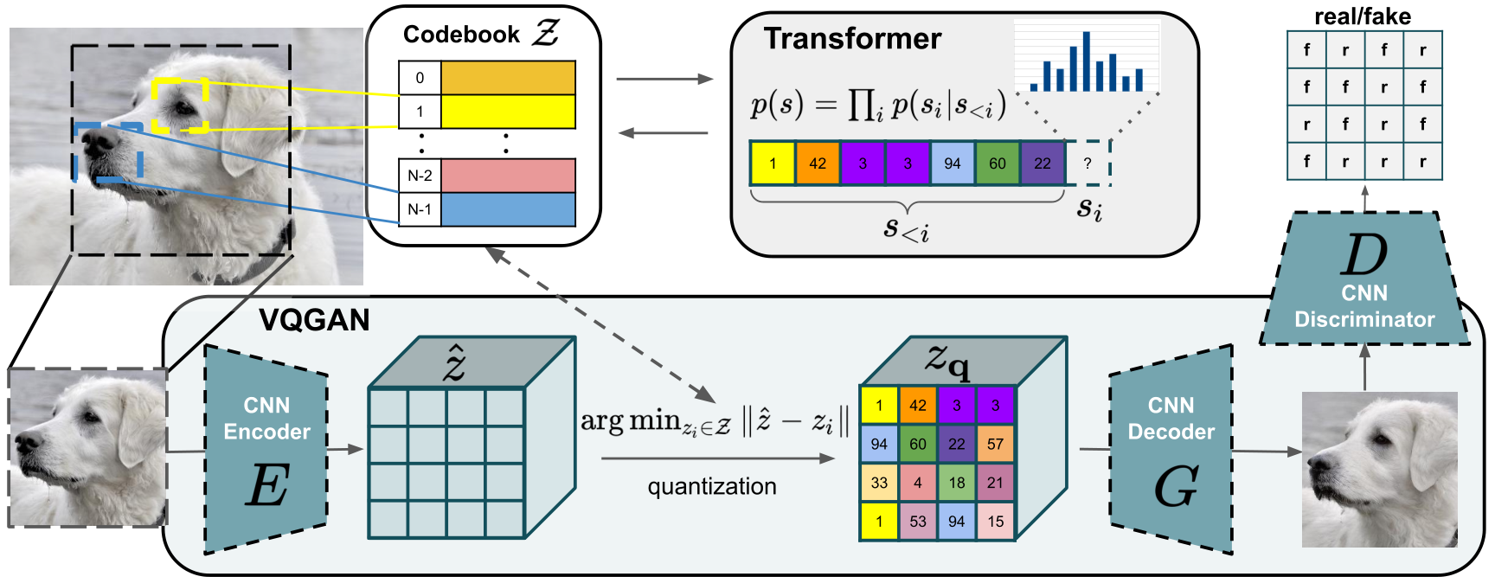
VQVAE → VQGAN → ViT-VQGAN
Methodology
Stage 1: Training encoder E, decoder G, discriminator D
Taming Transformers for High-Resolution Image Synthesis
https://arxiv.org/abs/2012.09841
Notes:
The first stage involves training the encoder E, decoder G, and discriminator D

Slide 43
VQVAE → VQGAN → ViT-VQGAN
Methodology
Taming Transformers for High-Resolution Image Synthesis
https://arxiv.org/abs/2012.09841
Notes:
Using similar losses as VQVAE, with the addition of a GAN loss and a modification from L2 to perceptual loss.

Slide 44
VQVAE → VQGAN → ViT-VQGAN
Methodology
Stage 2: Training the transformer to learn relationships between codebook entries
Taming Transformers for High-Resolution Image Synthesis
https://arxiv.org/abs/2012.09841
Notes:
In stage 2, VQGAN trains a transformer to learn relationships between codebook entries

Slide 45
VQVAE → VQGAN → ViT-VQGAN
Methodology
Differences from VQGAN:
Replacing CNN encoder/decoder with ViTs
Codebook optimization to improve codebook usage
Factorized codes: linear projection from encoder output to low dimension latent space for code index lookup, decouple code embedding and lookup
L₂-normalized codes: apply normalization on encoder output latent variables z_{e}(x) and codebook latent variables e, Euclidean distance effectively the cosine similarity of z_{e}(x) and e
Loss functions
Vector-quantized Image Modeling with Improved VQGAN
https://arxiv.org/abs/2110.04627
Notes:
ViT-VQGAN further improves upon VQGAN with the following modifications:
It replaces both the CNN encoder and decoder with ViTs, then it also introduced codebook optimization to improve codebook usage:
First, it uses factorized codes, which applies a linear projection from encoder output to a low dimension latent space for code index lookup, which decouples code embedding and lookup.
Second, it applied L2-normalization on the encoder output latent variables ze(x) and codebook latent variables e, so the resulting Euclidean distance is effectively the cosine similarity.
In addition, it also modified the loss functions to be a combination of several losses introduced in VQVAE and VQGAN.

Slide 46
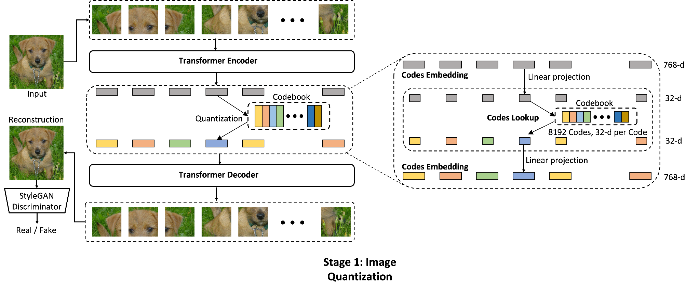
VQVAE → VQGAN → ViT-VQGAN
Methodology
Vector-quantized Image Modeling with Improved VQGAN
https://arxiv.org/abs/2110.04627
Notes:
The portion on the right depicts the codebook optimization part of ViT-VQGAN that includes a linear projection.

Slide 47
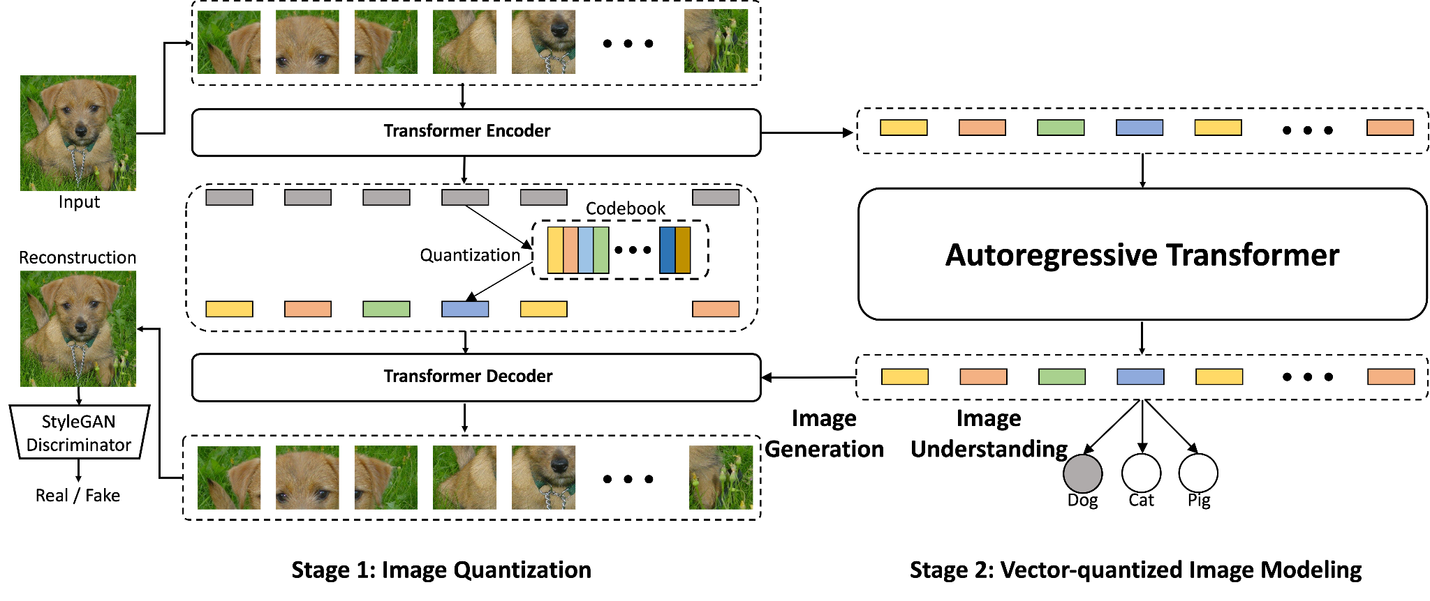
VQVAE → VQGAN → ViT-VQGAN
Methodology
Vector-quantized Image Modeling with Improved VQGAN
https://arxiv.org/abs/2110.04627
Notes:
This is the overall schematic in the ViT-VQGAN paper. It is similar to VQGAN, but replacing CNNs with transformer encoder and decoders.

Slide 48
Back to Parti Stage I: Using ViT-VQGAN as Image (De/)Tokenizer
Methodology
L_{ADV}
1
2
…
StyleGAN
Discriminator
8192
Codebook Lookup
(Quantization)
ViT
Encoder
ViT
Decoder
Input Image
256x256
Linear Project
Linear Project
Output (Reconstructed) Image 256x256
Image Tokenizer
Image Detokenizer
Super-Resolution Upsampler
Scaling Autoregressive Models for Content-Rich Text-to-Image Generation
Output Image 1024x1024
https://arxiv.org/abs/2206.10789
Notes:
Back to Parti stage I, this is the overall schematic of the image tokenizer and detokenizer training with ViT-VQGAN,
In Parti, it also uses a super-resolution upsampler to upsample the output image

Slide 49
Stage II: Encoder-Decoder Transformer (Autoregressive)
Methodology
Output (Generated)
Image
Text Tokens
Predicting Next Token
Input (Training)
Image
Scaling Autoregressive Models for Content-Rich Text-to-Image Generation
https://arxiv.org/abs/2206.10789
Notes:
Parti stage II involves the autoregressive model, which is essentially an encoder-decoder transformer

Slide 50
Stage II: Encoder-Decoder Transformer (Autoregressive)
Methodology
Training an encoder that takes text as input and outputs text tokens, and a decoder that autoregressively predicts the next image token with tokens generated from Stage I’s image tokenizer
Encoder: sentence-piece model of vocabulary size 16,000 on a sampled text corpus from training data, max token length = 128
Decoder: fixed output image token length = 1024 (32x32 tokens from a 256x256 input image)
Scaling Autoregressive Models for Content-Rich Text-to-Image Generation
https://arxiv.org/abs/2206.10789
Notes:
The encoder is designed to process textual input and convert it into text tokens, utilizing a sentence-piece model with a vocabulary size of 16,000 based on a sampled text corpus. It has a maximum token length capacity of 128. Meanwhile, the decoder focuses on predicting the next image token in a sequence, taking as input the image tokens generated from Stage I's image tokenizer. The output from the decoder is structured into a fixed length of 1024 image tokens, which correspond to a grid of 32x32 tokens for a 256x256 input image.

Slide 51
Parti Training
Design Considerations
Trained 4 size variants of Parti
Encoder and Decoder based on standard Transformers
Configuration prefers a larger decoder for generating image tokens, decoder has more layers
Scaling Autoregressive Models for Content-Rich Text-to-Image Generation
https://arxiv.org/abs/2206.10789
Notes:
4 size variants of Parti were trained with 350M, 750M, 3B, and 20B total parameters.

Slide 52
Parti Training
Design Considerations
Text Encoder Pretraining
Intend to warm-start the model with a pretrained text encoder
Very marginally helps with T2I generation softmax cross entropy loss with 3B Parti model
Pretrained on 2 datasets: the Colossal Clean Crawled Corpus (C4), image-text data
Performs comparably to BERT on GLUE after pretraining, but degrades after full encoder-decoder training
For future research: difference and unification of generic language understanding and visually-grounded language understanding
Scaling Autoregressive Models for Content-Rich Text-to-Image Generation
https://arxiv.org/abs/2206.10789
Notes:
For further design considerations, the authors employed text encoder pretraining with the intention to warm start the model, but found that it very marginally helps since it degrades after full encoder-decoder training.
They have listed this difference and unification of generic language understanding and visually-grounded language understanding for future research.

Slide 53
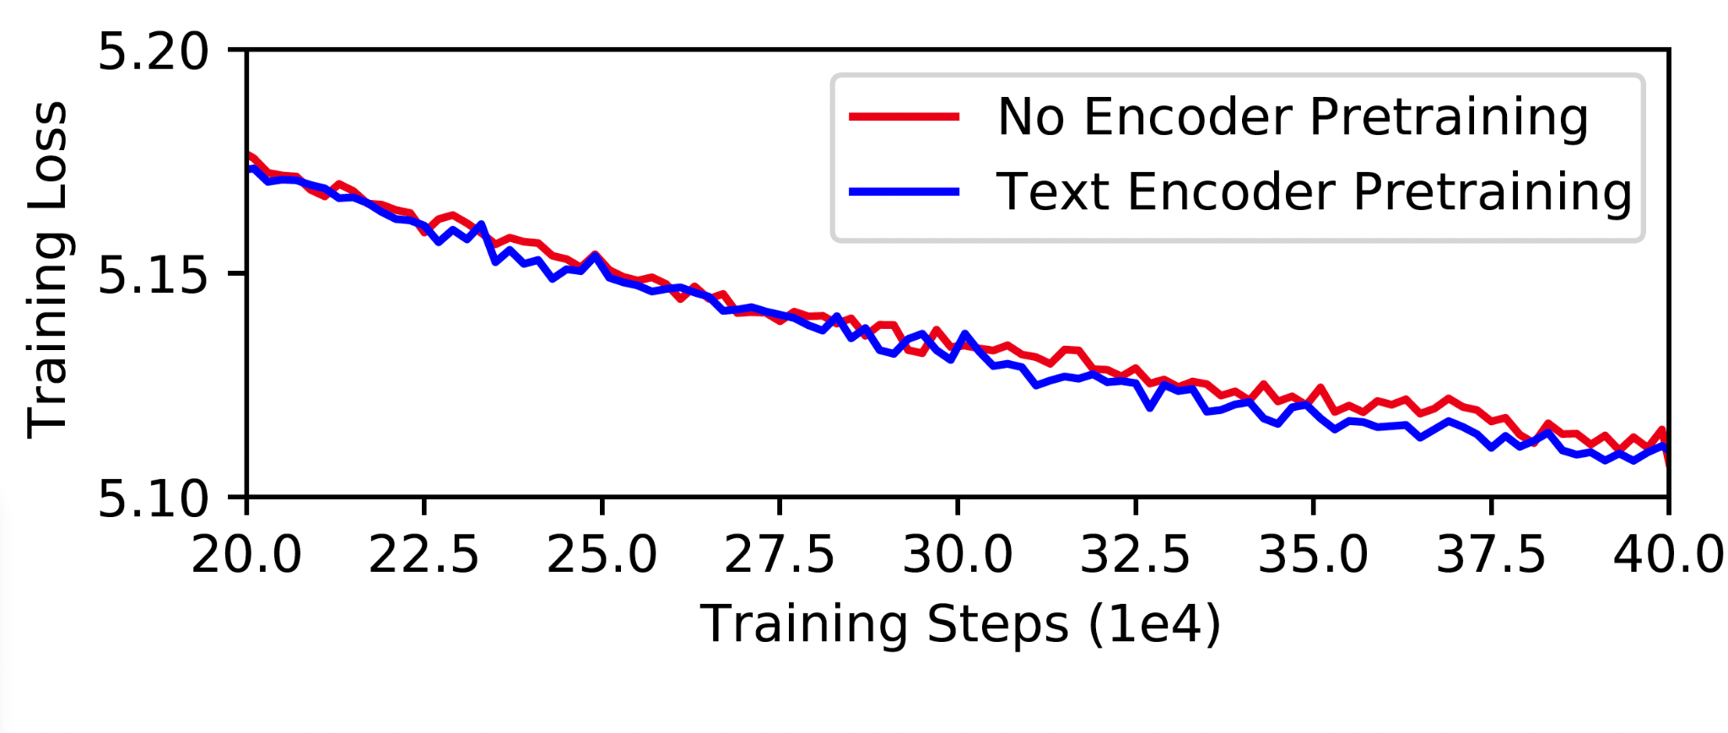
Parti Training
Design Considerations
Scaling Autoregressive Models for Content-Rich Text-to-Image Generation
https://arxiv.org/abs/2206.10789
Notes:
Here is the training loss graph with and without text encoder pretraining.

Slide 54
Parti Sampling
Design Considerations
Classifier-Free Guidance
Applied in the context of autoregressive models
Encourages alignment between generated sample and text prompt (similar to Make-A-Scene)
Reranking
Batch-sample images per text prompt (similar to DALL-E)
Rerank outputs based on alignment score of image and text embedding of a Contrastive Captioners Model (CoCa)
Scaling Autoregressive Models for Content-Rich Text-to-Image Generation
https://arxiv.org/abs/2206.10789
Notes:
The authors also applied classifier free guidance in the context of autoregressive models and reranking.

Slide 55
Parti Training
Pipeline
Stage I: Training of ViT-VQGAN
Train a 32M param encoder (tokenizer) and a 599M param decoder (detokenizer)
Learn 8192 image token classes for codebook
Train the discriminator and super-resolution upsampler
Finetune the detokenizer after Stage II training while freezing tokenizer and codebook
Losses the same as ViT-VQGAN
Stage II: Training of encoder-decoder autoregressive model
Pretrain the text encoder
Train the encoder and decoder with softmax cross-entropy loss with image tokens produced from Stage I’s tokenizer
Scaling Autoregressive Models for Content-Rich Text-to-Image Generation
https://arxiv.org/abs/2206.10789
Notes:
Here’s a summary of Parti’s training pipeline:
Stage I focuses on training the ViT-VQGAN, which consists of a 32 million parameter encoder (tokenizer) and a significantly larger 599 million parameter decoder (detokenizer). This stage also learns a set of 8192 image token classes, which are then used to create a codebook. In addition to learning this visual vocabulary, the discriminator and a super-resolution upsampler are trained to enhance image quality. Once the encoder-decoder framework has been pre-trained, the detokenizer is fine-tuned during the Stage II training while keeping the tokenizer and codebook fixed to ensure consistency in the learned representations. The losses during this phase are the same as those used in ViT-VQGAN.
Moving to Stage II, the training of the encoder-decoder autoregressive model. Here, the text encoder is pre-trained. Then, the encoder and decoder are trained together using softmax cross-entropy loss, which ensures that the model learns to predict the next image token effectively, based on the sequence of tokens generated by the tokenizer in Stage I.

Slide 56
Parti Inference
Pipeline
Pass text prompt through text encoder to output text tokens
Autoregressively generate image tokens with the transformer decoder, incorporating C-F guidance
Token space to image space: detokenize with ViT-VQGAN’s decoder to produce generated image
Upsample image
Generate 16 images per text prompt and conduct reranking
Scaling Autoregressive Models for Content-Rich Text-to-Image Generation
https://arxiv.org/abs/2206.10789
Notes:
During inference, a text prompt is passed through a text encoder, which converts the input into text tokens. These tokens are then used by an autoregressive transformer decoder that generates corresponding image tokens, incorporating Classifier-Free (C-F) guidance to enhance alignment between generated image and prompt. The image tokens are subsequently converted from token space to image space by the detokenization process using ViT-VQGAN's decoder. Following detokenization, the generated image may be upsampled to achieve higher resolution. To ensure diversity and select the best outcomes, the model generates 16 images per text prompt. These images are then subject to reranking, based on alignment score of image and text embedding of a Contrastive Captioners Model (CoCa).

Slide 57
Parti Datasets
Experiments
MS-COCO, Localized Narratives (COCO subset)
PartiPrompts: over 1600 prompts, each associated with a broad category from 12 categories (eg. animals, vehicles, world knowledge, abstract), and a challenge dimension from 11 dimensions (eg. basic, quantity, words & symbols.)
Scaling Autoregressive Models for Content-Rich Text-to-Image Generation
https://arxiv.org/abs/2206.10789
Notes:
The datasets used for evaluations are the MS-COCO dataset and the COCO subset of the Localized Narratives dataset. The localized narratives dataset has much more detailed prompts.
Then, the authors also developed PartiPrompts, a set of over 1600 prompts, with each prompt associated with a broad with a broad category from 12 categories (eg. animals, vehicles, world knowledge, abstract), and a challenge dimension from 11 dimensions (eg. basic, quantity, words & symbols.)

Slide 58
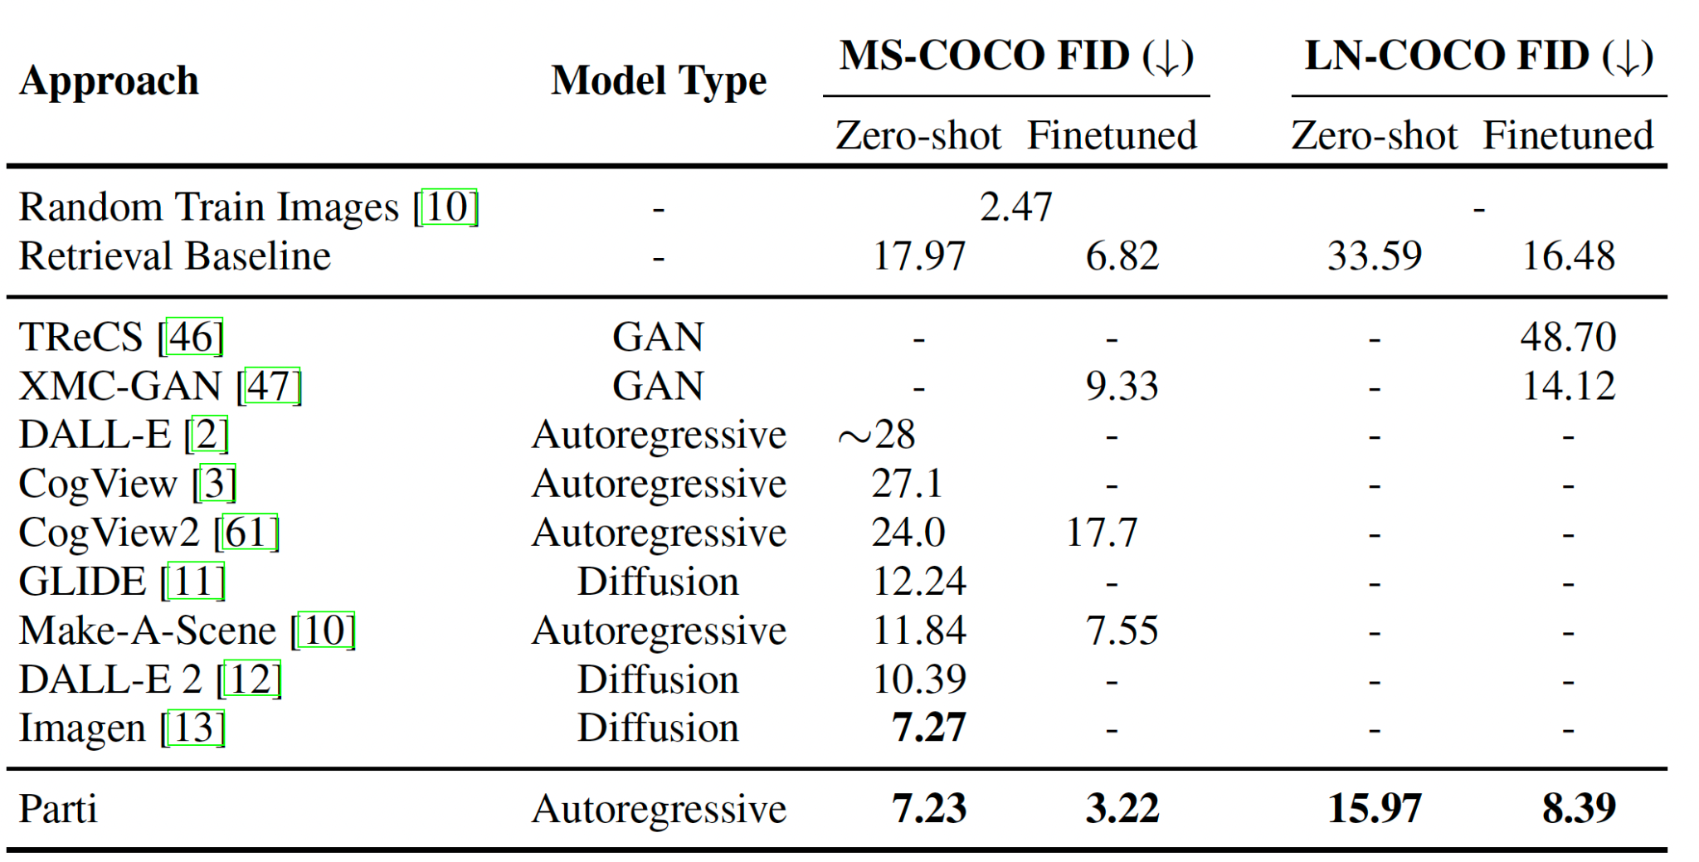
Parti Results (FID)
Experiments
Scaling Autoregressive Models for Content-Rich Text-to-Image Generation
https://arxiv.org/abs/2206.10789
Notes:
Here are the FID score results on zero-shot and finetuned MS-COCO and LN-COCO datasets, when compared with other SOTA T2I models at the time as well as the retrieval baseline.
The retrieval images simply retrieves images from the training dataset based on an alignment score between the text prompt embedding and the image embeddings.
We implement a retrieval baseline as follows. For every training data example, we compute image embeddings from an
EfficientNet-L2 ALIGN-based model. Then, given a text prompt, we identify the nearest training
image measured by the alignment between the text prompt embedding from the ALIGN-based model
and the image embeddings. This can be done at the scale of our data by using efficient similarity
search libraries such as ScaNN [51]. These retrieved examples (from the training set) are then
provided as the output of the baseline, to be evaluated by images actually generated by our models.
We manually visualize the retrieved images given the text prompts and observe that this retrieval
approach represents a high-quality baseline, especially for common text descriptions

Slide 59
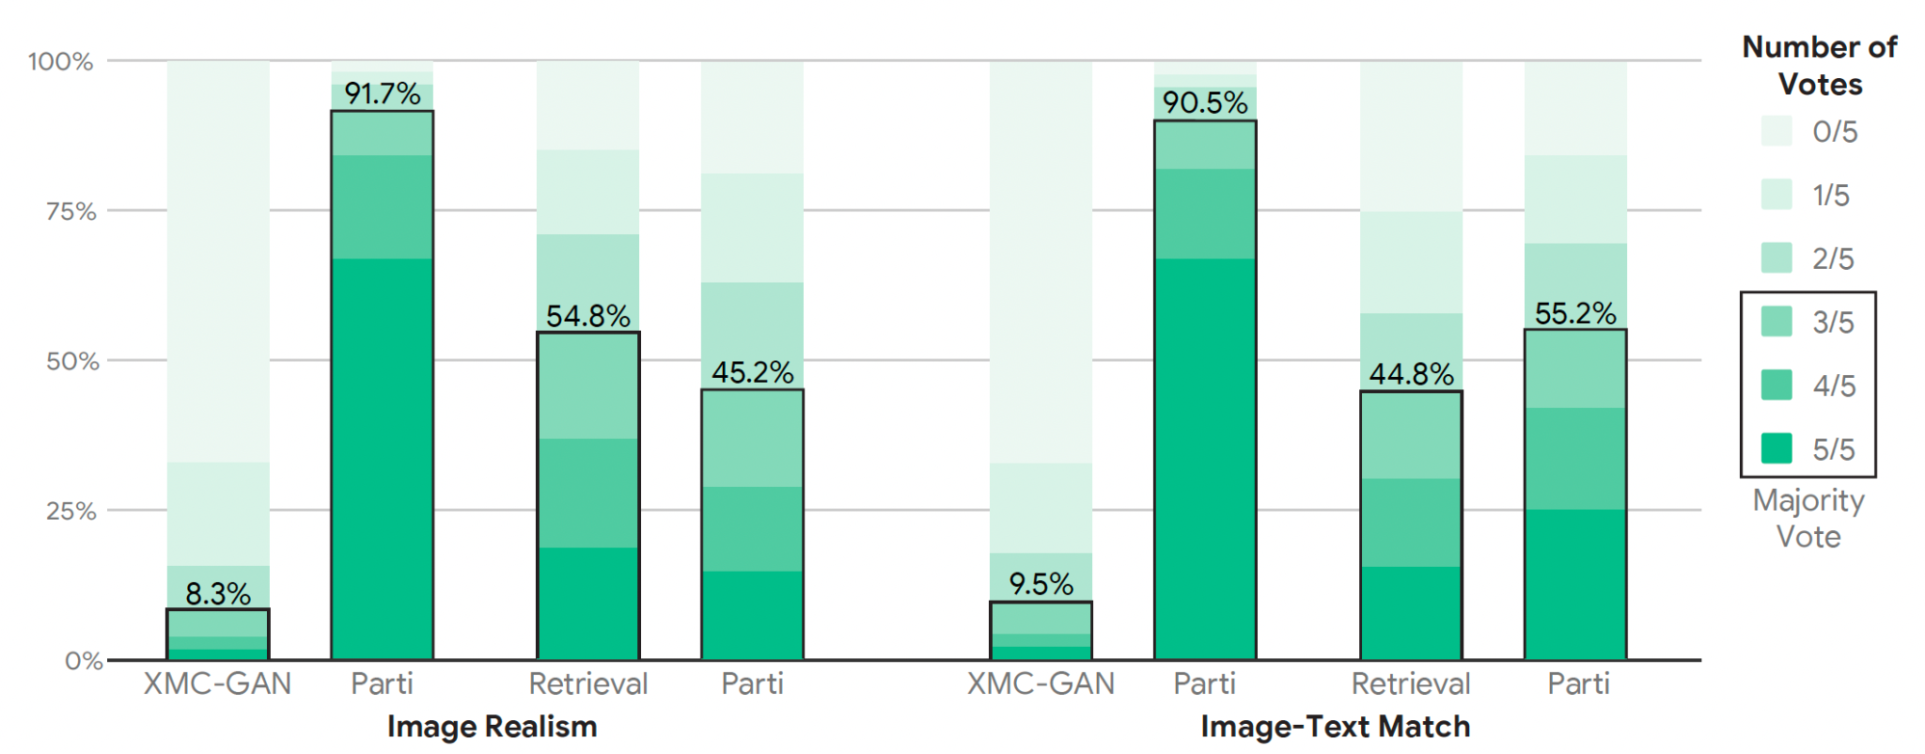
Parti Results (Human Evaluations on MS-COCO)
Experiments
Scaling Autoregressive Models for Content-Rich Text-to-Image Generation
https://arxiv.org/abs/2206.10789
Notes:
Here are some results based on human evaluations on the MS-COCO dataset when compared with XMC-GAN and the retrieval baseline,
Showing that Parti outperforms XMC-GAN in terms of image realism and image text match, and outperforming the retrieval baseline based on image-text match

Slide 60
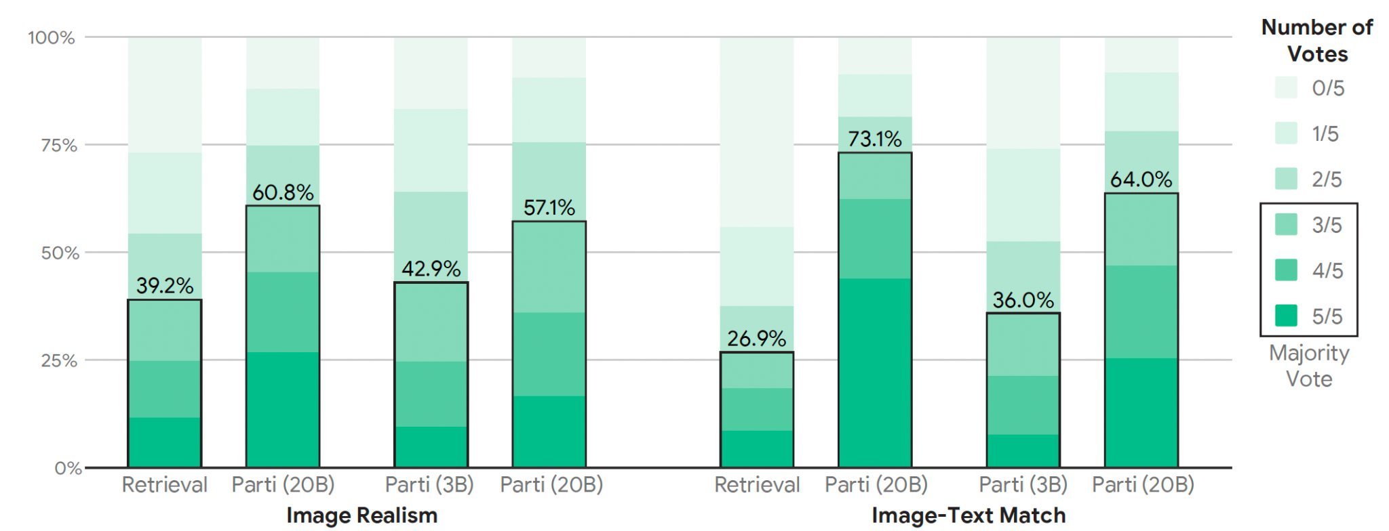
Parti Results (Human Evaluations on PartiPrompts)
Experiments
Scaling Autoregressive Models for Content-Rich Text-to-Image Generation
https://arxiv.org/abs/2206.10789
Notes:
On the new PartiPrompts, results show that the larger 20B parti model performs better than the 3B model as well as the retrieval baseline.

Slide 61
PixArt-α: Fast Training of Diffusion Transformer for Photorealistic Text-to-Image Synthesis
Motivation
To leverage Diffusion Transformer (DiT) to train a T2I model comparable to SOTA
To develop a training strategy that optimizes pixel dependency, text image alignment, and image aesthetic quality independently
To support high-resolution image synthesis (up to 1024px) with reduced training costs and improved efficiency
PixArt-α: Fast Training of Diffusion Transformer for Photorealistic Text-to-Image Synthesis
https://arxiv.org/abs/2310.00426
Notes:
The next paper is PixArt-alpha: Fast Training of Diffusion Transformer for Photorealistic Text-to-Image Synthesis
This paper aims to harness the capabilities of the Diffusion Transformer (DiT) to train a text-to-image (T2I) model comparable to the SOTA models. The method is motivated by designing a training strategy to independently optimize three critical components: pixel dependency, text-image alignment, and image aesthetic quality. PixArt-alpha also tries support high-resolution image synthesis up to 1024 pixels, achieving this with notably reduced training costs and improved efficiency.

Slide 62
Contributions
Developed a model whose training time is only 10.8% of Stable Diffusion v1.5’s training time with less than 1.25% of SD v1.5’s training data
Developed a 3-stage training strategy that focuses on streamlining subtasks with model initialization, pretraining, and finetuning
Incorporated cross-attention modules into DiT to inject text conditions and streamline the computation-intensive class-condition branch
Leveraged a large vision-language model LLaVA to auto-label dense pseudo-captions
PixArt-α: Fast Training of Diffusion Transformer for Photorealistic Text-to-Image Synthesis
https://arxiv.org/abs/2310.00426
Notes:
The core contributions of the paper are as follows:
Firstly, the model's training time is remarkably concise, requiring only 10.8% of the time needed for Stable Diffusion v1.5, while also using less than 1.25% of its training data
Secondly, it introduces a 3-stage training strategy, which enhances the process by concentrating on model initialization, followed by a targeted pretraining phase, and finetuning stage, each stage designed to streamline specific subtasks.
Thirdly, the introduction of cross-attention modules within the Diffusion Transformer (DiT) architecture that improves text condition injection and also refines the entire computation process, particularly in the computation intensive class-condition branch.
And lastly, it leveraged a large vision language model LLaVA to auto-label dense pseudo-captions.

Slide 63
Stage I: Learning Pixel Dependency
Methodology
Learning the pixel distribution of natural images without the text prompt (class-guided)
Initializing the model with a class-condition DiT-XL/2 with 28 transformer blocks trained on ImageNet
PixArt-α: Fast Training of Diffusion Transformer for Photorealistic Text-to-Image Synthesis
https://arxiv.org/abs/2310.00426
Notes:
The first stage of the training strategy is to learn pixel dependency.
This stage is dedicated to understanding the pixel distribution of natural images without the interference of text prompts, essentially teaching the model the inherent structure and coherence found within visual data. It does this by employing a class-conditioned Diffusion Transformer (DiT-XL/2) with 28 transformer blocks that have been pre-trained on the ImageNet dataset. This methodology allows PixArt-alpha to capture the essence of visual information. The model is trained on one million ImageNet images over 300,000 training steps.

Slide 64
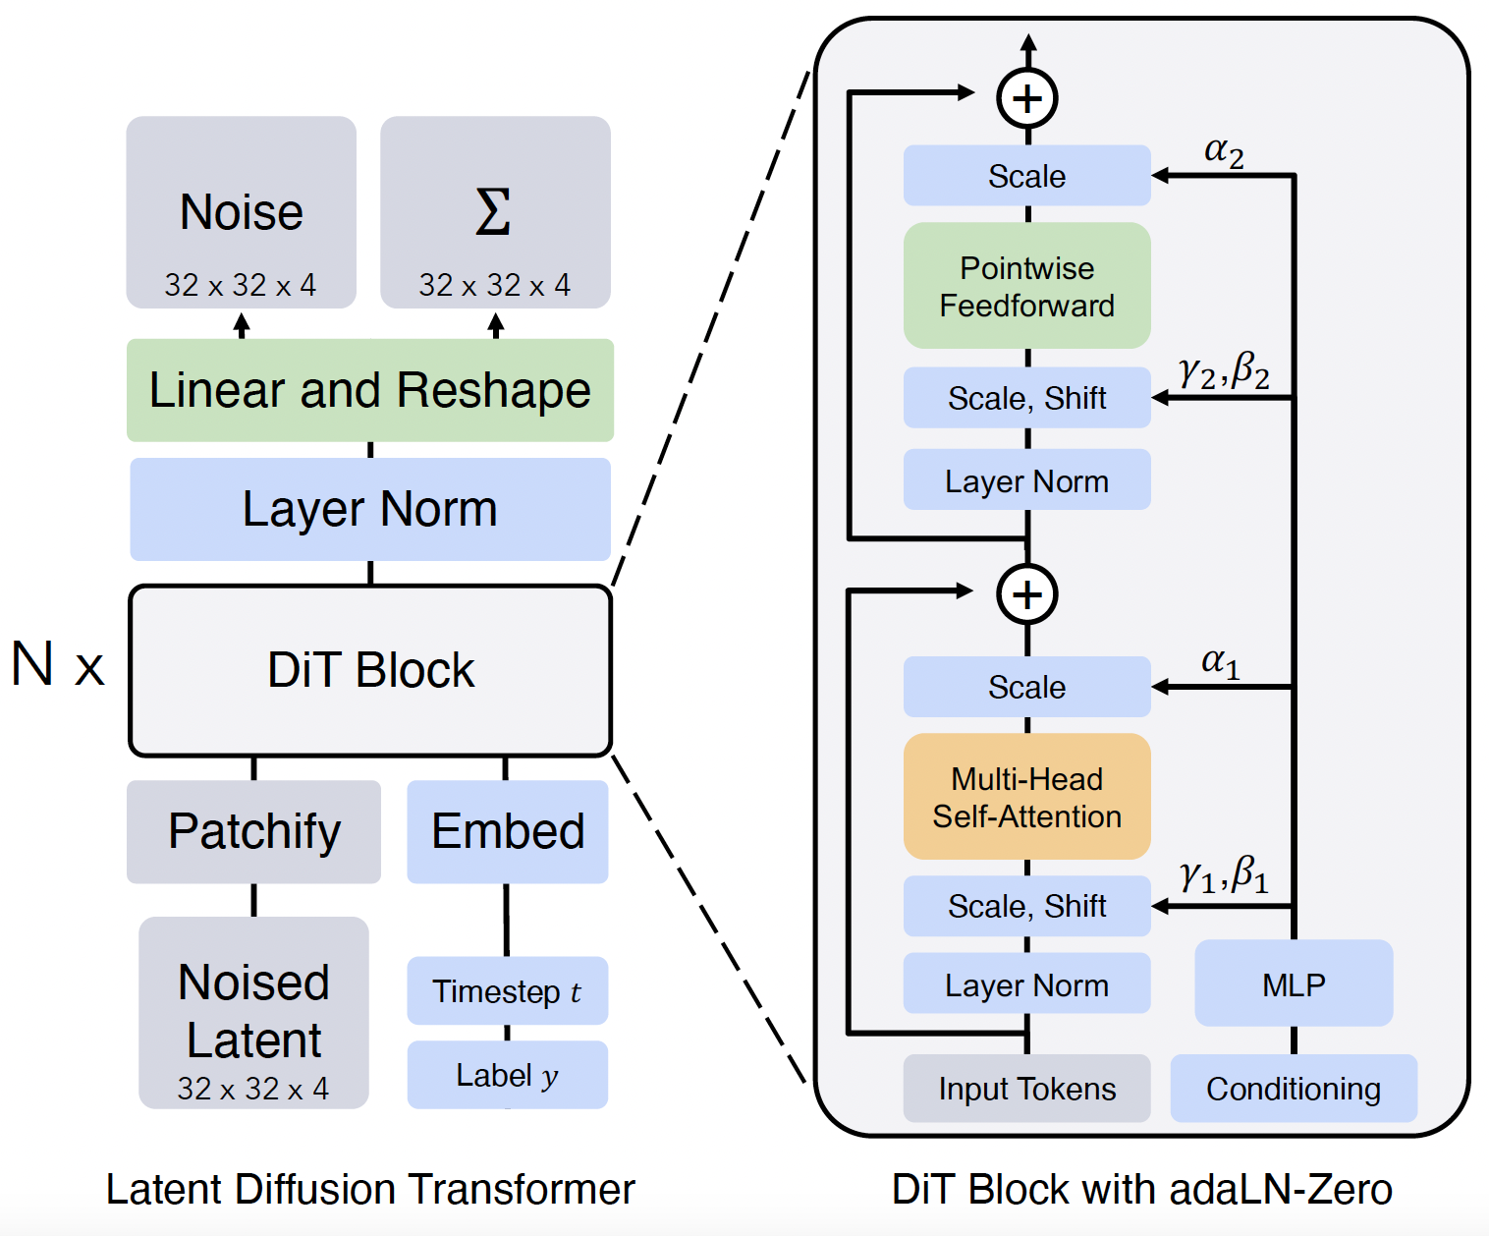
DiT
Methodology
Replacing U-Net backbone in LDMs with a transformer
Conditional inputs (diffusion timesteps and class labels) fed into transformer via MLP
AdaLN: ViT block with adaptive layer norm layers
PixArt-α: 256-d frequency embedding, followed by 2-layer MLP, and SiLU activations
Scalable Diffusion Models with Transformers
https://arxiv.org/abs/2212.09748
Notes:
This paper leverages the diffusion transformer architecture, which pivots an architectural change from the traditional U-Net backbone of LDMs to a transformer-based model. The DiT operates by first converting noise through linear layers and reshaping, followed by normalization and processing through multiple DiT blocks. These blocks are structured with multi-head self-attention and pointwise feedforward layers, interspersed with scaling and normalization.
Crucially, the conditional inputs such as diffusion timesteps and class labels are incorporated into the transformer via a Multilayer Perceptron (MLP). The adaptation of Vision Transformer (ViT) blocks, equipped with adaptive layer norm layers (AdaLN), ensures flexible normalization that caters to the properties of different layers' inputs.
Furthermore, the integration of Pixart-alpha with this architecture utilizes a 256-dimensional frequency embedding, followed by a 2-layer MLP.

Slide 65
Stage II: Text-Image Alignment Learning
Methodology
From pretrained class-guided image generation to T2I: need accurate alignment between detailed text descriptions and images
Challenge: text captions in datasets lack informative content, are misaligned, or exhibit long-tail characteristics
Solution: create highly informative text captions with LLaVA using an auto-labelling pipeline, boosting training efficiency and accuracy
PixArt-α: Fast Training of Diffusion Transformer for Photorealistic Text-to-Image Synthesis
https://arxiv.org/abs/2310.00426
Notes:
Stage II is centered on enhancing text-image alignment learning. The shift from pretrained class-guided image generation to text-to-image (T2I) generation calls for an accurate alignment between detailed text descriptions and the generated images. A significant challenge in this stage arises from the text captions in datasets, which often lack informative content, are misaligned with their corresponding images, or present a long-tail distribution that makes learning from them difficult. To counter these issues, PixArt–alpha implements a solution that involves creating highly informative text captions with the help of LLaVA, a large vision-language model. By leveraging LLaVA in an auto-labelling pipeline, PixArt-alpha aims to improve the informativeness of the text data, thereby enhancing the training efficiency and alignment accuracy.

Slide 66
Stage II: Text-Image Alignment Learning
Methodology
LAION Raw Captions vs. LLaVA Refined Captions
PixArt-α: Fast Training of Diffusion Transformer for Photorealistic Text-to-Image Synthesis
https://arxiv.org/abs/2310.00426
Notes:
Here are some examples of raw captions from the LAION dataset and LLaVA refined captions. As seen, refinements can deal with problems like text-image misalignment, deficient descriptions, and infrequent vocabulary causing the long tail characteristics

Slide 67
Stage II: Text-Image Alignment Learning
Methodology
Dataset Refinement Process
Auto-labelling with vision-language model LLaVA
Prompt: “Describe this image and its style in a very detailed manner”
Used the SAM dataset instead of LAION
Vocabulary analysis shows LLaVA refined SAM and LAION datasets increased in total noun number and valid distinct noun/total distinct noun ratio, with SAM-LLaVA outperforming LAION-LLaVA
PixArt-α: Fast Training of Diffusion Transformer for Photorealistic Text-to-Image Synthesis
https://arxiv.org/abs/2310.00426
Notes:
Here is the detailed dataset refinement process: using the large vision-language model LLaVA, the dataset undergoes an auto-labelling process with prompts that encourage descriptive richness, particularly asking to "Describe this image and its style in a very detailed manner." Segment anything dataset is used instead of LAION. When combined with LLaVA, SAM leads to a more robust vocabulary as demonstrated by a thorough vocabulary analysis. This analysis shows an increase in the total number of nouns and a better ratio of valid distinct nouns to total distinct nouns, indicating a more descriptive and varied dataset. In this stage, 10M SAM captions are refined.

Slide 68
Stage III: High-Resolution and Aesthetic Image Generation
Methodology
Finetuning on data with superior aesthetic quality: a 4M JourneyDB dataset and a 10M internal dataset combined
Converges significantly faster in this stage, owing to prior knowledge established in previous stages
PixArt-α: Fast Training of Diffusion Transformer for Photorealistic Text-to-Image Synthesis
https://arxiv.org/abs/2310.00426
Notes:
Stage III of the PixArt-alpha training focuses on generating high-resolution images with a refined aesthetic quality. This stage leverages fine-tuning on datasets that are distinguished by their superior aesthetic quality, specifically combining a 4 million image dataset from JourneyDB with a 10 million image internal dataset. The training in this stage benefits significantly from the foundational work established in the previous stages, resulting in faster convergence. The table suggests that as the resolution increases from 256x256 to 1024x1024, fewer training steps are needed, and with a decrease in batch size, reflecting an optimization of the learning process due to the high quality of the input data and the cumulative knowledge from earlier training stages.

Slide 69
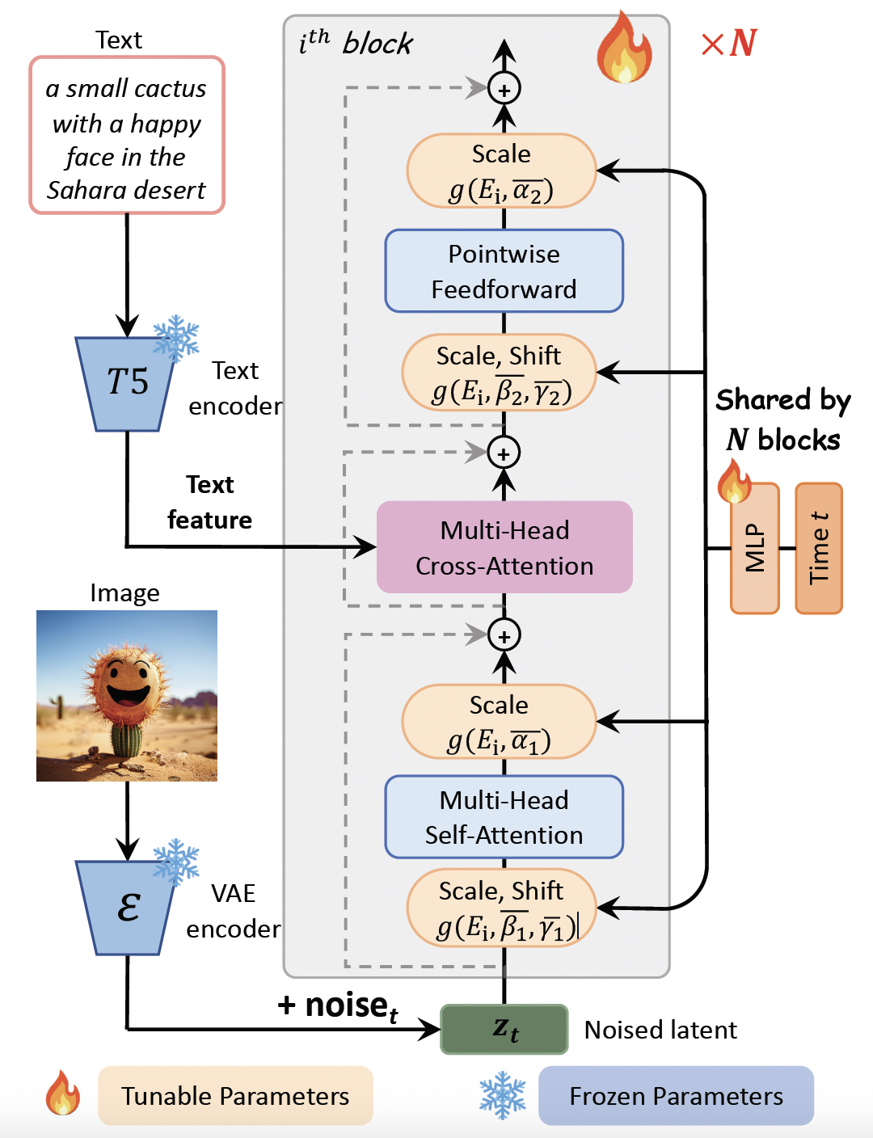
PixArt-α Training
Design Considerations
4.3B Flan-T5-XXL as text encoder for conditional feature extraction, fixed 120 text tokens
Pretrained and frozen VAE encoder from LDM for latent feature extraction
DiT-XL/2 as base architecture
PixArt-α: Fast Training of Diffusion Transformer for Photorealistic Text-to-Image Synthesis
https://arxiv.org/abs/2310.00426
Notes:
Here are some design considerations presented in this paper:
This paper used the DiT-XL/2 as the base architecture, a 4.3 billion flan T5 model as the text encoder for conditional feature extraction, as a pretrained and frozen VAE encoder from LDM for latent image feature extraction

Slide 70
PixArt-α Training
Design Considerations
Multi-Head Cross Attention
facilitate interactions between the model and text embeddings extracted from the language model
PixArt-α: Fast Training of Diffusion Transformer for Photorealistic Text-to-Image Synthesis
https://arxiv.org/abs/2310.00426
Notes:
Within the DiT block, multi-head cross attention is used to facilitate interactions between the model and text embeddings extracted from the language model

Slide 71
PixArt-α Training
Design Considerations
AdaLN-single
Linear projections in the adaLN module of DiT account for 27% of parameters
Not useful since class condition is not employed in T2I
Proposed adaLN-single: all N blocks share the same parameters for time conditions
Global MLP with layer-wise embeddings instead of layer-specific MLPs
PixArt-α: Fast Training of Diffusion Transformer for Photorealistic Text-to-Image Synthesis
https://arxiv.org/abs/2310.00426
Notes:
The authors of pixart-alpha modified the original adaptive layer norm layers in the DiT to make it more efficient. They found that the linear projections in the adaptive normalization layers module of the DiT account for a substantial proportion (27%) of the parameters. Such a large number of parameters is not useful since the class condition is not employed for T2I model, so they proposed the adaLayer Norm-single, where all N blocks share the same parameters for time conditions. Global MLP with layer-wise embeddings are used instead of layer-specific MLPs.

Slide 72
PixArt-α Training
Design Considerations
Re-parametrization
Introduction of layer-specific trainable embedding E_{i} that adaptively adjusts the shifts and scales in different blocks without the class condition
Preserves compatibility with pretrained weights when initialized to yield the same scales and shifts as pretrained DiT
PixArt-α: Fast Training of Diffusion Transformer for Photorealistic Text-to-Image Synthesis
https://arxiv.org/abs/2310.00426
Notes:
To adapt to this new structure, layer-specific trainable embedding Ei are introduced to adaptively adjusts the shifts and scales in different blocks without the class condition. This preserves compatibility with pretrained weights when initialized to yield the same scales and shifts as pretrained DiT.

Slide 73
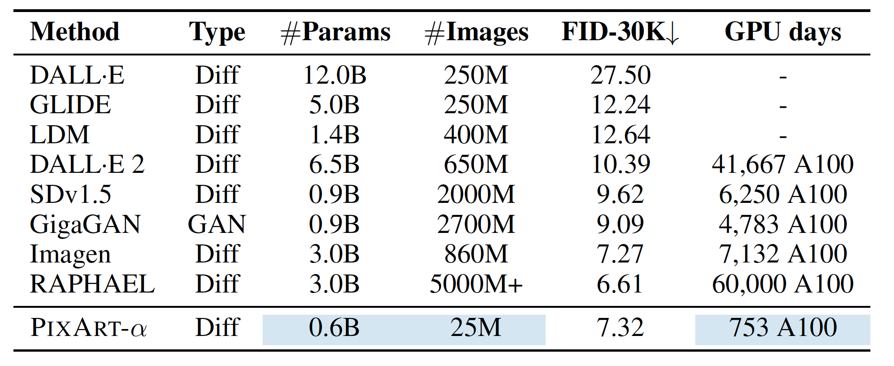
PixArt-α Results (FID on MS-COCO)
Experiments
PixArt-α: Fast Training of Diffusion Transformer for Photorealistic Text-to-Image Synthesis
https://arxiv.org/abs/2310.00426
Notes:
Here are some experimental results on the MS-COCO dataset, comparing the FID scores with other SOTA models, drawing attention to its low number of parameters, training images, and GPU days.

Slide 74
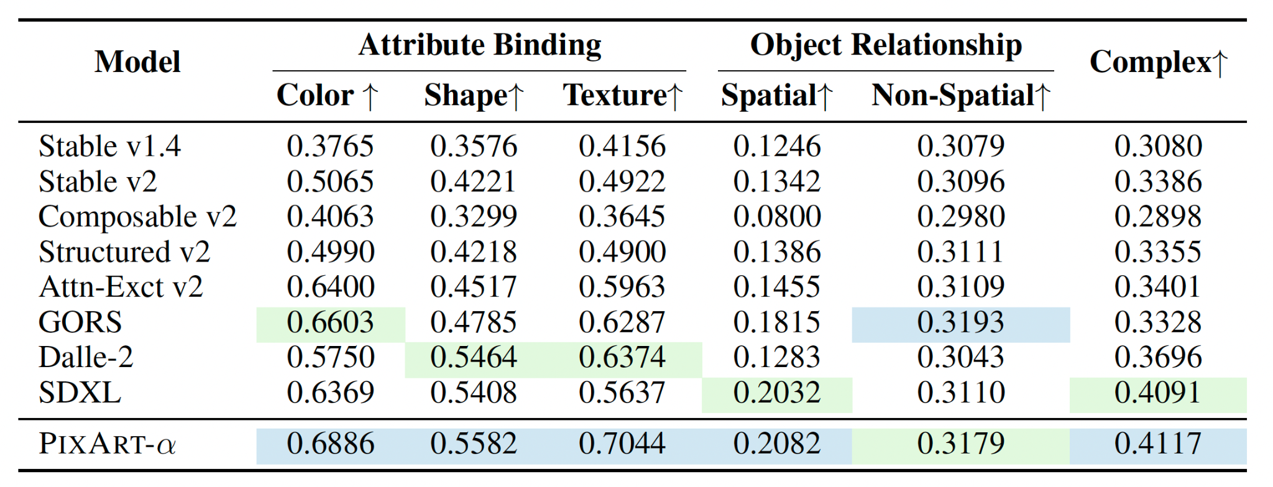
PixArt-α Results (T2I-Compbench)
Experiments
Benchmark for assessing alignment between text conditions and generated images
PixArt-α: Fast Training of Diffusion Transformer for Photorealistic Text-to-Image Synthesis
https://arxiv.org/abs/2310.00426
Notes:
Here are some results on the T2I compbench, a benchmark for assessing alignment between text conditions and generated images

Slide 75
PixArt-α Results (Human Evaluations)
Experiments
Employed 300 prompts from Feng et. al (2023)
50 participants ranked models based on perceptual quality and text image alignment
ERNIE-ViLG 2.0: Improving Text-to-Image Diffusion Model with Knowledge-Enhanced Mixture-of-Denoising-Experts
https://arxiv.org/abs/2210.15257
PixArt-α: Fast Training of Diffusion Transformer for Photorealistic Text-to-Image Synthesis
https://arxiv.org/abs/2310.00426
Notes:
And results on human evaluations in terms of perceptual quality and text image alignment.

Slide 76
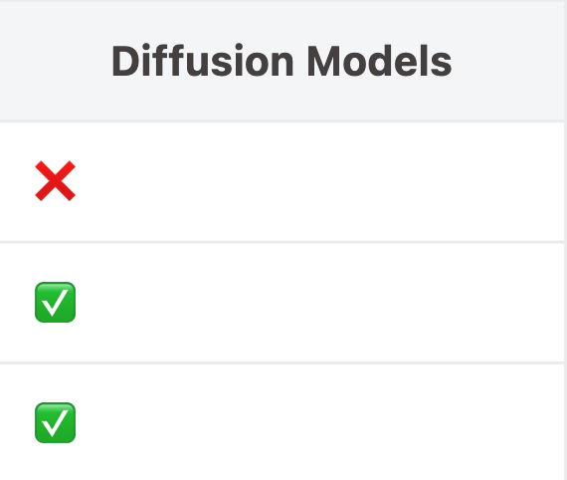
What makes a Good Generative Model?
Fast sampling
Model coverage/ diversity
High quality / high fidelity
Any SOTA methods that have diffusion models with fast sampling?

Slide 77
SDXL Turbo
Keywords
Adversarial Diffusion Distillation (ADD)
a new distillation technique for text-to-image models
Classifier-free guidance not used
Highlights
Single-step image generation
Extremely Fast (Real-time)
SDXL 50steps -> SDXLTurbo 1steps
Combining
Superior sample quality of DMs
Inherent speed of GANs
Adversarial Diffusion Distillation
https://arxiv.org/abs/2311.17042
Notes:
A key feature of ADD is its elimination of classifier-based guidance, which is a common component in other generative models. The highlight of ADD is its capability for single-step image generation, boasting a fast (real-time) generation process. This is a notable improvement from the standard SDXL model that typically requires 50 steps for image synthesis, SDXL Turbo, condenses this process into a single step. The method emphasizes the combination of two major benefits: the superior sample quality of traditional diffusion models (DMs) and the inherent speed of Generative Adversarial Networks (GANs), such that it combines quality and speed in image generation.

Slide 78
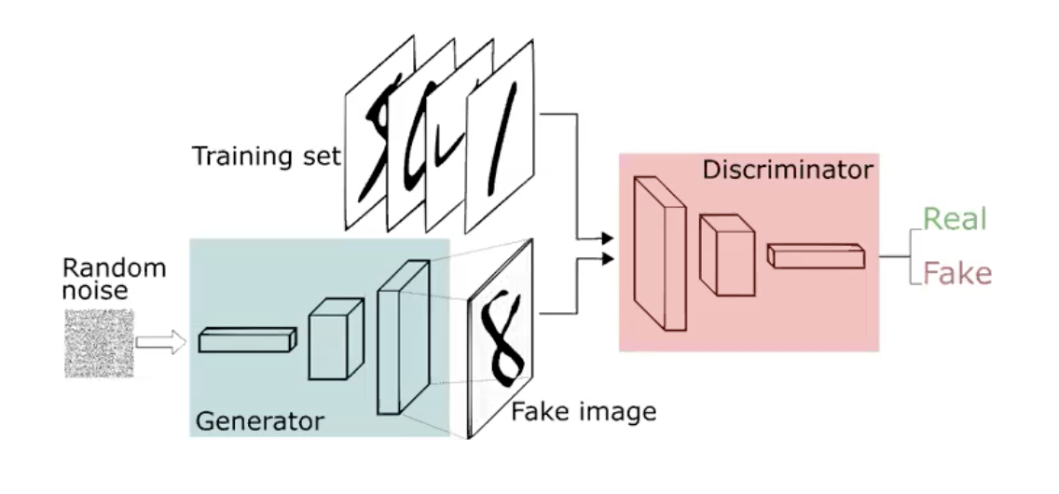
Revisit Adversarial Models (GANs)
Generator
optimize to synthesize samples that capture distribution of training data
Discriminator
optimize to classify real and fake data
Both get better in each epoch during training
must be in a fair fight
Generative Adversarial Networks
https://arxiv.org/abs/1406.2661

Slide 79
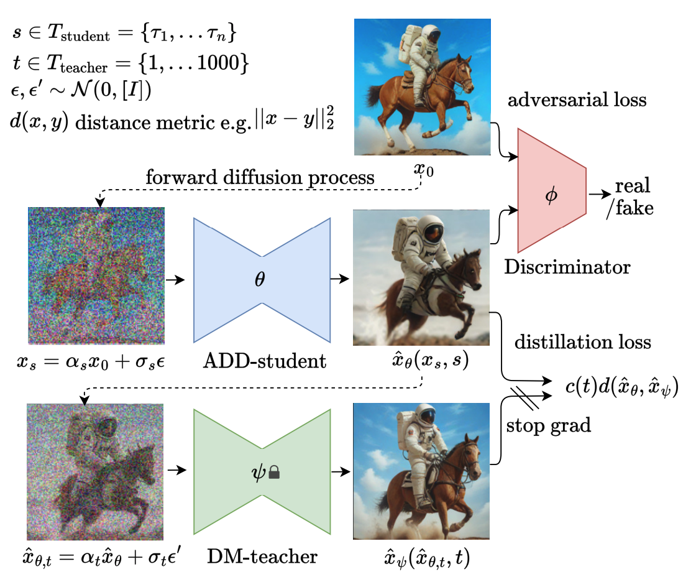
SDXL Turbo
Training Process
Generation Process
Generator
Generator
Adversarial Diffusion Distillation
https://arxiv.org/abs/2311.17042

Slide 80
SDXL Turbo
Adversarial Diffusion Distillation (ADD)
U-Net (pixel space) as Gen
ViT with DINO objective as Disc
SDXL/SD2.1 as Teacher model
Training Objective
Adversarial Loss
hinge loss with gradient penalty
Distillation Loss
weighted L2 loss
Training Process
Hinge Loss
Generator
U-Net
ViT-S with DINO obj
alpha_t
L2
Reconstruction
Adversarial Diffusion Distillation
https://arxiv.org/abs/2311.17042

Slide 81
Summary
Pivotal Text-To-Image Models:
LDM: First work to use Latent + Cross Attention
Imagen: Cascaded Diffusion Model
Dall-E 2: CLIP Embedding + Latent
Parti: Transformer Based Autoregressive Model
PixArt-Alpha: Diffusion Transformer
SDXL Turbo: Adversarial Distillation model from SDXL
Common metrics For Text-To-Image models:
FID: Measure Image Fidelity
CLIPScore: Measure Image-Text alignment

Slide 82
There are more T2I models to explore…
ImagenHub: Standardizing the evaluation of conditional image generation models
https://arxiv.org/abs/2310.01596

Slide 83
Reference
https://sander.ai/2022/05/26/guidance.html
https://www.assemblyai.com/blog/how-imagen-actually-works/
https://vinesmsuic.github.io/paper-ddpm-ext3
https://vinesmsuic.github.io/paper-ddpm-ext4
https://medium.com/@onkarmishra/stable-diffusion-explained-1f101284484d
https://en.wikipedia.org/wiki/Stable_Diffusion
https://www.youtube.com/watch?v=JbfcAaBT66U
https://jalammar.github.io/illustrated-stable-diffusion/
https://sites.research.google/parti/
https://mlberkeley.substack.com/p/vq-vae
https://ameroyer.github.io/portfolio/2019-08-15-VQVAE/
https://www.youtube.com/watch?v=wcqLFDXaDO8
https://compvis.github.io/taming-transformers/
https://ljvmiranda921.github.io/notebook/2021/08/08/clip-vqgan/
https://blog.research.google/2022/05/vector-quantized-image-modeling-with.html
https://pixart-alpha.github.io/
https://www.youtube.com/watch?v=RDM1yAQna8o
https://github.com/facebookresearch/DiT
https://www.wpeebles.com/DiT.html

