Slide 1
Lecture 16:Vision Transformer
Presenters: Niousha Sadjadi and Anthony Boyko

Slide 2
Outline
Review of Transformers
Series of methods
Image GPT
Vision Transformer (ViT)
DeiT
Swin Transformer
DINO
Masked Autoencoders
MetaFormer
SwiftFormer

Slide 3
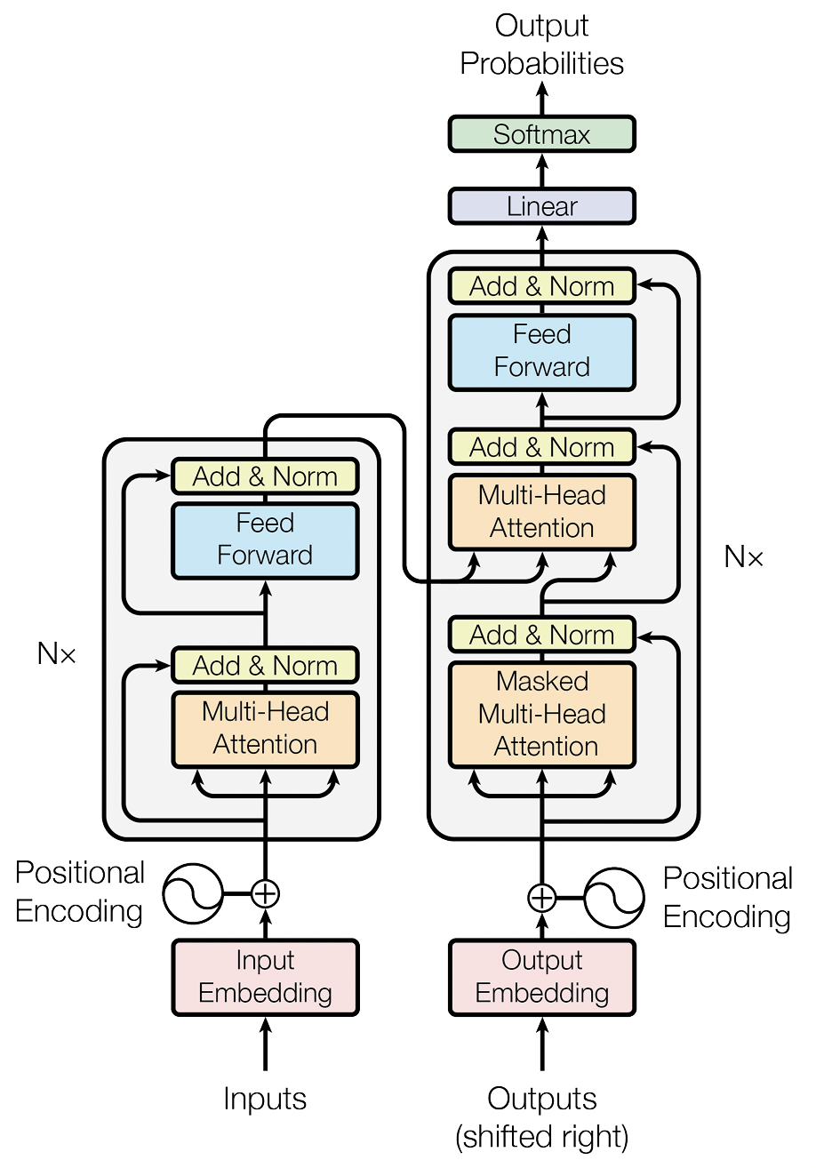
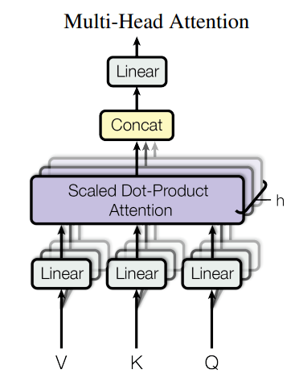
Review of Transformers
In vision transformer, we only use the encoder section

Slide 4
Transformers in Computer Vision
Transformers are successful in NLP domain
Extend transformers idea to image
Image GPT was suggested by OpenAI
Shortly after, Vision Transformer (ViT) was suggested by Google
It is a successful approach
Increase interest in using transforms in vision
Fundamental challenge
How to create a sequence from an image?

Slide 5
Image GPT
Generative Pretraining from Pixels
Pre-process
Pre-training
Evaluation
Chen, M., Radford, A., Child, R., Wu, J., Jun, H., Luan, D., & Sutskever, I.. “Generative Pretraining From Pixels.” Proceedings of the 37th International Conference on Machine Learning (2020)
Notes:
chrome-extension://efaidnbmnnnibpcajpcglclefindmkaj/https://cdn.openai.com/papers/Generative_Pretraining_from_Pixels_V2.pdf
https://www.youtube.com/watch?v=YBlNQK0Ao6g
https://www.youtube.com/watch?v=H5vpBCLo74U

Slide 6
Image GPT (Pre-process)
Convert image to sequence
Reorder pixels to create a sequence
ImageNet size: 224*224*3 (150,528 pixels!!)
Context reduction
Resize to lower resolution: 32*32*3 (3,072 pixels)
Customize color palette to change RGB: 32*32*1 (1,024 pixels)
Create a sequence of pixels
Chen, M., Radford, A., Child, R., Wu, J., Jun, H., Luan, D., & Sutskever, I.. “Generative Pretraining From Pixels.” Proceedings of the 37th International Conference on Machine Learning (2020)

Slide 7
Image GPT (Pre-training)
Uses GPT-2 architecture with one of the following objectives
Autoregressive: Next pixel prediction
BERT: Masked pixel prediction
Chen, M., Radford, A., Child, R., Wu, J., Jun, H., Luan, D., & Sutskever, I.. “Generative Pretraining From Pixels.” Proceedings of the 37th International Conference on Machine Learning (2020)

Slide 8
Image GPT (Pre-training) 2
Autoregressive: Given dataset $X$ and the data $x=\left(x_{1}, …, x_{n}\right)$ where $x∈X$, pick a permutation $π$ of the set $[1, n]$, then:
$$p\left(x\right)=\prod_{i=1}^{n}{p(x_{π_{i}}|x_{π_{1}}, …,x_{π_{i−1}}, θ)}$$
Image GPT uses identity permutation $π_{i}=i$ for $1≤i≤n$
Train the model by minimizing the negative log-likelihood:
$$L_{AR}=𝔼_{x\sim X}[−\log{p(x)}]$$

Slide 9
Image GPT (Pre-training) 3
BERT: Samples a sub-sequence $M⊂[1, n]$, and each index $i$ independently has probability 0.15 of appearing in $M$.
$M$ is called the BERT mask
Train the model by minimizing the negative log-likelihood of the “masked” elements $x_{M}$ conditioned on the “unmasked” ones $x_{[1, n]∖M}$:
$$L_{BERT}=𝔼_{x\sim X}𝔼_{M}\sum_{i∈M}{[−\log{p(x_{i} |{ x}_{[1, n]∖M})}]}$$

Slide 10
Image GPT (Pre-training) 4
Uses GPT-2 architecture with one of the following objectives
Unsupervised training
Hidden states
Independently
Chen, M., Radford, A., Child, R., Wu, J., Jun, H., Luan, D., & Sutskever, I.. “Generative Pretraining From Pixels.” Proceedings of the 37th International Conference on Machine Learning (2020)

Slide 11
Image GPT (Evaluation)
Add a classification head on top of the representation (hidden states of transformer)
1. Fine tuning: Train whole model (transformer + classification head)
$$L_{GEN}∈\left\{L_{AR},L_{BERT}\right\}$$
$$L_{GEN}+L_{CLF}$$
Classifier
Chen, M., Radford, A., Child, R., Wu, J., Jun, H., Luan, D., & Sutskever, I.. “Generative Pretraining From Pixels.” Proceedings of the 37th International Conference on Machine Learning (2020)

Slide 12
Image GPT (Evaluation) 2
Add a classification head on top of the representation (hidden state of transformer)
2. Linear probe: Train classification head (Freeze transformer)
Classifier
$$L_{CLF}$$
Chen, M., Radford, A., Child, R., Wu, J., Jun, H., Luan, D., & Sutskever, I.. “Generative Pretraining From Pixels.” Proceedings of the 37th International Conference on Machine Learning (2020)

Slide 13
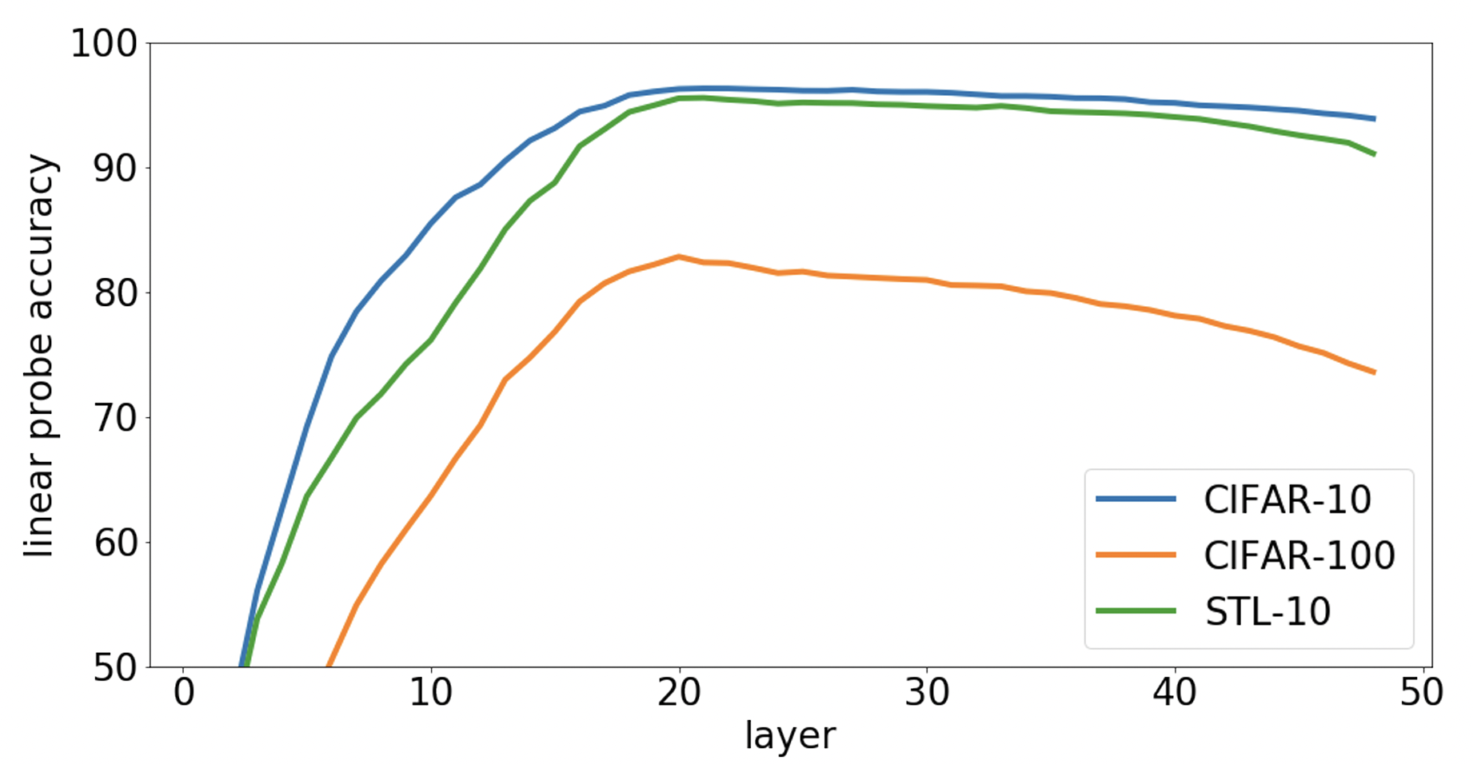
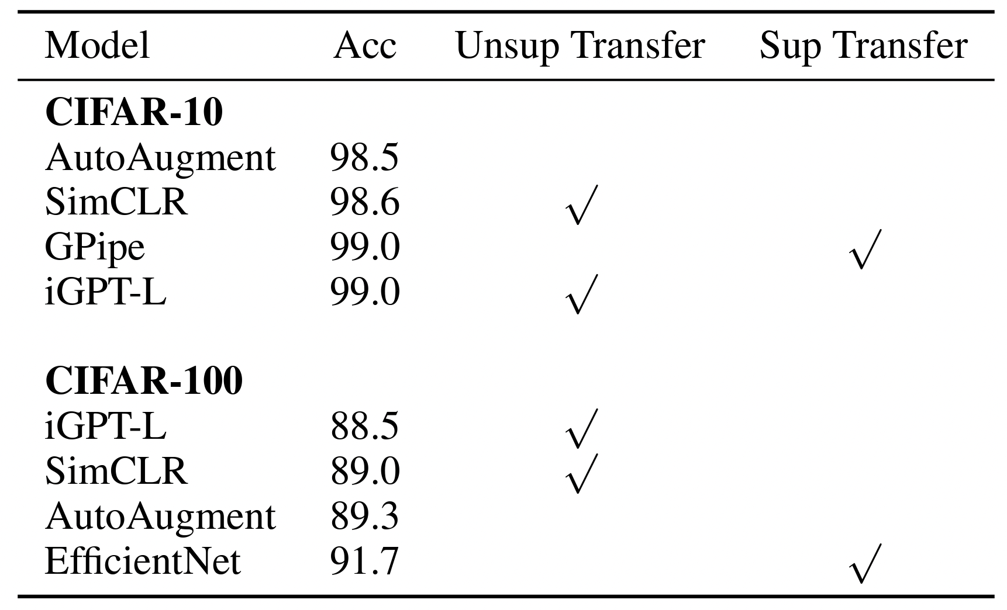
Image GPT (Results)
Autoregressive pre-trained on ImageNet
Fine tuning Evaluation
Linear probe on different layers
Chen, M., Radford, A., Child, R., Wu, J., Jun, H., Luan, D., & Sutskever, I.. “Generative Pretraining From Pixels.” Proceedings of the 37th International Conference on Machine Learning (2020)

Slide 14
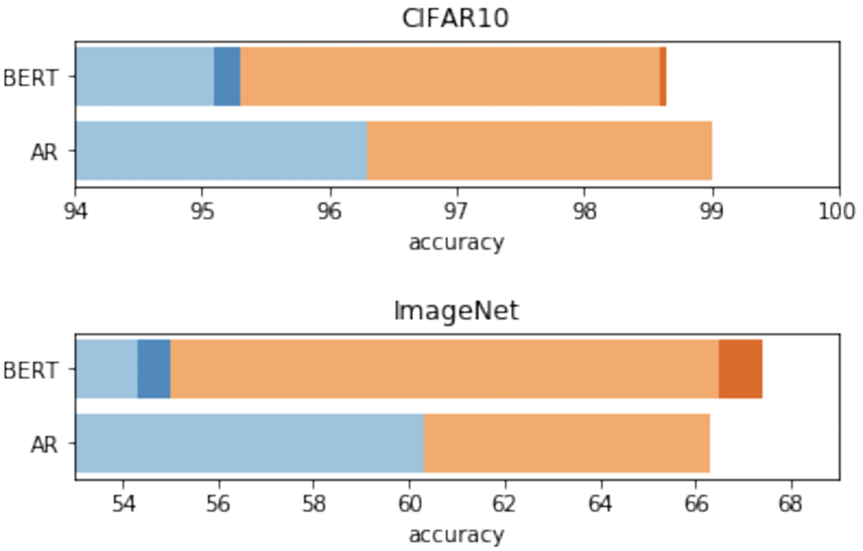
Image GPT (Results) 2
Train the model with AR and BERT objective individually
Blue bars: linear probe accuracy
Orange bars: Fine tuning accuracy
Pre-trained on ImageNet
Sample multiple independent masks, and take average
Pre-trained on web images
Chen, M., Radford, A., Child, R., Wu, J., Jun, H., Luan, D., & Sutskever, I.. “Generative Pretraining From Pixels.” Proceedings of the 37th International Conference on Machine Learning (2020)

Slide 15
Image GPT (Results) 3
https://openai.com/research/image-gpt

Slide 16
Vision Transformer (ViT)
Image GPT lose many details from the image
Resize them to 32*32
ViT solved this problem by creating sequence from patches
Paper is “AN IMAGE IS WORTH 16X16 WORDS: TRANSFORMERS FOR IMAGE RECOGNITION AT SCALE ”
Very successful
Many other papers use this idea as their backbone
Notes:
chrome-extension://efaidnbmnnnibpcajpcglclefindmkaj/https://arxiv.org/pdf/2010.11929v2.pdf

Slide 17
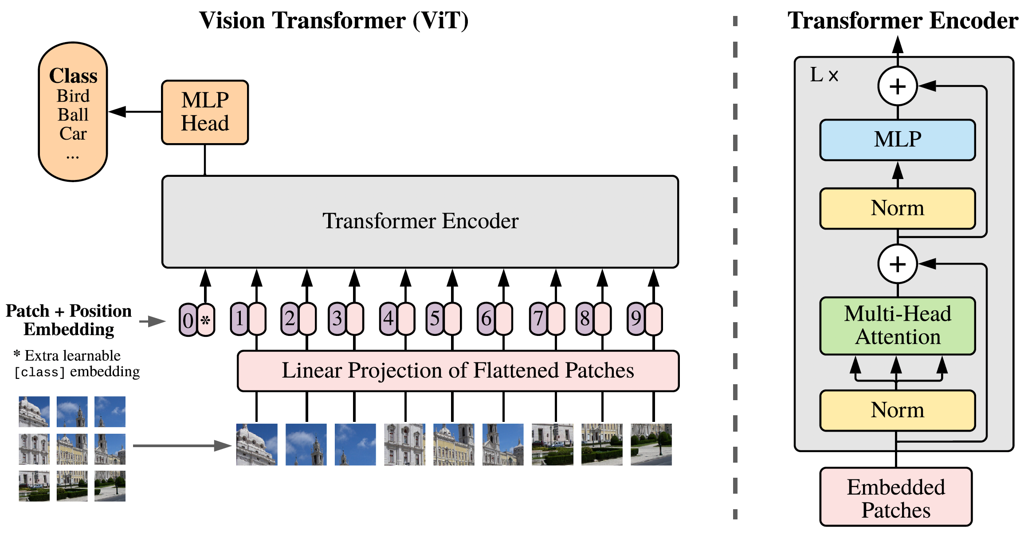
ViT Architecture
Dosovitskiy, A., Beyer, L., Kolesnikov, A., Weissenborn, D., Zhai, X., Unterthiner, T., Dehghani, M., Minderer, M., Heigold, G., Gelly, S., Uszkoreit, J., & Houlsby, N. (2020). An Image is Worth 16x16 Words: Transformers for Image Recognition at Scale. ArXiv, abs/2010.11929.

Slide 18
ViT Architecture 2
$${z′}_{l}=MSA\left(LN\left(z_{l−1}\right)\right)+z_{l−1}$$
$$z_{l}=MLP\left(LN\left({z′}_{l}\right)\right)+{z′}_{l}$$
MLP
Head
Transformer Encoder
$$y=LN(z_{L}^{0})$$
$$z_{0}=\left[x_{Class};x_{p}^{1}E;…;x_{p}^{N}E\right]+E_{pos}$$
Trainable Vector
[CLS token]
. . . . . . . . .
Convert integer to D-dimension vector
Position
Embedding
Linear Projection
Linear transform
from P*P*C to D
….
1
2
3
Flatten
Split the image to 16*16 Patches
4
5
6
7
8
9
1
2
3
4
5
6
7
8
9

Slide 19
ViT Results
ViT outperforms CNN-based model
JFT: contains 300M data for training, not publicly available
Faster than CNN
Dosovitskiy, A., Beyer, L., Kolesnikov, A., Weissenborn, D., Zhai, X., Unterthiner, T., Dehghani, M., Minderer, M., Heigold, G., Gelly, S., Uszkoreit, J., & Houlsby, N. (2020). An Image is Worth 16x16 Words: Transformers for Image Recognition at Scale. ArXiv, abs/2010.11929.

Slide 20
ViT Results 2
Feature extraction is similar to CNN
Effectiveness of positional embedding
Size of attended area
Dosovitskiy, A., Beyer, L., Kolesnikov, A., Weissenborn, D., Zhai, X., Unterthiner, T., Dehghani, M., Minderer, M., Heigold, G., Gelly, S., Uszkoreit, J., & Houlsby, N. (2020). An Image is Worth 16x16 Words: Transformers for Image Recognition at Scale. ArXiv, abs/2010.11929.

Slide 21
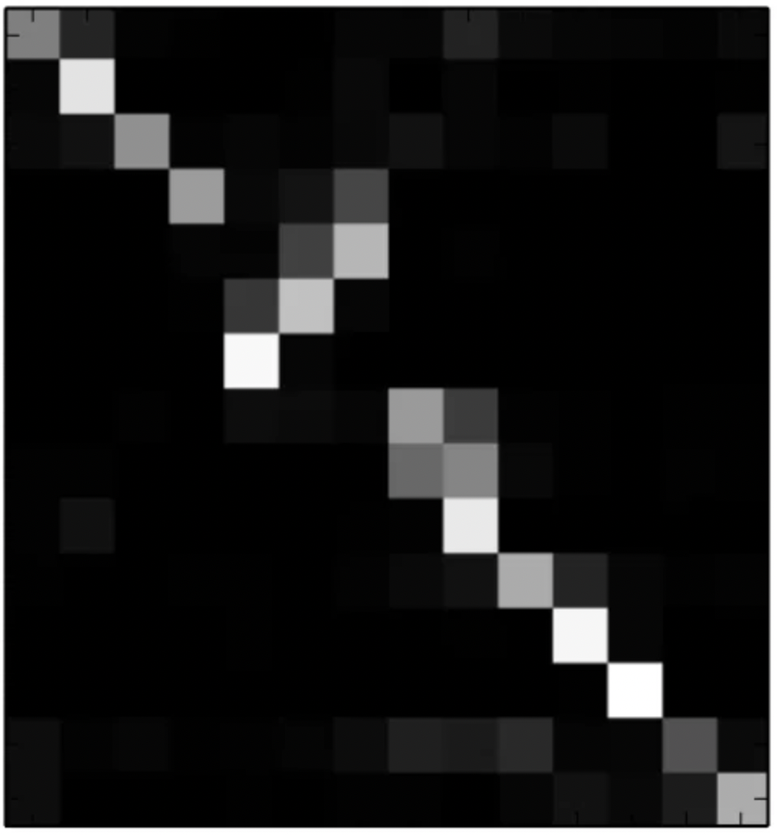
ViT Results 3
. . . . . . . .
$$Z_{1}$$
$$Z_{2}$$
$$Z_{3}$$
$$Z_{n}$$
$$X_{1}$$
$$X_{2}$$
$$X_{3}$$
. . . . . . . .
$$X_{n}$$
For layer $l$
Dosovitskiy, A., Beyer, L., Kolesnikov, A., Weissenborn, D., Zhai, X., Unterthiner, T., Dehghani, M., Minderer, M., Heigold, G., Gelly, S., Uszkoreit, J., & Houlsby, N. (2020). An Image is Worth 16x16 Words: Transformers for Image Recognition at Scale. ArXiv, abs/2010.11929.

Slide 22
DeiT
ViT problems:
Use a massive dataset for training
The dataset is not publicly available
DeiT suggested by Facebook
Paper is “Training data-efficient image transformers & distillation through attention”
Use ImageNet which is 10 times smaller
Notes:
https://medium.com/aiguys/deit-training-data-efficient-image-transformer-distillation-through-attention-facebook-ai-9b60aea3da07
chrome-extension://efaidnbmnnnibpcajpcglclefindmkaj/https://arxiv.org/pdf/2012.12877.pdf

Slide 23
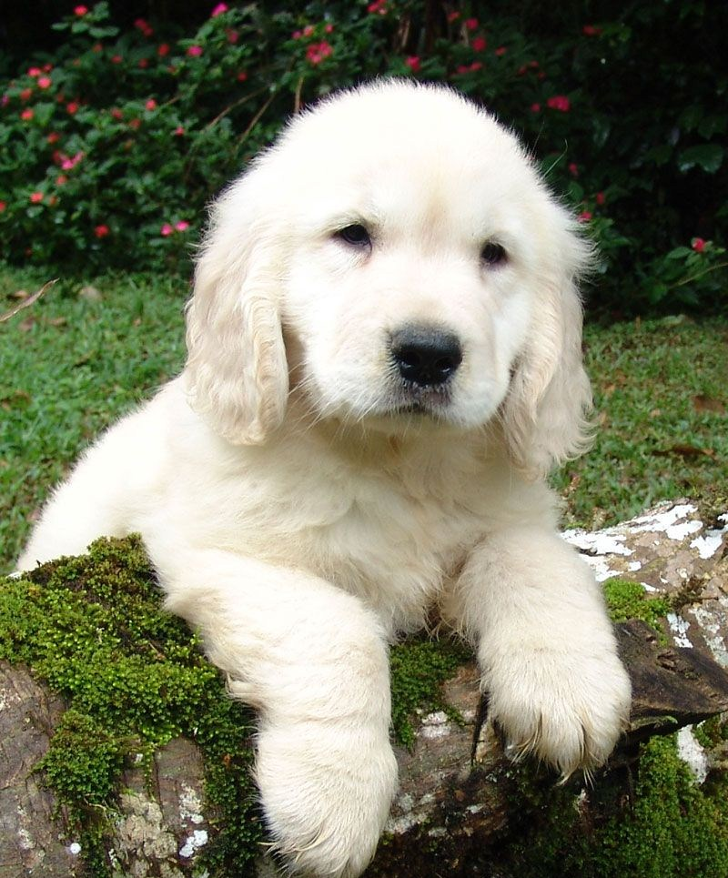
Knowledge Distillation
The student network tries to become more like teacher network
Soft Distillation:$L_{t}=\left(1−λ\right)L_{CE}\left(ψ\left(Z_{s}\right), y\right)+λτ^{2}KL(ψ(Z_{s}/τ),ψ(Z_{t}/τ))$
Hard Distillation:$L_{t}=\frac{1}{2}L_{CE}\left(ψ\left(Z_{s}\right), y\right)+\frac{1}{2}L_{CE}\left(ψ\left(Z_{s}\right), y_{t}\right)$
Teacher (Pre-trained)
$$Z_{t}$$
$ψ$: Softmax
$λ$: Weight of loss
$τ$: Softmax temperature
$L_{CE}$: Cross-entropy loss
Distilled Knowledge
Student
$$Z_{s}$$

Slide 24
ViT Architecture Review
$${z′}_{l}=MSA\left(LN\left(z_{l−1}\right)\right)+z_{l−1}$$
$$z_{l}=MLP\left(LN\left({z′}_{l}\right)\right)+{z′}_{l}$$
MLP
Head
Transformer Encoder
$$y=LN(z_{L}^{0})$$
$$z_{0}=\left[x_{Class};x_{p}^{1}E;…;x_{p}^{N}E\right]+E_{pos}$$
Trainable Vector
[CLS token]
. . . . . . . . .
Convert integer to D-dimension vector
Position
Embedding
Linear Projection
Linear transform
from P*P*C to D
….
1
2
3
Flatten
Split the image to 16*16 Patches
4
5
6
7
8
9
1
2
3
4
5
6
7
8
9

Slide 25
DeiT Architecture
$$L_{CE}$$
$$L_{teacher}$$
MLP
MLP
True Label
Transformer Encoder
Prediction
. . . . . . . . .
Teacher Model
[convolution-teacher]
CLS Token
Linear Projection
Distillation Token
. . . . . . . . .

Slide 26
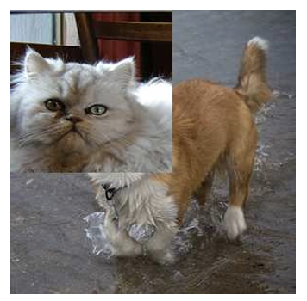
DeiT Results
Use augmentations such as RandAugment, CutMix.
Variant architectures
Fine-tuned on same dataset, but 384*384 resolution
Yun, S., Han, D., Oh, S., Chun, S., Choe, J., & Yoo, Y.J. (2019). CutMix: Regularization Strategy to Train Strong Classifiers With Localizable Features. 2019 IEEE/CVF International Conference on Computer Vision (ICCV), 6022-6031.
E. D. Cubuk, B. Zoph, J. Shlens and Q. V. Le, "Randaugment: Practical automated data augmentation with a reduced search space," 2020 IEEE/CVF Conference
on Computer Vision and Pattern Recognition Workshops (CVPRW, pp. 3008-3017.

Slide 27
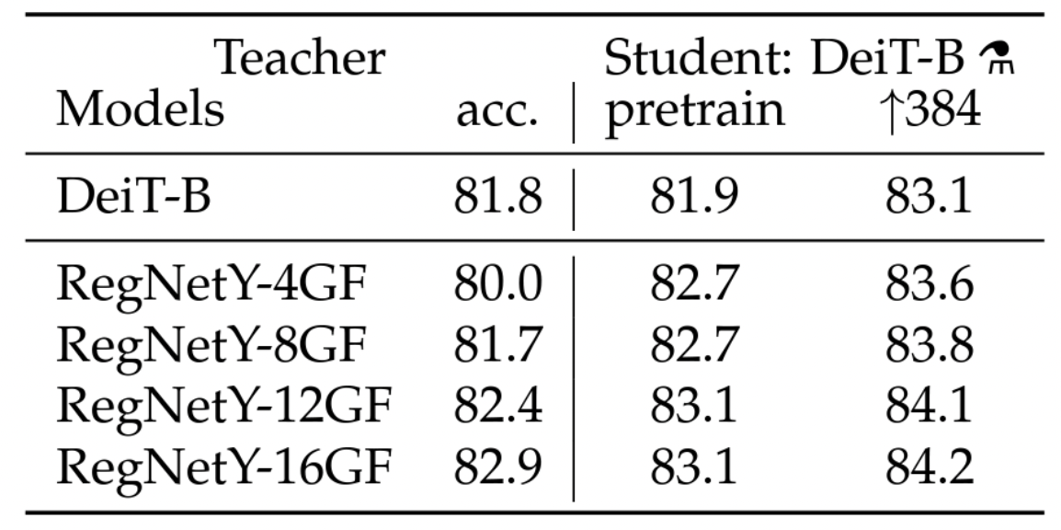
DeiT Results 2
Different teacher model

Slide 28
DeiT Results 3
Different distillation strategies

Slide 29
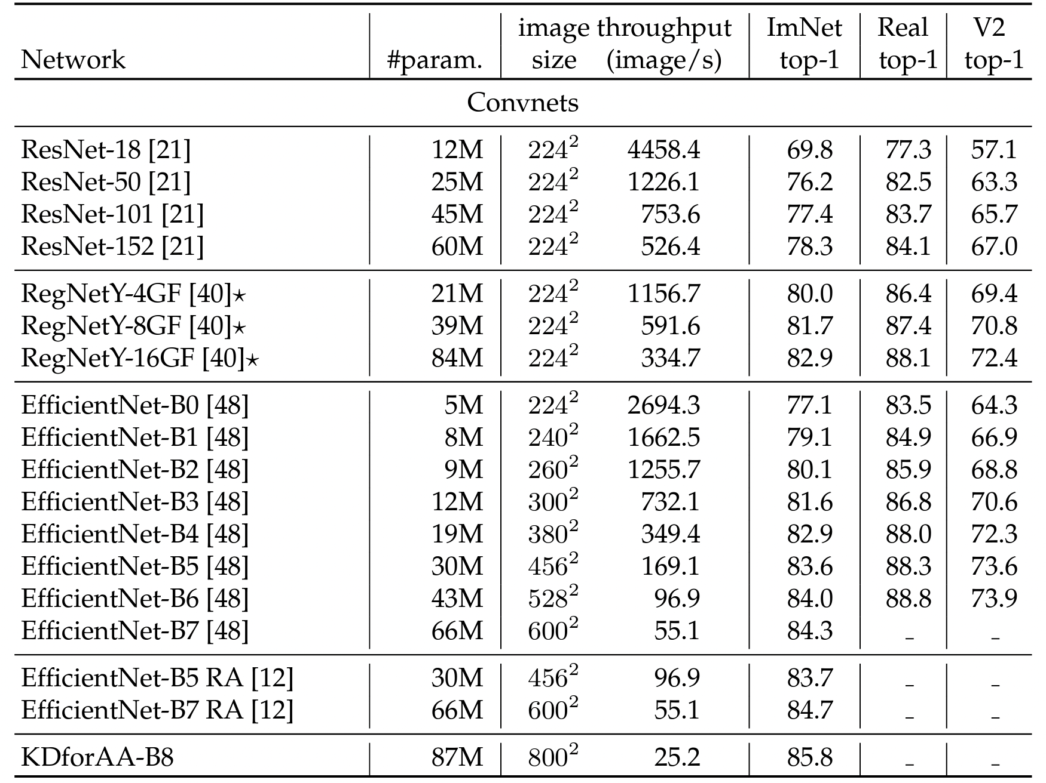
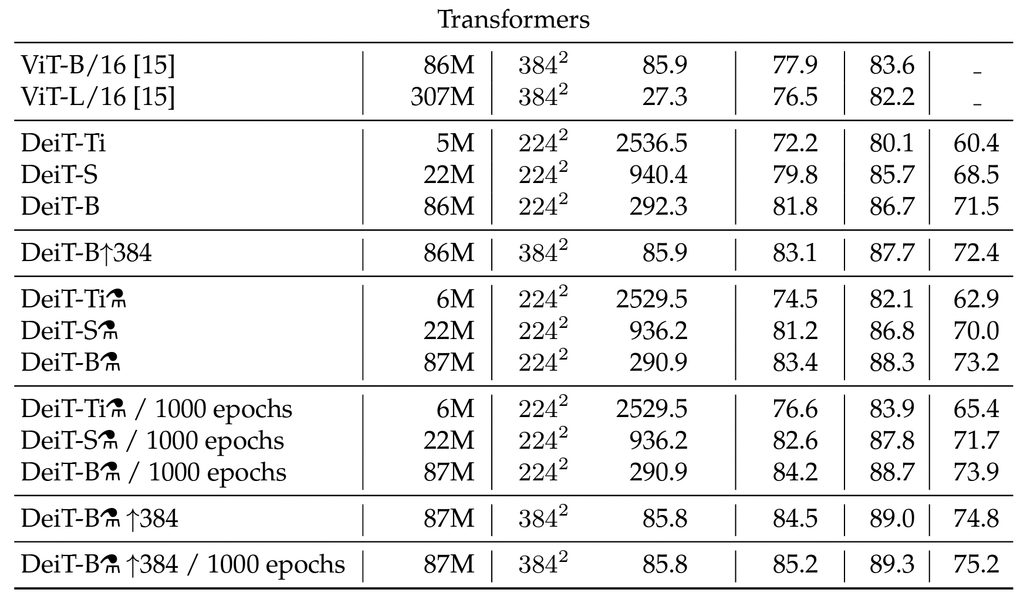
DeiT Results 4
DeiT compared to CNN (much faster)

Slide 30
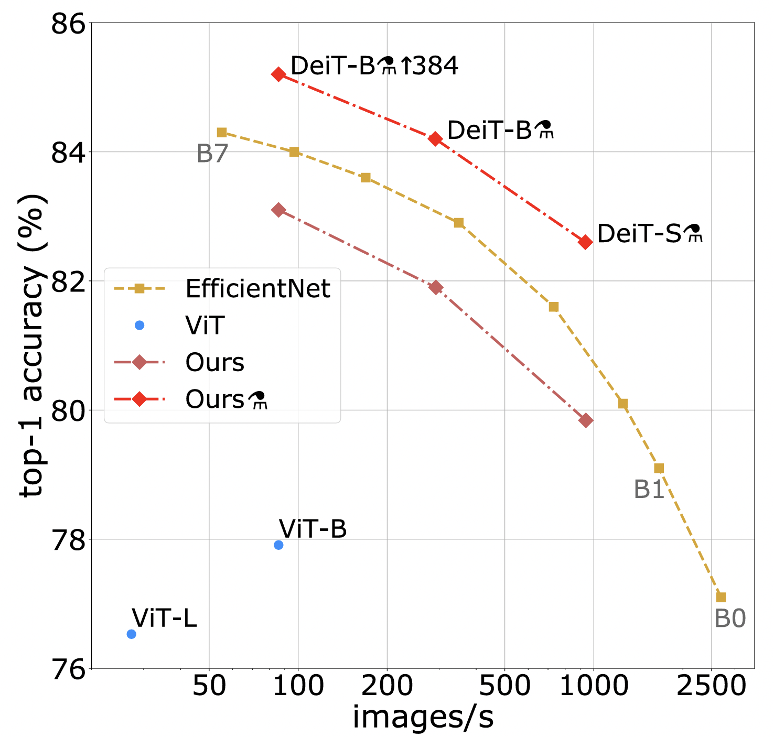
DeiT Results 5
DeiT with distillation outperforms EfficientNets
DeiT has the same architecture as ViT but trained in a data-starving regime

Slide 31
Swin Transformer
Swin Transformer suggested by Microsoft
Paper is “Swin Transformer: Hierarchical Vision Transformer using Shifted Windows”
ViT’s computational complexity is quadratic to the image size
Swin Transformer addresses this issue by introducing two blocks:
Patch merging
Swin transformer
Notes:
https://www.youtube.com/watch?v=qUSPbHE3OeU
https://www.youtube.com/watch?v=ORWdELQ1h9M
chrome-extension://efaidnbmnnnibpcajpcglclefindmkaj/https://arxiv.org/pdf/2103.14030.pdf

Slide 32
Swin Architecture
W
Linear Embedding
4*4*3 = 48
C
H
# of patch = $\frac{H}{4}∗\frac{W}{4}$
# of patch = $\frac{H}{4}∗\frac{W}{4}$

Slide 33
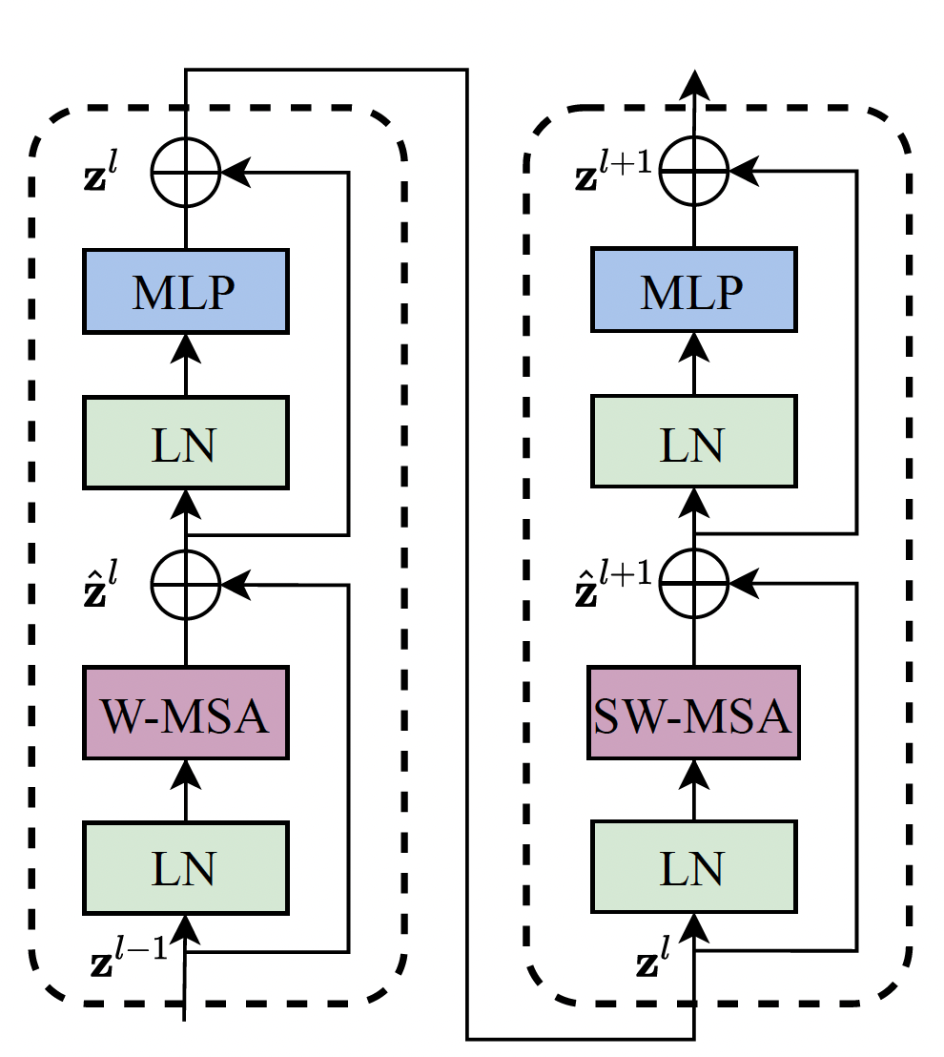
Swin Architecture 2
Swin Transformer contains two sub-units
Identical to Transformer but replaced the standard multi-head self-attention (MSA) with:
Window MSA (W-MSA)
Shifted Window MSA (SW-MSA)

Slide 34
Swin Architecture 3
Window MSA (W-MSA)
Computes attention only within each window
Window size is fixed, so the complexity is linear with respect to the number of patches
However, lack of attention between different windows
…
…
…

Slide 35
Swin Architecture 3
Window MSA (W-MSA)
Computes attention only within each window
Window size is fixed, so the complexity is linear with respect to the number of patches
However, lack of attention between different windows
…
…
…

Slide 36
Swin Architecture 4
Shifted Window MSA (SW-MSA)
To Solve the limitation, let’s shift the window by half the size of the window: $M/2$
Problems:
9 windows!
Add padding?

Slide 37
Swin Architecture 5
Shifted Window MSA (SW-MSA)
Cycle shift
Masked
MSA
Reverse Cycle Shift
…
Masked
MSA

Slide 38
Swin Architecture 6
Linear Embedding
$$\frac{H}{8}∗\frac{W}{8}∗4C$$
$$\frac{H}{8}∗\frac{W}{8}∗2C$$
$$\frac{H}{4}∗\frac{W}{4}∗C$$

Slide 39
Swin Output
Image classification: Use the last output
Object detection and Image segmentation: Use the output of all the stages

Slide 40
Swin Variants
Swin-T: C = 96, layer numbers = {2, 2, 6, 2}
Swin-S: C = 96, layer numbers = {2, 2, 18, 2}
Swin-B: C = 128, layer numbers = {2, 2, 18, 2}
Swin-L: C = 192, layer numbers = {2, 2, 18, 2}

Slide 41
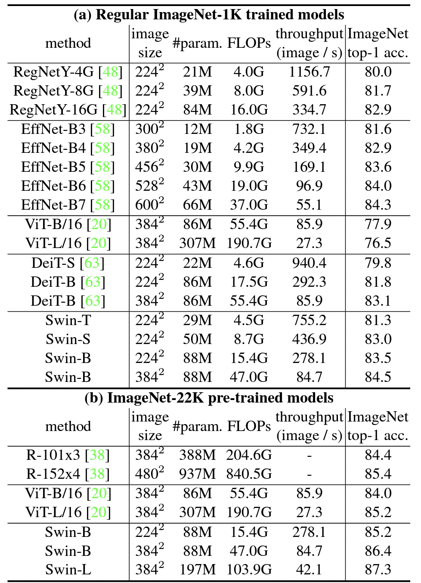
Swin Results
Image classification results

Slide 42
Emerging Properties in Self-Supervised Vision Transformer
Self-distillation with no labels (DINO)
Self-supervised approach to ViT
Builds upon Deit
Highlights the success of k-NN without additional finetuning
Comes with a few stipulations (needs momentum encoder and multi-crop augmentation).

Slide 43
Self-Distillation With No Labels
For an input image $x$
Generate a pair of views ($x_{1}$, $x_{2}$) [random transformation on $x$]
Input to a network $g_{θ}$ Process prediction
Use probabilities to calculate loss
Update weights
p₁
Loss:
-p₂ log p₁
p₂
sg
Softmax
Softmax
centering
student $g_{θ_{s}}$
ema
teacher $g_{θ_{t}}$
$${ x}_{1}$$
$${ x}_{2}$$
$$x$$
Notes:
Here is an example of a pair of views (x1, x2)
Architecture is the same for both, but weights are different
We pass
Ema – expontential moving average
Sg is stop gradient

Slide 44
Network Cost Function
Given a set of global views $x$ and a set of local views $x′$. We wish to minimize the cross-entropy loss $L_{CE}$.
This multi-crop component of the architecture
Authors use 2 global views at 224² and 96² pixels respectively.
Global views are large parts of the original image (> 50%)
Local views are small patches (< 50%)
Notes:
Formally is extension to the loss function used in knowledge distillation.
Also each of the views given as input have had random distorted views, crops, etc....

Slide 45
Teacher Network
Unlike knowledge distillation there is no priori for the teacher!
Solve this by using previous iterations from the students to make one (momentum encoder)
Exponential moving average (EMA) on these previous iterations is how the teacher network updates it weights
Notes:
Lamda follows a cosine schedule from 0.996-1

Slide 46
Avoiding Collapse
Collapse in ML is where the model experiences dimension reduction and in turn stops being a useful predictor
DINO avoids collapse by using two operations to the teacher network:
Centering: Centering is just adjusting the update rule for the teacher network to be dependent on the mean of each batch (reduce variance in update rule)
Sharpening: Sharpening is edge enhancement and has the opposite effect of centering and is accomplished by using a low temperature in the Softmax normalization.

Slide 47
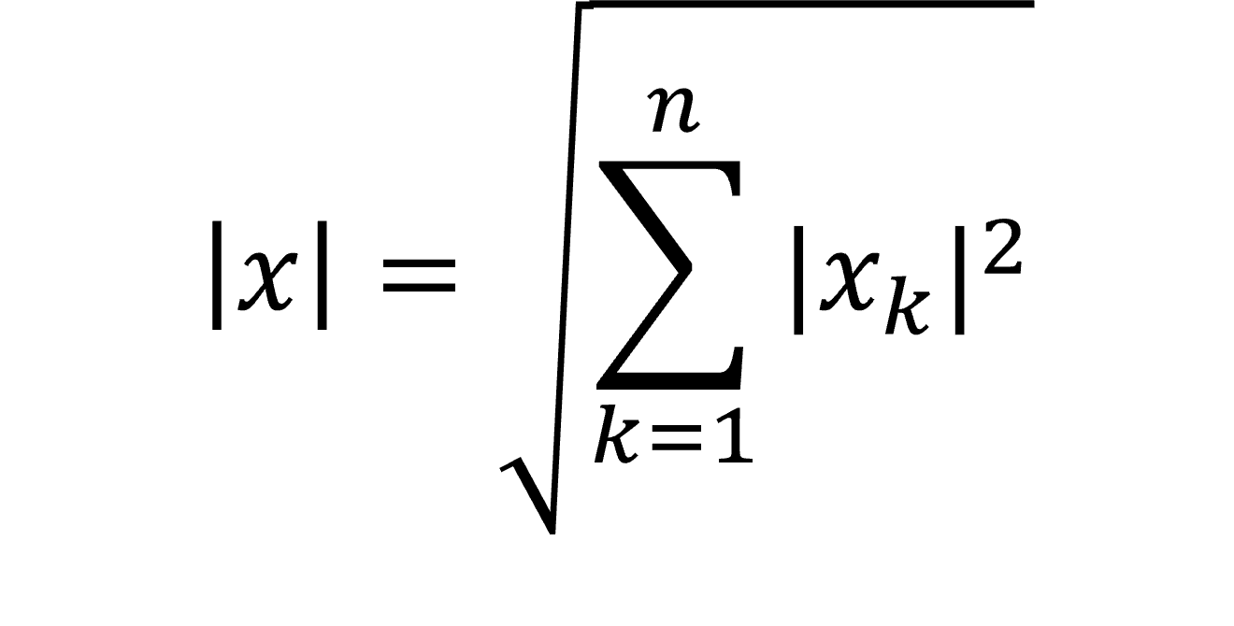
Architecture
Network
Projection Head
3-layer Multi-Layer Perceptron (MLP)
Input
ViT or ResNet backbone
Output
L₂ Norm
Fully Connected Layer
Notes:
Note there is no BN due to ViT not using this
MLP has 2048 hidden dimensions

Slide 48
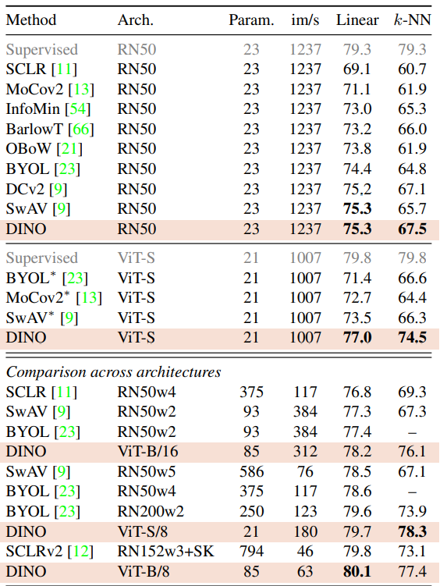
Main Comparison on ImageNet
Comparing performance for linear and k-NN evaluation on ImageNet
Evaluated on ResNet-50 and ViT architectures

Slide 49
Comparison with SSL frameworks on ImageNet
Image Retrieval
Copy Detection
Video Instance Segmentation
Transfer Learning

Slide 50
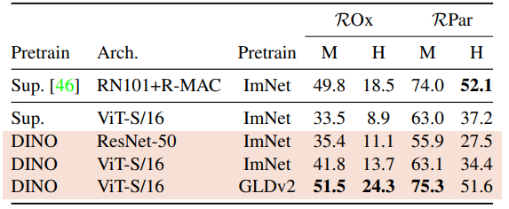
Image Retrieval
Evaluated on ImageNet and Google Landmarks v2 (GLDv2) dataset
Mean Average Precision (mAP) is based on revisited Oxford and Paris
(M) and (H) refer to medium and hard splits respectively

Slide 51
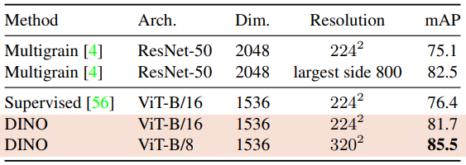
Copy Detection
Evaluation is on the "strong" subset of the INRIA Copydays dataset
Goal is detecting images that been distorted
10k distractor images are randomly sampled from YFCC100M dataset
Copy detection use cosine similarity on the features
20k images were used to learn the features from YFCC100M dataset

Slide 52
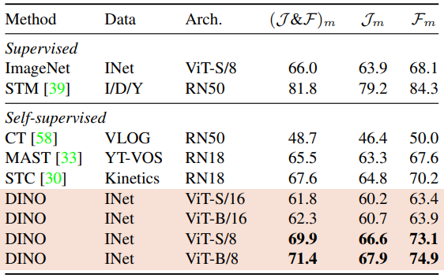
Video Instance Segmentation
Tracks features on video files
Trained on ImageNet
Two metrics for tracking
$𝒥_{m}$ – mean region similarity
$ℱ_{m}$ – contour-based accuracy

Slide 53
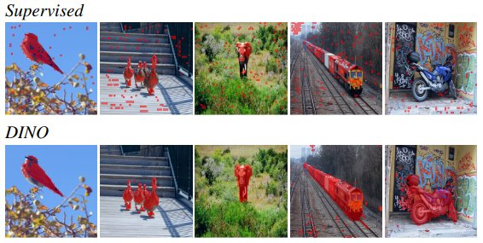
Video Instance Segmentation 2
Segmentation is a visualization mask obtained through thresholding the self-attention maps
Threshold is 60% of the mass
Comparison is the Jaccard similarity using images from PASCAL VOC12 dataset.

Slide 54
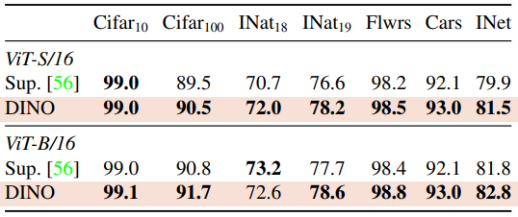
Transfer Learning
DINO versus Supervised approach when evaluating transfer learning
DINO outperforms on almost every dataset for both network architectures

Slide 55
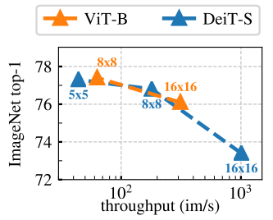
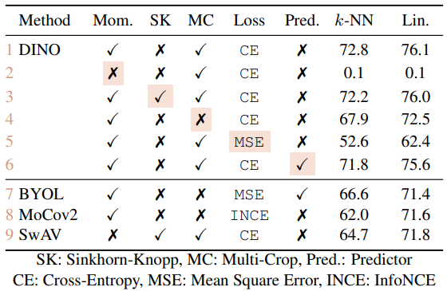
Ablation Study of DINO
Smaller patches sizes show better performance
Cost is significantly slower performance
Highlighted entries in the columns indicate different setting from the default
Sinkhorn-Knopp has minimal effect
Switching to MSE has huge performance loss

Slide 56
Masked Autoencoders Are Scalable Vision Learners
Introduced an asymmetric encoder-decoder architecture
Encoder uses a subset of the data
Decoder use encoded data plus a learned component to represent the rest of the input image
Shows masking a high proportion of the input image to be meaningful self-supervisory task
Use of MAE increases training speed from 2.8x – 4.1x

Slide 57
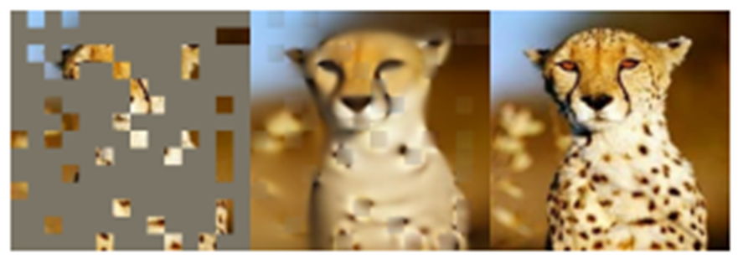
What is a Mask?
It is a matrix used to determine which parts of the input to use

Slide 58
Masking Strategies
Can take different strategies (random, blocks, grid)
Can ignore different ratios of the input (50%, 75%, etc.)
In this paper random sampling showed the best results

Slide 59
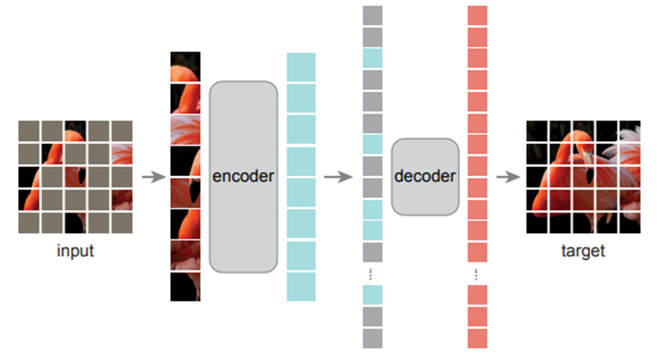
What is a Masked Autoencoder (MAE)?
Take an image
Ignore a portion of the input (masking)
Encode the remaining data
Add some additional features (positional data)
Decode the encode data
Use the decoded data to reconstruct the input

Slide 60
Approach
Masking:
Divide the input into a series of patches
Sample a subset of the patches and remove (mask) the rest
MAE encoder:
Using a ViT take the unmasked patches as input
Embed the unmasked patches
Process using a series of transformer blocks
MAE decoder:
Input is both the encoded visible patches and mask tokens
Mask tokens represent a shared, learned feature vector representing the missing patch
Reconstruction target:
Decoder’s output is reshaped to form the reconstructed image
Loss function is MSE between predicated and original image

Slide 61
Ablation

Slide 62
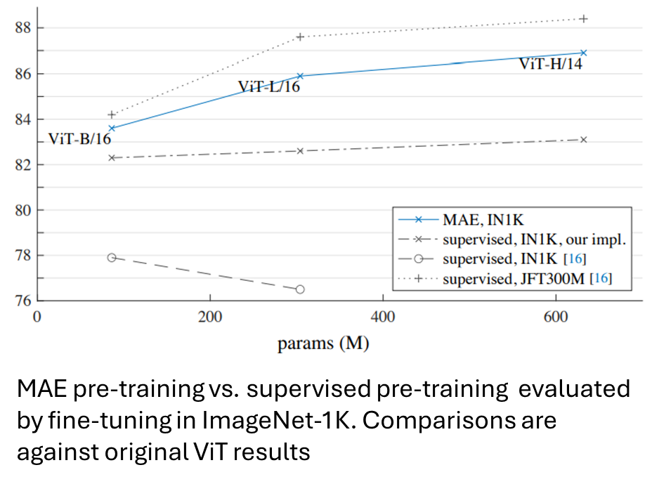
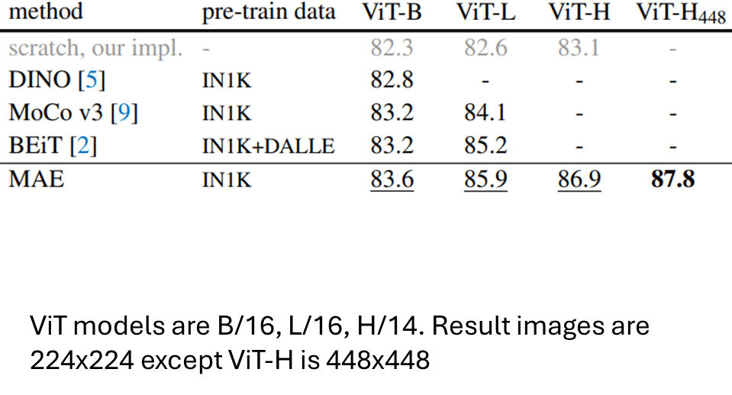
Compared With Previous on ImageNet-1K

Slide 63
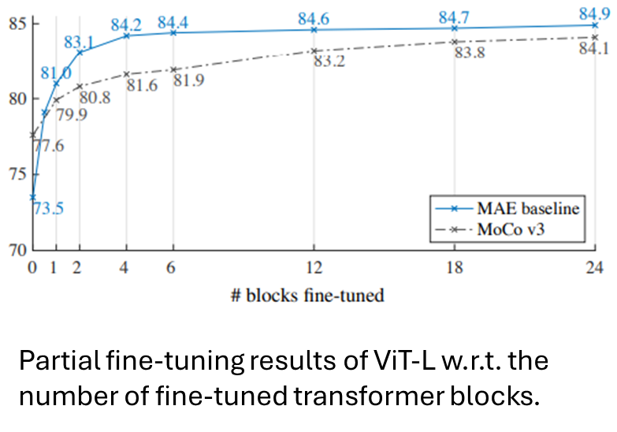
Partial Fine-tuning
As opposed to linear probing or full fine-tuning
Linear probing does not capture strong but non-linear features (something deep learning does do however)
Partially fine tuning is applying fine-tuning to transformer block level

Slide 64
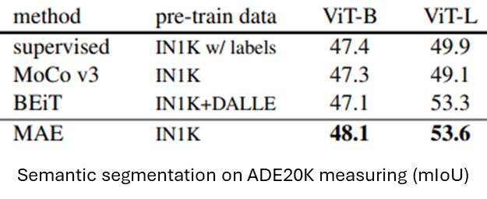
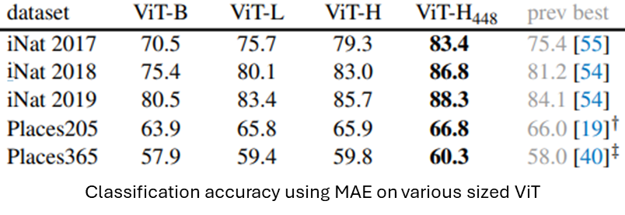
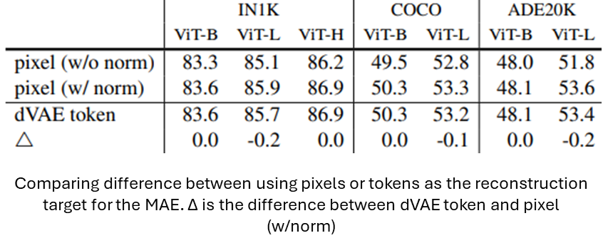
Transfer Learning

Slide 65
MetaFormer is Actually What You Need for Vision
Proposes a generalized architecture for transformers that DON'T use attention
Demonstrates that even a simple token mixer such as pooling can produce competitive results in computer vision tasks
Notes:
The number of multiply-accumulate (MAC) operations of convolutional neural networks in our experiments

Slide 66
MetaFormer
+
+
+
MetaFormer is an abstracted architecture
Derived from transformers
Removes attention from transformers
Replaces it with an abstracted token mixer
PoolFormer uses pooling instead of attention
Channel MLP
Channel MLP
Channel MLP
Norm
Norm
Norm
+
+
+
Token Mixer
Attention
Pooling
Norm
Norm
Norm
Input Emb.
Input Emb.
Input Emb.
MetaFormer
(General Arch.)
Transformer
(e.g. Deit)
PoolFormer
(proposed)

Slide 67
PoolFormer
+
Input
D₀ :
3 x H x W
Stage 1
D₁ :
C₁ x H/4 x W/4
Stage 2
D₂ :
C₂ x H/8 x W/8
Stage 3
D₃ :
C₃ x H/16 x W/16
Stage 4
D₄ :
C₄ x H/32 x W/32
Channel MLP
L/6 PoolFormer
Blocks
L/6
PoolFormer
Blocks
L/2 PoolFormer
Blocks
L/6 PoolFormer
Blocks
Norm
Patch Embedding
Patch Embedding
Patch Embedding
Patch Embedding
+
Pooling
Framework of PoolFormer with L PoolFormer blocks
Norm
PoolFormer Block

Slide 68
Results
Image Classification
Object Detection and Instance Segmentation
Semantic Segmentation

Slide 69
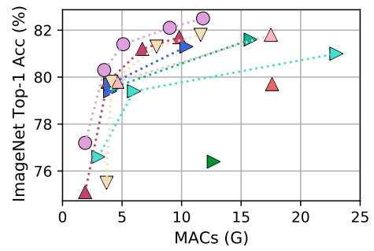
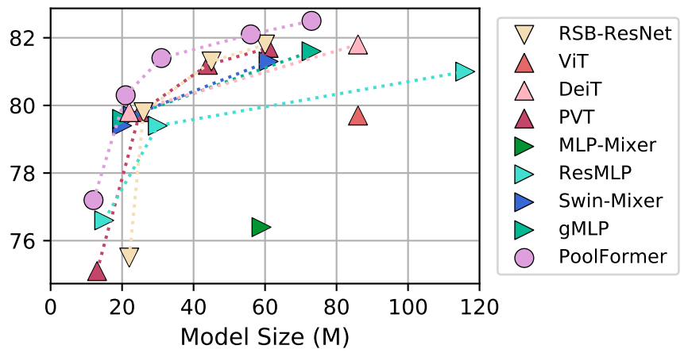
Image Classification
ResNet is a comparison against CNNs
ViT, DeiT, PVT for attention
MLP, Swin, etc.. For spatial MLP

Slide 70
Object Detection & Instance Segmentation
Object detection with backbone of Mask R-CNN and RetinaNet against ResNet
Mask R-CNN is evaluated with bounding box AP and mask AP
RetinaNet is evaluated on two things:
bounding box AP
S, M, L sized objects AP

Slide 71
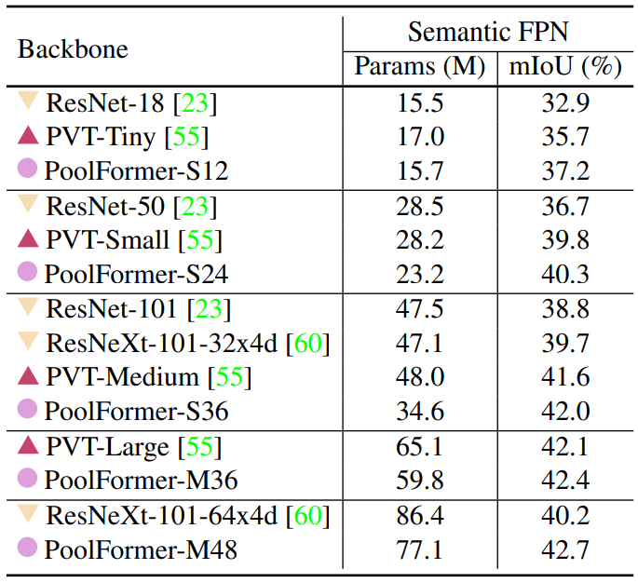
Semantic Segmentation
Uses the ADE20K dataset
20k images in training set
2k images in validation set

Slide 72
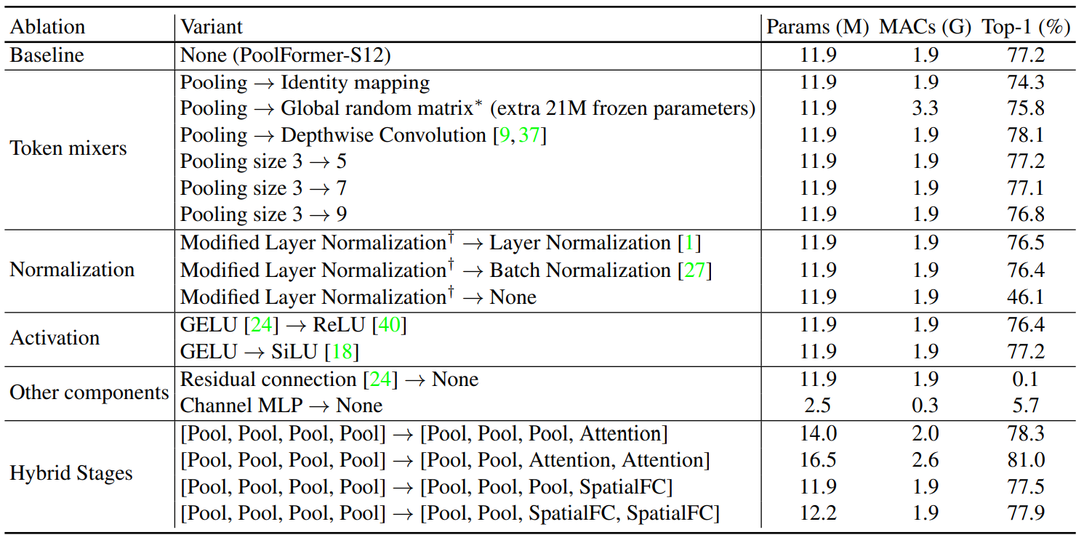
Ablation Study
Although this paper is using pooling to highlight the generalization of MetaFormer the ablation study shows attention is a great addition to the proposed work.

Slide 73
SwiftFormer: Efficient Additive Attention for Transformer-based Real-time Mobile Vision Applications
Introduction of efficient additive attention
Replace expensive matrix multiplication operations with an additive approach

Slide 74
Reminder of How Attention is Calculated
Attention scores are computed by taking the Softmax of two matrices ($Q$, and $K$) with $d$ dimensions
Time complexity is O($n^{2}∗d$)
If we transpose $Q$ instead of $K$ complexity is O($n∗d^{2}$)
Notes:
Q is a query, k is a key and v is a value

Slide 75
Separable Self-attention
Given $Q$ queries, $K$ keys, and $V$ values encode them element-wise
Project the query matrix $Q$ into a nx1 vector $q$.
Apply Softmax to create context scores
Multiply context scores by the key matrix $K$ and pool to create a context vector $S$
Elementwise multiplication between $S$ and $V$ returns attention scores
Notes:
Pooling is just summation symbol

Slide 76
Efficient Additive Attention
As we saw traditionally attention depends on 3 components being a query matrix $Q$, a key matrix $K$, and a value matrix $V$
Efficient additive attention REMOVES the key-value interactions during encoding
The model rather retains that interaction the addition of a linear projection layer
Therefore, the model depends on two matrices being the query $Q$ and key $K$

Slide 77
Global Attention Query Vector
Let $α$ represent the global attention query vector
Where $w_{a}$ is learnable parameter for the attention weights

Slide 78
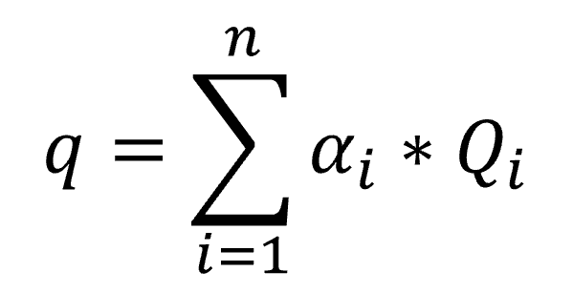
Global Query Vector
Pool the learned attention with the query matrix to create $q$ the global query vector

Slide 79
Efficient Additive Attention Output
Preform element-wise multiplication between Key matrix $K$ and global query vector $q$
Time complexity is O(nxd) for this step
Perform linear transformation $T$
Add normalized query matrix $\hat{Q}$

Slide 80
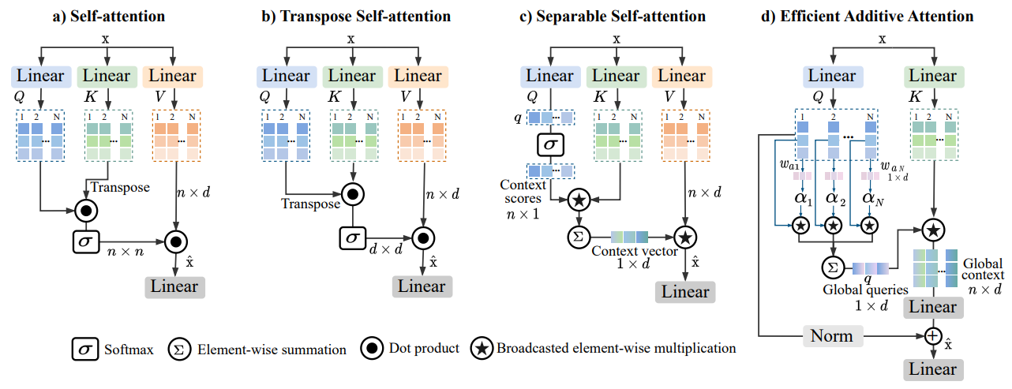
How Additive Attention Differs
Self-attention as it is typically used on the spatial dimensions (nxn)
Transpose attention rather uses attention on feature dimensions (dxd)
Separable uses element-wise operations on the query matrix to improve efficiency
Efficient Additive Attention takes further with a series of smaller operations being summed together

Slide 81
SwiftFormer Encoder
H/4, W/4, C₁
H/8, W/8, C₂
H/16, W/16, C₃
H/32, W/32, C₄
SwiftFormer Encoder
DWConv 3x3
Local Representation
Conv
Encoder
Conv
Encoder
Conv
Encoder
Conv
Encoder
Patch Embed
SwiftFormer
SwiftFormer
SwiftFormer
SwiftFormer
Conv 1x1
Efficient Additive Attention
Stage 1
Stage 2
Stage 3
Stage 4
Linear
Overall architecture consists of 4 stages where between each stage a down sampling layer that reduces spatial size by a factor of 2
Conv Encoder
+
DWConv 3x3
Conv
1x1
Conv
1x1
+
Norm
GeLU

Slide 82
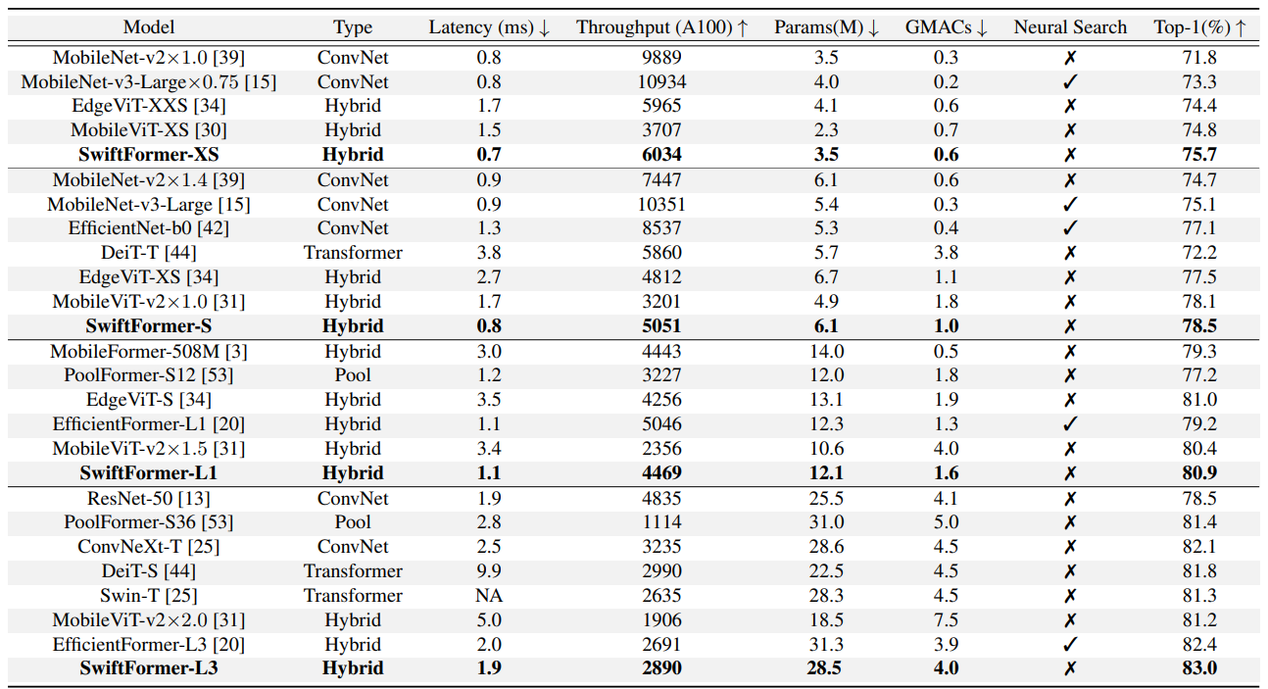
Results: Image Classification

Slide 83
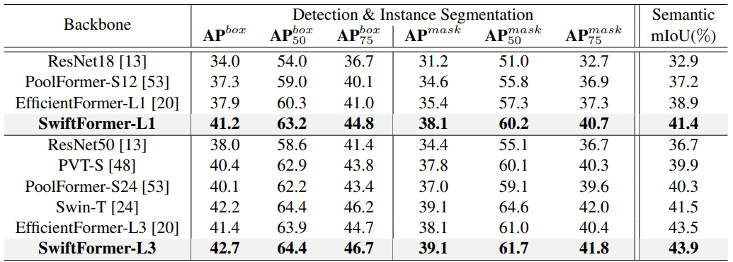
Results: Detection & Instance Segmentation

Slide 84
Thank You!
Any Questions?

