Slide 1
Lecture 15: LLM Prompting
Presenters: Linda Zeng and Xiang Li

Slide 2
What is prompt engineering?
Find an effective way to communicate with AI tools
Notes:
It is significant in communicating effectively with LLMs.
It's all about designing. coming up with proper questions to get answers you are looking for from the LLMs.
In today's presentation, we are going to discuss some practical prompt engineering techniques. OK, now lets dive right into it.

Slide 3
Chain-of-Thought Prompting

Slide 4
Chain-of-Thought Prompting
Introduces chain-of-thought prompting as a novel method.
Significantly improves LLMs' complex reasoning tasks performance.
Arithmetic reasoning
Commonsense reasoning
symbolic reasoning
Notes:
The Chain of thought prompting is the most commonly used and important prompting methods and all the subsequent prompting method will be based on the chain of thought prompting
So, whats is Chain of thought prompting? It’s an approach to improve the reasoning ability of LLMs in arithmetic reasoning, commonsense reasoning and symbolic reasoning.

Slide 5
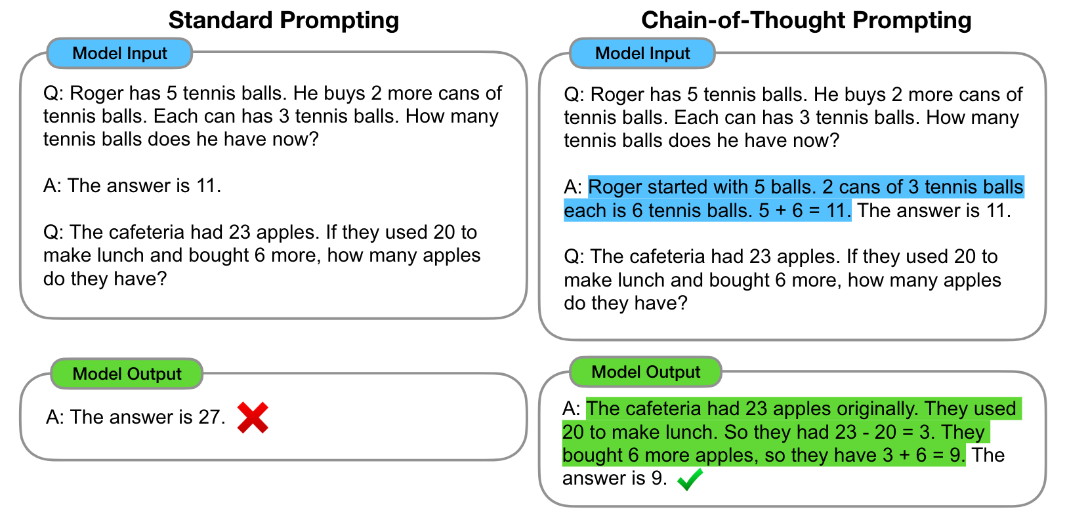
Traditional Prompting vs Chain-of-Thought
Traditional Prompting
In-context few-shot learners
Works poorly on tasks that require reasoning abilities
Not improving with increasing language model scale
Chain-of-thought
Series of intermediate reasoning steps
Mimic human step-by-step thought
Notes:
Chain of thought prompting will give you a very structured answer and stepwise answer, which will be very easy to follow and understand.
From the human perspective this is very intuitive as it is how the humans think – we never reach the final answer from the beginning, in stead we iterate through our thinking procedure.
In traditional prompting or standard prompting, the exemplars only contain the final answer. They perform poorly on tasks that require reasoning abilities [compare the two pictures] Moreover, as we can see in the next few slides, we observe a significant enhancement in the efficacy of Chain of Thought Prompting relative to standard prompting methods, particularly as the scale of the model expands.

Slide 6
Comparision

Slide 7
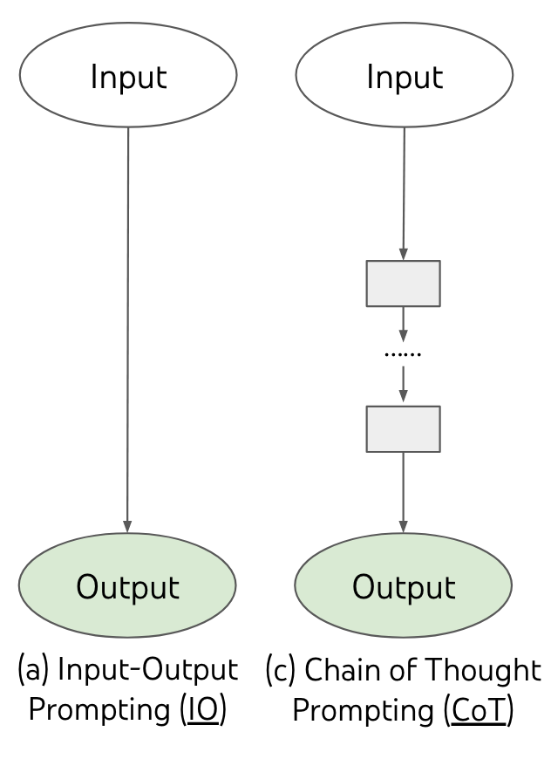
Chain-of-thought Prompting Principals
Step-by-Step Guidance - Breaking complex problems into smaller steps
“Let’s do it step by step.”
Explicit Reasoning Chains - Creating prompts that detail the reasoning process step by step
“Consider the dangers of lightning. Next, evaluate the safety of being outdoors vs. indoors. Conclude with the safest option.”
Use of Examples - Providing solved examples with detailed reasoning step
“If A is bigger than B and B is bigger than C, then A is the biggest. For example, if A = 5, B = 3, and C = 2, then 5 is the biggest.”
Iterative Refinement - Refining prompts based on model output for clarity and effectiveness
"Consider the relationship between A, B, and C step by step, starting with comparing A and B.”
Step 1
Step n
Notes:
Chain of Thought does not fit into every problem you have. It’s more likely to work on problems with the kind of like step by step thinking, I think you can easily identify them when you see them.
The strategy is simple divide and conquer; you split a big task into many sub-tasks and solve them one by one. When all the intermediate steps are solved we basically solve the main problem.
Here are some CoT principals that you can use in chatgpt.

Slide 8
Attractive Properties of CoT
Enables decomposition of multi-step problems.
Provides interpretable insights into LLM's reasoning.
How the answer was derived?
Easy to debug when reasoning path went wrong
Broad applicability across diverse reasoning tasks.
(Any) problems solvable via language.
Simple, off-the-shelf
Notes:
So here are some reasons why people are using CoT
First, it decompose hard problems into simpler and more intuitive sub problems.
Second, it provide some level of interpretation to the LLM reasoning path
Third, it is broadly applicable across diverse reasoning tasks, theoretically we can apply it to any langue solvable problems
Last, it is simple and off the shelf, does not require any additional training or fine tuning, you can apply CoTs with just a bunch of prompts.

Slide 9
Evaluation - Arithmetic Reasoning
Benchmark:
Five math word problems: GSM8K, SVAMP, ASDiV, AQuA, MAWPS
“Josh decides to try flipping a house. He buys a house for $80,000 and then puts in $50,000 in repairs. This increased the value of the house by 150%. How much profit did he make?” (GSM8K)
Baseline: Standard prompting with in-context exemplars
CoT: 8 few-shot exemplars with chains of thought for prompting
Language models:
GPT3
LaMDA
PaLM
UL2 20B
Codex
Notes:
As we discussed before, the CoT approach mainly focus on improving the reasoning on three areas: the arithmetic reasoning, common sense reasoning and symbolic reasoning. In the evaluation section, we will discuss them one by one.
The first one is the Arithmetic reasoning,
The baseline we are using is the standard prompt with some in-context exemplars. The CoT approach augment each input with 8 few shot examplars with chain of thought prompt.

Slide 10
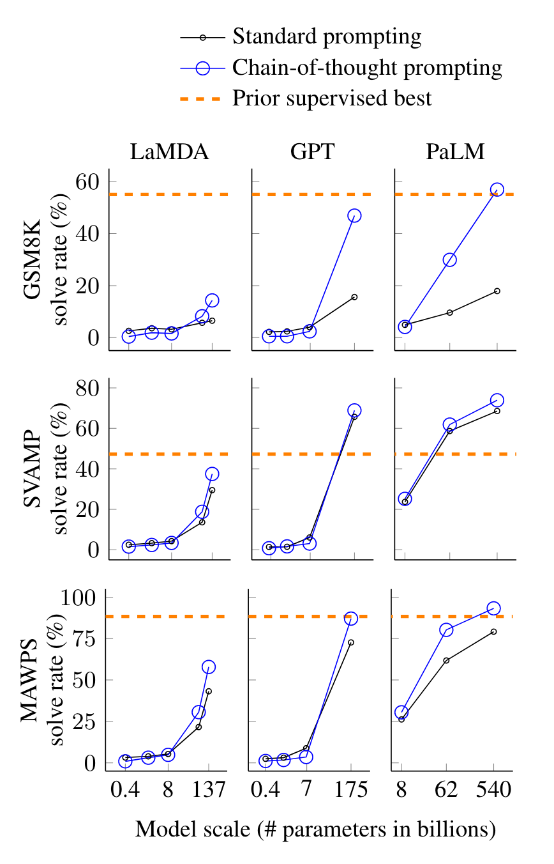
Evaluation - Arithmetic Reasoning
CoT is an emergent ability of the model scale
No effect on small models
Harder problems have a greater improvement
Performance doubled on GSM8K
Error analysis on LaMDA 137B for GSM8K
46% - calculator errors, symbol mapping error
54% - semantic misunderstanding
PaLM 62B -> PaLM 540B
Notes:
Here are the evaluation results.
The y-axis represent the problem solve rate and the x-axis represent the model scale.
First, The CoT prompting des not increase the performance for small models, and only yields performance gain when used on models larger than 100B parameters.
Second, chain-of-thought prompting has larger performance gains for more-complicated problems.
The author randomly examined 50 samples for which the model gave the wrong answer, 46% of them were minor errors such as calculator error, symbol mapping errors or one reasoning step missing and the rest 54% are semantic misunderstanding. When Scaling the PaLM from 62B to 540B, a large portion of the semantic understanding errors are fixed.

Slide 11
Evaluation - Commonsense Reasoning
Benchmark: Five common sense reasoning datasets
Q: Yes or no: Would a pear sink in water?
CoT: Same as arithmetic reasoning
Q: Yes or no: Would a pear sink in water? A: The density of a pear is about 0.6 g/cm^3, which is less than water. Thus, a pear would float. So the answer is no.
Results for PaLM
Notes:
The second task is Common sense reasoning,
Benchmarks
CoT prompting
With chain-of-thought prompting, the performance of PaLM is even better than previous supervised state of the art.

Slide 12
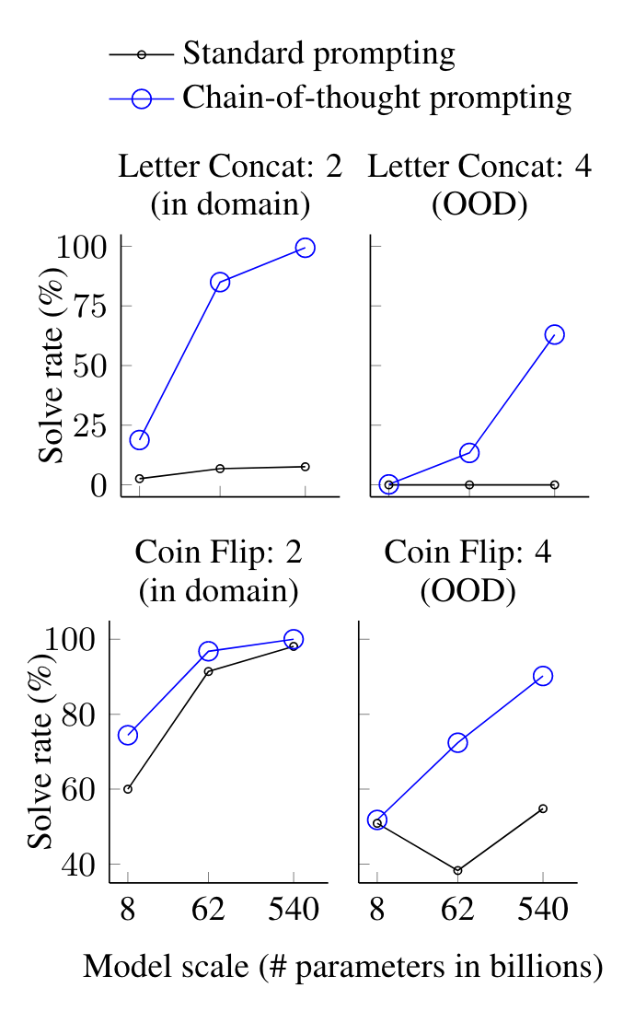
Evaluation - Symbolic Reasoning
Tasks
Last letter concatenation. (e.g., “Amy Brown” -> “yn”).
Coin flip. (e.g., “A coin is heads up. Alice flips the coin. Bob does not flip the coin. Is the coin still heads up?”)
CoT prompting: same as in common sense
Q: Take the last letters of the words in “Lady Gaga” and concatenate them. A: The last letter of “Lady” is “y”. The last letter of “Gaga” is “a”. Concatenating them is “ya”. So the answer is ya.
Results for PaLM
In domain vs OOD
Standard prompting provide lower bound of LLMs
Notes:
In domain test: examples had the same number of steps as the training/few shot learining. In-domain evaluations are toy tasks, all the model has to do is just repeat the same steps with the same new symbols in the test time example.
Right figure shows the result for PaLM, PaLM with 540B parameters almost 100% solve the in-domain questions.
Even this is toy model, standard prompting still performs poorly.
Out-of-domain test: evaluation examples had more steps than those in exemplars.

Slide 13
Limitation of CoT
Emulate the thought process, but not necessarily reasoning
Cost of manually augmenting exemplars with CoTs
Emergence of CoT reasoning only at large model scale
No guarantee of correct reasoning paths
Notes:
Although chain of thoughts emulates the thought processes of human reasoners, this does not answer the question whether the neural network is actually reasoning.
Although the cost of manually augmenting exemplars with chains of thoughts is minimal in the few-shot settings, such annotation costs could cause big problems when finetuning
The emergence of CoT reasoning capability only at large model scale makes it costly to serve in real world applications, some future work could be how to adapt it to smaller models.
There’s no guarantee of correct reasoning paths, which can lead to both correct and incorrect answers

Slide 14
Self-Consistency Improves Chain of Thought Reasoning in Language Models

Slide 15
Motivation
Analogous to the human way of thinking:
If multiple different ways of thinking lead to the same answer, one has greater confidence that the final answer is correct.
Complex reasoning tasks typically admit multiple reasoning paths that reach a correct answer.
Correct reasoning processes tend to have greater agreement in their final answer than incorrect processes.

Slide 16
Traditional CoT vs CoT w/ Self Consistency

Slide 17
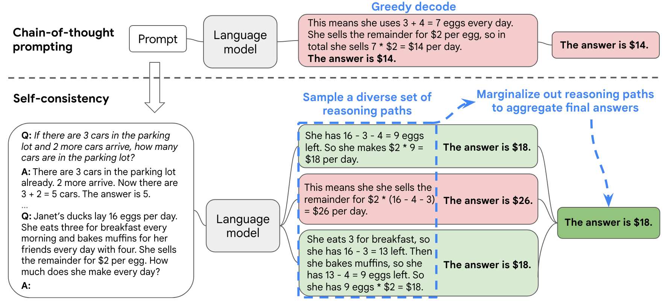
3 steps of Self Consistency
Prompting LLM with CoT
Sampling from the LLM decoder to get diverse reasoning paths
Selecting the most consistent answers (e.g. majority voting)

Slide 18
Another example
Notes:
Another example of how the self consistency works. In greedy decode, which is the naïve CoT, once the decoder output an answer, it is what it is with no other options. With self-consistency, more reasoning paths could be generated, even if the problem is hard and some of the arguments are wrong, we still have chance that the final answer is correct.

Slide 19
Understanding the Consistency
Decomposition of decoder output into $(r_{i}→a_{i})$
Reasoning path $r_{i}$
Final answer $a_{i}$
Example
Common Sense reasoning
Q: Yes or no: Would a pear sink in water?
$r_{i}$: Considering that pears have a density less than water, we can infer that a pear would float in water.
$a_{i}$: The answer is yes, a pear would float in water.
Symbolic reasoning
Q: Take the last letters of the words in “Lady Gaga” and concatenate them.
$r_{i}$: The last letter of “Lady” is “y”. The last letter of “Gaga” is “a”.
$a_{i}$: The answer is “ya”.
Notes:
We need to decompose the decoder output into two part, the reasoning path ri and the final answer ai.
The parser is task dependent.
For arithmetic reasoning, we parse the first numerical part as the final answer after the model generates “The answer is ”.
For commonsense reasoning, we parse the full string answer as the final answer after the model generates “The answer is ”.
Most generated outputs have a consistent format of “{Reasoning paths}. The answer is X.” if we prompt the language model in this format.

Slide 20
Understanding the Aggregation
*Majority vote: $argmax_{α}\sum_{i=1}^{m}{1(a_{i}=α)}$
Weighted probability of each reasoning and answer pair
Unnormalized probability
$$P\left(r_{i}, a_{i}\right| prompt, question)$$
Normalize the conditional probability by output length
$$P\left(r_{i}, a_{i} \right| prompt, question) =\exp^{\frac{1}{K}\sum_{k}{logP\left(t_{k}\right|prompt, question, t_{1}, …, t_{k−1} )}}$$
Notes:
There are two aggregation approach, the first approach is majority sum, the second approach is weighted p..
Here’s the comparison between different aggregation approaches. Despite the fancy formula, the majority voting has the best performance among all methods.

Slide 21
Properties of Self Consistency
Self-ensemble
No additional training required
No additional human annotation
No auxiliary models
No fine-tuning
…
Off-the-shelf method
Robust to sampling strategies and imperfect prompts.
Sometimes CoT hurts performance , while CoT-SC dose not

Slide 22
Evaluation
Benchmarks:
Arithmetic reasoning: same as CoT paper
Commonsense reasoning: CommonsenseQA, StrategyQA, ARC(new)
Symbolic Reasoning: same as CoT paper
Baseline: 8 few-shot exemplars with CoT prompting
Language models: GPT3, LaMDA, PaLM, UL2 20B, Codex
Notes:
For the evaluation part, this paper uses the same three benchmarks used in the previous CoT paper with some minor changes.
They introduced ARC (AI2 Reasoning challenge) and remove Codex from the language model test list.
Result: Self-consistency improves all three kinds of reasoning performance over all four language models significantly over chain-of-thought prompting.

Slide 23
Results
Self-consistency improves all three kinds of reasoning performance over all four language models significantly over chain-of-thought prompting.
The more reasoning path, the better
Self-Consistency Improves Robustness to Imperfect Prompts
Notes:
One previous study shows that the naïve CoT could potentially hurt the performance compared to standard prompting. But the self consistency can robustly boost the performance compared to standard prompting.
In the study they also report that Human annotators sometime make minor mistakes when creating the prompts. Self consistency can help to improve the LLM’s robustness to imperfect prompts.

Slide 24
Tree of Thoughts Prompting

Slide 25
Motivation: General Problem Solver
Analogy: Linkedlist -> Tree structure
Thinking is not always linear
CoT is good, but still token-level, left-to-right decision-making
CoT/CoT-SC has a linear topology
“Backtracking” is impossible
The objectives of the Tree of thought
Enhances LMs for complex problem-solving beyond token-level decisions
Deliberate decision-making, multiple reasoning paths, and strategic backtracking
Notes:
Let’s take this analogy, in data structure 101 after we learn linkedlist what we learn? We learn tree structures. Imagine you are solving a puzzle, you are not always thinking in a straightforward manner.
Cot is good, but still token level,

Slide 26
Sequential problem-solving vs ToT

Slide 27
What we need to build a ToT?
How to decompose the intermediate steps into thought steps?
How to generate potential thoughts from each state?
How to heuristically evaluate states?
What search algorithm to use?
What tasks to evaluate?
Game of 24: Give four numbers and use arithmetic operations to achieve 24.
Creative writing: Generating original narratives or poems.
Crossword: Filling a grid with words based on clues.

Slide 28
Methodology
How do we break down problems into thought steps?
A step cannot be too big or too small
E.g. a line of equation for Game of 24
Generate potential thoughts
Sample i.i.d. thoughts from CoT prompt:
Thought space is rich and unnumerable, i.i.d sample increases diversity
E.g. Creative writing
Propose thoughts sequentially using a “propose prompt”:
Thought space is limited, propose under same context to avoid duplicate
E.g. Game of 24, Crosswords
Notes:
There are two approaches when generate candidates for the next thought step, the first one is called sample and the second is called propose.
Sample works better when people are work with larger thought space and the space is unnumerable, such as creative writing. IID sampling can increase the thought space diversity.
Propose work better when the thought space is limited and in this case let’s say we only have a few options to choose from in each step, proposing different thoughts in the same context can avoid duplicates.

Slide 29
Methodology Heuristic evaluation of state/tree node
Value each state independently (scenario: Game of 24)
Used to quickly assess the viability of individual steps without considering the broader context of other possible steps
State 1: [5 + 7 = 12 (left: 3, 2)] -> Evaluation: Likely (Reasoning: 12 is halfway to 24, and remaining numbers can potentially multiply to 2 to reach 24).
State 2: [5 * 2 = 10 (left: 7, 3)] -> Evaluation: Unlikely (Reasoning: 10 is less ideal as a starting point, and it's harder to incorporate the remaining numbers to reach 24).
Voting across states (scenario: Crosswords)
Used when decisions need to be made between closely competitive options, especially when direct evaluation might not clearly favor one option over others.
State 1: Filling "apple" in the horizontal space -> Vote: 3 votes (Reasoning: Fits well with vertical words, common fruit name).
State 2: Filling "apricot" in the same space -> Vote: 2 votes (Reasoning: Fits but less common, makes adjoining vertical fills harder).

Slide 30
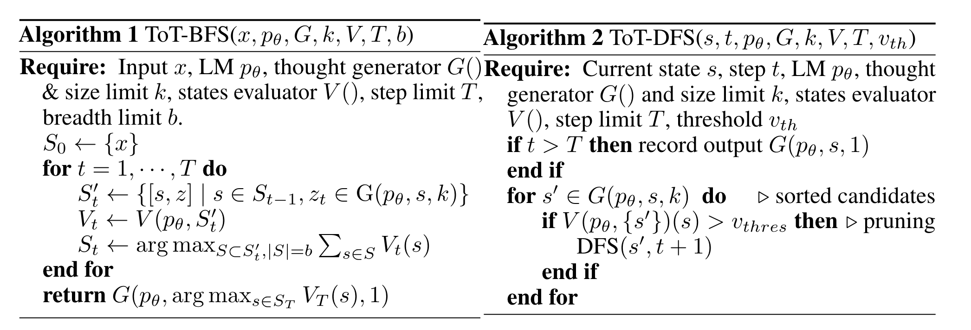
Methodology Selecting a search algorithm
BFS
Maintains a set of the most promising states per step.
For Game of 24 and Creative Writing, where the tree depth is limit
DFS
Explores the most promising state first until the final output is reached(either success or failure).
Notes:
DFS: for crossword

Slide 31
Experiments setup

Slide 32
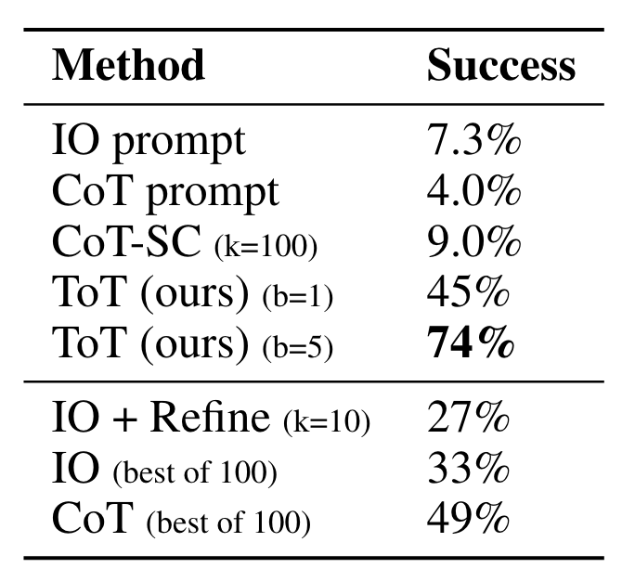
Evaluation – Game of 24
Baseline: standard IO prompting
ToT setup:
Decompose the thoughts into 3 steps
Propose Prompt
Independent state estimator
BFS (b=5)
Notes:
When using ToT to solve the Game of 24, it is natural to decompose the thoughts into 3 steps, each an intermediate equation, since in each step one digit will be used in the calculation.
Independent state estimator: we prompt LM to evaluate each thought candidate as “sure/maybe/impossible” with regard to reaching 24.
See the results in the table.
IO, CoT, and CoT-SC prompting methods perform badly on the task,
In contrast, ToT with a breadth of b = 1 already achieves a success rate of 45%, while b = 5 achieves 74%.
They also compared the “best of k” candidate in CoT and IO to ensure faireness to mimic ToT can visit multiple candidate in each step. But the performance is still low.

Slide 33
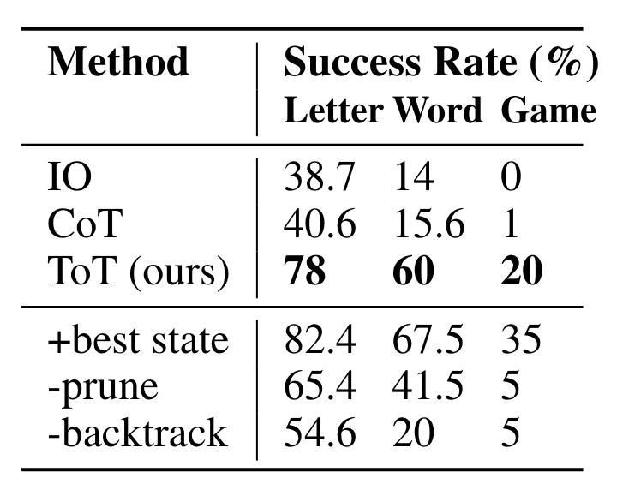
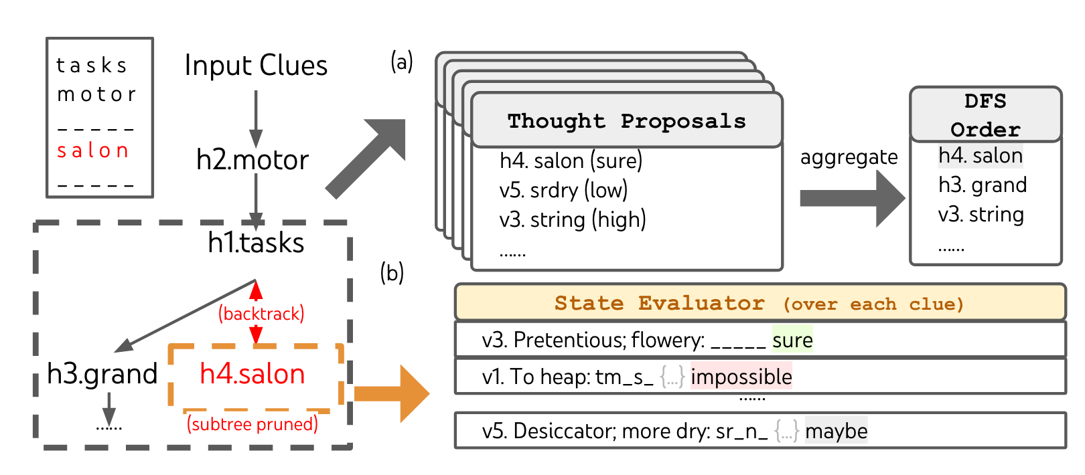
Evaluation – Crossword
Baseline: standard IO prompting with 5 exemplars
ToT setup:
Decompose the thoughts into at most 10 steps
Proposal prompt
Voting across states
DFS

Slide 34
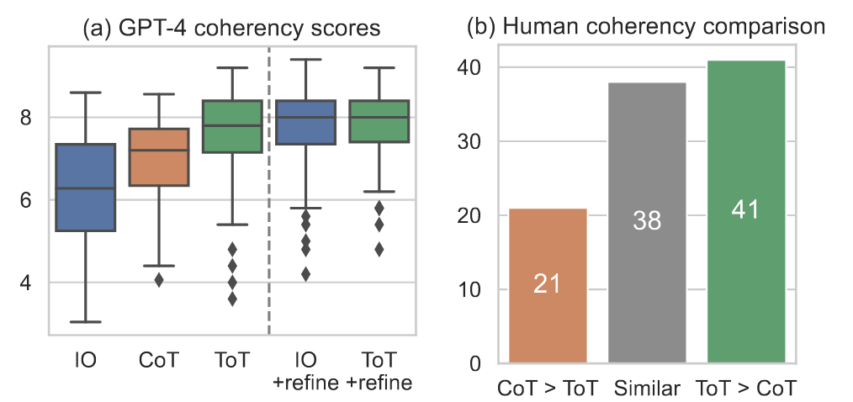
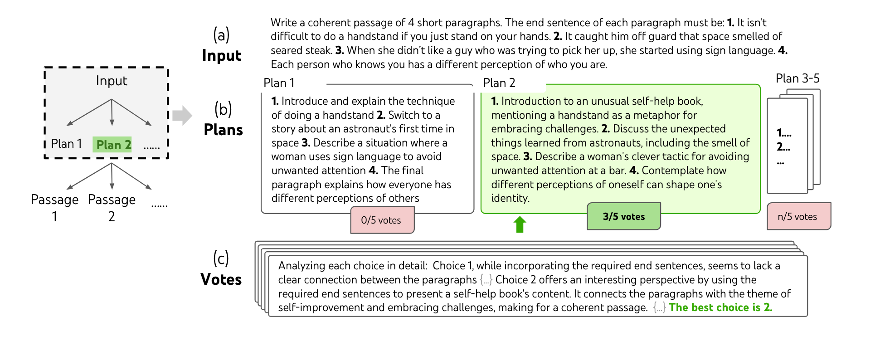
Evaluation – Creative Writing
Baseline: zero-shot IO
ToT setup:
Decompose the thoughts into 2 steps
Sample prompt
Voting across states
BFS (b=1)

Slide 35
Program of Thoughts Prompting

Slide 36
Motivation
Why let LM do the math if you have a calculator?
Why let LM execute the program if you have an interpreter?
So…
Delegate computation to program interpreter
Decoupling complex computation from reasoning and language understanding.

Slide 37
Understanding the gap between Cot and PoT
Why LM are not ideal for solving expressions
LLMs often make errors in arithmetic calculations, particularly with large numbers
They struggle to solve complex mathematical problems like polynomial or differential equations
LLMs are inefficient at handling iterative processes, especially with a high number of iterations

Slide 38
Understanding the gap between Cot and PoT
CoT uses LLM for both reasoning and computation
PoT uses code interpreter for external computation
PoT breaks down complex equations into multi-step thought processes
PoT assigns semantic meanings to variables

Slide 39
Few-shot PoT vs Zero-shot PoT

Slide 40
PoT as an Intermediate Step
Program of Thoughts (PoT) for computations in problems needing textual reasoning
Execute PoT-generated programs for intermediate results, then use Chain of Thoughts (CoT) for the final answer.
Notes:
For certain problems requiring textual reasoning and computational part, we use PoT as an intermediate step.

Slide 41
Chain of Thoughts vs Program of Thoughts
Notes:
Here’s an example in which LLM is asked to compute the fibbonacci number

Slide 42
Evaluation
Benchmarks:
Five Math problem datasets, GSM8K, AQuA, SVAMP, TabMWP, MultiArith
Three financial datasets, FinQA, ConvFinQA, and TATQA
Notes:
Five math problem datasets and three financial datasets are used as benchmarks

Slide 43
Evaluation
Implementation details
Model: mainly used Codex (code-davinci-002), also used GPT-3, PaLM, LaMDA
Few-shot settings: 4-8 shots for all datasets
Baselines
IO Prompt
CoT
CoT-SC (with majority voting)

Slide 44
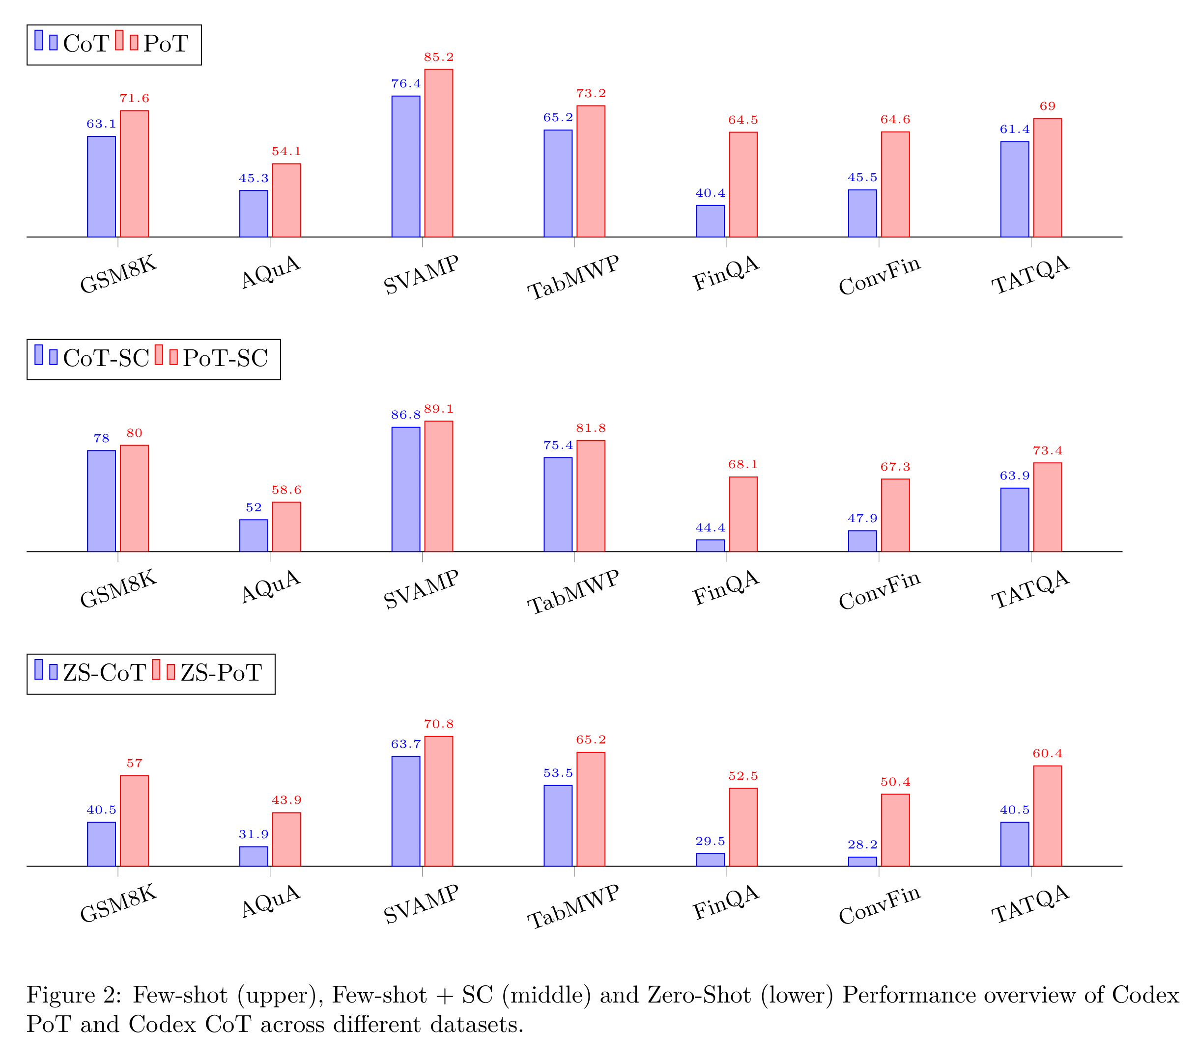
Results (Compared to CoT)
Under few-shot
8% gain on math datasets
15% gain on financial datasets
Under zero-shot
12% gain on math dataset
On average, the performance of PoT-SC was 10% better than CoT-SC

Slide 45
Evaluation results: Few-shot (+ Self-Consistency)

Slide 46
Evaluation results - Zero-shot

Slide 47
Least-to-Most Prompting Enables Complex Reasoning in Large Language Models

Slide 48
Problem Statement
COT performs poorly on tasks requiring generalization from easy to difficult problems.
Eg: prompt examples are much easier than test cases
Typical generalization tasks:
Symbolic manipulation
Compositional generalization
Numerical reasoning
Notes:
Chain of Thought struggles with tasks that require first understanding then generalize knowledge from easy to more complex problems.
Typically, COT performs poorly when examples in provided prompts are much easier than the test cases.
Standard tasks involving broad application skills include A, B, and C.
To improve the performance of LM on generalization tasks, the authors propose the idea of Least-to-Most prompting. This idea is quite intuitive.

Slide 49
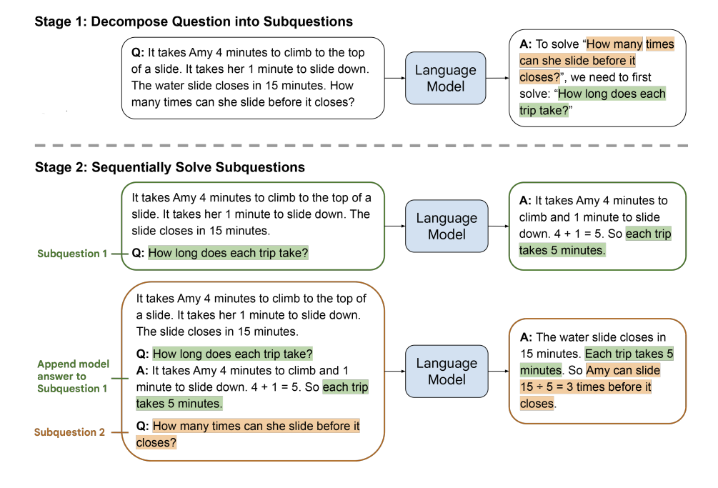
Least-to-most Prompting details
​Prompts are omitted in this example
Both stages are implemented by few-shot prompting.​
Pre-trained model
Combine with other prompting techniques (CoT/ self-consistency)​
Notes:
So basically, I will now talk it through with the example here. SO the LtM prompting have two types of prompts because they have two steps.
So what they do is, say we are trying to solve this math problem. It's a new question. And they gave examples on how questions are reduced. So they will have multiple samples, where there is a question, and followed by sub-questions.
To solve this question with LtM Prompting, we need to first, break the question into couple sequential sub-questions, and solve them one after another.
…
In summary, this model has two stages, and each stages need

Slide 50
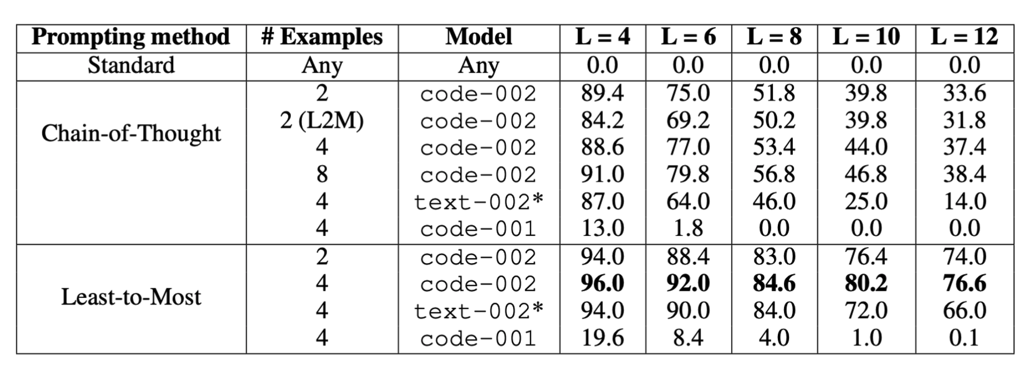
Evaluation (CoT vs. LtM)
Symbolic Manipulation
Task: last-letter-concatenation(“thinking, machine” → ‘ge’)
Testing list construction:
Randomly select words from Wiktionary
List length varies from 4 to 12 words
Construct 500-examples lists for each length (100 for text-davinci-002)
Baselines: standard prompting
Result:
Notes:
The authors evaluate this model with the typical 3 generalization tasks. The first one here is Symbolic Manipulation.
The results in the second row for COT prompting correspond to the experiment where we use for COT the same prompt examples that uses for LtM.
The results of text-davinci-002 are based on a subset of 100 random examples, rather than the full set of 500 examples.
Some key findings include:
While text-davinci-002 shows similar accuracy to code-davinci-002 on small list sizes, the accuracy drops off much faster when moving to larger list sizes. It's the same for both COT and LtM.
-> code-davinci-002 model has an advantage for questions with iteration and recursion.

Slide 51
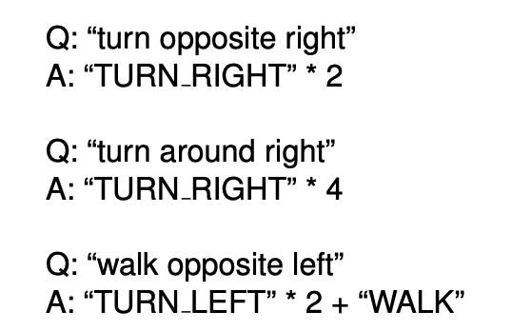
Evaluation (CoT vs. LtM)
Compositional Generalization
Task: mapping natural language commands to action sequences
Dataset: SCAN
LM: code-davinci-002 in GPT-3
Use Python notations in both conditions

Slide 52
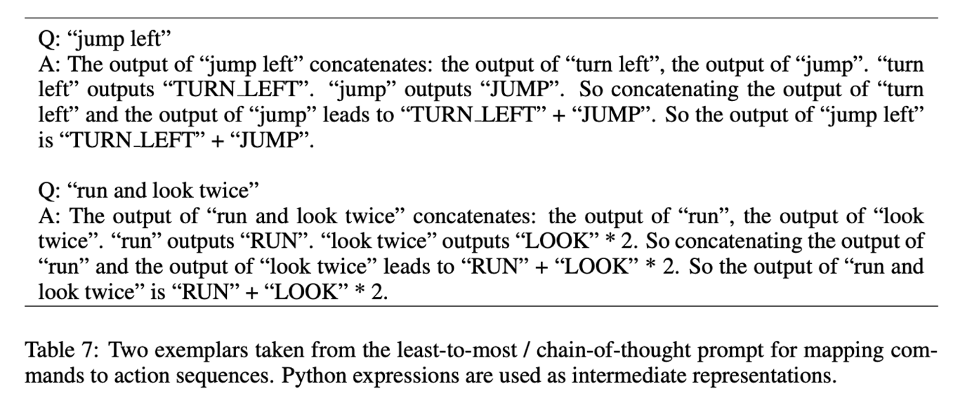
Evaluation (CoT vs. LtM)
Compositional Generalization
task: mapping natural language commands to action sequences
Dataset: SCAN
LLM used in this task: code-davinci-002 in GPT-3
use Python notations in both conditions

Slide 53
Evaluation (CoT vs. LtM)
Compositional Generalization (cont.)
Result:
Solving rate of LtM doesn't change when testing on all other splits and even the full SCAN dataset.

Slide 54
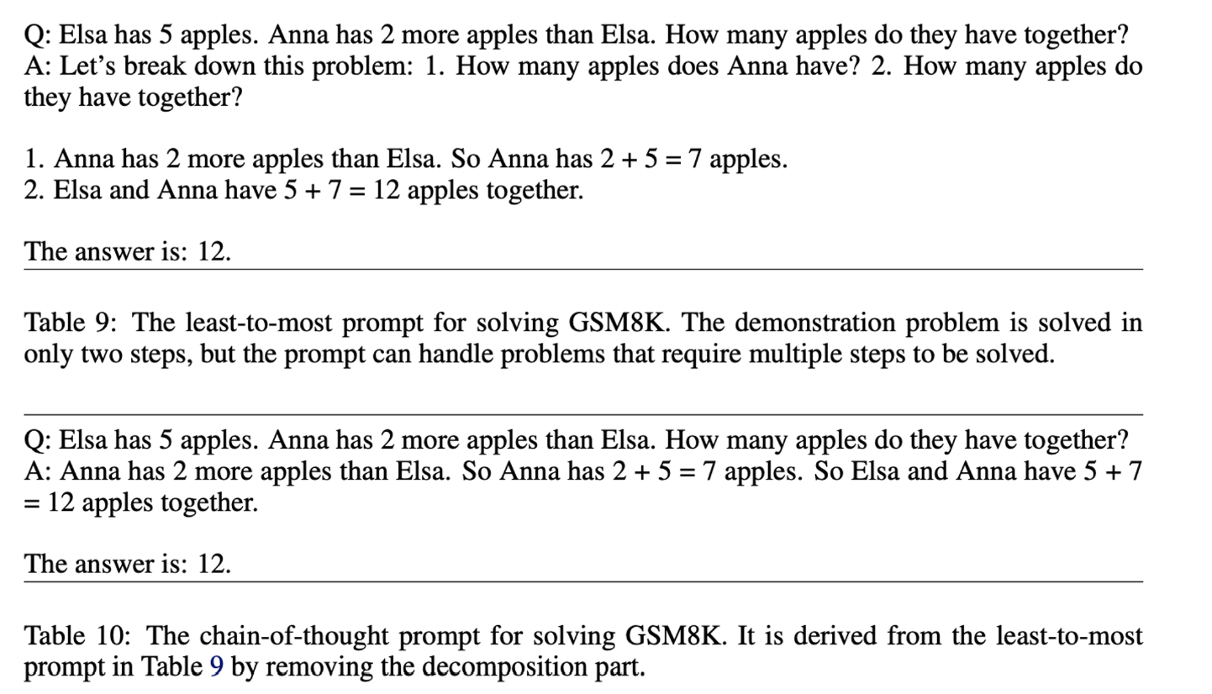
Evaluation (CoT vs. LtM)
Math Reasoning
Task: Math Problem
Datasets:
GSM8K (Cobbe et al., 2021
DROP (Dua et al., 2019)
LM: code-davinci-002 in GPT-3

Slide 55
Evaluation (CoT vs. LtM)
Math Reasoning (Cont.)
Result:

Slide 56
Limitation
Decomposition prompts typically don’t generalize well across different domains.
Generalizing decomposition can even be difficult within the same domain.

Slide 57
Measuring and Narrowing the Compositionality Gap in Language Models

Slide 58
Problem Statement
"While language models (LMs) have shown strong question answering performance, it remains unclear how much is due to memorization of huge corpora vs. how much is due to reasoning."

Slide 59
Memorization of huge corpora vs. Reasoning
Quantify the compositional ability of a LM with multi-hop reasoning
Compositionality Gap
Introduce new dataset
Compositional Celebrities (CC):
contains 8.6k 2-hop questions
combines frequently stated facts in improbable ways.
Example Q&A 1: What is the capital of the birthplace of Levy Mwanawasa? Lusaka.
Example Q&A 2: Who was the President of the United States when Sting was born? Harry S. Truman.
Notes:
Compositionality Gap: This term measures how often while a model can generate correct answers to all sub-problems, it still cannot correctly answer the overall question.
CC: a new generated dataset. It combines frequently stated facts in improbable ways.
each fact has likely appeared many times in the training dataset
the combination of both facts is sufficiently unnatural that it likely never appeared in the training set or on the internet at all

Slide 60
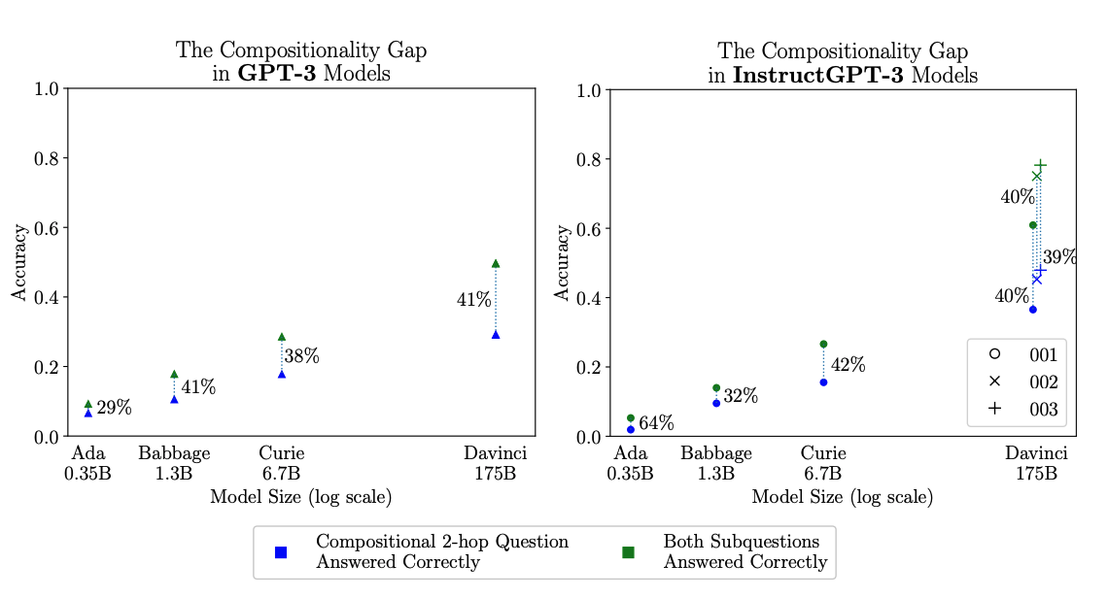
Evaluate compositional ability of GPT-3 on CC
The Compositionality Gap doesn't shrink while increasing GPT-3 model size.
Knowing the world more ≠ increasing ability of composing this knowledge
Notes:
The compositionality gap does not decrease with scale.
This plot shows accuracy for the compositional questions(blue) and the two sub-questions that comprise them(green) in the Compositional Celebrities dataset.
Percentages are relative and indicate the compositionality gaps.

Slide 61
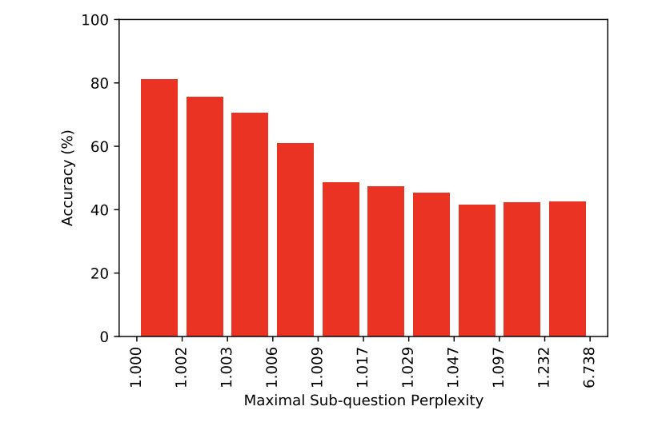
As the perplexities assigned to correct sub-question answers decrease, the probability of answering the compositional question correctly increases.
LM: Davinci-002
Notes:
How can we determine which facts GPT-3 will and will not be able to compose?
So here in this graph, each bar represents a different set of questions. In each set, Davinci-002 correctly answered both parts of the questions.
These sets are arranged from least to most challenging, based on the model's maximal perplexity level of each question. Higher perplexity level means that the model is not sure about what the correct answer is.
Each bar corresponds to 10% of these types of questions.
So when the model becomes more confident about the correct answers, it's more likely for the model to answer the questions correctly.

Slide 62
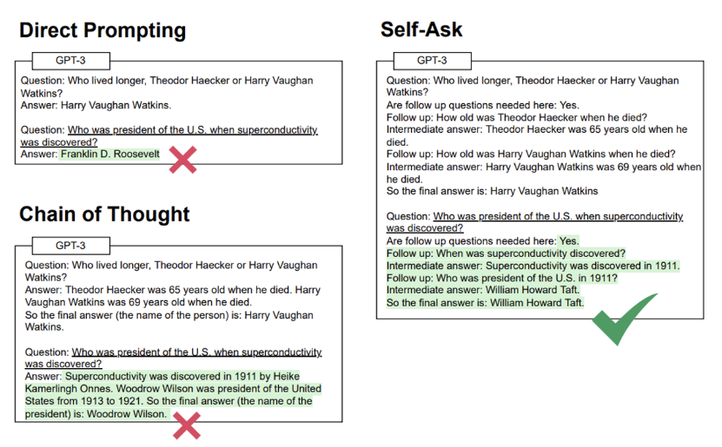
Elicitive Prompting -> Self-ask Prompt
Elicitive Prompting can narrow the compositionality gap.
Self-ask Prompt
requires a one- or few-shot prompt demonstrates how to answer the questions
The phrase “Are follow up questions needed here:” also slightly improves results.
completely automatic
Notes:
Here, the graph demonstrates a comparison between direct prompting, COT, and Self-Ask on a question from Bamboogle.
Text with a white background is the prompt, text with a green background is the LM output, and underlined text is the inference-time question.
The prompt is a shortened example for the sake of demonstration. The authors use a 4-shot prompt for this dataset.
So in this example, The prompt question is xxx. The authors use the same setup for asking and answering questions in all three metrics. The only thing that changes is how they put together the process of answering questions. The model generates questions and answers them based on its internal knowledge—what it has learned during its training. However, this is limited to the data the model was trained on and its ability to infer new information from that data.

Slide 63
Self-ask + Search Engine
Notes:
So an updated version of self-ask is to add a search engine.
Self-ask with a search engine" extends this process by allowing the LLM to leverage an external search engine for information beyond its own training data.
This means when the model encounters a gap in its knowledge or when it needs more up-to-date information, it can search the internet for the latest data, statistics, or facts.
So this example is basically showing the process of feeding each sub-question into SE API, then add answers to the following prompt in sequence.

Slide 64
Evaluation
Baselines:
Direct Prompting
Chain of Thought
Search Engine
Search Engine + LM postprocessing
few-shot prompting for all promptings
LLM: Davinci-002
Datasets:
2WikiMultiHopQA (Ho et al., 2020)
Musique (Trivedi et al., 2022)
Bamboogle (new!)
A handcrafted dataset with 2-hop questions
All questions are difficult to be unanswerable by a popular internet search engine
All supporting pieces of evidence can be found in Wikipedia
Notes:
Bamgoole: dataset with 2-hop questions written by the authors, where all questions are sufficiently difficult to be unanswerable by a popular internet search engine.
But both supporting pieces of evidence can be found in Wikipedia.
SE + Postprocessing = use Davinci-002 to extract the final answer from the one the search engine returns.

Slide 65
Evaluation
Table 1
Self-ask improves over
CoT by smaller amount on 2Wiki and Musique
Bamboogle by a large amount (11% )
Self-ask achieves similar or better performance while running more than 30% faster than Least-to-Most
Notes:
Table 1 uses Davinci-002 accuracy (%) on Bamboogle, 2 Wiki- Multi-Hop QA, and Musique. For Bamboogle, the accuracy is manually judged by the authors; for the other datasets, the metric is exact match.
Appendix table 14 has more results on the same datasets using other metrics.

Slide 66
Limitations
Didn’t experiment with models larger than 175 billion parameters
May behave differently in a more thorough empirical evaluation

Slide 67
ReAct: Synergizing Reasoning and Acting in Language Models

Slide 68
Motivation
LLMs have demonstrated the ability to execute a sequence of reasoning traces to deduce answers for verbal reasoning questions
However, CoT is still a static black box.
Lead to hallucination and error propagation over the reasoning process.
Pre-trained language models can be used to plan and take actions in interactive environments via language priors
Notes:
COT is a static black box, meaning that this model uses its own internal representation and is not grounded in the external world. So it will lead to ….
And also, recent studies have looked into how pre-trained language models can be used to plan and take actions in interactive environments, mainly by predicting actions via language priors, or prompts.
Therefore, they propose the idea of ReAct, a general paradigm that combines reasoning and acting with language models aim to solve diverse tasks on language reasoning and decision making.

Slide 69
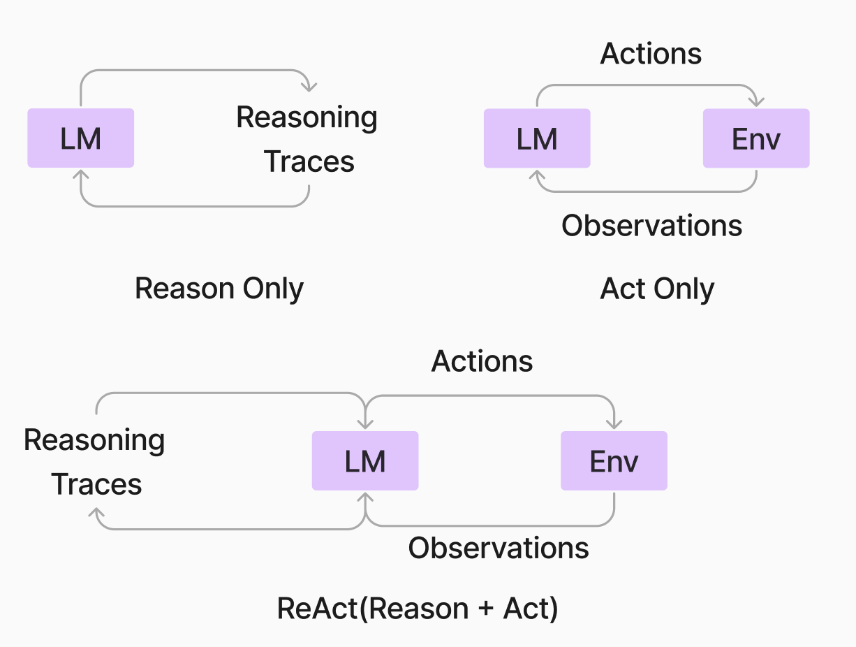
ReAct
Notes:
Let's jump in and take a look on what they did and what these things actually are.
So, 1st off is the idea of just reasoning. This came with the COT we just talked about. SO you just taking a LM, and bring the reasoning upfront, and you can increase the performance of a model.
If you just ask the LM to answer a questions, they will likely to give you an answer. And everything comes after that would be justification for that answer, which may lead to hallucination problems. If do the other way around, then the reasoning primes what is going to be needed in the answer, so that the answer itself ends up being a better answer.
There was another paradigm of thinking of that if you can actually get them to do something in an environment (taking an action), and then use that as an observation back in.
There are a bunch of ideas that were going around about using actions over environment to help the LM.
This is where REACT comes in ...
So we have this reasoning upfront, then we've got taking some kind of action, then we're getting some observations back into the LM. And then this can be used for refining the reasoning. So you're getting multi-step ways of thinking, not just in one shot, but multiple shot over this.

Slide 70
ReAct
Notes:
(1) ask the question straight up
(1c) basically teling it to go do a search for this, bring back the obsn, and comes to the answer here.
(1d) REACT comes in, in this way, so first of all it will have a thought, which is the reasoning a tracing that's going on here. SO, in this case of this question, the thought is xxx.
So you can see here that this is multiple step reasoning of what it's doing.
And it has the action of ….
Then now with that using all that has been already created, it comes up with the next logical step, or thought

Slide 71
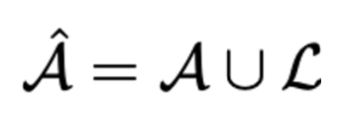
ReAct
Idea: Expand the agent’s action space to
: the language space, which is referred to as a thought or a reasoning trace.
: the action space
: the agent's action space
Difficulties
L is unlimited, learning in this augmented action space is difficult
requires strong language priors
Solution:
use a frozen LLM PaLM-540B (Chowdhery et al., 2022)
few-shot in-context examples

Slide 72
Evaluation – knowledge-intensive reasoning tasks
Setups:
Datasets:
multi-hop question answering
HotPotQA (Yang et al., 2018): a multi-hop question answering benchmark
fact verification
FEVER (Thorne et al., 2018): a fact verification benchmark
Question only (no supported paragraph is provided)
Action Space:
A self-made Wikipedia web API with three types of actions to support interactive information retrieval.
search[entity]: returns the first 5 sentences from the corresponding entity wiki page if it exists, or else suggests top-5 similar entities from the Wikipedia search engine
lookup[string]: return the next sentence in the page containing string
finish[answer]: finish the current task with answer

Slide 73
Evaluations
Prompting Methods:
ReAct Prompting:
Randomly select 6 and 3 cases from the training set and manually compose ReAct-format trajectories to use as few-shot exemplars in the prompts
more examples don’t improve performance
each trajectory consists of multiple thought-action-observation steps (Fig. 1d)
Baselines:
Standard prompting (Standard)
Chain-of-thought prompting (CoT)
CoT + self-consistency baseline (CoT-SC): sampling 21 CoT trajectories with decoding temperature 0.7 during inference and adopting the majority answer
Acting-only prompt (Act)
Combining Internal and External Knowledge
ReAct → CoT-SC: when ReAct fails to return an answer within given steps, back off to CoT-SC
CoT-SC → ReAct: when the majority answer among n CoT-SC samples occurs less than n/2 times, back off to ReAct
Fine-tuning
bootstrapping approach
3,000 trajectories with correct answers generated by ReAct
decode trajectories conditioned on input questions/claims
Notes:
Fine-tuning: we consider a bootstraping approach similar to Zelikman et al. (2022), using 3,000 trajectories with correct answers generated by ReAct (also for other baselines) to finetune smaller language models (PaLM-8/62B) to decode trajectories (all thoughts, actions, observations) conditioned on input questions/claims.
More details are in Appendix B.1.

Slide 74
Evaluations
Decoding Temperature?
It's a parameter used in NLP that controls the trade-off between deterministic and randomness
Temperature Value
Temperature = 1: the neutral stage, no preference
Temperature > 1: Increase diversity and creativity, but may cost coherence and accuracy
Temperature < 1: Less novelty, aims for more deterministic result; improve readability

Slide 75
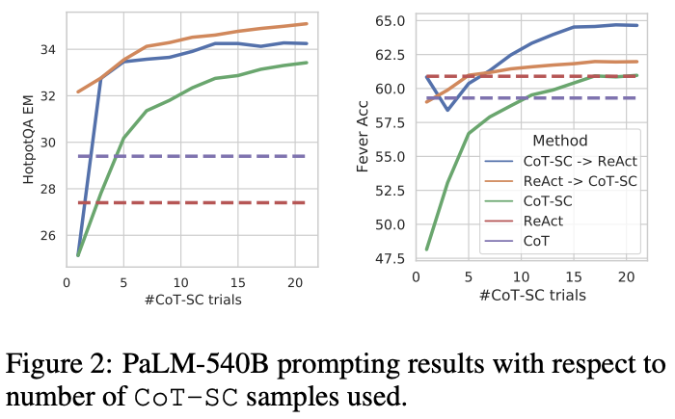
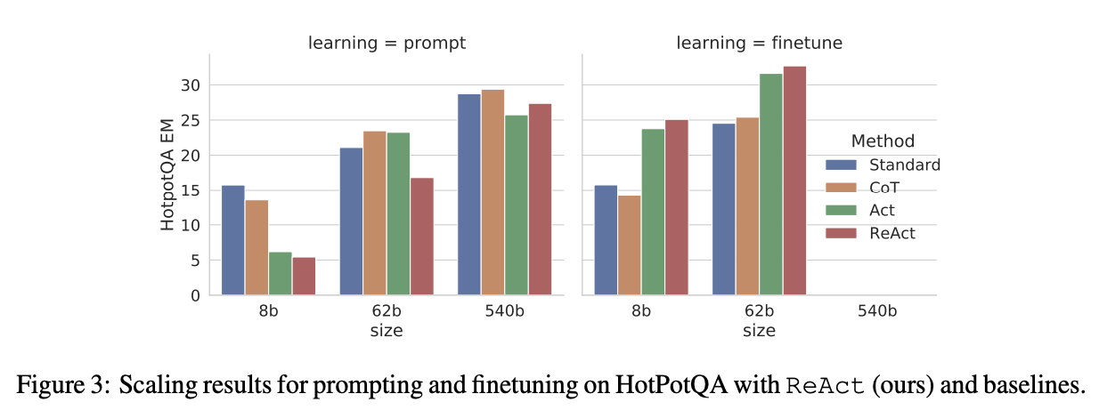
Results and Observations
(Table 1) ReAct outperforms Act consistently
(Table 1) ReAct + CoT-SC perform best for prompting LLMs
ReAct performs best for fine-tuning
Notes:
Also shown in Table 1, the best prompting method on HotpotQA and Fever are ReAct → CoT-SC and CoT-SC → ReAct respectively.
Furthermore, Figure 2 shows how different methods perform with respect to the number of CoT-SC samples used.
While two ReAct + CoT-SC methods are advantageous at one task each, they both significantly and consistently outperform CoT-SC across different number of samples, reaching CoT-SC performance with 21 samples using merely 3-5 samples.
These results indicate the value of properly combining model internal knowledge and external knowledge for reasoning tasks.

Slide 76
Results and Observations (ReAct vs. CoT)
Hallucination is a serious problem for CoT
Interleaving reasoning, action, and observation enhances ReAct's reliability, but this structure also limits its reasoning flexibility, resulting in a higher error rate compared to CoT.
For ReAct, successfully retrieving informative knowledge via search is critical.
Notes:
Hallucination is a serious problem for CoT, resulting in much higher false positive rate than ReAct (14% vs. 6%) in success mode, and make up its major failure mode (56%).
2. When we mix up thinking, doing, and watching steps, it actually helps ReAct be more down-to-earth and reliable. But, this kind of setup also makes it harder for it to flexibly think through problems, which means it might mess up its reasoning a bit more often than the Chain of Thought method.

Slide 77
Evaluations – decision-making tasks
Text-based game
ALFWorld -- A synthetic text-based game
Prompting Methods:
ReAct Prompt
Inner Monologue (IM) -- The closest prior work
Baseline: BUTLER (Shridhar et al., 2020b)

Slide 78
Results and Observations
The best ReAct trial achieves an average success rate of 71%, significantly outperforming the best Act (45%) and BUTLER (37%) trials.
The worse ReAct trial (48%) outperforms the best trial of both methods
ReAct performs consistently
ReAct vs. IM
ReAct substantially outperforms IM-style prompting (ReAct-IM)
Many ReAct-IM trajectories struggled to determine where an item would likely be within the ALFWorld environment, due to a lack of commonsense reasoning. ← solved by ReAct
ALFWorld
Notes:
REACT vs IM 点1 ：(71 vs. 53 overall success rate)

Slide 79
Evaluations – decision-making tasks
Webpage navigation
WebShop – an online shopping env with 1.18M real-world products + 12k human instructions
Evaluated by average score and success rate on 500 test instructions
Act prompts: actions to search, choose product, choose options, and buy
Prompting Methods:
ReAct prompts: all prompts for Act + what to explore, when to buy, and what products options are relevant to the instructions
Imitation learning (IL) rained with 1,012 human annotated trajectories
Imitation + reinforcement learning (IL + RL): trained with datasets for IL + 10,587 extra training instruction

Slide 80
Result and Observations
ReAct achieves significantly better performance,(10% increase) over the previous best success rate.
Existing methods are still far from the performance of expert humans.
WebShop

Slide 81
Self-Refine: Iterative Refinement with Self-Feedback

Slide 82
Problem Statement
Although LLMs may generate intelligible initial output, lots of them still fall short in addressing intricate requirements.
Notes:
Large language models are good at creating clear text but often struggle with complex tasks, like generating conversations or making code easier to read.
These models can produce a basic first draft but usually improve with extra rounds of edits, where each version is better than the last.
This process, known as iterative refinement, may use special training or feedback from experts, but getting enough data or expert time can be hard and expensive. This highlights the importance of finding a way to refine outputs effectively across different tasks without needing a lot of supervision.

Slide 83
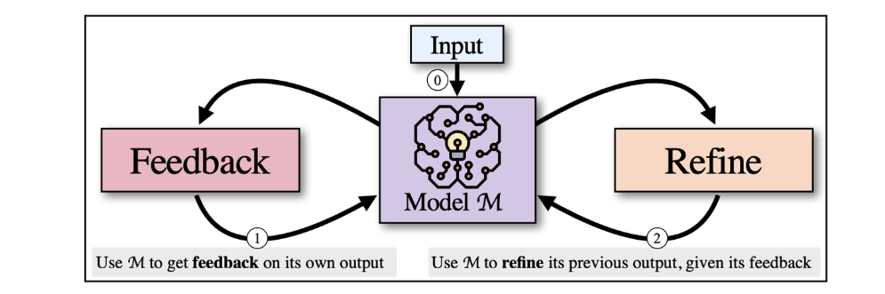
Self-Refine - Big picture
Alternates between two generative steps–FEEDBACK and REFINE.
3 prompts are needed during the entire process
initial generation, feedback, refinement
Notes:
SELF-REFINE improves its outputs through a process of iterative feedback, where it takes its initial responses and refines them based on evaluations or corrections.
This method involves generating an initial set of answers and then selecting one to enhance further, rather than producing multiple answers without subsequent improvement.
So we have an initial input (0), then SELF-REFINE starts by generating an output and passing it back to the same Model M to get feedback(1). The feedback is then passed back to M, which refines the previously generated output (2). Steps (1) and (2) iterate until a stopping condition is met.
It is instantiated with a LM such as GPT-3.5 and does not involve human assistance.

Slide 84
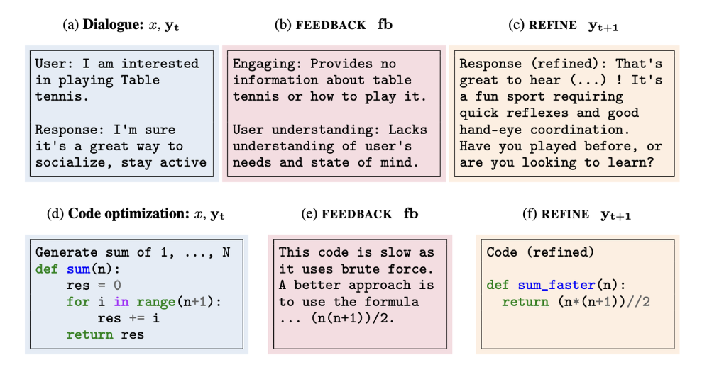
Self-Refine - Big picture

Slide 85
Self-Refine - Algorithm
Contains input-output pairs dfd. for the task.
Contains input-output-feedback triples for the task.
Contains input-output-feedback-refined quadruples for the task.

Slide 86
Self-Refine - Algorithm
: actionable and specific
actionable: contain a concrete action that can possibly increase the output
specific: identify concrete phrases in the output to change
Stopping condition. :
stops at a specified timestep. , or
extracts a stopping indicator (e.g. a scalar stop score) from the feedback

Slide 87
Evaluation
Tasks:
Dialogue Response Generation (Appendix M; Mehri and Eskenazi, 2020)
Code Optimization (Appendix N; Madaan et al., 2023)
Code Readability Improvement (Appendix L; Puri et al., 2021)
Math Reasoning (Appendix O; Cobbe et al., 2021)
Sentiment Reversal (Appendix P; Zhang et al., 2015)
(new task 1) Acronym Generation
(new task 2) Constrained Generation (a harder version of Lin et al. (2020) with 20-30 keyword constraints instead of 3-5)
Instantiating Self-Refine:
Stopping condition:
reach the desired output quality or task-specific criterion
upper limit: 4 iterations
Notes:
Constrained generation refers to the process of generating text (like stories, answers, or code) under specific rules or conditions.
It's like playing a word game where you have to write a story but can only start each sentence with a certain letter, or you need to include specific words in your text.

Slide 88
Evaluation
Comparison methods:
Same base LLMs, with and without feedback-refine iterations
Baseline LLMs:
GPT-3.5 (text-davinci-003)
ChatGPT (gpt-3.5-turbo)
GPT-4 (OpenAI, 2023)
Baseline LLM for Code-based tasks:
CODEX (code-davinci-002)
Greedy decoding with a temperature of 0.7 for all setups.
Prompts: same from previous works + new created ones
Metrics:
Task specific metric: automated metrics from prior work
Human-pref: perform a blind human A/B evaluation on a subset of the outputs to select the preferred output
GPT-4-pref
Notes:
Task specific metric: When available, we use automated metrics from prior work (Math Reasoning: % solve rate; Code Optimization: % programs optimized; Constrained Gen: coverage %)
Human-pref: In Dialogue Response Generation, Code Readability Improvement, Sentiment Reversal, and Acronym Generation, since no automated metrics are available, we perform a blind human A/B evaluation on a subset of the outputs to select the preferred output. Additional details are provided in Appendix C.
GPT-4-pref: The authors use GPT-4 as a proxy for human preference following prior work and found high correlation (82% for Sentiment Reversal, 68% for Acronym Generation, and 71% for Dialogue Response Generation) with human-pref. For Code Readability Improvement, we prompt GPT4 to calculate fraction of the variables that are appropriately named given the context (e.g., x = [] → input_buffer = []). Additional details are provided in Appendix D.

Slide 89
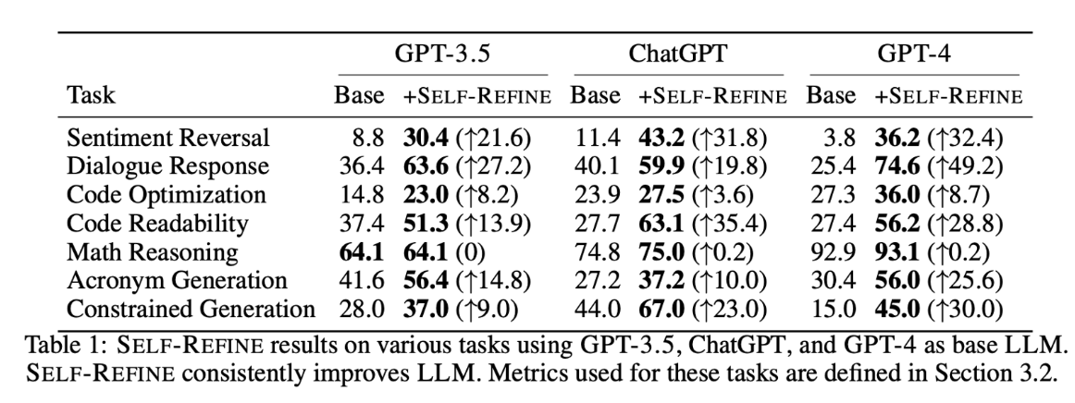
Results
Main result
SELF-REFINE consistently improves over base models across all model sizes, and additionally outperforms the previous state-of-the-art across all tasks.
Improvement is consistent across base LLMs sizes

Slide 90
Quantitative Analysis
Feedback vs. Refine vs. Iterations
Feedback Quality
good feedback > generic feedback > no feedback
emphasize that feedback quality plays a crucial role in SELF-REFINE

Slide 91
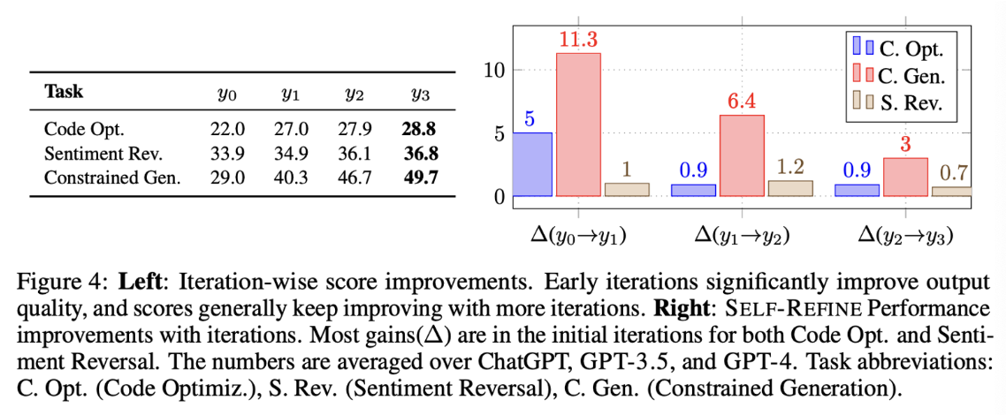
Quantitative Analysis
Feedback vs. Refine vs. Iterations
Multiple iterations of feedback-refine
On average, the quality of the output improves as the number of iterations increase.
The performance may not always monotonically increase with iterations.
Notes:
Figure 4 highlights the diminishing returns in the improvement as the number of iterations increases.
For tasks with multi-aspect feedback, output quality can vary during iteration with improvement in one aspect but decline in another aspect.
SELF-REFINE generates numerical scores for different quality aspects, leading to a balanced evaluation and appropriate output selection

Slide 92
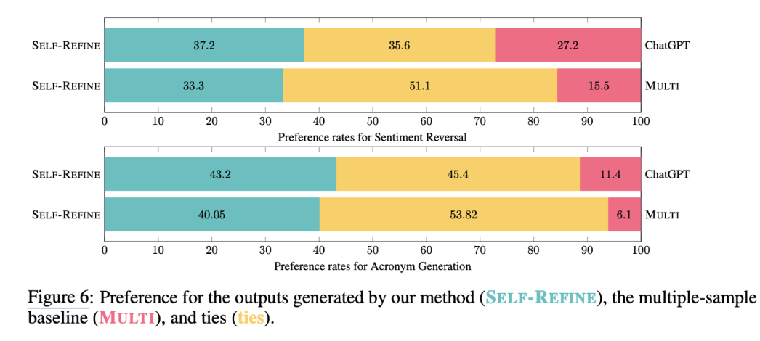
Quantitative Analysis
Does SELF-REFINE improve because...
Multiple output? or Refining?
compare SELF-REFINE with ChatGPT, when ChatGPT generates k = 4 samples (but without feedback and refinement)
compare the performance of SELF-REFINE against these k initial outputs in a 1 vs. k evaluation.
Can find more relevant content in Appendix H
Notes:
The authors examine how SELF-REFINE performs compared to ChatGPT when ChatGPT just makes 4 different answers without making them better through feedback.
Then, the authors checked if the result of SELF-REFINE can do better than all these 4 outputs from ChatGPT.
Even though it's tougher for one refined answer to compete against four initial ones, people still liked the SELF-REFINE answer better.
This proves that making answers better based on feedback is more effective than just having several first attempts.

Slide 93
Quantitative Analysis
Does SELF-REFINE work with weaker models?
Instantiated SELF-REFINE with Vicuna-13B (Chiang et al., 2023), a less powerful base model
This model doesn’t fit well with Vicuna-13B because:
It was not able to consistently generate the feedback in the required format
Even when provided with Oracle (Welleck et al., 2022) or hard-coded feedback, it often failed to adhere to the prompts for refinement
Rather than refining the output, Vicuna-13B repeats the original ones or hallucinates.
Notes:
Oracle feedback: This method uses correctness information to guide model refinement, only progressing to REFINE stage if the current answer is incorrect.

Slide 94
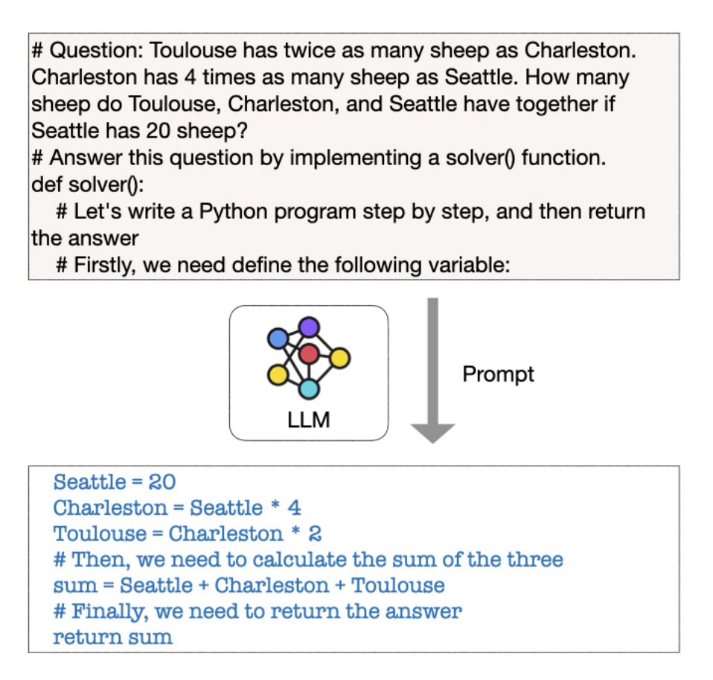
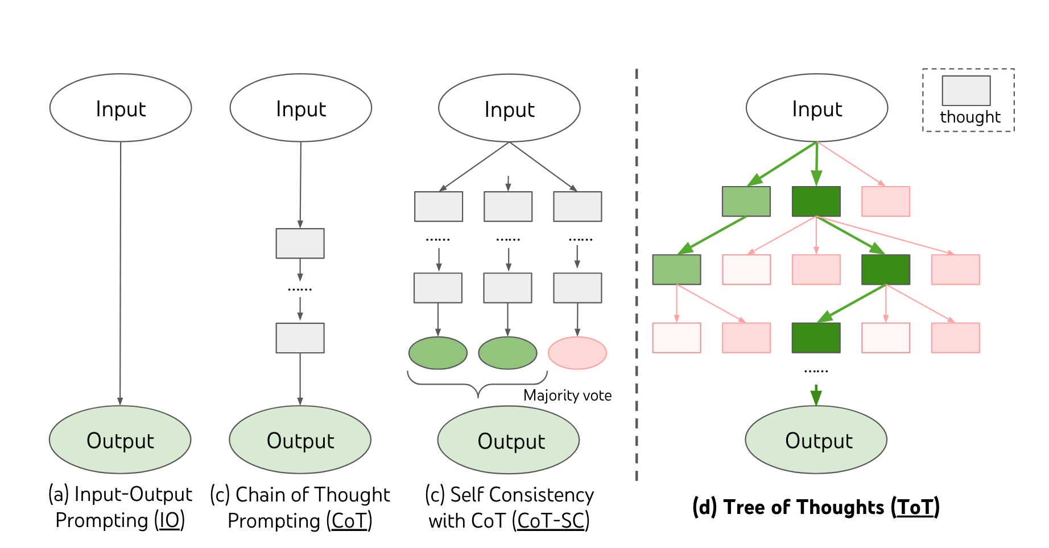
Summary & Recap
Chain-of-Thought Prompting
Self-consistency CoT
Tree of Thoughts Prompting
Program of Thoughts Prompting
Notes:
COT brings the reasoning primes what is going to be needed in the answer, so that the answer itself ends up being a better answer.
To summarize,
Chain-of-thought prompting enables language models to articulate intermediate reasoning steps toward solving complex tasks.
Self-consistency CoT improves accuracy by generating multiple reasoning paths and selecting the most consistent solution.
Tree of Thoughts Prompting enhances problem-solving by organizing reasoning into a tree structure, allowing for exploration of multiple solution pathways in stead of just token wise left to right exploration
Program of Thoughts Prompting systematically structures reasoning into executable steps, similar to a program, for precise and logical problem resolution.

Slide 95
Summary and Recap
Reason-only prompting
Least-to-Most Prompting
Reason + action prompting
Self-ask Prompt
ReAct
SELF-REFINE

Slide 96
Thanks!

