Slide 1
Lecture 14: Compressing and Sparsifying LLM
Presenters: Harrum Noor & Marium Aslam

Slide 2
Outline
Introduction
What is Sparsity?
Traditional transformer models
Mixture of Experts
Key components of MoE Architecture
The Role of Gating Mechanisms
Extending MoE Principle: Gshard
Gshard
Gshard Architecture
Evaluation and Results
CoLT5
CoLT5 Architecture
Evaluation and Results
Ablations
Limitations
Quantifying Large Language Models
Discussion

Slide 3
What is Sparsity?
Sparsity uses the idea of conditional computation. While in dense models all the parameters are used for all the inputs, sparsity allows us to only run some parts of the whole system.
Why Sparsify?
Efficiency
Speed
Energy consumption
Capacity generation

Slide 4
Traditional Transformer Architecture
Key innovation: The attention mechanism, allows them to consider the entire context of the input data, a substantial leap from prior sequence models that processed data one element at a time.
FF Layer
Attention Layer
Input
Input
Input
Input
Input

Slide 5
The Bottleneck
At scale, transformers need to tackle more data and complex problems. With huge number of parameters and operations needed, it makes them resource-intensive, leading to inefficiencies and limiting their scalability.
The solution? Conditional Computing/Sparse Models!

Slide 6
Mixture of Experts
Replace dense Feedforward layers with MoE layers!
MoE
MoE
MoE
MoE
Gating Mechanism
FF
Attention Layer
Attention Layer
Input
Input
Input
Input
Input

Slide 7
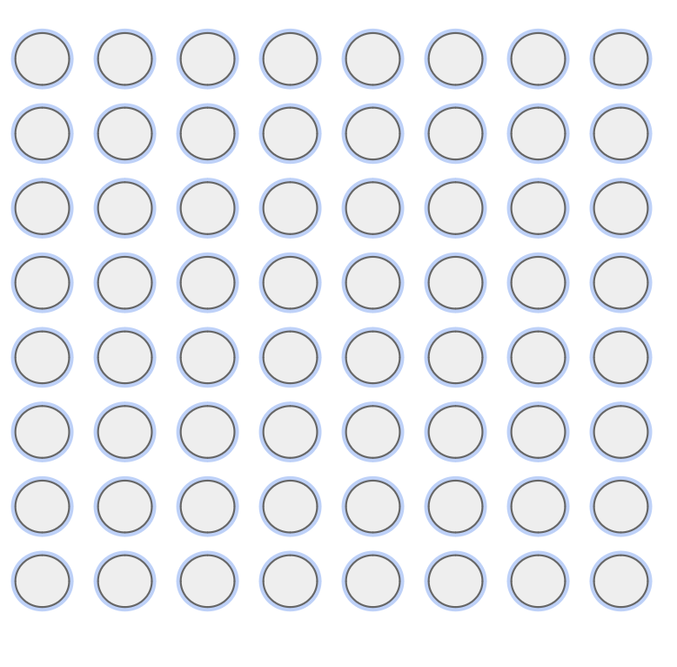
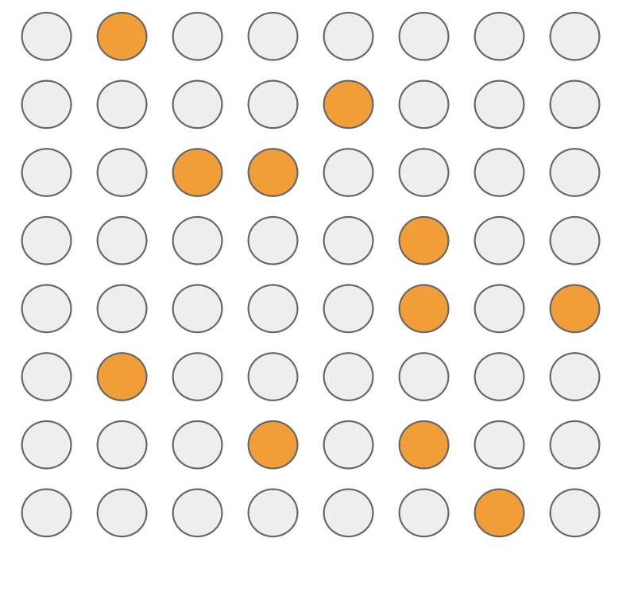
Why MoE?
A traditional GPT uses all neurons in all matrices for forward passing

Slide 8
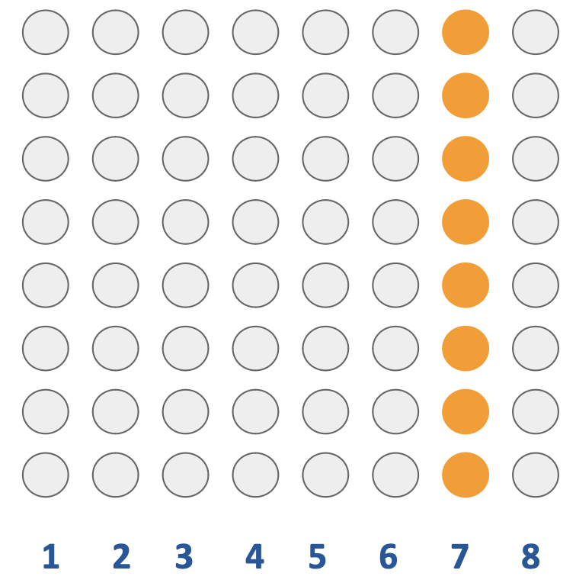
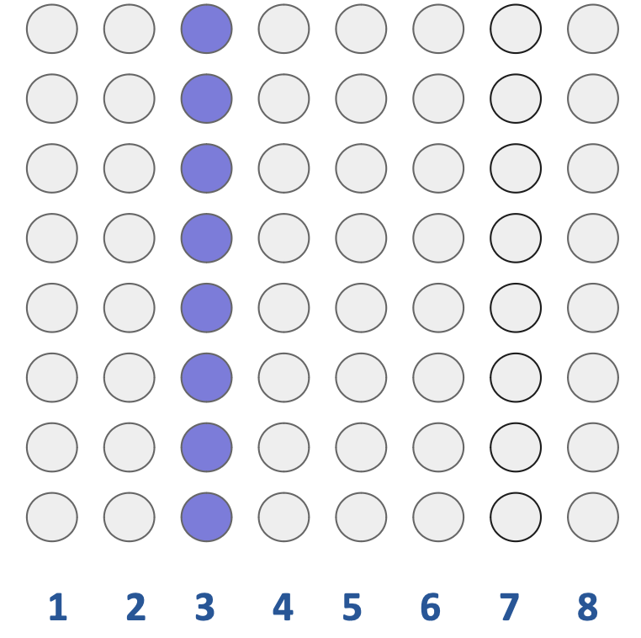
Why MoE?
What if we split the model into different models, each performing a specialized task?
Notes:
In language translation, think of these as punction experts, article experts

Slide 9
Routing Mechanism
Routing Mechanism: Decides which input token goes to which expert
It is learned so it improves over time and the experts specialize, so at inference, we are doing 1/#of Experts Compute!
Notes:
Learning Process: The routing mechanism is not static; it learns and adapts through training. As the MoE model is exposed to more data, the routing mechanism refines its criteria for selecting experts for different types of input tokens.
Expert Specialization: Over time, this learning process leads to the specialization of experts. Each expert becomes more adept at handling specific types of input tokens, improving the overall efficiency and effectiveness of the model. Reduced Computation: At inference time, the routing mechanism's learned behavior allows the model to use only a fraction of its total computational resources for each input token. Instead of engaging all experts, only the most relevant expert(s) for a given input token are activated.
Scalability: This approach significantly reduces the computational load, making the MoE model more scalable and efficient. The computational cost for processing an input token becomes roughly proportional to 1 divided by the number of experts, assuming each expert handles an equal share of the workload over time.

Slide 10
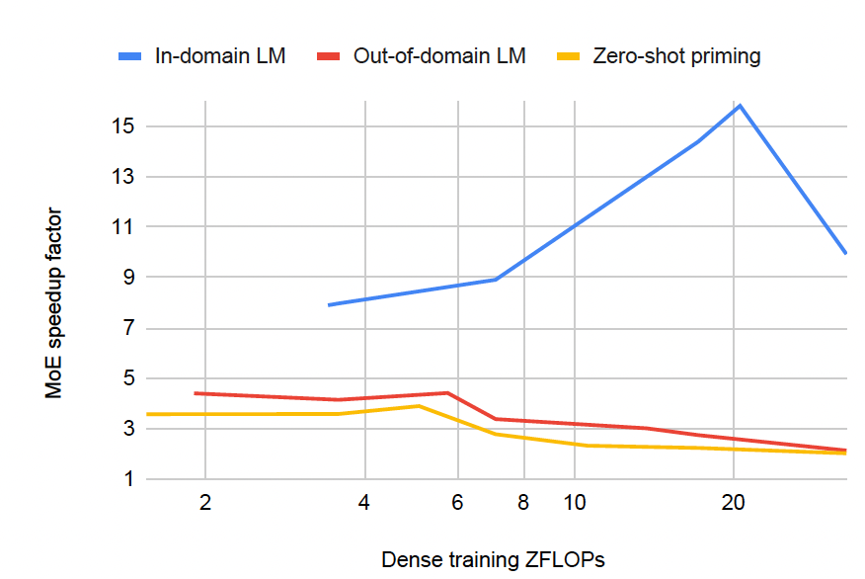
The Paper: Efficient Large Scale Language Modeling with Mixtures of Experts, Artetxe et al.
Evaluates MoE at Scale; MoEs can match the performance of dense models using ~4 times less compute
MoEs are most efficient when evaluated in-domain,
where they can match the performance of
dense models trained with 8-16x more compute
Estimate of how much more efficient MoEs are relative to dense models in representative datasets. A speedup factor of y indicates that an MoE model can match the performance of the corresponding dense model using y times less compute
Notes:
This graph compares the speedup factor of (MoE) over dense training in terms of zetta floating-point operations per second (ZFLOPs) across three different scenarios
X-Axis: Dense Training ZFLOPs
- The x-axis represents the computational power used for training language models, measured in zetta floating-point operations per second (ZFLOPs). The scale is linear, ranging from 1 to 20 ZFLOPs.
Y-Axis: MoE Speedup Factor
- The y-axis quantifies the speedup factor of Mixture of Experts (MoE) models compared to traditional dense training models. The scale is linear, ranging from 1 to above 15, indicating how many times faster the MoE model is than its dense counterpart.
Data Series:
- Blue Line (In-domain LM): This line shows the speedup factor for MoE models when used for in-domain language modeling tasks. The line has an upward trend, indicating that as the computational power increases, the MoE models become significantly faster than dense models, particularly after 10 ZFLOPs, reaching a peak speedup of over 15 times faster at around 15 ZFLOPs before declining slightly.
- Red Line (Out-of-domain LM): This line represents the speedup factor for MoE models in out-of-domain language modeling tasks. The speedup factor increases more gradually compared to the in-domain tasks, peaking at around 6 times faster at approximately 12 ZFLOPs and then declining.
- Yellow Line (Zero-shot priming): This line shows the speedup factor for MoE models when applied to zero-shot priming tasks. The speedup factor remains relatively constant and much lower than the other two scenarios, hovering around 3 to 4 times faster than dense models across all ZFLOPs.
Key Observations:
- In-domain language modeling benefits the most from MoE models, especially as the computational power increases beyond 10 ZFLOPs.
- The advantage of MoE models in out-of-domain language modeling grows at a slower rate and peaks at a lower value than in-domain modeling, indicating that MoE models may be more specialized.
- Zero-shot priming shows the least benefit from MoE models, suggesting that MoE may not be as effective for tasks requiring generalization without prior examples.
Interpretation:
- MoE models can greatly accelerate language modeling tasks by leveraging increased computational resources, particularly for in-domain tasks.
- There's a point of diminishing returns for both in-domain and out-of-domain LM after certain computational thresholds, indicating an optimal ZFLOPs range for MoE efficiency.
- Zero-shot priming's consistent speedup factor across different computational powers might suggest that for such tasks, MoE models do not benefit as much from additional computational resources as they do for specific language modeling tasks.

Slide 11
MoE Speed up factor
c(t) = exp (log c_{lo(t)} + r (log c_{hi(t)} - log c_{lo(t)}))
r = t - t_{lo/}t_{hi}-t_{lo}
t_{lo} and t_{hi} are the closest performance to t from the available models while being lower and higher than t.
c_{lo(t)} and c_{hi} are their corresponding training cost in ZFLOPs.
Speedup factor = c_{dense(t)/}c_{moe(t)}
Notes:
The speed-up factor is calculated using a function c(t), which is an exponential function.
Components of the Speed-Up Function:
c(t): This represents the computed cost function at a given performance level t.
r: This is a ratio representing how far the performance level t is between the lower and higher reference performances t_lo and t_hi.
Interpolation:
The speed-up factor interpolates the computational cost between two known data points: t_lo and t_hi, which are the closest performances to t from the available models that are lower and higher than t, respectively.
C_lo(t) and C_hi(t) are the corresponding training costs for t_lo and t_hi in ZFLOPs.
Speed-Up Factor Formula:
The speed-up factor is given by the ratio of the computational cost of the dense model at performance t (C_dense(t)) to the computational cost of the MoE model at the same performance (C_moe(t))

Slide 12
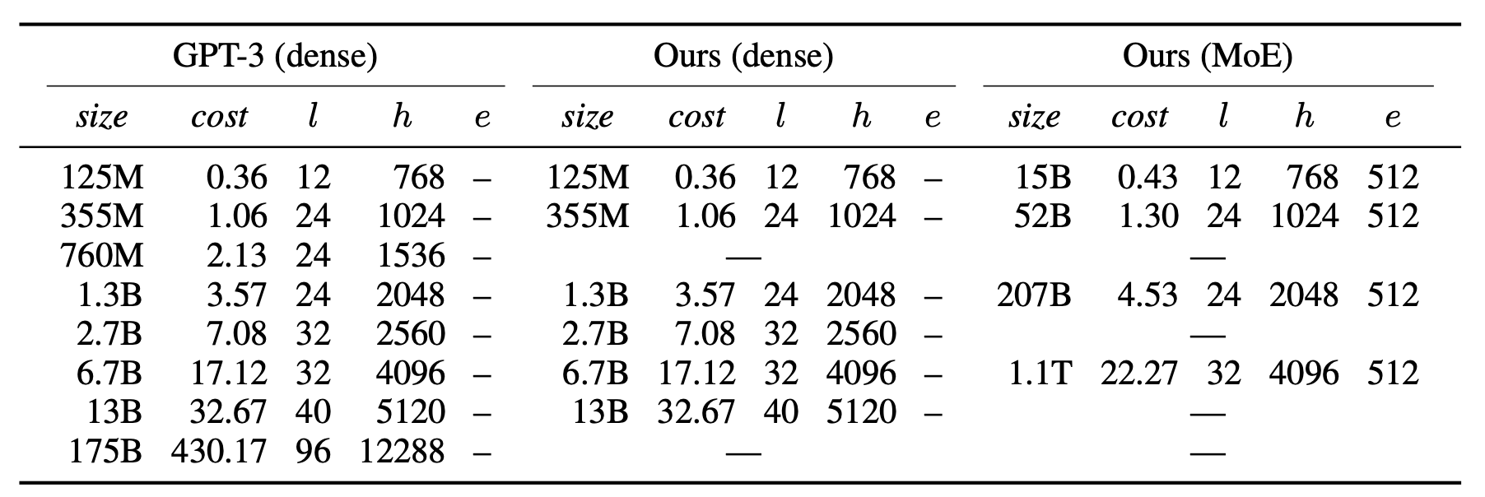
Experiments
Train auto-regressive transformer models that roughly match the sizes and architecture of GPT-3
For their dense models they use only dense attention (unlike GPT-3) & top-2 expert model.

Slide 13
Pretraining
Pretrained on a union of six English language datasets
BookCorpus (Zhu et al., 2019) consists of more than 10K unpublished books (4GB);
English Wikipedia, excluding lists, tables and headers (12GB);
CC-News(Nagel,2016) contains 63million English news articles crawled between September 2016 and February 2019 (76GB)
OpenWebText (Gokaslan and Cohen, 2019), an open-source recreation of the WebText dataset used to train GPT-2 (38GB)
CC-Stories (Trinh and Le, 2018) contains a sub- set of CommonCrawl data filtered to match the story-like style of Winograd schemas (31GB);
English CC100 (Wenzek et al., 2020), a dataset extracted from CommonCrawl snapshots be- tween January 2018 and December 2018, filtered to match the style of Wikipedia (292GB).

Slide 14
Evaluating Language Models: Perplexity and Performance
Understanding Perplexity:
In-Domain Perplexity: Measures how well a language model predicts text similar to what it was trained on.
Out-of-Domain Perplexity: Assesses the model's prediction capabilities on text that is different from the training data, providing insight into the model's generalization.
Analyzing Performance:
Downstream Task Performance: It's crucial to note that a model's low perplexity, indicating high predictive accuracy, does not necessarily translate to superior results in practical applications or downstream tasks (Tay et al., 2021)
Data Specifics:
In-Domain Data: This consists of a reserved portion of the training data, set aside to test the model's performance.
Out-of-Domain Data: 'The Pile' dataset to evaluate how well the model can handle data it hasn't seen during training.
Notes:
evaluate models on their ability to predict the next token in a sequence as measured by perplexity. Similar to training, they concatenate all documents in a given dataset using empty lines as separators, split the resulting sequence into non- overlapping blocks of 2048 tokens, and score each block independently, evaluate and report perplexity in both in- domain and out-of-domain settings. In-domain, we sample a held-out subset of the combined pretraining data. For out-of-domain they use data from The Pile a public dataset that combines data from 22 diverse sources

Slide 15
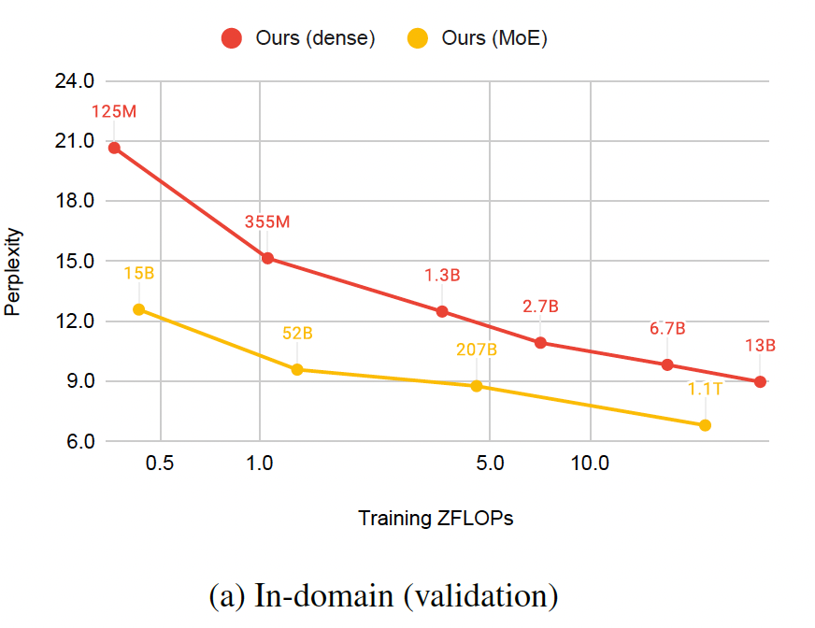
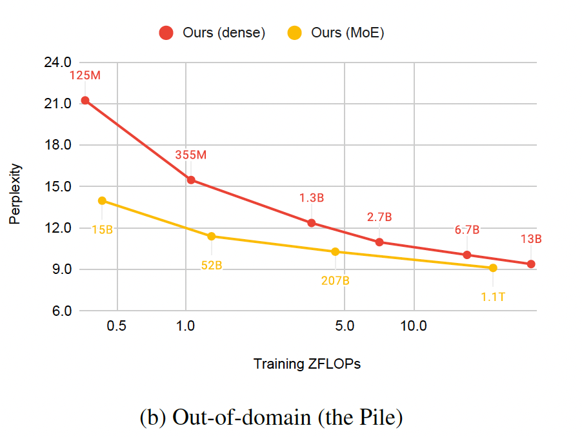
Results at Scale
The MoE model consistently shows lower perplexity than the dense model at equivalent computational costs, suggesting it's more efficient for in/out of domain data.
Artetxe M, Bhosale S, Goyal N, Mihaylov T, Ott M, Shleifer S, Lin XV, Du J, Iyer S, Pasunuru R, Anantharaman G. Efficient large scale language modeling with mixtures of experts. arXiv preprint arXiv:2112.10684. 2021 Dec 20.
Notes:
Overall, these graphs are suggesting that MoE models are not only more parameter-efficient but also scale better with computational resources compared to dense models, both when dealing with familiar data and when generalizing to new, unseen data.

Slide 16
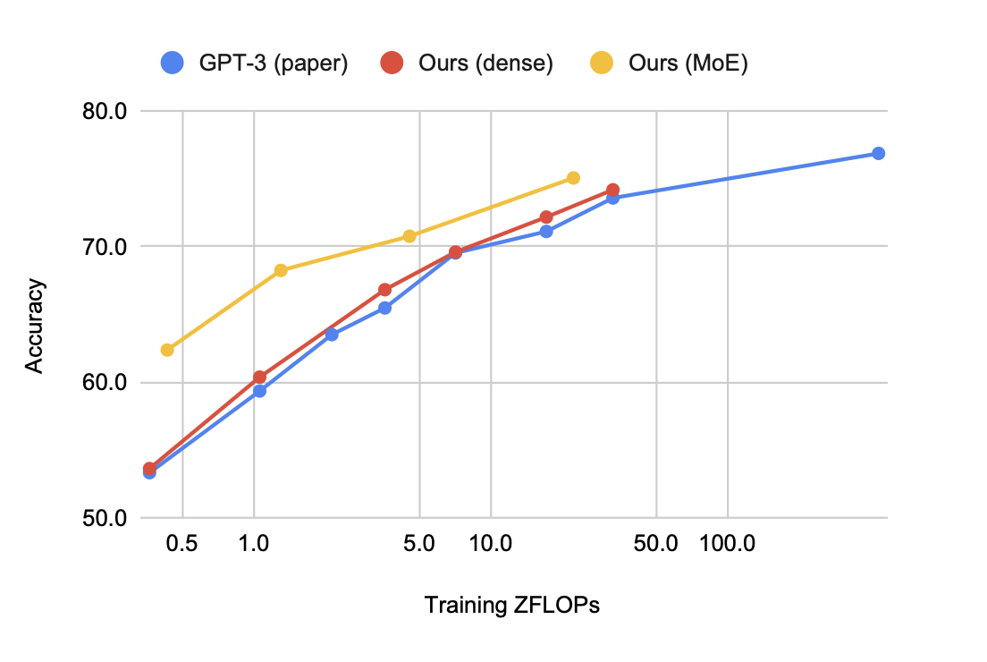
Results at Scale
Best on CommonCrawl
Highest accuracy
Artetxe M, Bhosale S, Goyal N, Mihaylov T, Ott M, Shleifer S, Lin XV, Du J, Iyer S, Pasunuru R, Anantharaman G. Efficient large scale language modeling with mixtures of experts. arXiv preprint arXiv:2112.10684. 2021 Dec 20.

Slide 17
Why Scale?
Scaling neural networks brings dramatic quality gains
For computer vision, increasing the model capacity has led to better image classification
In language processing, it has yielded consistent gains on language understanding tasks
Notes:
Why are we scaling?

Slide 18
GShard
Google builds a 600 billion parameter transformer to do massively multilingual, massive machine translation. Interestingly, the larger model scale does not come from increasing depth of the transformer, but from increasing width in the feedforward layers, combined with a hard routing to parallelize computations on up to 2048 TPUs
Lepikhin, Dmitry, et al. "Gshard: Scaling giant models with conditional computation and automatic sharding." arXiv preprint arXiv:2006.16668 (2020).

Slide 19
Based on SPMD
Single Program, Multiple Data: Used in parallel computing where a single program is executed by all processors simultaneously, but each processor works on a different set of data

Slide 20
Gshard Architecture
Traditional transformer
Sharding!
MoE

Slide 21
Gating Mechanism
Gs,E​=GATE(x_{s​}) The gating score of each expert where X is the input token
FFN_{e}​(x_{s}​)=w_{oe}​⋅ReLU(w_{ie​}⋅x_{s}​) computation happening inside the expert
y_{s}​= $\sum_{e=1}^{E}{Gs,e}$⋅ FFN_{e}​(xs​) Weighted sum where weights is the gating score
Notes:
This equation denotes that for a given input token xs​, a gating mechanism determines which experts should be activated. The gating function, represented as GATE, outputs a vector Gs,E​ that contains a gating score for each expert EE. These scores determine the weight or importance of each expert's contribution for the given input.
This represents the computation within each expert. Each expert e is a feed-forward neural network, which first applies an input projection (multiplying the input token xsxs​ by a weight matrix wiewie​), then applies a ReLU activation function, and finally applies an output projection woe​. The ReLU activation function introduces non-linearity into the model, allowing it to learn complex patterns.
The final output ys​ for the input token xs​ is computed as the weighted sum of the outputs from all experts. The weights for this sum come from the gating scores Gs,EGs,E​, ensuring that only the outputs of the relevant experts, as determined by the gating function, are used in computing the final output

Slide 22
Gating Mechanism Consideration
Load Balancing
Auxiliary Loss
Random Routing
Notes:
The auxiliary loss lauxlaux​ is defined as:
laux=1E∑e=1EceS⋅melaux​=E1​∑e=1E​Sce​​⋅me​
Here’s the intuition behind the formula:
We want to minimize the variance in how much each expert is used, which would be represented by the squared term (ceS)2(Sce​​)2. However, cece​ isn’t differentiable because it comes from a discrete counting process.
Instead, we use meme​ as a stand-in for ceSSce​​ because it is differentiable. It represents the average gate activation for expert ee, which we can backpropagate through.
The loss function penalizes the model when the usage of experts deviates from the mean gate value meme​ weighted by the proportion of tokens ceSSce​​. This encourages the training process to steer gate activations toward a uniform distribution.

Slide 23
How to implement Gshard?
Very efficient and easy to use
Everything has been handled
User only adds annotations using annotation APIs ( replication, distribution)
Compiler generates a single program to be launched on all devices for parallel execution. (SPMD)

Slide 24
XLA Compiler
Unified Compilation Across Frameworks: Acts as a common backend for various machine learning frameworks, such as TensorFlow and PyTorch
Partitioning for Parallelism: Breaks down large computations into smaller, parallelizable operations
Handles Data Communication: handles the intricate patterns of cross-device data transfer

Slide 25
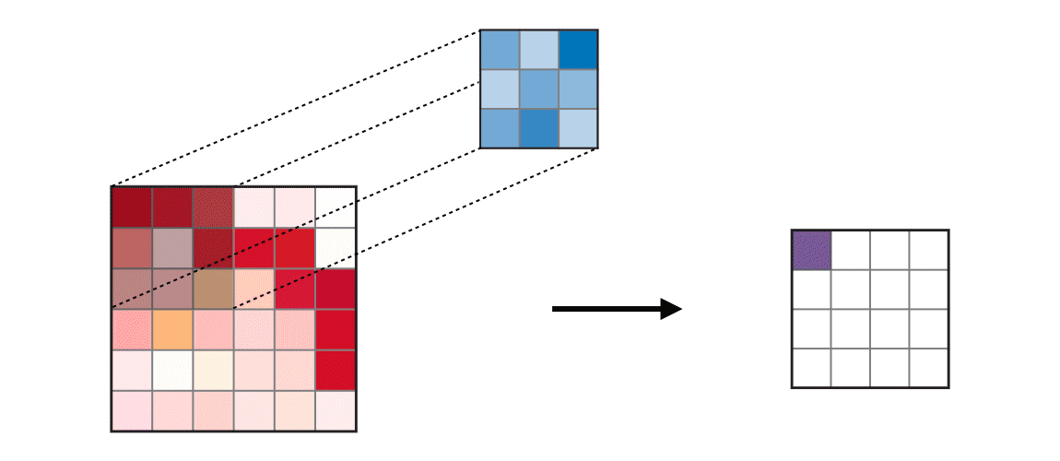
Partitioning Considerations
Padding
Halo exchange
Source: https://ogre51.medium.com/an-intuitive-introduction-to-convolutional-neural-networks-813cde3d3a5e

Slide 26
Datasets and baselines
Web-Scale Dataset: Training corpus mined from the web, with parallel documents for 100 languages to and from English.
Volume of Data: A total of 25 billion training examples.
Imbalance in Language Pairs: Data quantity ranges from billions (high-resource languages) to tens of thousands (low-resource languages) examples per language pair.
Baseline Formation: Bilingual Neural Machine Translation models for each language pair

Slide 27
Model Variations
Explored varying two variables,
Number of layers in the Transformer encoder-decoder stack (L)
The total number of experts used for every other MoE layer (E)

Slide 28
Results

Slide 29
Results
Consistent Quality Gains with Deeper Models: Increasing the depth of the network while keeping the number of experts resulted in consistent quality gains across all languages. The reason is associated with better generalization performance as depth increases.
Improvements for High-Resourced Tasks with More Experts: High-resourced languages appeared to require more capacity, and hence, increasing the number of experts per layer provided larger gains.

Slide 30
Giant model comparison
Their best quality dense single Transformer model, which has 2.3 billion parameters and achieved a BLEU score of 6.1, required a staggering 235.5 TPU v3 core-years.

Slide 31
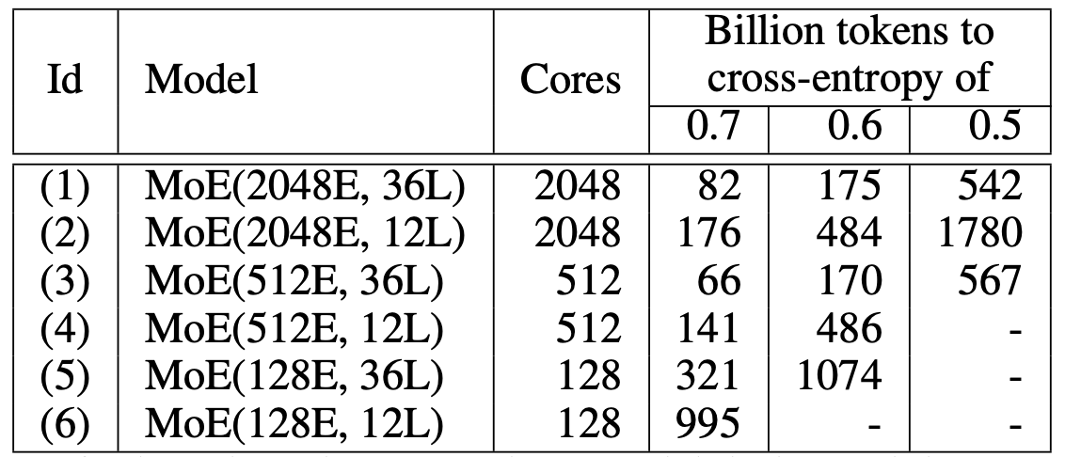
Results: Training Efficiency
Deeper models are more sample efficient, converge faster with fewer examples attributed to the acceleration effect of over-parametrization

Slide 32
Results: Performance
Largest model (600B) can be trained under 4 days achieving the best quality
Scaling with conditional computation is way more practical compared to dense scaling
Takes more than ten times to train

Slide 33
Results: Memory Consumption
Memory consumption in Gshard comes from
• Replicated weights (e.g. transformer feed-forward layers) • Distributed weights (MoE feed-forward layers) • Activations (output of each layer that is used in both forward and backward pass).

Slide 34
Results: Memory Consumption
As we go up, the activation increases since we have to keep them in memory

Slide 35
Gshard Key Takeaways
SPMD framework for massive scaling
Provides annotation APIs and uses XLA compiler
Is able to train massive multilingual machine translation model of 600B size in 4 days

Slide 36
CoLT5: Conditional Long T5
Many natural language processing tasks benefit from long inputs, but processing long documents with Transformers is expensive. Why?
Quadratic Attention Complexity
Feedforward and projection layers applied to each token
But not all tokens are equally important, especially in long input!
Solution: CoLT5; A long-input Transformer model that employs conditional computation
Ainslie, Joshua, et al. "Colt5: Faster long-range transformers with conditional computation." arXiv preprint arXiv:2303.09752(2023).
Notes:
Introducing ColT5

Slide 37
CoLT5 Intuition
Enables fast processing of long inputs by combining architecture improvements for both attention and feedforward layers
COLT5 is based on the intuition that some tokens are more important than others, and we can achieve better quality for lower cost by devoting more computation to important tokens

Slide 38
Architecture
Full Attention
Local Attention

Slide 39
CoLT5 Conditional Computation
CoLT5 Conditional Computation consists of 3 components
CoLT5
Routing modules
Cond. FF Layer
Cond. Attention layer

Slide 40
CoLT5 Routing Mechanism
Routing function is Learnable
Multiply inputs with a learned embedding to obtain routing scores
Normalize
Select the top-k highest scoring inputs.
Routing score of token i
si = Xi · u
X_{i} = The representation of token I
u = A d-dimensional learnable embedding.

Slide 41
Conditional Feed Forward
COLT5 conditional feed forward layer applies an additional high-capacity feedforward layer to selected tokens.
X_{i} = X_{i} + FFd_{Light}(X_{i}) + s _{̃i} · FFd_{Heavy}(Xi)
Model state of i^{th} token
Normalized routing score (0 for non-routed)

Slide 42
Conditional Attention
Intuition: Most tokens have simple, local interactions, but some tokens benefit from heavier processing and long-range interactions
Consists of light and heavy attention branches with light branches having fewer heads and local attention.

Slide 43
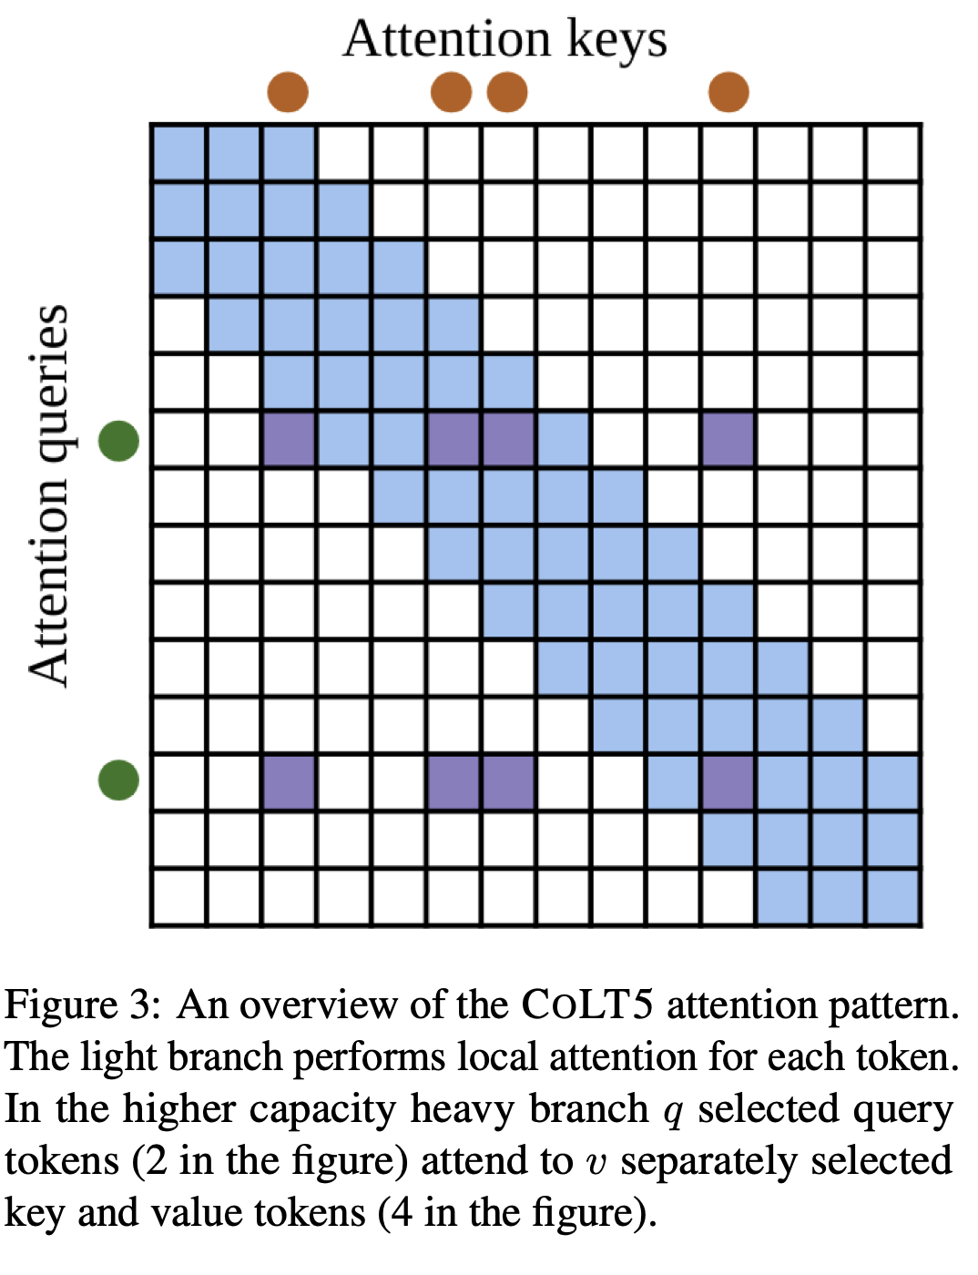
Attention
Local attention
Heavy attention with extra tokens

Slide 44
Experiments: Training
Pretraining: Pretrained on C4 dataset with batch size 256, input length 4096
Fine Tuning: Uses a constant learning rate of 0.001, batch size 128, and dropout rate 0.1 for all tasks and 16k input length

Slide 45
Experiments

Slide 46
Experiments: Datasets

Slide 47
Results
CoLT5 used way less time per sample for all three versions

Slide 48
Results
Achieves SOTA performance on the SCROLLS benchmark

Slide 49
Scaling to Extremely Large Inputs
COLT5 effectively scales to extremely long inputs, achieving stronger performance and faster speed than LONGT5. F1 on NarrativeQA as a function of inference time per sample for LONGT5 and COLT5 Large models using varying input lengths.

Slide 50
Ablation Study

Slide 51
Ablation Study
CoLT5 benefits from dynamically routing tokens, as it learns to identify and give more processing capacity to important tokens. This is essential because it indicates that the model is not just performing better due to having more parameters

Slide 52
Limitations
CoLT5 applies condition computation only in the encoder.
CoLT5 is specialized over long sequences and has to be trained from scratch.
Notes:
In COLT5, applying conditional computation in the decoder is complex because the model's routing method is not causal, generation of an output token at a certain position should not be influenced by tokens that come after it, which is necessary for tasks like language modeling where the model generates text one token at a time.

Slide 53
Comparison
Feature | Mixture of Experts | GShard | CoLT5
Scale | 1.1T | 600B | 5.3B
Sparsification technique | Splitting Feedforward | Splitting Feedforward& Sharding | Light branching
Sparsification | FF layer | FF layer | All 3
Expert Selection | Top 2 | Top 2 & Random Routing | NA
Attention | dense | dense | Sparse & dense
Specialization | Large Data/Scale | Parallelization | Long inputs

Slide 54
Quantization of LLMs
Notes:
So by now we all are aware of the difficulties of deploying large language models on a bigger scale, we have ofcourse the high compute requirements, the time it takes for training and the environmental impact of these high-energy computations. Now as harrum discussed sparsifying LLMs is one way of helping with that problem where we are reducing the number of parameters or computations needed for a given task. Another way to save memory and computation power is to quantize the parameters and variables of a model.

Slide 55
Basics: Quantization
A process which reduces the precision of the model's parameters, activations, or gradients to lower memory usage and computational requirements.
WHY?
for deploying large models on devices with limited resources
for reducing the carbon footprint of training and inference processes.
Large language models have been widely adopted but require significant GPU memory for inference
Notes:
I am going to go over the basics of quantization just so understanding the papers is easier, quantization is a process by which we reduce the precision or significant digits of a value to represent it in a smaller number of bits. Basically, a more memory efficient representation of a number. This most of the times comes with a loss in accuracy.

Slide 56
Quantization Techniques
Basic Techniques: Uniform and Non-uniform Quantization
Advanced techniques: Dynamic Quantization
Converting a model to use a reduced precision integer representation for the weights and/or activations. Calculations are dynamic.
Advanced techniques: Block-wise Quantization
divides input tensors into smaller blocks/chunks/categories that are independently quantized
Notes:
There are different techniques of quantization, basic techniques are uniform and non-uniform quantization where we will divide a distribution into intervals and quantize those intervals with a single value. Dynamic quantization is when we reduce the number of bits a model’s parameters will take during runtime, block-wise quantization is when we divide the data into chunks and quantize those chuncks independently.

Slide 57
Quantization Techniques
Advanced techniques: Mixed-precision Training
During the training of a neural network, mixed-precision uses more than one floating-point representations for different parts of the calculations.
The less critical parts of the computation, where high precision isn't as necessary, can be done in smaller bits (8 or 16-bit)
The more critical parts, which require higher precision, continue to use greater-bit (16 or 32-bit) computations.
This reduces the memory bandwidth and the amount of computation, speeding up training without a significant loss of accuracy.
On a mathematical level, it's about strategically choosing where you need high precision to maintain performance and where you can get away with less precision to gain speed.
Notes:
Another cool quantization is mixed-precision where we will choose the quantization based on the magnitude, smaller magnitude values may be reduced to a smaller bit representation like float 16 to int 8 while large magnitude values may be left as is. This way we do compress most of the values while keeping the outlier values full-precision, this gives a good balance between efficiency and precision.
Now moving to the papers under study,

Slide 58
Research papers under study
LLM.int8(): 8-bit Matrix Multiplication for Transformers at Scale
8-bit Optimizers via Block-wise Quantization
QLoRA: Efficient Finetuning of Quantized LLMs
BitNet: Scaling 1-bit Transformers for Large Language Models
LLM.int8(): 8-bit Matrix Multiplication for Transformers at Scale | 8-bit Optimizers via Block-wise Quantization | QLoRA: Efficient Finetuning of Quantized LLMs | BitNet: Scaling 1-bit Transformers for Large Language Models

Slide 59
LLM.int8(): 8-bit Matrix Multiplication for Transformers at Scale (2022)

Slide 60
LLM.int8()
For large transformer language models at and beyond 6.7B parameters, high-magnitude outliers emerge in all transformer layers
feed-forward and attention projection layers and their matrix multiplication operations are responsible for 95% of consumed parameters and 65-85% of all computation.
Bottlenecks; matrix multiplication operations in:
Feed-forward
Attention projection

Slide 61
LLM.int8()
Existing methods:
reduce memory use but degrade performance
usually require tuning quantization further after training
and have only been studied for models with less than 350M parameters
Extreme Outliers (up to 20x larger ) start emerging at every Transformer layer at the 6.7B params mark degrading performance of quantization at scale
Notes:
LLM.int8() maintains full 16-bit performance as we scale from 125M to 175B parameters. On the other hand, the baseline, 8-bit absmax vector-wise quantization, scales poorly and degenerates into random performance.

Slide 62
LLM.int8()
the first multi-billion-scale Int8 quantization procedure for transformers that does not incur any performance degradation (a 175B parameter transformer with 16 or 32-bit weights)
Reducing inference time by half while retaining full precision performance.
Performing 8-bit quantization for int8 matrix multiplication for the feed-forward and attention projection layers

Slide 63
Matrix Multiplications: Feed forward Layer
the input data is multiplied by weight matrices to produce outputs: compute intensive!

Slide 64
Matrix Multiplications: Attention Layer
Matrix multiplications:
Attention projection
Multiplying the input matrix by the weights to get the query, key, and value matrices.
Attention function
Calculating the dot product of queries and keys to form an attention matrix.
Applying softmax to the attention matrix to obtain weights for the values.
Multiplying the softmax weights by the values to produce the output of the attention mechanism.
Compute intensive!!

Slide 65
Matrix Multiplications: 8-bit Quantization
The solution: optimize the matrix multiplication operations for 8-bit integer precision during inference
Mixed precision decomposition
vector-wise quantization

Slide 66
8-bit Quantization: Mixed Precision Quantization
determine how each feature should be quantized based on its magnitude.
Identifies large magnitude outlier features within the data.
Outlier (higher magnitude) features are processed using higher-precision (16-bit) calculations
The rest of the features, (small magnitudes), are quantized using 8-bit precision.
Notes:
in matrix multiplication, where each row of one matrix and each column of another matrix are treated as independent vectors. By using separate scaling constants for each vector, vector-wise quantization improves the precision of the quantization, as it adjusts to the specific distribution of each vector.

Slide 67
Mixed Precision Quantization
The equation shows how the model's output (C) is calculated by separately processing the outliers and non-outliers, then combining them. Here's what the terms mean:
Xf16: This is the matrix of input data (hidden states) in 16-bit floating-point format.
Wf16: This represents the weight matrix of the neural network, also in 16-bit floating-point format.
Xf8 and Wf8: The lower-precision (8-bit) input and weight matrices for non-outlier data.
Sf16: A scaling factor applied to adjust the results from the lower precision back to the higher precision space.
O: The set of outlier feature indices that need high-precision processing.
Cf16: The final output matrix combining both high and low-precision calculations.
Notes:
The equation provided is essentially saying that you can perform matrix multiplication by breaking down the process into smaller, more manageable parts (the inner products of rows and columns), each scaled appropriately. Then, to get back to the original scale, you adjust these results using the outer product of the scaling constants.

Slide 68
8-bit Quantization: Vector-wise Quantization
separate normalization constants for each inner product in the matrix multiplication => improves quantization precision for most features
Each row of matrix 1 and column of matrix 2 are taken as independent vectors => sequence of independent inner products
Each vector is quantized independently, using its own scaling constants.
Notes:
in matrix multiplication, where each row of one matrix and each column of another matrix are treated as independent vectors. By using separate scaling constants for each vector, vector-wise quantization improves the precision of the quantization, as it adjusts to the specific distribution of each vector.

Slide 69
Vector-wise Quantization
find a scaling factor that can convert the float values of the vector into the 8-bit integer range without significant loss of information.
Xf16: This is the matrix of input data (hidden states) in 16-bit floating-point format.
Wf16: This represents the weight matrix of the neural network, also in 16-bit floating-point format.
Cxf16: Scaling constant for each row of Xf16
Cwf16: Scaling constant for each row of Wf16
Cz: The tensor resulting from the outer product of the row and column scaling constants.
Cf16: The final output matrix after quantization and matrix multiplication.
Q(.) is the quantization function
Notes:
The equation provided is essentially saying that you can perform matrix multiplication by breaking down the process into smaller, more manageable parts (the inner products of rows and columns), each scaled appropriately. Then, to get back to the original scale, you adjust these results using the outer product of the scaling constants.

Slide 70
Vector-wise Quantization: scaling constants?
Absmax quantization (symmetric): scales the input values by a constant derived from the largest absolute value in the tensor =>
$X_{i8}=S_{xf16}{.X}_{xf16}= \frac{127 .{ X}_{xf16}}{max⁡(|X_{xf16}|)}$
ensuring that the extreme values are captured
but it can lead to less efficient use of the available bit range for other values
Zeropoint quantization (asymmetric): involves shifting the distribution of the input values =>
entire range of the bit representation is used effectively
accommodating asymmetric data distributions
reducing quantization error across the board.
$X_{i8}={nd}_{xf16}{.X}_{xf16}+z_{xf16}$
${nd}_{xf16} = \frac{2 . 127 }{\max\left(\left|X_{xf16}\right|\right)−min⁡(|X_{xf16}|)}$
$z_{xf16}$ =$X_{xf16} . min⁡(|X_{xf16}|)$
Notes:
The equation provided is essentially saying that you can perform matrix multiplication by breaking down the process into smaller, more manageable parts (the inner products of rows and columns), each scaled appropriately. Then, to get back to the original scale, you adjust these results using the outer product of the scaling constants.

Slide 71
LLM.int8() Results: C4 perplexity
Notes:
absmax, row-wise, and zeropoint quantization fail as we scale, where models after 2.7B parameters perform worse than smaller models.
Zeropoint quantization fails instead beyond 6.7B parameters.
Zeropoint quantization shows an advantage due to asymmetric quantization but is no longer advantageous when used with mixed-precision decomposition
Our method, LLM.int8(), is the only method that preserves perplexity. As such, LLM.int8() is the only method with a favorable scaling trend.

Slide 72
LLM.int8() Results: Time Complexity
The quantization overhead can slow inference for models with less than 6.7B parameters, as compared to a FP16 baseline.
However, models of 6.7B parameters or less fit on most GPUs and quantization is less needed in practice.
LLM.int8() run times is about two times faster for large matrix multiplications equivalent to those in 175B models.

Slide 73
Moving On
So we are able to quantize the parameters in the feed-forward and attention projection layers during inference but;
What about training?
What about the attention function computations?

Slide 74
8-bit Optimizers via Block-wise Quantization (2022)

Slide 75
8-bit Optimizers via Block-wise Quantization
optimization in neural networks by using 8-bit statistics to maintain the performance levels of 32-bit optimizer states during training
reducing the memory footprint of optimizer gradient statistics
optimizer states use 33-75% of the total memory footprint during training

Slide 76
8-bit Optimizers: Optimizer gradient statistics?
Regular optimizers in machine learning update model parameters purely based on the gradient calculated from the current batch of data.
Stateful optimizers, on the other hand, keep track of past gradients and use this information to inform updates.
For example, SGD with momentum considers past gradients to smooth out updates
Adam keeps track of the squared sum of past gradients to adapt the learning rate for each parameter.

Slide 77
8-bit Optimizers via Block-wise Quantization
development of optimizers that use 8-bit representations for these gradient statistics, as opposed to the standard 32-bit.
reduces the memory usage of the optimizer states, allowing larger models to be trained within the same memory constraints without losing the performance benefits that come from using stateful optimizers.
Key Innovations:
block-wise dynamic quantization
stable embedding layer
Notes:
This approach reduces the memory usage of the optimizer states, allowing larger models to be trained within the same memory constraints without losing the performance benefits that come from using stateful optimizers.

Slide 78
8-bit Optimizers: Block-wise Quantization
isolates outliers and distributes the error more equally over all bits
Breaks down a tensor into smaller blocks, normalizing each block independently for efficient computation and processed in parallel
Dynamic Range Adjustment: Each block's values are normalized within the range [-1, 1], using the maximum value within that block as a reference.
Tqbi: The quantized value of tensor T for block b at index i.
Qmapj: A function mapping the j-th element to its quantized form.
Nb: The normalization constant for block b, which is the maximum absolute value within that block.

Slide 79
8-bit Optimizers: Block-wise Quantization
Why it’s good?
Robustness to outliers
independence from inter-core synchronization, which enhances computational efficiency
The method guarantees that the largest values (outliers) are quantized without error, thus maintaining precision in the quantization process.
Note (from chatgpt): Inter-core synchronization refers to the coordination required between different processor cores when they are working on a task together. In the context of the block-wise quantization method, avoiding inter-core synchronization means that each core can independently work on normalizing and quantizing a block of data without having to wait for or communicate with other cores.

Slide 80
8-bit Optimizers: Dynamic Quantization
adjusts for both small and large magnitude values with high precision
The method enhances dynamic tree quantization for tensors that don't need a sign bit by repurposing it for better precision in representing positive values.
accounts for the wide range of magnitudes in Adam's second state during language model training, offering a broader quantization range than standard methods.
Dynamic Tree quantization
Notes:
The second point is about adjusting the quantization technique used in optimizers like Adam, which generally involves keeping track of the "second state" – a running average of the square of gradients. Since these values are always positive, the sign bit typically used to indicate negative numbers in binary representation is not needed. The authors utilize this redundant sign bit to increase the precision of the quantization, thus allowing the optimizer to handle a broader range of values that the second state might encounter during training. This modification helps to maintain the fidelity of the optimizer's state representation, especially important for large-scale language models that can have significant variations in the scale of gradient information.

Slide 81
8-bit Optimizers: Stable embedding layer
Concept: It's a variation of the standard word embedding layer designed to support aggressive quantization by normalizing input distributions, which helps in avoiding extreme gradient variations.
Method: The layer is initialized with Xavier uniform initialization for consistent variance and applies layer normalization before adding position embeddings. This ensures the variance stays around one, avoiding large gradients that could destabilize training.
Novelty: Unlike common embedding layers that are unstable and require 16-bit precision, the Stable Embedding Layer allows for the use of 32-bit optimizer states for the embeddings themselves, improving training stability significantly.
significant memory savings without altering the original optimizer hyperparameters
facilitates stable training even when more aggressive quantization techniques are used
Notes:
Traditional embedding layers can become unstable with lower-precision formats like 8-bit integers because the reduced precision can lead to large errors or instabilities in the training process. However, the stable embedding layer described here allows for the use of 32-bit optimizer states even when the embeddings are quantized to 8-bit. This means that the calculations for updating the weights during training (handled by the optimizer) can still use high precision even though the embeddings themselves use low precision.

Slide 82
8-bit Optimizers: Results
8-bit out-performing in terms of speed and memory saved.
Notice LM training times!
Notes:
Median performance on diverse NLP and computer vision tasks: GLUE, object classification with (Moco v2) and without pretraining (CLS), machine translation (MT), and large-scale language modeling (LM). While 32-bit Adafactor is competitive with 8-bit Adam, it uses almost twice as much memory and trains slower. 8-bit Optimizers match or exceed replicated 32-bit performance on all tasks. We observe no instabilities for 8-bit optimizers. Time is total GPU time on V100 GPUs, except for RoBERTa and GPT3 pretraining, which were done on A100 GPUs.

Slide 83
QLoRA: Efficient Finetuning of Quantized LLMs (2023)

Slide 84
QLoRA: Efficient Finetuning of Quantized LLMs
Finetuning large language models (LLMs) is memory-intensive, with models like a 65B parameter LLM requiring over 780 GB of GPU memory for 16-bit finetuning
QLORA reduces the average memory requirements of finetuning a 65B parameter model from >780GB of GPU memory to <48GB
reaching 99.3% of the performance level of ChatGPT while only requiring 24 hours of finetuning on a single GPU.

Slide 85
Notes:
Low-rank Adapter (LoRA) finetuning [28] is a method that reduces memory requirements by using a small set of trainable parameters, often termed adapters, while not updating the full model parameters which remain fixed. Gradients during stochastic gradient descent are passed through the fixed pretrained model weights to the adapter, which is updated to optimize the loss function.

Slide 86
QLoRA: Key Innovations
(a) 4-bit NormalFloat (NF4), a new data type that is information theoretically optimal for normally distributed weights
(b) Double Quantization to reduce the average memory footprint by quantizing the quantization constants
(c) Paged Optimizers to manage memory spikes

Slide 87
QLoRA: 4-bit NormalFloat
a method to efficiently prepare data for quantization, a process that simplifies high-precision numbers into fewer bits:
The method groups data points into bins, ensuring each bin has an equal number of points, which is more efficient than traditional methods.
Works by spreading out the outliers more evenly instead of boxed together, you can get a good representation of the whole distribution with fewer bits
Notes:
This quantization approach is different because it balances the data across quantization bins more evenly. Traditional methods may not distribute data as uniformly, especially when there are outliers or a wide range of values. This method, by focusing on equalizing the number of values in each bin and optimizing for a normal distribution, aims to minimize information loss during the quantization process. It's particularly suited to neural network weights that usually follow a normal distribution around zero.

Slide 88
QLoRA: Double Quantization
two-step process to compress the quantization constants themselves, which are used in the first quantization step.
Concept: Further compresses quantization constants to save memory, on top of the initial data quantization.
Method: Implements a secondary quantization process on the constants themselves, using 8-bit floats to reduce the memory footprint without performance loss.
Novelty: This method differs from traditional single-step quantization by adding a second layer of quantization specifically for the constants, significantly reducing the per-parameter memory cost.

Slide 89
QLoRA: Paged Optimizers
automatic page-to-page transfers between the CPU and GPU for error-free GPU processing when the GPU occasionally runs out-of-memory.
NVIDIA unified memory feature

Slide 90
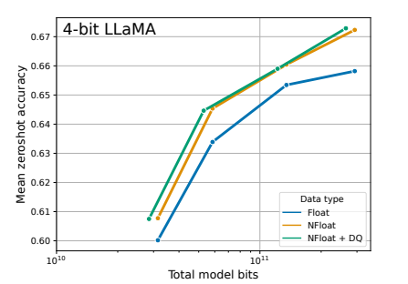
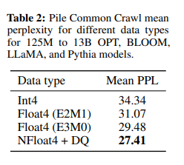
QLoRA: Results
QLoRA vs Standard Finetuning
quantized LLMs (OPT, BLOOM, Pythia, LLaMA) of different sizes (125M to 65B) with different data types are evaluated on language modeling and a set of zero-shot tasks.
Mean zero-shot accuracy over Winogrande, HellaSwag, PiQA, Arc-Easy, and ArcChallenge using LLaMA models with different 4-bit data types.
Notes:
Mean zero-shot accuracy over Winogrande, HellaSwag, PiQA, Arc-Easy, and ArcChallenge using LLaMA models with different 4-bit data types. The NormalFloat data type significantly improves the bit-for-bit accuracy gains compared to regular 4-bit Floats. While Double Quantization (DQ) only leads to minor gains, it allows for a more fine-grained control over the memory footprint to fit models of certain size (33B/65B) into certain GPUs (24/48GB).

Slide 91
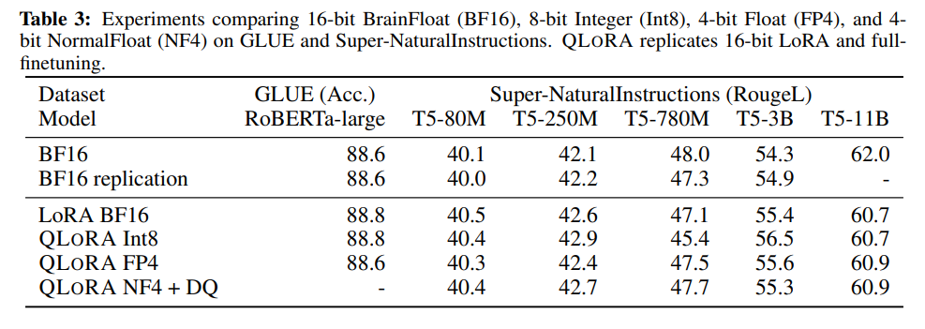
QLoRA: Results
QLoRA vs Standard Finetuning
Can the lost performance in 4-bit inference be recovered by conducting 4-bit adapter finetuning?
Notes:
comparison with full 16-bit finetuning of RoBERTA and T5 models sized 125M to 3B parameters on GLUE and the Super-NaturalInstructions dataset. Results are shown in Table 3. In both datasets, we observe that 16-bit, 8-bit, and 4-bit adapter methods replicate the performance of the fully finetuned 16-bit baseline. This suggests that the performance lost due to the imprecise quantization can be fully recovered through adapter finetuning after quantization.

Slide 92
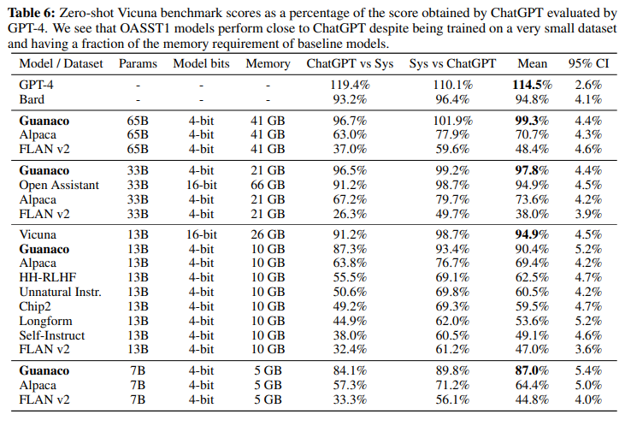
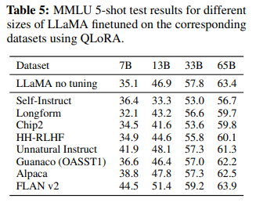
QLoRA: Results
QLoRA vs Chatbot State-of-the-art
Notes:
possible to finetune a quantized 4-bit model without any performance degradation

Slide 93
BitNet: Scaling 1-bit Transformers for Large Language Models (2023)

Slide 94
BitNet: Scaling 1-bit Transformers for Large Language Models
a scalable and stable 1-bit Transformer architecture designed for large language models
Introducing BitLinear: nn.Linear Layer replacement to train 1-bit weights from scratch.
directly trains the model with 1-bit precision weights, rather than reducing precision post-training

Slide 95
BitNet: Key Innovations
Quantization-Aware Training: This method trains models to perform well even when their weights are limited to 1-bit representations, in contrast to most other methods which quantize models only after training.
Optimization Techniques: It includes strategies like using model parallelism with higher-precision for optimizer states and gradients, and employing larger learning rates to handle the challenges of training with low-precision weights.

Slide 96
BitNet: BitLinear
Notes:
The novelty of BitLinear lies in its ability to maintain training stability and model accuracy even with the extreme quantization of weights to 1 bit, which is not commonly found in other methods that typically use higher precision weights.

Slide 97
BitNet: BitLinear
The weights are binarized using a sign function, which assigns a -1 or +1 value based on the weight's sign.
A scaling factor is computed to minimize the difference between the binarized weights and the original weights.
The activation functions are quantized to 8-bit precision for the tensor during training and per token during inference for efficiency and stability.
Notes:
The novelty of BitLinear lies in its ability to maintain training stability and model accuracy even with the extreme quantization of weights to 1 bit, which is not commonly found in other methods that typically use higher precision weights.

Slide 98
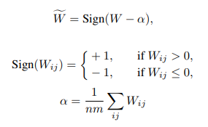
BitNet: BitLinear Weights
Binarizing weights and centralizing them to have zero mean.
Applying a scaling factor (β) post-binarization to align with the original weight distribution. (reduce the l2 error between the real-valued and the binarized weights.)
Notes:
The novelty of BitLinear lies in its ability to maintain training stability and model accuracy even with the extreme quantization of weights to 1 bit, which is not commonly found in other methods that typically use higher precision weights.

Slide 99
BitNet: BitLinear Activations
Activation functions are quantized to b-bit precision via absmax while ensuring the output's variance is maintained for stability.
Scaled to Range [-Q_{b,} Q_{b}]
Multiply by 2^{b}-1 and divide by maximum
Q_{b} = 2^{b}-1
Activations before non-linear functions are scaled onto the range [0, Q₈] by subtracting the minimum of the inputs so that all values are non-negative.
Notes:
The novelty of BitLinear lies in its ability to maintain training stability and model accuracy even with the extreme quantization of weights to 1 bit, which is not commonly found in other methods that typically use higher precision weights.

Slide 100
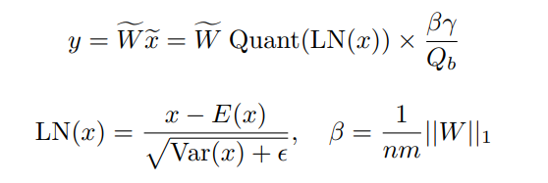
BitNet: BitLinear
the matrix multiplication can be written as: $y=\tilde{w}\tilde{x}$
assume that the elements in W and x are mutually independent and share the same distribution, Var(y) is estimated to be:
After layer norm: Var(y) ≈ E[LN(xe) 2 ] = 1
BitLinear:
Notes:
For the full-precision computation, the variance of the output Var(y) is at the scale of 1 with the standard initialization methods (e.g., Kaiming initialization or Xavier initialization), which has a great benefit to the training stability. To preserve the variance after quantization, we introduce a LayerNorm [BKH16] function before the activation quantization. In this way, the variance of the output y is then estimated as Var(y) ≈ E[LN(xe) 2 ] = 1,

Slide 101
BitNet: Model Parallelism using Group Quantization and Normalization
partitions the matrix multiplication on multiple devices.
Problem: All of the parameters α, β, γ, and η are calculated from the whole tensors => the tensors are not independent along the partition dimension
Solution: divide the weights and activations into groups and then independently estimate each group’s parameters.
W represents the weight matrix of the neural network, with dimensions n×m.
G refers to the number of groups the weight matrix is divided into along the partition dimension.
αg​ is the scaling factor for group g, computed as the mean of the weights within that group.
βg​ is the normalization factor for group g, calculated as the mean of the absolute values (L1 norm) of the weights within the group.
Notes:
For a weight matrix W ∈ R^(n×m), we divide it into G groups along the partition dimension, and each group has a size of (n/G) × m. We then estimate the parameters for each group independently:
The formula is indicating that for each group g of weights in the matrix W, you calculate the scaling (αg​) and normalization (βg​) factors based on the values within that specific group. This allows for localized calculations within each group, facilitating model parallelism without the need for extensive synchronization across different parts of the network.

Slide 102
BitNet: Model Training
Straight-through Estimator: Uses a method that bypasses non-differentiable functions to approximate gradients during backpropagation, allowing for the training of models with quantized weights.
Mixed Precision Training: Utilizes both low-precision quantization for weights and high-precision storage for optimizer states and gradients to maintain training stability and accuracy.
Large Learning Rate: Employs a high learning rate to overcome the insensitivity of 1-bit weights to small updates, which helps in achieving faster convergence and compensates for initial training phase challenges.
Notes:
It estimates the gradients of a function. Specifically, it ignores the derivative of the threshold function and passes on the incoming gradient as if the function was an identity function.
When we binarize the weights their gradient becomes 0, so during back propagation we just bypass the binarization function and directly passed the incoming gradient to the next layer.
One challenge for the optimization is that a small update on the latent weights often makes no difference in the 1-bit weights. This results in a biased gradient and update which are estimated based on the 1-bit weights. Specially at the beginning of the training.

Slide 103
BitNet: Energy Consumption
matrix multiplication with dimensions m × n and n × p
Vanilla Transformers:
BitNet:
Notes:
: BitNet trains 1-bit Transformers from scratch, obtaining competitive results in an energyefficient way. BitNet significantly outperforms state-of-the-art quantization methods. As the model size scales up, the cost savings become more significant while achieving competitive performance with the models trained with FP16.

Slide 104
BitNet: Energy Consumption
Notes:
: BitNet trains 1-bit Transformers from scratch, obtaining competitive results in an energyefficient way. BitNet significantly outperforms state-of-the-art quantization methods. As the model size scales up, the cost savings become more significant while achieving competitive performance with the models trained with FP16.

Slide 105
BitNet: Results with Downstream Tasks
Notes:
It proves that BitNet has much higher scaling efficiency. Given a fixed computation budget, BitNet achieves a significantly better loss. Meanwhile, the inference cost is much smaller to get the same performance as the FP16 models

Slide 106
BitNet: Comparison with FP16 Transformers
Notes:
It proves that BitNet has much higher scaling efficiency. Given a fixed computation budget, BitNet achieves a significantly better loss. Meanwhile, the inference cost is much smaller to get the same performance as the FP16 models

Slide 107
BitNet: Performance
Notes:
: BitNet trains 1-bit Transformers from scratch, obtaining competitive results in an energyefficient way. BitNet significantly outperforms state-of-the-art quantization methods. As the model size scales up, the cost savings become more significant while achieving competitive performance with the models trained with FP16.

Slide 108
BitNet: Results with Downstream Tasks
Notes:
It proves that BitNet has much higher scaling efficiency. Given a fixed computation budget, BitNet achieves a significantly better loss. Meanwhile, the inference cost is much smaller to get the same performance as the FP16 models

Slide 109
BitNet: Comparison with Post-training Quantization
Notes:
It proves that BitNet has much higher scaling efficiency. Given a fixed computation budget, BitNet achieves a significantly better loss. Meanwhile, the inference cost is much smaller to get the same performance as the FP16 models

Slide 110
BitNet: Comparison with Post-training Quantization
Notes:
It proves that BitNet has much higher scaling efficiency. Given a fixed computation budget, BitNet achieves a significantly better loss. Meanwhile, the inference cost is much smaller to get the same performance as the FP16 models

Slide 111
BitNet: Key Takeaways
It achieves competitive performance and task outcomes while greatly reducing memory and energy demands compared to traditional models.
Follows a similar scaling law as full-precision models, indicating strong potential for scaling up further in size.
Future Plans include increasing the size and training steps of BitNet and exploring its application in other architectures.

Slide 112
Quantization: Comparison Chart
Feature/Model | LLM.int8() | 8-bit Optimizers | QLoRA | BitNet
Precision | 8-bit quantization | 8-bit quantization | 4-bit quantization | 1-bit weights
Techniques | Vector-wise quantization, Mixed-precision decomposition | Block-wise quantization, dynamic quantization of optimizer states | Quantization of quantization constants, Paged Optimizers | BitLinear, Group quantization
Key Innovation | Maintains full precision performance | Preserves optimizer performance. | Enables large model finetuning on standard hardware | Scales Transformers with 1-bit precision
Model Size | Up to 175B parameters |  | 65B parameters | Large language models
Performance | No degradation | Comparable to 32-bit optimizers | Close to state-of-the-art models | Competitive with full-precision Transformers
Efficiency | Reduces memory footprint by 50% | Significant memory savings | Efficient finetuning on limited GPU | Reduces memory and energy consumption
Application | General large-scale LLMs | Optimizers for various tasks | Fine-tuning of LLMs | Training large language models

