Slide 1
Lecture 13: Efficient LLM Inference
Presenters:
Rushabh Nikhilkumar Solanki | Noble Saji Mathews

Slide 2
Overview
Early Exit-based mechanisms:
Patience-based Exit
Confident Adaptive Language Modeling
Parallel Inference on LLMs:
3. Speculative Sampling
4. Lookahead Decoding
Optimized Attention Algorithm:
5. Efficient Memory Management with Paged Attention
6. Flash-Decoding for long-context inference

Slide 3
Preliminary Papers
Shallow-Deep Networks: Understanding and Mitigating Network Overthinking
https://arxiv.org/abs/1810.07052
BranchyNet: Fast Inference via Early Exiting from Deep Neural Networks
https://arxiv.org/abs/1709.01686

Slide 4
Regular LM Inference
https://blog.research.google/2022/12/accelerating-text-generation-with.html

Slide 5
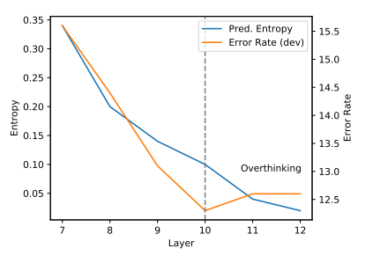
“Overthinking”
The Entropy can be used as the measure of how confident the classifier at an exit point is about the sample. It is defined as:
To see how each prediction evolves during a DNN’s forward pass, we attach Internal Classifiers (ICs) at each layer.
After a certain layer, model is confident (decreased entropy) on wrong predictions (increased error)!
BERT Loses Patience: Fast and Robust Inference with Early Exit: https://arxiv.org/abs/2006.04152
Notes:
Introduces ICs.
All inputs does not require to go through all the computation.
Explain plot – model changes correct output to incorrect: "overthinks".
What if we have exited from the earlier layer?

Slide 6
Efficient LM Inference
https://blog.research.google/2022/12/accelerating-text-generation-with.html

Slide 7
Shallow-Deep Networks | BranchyNet
These models use prediction probabilities (for SDN) or prediction entropy scores (for BranchyNet) as the confidence metric for early exiting.
The ICs can be applied to both pre-trained and untrained models.
Moreover, by using a weighted loss function, the training can be done jointly with ICs from scratch. This mode often improves the original accuracy.
The above figure sets the confidence metric threshold at 0.9, causing the model to stop processing early when the metric crosses this value.
BERT Loses Patience: Fast and Robust Inference with Early Exit: https://arxiv.org/abs/2006.04152
Notes:
SDN use CNNs for the experiments.

Slide 8
Evident Drawback
However, a higher confidence score from the model does not necessarily imply higher probability that the classifier is correct.
To Trust Or Not To Trust A Classifier: https://arxiv.org/abs/1805.11783
Notes:
For many input samples, their shallow representations at an earlier layer are adequate to make a correct classification, whereas the representation in the final layer may be otherwise distracted by over-complicated or irrelevant features that do not generalize well.

Slide 9
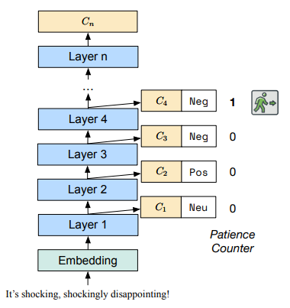
Patience-based Early Exit (PABEE)
BERT Loses Patience: Fast and Robust Inference with Early Exit: https://arxiv.org/abs/2006.04152
PABEE uses patience as the metric for early exiting.
The counter for patience is increased in the following way:
For classification:
For regression:
The above figure sets the patience to 1, causing the model to stop processing early when two consecutive same prediction classes are encountered for the first time​
Notes:
This method can dynamically adjust the accuracy-efficiency trade-off to fit different devices and resource constraints by tuning the patience hyperparameter without retraining the model.

Slide 10
How accurate and fast PABEE?
The proposed approach was evaluated on the GLUE Benchmark.
We can see ~1.5x speed-up in ALBERT model.

Slide 11
Accuracy increases?
This inference strategy can improve both the speed and performance of a fine-tuned PLM.
The authors claim that PABEE mechanism improves the accuracy of conventional inference as long as
where,
t is patience.
n is total number of ICs
q is misclassification probability of all ICs (excluding the final)
p is misclassification probability of final classifier.

Slide 12
Defends Against Adversarial Attack
TextFooler is a model that generates natural adversarial text.
The authors of TextFooler successfully attacked powerful pre-trained BERT.
PABEE defends more than 3x attacks compared to the original ALBERT on NLI tasks, and 2x on the Yelp sentiment analysis task.

Slide 13
Limitations
It only works on models with a single branch (e.g., ResNet, Transformer). Some adaption is needed for multi-branch networks (e.g., NASNet).
PABEE's effectiveness depends on the choice of patience hyper-parameter and tuning it can be challenging and may require extensive experimentation to find the optimal values for different datasets and models.

Slide 14
Confident Adaptive Language Model
Confident Adaptive Language Model: https://arxiv.org/abs/2207.07061
It is a framework for dynamically allocating different amounts of compute per input and generation timestep.
Basically, an early exit decoding.
The authors present a principled method for increasing model efficiency while remaining confident in the quality of the resulting predictions.
And, addresses several other challenges.

Slide 15
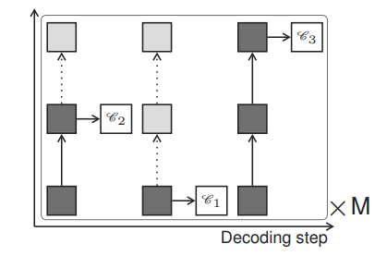
Impact of Early Exiting
Given a pair of source-target sequences (x, y), x is processed with the encoder to give representation s. Next, the decoder generates y step-by step. We compute hidden states at the time t as follows:
To calculate hidden state inside blue box (at layer 3, timestep 3), we would need hidden states inside red box (at layer 2, timesteps <= 3).
Confident Adaptive Language Model: https://arxiv.org/abs/2207.07061
DEPTH-ADAPTIVE TRANSFORMER: https://arxiv.org/pdf/1910.10073.pdf

Slide 16
State Propagation Oracle
The authors used an oracle confidence measure that exits at the earliest layer that agrees with the top prediction. This way the only factor that can cause divergence in the generation is the state copying mechanism for skipped layer.
This oracle achieved a ROUGE-L score of 38.24, compared to 38.32 with the full model, while only using an average of 1.53 layers (total of 8 layers) per token.
This indicates:
the model is robust to state copying from lower layers.
there is remarkable potential for saving compute.
= y3
= y1
= y2
Ground-truths = {y1, y2, …, yt}
Notes:
ROUGE-L is based on the longest common subsequence (LCS) between our model output and reference.

Slide 17
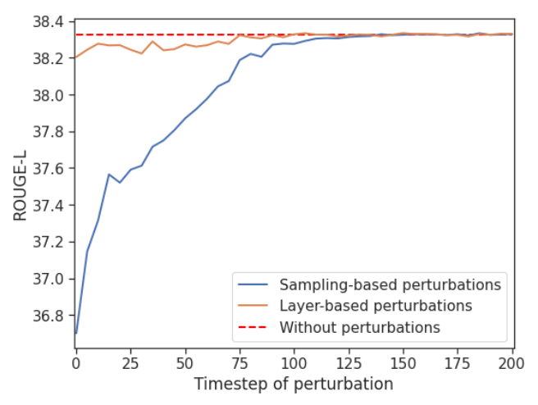
Sensitivity to Local Errors
Two kinds of perturbations:
sampling-based: where we select the 10th-ranked token of the last layer at timestep t.
layer-based: where we select the first layer’s prediction at timestep t (all other tokens are predicted greedily by last layer).
If model receives perturbations at earlier time steps, it negatively affects the performance compared to perturbations added later in time sequence (refer the blue line in the figure).

Slide 18
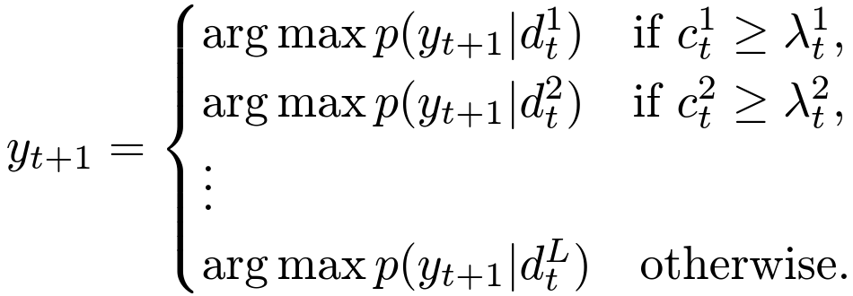
Handling Early-staged Local Errors
Use per-layer threshold and set higher threshold for earlier time steps.
The prediction can be written as:
where c's denotes the local confidence score.

Slide 19
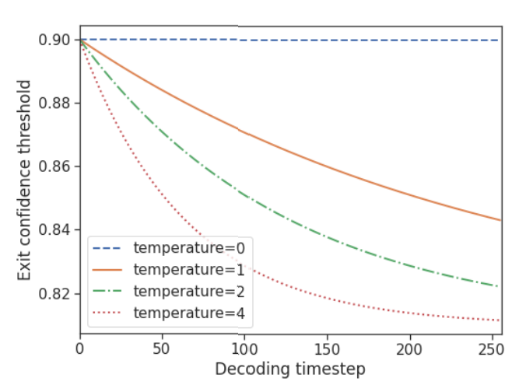
Decaying Threshold
Motivated by logarithmic behaviour in sampling-based perturbations, the authors used an exponential function with user-defined temperature:

Slide 20
Local Confidence Measures
The authors experimented with the following three confidence measures:
Softmax response
We take the difference between top two values of softmax.
Adds FLOPs – though the next layer can start its computation in parallel.
Hidden-state saturation
A parameter-free and fast compute alternative, we take cosine similarity between two consecutive hidden layers.
This measure tries to identify early saturation events of the hidden-state.
Early exit classifier
We train a dedicated linear classifier to predict the likelihood of exiting with local consistency given the current hidden state.
This measure is very fast to compute the inference and adds only |d| + 1 new parameters.

Slide 21
A principled method
The authors developed a method for calibrating local, per-token, exit decisions such that global sequence-level constraints are provably maintained with arbitrarily high probability (e.g. 95%).
This process is what they call Confident Adaptive Language Modeling.
What do we need for calibration?
A Calibration set.
It can consist of independent and identically distributed (i.i.d.) prompts to the LLM.
The global constraint.

Slide 22
Global Constraints
Textual Consistency
A bounded dissimilarity function
Calibration set (can be a set of i.i.d promts - e.g., paragraphs to be summarized, sentences to be translated, etc).
Adaptive output on test set
Standard output on test set
Tolerance
OR
Risk Consistency
A bounded risk function
Calibration set (given prompt can have multiple gold answers).
For risk or textual distance, we rely on standard metric used for dataset:
ROUGE-L for CNN/DM.
BLUERT for WMT
Token-F1 for SQuAD
For a given metric m, we use 1 – m for distance.

Slide 23
Calibrating Early Exits from Global Constraints
The approach uses the following basic recipe:
We specify a grid of possible values of that may result in acceptable generations;
We choose the λ that we can identify with rigourous statistical tools.
Therefore, our goal is to find λ using such that we satisfy either of two types of consistency constraints. At a glance, to find a λ that produces consistent continuations, the problem is casted to a multiple hypothesis testing problem (from hyper-parameter selection problem) over a large array of k candidate classifier exit thresholds.
This is done by applying Learn Then Test (LTT) framework by Angelopoulos et al. (Learn then test: Calibrating predictive algorithms to achieve risk control) to identify a subset of statistically valid, constraint-satisfying threshold
For all the experiments, the authors have set e = 0.05.
The obtained risk is guaranteed to be <= δ at least 95% of the time.

Slide 24
Performance-Efficiency Trade-off
For experimentation, CALM uses T5X framework with 8 layers.
Following plots compare the three confidence scores on three of the tasks:
CNN/DM (left) - for text summarization.
WMT (center) - for machine translation
SQuAD (right) - for question-answering

Slide 25
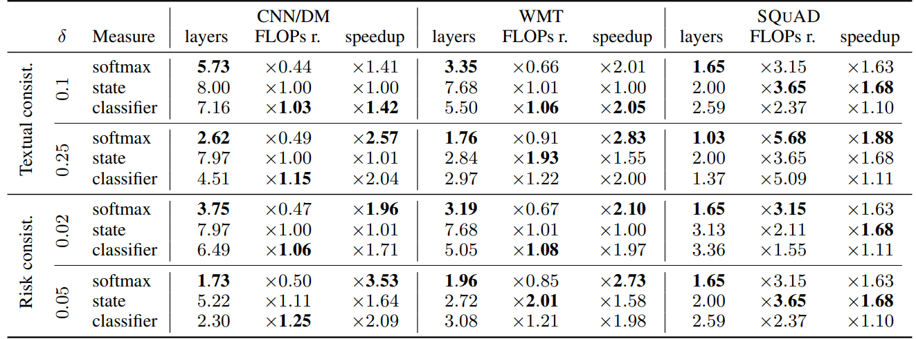
Speed-up Results
Across all model, the softmax confidence measure leads to the greatest decrease in number of decoder layers required.

Slide 26
Execution Example
CALM accelerates the generation by early exiting when possible, and selectively using the full decoder’s capacity only for few tokens, demonstrated here on a CNN/DM example with softmax-based confidence measure. The colors represent the number of decoding layers used for each token—light green shades indicate less than half of the total layers.

Slide 27
Limitation
We need to select the right confidence measure and as seen in the result table the most effective option (softmax-based) can be computationally expensive, potentially offsetting the efficiency benefit.

Slide 28
Speculative Decoding
Fast Inference from Transformers via Speculative Decoding: https://arxiv.org/abs/2211.17192
An algorithm to sample from autoregressive models faster without any changes to the outputs, by computing several tokens in parallel.
It uses more efficient approximation models to make a guess which is then confirmed by the slower target models.

Slide 29
Speculative Execution
By approximation model (97M parameter GPT-like model) sequentially
Continuation 1
Continuation 2
The quick brown fox
jumps
over
the
over
jumps
By target model (11B T5-XXL model) in-parallel
Speculative Decoding Explained: https://www.youtube.com/watch?v=hm7VEgxhOvk

Slide 30
One more prediction
The quick brown fox
jumps over the
Speculative Decoding Explained: https://www.youtube.com/watch?v=hm7VEgxhOvk

Slide 31
Incorrect Speculation
The quick brown fox
jumps
over
the
over
ate
By target model (11B T5-XXL model) in-parallel
Speculative Decoding Explained: https://www.youtube.com/watch?v=hm7VEgxhOvk

Slide 32
Corrected Path
The quick brown fox
ate
Speculative Decoding Explained: https://www.youtube.com/watch?v=hm7VEgxhOvk

Slide 33
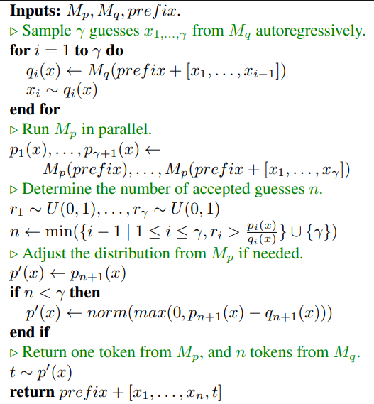
Speculative Sampling
The authors introduces a novel sampling method, speculative sampling, where the idea is to maximize the probability of these speculative task to be accepted, while guaranteeing that the outputs from the system have the same distribution as those from the target model alone.

Slide 34
Key observations
Hard language-modeling tasks often include easier subtasks that can be approximated well by more efficient models.
Inference from large models is often not bottlenecked on arithmetic operations, but rather on memory bandwidth and communication, so additional computation resources might be available.
The authors were able to accelerate inference without:
Changing the model architecture.
Changing the training-procedure or needing to re-train the models.
Change the model output distribution.

Slide 35
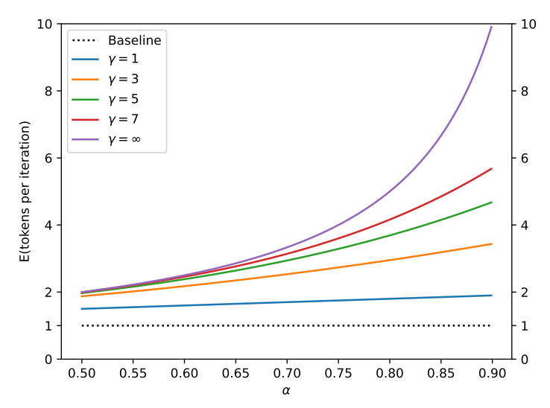
The trade-off
Number of tokens to be guessed by draft model: γ.
A measure of how well draft model (M_q) approximates target model (M_p): α
α ∝ E[#tokens per iteration]
Also,
α ∝ size[M_q]
This induces a trade-off between making M_q and M_p similar and making the M_q model cheap to run.

Slide 36
Walltime Improvement
A simplified trace diagram for a full encoder-decoder Transformer stack.

Slide 37
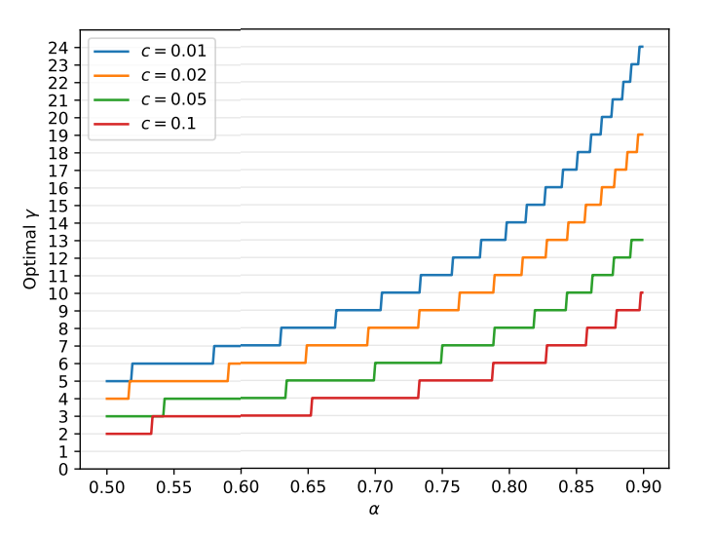
Choosing optimal γ
Given the
Cost co-efficient (ratio between the time for a single run of M_q and time for a single run of M_p): c
A measure of how well draft model approximates target model: α
the optimal γ is the one that maximizes the walltime.

Slide 38
Speed-up
Target Model: T5-XXL (11B)
Approximation models: T5-large (800M), T5-base (250M), and T5-small (77M)
T5-small (77M), with a good balance of c and α, provides the highest speedup out of the tested approximation models.
Tasks:
EnDe: English to German translation.
CNN/DM: Text summarization

Slide 39
Limitation
The latency is improved through increased concurrency at the cost of an increased number of arithmetic operations. Thus, this method is not helpful for configurations where additional computation resources are not available.

Slide 40
Lecture 13: Efficient LLM Inference (Part 2)
Presenters:
Rushabh Nikhilkumar Solanki | Noble Saji Mathews​

Slide 41
Efficient LLMs are a Full Stack Problem
Libraries for LLM inference and serving: Text Generation Inference, DeepSpeed, or vLLM
Techniques: Tensor parallelism, quantization, continuous batching of requests, optimized CUDA kernels …
How to get the most out of each GPU?
5.5x Throughput
50% lower latency
Taken from Keynote at Ray Summit 2023
~ 4x Throughput over SOTA
~5x Memory efficiency

Slide 42
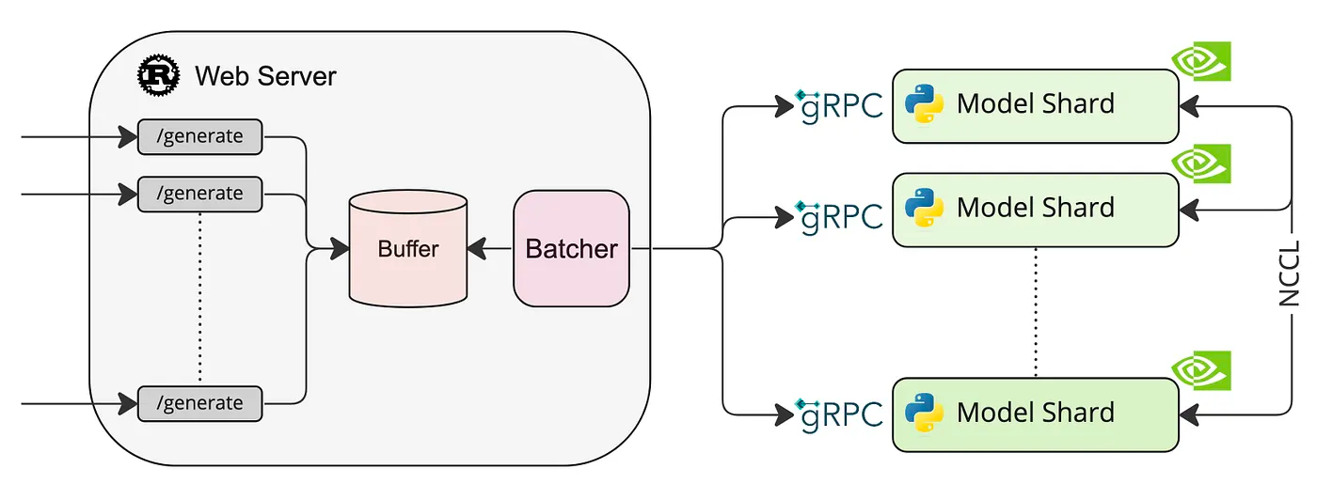
Rise of LLM based applications!
Need for more efficient way of handling LLM requests
GPU utilization must be maximized
Notes:
Paged Attention
Flash Decoding
Lookahead Decoding

Slide 43
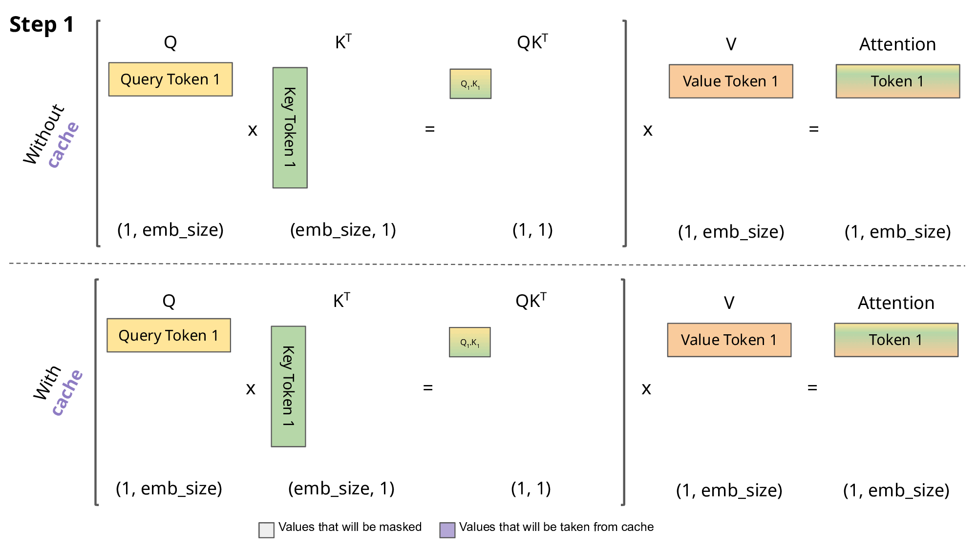
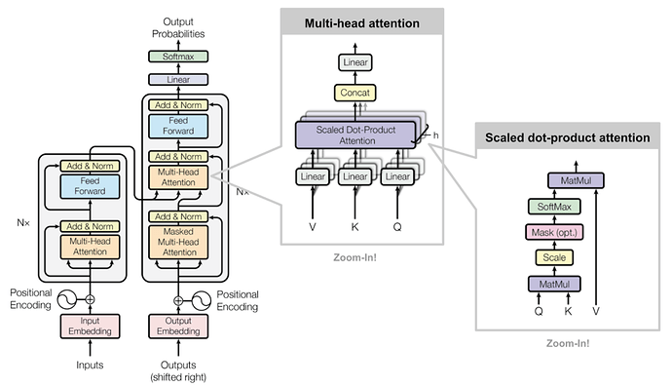
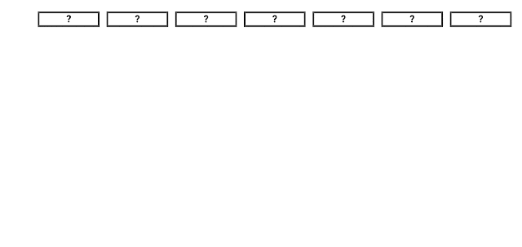
Let’s breakdown regular inference a bit!
Repeat
Max Length (2048 Tokens)
Special Token once done (<EOS>)
Decoder
Causal – Attention only depends on preceding tokens
Each Generation Step – calculate attention for new token
KV Cache for faster computation
High Throughput?
Grows with each step
Efficient management necessary

Slide 44
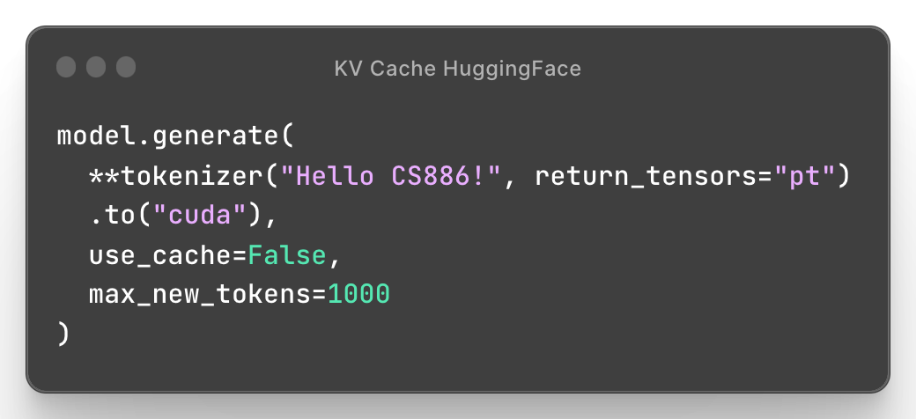
Managing KV-Cache
KV Cache for prompt
External Fragmentation
Hello | CS886! | I | am | past | Noble | <EOS> | <RESV> | … | <RESV> | … | ... | How
Request current step ^ | Future slots reserved |
Internal Fragmentation
Turning off KV-Cache drops performance by 5x on a Tesla T4 GPU running GPT2
Authors find 20.4-38.2% utilization of KV Cache
Internal Fragmentation: Unknown output length
Reservation: Used in Future steps (known length)
External Fragmentation: Different seq. lengths

Slide 45
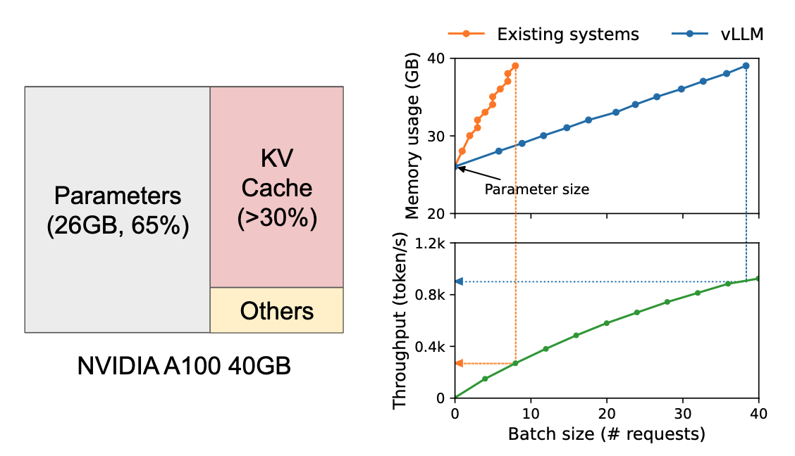
How much memory?
Contiguous spaces of memory allocated
Cannot do memory sharing
Sounds like… “Memory Fragmentation” & “Sharing” in OS
Serving a 13B Param LLM

Slide 46
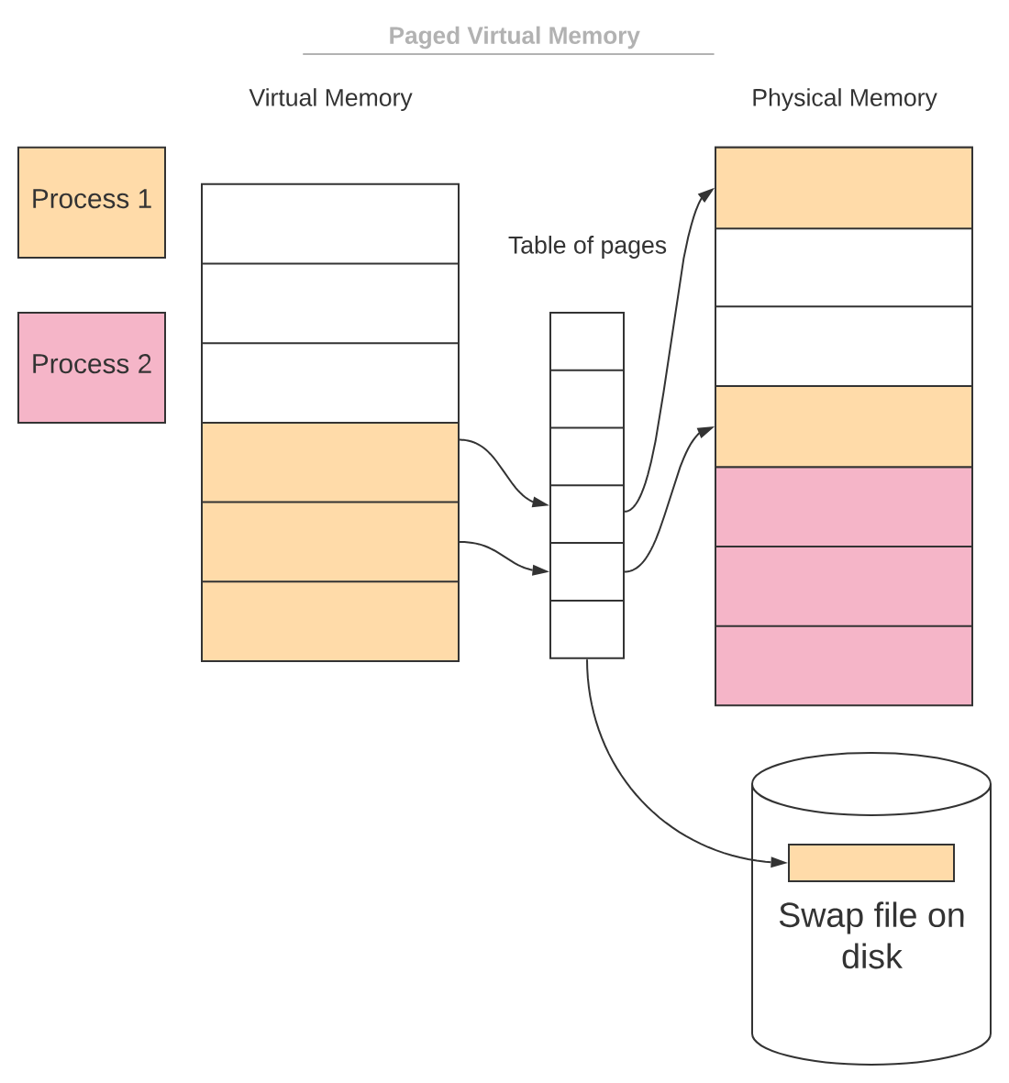
Memory on demand!
Processes as incoming requests
Virtual Memory to Logical KV Blocks
Physical Memory to Physical KV Blocks
Page table to Block Table

Slide 47
Memory on demand!
Prompt: We are learning about LLMs and
Assume block size of 4 instead of 16/32
Each token has set of K & V across layers which can be managed within a single KV Block
Block 0
1 | about | LLMs | and
2
3
4
5
6
7 | Today | we | are | learning
Block 0 | Today | we | are | learning
1 | about | LLMs | and
2
3
Phys. Block | # Filled
7 | 4
1 | 3
Logical KV Blocks
Block Table
Physical KV Blocks

Slide 48
Memory on demand!
Prompt: Today we are learning about LLMs and
Completion: memory
Block 0
1 | about | LLMs | and | memory
2
3
4
5
6
7 | Today | we | are | learning
Block 0 | Today | we | are | learning
1 | about | LLMs | and | memory
2
3
Phys. Block | # Filled
7 | 4
1 | 4
Logical KV Blocks
Block Table
Physical KV Blocks

Slide 49
Memory on demand!
Prompt: Today we are learning about LLMs and
Completion: memory management
Block 0
1 | about | LLMs | and | memory
2
3
4
5 | on | demand
6
7 | Today | we | are | learning
Block 0 | Today | we | are | learning
1 | about | LLMs | and | memory
2 | on | demand
3
Phys. Block | # Filled
7 | 4
1 | 4
5 | 2
Logical KV Blocks
Block Table
Physical KV Blocks

Slide 50
Multiple Requests
Block 0
1 | about | LLMs | and | memory
2
3 | Today | we | are | learning
4 | requests
5 | on | demand
6 | about | LLMs | and | multiple
7 | Today | we | are | learning
Block 0 | Today | we | are | learning
1 | about | LLMs | and | multiple
2 | requests
3
Internal Fragmentation
Logical KV Blocks - Request B
Block 0 | Today | we | are | learning
1 | about | LLMs | and | memory
2 | on | demand
3
Physical KV Blocks
Each request has its own block table and logical KV blocks
Logical KV Blocks - Request A
No External Fragmentation!

Slide 51
Decoding Techniques – Sharing KV Blocks
Block 0 | Today | we | are | learning
1 | about | LLMs | and
2
3
Block 0
1
2
3
4
5
6 | about | LLMs | and
7 | Today | we | are | learning
Logical KV Blocks - Seq B
Block 0 | Today | we | are | learning
1 | about | LLMs | and
2
3
Ref count 2
Physical KV Blocks
Logical KV Blocks - Seq A

Slide 52
Decoding Techniques – Sharing KV Blocks
Block 0 | Today | we | are | learning
1 | about | LLMs | and | multiple
2
3
Block 0
1
2
3
4
5
6 | about | LLMs | and
7 | Today | we | are | learning
Logical KV Blocks - Seq B
Block 0 | Today | we | are | learning
1 | about | LLMs | and | memory
2
3
Ref count 2
-> 1
Physical KV Blocks
Logical KV Blocks - Seq A

Slide 53
Decoding Techniques – Sharing KV Blocks
Block 0 | Today | we | are | learning
1 | about | LLMs | and | multiple
2
3
Block 0
1
2 | about | LLMs | and | multiple
3
4
5
6 | about | LLMs | and | memory
7 | Today | we | are | learning
Copy-on-write
Logical KV Blocks - Seq B
Block 0 | Today | we | are | learning
1 | about | LLMs | and | memory
2
3
Ref count 1
Physical KV Blocks
Logical KV Blocks - Seq A

Slide 54
Beam Search – Fork, Append & Free
Supported by dynamic block mapping and copy-on-write discussed

Slide 55
Paged Attention
Block-wise computation & Reduced Cache Misses
$a_{ij}= \frac{exp\left(q_{i}^{T}.k_{j}/\sqrt{d}\right)}{\sum_{t}{exp\left(q_{i}^{T}.k_{t}/\sqrt{d}\right)}}$
$o_{i}=\sum_{j=1}^{i}{v_{j}a_{ij}^{T}}$
If we have Blocks of size B
$A_{ij}= \frac{exp\left(q_{i}^{T}.K_{j}/\sqrt{d}\right)}{\sum_{t=1}^{i/B}{exp\left(q_{i}^{T}.K_{t}/\sqrt{d}\right)}}$
$o_{i}= \sum_{j=1}^{i/B}{V_{j}A_{ij}^{T}}$
Notes:
In the standard attention mechanism, the attention score Aij​ is computed using the dot product of the query vector qi and the key vector kj, typically normalized by the square root of the dimensionality of the key vectors (d​), and then applying the softmax function to get a distribution over keys
The output vector oi​ is then computed as a weighted sum of the value vectors vj​, where the weights are the attention scores

Slide 56
Paged Attention
Block-wise computation & Reduced Cache Misses
$a_{ij}= \frac{exp\left(q_{i}^{T}.k_{j}/\sqrt{d}\right)}{\sum_{t}{exp\left(q_{i}^{T}.k_{t}/\sqrt{d}\right)}}$
$o_{i}=\sum_{j=1}^{i}{v_{j}a_{ij}^{T}}$
If we have Blocks of size B
$A_{ij}= \frac{exp\left(q_{i}^{T}.K_{j}/\sqrt{d}\right)}{\sum_{t=1}^{i/B}{exp\left(q_{i}^{T}.K_{t}/\sqrt{d}\right)}}$
$o_{i}= \sum_{j=1}^{i/B}{V_{j}A_{ij}^{T}}$

Slide 57
Paged Attention
Block-wise computation & Reduced Cache Misses
$a_{ij}= \frac{exp\left(q_{i}^{T}.k_{j}/\sqrt{d}\right)}{\sum_{t}{exp\left(q_{i}^{T}.k_{t}/\sqrt{d}\right)}}$
$o_{i}=\sum_{j=1}^{i}{v_{j}a_{ij}^{T}}$
If we have Blocks of size B
$A_{ij}= \frac{exp\left(q_{i}^{T}.K_{j}/\sqrt{d}\right)}{\sum_{t=1}^{i/B}{exp\left(q_{i}^{T}.K_{t}/\sqrt{d}\right)}}$
$o_{i}= \sum_{j=1}^{i/B}{V_{j}A_{ij}^{T}}$

Slide 58
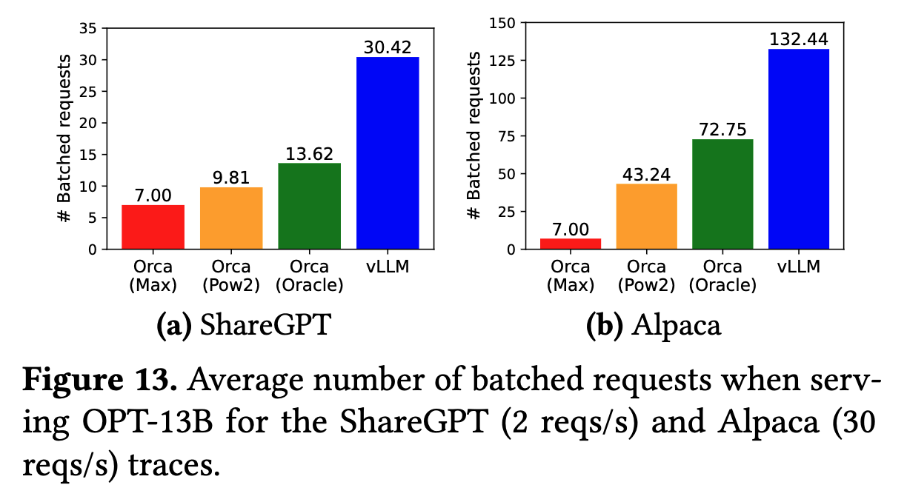
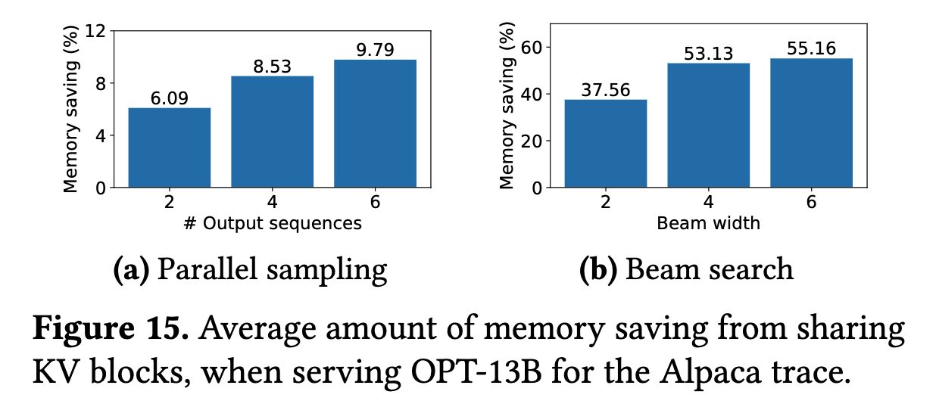
Results
With a larger number of sequences to sample, vLLM brings more improvement over the Orca baselines
- Higher throughput with shared prefix
- Chatbots can handle larger prompts efficiently
- Higher attention kernel latency doesn’t affect results significantly
vLLM’s PagedAttention can efficiently manage the memory usage and thus enable batching more requests than Orca.
- Block size of 16 is large enough to use GPU efficiently
- Recomputation more efficient than swapping when small
Notes:
Recomputation: This is a technique used in the context of deep learning models, especially during the training phase. Instead of storing all intermediate outputs (activations) in the GPU memory, which can be very memory-intensive, the model can save memory by recomputing activations on the fly during the backward pass of training.
Swapping: This refers to the strategy of temporarily storing data that doesn't fit into the GPU memory onto another storage medium, usually the CPU memory or disk. When the data is needed again (e.g., for gradient calculations), it is "swapped" back into the GPU

Slide 59
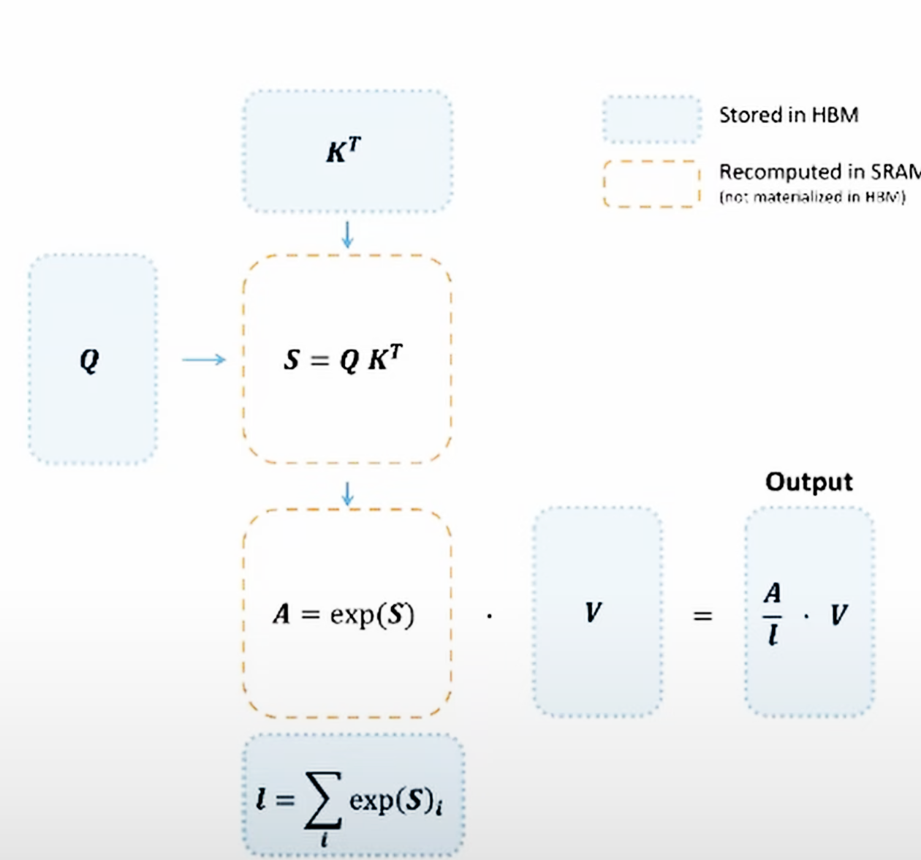
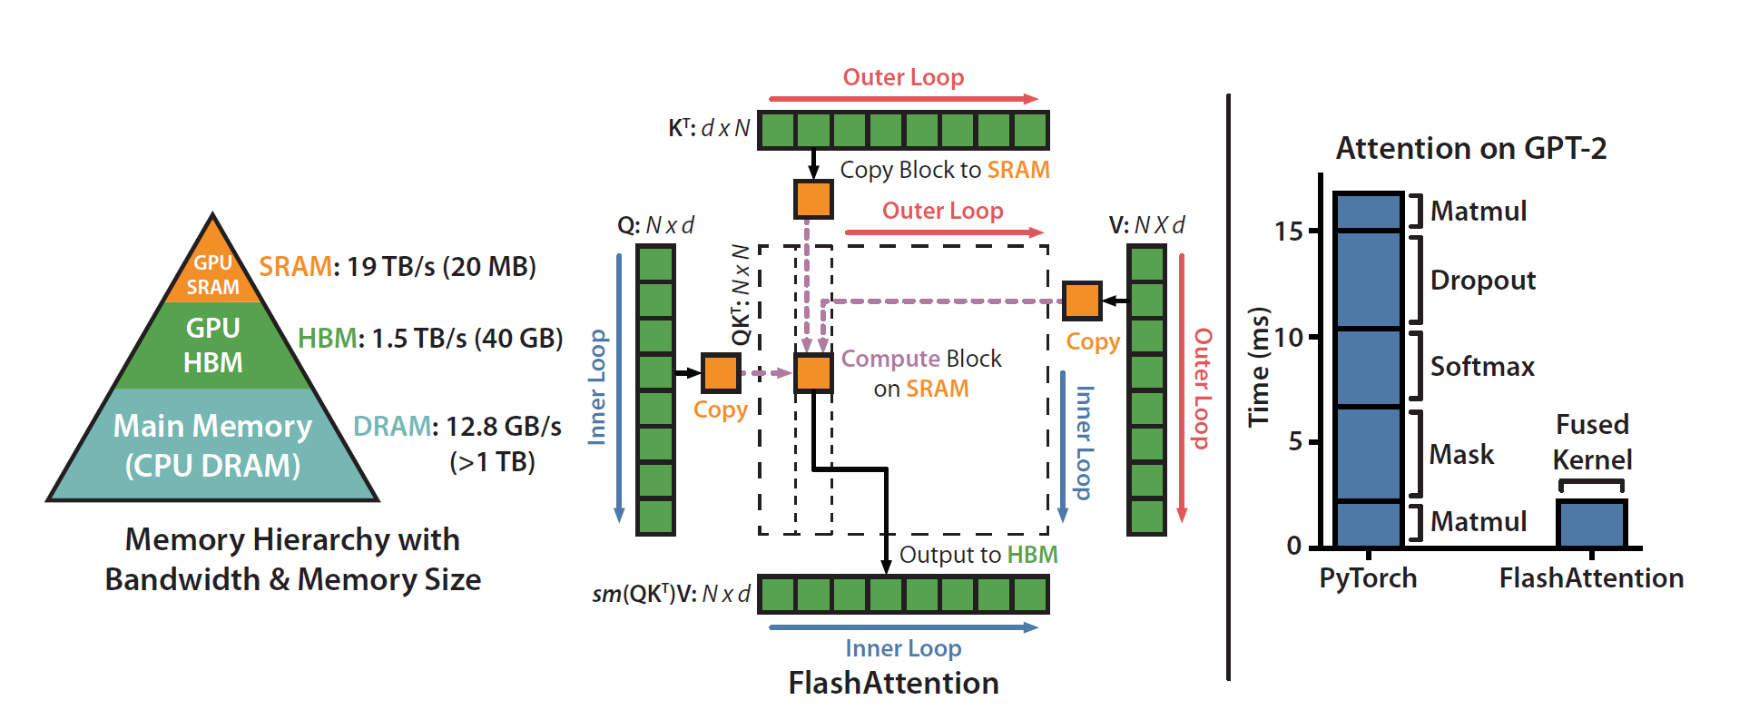
Flash-Attention (Re-visited)
2-4X Faster, 10-20X memory reduction
Flash Attention for training – bottleneck was memory bandwidth – FA2 (2x more) parallelizes across batch size and query length dimension – reduce non-matmul FLOPS
Tiling:
$$softmax\left(\left[A_{1},A_{2}\right]\right)\left[\begin{matrix}V_{1} \\ V_{2}\end{matrix}\right]=α softmax\left(A_{1}\right)∗V_{1}+β softmax\left(A_{2}\right)∗V_{2}$$
Recompute in backward pass (Inputs in SRAM)
$$S=Q∗K^{T}$$
$$A=exp⁡(S)$$
Notes:
https://gordicaleksa.medium.com/eli5-flash-attention-5c44017022ad

Slide 60
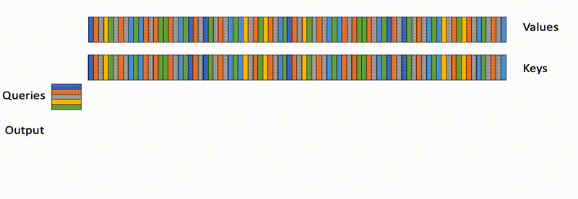
Flash-Decoding (PyTorch)
8X Faster Attention Computation during Inference for long sequences
Flash Attention for training – bottleneck was memory bandwidth – parallelizes across batch size and query length dimension
query length is typically 1 – batch size < Streaming Multiprocessors in long context

Slide 61
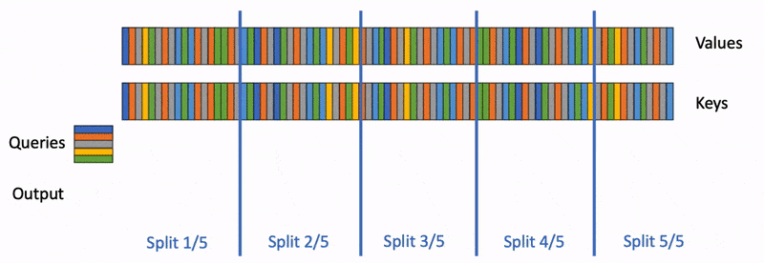
Flash-Decoding (PyTorch)
Parallelize computation
split the keys/values in smaller chunks
compute the attention of the query with each of these splits in parallel
1 extra scalar per row and per split: the log-sum-exp of the attention values
Use the log-sum-exp to scale the contribution of each split

Slide 62
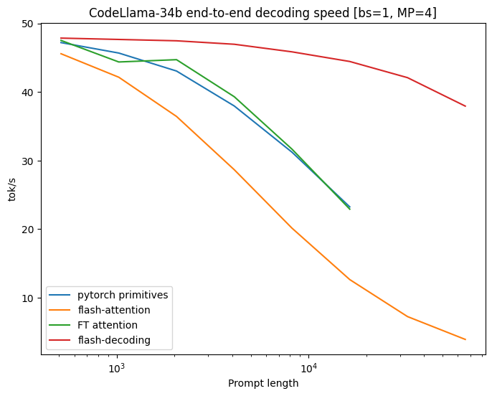
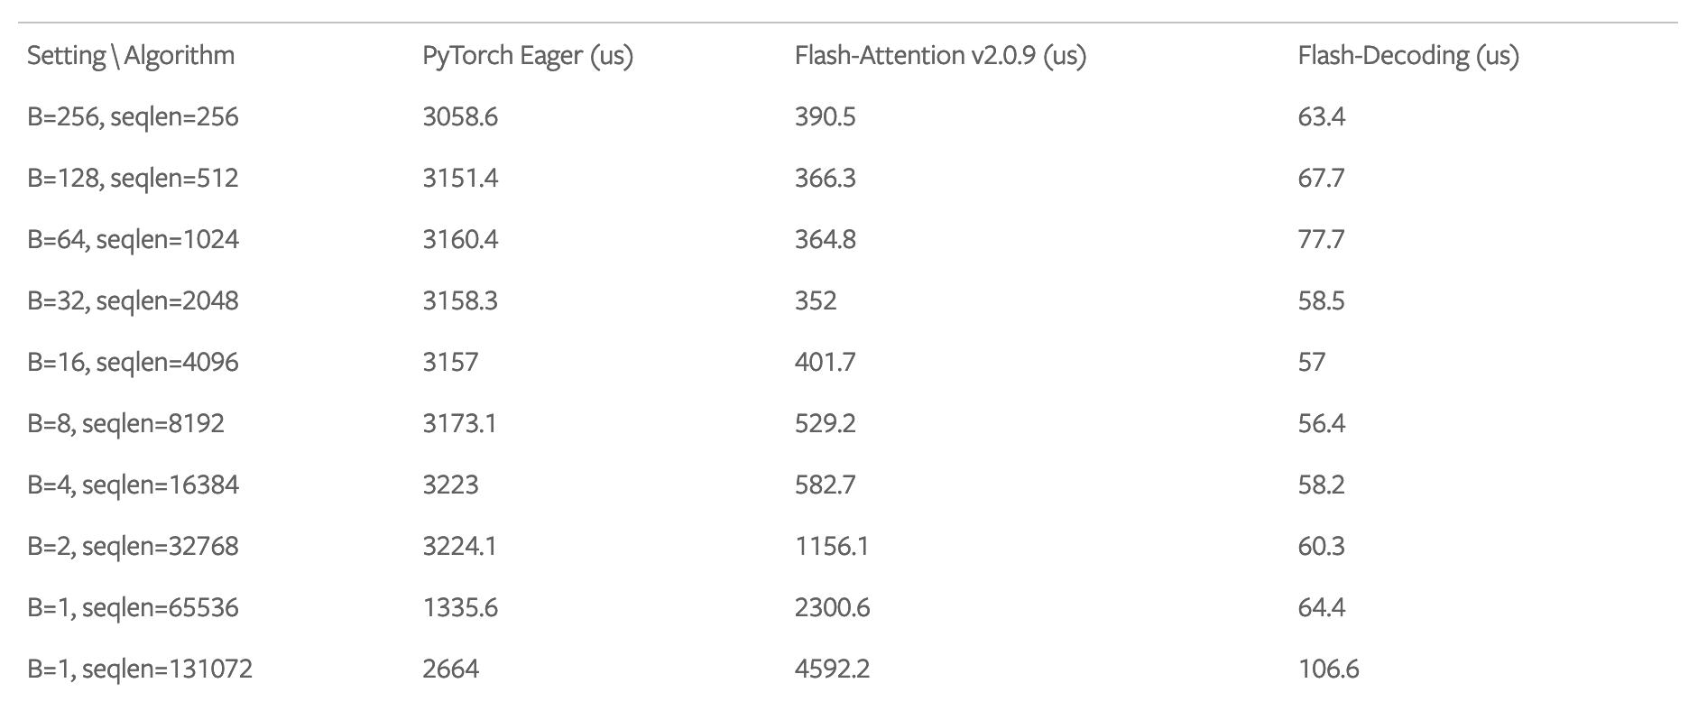
Benchmark – CodeLLama 34B
8x speedups in decoding speed for very large sequences
Scales much better than alternative approaches
Attention itself 50x Flash Att.

Slide 63
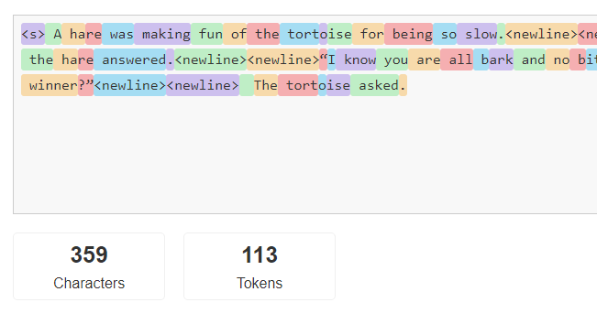
Lookahead Decoding
Speculative Decoding depends on how good your guess is
Core idea: Sometimes more than 1 correct token decoded in parallel
Naïve: 1 in 32000 (tokens in Llama2 Tokenizer) chance
Not all tokens are equally likely
Why not look at the prompt? (Summarization.. Patterns.. Code.)
N-grams as a lookup table
A smaller helper model? Small/Train!
Can a model only predict 1 token???
Notes:
Hard to sync

Slide 64
Yes it can!
How to increase token acceptance rate??

Slide 65
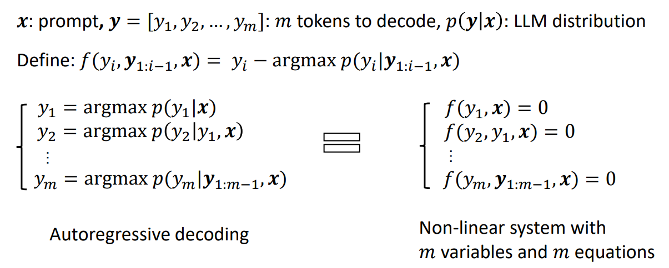
Jacobi iteration
Parallel token generation – model outputs an n-gram

Slide 66
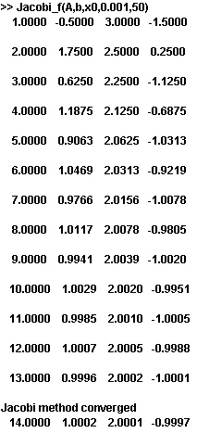
Jacobi – Revisiting Highschool
Consider the three-by-three system
Start with
Not this.. But pretty similar

Slide 67
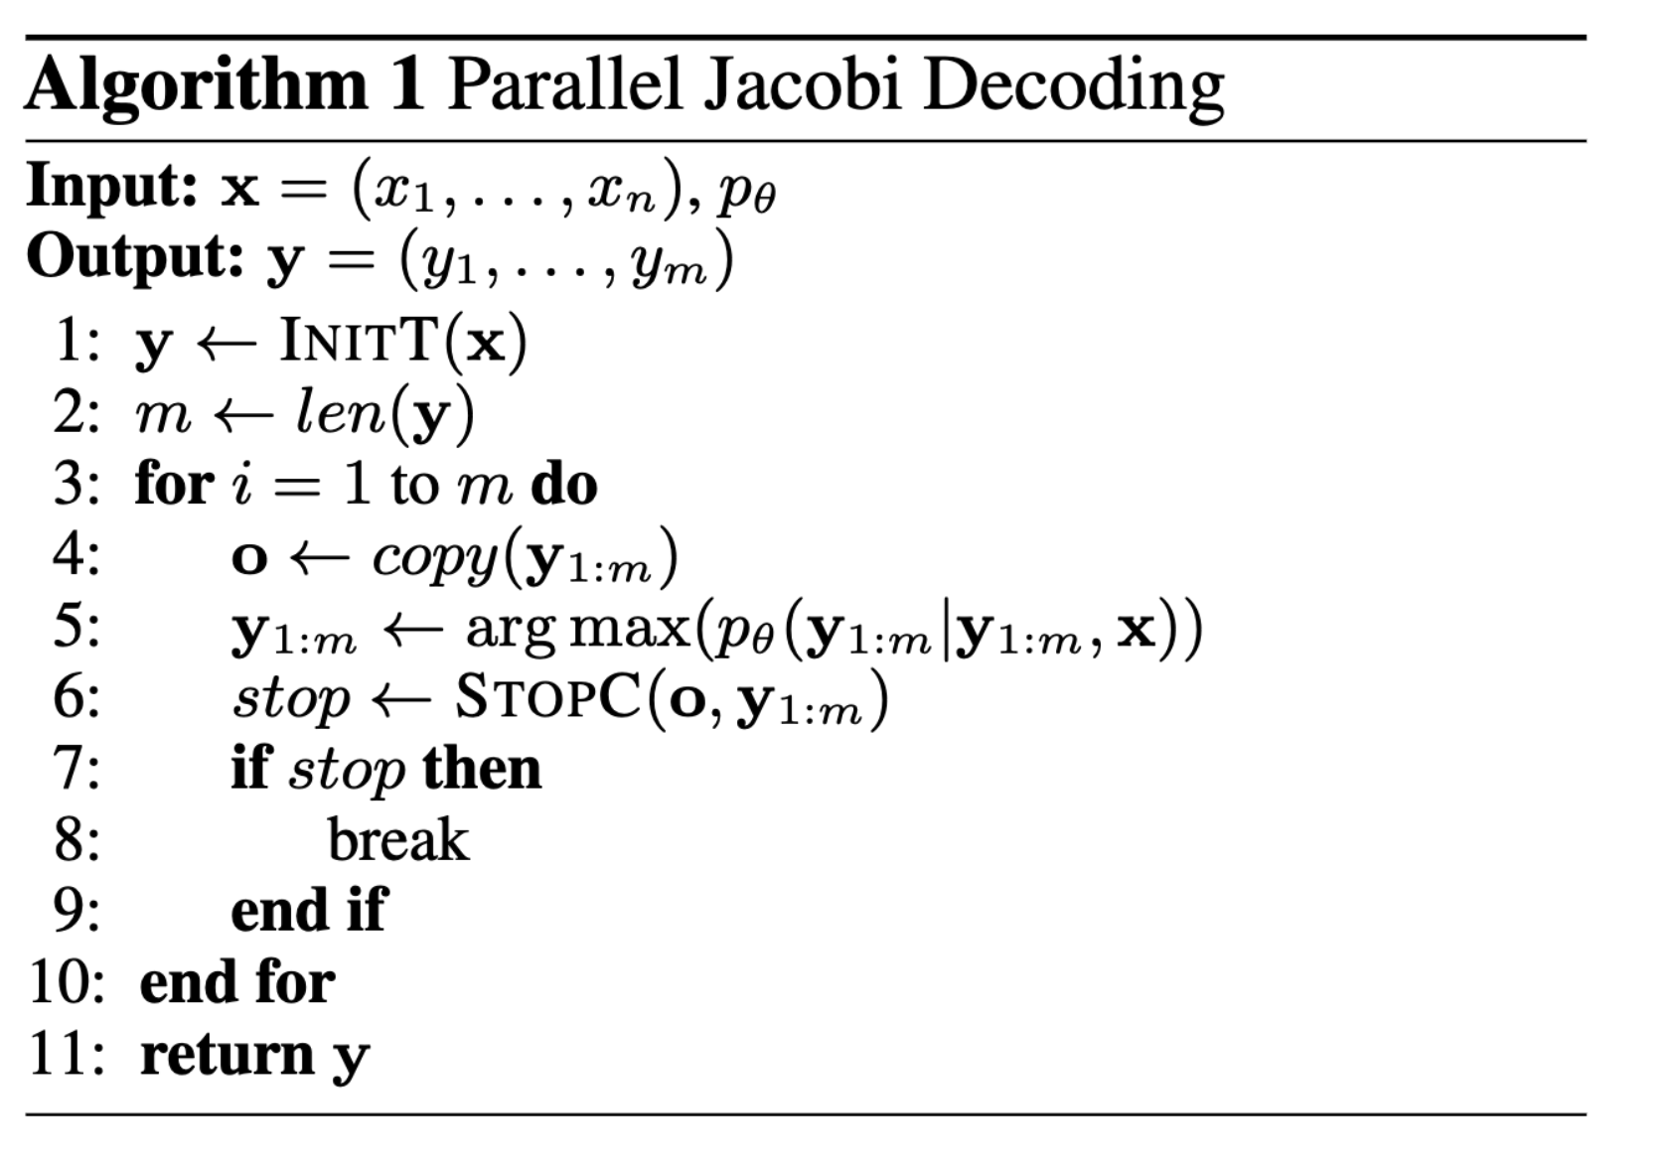
Jacobi iteration
Nonlinear Jacobi process is a parallel algorithm – CFM solvers
Properties discussed:
- solving all variables in at most m steps
- each step guarantees at least the very first token is correctly decoded
But… very few iterations successfully achieve the simultaneous decoding and correct positioning of multiple tokens

Slide 68
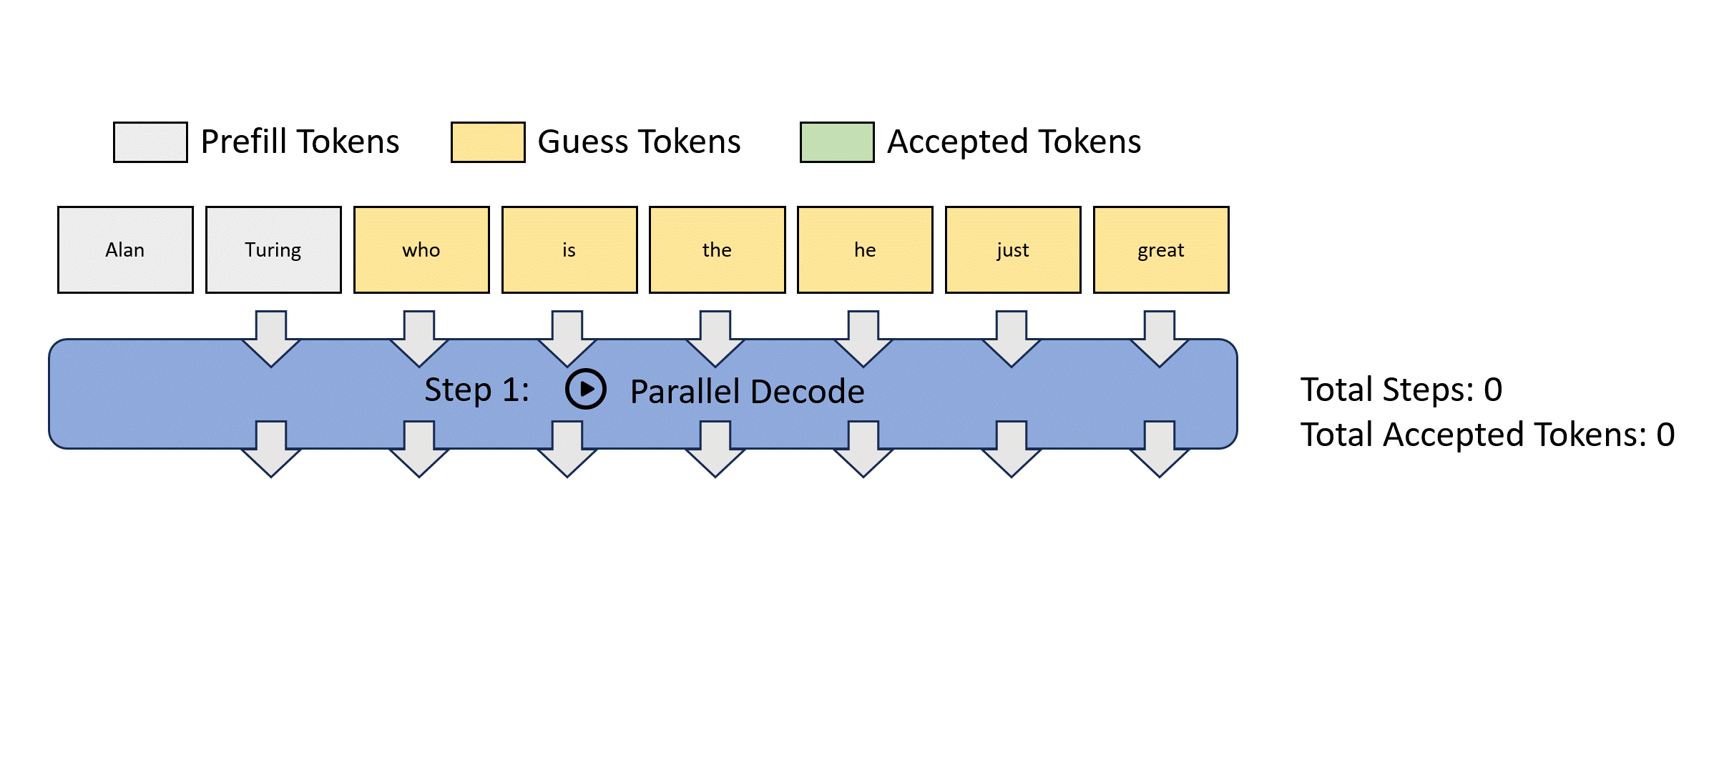
Can we do better?

Slide 69
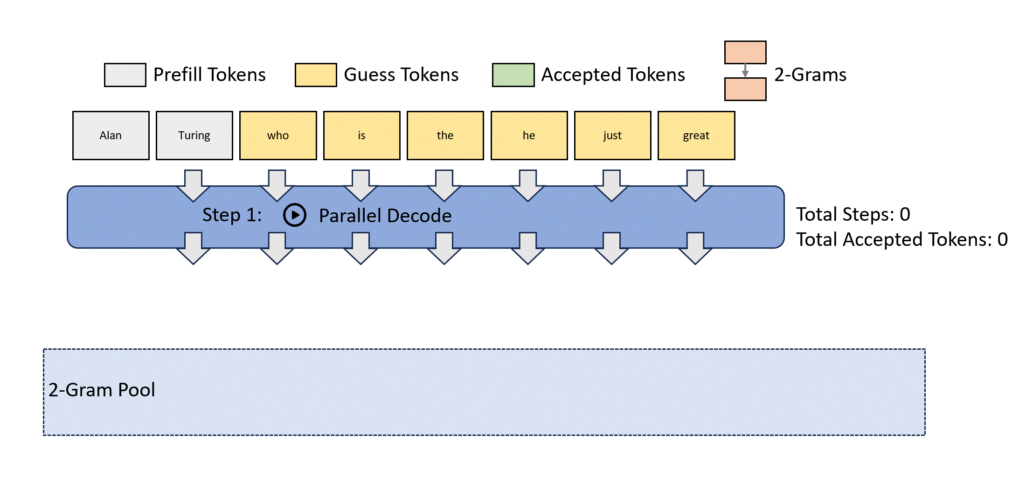
Lookahead!
Construct n-grams from jacobi iterations – “caching trajectories”

Slide 70
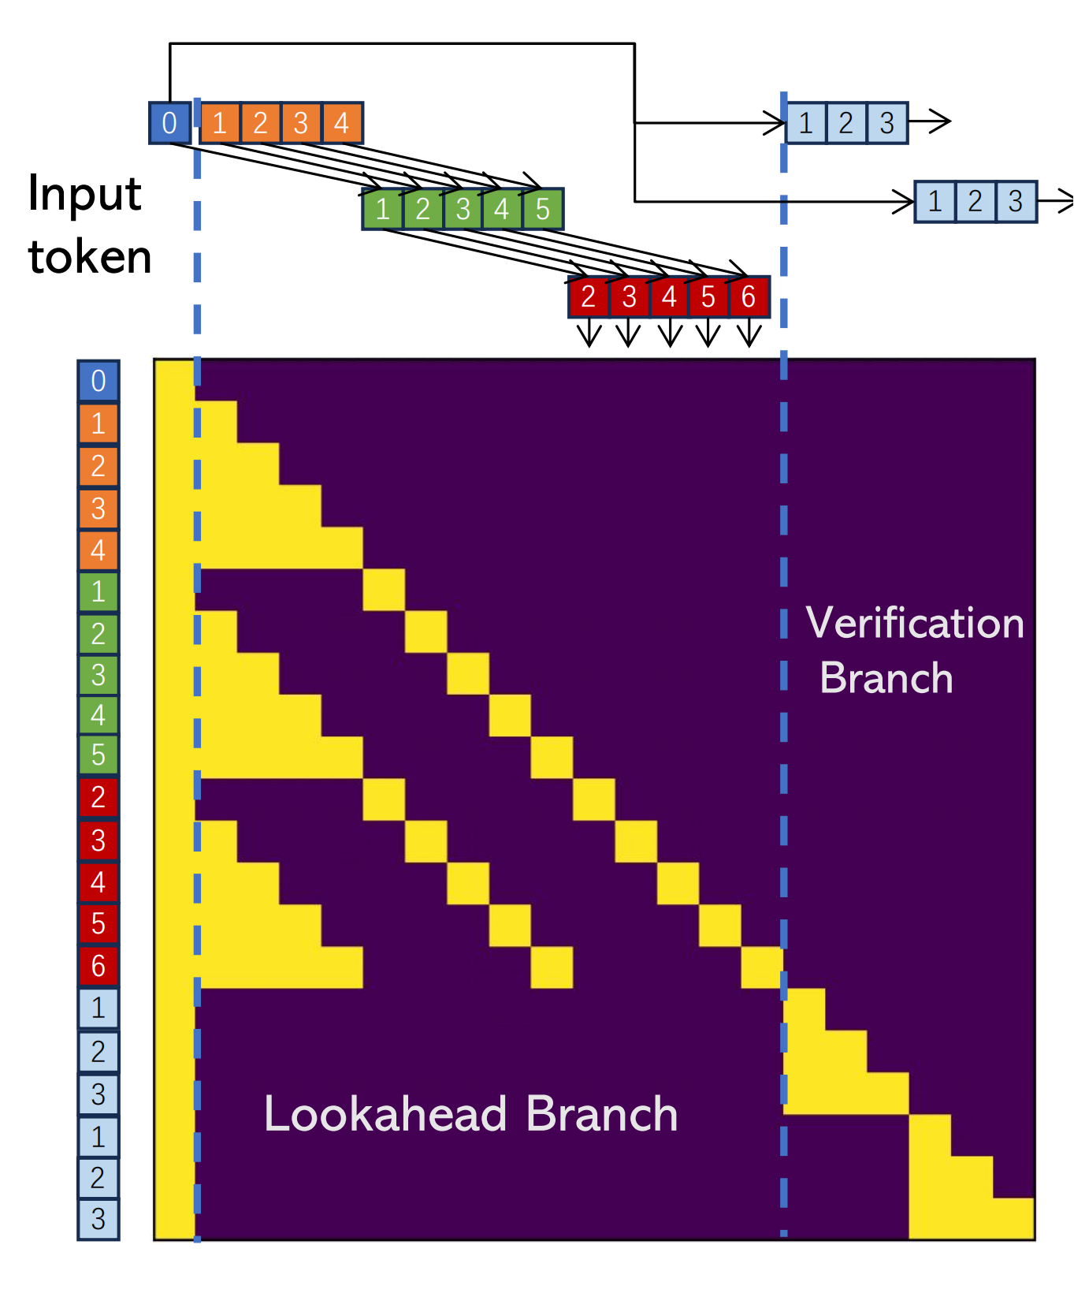
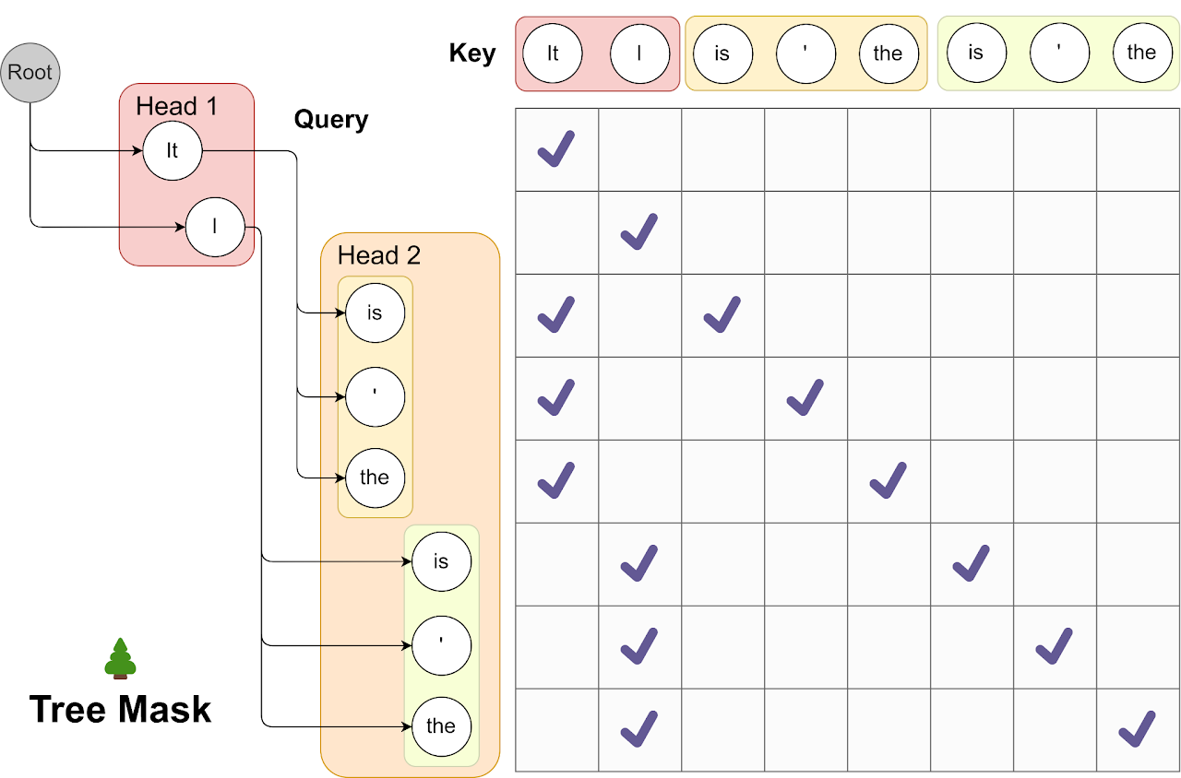
The lookahead branch aims to generate new N-grams.
two-dimensional window
Window size W=5 tokens: How far ahead we look in future token positions to conduct parallel decoding.
N-gram size N=4 Steps: How many steps we look back into the past Jacobi iteration trajectory to retrieve n-grams.
W*(N-1) + G*(N-1) FLOPs

Slide 71
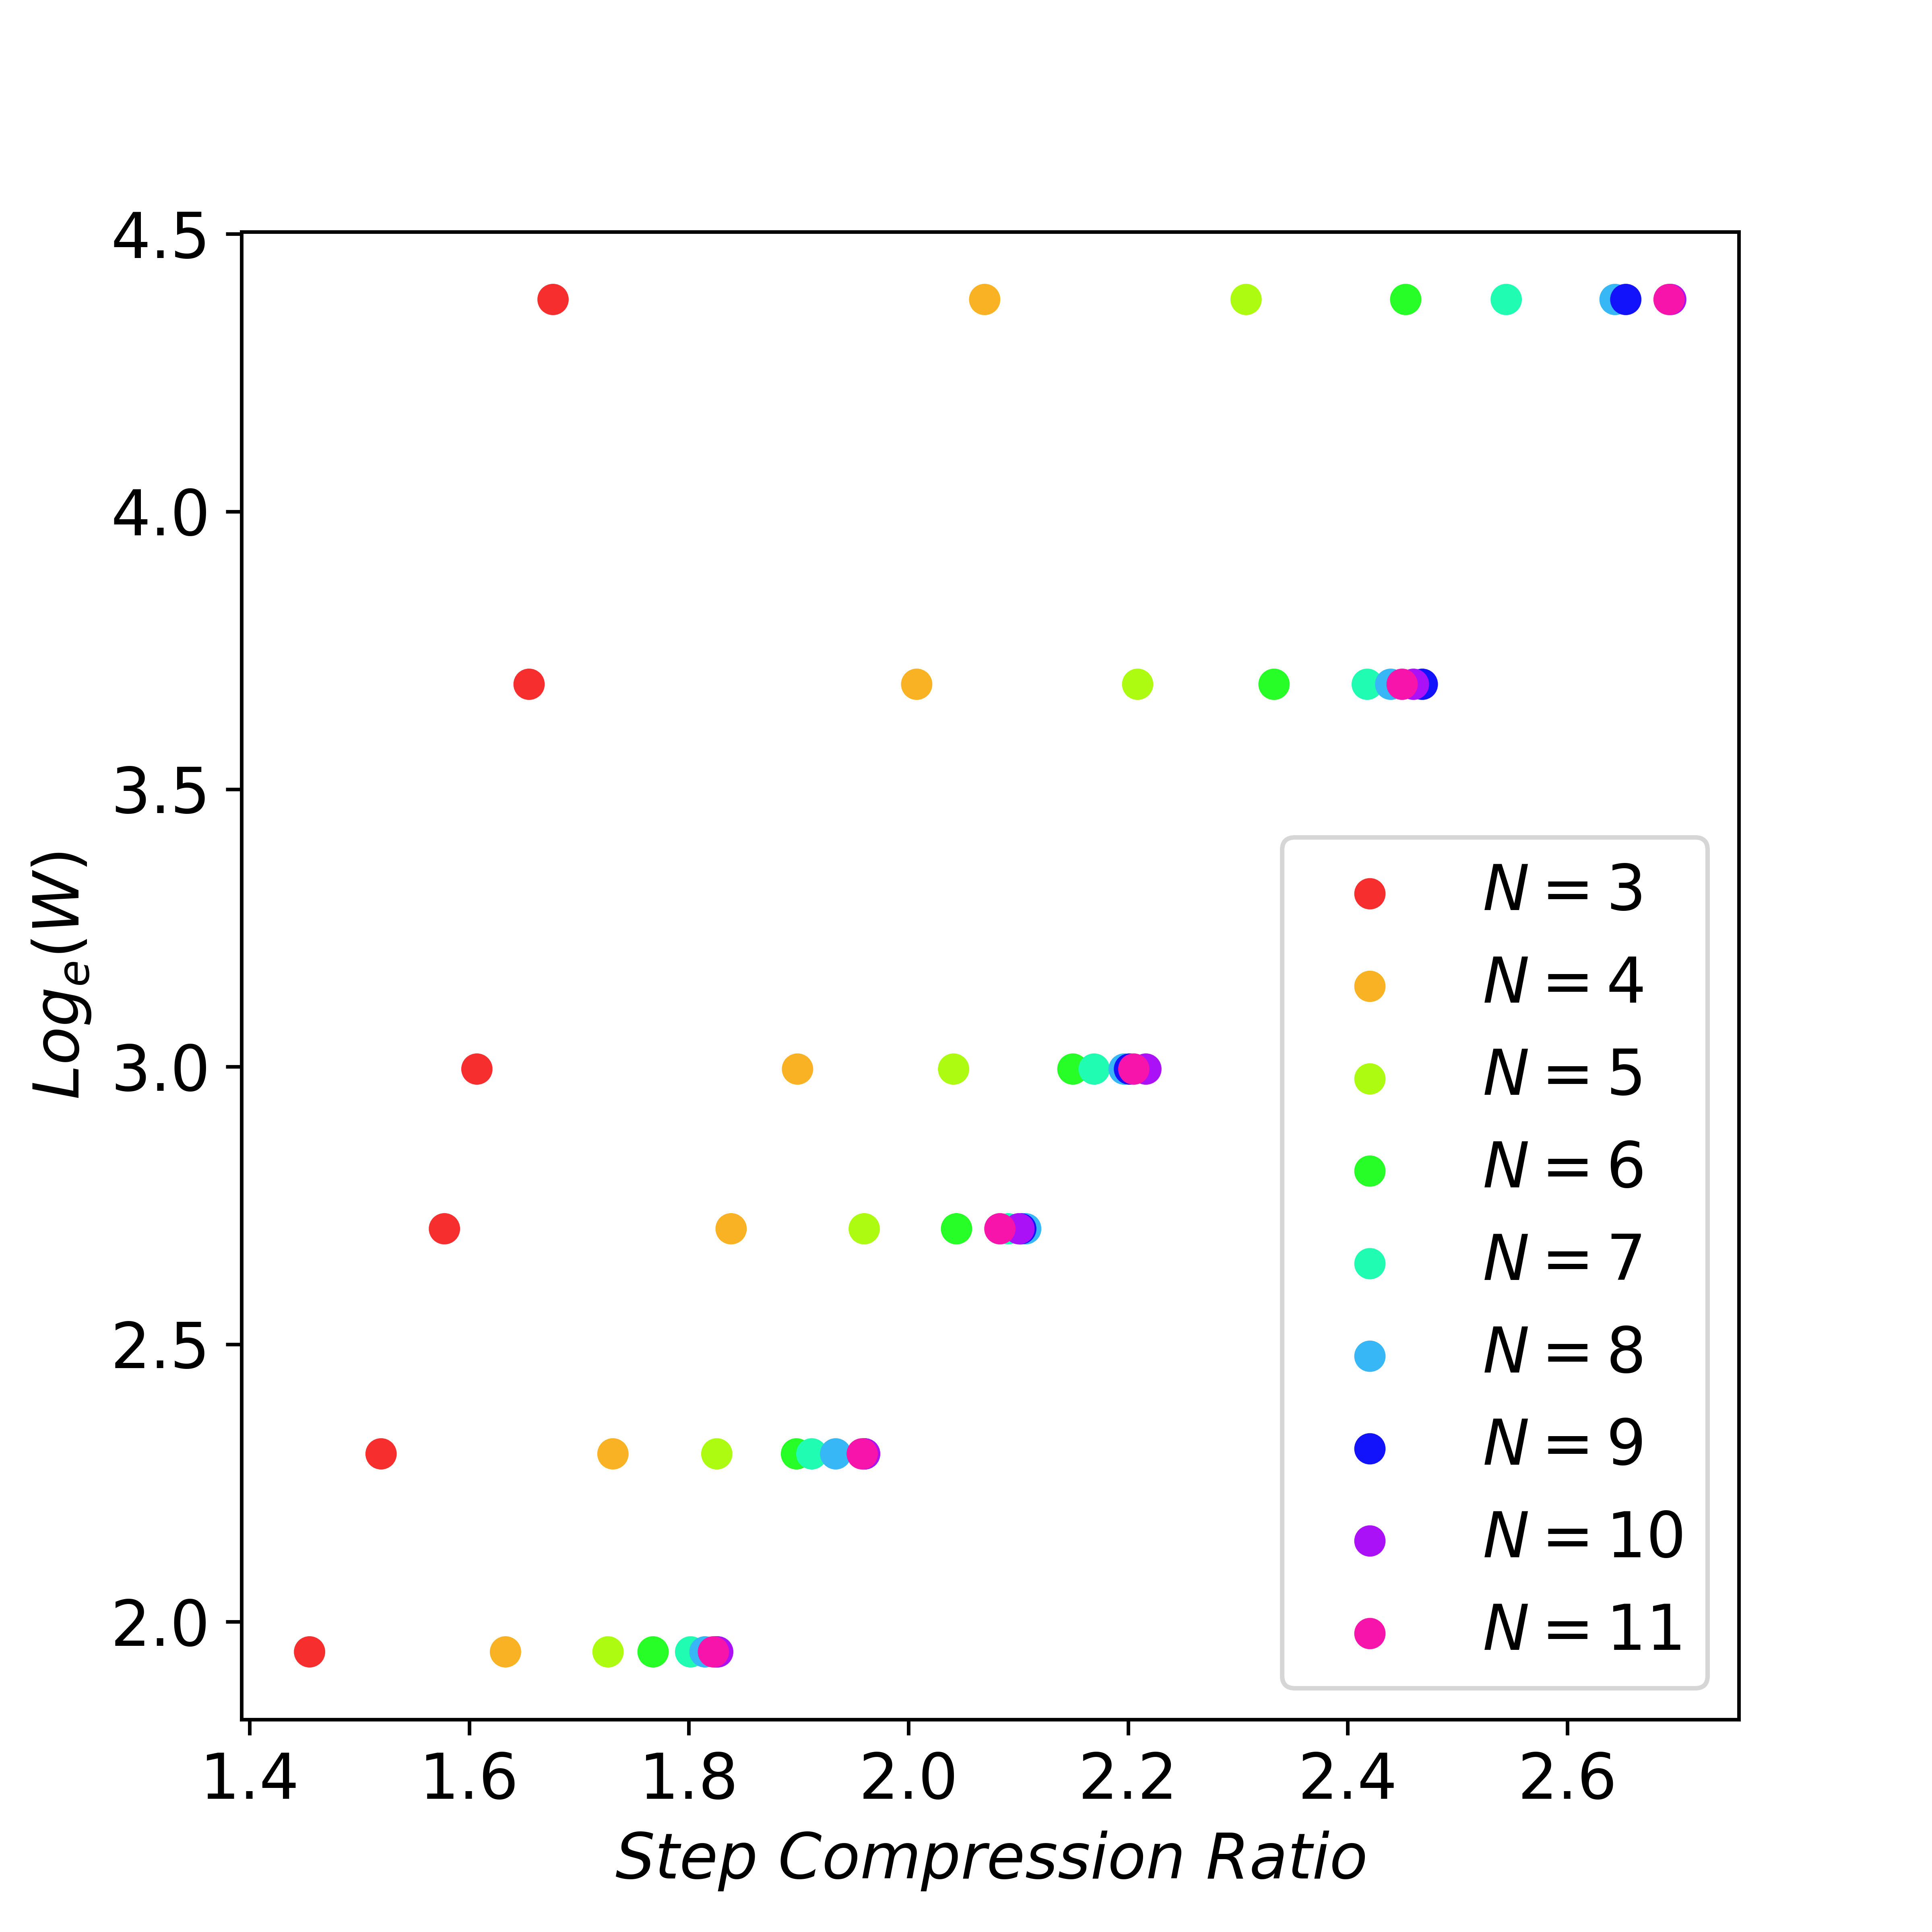
Scaling Law
When N is large enough, exponentially increasing window size W can linearly reduce the number of decoding steps. Candidates verified G=W

Slide 72
Reduce Latency! (Single GPU Results)
~1.5x speedup on LlaMA-chat
2x latency reduction on HumanEval (repeated n-grams- CodeLLaMA)
1.9x latency reduction in math problems (Instruct model)

Slide 73
Overall...
The initial two models, PABEE and CALM, adopted an early-exit strategy.
In addition to early-exit methodology, CALM also took into account global consistency.
Speculative Decoding presents an approach is compatible with the first two models, PABEE and CALM, as well as any other dynamic speed-up techniques.
LLM Inference is bottlenecked by memory constraints! We discussed how we can go about building an efficient KV Cache with block-wise attention (paged)
Flash Decoding looks at efficiently utilizing the GPU for the inference stage drawing on the enhancements of Flash Attention V1 &2 for training
Lookahead Decoding explores improving speculative decoding for latency critical applications

Slide 74
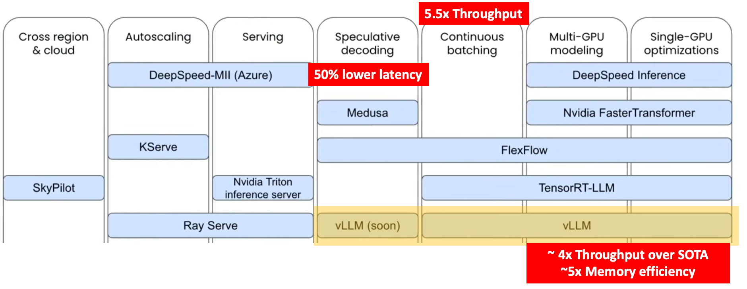
Discussion!

