Slide 1
Lecture 12:Optimized LLM Training
Presenters: Abdelrahman Ahmed and Matthew Yang
Notes:
Hello everyone and welcome to lecture 12,
In this lecture, we discuss optimized training of large language models.

Slide 2
Part 1:Maximize GPU Utilization
Abdelrahman Ahmed
Notes:
In this video, I will be presenting the first part,
where we talk about maximizing the GPU utilization for efficient and scalable training

Slide 3
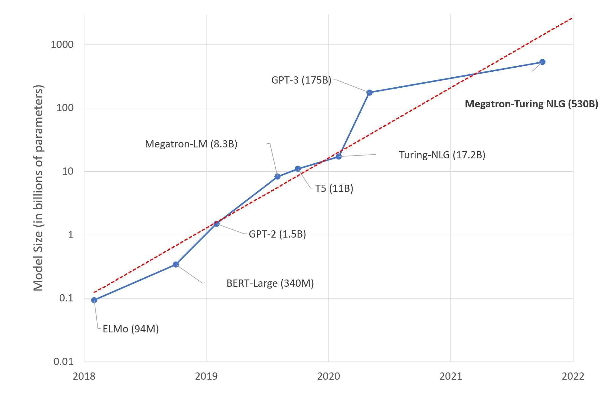
Why?
32GB VRAM → ~1.4 billion parameters max [ZeRO]
How can we do more (efficiently)?
https://huggingface.co/blog/large-language-models
Notes:
Why are we doing this?
We still can see big improvements with training bigger models.
BUT: as of right now, you can not fit more than 1.4 billion parameters in one GPU (of 32GB Memory)
So, how could we achieve more than that?
Well this is going to be the main topic of my presentation today

Slide 4
Outline
Parallelism
Data Parallelism
Pipeline Parallelism
Model Parallelism
ZeRO
Optimizations
Activation Checkpointing
Mixed Precision Training
Notes:
These are the topics that I aim to cover in this video.
While it is a very ambitious outline, I will try to touch on the main concepts and ideas
To give you an overall understanding of the process. Hopefully without boring you too much with the details

Slide 5
Data Parallelism
#0
Forward Pass
Backward Pass
Compute $\frac{∂x_{0}}{∂W}$
Compute (𝜕𝑥_0)/𝜕𝑊
Parameter Server (or all-reduce)
Minibatch $x$
$$x_{0}$$
#1
Forward Pass
Backward Pass
Compute $\frac{∂x_{1}}{∂W}$
Compute (𝜕𝑥_1)/𝜕𝑊
R$educe \frac{∂x}{∂W}$
Reduce 𝜕𝑥/𝜕𝑊
Broadcast $$W^{new}=W−η\frac{∂x}{∂W}$$
Broadcast 𝑊^𝑛𝑒𝑤=𝑊−𝜂 𝜕𝑥/𝜕𝑊
$$x_{1}$$
$$x_{2}$$
#2
Forward Pass
Backward Pass
Compute $\frac{∂x_{2}}{∂W}$
Compute (𝜕𝑥_2)/𝜕𝑊
Notes:
Replicate weights across devices
Split data into microbatches
Forward and backward normally
Then you reduce and broadcast
3X throughput (GPU/TPU/anything)

Slide 6
Data Parallelism
High throughput
Near-perfect scaling: (as large as your batch size)
Architecture Independent, and no model rewrite
Single GPU VRAM is still the bottleneck
Moderate communication overhead
Notes:
Amount of work by each worker is constant --> good
communication cost of aggregating gradients scales with the model size and limits compute efficiency on large models or systems with low communication bandwidth.

Slide 7
Pipeline Parallelism [Gpipe, Pipedream]
#0
#1
#2
Minibatch $x$
$$x_{0}$$
$$x_{1}$$
$$x_{2}$$
$$x_{1}$$
$$x_{0}$$
$$x_{2}$$
Notes:
Interlayer splitting
(Horizontal splitting)
Roughly 1/Nd weights (because there is optimizer weights, activations, etc)

Slide 8
Pipeline Parallelism [Naïve]
Example:
$M=1$ Micro-batches, $K=4$ devices
Forward time $t_{f}=1$, Backward time $t_{b}=2$
f |  |  |  |  |  |  |  |  |  | b
 | f |  |  |  |  |  |  | b
 |  | f |  |  |  | b
 |  |  | f | b | 2
 | Forward
 | Backward
 | Idle (Bubble)

Slide 9
Pipeline Parallelism (Gpipe)
[Gpipe]

Slide 10
Pipeline Parallelism (Full Example)
Example:
$M=8$ Micro-batches, $K=4$ devices
Forward time $t_{f}=1$, Backward time $t_{b}=2$
0 | 1 | 2 | 3 |  |  |  |  |  |  | 0 |  | 4 | 1 |  | 5 | 2 |  | 6 | 3 |  | 7 | 4 |  |  | 5 |  |  | 6 |  |  | 7 | 5
 | 0 | 1 | 2 | 3 |  |  |  | 0 |  |  | 1 |  | 4 | 2 |  | 5 | 3 |  | 6 | 4 |  | 7 | 5 |  |  | 6 |  |  | 7 | 5
 |  | 0 | 1 | 2 | 3 | 0 |  |  | 1 |  |  | 2 |  | 4 | 3 |  | 5 | 4 |  | 6 | 5 |  | 7 | 6 |  |  | 7 | 5
 |  |  | 0 | 0 | 2 | 1 | 1 |  | 2 | 2 |  | 3 | 3 |  | 4 | 4 | 2 | 5 | 5 |  | 6 | 6 |  | 7 | 7
 | Forward
 | Backward
 | Idle (Bubble)

Slide 11
Pipeline Parallelism (Bubble analysis)
Bubble time (per minibatch): $\left(K−1\right)⋅(t_{f}+t_{b})$
Ideal time: $M⋅(t_{f}+t_{b})$
Efficiency: $1−\frac{K−1}{M}$
For “Almost Linear” scaling [Gpipe], empirically: $M≥4K$
Efficiency: $1−\frac{K−1}{4K}=\frac{3}{4}+\frac{1}{4K}≈75\%$

Slide 12
Pipeline Parallelism
Architecture Independent, but needs code rewriting
Memory/device: Max Partition (weights) + activations for all micro-batches
Lowest communication volume
Model size scales linearly
Needs load balancing
Notes:
Pipeline parallelism reduces memory proportional to the number of pipeline stages, allowing model size to scale linearly with the number of workers.
However, it cannot scale indefinitely, increasing the pipeline size decreases the computation per pipeline stage,

Slide 13
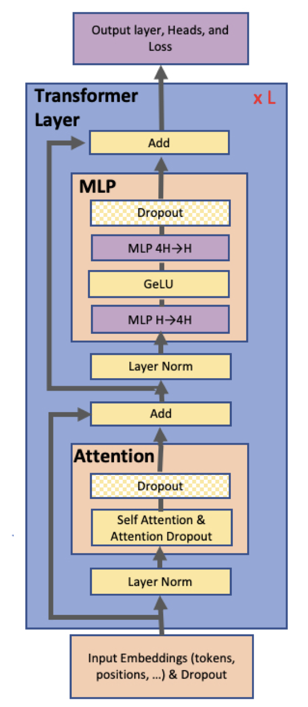
Model Parallelism [Megatron]
Minibatch $x$
#0
$$x_{0}$$
$$x_{1}$$
$$x$$
#1
$$x_{2}$$

Slide 14
Parallel GEMM
Column parallelism
$$A_{1}$$
A_11
A_21
A_31
A_41
$$X$$
Y1
$$A$$
X_11 | X_12 | X_13 | X_14
X_21 | X_22 | X_23 | X_24
Y_11
Y_21
$$X$$
A_11 | A_12
A_21 | A_22
A_31 | A_32
A_41 | A_42
$$×$$
$$=$$
$$Y$$
X_11 | X_12 | X_13 | X_14
X_21 | X_22 | X_23 | X_24
Y_11 | Y_12
Y_21 | Y_22
$$×$$
$$=$$
cat
$$=$$
X_11 | X_12 | X_13 | X_14
X_21 | X_22 | X_23 | X_24
A_12
A_22
A_32
A_42
Y_12
Y_22
$$×$$
$$=$$
Y2
$$X$$
$$A_{2}$$
$$XA=X\left[A_{1} A_{2}\right]=\left[XA_{1} XA_{2}\right]=\left[Y_{1} Y_{2}\right]=Y$$
Row parallelism
$$A_{1}$$
$$X_{1}$$
$$Y_{1}$$
$$A$$
X_11 | X_12
X_21 | X_22
A_11 | A_12
A_21 | A_22
Y1_11 | Y1_12
Y1_21 | Y1_22
$$X$$
A_11 | A_12
A_21 | A_22
A_31 | A_32
A_41 | A_42
$$×$$
X_11 | X_12 | X_13 | X_14
X_21 | X_22 | X_23 | X_24
$$Y$$
$$×$$
$$+$$
$$=$$
Y_11 | Y_12
Y_21 | Y_22
$$=$$
$$X_{2}$$
$$A_{2}$$
$$Y_{2}$$
X_13 | X_14
X_23 | X_24
$$×$$
A_31 | A_32
A_41 | A_42
Y1_11 | Y1_12
Y1_21 | Y1_22
$$XA=\left[X_{1} X_{2}\right] \left[\begin{matrix}A_{1} \\ A_{2}\end{matrix}\right]=X_{1}A_{1}+X_{2}A_{2}=Y_{1}+Y_{2}=Y$$

Slide 15
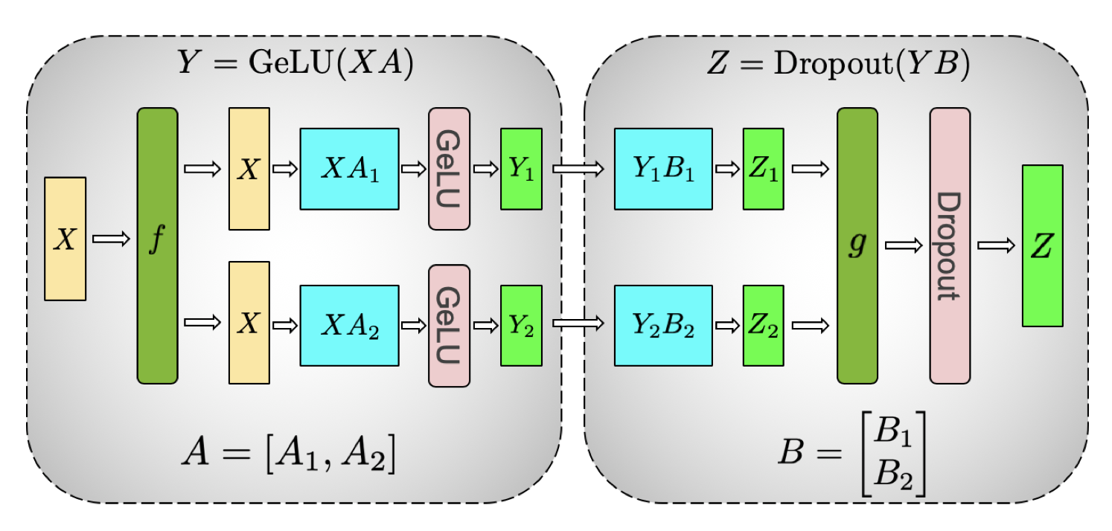
Model Parallelism (MLP)
Column
Row
$$GeLU\left(XA\right)=GeLU\left(X\left[A_{1} A_{2}\right]\right)=\left[GeLU\left(XA_{1}\right) GeLU\left(XA_{2}\right)\right]=\left[Y_{1} Y_{2}\right]=Y$$
$$YB=\left[Y_{1} Y_{2}\right] \left[\begin{matrix}B_{1} \\ B_{2}\end{matrix}\right]=Y_{1}B_{1}+Y_{2}B_{2}=Z_{1}+Z_{2}=Z$$

Slide 16
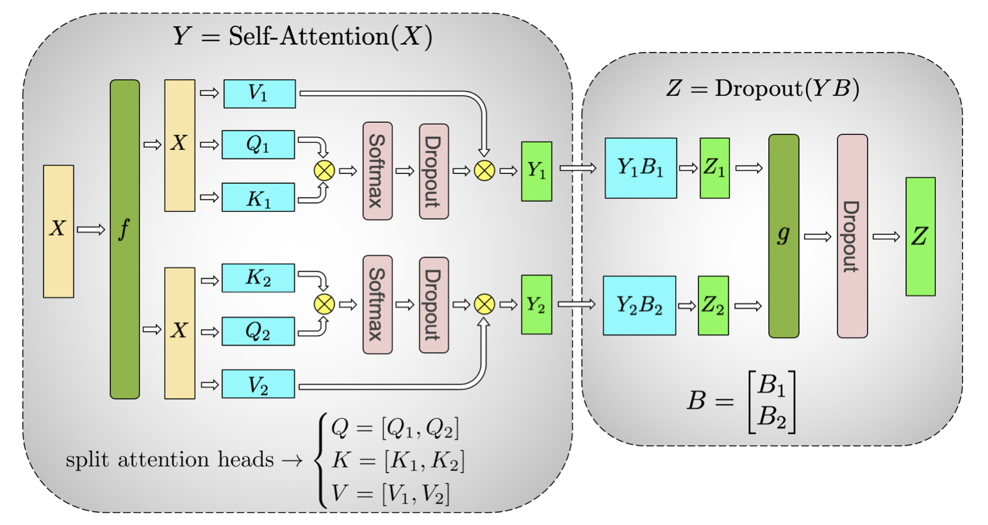
Model Parallelism (Self Attention)
Parallelize Attention Heads!
$$Y=\left[Y_{1} Y_{2}\right]=\left[Q_{1}K_{1}^{T}V_{1} Q_{2}K_{2}^{T}V_{2}\right]$$
$$Z=\left[Z_{1}+Z_{2}\right]=\left[Y_{1}B_{1}+Y_{2}B_{2}\right]=\left[Y_{1} Y_{2}\right]\left[\begin{matrix}B_{1} \\ B_{2}\end{matrix}\right]$$
Column
Row

Slide 17
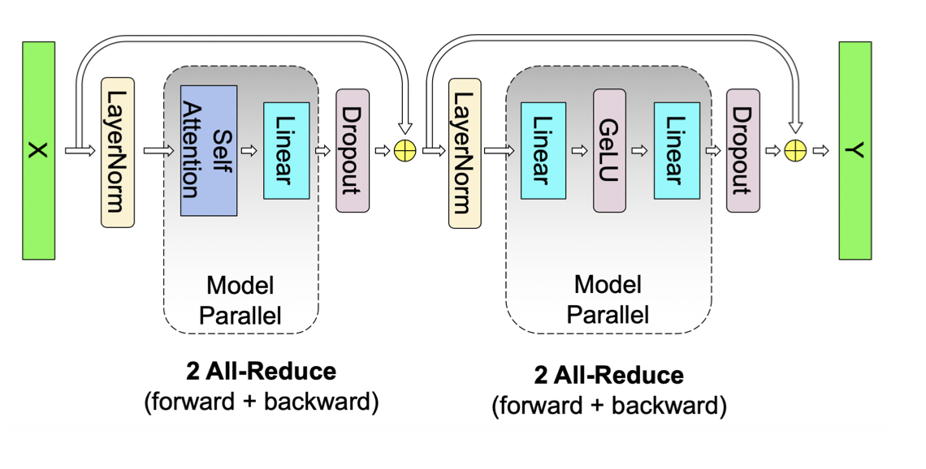
Model Parallelism (Transformer)

Slide 18
Model Parallelism (Results)

Slide 19
Model Parallelism
Architecture dependent
Highest communication volume
Parallelizes embedding layer and loss layer (GEMM + Masking)
Bad across inter-node GPUs (Communication Bottleneck)
To scale higher, use Data Parallel or Model pipelining
Highest memory efficiency
Notes:
MP reduces the granularity of the computation while also increasing the communication overhead
Model parallelism reduces the memory footprint proportional to the number of workers. Crucially, it is the only approach that reduces the activation memory for individual network layers

Slide 20
Parallelism Summary
#0
$$x_{0}$$
#1
$$x_{1}$$
$$x_{2}$$
#2
Can we combine them?
#0
$$x_{0}$$
$$x_{1}$$
$$x$$
#1
$$x_{2}$$
#0
#1
#2
$$x_{0}$$
$$x_{1}$$
$$x_{2}$$
$$x_{1}$$
$$x_{0}$$
$$x_{2}$$

Slide 21
3D Parallelism (Visualized)
DP
DP
PP
DP
PP
$$x_{0}$$
MP
PP
MP
MP
$$x_{1}$$
$$x_{2}$$

Slide 22
3D parallelism
[Bloom]

Slide 23
Mixed Precision Training
Notes:
Keep weights in FP32 because weightgrad*learning rate is too small
Training: memory is dominated by activations so it’s okay to keep this

Slide 24
Mixed Precision Training

Slide 25
Mixed Precision Training (Loss Scaling)

Slide 26
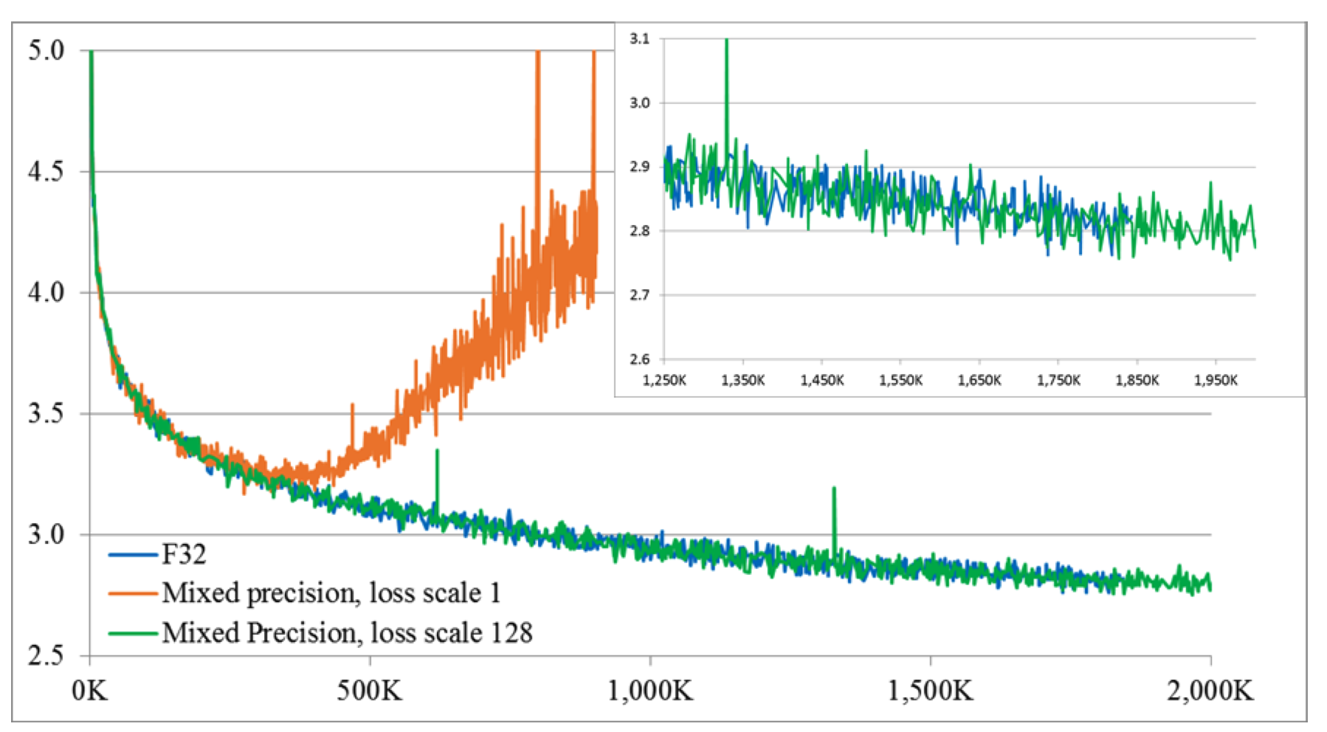
Mixed Precision Training

Slide 27
Mixed Precision Training
FP16 is faster than FP32
Reduces memory by approx. 2X
Notes:
DP has better scaling efficiency than MP because MP reduces the granularity of the computation while also increasing the communication overhead
Model parallelism reduces the memory footprint proportional to the number of workers. Crucially, it is the only approach that reduces the activation memory for individual network layers

Slide 28
Activation Checkpointing
[Ckpt]

Slide 29
Activation Checkpointing
$Ο(\sqrt{n})$ memory reduction
Ο(√𝑛) memory reduction
1 extra forward per minibatch (~33% Computation Increase)

Slide 30
ZeRO
Notes:
From Microsoft
FP16: parameters and gradients (2 +2) bytes
Optimizer States: FP32 parameters, momentum and variance: (4+4+4) bytes

Slide 31
ZeRO

Slide 32
ZeRO Example (4 Devices)

Slide 33
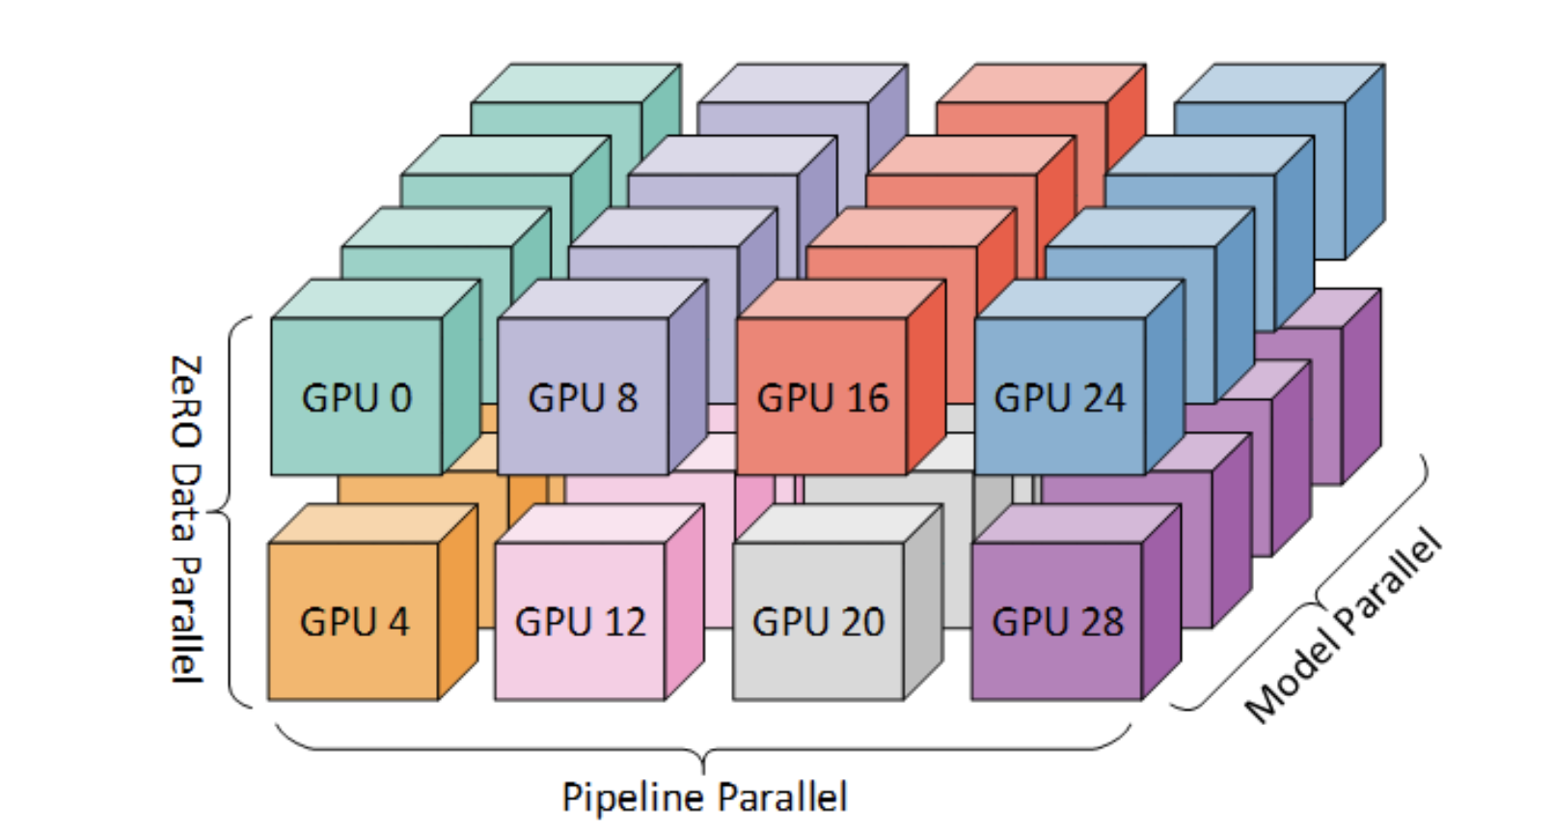
ZeRO + 3D Parallelism = DeepSpeed
[Deepspeed]
Notes:
Model parallelism has the largest communication overhead of the three strategies, and so we prioritize placing model parallel groups within a node to utilize the larger intra-node bandwidth. Here we apply NVIDIA Megatron-LM for tensor-slicing style of model parallelism. Data parallel groups are placed within a node when model parallelism does not span all the workers in a node. Otherwise, they are placed across nodes. Pipeline parallelism has the lowest communication volume, and so we can schedule pipeline stages across nodes without being limited by the communication bandwidth.

Slide 34
Appendix: ZeRO

Slide 35
Appendix: GPT-3 Scale
Notes:
180 billion parameters

Slide 36
References
[Gpipe]: https://arxiv.org/abs/1811.06965
[Pipedream]: https://arxiv.org/pdf/1806.03377.pdf
[Bloom]: https://arxiv.org/abs/2211.05100
[Megatron]: https://arxiv.org/abs/1909.08053
[Ckpt]: https://arxiv.org/pdf/1604.06174.pdf
[DeepSpeed]: https://www.microsoft.com/en-us/research/blog/deepspeed-extreme-scale-model-training-for-everyone/, https://github.com/microsoft/DeepSpeed

Slide 37
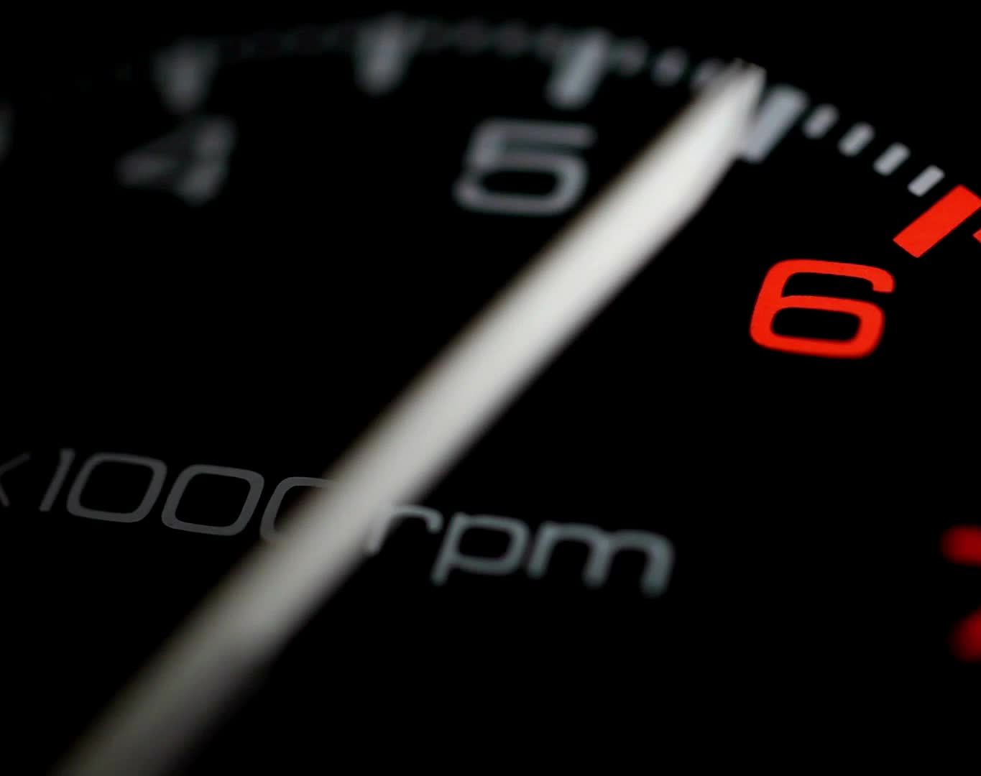
Part 2: Attention Acceleration
Matthew Yang

Slide 38
Overview
Positional Encoding
RoPE
ALiBi
Attention Inference Acceleration
Multi-Query Attention
Groupquery Attention
Attention I/O Acceleration
Flash Attention
Flash Attention v2

Slide 39
RoPE

Slide 40
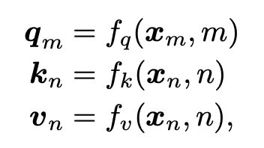
Positional Encoding Previously…
Why positional encoding?
The lack of position information in Transformers attention
Approaches in “Attention is All You Need”
Sine/cosine functions (the finalized approach)
Learned positional embeddings
Expand x_i + p_i: (x word embedding, i position, d dimension of x)
The model detects that this combination of sines/cosines means position i
Ablation study showed PE -> absolute pos learned by LR

Slide 41
RoPE Intuition
Intuition: find f, g s.t. relative position is captured
Idea in 2D: Suppose that x_m is a complex number. Rotate the complex number Wx by mθ. Then the inner product between two complex numbers captures the angle difference between them (derive)

Slide 42
RoPE Generalization
Since there is a bijection between C and R^2, we can transfer the idea of rotation to R^2 (derive rotation matrix)
We split d-dims into d/2 2D spaces so that every consecutive pair of vectors is rotated by mθ_i in R^2 --> the positional footprint of x_m

Slide 43
RoPE Generalization (cont’d)
Btw, we pick for the positional footprint
This leads to
represents a rotation of (n-m)θ_i because
Transpose = -θ (explain due to sin/cos odd/even)
Each of the d/2 sub-matrices only interacts with its counterpart (explain due to zero stays zero, and example of non-zero entry)

Slide 44
RoPE Generalization (cont’d 2)
Efficient computation of
Can we still do this for linear attention?
Yes, pull R out of phi since rotation applied before/after common choices of phi, e.g., , are the same.

Slide 45
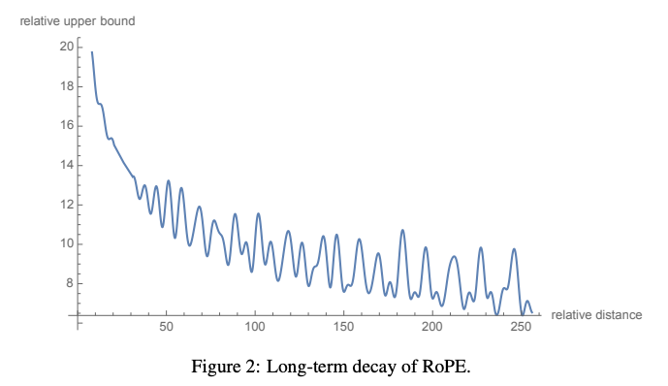
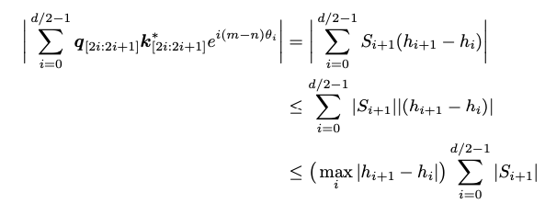
RoPE Generalization (cont’d 3)
RoPE is unlike sinusoidal encoding in that it is applied at every layer rather than just once before the encoder/decoder
A lot of mathematically motivated statements from RoPE. But at the end of the day, we just want q_m, k_n far from each other to have lower weight. The paper provides a weight decay bound

Slide 46
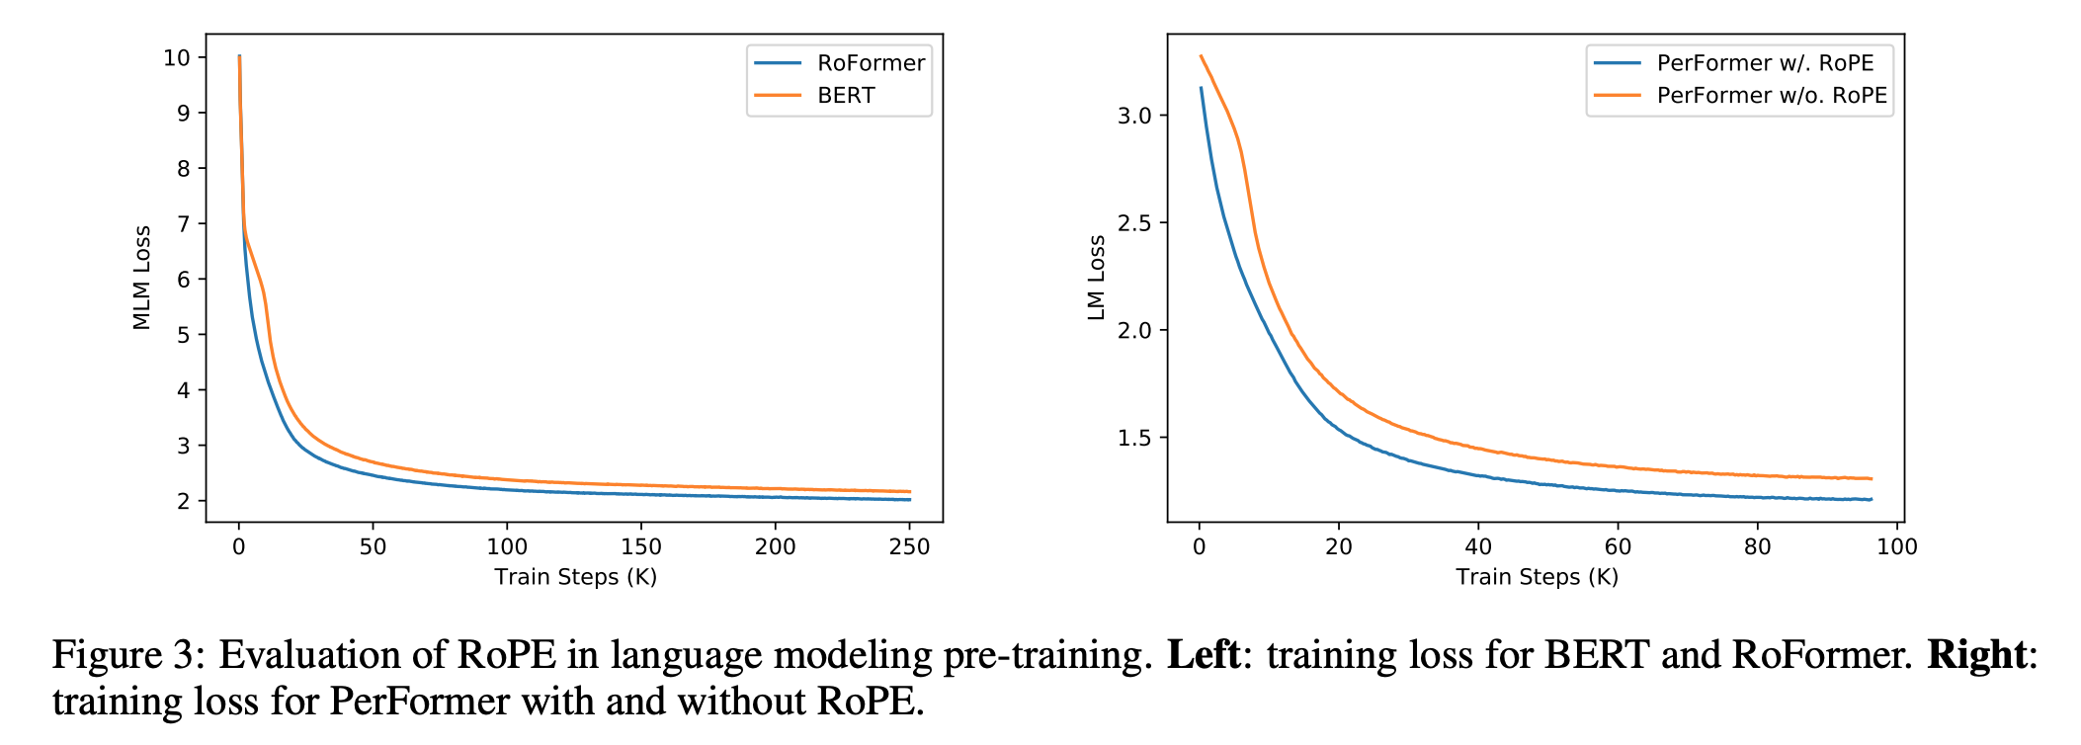
RoPE (RoFormer) Results
Translation score, fine-tuning on GLEU score
Masked LM / LM scores
Aside: used by GPT-3

Slide 47
ALiBi

Slide 48
ALiBi motivation
Models can take input lengths longer than it has seen during training:
X: n x d, W_q: d x d_q, W_k: d x d_k
(XW_q)(X_W_k)^T can be applied on arbitrarily large n without any changes to W_q / W_k
ALiBi: overcome the inability to extrapolate to sequence lengths longer than the ones seen during training
Existing approaches considered:
Sinusoidal (Attention Is All You Need)
Rotary (RoPE)
T5 Bias

Slide 49
Extrapolation in current approaches
Worst-to-best: Sinusoidal -> RoPE -> T5 Bias
T5 Bias: learned, shared bias (across heads) dependent on the distance between query and key (relative, not absolute)
T5 Bias training is twice as slow vs. the sinusoidal method
Then you might say, since L = 512 for T5 bias and L = 1024 for sinusoidal takes the same time, then we since T5 generalizes well, just train it on a shorter context!
But if we extrapolate L = 512 T5 bias to L = 1024 for inference, it still takes twice as long…

Slide 50
ALiBi mechanism
The encoding applied to a single query (note that only i positions are considered since the rest are masked)
Penalizes attention scores between distant query-key pairs, with the penalty increasing as the distance between a key and a query grows
Where m is a head-specific constant specified before training. With n heads, we set m = 1/2^(8/n)
Trainable slopes (m’s) didn’t work well
Slopes between 0 and 1, that had a higher density around 0 worked well
n x L x L (n heads) space, since each head has different m
ALiBi, unlike sinusoidal but similar to rotary, is applied at every layer

Slide 51
Perplexity
Given a LM, it can assign the probability to the sentence “a red fox”
P(a red fox) = P(a)P(red | a)P(fox | a red)
Pnorm (a red fox) = P(W)^(1/n). Here n = 3, Pnorm here = geometric mean
Perplexity(a red fox) = 1 / Pnorm(a red fox) -> lower is better

Slide 52
ALiBi vs. Sinusoidal
E.g., 1.3 billion parameter LM trained on L = 1024 tokens with ALiBi
achieves the same perplexity as a sinusoidal model on L = 2048
when both are tested on sequences of 2048 tokens
even though ALiBi is 11% faster and uses 11% less memory

Slide 53
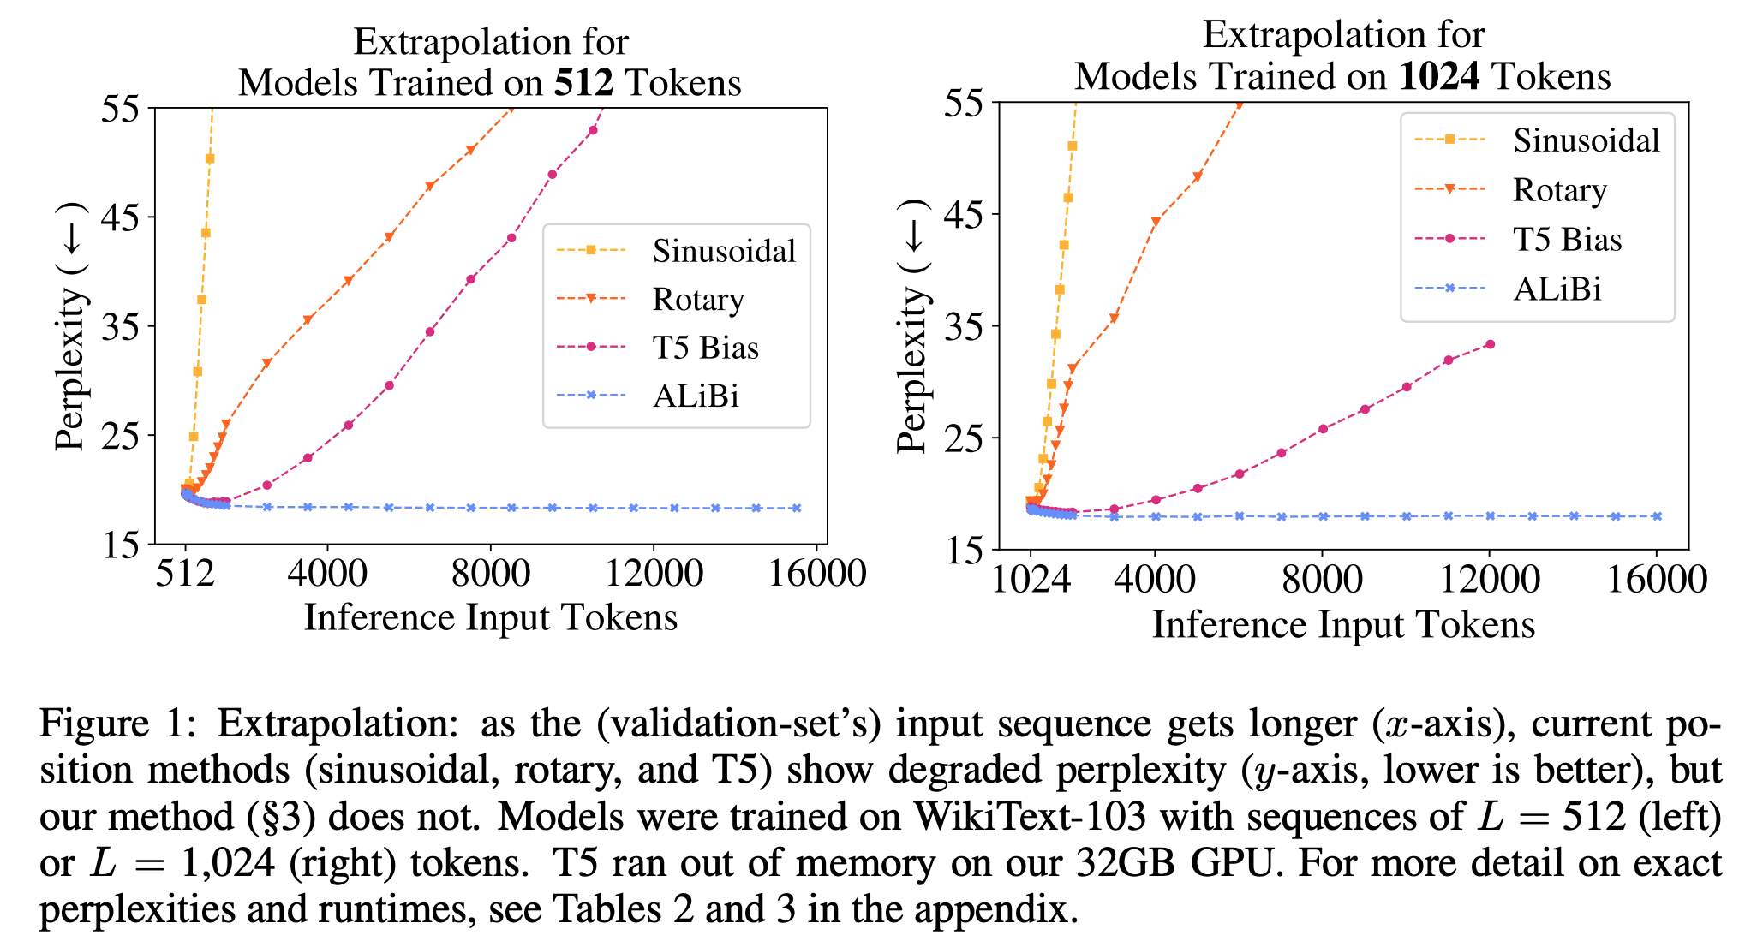
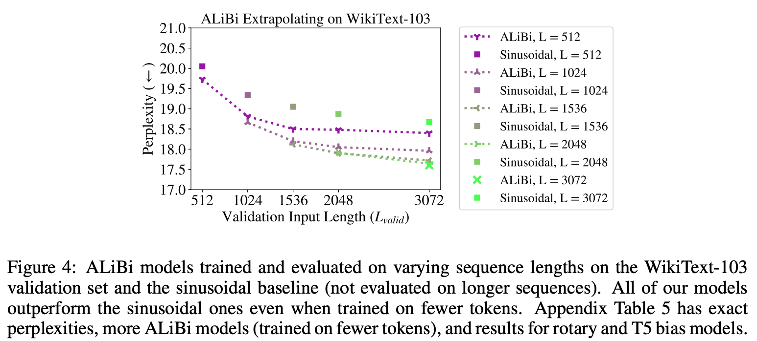
ALiBi Results (WikiText-103 + Toronto BookCorpus)

Slide 54
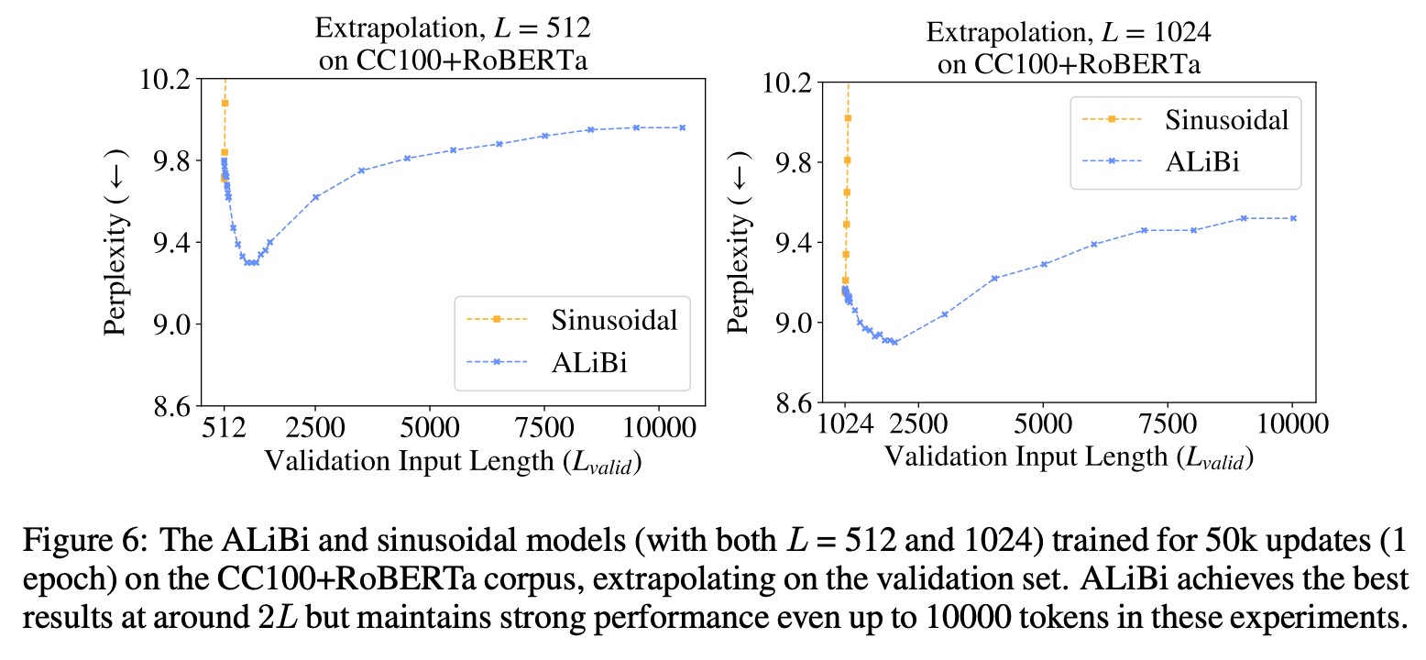
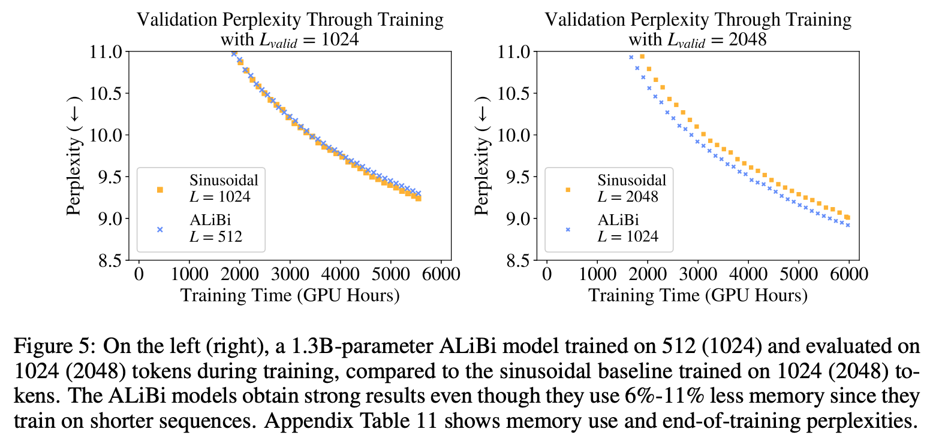
ALiBi Results (CC100 + RoBERTa corpus)

Slide 55
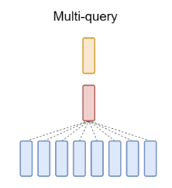
Multi-Query Attention

Slide 56
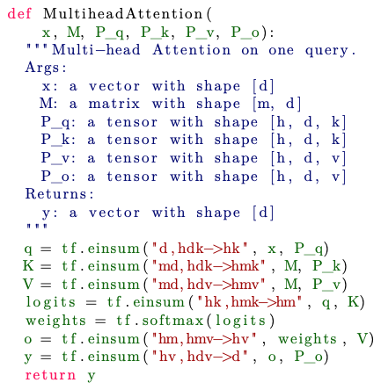
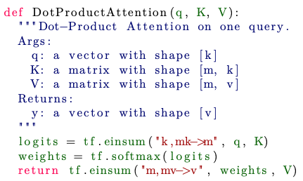
Attention Basics

Slide 57
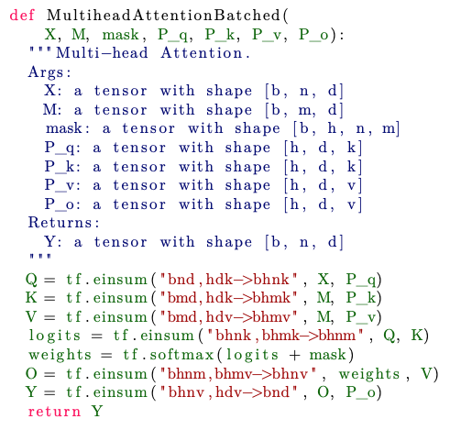
Multihead Attention During Training
Simplifying assumptions:
- m = n
- k = v = d/h
- n <= d
Total arithmetic operations: Θ(bnd^2)
Total memory accesses: Θ(bnd (XMQKVOY)+ bhn^2 (logits/weights)
+ d^2 (P_qkvo))
Memory-to-operations ratio: O(1/d + 1/k + 1/bn) = O(1/k + 1/bn) << 1
^ This low ratio is necessary for good performance on GPU,
Where computational compacity can be two orders of
magnitudes larger than memory bandwidth
Op: bndkh, Mem: bhnk
Op: bmdkh, Mem: bhmk
Op: bmdvh, Mem: bhmv
Op: bhnkm, Mem: bhnm
Op: bhnm, Mem: bhnm
Op: bhnmv, Mem: bhnv
Op: bhnvd, Mem: bnd

Slide 58
Multihead Attention During Inference
Simplifying assumptions:
- m depends on which call we’re at
- k = v = d/h
- n <= d
Across n calls… (to complete an entire sentence)
Total arithmetic operations: Θ(bnd^2) again
Total memory accesses: Θ(bdn^2 (KV) + nd^2(P_qkvo))
Memory-to-operations ratio: Θ(n/d + 1/b)
^ approx. 1 when n = d OR b = 1 -> mem becomes BOTTLENECK
Resolving 1/b easy, n/d non-trivial, came from reloading KV each step of the way
Note: in an efficient implementation, the ratio is Θ(1/d + 1/b)
Op: bhdk, Mem: bhk
Op: bhdk, Mem: bhk(m+1)
Op: bhdv, Mem: bhv(m+1)
Op: bhk(m+1), Mem: bh(m+1)
Op: bh(m+1), Mem: bh(m+1)
Op: bhmv, Mem: bhv
Op: bhdv, Mem: bd

Slide 59
Keeping n/d low
Limit n, the sequence length
Reduce the number of positions being attended to to a local neighborhood, thus reducing K/V
Multi-query Attention: keep the same K/V across different heads

Slide 60
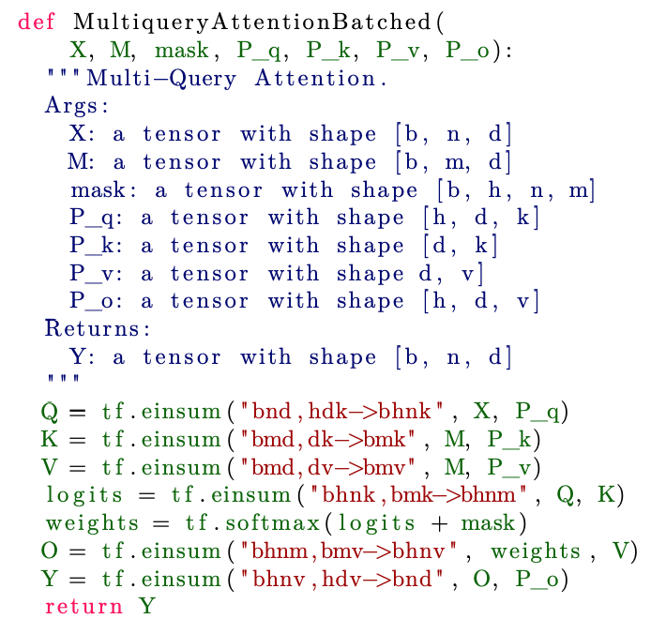
Multiquery Attention During Training
Total arithmetic operations: Θ(bnd^2)
Total memory accesses: Θ(bnd (XMQOY)+ bhn^2 (logits/weights) + d^2 (P_qkvo))
Memory-to-operations ratio: O(1/k + 1/bn) << 1
Op: bndkh, Mem: bhnk
Op: bmdk, Mem: bmk
Op: bmdv, Mem: bmv
Op: bhnkm, Mem: bhnm
Op: bhnm, Mem: bhnm
Op: bhnmv, Mem: bhnv
Op: bhnvd, Mem: bnd

Slide 61
Multiquery Attention During Inference
Across n calls… (to complete an entire sentence)
Total arithmetic operations: Θ(bnd^2) again
Total memory accesses: Θ(bnd (xqoy) + bkn^2 (KV) + d^2(P_qkvo))
Memory-to-operations ratio: Θ(1/d + n/dh + 1/b), n/d reduced by a factor of h
Op: bhdk, Mem: bhk
Op: bdk, Mem: bk(m+1)
Op: bdv, Mem: bv(m+1)
Op: bhk(m+1), Mem: bh(m+1)
Op: bh(m+1), Mem: bh(m+1)
Op: bhmv, Mem: bhv
Op: bhdv, Mem: bd

Slide 62
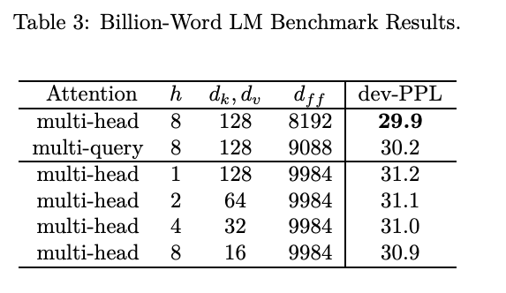
Multiquery Results
Why only the speed-up for the decoder? Because for decoders, we iteratively reload the K/V’s during inference. Encoders don’t have this problem/bottleneck, so we don’t apply it to them.

Slide 63
The Problem with Multiquery Attention
We’ll need to re-train existing models just for faster inference
Solution: Adapt multihead attention (MHA) to multiquery attention (MQA) with a small fraction of the original training compute with Uptraining
Quality degradation and training instability
Solution: Groupquery Attention (GQA)

Slide 64
Group-Query Attention

Slide 65
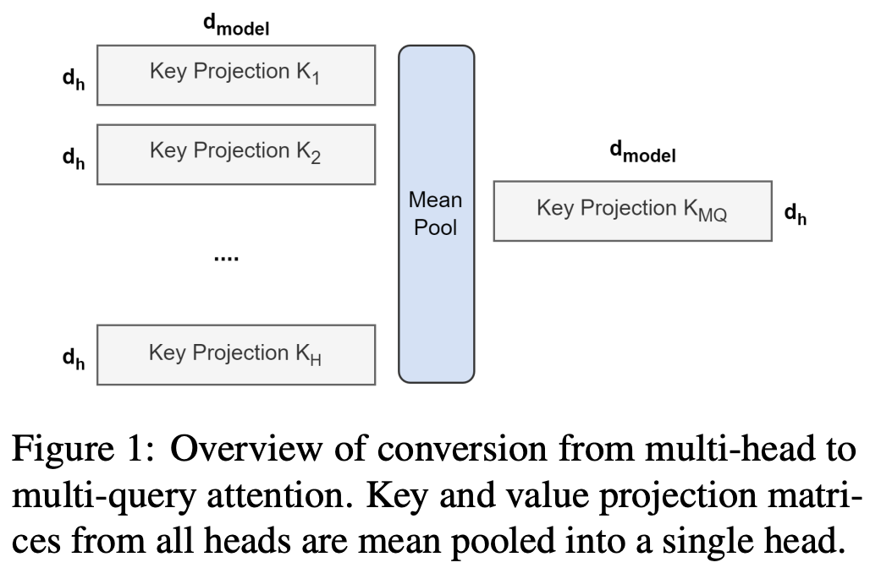
Uptraining
Key and value projection matrices (P_kv) are mean pooled into a single projection matrix
Works better than selecting one key/value projection matrix
Or randomly initializing the projection matrix
The pooled projection matrix is then trained for α = 5% of its original training steps

Slide 66
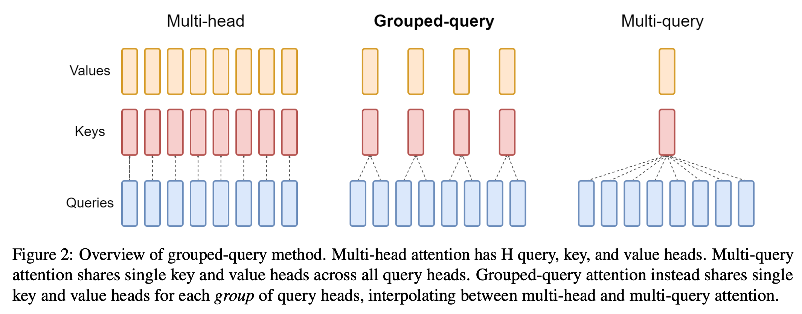
Groupquery Attention
GQA is the natural middle of MQA and MHA: heads are divided into G groups, with each group sharing a single key and value head
When converting MHA to GQA, we mean pool each group’s key/value heads into a single key/value head, and train for α steps

Slide 67
Groupquery Attention (cont’d)
Recall that across n calls of inference… (to complete a sentence)
Total arithmetic operations: Θ(bnd^2)
Total memory accesses: Θ(bdn^2 (KV) + nd^2(P_qkvo))
So larger MHA models (with larger d) already suffer more from ops than mem, which reduces the n/d ratio, as desired
-> MQA might be too extreme -> GQA better
In standard sharding, the single key/value head will be replicated once for each model partition
GQA removes this waste
GQA, like MQA, is for reducing the reloading of K, V during decoder inference, and thus is not applied to encoder self-attention layers

Slide 68
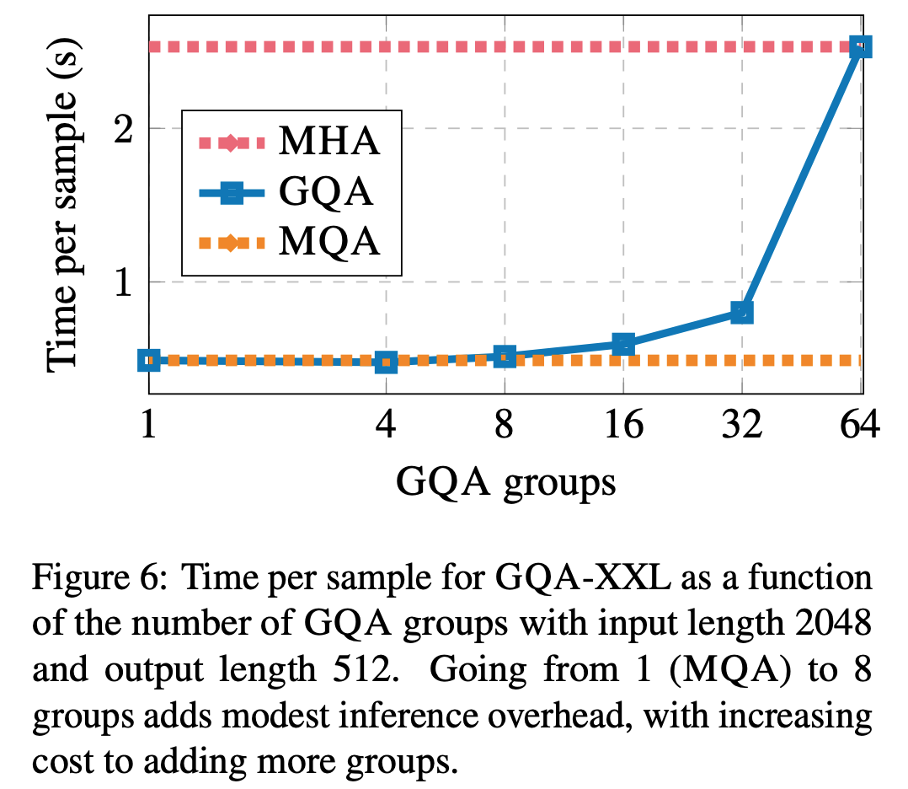
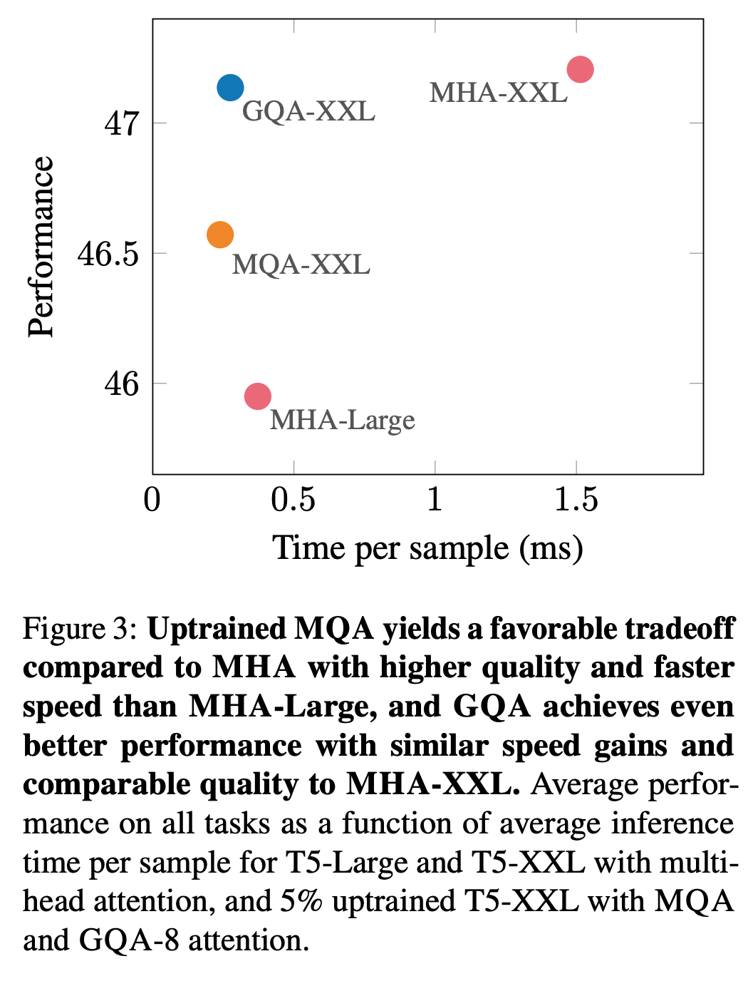
Groupquery Attention Results

Slide 69
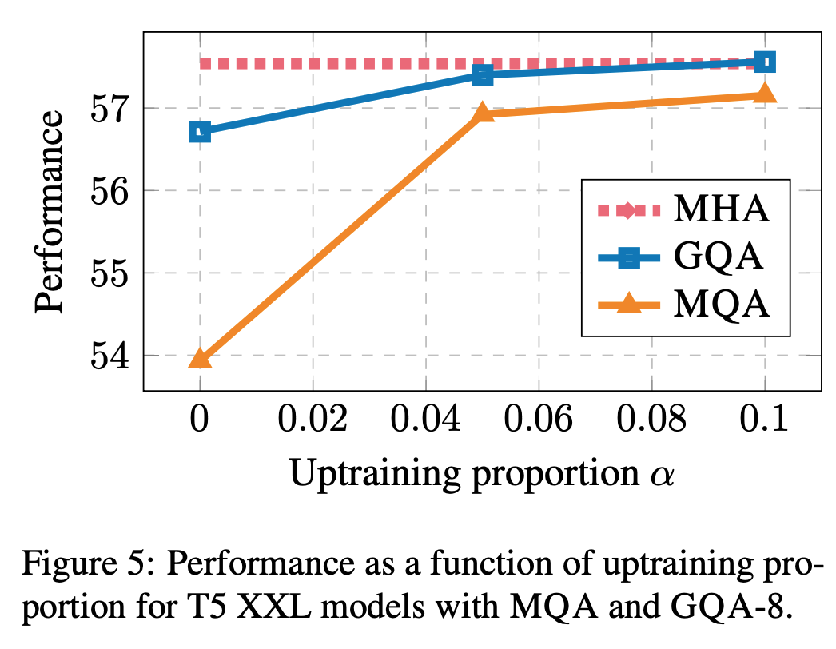
Uptraining Results

Slide 70
Flash Attention

Slide 71
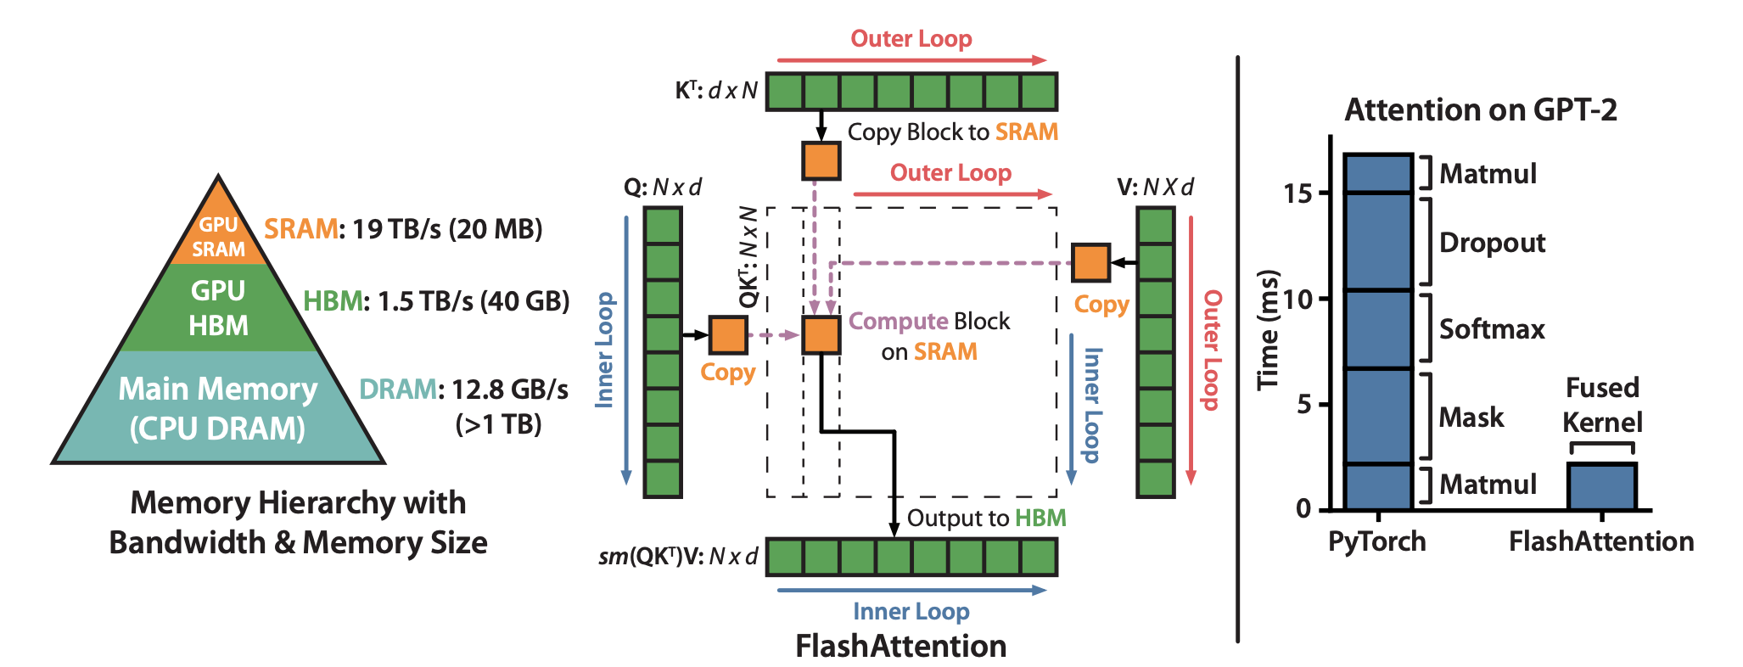
Previous Attention Speedups
Speed up attention with sparse/low-rank approximation
But Flash Attention speeds things up by reducing reads/writes to slow memory (high bandwidth memory, or HBM) and deferring them to fast memory (on-chip SRAM), without approximation

Slide 72
GPU basics
A100 GPU, a standard (SOTA ?) GPU
40 – 80GB of HBM, 1.5-2.0TB/s
192KB of SRAM, 19TB/s
SRAM are much smaller, but much faster
GPUs have many threads to execute an operation (called a kernel). Each kernel loads inputs from HBM to registers and SRAM, computes, then writes outputs to HBM
Operations are either (depending on op-to-mem-access ratio)
Compute-bound: e.g., matrix multiply, convolution
Memory-bound: e.g., activation, dropout, sum, softmax, batch norm

Slide 73
Standard Attention
Matrix dimensions
Storing takes O(N^2) memory
Often N >> d (e.g., GPT-2, N = 1024, d = 64)
We can speed up the memory-bound operations with Flash Attention

Slide 74
Standard Attention (cont’d)
Load Q, K by blocks from HBM, compute S = QK^T
Write S to HBM
Read S from HBM, compute P = softmax(S)
Write P to HBM
Load P and V from HBM, compute O = PV
Write O to HBM
Return O

Slide 75
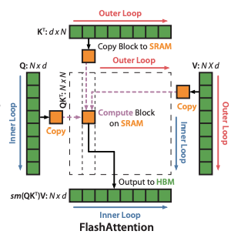
Flash Attention Forward Pass
Tiling so that everything fits
Re-computation for softmax
For a single row,
m(x) = max x_i f(x) = exp(x – m(x)) l(x) = sum(f(x)) softmax(x) = f(x) / l(x)
Now for [x1 x2]concatenated into the same row:
m(x) = m([x1 x2]) = max(m(x1), m(x2)) f(x) = [exp(m(x1)-m(x))f(x1) exp(m(x2)-m(x))f(x2)]
l(x) = l([x1 x2]) = exp(m(x1)-m(x))l(x1) + exp(m(x2)-m(x))l(x2) softmax(x) = f(x) / l(x)

Slide 76
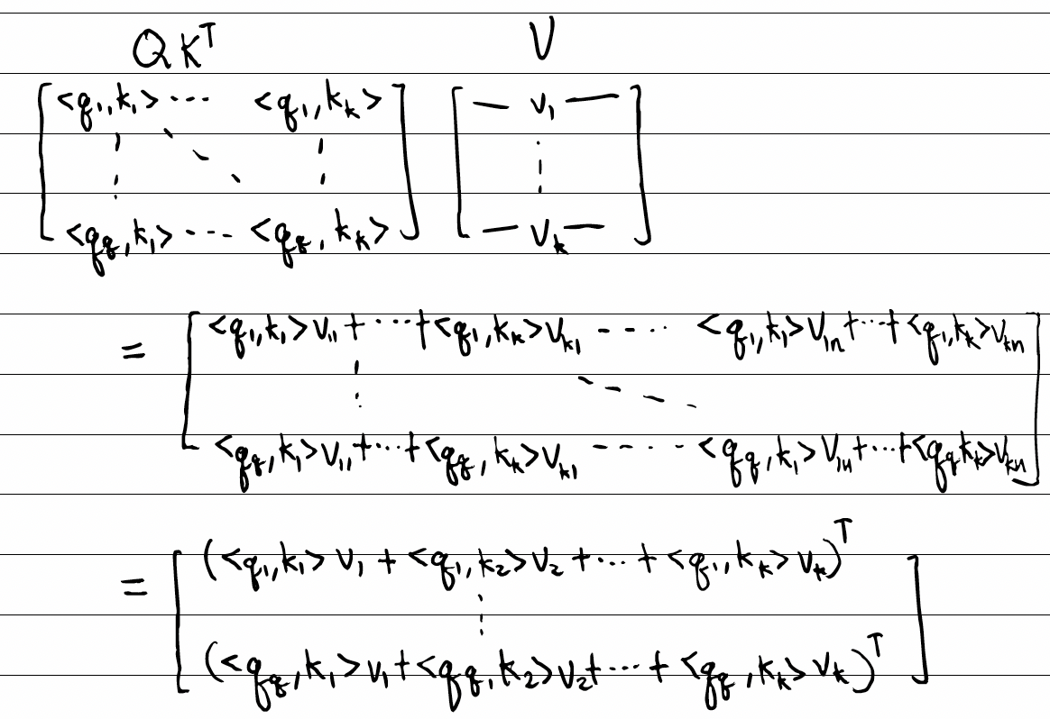
Flash Attention (cont’d)
For loop on Kj, Vj
Load Kj, Vj from HBM to SRAM
For loop on Qi, Oi
Load Qi, Oi, li, mi from HBM to SRAM
On chip, ompute Sij = QiKj^T
On chip, compute mij = rowmax(Sij)
Pij = exp(Sij - mij)
lij = rowsum(Pij)
On chip, compute mi' = max(mi, mij)
li’ = exp(mi – mi’)li + exp(mij – mi’)lij
Write Oi <- diag(li’)^-1(diag(li)exp(mi-mi’)Oi + exp(mij – mi’)PijVj) to HBM
li <- li’, mi <- mi’
Return O

Slide 77
Flash Attention Guarantees
Flash Attention requires O(N) additional memory
Naïve vs. Flash Attention HBM accesses
Naïve: Nd+N^2 HBM accesses
Flash Attention: N^2d^2M^-1 HBM accesses
Note: N^2d^2M^-1 comes from Q/O, read/written T_cNd times
In terms of memory access complexity, there is nothing better under mild assumptions in terms of N, d, and M

Slide 78
Block-Sparse Flash Attention
Block-Sparse: mask QK^T (only keep certain blocks)
For ease of integration with Flash Attention, we want each block of the mask M to be all 1s/0s
Implementation in Flash Attention: just skip zero blocks! The 2nd term that depends on Q/O will take s% of the previous number of HBM accesses since the number of passes on Q is reduced in the same ratio
Nd + N^2d^2M^-1s HBM accesses

Slide 79
Flash Attention Results

Slide 80
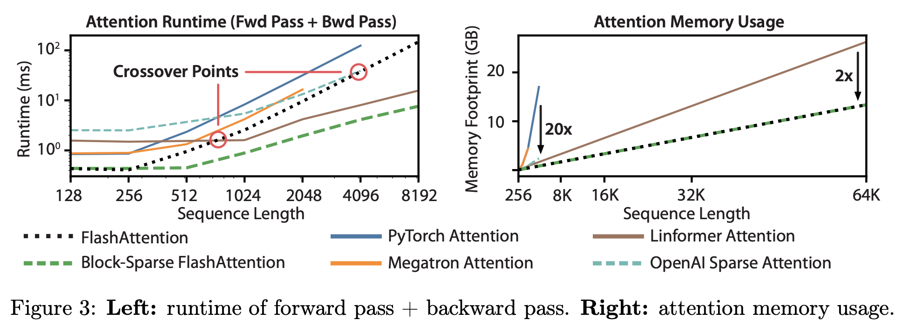
Flash Attention Results (cont’d)

Slide 81
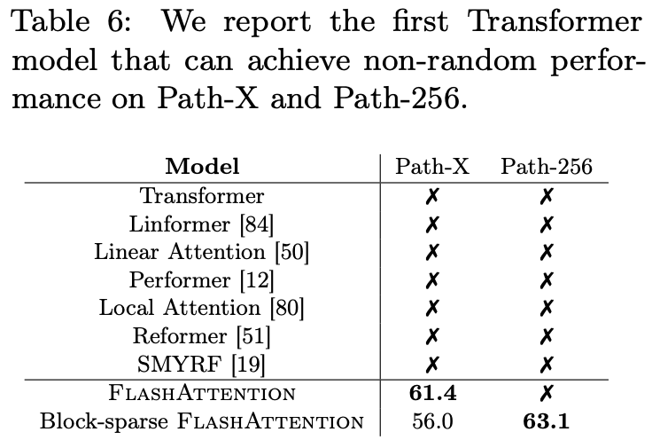
Flash Attention Results (cont’d 2)
Path-X: 16K context, Path-256 64K context
Limitations
Needed to write Flash Attention in CUDA (lack of PyTorch support for fine-grained control of memory access)
Other IO-Aware DL outside of Attention
Multi-GPU Flash Attention

Slide 82
Flash Attention v2

Slide 83
Flash Attention v2
Reduce non-matmul FLOPs
From Oi <- diag(li’)^-1(diag(li)exp(mi-mi’)Oi + exp(mij – mi’)PijVj)
To Oi <- exp(mi-mi’)Oi + exp(mij – mi’)PijVj
And multiplying by diag(li)^-1 at the end
Causal masking in LM: if we mask the block of S_ij = Q_iK_j anyway, don’t even bother calculating it

Slide 84
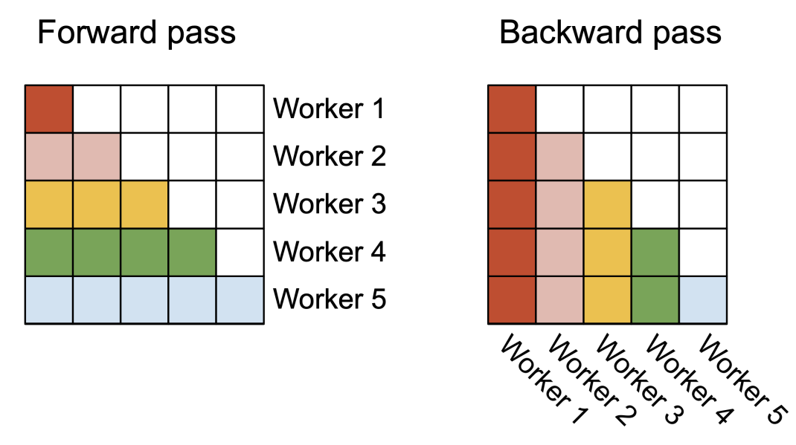
Flash Attention v2 (cont’d)
Parallelism: in v2, Q/O is on the outside loop, and K/V is the inner. The outside loop is parallelizable as it writes to different O blocks
In the backward pass, K/V is on the outside loop. Thus we can parallelize as follows:

Slide 85
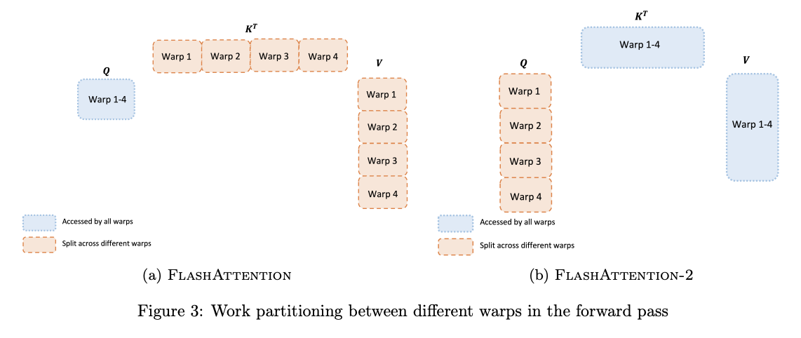
Flash Attention v2 (cont’d 2)
Warp Partitioning: split-Q rather than split-KV
Within each thread block, threads are grouped into warps (32 threads)
So that warps don’t have to communicate at the end to aggregate (sum up) the results

Slide 86
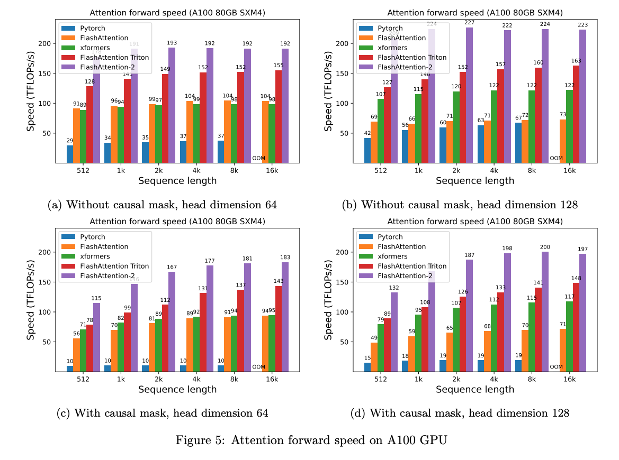
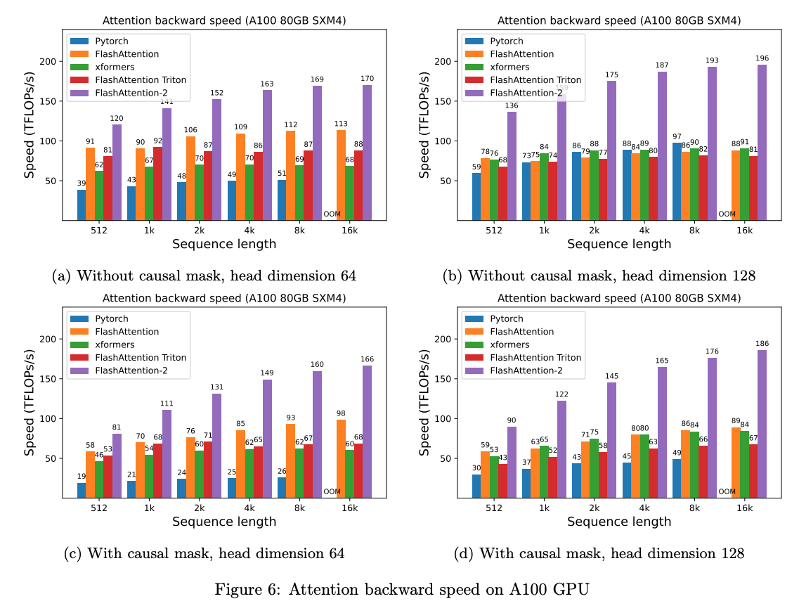
Flash Attention v2 Results

Slide 87
References
Attention is All You Need (https://arxiv.org/pdf/1706.03762.pdf)
RoPE (https://arxiv.org/pdf/2104.09864.pdf)
ALiBi (https://arxiv.org/pdf/2108.12409.pdf)
Multi Attention (https://arxiv.org/pdf/1911.02150.pdf)
Group Attention (https://arxiv.org/pdf/2305.13245v2.pdf)
Flash Attention (https://arxiv.org/pdf/2205.14135.pdf)
Flash Attention-2 (https://arxiv.org/pdf/2307.08691.pdf)
Investigation on what positional embeddings learn (https://aclanthology.org/2020.emnlp-main.555.pdf)

