Slide 1
Lecture 10: Scaling Laws
Presenters: Carter Blair and Cole Wyeth

Slide 2
Outline
Scaling Laws (40 min)
Kaplan et al., 2020 (OpenAI)
Kaplan et al., 2021 (OpenAI – Scaling for Transfer)
Hutter, 2021 (DeepMind)
Hoffman et al., 2022 (DeepMind)
Emergent Abilities (20 min)
Wei et al., 2022
Schaeffer et al., 2023
Complicating Scaling Laws (20 min)
Wei et al., 2022 (U-Shaped)
Tay et al., 2022

Slide 3
Motivation
Scientific problem: How does model performance change with increasing scale?
Engineering importance: Training frontier models costs millions of dollars
Safety importance: Models are black boxes with often unexpected capabilities

Slide 4
Scaling Laws

Slide 5
Scaling Laws for Neural Language Models, Kaplan et al. 2020
Main RQ: What is the relationship between compute, data, the number of parameters, and performance?

Slide 6
Kaplan et al., 2020 - Main Idea
Train models of vastly different scale (data, compute, params) and find the loss is predictably related to the scale
Offer a predictive framework
They make certain recommendations based on the scaling laws
Ratio between parameters and data
Don’t train to convergence
Critical batch size

Slide 7
Kaplan et al., 2020 - Main Results
Performance depends strongly on scale, weakly on model shape
Performance scales with each of compute (C), data (D), and # of parameters (N) when not bottlenecked by the other two
Performance improves predictably if we scale N and D in tandem, but suffers diminishing returns if N or D is held fixed
Training curves are predictable, so we can (roughly) predict the final loss by extrapolating the early part of the training curve, regardless(ish) of model size
We can predict how well the model will perform on OOD data by looking at the training validation accuracy
Large models are more sample efficient than small ones
Convergence is inefficient!
The ideal batch size ($B_{crit}$) is roughly a power of the loss only

Slide 8
Kaplan et al., 2020
Performance mostly depends on scale
$d_{model}$: dimension of residual stream
$d_{ff}$: dimension of intermediate feed forward layer
$n_{layer}$: number of layers
$n_{heads}$: number of attention heads per layer
Hold total non-embedding parameter count $N$ fixed
”This was simplest for the case of $n_{heads}$” (right)
When varying $n_{layer}$, we simultaneously varied $d_{model}$ while keeping $N≈12n_{layer}d_{model}^{2}$ fixed (middle)
Similarly, to vary $d_{ff}$ at fixed model size we also simultaneously varied the $d_{model}$ parameter (left)

Slide 9
Kaplan et al., 2020
A Power Law: ${y=(cx)}^{a}$
Linear on a log scale: $ln⁡⁡\left(y\right)=a \text{ln}\left(x\right)+a\ln{(c)}$

Slide 10
Kaplan et al., 2020
Performance has a power-law relationship with each of the three scale factors N, D, C when not bottlenecked by the other two, with trends spanning more than six orders of magnitude

Slide 11
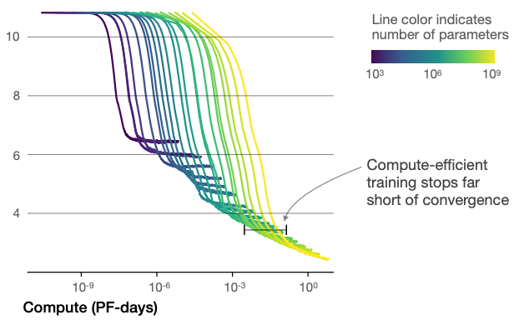
Kaplan et al., 2020
Training curves follow predictable power-laws whose parameters are roughly independent of the model size.
By extrapolating the early part of a training curve, we can roughly predict the loss that would be achieved if we trained for much longer.

Slide 12
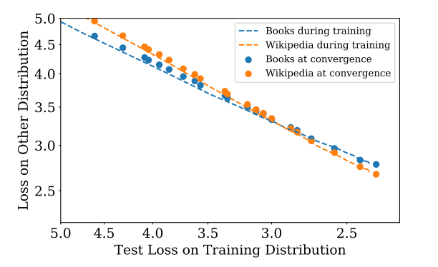
Kaplan et al., 2020
When we evaluate models on text with a different distribution than they were trained on, the results are strongly correlated to those on the training validation set with a roughly constant offset in the loss

Slide 13
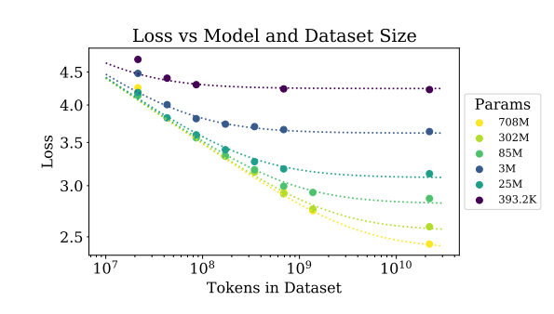
Kaplan et al., 2020
Large models are more sample-efficient than small models, reaching the same level of performance with fewer optimization steps (Left) and using fewer data points (Right).

Slide 14
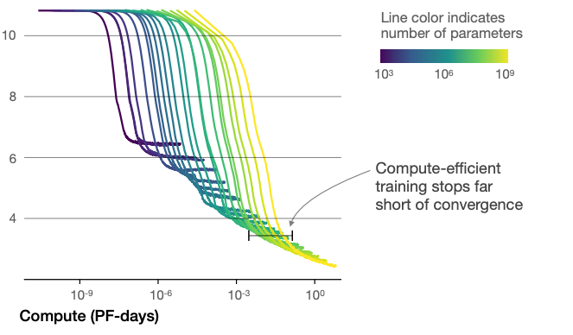
Kaplan et al., 2020
Convergence is inefficient
When working within a fixed compute budget C but without any other restrictions on the model size N or available data D, we attain optimal performance by training very large models and stopping significantly short of convergence.
For example, imagine you have${10}^{−4}$ PF-days of compute
Smaller model trained to convergence achieve a loss of ~ 6
Larger models achieve a loss <5

Slide 15
Kaplan et al., 2020
Performance improves predictably as long as we scale up N and D in tandem, but enters a regime of diminishing returns if either N or D is held fixed while the other increases.
The performance penalty depends predictably on the ratio ${N^{0.74}}/D$
every time we increase the model size 8x, we only need to increase the data by roughly 5x to avoid a penalty.
Loss over loss with inf. data
Params per data

Slide 16
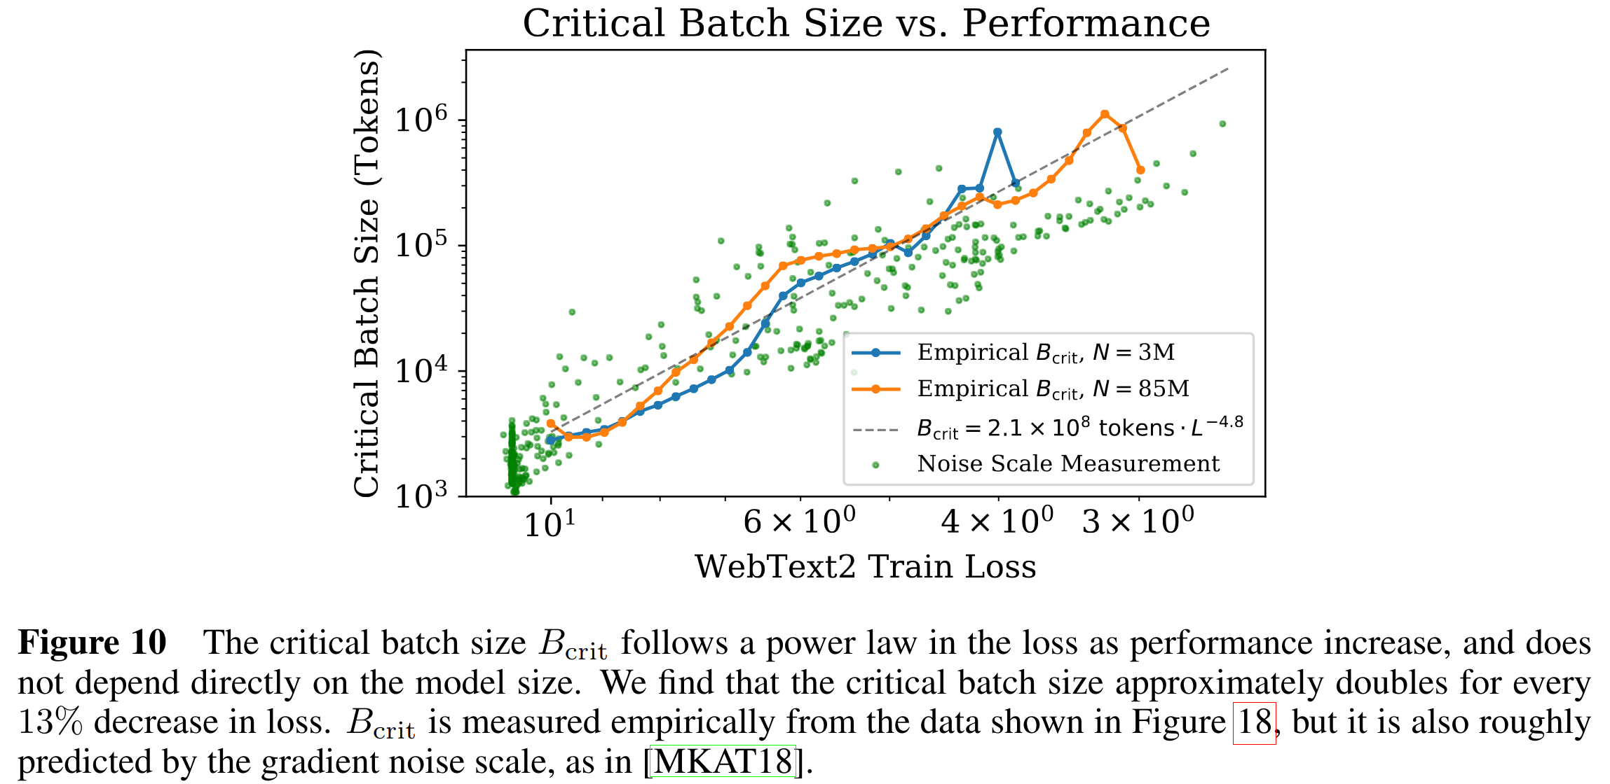
Kaplan et al., 2020
The ideal batch size for training these models is roughly a power of the loss only, and continues to be determinable by measuring the gradient noise scale [MKAT18]; it is roughly 1-2 million tokens at convergence for the largest models we can train. (Section 5.1)

Slide 17
Kaplan et al., 2020
Takeaways
Cross-entropy loss scales predictably with model scale
Model shape matters far less than scale
The amount of embedding parameters doesn’t really matter
We can predict the final loss of a model based on the early part of the training curve
Training models to convergence is compute inefficient
The ideal batch size is a power of loss only and does not depend on model size

Slide 18
Scaling Laws for Transfer, Kaplan et. al. 2021
Main RQ: What are the empirical scaling laws for transfer learning?

Slide 19
Kaplan et. al. 2021 – Main Results
Pretraining is very valuable in the low-data regime
Quantify "effective data transferred" with (yet) another power law
Conjectured measurement of similarity between datasets
Investigate "ossification": Can pretraining hurt performance?

Slide 20
Kaplan et. al. 2021

Slide 21
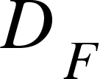
Kaplan et. al. 2021
= Fine tuning data
N = non-embedding model parameters

Slide 22
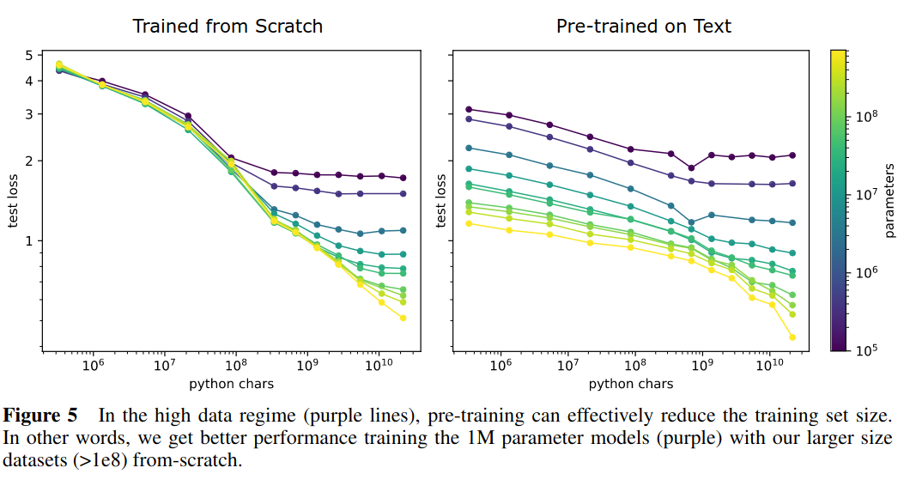
Kaplan et. al. 2021
"Ossification": when pre-training hurts performance
This can take place when models are small and data is plentiful

Slide 23
Kaplan et. al. 2021
Takeways
Scaling laws are pervasive in transfer as well as training
Pretraining is very useful when finetuning data is scarce
Pretraining can hurt when finetuning data is plentiful relative to model size

Slide 24
Learning Curve Theory, Hutter 2021
Main RQ: Can we mathematically replicate the observed neural scaling power laws?

Slide 25
Hutter 2021 – Main Results
Learning a finitely-parameterized model usually leads to power laws with exponents ½ and 1
Attempts to explain power law exponents in Kaplan et. al. 2020 with (countably) infinitely-parameterized models
An alternative is to scale model size up with data, but this is not pursued
Later, Hoffman et. al. 2022 obtained ordinary exponent ½ scaling laws after all (but by scaling models with data!)

Slide 26
Training Compute Optimal Large Language Models, Hoffmann et. al. 2022
Main RQ: What is the optimal tradeoff between model size and number of tokens given a fixed compute budget?

Slide 27
Hoffman et. al. 2022 – Main Results
Large languages models are significantly undertrained (perhaps because of scaling strategies from Kaplan et. al., 2022)
Model size and number of training tokens should be scaled equally
Introduces the Chinchilla model and finds that it outperforms the much larger Gopher by training on more tokens.

Slide 28
Hoffman et. al. 2022
A better learning rate schedule leads to experimental results drastically different from Kaplan et. al., 2020
". . . we find that setting the learning rate schedule to approximately match the number of training tokens results in the best final loss regardless of model size." (Hoffman et. al. 2022)

Slide 29
Hoffman et. al. 2022
Goal is to find optimal parameter count $N_{opt}$and token count $D_{opt}$ given a fixed compute budget C
The authors tried three approaches to estimating these values

Slide 30
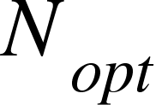
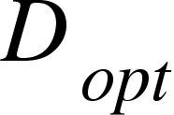
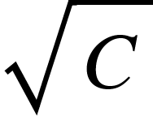
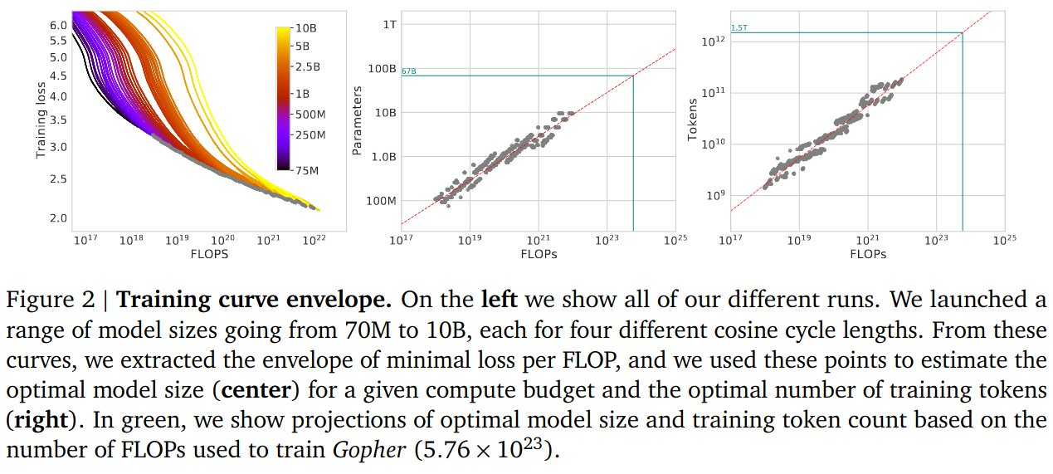
Hoffman et. al. 2022 – Approach 1
Trained 4 models for each parameter count N, trying a range of horizons for learning rate decay
Use the parameter and training token counts of the lowest loss run for each FLOP count as and estimates
Fit and separately: both are proportional to

Slide 31
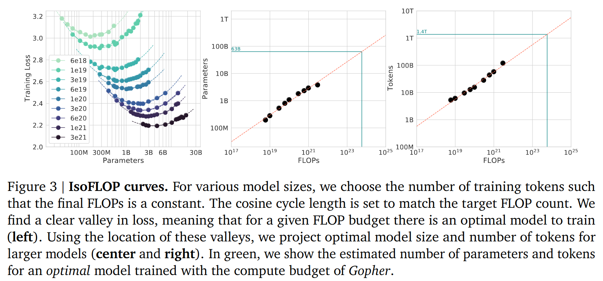
Hoffman et. al. 2022 – Approach 2
Fits the final training loss
Exponents are a = 0.49 and b = 0.51 for and resp.

Slide 32
Hoffman et. al. 2022 – Approach 3
Fit an explicit model by minimizing Huber loss
Exponents are a = 0.46 and b = 0.54 for and resp.

Slide 33
Hoffman et. al. 2022
The authors conclude that with Gopher's compute budget, a smaller model should have been trained on more tokens
They train Chinchilla, a 70 billion parameter model, on 1.4 trillion tokens
Chinchilla's smaller size reduces inference and finetuning time

Slide 34
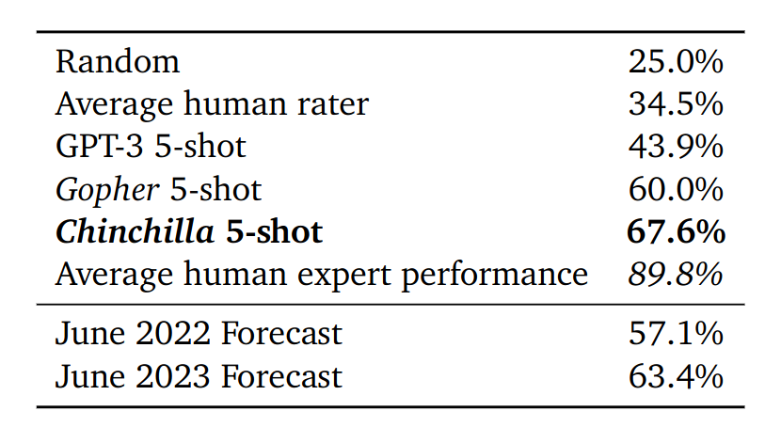
Hoffman et. al. 2022

Slide 35
Hoffman et. al. 2022
Takeaways
Data and parameters should be scaled together
Models still shouldn't be trained all the way to convergence
Choose your learning rate schedule carefully!

Slide 36
Emergent Abilities

Slide 37
Emergent Abilities of Large Language Models, Wei et al, 2022
Main RQ: A survey and discussion of emergent abilities and their causes

Slide 38
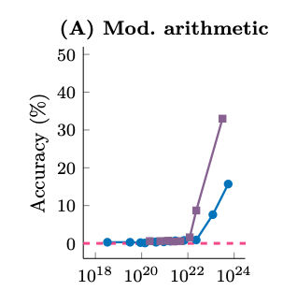
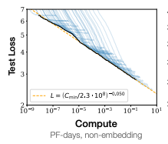
Emergent Abilities of Large Language Models, Wei et al, 2022
Scaling Laws: A predictable and smooth relationship between scale (FLOPs or params.) and cross-entropy loss (left)
Emergent abilities: Abilities/performance metrics that are a discontinuous function of scale (right)
Training FLOPs

Slide 39
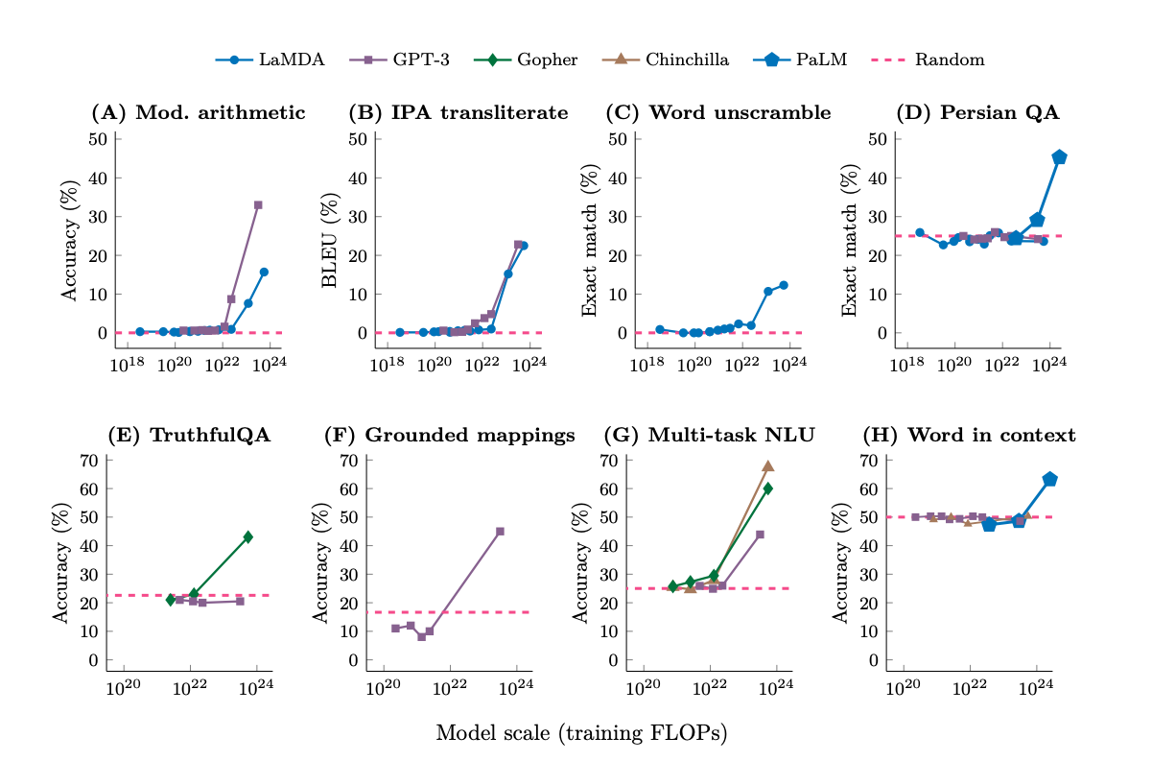
Emergent Abilities of Large Language Models, Wei et al, 2022
Examples of emergent abilities
Tasks from BIG-Bench

Slide 40
Emergent Abilities of Large Language Models, Wei et al, 2022
A closer look at BIG-Bench
Exact string matching
Are the metrics hiding information? (I.e. not giving partial credit?)
Maybe not?
Emergent abilities are observed on classification tasks too
Target Output | Model Output | Score
Hello | laskjdfal89u09u0 | 0
Hello | Hellu | 0
Hello | Hello | 1

Slide 41
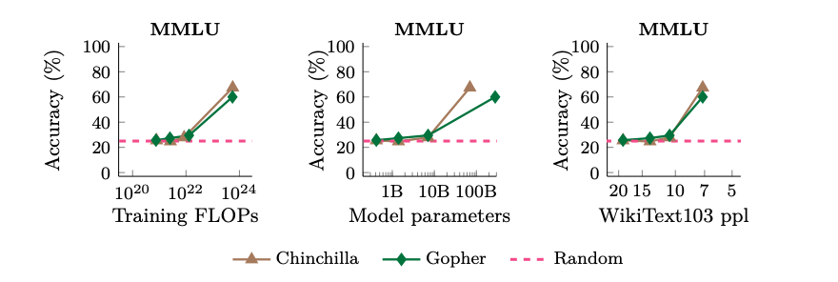
Emergent Abilities of Large Language Models, Wei et al, 2022
Perplexity (how surprised a model is by real text) may relate to emergent abilities differently
Word Index: | 0 | 1 | 2 | 3
Word: | The | quick | brown | fox
High ppl: | 0.01 | 0.01 | 0.03 | 0.05
Low ppl: | 0.4 | 0.95 | 0.97 | 0.99

Slide 42
Emergent Abilities of Large Language Models, Wei et al, 2022
Takeaways:
Overall, emergent abilities should probably be viewed as a function of many correlated variables.
This analysis does not explain why downstream metrics are emergent or enable us to predict the scale at which emergence occurs.
Even though we can predict the loss with model scale, we can’t use the loss to predict what abilities a model will have

Slide 43
Schaeffer et. al. 2023, Are Emergent Abilities of Large Language Models a Mirage?
Main RQ: Is the apparently sudden emergence of new abilities in large language models actually a result of the metrics chosen to measure them?

Slide 44
Schaeffer et. al. 2023 – Main Results
Nonlinear or discontinuous metrics can appear to show sudden changes in ability where linear or continuous metrics do not
Explains emergence on published benchmarks
Produces apparent "emergent abilities" by changing the choice of metric

Slide 45
Schaeffer et. al. 2023
Over 92% of emergent abilities on BIG-Bench are on tasks measured by one of the following metrics:
Multiple Choice Grade is discontinuous
What about Exact String Match?
$$\text{Multiple} \text{Choice} \text{Grade} ≝\left\{\begin{aligned}1 \text{if} \text{highest} \text{probability} \text{mass} \text{on} \text{correct} \text{option} \\ 0 \text{otherwise}\end{aligned}\right.$$
$$\text{E}\text{xact} \text{String} \text{Match} ≝\left\{\begin{aligned}1 \text{if} \text{output} \text{string} \text{exactly} \text{matches} \text{target} \text{string} \\ 0 \text{otherwise}\end{aligned}\right.$$

Slide 46
Schaeffer et. al. 2023
As a theoretical example, requiring several tokens to be perfectly matched causes a sharp transition in performance:
A poor model might require many samples to observe nonzero success
But token edit distance is not so sharp:
$$ℒ_{CE}(N)={\left(\frac{N}{c}\right)}^{α}$$
$$ℒ_{CE}\left(N\right)=−\log{{\hat{p}}_{N}(v^{∗})}$$
$$p(\text{single} \text{token} \text{correct})= e^{−ℒ_{CE}(N)}=e^{−{\left(N/c\right)}^{α}}$$
$$\text{Accuracy}\left(N\right)≈ p_{N}(\text{single} \text{token} \text{correct})^{\# of tokens}=\text{exp}{\left(−{\left(\frac{N}{c}\right)}^{α}\right)}^{L}$$
$$\text{Token} \text{Edit} \text{Distance}\left(N\right)≈L\left(1−p_{N}\left(\text{single} \text{token} \text{correct}\right)\right)=L\left(1−\text{exp}(−{\left(N/c\right)}^{α})\right)$$

Slide 47
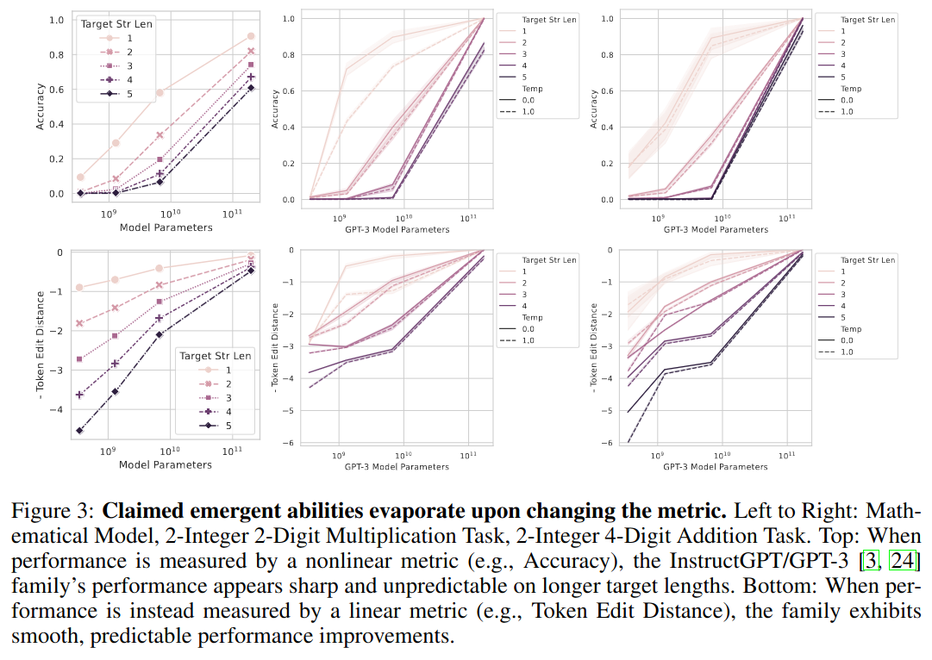
Schaeffer et. al. 2023
InstructGPT/GPT-3 family is claimed to have emergent arithmetic abilities
Switching from Exact String Match to Token Edit Distance, these abilities emerge gradually instead of suddenly

Slide 48
Schaeffer et. al. 2023
Many cases of "emergent abilities" can be attributed to the choice of metric and the resolution of measurements
Deliberately choosing a poor metric can induce apparently emergent abilities
Some candidate emergent abilities remain (under BLEU and normalized aggregate score metrics)

Slide 49
Complicating Scaling Laws

Slide 50
Inverse scaling can become U-shaped, Wei et al., 2022
Main RQ: Over what scales does inverse scaling on certain tasks hold?

Slide 51
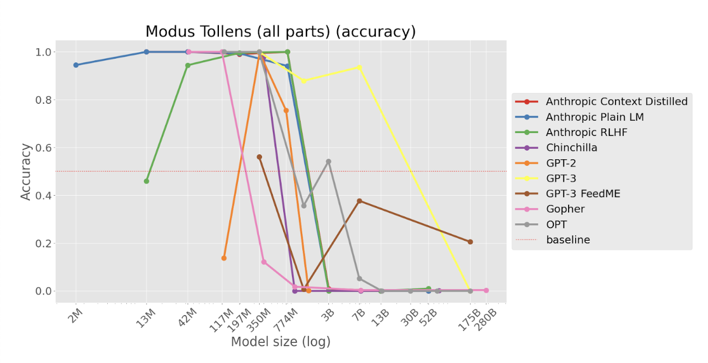
Inverse scaling can become U-shaped, Wei et al., 2022
Inverse Scaling Prize, McKenzie et al., 2022
A competition to find tasks where larger models do worse
11 Inverse scaling tasks found
Eg. Modus tollens classification: “If p then q, not q, ∴ not p”
Present models with a modus tollens argument and ask whether it is valid
Humans often make mistakes on this and larger models can better imitate these human mistakes

Slide 52
Inverse scaling can become U-shaped, Wei et al., 2022
Wei et al. found that increasing size even further will cause an uptick in performance

Slide 53
Inverse scaling can become U-shaped, Wei et al., 2022
How to explain U-shaped scaling?
“We do not experimentally investigate how or why U-shaped scaling occurs, but we hypothesize that it can happen when a task contains a “distractor task”. Medium-sized models can perform the distractor task better than smaller models, which hurts performance in comparison to the smaller models. As the models scale further, the larger models can ignore the distractor task and perform the true task, which can be seen as an emergent ability that derives from scaling”
E.g.. For modus tollens
Distractor task: Produce most likely answer (and replicate common human errors)
True task: Perform valid logical reasoning

Slide 54
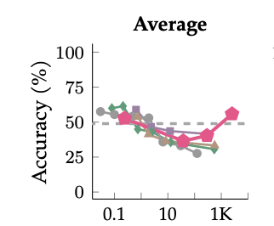
Inverse scaling can become U-shaped, Wei et al., 2022
However, even though large models perform better than medium models, they only perform about as well as small models
Inverse scaling tasks are not solved

Slide 55
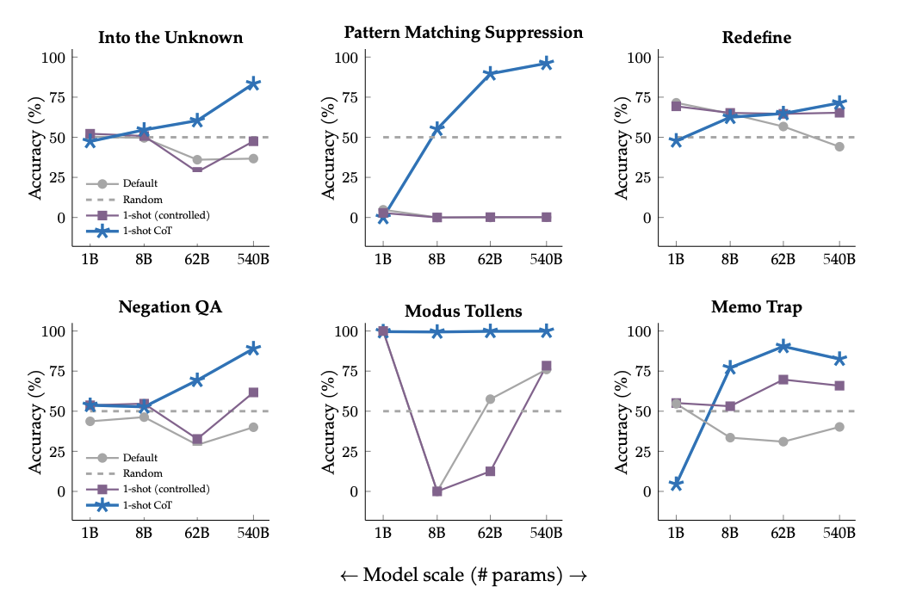
Inverse scaling can become U-shaped, Wei et al., 2022
How to improve?
1-shot
Chain of thought (CoT)

Slide 56
Inverse scaling can become U-shaped, Wei et al., 2022
Takeaways
Increasing scale seems to turn inverse scaling into U-shaped scaling
Inverse scaling may not be a big issue
However, there is still room for improvement
Techniques like 1-shot prompting and CoT can help

Slide 57
Transcending Scaling Laws with 0.1% Extra Compute, Tay et al., 2022
Main RQ: Can new training techniques improve scaling?

Slide 58
Transcending Scaling Laws with 0.1% Extra Compute, Tay et al., 2022
The new training procedure:
First take the PALM base model, then
Use an extra 0.1% compute on the same data to train with an objective that combines prefix language modelling and long-short span corruption (infilling)
The quick brown fox <targets> AND The <targets> fox jumped over the lazy dog
Mixture of denoisers
Regular denoising: Noise is sampled as spans and replaced with sentinel tokens. Spans are typically uniformly sampled with a mean of 3 and a corruption rate of 15%.
Extreme Denoising: Here, the noise level is significantly increased, either by corrupting a large percentage of the original text or by replacing very long spans of text. Spans for extreme denoising are typically uniformly sampled with a mean length of 32 or a corruption rate of up to 50%.
Sequential Denoising: Noise is always sampled from the start of the text to a randomly sampled point in the text

Slide 59
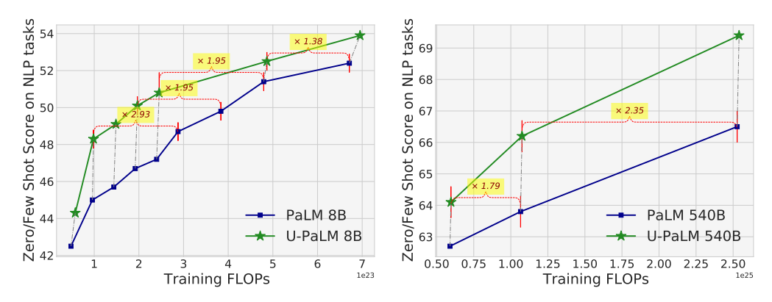
Transcending Scaling Laws with 0.1% Extra Compute, Tay et al., 2022
Results:
Improved scaling properties:
Compute Savings:
For the 540B model, the saving rates at the middle checkpoint is approximately 2x. This is equivalent to about 4.4 million TPUv4 hours for the 540B model.
Savings seems to increase with the amount of causal language modelling already done

Slide 60
Transcending Scaling Laws with 0.1% Extra Compute, Tay et al., 2022
Takeaways
Scaling laws may hold for autoregressive training
But, new training schemes, like UL2, could give us unexpected extra performance

Slide 61
Final Questions?

