Slide 1
Lecture 1: Introduction to Foundation Models
Presenters: Wenhu Chen

Slide 2
Outline
Background (20 mins)
Logistics (10 minutes)
Syllabus (40 minutes)
Break (5 minutes)
Round-table Introduction (20 mins)
Topic Assignment (30 minutes)

Slide 3
A bit about myself
I started my PhD in 2017 at University of California, Santa Barbara
I worked on natural language processing.
Knowledge graph reasoning, Dialog System, Data-to-Text Generation, Image Captioning, Question Answering.
I graduated in 2021 and joined Google Research.
I started as assistant professor at university of Waterloo since 2022
I worked more broadly now on several things
Large Language Model Reasoning
Large Multimodal Models
Generative AI (image/video/audio generation)

Slide 4
Background

Slide 5
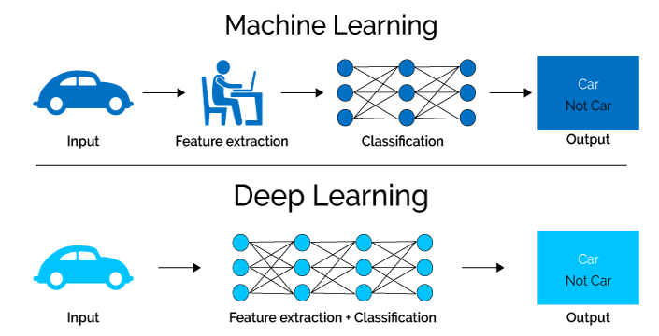
Background
Machine Learning -> Deep Learning

Slide 6
History of Deep Learning
Specialized DL (Before BERT/Elmo in 2018)
Design specialized model architectures.
Leveraging task-specific features.
Train the specialized models with limited data.
Transfer DL (Between 2018 - 2021)
Train a model with large amount of training data.
Use the features of the trained model to initialize part of the architecture
Design specialized modules on top of the trained features.
Train the partially specialized model with limited data.
Foundation Model (After 2021)
Train a single huge model on astronomical amount of data
Prompt the single model for everything

Slide 7
Specialized MT

Slide 8
Specialized Dialog

Slide 9
Specialized QA

Slide 10
Parameters of Specialized DL
Parameters | Specialized DL
Model Size | < 100M parameters
Data Size | 10K -> 1M tokens
Architecture | Specialized
Generalization | None

Slide 11
Pros and Cons of Specialized DL
Pros
The model considers the inductive bias for architecture design
The model can be effectively trained with limited amount of data
The model is normally small in size, easy to deploy for applications
Cons
Each task requires lots of expertise for architecture design
Each task requires annotating specialized dataset
The model cannot benefit from other annotated data, it needs to start from scratch literally to gain its skill
Hosting many specialized models incur high costs

Slide 12
Transfer Learning
We can train our model on massive amount of data to learn neural representation or initialize certain part of the weights.
Then transfer to new tasks by adding layers on on top of the learned neural representation.
This can leverage some cross-task similarity to enhance model performance across different tasks.

Slide 13
Transfer Learning in Word Vector (1)
How to represent the word in deep learning
1-hot vector, sparse representation with huge dimension
Word vector, dense representation with small dimension

Slide 14
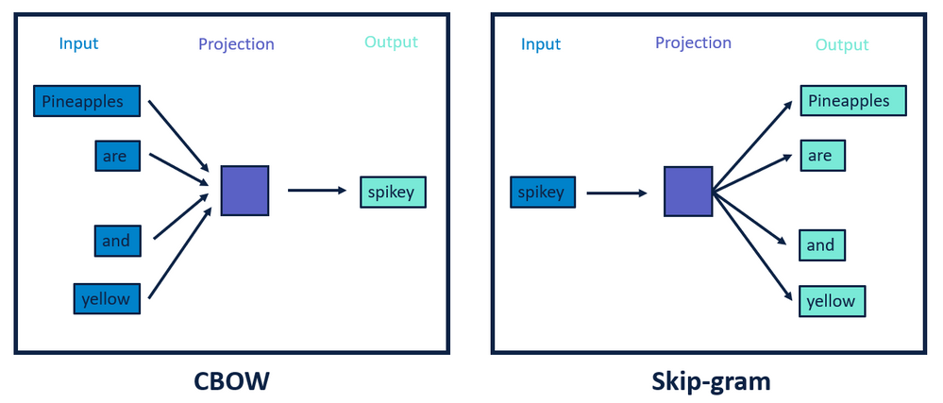
Transfer Learning in Word Vector (2)
Word2Vec trained a model like this in 2013

Slide 15
Transfer Learning in Vision

Slide 16
Transfer Learning in BERT (1)

Slide 17
Transfer Learning in BERT (2)

Slide 18
Transfer Learning in BERT (3)

Slide 19
Transfer Learning in Vision (1)

Slide 20
Transfer Learning in Vision (2)

Slide 21
Parameters of Transfer DL
Parameters | Specialized DL | Transfer DL
Model Size | < 100M parameters | 100M -> 1B parameters
Data Size | 10K -> 1M tokens | 100M -> 10B tokens
Architecture | Specialized | General
Generalization | None | Reasonable

Slide 22
Pros and Cons of Transfer DL
Pros:
The model shows much stronger capability than Specialized DL
The model can generalize to unseen cases
The model requires very few fine-tuning
Cons:
The model’s performance is still not perfect.
There is still fine-tuning needed for the downstream tasks

Slide 23
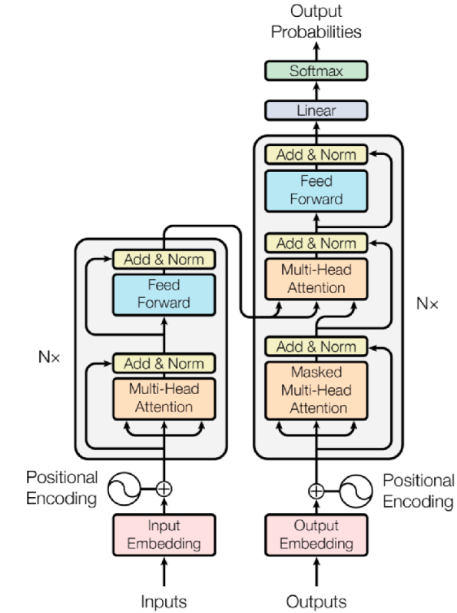
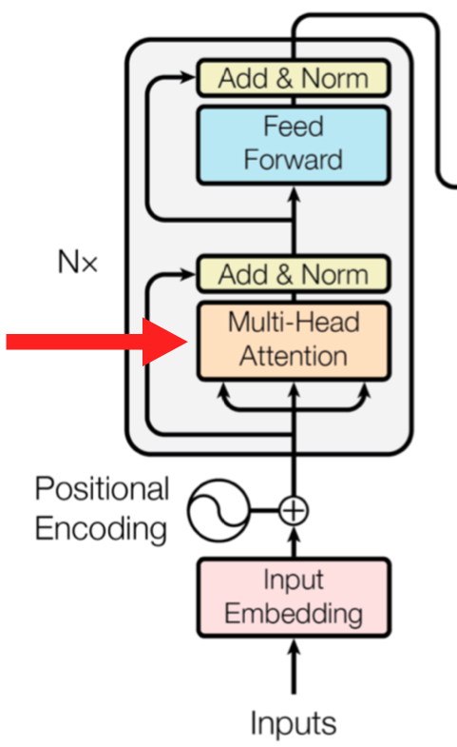
Transformers (Vaswani et al. 2017)
Transformers come from a paper called “Attention Is All You Need”
Attention module

Slide 24
GPT-2 (Radford et al. 2019)

Slide 25
GPT-2 (Radford et al. 2019)
Training Objective: next work prediction
Nothing surprising here, these are the traditional LM loss:
$$P\left(w_{0:n}\right)= \prod_{i=0}^{n}{P(w_{i}|w_{0:i−1})}$$
We want to estimate the probability distribution of sequence of words (or tokens in general).

Slide 26
GPT-3 (Brown et al. 2020)

Slide 27
In-context Learning

Slide 28
Few-shot Learning

Slide 29
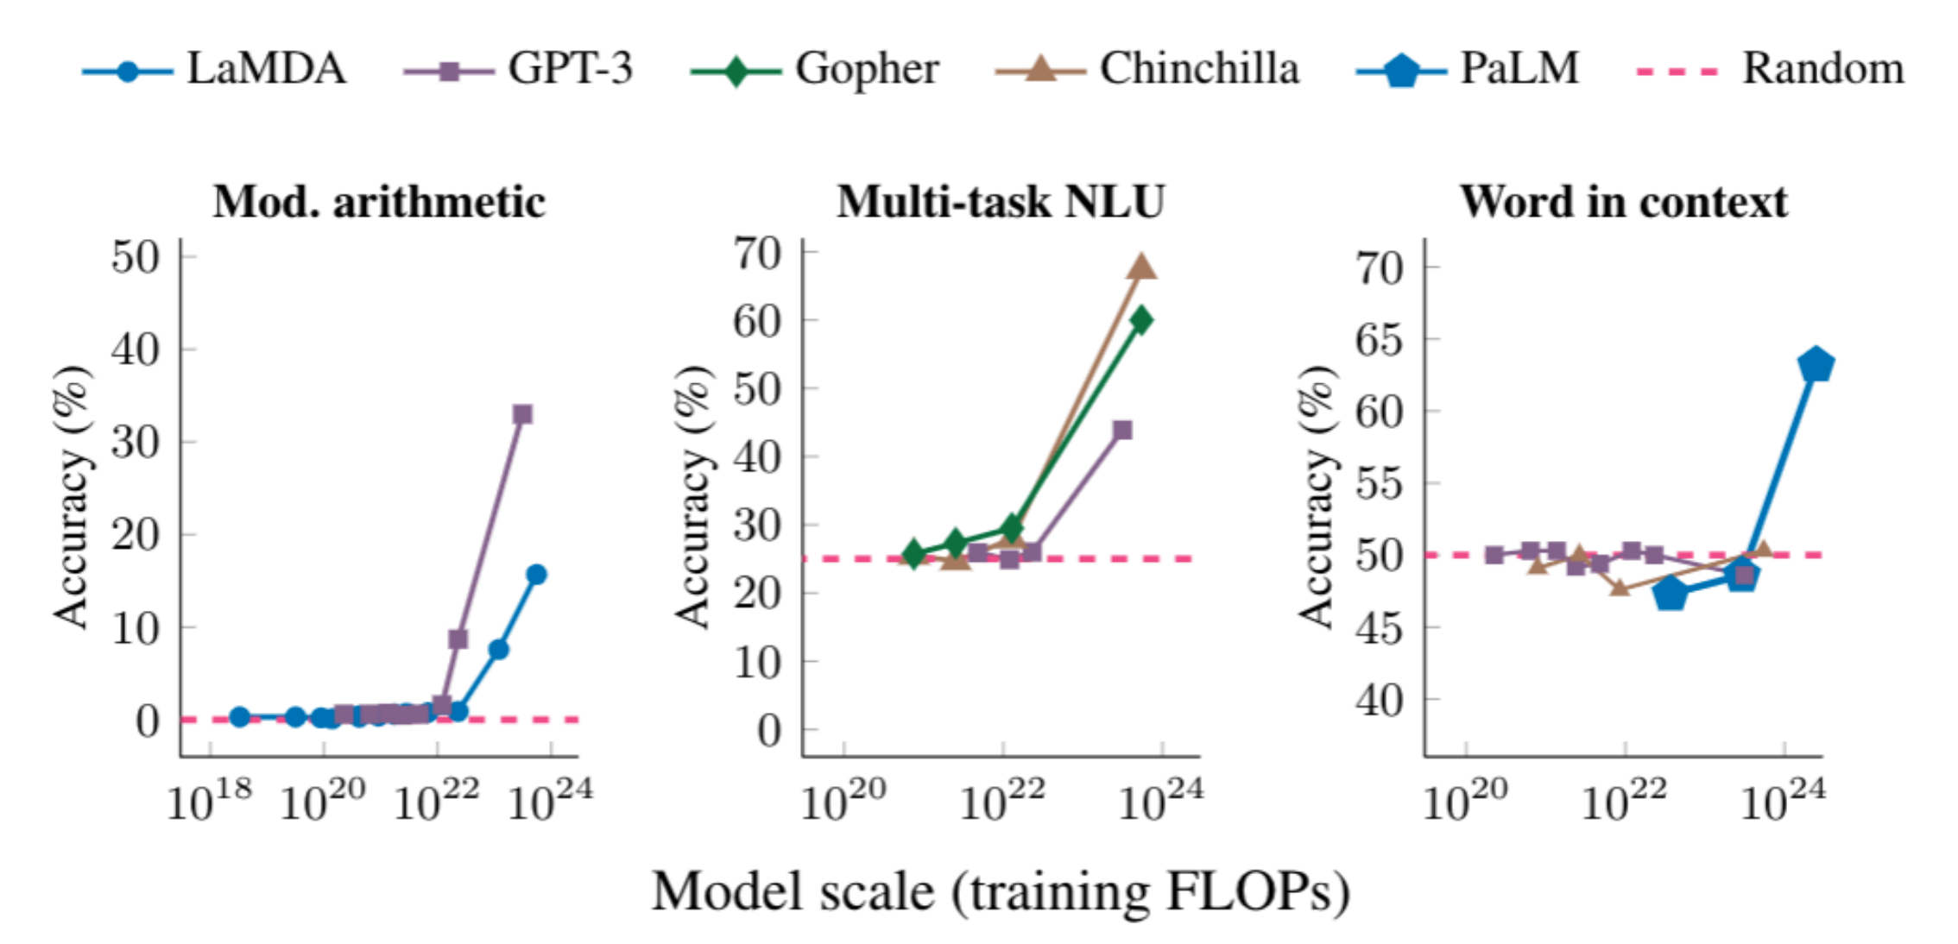
Emergent Ability (Wei et al. 2022)
When the model size grows from 0.1B -> 1.5B -> 175B, the model starts be really good in zero-shot and few-shot tasks
This is called “emergent abilities”.

Slide 30
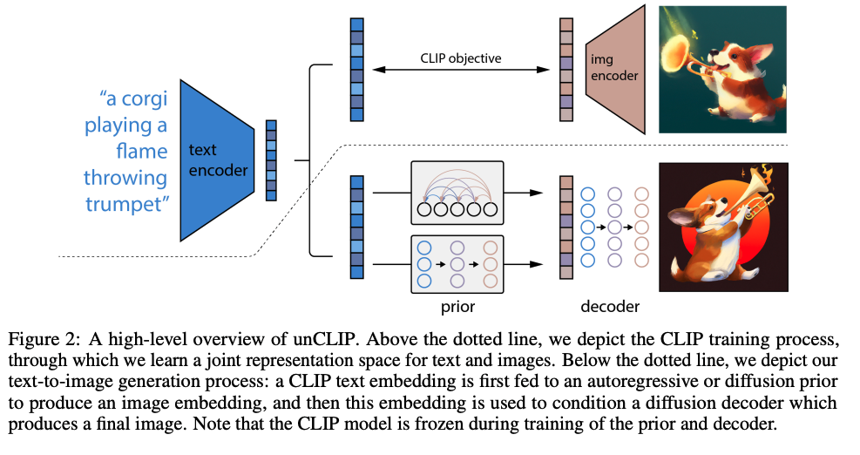
Diffusion Models (Images)

Slide 31
Diffusion Models (Videos)

Slide 32
Diffusion Models (Videos)

Slide 33
Gemini (Google et al. 2023)

Slide 34
What can Gemini do?

Slide 35
Parameters of Foundation DL
Parameters | Specialized DL | Transfer DL | Foundation DL
Model Size | < 100M parameters | 100M -> 1B parameters | 7B -> 1T parameters
Data Size | 10K -> 1M tokens | 100M -> 10B tokens | 100B -> 30T tokens
Architecture | Specialized | General | General
Generalization | None | Reasonable | Strong

Slide 36
Logistics of the Course

Slide 37
Presentation (40%)
In-class presentation in group of two
Make slides
Present slides
Leading discussion
Duration of 80 minutes
I have posted the slides template on the web
Crystal clear with enough details
Don’t do screenshot, use the Powerpoint figures and formulas
Expect to spend 1-2 week of time on it.
First round: Deadline on Feb 8th
I will provide feedback, and then you need revise to re-submit

Slide 38
Reading Notes (10%)
Pick the recent paper you read, outside of the listed paper pool on the course website
Write a 4-page long reading notes (font size=11)
It should be related to foundation models. It could be the application of foundation model in your area
Deadline on Feb 28th

Slide 39
Project (50%)
Pick a project of your interest, for a team of up to 2
It needs to be relevant to one of the topics I’m covering
It doesn’t need to reach conference paper level
You need to show what you learned or discovered
Proposal Deadline: Feb 21st
Report Deadline: April 10th

Slide 40
Course Syllabus

Slide 41
L3: RNN & CNN

Slide 42
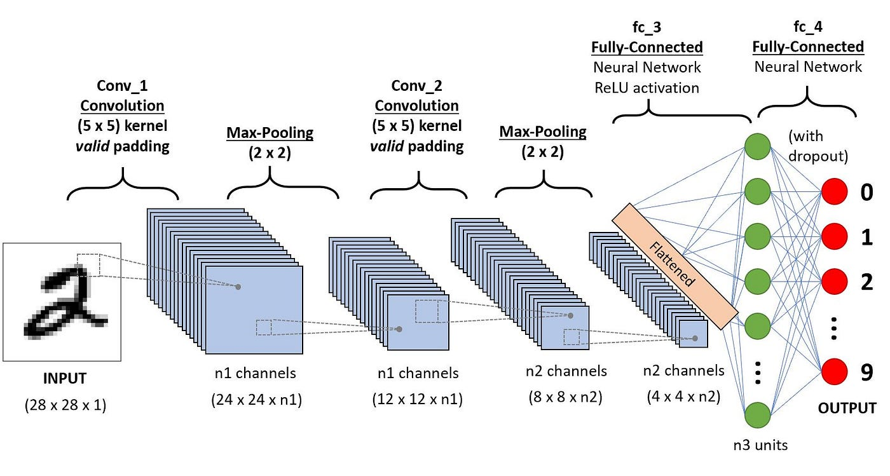
L3: RNN & CNN

Slide 43
L3: RNN & CNN
Cover the basic design of recurrent neural networks
Different Recurrent Neural Network
Highway Networks
GRU
LSTM
Stacking-LSTM
Different Convolutional Neural Netowk
ImageNet
ResNet
ResNext
UNet
DenseNet
Convext

Slide 44
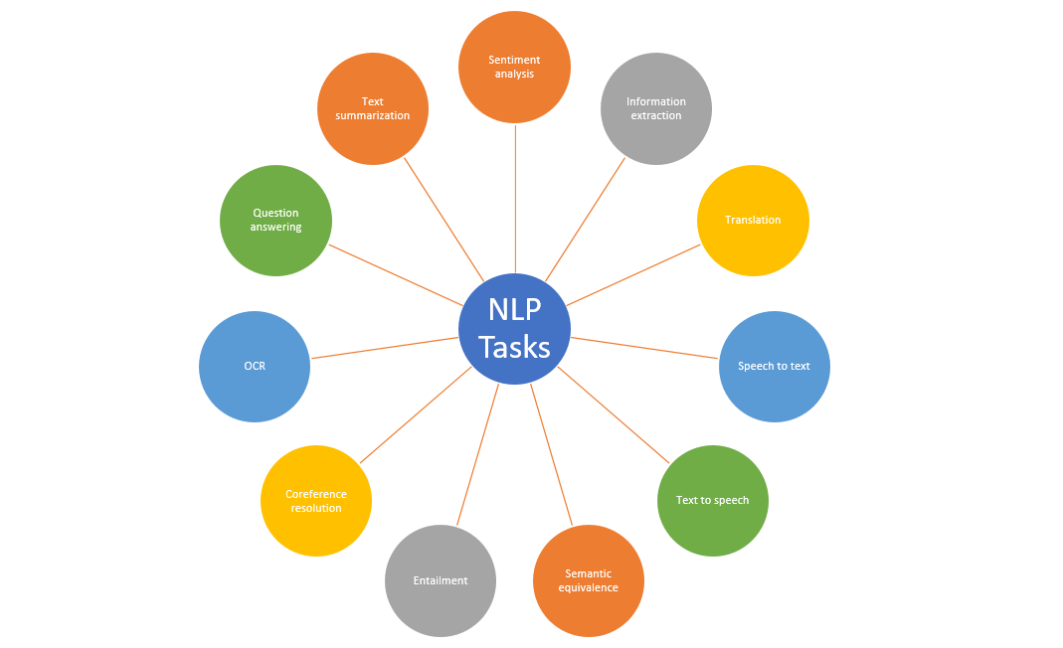
L4: CV and NLP

Slide 45
L4: CV and NLP

Slide 46
L4: CV & NLP
Cover the major CV and NLP tasks. Tell us what they are and what are the common models to solve these tasks.
NLP
MT
Summarization
QA
….
CV
Classification
Segmentation
Tracking
Detection
….

Slide 47
L5: Self-Attention and Transformer

Slide 48
L5: Self-Attention and Transformer

Slide 49
L5: Self-Attention and Transformer
Detailed Explanation about Self-Attention
Go through the tutorial in https://nlp.seas.harvard.edu/annotated-transformer/.
Explain the code step by step
Image Transformer
Vision Transformer

Slide 50
L6: Efficient Transformers

Slide 51
L6: Efficient Transformers
Covering different efficient transformer architectures
Projection-based approach
Linformer
Perceiver
Random Feature Attention
Sparse attention
Longformer
Sparseformer
State Space Model (S4)

Slide 52
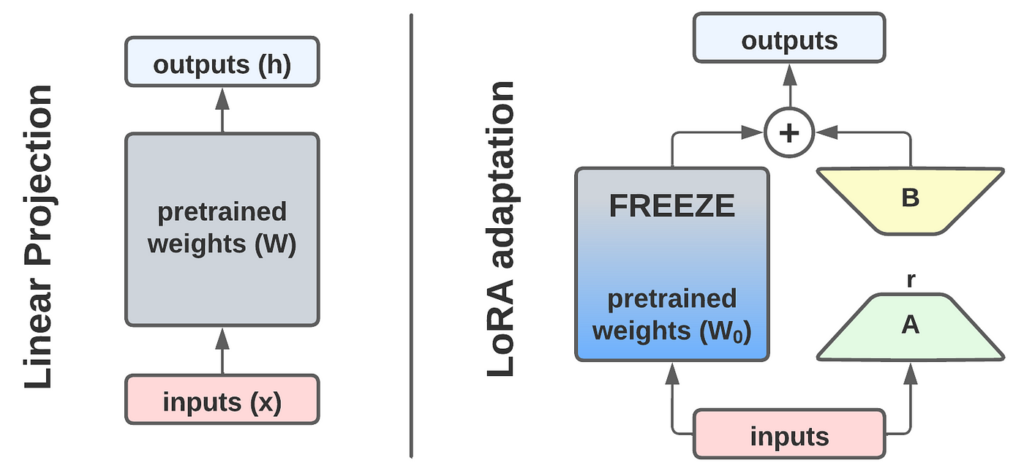
L7: Parameter-efficient Tuning
Adapter
LoRA

Slide 53
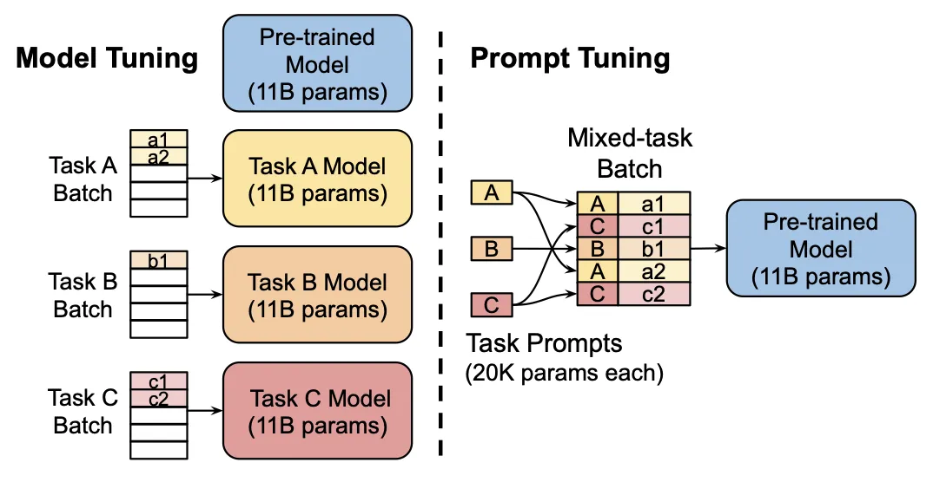
L7: Parameter-efficient Tuning

Slide 54
L7: Parameter-efficient Tuning
Full-parameter tuning is expensive
Tuning part of the parameters
Adapter
LoRA
Prompt Tuning
Prefix Tuning
Unified Prompt Tuning

Slide 55
L8: Language Model Pre-training

Slide 56
L8: Language Model Pre-training

Slide 57
L8: Language Model Pre-training
Cover different unsupervised pre-training approach
Masked Language Model
Unified Language Model
ALEBRT
RoBERTa
ERNIE
ELECTRA
Compare their objective and performance

Slide 58
L9: Large Language Models
T5

Slide 59
L9: Large Language Models

Slide 60
L9: Large Language Models

Slide 61
L9: Large Language Models
Covering the existing prominent LLMs
T5
GPT-3
Codex
PaLM
Llama-2
Mixtral of Experts
…

Slide 62
L10: Scaling Law
For optimal performance all three factors must be scaled up in tandem. Empirical performance has a power-law relationship with each individual factor when not bottlenecked by the other two

Slide 63
L10: Scaling Law

Slide 64
L10: Scaling Law
Covering the two scaling laws
OpenAI scaling law
Chinchilla scaling law
Covering the emerge abilities
Emergent abilities
Debate about emerge abilities
Transcending scaling law

Slide 65
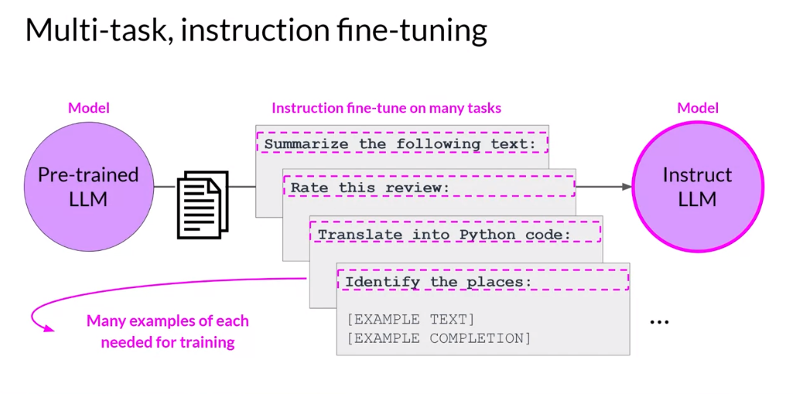
L11: Instruction Tuning & RLHF
Unify all the NLP tasks as instruction following format to enhance its generalization

Slide 66
L11: Instruction Tuning & RLHF

Slide 67
L11: Instruction Tuning & RLHF
Instruction Tuning
FLAN-T5
InstructGPT
LIMA
T0
RLHF
PPO in InstructGPT
DPO
Zephyr

Slide 68
L12: Efficient LLM Training

Slide 69
L12: Efficient LLM Training
When the model scales up, it is difficult to train
Infrastructure-wise optimization: Megatron, ZeRO
How to parallelize
How to partition model/gradients/optimizer states
Network-wise optimization
Better length extrapolation: Alibi, RoPE
Efficient Attention: Group Attention
CUDA-kernel optimization
Flash-Attention

Slide 70
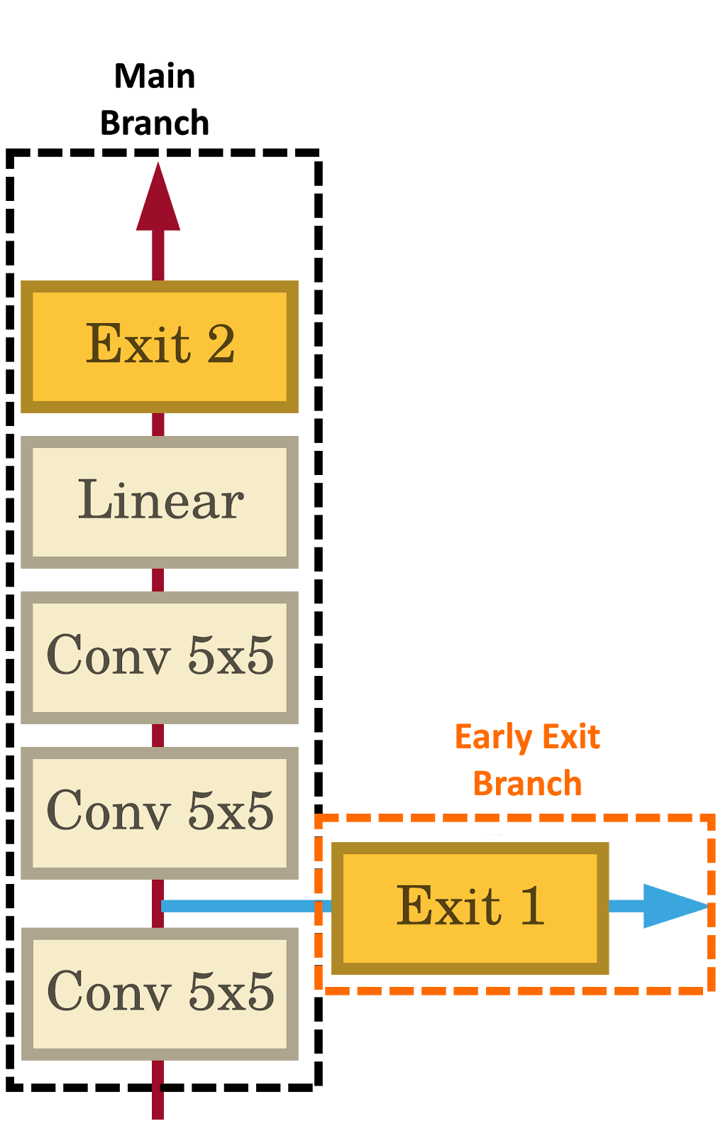
L13: Efficient LLM Inference
Speculative Decoding
Early Exiting
Paged Attention

Slide 71
L13: Efficient LLM Inference
Coverage
Early Exit in Transformer
Speculative Decoding
Paged Attention
Flash Decoding
Lookahead Decoding

Slide 72
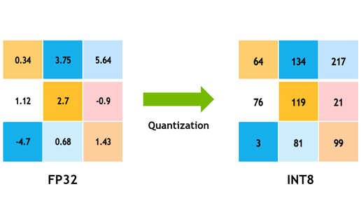
L14: Compress and Sparsify LLM
Sparse LLM
Bits & Bytes

Slide 73
L14: Compress and Sparsify LLM
Sparsify LLM
MoE architecture
Gshard architecture
Quantization
8bit quantization
QLora 4bit quantization
BitNet 1bit quantization

Slide 74
L15: Prompting LLM

Slide 75
L15: Prompting LLM
Prompting Methods
CoT
PoT
ToT
Least-to-Most
Self-Ask
ReAct
Self-Refine

Slide 76
L16: Vision Transformers

Slide 77
L16: Vision Transformers
Different ViT
Swin Transformers
DINO
DINO-2
SwiftFormer
MetaFormer
Masked Autoencoder

Slide 78
L17: Diffusion Model
Score-based Generative Model with SDE

Slide 79
L17: Diffusion Model
Denoising Diffusion Probabilistic Models
Denoising Diffusion Implicit Models

Slide 80
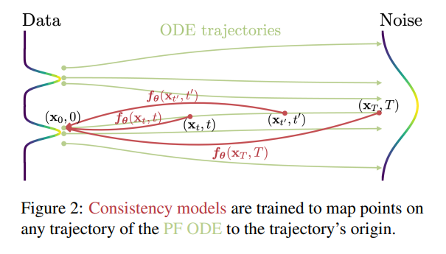
L17: Diffusion Model
Consistency Models

Slide 81
L17: Diffusion Model
Existing Diffusion Models
Score-based model
SDE
DDPM
DDIM
DPM-Solver
Consistency Model

Slide 82
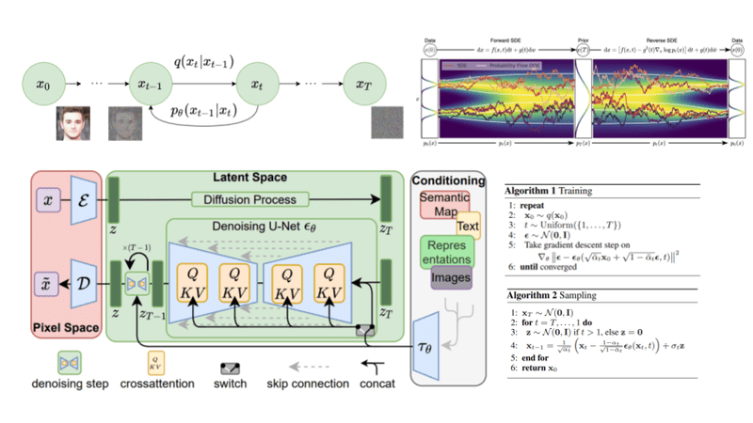
L18: Image Generation
Google Imagen
Stable Diffusion

Slide 83
L18: Image Generation
Coverage of the prominent image generation
Latent Diffusion Model
Imagen
Parti
Dalle-2
Pixart-alpha
Stable Diffusion-XL Turbo

Slide 84
L19: Multimodal Pre-training

Slide 85
L19: Multimodal Pre-training
Coverage of Text-Language Pre-training
CLIP
BLIP
CoCa
Oscar
VinVL
ALIGN
SigLIP

Slide 86
L20: Large Multimodal Models

Slide 87
L20: Large Multimodal Models
Coverage of LMMs
Flamingo
Llava
InstructBLIP
PaLI/PaLI-X
Emu2
InternVL
Gemini

Slide 88
L21: LLM & Tool Augmentation

Slide 89
L21: LLM & Tool Augmentation
Coverage of Tool LLMs
Toolformer
ReAct
ToolLM
TookenGPT
AgentBench
CogAgent

Slide 90
L22:LLM & Retrieval Augmentation

Slide 91
L22:LLM & Retrieval Augmentation
Coverage of this Topic:
REALM
RAG
Retro
Self-RAG
RePLUG

Slide 92
Round-table Introduction

Slide 93
A bit about you
Tell me a bit about yourself
What are you working on?
Who are you working with?
What do you expect from this course?
How does foundation models benefit your research?

Slide 94
Topic Assignment and Discussion

Slide 95
Choose the Presentation
I will share the preference sheet
You need to find a teammate to form a group of two
Deadline for selection: before this Sunday
If you did not fill out in time, I will arrange it for you
I will post the results early next week according to your preference
Subject to swap if both teams consent

Slide 96
Discussion Phase
Discuss with your teammates in the class
Talk to me regarding lecture content and topics
Q&A about the project

