Slide 1
A Graph Theoretic Approach to Cache-Conscious Placement of Data for Direct Mapped Caches
Mirza Beg and Peter van Beek
University of Waterloo
June 6 2010

Slide 2
Outline
Motivation and Introduction
Background
Data Assignment to Cache
Evaluation
Related Work
Conclusions

Slide 3
Outline
Motivation and Introduction
Background
Data Assignment to Cache
Evaluation
Related Work
Conclusions

Slide 4
Motivation
Cache is a bottleneck for data access
Important to improve cache locality
instrumental for program performance
Important to improve theoretical understanding of cache management

Slide 5
Introduction
Direct mapped cache
Each block has only one place it can appear in cache
Types of cache misses
Compulsory misses
Conflict misses
Capacity misses
Goal is to minimize number of conflict misses
Place data in memory such that it is mapped to the cache to cause minimum number of misses

Slide 6
Problem
Memory objects
Cache
Object access sequence
o₁
< o₁, o₂, o₄, o₁, o₄,
o₂, o₁, o₄, o₅, o₄,
o₄, o₁, o₃, o₂, o₄,
……
o_{n-1}, o₉, o_{n}, o₁, o₄ >
o₂
k
o_{n}

Slide 7
Problem
A direct mapped cache with k lines
O: the set of all objects accessed during the program run
σ : sequence of object accesses
Defn: Given O and σ , find a mapping
f: O → {1, …, k} such that the number of conflict misses is minimized
The problem in general is NP-complete

Slide 8
Limiting Assumptions
Direct mapped cache
Object sizes equal to the size of line in cache
Accurate profile information
Known sequence of object accesses

Slide 9
Outline
Motivation and Introduction
Background
Data Assignment to Cache
Evaluation
Related Work
Conclusions

Slide 10
Graph Theory
Interval Graph: An intersection graph of a set of intervals

Slide 11
Graph Theory
Several NP-hard problems become polynomial because interval graphs have a perfect elimination order (PEO)
The PEO of an interval graph can be determined in linear time
For a graph with a PEO the chromatic number can be determined in linear time
All maximal cliques can be found in linear time
Induced sub-graphs of interval graphs are also interval graphs

Slide 12
Outline
Motivation and Introduction
Background
Data Assignment to Cache
Evaluation
Related Work
Conclusions

Slide 13
Program Profile
Memory reads are recorded
The interval begins at the first read and ends at the last
What are the events in the sequence ?
Memory reads are recorded
Where the interval starts and stops ?
From the first read to the last
<o₁, o₂, o₃, o₁, o₂, o₃, o₁, o₂, o₁, o₄, o₁, o₄, o₁, o₄, o₁, o₄ >
o₁
o₂
o₄
o₃

Slide 14
Conflict Graph
Each vertex represents a memory object
Each edge weight represents the number of conflict misses caused if the objects connected to the edge are assigned to the same line in the cache
o₁
6
4
o₂
5
o₃
6
8
2
2
o₄
o₅
6
= ( o₁, o₂, o₃, o₁, o₂, o₃, o₁, o₂, o₁, o₄, o₁, o₄, o₁, o₄, o₁, o₄, o₃, o₂,
o₅, o₂, o₅, o₂, o₅, o₂, o₅, o₂, o₄, o₅, o₅, o₄, o₅, o₄, o₅ )
= ( o₁, o₂, o₃, o₁, o₂, o₃, o₁, o₂, o₁, o₄, o₁, o₄, o₁, o₄, o₁, o₄, o₃, o₂,
o₅, o₂, o₅, o₂, o₅, o₂, o₅, o₂, o₄, o₅, o₅, o₄, o₅, o₄, o₅ )

Slide 15
Theoretical Results (I)
Theorem: Given a sequence of data accesses, the conflict graph of a program is an interval graph
Results for interval graphs apply to conflict graphs
Theorem: Chromatic number of the conflict graph can be determined in linear time
If the number of cache lines is greater than the chromatic number of the conflict graph then the objects can be optimally assigned to cache lines for zero conflict misses

Slide 16
Theoretical Results (II)
Corollary: Chromatic number for conflict graph gives number of cache lines required to achieve zero conflict misses
Corollary: For a placement that creates no cache conflicts, the sum of edges in the sub-graph for objects assigned to same cache line is zero, for each cache line
No two objects having an edge between them in conflict graph are assigned to same cache line

Slide 17
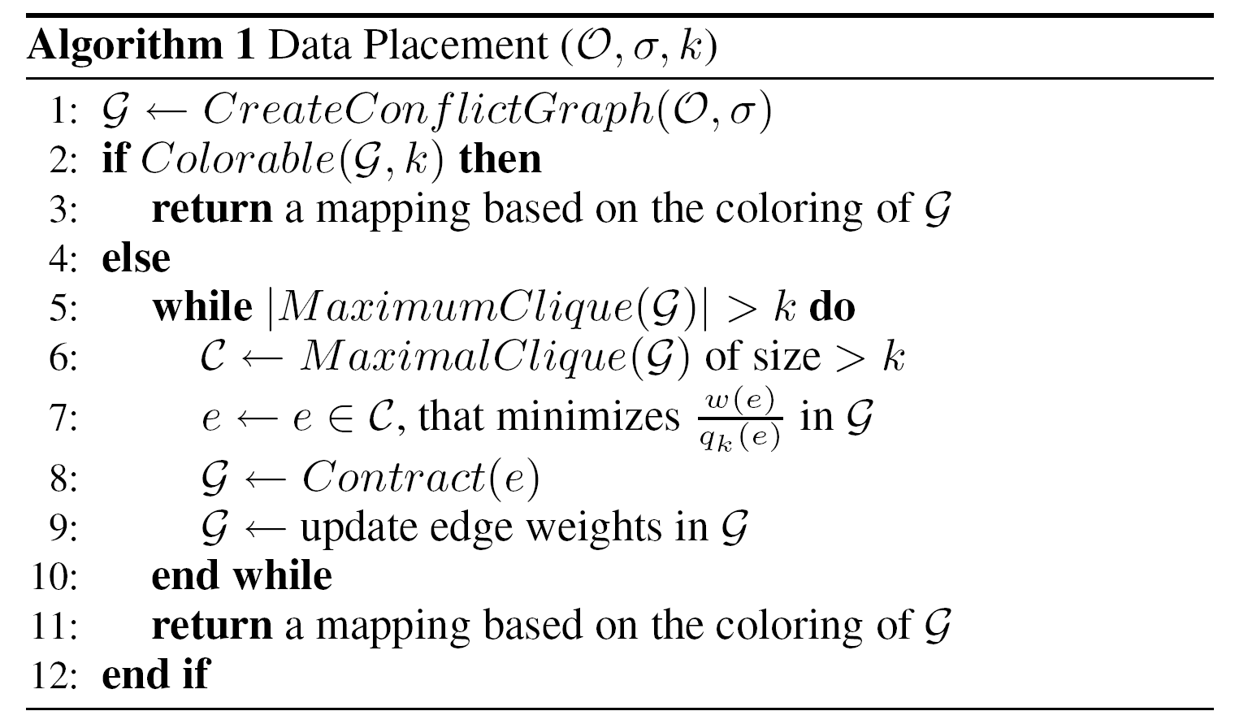
Assignment of Objects to Cache

Slide 18
Assignment of Objects to Cache
o₁
o₁
o₁
o₂
6
6
4
10
5
o₃
o₂
6
o₂
o₃
o₃₄
6
o₄
8
8
2
2
o₄
6
o₅
o₅
o₅
6

Slide 19
Outline
Motivation and Introduction
Background
Data Assignment to Cache
Evaluation
Related Work
Conclusions

Slide 20
Evaluation
A small set of benchmarks (C)
A comparison of the number of misses between
Cache conscious placement algorithm (ours)
Modulo assignment (current practice)
Simulation of the cache
Assumes freedom to rearrange objects in memory (e.g. array elements)

Slide 21
Profiler
Record the access sequence of memory objects for a complete run of the program
Instrument the code for memory allocations and accesses
Output: an ordered sequence of memory objects

Slide 22
Evaluation
Bisort from the Olden benchmark

Slide 23
Evaluation
Cachekiller

Slide 24
Outline
Motivation and Introduction
Background
Data Assignment to Cache
Evaluation
Related Work
Conclusions

Slide 25
Related Work
First to study hardness of the offline cache conscious data placement [Thabit 1982]
A complete framework for profile bases cache conscious data placement [Calder et al. 1998]
Even if there are a small number of misses, cache conscious data placement cannot be reasonably approximated [Petrank and Rawitz 2002]
Optimal register allocation for SSA-form programs [Hack and Goos 2006]

Slide 26
Outline
Motivation and Introduction
Background
Data Assignment to Cache
Evaluation
Related Work
Conclusions

Slide 27
Conclusions
Identified relationship between conflict graphs and interval graphs
Gives us a better understanding of direct-mapped caches
An offline algorithm for cache conscious data placement for direct mapped caches
an optimal assignment if there exists one with no conflict misses
a heuristic to decrease the size of the conflict graph, otherwise

Slide 28
Questions & Comments

