Slide 1
Null Values
Chapter 5 (6/E)
Chapter 8 (5/E)

Slide 2
Lecture Outline
Dealing with null values
Three-valued logic
Effects in WHERE clauses
IS NULL
Effects on aggregation
Effects on GROUP BY, set operations, and SELECT DISTINCT
Treatment in ORDER BY clauses
Effects in CHECK constraints
Outer joins

Slide 3
Semantics of NULL
Recall possible meanings of NULL
Unknown value
Unavailable or withheld value
Not applicable attribute
Each stored NULL value incomparable to every other stored value
Even if other value also NULL
unknown ≟ 5 → unknown
unknown ≟ unknown → unknown
Comparisons involving unknown values are neither true nor false.
Thus, SQL uses a three-valued logic:
TRUE, FALSE, and UNKNOWN

Slide 4
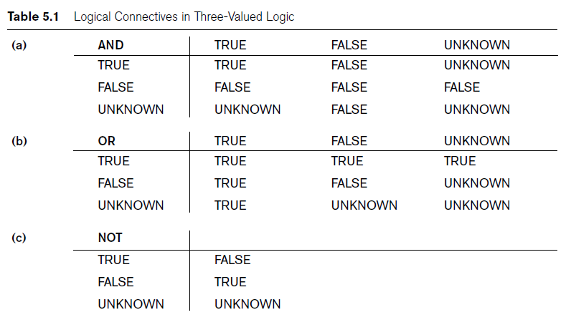
Three-Valued Logic
Similarly, any operation involving an unknown value produces an unknown value for the result.
e.g., unknown + 5 → unknown

Slide 5
Evaluating WHERE
Recall that WHERE clause evaluates each tuple in turn and returns only those for which the condition evaluates to true.
Tuples that evaluate to false or unknown are rejected.
Cannot use
WHERE phone = NULL
to test for null value in a tuple.
Many tautologies do not hold for columns with NULLs.
e.g., no “law of the excluded middle”
SELECT *
FROM Student
WHERE age > 18 OR NOT age > 18
might not return all Student tuples

Slide 6
Is NULL
Most SQL operators are NULL-intolerant.
They return unknown if an operand is NULL.
SQL provides special test that is NULL-tolerant
IS [NOT] NULL
Need to account for NULLs when formulating queries
Not handling NULLs is a common source of errors

Slide 7
When NULLs are Ignored
Consider aggregating values for budget in the following.
e.g., max(budget), sum(budget), average(budget)
NULL values in tuples ignored for aggregation (even for COUNT)
Only non-NULL values included in aggregations.
i.e., sum() handled differently from +
Example:
SELECT COUNT(*), COUNT(budget), AVERAGE(gross-budget)
FROM Film
WHERE genre = 'comedy';
all comedies counted for first aggregation;
only comedies with non-NULL budget counted for second aggregation;
only comedies with non-NULL budget and non-NULL gross included in third aggregation
Film
title | genre | year | director | minutes | budget | gross

Slide 8
When all NULLs Are Treated Equal
Grouping and set operations treat all NULLs as the same value
e.g., GROUP BY budget forms separate group for all tuples with NULL value in budget
Similarly for set operations: all NULLs treated as if a single value
e.g., {(A,B,NULL),(A,B,C)} ∩ {(A,B,D),(A,B,NULL)} = {(A,B,NULL)}
(SELECT genre, budget
FROM Film
WHERE gross > 15000000)
UNION
(SELECT genre, budget
FROM Film
WHERE year > 2000)
Similarly, too, for duplicate elimination with SELECT DISTINCT
Finally ORDER BY
NULLs sorted together, but sort order with respect to other values is implementation-dependent

Slide 9
NULLs in SQL’s DDL
By default, must be aware of possible NULLs for all columns.
Recall, however, a column can be declared NOT NULL.
NULL values cannot occur; querying simplified
Recall: Primary key columns must be declared NOT NULL
Unlike WHERE clause, CHECK constraints and FOREIGN KEY constraints ensure that no tuple returns false.
Therefore NULLs accepted
e.g.,
CHECK (age > 18)
allows tuples with NULL value for age

Slide 10
Join Operator
For convenience, SQL’s join operator (algebra’s ${\text{⋈}}_{<join condition>}$)
Permits users to specify a table resulting from a join operation
Table1 [INNER] JOIN Table2 ON <condition>
May appear in the FROM clause of a query
Keyword INNER is optional
Result is a single joined table
Equivalent to including <condition> in WHERE clause
Number of rows in result in range [0,|Table1|*|Table2|]
Data from Table1 appear in result only if matching row exists in Table2.
Data from Table2 appear in result only if matching row exists in Table1.

Slide 11
Left Outer Join Operator
Every tuple in left table appears in result
If matching tuple(s) in right table, works like inner join
If no matching tuple in right table, one tuple in result with left tuple values padded with NULL values for columns of right table
Table1 LEFT [OUTER] JOIN Table2 ON <condition>
SELECT *
FROM Customer LEFT JOIN Sale ON Customer.custid = Sale.custid
Customer
custid | name | address | phone
1205 | Lee | 633 S. First | 555-1219
3122 | Willis | 41 King | 555-9876
2134 | Smith | 213 Main | 555-1234
1697 | Ng | 5 Queen N. | 555-0025
3982 | Harrison | 808 Main | 555-4829
Sale
saleid | date | custid
A17 | 5 Dec | 3122
B823 | 5 Dec | 1697
B219 | 9 Dec | 3122
C41 | 15 Dec | 1205
X00 | 23 Dec | NULL
Customer.custid | name | address | phone | saleid | date | Sale.custid
1205 | Lee | 633 S. First | 555-1219 | C41 | 15 Dec | 1205
3122 | Willis | 41 King | 555-9876 | A17 | 5 Dec | 3122
3122 | Willis | 41 King | 555-9876 | B219 | 9 Dec | 3122
2134 | Smith | 213 Main | 555-1234 | NULL | NULL | NULL
1697 | Ng | 5 Queen N. | 555-0025 | B823 | 5 Dec | 1697
3982 | Harrison | 808 Main | 555-4829 | NULL | NULL | NULL

Slide 12
Other Outer Join Operators
Table1 RIGHT [OUTER] JOIN Table2 ON <condition>
Every tuple in right table appears in result (padded on left if needed)
Table1 FULL [OUTER] JOIN Table2 ON <condition>
Every tuple in either table appears in result (padded if needed)
SELECT *
FROM Customer FULL JOIN Sale ON Customer.custid = Sale.custid
Customer
custid | name | address | phone
1205 | Lee | 633 S. First | 555-1219
3122 | Willis | 41 King | 555-9876
2134 | Smith | 213 Main | 555-1234
1697 | Ng | 5 Queen N. | 555-0025
3982 | Harrison | 808 Main | 555-4829
Sale
saleid | date | custid
A17 | 5 Dec | 3122
B823 | 5 Dec | 1697
B219 | 9 Dec | 3122
C41 | 15 Dec | 1205
X00 | 23 Dec | 0000
Customer.custid | name | address | phone | saleid | date | Sale.custid
1205 | Lee | 633 S. First | 555-1219 | C41 | 15 Dec | 1205
3122 | Willis | 41 King | 555-9876 | A17 | 5 Dec | 3122
3122 | Willis | 41 King | 555-9876 | B219 | 9 Dec | 3122
2134 | Smith | 213 Main | 555-1234 | NULL | NULL | NULL
1697 | Ng | 5 Queen N. | 555-0025 | B823 | 5 Dec | 1697
3982 | Harrison | 808 Main | 555-4829 | NULL | NULL | NULL
NULL | NULL | NULL | NULL | X00 | 23 Dec | 0000

Slide 13
Lecture Summary
NULL values need careful consideration.
Most operators are NULL-intolerant.
Some queries must use IS [NOT] NULL to operate correctly.
Aggregations ignore NULLs.
Partitioning and set operators treat all NULLs as equal.
Check constraints are NULL-tolerant.
Include NOT NULL for column declarations where appropriate.
Recall: required for primary keys
Outer joins
LEFT, RIGHT, and FULL

