Slide 1
Nested Queries and Aggregation
Chapter 5 (6/E)
Chapter 8 (5/E)

Slide 2
Lecture Outline
More Complex SQL Retrieval Queries
Self-Joins
Renaming Attributes and Results
Grouping, Aggregation, and Group Filtering
Ordering Results
Nested SPJ Queries

Slide 3
Review of SPJ Queries in SQL
SPJ (select-project-join) queries
SQL’s basic select-from-where queries
Equivalent to using only σ, π, and ⋈ (or ×) in Relational Algebra
(and possibly ρ, if attributes need to be renamed before joining)

Slide 4
Renaming in SQL
For convenience, include renaming (like ρ) as well
Aliases or tuple variables
Provide alternative names for tables or columns
SELECT name, sale_date, product, quantity AS amount
FROM Customer C, Sale AS S(id,sale_date,custid), LineItem
WHERE C.custid = S.custid AND id = saleid;
Keyword AS is optional
Customer
custid | name | address | phone
Sale
saleid | date | custid
LineItem
saleid | product | quantity | price

Slide 5
Self-joins
Renaming is mandatory if table used more than once in a query
Example
Give the last names and salaries of employees and their managers whenever the employee earns more than the manager.
Think of the EMPLOYEE table as two tables, one for employees and one for managers.
SELECT E.Lname, E.Salary, M.Lname, M.Salary
FROM EMPLOYEE E, EMPLOYEE M
WHERE E.Super_ssn = M.Ssn and E.Salary > M.Salary;
EMPLOYEE
Fname | Minit | Lname | Ssn | Bdate | Address | Sex | Salary | Super_ssn | Dno
E
Fname | Minit | Lname | Ssn | Bdate | Address | Sex | Salary | Super_ssn | Dno
M
Fname | Minit | Lname | Ssn | Bdate | Address | Sex | Salary | Super_ssn | Dno

Slide 6
Aggregate Functions
Used to accumulate information from multiple tuples, forming a single-tuple summary
Built-in aggregate functions
COUNT, SUM, MAX, MIN, and AVG
Used in the SELECT clause
Examples:
How many movies were directed by Steven Spielberg?
SELECT COUNT(*)
FROM Film
WHERE director='Steven Spielberg‘;
All tuples in result are counted, with duplicates!
COUNT(title) or COUNT(director) give same result!
COUNT(DISTINCT year) would include each year only once!
What was the total movie profit since 2010, across how many directors?
SELECT SUM(gross - budget), COUNT(DISTINCT director)
FROM Film
WHERE year >= 2010;
Notes:
Ignore problem of NULL values for now. (They are ignored for aggregation.)

Slide 7
Grouping Before Aggregation
How can we answer a query such as
“How many films were directed by each director after 2001?”
Need to produce a result with one tuple per director
Partition relation into subsets of tuples based on grouping column(s)
Apply function to each such group independently
Produce one tuple per group
GROUP BY clause to specify grouping attributes
SELECT director, COUNT(*)
FROM Film
WHERE year > 2001
GROUP BY director;
Every selector in SELECT clause must be a grouping column or an aggregation function
e.g., SELECT director, year, COUNT(*)
would not be allowed unless also grouping by year
i.e., GROUP BY director, year

Slide 8
HAVING Clause
After partitioning into groups, whole partitions can be discarded.
Provides a condition on the grouped tuples
Having clause cannot reference individual tuples within group
Can reference grouping column(s) and aggregates only
Contrast WHERE clause to HAVING clause
Note: As for aggregation, no GROUP BY clause means relation treated as one group

Slide 9
Ordering of Query Results
Final output of a query can be sorted by one or more column values
Use ORDER BY clause
Keyword DESC for descending order of values
Optionally use keyword ASC for ascending order (default)
Example
SELECT dept, term,
COUNT(DISTINCT instructor) AS num_instructors
FROM Course
GROUP BY dept, term;
ORDER BY dept, term DESC;
Note that this is sorted ascending by department.
Within each department, terms sorted in descending order.
What if DISTINCT omitted? What if term omitted from SELECT clause? What if dept omitted from GROUP BY clause? What if dept omitted from ORDER BY clause?
Course
dept | cnum | instructor | term

Slide 10
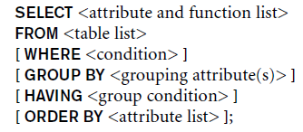
Summary of SQL Queries
Assemble all tables according to From clause (“,” means to use ×).
Keep only tuples matching Where clause.
Group into blocks based on Group By clause.
Keep only blocks matching Having clause.
Create one tuple for each block using Select clause.
Order resulting tuples according to Order By clause.

Slide 11
Nested Queries
Any table can be used in FROM clause.
select-from-where produces a table.
Thus can nest one query within another.
Example:
Give the biographical information for directors of profitable movies.
SELECT name, birth, city
FROM ( SELECT director
FROM Film
WHERE gross > budget) AS Profitable,
Person
WHERE director = name
Film
title | genre | year | director | minutes | budget | gross
Person
name | birth | city

Slide 12
Nested Queries (cont’d.)
Any column can be used in SELECT and WHERE clauses.
But refers to only one tuple value at a time
select-from-where can produce a one-column table that contains only one tuple.
Thus queries can also be nested in SELECT and WHERE clauses
Example:
Which film(s) had the highest budget?
SELECT *
FROM Film
WHERE budget = ( SELECT MAX(budget)
FROM Film);

Slide 13
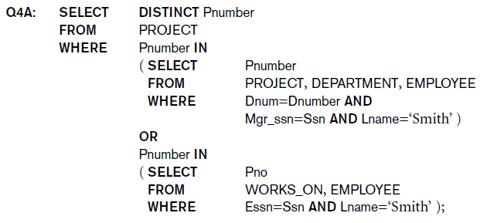
Using IN for Membership Test
Comparison operator IN
Compares value v with a set (or bag) of values V
Evaluates to TRUE if v is one of the elements in V
Allows any relation in WHERE clause
Can omit DISTINCT from this solution. Why?

Slide 14
Using IN (cont’d.)
Use tuples of values in comparisons
Requires parentheses

Slide 15
Nested 1-Column Queries
Use other comparison operators to compare a single value v
= ANY (or = SOME) operator
Returns TRUE if the value v is equal to some value in the set V
Equivalent to IN
Also available for >, >=, <, <=, and <>
>= ALL operator
Returns TRUE if the value v is greater than or equal to every value in the set V
Equivalent to =(SELECT MAX(…)…)
Also available for =, >, <, <=, and <>

Slide 16
Correlated Nested Queries
Correlated nested query
Evaluated once for each tuple in the outer query
Such queries are easiest to understand (and write correctly) if all column names are qualified by their relation names.
Note that the inner query can refer to E, but the outer query cannot refer to D.

Slide 17
EXISTS and UNIQUE Functions
[NOT] EXISTS function
Check whether result of correlated nested query is empty or not
EXISTS equivalent to (SELECT COUNT(*) … ) <> 0
SELECT name, phone
FROM Customer C
WHERE NOT EXISTS ( SELECT *
FROM Sale S
WHERE C.custid = S.custid);
Note that columns selected in inner query are irrelevant.
SQL function UNIQUE(Q)
Returns TRUE if no duplicate tuples in result of query Q
Customer
custid | name | address | phone
Sale
saleid | date | custid

Slide 18
Lecture Summary
Complex SQL:
Self joins
Aggregate functions
Grouping
Sorting
Nested queries
Relational algebra expressions can handle self joins and nested queries with no additional operators
Grouping, aggregations, and sorting require additional operators

