Slide 1
Basic SQL
Chapter 4 (6/E)
Chapter 8 (5/E)

Slide 2
Lecture Outline
SQL Data Definition and Data Types
Specifying Constraints in SQL
Basic Retrieval Queries in SQL
Set Operations in SQL

Slide 3
Basic SQL
Structured Query Language
Considered one of the major reasons for the commercial success of relational databases
Statements for data definitions, queries, and updates
Both DDL and DML
Core specification plus specialized extensions
Terminology:
Relational Model | SQL
relation | table
tuple | row
attribute | column
Syntax notes:
Some interfaces require each statement to end with a semicolon.
SQL is not case-sensitive.

Slide 4
SQL Data Definition
CREATE statement
Main SQL command for data definition
SQL schema
Identified by a schema name
Includes an authorization identifier (owner)
Components are descriptors for each schema element
Tables, constraints, views, domains, and other constructs
CREATE SCHEMA statement
CREATE SCHEMA COMPANY AUTHORIZATION ‘Jsmith’;

Slide 5
CREATE TABLE Command
Specify a new relation
Provide name
Specify attributes and initial constraints
Base tables (base relations)
Relation and its tuples are physically stored and managed by DBMS
Can optionally specify schema:
CREATE TABLE COMPANY.EMPLOYEE ...
or
CREATE TABLE EMPLOYEE ...
Include information for each column (attribute) plus constraints
Column name
Column type (domain)
Key, uniqueness, and null constraints

Slide 6
BASIC Data Types
Numeric data types
Integer numbers: INT, INTEGER, SMALLINT, BIGINT
Floating-point (real) numbers: REAL, DOUBLE , FLOAT
Fixed-point numbers: DECIMAL(n,m), DEC(n,m), NUMERIC(n,m), NUM(n,m)
Character-string data types
Fixed length: CHAR(n), CHARACTER(n)
Varying length: VARCHAR(n), CHAR VARYING(n), CHARACTER VARYING(n), LONG VARCHAR
Large object data types
Characters: CLOB, CHAR LARGE OBJECT , CHARACTER LARGE OBJECT
Bits: BLOB, BINARY LARGE OBJECT
Boolean data type
Values of TRUE or FALSE or NULL
DATE data type
Ten positions
Components are YEAR, MONTH, and DAY in the form YYYY-MM-DD

Slide 7
MORE Data Types
Additional data types
TIMESTAMP data type
Includes the DATE and TIME fields
Plus a minimum of six positions for decimal fractions of seconds
Optional WITH TIME ZONE qualifier
INTERVAL data type
Specifies a relative value that can be used to increment or decrement an absolute value of a date, time, or timestamp
Columns can be declared to be NOT NULL
Columns can be declared to have a default value
Assigned to column in any tuple for which a value is not specified
Example
CREATE TABLE EMPLOYEE (
…
NICKNAME VARCHAR(20) DEFAULT NULL,
…
Province CHAR(2) NOT NULL DEFAULT 'ON',
…
);

Slide 8
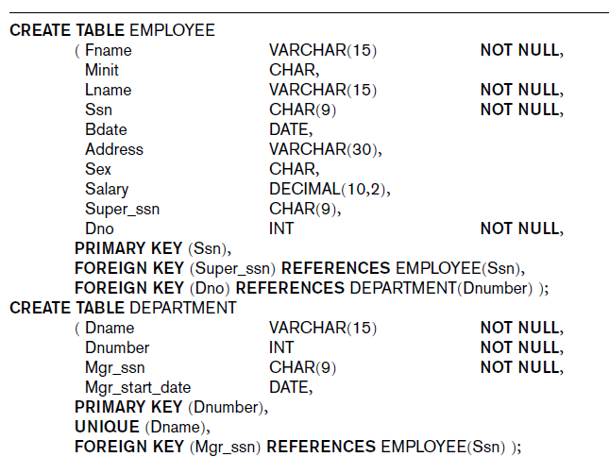
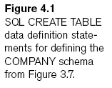
) ;
) ;

Slide 9
Domains in SQL
Name used in place of built-in data type
Makes it easier to change the data type used by numerous columns
Improves schema readability
Example:
CREATE DOMAIN SIN_TYPE AS CHAR(9);

Slide 10
Specifying Key Constraints
PRIMARY KEY clause
Specifies one or more attributes that make up the primary key of a relation
Dnumber INT NOT NULL PRIMARY KEY,
Primary key attributes must be declared NOT NULL
UNIQUE clause
Specifies alternate (candidate) keys
Dname VARCHAR(15) UNIQUE;
May or may not allow null values, depending on declaration
If no key constraints, two or more tuples may be identical in all columns.
SQL deviates from pure relational model!
Multiset (bag) behaviour

Slide 11
Referential Constraints
FOREIGN KEY clause
FOREIGN KEY (Dept) REFERENCES DEPARTMENT (Dnum),
Default operation: reject update on violation
Attach referential triggered action clause in case referenced tuple is deleted
Options include SET NULL, CASCADE, and SET DEFAULT
Foreign key declaration must refer to a table already created

Slide 12
Specifying Tuple Constraints
Some constraints involve several columns
CHECK clause at the end of a CREATE TABLE statement
Apply to each tuple individually
Example
CHECK (Dept_create_date <= Mgr_start_date)

Slide 13
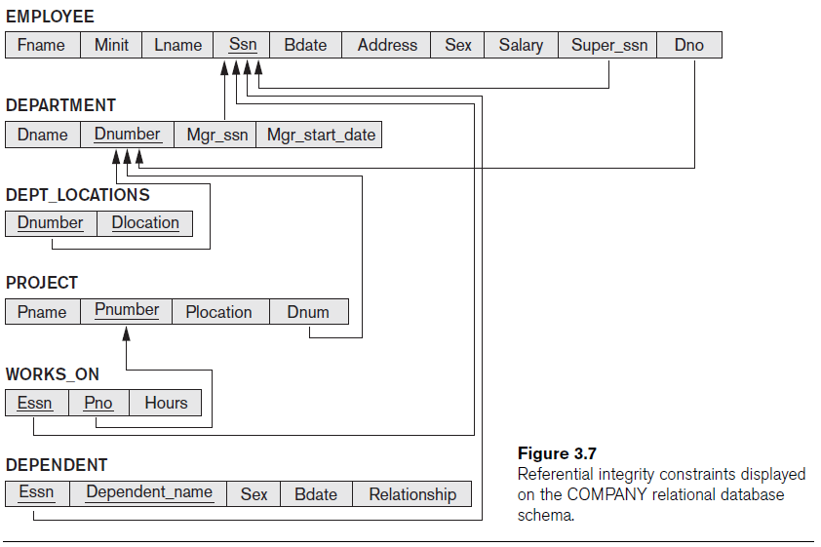
Example
Recall Employee example:

Slide 14
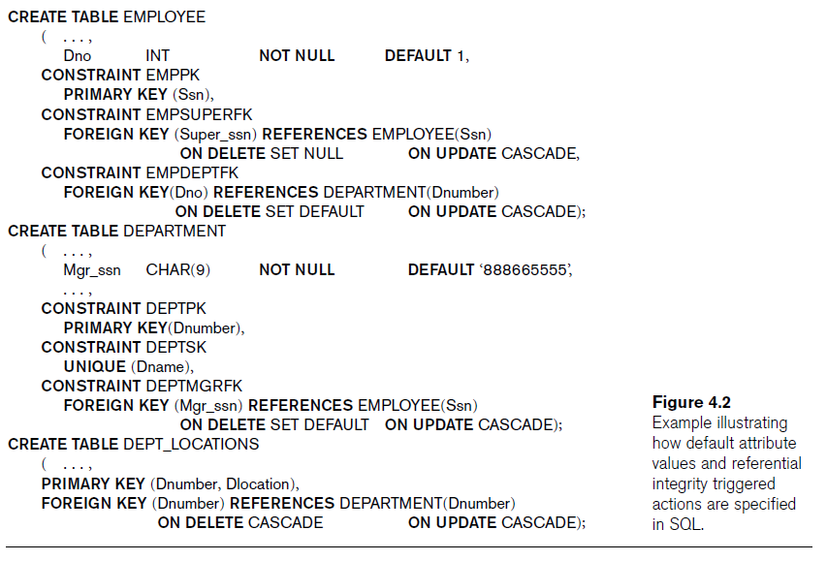

Slide 15
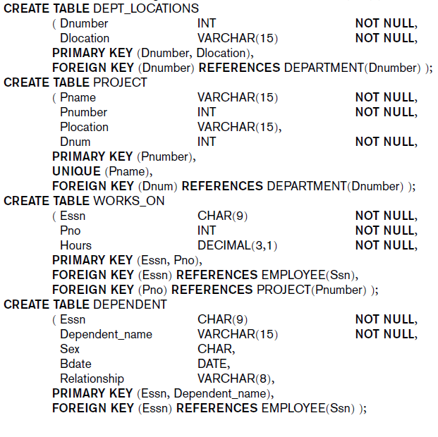

Slide 16
Basic SQL Retrieval Queries
All retrievals use SELECT statement:
SELECT <return list>
FROM <table list>
[ WHERE <condition> ] ;
where
<return list> is a list of expressions or column names whose values are to be retrieved by the query
<table list> is a list of relation names required to process the query
<condition> is a Boolean expression that identifies the tuples to be retrieved by the query
Example
SELECT title, year, genre
FROM Film
WHERE director = 'Steven Spielberg' AND year > 1990;
Omitting WHERE clause implies all tuples selected.

Slide 17
Semantics for 1 Relation
Start with the relation named in the FROM clause
Consider each tuple one after the other, eliminating those that do not satisfy the WHERE clause.
Boolean condition that must be true for any retrieved tuple
Logical comparison operators
=, <, <=, >, >=, and <>
For each remaining tuple, create a return tuple with columns for each expression (column name) in the SELECT clause.
Use SELECT * to select all columns.
Film
title | genre | year | director | minutes | budget | gross
The Company Men | drama | 2010 | John Wells | 104 | 15,000,000 | 4,439,063
Lincoln | biography | 2012 | Steven Spielberg | 150 | 65,000,000 | 181,408,467
War Horse | drama | 2011 | Steven Spielberg | 146 | 66,000,000 | 79,883,359
Argo | drama | 2012 | Ben Affleck | 120 | 44,500,000 | 135,178,251

Slide 18
SELECT-FROM-WHERE Semantics
What if there are several relations in the FROM clause?
Start with cross-product of all relation(s) listed in the FROM clause.
Every tuple in R₁ paired up with every tuple in R₂ paired up with …
Consider each tuple one after the other, eliminating those that do not satisfy the WHERE clause.
For each remaining tuple, create a return tuple with columns for each expression (column name) in the SELECT clause.
Steps 2 and 3 are just the same as before.
SELECT actor, birth, movie
FROM Role, Person
WHERE actor = name and birth > 1940;
Role
actor | movie | persona
Ben Affleck | Argo | Tony Mendez
Alan Arkin | Argo | Lester Siegel
Ben Affleck | The Company Men | Bobby Walker
Tommy Lee Jones | The Company Men | Gene McClary
Person
name | birth | city
Ben Affleck | 1972 | Berkeley
Alan Arkin | 1934 | New York
Tommy Lee Jones | 1946 | San Saba

Slide 19
Ambiguous Column Names
Same name may be used for two (or more) columns (in different relations)
Must qualify the column name with the relation name to prevent ambiguity
Customer
custid | name | address | phone
Sale
saleid | date | custid
LineItem
saleid | product | quantity | price
SELECT name, date, product, quantity
FROM Customer, Sale, LineItem
WHERE price > 100 AND Customer.custid = Sale.custid AND Sale.saleid = LineItem.saleid;
Note
If SELECT clause includes custid, it must specify whether to use Customer.custid or Sale.custid even though the values are guaranteed to be identical. ☹

Slide 20
2-Relation Select-From-Where
SELECT award, actor, persona, Role.movie
FROM Honours, Role
WHERE category = 'actor' AND winner = actor
AND Honours.movie = Role.movie
Honours
movie | award | category | winner
Lincoln | Critic's Choice | actor | Daniel Day-Lewis
Argo | Critic's Choice | director | Ben Affleck
Lincoln | SAG | supporting actor | Tommy Lee Jones
Lincoln | Critic's Choice | screenplay | Tony Kushner
War Horse | BMI Flim | music | John Williams
Role
actor | movie | persona
Ben Affleck | Argo | Tony Mendez
Tommy Lee Jones | Lincoln | Thaddeus Stevens
Daniel Day-Lewis | The Boxer | Danny Flynn
Daniel Day-Lewis | Lincoln | Abraham Lincoln
Honours.movie | award | category | winner | actor | Role.movie | persona
Lincoln | Critic's Choice | actor | Daniel Day-Lewis | Ben Affleck | Argo | Tony Mendez | ✗
Lincoln | Critic's Choice | actor | Daniel Day-Lewis | Tommy Lee Jones | Lincoln | Thaddeus Stevens | ✗
Lincoln | Critic's Choice | actor | Daniel Day-Lewis | Daniel Day-Lewis | The Boxer | Danny Flynn | ✗
Lincoln | Critic's Choice | actor | Daniel Day-Lewis | Daniel Day-Lewis | Lincoln | Abraham Lincoln | ☑
Argo | Critic's Choice | director | Ben Affleck | Ben Affleck | Argo | Tony Mendez | ✗
Argo | Critic's Choice | director | Ben Affleck | Tommy Lee Jones | Lincoln | Thaddeus Stevens | ✗
Argo | Critic's Choice | director | Ben Affleck | Daniel Day-Lewis | The Boxer | Danny Flynn | ✗
Argo | Critic's Choice | director | Ben Affleck | Daniel Day-Lewis | Lincoln | Abraham Lincoln | ✗
Lincoln | SAG | supporting actor | Tommy Lee Jones | Ben Affleck | Argo | Tony Mendez | ✗
Lincoln | SAG | supporting actor | Tommy Lee Jones | Tommy Lee Jones | Lincoln | Thaddeus Stevens | ✗
Lincoln | SAG | supporting actor | Tommy Lee Jones | Daniel Day-Lewis | The Boxer | Danny Flynn | ✗
…

Slide 21
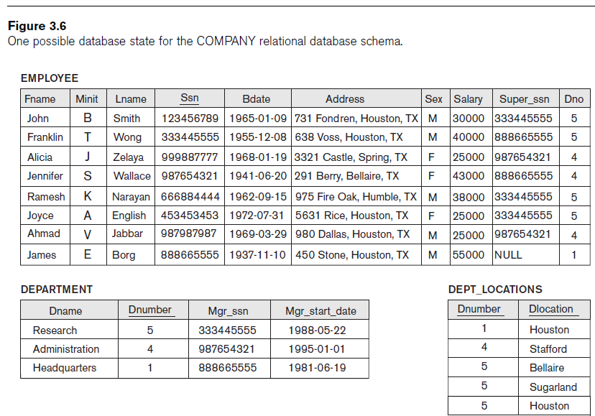
Recall Sample Tables

Slide 22
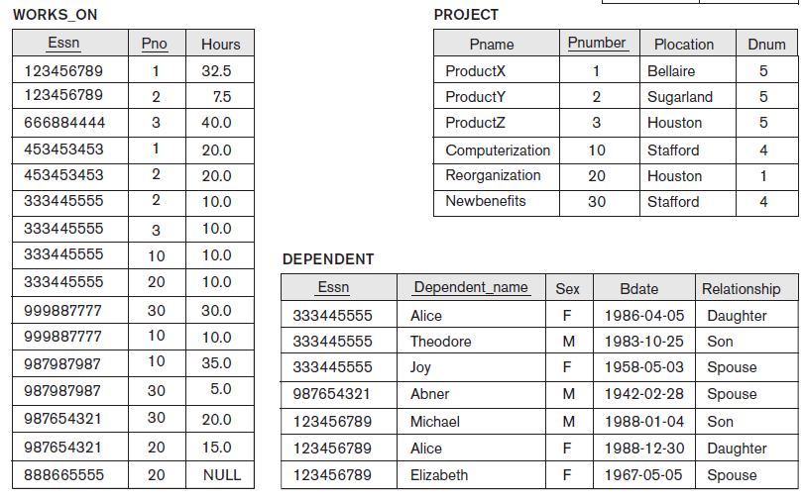

Slide 25
Tables as Sets in SQL
Duplicate tuples may appear in query results
From duplicates in base tables
From projecting out distinguishing columns
Keyword DISTINCT in the SELECT clause eliminates duplicates

Slide 26
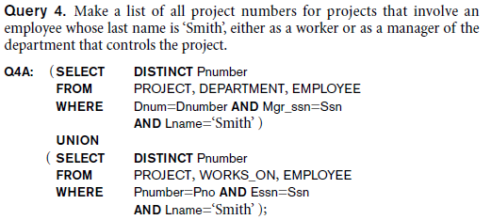
Set Operations
Result treated as a set (no duplicates)
UNION, EXCEPT (difference), INTERSECT
Corresponding multiset (bag) operations:
UNION ALL, EXCEPT ALL, INTERSECT ALL
Arguments must be union-compatible
Same number of columns
Corresponding columns of same type

Slide 27
Other Operators
Standard arithmetic operators:
Addition (+), subtraction (–), multiplication (*), and division (/)
[NOT] LIKE comparison operator
Used for string pattern matching
Percent sign (%) matches zero or more characters
Underscore (_) matches a single character
e.g., to also match Tommy Lee Jones as supporting actor:
SELECT award, actor, persona, Role.movie
FROM Honours, Role
WHERE category LIKE '%actor' AND winner = actor AND Honours.movie = Role.movie;
[NOT] BETWEEN comparison operator
WHERE year BETWEEN 1990 AND 2010
equivalent to WHERE year >= 1990 AND YEAR <= 2010

Slide 28
Lecture Summary
Introduction to SQL
Comprehensive language
Data definition including constraint specification
Basic SELECT-FROM-WHERE
Set operators

