Slide 1
Constraints and Updates
Chapter 3 (6/E)
Chapter 5 (5/E)

Slide 2
Lecture Outline
Constraints in Relational Databases
Update Operations
Brief History of Database Applications (from Section 1.7)

Slide 3
Relational Model Constraints
Constraints
Restrictions on the permitted values in a database state
Derived from the rules in the miniworld that the database represents
Inherent model-based constraints or implicit constraints
Inherent in the data model
e.g., duplicate tuples are not allowed in a relation
Schema-based constraints or explicit constraints
Can be directly expressed in schemas of the data model
e.g., films have only one director
Application-based or semantic constraints
Also called business rules
Not directly expressed in schemas
Expressed and enforced by application program
e.g., this year’s salary increase can be no more than last year’s

Slide 4
Domain Constraints
Declared by specifying the data type for each attribute:
Numeric data types for integers and real numbers
Characters
Booleans
Fixed-length strings
Variable-length strings
Date, time, timestamp
Money
Other special data types

Slide 5
Key Constraints
Uniqueness constraints on tuples
SK ⊆ {A₁, A₂, ..., A_{n}} is a superkey of R(A₁, A₂, ..., A_{n}) if
In any relation state r of R, no two distinct tuples can have the same values for SK
t₁ [SK] = t₂ [SK] ⇒ t₁ = t₂
K is a key of R if
K is a superkey of R
Removing any attribute from K leaves a set of attributes that is not a superkey of R any more
No proper subset of K is a superkey of R
If K is a key, it satisfies two properties
No two distinct tuples have the same values across all attributes in K (i.e., it is a superkey)
It is a minimal superkey (i.e., no subset of K has this uniqueness constraint)

Slide 6
Key Constraints (cont’d.)
What are some possible keys for the following relation?
Note that the instance can show that something is not a key, but we need to declare as part of the schema that something is a key.
Uniqueness must hold in all valid relation states.
Serves as a constraint on updates.
Film
title | genre | year | director | minutes | budget | gross
The Company Men | drama | 2010 | John Wells | 104 | 15,000,000 | 4,439,063
Lincoln | biography | 2012 | Steven Spielberg | 150 | 65,000,000 | 181,408,467
War Horse | drama | 2011 | Steven Spielberg | 146 | 66,000,000 | 79,883,359
Argo | drama | 2012 | Ben Affleck | 120 | 44,500,000 | 135,178,251
Fire Sale | comedy | 1977 | Alan Arkin | 88 | 1,500,000 | NULL
Lincoln | biography | 1992 | Peter W. Kunhardt | 240 | NULL | NULL
Life | comedy | 1999 | Ted Demme | 108 | 75,000,000 | 63,844,974
Life | drama | 1999 | Eun-Ryung Cho | 19 | NULL | NULL

Slide 7
Key Constraints (cont’d.)
Primary key of the relation
Relation schema may have more than one key.
Declare one chosen key among candidates as primary
Its values will be used to refer to specific tuples
Cannot have the value NULL for any tuple
Diagrammatically, underline attribute
Other candidate keys are designated as unique
Non-null values cannot repeat, but values may be NULL

Slide 8
Satisfying Integrity Constraints
Relational database schema S
Set of relation schemas S = {R₁, R₂, ..., R_{m}}
Set of integrity constraints IC
Valid relational database state
Set of relation states DB = {r₁, r₂, ..., r_{m}}
Each r_{i} is a state of R_{i} such that r_{i} satisfies integrity constraints specified in IC
Invalid state
Does not obey all the integrity constraints

Slide 9
Other Integrity Constraints
Already defined domain constraints and key constraints
Entity integrity constraint
No primary key value can be NULL
Referential integrity constraint
Specified between two relations
Allows tuples in one relation to refer to tuples in another
Maintains consistency among tuples in two relations
Foreign key rules:
Let PK be the primary key in one relation R₁ (set of attributes in its relational schema declared to be primary key)
Let FK be a set of attributes for another relation R₂
The attribute(s) FK have the same domain(s) as the attribute(s) PK
Value of FK in a tuple t₂ of the current state r₂(R₂) either occurs as a value of PK for some tuple t₁ in the current state r₁(R₁) or it is NULL

Slide 10
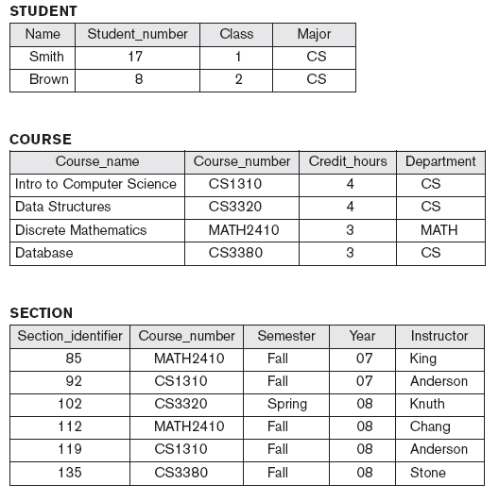
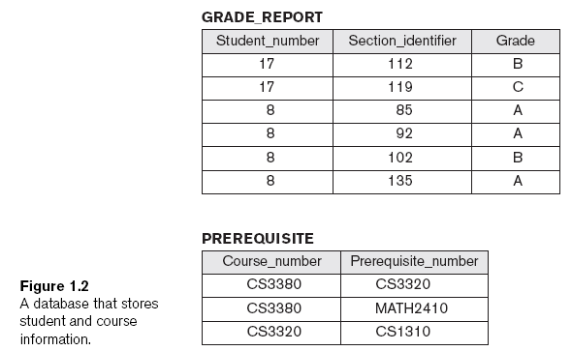

Slide 11
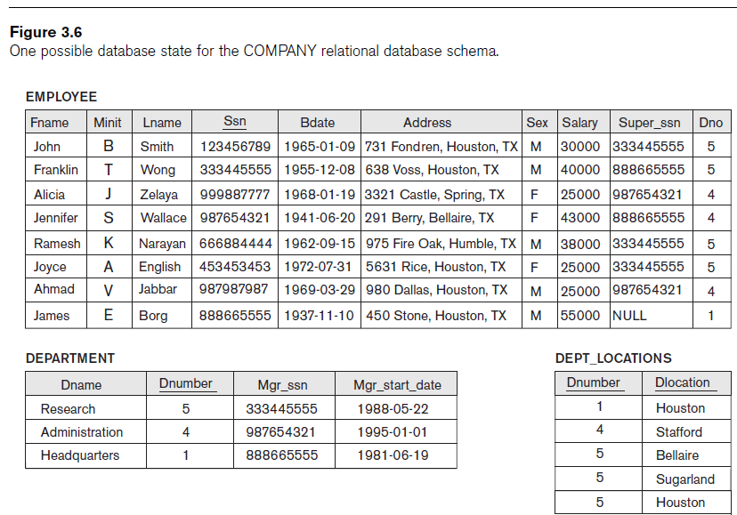

Slide 12
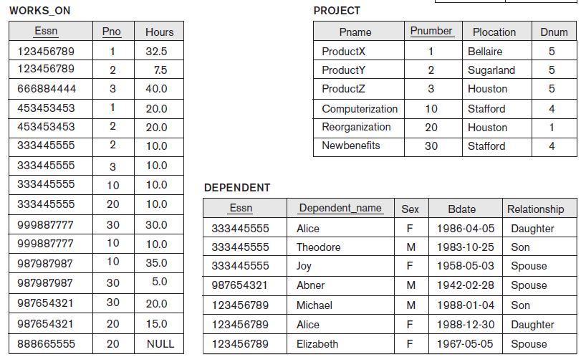

Slide 13
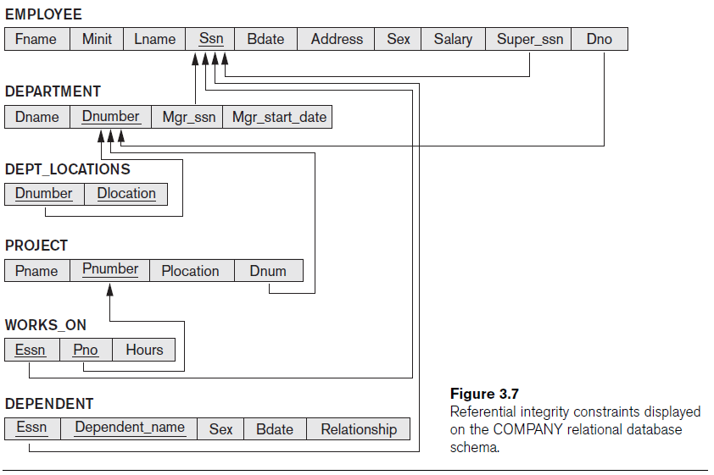
Diagramming Ref Constraints
Show each relational schema
Underline primary key attributes in each
Directed arc from each foreign key to the relation it references

Slide 14
More Integrity Constraints
Functional dependency constraint
Establishes a functional relationship among two sets of attributes X and Y
Value of X attributes determines a unique value of Y attributes
(more later in the course)
Semantic integrity constraints
Specified by business rules outside the schema
Sometimes declared using database triggers and assertions
Often undeclared but checked within application programs
State (static) constraints
Define conditions that a valid state of the database must satisfy
Transition (dynamic) constraints
Define valid state changes in the database

Slide 15
Update Operations
Operations of the relational model are retrievals or changes
Basic operations that change the states of relations in the database:
Insert
Delete
Update (or Modify)
Updates must be consistent with constraints

Slide 16
The Insert Operation
Select a relation R and provide a list of attribute values for a new tuple t to be inserted into (appended to) R
Need to check against all constraints
If an insertion violates one or more constraints
Default option is to reject the insertion

Slide 17
The Delete Operation
Select the tuple(s) to be deleted
Can violate referential integrity only
If tuple being deleted is referenced by foreign keys from other tuples
Restrict
Reject the deletion
Cascade
Propagate the deletion by deleting tuples that reference the tuple being deleted
Set null or set default
Modify the referencing attribute values that cause the violation

Slide 18
The Update Operation
Select the tuple (or tuples) to be modified
If attribute not part of a primary key nor of a foreign key
Usually causes no problems
Updating a primary/foreign key
Similar possible constraint violations as with Insert/Delete

Slide 19
The Transaction Concept
Transaction
Executing program includes some database operations
To be considered as if it were just a single operation
Must leave the database in a valid or consistent state
Online transaction processing (OLTP) systems
Examples: reservation systems, purchase systems
Execute transactions at rates that reach several hundred per second

Slide 20
Brief History
Relational model
Formulated by E.F.Codd (IBM) before 1970
First commercial implementations available in early 1980s
Predominant database model used today
(earlier) Hierarchical and network models
Preceded the relational model
Pointer-based
Access relied on record-at-a-time navigation
(later) Object-oriented applications and more complex databases
Object-relational model
Used in specialized applications: engineering design, multimedia publishing, and manufacturing systems

Slide 21
Recent History
Interchanging data on the Web for e-commerce using XML
Extended markup language (XML) primary standard for interchanging data among various types of databases and Web pages
Moving to cloud-based services
Extending database capabilities for new applications
Extensions to support specialized requirements for applications
Enterprise resource planning (ERP)
e.g., SAP
Customer relationship management (CRM)
e.g., SAP
Enterprise content management (ECM)
e.g., Open Text
includes extensions to information retrieval (IR) to deal with documents (proposals, reports, news articles, etc.)

Slide 22
Lecture Summary
Classify database constraints into:
Inherent model-based constraints, explicit schema-based constraints, and application-based constraints
Modification operations on the relational model:
Insert, Delete, and Update
Database applications have evolved
Current trend: “Big data” involving Web, social networks, scientific or financial streams

