Slide 1
The Relational Data Model
Chapter 3 (6/E)
Chapter 5 (5/E)

Slide 2
Lecture Outline
Relational Model Concepts
Relational Database Schemas
Update Operations
Brief History of Database Applications (from Section 1.7)

Slide 3
Relational Model Concepts
Represent data as a collection of relations
Table of values
Each row (tuple)
Represents a record of related data values
Facts that typically correspond to a real-world entity or relationship
Each column (attribute)
Holds a corresponding value for each row
Slot for a specific interpretation for a row

Slide 4
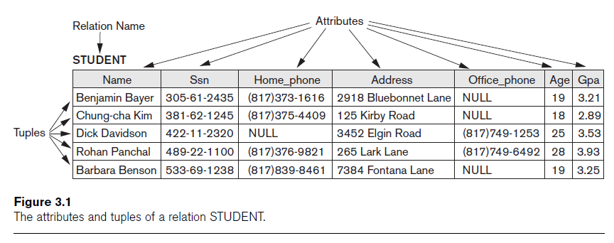
Relational Model (cont’d.)
Schema describes table
Table name, attribute names and types
Instance denotes the current contents of the table
The relation (or relation state)

Slide 5
Domains
Domain D
Set of atomic values
{0,1,2,…}
{Jo Smith, Dana Jones, Ashley Wong, Y. K. Lee,…}
Atomic
Each value indivisible
Domain specified by Data type rather than by enumeration
Integer, String, Date, Real, etc.
Can be specified by format: (ddd)ddd-dddd

Slide 6
Schemas and Attributes
Relation schema
A relation name R and a list of attributes: A₁, A₂, ..., A_{n}
Denoted by R(A₁, A₂, ..., A_{n})
Attribute A_{i}
Name of a role in the relation schema R
Associated with a domain dom(A_{i})
Attribute names do not repeat within relation schema, but domains can repeat.
Degree (or arity) of a relation
Number of attributes n in its relation schema

Slide 7
Formalization
Relation (or relation state)
Set of n-tuples r = {t₁, t₂, ..., t_{m}}
Unordered, no duplicates
Each n-tuple t
Ordered list of n values t =<v₁, v₂, ..., v_{n}>
Each value v_{i}, 1 ≤ i ≤ n, is an element of dom(A_{i})
Instance of relation schema R(A₁, A₂, A₃, …, A_{n})
Finite subset of the Cartesian product of the domains defining R:
rel(R) ⊆ (dom(A₁) × dom(A₂) × ... × dom(A_{n}))
Because of updates, relations are time-varying
rel(R) is relation state at a given time
Reflects only (and all) the valid tuples that represent a particular state of the real world

Slide 8
Relational Model Notation
Symbolic notation
Uppercase letters Q, R, S denote relation names
Corresponding lowercase letters q, r, s denote corresponding relation states
Uppercase letters A, B, C, …, H denote attributes
Attribute A can be qualified with the relation name R to which it belongs using the dot notation, e.g., R.A
Lower case letters t, u, v denote tuples

Slide 9
Alternative defn of relation
Tuple considered as a function from attributes to values
t_{j} : {A₁, A₂, A₃, …, A_{n}} → $\text{dom}\text{(}\text{A}\text{1}\text{)}$ $∪\text{dom}\text{(}\text{A}\text{2}\text{)}$ $∪$ … $∪\text{dom}\text{(}\text{A}\text{n}\text{)}$
Use notation t_{j}[A_{i}] or t_{j}.A_{i} to refer to tuple’s value v_{i} from dom(A_{i})
Similarly t_{j}[A_{u}, A_{w}, ..., A_{z}] and t_{j}.(A_{u}, A_{w}, ..., A_{z}) refer to the subtuple of values <v_{u}, v_{w}, ..., v_{z}> from t_{j} for attributes A_{u}, A_{w}, ..., A_{z}
Therefore, tuple is a set of <attribute, value> pairs
e.g., for attendee (id, givenName, surname, company, dateOfBirth)
t = <10483, John, Doe, IBM, 1978-11-05>
t[id] = 10483, t[givenName] = John, t[surname] = Doe, t[company] = IBM, t[dateOfBirth] = 1978-11-05
t.id = 10483, t.givenName = John, t.surname = Doe, t.company = IBM, t.dateOfBirth = 1978-11-05
t = { <id, 10483>, <givenName, John>, <surname, Doe>, <company, IBM>, <dateOfBirth, 1978-11-05> }

Slide 10
Values in Tuples
Each value in a tuple is atomic
Flat (as opposed to nested) relational model
Composite and multivalued attributes not allowed
Historically relation is said to be in First normal form (1NF)
Composite attributes
Split into simple component attributes
e.g., Waterloo, Ontario treated as atomic or split into two attributes to store Waterloo separately from Ontario
Multivalued attributes
Must be represented by separate relations
Recall: Director could be stored as attribute of FILM because only one director per film assumed, but multiple characters in a film implies that ROLE must have its own relation.

Slide 11
NULL Values
Assume each domain is augmented with a special NULL value
Represent the values of attributes that may be unknown or may not apply to a tuple
Interpretations for NULL values
Nothing is known about the value
Value exists but is (currently) not available
Value undefined
i.e., attribute does not apply to this tuple
If an attribute for a tuple is mapped to NULL, cannot make any assumptions about the value for that attribute (for that tuple)
e.g., Ashley’s telephone number is NULL could mean
Ashley doesn’t have a phone
Ashley has a phone but we don’t know the number (perhaps withheld)
Ashley has a phone that has no number
Ashley may or may not have a phone, but regardless we don’t have a number for Ashley

Slide 12
Meaning of a relation
Assertion
Each tuple in the relation interpreted as a fact.
No other similar facts are of interest to the enterprise.
e.g., a relation for Classlist includes only registered students and all registered students are included in Classlist
presence in list ⇔ registered student
Predicate
Values in each tuple interpreted as values that satisfy predicate
e.g., Name of student having ID 83201556 is Lee Wong

Slide 13
Lecture Summary
Characteristics differentiate relations from ordinary tables or files
Schemas vs. instances (states)
Formal definitions for relations and tuples
Null values

