Slide 1
Introduction to Transaction Processing
Chapter 21 (6/e)
Chapter 17 (5/e)

Slide 2
Lecture Outline
Introduction to Transaction Processing
Desirable Properties of Transactions
Transaction Support in SQL

Slide 3
Definitions
Transaction: an executing program (process) that includes one or more database access operations
A logical unit of database processing
Example from banking database: Transfer of $100 dollars from a chequing account to a savings account
Characteristic operations
Reads (database retrieval, such as SQL SELECT)
Writes (modify database, such as SQL INSERT, UPDATE, DELETE)
Note: Each execution of a program is a distinct transaction with different parameters
Bank transfer program parameters: savings account number, chequing account number, transfer amount
Online Transaction Processing (OLTP) Systems: Large multi-user database systems supporting thousands of concurrent transactions (user processes) per minute

Slide 4
Why we need transactions
A database is a shared resource accessed by many users and processes concurrently.
Not managing this concurrent access to a shared resource will cause problems (not unlike in operating systems)
Problems due to concurrency
Problems due to failures

Slide 5
Transaction Processing Model
Simple database model:
Database: collection of named data items
Granularity (size) of each data item immaterial
A field (data item value), a record, or a disk block
TP concepts are independent of granularity
Basic operations on an item X:
read_item(X): Reads a database item X into a program variable
For simplicity, assume that the program variable is also named X
write_item(X): Writes the value of program variable X into the database item named X
Read and write operations take some amount of time to execute

Slide 6
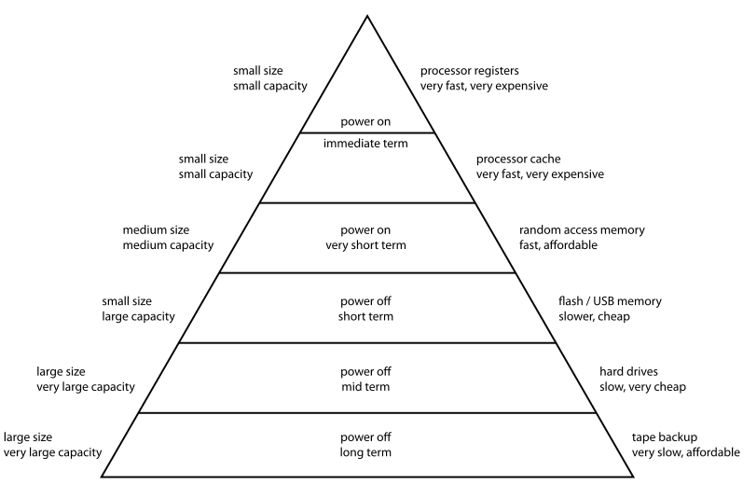
Computer Storage Hierarchy
program variables
DB items

Slide 7
READ AND WRITE OPERATIONS
DBMS pages
Database File
Memory Buffers (cache)
Disk
Basic unit of data transfer from the disk to the computer main memory is one disk block (or page).
read_item(X) includes the following steps:
Find the address of the disk block that contains item X.
Copy that disk block into a buffer in main memory (if that disk block is not already in some main memory buffer).
Copy item X from the buffer to the program variable named X.
write_item(X) includes the following steps:
Find the address of the disk block that contains item X.
Copy that disk block into a buffer in main memory (if it is not already in some main memory buffer).
Copy item X from the program variable named X into its correct location in the buffer.
Store the updated block from the buffer back to disk
either immediately or, more typically, at some later point in time

Slide 8
Back to Transactions
Transaction (sequence of executing operations) may be:
Stand-alone, specified in a high level language like SQL submitted interactively, or
More typically, embedded within application program
Transaction boundaries: Begin_transaction and End_transaction
Application program may include specification of several transactions separated by Begin and End transaction boundaries
Transaction code can be executed several times (in a loop), spawning multiple transactions
Transactions can end in two states:
Commit: transaction successfully completes and its results are committed (made permanent)
Abort: transaction does not complete and none of its actions are reflected in the database

Slide 9
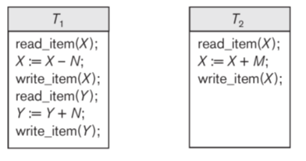
Transaction Notation
Focus on read and write operations
T₁: b₁; r₁(X); w₁(X); r₁(Y); w₁(Y); e₁;
T₂: b₂; r₂(Y); w₂(Y); e₂;
b_{i} and e_{i} specify transaction boundaries (begin and end)
i specifies a unique transaction identifier (Tid)
w₅(Z) means transaction 5 writes out the value for data item Z

Slide 10
Modes of concurrency
Interleaved processing: concurrent execution of processes is interleaved on a single CPU
Parallel processing: processes are concurrently executed on multiple CPUs
Basic transaction processing theory assumes interleaving

Slide 11
What can go wrong?
Consider two concurrently executing transactions:
System might crash after transaction begins and before it ends.
Money lost if between 3 and 6 or between c and d
Updates lost if write to disk not performed before crash
Chequing account might have incorrect amount recorded:
$20 withdrawal might be lost if T2 executed between 4 and 6
$100 deposit might be lost if T1 executed between a and c
In fact, same problem if just 6 executed between a and c
 | at ATM window #1 |  | at ATM window #2
1 | read_item(savings); | a | read_item(chequing);
2 | savings = savings - $100; | b | chequing = chequing - $20;
3 | write_item(savings); | c | write_item(chequing);
4 | read_item(chequing); | d | dispense $20 to customer;
5 | chequing = chequing + $100;
6 | write_item(chequing);

Slide 12
ACID Properties
Atomicity: A transaction is an atomic unit of processing; it is either performed in its entirety or not performed at all.
Consistency preservation: A correct execution of the transaction must take the database from one consistent state to another.
Isolation: Even though transactions are executing concurrently, they should appear to be executed in isolation – that is, their final effect should be as if each transaction was executed in isolation from start to finish.
Durability: Once a transaction is committed, its changes (writes) applied to the database must never be lost because of subsequent failure.
Enforcement of ACID properties:
Database constraint system (and application program correctness) responsible for C (introduced in previous classes)
Concurrency control responsible for I (more in next class)
Recovery system responsible for A and D (more in next class)

Slide 13
Transaction Support in SQL
A single SQL statement is always considered to be atomic.
Either the statement completes execution without error or it fails and leaves the database unchanged.
No explicit Begin_Transaction statement.
Transaction initiation implicit at first SQL statement and at next SQL statement after previous transaction terminates
Every transaction must have an explicit end statement
COMMIT: the DB must assure that the effects are permanent
ROLLBACK: the DB must assure that the effects are as if the transaction had not yet begun

Slide 14
Sample SQL transaction
update_proc() {
EXEC SQL WHENEVER SQLERROR GO TO error;
EXEC SQL INSERT
INTO EMPLOYEE
VALUES ('Robert','Smith','991004321',2,35000);
EXEC SQL UPDATE EMPLOYEE
SET SALARY = SALARY * 1.1
WHERE DNO = 2;
EXEC SQL COMMIT;
return(0);
error: /* continue if error on rollback */
EXEC SQL WHENEVER SQLERROR CONTINUE;
EXEC SQL ROLLBACK;
return(1);
}

Slide 15
Lecture Summary
Transaction concepts
ACID properties for transactions
Transaction support in SQL

