Slide 1
Database System Concepts and Architecture
Chapter 2

Slide 2
Lecture Outline
Data Models
Three-Schema Architecture and Data Independence
Database Languages and Interfaces
The Database System Environment
DBMS Architectures
Classification of Database Management Systems

Slide 3
Data Model
Collection of concepts that describe the structure of a database
Provides means to achieve data abstraction
Suppression of details of data organization and storage
Highlighting of the essential features for an improved understanding of data
Includes basic operations
Retrievals and updates on the database
Dynamic aspect or behavior of a database application
Allows the database designer to specify a set of valid operations allowed on database objects

Slide 4
Categories of Data Models
High-level or conceptual data models
Close to the way many users perceive data
For example, object-oriented models
Low-level or physical data models
Describe the details of how data is stored on computer storage media
Include explicit access paths
Structure that makes locating particular database records efficient
Example: Index
Allows direct access to record by looking up a value
Compromise: Representational data models
Abstract model of data
Emphasize aspects that should be understood by end users
Close enough to how data organized in computer storage that they can be implemented efficiently
Where does the relational data model fit?

Slide 5
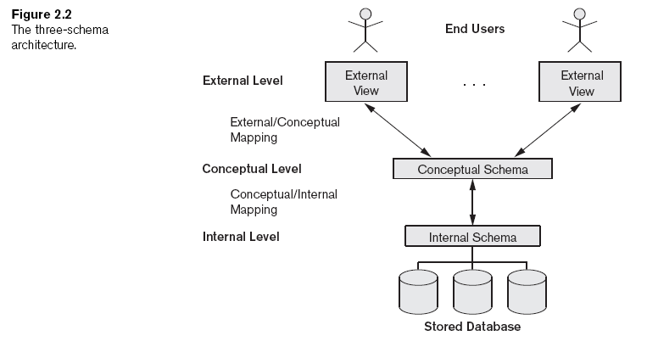
Three-Schema Architecture
Internal level
Describes physical storage structure of the database
Conceptual level
Describes structure of the whole database for the complete community of users
External or view level
Describes part of the database of interest to a particular user group

Slide 6
Data Independence
Capacity to change the schema at one level of a database system without having to change the schema at the next higher level
Change the mappings between schemas
Conceptual schema reflects the enterprise
Relatively stable
Serves as Universe of Discourse
Physical data independence achieved through conceptual/internal mapping
Logical data independence achieved through external/conceptual mappings

Slide 7
DBMS Languages
Data definition language (DDL)
Defines conceptual schema
Storage definition language (SDL)
Specifies the internal schema
View definition language (VDL)
Specifies user views/mappings to conceptual schema
Data manipulation language (DML)
Allows retrieval, insertion, deletion, modification
Low-level or procedural DML
Must be embedded in a general-purpose programming language
Record-at-a-time
High-level or non-procedural DML
Can be used on its own to specify complex database operations concisely
Set-at-a-time or set-oriented

Slide 8
DBMS Interfaces
Menu-based interfaces for Web clients or browsing
Forms-based interfaces
Graphical user interfaces
Natural language interfaces
Speech input and output
Interfaces for parametric users
Interfaces for the DBA

Slide 9
DBMS Component Modules
Stored data manager
DDL compiler
Interactive query interface
Query compiler
Query optimizer
Precompiler
Runtime database processor
System catalog
Concurrency control system
Backup and recovery system

Slide 10
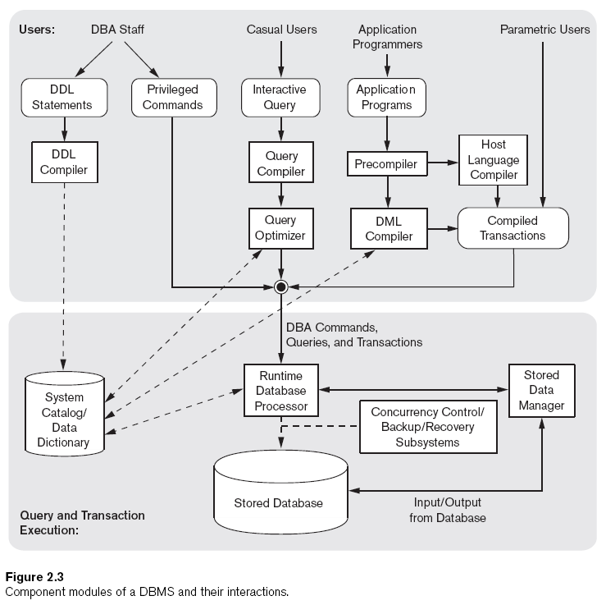

Slide 11
Clicker Question #30
When using DB2, a DBA can organize the data to try to minimize access time by declaring that records are to be stored in “arrival sequence” so that new ones are stored near one another on the disk. This is an example of
A: physical independence
B: logical independence
C: a relational schema
D: specifying an access path
E: backup and recovery

Slide 12
DBMS Utilities
Loading
Load existing data files
Backup
Creates a backup copy of the database
Database storage reorganization
Reorganize a set of database files into different file organizations
Performance monitoring
Monitors database usage and provides statistics to the DBA

Slide 13
DBMS-Related Facilities
CASE Tools
Data dictionary (data repository) system
Stores design decisions, usage standards, application program descriptions, and user information
Application development environments
Communications software

Slide 14
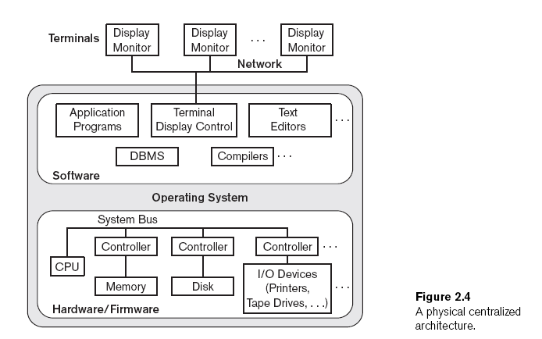
Centralized DBMS Architecture
All DBMS functionality, application program execution, and user interface processing carried out on one machine

Slide 15
Basic Client/Server Architectures
Servers with specific functionalities
File server
Maintains the files of the client machines.
Printer server
Connected to various printers; all print requests by the clients are forwarded to this machine
Web servers or e-mail servers
Client machines
Provide user with:
Appropriate interfaces to use these services
Local processing power to run local applications
DBMS example
Server handles query, update, and transaction functionality
Client handles user interface programs and application programs

Slide 16
Client/Server DBMS Software
Open Database Connectivity (ODBC)
Provides application programming interface (API) for C and C++
Call Level Interface (CLI)
Allows client-side programs to call the DBMS
Both client and server machines must have the necessary software installed
JDBC
Allows Java client programs to access one or more DBMSs through a standard interface
Alternative: Microsoft’s ADO.NET

Slide 17
3-Tier Client-Server DBMS Architecture
Code partitioned between clients (user interfaces), application server, and DBMS modules
Database

Slide 18
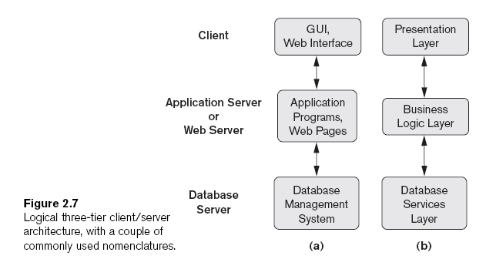

Slide 19
Classification of DBMSs
General or special-purpose
Data model
Relational
Object
Object-relational
Hierarchical and network (legacy)
Native XML
Number of users
Single-user
Multiuser
Number of sites
Centralized
Distributed
Homogeneous
Heterogeneous (Federated)
Licensing
Open source
Proprietary

Slide 20
Lecture Summary
Main categories of data models
Three-schema architecture
Types of languages and interfaces supported by DMBSs
Components and services provided by the DBMS
DBMS computing architectures
DBMS classification criteria

