Slide 1
Functional Dependencies
Chapter 15.1-15.2, 15.5 (6/E)
Chapter 10.1-10.2, 10.5 (5/E)

Slide 2
Lecture Outline
Design guidelines for relation schemas
Functional dependencies
Definition and interpretation
Formal definition of keys
Boyce-Codd Normal Form (BCNF)
Application of dependency theory to checking DB design

Slide 3
Goodness in Relational Design
Clarity of attributes provides semantics for relation schema.
Naming of attributes
Fit of attributes with each other
Guideline 1
Design each relation schema so that it is easy to explain its meaning.
Natural result of good ER design
Do not arbitrarily combine attributes from multiple entity types and relationship types into a single relation.
How can we measure how well attributes fit together?
Amount of redundant information in tuples
Amount of NULL values in tuples
Possibility of generating spurious tuples

Slide 4
Mis-packaged Attributes
Every tuple includes employee data and department data
Redundancy
Dept name and manager id repeated for every employee in dept
Potential for too many NULL values
Departments with no employees need to pad tuple with NULLS
Employees not in any department need to pad tuples with NULLS
Update anomalies
Deleting the last employee in a dept should not delete dept
Changing the dept name/mgr requires many tuples to be updated
Inserting employees requires checking for consistency of its dept name and manager
Guideline 2
Design relational DB schema so that every fact can be stored in one and only one tuple.

Slide 5
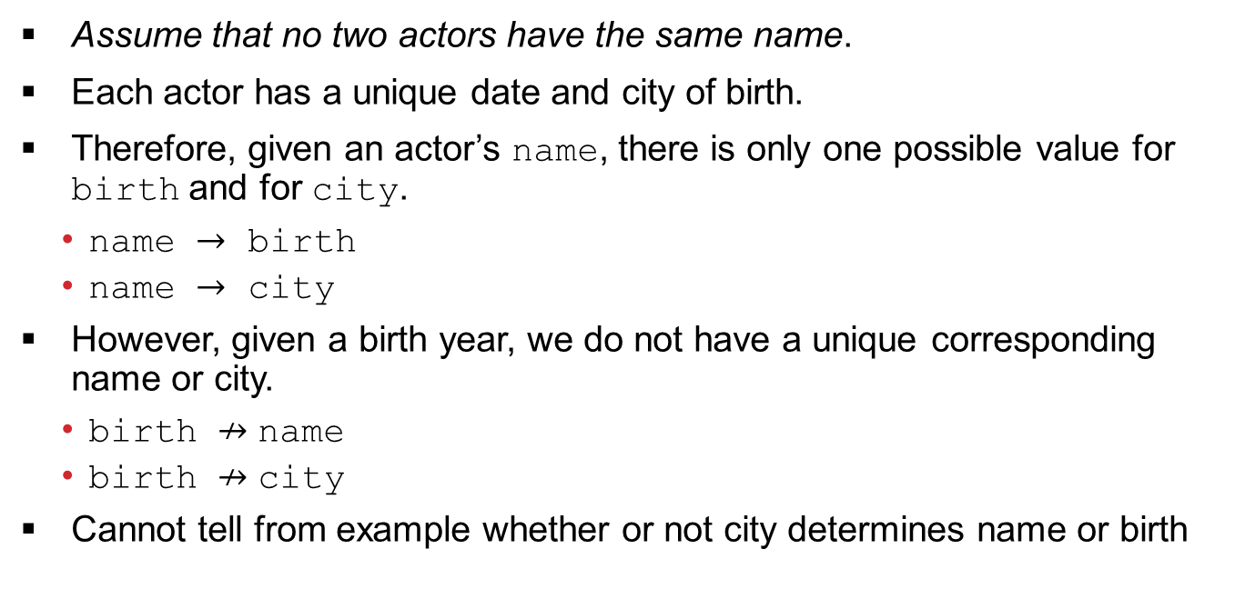
Simple Dependencies
Actor
name | birth | city
Ben Affleck | 1972 | Berkeley
Alan Arkin | 1934 | New York
Tommy Lee Jones | 1946 | San Saba
John Wells | 1957 | Alexandria
Steven Spielberg | 1946 | Cincinnati
Daniel Day-Lewis | 1957 | Greenwich
Assume that no two actors have the same name.
Each actor has a unique date and city of birth.
Therefore, given an actor’s name, there is only one possible value for birth and for city.
name $→$ birth
name $→$ city
However, given a birth year, we do not have a unique corresponding name or city.
birth ↛ name
birth ↛ city
Cannot tell from example whether or not city determines name or birth

Slide 6
Functional Dependency
Constraint between two sets of attributes from the database
Property of semantics or meaning of the attributes
Recognized and recorded as part of database design
Given a relation state
Cannot determine which functional dependencies hold
Can state that functional dependency does not hold if there are tuples that show violation of the dependency
Write {B₁,B₂,…,B_{i}} → {C₁,C₂,…,C_{j}} but can omit set braces if i=1 or j=1, respectively.
{name} → {birth,city} or name → {birth,city}
Given relation scheme R(A₁,A₂,…,A_{n}) and sets of attributes X ⊆ {A₁,A₂,…,A_{n}}, Y ⊆ {A₁,A₂,…,A_{n}}, X → Y specifies the following constraint: for any tuples t₁ and t₂ in any valid relation state r of R, if t₁[X] = t₂[X] then t₁[Y] = t₂[Y] .

Slide 7
Trivial Functional Dependencies
Some dependencies must always hold
{birth, date} → {birth, date}
{birth, date} → date
{birth, date} → birth
For any relation schema R and subsets of attributes X and Y in R, if Y ⊆ X, then X→ Y.

Slide 8
Another Look at Keys
Assume that EMPLOYEE(EmpNo, FirstName, LastName, Department, Email, Phone) has keys:
EmpNo
Email
(FirstName, LastName, Department)
Some functional dependencies:
EmpNo→ {EmpNo ,FirstName, LastName, Department, Email, Phone}
Email → {EmpNo ,FirstName, LastName, Department, Email, Phone}
{FirstName, LastName, Department} → {EmpNo ,FirstName, LastName, Department, Email, Phone}
{EmpNo, Email, Phone} → {EmpNo ,FirstName, LastName, Department, Email, Phone}
Given relation scheme R(A₁,A₂,…,A_{n}) and set of attributes X in R. X is a superkey for R if X → {A₁,A₂,…,A_{n}}.
Often written as X → R
To determine that X is a key, need to also show that no proper subset of X determines R
∄Y such that Y⊊ X and Y → R

Slide 9
Boyce-Codd Normal Form
A relation schema R is in Boyce-Codd Normal Form (BCNF) if whenever a nontrivial functional dependency X → A holds in R, then X is a superkey of R.
If X → A and A ∉ X, then X → R
Relation schemas in BCNF avoid the problems of redundancy
We won’t worry about other normal forms in this class.
Examples
Dnumber → {Dname, Dmgr_ssn} but Dnumber ↛ Ename
Pnumber → {Pname, Plocation} but Dnumber ↛ SSn
SSn → Ename but SSn ↛ Pnumber

Slide 10
Lecture Summary
Informal guidelines for good design
Functional dependency
Basic tool for analyzing relational schemas
Check for Boyce-Codd Normal Form (BCNF) to validate designs

