Slide 1
Relational Database Design Via ER Modelling
Chapter 9 (6/E)
Chapter 7 (5/E)

Slide 2
Lecture Outline
Relational Database Design Using ER-to-Relational Mapping
Algorithm to convert the basic ER model constructs into relations
Mapping EER Model Constructs to Relations
Additional steps for EER model

Slide 3
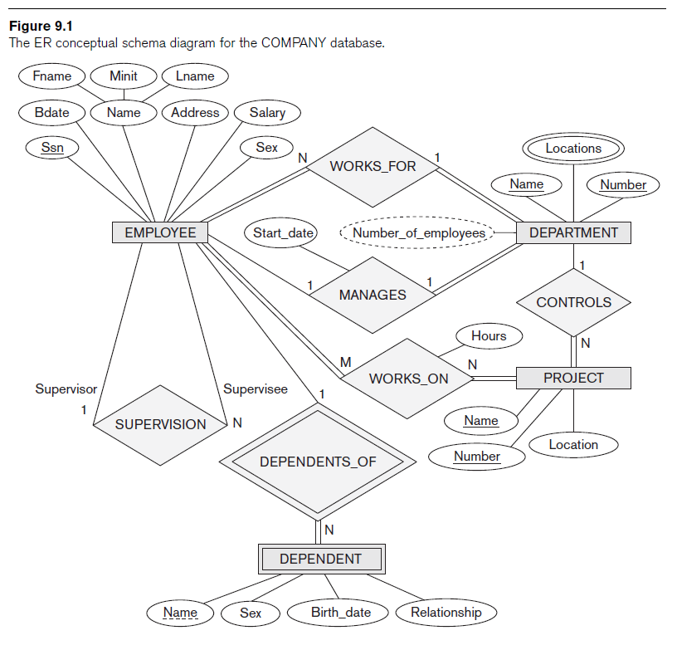
Recall (basic) ER Diagram

Slide 4
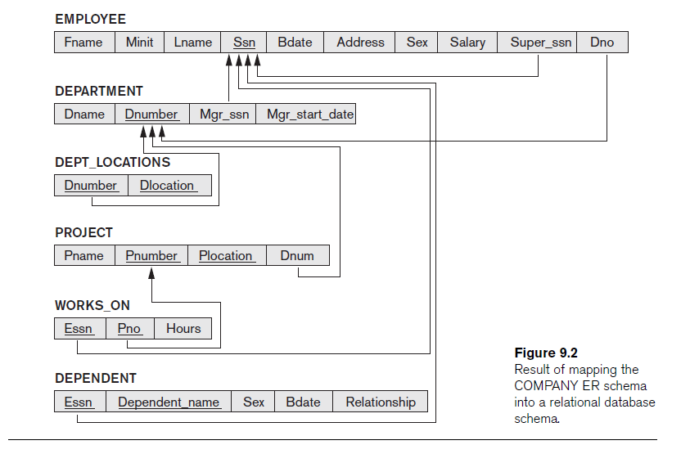
End Goal: Relational Model

Slide 5
Step 1: Map Regular Entity Types
For each regular entity type, create a relation schema R that includes all the single-valued attributes of E
“Flatten” composite attributes
Example renames some attributes (e.g., Dname), but not needed
Pick one of the keys as “primary key” and declare the rest to be unique
Called entity relations
Each tuple represents an entity instance

Slide 6
Step 2: Map Weak Entity Types
For each weak entity type, create a relation schema R and include all single-valued attributes of the weak entity type and of the identifying relationship as attributes of R
Include primary key attribute of identifying entity as foreign key attribute of R
Primary key of R is primary key of identifying entity together with partial key from R
Omit the identifying relationship when subsequently translating (other) relationship types to relation schemas

Slide 7
Step 3: Map Binary 1:1 Relationship Types
For each binary 1:1 relationship type R, identify relation schemas that correspond to entity types participating in R
Apply one of three possible approaches:
Foreign key approach
Add primary key of one participating relation as foreign key attribute of the other, which will also represent R
If only one side is total, choose it to represent R (why?)
Declare foreign key attribute as unique
Merged relationship approach
Combine the two relation schemas into one, which will also represent R
Make one of the primary keys “unique” instead
Cross-reference or relationship relation approach
Create new relation schema for R with two foreign key attributes being copies of both primary keys
Declare one of the attributes as primary key and the other one as unique
Add single-valued attributes of relationship type as attributes of R

Slide 8
Step 4: Map Binary 1:N Relationship Types
Foreign key approach
Identify relation schema S that represents participating entity type at N-side of 1:N relationship type
Include primary key of other entity type (1-side) as foreign key in S
Relationship relation approach
Create new relation schema for S with two foreign key attributes being copies of both primary keys
Declare the foreign key attribute for the relation schema corresponding to the participating entity type on the N-side as primary key
Include single-valued attributes of relationship type as attributes of S

Slide 9
Step 5: Map Binary M:N and Higher order Relationship Types
For each binary M:N relationship type or ternary or higher order relationship type, create a new relation S
Include primary key of participating entity types as foreign key attributes in S
Make all these attributes primary key of S
Include any simple attributes of relationship type in S

Slide 10
Step 6: Map Multivalued Attributes
For each multivalued attribute
Create new relation R with attribute to hold multivalued attribute values
If multivalued attribute is composite, include its simple components
Add attribute(s) for primary key of relation schema for entity or relationship type to be foreign key for R
Primary key of R is the combination of all its attributes

Slide 11
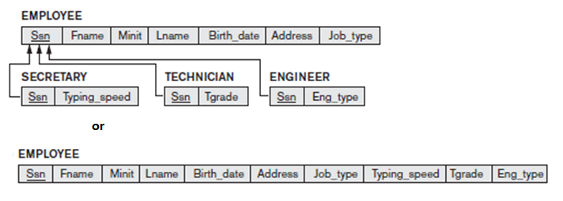
Options for Mapping Specialization or Generalization
For any specialization (total or partial, disjoint or overlapping)
Separate relation per superclass and subclasses
Single relation with at least one attribute per subclass
Introduce a Boolean attribute if none specific for subclass

Slide 12
Specialization Options (cont’d)
For total specializations (and generalizations) only
Separate relation per subclass relations only
Overlapping subclasses will result in multiple tuples per entity
For disjoint specializations only
Single relation with one type attribute
Type or discriminating attribute indicates subclass of tuple
Might require many NULL values if several specific attributes exist in subclasses

Slide 13
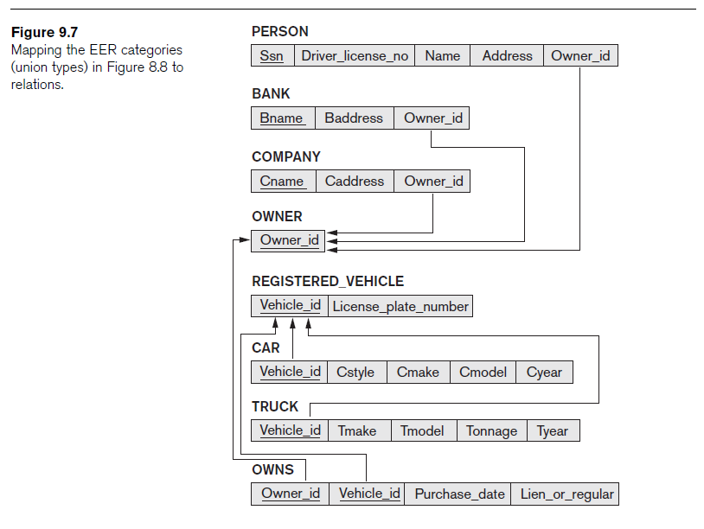
Mapping Union Types
Create relation schema to represent union type (generalization)
Specify a new key attribute
Surrogate key
Example: Owner and Registered Vehicle

Slide 14
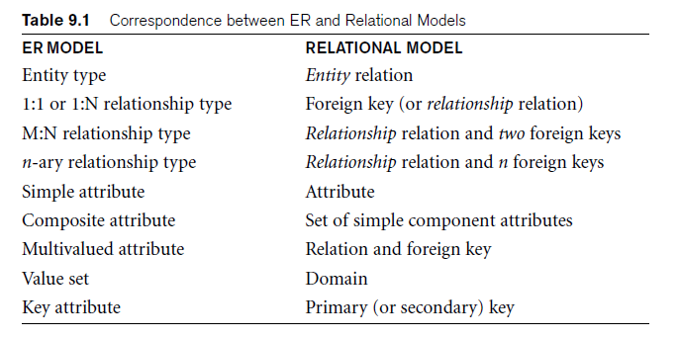
Lecture Summary
Algorithm for ER-to-relational mapping
Extensions for mapping constructs from EER model into relational model

Slide 15
Exercise
Translate the following ER Diagram into a relational database schema.

Slide 16
Exercise
What ER Diagram might produce the following relational database schema?

