Slide 1
Databases and Database Users
Chapter 1
Acknowledgement:
Most slides for this course have been adapted from slides made available by Addison Wesley to accompany Elmasri and Navathe’s textbook.

Slide 2
Lecture Outline
Introduction
An Example
Characteristics of the Database Approach
Actors on the Scene
Workers behind the Scene
When Not to Use a DBMS

Slide 3
Wealth of Data
Traditional database applications
Store numeric short textual information
Typically for managing enterprises
Text and multimedia databases
Store documents, digital images, audio, and video streams
Geographic information systems (GIS)
Store maps, weather data, and satellite images
For route-finding, agriculture, and natural resource management
Data warehouses and online analytical processing (OLAP) systems
Store historical business information
For business analytics and decision support
Real-time and active database technology
Store process models, constraints, and key performance indicators
Control industrial and manufacturing processes

Slide 4
Terminology
Database
Collection of related data (logically coherent)
Known facts that can be recorded and that have implicit meaning
Represents some aspect(s) of the real world (miniworld)
Built for a specific purpose
Examples of large databases
Amazon.com, Canadian Census, The Bay’s product inventory, data collection underlying Quest

Slide 5
Terminology (cont'd.)
Database management system (DBMS)
Collection of programs
Enables users to create and maintain a database
Allows multiple users and programs to access and manipulate the database concurrently
Provides protection against unauthorized access and manipulation
Provides means to evolve database and program behaviour as requirements change over time
Examples of database management systems
IBM’s DB2, Microsoft’s Access and SQL Server, Oracle, MySQL, SAP’s SQL Anywhere

Slide 6
Terminology (cont'd.)
Defining a database
Specifying the data types, structures, and constraints of the data to be stored
Uses a Data Definition Language
Meta-data
Database definition or descriptive information
Stored by the DBMS in the form of a database catalog or data dictionary
Phases for designing a database:
Requirements specification and analysis
Conceptual design
e.g., using the Entity-Relationship model
Logical design
e.g., using the relational model
Physical design

Slide 7
Terminology (cont'd.)
Populating a database
Inserting data to reflect the miniworld
Query
Interaction causing some data to be retrieved
uses a Query Language
Manipulating a database
Querying and updating the database to understand/reflect miniworld
Generating reports
Uses a Data Manipulation Language
Application program
Accesses database by sending queries and updates to DBMS
Transaction
An atomic unit of queries and updates that must be executed as a whole
e.g., buying a product, transferring funds, switching co-op streams

Slide 8
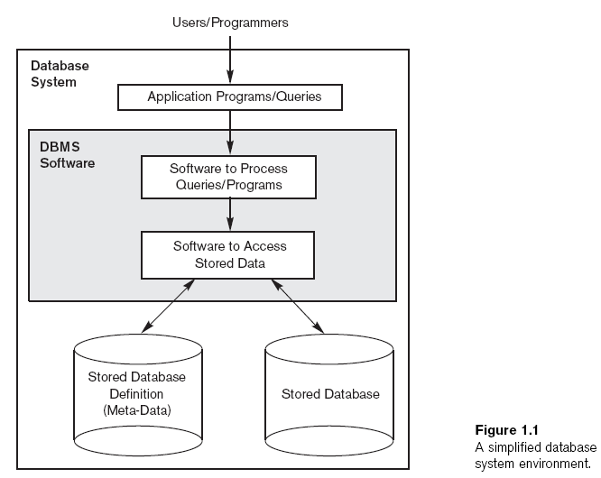
DBMS Schematic

Slide 9
An Example
Movie database
Information concerning movies, actors, awards
Data records
Film
Person
Role
Honours
Define structure of each type of record by specifying data elements to include and data type for each element
String (sequence of alphabetic characters)
Numeric (integer or real)
Date (year or year-month-day)
Monetary amount
etc.

Slide 10
An Example (cont'd.)
Populate MOVIES database
Store data to represent each film, actor, director, award, role
Film
title | genre | year | director | runtime | budget | gross
The Company Men | drama | 2010 | John Wells | 104 | 15,000,000 | 4,439,063
Lincoln | biography | 2012 | Steven Spielberg | 150 | 65,000,000 | 181,408,467
War Horse | drama | 2011 | Steven Spielberg | 146 | 66,000,000 | 79,883,359
Argo | drama | 2012 | Ben Affleck | 120 | 44,500,000 | 135,178,251
Fire Sale | comedy | 1977 | Alan Arkin | 88 | 1,500,000 | 0
Person
name | birth | city
Ben Affleck | 1972 | Berkeley
Alan Arkin | 1934 | New York
Tommy Lee Jones | 1946 | San Saba
John Wells | 1957 | Alexandria
Steven Spielberg | 1946 | Cincinnati
Daniel Day-Lewis | 1957 | Greenwich
Honours
movie | award | category | winner
Lincoln | Critic's Choice | actor | Daniel Day-Lewis
Argo | Critic's Choice | director | Ben Affleck
Lincoln | Screen Actors Guild | supporting actor | Tommy Lee Jones
Lincoln | Screen Actors Guild | actor | Daniel Day-Lewis
Lincoln | Critic's Choice | screenplay | Tony Kushner
Argo | Screen Actors Guild | cast | Argo
War Horse | BMI Flim | music | John Williams
Role
actor | movie | persona
Ben Affleck | Argo | Tony Mendez
Alan Arkin | Argo | Lester Siegel
Ben Affleck | The Company Men | Bobby Walker
Tommy Lee Jones | The Company Men | Gene McClary
Tommy Lee Jones | Lincoln | Thaddeus Stevens
Alan Arkin | Fire Sale | Ezra Fikus
Daniel Day-Lewis | Lincoln | Abraham Lincoln

Slide 11
An Example (cont'd.)
Manipulation involves querying and updating
Examples of queries:
List the cast of characters for Lincoln.
Who directed a drama in 2012?
Who directed a film in which he or she also played a role?
What awards were won by War Horse?
Examples of updates:
Record that Argo won a Golden Globe award for best picture.
Add another $395,533 to the gross earnings for Lincoln.
Change the birthplace for Daniel Day-Lewis to London.
Delete Fire Sale from the database.

Slide 12
Terminology (cont'd.)
Reorganizing a database
Changes the metadata rather than the data
More drastic than data updates
May require massive changes to the data
May require changes to some application programs
Uses the Data Definition Language again
Examples:
Rename gross to be domestic earnings and add a new column for foreign earnings.
Move director from FILM to a separate relation DIRECTOR with columns for person and movie
Change birth from yyyy to yyyy/mm/dd
Split name in PERSON to separate surname from given names.
Include column movieID in FILM (to accommodate remakes and other duplications of film title) and update other relations accordingly.

Slide 13
Pre-DBMS Databases
Used traditional file processing
Each user defines and implements the files needed for a specific software application
As the application base grows
many shared files
a multitude of file structures
a need to exchange data among applications
Eventually recognized that data is a critical corporate asset (along with capital and personnel)

Slide 14
Database Approach
Single repository maintains data that is defined once and then accessed by various users
Addresses a variety of problems
redundancy: multiple copies
inconsistency: independent updates
inaccuracy: concurrent updates
incompatibility: multiple formats
insecurity: proliferation
inauditability: poor chain of responsibility
inflexibility: changes are difficult to apply

Slide 15
Characteristics of the Database Approach
Programs isolated from data through abstraction
Does not expose details of how (or where) data is stored or how operations are implemented
Data sharing through multiple views
Multiuser transaction processing
Encapsulates sequence of operations to behave atomically
Data is self-defining
Database system contains complete definition of structure and constraints as meta-data
Database catalog used by:
DBMS software
Database users who need information about database structure

Slide 16
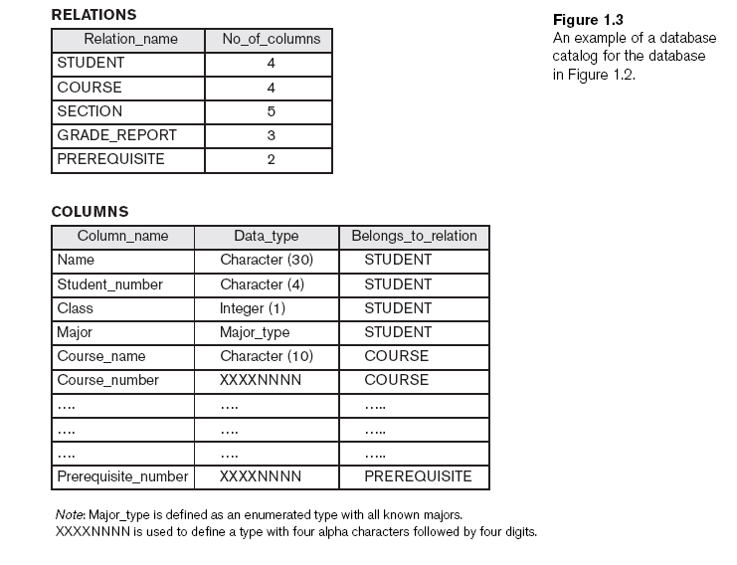
Database Catalog

Slide 17
Actors on the Scene
Database administrator (DBA) responsible for:
Authorizing access to the database
Coordinating and monitoring its use
Acquiring software and hardware resources
Tuning the DBMS for best performance
Database designer responsible for:
Identifying the data to be stored
Choosing appropriate structures to represent and store this data

Slide 18
Actors on the Scene (cont'd.)
End users
Those whose jobs require access to the database
Naive or parametric end users
canned queries and updates
Casual end users
occasional, special-purpose access
Sophisticated end users
deep knowledge of database design and DBMS facilities
Standalone users
users of personal databases
System analysts
Determine requirements of end users
Application programmers
Implement complex specifications (business logic) as programs

Slide 19
Workers behind the Scene
DBMS system designers and implementers
Design and implement the DBMS modules and interfaces as a software package
Tool developers
Design and implement tools
Operators and maintenance personnel
Responsible for running and maintenance of hardware and software environment for database system

Slide 20
When Not to Use a DBMS
More desirable to use regular files for:
Simple, well-defined applications with no expected changes at all
Small variety of data and/or small amount of data
Stringent, real-time requirements that cannot afford DBMS overhead
Only single (personal) access to data
Unlikely that any of these apply to corporate data management.
In fact, corporations often maintain many databases across many database systems.

Slide 21
Lecture Summary
Database
Collection of related data (recorded facts)
DBMS
Generalized software package for implementing and maintaining a computerized database
Provides many services to manage data resources
Several categories of database users

