Slide 1
CS 338 Computer Applications in Business: Databases
M. Tamer Özsu
tamer.ozsu@uwaterloo.ca
DC 3350

Slide 2
CS 338
https://cs.uwaterloo.ca/~tozsu/cs338/
Lectures
Tuesdays and Thursdays 11:30 am - 12:50 pm
MC 4061
Office hours
Tuesdays 1:30 - 3:00 pm, DC 3350
Tas
Yuexing Luo (F 9:00-10:00AM)
John Morcos (W 1:30-2:30PM)
Daniel Patrick Recoskie (M 9:00-10:00AM)
Yizhe Zeng (Th 9:00-10:00AM)

Slide 3
Why would I want to pay attention in this course?
“This course is designed primarily to meet the needs of students who are interested in the business or public sector of the economy. The course presents methods used for the storage, selection, and presentation of data.”
Use database terminology knowledgeably
Understand DB concepts that arise in the workplace
Interact with (direct, understand) IT personnel
Understand technical articles involving DB technology
Discuss DB concepts in a job interview

Slide 4
Course Topics
Why do we use databases?
Functionality provided by a Database Management System
How do we use a Database Management System?
Relational model, foundational query languages SQL
Transactions, concurrency, and recovery
Security
Distributed databases
How do we design a database?
Entity-Relationship (ER) modeling
Accommodating and enforcing constraints

Slide 5
Resumé Blurb (under Education)
CS 338: Computer Applications in Business: Databases
Implemented a database in DB2, defined schemas, developed queries, and performed manipulations in SQL.
Transformed a business description into Entity-Relationship diagrams, which were then used to specify a SQL Schema.
Applied knowledge of data redundancy, security, backups and recovery, data dependencies and other constraints in database design.
Capable of documenting an organization or project's data needs, participating in requirement gathering, and liaising with technical staff (such as DBAs) to deploy systems.
N.B. Employers will be suspicious or angry if you include the exact same description as other students who have taken the course. You may want to use this as a template, but definitely express it in your own words.

Slide 6
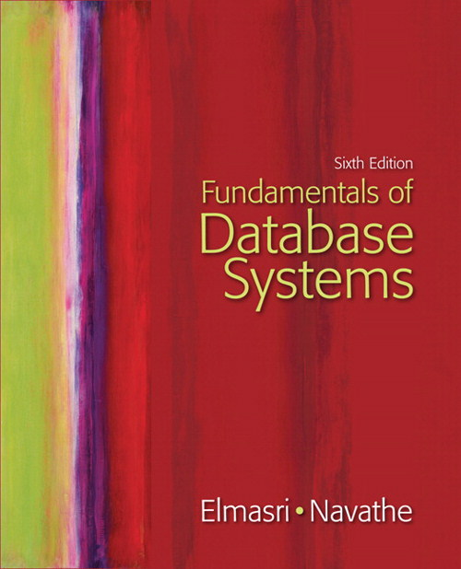
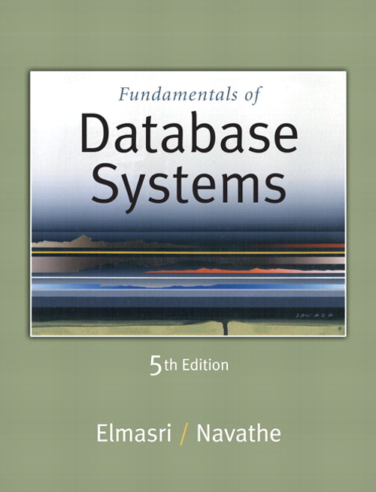
Textbook (Recommended)
R. Elmasri and S. Navathe, Fundamentals of Database Systems, 6/E, Addison Wesley, 2010.
Sixth or Fifth Edition
Copies on Reserve in Davis Center Library (both 5th and 6th editions)
Used copies available on campus
Note: Course slides adapted from authors’ / publisher’s slides

Slide 7
Getting help
Piazza (https://piazza.com/uwaterloo.ca/fall2013/cs338/home)
Messaging forum
Ask public questions here
Assignments and model solutions posted
Announcements posted (as well as on website)
TAs will monitor this.
Also instructor and TA office hours
Instructor: Tuesdays 1:30-3:00 pm, DC 3350
TA hours: See slide 2 and the web site

Slide 8
Clickers
Active learning lasts longer than passive listening.
You will get some credit just for participation and need not be overly concerned about clicker grades.
up to 2% bonus for participating (based on your best 90%)
up to 2% bonus for correct answers (based on your best 75%)
Clicker questions allow you to show me what you understand without having to raise your hand and identify yourself.
Bookstore ~$42 (return for ~$20)
Used $30 when available
web>clicker (netbook, smartphone: iOS, Android, Blackberry) ~$10
14 day free trial; 180 day license
See http://www.math.uwaterloo.ca/~pkates/CTE/clickers/web-clicker.html
Clicker Registration and Information
Be sure to register your clicker here:
http://www.student.cs.uwaterloo.ca/~pkates/uw-clicker.html

Slide 9
Using Your Clicker
Turn it on:
Press the ON/OFF button. A solid blue light should appear next to the top Power button. If your clicker came wrapped in packaging, pull out the small plastic tab on the back to activate the batteries.
Change the frequency to DA:
The instructions on the back of your clicker say
Press and hold the ON/OFF button until the top blue Power light flashes. Enter the 2 letter frequency code (DA).
The code for each classroom (DA for MC4061) is posted near the podium at the front of the class. When the clicker is turned off it forgets any changes in frequency that have occurred and the clicker frequency is again AA when the clicker is turned on.
How do I know if my vote has been received?
When the receiver acknowledges a vote, the Vote Status light on the clicker (the third light) will flash green for a moment. If it flashes red instead, then either the voting period hasn't started, or the receiver didn't respond to your vote. In the latter case, change the frequency of your clicker if necessary and vote again. Raise your hand for assistance if you don't see a green response.
Can I change my vote/choice?
Yes. While the voting process is active, you can vote as often as you like. Only your last (most recent) choice/vote is recorded.

Slide 10
Evaluation
Components
Midterm 1: 25% (TUesday, October 8th, in class)
Midterm 2: 25% (Thursday, November 14th, in class)
Final: 50%
Clicker participation: bonus factor of 2%
Clicker correctness: bonus factor of 2%
Example calculation:
M1=72%, M2=61%, F=68%, Cp=80%, Cc=50%
Average = 67% → 68% → 69% = Assigned grade

Slide 11
Assignments
Four assignments throughout term
Sample solutions released on “due date”
Goal is to give you practice with material in order to provide self-assessment and guidance
Assignment performance not part of evaluation
You need not polish a submission.
You can work alone or with others.
You can seek help from TAs.
You will have more trouble learning the material (and passing the course) if you do not attempt the assignments

Slide 12
DB2
IBM’s relational database management system DB2
Microsoft’s relational database management systems SQL Server
You can use your own personal copy of DB2 or MySQL
For some assignments
Writing SQL, applying DB concepts
Tutorial on website

Slide 13
Course Content
Introduction to database systems
Relational data model
SQL (ad hoc queries)
Relational algebra
Views and view management
Entity-Relationship (ER) model
Extended ER model
Mapping ER models to relational
DBMS architecture
Transactions
Database security and privacy
Distributed databases
Data warehouses
Data analytics
Relational database
principles
Data modeling
DBMS functionality
Related topics

Slide 14
Summary
Look at Web site, including course schedule.
Material build on itself
Like other courses in Math
Initial lectures focused on terminology and background knowledge
May be an “overwhelming amount of details”
Don’t fall behind!

