Slide 1
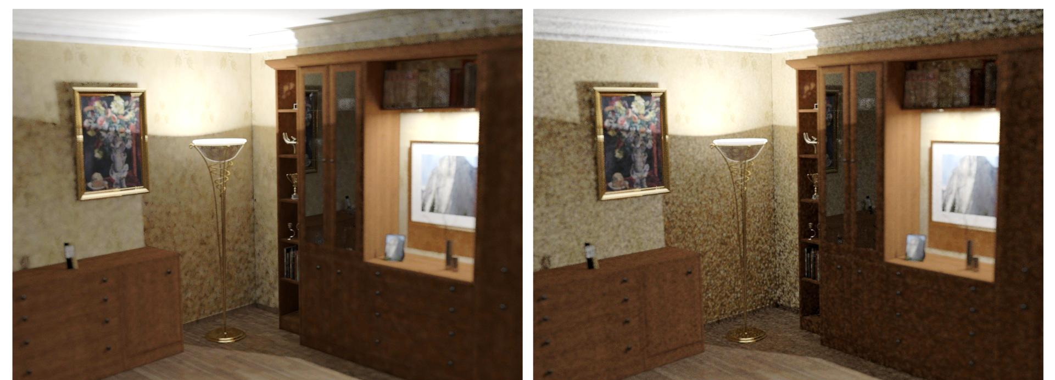
Adaptive Progressive Photon Mapping
Adaptive PPM
Original PPM
Anton S. Kaplanyan
Karlsruhe Institute of Technology, Germany

Slide 2
Progressive Photon Mapping in Essence
Pixel estimate using eye and light subpaths
$$I≈\sum_{N,i}{W_{N}k(x_{N}−y_{i})γ_{i}}$$
Generate full path by joining subpaths
Eye subpath
importance
Photon
radiance
Kernel-regularized connection of subpaths
$$W_{N}$$
$$γ_{i}$$
$$γ_{i+1}$$
Notes:
Progressive photon mapping can be interpreted as an estimator that constructs the full paths from camera to light by constantly connecting two fresh subpaths.
The estimation is a sum, where W_n is the importance of the eye subpath and gamma_i is the outgoing radiance from a light subpath (photon), as described in Probabilistic PPM [KnausZwicker2011].
So, the actual construction is a regularized (imprecise) junction of two end vertices.

Slide 3
Reformulation of Photon Mapping
PPM = recursive (online) estimator [Yamato71]
$$I_{N}=\frac{N−1}{N}I_{N−1}+W_{N}\sum_{i}{k(x−x_{i}) γ_{i}}$$
Rearrange the sum to see that
$$I_{N}=\frac{N−1}{N}I_{N−1}+\sum_{i}{k\left(x−x_{i}\right)[W_{N}γ_{i}]}$$
Kernel
estimation
Path
contribution
Notes:
We write this estimation for every photon map in a recursive manner. This is the first step that allows us to apply the knowledge about recursive (aka online) estimation accumulated in the statistical research.
To do that, we push the W_n term into the sum to reduce the expression to the canonical form of kernel estimation for the new function, which now represents the complete path contribution.
Using this form, we can apply many statistical results from recursive estimation field.

Slide 4
Radius Shrinkage
Shrink radius (bandwidth) for $N$^{th} photon map
$$r_{N}^{2}=r_{0}^{2} N^{α−1}, α∈\left(0;1\right)$$
User-defined parameters $r_{0}$ and $α$
Problem:
Optimal value $r_{0}$ of and $α$ are unknown
Usually globally constant / k-NN defined
Notes:
Radius, or kernel bandwidth, is the central parameter for efficiency of the kernel estimation in general.
Knaus and Zwicker shown that the radius must be decreased exponentially.
This equation has two extremely important parameters.
It is an initial radius; and a shrinkage rate alpha.
The alpha parameter is usually defined by user, while the initial radius can be selected using k-NN.

Slide 5
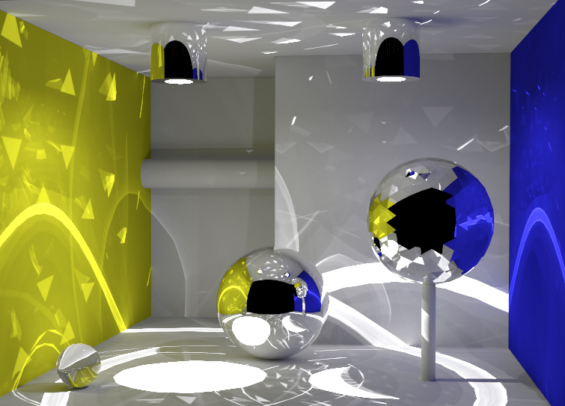
User Parameters Example
Box scene
(reference)
Notes:
This is a Box scene with complicated illumination.
We show how these two parameters affect the rendering.

Slide 6
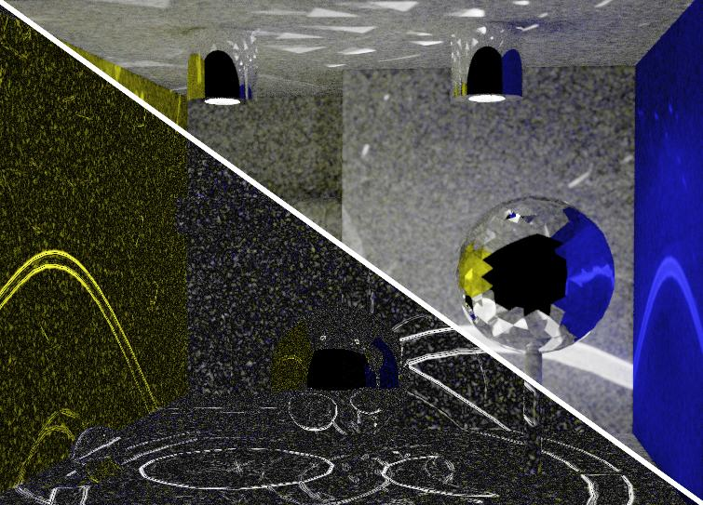
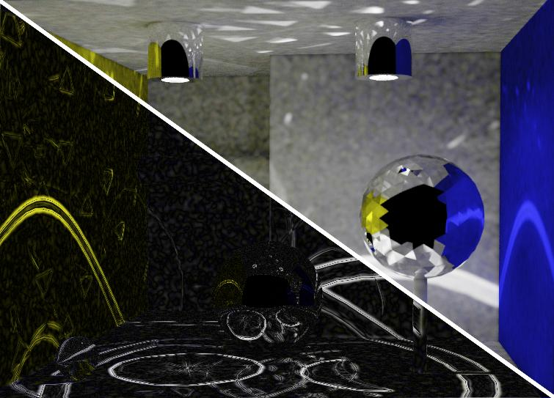
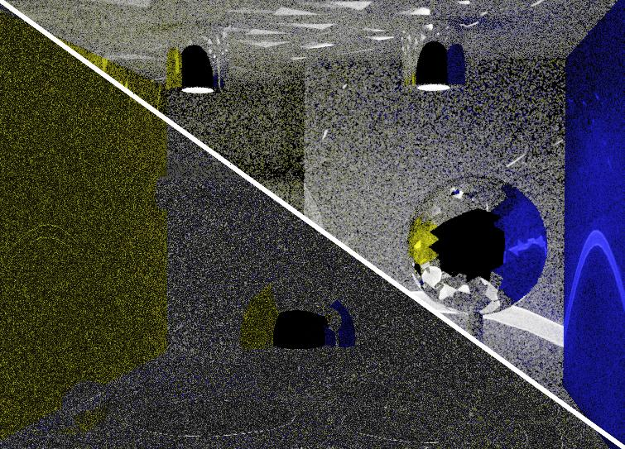
User Parameters Example
$$r$$
$$r$$
Larger $r_{0}$
Difference
image
$$r$$
$$r$$
Larger 𝛼
Notes:
First, we initialize the algorithm with a large initial kNN-selected radius and a small alpha of 0.5.
This leads to a lot of bias, like smoothened caustics due to the large initial radius, yet the noise quickly becomes apparent due to a rapid radius shrinkage.
The second case suffers from high image noise due to a small and quickly shrinking initial radius.
The third case demonstrates high bias that appears due to initially large and slowly shrinking radius.
In the fourth, a too-small initial radius can lead to high noise, while bias becomes apparent due to slow shrinkage rate.

Slide 7
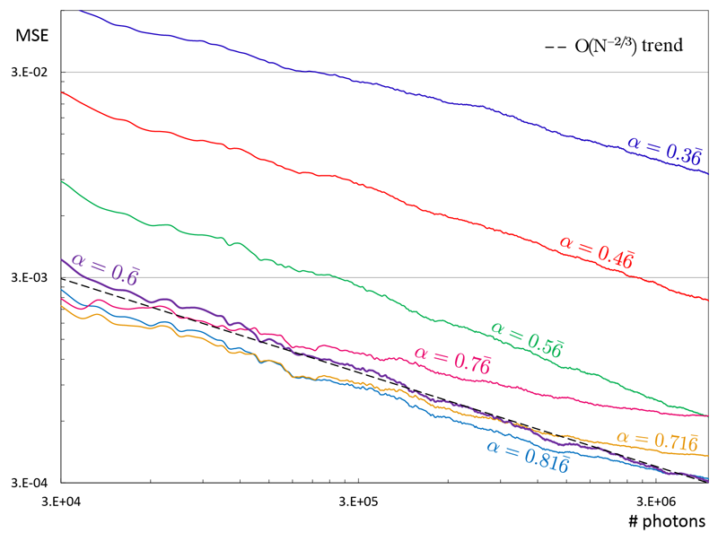
Radius Shrinkage Parameters
$$α$$
$$r_{0}$$
$$r_{0}$$
…
$$r_{0}$$
Notes:
If we measure the convergence rate with different parameters alpha and r_0 (vertically – MSE, horizontally – number of photons), it appears that the parameter alpha influences the slope of the plot (in log-log scale) in a non-trivial manner. And parameter r_0 influences the starting error.

Slide 8
Adaptive Progressive Photon Mapping
Progressive Photon Mapping
Adaptive PPM
Notes:
As we have seen, these parameters are extremely important for rendering.
We will show how we one option to choose them.

Slide 9
Optimal Convergence of Progressive Photon Mapping
Notes:
First, we will show how to choose alpha parameter for asymptotically optimal convergence.

Slide 10
Optimal Asymptotic Convergence Rate
$$α$$
$$r_{0}$$
$$r_{0}$$
…
$$r_{0}$$
Notes:
Here, we will do an asymptotic analysis, focusing on the optimal alpha parameter.
Note that under the asymptotic assumptions, there is no dependency on the other parameter r_0,
since we analyze the convergence slope, but not the absolute value of the error.

Slide 11
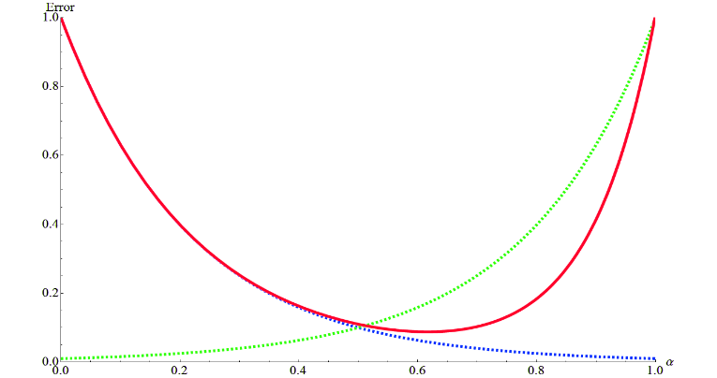
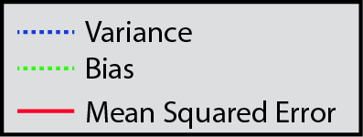
Optimal Convergence Rate
Variance and bias depend on $\text{α}$ [KZ11]
$${Var}_{Meas}\left(\text{α}\right)\sim N^{−\text{α}} {Bias}_{Kernel}^{2}(\text{α})\sim N^{\text{α}\text{−1}}$$
Optimal rate is $MSE∝N^{− 2/3}$ with ${\text{α}}_{opt}=2/3$
Asymptotic convergence
Unbiased Monte Carlo is faster: $MSE∝N^{−1}$
$${\text{α} }_{opt}$$
Notes:
As it was explained by Toshiya Hachisuka in his part of the course, both bias and variance depend on this parameter.
If we put them together into MSE (with some additional analysis described in the Adaptive Progressive Photon Mapping paper), we can deduce the asymptotic behavior of MSE with respect to the parameter alpha. The MSE plot has a minimum.
The optimal asymptotic convergence rate is achieved with alpha = 2/3.
Interestingly, kernel-estimation-based methods are asymptotically slower than unbiased methods.

Slide 12
Convergence Rate of Kernel Estimation
Convergence rate for $d$ dimensions
$$MSE∝N^{− 4/(d+4)}$$
Suffers from curse of dimensionality
Adding a dimension reduces the rate!
Shutter time kernel estimation – not recommended
Wavelength kernel estimation – not recommended
Volumetric photon mapping $MSE∝N^{− 4/7}$
Notes:
Moreover, the asymptotic convergence rate of kernel estimation methods depends on the number of dimensions involved in the estimation.
This is a well-known formula in statistics for computing the asymptotic convergence rate of d-dimensional kernel estimation.
Note that unlike, for example, Monte Carlo methods, kernel estimation suffers from curse of dimensionality.
What does that mean for rendering? Every time we add a new dimension, we decrease the convergence rate and quickly face the curse of dimensionality.
For example, if we add kernel estimation in time domain for support of motion blur, then in this case we add one more dimension, and the convergence rate decreases. The same holds if we attempt to do spectral rendering by kernel estimation of wavelength during gathering. Both methods are not practically recommended, since they decrease the asymptotic convergence rate. In order to support motion blur and spectral rendering, one can pre-sample these domains before each pass, as was described by Toshiya Hachisuka in his part of the course.
Another interesting detail is that original volumetric photon mapping suffers from slower convergence due to 3-dimensional kernel estimation (as opposed to 2 dimensions for regular photon mapping). Thus, using photon beams as a primitive is more desirable.

Slide 13
Adaptive Bandwidth Selection
Notes:
This was an asymptotic analysis. In practice, we have to worry about behavior of MSE on a finite number of photons.
We will show how to select the bandwidth (radius) parameter r to achieve faster convergence in finite time.

Slide 14
Optimal Asymptotic Convergence Rate
$$α$$
$$r_{0}$$
$$r_{0}$$
…
$$r_{0}$$
Notes:
To minimize the MSE on a finite set of samples, we optimize it w.r.t. the second free parameter, kernel radius (bandwidth) r.
In recursive estimation in statistics, this is also a well-known approach called bandwidth selection.

Slide 15
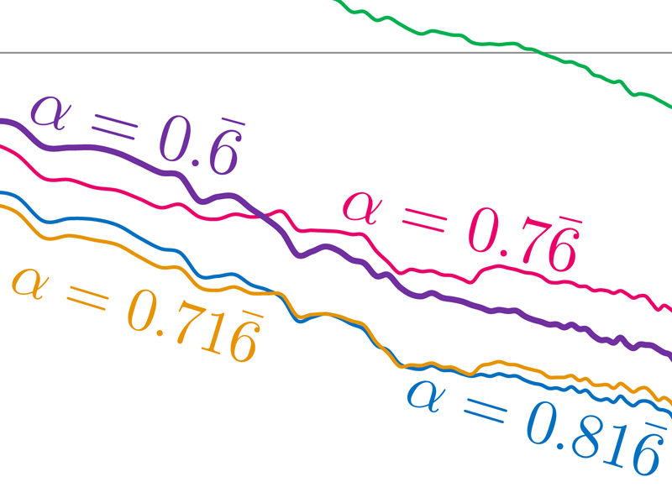
Adaptive Bandwidth Selection
${\text{α}}_{opt}$ might not yield minimal $MSE$
Minimize $MSE$ with respect to $r_{0}$
Achieve variance ↔ bias tradeoff
Select optimal $r$ using past samples
Notes:
As we can see from this plot, minimizing MSE with respect to the parameter alpha is not enough for practical rendering.
Even the optimal value of alpha, 2/3 (magenta), might lead to high MSE at early stages of rendering, while providing the steepest slope.
We will show that both variance and bias depend on kernel bandwidth (radius) r.
It is possible to select the optimal bandwidth in a way to achieve the trade-off between variance and bias, using the past photon maps.

Slide 16
Estimation Error
Mean Squared Error [Hachisuka et al. 2010]
$$MSE={Var}_{Est}+{Bias}_{Kernel}^{2}$$
Notes:
As was mentioned by Toshiya Hachisuka earlier in this course, we know that the mean squared error of such recursive kernel estimator can be decomposed into variance and a bias squared.

Slide 17
Estimation Error
$$MSE={Var}_{Meas}+{Var}_{Kernel}+{Bias}_{Kernel}^{2}$$
Variance is two-fold:
Path measurement contribution
Kernel estimation
Notes:
The variance in our case consists of two subterms:
- the variance directly related to the kernel estimation (that is, the noisy distribution of photons);
- and the variance coming from the high-dimensional path integral.

Slide 18
Estimation Error
$$MSE≈{Var}_{Meas}+{Bias}_{Kernel}^{2}$$
Measurement variance is higher
$${Var}_{Meas}≫{Var}_{Kernel}$$
Notes:
It can be shown that the measurement variance is significantly higher (see the original paper for details).

Slide 19
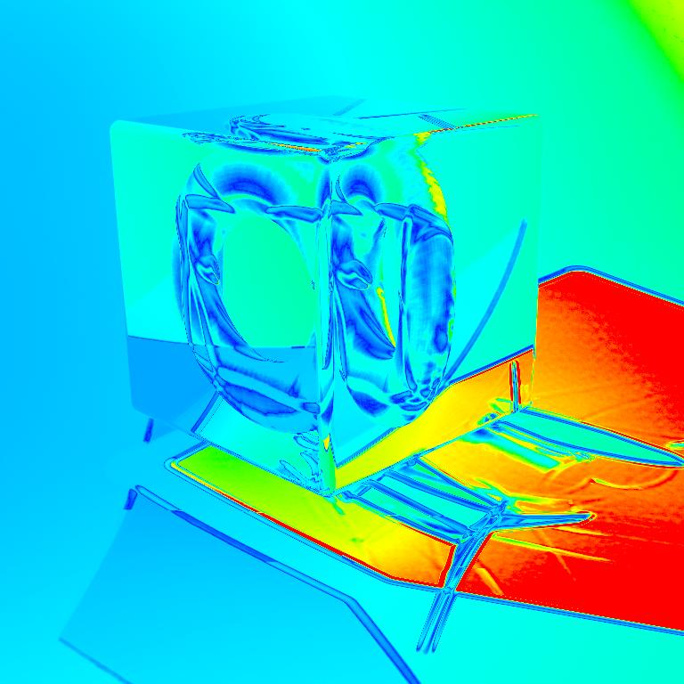
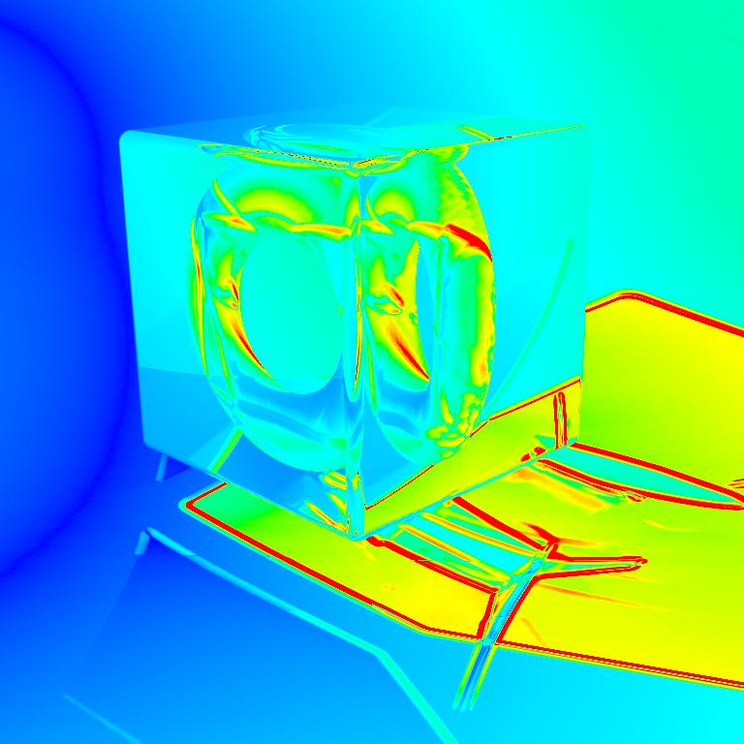
Estimation Error
So, MSE has noise (path variance) and bias
$$MSE≈{Var}_{Meas}+{Bias}_{Kernel}^{2}$$
Variance
Bias
Notes:
Thus the major contributors to the error of photon mapping class methods are the variance stemming from the path sampling (image noise); and the bias introduced by kernel estimation (blurred illumination). This error directly depends on the two parameters (alpha and r) we described earlier.

Slide 20
Adaptive Bandwidth Selection
Both variance and bias depend on $r$
$${Var}_{Meas}\left(r\right)\sim r^{−2}$$
$${Bias}_{Kernel}\left(\text{r}\right)\sim ∆I{ r}^{2}$$
Where $∆I=∆(W_{N}γ_{i})$ is a pixel Laplacian
Laplacian $∆I$ is unknown
Notes:
As was explained by Toshiya Hachisuka in his error analysis part of the course, both variance and bias depend on kernel bandwidth.
Interestingly, both terms have a counter-dependence on the bandwidth, which suggests that we can balance between variance and bias just by changing this bandwidth r.
We generalize Toshiya’s error analysis for stochastic progressive photon mapping case, where the kernel estimation point can also vary.
In this case, bias depends on the so-called pixel Laplacian ∆𝐼, which can be intuitively explained as an average curvature of the estimated radiance around the all estimation points within the pixel.
This pixel Laplacian is unknown and needs to be robustly estimated.

Slide 21
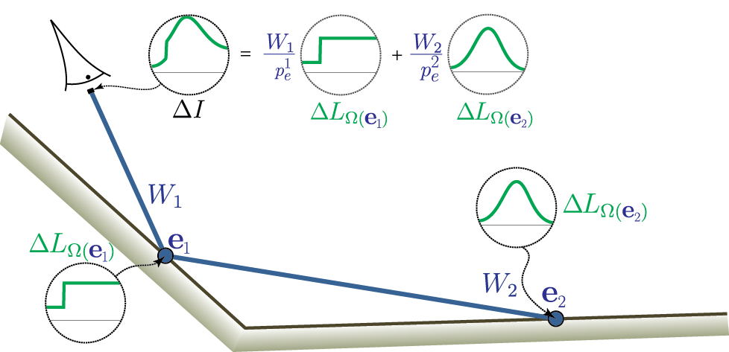
Estimating Pixel Laplacian
$∆I$ consists of Laplacians at all shading points
Weighted per-vertex Laplacians $∆γ_{i}=∆L$
Notes:
In order to estimate pixel Laplacian, we expand it into Laplacians at each potential shading point.
This way we can estimate Laplacian with kernel method at a shading point and then compute a Monte-Carlo estimate of the resulting pixel Laplacian by taking into account the importance weight of the camera subpath and the probability of sampling this shading point.

Slide 22
Estimating Per-Vertex Laplacian
Estimate per-vertex Laplacian at a point
Recursive finite differences [Ngen11]
Yet another recursive estimator
Another shrinking bandwidth $h$
Robust estimation on discontinuities
$$∆L_{u}=\frac{ L_{x+uh}+L_{x−uh}−{2L}_{x}}{h^{2}}$$
$$x−uh$$
$$x$$
$$x+hu$$
Notes:
In order to estimate Laplacian at each shading point, Toshiya mentioned that the derivatives of the kernel can be used.
However, we found that such an estimation is instable on the radiance discontinuities, such as, for example, a hard edge of a shadow.
Thus, we use a recent approach of recursive finite differencing along tangent axes of the surface.
This is a standalone recursive estimator, which has multiple kernel estimators and computes the Laplacian as a recursive finite difference of them.
This estimator has its own independent shrinking bandwidth parameter h, which can be selected in a more simplified way and does not influence the quality of bandwidth selection too much (please see the original paper for more details on it).
Unlike kernel derivatives estimator, this recursive finite differencing estimator is robust on discontinuities, which is an important property for our bandwidth selection method.

Slide 23
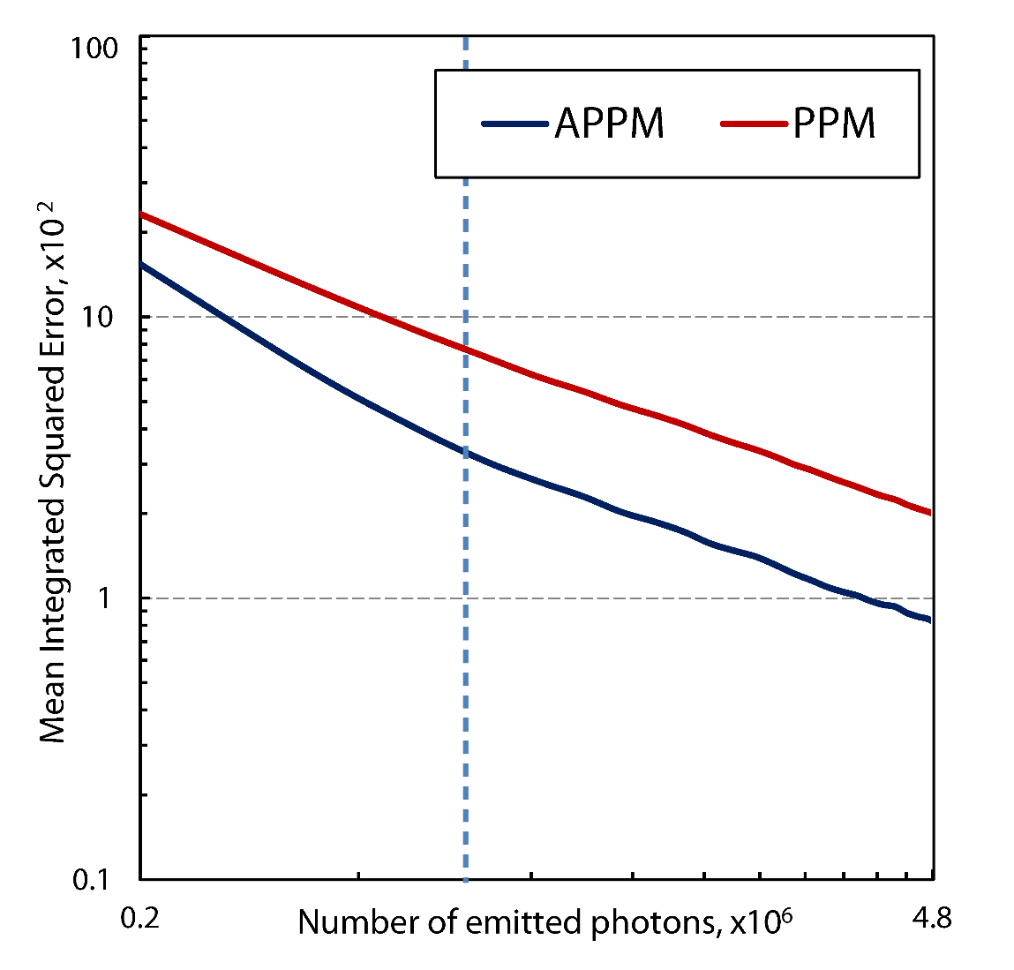
Adaptive Bandwidth Selection
Estimate all unknowns
Path variance
Pixel Laplacian
Minimize MSE as MSE(r)
Lower initial error
Keeps noise-bias balance
Data-driven bandwidth selector
Notes:
Now, that we have all the unknowns to select the optimal bandwidth on the fly, we can achieve faster convergence in practical scenarios of finite time.
After estimating all the unknowns, we minimize the MSE with respect to the parameter r.
After a few photon maps, MSE becomes already smaller than with the best manually-chosen parameters.
However, at some point, the lines become parallel, which suggests that the asymptotic convergence rate is the same.
The proposed selector always tries to keep the balance between image noise and bias.
The selector uses past samples to estimate several auxiliary values, so it learns from the data.

Slide 24
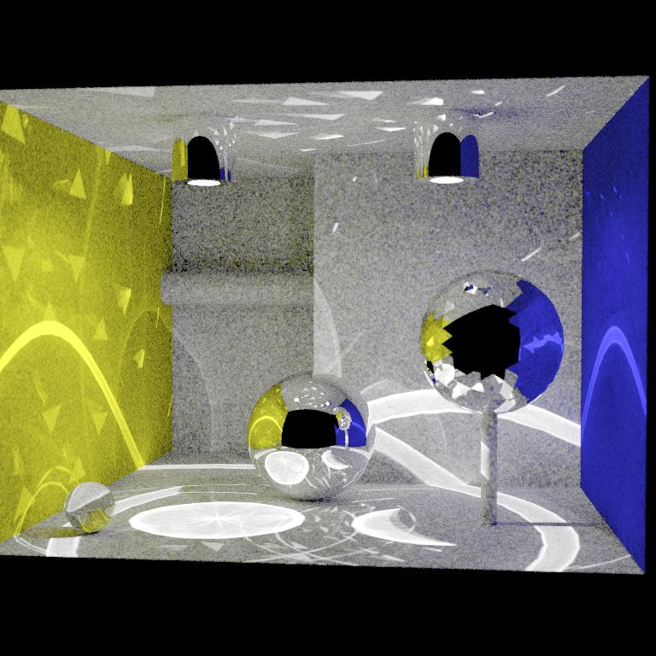
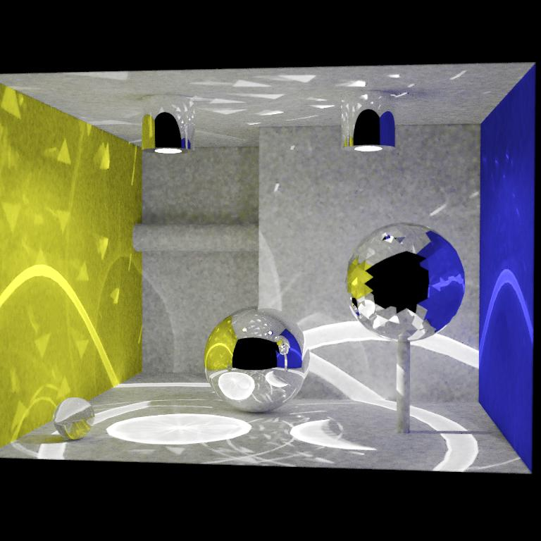
Results
Progressive Photon Mapping
Adaptive PPM
20 seconds!
Notes:
Here are some results.
Equal time comparison. Less variance in flat regions, yet caustic edges are sharp.

Slide 25
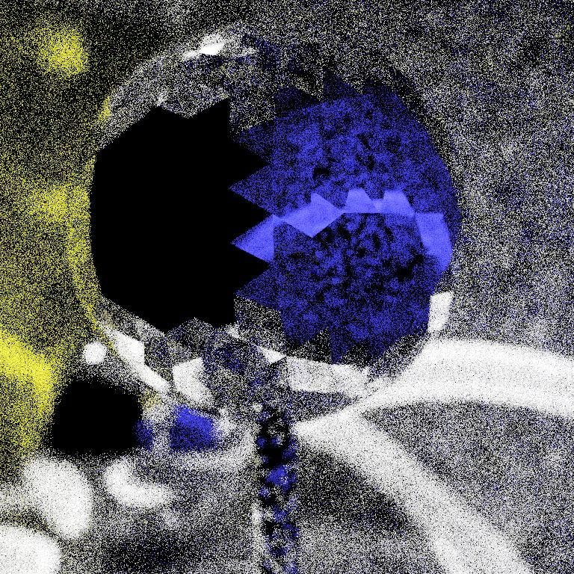
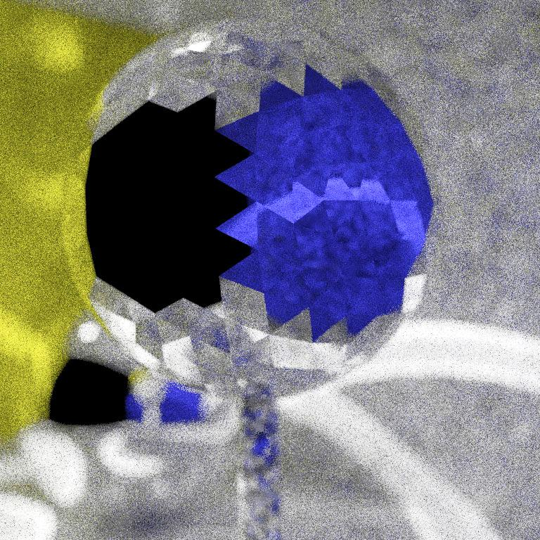
Results
Progressive Photon Mapping
Adaptive PPM
3 seconds!
Notes:
Equal time comparison. Heavy out of focus region (different shading points within pixel support).
Less variance, caustic edges remain sharp even out of focus, yet gathering radius is enlarged where possible.

Slide 26
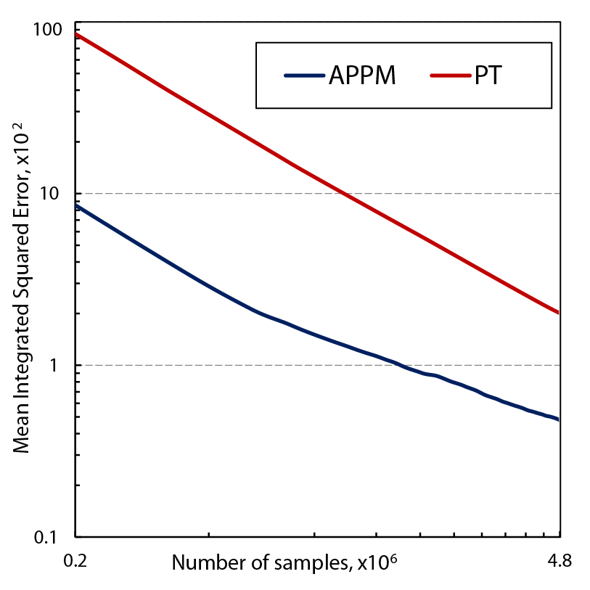
Conclusion
Optimal asymptotic convergence rate
Asymptotically slower than unbiased methods
Not always optimal in finite time
Adaptive bandwidth selection
Based on previous samples
Balances variance-bias
Speeds up convergence
Attractive for interactive preview
Notes:
To conclude my part, we have deduced the asymptotic convergence rate for photon mapping class methods.
The asymptotic convergence is slower comparing to unbiased methods whenever one applies a kernel estimation (please notice that the slopes of the plots on the figure are different).
However, that does not necessarily mean the results are inferior – in many practical cases the initial error is much lower because of efficient variance reduction; and might still stay low after long rendering time.
The second part is the adaptive bandwidth (radius) selection.
The method uses the same photon map data to estimate the pixel Laplacian, thus an additional sampling is not needed.
This selection technique allows to significantly cut the amount of bias and variance in the image starting already from the first photon map.
This property makes it attractive for fast interactive preview renderers, but also reduces the bias in final images.

Slide 27
Thank you for your attention.

