Slide 1
Bigtable
A Distributed Storage System for Structured Data
Chang, et al. (2006)
Google, Inc.
Presented by:
Siddhartha Sahu
September 26, 2016
CS848, University of Waterloo

Slide 2
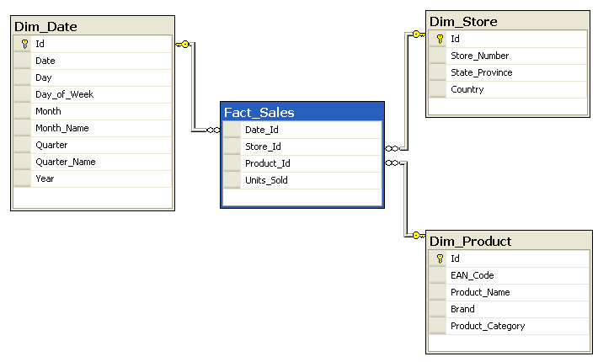
What is the problem?
100 TB
To build a storage system
8 TB
4 TB
4 TB
8 TB
...
Structured
Server 1
Server 2
Server 3
Server N
Huge data size
Distributed

Slide 3
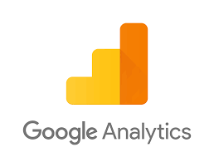
Why is it important?
It provides a stable abstraction over which other applications can be built.
8 TB
4 TB
4 TB
8 TB
...
Server 1
Server 2
Server 3
Server N

Slide 4
Why is it hard?
Availability
Fault Tolerance
Performance satisfying different workloads
Reliable abstraction
Custom requirements
Integration with other systems
Distributed environment makes the problem inherently difficult.
8 TB
4 TB
4 TB
8 TB
Batch Job
...
Server 1
Server 2
Server 3
Server N
40 TB
Realtime
100 GB

Slide 5
Solution: Bigtable
The word Bigtable is overloaded, and applies to both:
the overall service architecture
the structure of stored data
Multi dimensional dimensional data format
Does not support a full relational data model
Data is dynamically sharded across multiple servers
Provides parallelism and fault tolerance
Works together with other Google services
Chubby, GFS, Job Scheduler

Slide 6
Schema
Map: (row:string, column:string, time:int64) → string
Sorted
t_{n}
 | contents |  | language |  | anchor1 | anchor2
ca.waterloo.www
ca.waterloo.www/about-us
...
...
t₂
 | contents |  | language |  | anchor1 | anchor2
ca.waterloo.www
ca.waterloo.www/about-us
t₁
 | contents |  | language |  | anchor1 | anchor2
ca.waterloo.www | <html> |  | en |  | facebook.com
ca.waterloo.www/about-us | <html> |  |  |  |  | acm.org
Table
Sorted
Sparse
...
Column Family
Column Family
Column Family
ACLs
Compression
GC: versions/time
Atomic operations at single row level only
Locality groups
Notes:
sparse, distributed, persistent multi-dimensional sorted map
API

Slide 7
Sharding
API
 | contents |  | language |  | anchor1 | anchor2
ca.waterloo.www | <html> |  | en |  | facebook.com
ca.waterloo.www/about-us | <html> |  |  |  |  | acm.org
 | contents |  | language |  | anchor1 | anchor2
ca.waterloo.www | <html> |  | en |  | facebook.com
ca.waterloo.www/about-us | <html> |  |  |  |  | acm.org
Dynamically partitioned into row ranges
called Tablets
Locality properties depend on row key
Atomic operations still happen on single partition
Tablet
Sorted
 | contents |  | language |  | anchor1 | anchor2
com.google.com | <html> |  | en
 | <html>
Tablet
Table
...
create, delete tables
read, write, scan
Batching writes
client supplied scripts in Sawzall: transforms, filters, aggregate
 | contents |  | language |  | anchor1 | anchor2
tz.speedtest.www
 | <html>
Tablet

Slide 8
Bigtable Architecture
Tablet
GFS
SSTable
Tablet server
...
Master
Tablet
SSTable
Client Applications
METADATA
...
Bigtable Library
Chubby
Tablet
SSTable
Tablet server
...
Tablet
SSTable
Job Scheduler
Notes:
A Bigtable cluster stores a number of tables. Each ta-
ble consists of a set of tablets, and each tablet contains
all data associated with a row range. Initially, each table
consists of just one tablet. As a table grows, it is auto-
matically split into multiple tablets, each approximately
100-200 MB in size by default.

Slide 9
Chubby
Lock service
hierarchical namespace of directory and files
Uses paxos for consensus
clients hold locks as long as session is alive
Used to:
elect master
bootstrap tablets
monitor tablet servers
store schema and ACLs
Tablet
GFS
SSTable
Tablet server
...
Master
Tablet
SSTable
METADATA
...
Chubby
Tablet
SSTable
Tablet server
...
Tablet
SSTable
Job Scheduler

Slide 10
METADATA tablets
Tablet
GFS
SSTable
Tablet server
...
Master
Tablet
SSTable
Client Applications
METADATA
...
Bigtable Library
Chubby
Tablet
SSTable
Tablet server
...
Tablet
SSTable
Job Scheduler

Slide 11
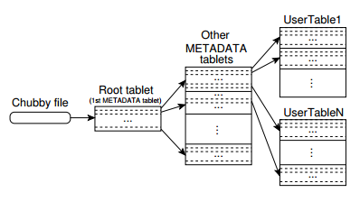
How to locate tablets?
Special METADATA table pointing to all other tablets
Row key = encode(tablename+last row)
how do you use this to look up tablets?
Also stores logs for debugging
Client optimizations:
cache fetches
prefetching
Never Split

Slide 12
Master
Assign tablets to servers
How to evenly balance traffic?
Detect tablet server failures
periodic ping
verify lock file in chubby
Startup
Find live servers from chubby
Get live assignments
Cross check with METADATA table
Start unassigned tablets
No communication with clients
Tablet
GFS
SSTable
Tablet server
...
Master
Tablet
SSTable
Acquire lock
METADATA
...
Chubby
Tablet
SSTable
Tablet server
...
Tablet
SSTable
Job Scheduler

Slide 13
Tablet Servers
Multiple tablets
Handles all read and write requests
Dynamic sharding
Acquire lock
Tablet
GFS
SSTable
Tablet server
...
Master
Tablet
SSTable
Client Applications
METADATA
...
Bigtable Library
Chubby
Tablet
SSTable
Tablet server
...
Optimizations
Scan cache
Block cache
Preload another instance before killing itself?
Acquire lock
Tablet
SSTable
Job Scheduler

Slide 14
SSTable
Tablet
GFS
SSTable
Tablet server
...
Master
Tablet
SSTable
Client Applications
METADATA
...
Bigtable Library
Chubby
Tablet
SSTable
Tablet server
...
Tablet
SSTable
Job Scheduler

Slide 15
SSTable
Ordered immutable map
64KB blocks, but configurable
Index at the end
Why?
Binary search to find blocks
Why not hashing?
Optimizations
Single SSTable for each locality group
In-memory serving
compression: two pass
single block
small data window
Blocks
Index
Notes:
10-to-1 reduction in space

Slide 16
SSTable & memtable
Optimization: Bloom filters
Speeds up non-existent data access
Optimization: single commit log per server
Sort before recovery
Two log file threads
Compact all data before dying
Read Operation
merged view
memtable
memtable
RAM
minor compaction
GFS
commit log
SSTable
SSTable
SSTable
Write Operation
How is the merged view created?
SSTable
SSTable
Notes:
lexicographically sorted data structures, the merged view can be formed efficiently

Slide 17
Merging Compaction
memtable
RAM
GFS
commit log
SSTable
SSTable
SSTable
SSTable
SSTable

Slide 18
Merging Compaction
memtable
RAM
GFS
commit log
SSTable
SSTable
SSTable
SSTable
SSTable
SSTable

Slide 19
Merging Compaction
memtable
RAM
GFS
commit log
SSTable
SSTable
SSTable

Slide 20
Major Compaction
memtable
RAM
GFS
commit log
SSTable
SSTable
SSTable
Bounds number of SSTables created
Removes all deleted data

Slide 21
Major Compaction
memtable
RAM
GFS
commit log
SSTable
SSTable
SSTable
SSTable

Slide 22
Major Compaction
memtable
RAM
GFS
commit log
SSTable

Slide 23
Immutability properties
SSTables are immutable
No contention for reads
Deleted data removed during garbage collection
Split child tablets can share SSTables
memtable is mutable
use copy-on-write
How to deal with caches?
Notes:
10-to-1 reduction in space

Slide 24
Performance evaluation
Notes:
10-to-1 reduction in space

Slide 25
Conclusion
Lessons learned:
many kinds of failures in Distributed Systems
aim for a simple design
delay implementing features
proper monitoring
Discussion question:
Having a separate metadata and master servers is an interesting design. Can the same design be used in other systems like GFS?
Notes:
10-to-1 reduction in space

Slide 26
Picture Acknowledgments
Slide 2,3 & 4
https://en.wikipedia.org/wiki/Star_schema
Slide 3 & 4
https://www.flickr.com/photos/121483302@N02/14253849274
http://suprtektalk.blogspot.ca/2015/02/google-earth-pro-is-free.html
http://calpersloan.com/google-finance-logo
https://developers.google.com/analytics/terms/branding-policy
http://logos.wikia.com/wiki/Orkut
Slide 11 & 19
Images from the paper
Chang, Fay; Dean, Jeffrey; Ghemawat, Sanjay; Hsieh, Wilson C; Wallach, Deborah A; Burrows, Michael ‘Mike’; Chandra, Tushar; Fikes, Andrew; Gruber, Robert E (2006), "Bigtable: A Distributed Storage System for Structured Data"
Notes:
10-to-1 reduction in space

