Slide 1
Storm @ Twitter
[Toshniwal et. al. SIGMOD’14]
Presenter: Anil Pacaci
apacaci@uwaterloo.ca

Slide 2
Motivation
Data Processing Guarantees
Fault-tolerance
Horizontal Scalability
Easy to use
Storm: Open-source, Real-time Hadoop
Stream Processing
Distributed RPC
Continuous Computation

Slide 3
Storm Data Model
Streams
Spouts
Bolts
Topologies
T
T
T
T
T

Slide 4
Storm – Word Count Example
Tweet Spout
cat - 1
the
and - 1
cat
the - 2
The cat and the fiddle
and
fiddle - 1
the
Tweet Parse
Bolt
Word Count
Bolt
fiddle

Slide 5
Storm Primitives
Spout API Bolt API

Slide 6
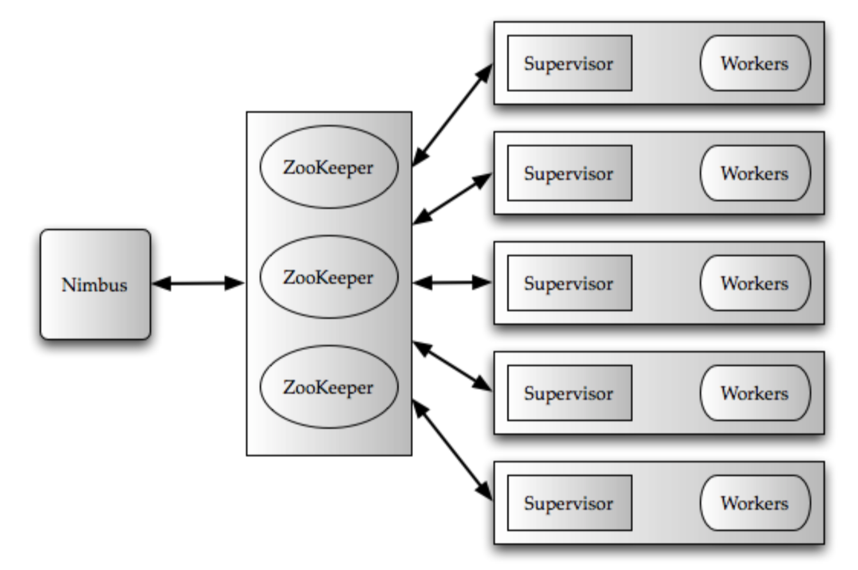
Storm Architecture
Master/worker
Stateless
ZooKeeper
Executor
Tasks
Bolts / Spouts
Language Support
Thrift-based

Slide 7
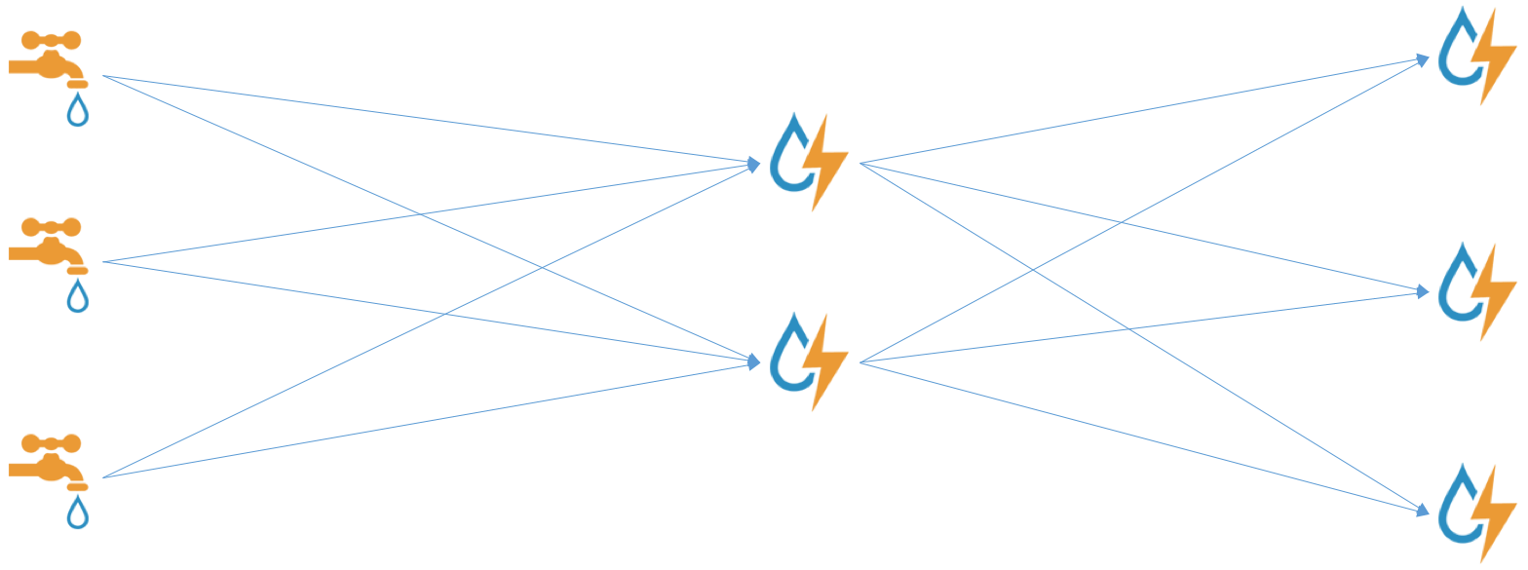
Stream Partitioning
Shuffle
Random partitioning
Fields
Consistent hashing on field
All
Replication
Global
Entire Stream to Single Bolt
Local

Slide 8
Word Count - Distributed
Shuffle Grouping
Field Grouping
cat - 1
The little dog laughed
the
the
fiddle - 1
cat
fiddle
and
dog - 1
and - 1
the
dog
little
laughed
the - 3
The cat and the fiddle
little - 1
laughed - 1
Tweet
Spout
Tweet Parse
Bolt
Word Count
Bolt

Slide 9
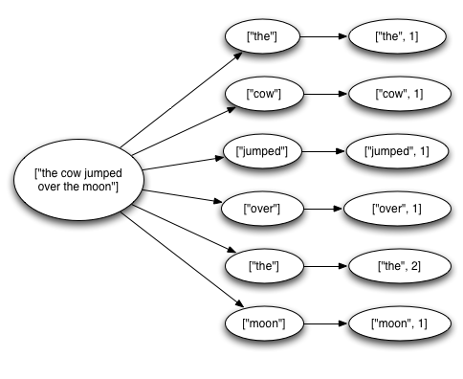
Message Guarantees
At most once
No special action
At least once
Provenance Tree

Slide 10
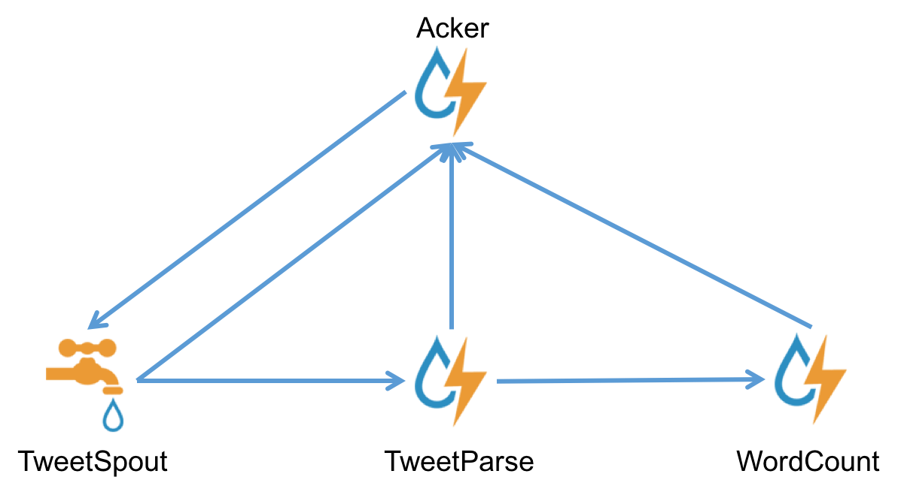
At least once Guarantee
ID | XOR
tid1 | 1010
“Acker” Bolt
(tupleid, timeout)
TweetSpout:
emit tid1
tid1:1010

Slide 11
At least once Guarantee
ID | XOR
tid1 | 0110
“Acker” Bolt
(tupleid, timeout)
TweetParse:
emit tid1
tid1:1010
tid1:1100

Slide 12
At least once Guarantee
ID | XOR
tid1 | 1100
“Acker” Bolt
(tupleid, timeout)
TweetParse:
ack tid1
tid1:1010
tid1:1100

Slide 13
At least once Guarantee
ID | XOR
tid1 | 0000
“Acker” Bolt
(tupleid, timeout)
WordCount:
ack tid1
tid1:1010
tid1:1100

Slide 14
Experiments – Fault Tolerance

Slide 15
Conclusions
General Purpose Stream Data Processing
Distributed
Fault-tolerant
Message Processing Guarantees
Deployed at Twitter Scale
30 topologies in 200 Node cluster
50 Billion Message/Day
Average latency < 50ms

Slide 16
Discussion
Comparison to Hadoop
Batch processing vs stream processing
Real-time
Comparison to STREAM – CQL
Distributed vs centralized
Declarative vs UDF
Exactly once semantics?

Slide 17
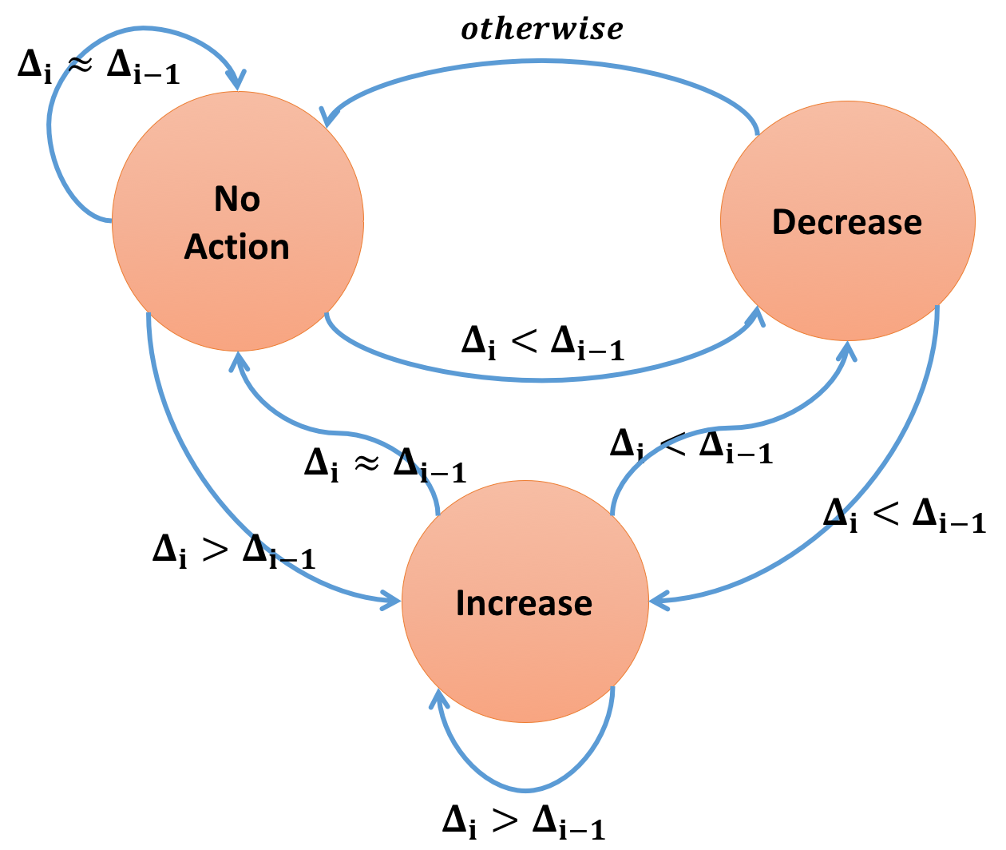
Twitter Experience
ZooKeeper Scalability
Commodity Cluster: 300 workers
Database Hardware: 1200 Workers
In-house Kafka Client
Max Spout Tuning
# of in-fly tuples
Last action – last progress

