Slide 1
Surprises in a Survey of the Graphs, Computations, and Software Used in Practice
  Semih Salihoglu
  University of Waterloo
Joint with Jimmy Lin, Frank McSherry, Amine Mhedbhi, Tamer Ozsu, Siddharta Sahu

Slide 2
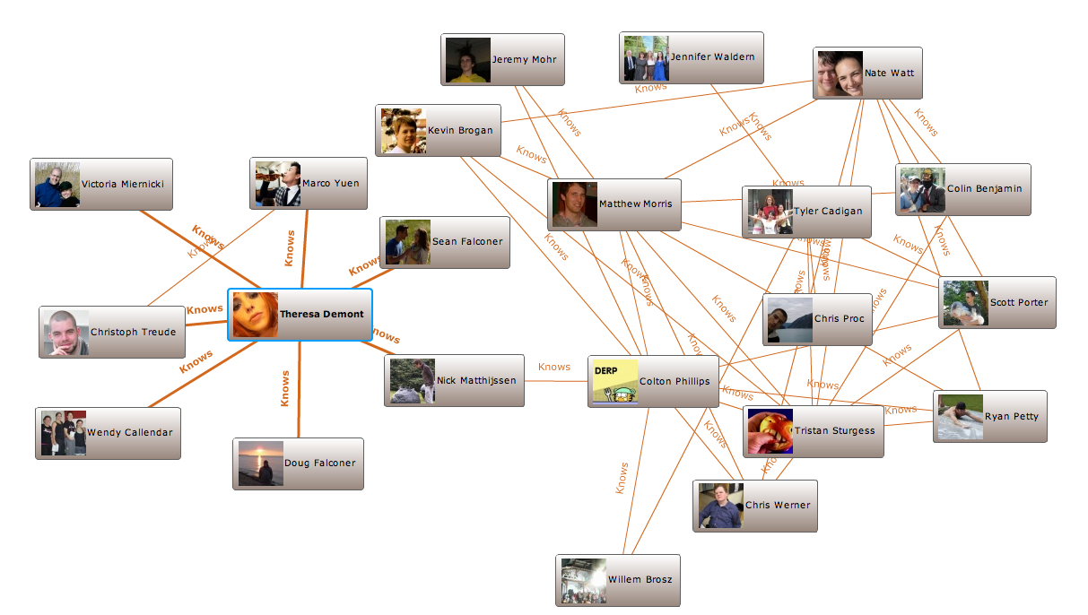
Graph Data, Computations, & Software in Academia
VLDB, SIGMOD, ICDE, KDD, OSDI, ICML, NIPS, SC, SOCC etc.
Graphs
Software
Master
Worker 1
Worker 2
…
Worker k
…
Distributed File System
Social & web, SNAP graphs, RDF, knowledge, scientific
Pregel-like systems, RDBMSs, RDF engines, Linear Algebra Software
Computations/Queries
PageRank, BFS, WCC/SCC, shortest paths, and different ML

Slide 3
High-level Survey Questions
What kind of:
Graph Data
Computations
Software
Major challenges
do real users have in practice?

Slide 4
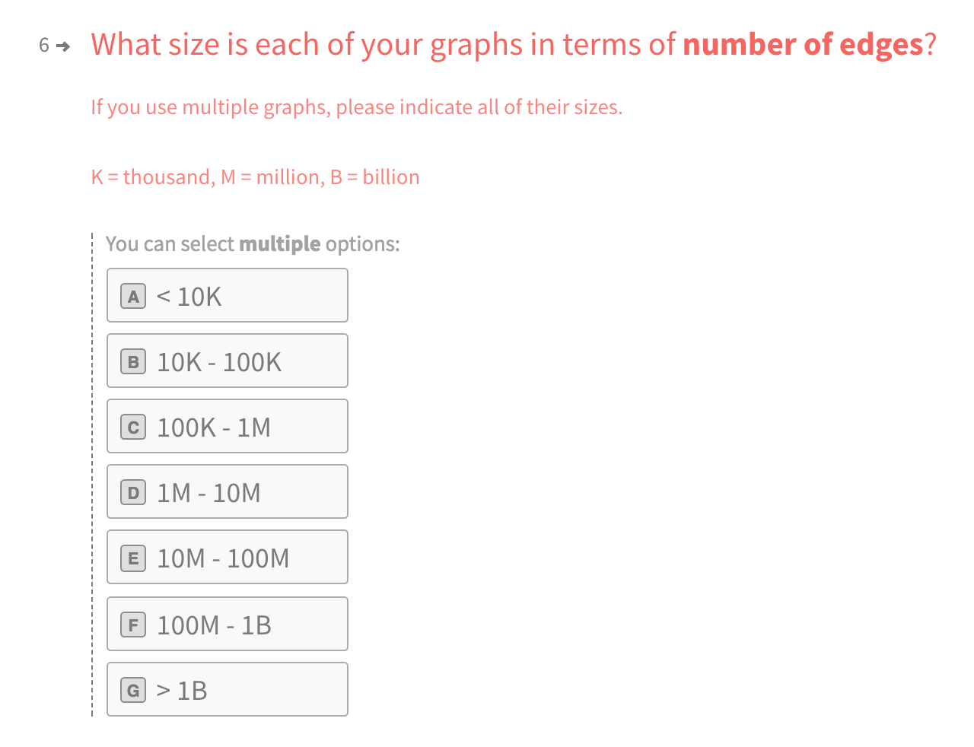

Survey Methodology (1): Survey Format
Online survey on Typeform.
34 questions
  Multiple choice
  Short answer

Slide 5
Survey Methodology (2): Participant Recruitment
44 graph software, selected those with mailing lists
Arrango DB | Apache Flink/Gelly
Caley | Apache Giraph
JanusGraph | Apache Spark/GraphX
Neo4j | Cytoscape
OrientDB | Elasticsearch X-Pack Graph
Graph for Scala | Apache Jena
GraphStream | DGraph
Graphtool | SparkSee
NetworKit | Virtuoso
NetworkX | Gremlin
SNAP | Conceptual Graphs
Dist. Graph Proc. Systems
Graph DBs
Visualization
RDF Engine
Graph Libraries
Query Language
Dsgn & Spec. Lang.
April 2017: posted link to mailing lists
Note: bias towards Graph DBs
  Larger and more active user bases

Slide 6
Participants
89 participants
Field | #
IT | 48
Research in Academia | 31
Finance | 12
Research in Industry | 11
Government | 7
Healthcare | 5
Defense and Space | 4
Pharmaceutical | 3
Retail & Ecommerce | 3
Transportation | 2
Telecommunications | 1
Insurance | 0
Other | 5
Research Participants (RP): 36
The Rest: Industry Participants (IP): 53
Organization Size (# employees) | #
1-10 | 27
10-100 | 23
100-1K | 14
1K-10K | 6
>10K | 15
Roles | #
Engineer | 27
Researcher | 23
Data Analyst | 14
Manager | 6

Slide 7
Types of Graphs: Real-world Entities (1)
Q1: Which real-world entities do your graphs represent?
Entity
Humans (e.g. customers, friends)
Non-Human Entities (e.g. web, products, files)
RDF
Scientific (e.g. proteins, molecules, bonds)

Slide 8
Types of Graphs: Real-world Entities (1)
Q1: Which real-world entities do your graphs represent?
Entity | # Participants (89)
Humans (e.g. customers, friends) | 44
Non-Human Entities (e.g. web, products, files) | 61
RDF | 23
Scientific (e.g. proteins, molecules, bonds) | 15
9 Research P.
6 Industry P.

Slide 9
Types of Graphs: Real-world Entities (2)
Q2: Which non-human entities do your graphs represent?
52 different entities broadly in 7 different groups:
Web
Business & financial
Products/order/tranx
Geo maps
Infrast. networks
Digital data
Know. & text
 | Web | Bus & Financial | Product | Geo | Infrast. | Digital | Knowledge
# Participants (89) | 4 | 8 | 13 | 7 | 9 | 5 | 11
1 Research Particitipant
12 Industry Participant
This is traditional relational enterprise (TPC-C) data!
How about academic publications?

Slide 10
Academic Publications Review
90 graph algorithms/systems papers in proc. of conferences
Conference | Field | Year
VLDB | Databases | 2014
KDD | Data Mining | 2015
ICML | Machine Learning | 2016
OSDI | Operating Systems | 2016
SC | High Per. Computing | 2016
SOCC | Cloud Computing | 2016

Slide 11
Types of Graphs: Real-world Entities (2)
Q2: Which non-human entities do your graphs represent?
52 different entities broadly in 7 different groups:
Web
Business & financial
Products/order/tranx
Geo maps
Infrast. networks
Digital data
Know. & text
 | Web | Bus & Financial | Product | Geo | Infr. | Digital | Knowledge
# Participants (89) | 4 | 8 | 13 | 7 | 9 | 5 | 11
# Academic Pubs (90) | 30 | 8 | 2 | 11 | 2 | 0 | 3

Slide 12
Types of Graphs: Scale
Q: How large are your graphs in terms of |V|,|E|, bytes?
|E| | <10K | 10K-100K | 100K-1M | 1M-10M | 10M-100M | 100M-1B | >1B
# Participants | 23 | 22 | 13 | 9 | 21 | 21 | 20
8 RP
12 IP
# Bytes | <10MB | 10MB-100MB | 100MB-1GB | 1GB-10GB | 10GB-100GB | 100GB-1TB | >1TB
# Participants | 23 | 22 | 13 | 9 | 21 | 21 | 20
xd
Large-scale graphs are everywhere!
Various entities: social, scientific, RDF, product, digital data (and possibly more)

Slide 13
Types of Graphs: Other Questions
Data on V and E?
Directed vs Undirected?
Dynamism: Static, Dynamic, Streaming?
 | Static | Dynamic | Streaming
# Participants | 40 | 55 | 18

Slide 14
Types of Computations: Graph Computations
Q: What kind of graph queries and computations (not including ML) do you run?
  Q1: Multiple choice
    Problem: No list of graph queries/computations
    List from academic pubs.
  Q2: Short answer

Slide 15
Types of Computations: Graph Computations
Query/Computation
Aggregations (e.g., counting the number of triangles)
Connected Components
Diameter Estimation
Finding Frequent or Densest Subgraphs
Graph Coloring
Graph Partitioning
Minimum Spanning Tree
Neighborhood Queries (e.g., 2-dgr neighbors of a node)
Node-similarity (e.g., SimRank)
Ranking and Centrality Scores (e.g., PageRank, betweenness centrality)
Reachability Queries
Short/shortest paths
Subgraph matching (e.g., find all diamonds, SPARQL patterns)

Slide 16
Types of Computations: Graph Computations
Query/Computation | # Participants | # Academic Pubs.
Connected Components | 55 | 12
Neighborhood Queries (e.g., 2-dgr neighbors of a node) | 51 | 3
Short/shortest paths | 43 | 16
Subgraph matching (e.g., find all diamonds, SPARQL patterns) | 33 | 21
Ranking and Centrality Scores (e.g., PageRank, betweenness centrality) | 32 | 22
Aggregations (e.g., counting the number of triangles) | 30 | 7
Reachability Queries | 27 | 3
Graph Partitioning | 25 | 5
Node-similarity (e.g., SimRank) | 18 | 3
Finding Frequent or Densest Subgraphs | 11 | 2
Minimum Spanning Tree | 9 | 2
Graph Coloring | 7 | 3
Diameter Estimation | 5 | 2

Slide 17
Types of Computations: Machine Learning
Q: What kind of ML computations do you run?
  ML comp. in academic pubs are of 3 kind:
    High-level classes of algorithms:
      clustering, classification, regression
    Specific algorithms/techniques
      SGD, ALS
    Problems solved with ML
      community detection, link pred., recommendation.

Slide 18
Types of Computations: ML Computations & Problems
Computation | # Participants
Clustering | 42
Classification | 28
Regression (Linear/Logistic) | 11
Graphical Model Inference | 10
Collaborative Filtering | 9
Stochastic Gradient Descent | 4
Alternating Least Squares | 0
Problems | # Participants
Community Detection | 31
Recommendation Systems | 26
Link Prediction | 25
Influence Maximization | 14
ML is very popular on graphs!
at least 61/89 participants use ML on graphs.

Slide 19
Types of Computations: Other Questions
Traversals: BFS vs DFS? => They use both
Streaming/Incremental Computations? (short-answer)
  32 yes
  e.g., continuous aggregations, approximate connected comp, k-core, hill climbing
Note: None of the 22 software we picked handles streams.

Slide 20
Types of Software: For Querying and Computations
Q: Which types of graph software do you use for querying and running computations on graphs?
Software | # Participants
Graph Database | 59
Distributed Data Processing System (e.g., Hadoop, Spark) | 29
Apache Tinkerpop/Gremlin | 23
RDBMS | 21
RDF System | 16
Distributed Graph Processing System (e.g., Giraph, GraphX, GraphLab) | 14
Linear Algebra Library (e.g., Matlab, LAPACK) | 8
In-Memory Graph Library (e.g., SNAP, GraphStream) | 7
None of the 22 software is RDBMS!
RDBMSs still play an important role!

Slide 21
Types of Software: For Non-Querying Tasks
Q: Which types of graph software do you use for the following non-querying tasks?
Software
Cleaning
Debugger
ETL
Graph Visualization
Synthetic Graph Generator

Slide 22
Types of Software: For Non-Querying Tasks
Q: Which types of graph software do you use for the following non-querying tasks?
Software | # Participants
Graph Visualization | 55
ETL | 15
Cleaning | 5
Synthetic Graph Generator | 4
Debugger | 2
Visualization is a very important and common task!
(more on this soon)

Slide 23
Types of Software: Other Questions
Architecture: Serial vs parallel vs distributed?
Multiple software for processing same graph?
  e.g., Graph DB & RDBMS format, graphml & csv

Slide 24
Major Challenges (1)
Q: What are your top 3 challenges?
Challenge
Benchmarks
ETL
Debugging & testing
Faster graph or machine learning algorithms
Graph cleaning
More general purpose graph software (e.g., that can perform offline, online, and streaming computations)
Query languages / Programming APIs
Scalability (i.e., software that can process larger graphs)
Usability (i.e., easier to deploy, configure, and use)
Visualization

Slide 25
Major Challenges (1)
Q: What are your top 3 challenges?
Challenge | # Participants
Scalability (i.e., software that can process larger graphs) | 45
Visualization | 39
Query languages / Programming APIs | 39
Faster graph or machine learning algorithms | 35
Usability (i.e., easier to deploy, configure, and use) | 25
Benchmarks | 22
ETL | 20
More general purpose graph software (e.g., that can process offline, online, and streaming computations) | 20
Graph cleaning | 17
Debugging & testing | 10

Slide 26
Major Challenges (2)
Q: What’s your top challenge?
42 responded
  All sorts of challenges (some from previous table)
But confirming:
Scalability, Visualization, & Query Languages!

Slide 27
Summary of Findings
Graphs are indeed everywhere!
  Social, web, product, finance, digital, text, etc.
  Including traditional enterprise data.
Graphs are indeed very large!
ML on graphs is very popular.
Scalability is the most pressing challenge!
  Visualization & Query Languages
Visualization is a common and important task!
RDBMS still play an important role!

Slide 28
Further Questions to Answer
Benefits of representing data as graphs?
Exact scale of graphs?
Incremental and streaming computations?
Visualization?
  What’s it used for?
  What are the challenges?
Challenges in Query Languages?

