Slide 1
ERNIE: Enhanced Representation through KNowledge IntEgration
Authors: Yu Sun, Shuohuan Wang, Yukun Li, Shikun Feng Xuyi Chen, Han Zhang, Xin Tian, Danxiang Zhu, Hao Tian, Hua Wu
Presenter: Futian Zhang

Slide 2
Sesame Street
Ernie
Bert

Slide 3
Outline
Ernie Model
Motivation
Related Work
Ernie
Experiment Results

Slide 4
Motivation
If the model learns more about prior knowledge, the model can obtain more reliable language representation.
In addition to basic masking strategy, they use two kinds of knowledge strategies: phrase-level strategy and entity-level strategy to help the model learn the prior knowledge.
Relationship?
Harry Potter <———>J. K. Rowling

Slide 5
Related Work
Context-independent Representation
Word2Vec
Glove
They generate a single word embedding representation for each word in the vocabulary.

Slide 6
Related Work
Context-aware Representation
Skip-thought, Cove, ULMFit, ELMo, GPT
BERT

Slide 7
Review: Bert
Bert Structure

Slide 8
Bert Masked Language Model
15% token:
80% “[MASK]” token + 10% Random word+ 10% original word
Learn to predict the masked word

Slide 9
Bert Next Sentence Prediction
Try to model the relationship between two sentences which is not captured by traditional language models

Slide 10
Related Work
Context-aware Representation
Skip-thought, Cove, ULMFit, ELMo, GPT
BERT
MT-DNN, GPT-2, XLM …

Slide 11
Related Work
Heterogeneous Data
Universal sentence encoder
adopts heterogeneous training data drawn from Wikipedia, web news, web QA pages and discussion forum
Sentence encoder
based on response prediction benefits from query-response pair data drawn from Reddit conversation
XLM
introduce parallel corpus to BERT, which is trained jointly with masked language model task

Slide 12
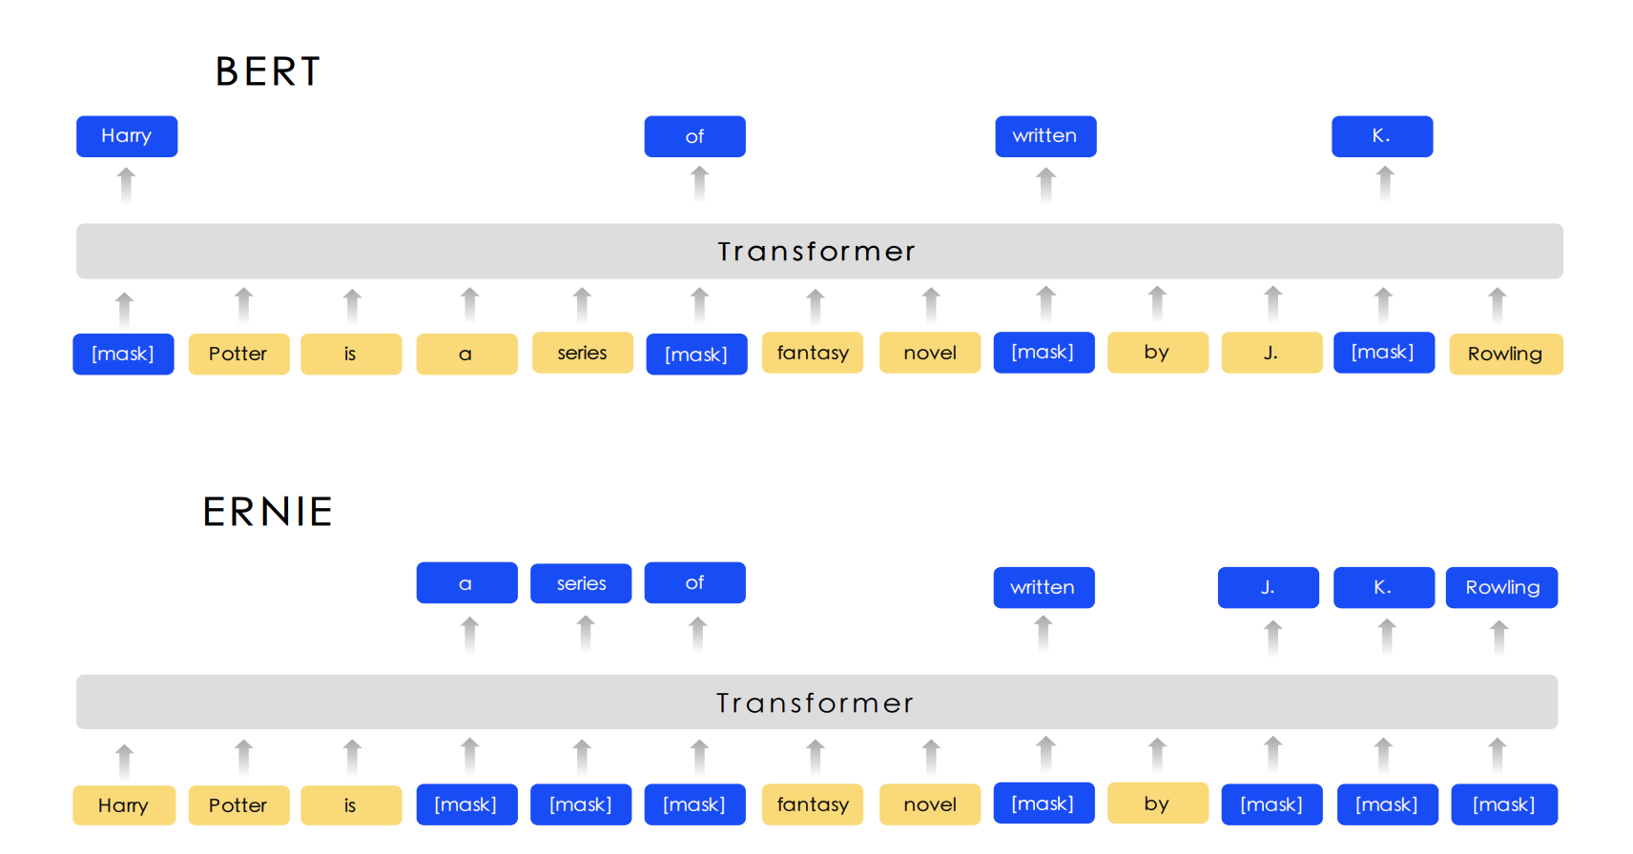
Ernie
The different masking strategy between BERT and ERNIE

Slide 13
Encoder
multi-layer Transformer
capture the contextual information
Chinese corpus
add spaces around every character
use the WordPiece to tokenize Chinese sentences
For a given token, its input representation is constructed by summing the corresponding token, segment and position embeddings.
The first token is [CLS]

Slide 14
Knowledge Integration
multi-stage knowledge masking strategy
integrate phrase and entity level knowledge into the Language representation.

Slide 15
Knowledge Integration
Basic-Level Masking
treat a sentence as a sequence of basic Language unit
English: word
Chinese: Chinese Character, like “字”

Slide 16
Knowledge Integration
Basic-Level Masking
Mask 15% units during training process, others as inputs
Train the transformer to predict the masked units
obtain a basic word representation

Slide 17
Knowledge Integration
Phrase-Level Masking
a small group of words or characters together acting as a conceptual unit
English: lexical analysis and chunking tools to get the boundary
Chinese: language dependent segmentation tools to get the word/phrase information

Slide 18
Knowledge Integration
Phrase-Level Masking
use basic language units as training input
randomly select a few phrases in the sentence
mask and predict their basic unit
phrase information is encoded into the word embedding

Slide 19
Knowledge Integration
Entity-Level Masking
Name entities contain persons, locations, organizations, products, etc.
entities contain important information in the sentences

Slide 20
Knowledge Integration
Entity-Level Masking
first analyze the named entities in a sentence
then mask and predict all slots in the entities

Slide 21
Knowledge Integration
Basic-Level Masking
Phrase-Level Masking
Entity-Level Masking
A word representation enhanced by richer semantic information is obtained.

Slide 22
Outline
Ernie Model
Motivation
Related Work
Ernie
Experiment Results

Slide 23
Model
ERNIE has the same models size as BERT-Base
12 encoder layers, 768 hidden units and 12 attention heads

Slide 24
Heterogeneous Corpus Pre-training
mixed Chinese corpus:
Chinese Wikipedia and Baidu Baike
encyclopedia articles
Baidu news
movie names, actor names, football team names
Baidu Tieba
open discussion forum as dialogue
Chinese characters
traditional-to-simplified conversion
English letters
UPPER-To-lower

Slide 25
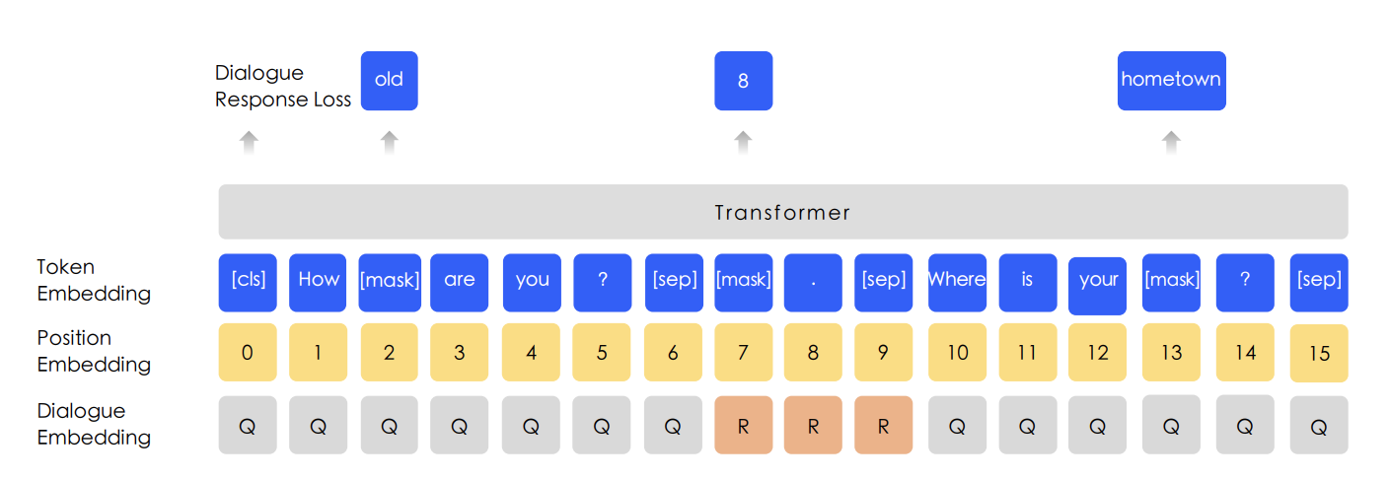
Dialogue Language Model
multi-turn conversations
QRQ, QRR, QQR, where Q and R stands for ”Query” and ”Response” respectively)
replacing the query or the response with a randomly selected sentence

Slide 26
Dialogue Language Model
fake sample
replacing the query or the response with a randomly selected sentence
judge whether the multi-turn conversation is real or fake

Slide 27
Dialogue Language Model
purpose
help ERNIE to learn the implicit relationship in dialogues
enhances the model’s ability to learn semantic representation
pre-trained alternatively with the MLM task

Slide 28
Experiments on Chinese NLP Tasks
Natural Language Inference
Semantic Similarity
Named entity recognition
Sentiment analysis
Question answering

Slide 29
Natural Language Inference
The Cross-lingual Natural Language Inference (XNLI) corpus
The pairs are annotated with textual entailment and translated into 14 languages including Chinese.
The labels contains contradiction, neutral and entailment.

Slide 30
Semantic Similarity
The Large-scale Chinese Question Matching Corpus (LCQMC)
identifying whether two sentences have the same intention

Slide 31
Named entity recognition
MSRA-NER dataset
contains several types including person name, place name, organization name and so on

Slide 32
Sentiment analysis
ChnSentiCorp
includes comments in several domains such as hotels, books and electronic computers
to judge whether the sentence is positive or negative

Slide 33
Question answering
NLPCC-DBQA dataset
to select answers of the corresponding questions

Slide 34
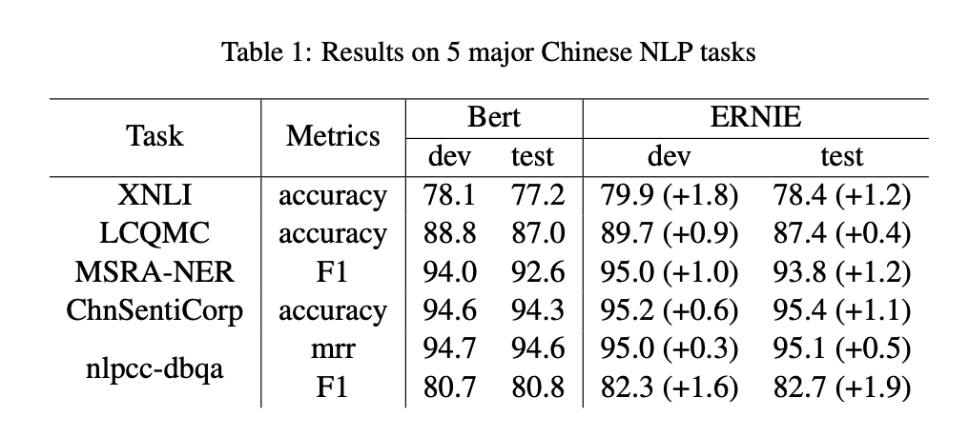
Experiment results
Outperform Bert on all tasks

Slide 35
Ablation Studies
Effect of
Knowledge Masking Strategies
DLM

Slide 36
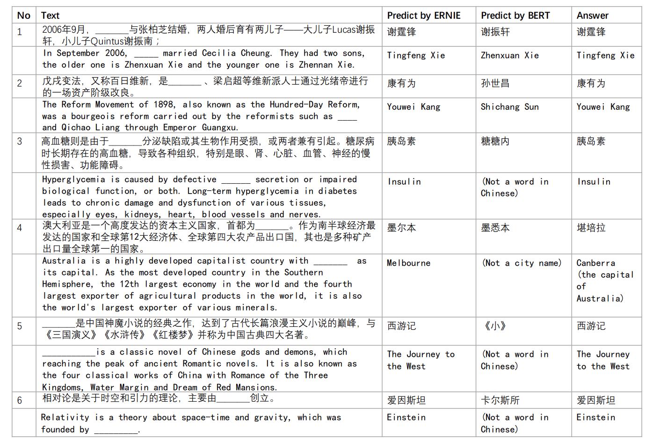
Cloze Test
the name entity is removed and the model need to infer what it is

Slide 37
Cloze Test
Case 1:
Bert: try to copy the name appeared in the context
Ernie: remembers the knowledge about relationship

Slide 38
Cloze Test
Case 2 and 5:
Bert: successfully learn the patterns but failing to fill in the slot with the correct entity
Ernie: correct entities

Slide 39
Cloze Test
Case 3 and 6:
Bert: hard to predict the semantic concept
Ernie: predicts correct entities

Slide 40
Cloze Test
Case 4:
Bert: several characters related, but cannot predict the semantic concept
Ernie: wrong in entity but correct in semantic type

Slide 41
THANKS!
Any questions?

