Slide 1
Predicting Protein Structure with Alphafold2
Yonghan Yu
CS886
Department of Computer Science
University of Waterloo

Slide 2
Background & Introduction

Slide 3
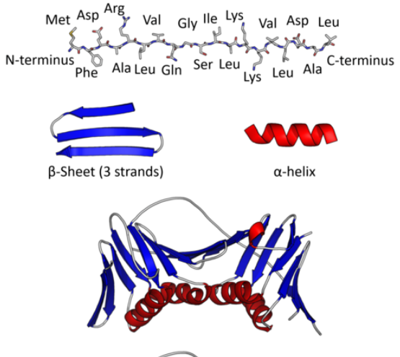
Introduction to Protein Structure
Protein are folded from peptides
Primary structure: sequence of amino acids
Secondary structure: structure of local segments
Tertiary structure: 3-d structure of protein

Slide 4
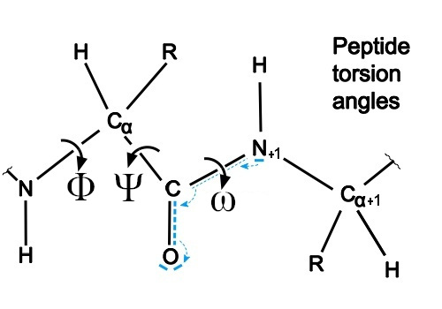
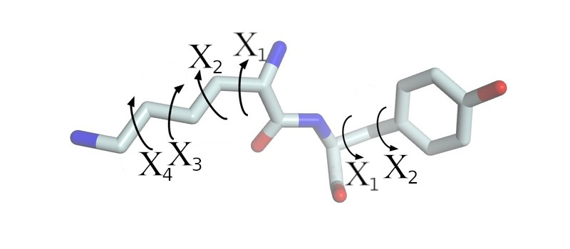
Introduction to Protein Structure
Structure can be described with torsion angles:
Backbone: φ, ψ, ω Side chain: χ

Slide 5
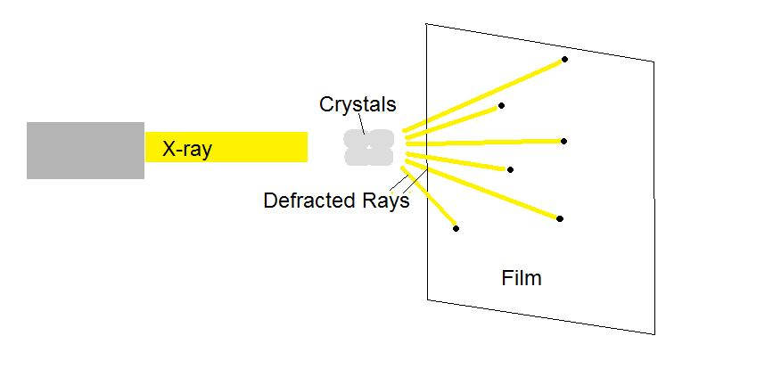
Wet-lab Protein Structure Determination
Protein are crystallized for fixing structure
X-rays are generated towards the crystallized protein
Publicly available structure database: protein data bank (PDB)

Slide 6
Template-based Structure Prediction
Given the sequence of target protein:
Search for structure in the database
Use most similar structures as template
Search fragmented secondary structure in database
Combine template and fragmented structure with statistic model

Slide 7
Evolution and Protein Structure
Similar proteins in different species may have same functionality
Same function means similar structure
The peptide sequence might be different
Residue pair close in proximity tends to coevolve
Similar proteins in different species may have same functionality
Same function means similar structure
The peptide sequence might be different
Residue pair close in proximity tends to coevolve

Slide 8
DCA and MSA in Protein Prediction
Direct Coupling Analysis
Use the correlation between residue to estimate the proximity in structures
The correlation can be deduced from residue coevolution
Multiple Sequence Alignment
Align multiple peptide sequence for similar protein from multiple organism
Detect sequence homology

Slide 9
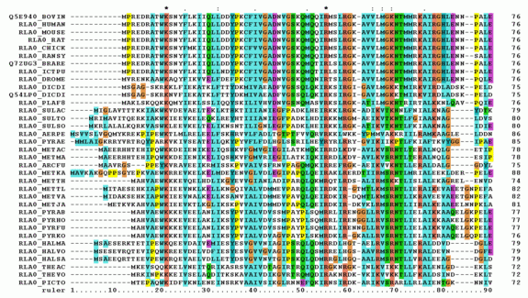
DCA and MSA in Protein Prediction

Slide 10
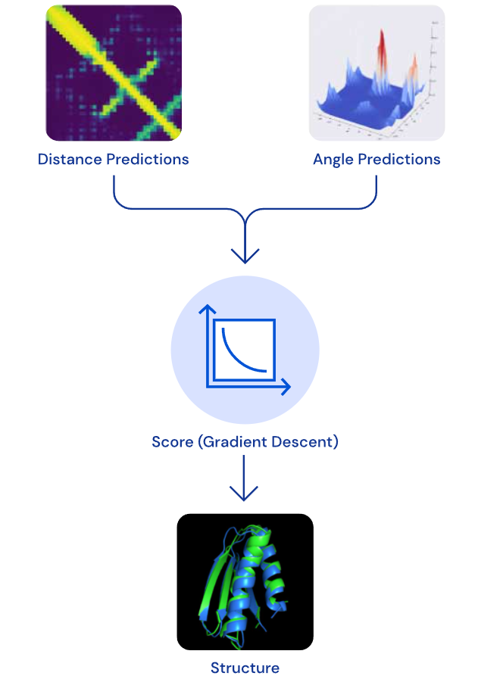
Reconstruction of Protein Structure
Previous works predict residue distance map, torsion angle and secondary structure
Tertiary structure is than folded on predicted value

Slide 11
End-to-end Protein Structure Prediction with AlphaFold2

Slide 12
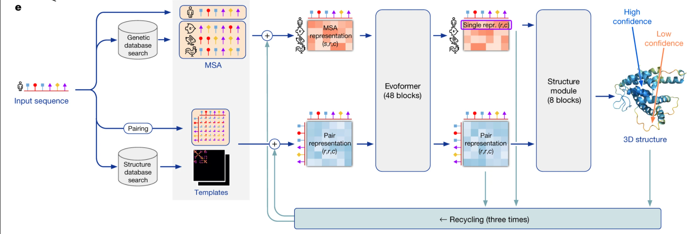
Overview of the AlphaFold Network
AlphaFold2 uses 48 blocks of Evoformer and 8 blocks of Structure Module

Slide 13
MSA Clustering and BERT Style MSA Prediction
The evoformer scales as ${N_{seq}}^{2}×$ $N_{res}$
To reduce the computational cost, the MSA is clustered:
$N_{cluster}$ random representative sequence are selected as cluster center
Deletion statistics are calculated for each cluster as extra feature
A mask is generated for sequence of cluster center
The mask position is replaced with amino acids or a special masking token (0.7)
A MSA BERT is used to predict the special masking token
Non-representative sequence are used as extra feature

Slide 14
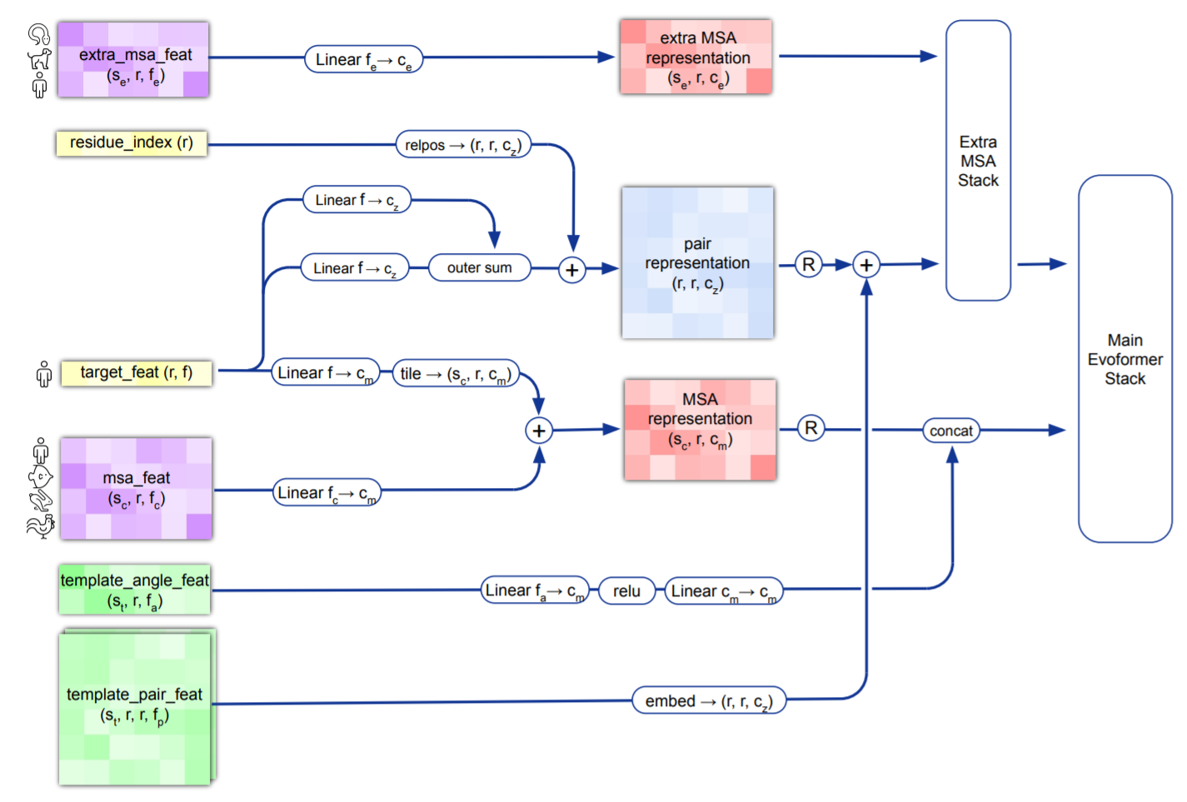
Input Feature Generation

Slide 15
Evoformer Module
Each evoformer stack consists of MSA attention units and Triangle attention unit
The MSA attention are sum of row-wise MSA attention, colume-wise MSA attention and Linear projection of MSA
The MSA attention are used to update the pair-wise representation
The pair-wise representation are updated with Triangle update to form Triangular self-attention

Slide 16
Evoformer Module

Slide 17
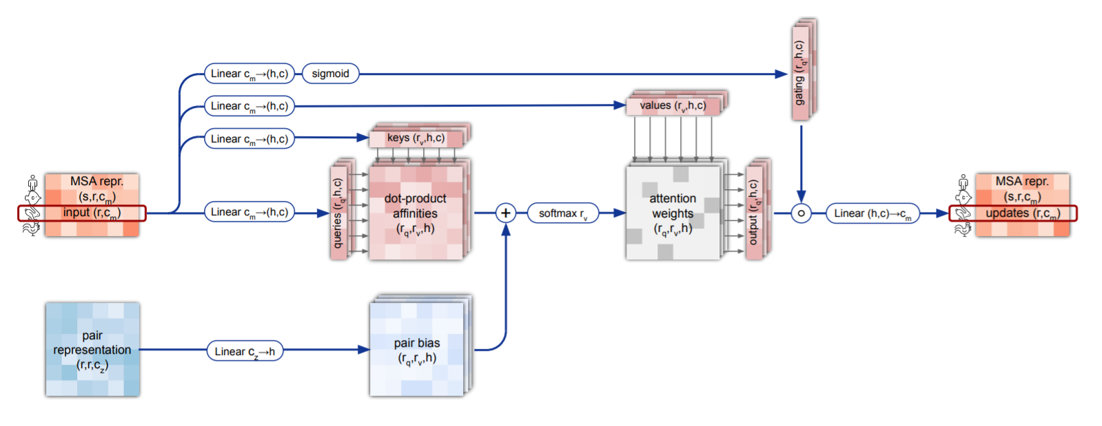
Row-wise MSA Attention

Slide 18
Column-wise MSA Attention

Slide 19
Triangular Multiplicative Update

Slide 20
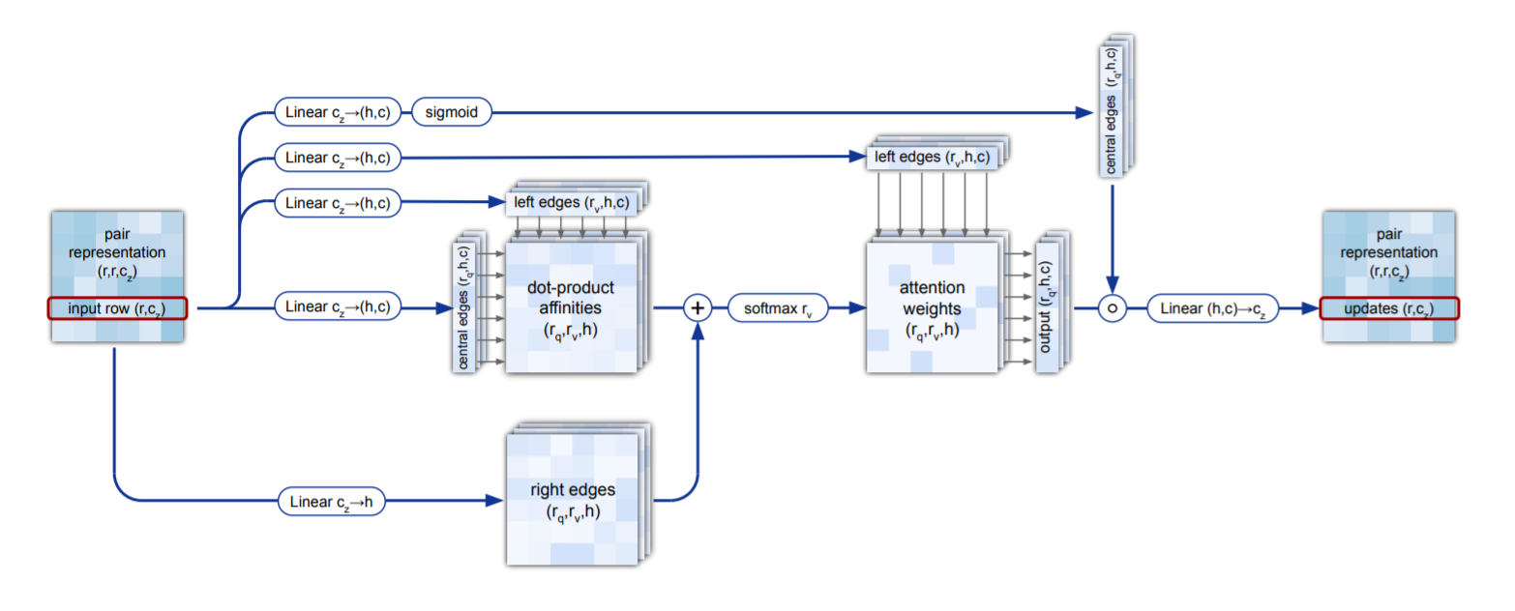
Triangular Self Attention

Slide 21
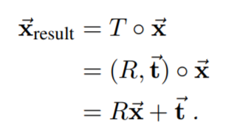
Transformation in 3D Space
Changing coordinates without influencing structure
Translation: defined as t
Rotation: defined as R
Euclidean transformation:

Slide 22
Structure Module
The structure module use a simple 3D embedding of the backbone frame
The 3D embedding are consisted of frames per-residue
Frames are defined as Euclidean transformation
Each frame are at the same starting location with same orientation
Evoformer outputs are used to update the backbone frames with Invariant Points Attention (IPA)

Slide 23
Structure Module

Slide 24
Invariant Point Attention
IPA acts on Euclidean transform T (coordinates)
IPA is update the local frames invariant to its global rotation and translation

Slide 25
Invariant Point Attention

Slide 26
Find-tunning with Structure Violation
The initial trained network produce structure that violates physics
The peptide bonds may be too long
The bond angle may exceed maximum possible value
Two atoms may clash in the predicted structure
Structure violations loss are defined to fine turning the network after initial training

Slide 27
Network Training
The AlphaFold2 is trained on both labelled and unlabelled data
Labelled data: structures from PDB
Unlabelled data: high-confidence structures predicted by AlphaFold2
The predicted structure is recycled three times with shared weight
Each time the AlphaFold2 improved slightly over previous structure

Slide 28
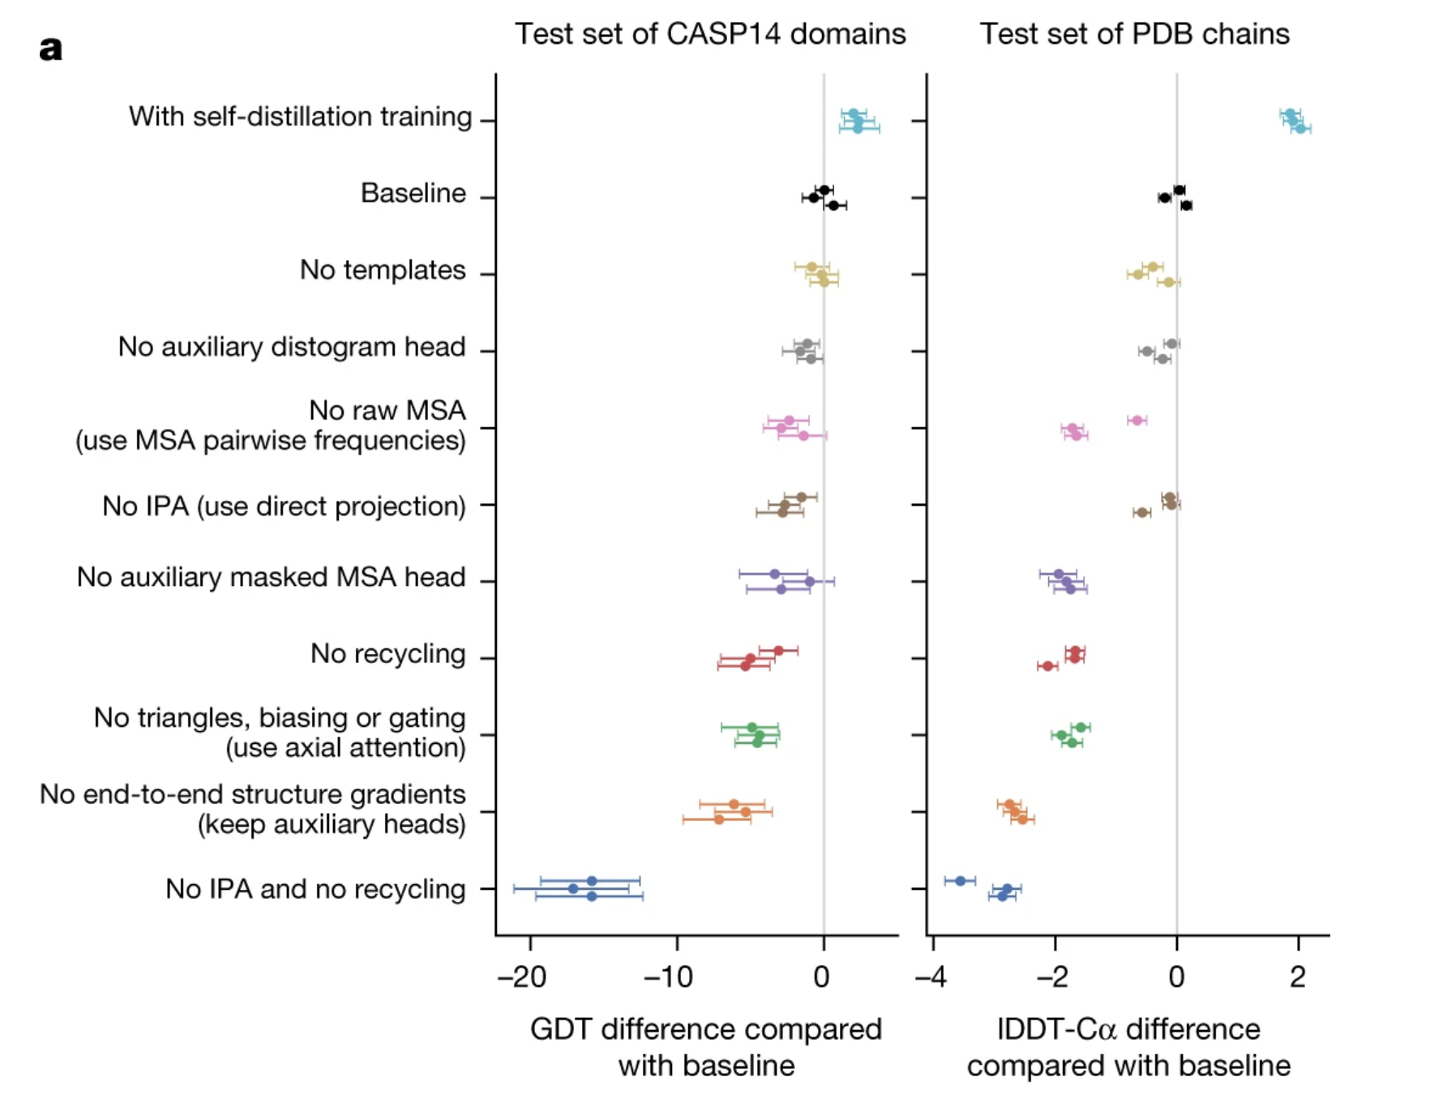
AlphaFold2 is Successful as of Combined Methods

Slide 29
Q&A

