Slide 1
True Knowledge: Open-Domain Question Answering using Structured Knowledge and Inference
Author: William Tunstall-Pedoe
Presenter: Bahareh Sarrafzadeh
CS 886
Spring 2015

Slide 2
Open Domain QA Platform
Direct Answers
Any Domain
Understanding the Question
Structured Knowledge

Slide 3
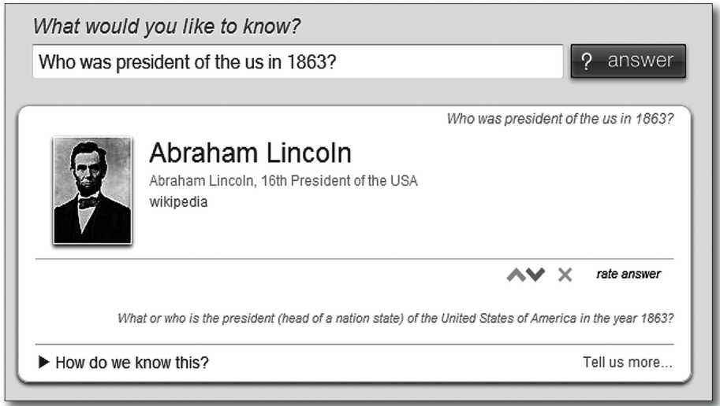
Example Question Response

Slide 4
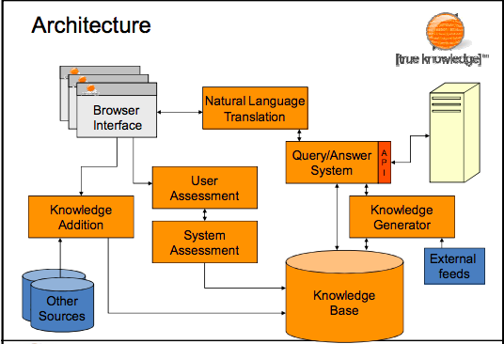
How the System Works
Notes:
Users can interact with the system using a browser interface. User questions are translated into an internal query language using the natural language translation system. The resulting queries are then executed to produce answers using both static knowledge stored in the knowledge base and facts generated by inference. External feeds of knowledge such as financial information can be brought into the platform through this system too.
Knowledge can be added to the platform by users using the browser interface too. Knowledge integrity is managed by two systems. First, user assessment allows users to contradict or endorse existing facts, optionally providing additional sources for the knowledge in the platform. Second, system assessment uses the inference system to switch off knowledge that is in semantic conflict with other knowledge in the knowledge base.

Slide 5
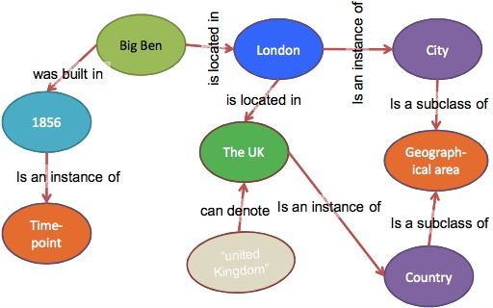
Knowledge Representation
Notes:
The knowledge in the knowledge base is represented in a single unified format: named relations between pairs of named entities referred to as “facts.”

Slide 6
Knowledge Categories
Commonsense Knowledge
already known
doesn’t directly answer the questions;
essential for understanding the questions;
e.g. “London is a place”, “Cities are kinds of place”
Factual Knowledge
isn’t generally known;
used to generate answers for the questions;
e.g. “Big Ben was built in 1856”
Lexical Knowledge
facts about what words or phrases are used to communicate entities in the KB in natural language;
vital for understanding different ways a question can be asked;
e.g. “the uk” and “United Kingdom”
Notes:
Knowledge is categorized into 3 broad classes ..

Slide 7
Representation
Basic KR is very simple
[london] [is an instance of] [city]
Temporal Knowledge is represented by “facts about facts”
[fact: [“123”]] [applies for time period] [<1970 onwards>]

Slide 8
Commonsense Ontology
Manually build an Ontology that
Covers and describes all entities that could be talked about;
Defines classes for each entity;
Provides robust facts about each class;

Slide 9
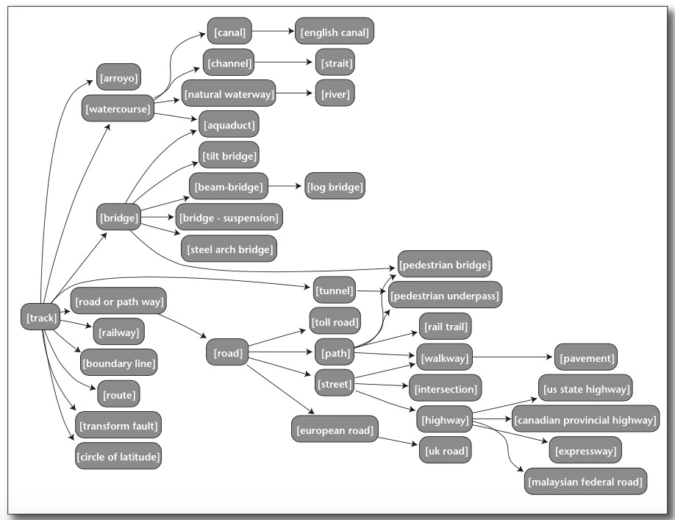

Slide 10
Answering a Question with Ontological Knowledge

Slide 11
Query Language
Queries are similar to KR but with variables.
e.g.: “Who is the president of US?”
Notes:
The query language corresponds closely to the fact representation except that variables can take the place of IDs. There are no primitive values. The header of the query also allows the user to specify what variables are the result of the query. Without any header variables the semantics of the query corresponds to a yes or no question.
In the example query, the query-processing engine has to find a value for the variable a that satisfies the other constraints: namely that a fact f exists where a is the first entity, the relation is [is the president of], and the right entity is the Unit- ed States. The final constraint is that fact f is believed true at the point in time that has the attribute [current time] (represented in the first line by the variable now). Semantically this query is identical to the question “Who is the president of the United States?” Had the query not specified the variable a as the result of the query, the corre- sponding English question would have been “Is there a current president of the United States?”

Slide 12
Inference and Extending Knowledge
Notes:
Inference is the ability to generate knowledge from other knowledge.
From the facts that Big Ben is located in London and that London is located in the United Kingdom it is possible to dynamically generate the fact that Big Ben is in the United Kingdom. No such static fact needs to be stored.

Slide 13
Inference
Inference achieved with rules (“generators”)
invoked during query processing
Rules designed to be as general as possible
Query processing integrates use of these rules in an efficient way
Explanations generated along the way
Inference can also be used to validate and reject new knowledge

Slide 14
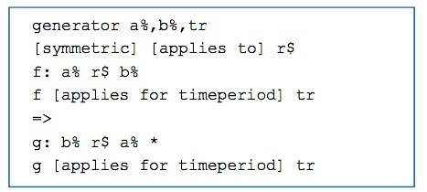
Example “dumb” Generator
Embodies symmetry
e.g. “a is married to b implies b is married to a”

Slide 15
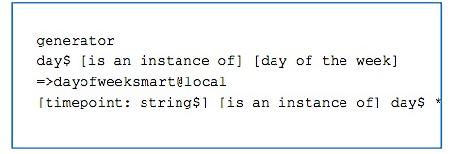
Example “smart” Generator
Smart generators have attached program code
can thus do any calculation that can be done on a computer
Example gives day of week for any date:

Slide 16
Translation
Turns natural language questions into queries
Basic approach is via templates
Each template gives method for translating a class of questions
the larger the better;
Disambiguation is used to remove unlikely interpretations after translation
Notes:
Translation is our term for the process of turning natural language questions into the language-independent True Knowledge queries. We implement this with a collection of templates, each of which describes how to turn a class of natural language questions into the correct query. A postprocessing step disambiguates and throws away unlikely interpretations of the question.

Slide 17
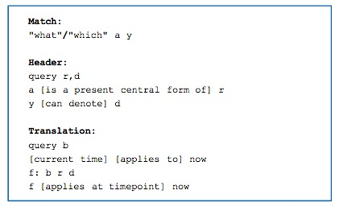
Example Template
What is the capital of France? What is the age of Eiffel Tower?

Slide 18
Translation Step One
“What is the capital of France?”

Slide 19
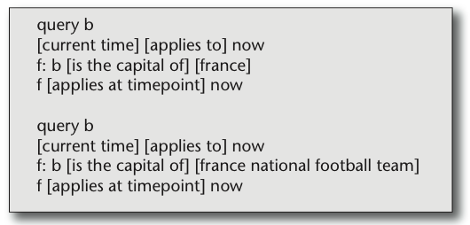
Candidate Translations

Slide 20
Knowledge Acquisition
Questions can be answered where sufficient Knowledge is available to:
understand the question
answer the question
Adding Knowledge
directly adding knowledge by staff
developing tools to add knowledge at scale
Knowledge Sources
Wikipedia, databases, user-supplied
Knowledge Extraction using NLP techniques

Slide 21
Comparison with Other Systems
Wolfram Alpha
Combines vast amount of structured data and computation to respond directly to users’ query
Knowledge is stored in a large collection of separate database tables
Mathematical code is used to access knowledge
Has no Ontology
Matches words in the query w/o any complex parsing
Large team of people involved in Knowledge acquisition

Slide 22
Comparison with Other Systems
Freebase
a project to compile a large structured knowledge base of the world’s knowledge
has an API that automat- ed systems can query
no natural language question-answering ability
lack of an inference system
Topics are also grouped into broad top-level categories rather than into a full ontology.

Slide 23
Comparison with Other Systems
CYC
AI project, started in 1984
combines
an ontology;
commonsense knowledge;
inference system;
complexity of the underlying KR system:
first order logic;
modal operators;
higher-order quantifiers;
Consistency of Knowledge
CYC: only within Micotheories
True Knowledge: across all its knowledge

Slide 24
Evaluation?
“We are automatically answering much more than half of the questions asked by the users.”
Using discussion forums
questions meant for people to answer;
not necessarily well-formed;
noisy;
Performance: 2%
Answerable Life Questions (ALQ)
hypothetical benchmark
day-to-day information needs of a population of users
Performance: 17%

Slide 25
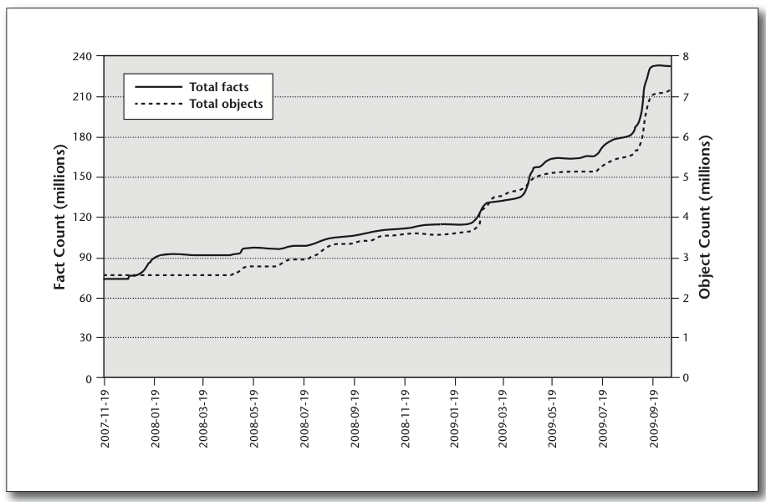
Progress and Results

