Slide 1
Jan. 27, 2022
CS 886 Deep Learning for Biotechnology
Ming Li

Slide 2
01. Word2Vec
02. Attention and Transformers
CONTENT
03. Pretraining, GPT and BERT
04. Deep learning in Proteomics
05. Student presentations begin

Slide 3
Deep learning in Proteomics
04
LECTURE FOUR

Slide 4
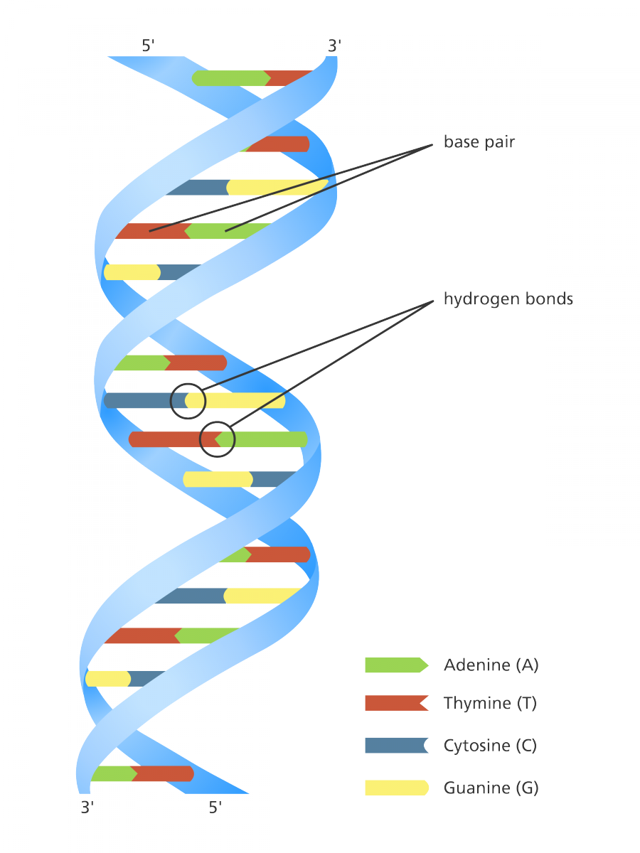
04
DNA
Simple things to know:
DNA = Deoxyribonucleic acid
4 bases (nucleotides): cytosine (C), guanine (G), adenine (A), thymine (T). C matches G, A matches with T.
Double helix structure: sugar-phosphate backbone

Slide 5
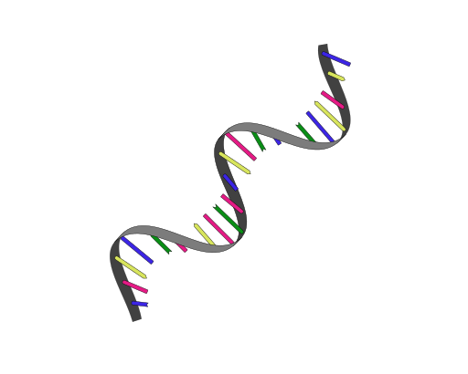
04
RNA
Simple things to know:
RNA = Ribonucleic acid
4 bases (nucleotides): cytosine (C), guanine (G), adenine (A), uracil (U). C matches G, A matches with U.
Single strand
mRNA, and non-coding RNAs: tRNA, rRNA, and many other type of RNAs
Covid-19 is an RNA virus.
Moderna and Pfizer covid-19 vaccines are mRNA vaccines.

Slide 6
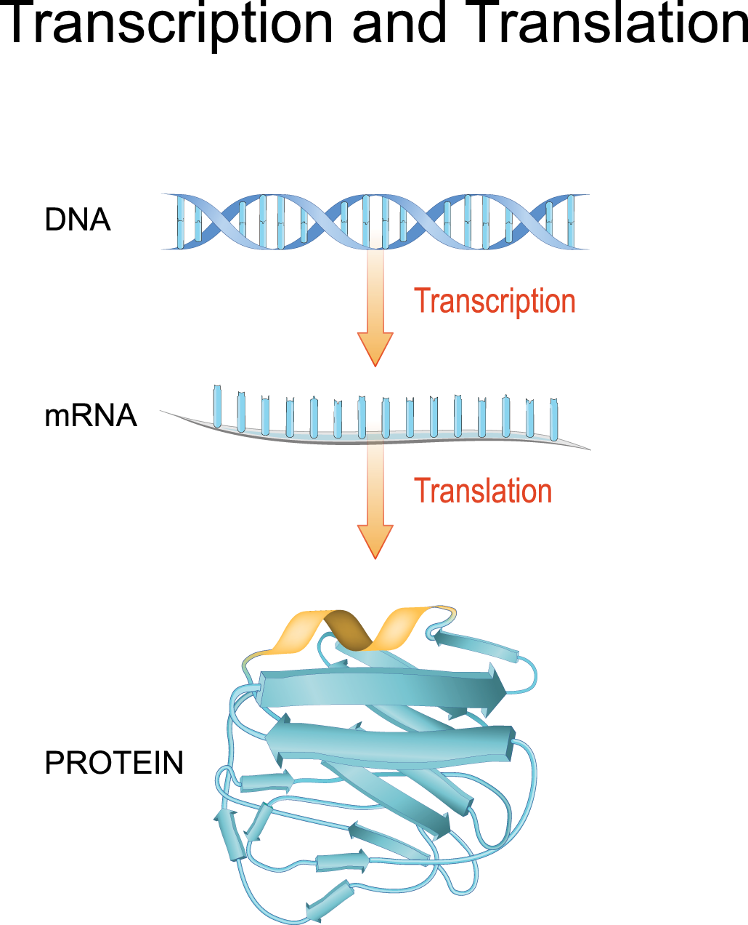
04
Protein
Simple things to know:
A gene is transcribed to mRNA, then mRNA is translated the protein sequence
A protein sequence is made from 20 amino acids
Then a protein sequence is folded into 3D structure. Predicting its structure is one of the 125 greatest problems for humanity listed in Science magazine.

Slide 7
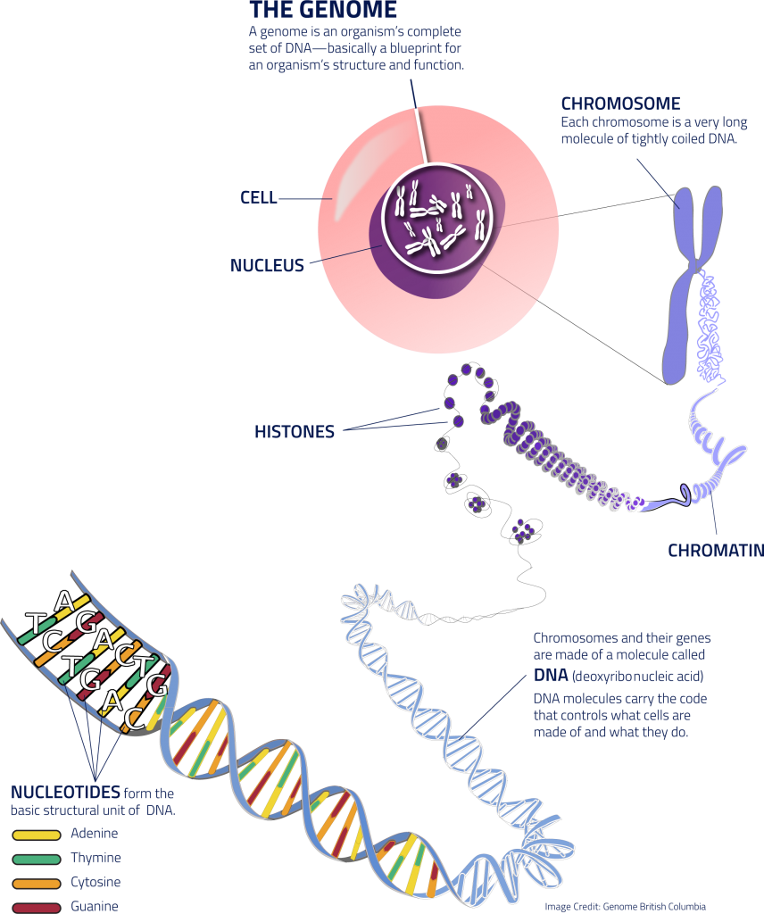
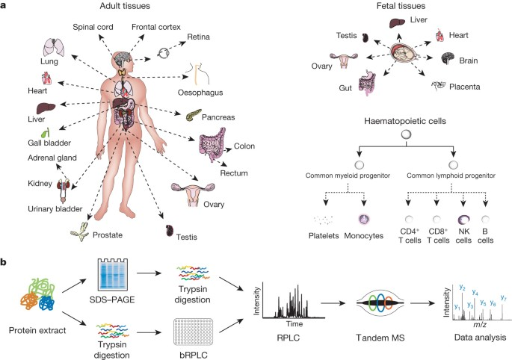
04
Omics
Simple things to know:
Genomics: sequence all genomes all species. PCR, easy to do.
Transcriptomics
Proteomics: identify all proteins in all body parts. cannot PCR, need to use Mass spectrometry.
Metabolomics

Slide 8
04
Mass Spectrometry (MS) for proteomics
MS

Slide 9
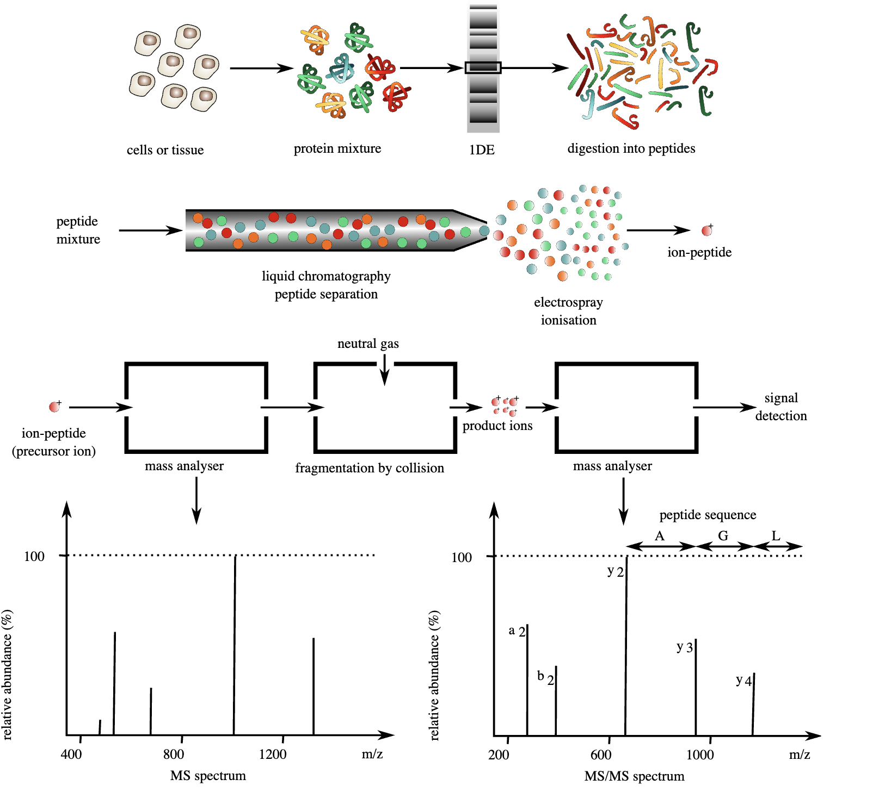
04
Tandem MS

Slide 10
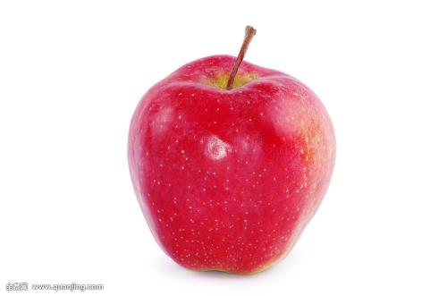
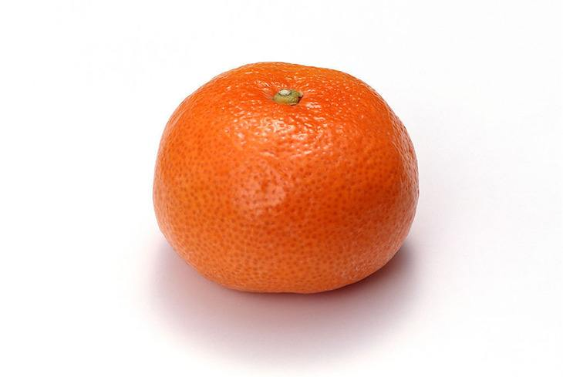
A small game (how to do de novo sequencing):
Given price list:
Apple: $2 each
Orange: $3 each
Question: What fruits did we buy, If we know
Total spending $10
First fruit $2
First 2 fruits $5
First 3 fruits $8
This is how we
do de novo
sequencing

Slide 11
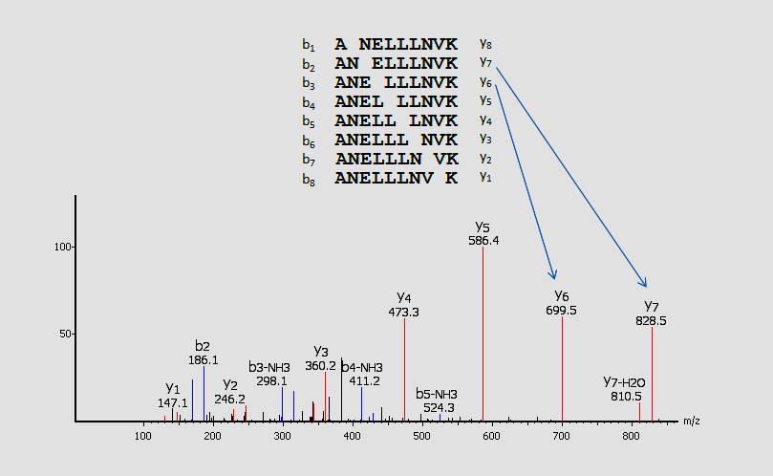
De novo peptide sequencing using MS (DDA --- 1 peptide per spectrum)
one apple
apple + orange
Task: From this picture, reconstruct the peptide sequence ANELLLNVK
DIA: Overlap 3 of above spectrum, reconstruct 3 peptides!

Slide 12
Optimization Algorithms in the past 20 years
Try all peptides matching precursor weight
Subsequence match and then extend.
Graph theory, spectrum
Dynamic programming
HMM
Integer linear programming
Probabilistic network
For over 20 years, many optimization alg’s
Time to Change:
Algorithm-centric to data-centric

Slide 13
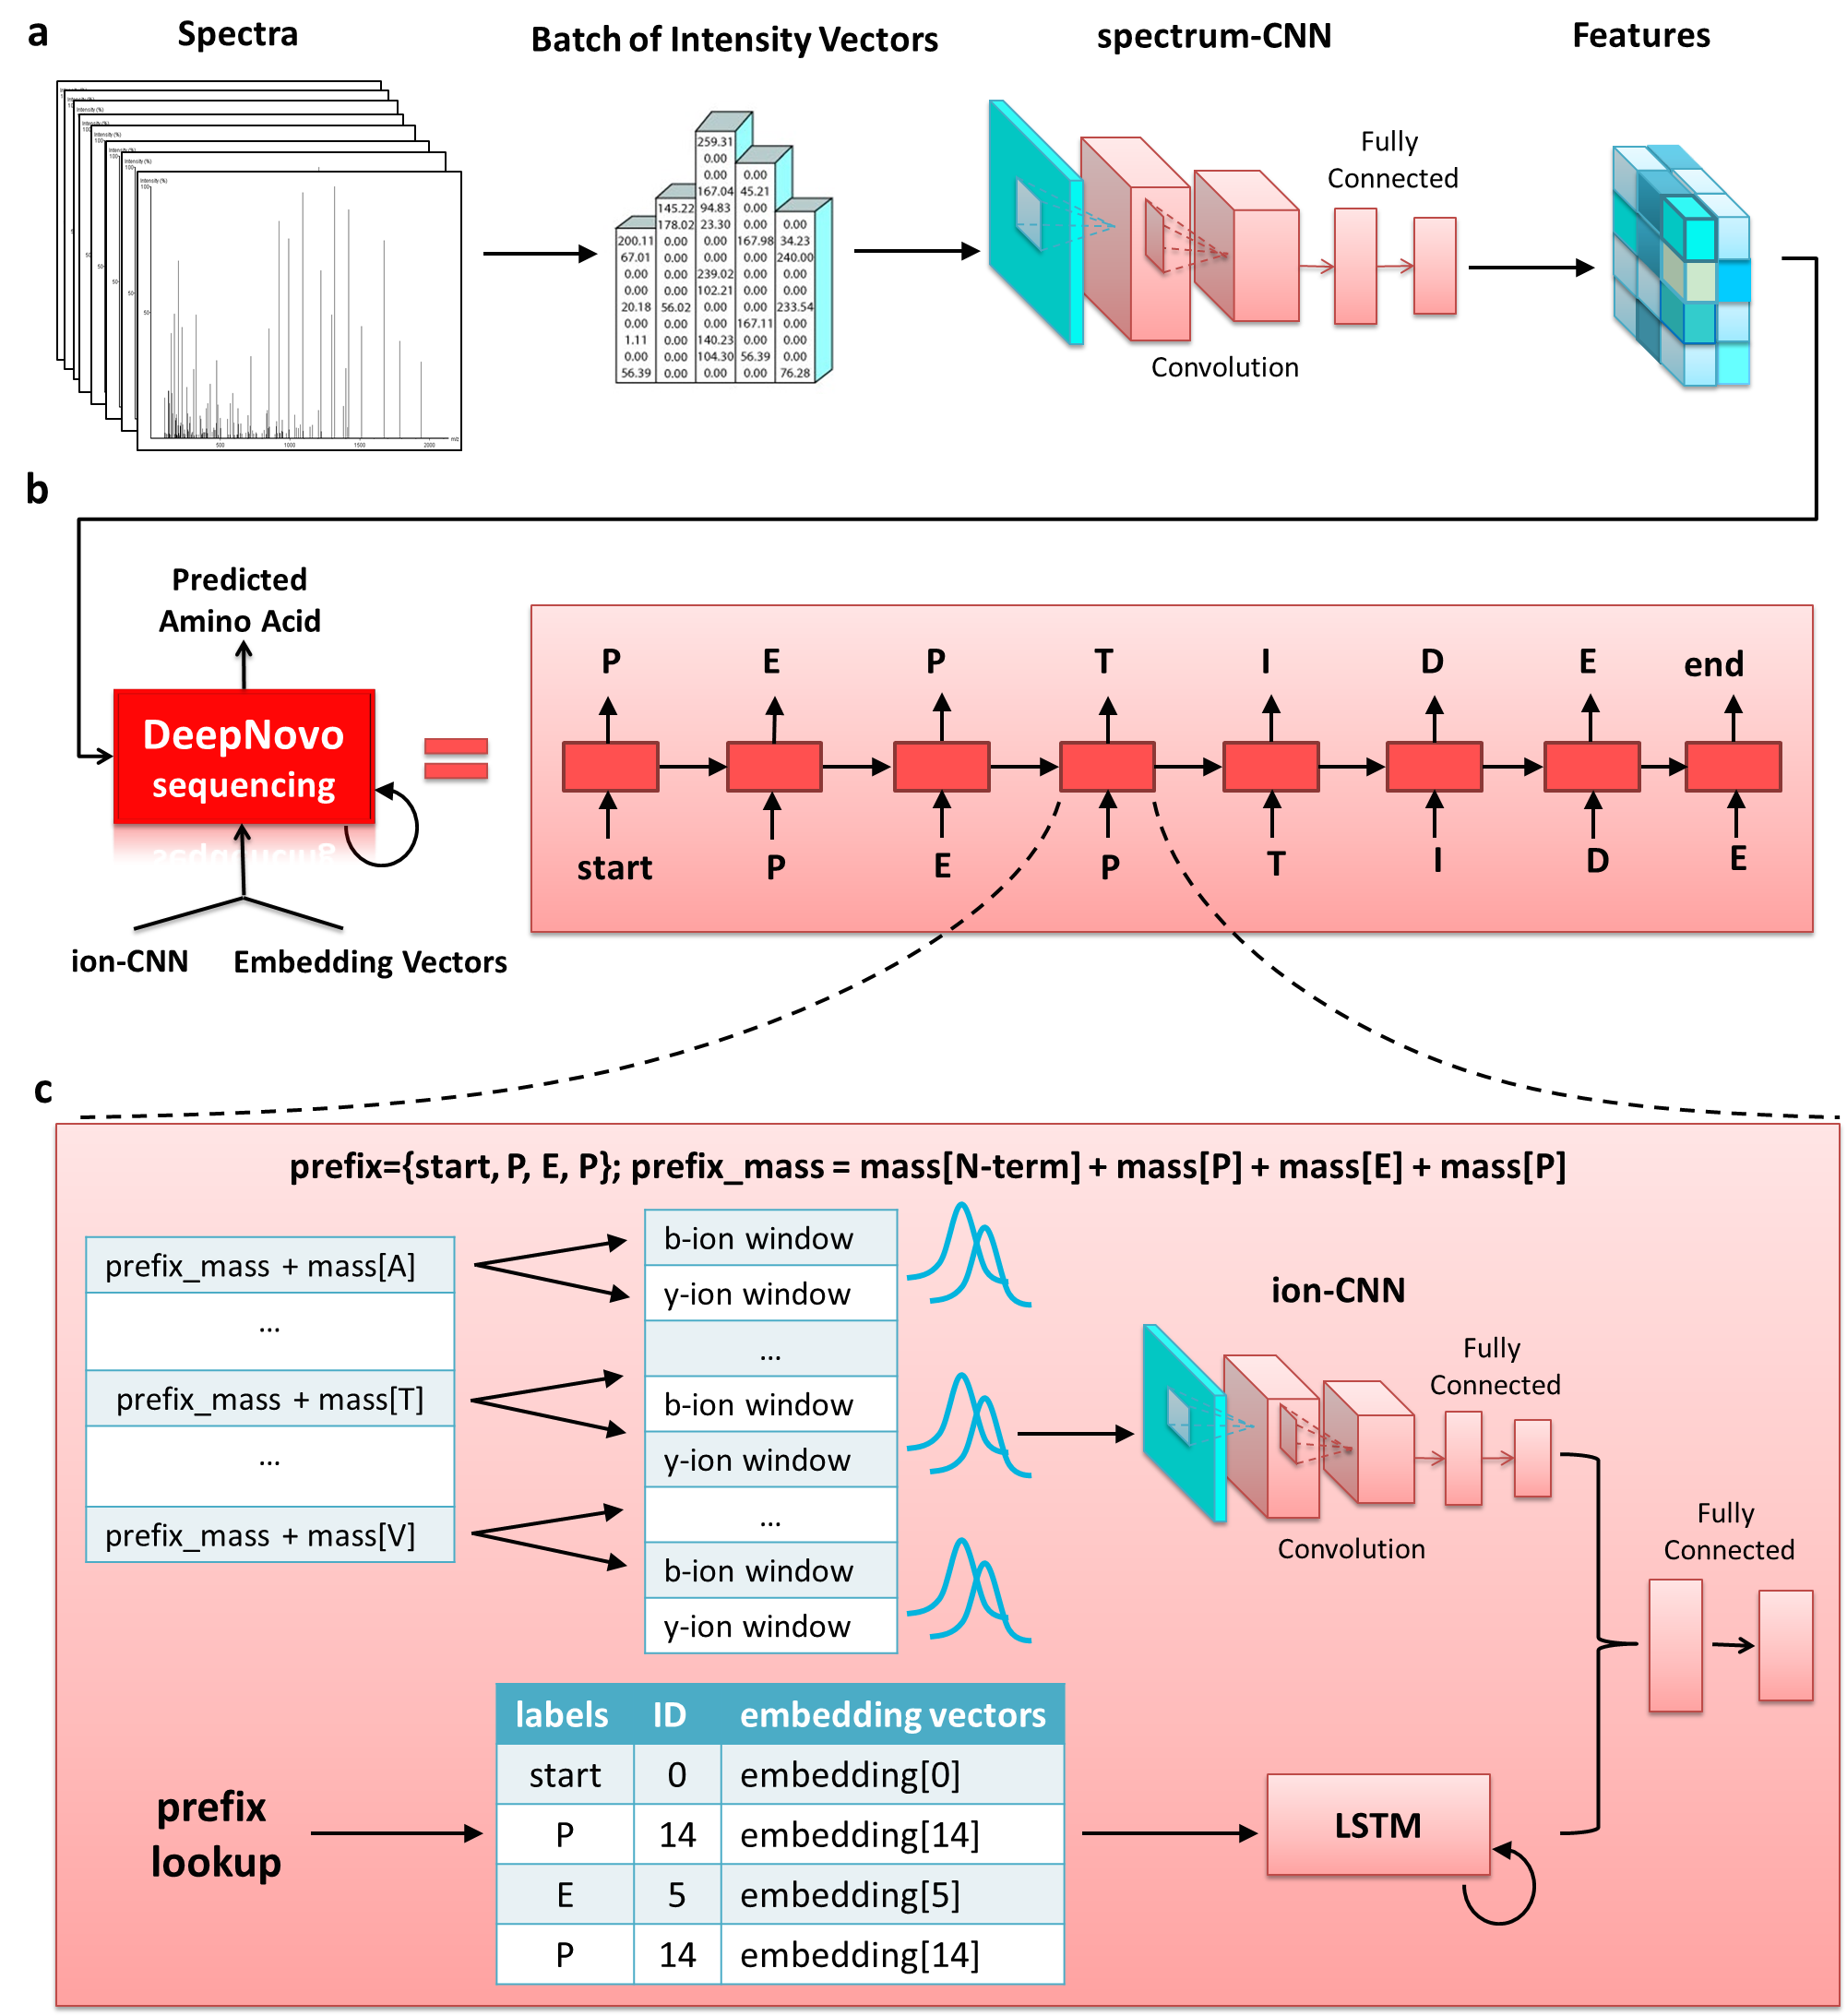
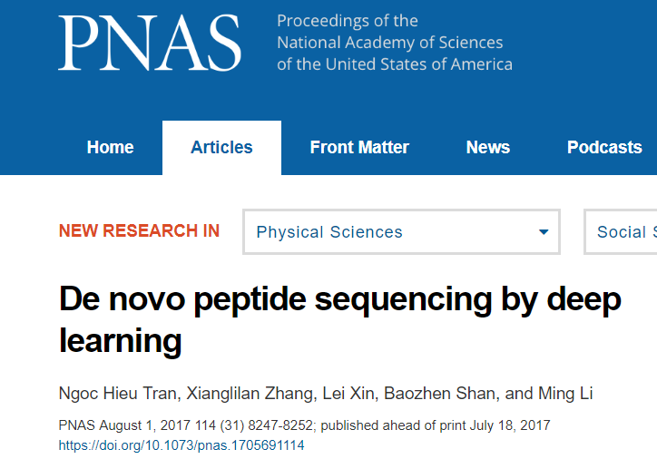
DeepNovo
for DDA:
Training data:
(Spectrum, peptide)
pairs
Process one vector at a time

Slide 14
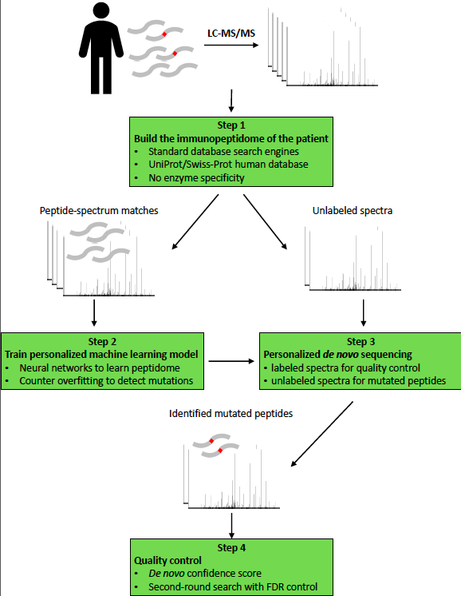
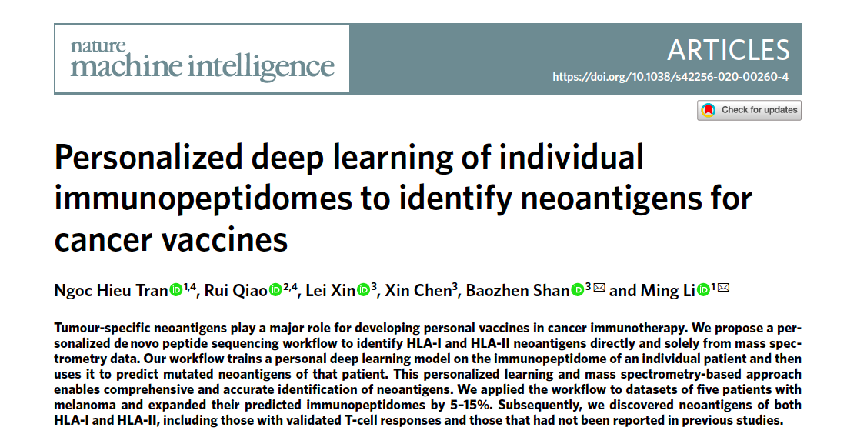
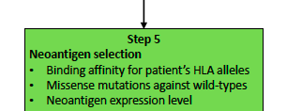
Personalized
Neoantigen
Discovery
Process
Personalized
training
de novo
neoantigen
sequencing

Slide 15
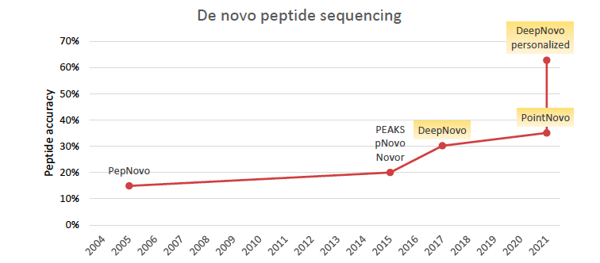
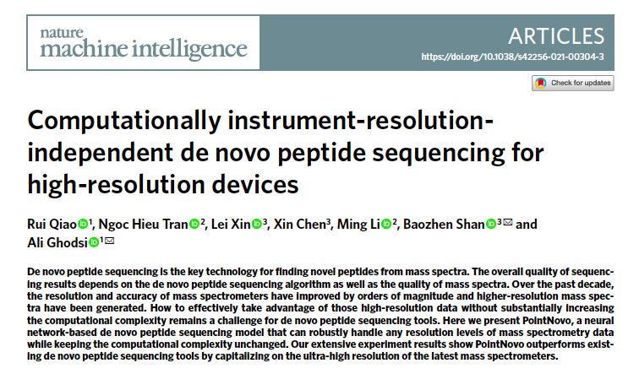
Improving de novo sequencing sensitivity by 3 folds
Deep learning

Slide 16
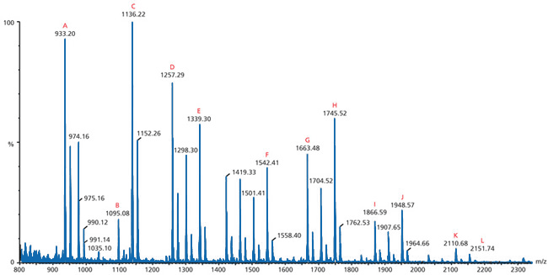
Predicting MS/MS Spectrum from peptides (this is important for data independent acquisition -- DIA)
ABCDEFGHIJKL

Slide 17
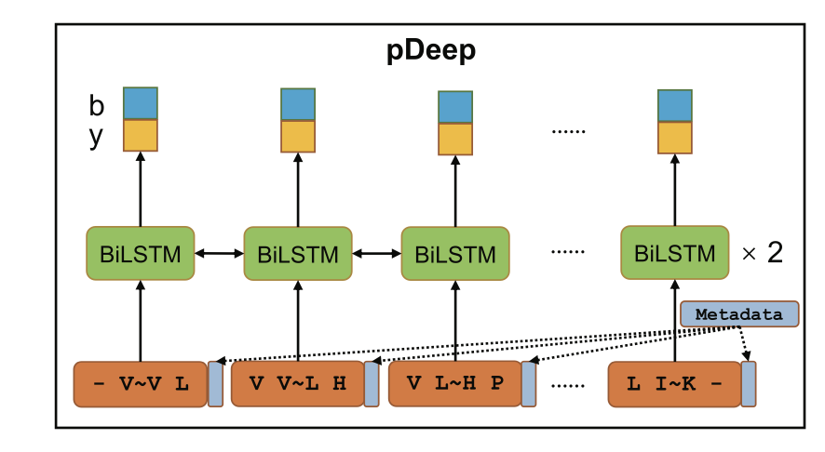
pDeep
Sequence: VVLHPNYSQVDIGLIK
One possible project: use a transformer to improve this (and other programs in Wen et al paper.

Slide 18
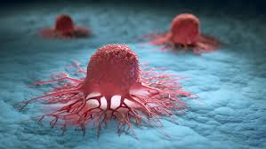
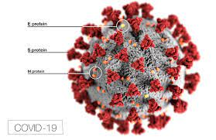
04
Personalized Cancer Immunotherapy: Neoantigens
10 million people died from Cancer in 2020.
COVID-19, 5 million died from COVID-19：
Combined, they killed more people than WWII per year
They share something in common: expression of neoantigens

Slide 19
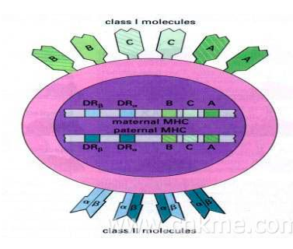
T cell immunity
8-10 amino acids
Antigen
Neoantigens
Normal
Cell
Cancer
cell

Slide 20
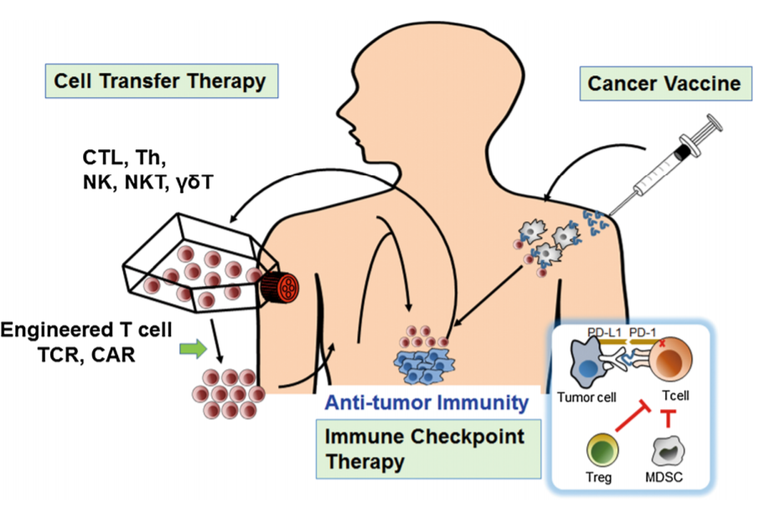
Cancer immunotherapies：
Neoantigens as
vaccine
Targetting
Neoantigens
1. Neoantigens as Biomarker
2. Neoantigen vaccine jointly use
Notes:
There are currently three major approaches to T cell-based cancer immunotherapy, namely, active vaccination, adoptive cell transfer therapy and immune checkpoint blockade.
Neoantigen-based immunotherapy, especially using cancer vaccines, represents the ultimate personalized medicine in that target antigens need to be determined in each individual patient.
This stage of personalized medicine is termed precision medicine, which in general applies to the selection of molecular targeted drugs. Neoantigen-based cancer vaccines also go beyond the current concepts of personalized medicine in that an individual cancer vaccine is manufactured for an individual patient on-demand according to the results of genomics and proteomics analysis and mutation selection.
While conventional personalized medicine seeks patient subgroups fitting to the drug, neoantigen-based cancer vaccines are tailored to the patient. In such a case, extensive safety and efficacy testing of each individual vaccine is not feasible, in contrast to the requirements for the development of chemical and biological drug products. Therefore, the development of personalized immunotherapies might require a paradigm shift from the currently available regulatory framework that was intended for conventional drug development.

Slide 21
The advent of novel therapies targeting neoantigens will revolutionize the treatment of cancer patients in the decade to come by fulfilling the promise of a personalized, individual treatment.
--- Thomas Wirth & Florian Kuhnel
Frontiers in immunology, Dec. 2017

Slide 22
Nature biotechnology Editorial（2017）
Personalized immunotherapy is all the rage, but the neoantigen discovery and validation remains a daunting problem.

Slide 23
Nature Biotechnology, Correspondence, Sept 2017
“Processing can be predicted by the existing algorithms, but prediction is preferably done by direct identification of peptides bound to the MHC in the tumor by elution followed by mass spectrometry (MS). However, the MS approach is fraught with sensitivity issues and the likelihood of missing important epitopes; at present there is no single high-throughput method that allows for a comprehensive and certain identification of putative neoepitopes”.

Slide 24
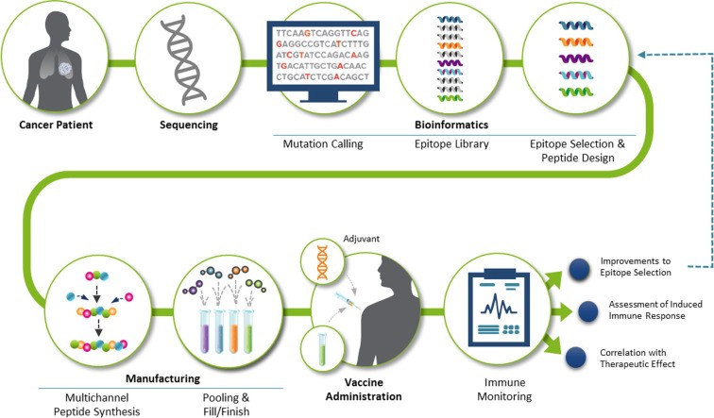
This was the personalized cancer immunotherapy process:
Too slow, too expensive, inaccurate

Slide 25
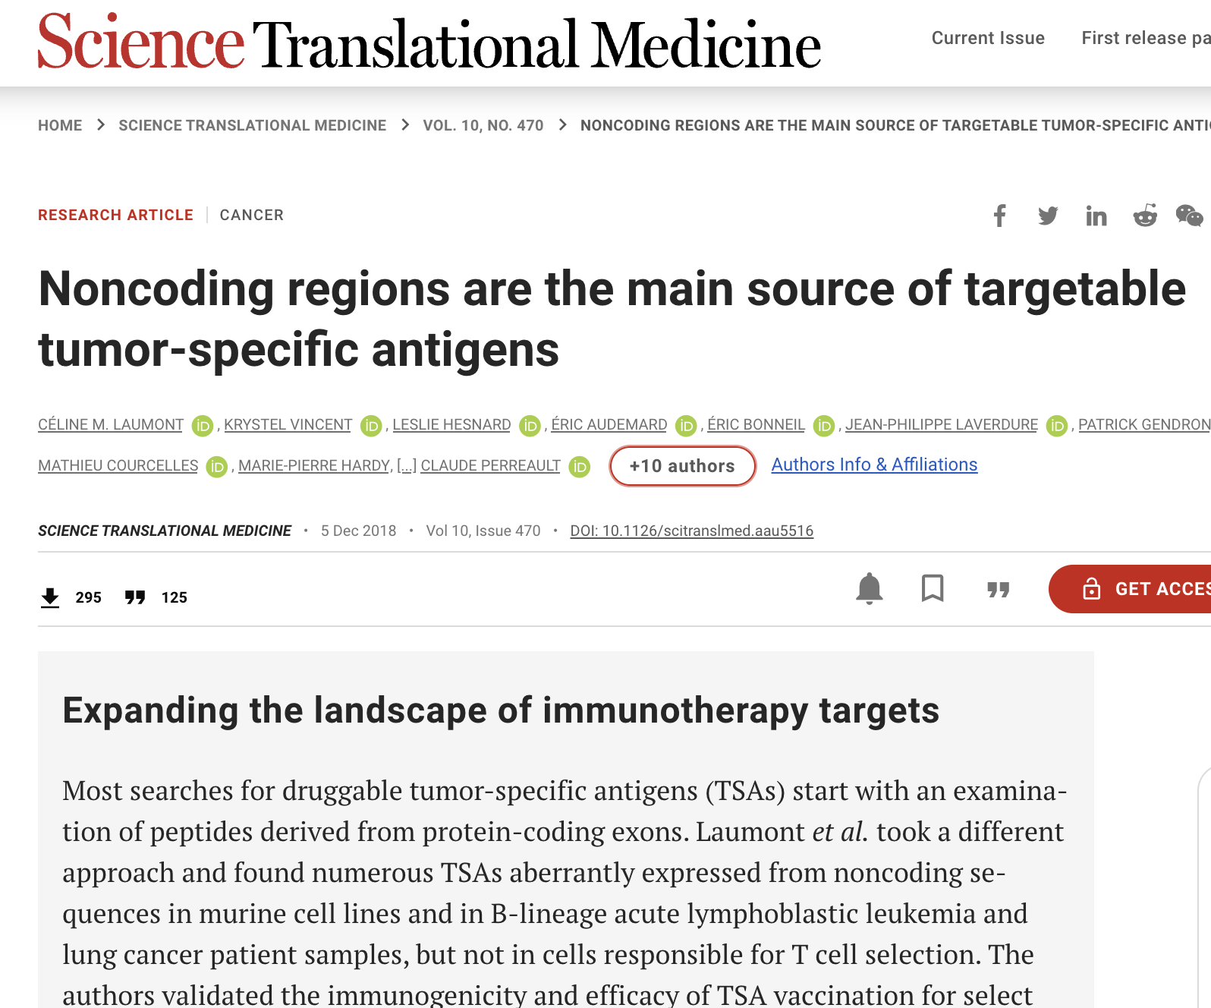
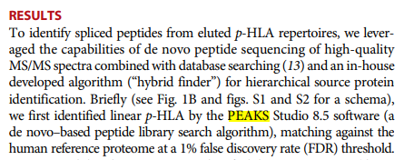
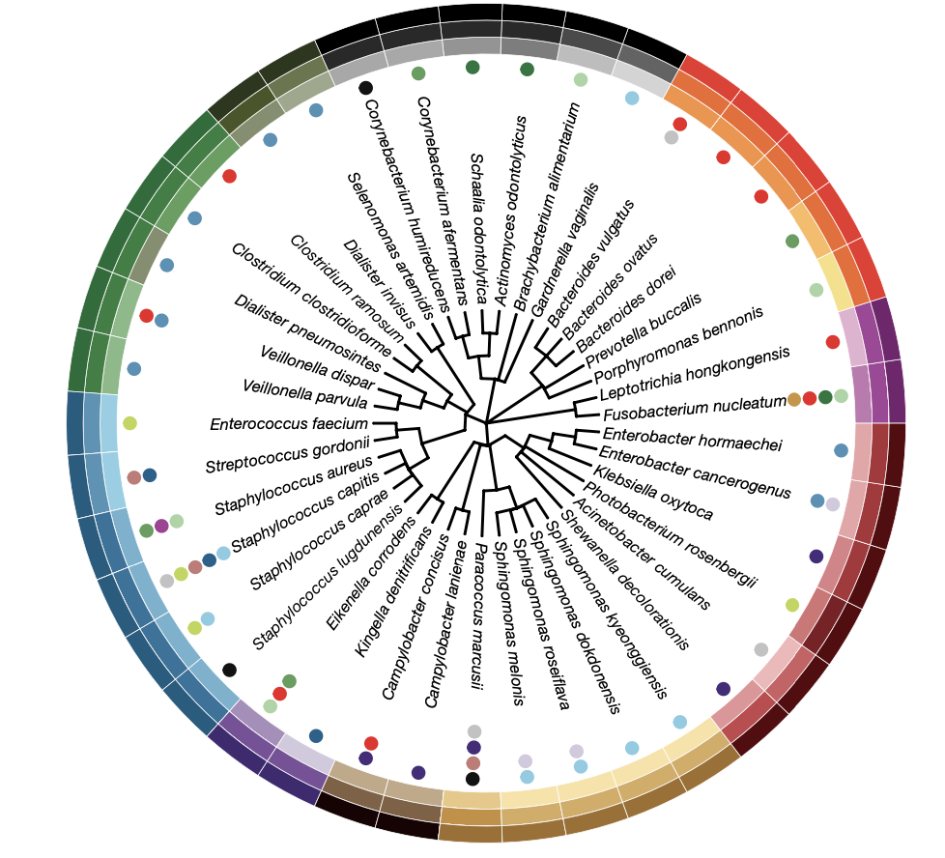
Immunopeptides: Why difficult？
Mutated peptides
Not genomic-templated
Noncoding, no mutation
Not even human
Need de novo sequencing
16sRNA seq. 41 species
248 HLA-1 antigens
35 HLA-2 antigens
9 patients, 13 tumors
Elicit immune reactivity

Slide 26
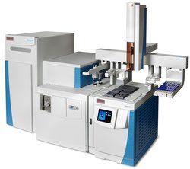
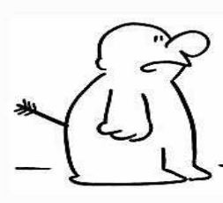
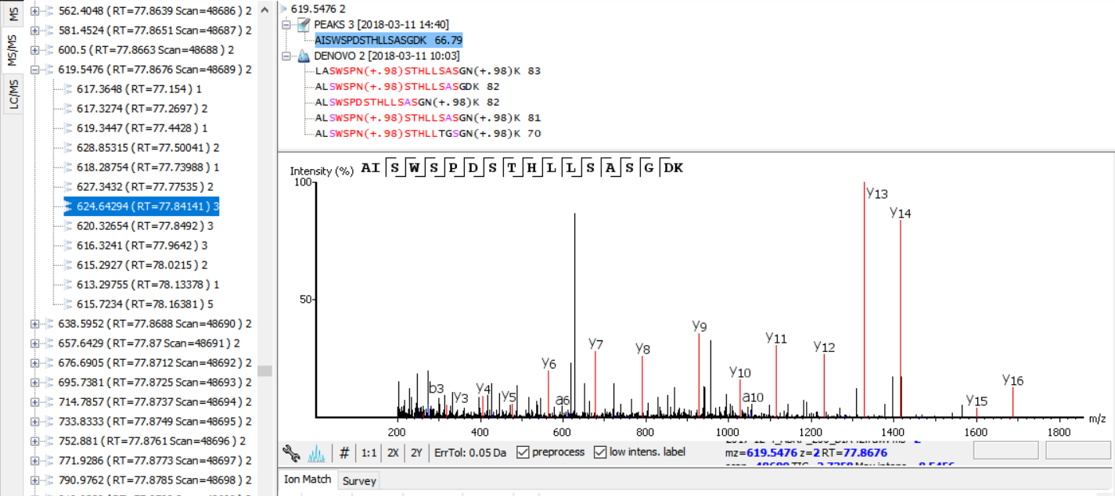
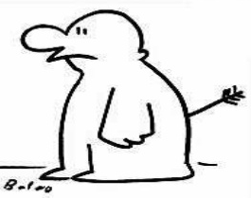
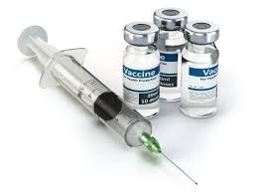
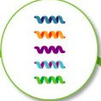
Personalized cancer immunotherapy dry lab pipeline
Personalized neoantigen
Discovery by DeepNovo
Biopsy
DIA
spectra
Mass Spec
Immunogenicity
Prediction
Vaccinate patients
Make vaccine

Slide 27
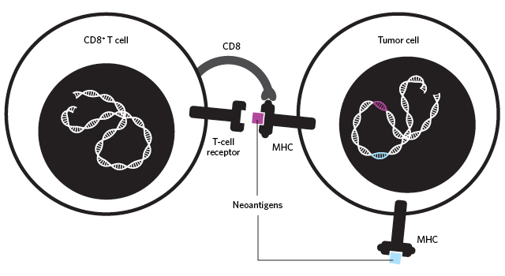
Immunogenicity Prediction by Deep Learning
Immunogenicity in nature: T cell binds to a cancer cell via a neoantigen

Slide 28
Monoclonal Antibody Sequencing
By DeepNovo

Slide 29
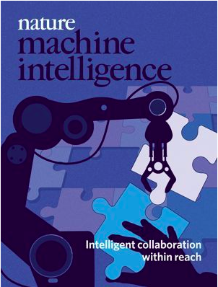
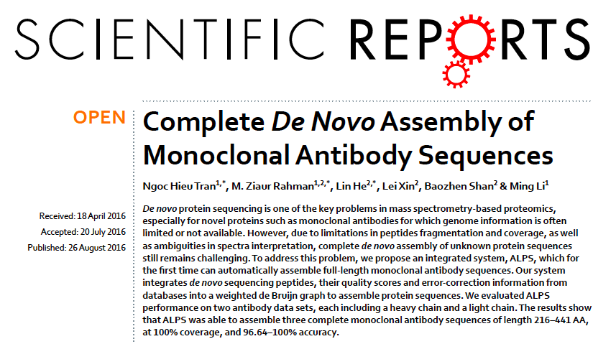
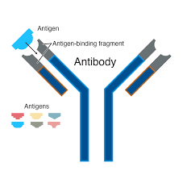
Importance of Antibodies
Target specific anti-cancer drugs
Drugs for autoimmune disease: Rheumatoid arthritis, multiple sclerosis
Neutralizing antibodies for COVID-19
Many other purposes.

Slide 30
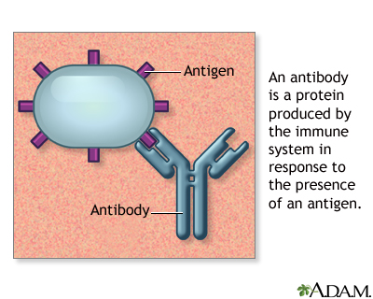
Monoclonal Antibody Sequencing
High precision MS, Lumos, accuracy: 1ppm
Break and block disulfide bonds
Use some reagent DTT 70C 30 min. to break disulfide bond, separate light and heavy chains
Meausre intact mass of different chains.
Several enzymes to digest to digest antibody into peptides → MS/MS → DeepNovo，

Slide 31
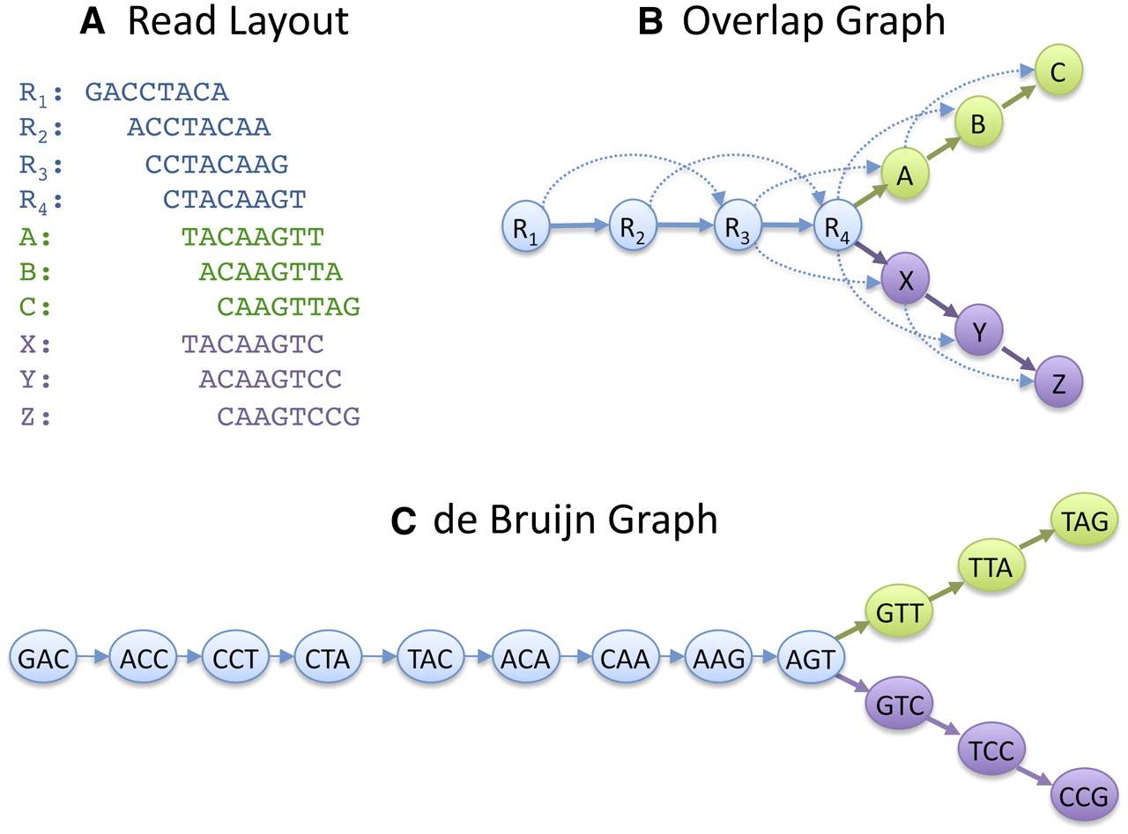
From Peptide Sequencing to Protein Assembly
de Bruijn graph for sequence assembly (Schatz et al., Genome Res. 2010)

Slide 32
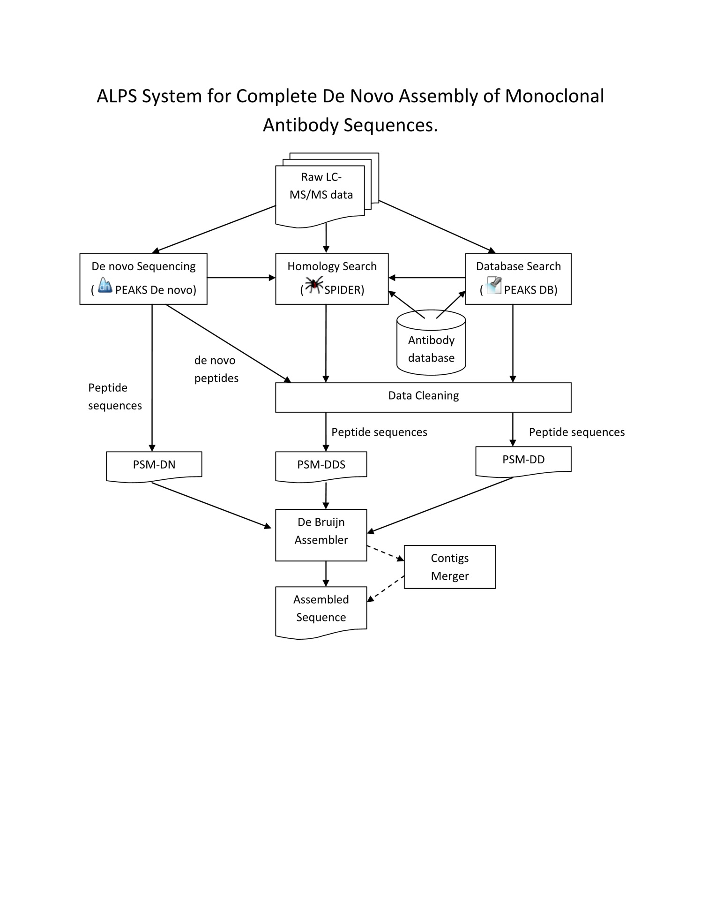
Antibody Sequencing with DeepNovo
ALPS: weighted de Bruijn graph for protein sequence assembly (Tran et al., 2016)

Slide 33
Science beyond cancer
Auto-immune diseases
Viral/bacterial infections (HIV, Influnza, SAR-CoV-2, Ebola)
Organ transplant
Peptidomics, neoantigen database
Cancer preventing vaccine?

Slide 34
Genome
Deep cell-cell communication ..
Memory
Proteome
Function
Peptidome
Notes:
Vienna General hospital 1844-46 before（Childbed fever – caused by autopsy doctors not washing hands, solved by washing hands) the Germ theory of Luis Pasteur 1861
neural communication,
2 Paper airplane – cell-cell short distance, 3 Paracrine: short distance group communication by say histimine – 4 endocrine – sending hormone long distance
1 Cell – cell direct contact – via antigen

Slide 35
04
Other applications of deep learning in proteomics
There are many other applications of deep learning in proteomics:
Retention time prediction.
Spectrum prediction
HLA binding prediction.
Post translation modification prediction
Protein structure prediction
Wen, B. et al. Deep Learning in Proteomics. Proteomics 20, e1900335 (2020).
NH Tran, JB Xu, M. Li: A tale of two solutions in protein science: immunopeptide sequencing and protein structure prediction

