Slide 1
Use One-Shot Learning for Mouse Gesture Recognition with Siamese Neural Network
Futian Zhang

Slide 2
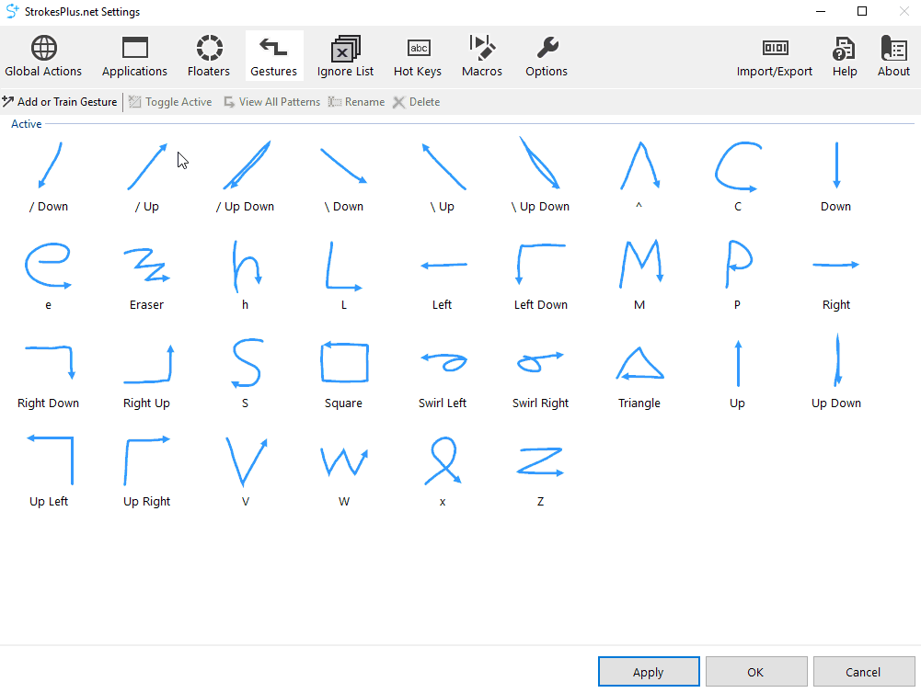
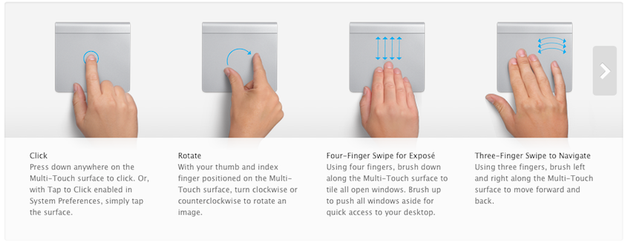
Background
Gesture Recognition
Recognize finger gesture to perform command
Apple Magic Trackpad
StrokesPlus Application

Slide 3
Siamese Neural Network (SNN)
A model architecture which contains at least two parallel, identical CNNs.
Two sample go to the same CNNs, produce scores, compare their similarity.
Learn similarity instead of directly classification
Notes:
In short, a Siamese Neural Network is any model architecture which contains at least two parallel, identical, Convolutional Neural Networks. This parallel CNN architecture allows for the model to learn similarity, which can be used instead of a direct classification. SNNs have found uptake primarily for image data, such as in facial recognition, although they do have their uses outside of this domain.

Slide 4
Training Set
Notes:
To train this network, we need a large classification dataset with labels. Each class has many samples. For example

Slide 5
Training Data
Positive Samples to learn similarity
Negative Samples to learn difference
Notes:
We need to use the training data to construct Positive samples and Negative samples. PS could tell the neural network what is the same class, and the NS could tell the difference between different classes.

Slide 6
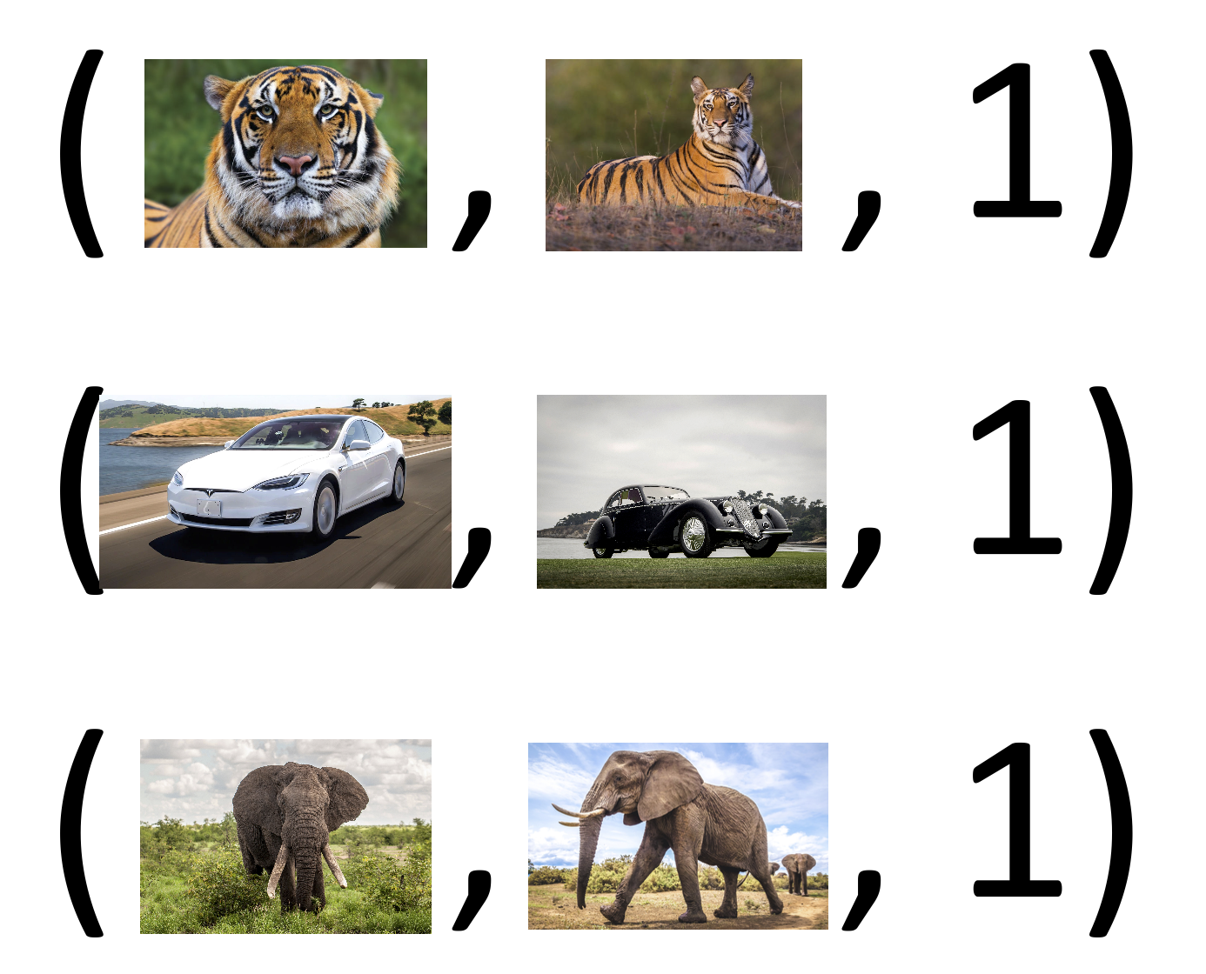
Positive Sample
Notes:
To build PS, we choose two pictures with the same class, and label them as 1 meaning that the same. For example…

Slide 7
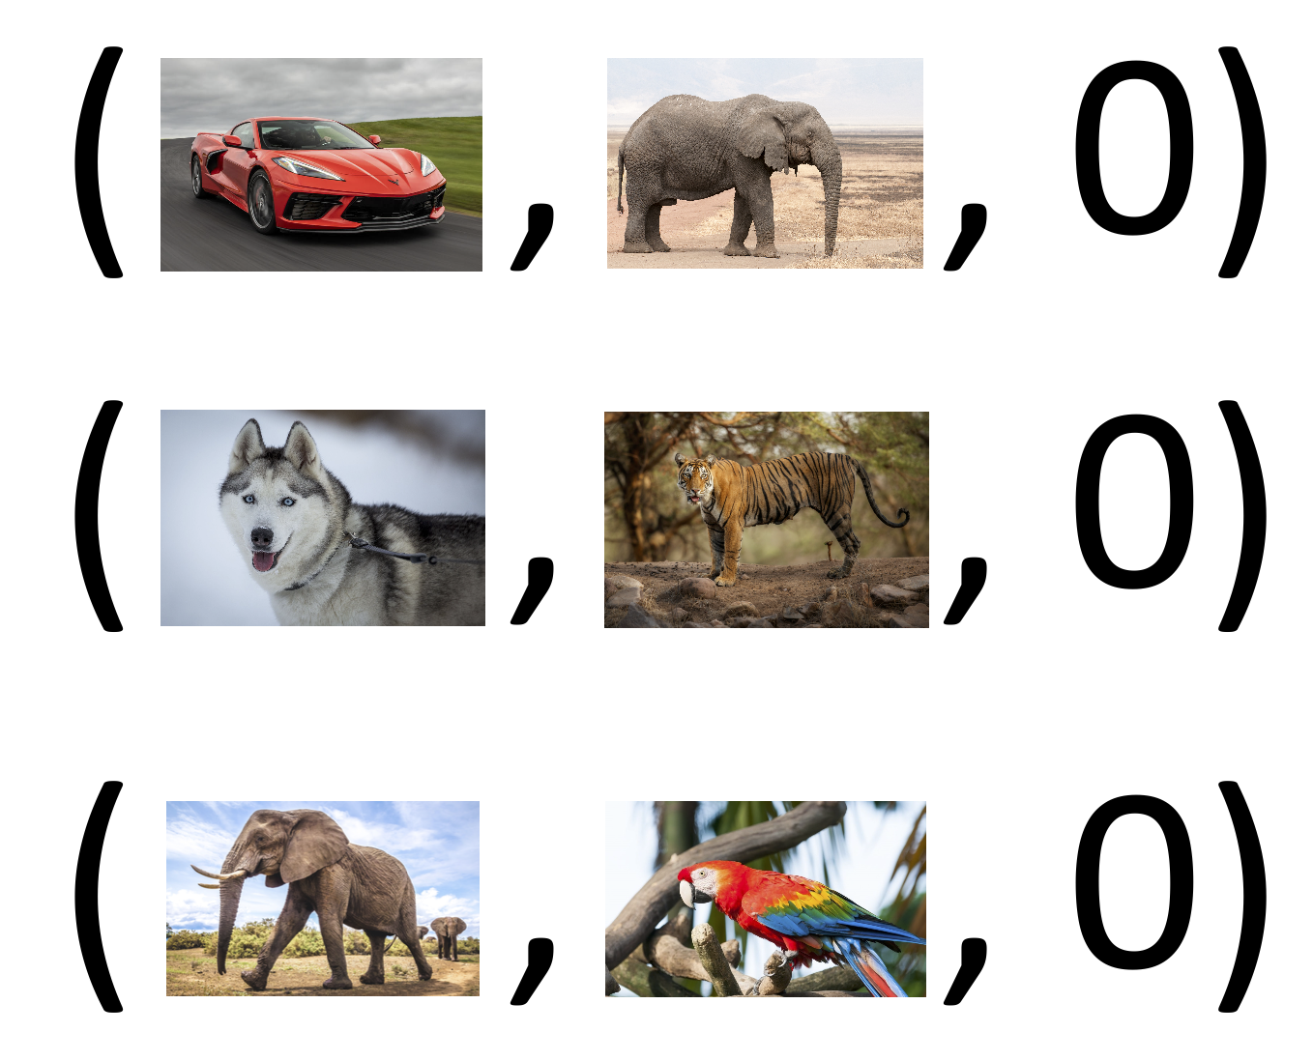
Negative Sample
Notes:
0, means that they are not the same

Slide 8
CNN for Feature Extraction
Notes:
We need to build a neutral network to extract feature. The neutral network has a few conv pooling and one flatten layer. The input x is a picture and the output fx is a vector.

Slide 9
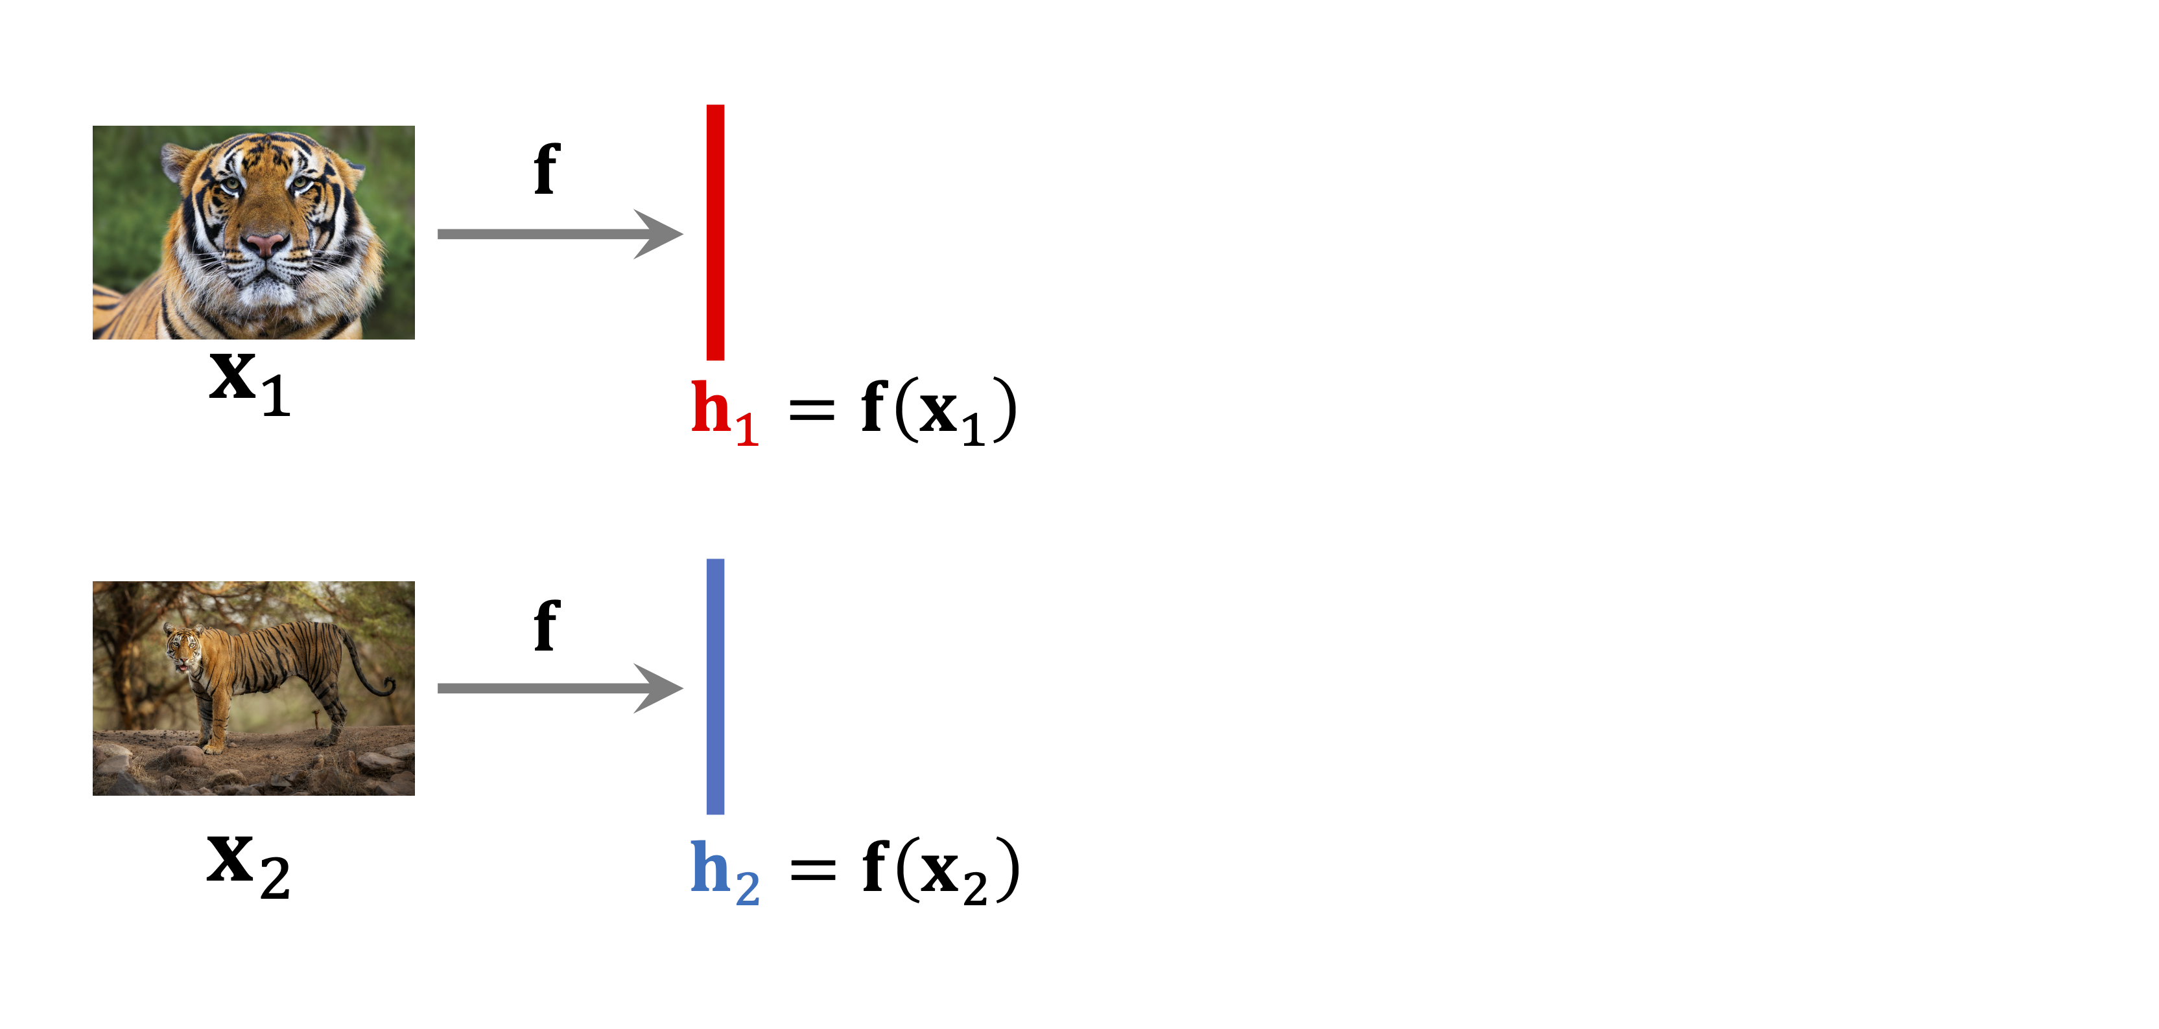
Training Siamese Network
Notes:
We now have the input, the neural network f. The feature for the two inputs h1 and h2. Noted that the two networks are all the same.

Slide 10
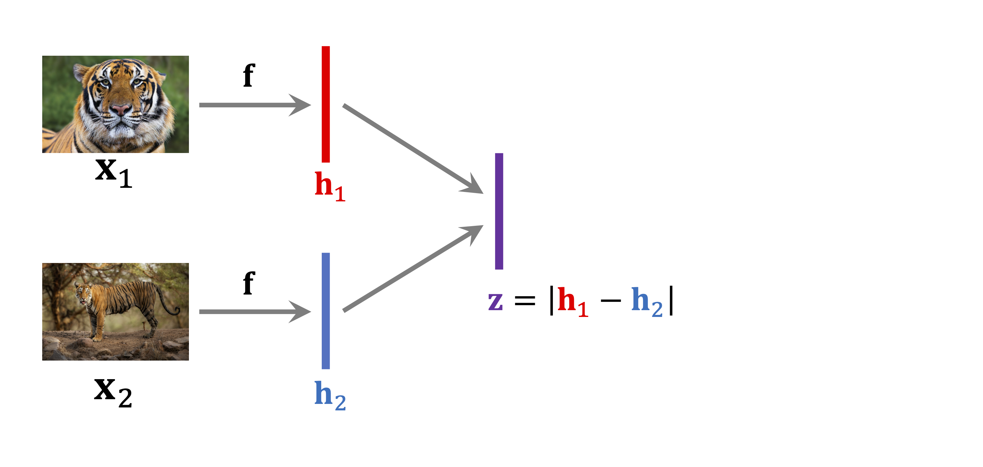
Training Siamese Network
Notes:
We use h1-h2 and get a vector, get the absolute value of z, which represents the distance.

Slide 11
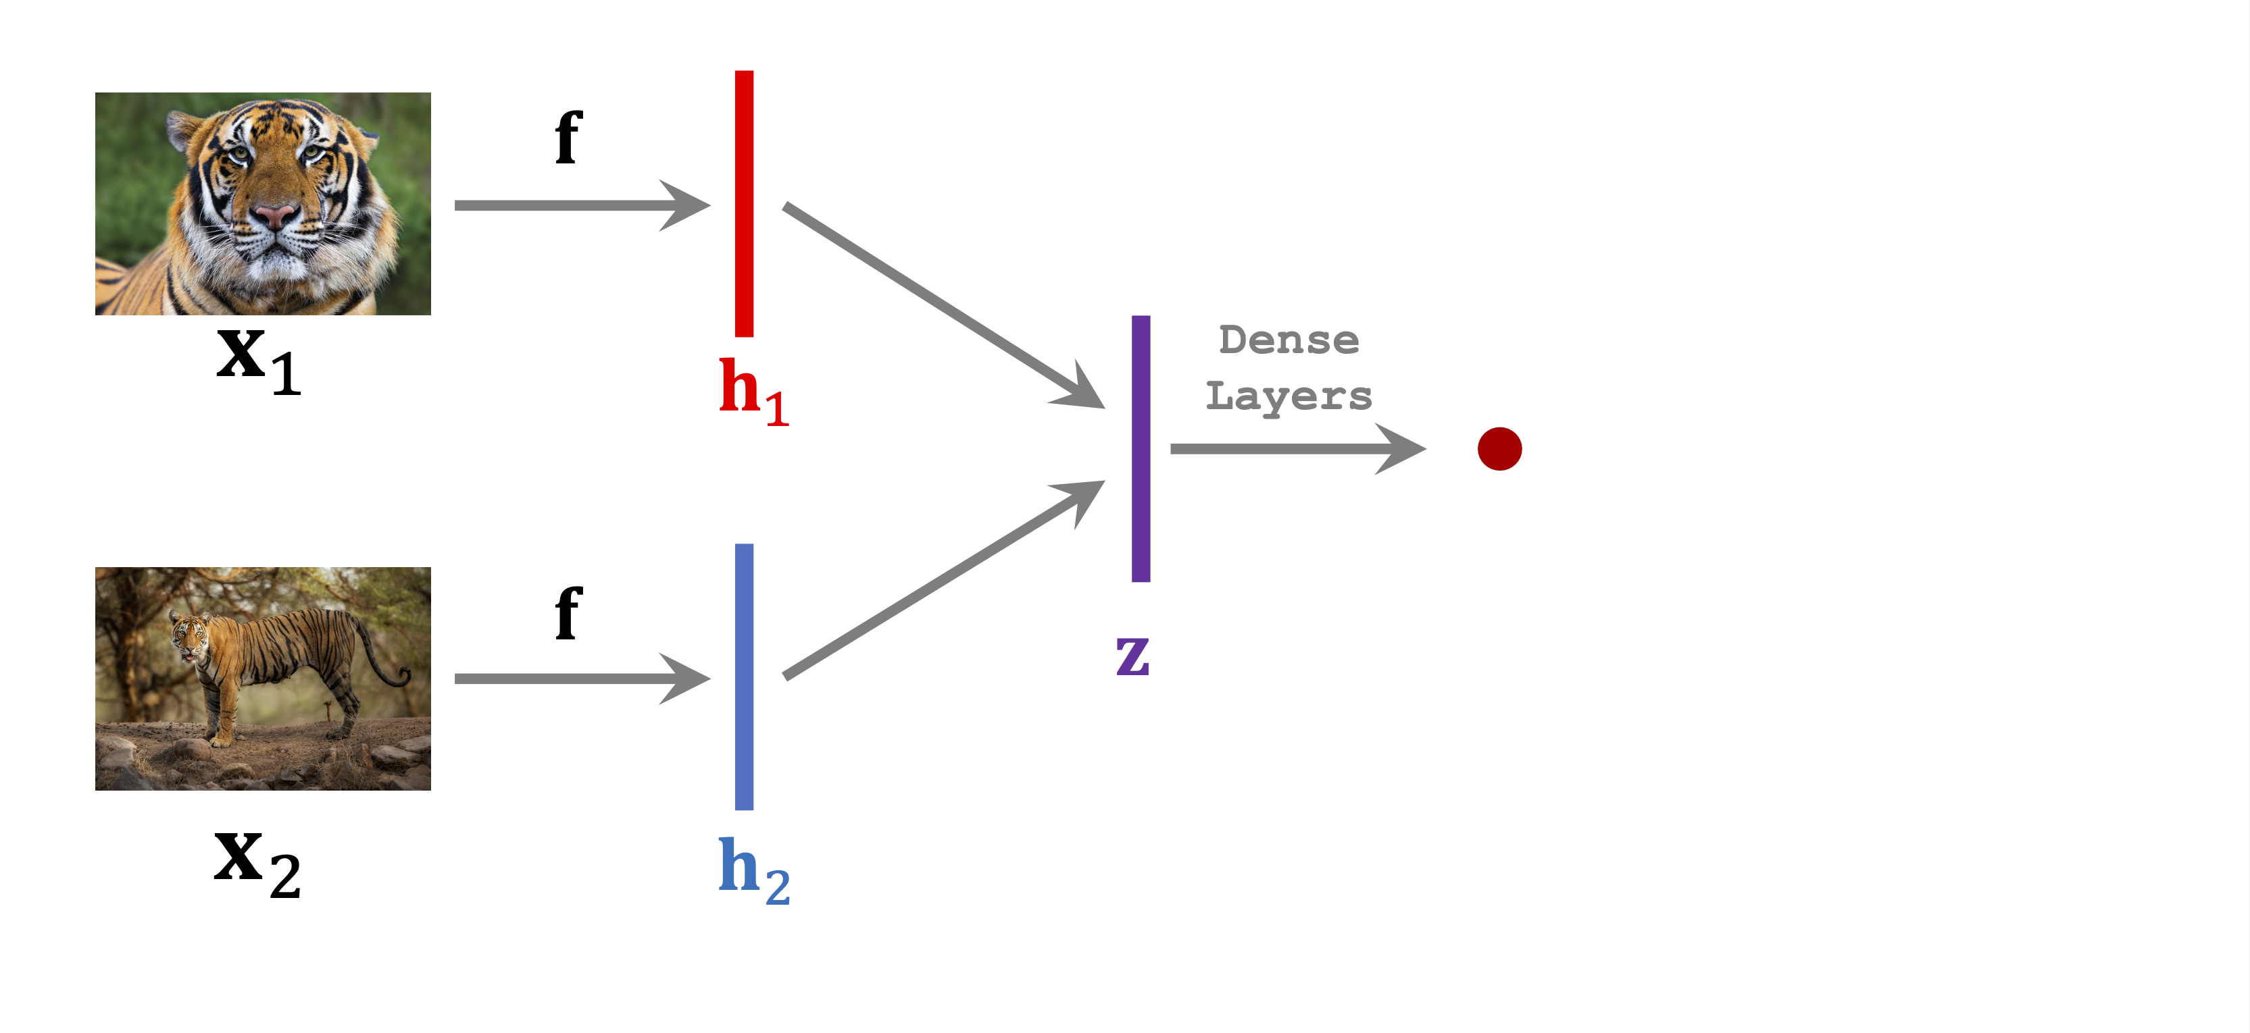
Training Siamese Network
Notes:
Then we use some dense layers to process the z and then produce a Scalar.

Slide 12
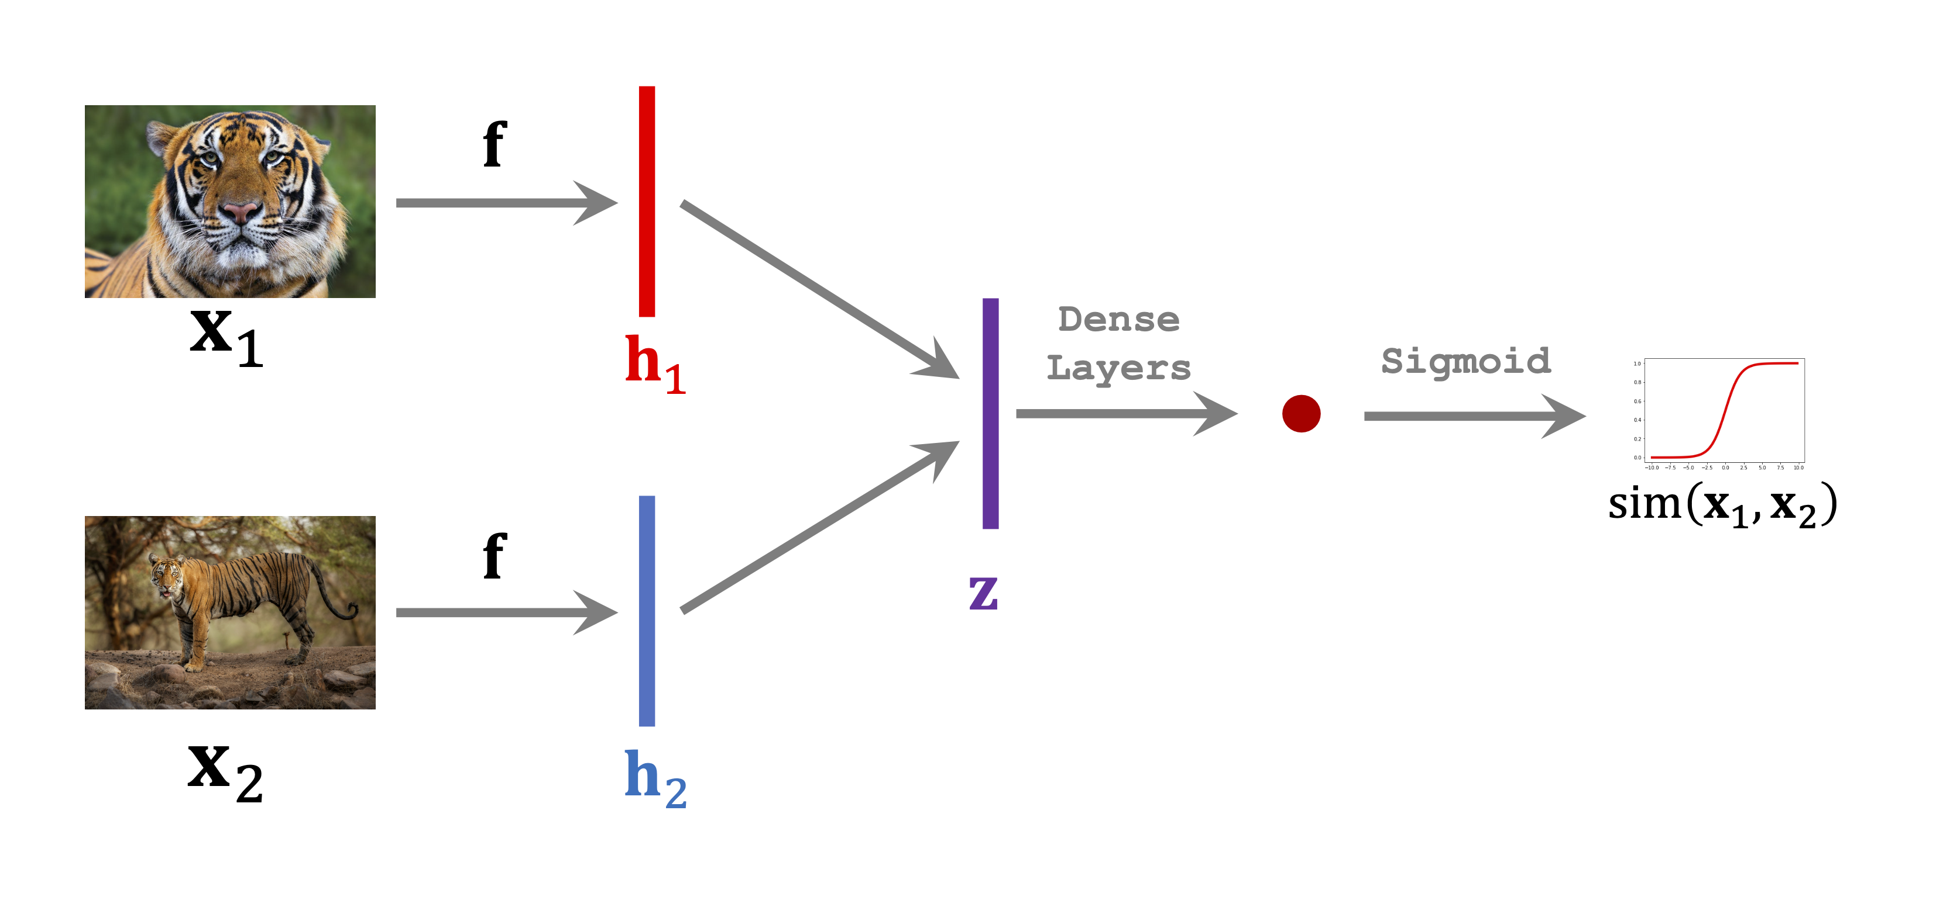
Training Siamese Network
Notes:
Then use sigmoid function to produce a value which represents the similarity. If they represent the same… else…
The

Slide 13
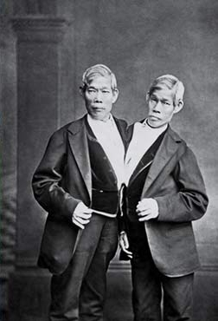
Training Siamese Network
Notes:
Why it’s called Siamese? First what is Siamese. Siamese is twins that connects together physically with two heads, which is very similar to the network.

Slide 14
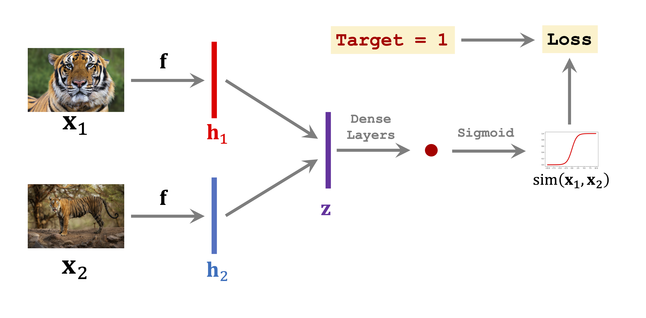
Training Siamese Network
Notes:
We know that those two pics are all tigers, so their label should be 1. We want the network to output 1. We use the difference between the label 1 and the output as loss function. It could be a cross entropy. Then we can use the backpropagation and gradient decent to update the network.

Slide 15
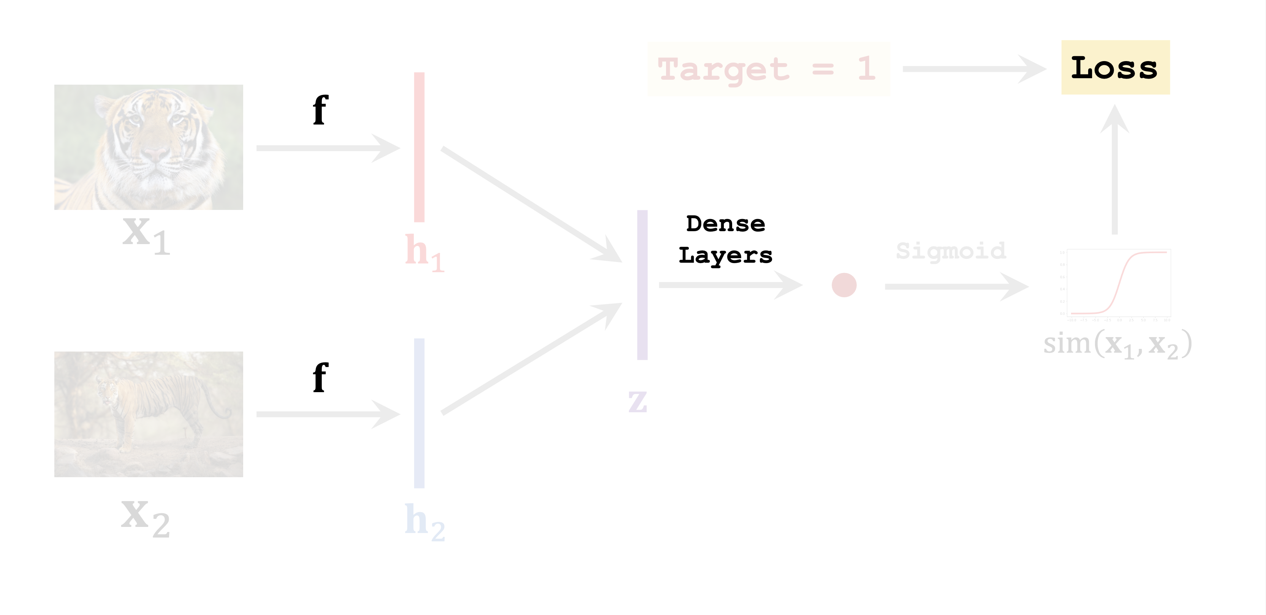
Training Siamese Network
Notes:
The networks need to be updated includes both the CNN and the fully connected network or the dense layers.

Slide 16
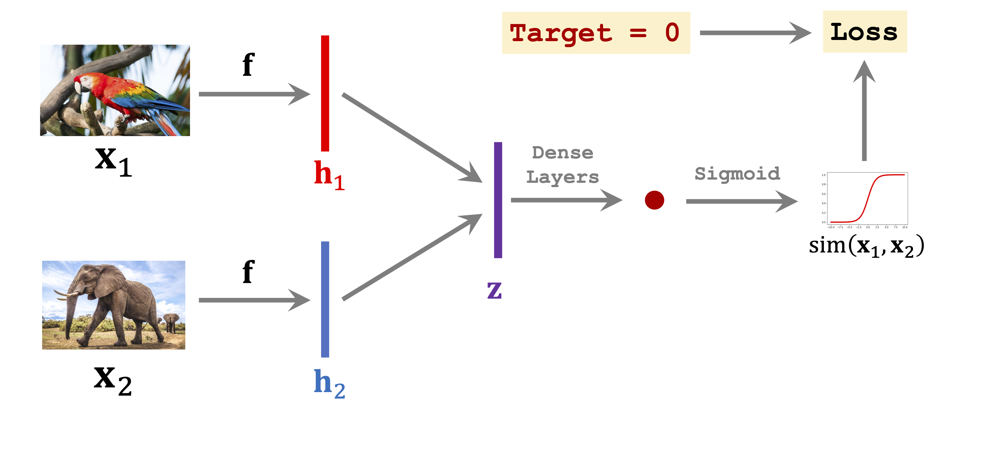
Training Siamese Network
Notes:
We also need to use negative sample to train the networks. The target is 0, and … rest is the same, update the conv and dense layers.

Slide 17
One-shot Prediction
6-way 1-shot prediction: Support set has 6 test classes with 1 sample in each class.
The training data does not necessarily contain the 6 classes.

Slide 18
One-Shot Prediction
Notes:
Now we have a query picture and I know that it must be one of the classes in the support set. Now we need to classify the query into the classes. The way we do it is to check the similarity of the query picture and the pic in the support set one by one.

Slide 19
One-Shot Prediction
Sim = 0.2
Sim = 0.8
Sim = 0.6
Sim = 0.5
Sim = 0.4
Sim = 0.6

Slide 20
One-Shot Prediction
Sim = 0.2
Sim = 0.8
Sim = 0.6
Sim = 0.5
Sim = 0.4
Sim = 0.6

Slide 21
SNN summary
Train a Siamese network on large-scale training set.
Given a support set of 𝑘-way 𝑛-shot.
𝑘-way: k classes
𝑛-shot: every class has n samples.
The training set does not contain the K classes.
Given a query, predict its class.
Use the Siamese network to predict the similarity.

Slide 22
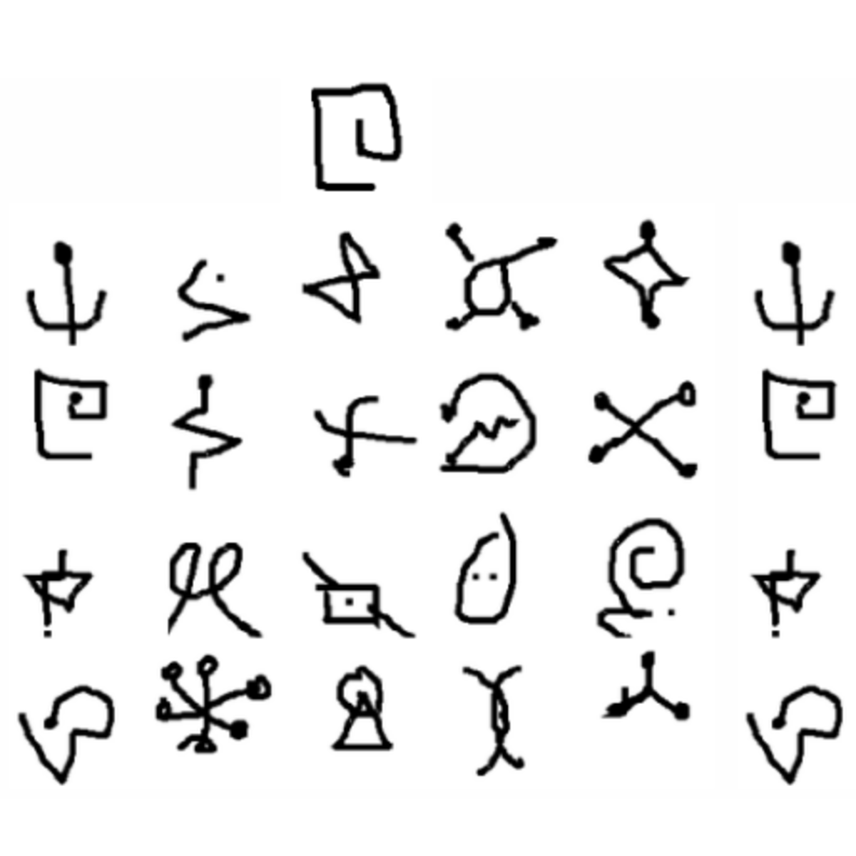
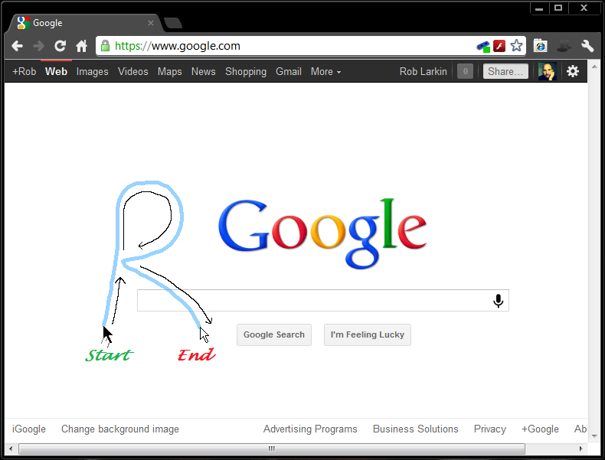
Use SNN to do gesture recognition
Dataset: Omniglot dataset
Support set and Query: Gesture image
Notes:
Also support user defined gesture

Slide 23
Use SNN to do gesture recognition
Train the Siamese network with Omniglot.
Add user defined gesture as support set.
Input gesture and find the corresponding class in the support set.

Slide 24
Example:
Video here

Slide 25
Limitation and future work
Direction
Drawing from left to right should not be the same as drawing from right to left
Apply to more input modality, like 3D gesture for VR/AR

Slide 26
Thanks!

