Slide 1
Lecture 7. Backpropagation - Gradient descent and computational graph
Computational Graph: used in for example
Tensorflow
Theano
CNTK

Slide 2
Backpropagation
Phase 1: Propagation
Forward pass, generating output values
Backward pass: calculating the gradients
Phase 2: Weight update
Updating the weights by a ratio of the weight’s gradient. This ratio is also called learning rate, η.
Δw_{ij} = -η E / w_{ij}

Slide 3
Computational Graph
$$a=f\left(b,c\right)$$
b
$$f$$
a
Computational graph representation:
Nodes: variables
Edges: operations/functions
c
Example
$$y=f\left(g\left(h\left(x\right)\right)\right)$$
$$u=h\left(x\right)$$
$$v=g\left(u\right)$$
$$y=f\left(v\right)$$
x
u
v
y
$$h$$
$$g$$
$$f$$

Slide 4
Computational Graph
Example: e = (a+b) ∗ (b+1)
c = a + b
e
6
d = b + 1
∗
e = c ∗ d
c
d
3
2
+1
+
a
b
2
1

Slide 5
Review: Chain Rule
Case 1
g
h
x
y
z
Case 2
x
s
z
y

Slide 6
Computational Graph
d
Example: e = (a+b) ∗ (b+1)
c
Compute ${∂e}/{∂b}$
e
=1x(b+1)+1x(a+b)
$$\frac{∂e}{∂c}$$
∗
$$\frac{∂e}{∂d}$$
Sum over all paths from b to e
=d
=c
=a+b
c
=b+1
d
+1
$$\frac{∂c}{∂a}$$
+
$$\frac{∂c}{∂b}$$
$$\frac{∂d}{∂b}$$
=1
=1
=1
a
b

Slide 7
The computational graph of e = (a+b) ∗ (b+1):
c
d
Compute ${∂e}/{∂b}$
e
15
a = 3, b = 2
$$\frac{∂e}{∂c}$$
$$\frac{∂e}{∂d}$$
∗
=d
=c
3
5
c
d
5
3
+1
$$\frac{∂c}{∂a}$$
+
$$\frac{∂c}{∂b}$$
$$\frac{∂d}{∂b}$$
=1
=1
=1
a
b
3
2

Slide 8
Computational Graph
Example: e = (a+b) ∗ (b+1)
Compute ${∂e}/{∂b}$
Compute ${∂e}/{∂b}$
=8
e
8
a = 3, b = 2
$$\frac{∂e}{∂c}$$
$$\frac{∂e}{∂d}$$
∗
=d
=c
3
5
c
d
1
1
+1
$$\frac{∂c}{∂a}$$
+
$$\frac{∂c}{∂b}$$
$$\frac{∂d}{∂b}$$
=1
=1
=1
a
b
1
Start with 1

Slide 9
Computational Graph
Example: e = (a+b) ∗ (b+1)
Compute ${∂e}/{∂a}$
=3
e
3
a = 3, b = 2
$$\frac{∂e}{∂c}$$
$$\frac{∂e}{∂d}$$
∗
=d
=c
3
5
c
d
1
+1
$$\frac{∂c}{∂a}$$
+
$$\frac{∂c}{∂b}$$
$$\frac{∂d}{∂b}$$
=1
=1
=1
a
b
1
Start with 1

Slide 10
Computational Graph
Reverse mode
What is the benefit?
Example: e = (a+b) ∗ (b+1)
e
Start with 1
Compute
and
1
$$\frac{∂e}{∂c}$$
∗
$$\frac{∂e}{∂d}$$
=d
=c
a = 3, b = 2
3
5
c
d
3
5
+1
$$\frac{∂c}{∂a}$$
+
$$\frac{∂c}{∂b}$$
$$\frac{∂d}{∂b}$$
=1
=1
=1
a
b
3
8

Slide 11
Summary
Two step computation:
Forward step: compute the values before differentiation for each node from the bottom.
Reverse step: compute the values for differentiation from the bottom.

Slide 12
Computational Graph
Parameter sharing: the same parameters appearing in different nodes
y=xe^{x^2}
x
$$x$$
u
u=e^{x^2}
$$x$$
∗
v
∗
y
x
$$x$$
x
$$u$$
Note: Treat each individual x as different variables
Adding three paths together: = e^{x^2} + 2x²e^{x^2}

Slide 13
Computational graphs for feed forward networks

Slide 14
Feedforward Network
y
W^{L}
W²
W¹
x
b¹
b²
b^{L}
= σ( … σ( σ( + ) + ) … + )
z¹=W¹x+b¹
z²=W²x+b²
x
z¹
a¹
z²
y
$$σ$$
$$σ$$
W¹
W²
b¹
b²

Slide 15
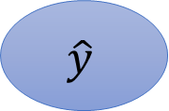
Loss Function of Feedforward Network
C=L(y’,y)
$$\hat{y}$$
$$C$$
y’
z¹=W¹x+b¹
z²=W²x+b²
x
z¹
a¹
z²
y
$$σ$$
$$σ$$
W¹
W²
b¹
b²

Slide 16
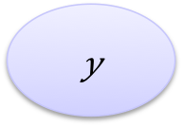
Gradient of Cost Function
C = L(y’,y)
To compute the gradient …
$$\hat{y}$$
$$C$$
Computing the partial derivative on the edge
y’
Using reverse mode
Output is always a scalar
x
z¹
a¹
z²
y
$$σ$$
$$σ$$
W¹
W²
vector
b¹
b²
vector

Slide 17
Jacobian Matrix
y=f(x), x=[x₁, x₂, x₃], y=[y₁, y₂]
size of y
size of x

Slide 18

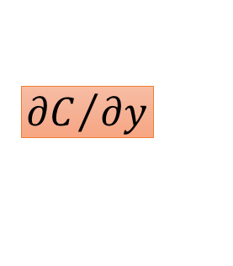
Gradient of Cost Function
Assuming a classifcation
problem
C=L(y’,y)
0
0
…
1
…
0
$$\hat{y}$$
$$C$$
y’
Last Layer
$${∂C}/{∂y}$$
…
…
$$r$$
y
…
…
Cross Entropy: C=-log y_{r}:
-1/y_{r} if i=r
0 otherwise
$$\frac{∂C}{∂y}=$$
Notes:
Only one dimension is 1, and others are all 0
Index of the dimension which is 1
Do we have to consider other dimensions?

Slide 19
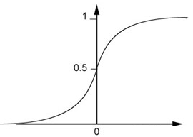
Gradient of Cost Function
square
C=L(y’,y)
is a Jacobian matrix
y
$$\hat{y}$$
$$C$$
y’
z²
i-th row, j-th column:
$${∂C}/{∂y}$$
i=j, differentiate on the sigmoid
O,w, 0
z²
y
$$σ$$
σ’ (z_{i}²)
$$y$$
How about softmax? ☺
Diagonal
Matrix
$$z$$
z_{i}²

Slide 20
C=L(y’,y)
$$\hat{y}$$
$$C$$
y’
$${∂C}/{∂y}$$
Z² / a¹
Z²=W²a¹
a¹
=W²
z²
y
$$σ$$
W²
Z² / W²

Slide 21
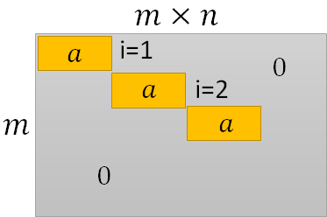
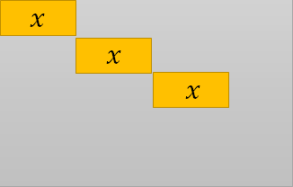
Thus, summing up everything on the path, we have:
C / W¹ =( C/ y) ( y/ z²) W² ( a¹/ z¹) ( z¹ / W¹)
C=L(y’,y)
$$\hat{y}$$
$$C$$
y’
$${∂C}/{∂y}$$
a¹ / z¹
x
W¹
z¹
a¹
W²
z²
y / z²
y
$$σ$$
$$σ$$
Z¹ / W¹
Z² / W²
W¹
W²
C / W¹

Slide 22
Computational Graphs for Recurrent Networks

Slide 23
Recurrent Network
y¹
y²
y³
h⁰
f
h¹
f
h²
f
h³
……
x¹
x²
x³
y^{t}, h^{t} = f(x^{t}, h^{t-1}, W^{i}, W^{h} , Wº)
h^{t} = σ(W^{i}x^{t} + W^{h}h^{t-1})
y^{t} = softmax(Wºh^{t})
(biases are ignored here)

Slide 24
Recurrent Network
y^{t}, h^{t} = f(x^{t}, h^{t-1}, W^{i}, W^{h} , Wº)
h^{t} = σ(W^{i}x^{t} + W^{h}h^{t-1})
y^{t} = softmax(Wºh^{t})
Wº
o¹
y¹
$$×$$
$$softmax$$
h⁰
m¹
z¹
h¹
$$×$$
$$+$$
$$σ$$
W^{h}
n¹
$$×$$
x¹
W^{i}

Slide 25
Recurrent Network
y^{t}, h^{t} = f(x^{t}, h^{t-1}, W^{i}, W^{h} , Wº)
h^{t} = σ(W^{i}x^{t} + W^{h}h^{t-1})
y^{t} = softmax(Wºh^{t})
Wº
y¹
y^{t} = softmax(Wºh^{t})
h⁰
h¹
h^{t} = σ(W^{i}x^{t} + W^{h}h^{t-1})
W^{h}
x¹
W^{i}

Slide 26
Recurrent Network
C=C¹ + C² + C³
C
y’¹
C¹
y’²
C²
y’³
C³
Wº
y¹
Wº
y²
Wº
y³
h⁰
h¹
h²
h³
W^{h}
W^{h}
W^{h}
x¹
W^{i}
x²
W^{i}
x³
W^{i}

Slide 27
Recurrent Network
C=C¹ + C² + C³
C
1
1
1
C¹
C²
y’³
C³
y’¹
y’²
Wº
y¹
Wº
y²
Wº
y³
h⁰
h¹
h²
h³
W^{h}
W^{h}
W^{h}
C/ W^{h}
C/ W^{h}
C/ W^{h}
x¹
W^{i}
x²
W^{i}
x³
W^{i}

Slide 28
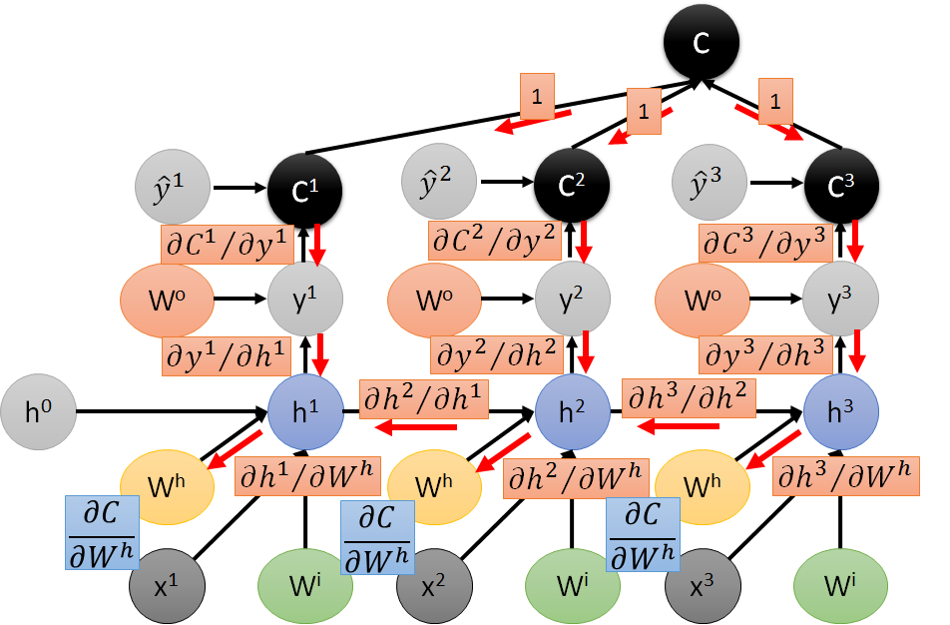
2
Remove first term, h²/h¹ in 2nd term and 3rd term, replace h¹/W^{h} by h²/W^{h}
Remove first two terms, remove h³/h² and h²/h¹
in 3rd term, replace h¹/W^{h} by h³/W^{h}
3
Then
Notice the benefit of the
top down computation
1
2
3

