Slide 1
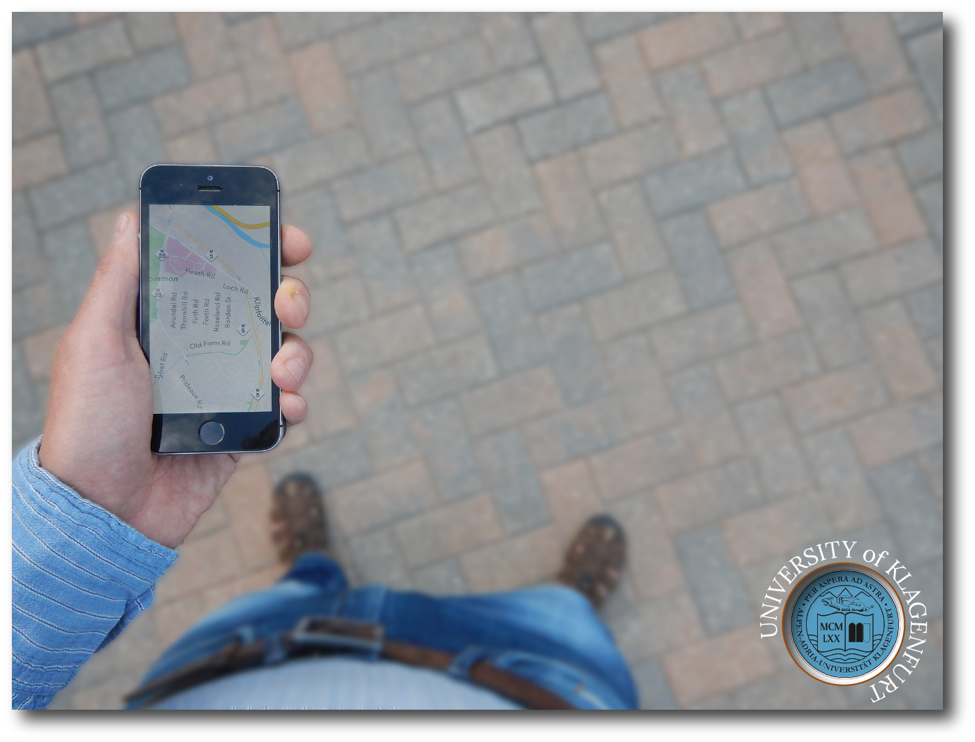
Comparing
direct off-screen pointing,
peephole,
and
flick&pinch interaction
for map navigation
David Ahlström

Slide 2
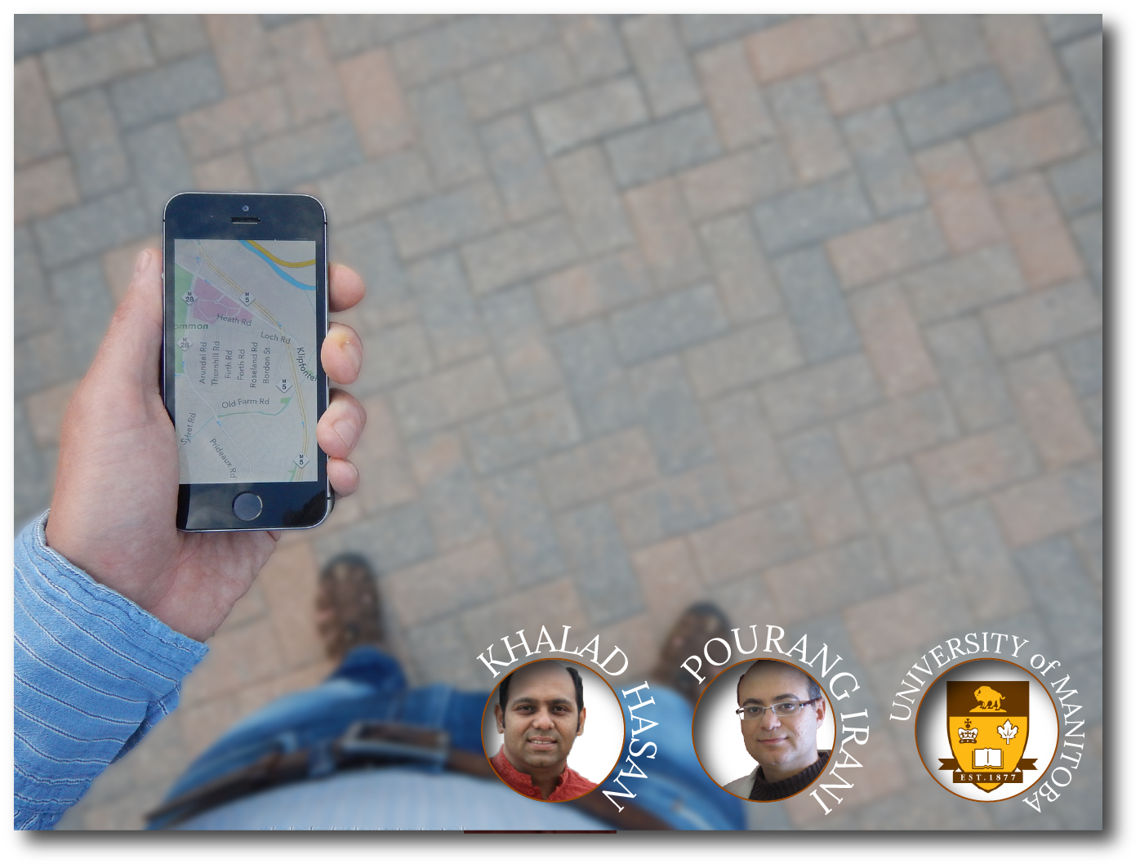
Comparing
direct off-screen pointing,
peephole,
and
flick&pinch interaction
for map navigation

Slide 3
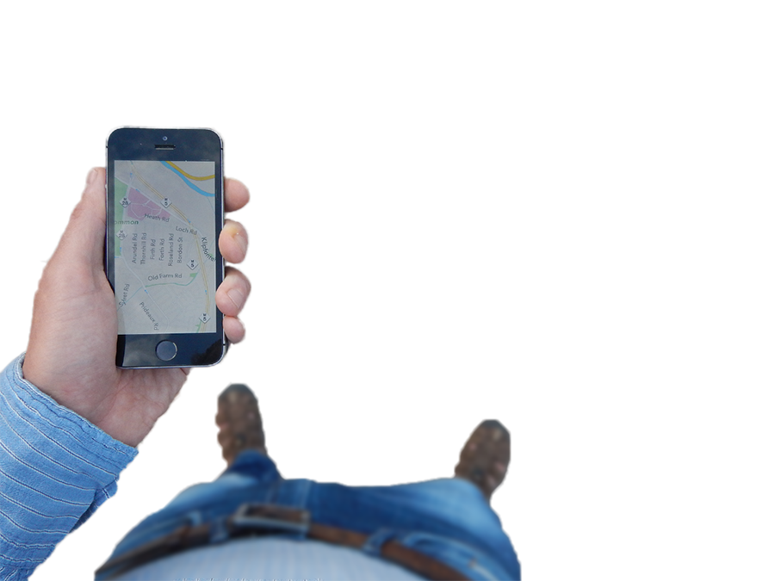
on-screen space
small –>
fat-finger
occlusion
frequent minute actions
off-screen space
large
unused

Slide 4
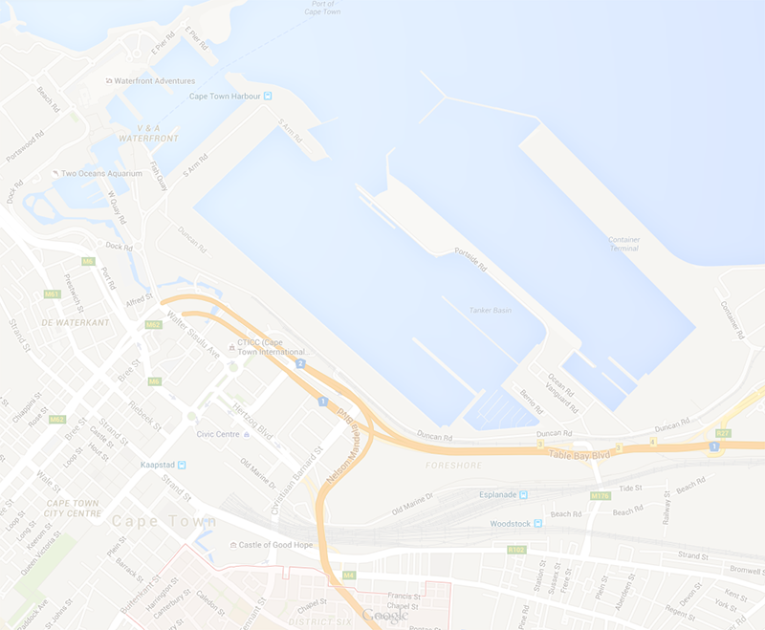

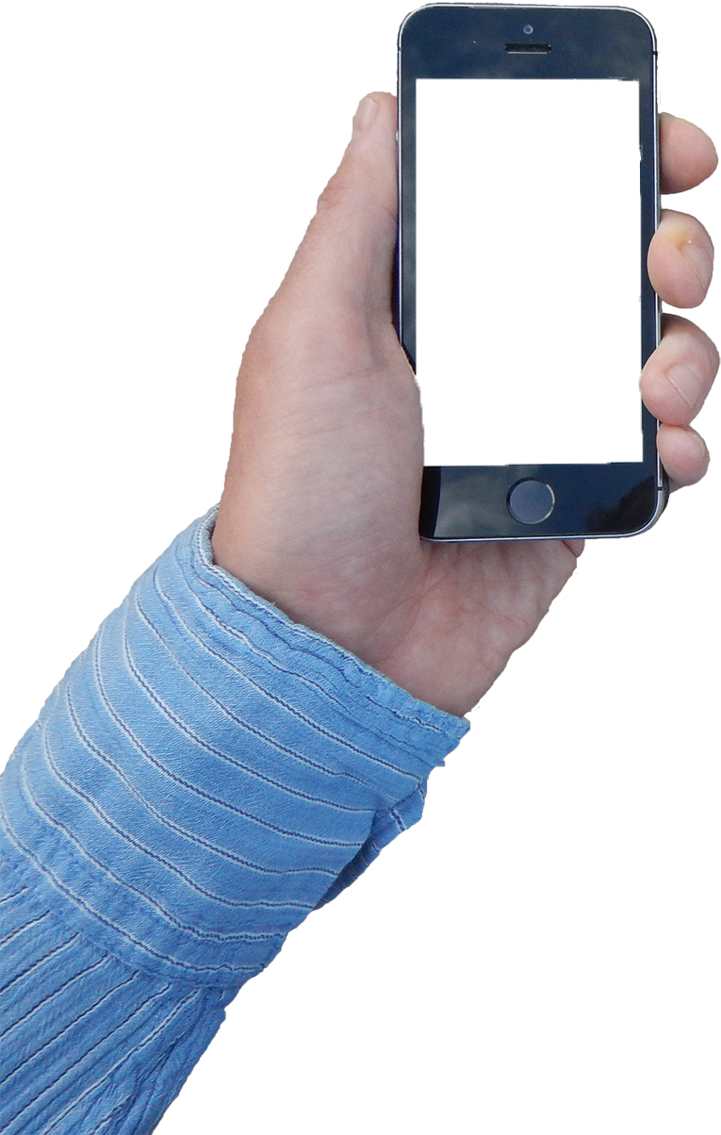
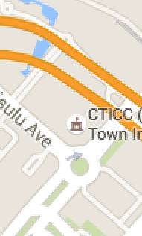
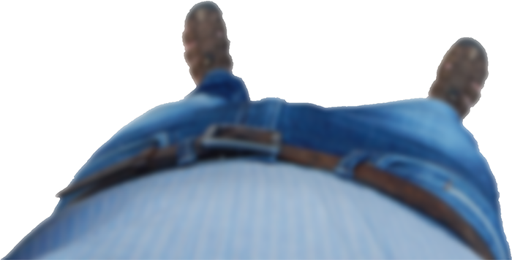
map navigation with
direct pointing
in off-screen space

Slide 5
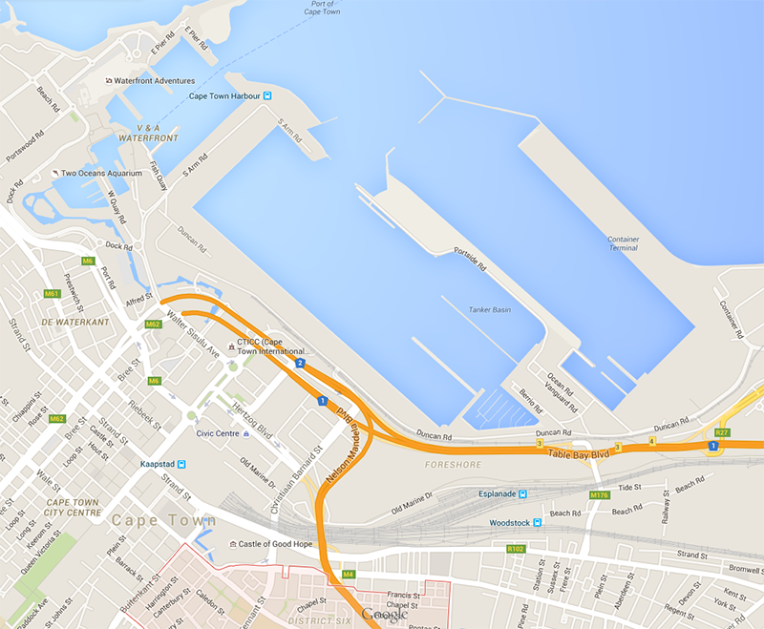
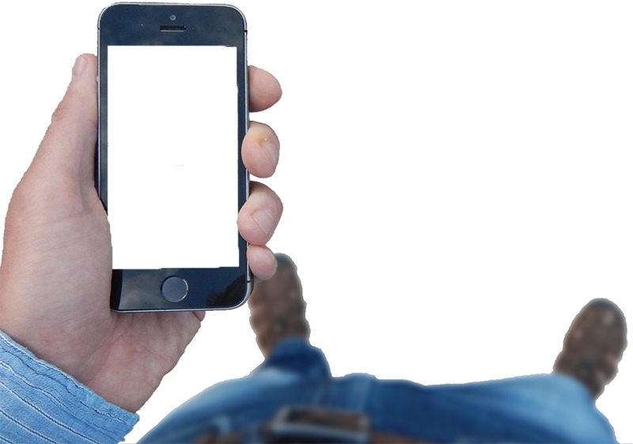
MAP
Hand

Slide 6






SideSight
Abracadabra
PalmSpace
Butler et al., 2008
Harrison et al, 2009
Kratz et al., 2012
Pan and zoom
Galaxy S4
Jones et al, 2012
Samsung, 2013

Slide 7
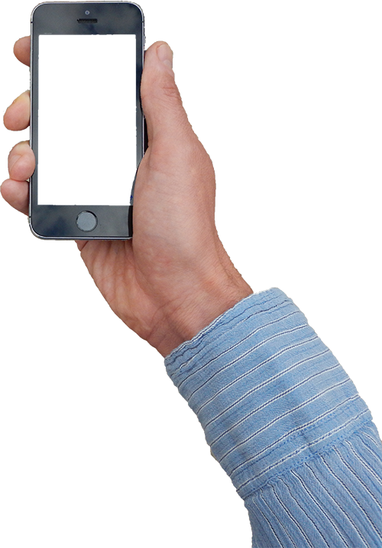
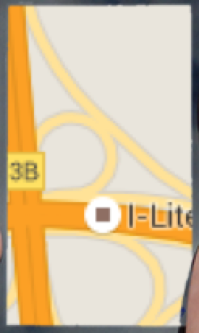
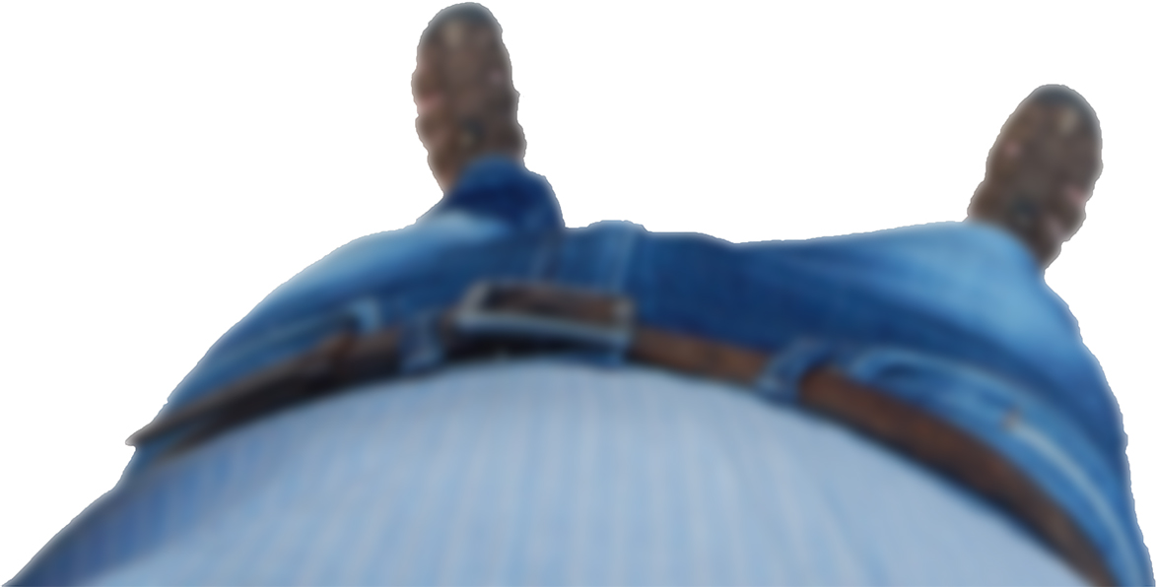
spatially aware handheld devices
Fitzmaurice, 1993
peephole interfaces
2002 – Tsang et al.
2003 – Yee
2006 – Mehra et al.
2006 – Olwal
2007 – Rohs et al.
2008 – Rohs & Oulasvirta
2008 – Cao et al.
2010 – Henze & Boll
2011 – Huber et al.
2012 – Pahud et al.
2014 – Spindler et al.
2014 – Kerber et al.

Slide 8
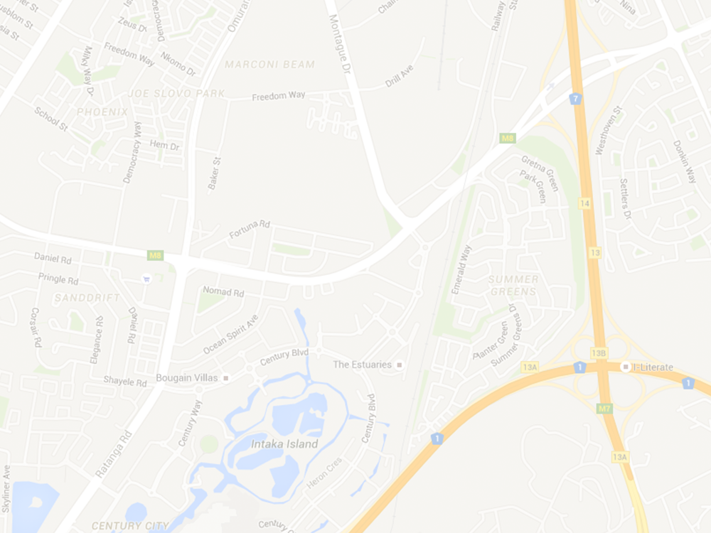

Slide 9
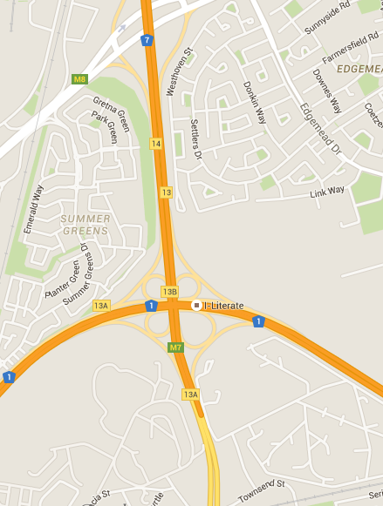


Slide 10
OFF-SCREEN POINTING &
map navigation?

Slide 11
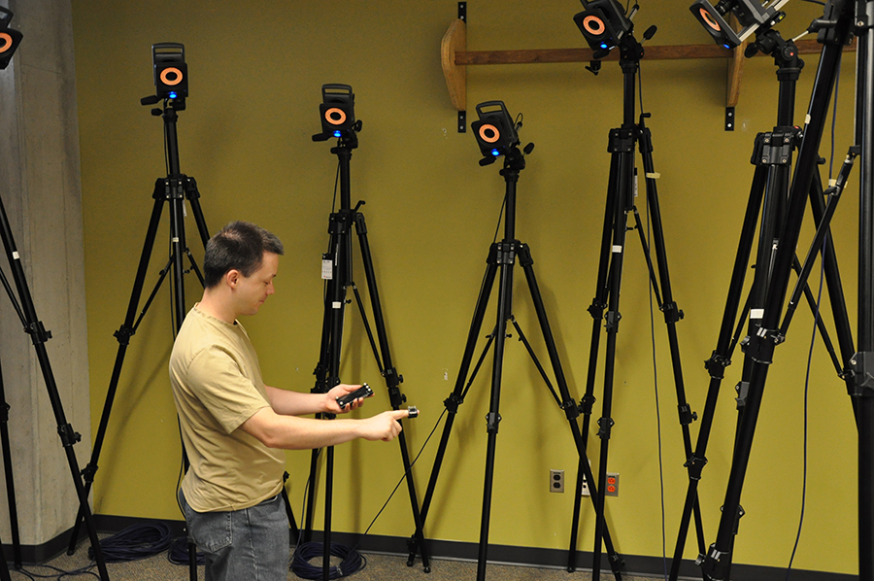

Slide 12

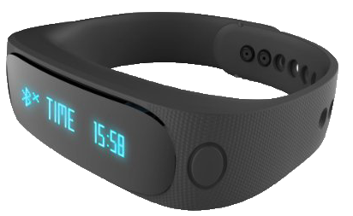
heart rate
running speed
elevation
air temperature
humidity
geographic position

Slide 13
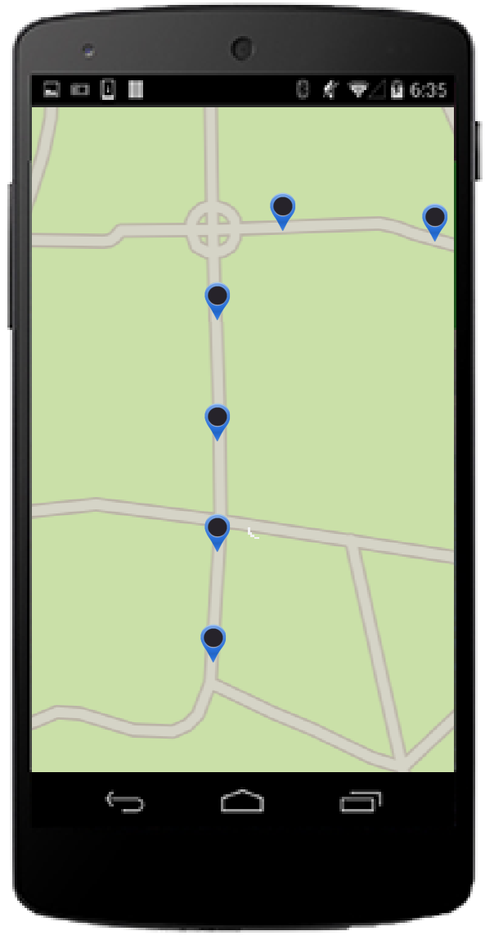

heart rate
running speed
elevation
air temperature
humidity
geographic position

Slide 14

Heart rate: 100 b/s
Speed: 12 km/h
Elevation: 235m Temperature 23°
Humidity: 42%

Slide 15
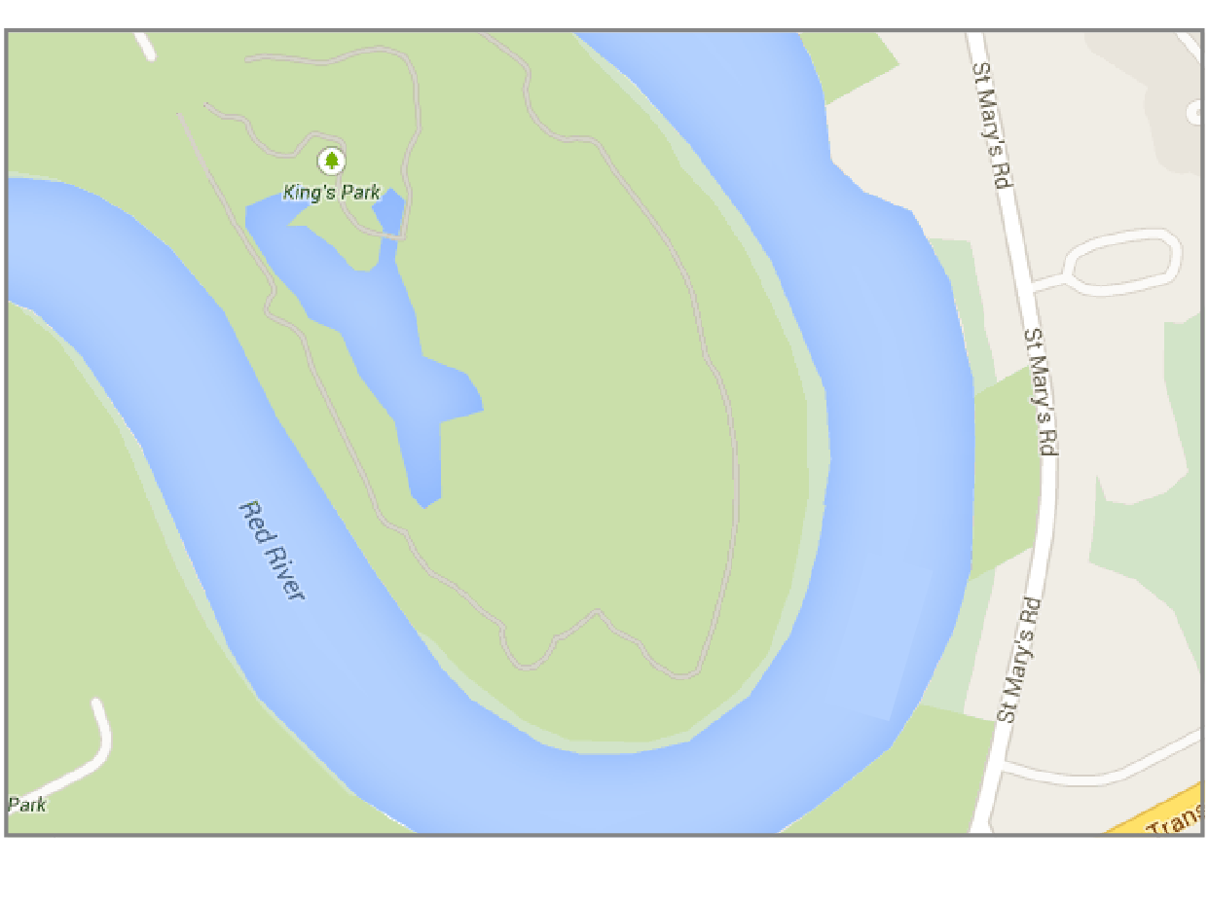

Slide 16
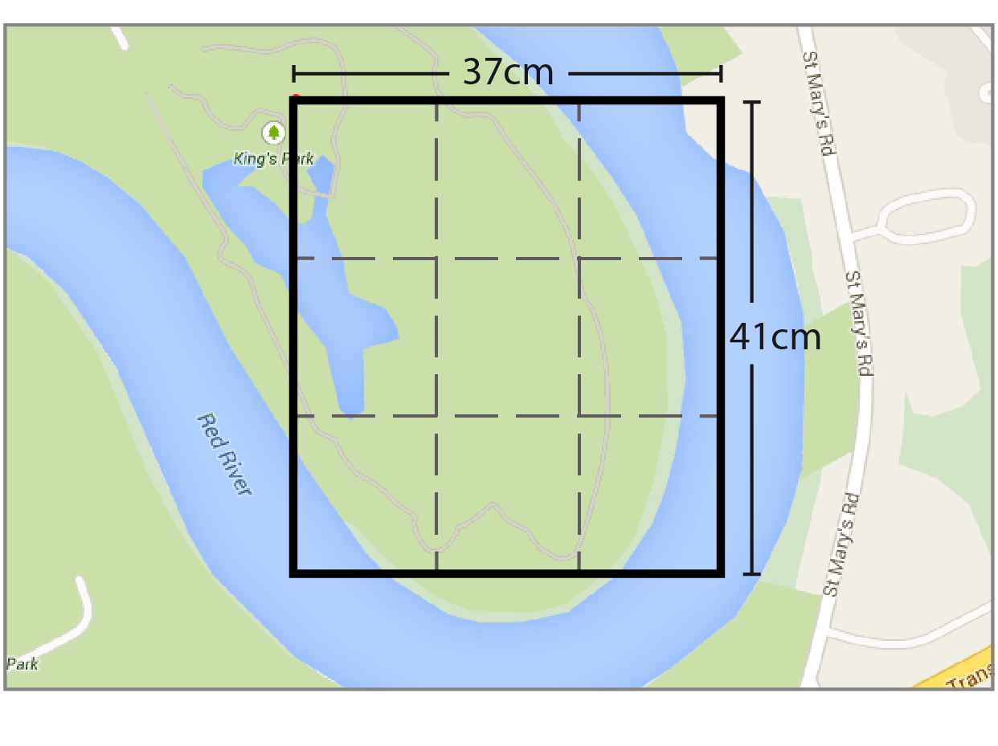

Slide 17


Slide 18
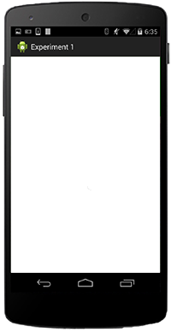

Slide 19
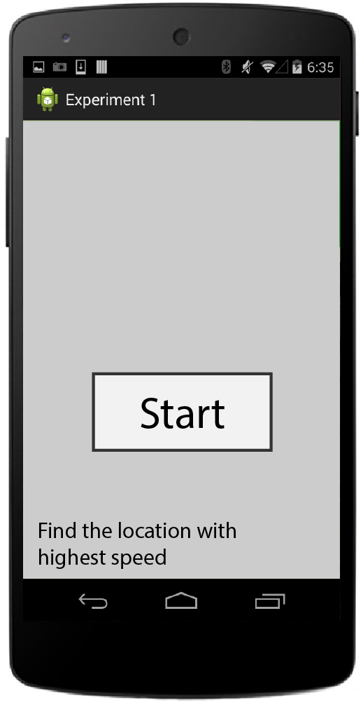

Slide 20
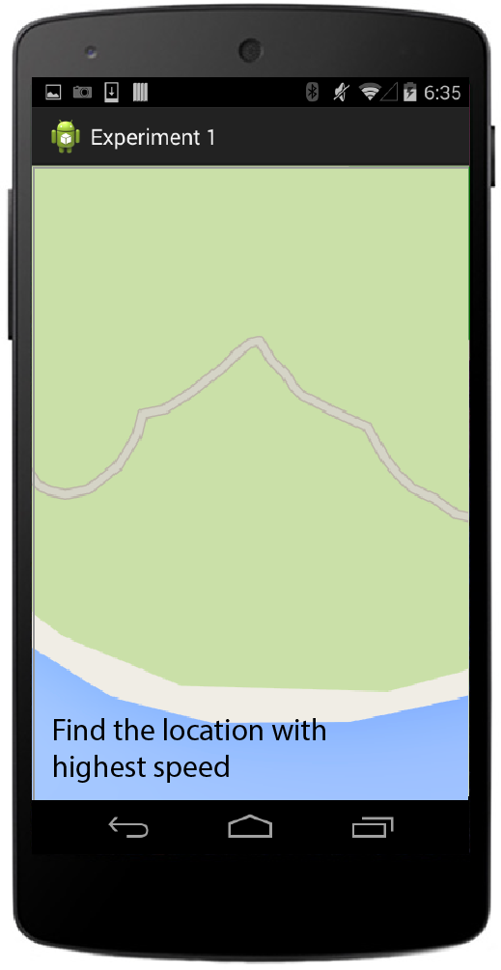
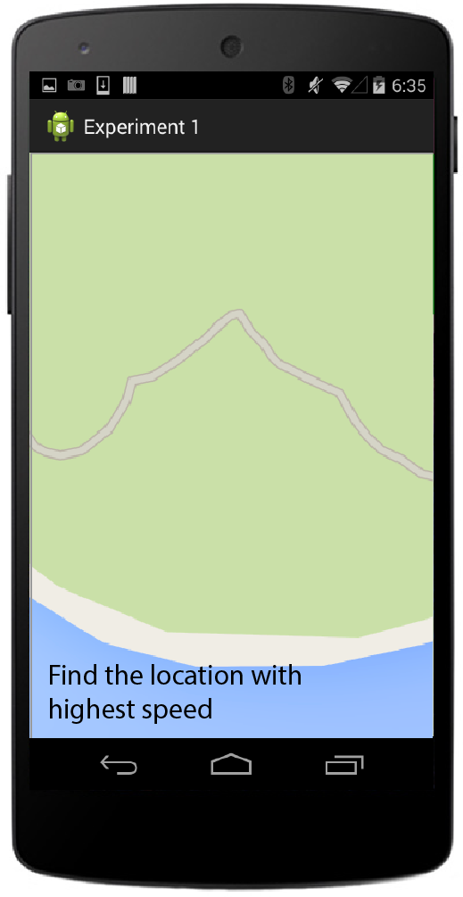

Slide 21
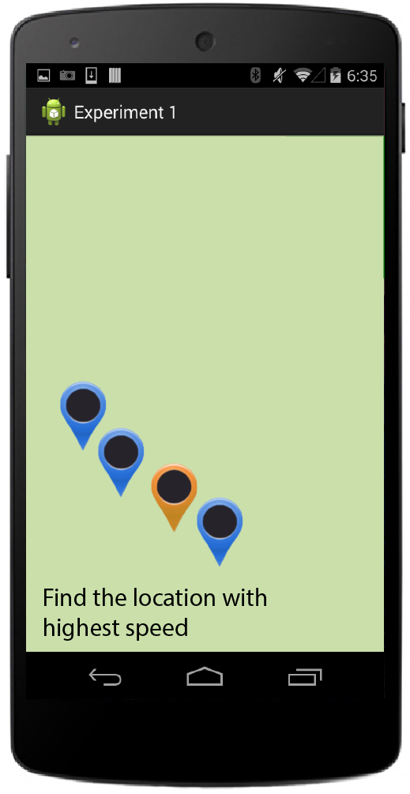

Slide 22
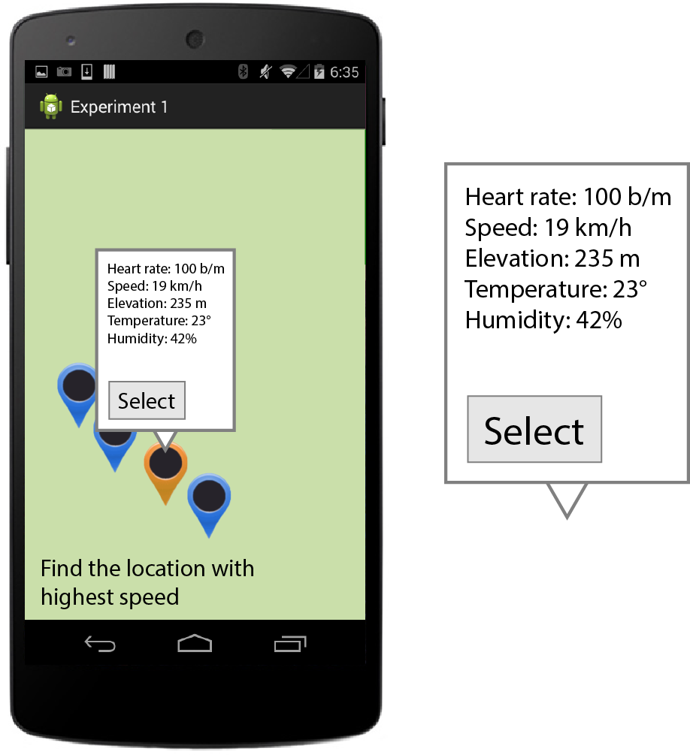

Slide 23
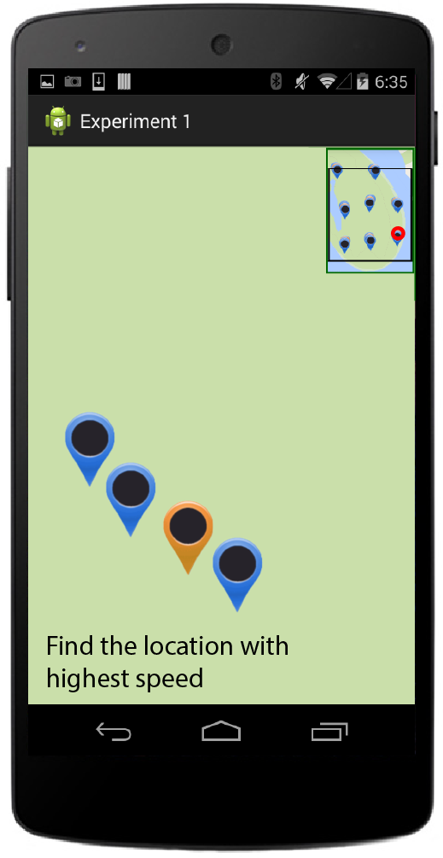
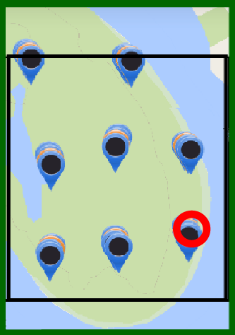
position cursor

Slide 24
3 × 2 repeated measures design
3 techniques
flick&pinch
peephole
off-screen pointing

Slide 25
3 × 2 repeated measures design
3 techniques
flick&pinch
peephole
off-screen pointing
2 overview
with on-screen overview
without on-screen overview

Slide 26
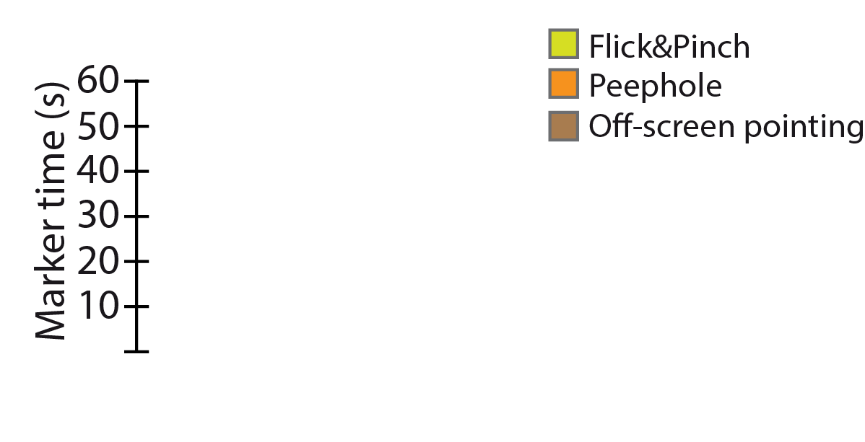
RESULTS

Slide 27
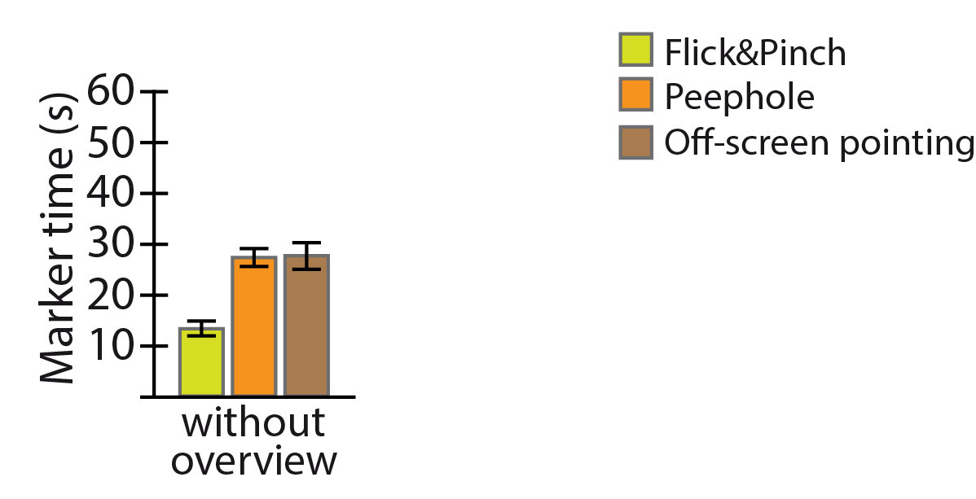
RESULTS

Slide 28
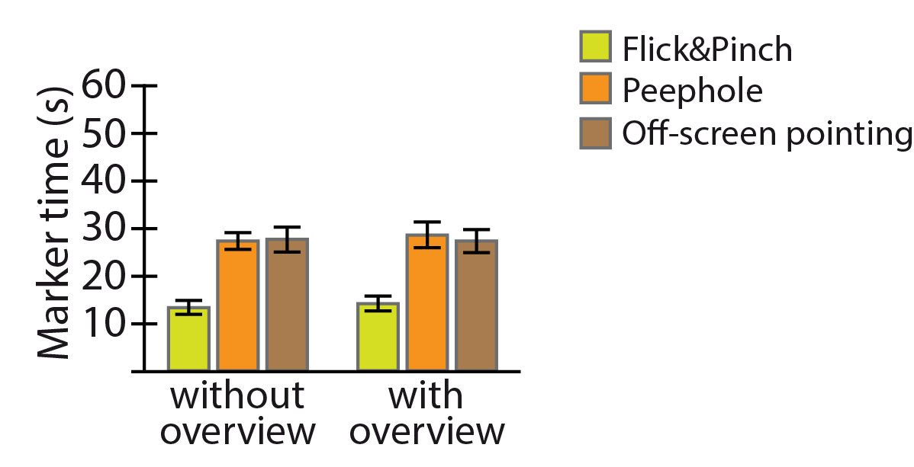
RESULTS

Slide 29
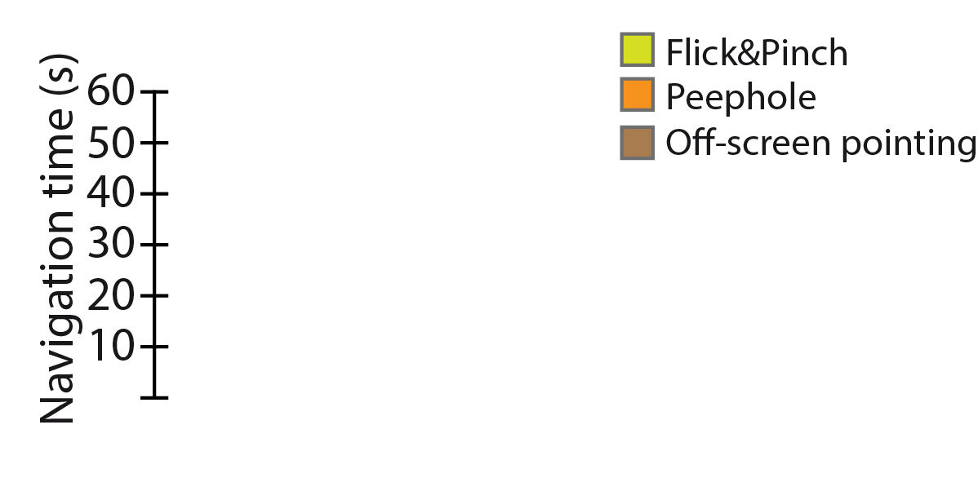
RESULTS

Slide 30
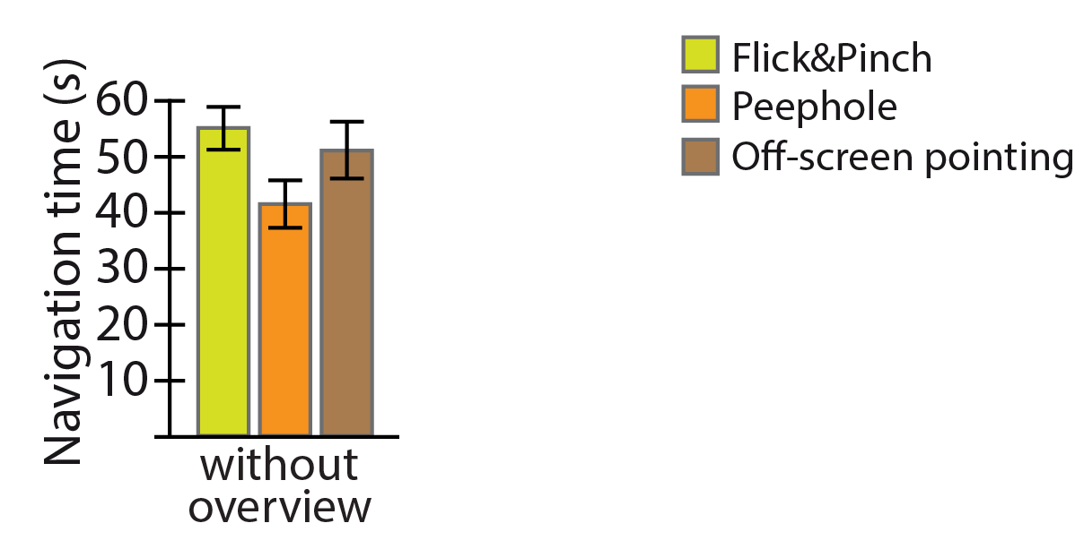
RESULTS

Slide 31
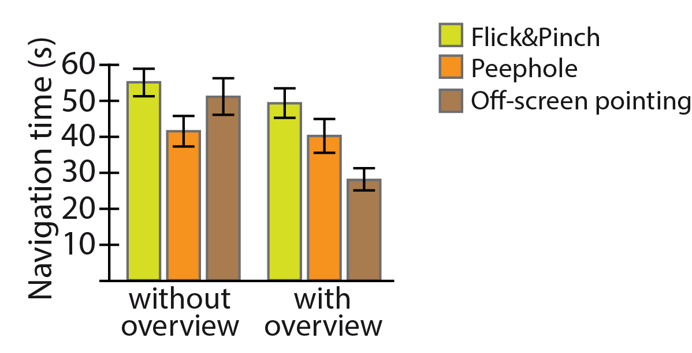
RESULTS

Slide 32
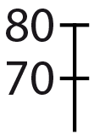

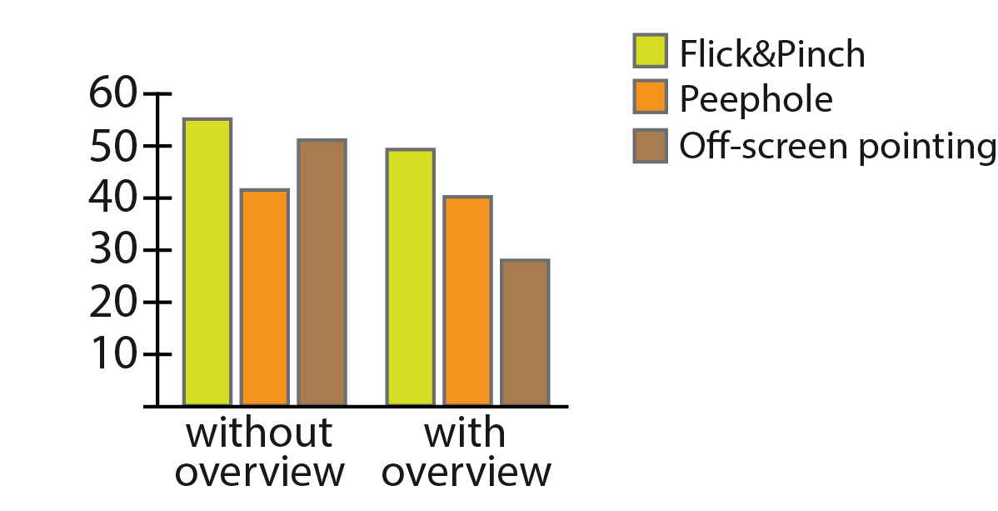
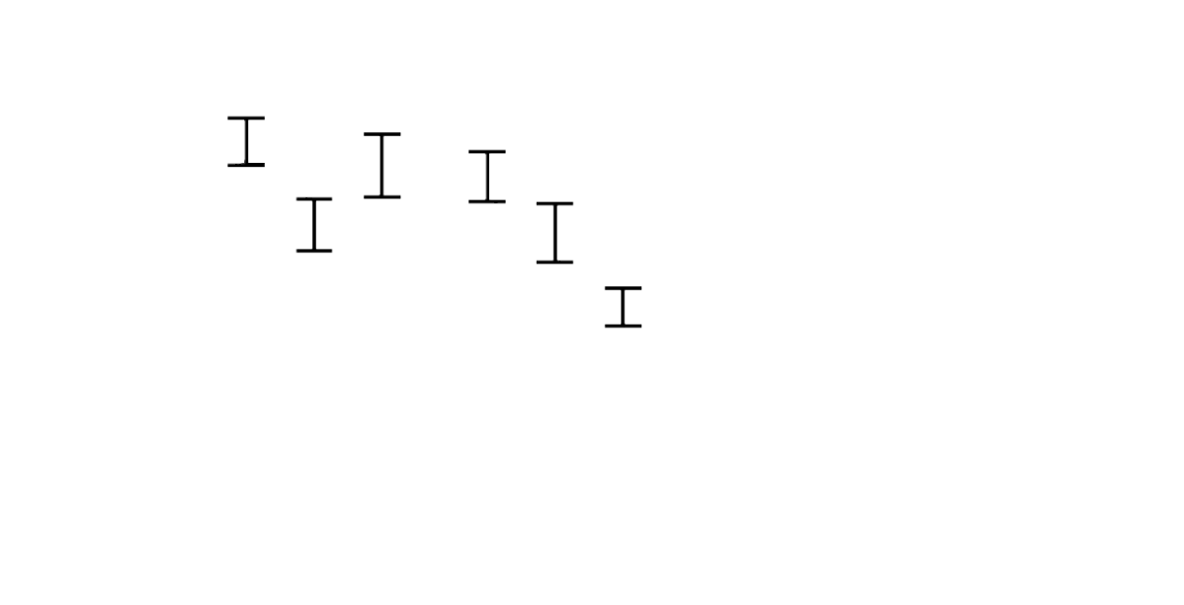






Top seconds
RESULTS
Time bars
Total time
Total time error bar
Total time (s)
Bars u label
errorbars
naviagtionlabel

Slide 33
introduced a new map navigation technique
demonstrated that direct off-screen pointing can improve map navigation
gained first insight of its possible strengths and weaknesses

Slide 34
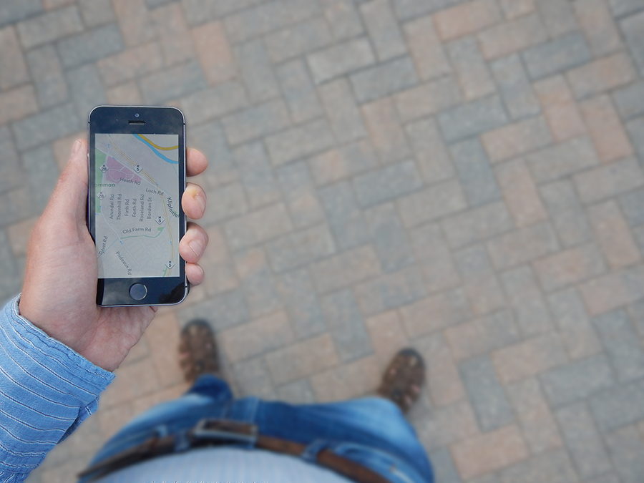
Thank you
Comparing direct off-screen pointing, peephole, and flick&pinch interaction for map navigation
Khalad Hasan
University of Manitoba
David Ahlström
University of Klagenfurt
Pourang Irani
University of Manitoba

