Slide 1



Smartwatches + Head-Worn Displays: the ‘New’ Smartphone
Marcos Serrano¹, Khalad Hasan², Barrett Ens²,
Xing-Dong Yang³, Pourang Irani²
¹ IRIT- University of Toulouse Toulouse, France | ² University of Manitoba Winnipeg, MB, Canada | ³ University of Calgary Calgary, AB, Canada

Slide 2
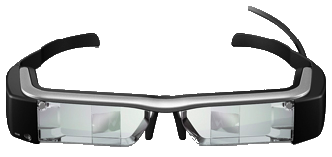
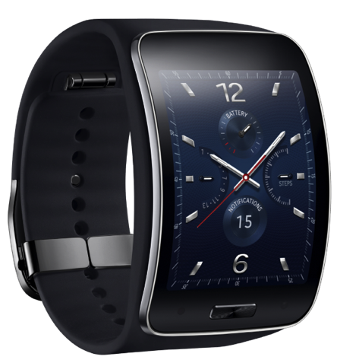
Motivation

Slide 3
Research Question
+

Slide 4
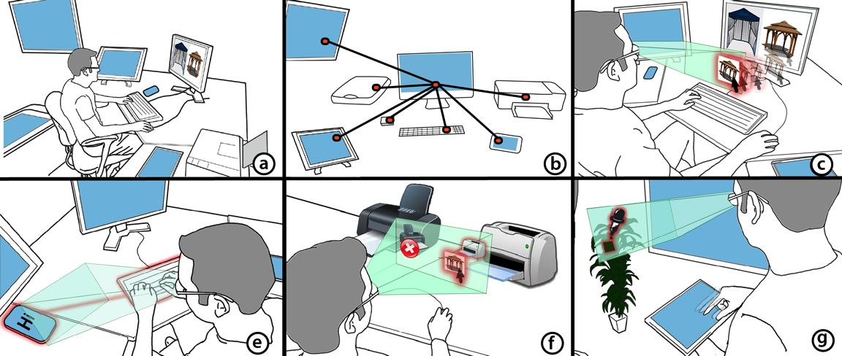
Gluey: Developing a Head-Worn Display Interface to Unify the Interaction
Experience in Distributed Display Environments
Conditionally accepted, MobileHCI 2015

Slide 5
Design
Space

Slide 6

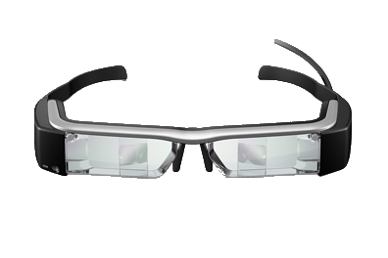
Input | Output

Slide 7
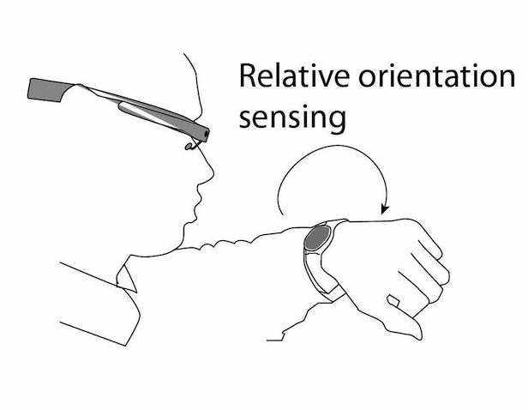
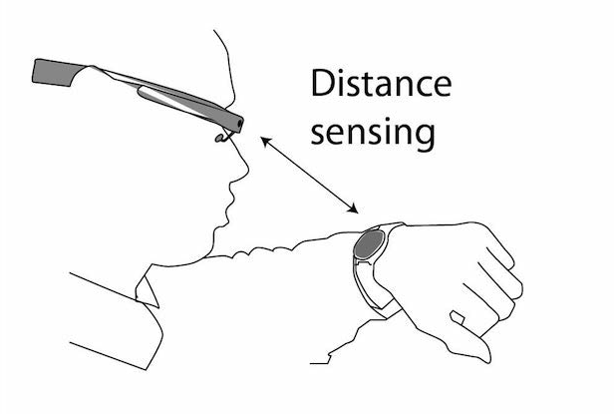
Proxemic Interaction

Slide 8
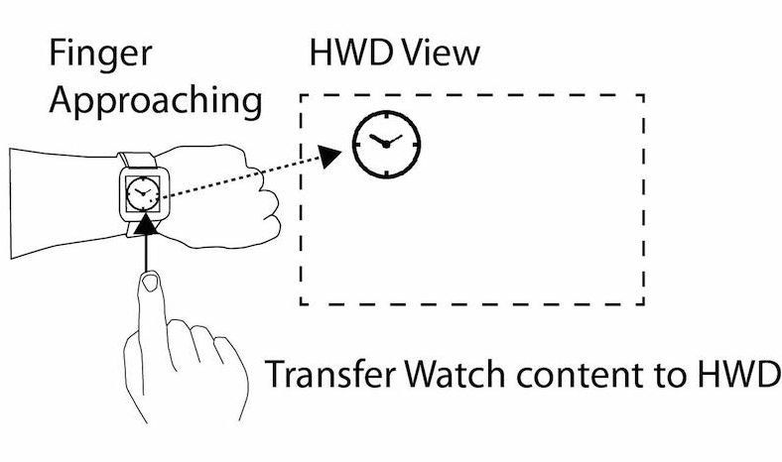
Inter-Device Mode Sensing

Slide 9
Input | Output

Slide 10
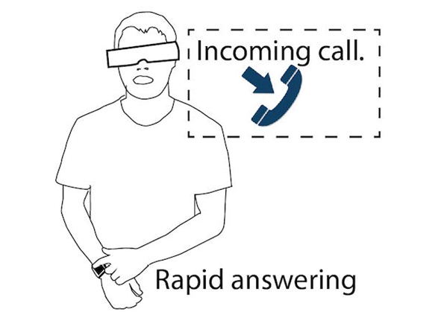
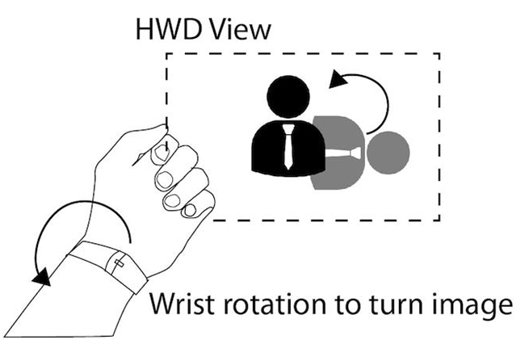
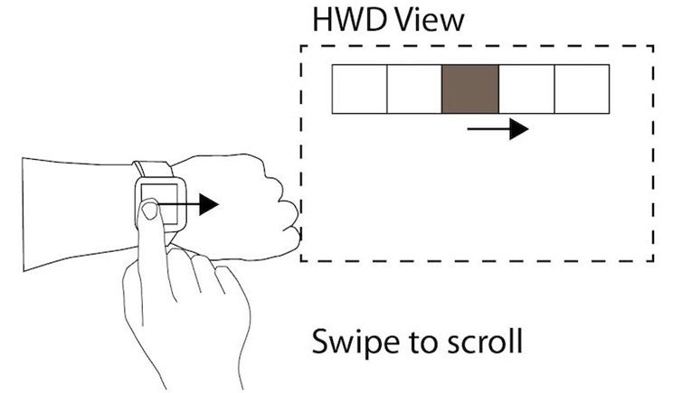
SW as Auxiliary Input Device

Slide 11
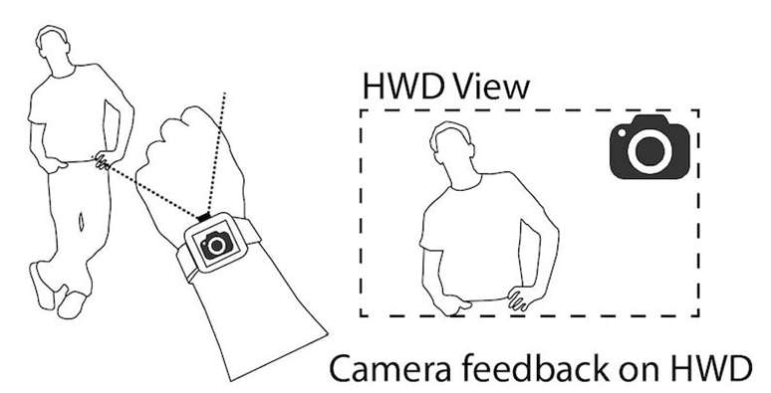
SW as always-available Camera

Slide 12
Input | Output

Slide 13
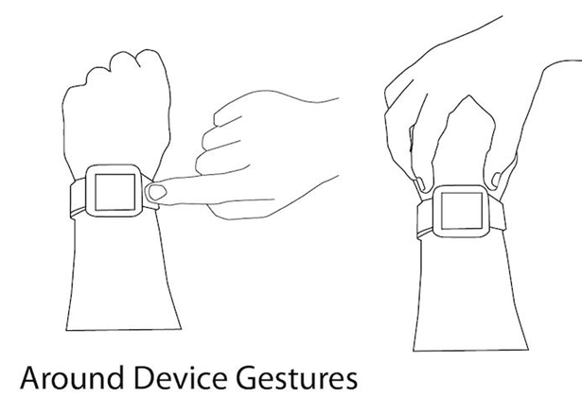
Around Device Input

Slide 14
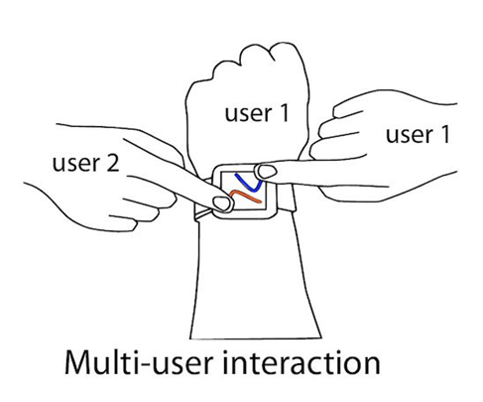
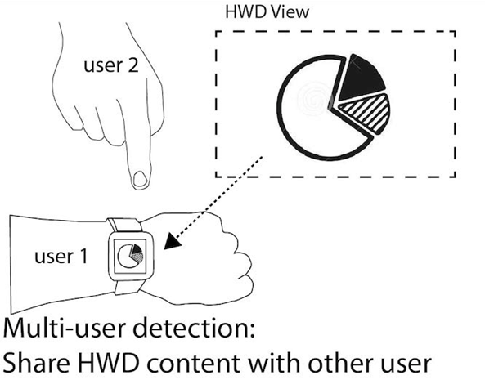
Multi-user Sensing

Slide 15
Input | Output

Slide 16
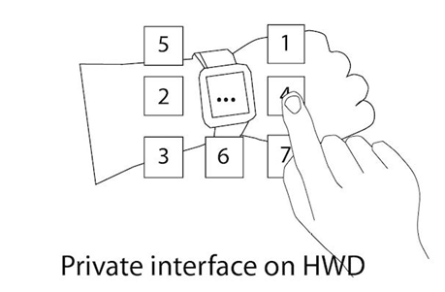
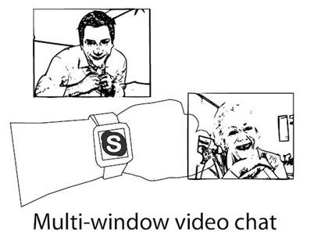
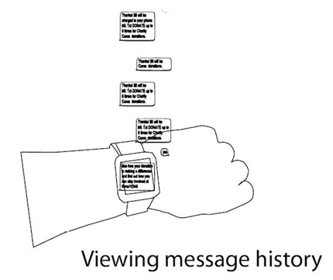
Around-Device Content

Slide 17
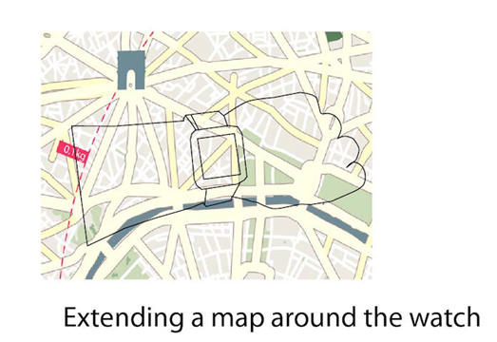
Information Overlay

Slide 18
