Slide 1


Are You Comfortable Doing That?: Acceptance Studies of Around-Device Gestures in and for Public Settings
David Ahlström, Khalad Hasan, Pourang Irani

Slide 2
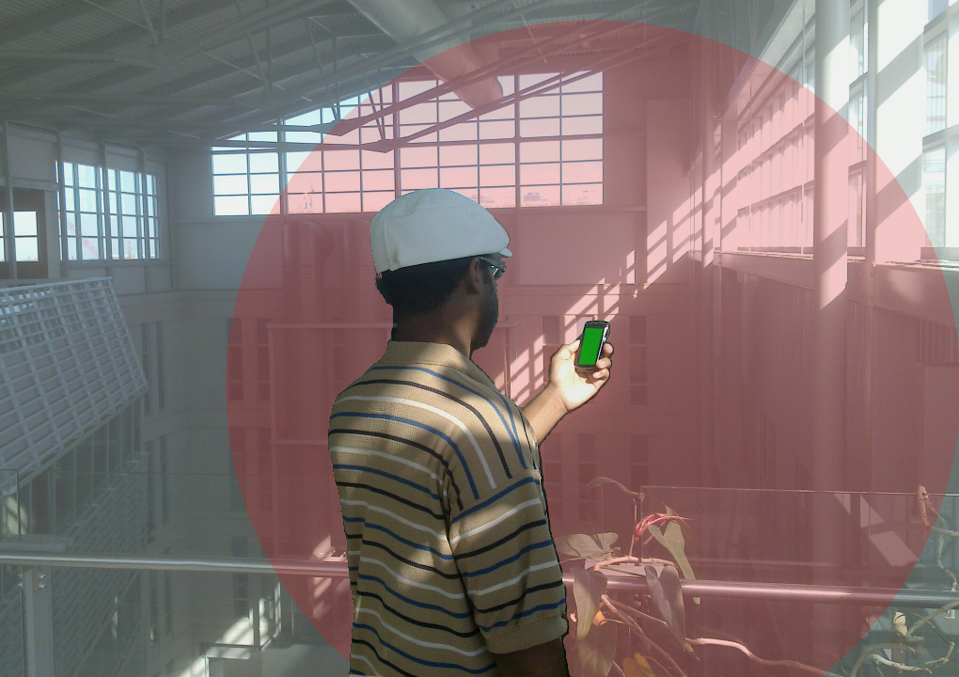
Around-Device Interaction
Off-screen space
On-screen space

Slide 3
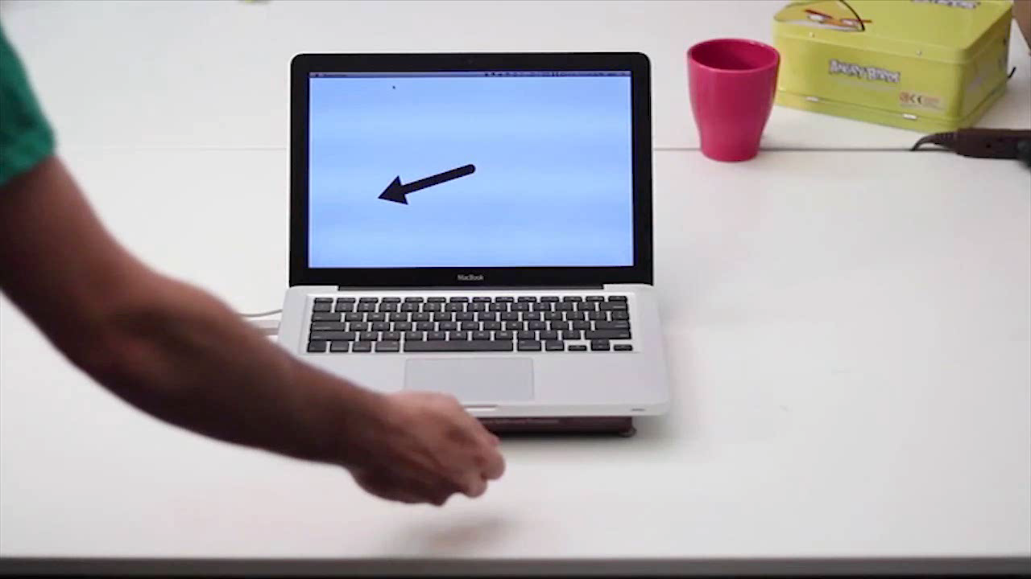
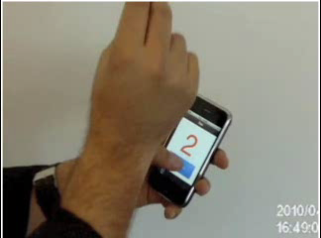
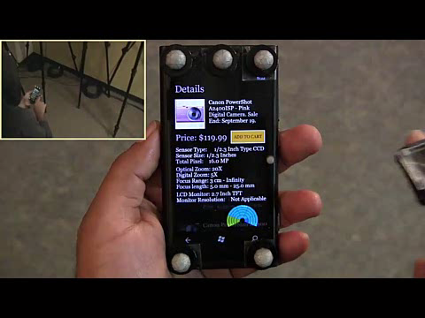
Motivation
Toffee. Xiao et al., 2014
MagiTact. Ketabdar et al., 2011
Ad-Binning. Hasan et al., 2013
3

Slide 4
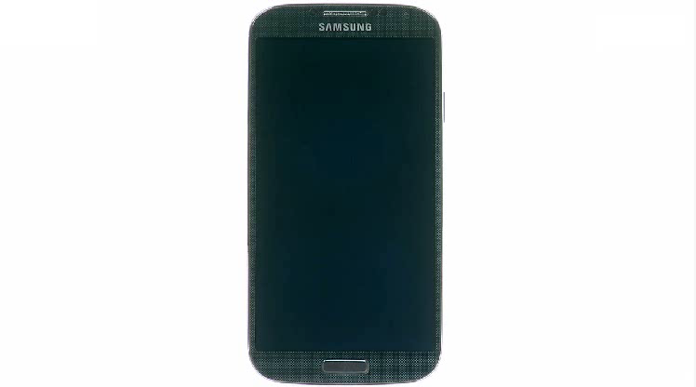
Motivation
4

Slide 5
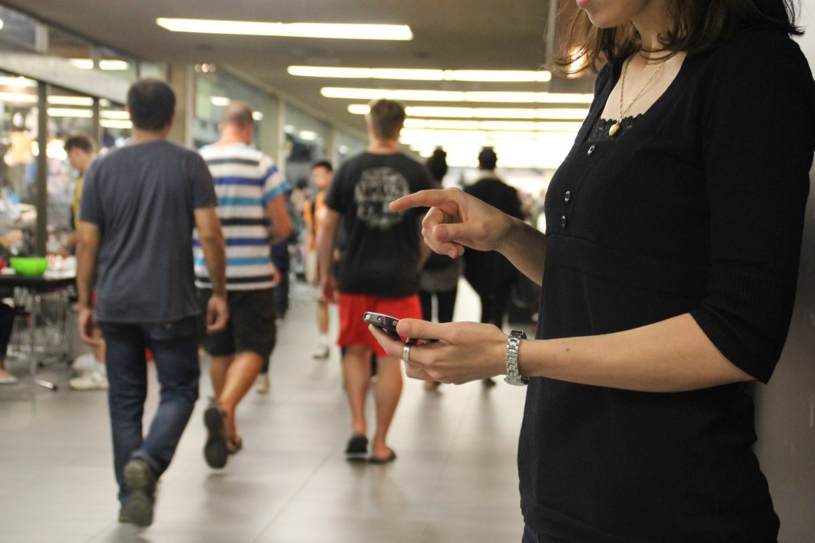
Motivation
5

Slide 6
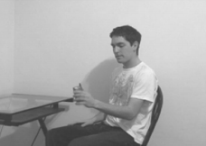
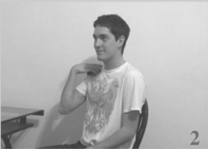
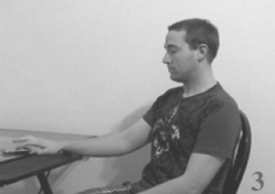
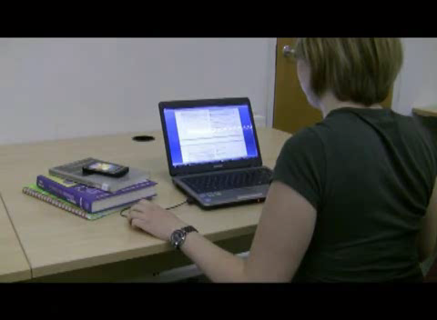
Social Acceptability
Usable gestures for mobile interfaces
Rico and Brewster, 2010
Would You Do That?
Montero et al., 2010
6

Slide 7
But why bother?
Help design AD-gestures so they become mainstream
Build new sensing mechanisms to suit what seems acceptable

Slide 8

Yang et al. 2013

Slide 9
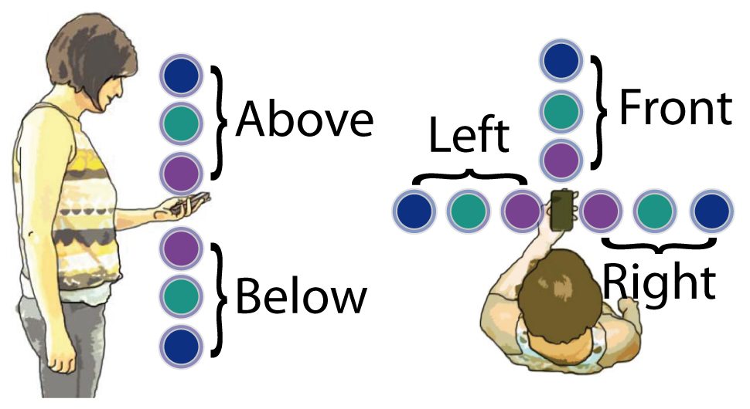
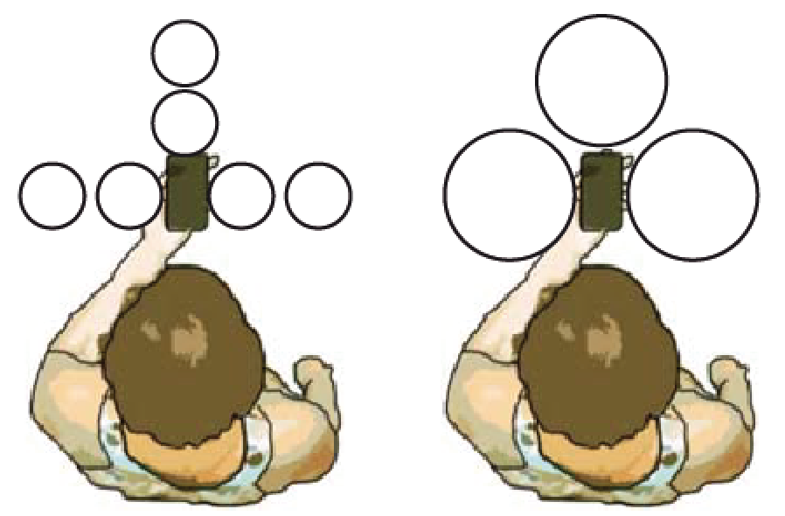
Motivation
Small, 9 Sec
Large, 3 sec
9

Slide 10
Contributions
AD-gesture features influence user comfort and acceptance
AD-gestures acceptability by users with introversion or extroversion traits
A set of recommendations to assist AD-interaction designers
10

Slide 11
Studies
Study 1: Gesture Location and Distance
Study 2: Gesture Size and Duration
Study 3: Spectators
Study location: Canada and Austria
11

Slide 12
Study 1
Region and Distance
12

Slide 13
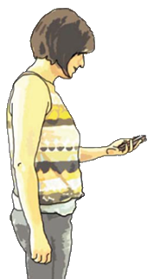
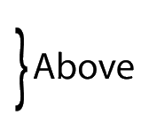


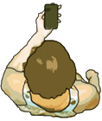
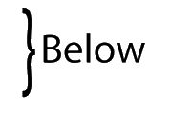

Region
13

Slide 14
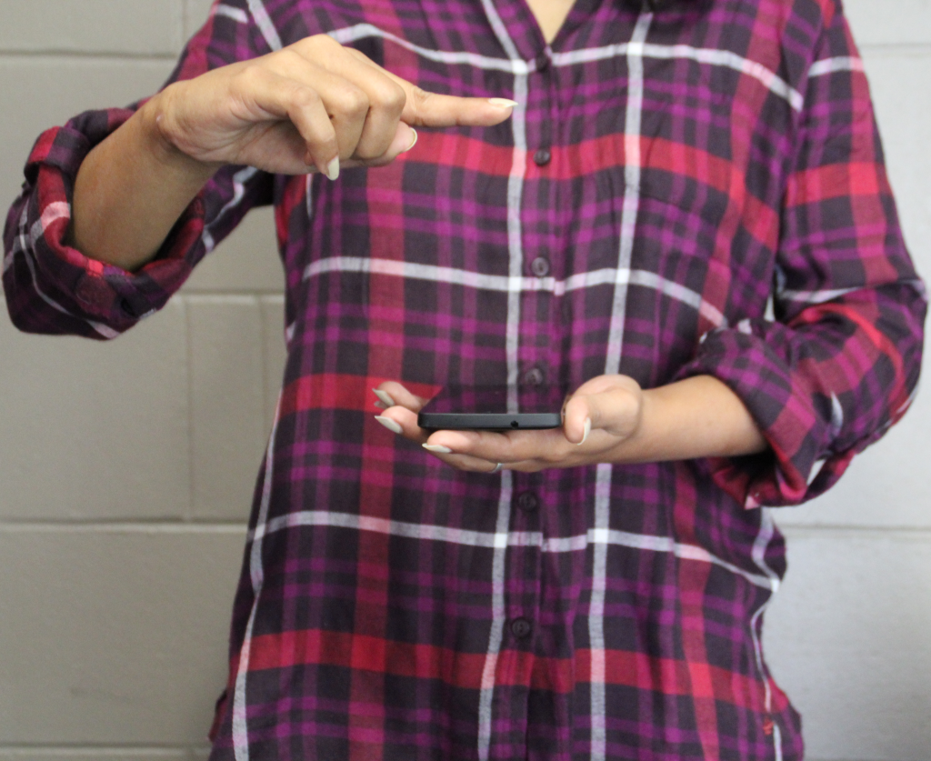
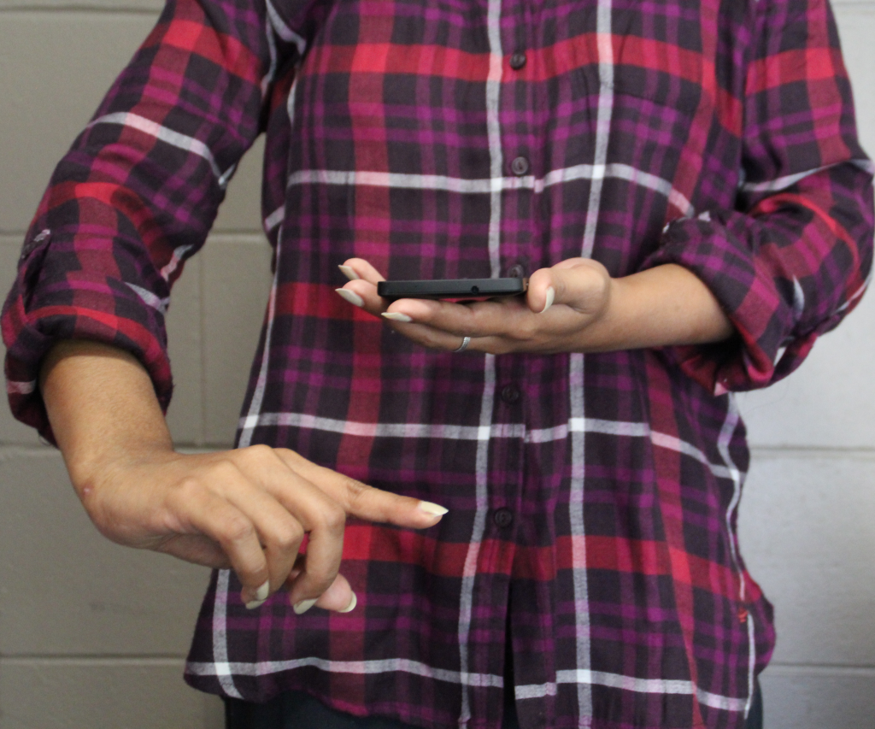
Region
Above
Below

Slide 15
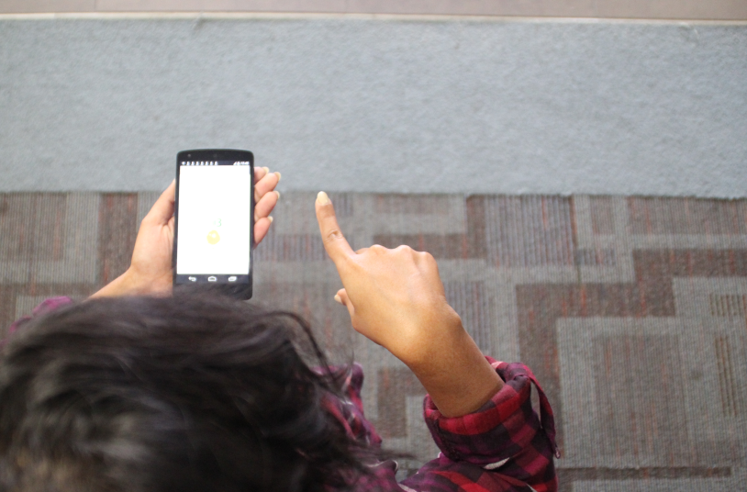
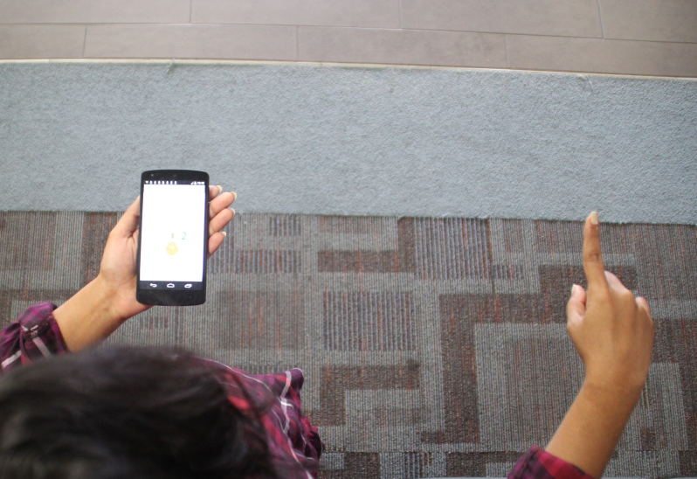
Distance
Near
Far

Slide 16





Distance
16

Slide 17
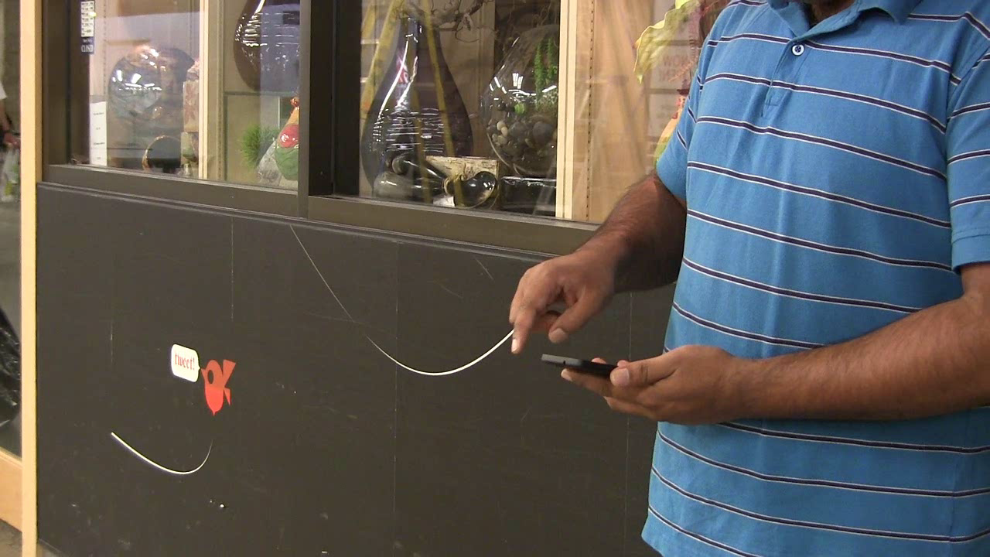
17

Slide 18
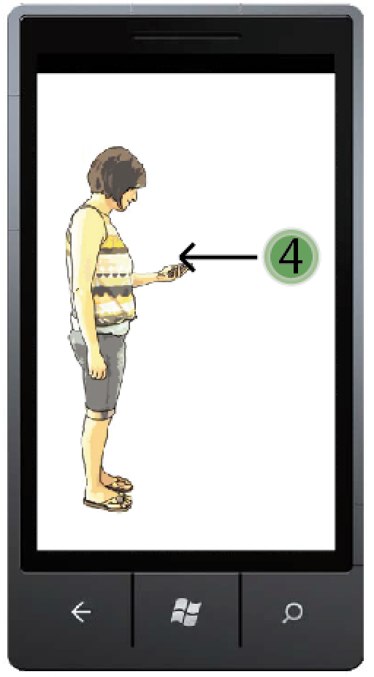
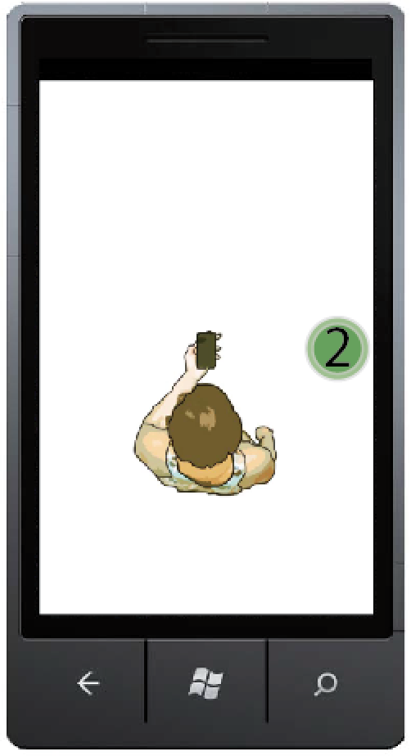
Task Screen
18
5 Regions x 3 Distance x 3 Repetitions * 2 Locations
= 90 trials / participant

Slide 19
Questionnaire
Q1. Overall Impression during such gestures
1
2
3
4
4
10
5
3
6
1
It felt terribly uncomfortable
It felt confortable
19

Slide 20
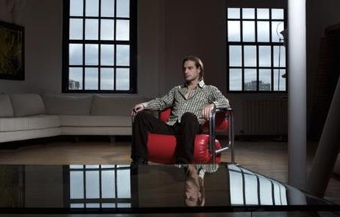
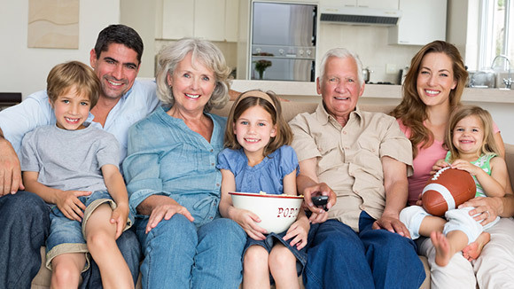

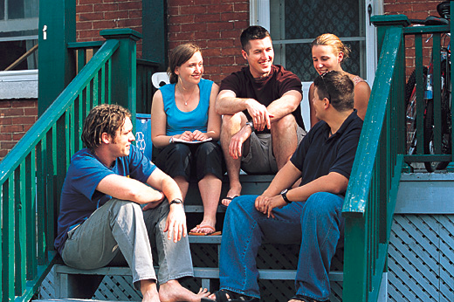

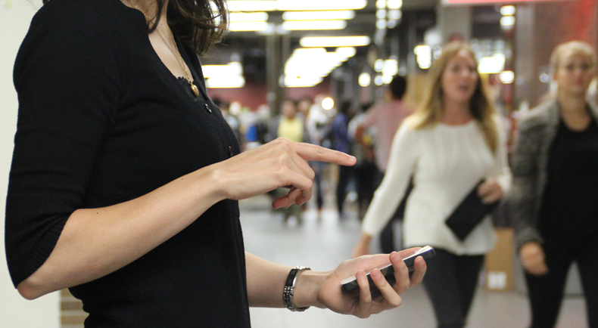
Questionnaire
Q2. In front of whom do you think you would feel comfortable using such gestures?
Family
Partner
Alone
Friends
Colleagues
Strangers
20

Slide 21
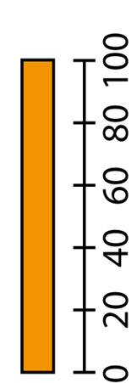
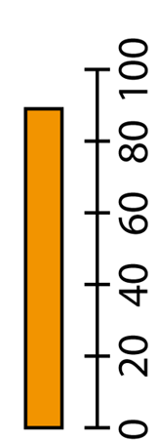
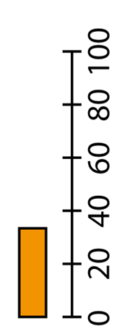
Results: Acceptance Rate (%)
Q2. In front of whom do you think you would feel comfortable using such gestures?
Family
Partner
Alone
Friends
Colleagues
Strangers
21

Slide 22
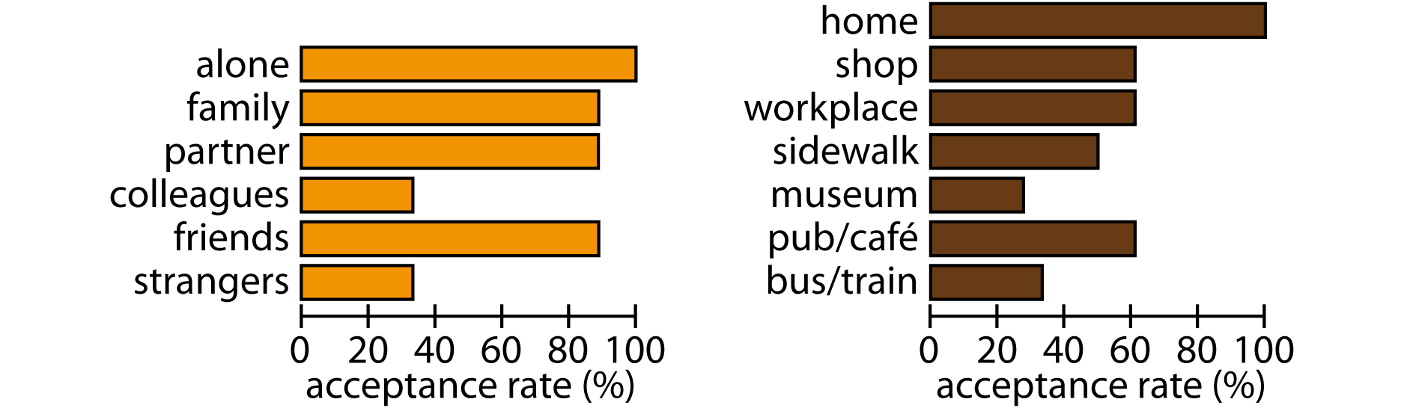
Results
22

Slide 23
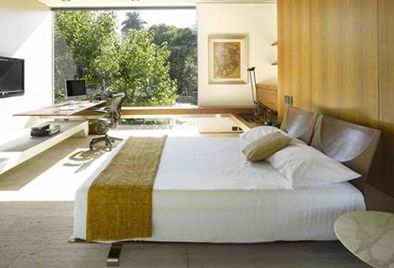
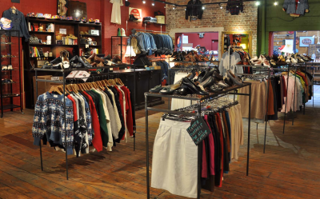

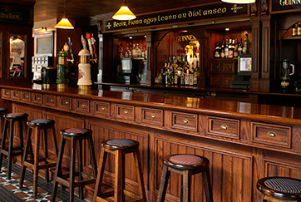
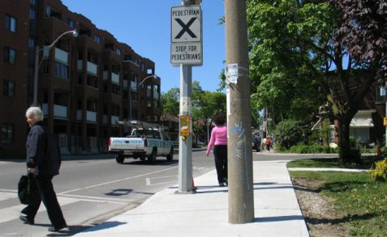

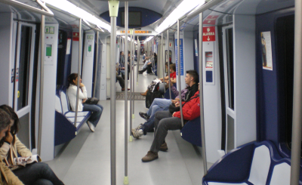
Questionnaire
Q3. In which locations do you think you would feel comfortable using such gestures?
Home
Shop
Work place
Pub/Cafe
Side walk
Museum
Bus/Train
23

Slide 24
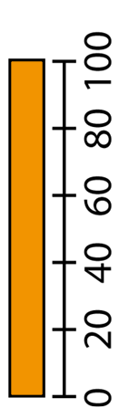
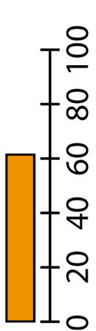
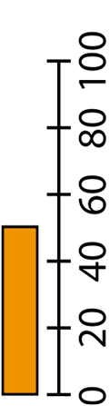
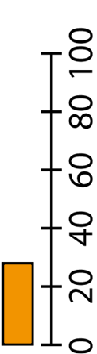
Results
Q3. In which locations do you think you would feel comfortable using such gestures?
Home
Shop
Work place
Pub/Cafe
Side walk
Museum
Bus/Train
24

Slide 25
Results
25

Slide 26
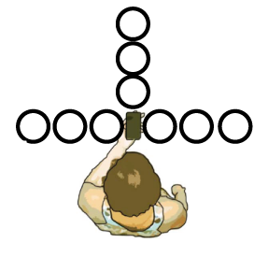
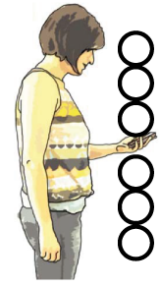
Questionnaire
Q4. Write a number from 1 to 5 in each of the circles to indicate how comfortable you felt performing a gesture at that particular position
26

Slide 27
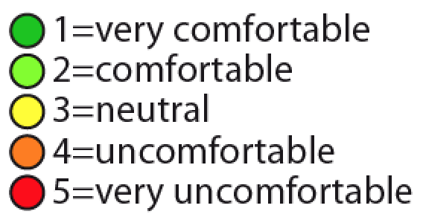
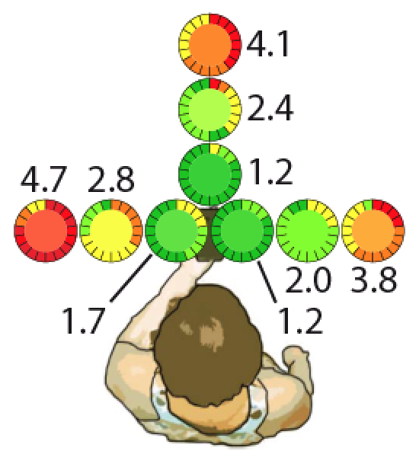
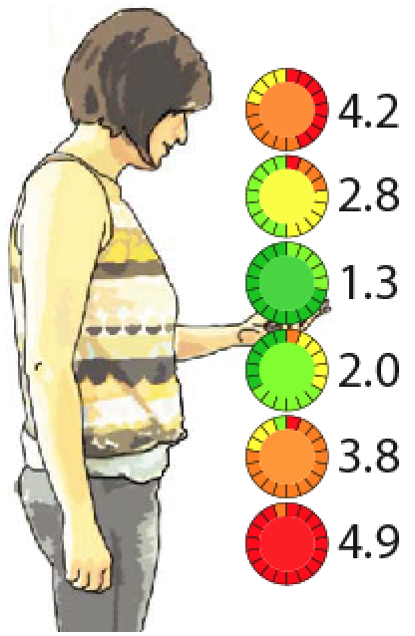
Results
27

Slide 28

Extraversion and Introversion
28

Slide 29
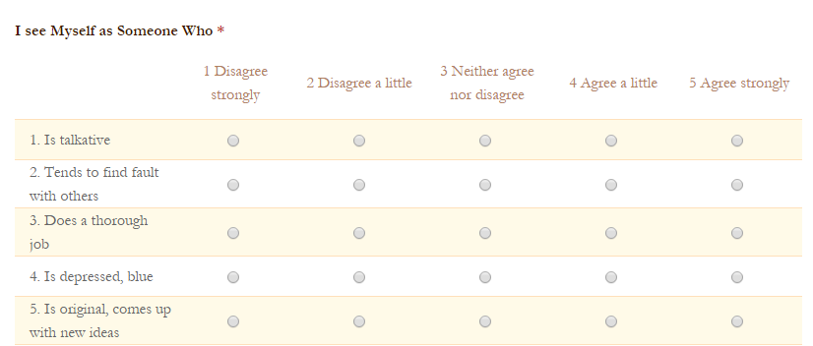
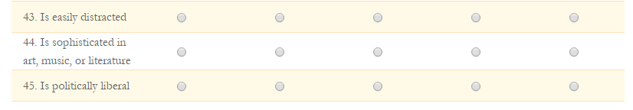
Big Five questionnaire
9 participants: Extraversion percentile score below 50
9 participants: Extraversion percentile score above 50
http://www.outofservice.com/bigfive/
29

Slide 30
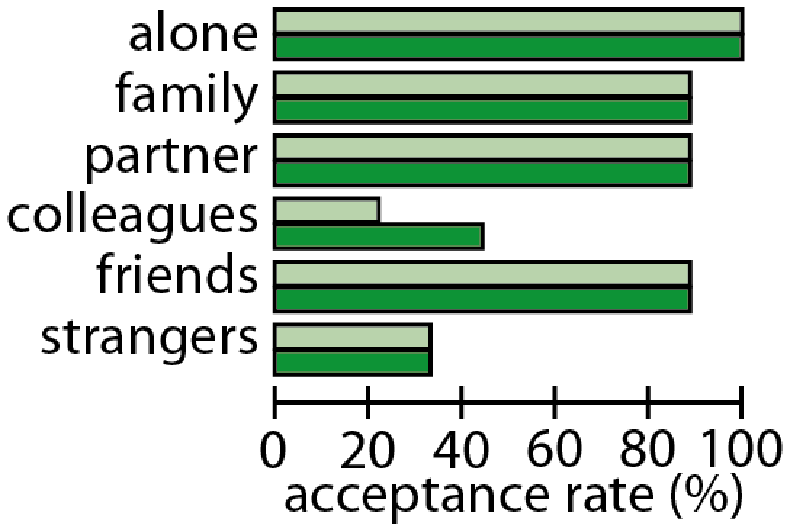

Results: In front of whom
30

Slide 31
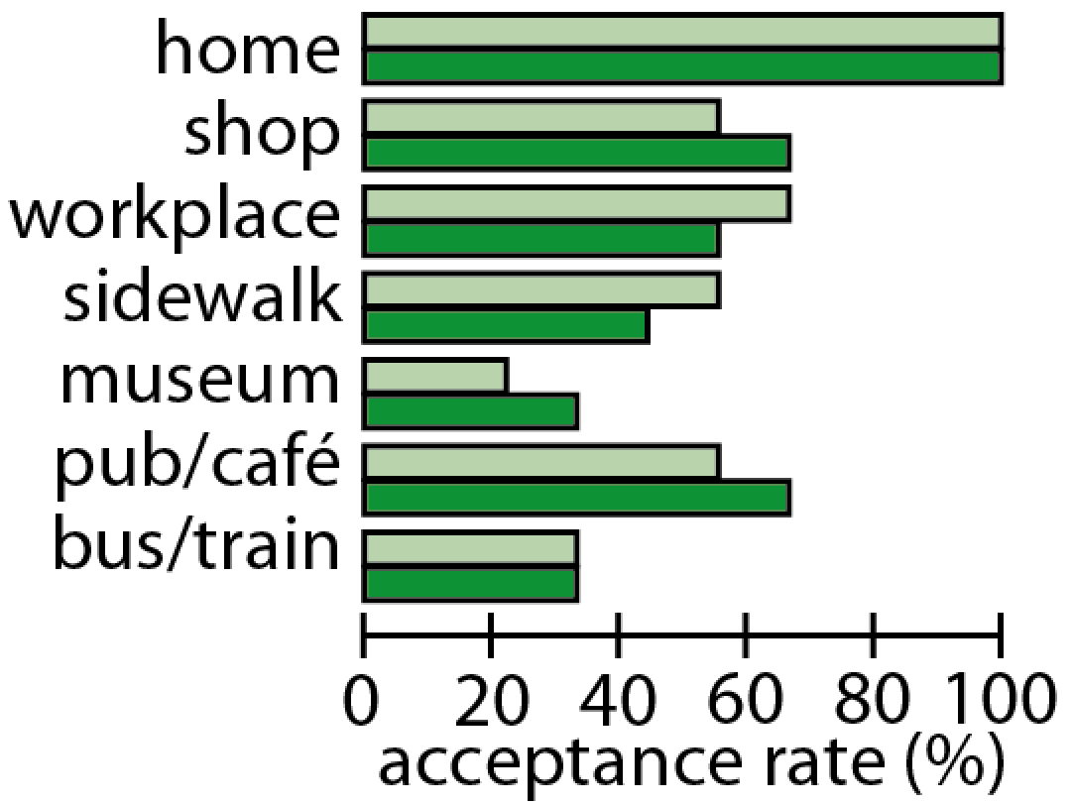
Results: Locations
31

Slide 32
Study 2
Size and Duration
32

Slide 33
Size
Small Gesture
Large Gesture
33

Slide 34
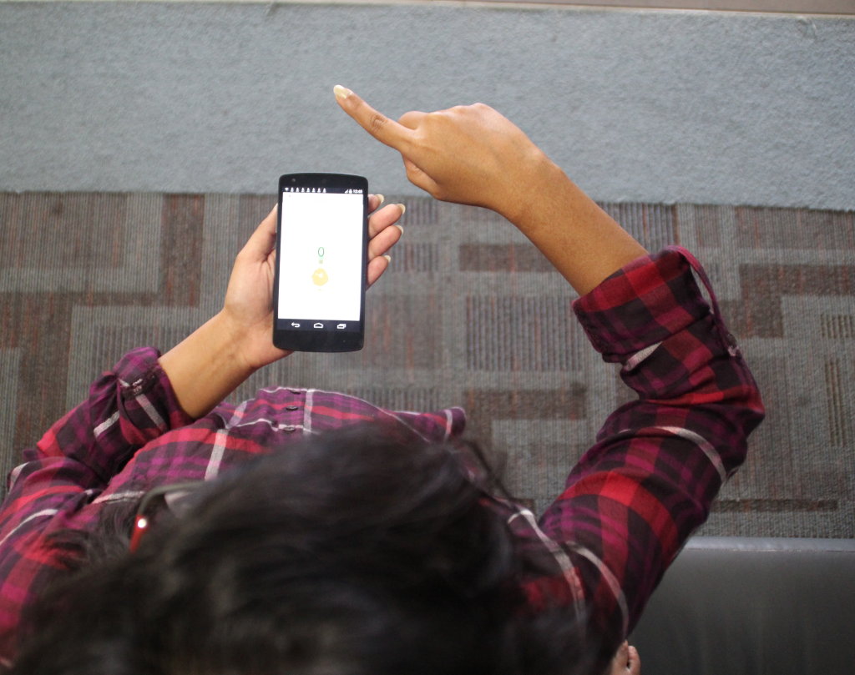



Size
Small Gesture
Large Gesture
34

Slide 35




Duration
3sec 6sec 9sec
35

Slide 36


Small
Gesture
6 Sec
Large
Gesture
9 Sec
36

Slide 37




Task Screen
37
3 Sec
Large Gesture
6 Sec
Small Gesture
6 Sec
Small Gesture
With time (ms)

Slide 38

Questionnaire
Q1. Overall Impression during such gestures
38

Slide 39

Questionnaire
Q1. Overall Impression during such gestures
39

Slide 40
Summary
Smaller gestures felt more comfortable
40

Slide 41

Summary
3sec < 6sec < 9sec gestures
41

Slide 42
Summary
Right region significantly different from others
42

Slide 43
Questionnaire
Q2. In front of whom do you think you would feel comfortable using such gestures?
Family
Partner
Alone
Friends
Colleagues
Strangers
43

Slide 44



Results: Acceptance Rate (%)
Q2. In front of whom do you think you would feel comfortable using such gestures?
Family
Partner
Alone
Friends
Colleagues
Strangers
44

Slide 45






Duration: Acceptance Rate (%)
Q2. In front of whom do you think you would feel comfortable using such gestures?
Family
Partner
Alone
Friends
Colleagues
Strangers
45

Slide 46






Size: Acceptance Rate (%)
Q2. In front of whom do you think you would feel comfortable using such gestures?
Family
Partner
Alone
Friends
Colleagues
Strangers
46

Slide 47

Results
47

Slide 48
Questionnaire
Q3. In which locations do you think you would feel comfortable using such gestures?
Home
Shop
Work place
Pub/Cafe
Side walk
Museum
Bus/Train
48

Slide 49







Results
Q3. In which locations do you think you would feel comfortable using such gestures?
Home
Shop
Work place
Pub/Cafe
Side walk
Museum
Bus/Train
49

Slide 50







Duration: Acceptance Rate (%)
Q3. In which locations do you think you would feel comfortable using such gestures?
Home
Shop
Work place
Pub/Cafe
Side walk
Museum
Bus/Train
50

Slide 51







Size: Acceptance Rate (%)
Q3. In which locations do you think you would feel comfortable using such gestures?
Home
Shop
Work place
Pub/Cafe
Side walk
Museum
Bus/Train
51

Slide 52

Results
52

Slide 53
Study 3
Spectators
53

Slide 54
Study 3 Details
24 participants/spectators
One of the authors acted
Train, café, library, restaurant, birthday party
Used images from Study 1 and “draw” digits until someone was looking
54

Slide 55

55
55

Slide 56
Questionnaire
Q1. Select one or more items from the list below:
12
12
0
1
5
1
0
2
I was wondering what you were doing
I did not think much about it
I thought it was annoying/disturbing
I thought it looked fancy / interesting
I thought "What a weird behavior"
I thought it looked stupid / strange
I thought the movements were inappropriate
I thought it looked ________ (cool idea, cool)
56

Slide 57
Questionnaire
Q2. In front of whom do you think you would feel comfortable using such gestures?
Family
Partner
Alone
Friends
Colleagues
Strangers
57

Slide 58






Results: Acceptance Rate (%)
Q2. In front of whom do you think you would feel comfortable using such gestures?
Family
Partner
Alone
Friends
Colleagues
Strangers
58

Slide 59

Results
59

Slide 60
Questionnaire
Q3. In which locations do you think you would feel comfortable using such gestures?
Home
Shop
Work place
Pub/Cafe
Side walk
Museum
Bus/Train
60

Slide 61







Results
Q3. In which locations do you think you would feel comfortable using such gestures?
Home
Shop
Work place
Pub/Cafe
Side walk
Museum
Bus/Train
61

Slide 62

Results
62

Slide 63


Study 1 vs. Study 3
Users
Spectators
63

Slide 64


Study 1 vs. Study 3
Users
Spectators
64

Slide 65
Design Recommendations
Distance: close to device, more acceptable
Distance: no further than 30cm from device “socially awkward” (proximity: “intimate space”)

Slide 66
Design Recommendations
Input region: consider handedness, better ratings for gestures to the right of the smartphone for right-handed users
Input region: above, below, and left are OK if no further than 30cm away from the device

Slide 67
Design Recommendations
Size: smaller the better, 15x15cm might be the threshold for acceptable public gestures
Duration: critical! Acceptance drops markedly after 6sec
Clear interplay between properties

Slide 68
Methodology
Need to define “acceptability-continuum”
Breaking gestures into micro-properties
e.g., size, duration, location
Observe vs. first-hand experience
Linkages between personality traits and user perception
68

Slide 69
Are You Comfortable Doing That?: Acceptance Studies of Around-Device Gestures in and for Public Settings
David Ahlström, Khalad Hasan, Pourang Irani
Thank you

