Slide 1
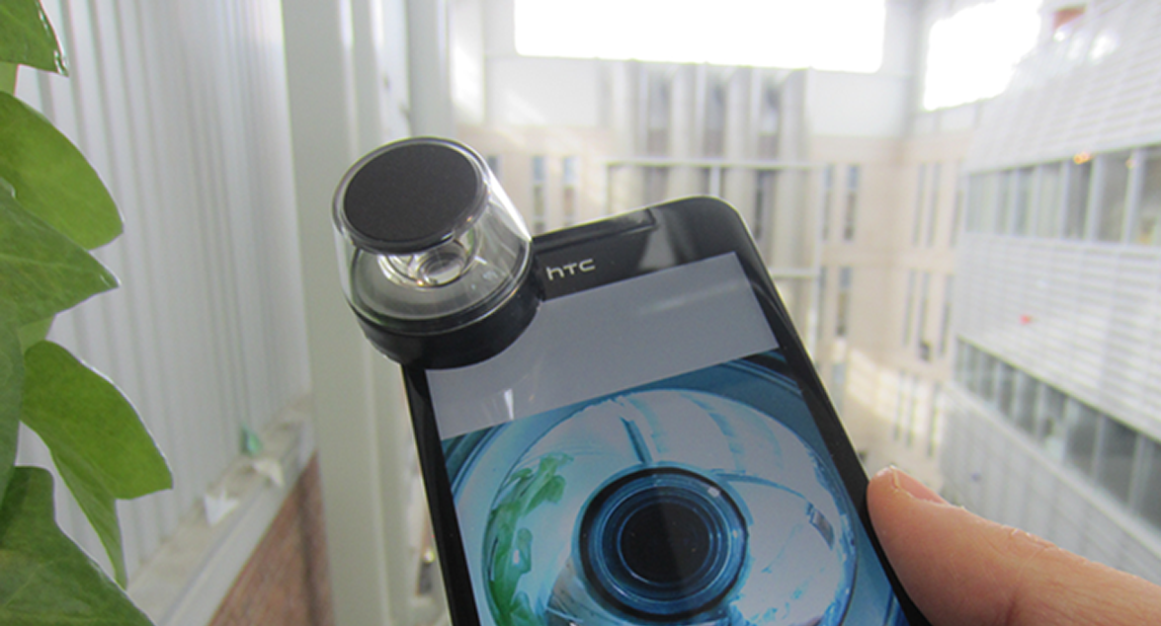


SURROUND-SEE
ENABLING PERIPHERAL VISION ON SMARTPHONES DURING ACTIVE USE
XING-DONG YANG
KHALAD HASAN
NEIL BRUCE
POURANG IRANI
Notes:
Thanks Tom.
My name is xingdong yang and I am a new graduate from uofa, canada.
I am gonna talk about surround-see project.
This project was collaborated with my colleagues …

Slide 2
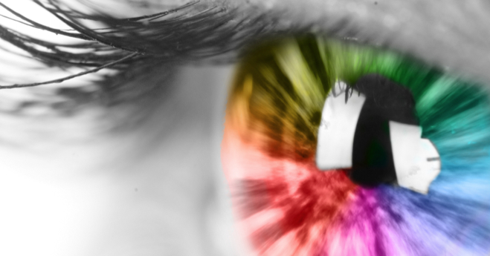
2
Notes:
Human vision is key cognitive element. It gives us ability to navigate, see our surroundings and act accordingly.

Slide 3
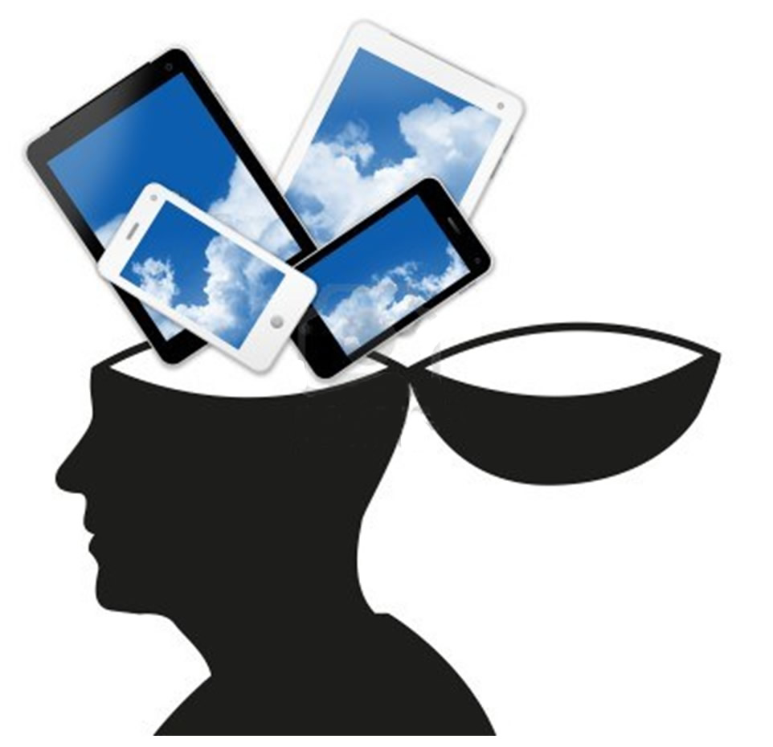
3

Slide 4
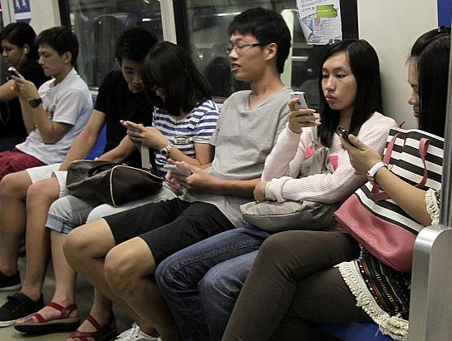
PEOPLE REALLY LIKE
MOBILE PHONES
4

Slide 5
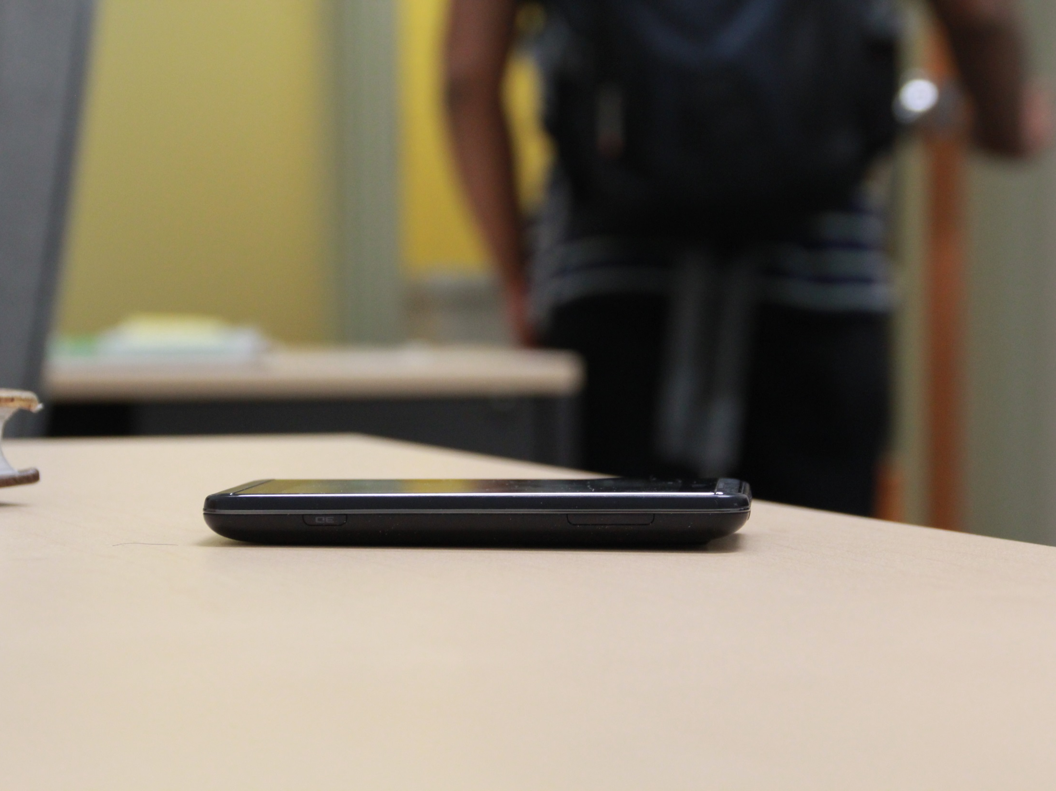
FORGET YOUR PHONE?
5
Notes:
I think most people have smartphone. We like those devices because they are small, they are portable, and they are very smart. But as a user, we do make mistakes or forget things, e.g. mute their phones in a quite classroom or forgot to take their phone with them and leave it on the table of a coffee shop

Slide 6
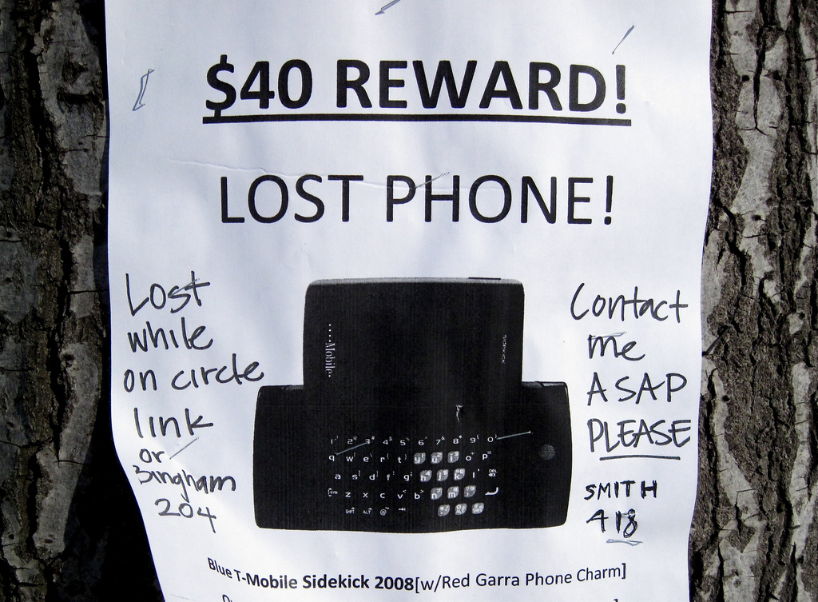
6
Notes:
When it happens, this doesnot seem like a very useful way to find your phone

Slide 7
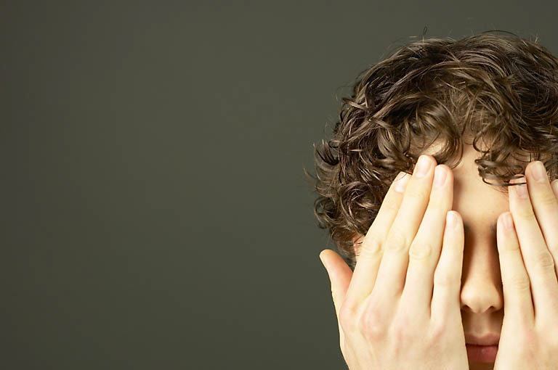
7
Notes:
For one with vision, it can be difficult to imagine what may or may not be possible without.

Slide 8
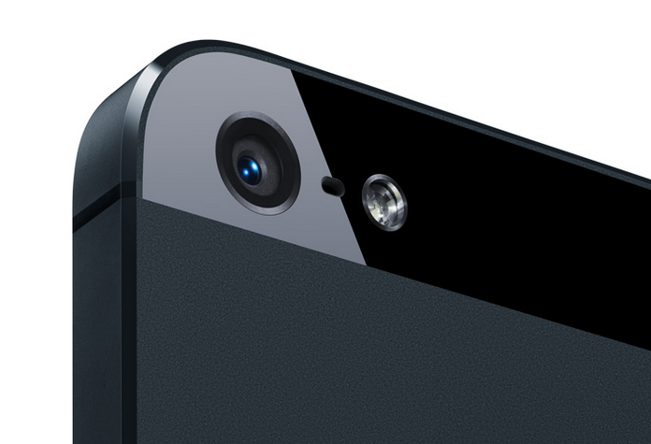
WHAT ABOUT THE
BUILT-IN CAMERAS?
8
Notes:
Today’s smartphones have come a long way to sense actions, but have very limited ‘seeing’ capabilities. The front and back cameras are the main means by which a smartphone can ‘see’. But during active use, this is not very useful.

Slide 9
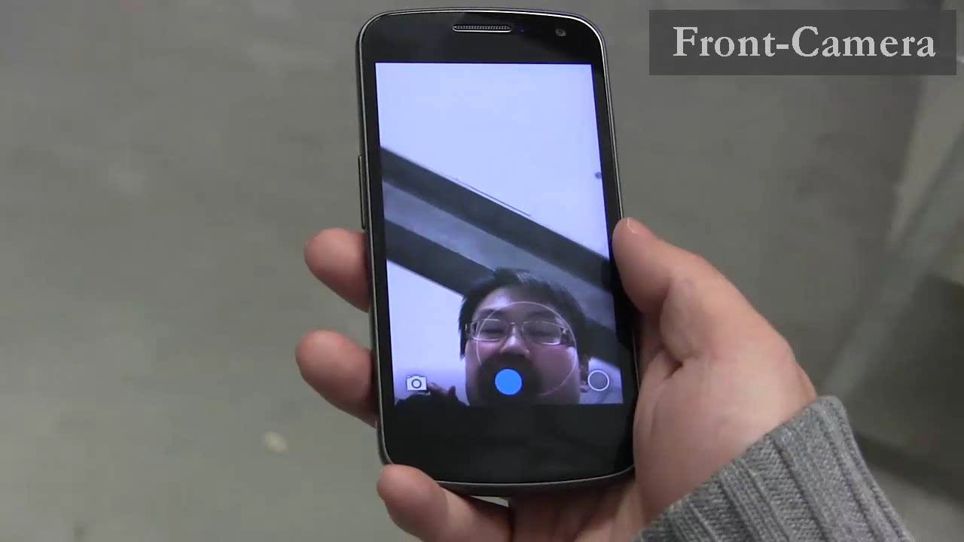
FRONT AND BACK CAMERAS ARE LIMITED
9
Notes:
Unfortunately, during active use, their use is limited. The front and back camera faces the sky and the ground do not provide the device a peripheral vision of its surrounding location.

Slide 10
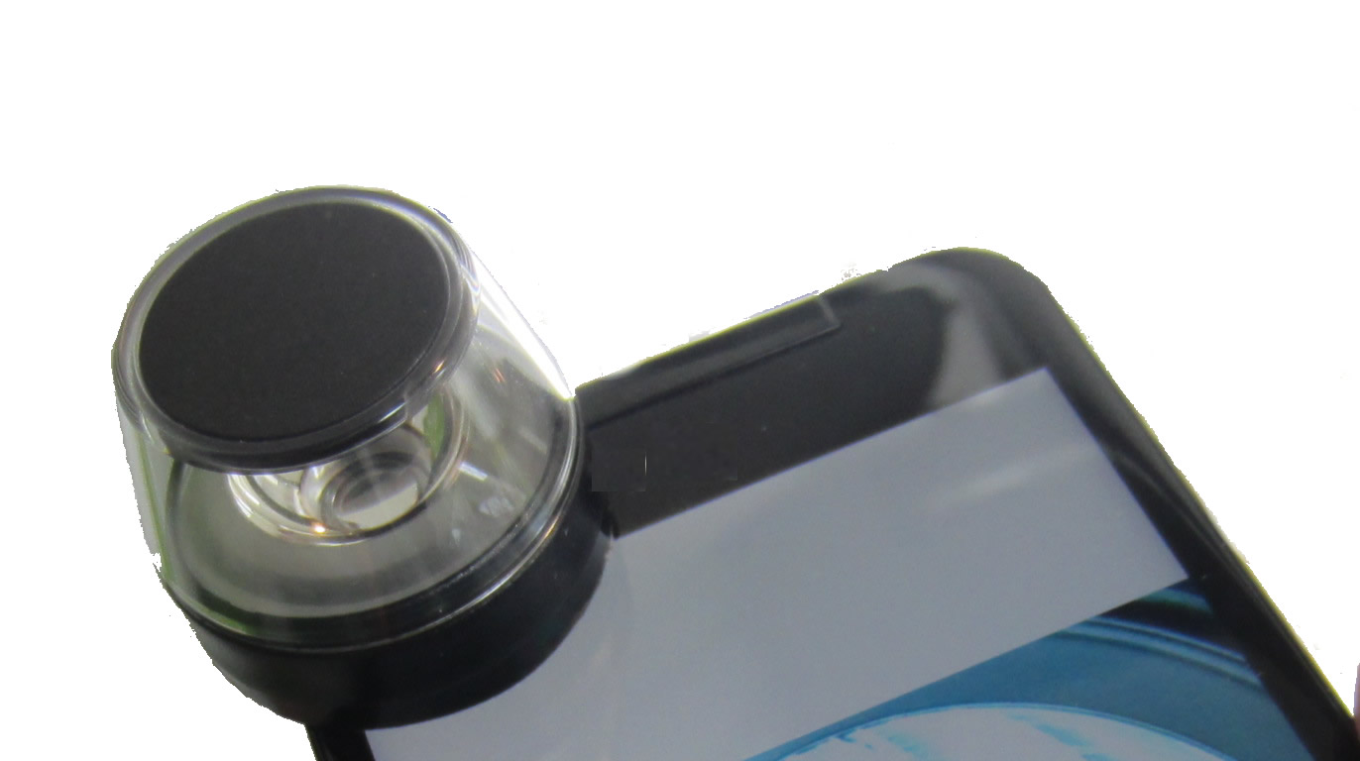
WHAT IS POSSIBLE IF MOBILES CAN
SEE
THEIR SURROUNDINGS?
10
Notes:
We explore this main question. What is possible if our mobiles can ‘see’ their surroundings.

Slide 11
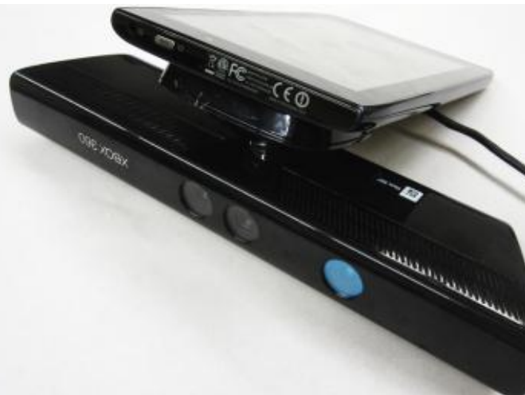
CRASHALERT
[HINCAPIÉ-RAMOS & IRANI 2013]
11
Notes:
This approach has been proposed, but for limited use.
CrashAlert is the first mobile device that opens a third eye for the user. It looks for the incoming obstacles and alerts the user when the user is walking and his attention is on the screen of the mobile device.
However, this device was shown to be useful for safer walking and does not provide alternative methods for vision.

Slide 12
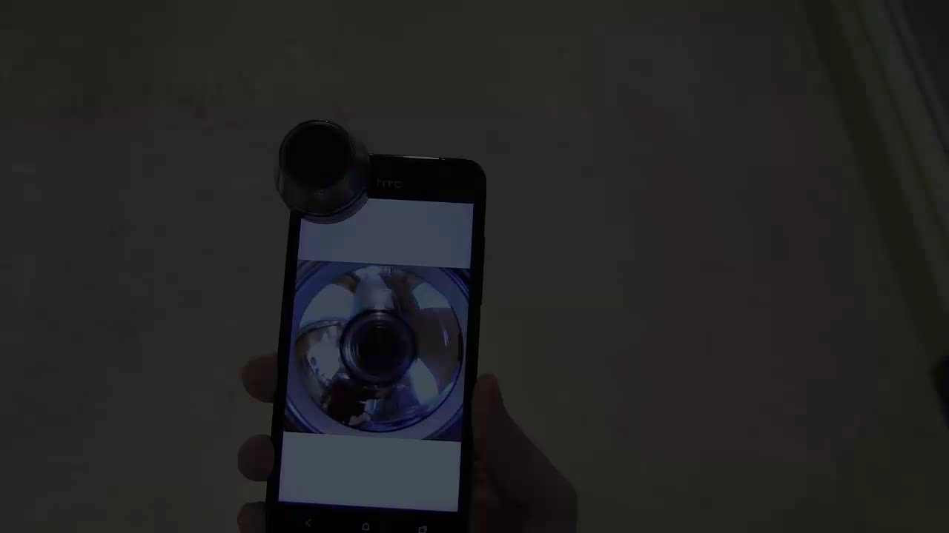
12
Notes:
So we created a self-contained prototype – surround-see.
A smartphone that can see and react to events happening in its surroundings.
Surround-see augments the built-in camera of a smartphone with an omni-directional lens. this allows the phone to see the entire 360 degree horizontal space in its periphery.

Slide 13
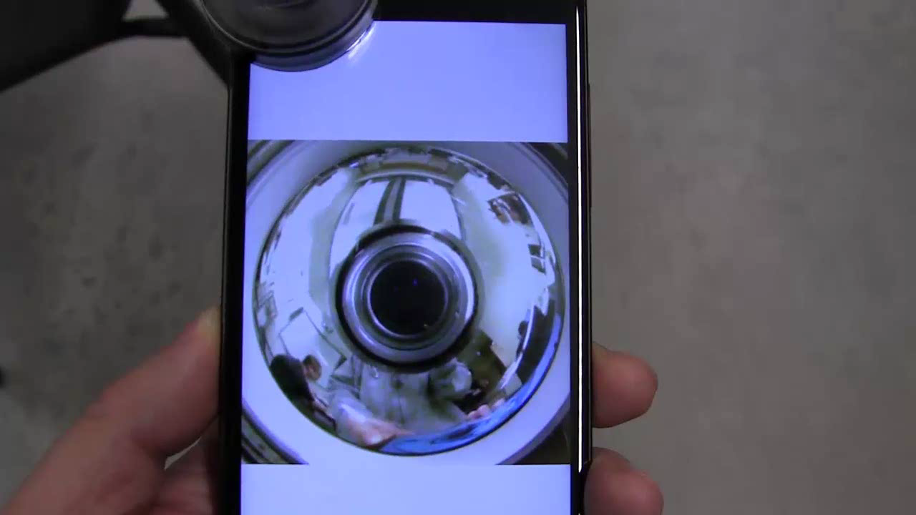
OMNI-DIRECTIONAL LENS
13
Notes:
this donnut shaped image is the omni-direction image seen by the surround-see when I was walking in our lab.

Slide 14
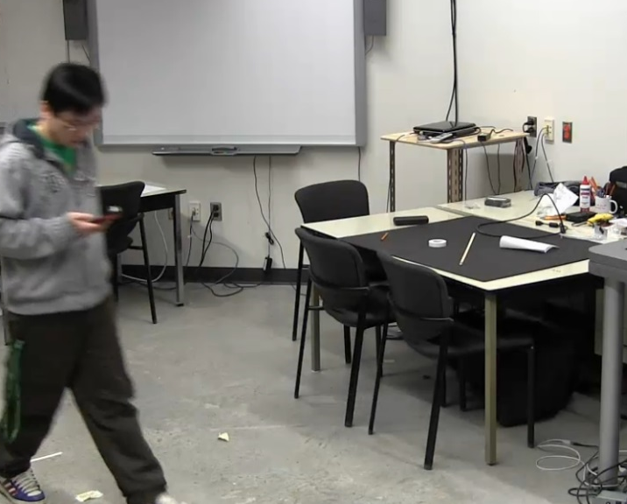
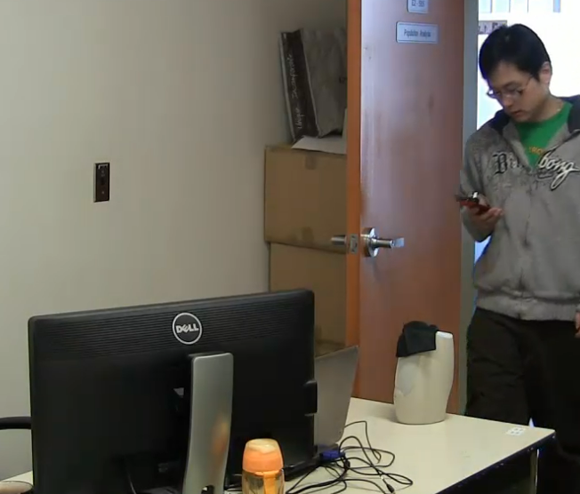
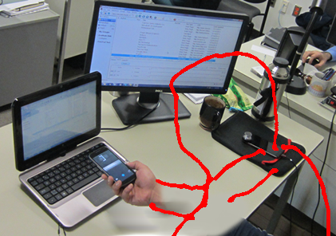
CAPABILITIES
1
RECOGNIZING THE DEVICE’S PERIPHERAL ENVIRONMENT
14
Notes:
Here I am gonna show you three primary (major) capabilities we implemented with surround-see and then present the major interaction techniques possible.
The first requirement to make a smartphone ‘see’ is to allow it to recognize it’s peripheral environment

Slide 15

RECOGNIZING THE DEVICE’S PERIPHERAL ENVIRONMENT
15
Notes:
With this capability surround-see can recognize its location such as the room it is in
It can also recognize the specific location in that room such as the user’s desk.
Which is not possible with popular gps system

Slide 16
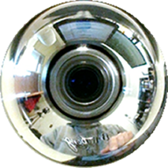
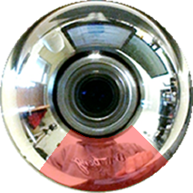

UNWRAP
SVM
16
Notes:
So how do we make this happen?
We first unwrapped the omni-directional image to a panoramic image.
the user’s body was removed from the panoramic image.
We then use the panoramic image to train a machine learning classifier. Here we use support vector machine.
Once trained with a significant number of samples, the classifier can be used to recognize locations.

Slide 17
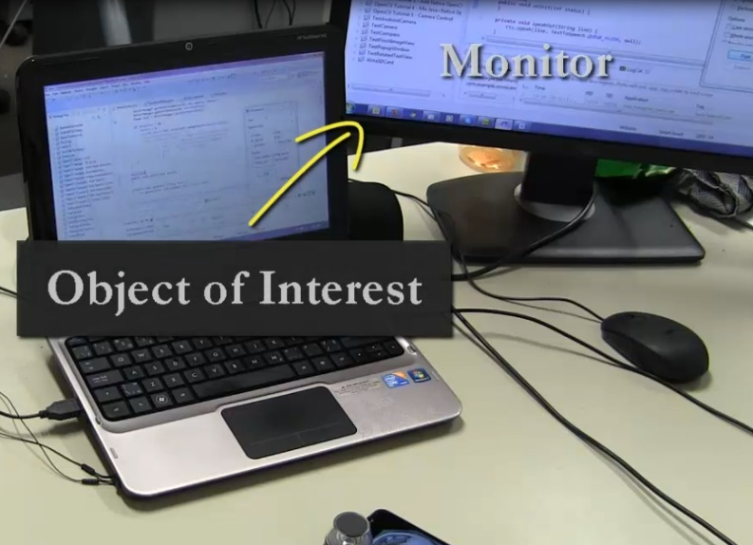
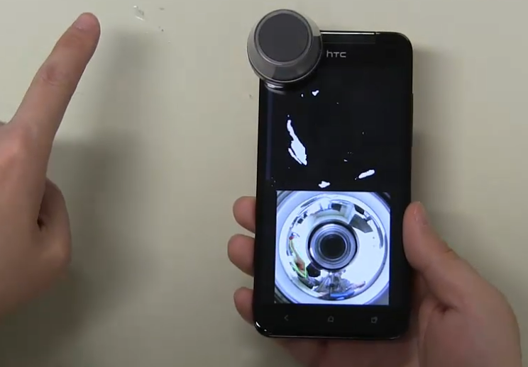
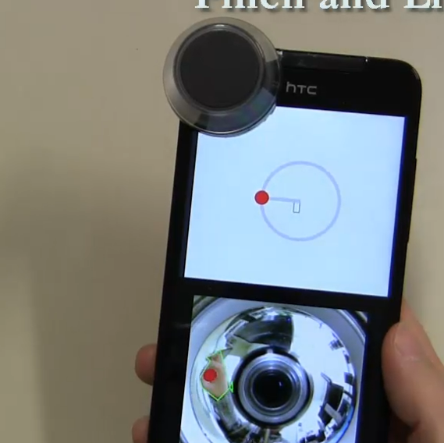
CAPABILITIES
2
RECOGNIZING PERIPHERAL ITEMS
17
Notes:
The next capability for ‘seeing’ is to allow the device to recognize specific items in its surroundings

Slide 18
RECOGNIZING AN OBJECT
18
Notes:
As you can see from this video here, surround-see can recognize objects, such as the monitor on user’s desk
Object recognition was implemented using feature point matching using the ORB algorithm. Alternatively, a more robust TLD algorithm can be used.

Slide 19
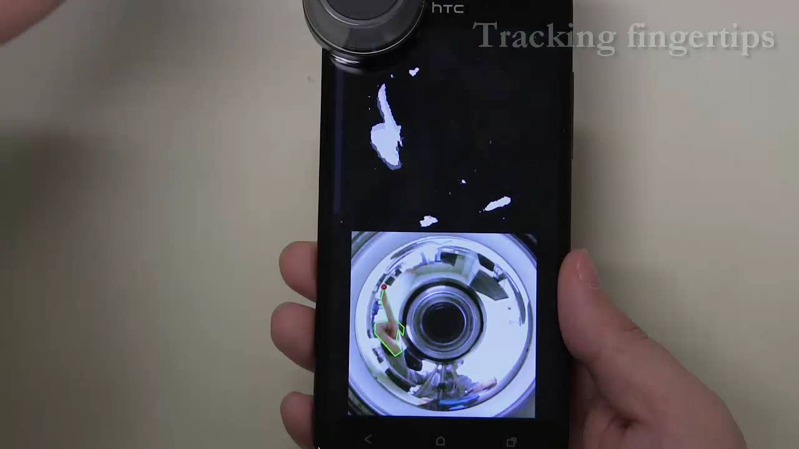
RECOGNIZING THE USER’S HAND
19
Notes:
Surround-see can track user’s finger movement around the phone.
It can detect pinch and lift gestures

Slide 20

HAND POSTURES
20
Notes:
Surround-see can also recognize simple hand postures based on the number of detected finger tips.
Hand detection was implemented using a skin color model. The user’s hand was detected by looking for blobs that are larger than a threshold size.
The user’s fingertips were detected by searching through the contour points, and identifying those with a curvature less than a threshold value

Slide 21
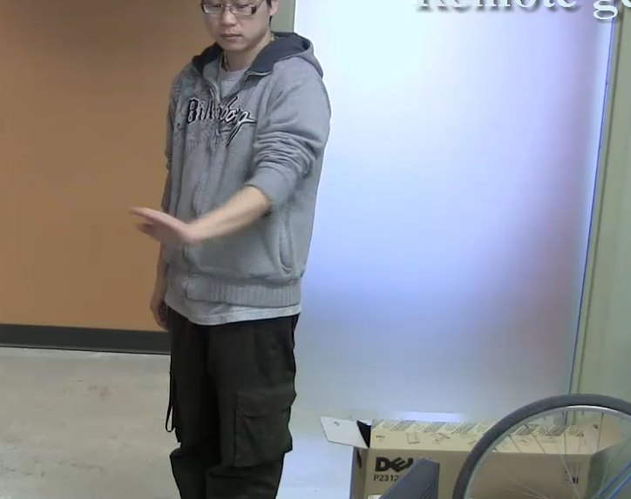
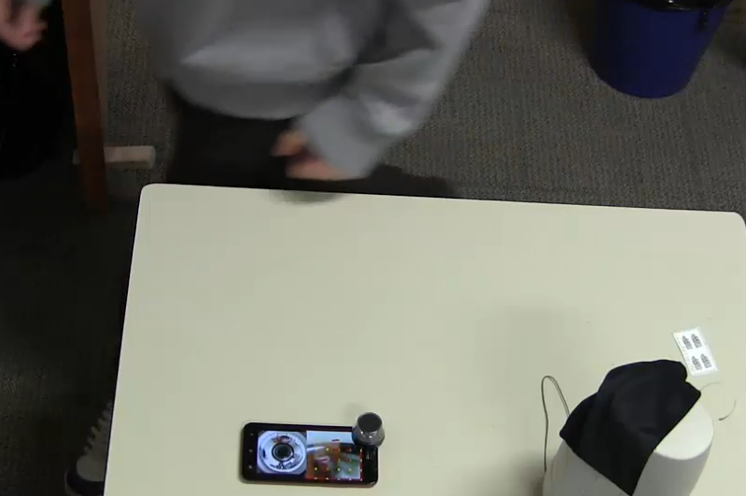
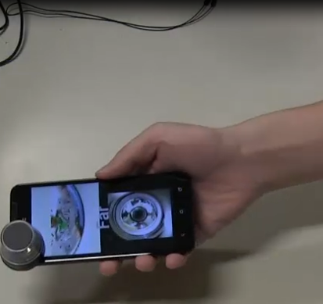
CAPABILITIES
3
DETECTING USER ACTIVITIES
IN THE PERIPHERY
21
Notes:
Finally, the system is capable to detect different peripheral activities in the phone’s vicinity.

Slide 22
REMOTE GESTURING
22
Notes:
It understand the user’s hand wave when the user is not at the desk.
Here we use background subtraction to remove any skin-color noise in the background.

Slide 23
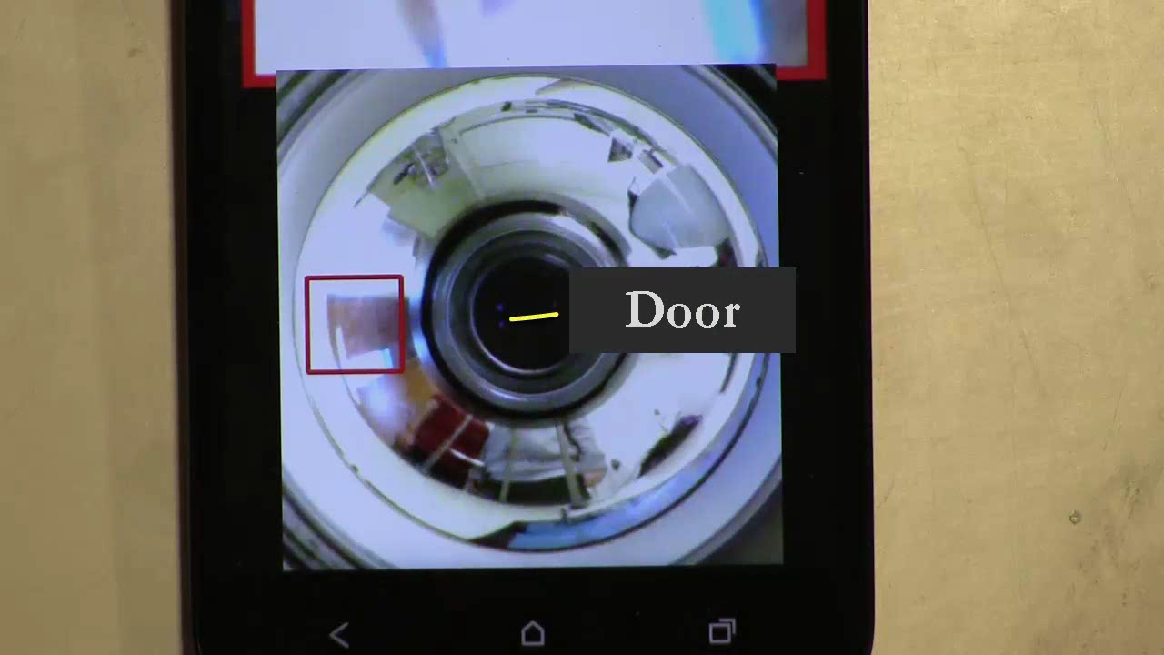
TRACKING REGION OF INTEREST (ROI)
23
Notes:
surround-see can be configured to focus its attention on a particular region such as the door.
Tracking the region of interest is independent of the orientation of the phone.
Lets watch that again

Slide 24
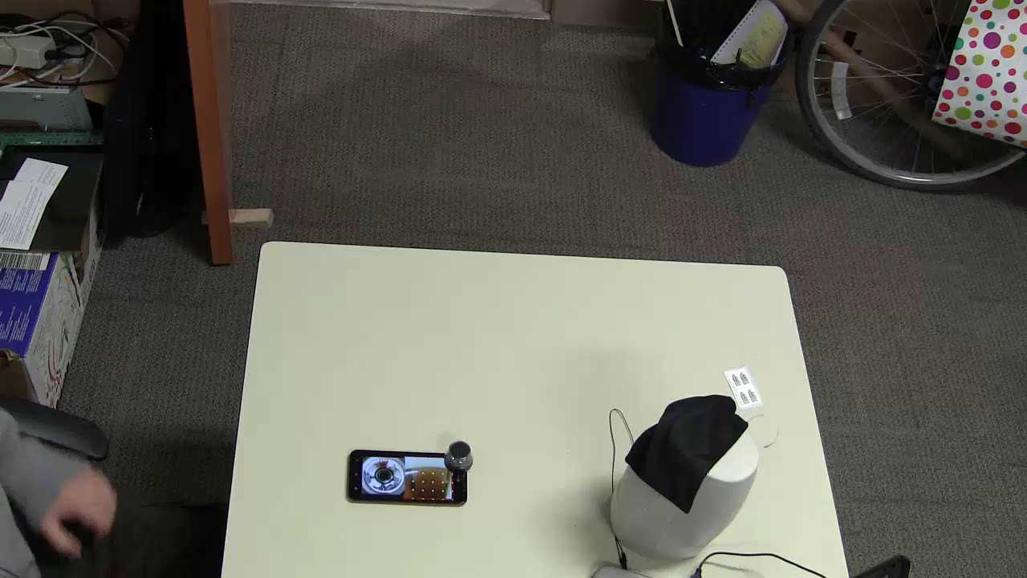
DETECTING USER ACTIVITY WITHIN A ROI
24
Notes:
This way, it knows when the user leaves the desk without taking it with him and when he comes back.
Motion detection was implemented using optical flow

Slide 25
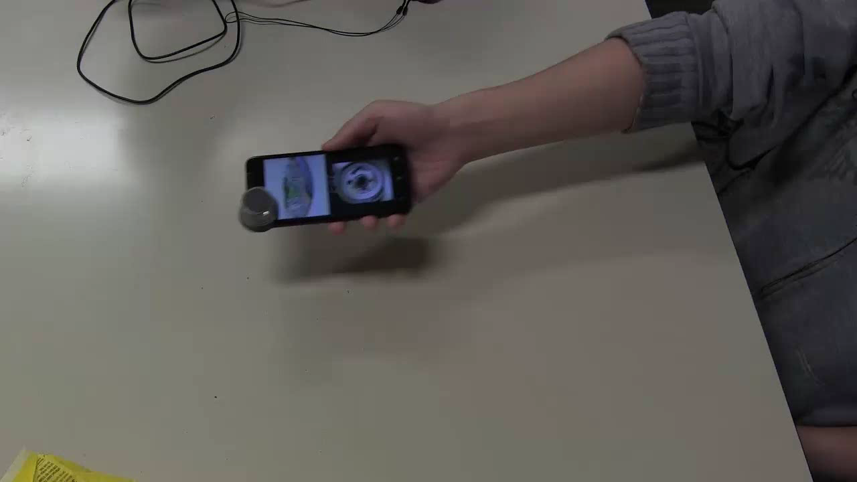
PROXIMITY TO USER
25
Notes:
Similarly, it knows whether it is far or near to the user.

Slide 26
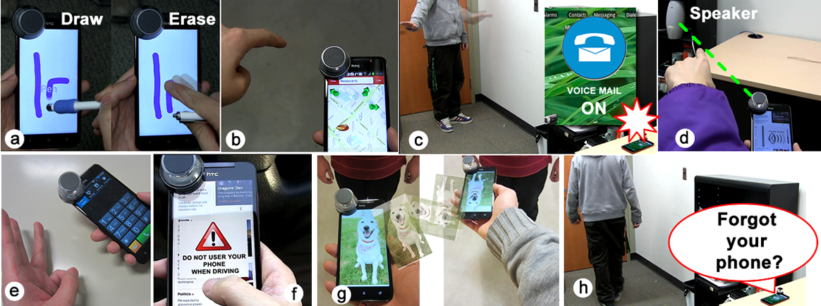
SURROUND-SEE
INTERACTIONS
26
Notes:
We have developed a variety of interaction technique with surround-see.
Now I am gonna show you how surround-see can be used in our daily activities.
Here im gonna use a story to demonstrate

Slide 27
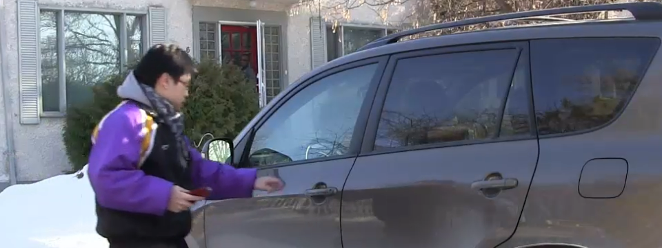
1
LOCATION-BASED
NOTIFICATIONS
27
Notes:
First one is location based messaging.

Slide 28
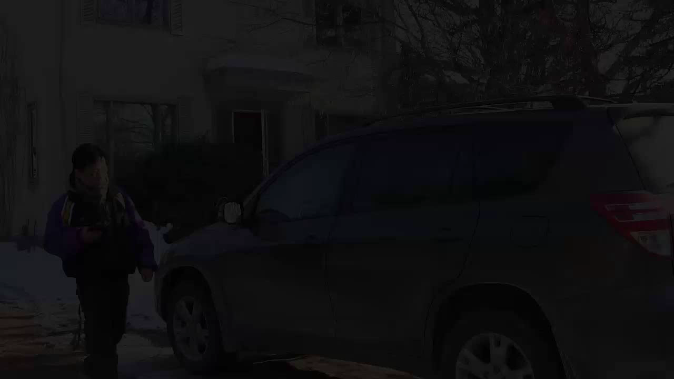
28
Notes:
In the morning, the user jumps into his car and begins browsing news before starting his vehicle.
Surround-see notices this and shows a warning message.

Slide 29
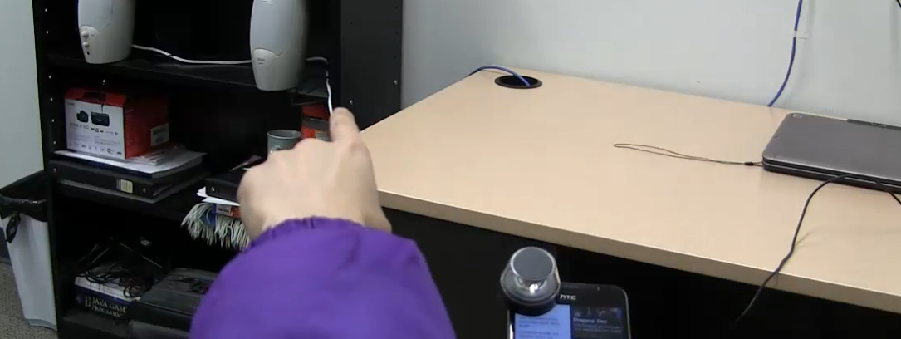
2
CONTROLLING
REMOTE OBJECTS
29

Slide 30
30
Notes:
When he comes to the office, he decides to turn on his speaker by pointing at them and increases the music volume to wake himself up.
He can use pinch gesture to reduce the volume.

Slide 31
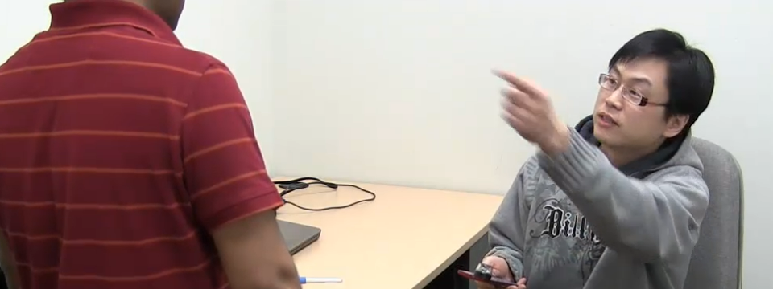
3
PROXIMITY-BASED
SCREEN ROTATION
31

Slide 32

32
Notes:
Later a colleague enters his office and asks about his weekend.
The user shows him a picture that he took on the weekend with his mobile and surround-see re-orients the image as the device is positioned closer to his colleague.

Slide 33
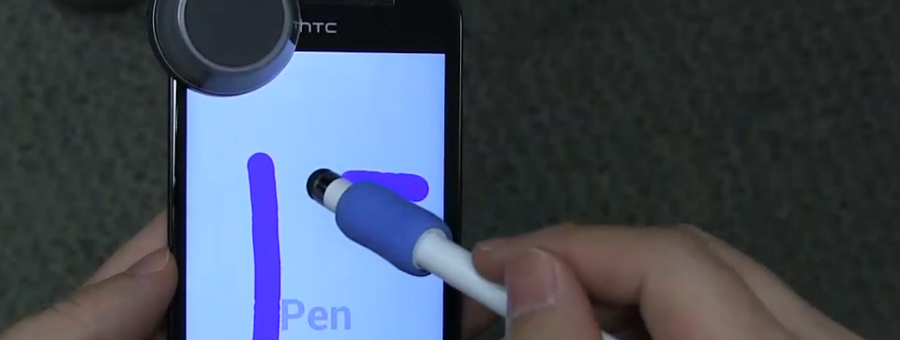
4
PEN VS. TOUCH
33

Slide 34
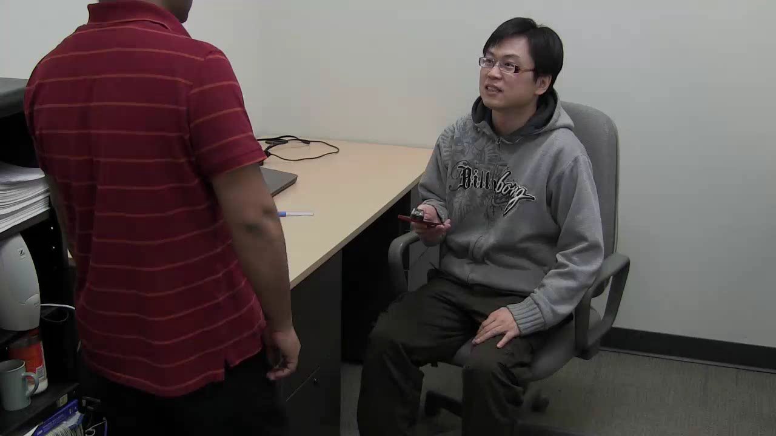
34
Notes:
Later his colleague asks him about a location and he draws the map using a pen.
The pen is distinguish from the user’s finger, which is used for erasing.
Note that the user did not have to switch modes to distinguish different input devices.

Slide 35
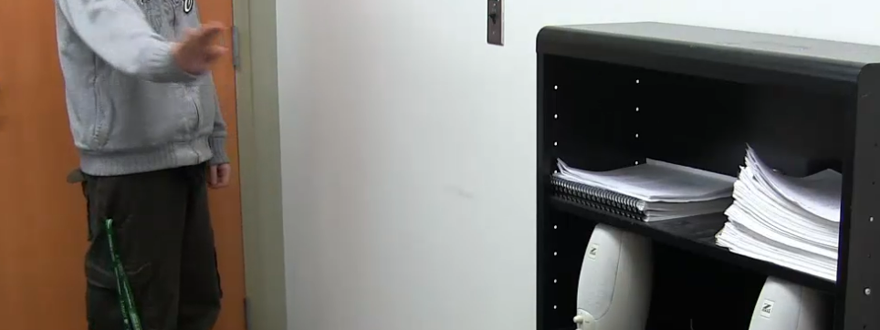
5-6
NOTIFY TO TAKE THE PHONE
...
REMOTE OPERATION
35

Slide 36

36
Notes:
He then decides to leave but for only a few minutes.
Surround-see asks if he wishes to take his mobile with him.
He gestures to the device remotely so his phone enters voice mail mode.

Slide 37
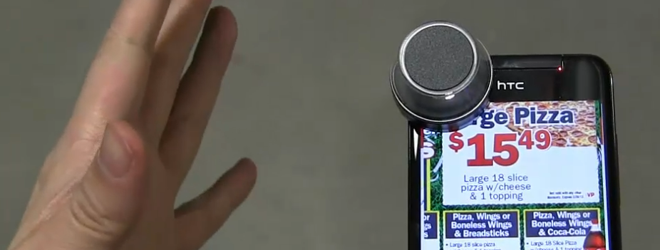
7-8
OFF-SCREEN POINTING
…
POSTURE FOR SPEED-DIALING
37

Slide 38
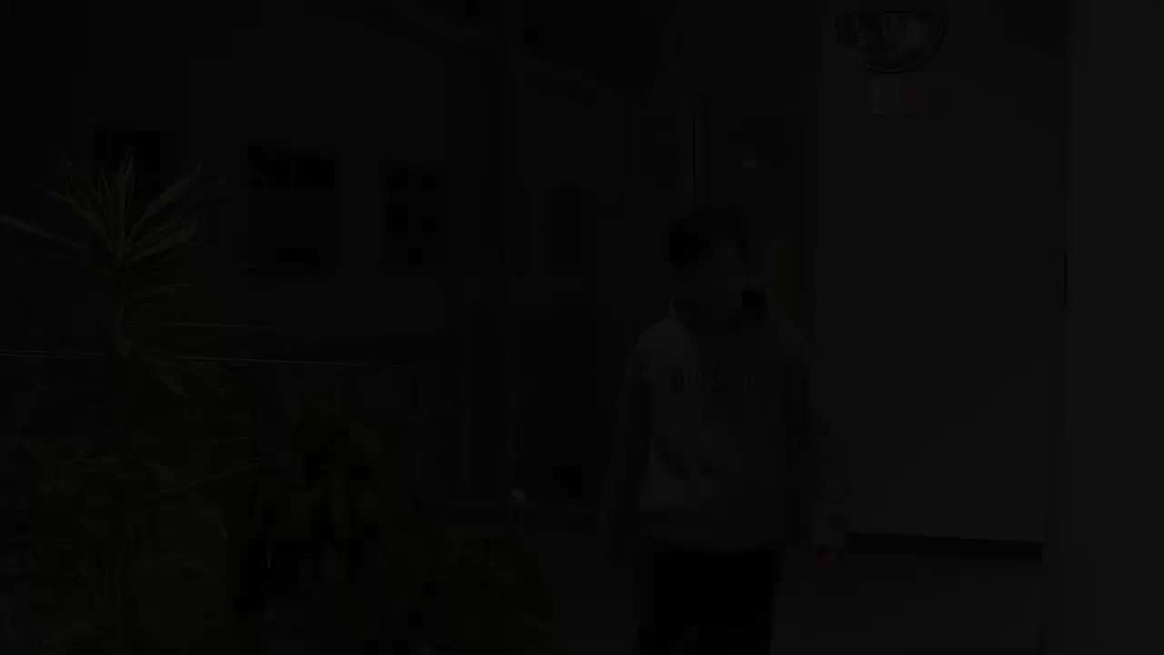
38
Notes:
Later in the day, he decides to grab dinner at a take out.
He recalls it being in the north west of his office and he points in mid air to the approximate location which opens up a coupon for it
Then he issues a hand posture which speed dials the restaurant.

Slide 39
ELICITING
USER FEEDBACK
39
Notes:
So we conducted a survey to assess primarily whether users feel comfortable about having smartphones in their environment ‘see’. There are issues of privacy and comfort that need to be considered. We therefore asked users to rank how comfortable they would feel with the various interaction techniques and capabilities of Surround-See.

Slide 40
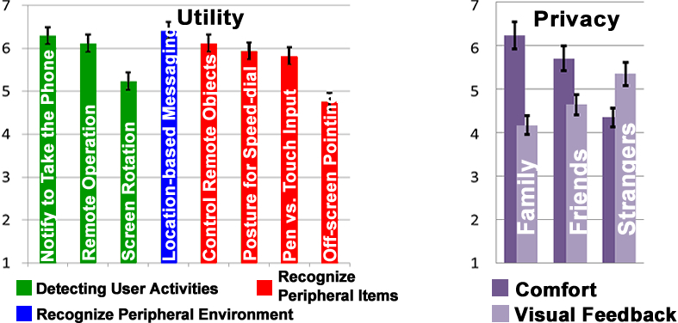
Notes:
PUT A BETTER VERSION OF IMAGE
SAY THE MAIN RESULTS HERE

Slide 41
NOTIFY TO TAKE THE PHONE
REMOTE OPERATION
SCREEN ROTATION
LOCATION-BASED MESSAGING
CONTROL REMOTE OBJECTS
POSTURE FOR SPEED-DIALING
PEN VS. TOUCH INPUT
OFF-SCREEN POINTING
TECHNIQUES
41
Notes:
And we asked them to rate these 8 interactions techniques that was just shown

Slide 42
NOTIFY TO TAKE THE PHONE
REMOTE OPERATION
SCREEN ROTATION
LOCATION-BASED MESSAGING
CONTROL REMOTE OBJECTS
POSTURE FOR SPEED-DIAL
PEN VS. TOUCH INPUT
OFF-SCREEN POINTING
6
SCORE
HIGHEST = 7
42
Notes:
Overall, participants welcomed the idea of mobile seeing.
These 4 features were ranked amongst the highest with an average score higher than 6.
They mostly like the intelligent features (Notify to Take the Phone and Location-based Messaging) features to support remote operations (Controlling Remote Objects and Remote Operation).

Slide 43
LOCATION-BASED MESSAGING
“I always forgot to mute my phone”
“It could take control,
when you forget to do something”
43
Notes:
We also got insightful comments from users.
Participants commented that they always forgot to mute their phone and
another commented that Location-based Messaging is a useful feature because “it could take control, when you forget to do something”.

Slide 44
REMOTE OPERATION
“I always leave the phone away
and
need to return briefly only to set it”
44
Notes:
A participant commented that Remote Operation is “good because most of the time I leave the phone away and need to return briefly only to set it”.

Slide 45
USERS WANT TO CONTROL THEIR SMARTPHONES EVEN AT A DISTANCE
45
Notes:
So I think it is a quite promising feedback from the users.
One insight is even when users are not holding the
The results of this survey indicate what is missing in the current smartphone usage, one of which is remote operation
One of which is remote operation and this raise question of is touchscreen a limit for mobile interaction?

Slide 46
CONCLUSION
CONCEPT OF MOBILE SEEING
THIS SUPPORTED BY 3 CAPABILITIES
NEW INTERACTIONS NOT SUPPORTED BY THE CURRENT MOBILE USAGE
2 MAJOR INSIGHTS
46
Notes:
We presented and introduce the concept of letting our mobiles ‘see’ their surroundings during active use
For this, we showed that 3 Capabilities can lead to a good number of Novel Interactions not supported on current mobile devices
We also identified two major insights if this were to be introduced: - users would feel comfortable, but only in certain cases [list the one or two briefly] and that users want to interact with their devices, even remotel.

Slide 47
LIMITATIONS
WIDER FIELD-OF-VIEW
USER RECOGNITION
FORM FACTOR
47
Notes:
[Discuss these limitations]
We are identifying methods to extend surround-see to resolve these limitations.

Slide 48
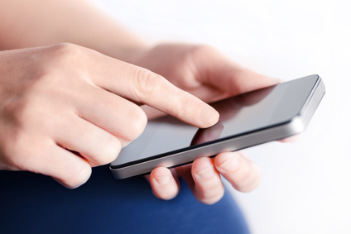
IS TOUCH-BASED INTERACTION
A LIMIT?
48

Slide 49
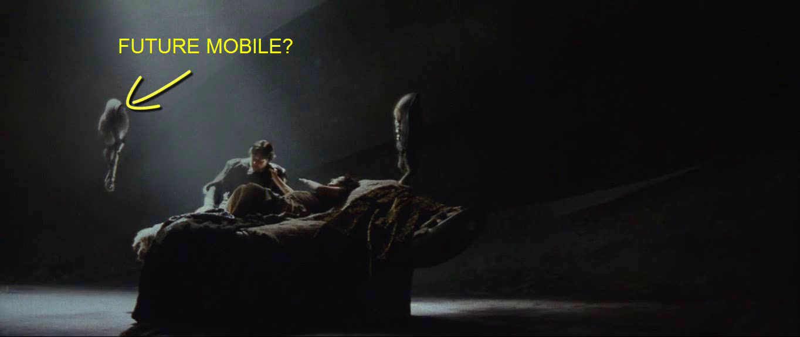
WHAT IS NEXT?
49
Notes:
The purpose of this work is to open some space for us to think about what future mobile interaction would be like
Would future mobile be like a flying robot like the one?
It can also follow people around.
So the future is in our hand and is up to us to create

Slide 50
END
Notes:
So here it comes to the end of this talk.
Thanks for listening!

Slide 51
QUESTIONS?
XING-DONG YANG
xingdong@ualberta.ca
Notes:
So here it comes to the end of this talk.
Thanks for listening!

