Slide 1

Enabling User Interactions with Video Contents
Khalad Hasan, Yang Wang, Wing Kwong and Pourang Irani

Slide 2


2
Motion Control

Slide 3


3
End Call
Voice Control

Slide 4
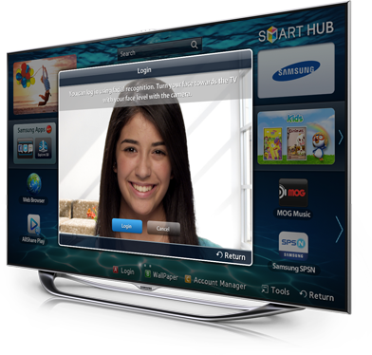
4
Face Recognition

Slide 5
5
Gaps
  Interaction with video contents
  Suitable querying and interface component
  Selection technique
Motivation

Slide 6
6
Gaps
  Interaction with video contents
  Suitable querying and interface component
  Selection technique
Motivation

Slide 7
7
Computer Vision
  Comparison among state-of-art algorithms
  Apply best algorithm to extract objects
HCI
  Interaction with video contents
  Techniques for selection
Contribution

Slide 8
8
Object
Detection & Tracking

Slide 9
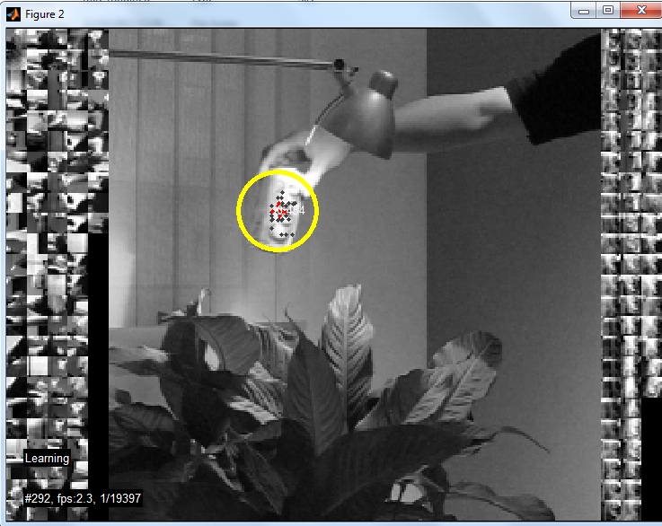
9
Datasets: http://vision.ucsd.edu/~bbabenko/project_miltrack.shtml
Tracking-Learning-Detection (TLD): Kalal et al.

Slide 10
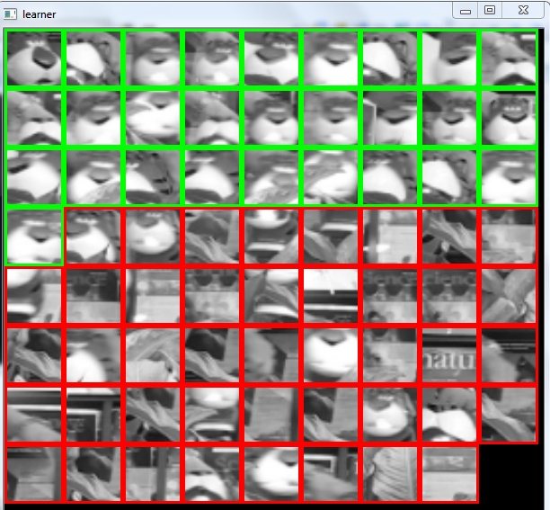
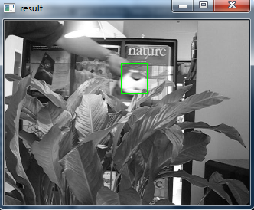
10
Struck: Hare et al.

Slide 11
11
 | Struck | TLD | Struck | TLD
 | Time(sec) | Time(sec) | Frame/Sec | Frame/Sec
Coke | 251 | 47 | 1.16 | 6.21
Girl | 401 | 93 | 1.32 | 5.69
Tiger1 | 394 | 53 | 0.90 | 6.68
Tiger2 | 334 | 62 | 1.09 | 5.89
Average | 345.00 | 63.75 | 1.12 | 6.12
Speed Comparison

Slide 12
12
 | TLD | Struck
Coke | 0.94 | 0.69
Girl | 0.93 | 0.80
Tiger1 | 0.86 | 0.77
Tiger2 | 0.79 | 0.63
Average | 0.88 | 0.72
Precision

Slide 13
13
Interactions

Slide 14
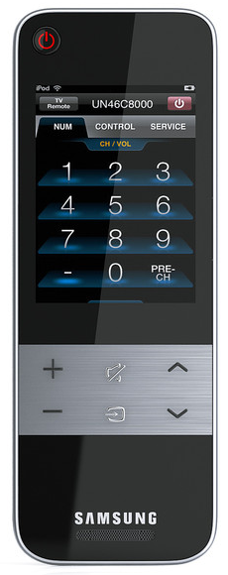
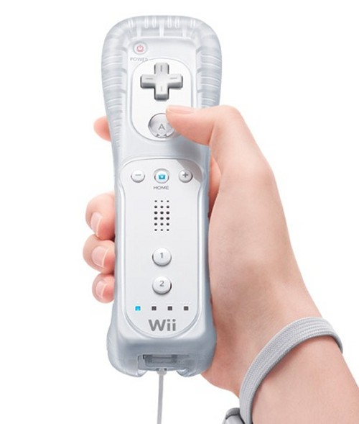
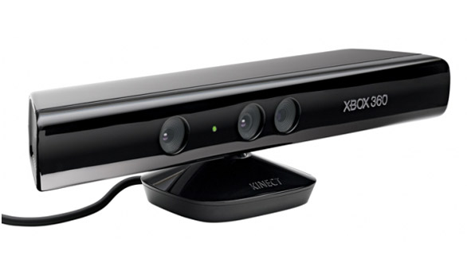
14
Input Device

Slide 15
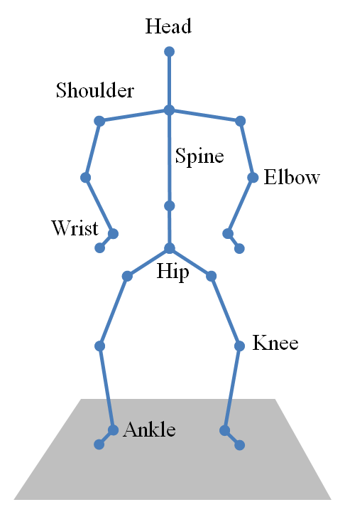
15
Kinect Input

Slide 16
  Target
Static Target Selection

Slide 17
Moving Target Selection

Slide 18
18
  Left-hand with Basic
  Left-hand with Ghost
  Left-hand with Crossing
  Depth with Basic
  Depth with Ghost
  Depth with Crossing
Selection Techniques

Slide 19
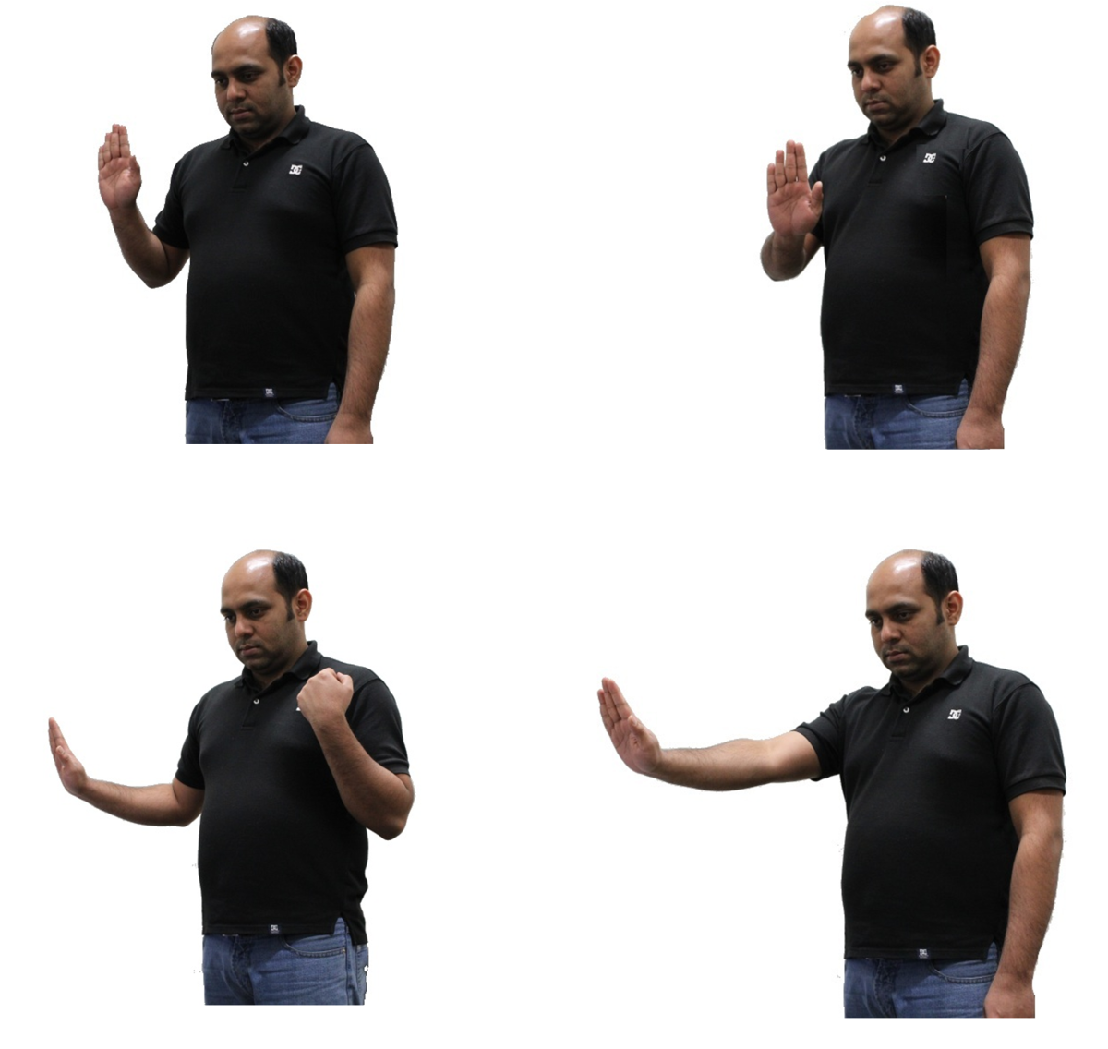
19
  Left-hand with Basic
Selection Techniques

Slide 20
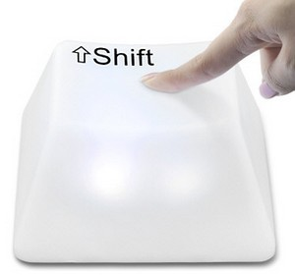
Action
Target Ghost (Khalad et al. CHI 2011)

Slide 21
21
  Left-hand with Ghost
Selection Techniques

Slide 22
22
  Left-hand with Crossing
Selection Techniques

Slide 23
23
Selection
  Left-hand
  Depth
Selection Techniques

Slide 24
24
Task Completion Time (ms)
6,000 ―
4,000 ―
2,000 ―
0 ―
Left-hand
Depth
Basic Ghost Crossing
Technique
Results

Slide 25
25
Average Number of Attempts
2.0 ―
1.5 ―
1.0 ―
0.5―
0 ―
Left-hand
Depth
Basic Ghost Crossing
Technique
Results

Slide 26

26

Slide 27
27
  TLD is faster & accurate
  Both hands for Kinect based interactions
  Selection is best achieved with static proxies
Take-Home

Slide 28
28
Computer Vision
  Multiple tracked objects
  Online detection & tracking
HCI
  Selection Techniques
  New form of interactions with Kinect
Future work

Slide 29
Thank you

