Slide 1


AD-Binning:
Leveraging Around-Device Space for Storing, Browsing and Retrieving Mobile Device Content
Khalad Hasan, David Ahlström, Pourang Irani

Slide 2
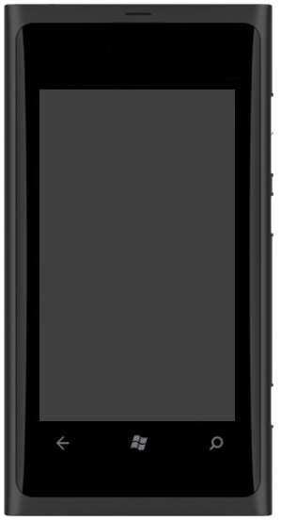


Motivation
40% users
60% users
27.8 billion more queries than on
desktops by 2016
Source: http://www.digby.com/mobile-statistics/
2

Slide 3
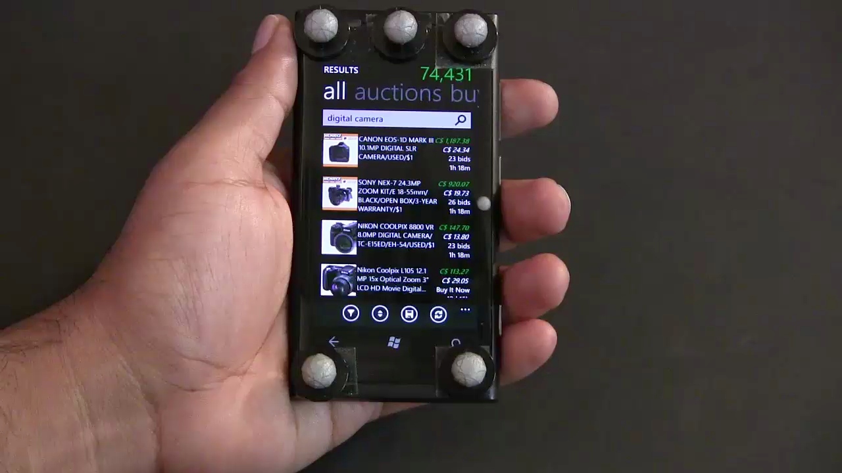
Motivation
3

Slide 4
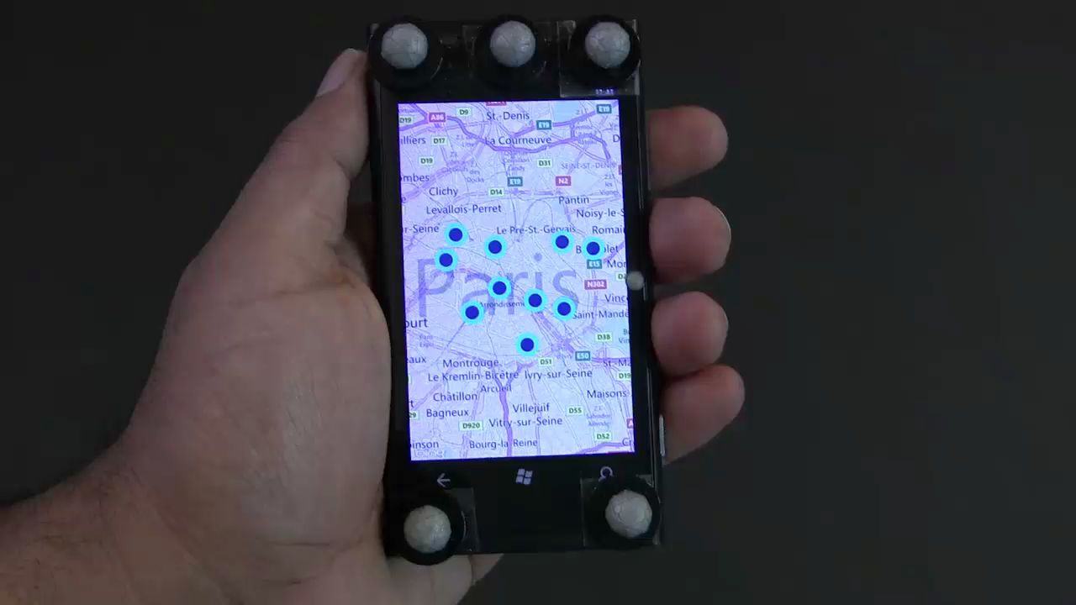
Motivation
4

Slide 5
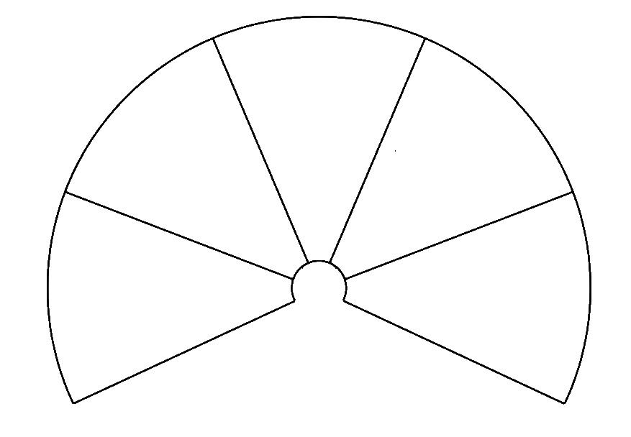
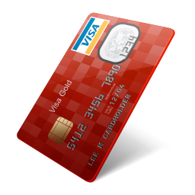

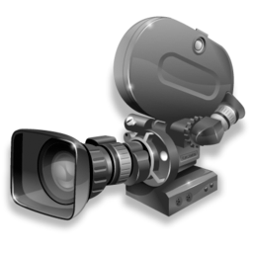
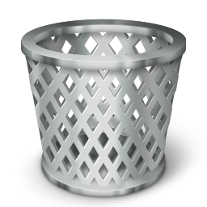





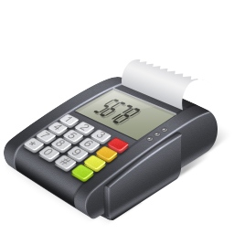

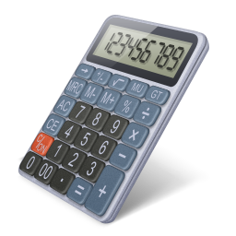
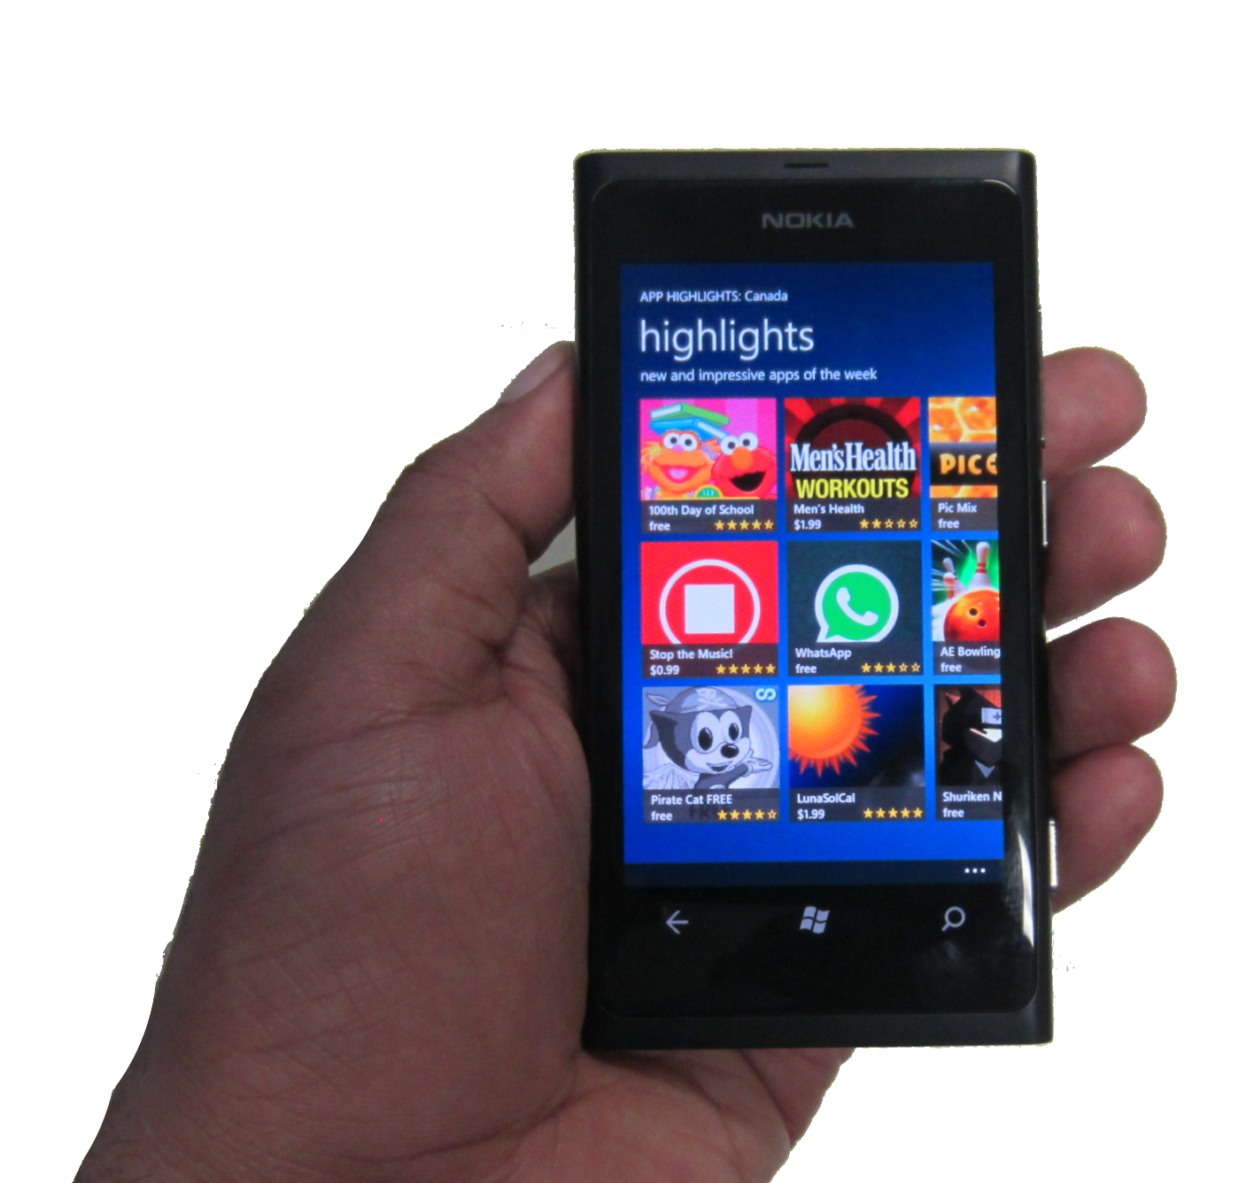




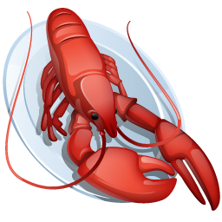


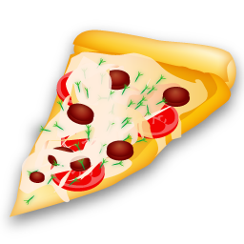
Around Device Binning (AD-Binning)
5

Slide 6
Contributions
AD-Binning for Browsing content on mobiles
Design space
Evaluation with a popular data analytic task
6

Slide 7
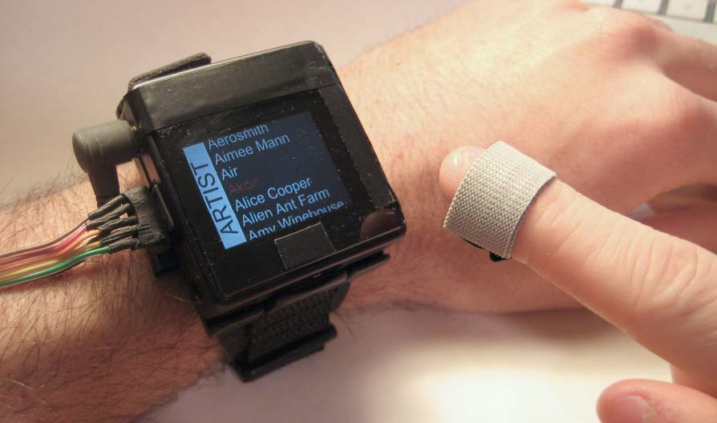
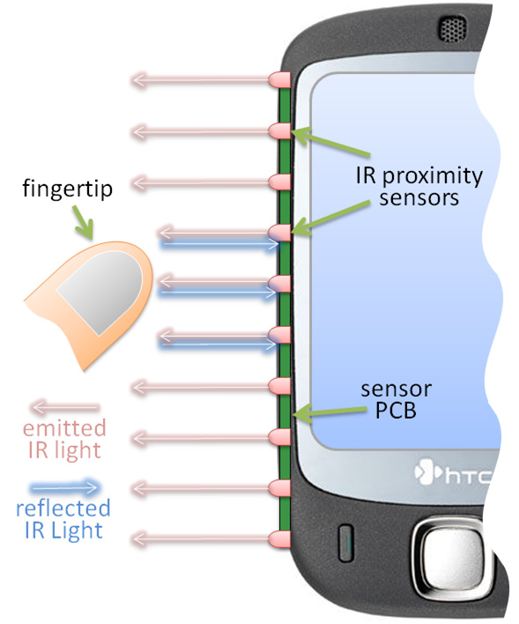
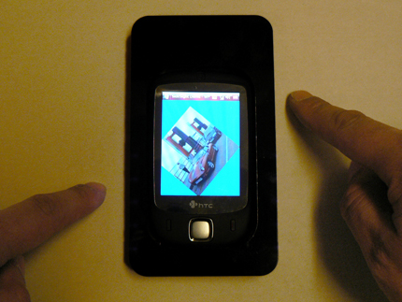
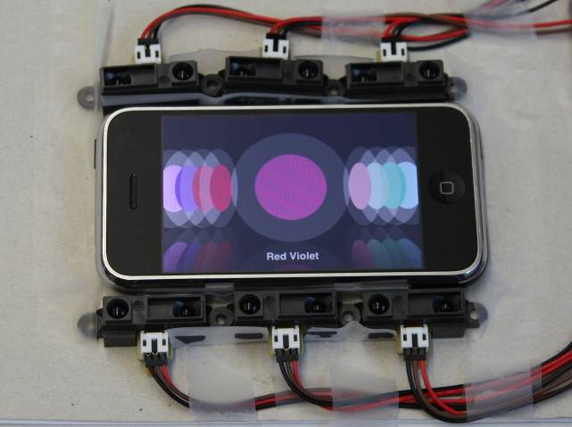
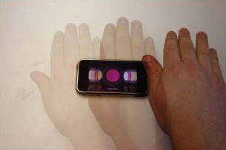
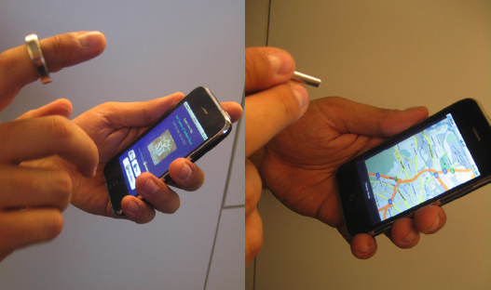
SideSight Butler et al., 2008
Abracadabra Harrison & Hudson, 2009
Hoverflow Kratz & Rohs, 2012
MagiTact Ketabdar et al., 2011
7

Slide 8
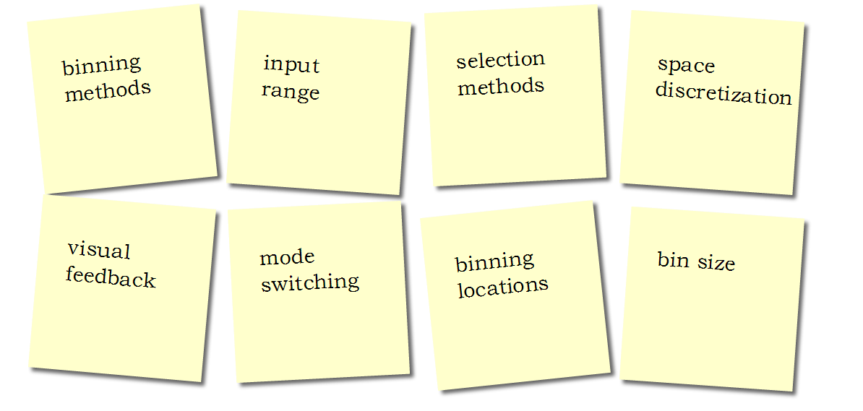
AD-binning design Space
8

Slide 9
Input Range
9

Slide 10
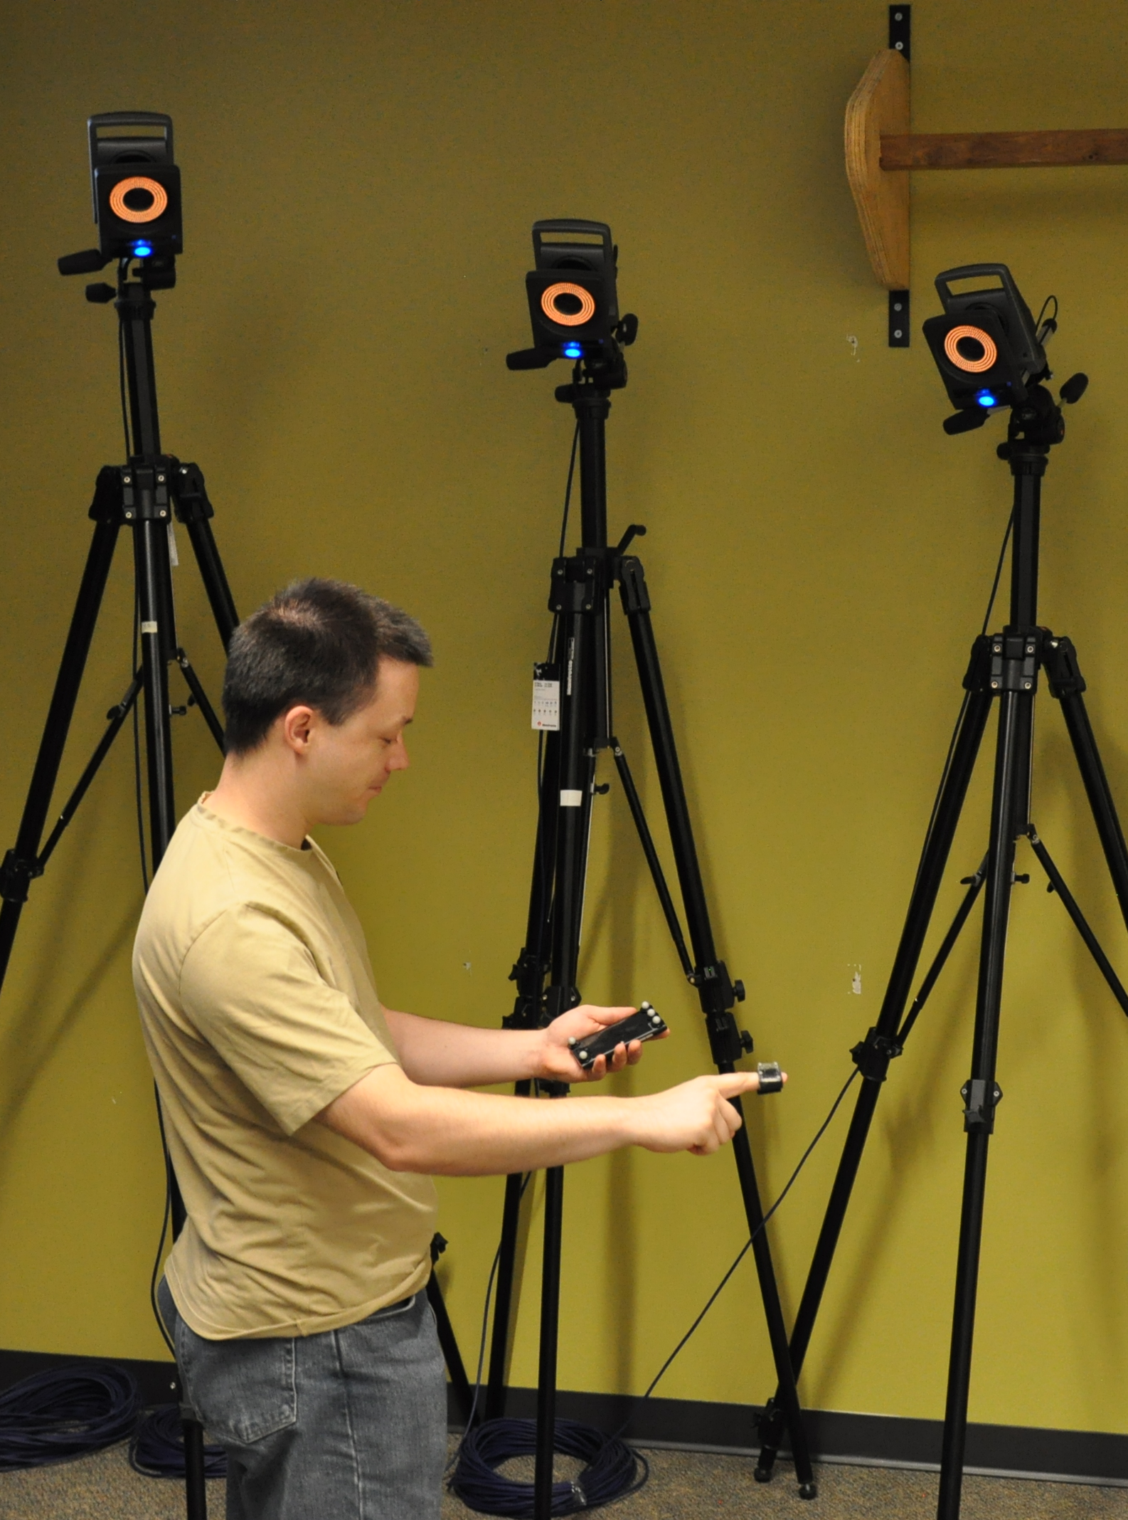
10

Slide 11
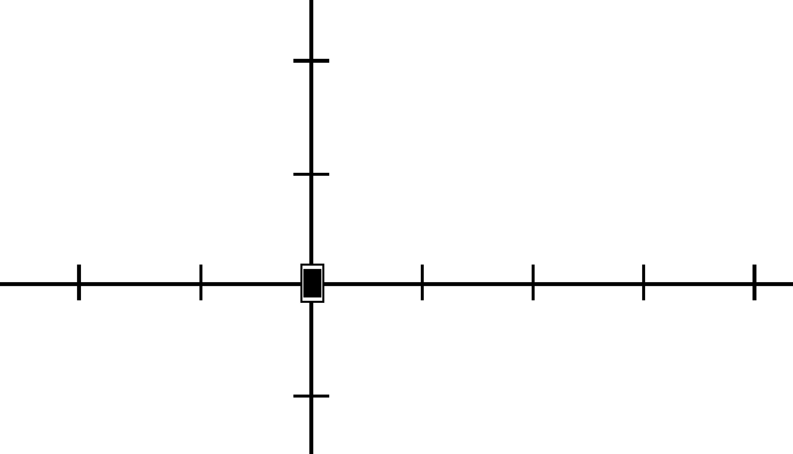
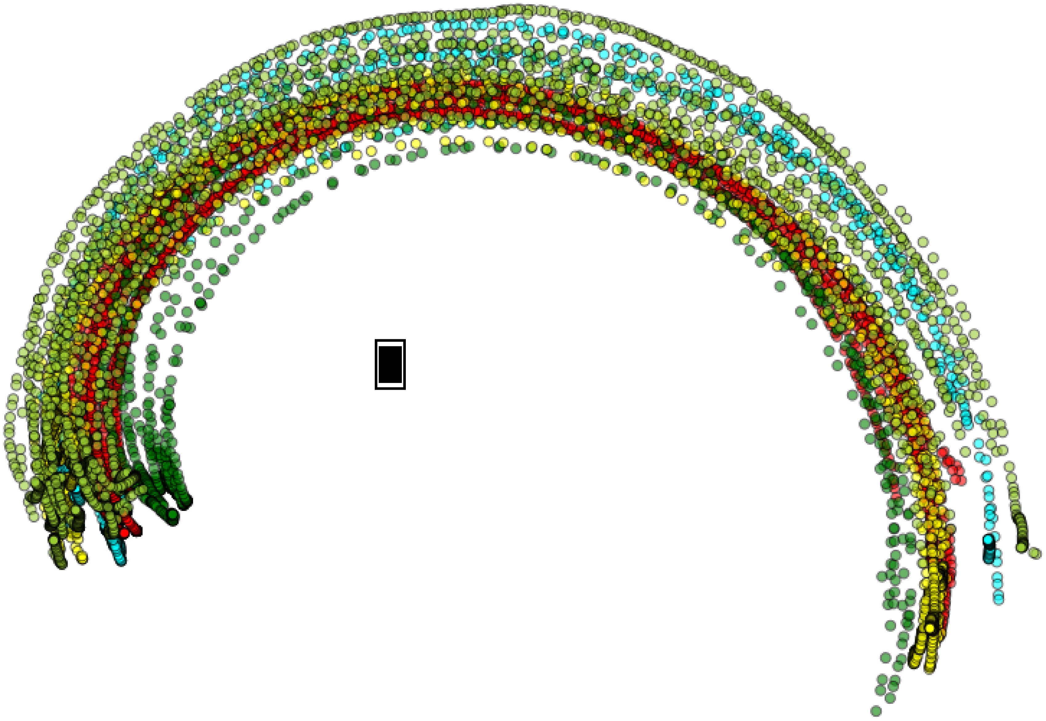
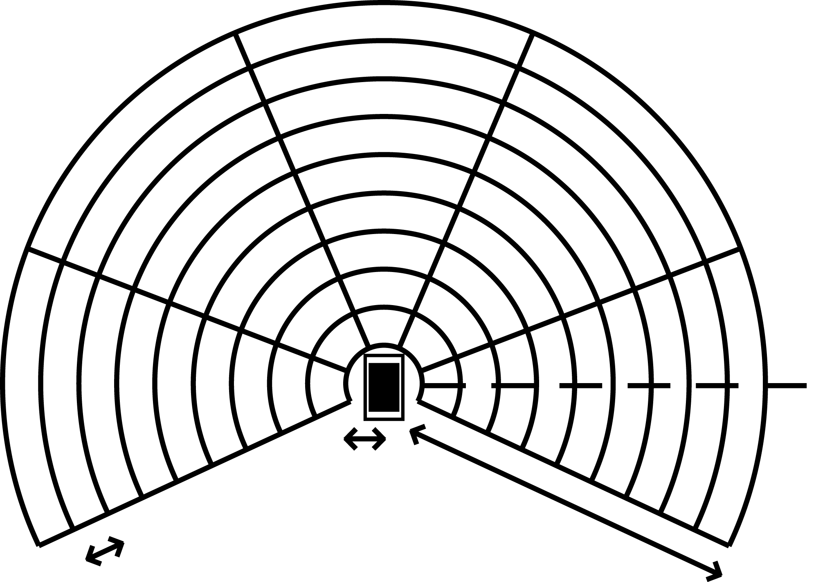
67°
113°
40
159°
20
21°
0°
-40
-20
20
40
60
6cm
34cm
-20
335°
205°
11

Slide 12
Selection Methods
& Bin Sizes
12

Slide 13
Selection Techniques
Tap
BackTap
Dwell
LiftOff
Pierce
DownUp
13

Slide 14
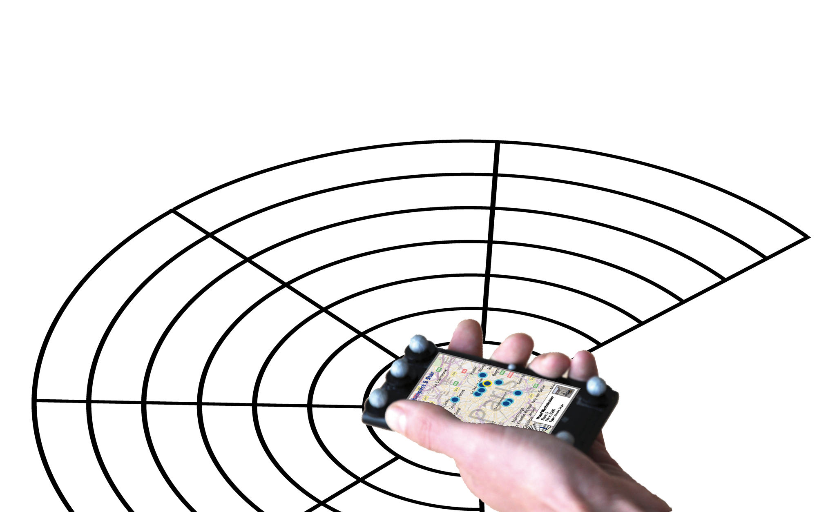

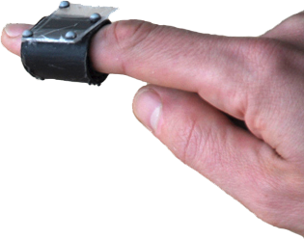
Dwell
14

Slide 15
LiftOff
15

Slide 16
Pierce
16

Slide 17
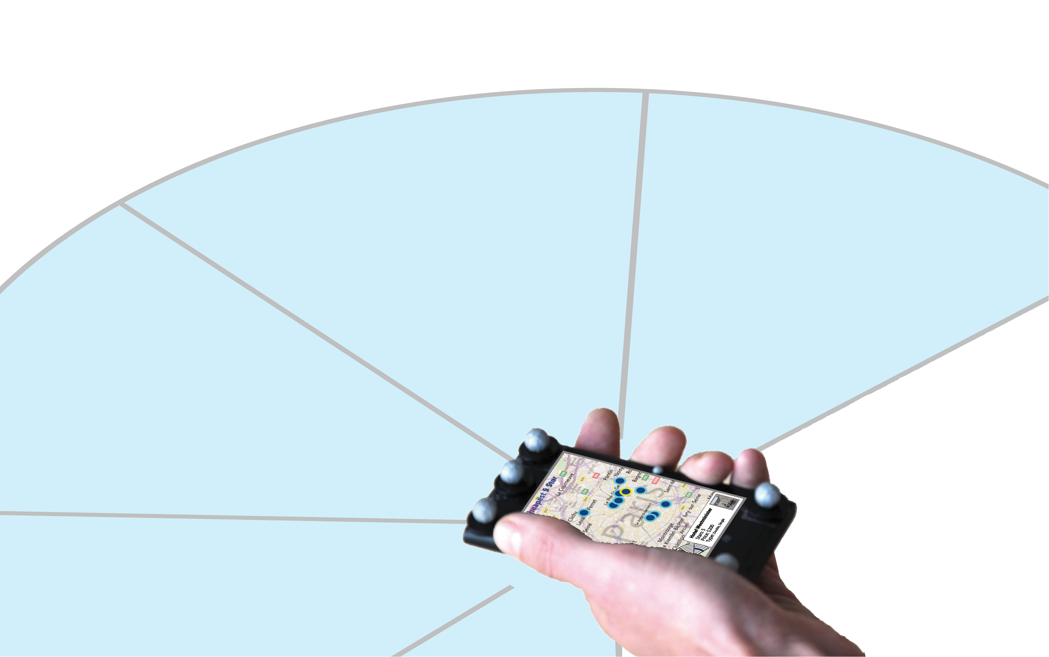
Pierce
17

Slide 18
DownUp
18
18
12
24
18
18

Slide 19
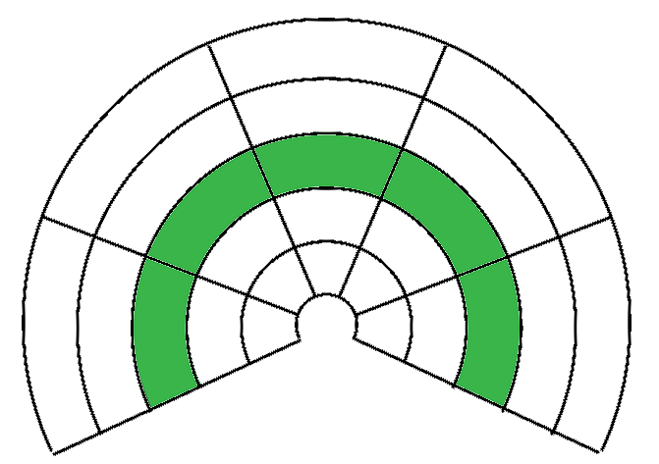
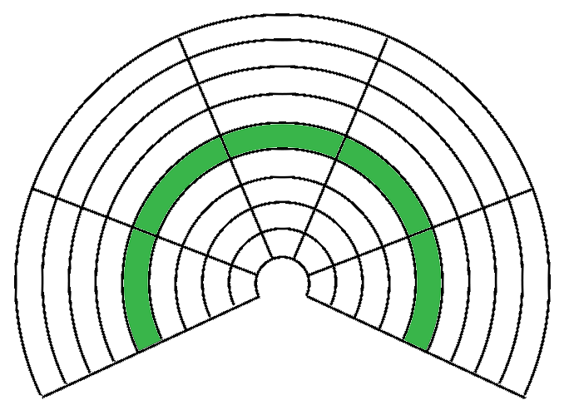
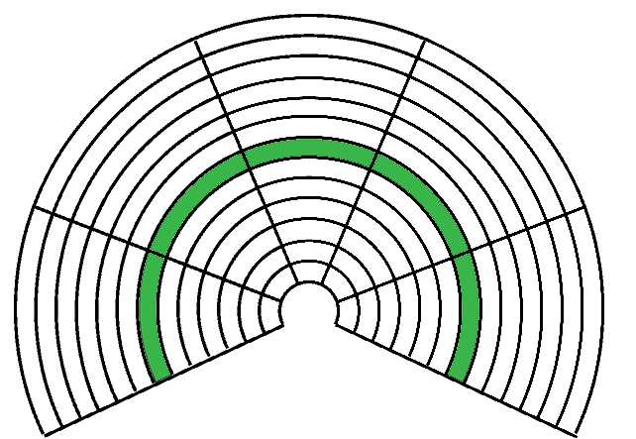
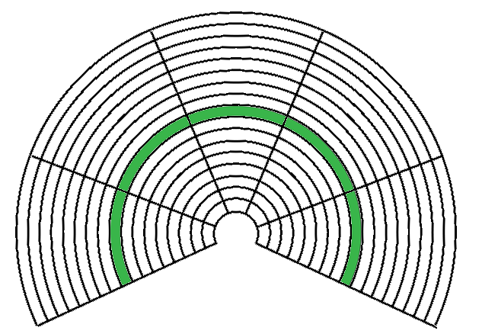
Bin Size
68mm – 5 bins
38mm – 9 bins
26mm -13 bins
20mm -17 bins
19

Slide 20
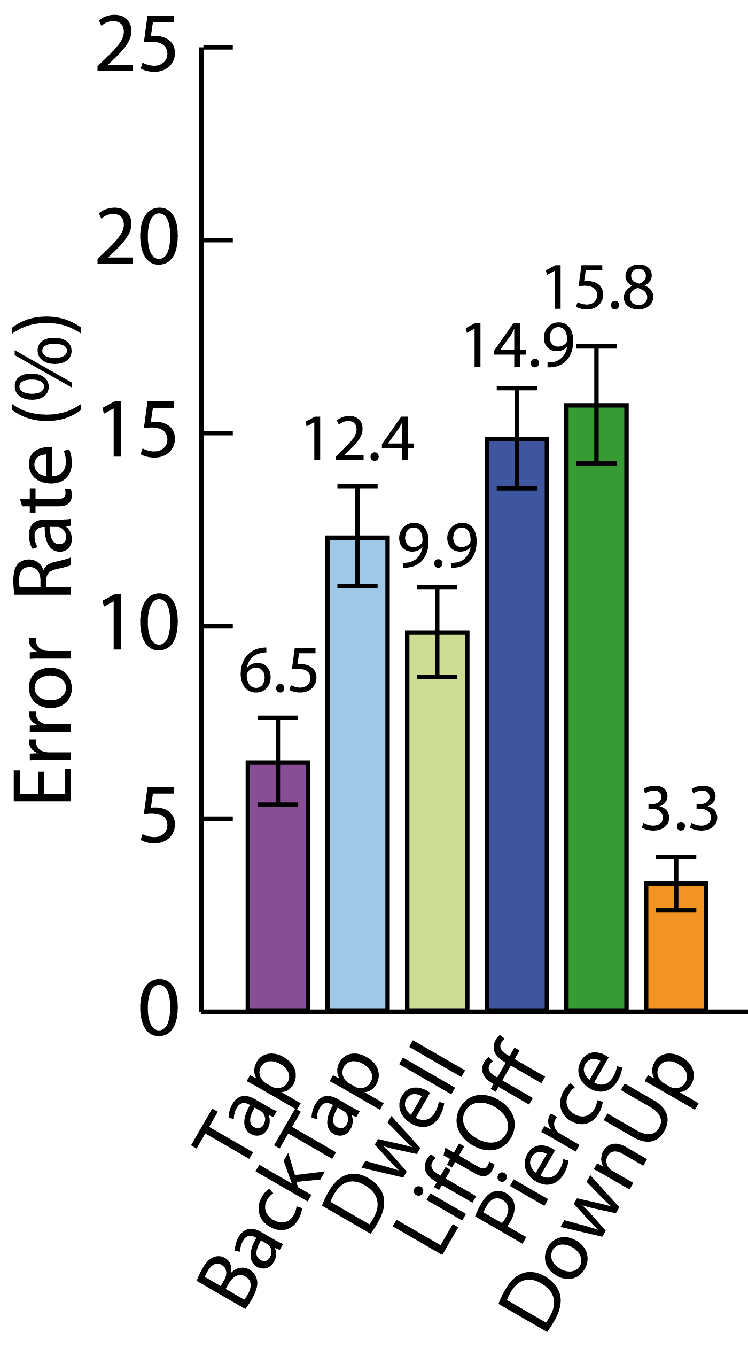
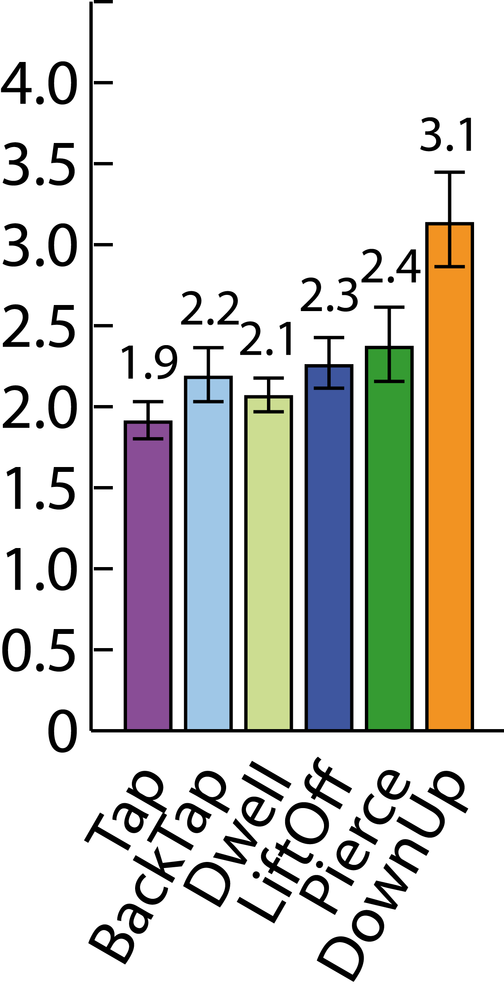
Error bars: 1 S.E.
Error bars: 95% CI.
Error Rate (%)
Trial Time (s)
20

Slide 21
68mm – 5 bins
38mm – 9 bins
26mm – 13 bins
20mm – 17 bins
Tap
BackTap
Dwell
LiftOff
Pierce
DownUp
21

Slide 22
Space Discretization
22

Slide 23
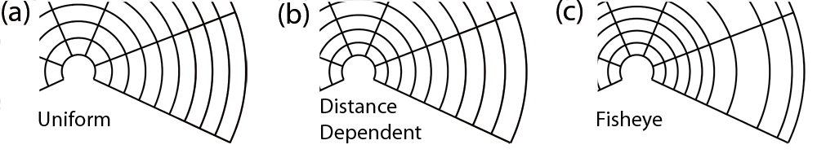
Discretization Techniques
Distances
Locations
23

Slide 24
Binning & Retrieval
24

Slide 25
Automatic
no user control
full user control
25

Slide 26
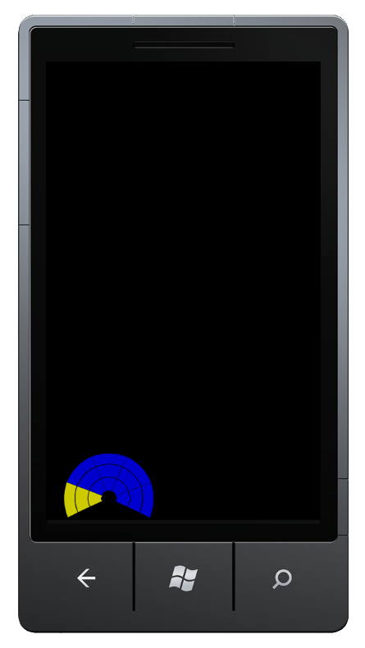
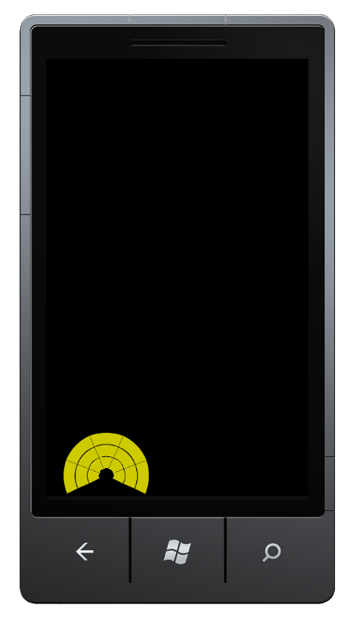
26

Slide 27
Automatic
Tap&Bin
no user control
full user control
27

Slide 28
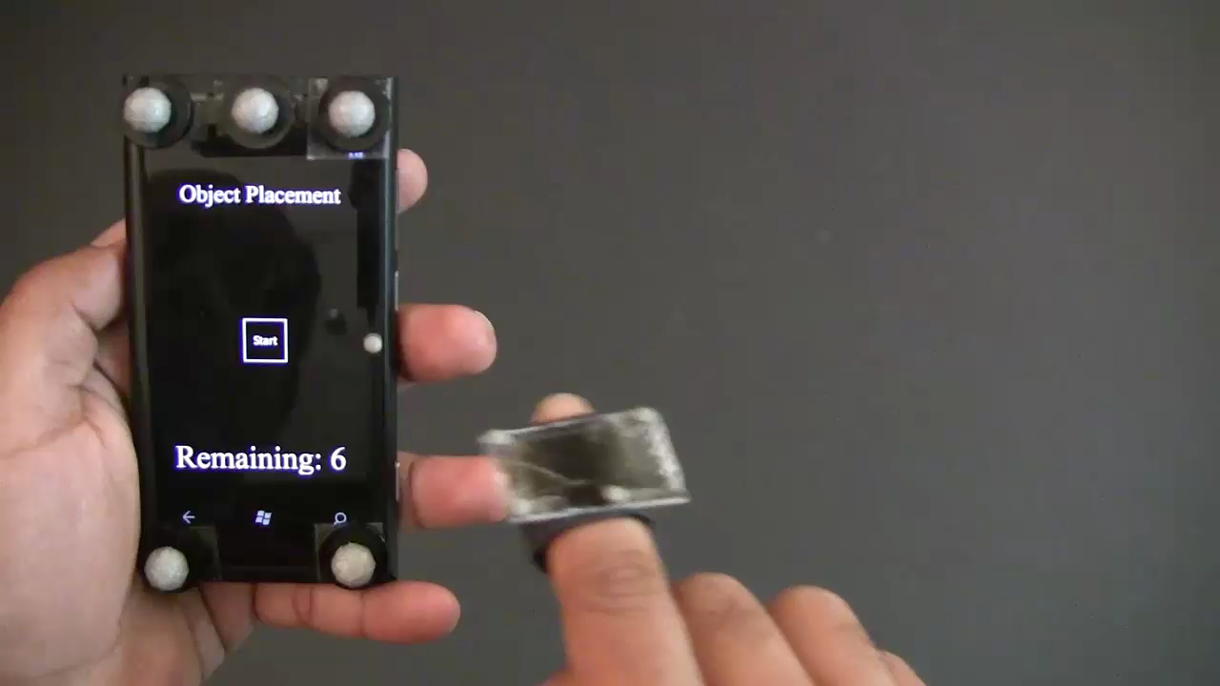
28

Slide 29
Automatic
Flick&Bin
Tap&Bin
no user control
full user control
29

Slide 30
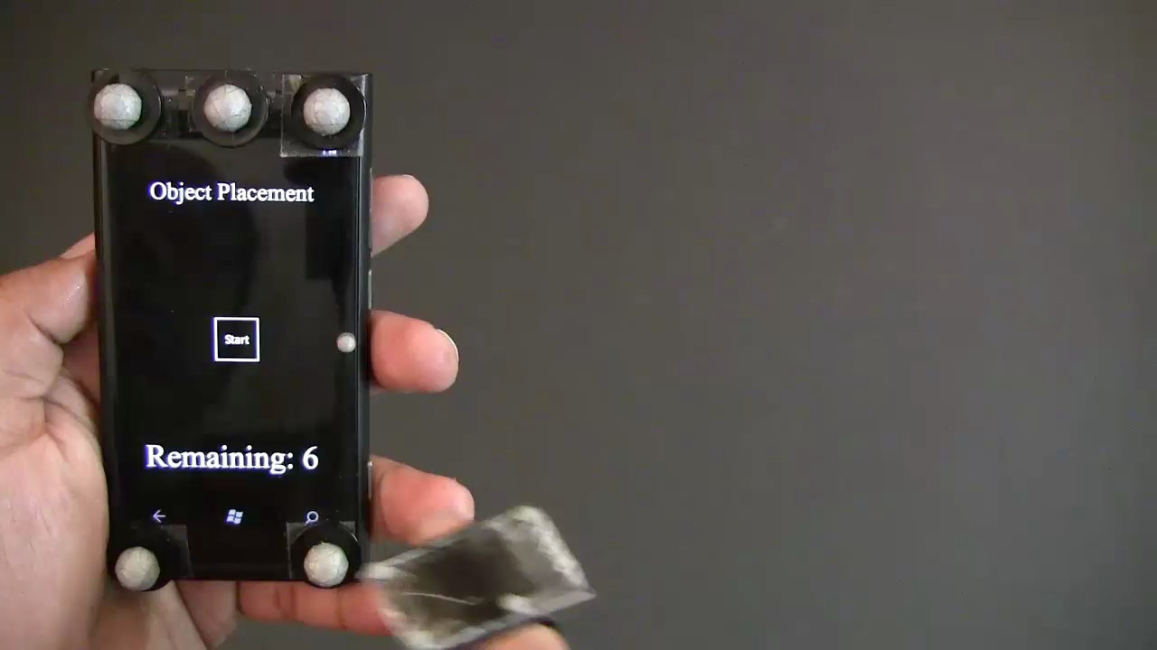
30

Slide 31
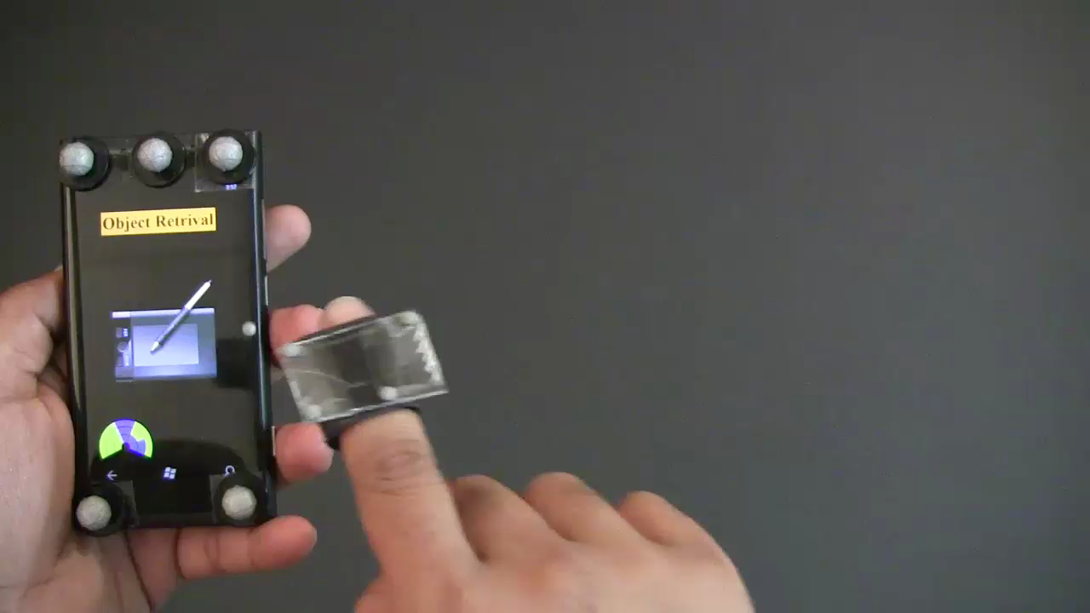
Retrieval phase
31

Slide 32
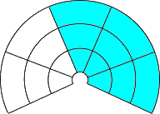
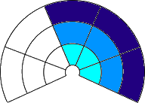
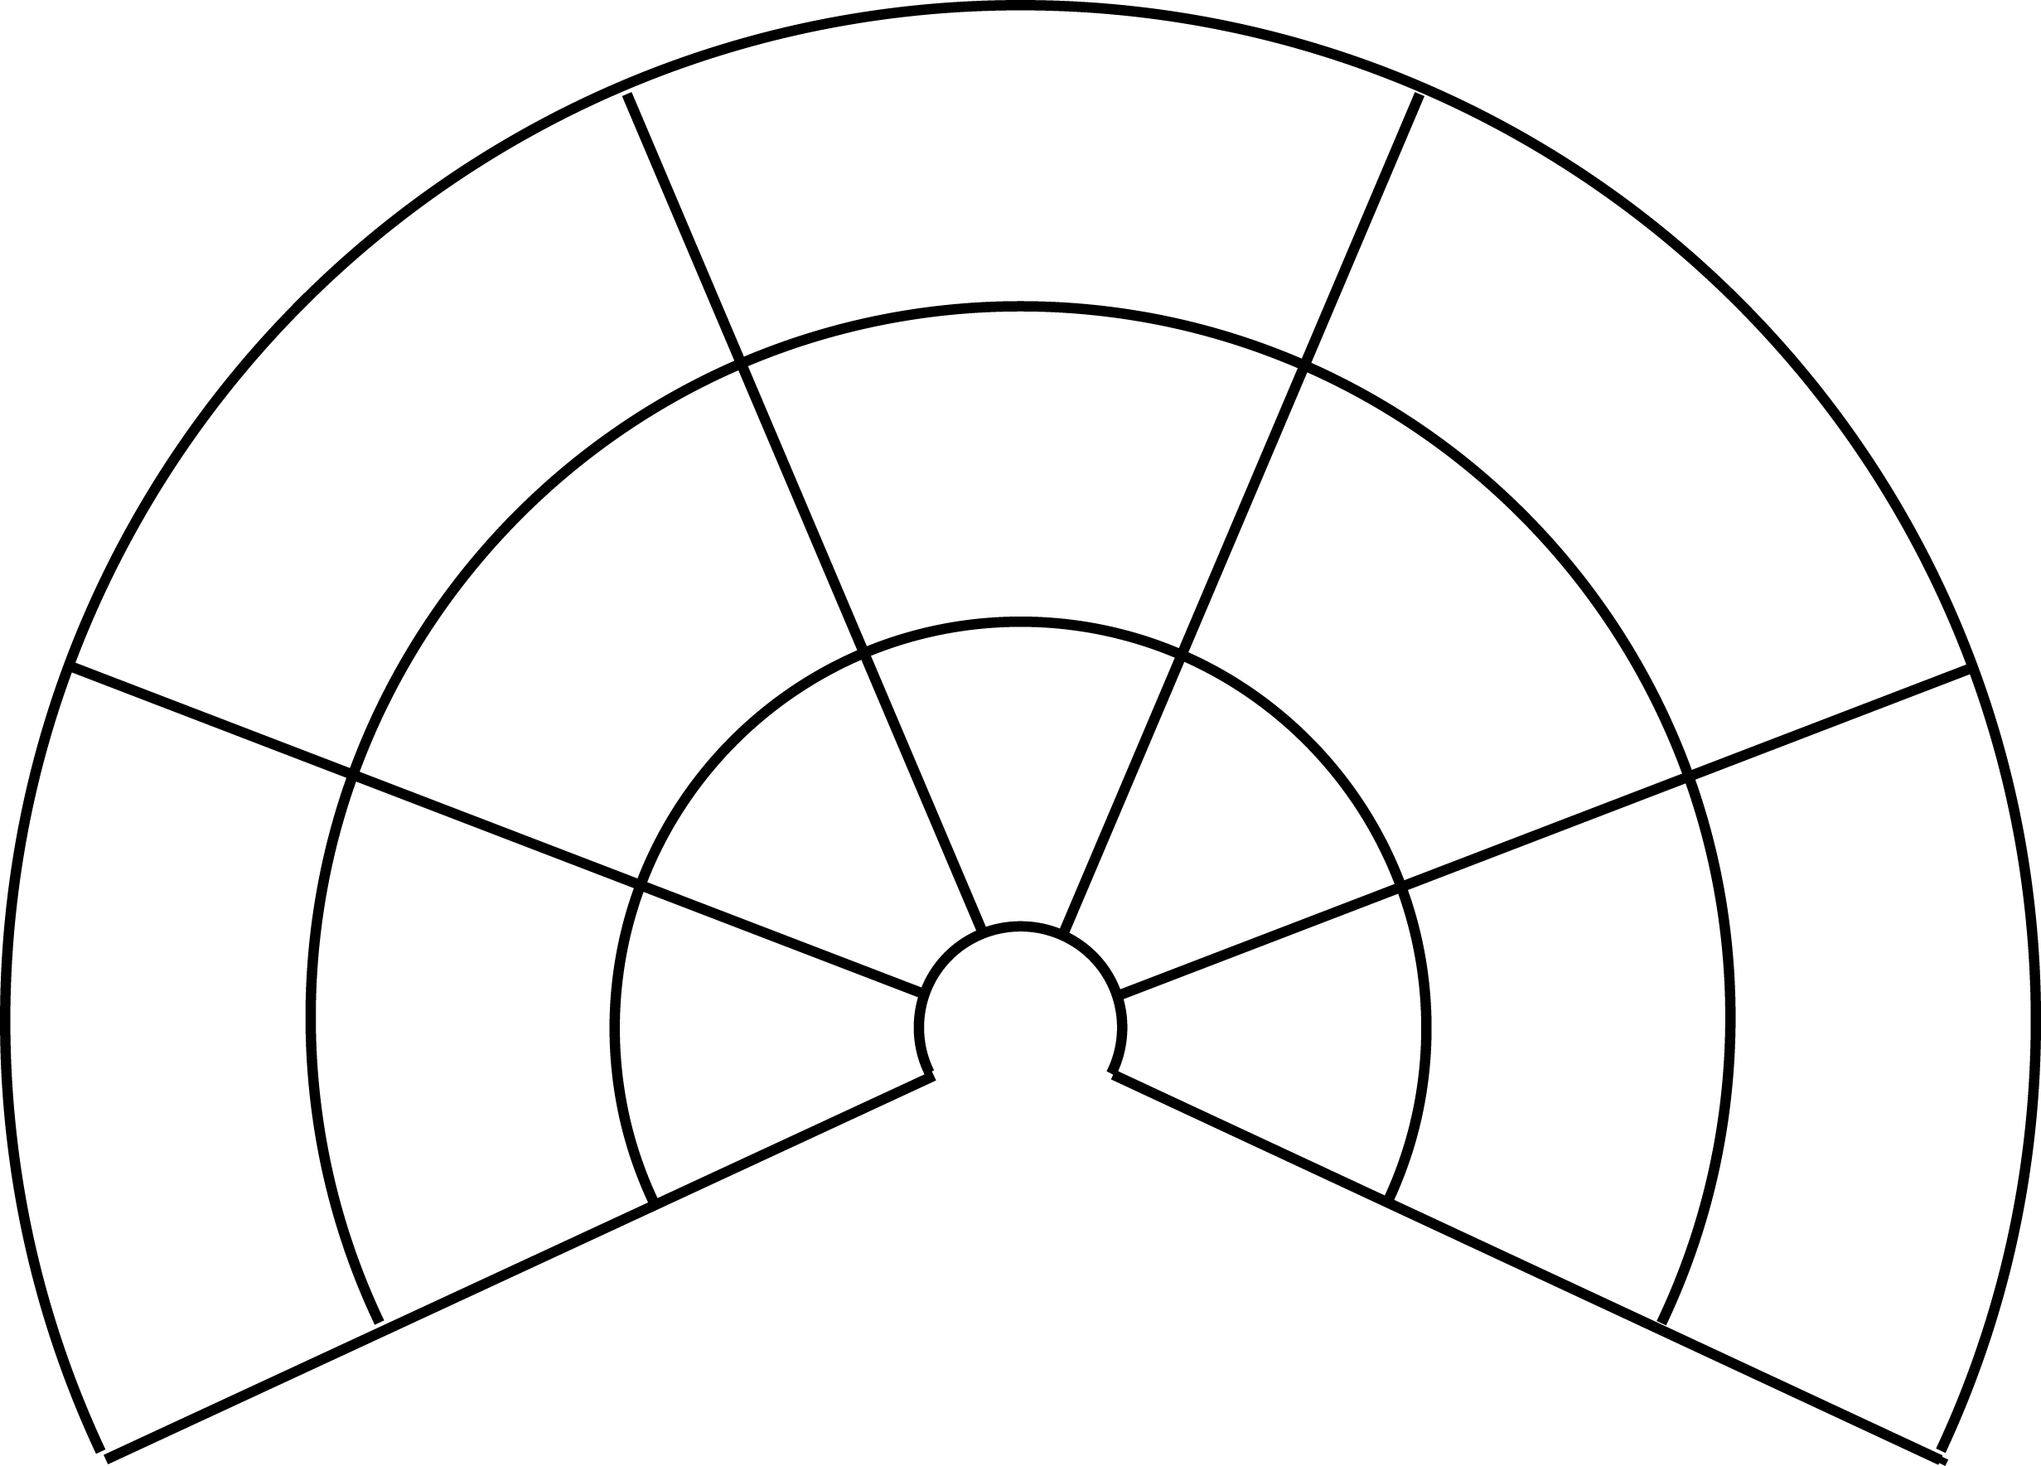
6 items
12 items
Flick & Bin
Tap& Bin
Binning phase
32

Slide 33
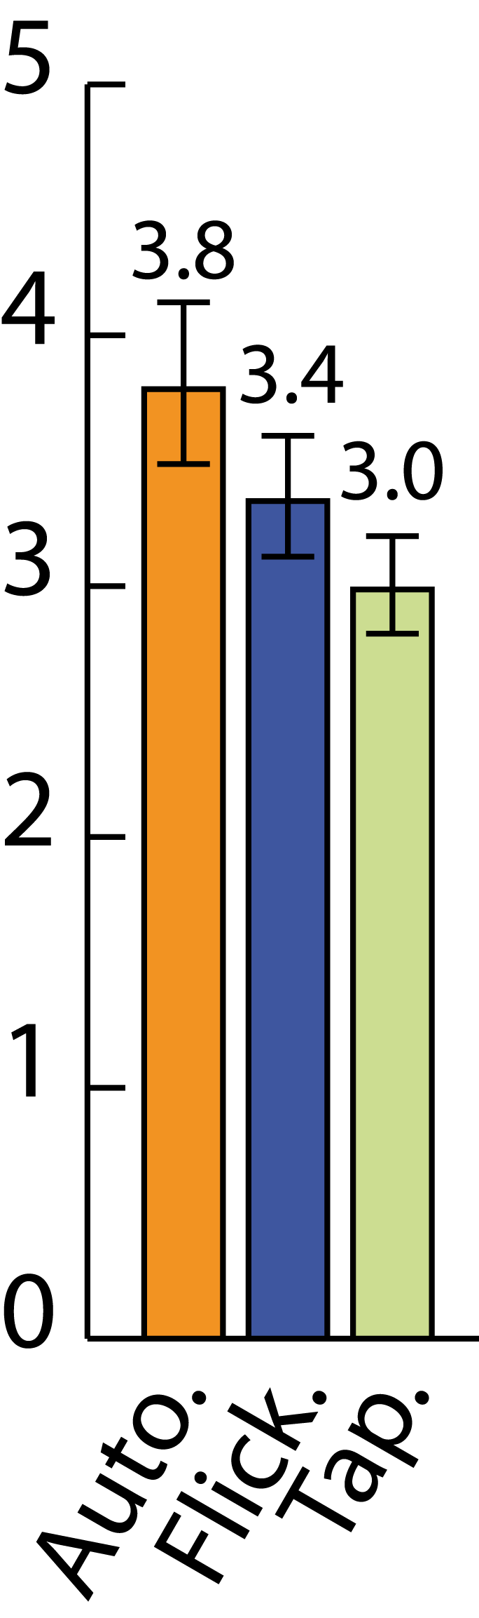
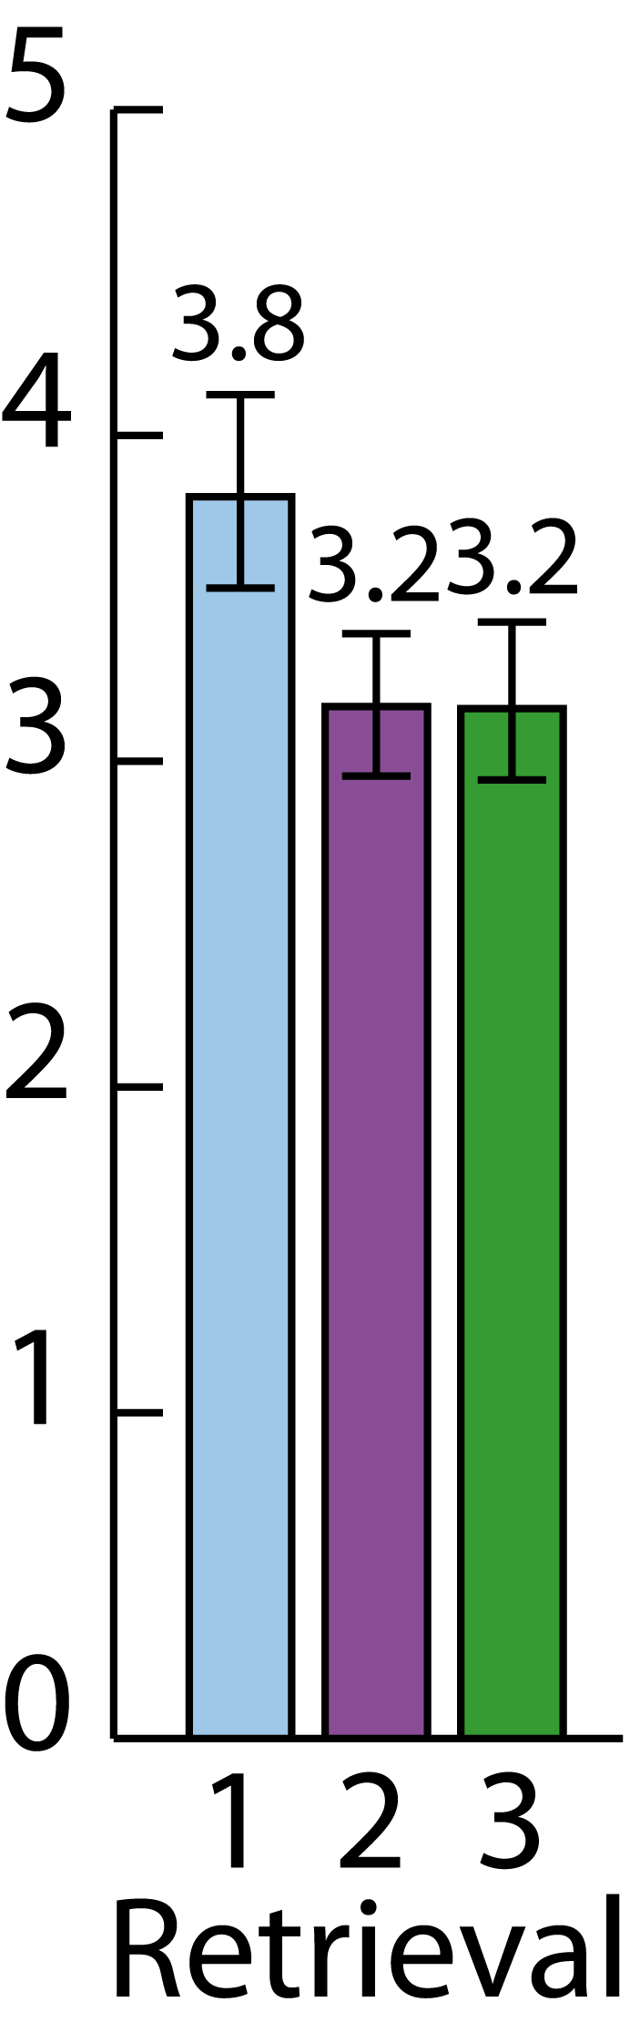
Error bars: 95% CI.
21%
Retrieval phase
33

Slide 34
Data Analytic Task
34

Slide 35
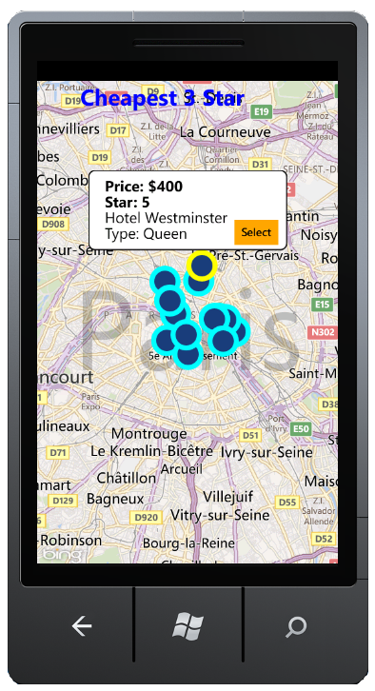
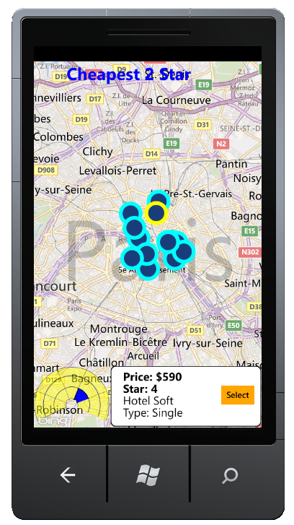
on-screen
AD-bins
35

Slide 36
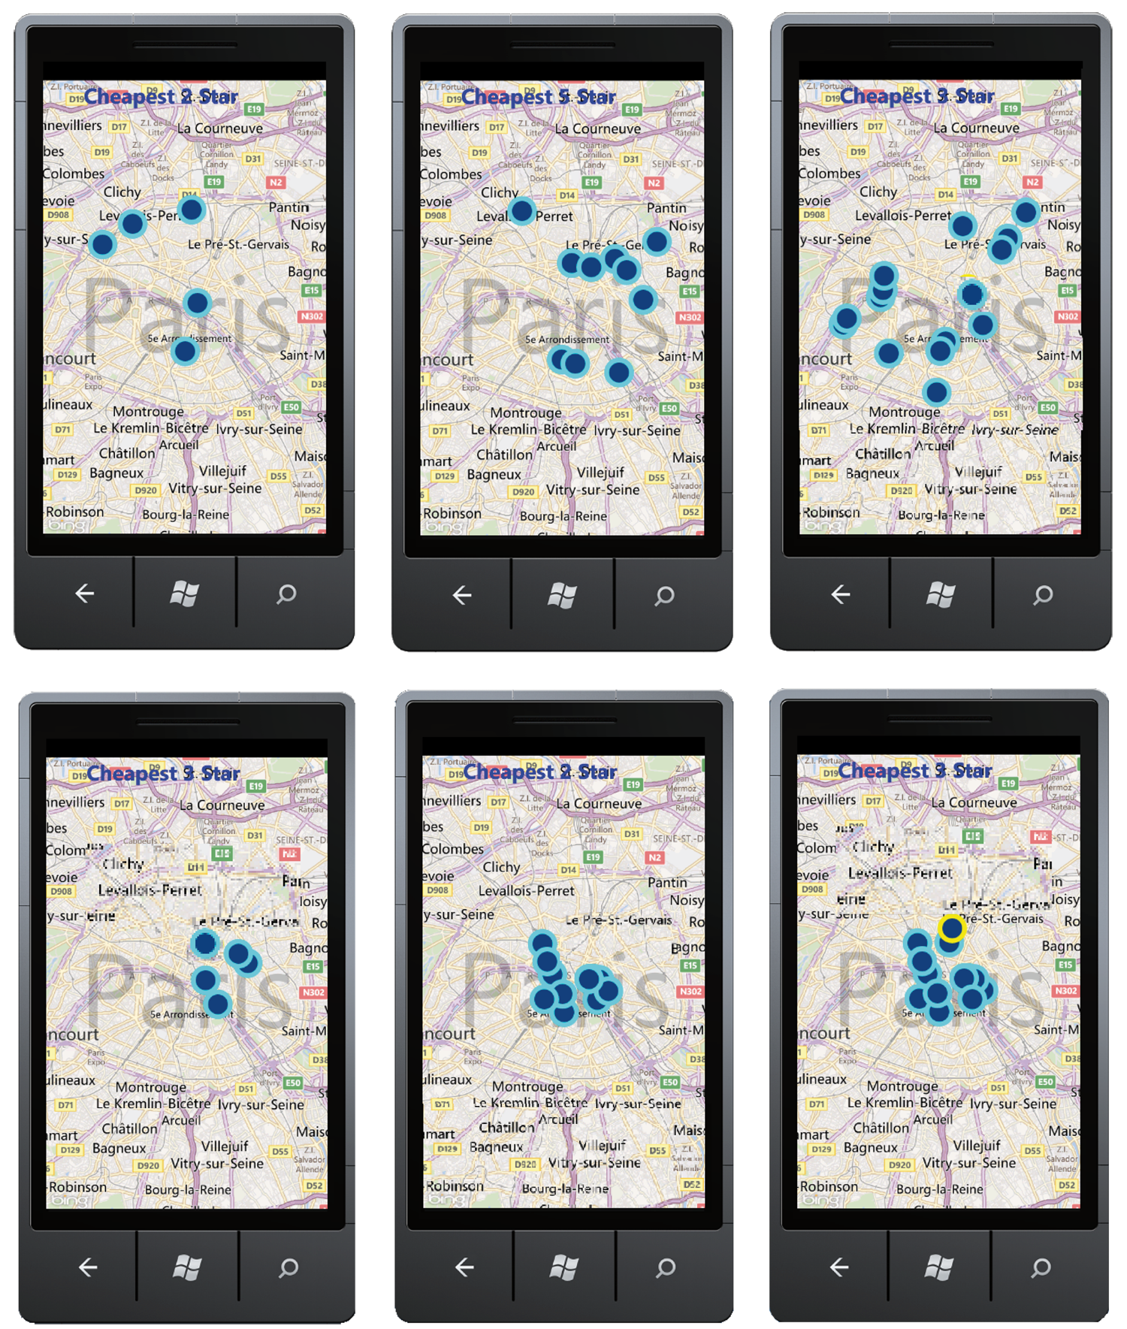
5
10
15
sparse
dense
36

Slide 37
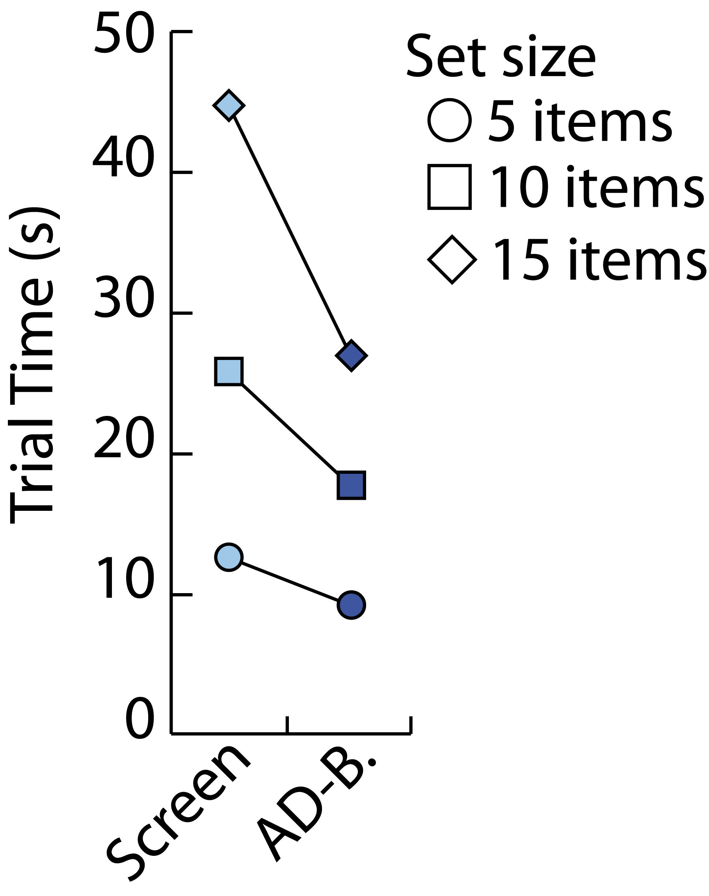
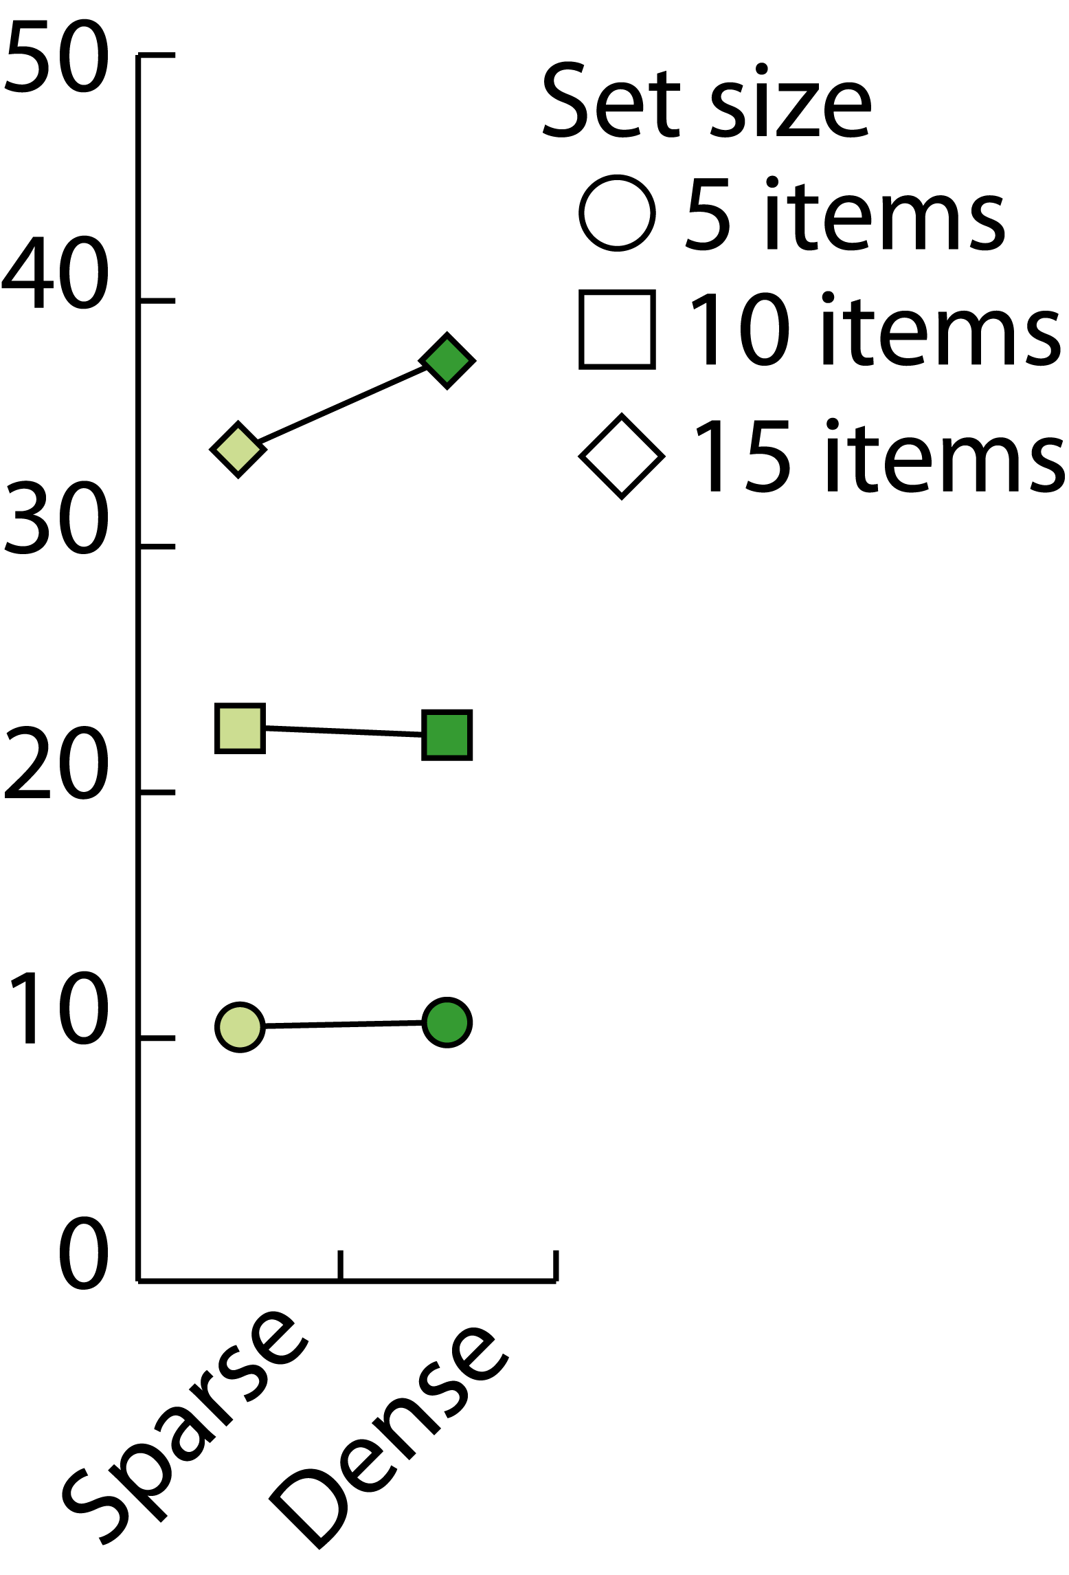
5
10
15
Trial Time (s)
40%
sparse
32%
28%
dense
37

Slide 38

38

Slide 39
AD-Binning:
Leveraging Around-Device Space for
Storing, Browsing and Retrieving
Mobile Device Content
Khalad Hasan, David Ahlström, Pourang Irani
Thank you

