Slide 1

EdgeSplit: Facilitating the Selection of Off-Screen Objects
Zahid Hossain
Khalad Hasan
Hai-Ning Liang
Pourang Irani

Slide 2
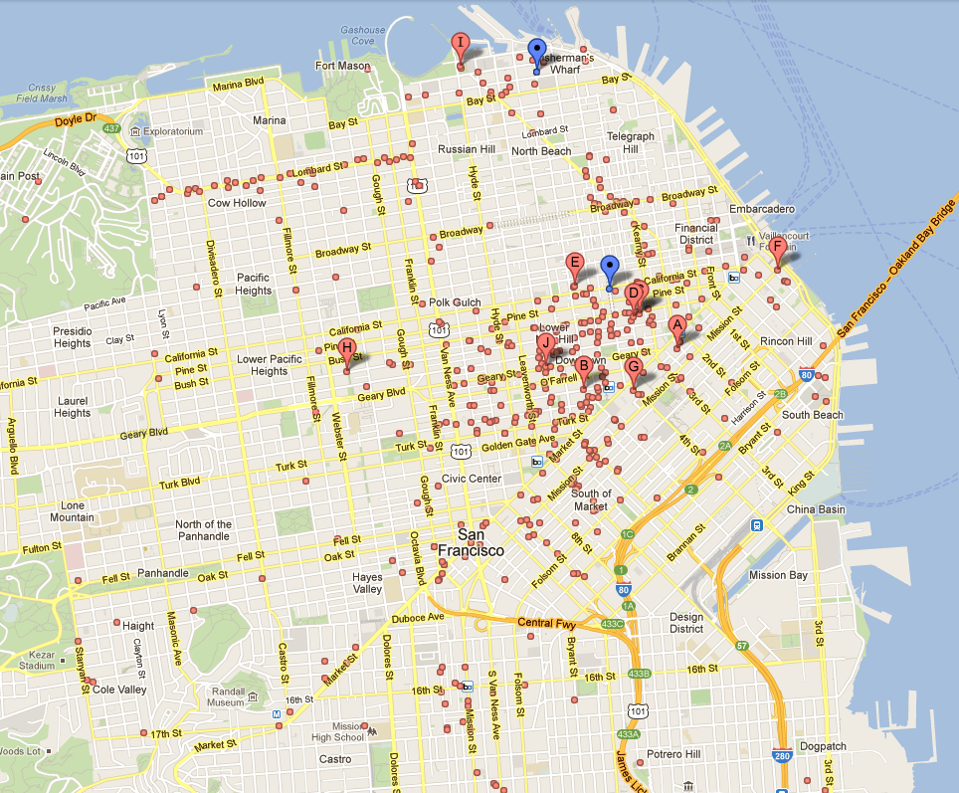
Motivation
Searching for suitable hotel in busy city needs lots of panning and zooming which is hard to do in mobile device
Notes:
The figure shows the hotels in bay area of San Francisco City
While searching for suitable hotels in small device like mobile we need to pan and zoom this type of image hundred times to get our desire one
That’s why we need off-screen visual cues for such case along with selection facility so that user can have the whole information in current screen space without panning and zooming too much

Slide 3
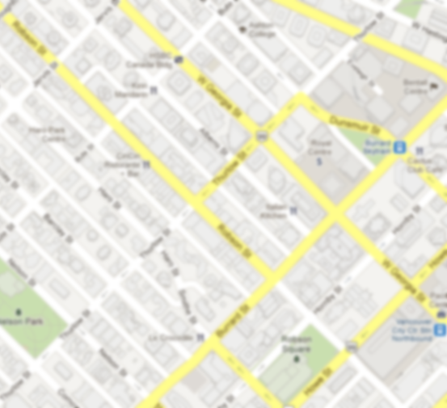
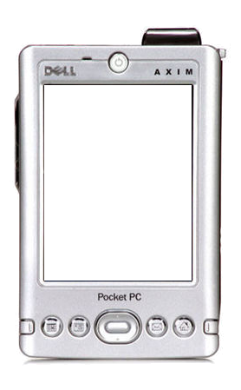
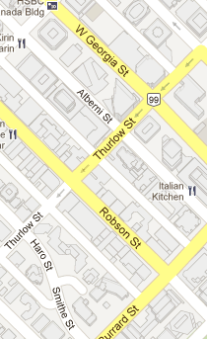
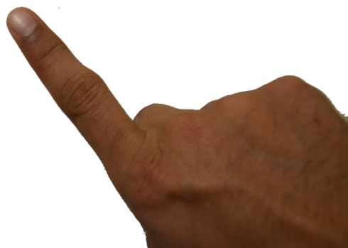
Motivation
W
W
W
W
W
W
Walmart
0.5 KM
W
W
W
W
W
W
Off-screen visual cues along with selection can solve too much map navigation problem
Notes:
- It is better to have off-screen visual cues along with selection facility to avoid panning and zooming too much

Slide 4
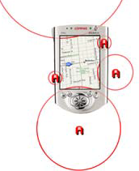
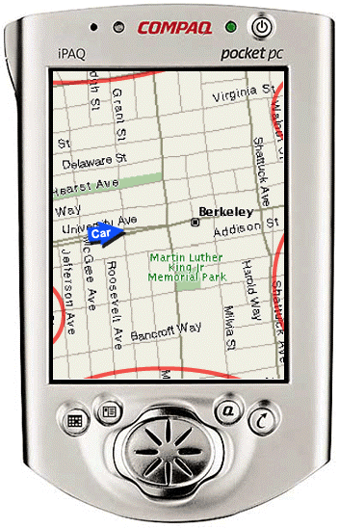
Motivation – Problems in Current Methods
Halo
[Baudisch, P. and Rosenholtz, R., CHI ‘03]

Slide 5
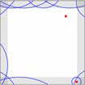
Motivation – Problems in Current Methods
Overlapping off-screen visual cues : Hard to identify and select
Notes:
Overlapping off-screen visual cues : Hard to identify and select
Large number of objects make visualization cluttered : Trouble in selection
Very small visual cues : Not good for selection

Slide 6
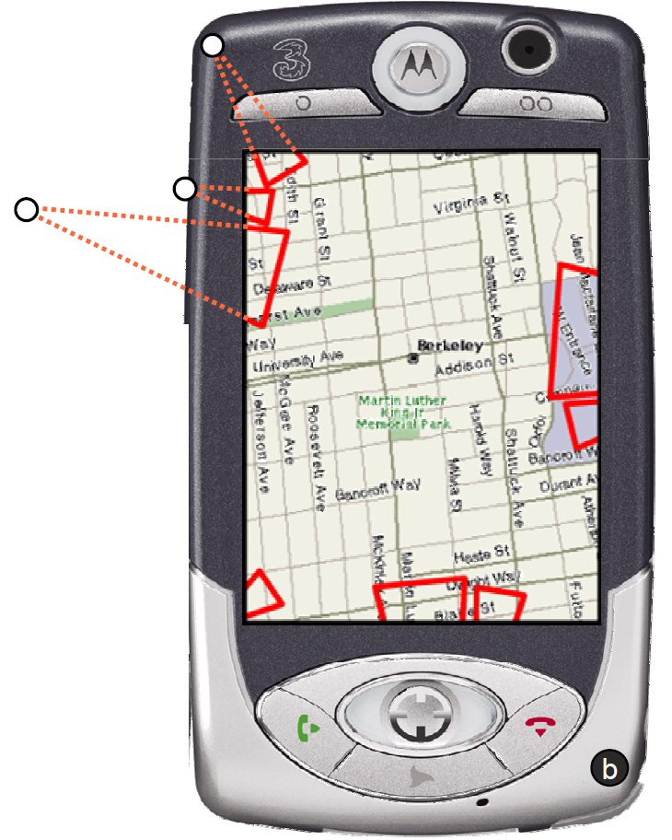
Motivation – Problems in Current Methods
Wedge
[Gustafson, S., Baudisch, P., Gutwin, C. and Irani, P., CHI ‘08]

Slide 7
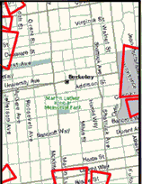
Motivation – Problems in Current Methods
Large number of objects make visualization cluttered : Trouble in selection
Notes:
Overlapping off-screen visual cues : Hard to identify and select
Large number of objects make visualization cluttered : Trouble in selection
Very small visual cues : Not good for selection

Slide 8
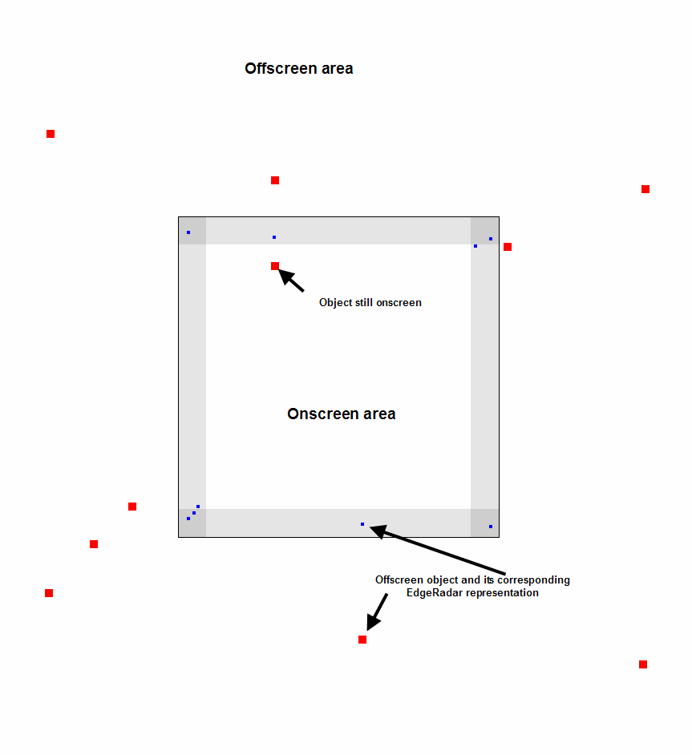
Motivation – Problems in Current Methods
EdgeRadar
[Gustafson, S. and Irani, P., CHI ‘07]

Slide 9
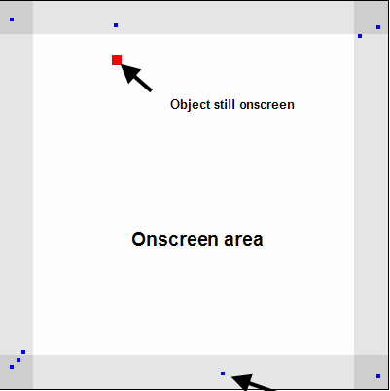
Motivation – Problems in Current Methods
Very small visual cues : Not good for selection
Notes:
Overlapping off-screen visual cues : Hard to identify and select
Large number of objects make visualization cluttered : Trouble in selection
Very small visual cues : Not good for selection

Slide 10
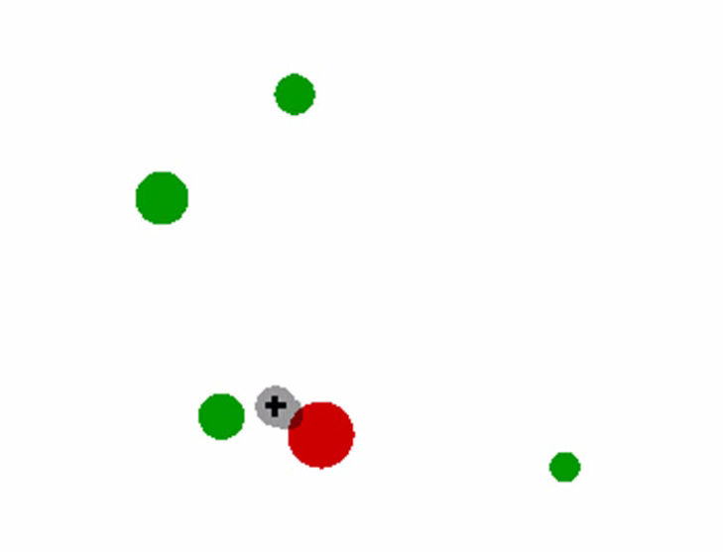
Target Selection Techniques
Area Cursor
Bubble Cursor
[Kabbash, P. and Buxton, W., CHI ‘95]
[Grossman, T. and Balakrishnan, R., CHI ‘05]
Notes:
There are some research work on target selection like area cursor, bubble cursor, hopping and starburst
But these are not embedded with any of the off-screen visualization techniques
These can be used as additional selection facility for all techniques

Slide 11
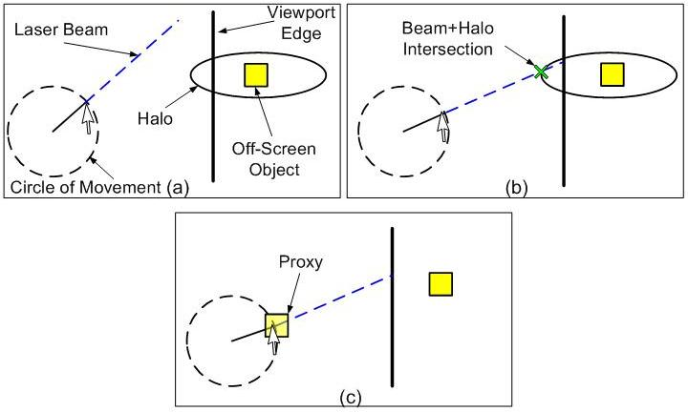
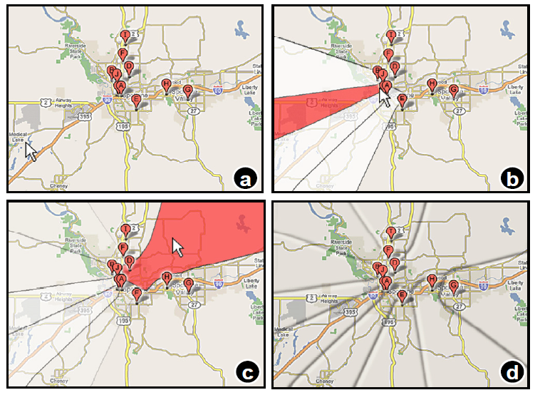
Target Selection Techniques
Hopping
Starburst
[Irani, P., Gutwin, C. and Yang, X., CHI ‘06]
[Baudisch, P., Zotov, A., Cutrell, E. and Hinckley, K., AVI ‘08]

Slide 12
Motivation
Current off-screen visualization techniques focus only on visualization
None of these facilitate selection with visualization
Existing target selection techniques cannot be embedded with any off-screen visualization techniques. These can be used for methods as additional feature.
Notes:
All the off-screen visualization techniques worked on representation of objects maintaining accurate distance and direction
None of these worked with how to embed selection facility within visualization

Slide 13
Proposed
Technique
13

Slide 14
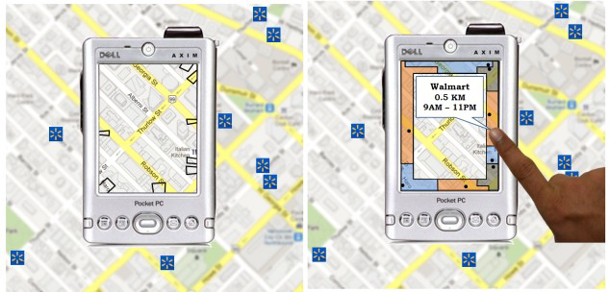
EdgeSplit
Notes:
- We propose edge split which solve this problem

Slide 15
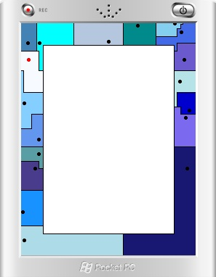
Construction of EdgeSplit
Inspired by EdgeRadar
It divides the radars into polygons
Each subdivided area hosts only one proxy
A new partitioning algorithm to form these polygons
15
Notes:
Inspired by EdgeRadar for visualization of off-screen cues
Similar to EdgeRadar, our proposed EdgeSplit has four docked rectangles (or ‘radars’) to display proxies of objects located off the screen
It divides the radars into polygons such that each subdivided area hosts only one proxy and through which the objects can be selected
We have developed a simple partitioning algorithm to form these polygons

Slide 16
Construction: Step 1
Notes:
Step 1: At first sort the targets according to X values. Then draw vertical lines between each of the adjacent targets

Slide 17
Construction: Step 2
Notes:
Step 2: Sort targets according to Y values and draw horizontal lines between each of the adjacent targets

Slide 18
Construction: Step 3
Notes:
Step 3: Lets define separate color for each targets. Now we have got a set of rectangles which we will fill according to its nearest target’s color.

Slide 19
Construction: Step 4
Notes:
Step 4: For each rectangles find distance between the center of the rectangle and each of the targets position. Fill the rectangle with the color of the target which is in smallest distance. In this case Purple color.

Slide 20
Construction: Step 5
Notes:
Step 5: After considering all the rectangles we have got this space partition for selecting individual target.

Slide 21
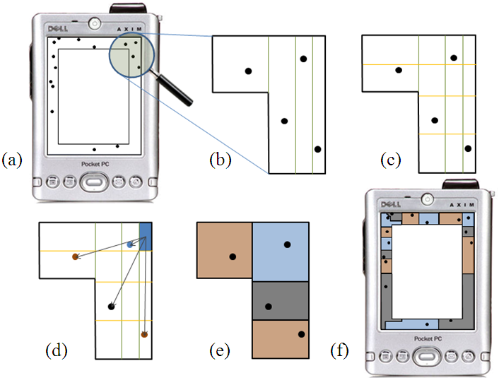
Algorithm in a Nutshell
Notes:
Partitioning Algorithm in a Nutshell

Slide 22
Experiment
22

Slide 23
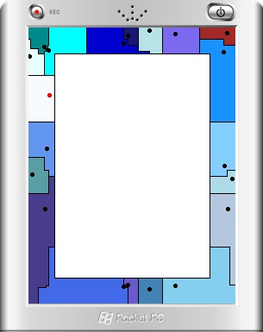
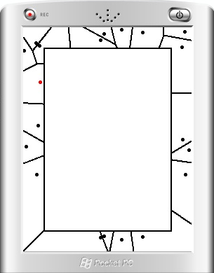
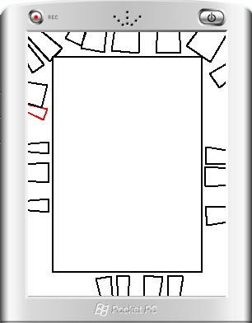
Techniques in experiment
EdgeSplit
EdgeRadar with Voronoi
Wedge
Notes:
Wedge: Current state of art best off-screen visualization technique.
Modification of Wedge: We added selection option along with wedge visualization so that user can directly select it on touching the isosceles triangle.
EdgeRadar with Vornoi: We added voronoi partition algorithm along with EdgeRadar to see how our partition algorithm performs against this well-known partition algorithm

Slide 24
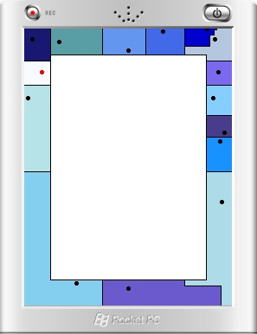
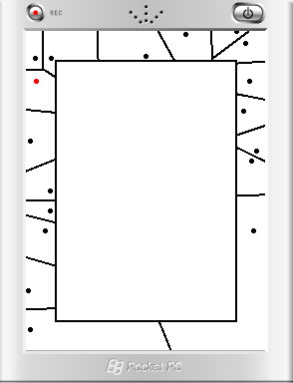
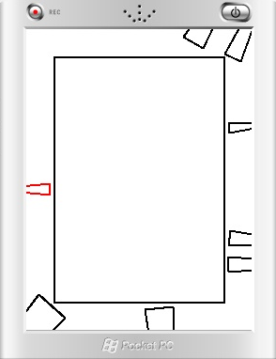
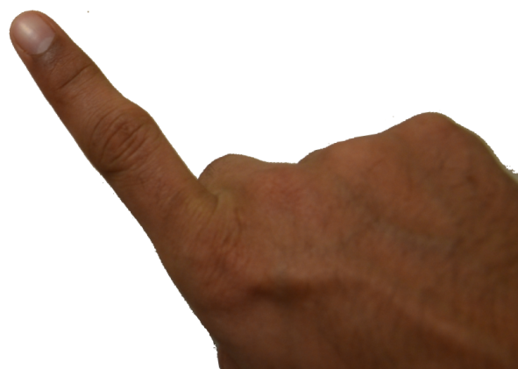
Task: Locate
24

Slide 25
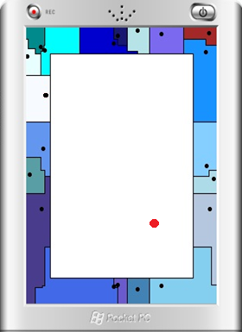
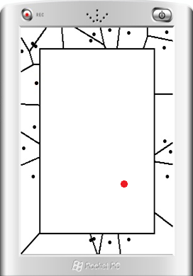
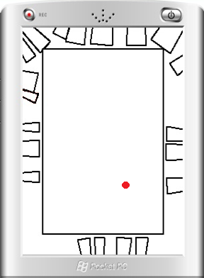



Task: Closest
25
Notes:
Closest: Finding the closest target in off-screen from randomly placed on-screen object

Slide 26
12 Participants
× 3 Techniques
× 2 Task
× 2 Target Distance (Small, Large)
× 2 Target Density ( Low, High)
× 8 Trials per condition
= 2,304 Trials
Design
Notes:
12 Participants
- 3 Techniques (EdgeSplit, EdgeRadar with Voronoi and Wedge)
- 2 Task (Locate and Closest)
- 2 Target Distance (Small(60 pixel from edge of device), Large(60 to max distance))
- 2 Target Density ( Low(1-3 distractors around the target), High(4-6 distractors around the target))
× 8 Trials per condition
= 2,304 Trials

Slide 27
Results

Slide 28
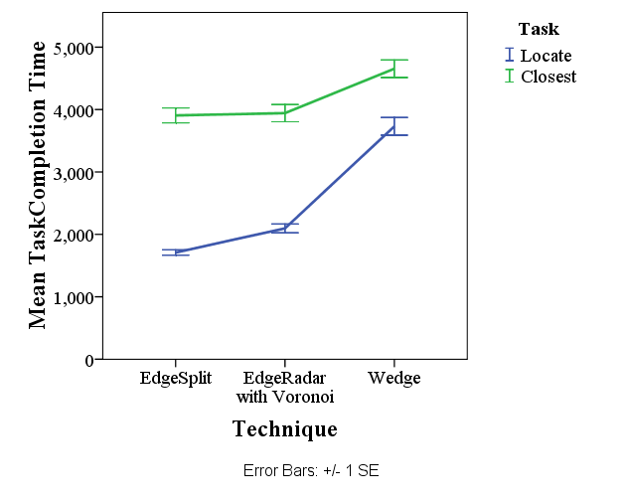
Task completion time
Notes:
The RM-ANOVA yielded a significant main effect of Technique (F_{2,22} = 55.91, p < 0.001) on completion time.
Post-hoc comparisons showed that EdgeSplit with new partition (M= 2808ms, s.e.=126) was significantly faster than EdgeSplit with Voronoi (M=3042ms, s.e.=144; p < 0.01). In addition, both techniques were significantly faster than Wedge (M=4253 ms, s.e. 157; p < 0.001)

Slide 29
Task completion time
The RM-ANOVA yielded a significant main effect of Technique (F_{2,22} = 55.91, p < 0.001) on completion time.
Post-hoc comparisons showed that EdgeSplit with new partition (M= 2808ms, s.e.=126) was significantly faster than EdgeSplit with Voronoi (M=3042ms, s.e.=144; p < 0.01). In addition, both techniques were significantly faster than Wedge (M=4253 ms, s.e. 157; p < 0.001)

Slide 30
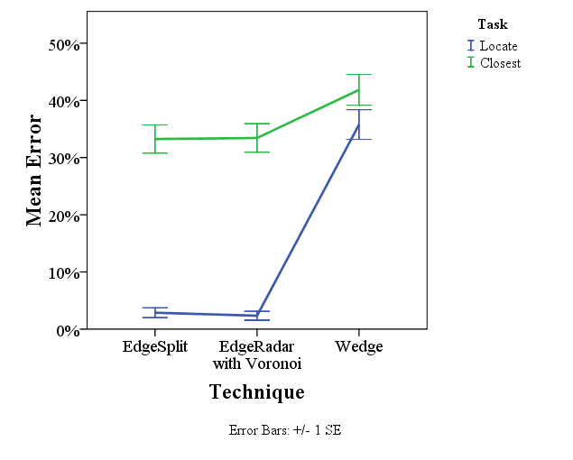
Mean Error
Notes:
The RM-ANOVA yielded significant main effects of Technique (F_{2,22} = 15.97, p < 0.001) on the number of attempts.
Post-hoc analysis showed that Wedge (M=1.89, s.e.=0.1) had significantly higher number of attempts than EdgeSplit with new partition(M=1.44, s.e=0.07) and EdgeSplit with Voronoi (M=1.45, s.e.=0.08) (p < 0.01).
However, there was no significant difference between the two versions of EdgeSplit (p = 1.00)

Slide 31
Mean Error
The RM-ANOVA yielded significant main effects of Technique (F_{2,22} = 15.97, p < 0.001) on the number of attempts.
Post-hoc analysis showed that Wedge (M=1.89, s.e.=0.1) had significantly higher number of attempts than EdgeSplit with new partition(M=1.44, s.e=0.07) and EdgeSplit with Voronoi (M=1.45, s.e.=0.08) (p < 0.01).
However, there was no significant difference between the two versions of EdgeSplit (p = 1.00)

Slide 32
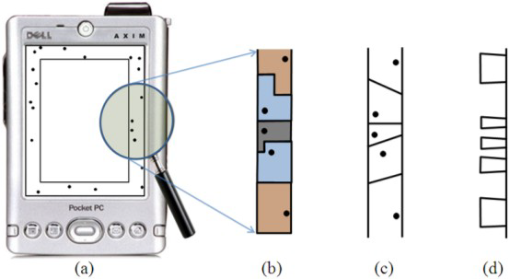
Discussion
Notes:
Largest selection area in EdgeSplit than other techniques as per design

Slide 33
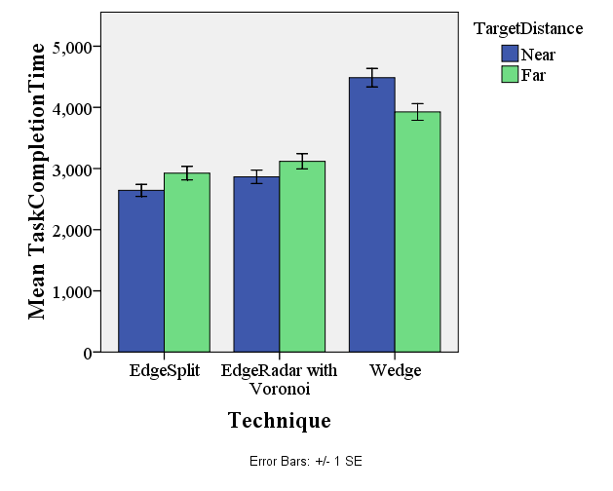
Discussion
Notes:
For Nearest target Wedge take longer time to complete the task. It is the reason of less selection area provided by this technique compared to others.

Slide 34
Summary
EdgeSplit and EdgeRadar with Voronoi facilitate better off-screen target visualization+selection
EdgeSplit achieves better completion time and minimum error rate compared to other techniques
EdgeSplit gives larger selection area compared to other off-screen visualization techniques

Slide 35
Proposed
A novel technique to facilitate selection of off-screen objects: EdgeSplit
Result Summary
EdgeSplit achieves completion times com-parable to existing state-of-the-art technique
EdgeSplit can facilitate improved selection
Conclusion

Slide 36
EdgeSplit: Facilitating the Selection of Off-Screen Objects
Zahid Hossain
Khalad Hasan
Hai-Ning Liang
Pourang Irani
Thank you

