Slide 1



How to Position the Cursor?
An Exploration of Absolute and Relative Cursor Positioning for
Back-of-Device Input
Khalad Hasan
Xing-Dong Yang
Hai-Ning Liang
Pourang Irani

Slide 2
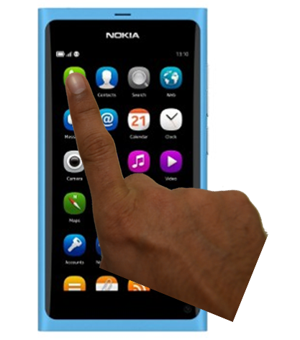
Motivation
Occlusion
Notes:
One-handed interaction is convenient and allows users to multi-task by freeing their other hand for tasks such as holding a bus handle. Karlson et al. [9] have found that users prefer using one hand for two handed tasks. Despite some advantages, this form of interaction imposes several limitations, such as occlusion and reachability [8, 20, 27].

Slide 3
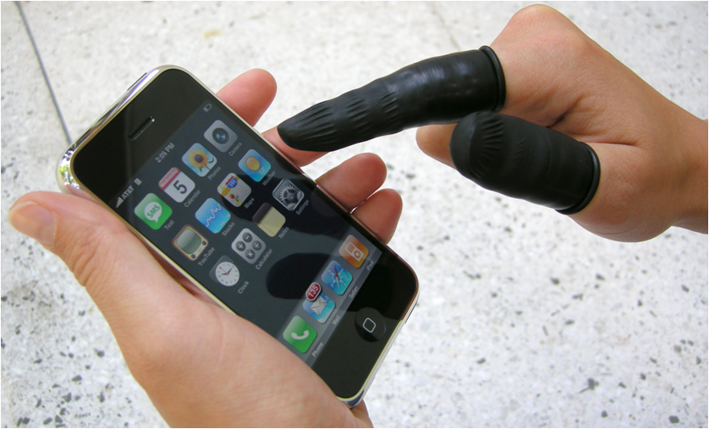
Motivation
Fat-finger
http://blog.mailboxtees.com/2008/04/18/iphone-stylus-for-big-fat-fingers--iphone-finger-covers-for-dirty-sticky-fingers.aspx
Notes:
One-handed interaction is convenient and allows users to multi-task by freeing their other hand for tasks such as holding a bus handle. Karlson et al. [9] have found that users prefer using one hand for two handed tasks. Despite some advantages, this form of interaction imposes several limitations, such as occlusion and reachability [8, 20, 27].

Slide 4
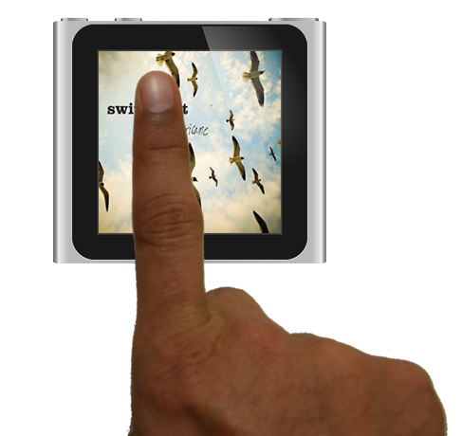
Motivation
Reachability
Notes:
Overlapping off-screen visual cues : Hard to identify and select
Large number of objects make visualization cluttered : Trouble in selection
Very small visual cues : Not good for selection

Slide 5
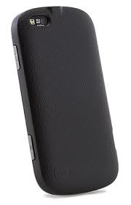
Solution
Back-of-device input
Notes:
Prior studies have shown that these challenges can be overcome by allowing users to interact with the back-side of the device back-of-device input

Slide 6
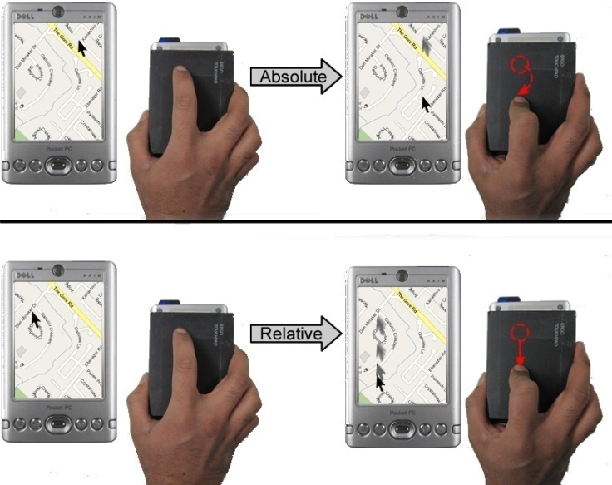
We explored
Notes:
Prior studies have shown that these challenges can be overcome by allowing users to interact with the back-side of the device back-of-device input

Slide 7
Research Questions
Suitable selection mechanism
Cursor positioning (absolute or relative)
Target size and location
Notes:
suitable selection mechanism for the BoD input?
(2) Which mode of cursor positioning (absolute or relative) is preferable on the back?
(3) How will target size and location affect performance with these two modes?

Slide 8
Contributions
Identify suitable selection mechanisms
Benefits of absolute and relative cursor control
Examine variations of absolute pointing mode to resolve the reachability
Notes:
To answer these questions, we conducted three separate studies and from the results we make the following contributions: (1) identify suitable selection mechanisms for one-handed BoD input; (2) explore the benefits of absolute and relative cursor control for BoD input; (3) examine two variations of absolute pointing mode to resolve the reachability issues discovered in our studies.

Slide 9
Related Work

Slide 10
Back-of-device Input

Slide 11
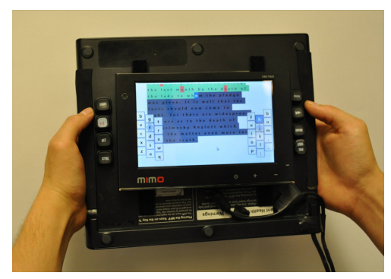
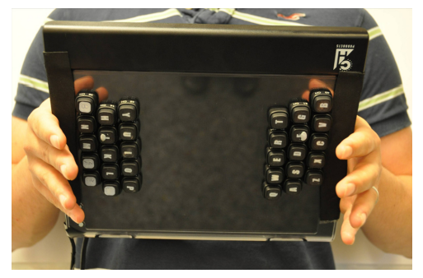
ReadType
Scott et. al
Notes:
Prior studies have shown that these challenges can be overcome by allowing users to interact with the back-side of the device back-of-device input

Slide 12
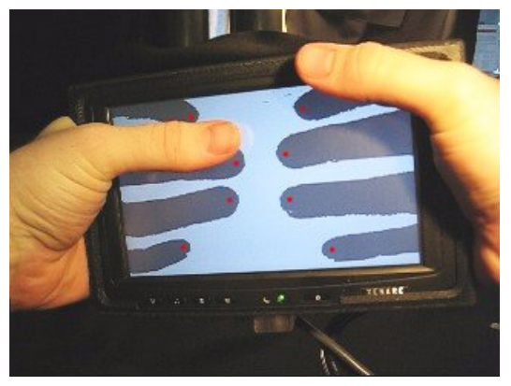
LucidTouch
Widgor et. al
Notes:
Prior studies have shown that these challenges can be overcome by allowing users to interact with the back-side of the device back-of-device input

Slide 13
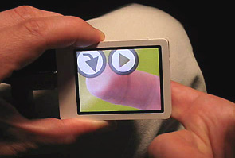
nanoTouch
Patrick Baudisch and Gerry Chu
Notes:
Prior studies have shown that these challenges can be overcome by allowing users to interact with the back-side of the device back-of-device input

Slide 14
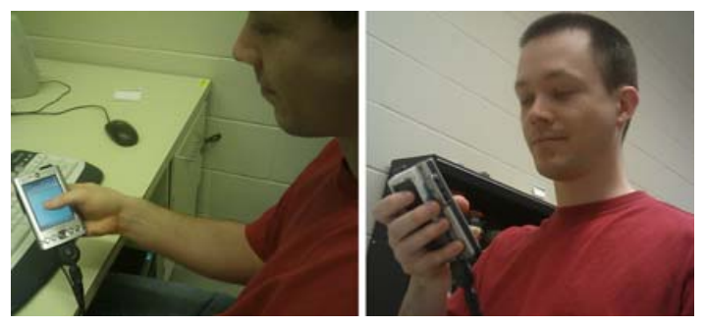
Dual-Surface Input
Yang et. al
Notes:
Prior studies have shown that these challenges can be overcome by allowing users to interact with the back-side of the device back-of-device input

Slide 15
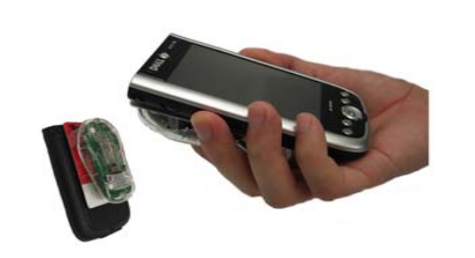
Behind-the Display
Yang et. al
Notes:
Prior studies have shown that these challenges can be overcome by allowing users to interact with the back-side of the device back-of-device input

Slide 16
Cursor Positioning

Slide 17
Absolute Input
Notes:
Prior studies have shown that these challenges can be overcome by allowing users to interact with the back-side of the device back-of-device input

Slide 18
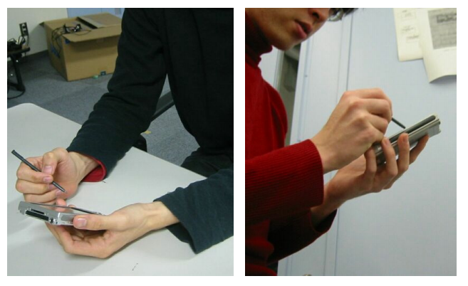
Relative Input
Hybrid Touch
Notes:
Prior studies have shown that these challenges can be overcome by allowing users to interact with the back-side of the device back-of-device input

Slide 19
Selection Mechanism
Lift-off
Land on
Notes:
Prior studies have shown that these challenges can be overcome by allowing users to interact with the back-side of the device back-of-device input

Slide 20
Experiments
20

Slide 21
Experiment 1:
  Selection Mechanism
Experiment 2:
  Absolute vs relative cursor Movement
Experiment 3:
  Exploring accuracy and reachability with absolute pointing
21

Slide 22
Selection Methods:
Side-button
Double-tap
Frontside-touch
  Did not include lift-off selection
Cursor Movement:
Relative
Absolute
22

Slide 23
Design
Cursor movement (2) ×
Selection mechanism (3) ×
Target size (3) ×
Repetitions (6) ×
Participants (12)
23

Slide 24
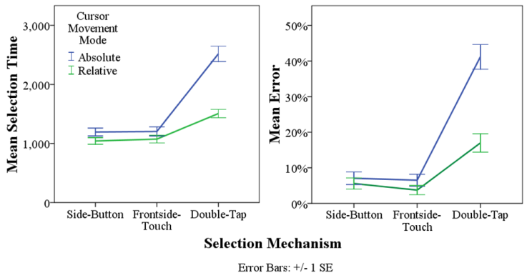
Results
24

Slide 25
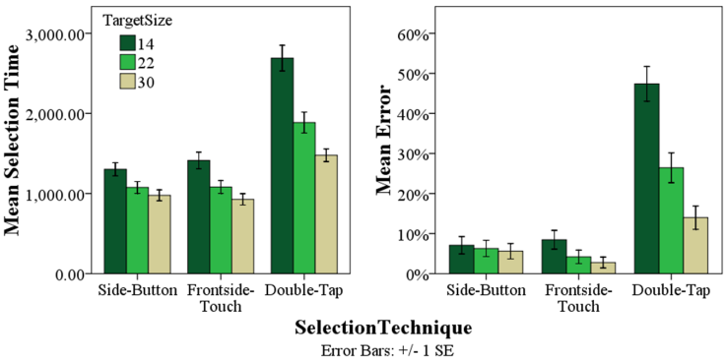
Results
25

Slide 26
Experiment 1:
  Selection Mechanism
Experiment 2:
  Absolute vs relative cursor Movement
Experiment 3:
  Exploring accuracy and reachability with absolute pointing
26

Slide 27
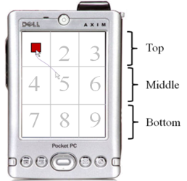
Tasks
27

Slide 28
Design
Cursor movement (2) ×
Target size (3) ×
Locations (9) ×
Repetitions (3) ×
Participants (12)
28

Slide 29
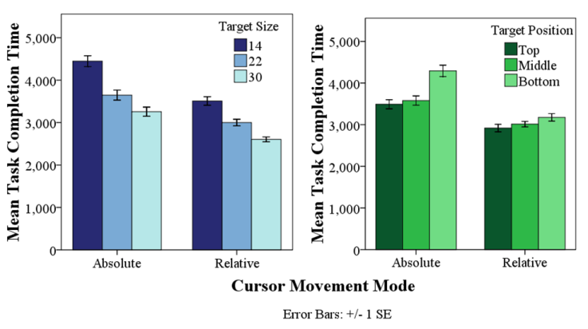
Results
29

Slide 30
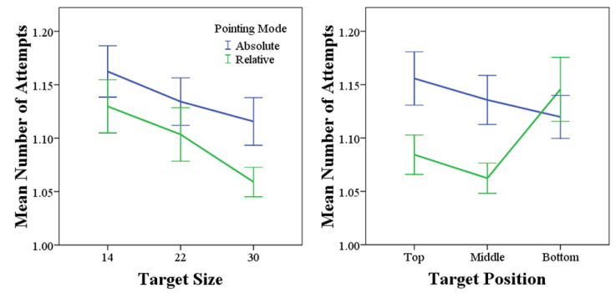
Results
30

Slide 31
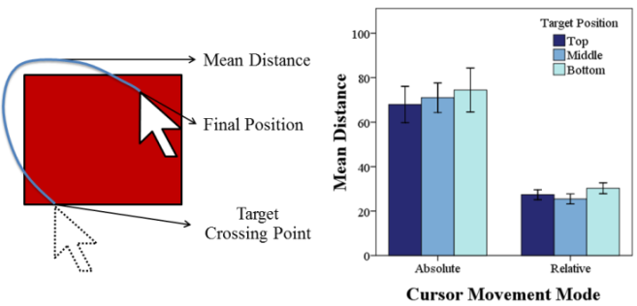
Results
31

Slide 32
Experiment 1:
  Selection Mechanism
Experiment 2:
  Absolute vs relative cursor Movement
Experiment 3:
  Exploring accuracy and reachability with absolute pointing
32

Slide 33
Two variations
of Absolute
33

Slide 34
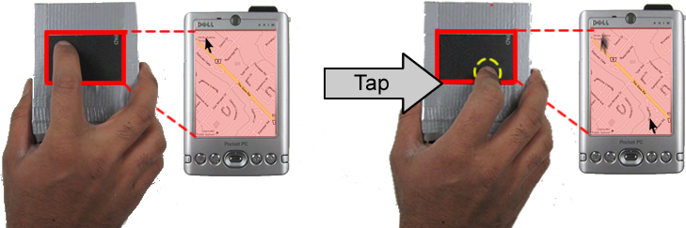
ThumbSpace
34

Slide 35
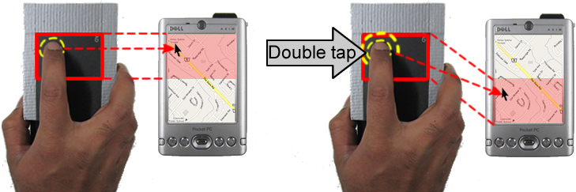
SlidingWindow
35

Slide 36
Design
Technique (4) ×
Target Position (2) ×
Repetitions (12) ×
Participants (12)
36

Slide 37
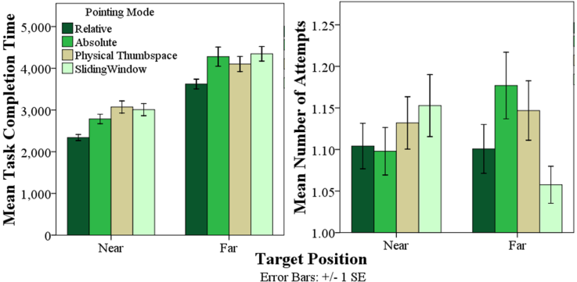
Results
37

Slide 38
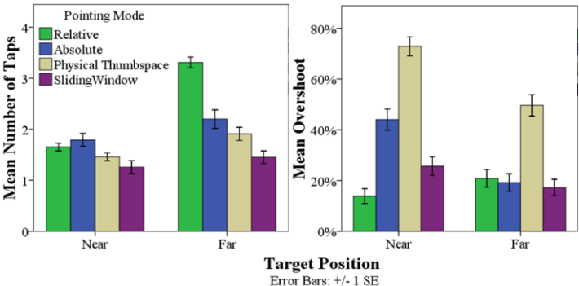
Results
38

Slide 39
Limitations
Results are influenced by the target sizes
Tested on single touch device
A variety of mapping factors were not tested
39

Slide 40
Guidelines
Separating selection and cursor control
Targets should be at least 30 pixels in size (6.6 mm)
and preferably placed in the top index-reachable part
When using Relative positioning, targets can be as small as 22 pixels
40

Slide 41
Guidelines
For tasks requiring precision, Relative positioning should be provided
When distorting the 1:1 mapping between the input space and display, consider providing additional visual feedback
41

Slide 42
Conclusion
we examine which selection mechanisms are suitable
Compare the performance of Absolute and Relative cursor positioning modes
Two approaches to solving the reachability issue
42

Slide 43

How to Position the Cursor?
An Exploration of Absolute and Relative Cursor Positioning for
Back-of-Device Input
Khalad Hasan
Xing-Dong Yang
Hai-Ning Liang
Pourang Irani
Thank you

